Slide 1
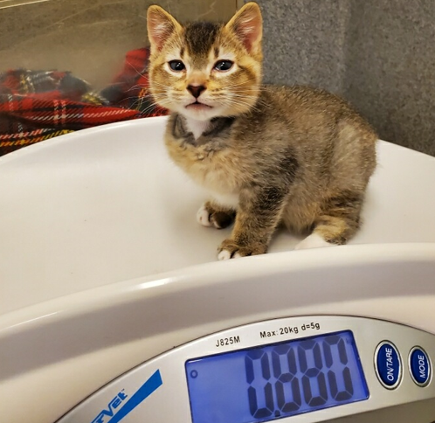
Cardiovascular Manifestations of Mucolipidosis II: A Translational Feline Model
Alex Serna
Notes:
“This summer I worked with the Stern Lab studying the cardiovascular manifestations of mucolipidosis 2 in the feline model. In the bottom left is an example of a cat affected by this disease”

Slide 2
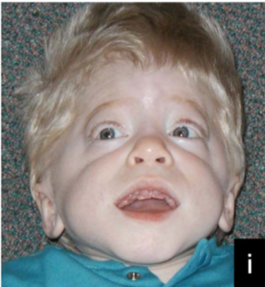
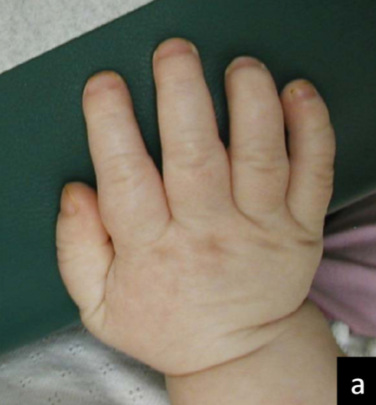
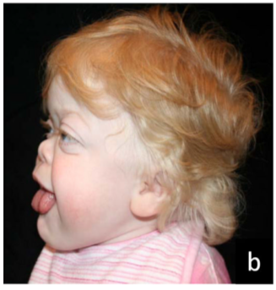
Mucolipidosis II
Introduction Methods Results Discussion Conclusion
Affects infant to juvenile children, clinical signs include skeletal and neurological abnormalities and excessive heart valve thickening
High mortality rate (median survival time of 5 years) due to poorly characterized cardiovascular disease leading to fulminant congestive heart failure
Cathey, S. S., Leroy, J. G., Wood, T., Eaves, K., Simensen, R. J., Kudo, M., Stevenson, R. E., & Friez, M. J. (2010). Phenotype and genotype in mucolipidoses II and III alpha/beta: a study of 61 probands. Journal of medical genetics, 47(1), 38–48. https://doi.org/10.1136/jmg.2009.067736
Notes:
“Mucolipidosis II is a hereditary lysosomal storage disorder affecting infant to juvenile children. This mutation presents phenotypically with skeletal deformities, neurologic lesions, excessive heart valve thickening, as well as other pathologic clinical manifestations. Unfortunately, the vast majority of these children pass away very early into life due to poorly characterized cardiovascular disease leading to fulminant congestive heart failure.”

Slide 3
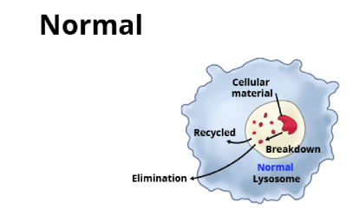
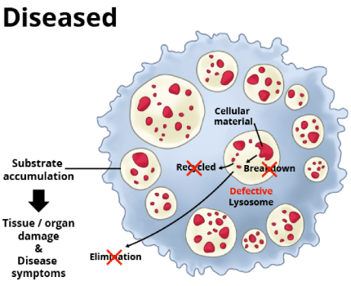
Mechanism
Introduction Methods Results Discussion Conclusion
N-acetylglucosamine-1-phosphotransferase (Protein)
Acid Hydrolases
(Lysosomal Enzymes)
Lysosomes
Notes:
“For both humans and felines, the mechanism of disease is the same. In a healthy patient without the disease, the GNPTAB gene would normally code for this protein whose function is to tag acid hydrolases with a Mannose 6 Phosphate residues, allowing them to be properly compartmentalized in lysosomes. These acid hydrolases, such as cathepsin proteases, are important for the breakdown and recycling of cellular waste.”
“However, patients with ML2 have a nonsense mutation in the GNPTAB gene resulting in an early stop codon and creating a nonfunctional beta subunit for the protein. Because of this, acid hydrolases are no longer properly packaged in lysosomes and instead are released extracellularly. This results in the accumulation of cellular waste in cells as well as increased hydrolase activity elsewhere in the body, believed to be responsible for the observed disease symptoms.”

Slide 4
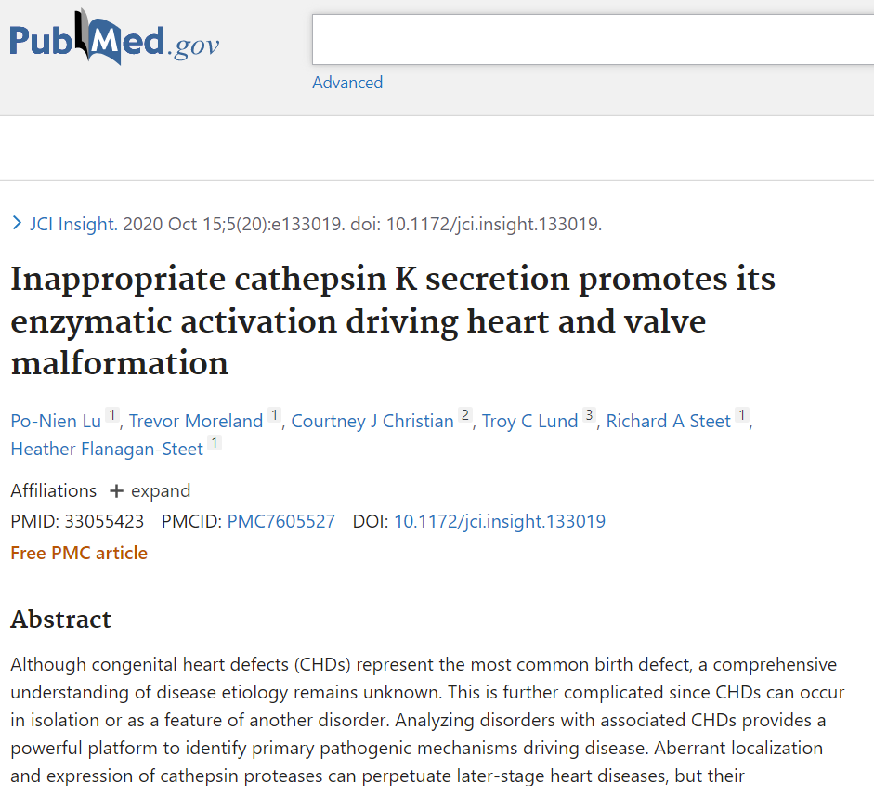
Past Research Findings
Introduction Methods Results Discussion Conclusion
Extracellular cathepsin K activity tied to abnormal cartilage and bone development
Reducing cathepsin K activity significantly improved cardiac phenotypes
Treatment of MLII with small molecule inhibitors (Odanacatib and Losartan)
Lu, P. N., Moreland, T., Christian, C. J., Lund, T. C., Steet, R. A., & Flanagan-Steet, H. (2020). Inappropriate cathepsin K secretion promotes its enzymatic activation driving heart and valve malformation. JCI insight, 5(20), e133019. https://doi.org/10.1172/jci.insight.133019
Notes:
“Interestingly enough, there exists a zebrafish model for ML2 that has been extensively studied in the past. These studies have identified that ML2 zebrafish show increased cathepsin K secretion and activity as well as altered myocardial and valvular formation. Most importantly however, they found that reducing the activity of these enzymes through small molecule inhibitors resulted in halted cardiac disease progression and improved cardiac function. While these findings demonstrate promising therapeutic strategies and targets for treating ML2 in the zebrafish model, large species variations between zebrafish and humans make extrapolation of these results difficult.”

Slide 5
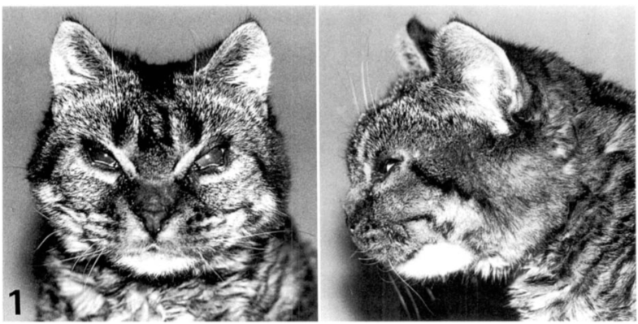
Hypothesis
Introduction Methods Results Discussion Conclusion
Naturally occuring novel feline model
for MLII has been developed
Feline MLII results from a genetic mutation in GNPTAB and creates a cardiovascular phenotype characterized predominantly by changes to the mitral and aortic valve that lead to volume overload and congestive heart failure. These findings will mimic those observed in zebrafish and children with MLII, and support use of the feline MLII colony in studies aiming to alter cardiovascular outcomes.
Bosshard, N. U., Hubler, M., Arnold, S., Briner, J., Spycher, M. A., Sommerlade, H. J., von Figura, K., & Gitzelmann, R. (1996). Spontaneous mucolipidosis in a cat: an animal model of human I-cell disease. Veterinary pathology, 33(1), 1–13. https://doi.org/10.1177/030098589603300101
Notes:
“Thankfully, a naturally occurring novel feline model for ML2 has recently been developed. Having a mammalian large animal model for this disease is extremely valuable as it may help us bridge the gap between the currently studied zebrafish and human research models. Additionally, these animals seem to present with a cardiac phenotype very similar to human ML2 patients.That being said, the data is limited to a few previously examined cats, therefore our study aims to obtain more data regarding the genotype-phenotype relationship in the ML2 feline model to better characterize the disease.” Then read hypothesis

Slide 6
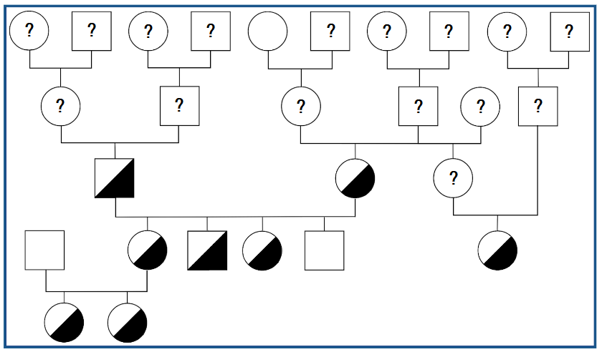
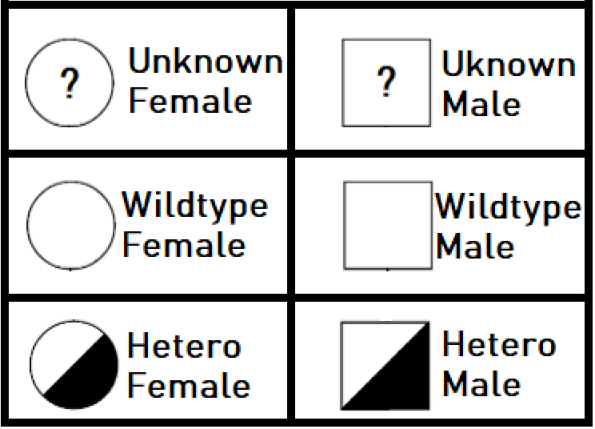
Aim 1: Expansion of the Feline MLII Research Colony
Introduction Methods Results Discussion Conclusion
Received heterozygous cats from U Penn as well as affected kitten heart samples
Pedigree currently incomplete, waiting to hear back from the previous principal investigators regarding where MLII affected cats fit in
Notes:
“In order to learn more about how this disease presents in the feline model, we had to breed more affected kittens. Originally, these cats as well as a few affected kitten heart samples were shipped to us by the University of Pennsylvania, this explains why the genotype information of many of the previous ML2 colony cat generations are not in our records. We have requested this information and are currently awaiting a response.”
Got samples from our collaborators at penn, took over the project, currently awaiting a response from them
Heterozygous instead of hetero (fix unknown)
Waiting to receive additional information from our collaborators at Penn

Slide 7
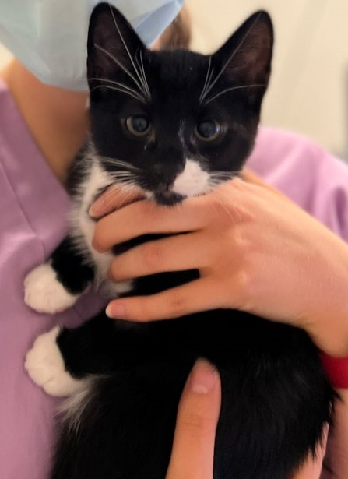
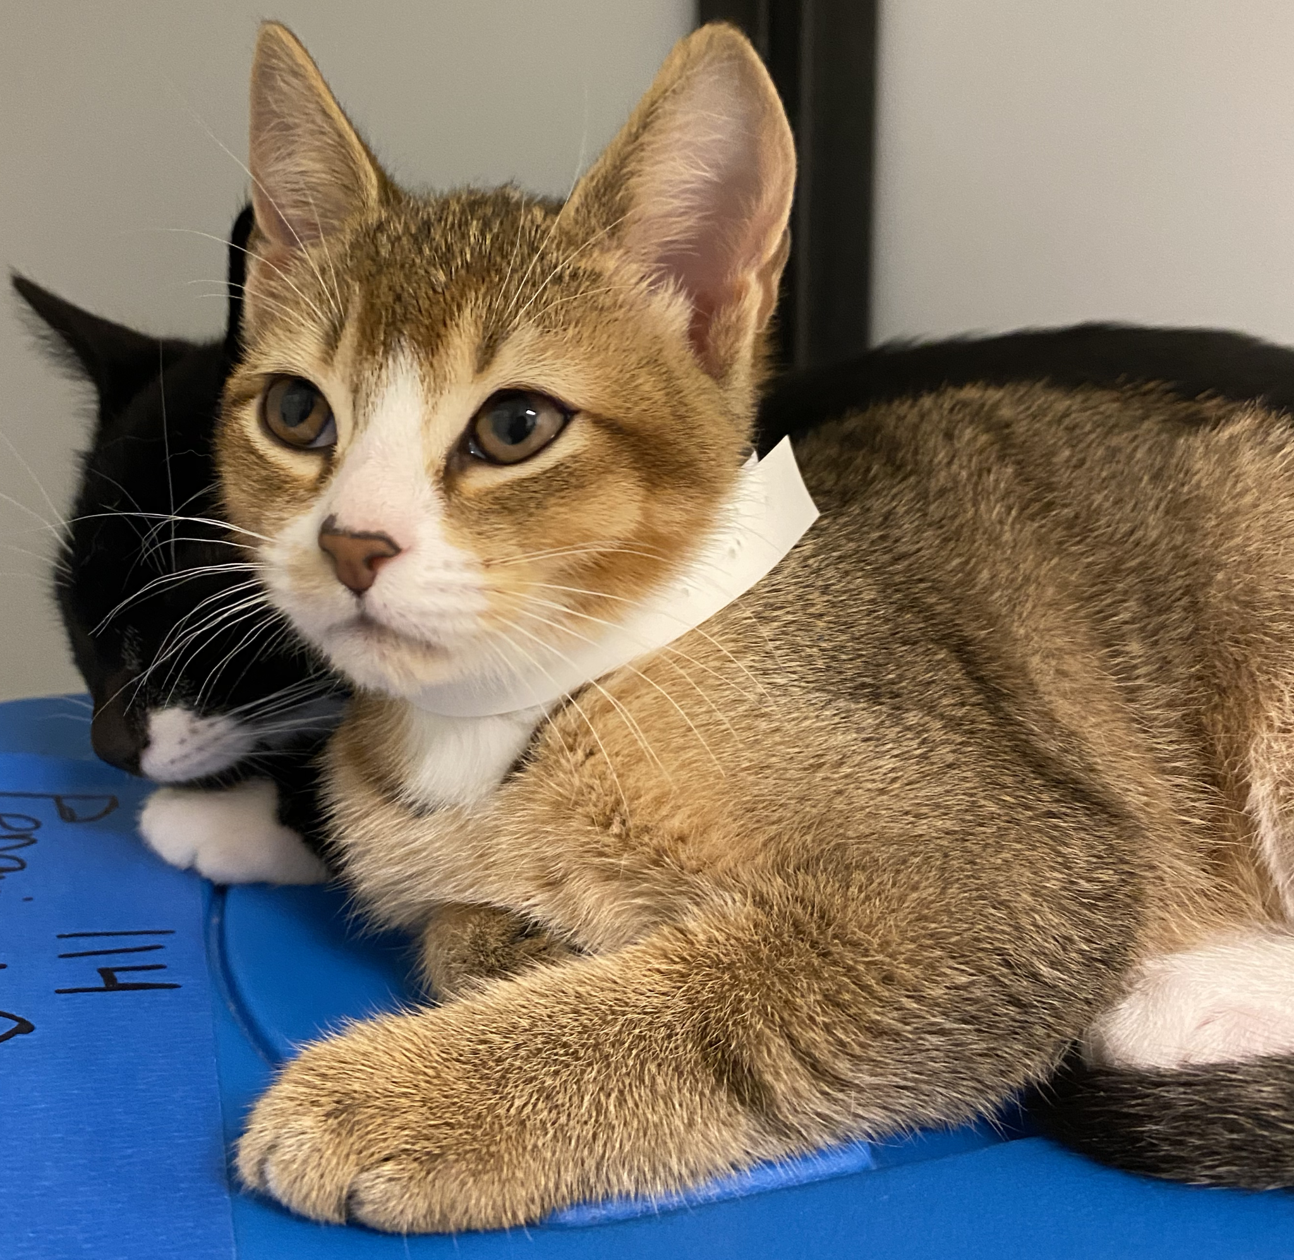
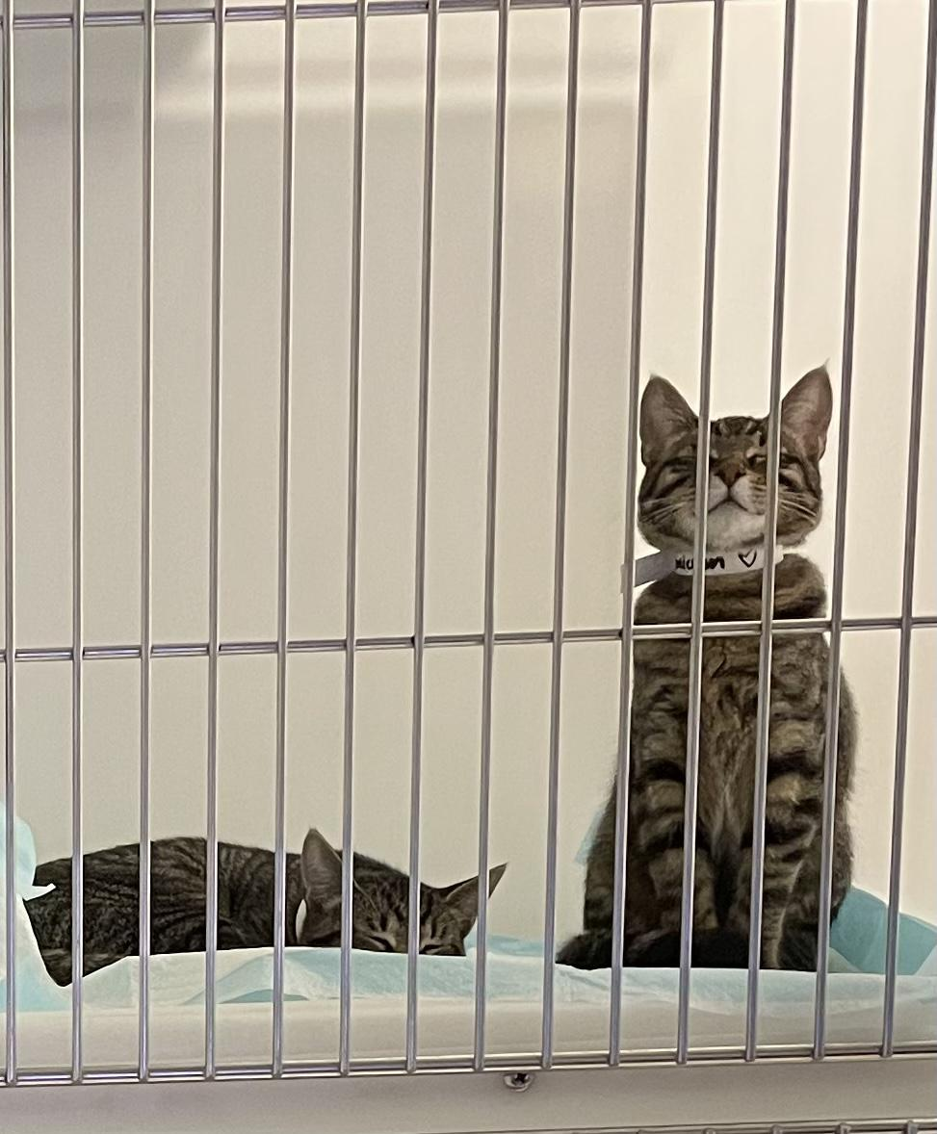
Aim 1: Expansion of the Feline MLII Research Colony
Introduction Methods Results Discussion Conclusion
Wildtype
Penguin
Heterozygous
Chicken/Ostrich
Heterozygous
Delta & Omicron
Notes:
“These are 4 of the kittens that we produced this summer. Unfortunately, none of them are affected but 3 are heterozygous, we plan to grow and breed them with hopes of creating more affected cats”.

Slide 8
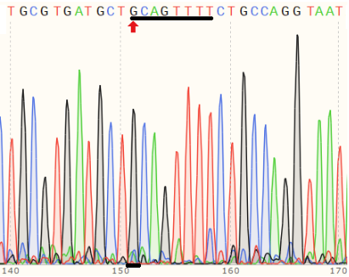
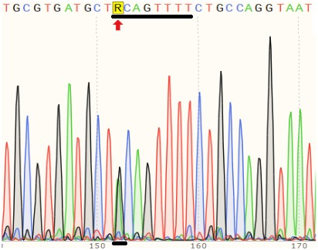
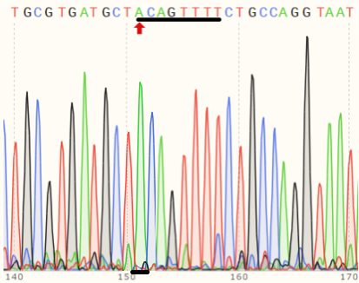
Genotyping the Colony
Introduction Methods Results Discussion Conclusion
Wildtype
Heterozygous
Homozygous
Above are examples of reverse strands demonstrating the ML2 mutation (G->A)
Notes:
“In order to determine the genotypes of each cat in our colony, I extracted DNA from the cats and sent off the samples to the UCDNA services. From this I obtained chromatograms utilizing the SnapGene viewer software. The color of each peak is representative of the base pair at that location. The wild type has a G (indicated by the black pillar), while those homozygous for the disease have an A (indicated by the green pillar) at this location. Those that are heterozygous have two smaller pillars, one of each color.”

Slide 9
Whole Genome Sequencing
Introduction Methods Results Discussion Conclusion
Hoping to validate the genotype/phenotype relationship and rule out mutations
HMW DNA from 13 colony cats was submitted, sequences generated at a 30x coverage
Allows us to find and determine whether there are any other mutations that may be responsible for observed cardiac phenotypes in our MLII population
Notes:
“While it is currently understood where in the genome this mutation can be found, our goal is to validate this genotype-phenotype relationship and rule out other mutations in separate genes that could be causing other pathologic findings possibly impacting the ML2 disease pathway. In order to do this, high molecular weight DNA of 13 ML2 colony cats was extracted and sent off for whole genome sequencing. These sequences were generated at a 30x coverage, are being aligned to the current feline reference genome, and will have variants called. Afterwards, findings will be filtered according to P-value/protein function in order to draw conclusions.”

Slide 10
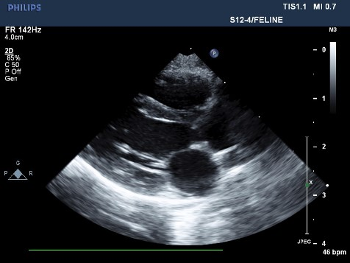
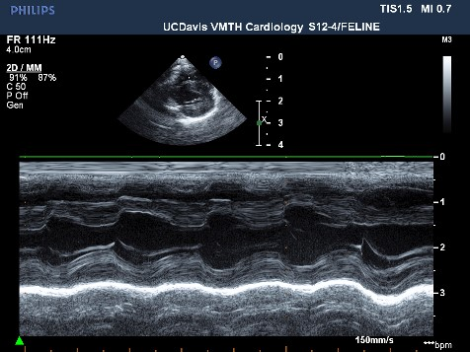
Characterization of the 2D, m-mode, color and spectral Doppler echocardiographic characteristics as well as gross and histopathologic features of MLII affected kittens
Aim 2: Echocardiographic and Histopathologic Evaluation
Introduction Methods Results Discussion Conclusion
2D
M-Mode
Notes:
“Our next aim was to perform routine echocardiograms on each of the colony cats every 2 months. In general, we expect ML2 affected cats to exhibit signs of fulminant congestive heart failure. These include increased chamber size, reduced integrity and structure of the valves due to accumulation of matrix in them, and regurgitation causing volume overload.”

Slide 11
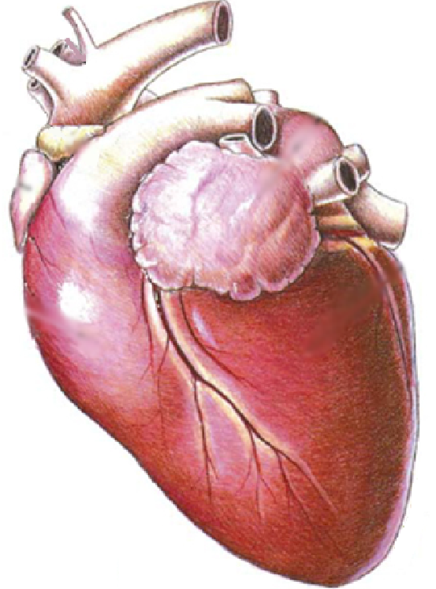
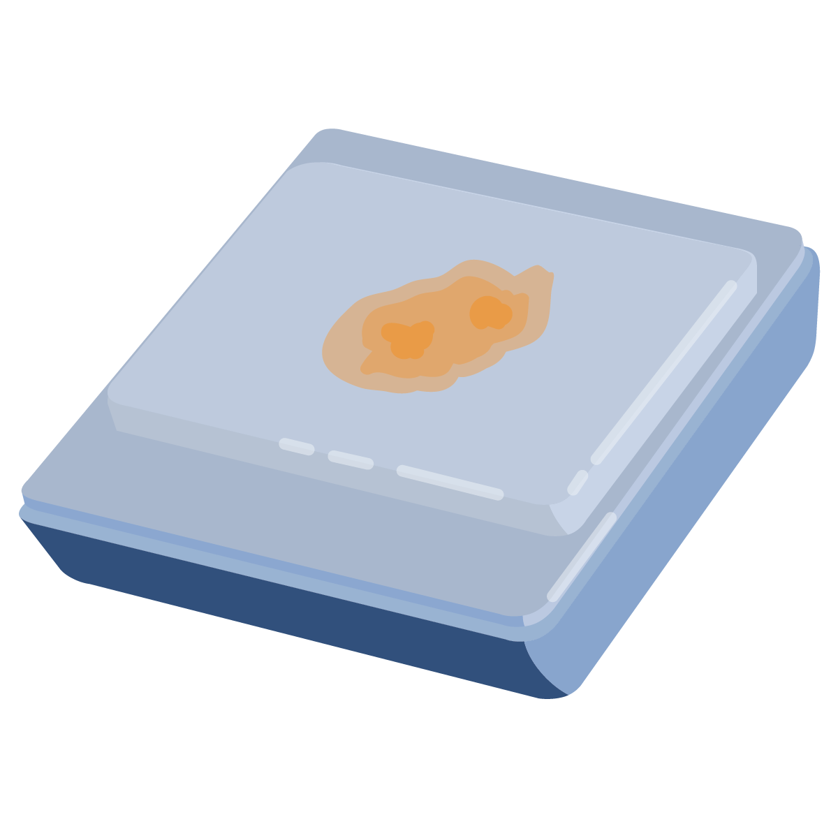
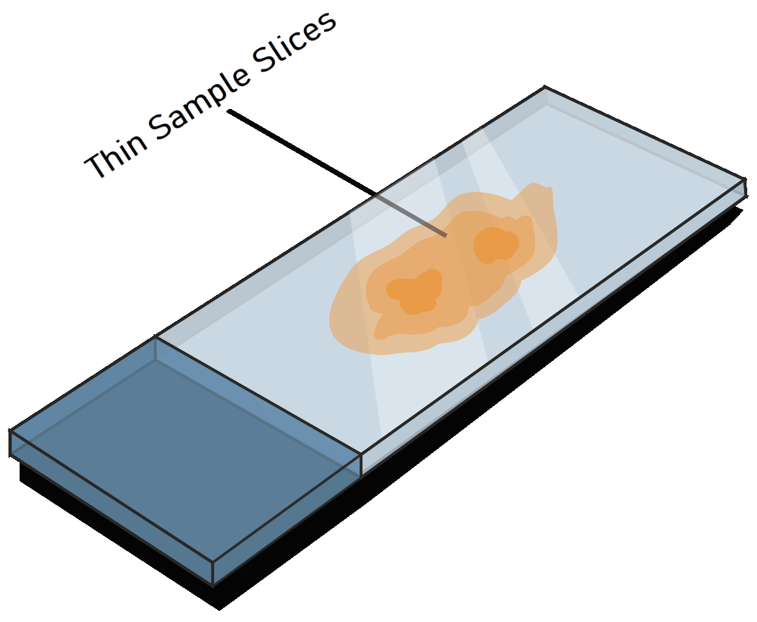
Tissue Collection Process
Introduction Methods Results Discussion Conclusion
MLII Affected
Heart Collection
FFPE Tissue Block
H&E and Trichrome Stained Slides
Notes:
“Aside from echos, we also collected tissue. In terms of the tissue collection process, we begin with a healthy ML2 cat. They are continuously monitored closely for congestion, at the first sign of change in quality of life such as kittens displaying tachypnea or fluid accumulation they have a final echocardiogram performed before undergoing humane euthanisia and tissue harvesting. Once cardiovascular tissue is harvested it is evaluated for gross and morphologic lesions as well as possible congenital defects. Areas of interest are then placed in formalin fixed paraffin embedded tissue blocks. Slides are then stained using H&E as well as Masson’s Trichrome staining techniques. While we did not produce any affected kittens this ourselves this summer, we did have previously affected kitten samples from Penn.”

Slide 12
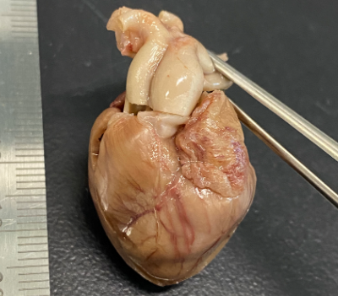
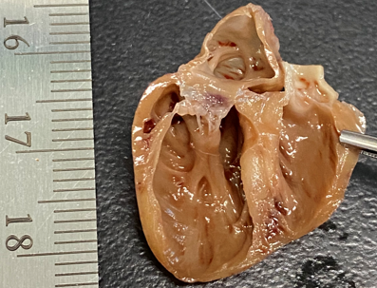
Gross Inspection Findings
Introduction Methods Results Discussion Conclusion
Affected MLII cats demonstrate other congenital heart defects
Notes:
“In terms of gross inspection findings, the ML2 affected kitten hearts we examined demonstrated a dilated and thin walled left ventricle with a thick mitral valve. Additionally, a couple of congenital heart defects including 2 PDA’s and 2 double chambered right ventricles were observed. For those who aren’t aware a PDA in a cat is extremely rare, the cardiology service here sees 1, if that, a year. With this in mind, I think you can appreciate how unlikely it is that 2 of our 3 affected kitten hearts would have a naturally occurring PDA while none of our many unaffected heterozygous who are closely related to these kittens displayed any signs of congenital defects such as this. This may suggest that ML2 presents differently in cats as compared to human ML2 patients who, despite being more likely to have one naturally, have not had any PDAs recorded.”

Slide 13
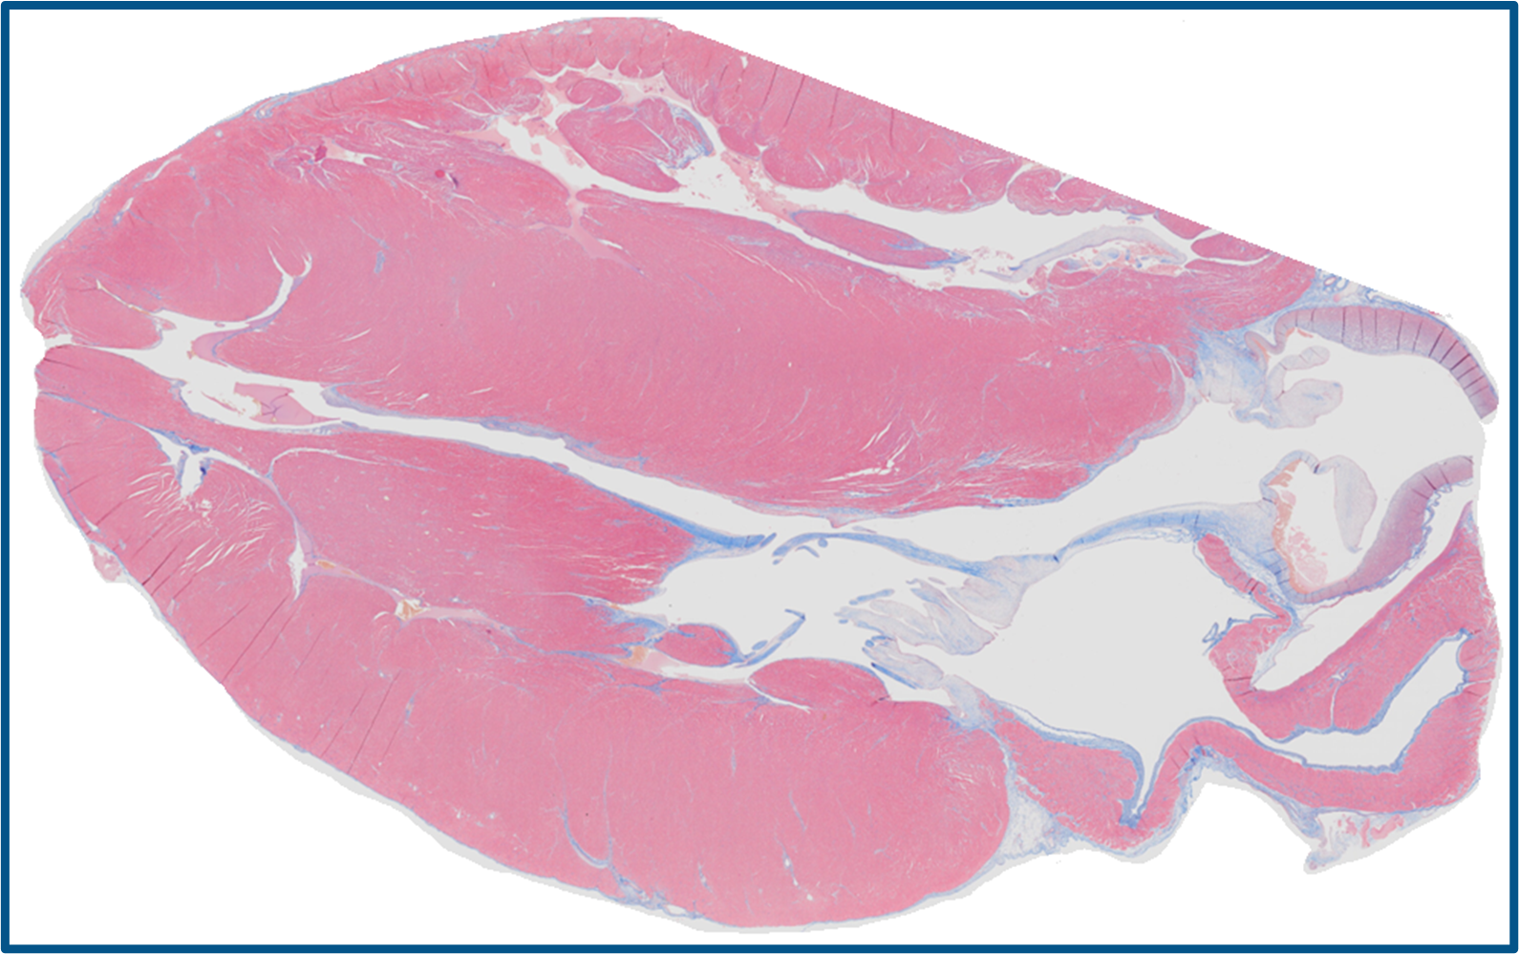
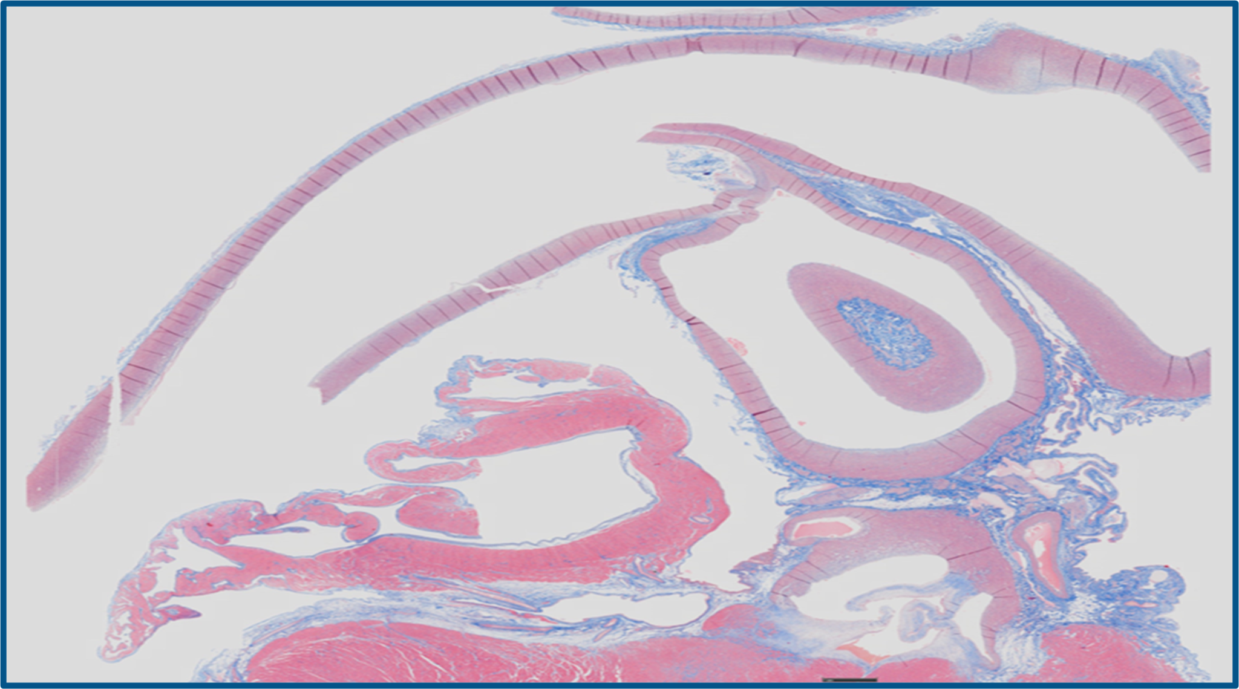
Histopathology Findings
Introduction Methods Results Discussion Conclusion
Excessive amounts of collagen present in the aortic and mitral valves with a patent ductus arteriosus (PDA) present in two of the MLII affected kittens
Mitral and Aortic Valve Thickening
in Masson’s Trichrome Stain
MLII PDA in Masson's Trichrome Stain
Notes:
“In terms of histopathology slide findings, we utilized Masson’s Trichrome Stain because it stains collagen blue. We found excessive amounts of collagen and thickening present in the aortic and mitral valves as well as the PDA I had just spoke about earlier.”

Slide 14
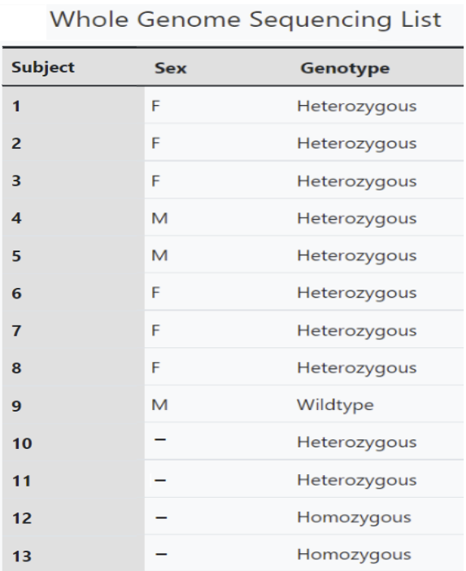
Whole Genome Sequencing
Introduction Methods Results Discussion Conclusion
Recently received sequencing files from earlier this week
Files have been downloaded checked for possible corruption
Currently in the process of mapping to the host genome
Notes:
“In terms of our whole genome sequencing progress, we have received files earlier this week. Since then we have downloaded them and ensured that none were corrupted. As of now and for the next few weeks, we are focused on mapping these whole genome sequences to the host genome, removing duplicate reads, calling variants, and filtering by P-value to draw conclusions.”

Slide 15
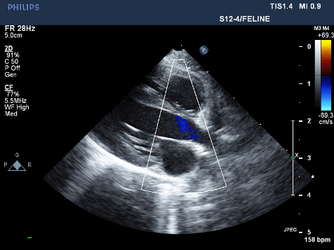
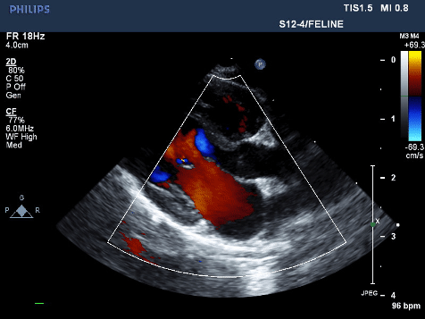
Echocardiogram Findings
Introduction Methods Results Discussion Conclusion
Unremarkable LA -> LV Flow
Mitral Regurgitation
Notes:
“In terms of echocardiographic findings, all but one unaffected heterozygous cats in our study demonstrated echos within normal limits such as the one in the left. These cats showed no evidence of volume overload, no leaky valves, and all had normal chamber sizes. This helps to support and suggest that any heart abnormalities we see in our ML2 affected patients can be attributed solely to that mutation.”
“That being said however, we did see a minor trace of mitral regurgitation in one of the unaffected carriers”.

Slide 16
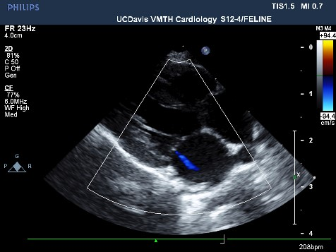
Mitral Regurgitation
Introduction Methods Results Discussion Conclusion
Backflow of blood in the left side of the heart due to incomplete/weak closing of the mitral valve
Found in the echocardiographic screening of a heterozygous cat
Suspecting that this can be a result of a separate mutation that made its way into the colony due to inbreeding
Notes:
“Mitral Regurgitation occurs when the heart has a leaky mitral valve, resulting in inappropriate blood flow backwards towards the atrium. This particular case was from a heterozygous cat in our study, meaning we were not anticipating to find any cardiac abnormalities during her echo. That being said, this amount mitral regurgitation is very minor and would usually be ignored assuming a normal atrial chamber size. Since it could leads us to consider whether or not a separate mutation affecting heart function may have made its way into our colony, we will be closely following and monitoring the disease progression of this cat, further supporting the use of whole genome sequencing for our study in hopes of ruling this out as a separate mutation in our colony’s bloodline.”

Slide 17
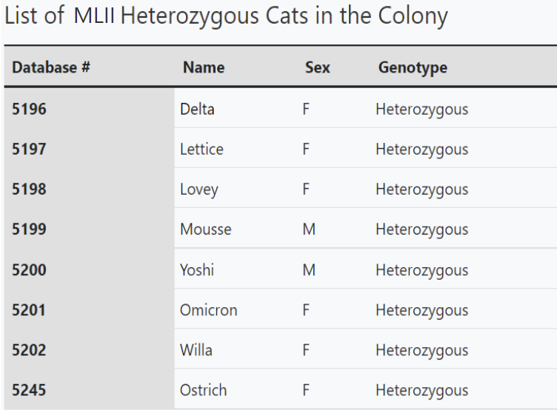
Future Breeding Pairs
Introduction Methods Results Discussion Conclusion
Although we were unable to collect more MLII affected data this summer, we now have 8 heterozygous cats in our colony
Notes:
“Although this summer we were unable to produce any additional ML2 affected cats, we do now have a total of 8 heterozygous cats in our colony. This has allowed us to set up various breeding pairs for the future with hopes of producing affected kittens. This is currently ongoing.”

Slide 18
Plans Moving Forward
Introduction Methods Results Discussion Conclusion
Create new breeding pairs and continue expansion of the MLII colony
Continue mapping whole genome sequencing data for 13 cats and call variants
Ultimately, this will likely help us produce more MLII affected kittens, providing us with more samples. Additionally, identifying call variants can help us find and remove any unwanted mutations responsible for other cardiac disease (such as the MR observed). This can also allow us to ensure cardiac phenotypes observed are purely a result of the MLII mutation.
Notes:
“As I mentioned, our current goals moving forward are to establish breeding pairs, continuing expansion of the colony, as well as continue mapping the whole genome sequences of the 13 cats to the reference genome then call variants. We will look to see if the cats with a PDA are genetically unique in any way. Ultimately, this helps us ensure that cardiac phenotypes observed are purely a result of the ML2 mutation and not due to something else.”

Slide 19
Potential Future Directions
Introduction Methods Results Discussion Conclusion
Monitor blood for alterations in cardiac enzyme levels/other biomarkers of disease
Collect more samples of heart tissue (histopath, biochemical, and cardiomyocyte) for further functional and biochemical analysis (evaluate efficacy of therapies)
Conduct preclinical therapy trials (cathepsin K inhibitors, TGFß pathway modulators, gene therapies?)
Translate these findings to human clinical trials
Notes:
Basically read out the slide
These studies will provide functional and biochemical readouts in which to later evaluate the efficacy of therapies.

Slide 20
Acknowledgements
Introduction Methods Results Discussion Conclusion
Special Thanks To:
Joshua Stern PhD, DVM, DACVIM
Carina Gonzalez
Joanna Kaplan DVM, DACVIM
Victor Rivas
Amanda Crofton DVM
Jalena Wouters
Research Funding:
Student Funding:
Students Training in Advanced Research (STAR) Program
T35 OD010956
Notes:
Special thanks to the National MPS Society for research finding as well as the NIH and STAR for student funding.

Slide 21
Questions?
Introduction Methods Results Discussion Conclusion

