Slide 1
Modulation of antimicrobial peptide expression as a novel approach for treating infectious keratitis
Allison Shannon, Sanskruti Potnis, Theint Aung, Melinda Quan, Brian Leonard
Murphy-Russell-Leonard-Thomasy Laboratory
STAR Summer Research
July 29th, 2020

Slide 2
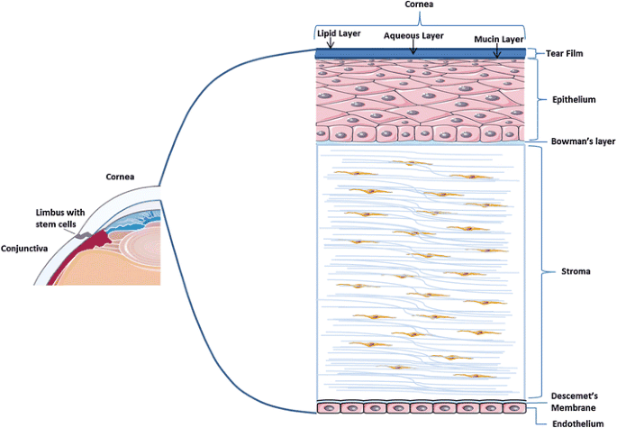
https://clintransmed.springeropen.com/articles/10.1186/s40169-017-0158-1
Notes:
Here is a diagram to help orient the audience to the anatomy of the cornea. You can see this is a cross section of the cornea, with the top layer being the outermost layer and the bottom being the innermost layer. My research pertains to the epithelial layer.

Slide 3
Introduction
Corneal ulceration is a common problem in both veterinary and human ophthalmology
Ulcers can be complicated by pathogens resulting in infectious keratitis
Due to the rise of antibiotic resistance, development of improved treatment approaches are needed
Antimicrobial peptides (AMPs) are naturally occurring antibiotics and modulation of expression could represent a novel approach to treatment of infectious keratitis
Photo Credit: Brian Leonard
Notes:
Corneal ulceration is a common problem in both human and veterinary patients
Ulcers can be complicated by pathogens resulting in infectious keratitis
Common pathogens on the ocular surface include: Pseudomonas aeruginosa, Staphylococcus aureus, Streptococcus pneumoniae, Fusarium fungi, and various viruses
Treatment of infectious keratitis usually requires frequent antibiotic therapy
However, antibiotic resistance is becoming a major problem worldwide and improved treatment approaches are needed
Antimicrobial peptides (AMPs) are naturally occurring antibiotics made by the host
Modulation of their expression could be a potential therapeutic alternative for infectious keratitis

Slide 4
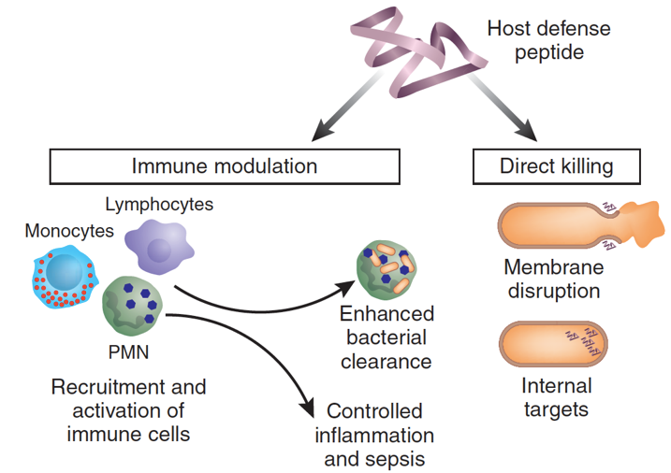
What are AMPs?
Expressed by epithelial cells and leukocytes
Functions:
Direct antimicrobial killing
Immunomodulation
Many others
Expression is constitutive or inducible
AMPs relevant to the cornea include:
Cathelicidin (LL-37)
β-defensins (hBD 1-3)
http://2017.igem.org/Team:XJTLU-CHINA/PeptideProduction
Notes:
Antimicrobial peptides (AMPs) serve as soluble effector molecules with broad spectrum activity against bacteria, fungi, and viruses
They are expressed by epithelial cells and leukocytes
In addition to their direct antimicrobial activity, AMPs have immunomodulatory effects including chemotaxis, cytokine production, epithelial cell proliferation, promotion of cell migration, angiogenesis, apoptosis, and wound healing
They also have many other functions that are being discovered, such as influencing canine coat color
AMPs can be constitutively expressed or are inducible by pathogenic or inflammatory stimuli
The AMPs relevant to the cornea are cathelicidin, or LL-37, and the human beta defensins 1-3

Slide 5
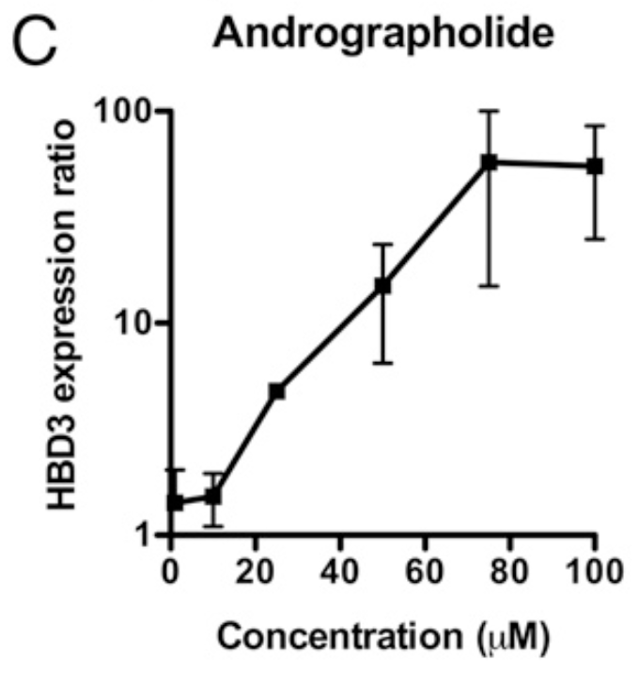
Introduction
Natural molecules can upregulate hBD3
Andrographolide
Oridonin
Isoliquiritigenin
Andrographolide was able to increase hBD3 mRNA expression by 100-fold in human colonic cells
…What about in human corneal epithelial cells (hTCEpi cells)???
Notes:
A recent study identified that we can upregulate the antimicrobial peptide, human beta defensin 3, using natural molecules
These natural molecules are known as andrographolide, oridonin, and isoqliquiritigenin
Interestingly, these molecules could increase AMP expression without the adverse events of being pro-inflammatory mediators. Meaning the end result would be improved clarity in addition to antimicrobial effects when applied to the cornea.
This group determined that andrographolide could increase hBD3 mRNA expression by 100-fold in human colonic epithelial cells and organoid cells
Being a community of ophthalmic researchers we were interested in doing this in immortalized human corneal epithelial cells (hTCEpi cells)

Slide 6
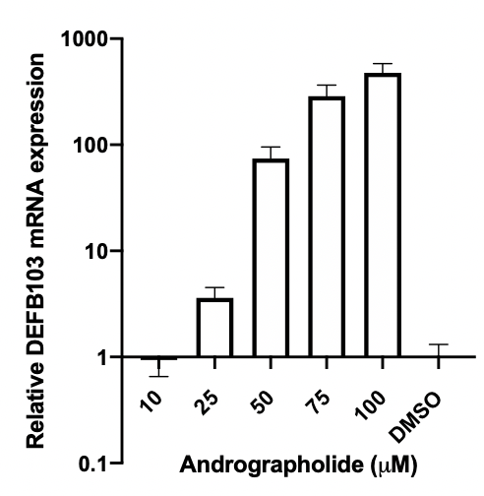
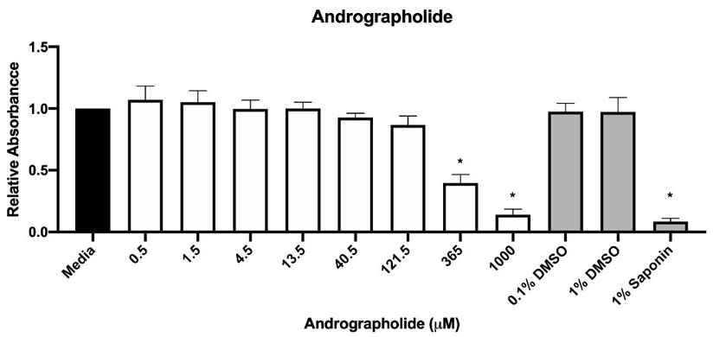
Preliminary Data
1a)
2)
Figure 1a. Toxicity assays of andrographolide hTCEpi cells
1b)
Figure 2. hBD3 mRNA expression in hTCEpi cells after treatment with andrographolide
Figure 1b. Relative absorbance of hTCEpi cells treated with andrographolide
Notes:
The previously mentioned paper identified doses of andrographolide that were tolerable by colonic epithelial cells, however we needed to know what would be safe and tolerable in corneal epithelial cells
Here is the preliminary data of MTT assays generated by Sanskruti Potnis, who was elemental in paving the way on determining what doses of andrographolide are tolerated by corneal epithelial cells
MTT assays are routine toxicity assays in which the cells are exposed to the treatment of interest at a particular concentration for 24 hours. A colormetric change can be detected where bright purple indicates healthy cells while light purple or no color means dead or dying cells.
Figure 1a shows images from the toxicity assays. You can see that by the time we hit around 121 micromolar of andrographolide there is a color change indicating cytotoxicity
and Figure 1b shows the quantification of this colormetric change
Sanskruti and Dr. Leonard were able to refine this data and determined that up to 100 micromolar of andrographolide seemed to be okay for corneal epithelial cells
Now we had an idea of doses that wont kill the cells
Once again, we wanted to show that andrographolide can upregulate human beta defensin 3 in corneal epithelial cells
Here in figure 2 you can see that andrographolide can in fact upregulate hBD3 mRNA expression, which is labeled for the gene name, DEFB103
You can see there is about a 300-fold increase compared to controls
Based on this preliminary data, my STAR project was centered on identifying induction of hBD3 by andrographolide at the peptide level.
Because knowing the mRNA results is one thing, but it is critical to determine peptide levels so that we know there is truly hBD3 protein present

Slide 7
Hypothesis
Treatment of hTCEpi cells with andrographolide in vitro will upregulate hBD3 peptide expression in a dose-dependent manner when compared with vehicle controls
Notes:
Therefore, we hypothesized that treatment of hTCEpi cells with andrographolide in vitro will upregulate hBD3 peptide expression in a dose-dependent manner when compared with vehicle controls

Slide 8
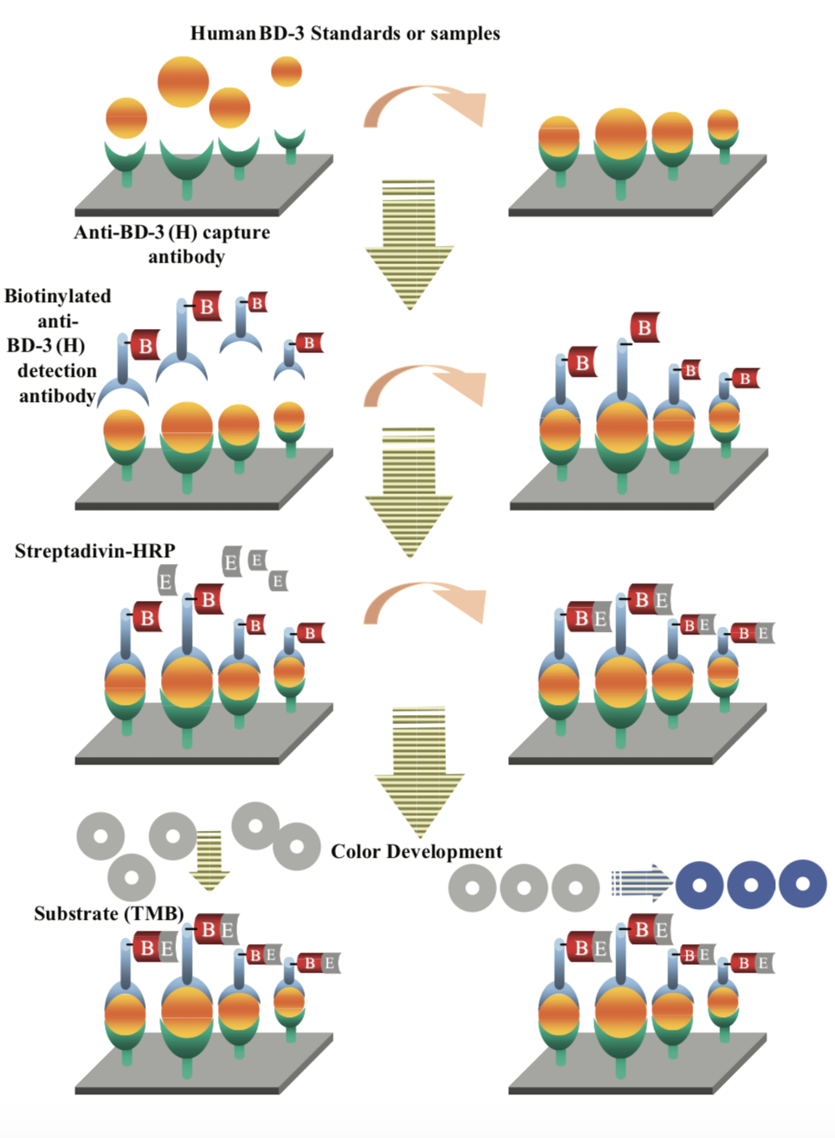
Methods
Grew hTCEpi cells to near confluence
Treated hTCEpi cells with andrographolide for 48 hours at a range of concentrations (10-100μM)
Dimethyl sulfoxide (DMSO) was the vehicle control
Collected cell culture supernatant and quantified peptide expression using β-defensin 3 ELISA
https://www.phoenixpeptide.com/doc/protocol/EK-072-38.pdf
Notes:
To conduct this experiment, we first had to grow human corneal epithelial cells to near confluence
Corneal cells were then treated with andrographolide for 48 hours at a range of concentrations from 10-100μM
We used dimethyl sulfoxide (DMSO) as a vehicle control
Lastly, we collected the cell culture supernatant and used a commercially available peptide ELISA to quantify hBD3 peptide levels
For those of you that are unfamiliar with capture ELISA I can summarize the steps in this figure. First you are given a plate of wells that are precoated with capture antibody that recognize the hBD3 protein, you then pour in your supernatant of hBD3. Then you add your detection antibody and a peroxidase enzyme that will detect a colormetric change when hBD3 protein is present. Lastly you record absorbance using a spectrophotometer to determine the concentration of hBD3 peptide that is present in your sample.
Our results from the ELISA are really exciting

Slide 9
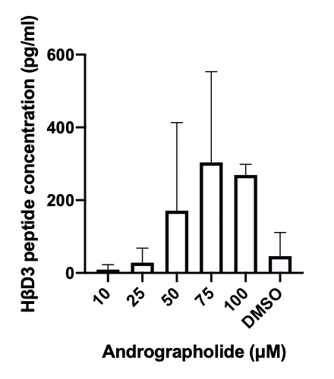
Results
Notes:
You can see overall trend that with increasing concentrations of andrographolide there is a dose dependent increase in human beta defensin 3 peptide expression well beyond baseline
This is directly reflective of the mRNA data
We acknowledge that the standard deviations are large however this graph represents 2 independent experiments and we plan to do 3 more

Slide 10
Significance and Future Plans
Proof-of-concept that we can modulate AMP expression using andrographolide
Novel approach toward treatment of infectious keratitis
Future plan:
Continue replicates of in vitro induction experiment
Determine AMP activity of induction supernatants on clinical bacterial isolates
Complete and submit review paper for publishing
Notes:
This study serves as a proof-of concept that we can modulate AMP expression using andrographolide.
Our data provides the basis for initiating translational studies with andrographolide used as a novel approach toward treatment of infectious keratitis.
We plan to continue with replicates of our in vitro induction experiments
And determine antimicrobial activity of induction supernatants on clinical bacterial isolates.
Due to COVID 19, I had to alter my STAR project. Because of this I have also been working on a review paper that places this work in the context of how we can modulate antimicrobial peptides expression for betterment of patients with disease.

Slide 11
Acknowledgements
Special thanks to
Sanskruti Potnis
Theint Aung
Melinda Quan
Dr. Brian Leonard
Financial support was provided by
Students Training in Advanced Research (STAR) Program
National Institutes of Health (NIH)
Notes:
I would like to acknowledge that financial support was provided by the Students Training in Advanced Research (STAR) Program and the National Institutes of Health

Slide 12
References
Austin, A., T. Lietman, and J. Rose-Nussbaumer, Update on the Management of Infectious Keratitis. Ophthalmology, 2017. 124(11): p. 1678-1689.
Green, M., A. Apel, F. Stapleton, Risk factors and causative organisms in microbial keratitis. Cornea, 2008. 27(Number 1): p. 22-27.
Kecová, H., Z. Hlinomazová, P. Rauser, A. Necas, Corneal Inflammatory Diseases – Infectious Keratitis in Dogs. Acta Vet Bmo, 2004. 73: p. 359-363.
Leonard, B.C., V.K. Affolter, and C.L. Bevins, Antimicrobial peptides: agents of border protection for companion animals. Vet Dermatol, 2012. 23(3): p. 177-e36.
McDermott, A.M., The role of antimicrobial peptides at the ocular surface. Ophthalmic Res, 2009. 41(2): p. 60-75.
Sechet, E., et al., Natural molecules induce and synergize to boost expression of the human antimicrobial peptide beta-defensin-3. Proc Natl Acad Sci U S A, 2018. 115(42): p. E9869-E9878.

Slide 13
Thank you!
Questions?
Allison Shannon
ahshannon@ucdavis.edu
Notes:
Thank you and I can take any questions you all might have

