Slide 1
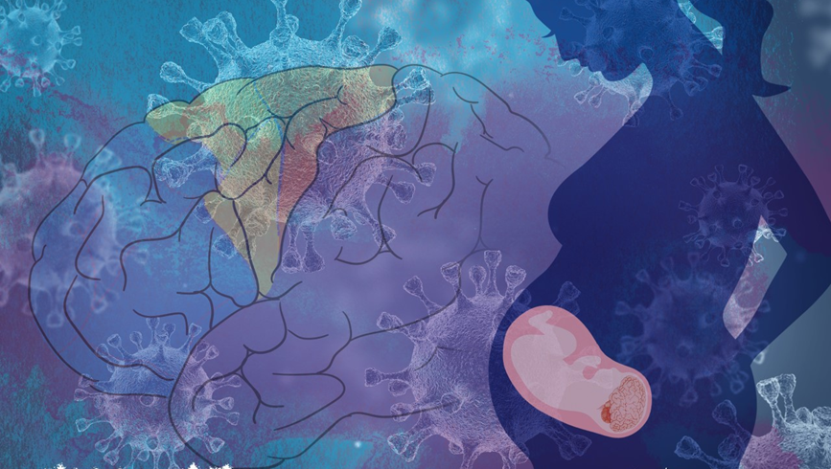


Evaluating social development in a nonhuman primate model of maternal immune activation
UC Davis Conte Center
STAR Oral Presentation
July 26, 2023
Student: Brittany Davis
Mentor: Melissa Bauman

Slide 2

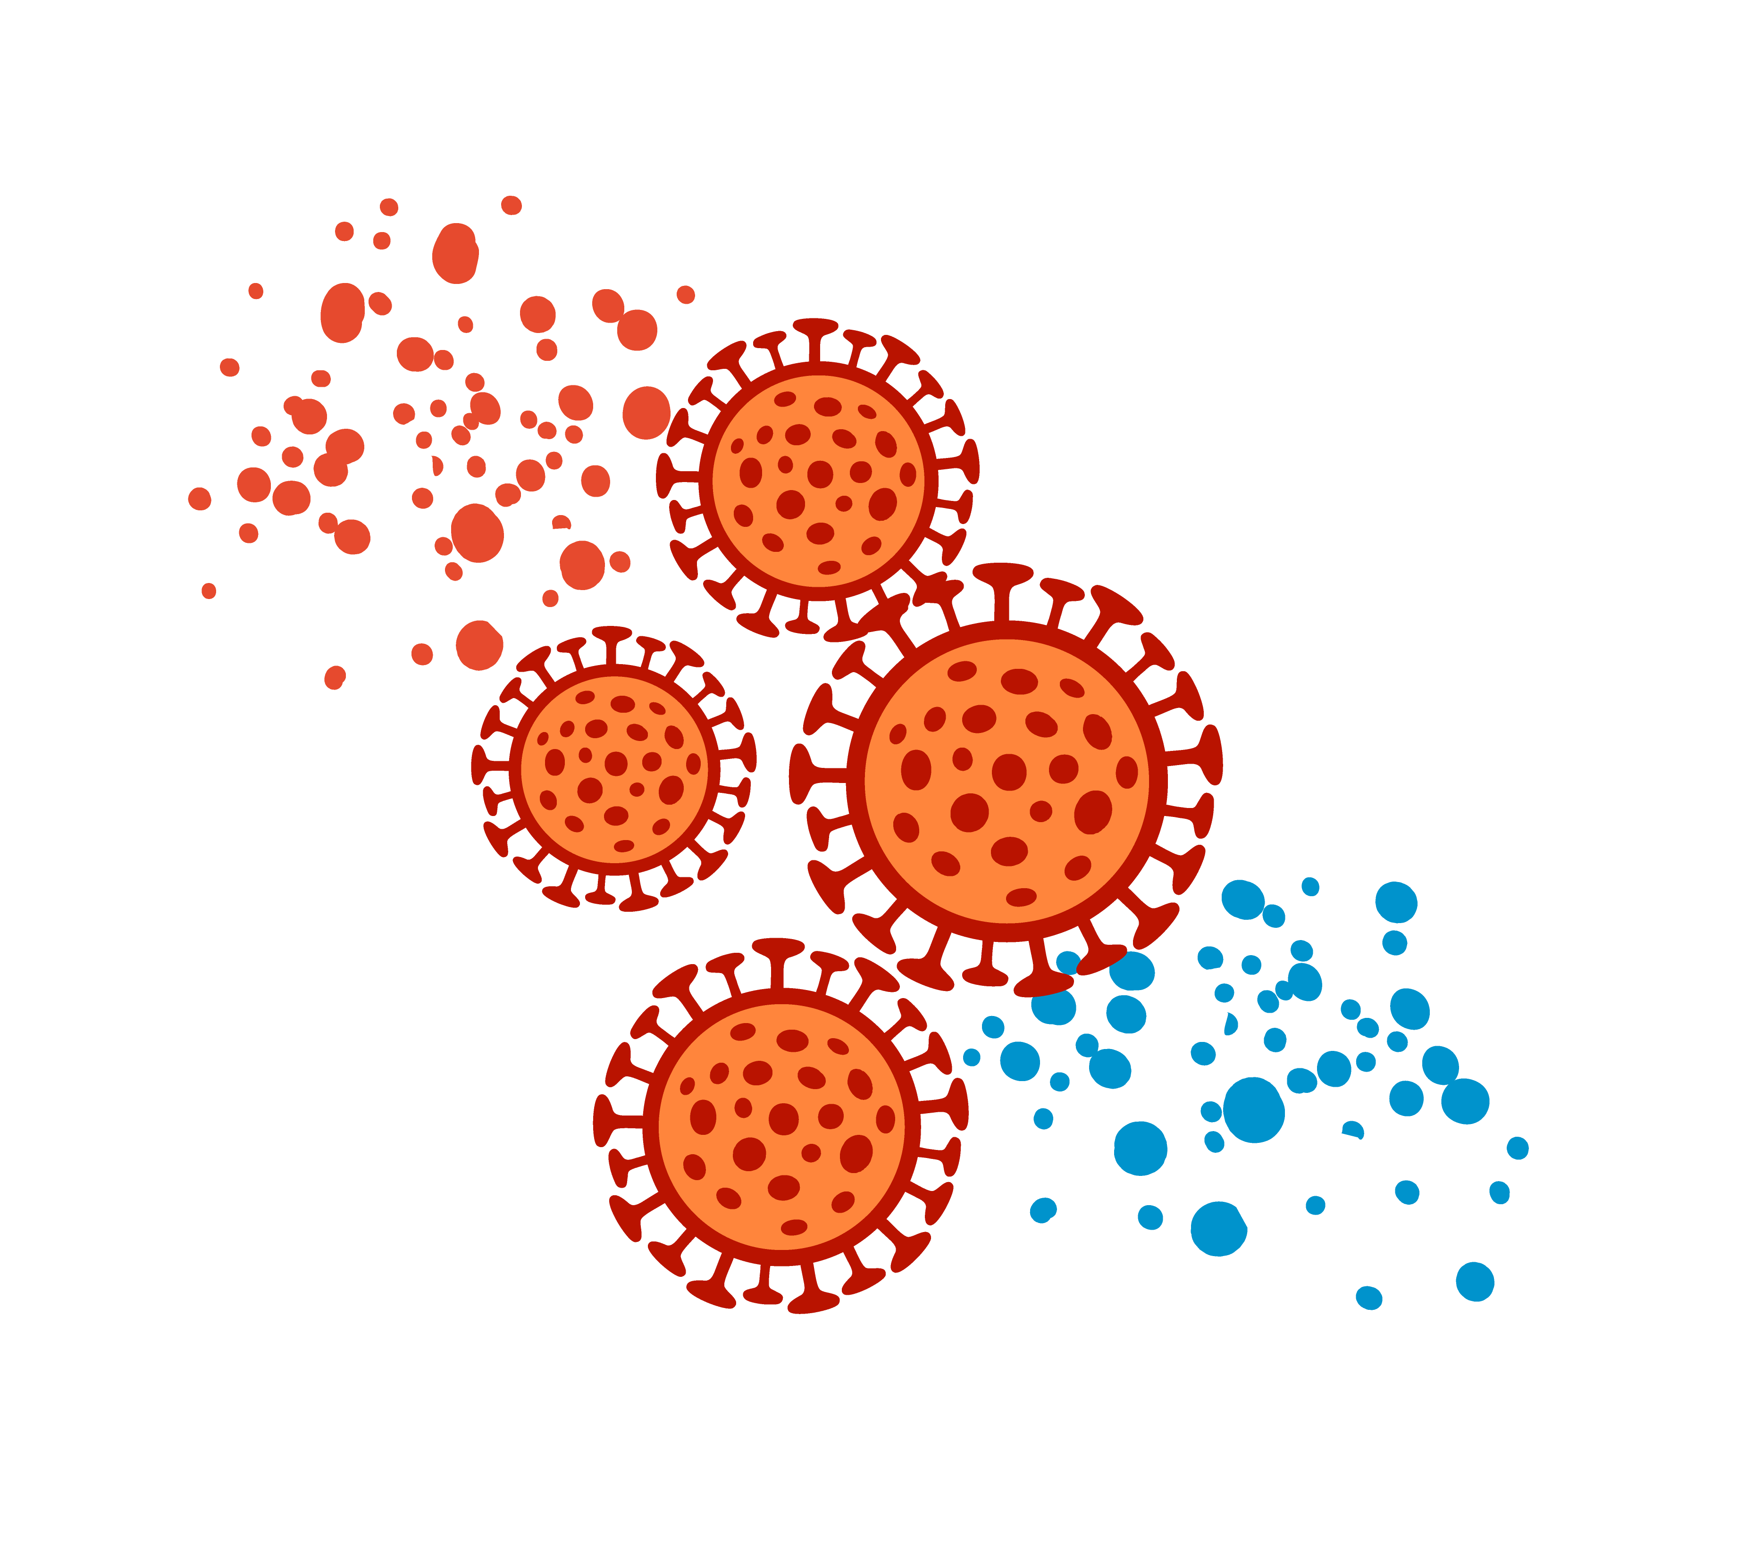
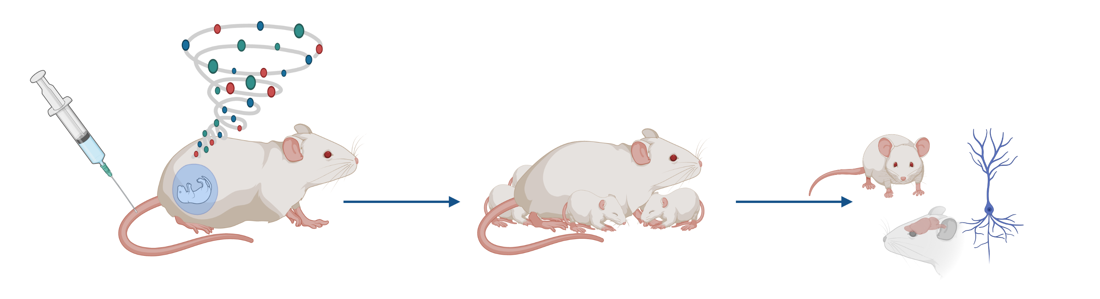
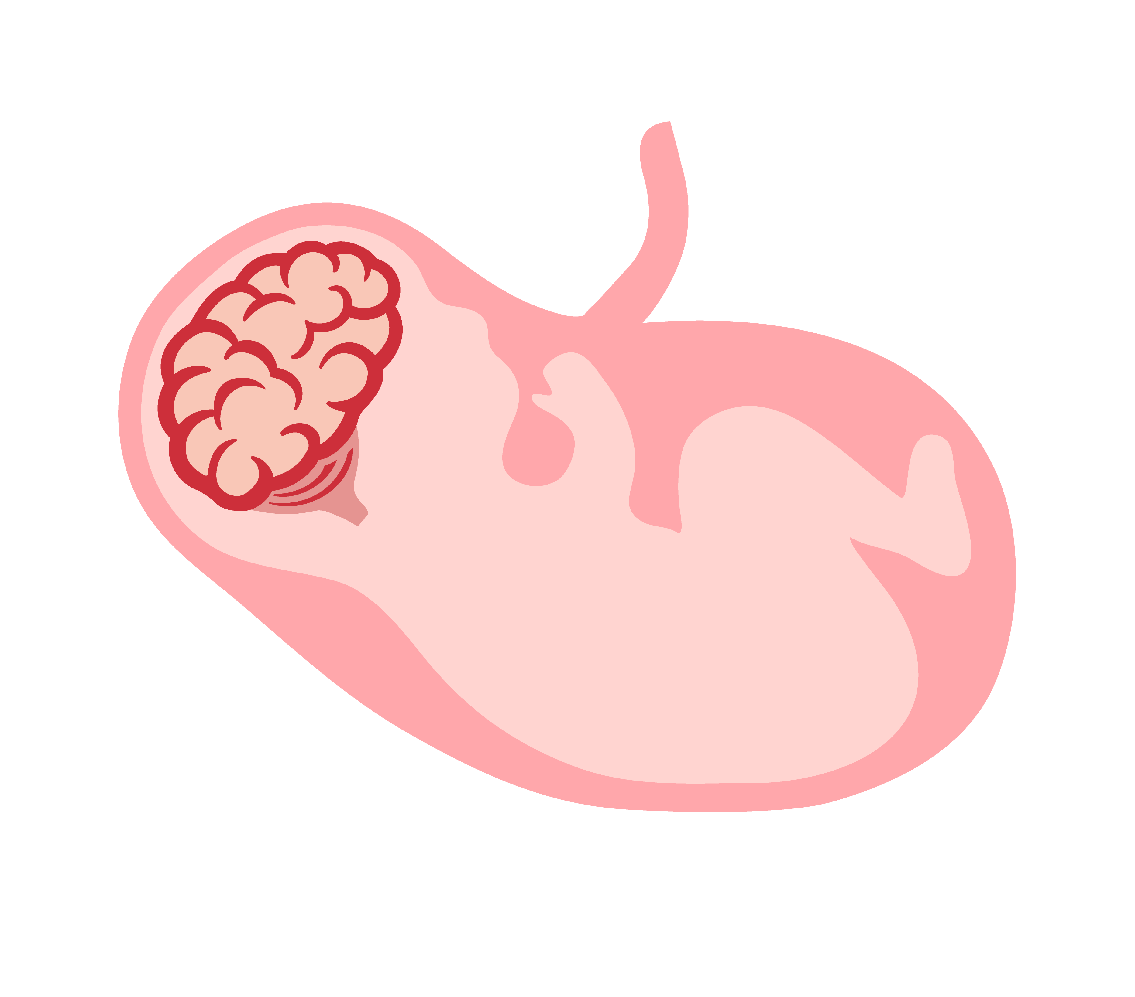
UC Davis Conte Center
Exposure to infection during pregnancy is associated with an increased risk of offspring neurodevelopmental disorders (NDDs)
The increased risk of NDDs does not appear to be linked to specific viral or bacterial infections - implicates the mother’s immune response to the pathogen
Animal models can be used to explore the link between maternal immune activation (MIA) and altered offspring neurodevelopment in a controlled environment
Maternal Immune Activation (MIA) Model
Stimulate maternal cytokines during pregnancy
Offspring brain and behavioral development

Slide 3
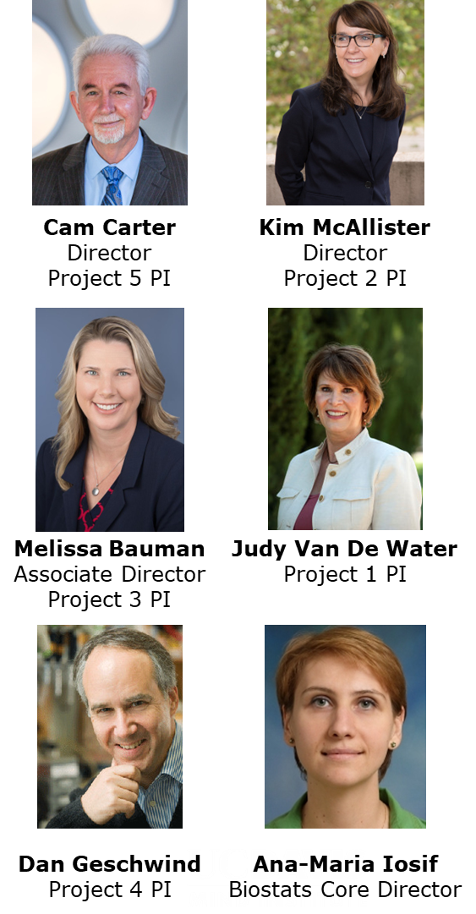
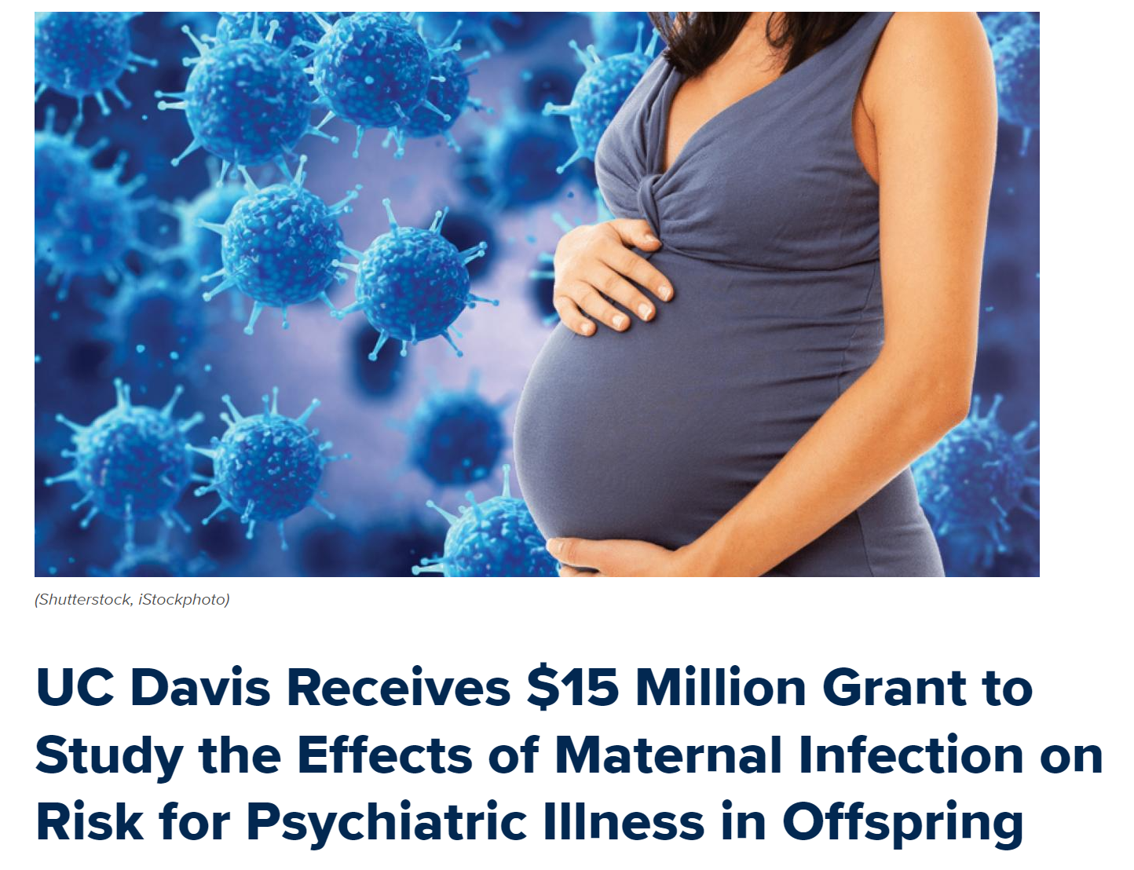
UC Davis Conte Center
2015
Silvio O. Conte Center for Basic or Translational Mental-Health
“Neuroimmune mechanisms of psychiatric disorders” (Carter, PI)
2020
Conte Center Renewal
(Carter/McAllister, MPI)
Interdisciplinary Team Science
Collaborators
UC Davis
UCLA
UNC
8+ Departments
UC Davis Health
UC Davis
UC Davis Centers
Mind Institute
Imaging Research Center
Center for Neuroscience
California National Primate Research Center

Slide 4
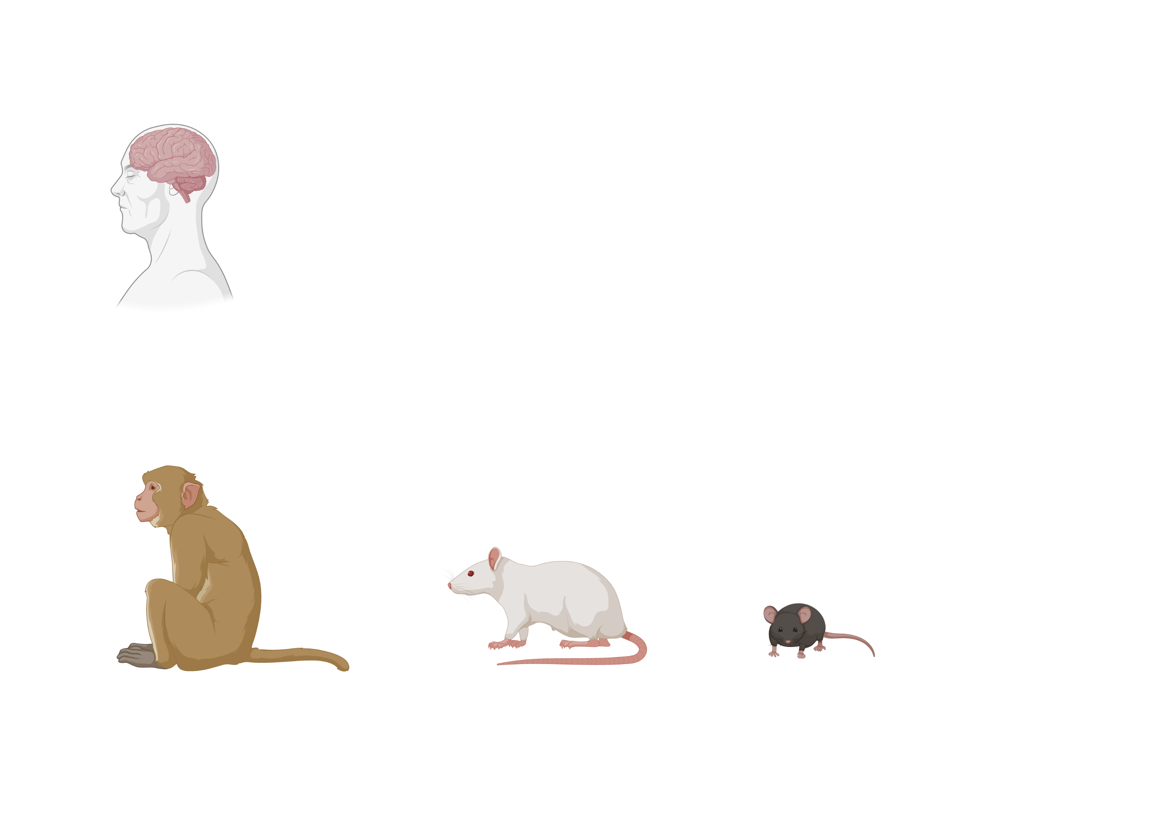
UC Davis Conte Center
2015
Silvio O. Conte Center for Basic or Translational Mental-Health
“Neuroimmune mechanisms of psychiatric disorders” (Carter, PI)
2020
Conte Center Renewal
(Carter/McAllister, MPI)
Interdisciplinary Team Science
Rodent
MIA Models
Nonhuman Primate
MIA Models
Schizophrenia
Research

Slide 5
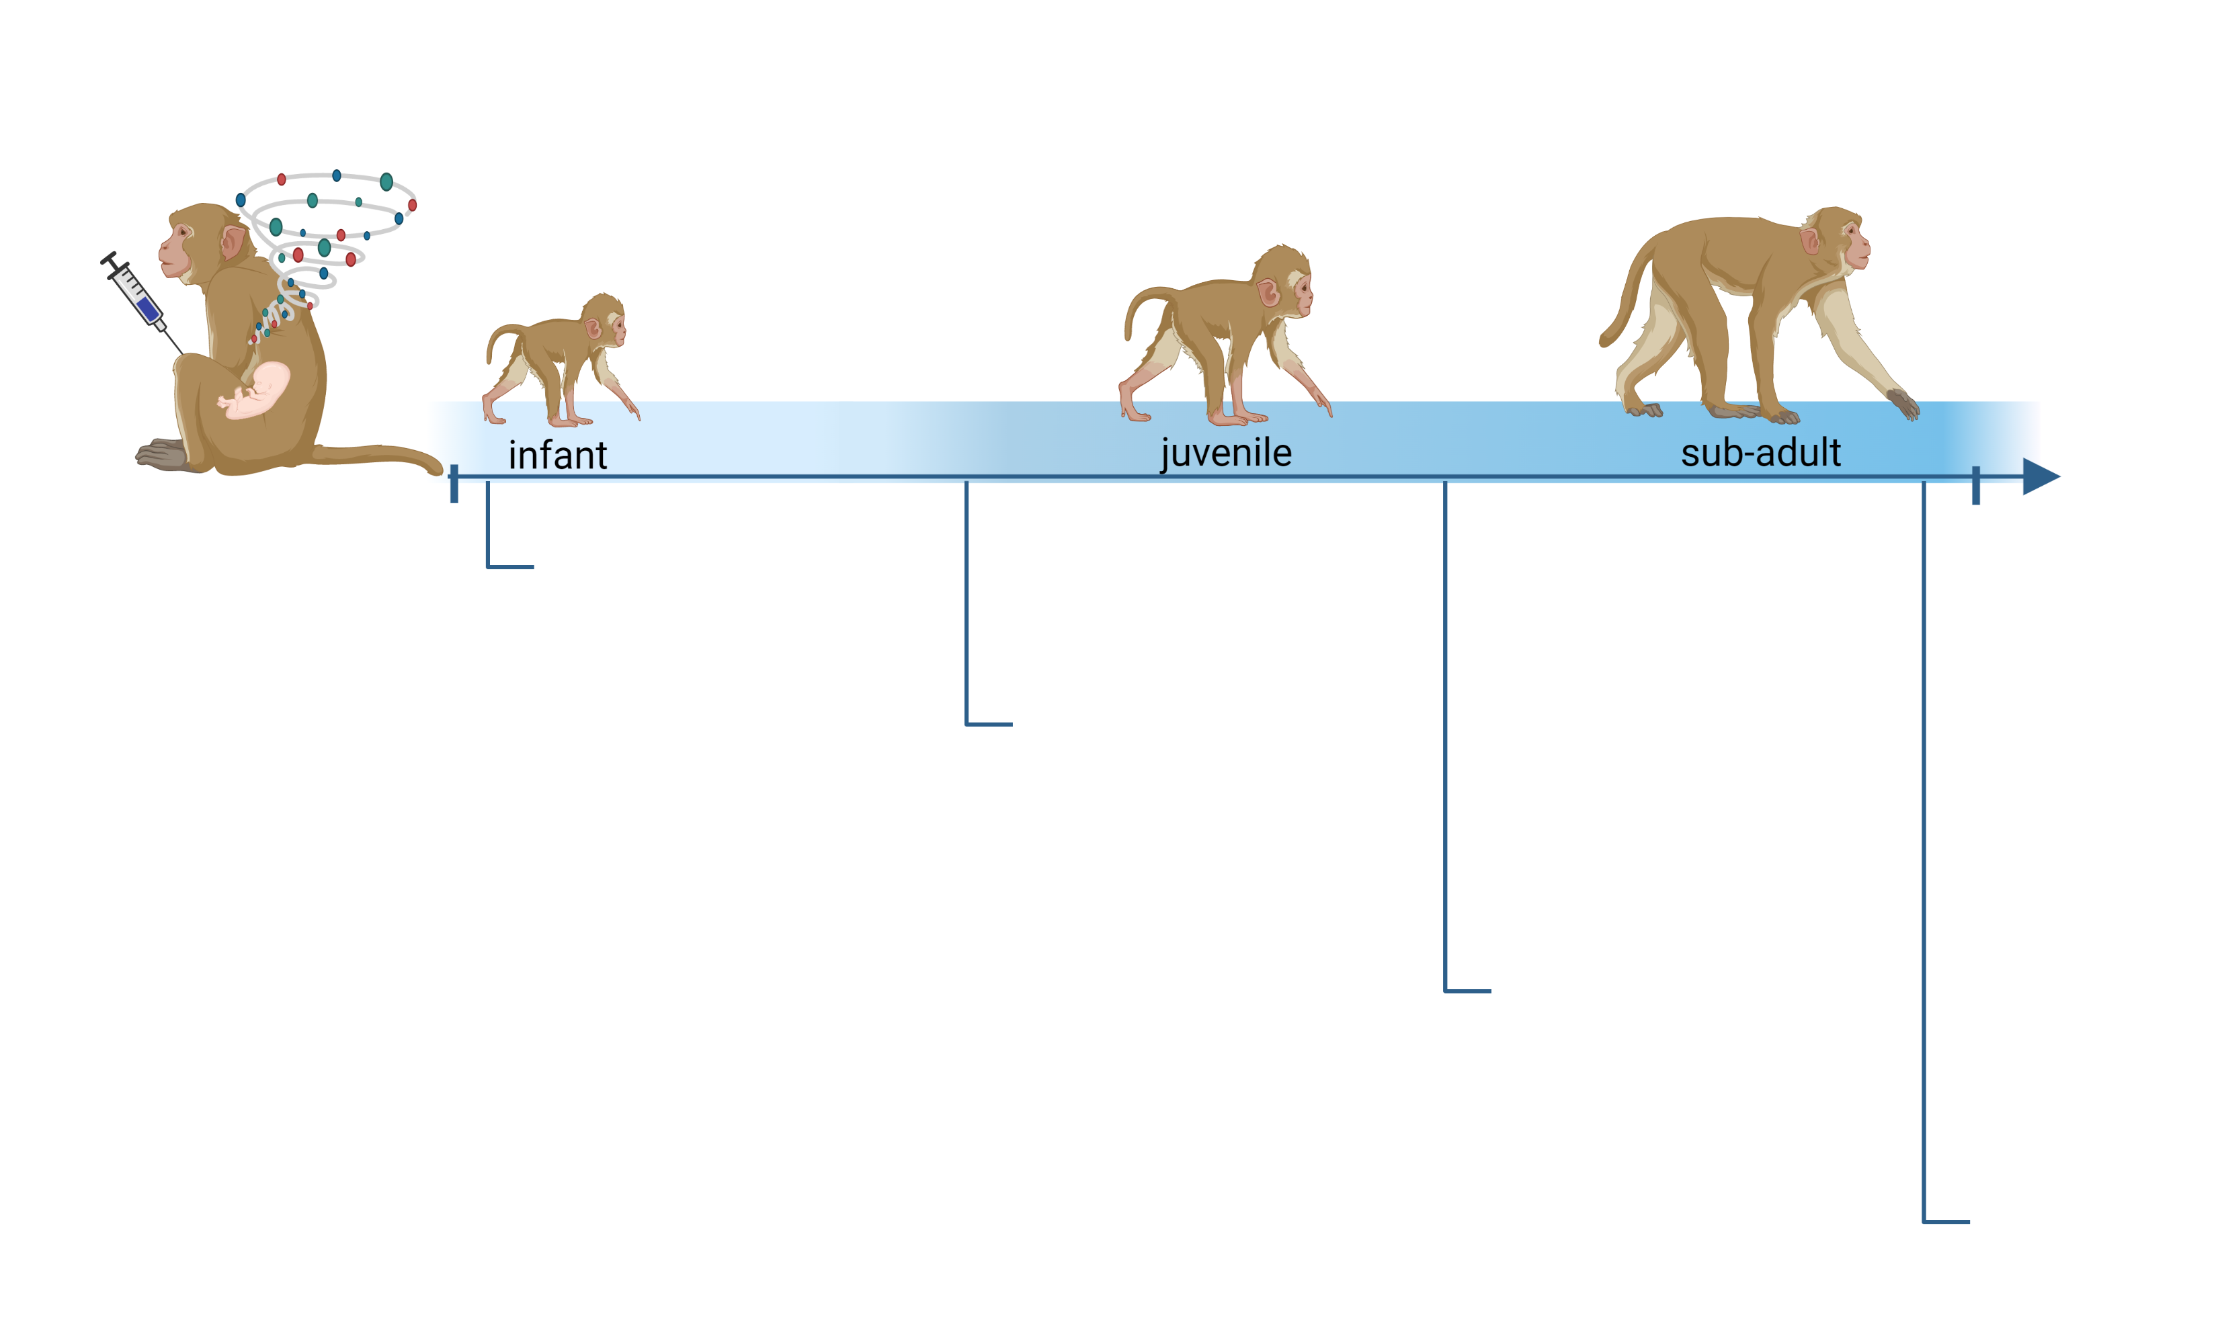
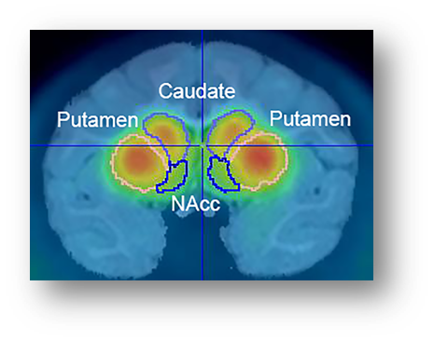
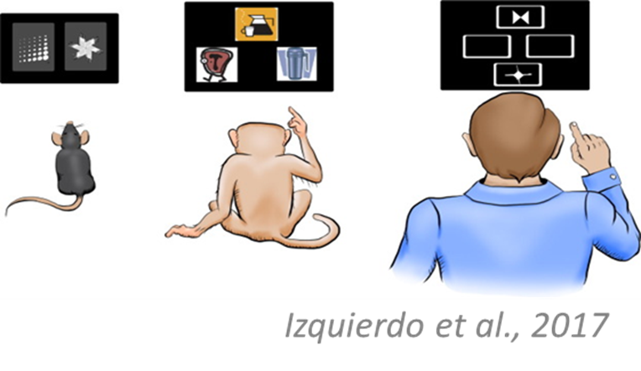
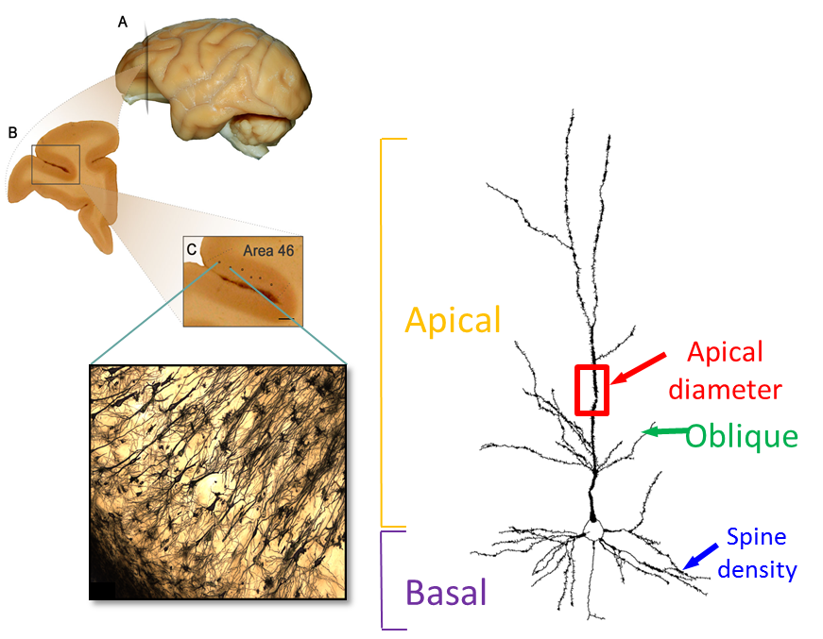
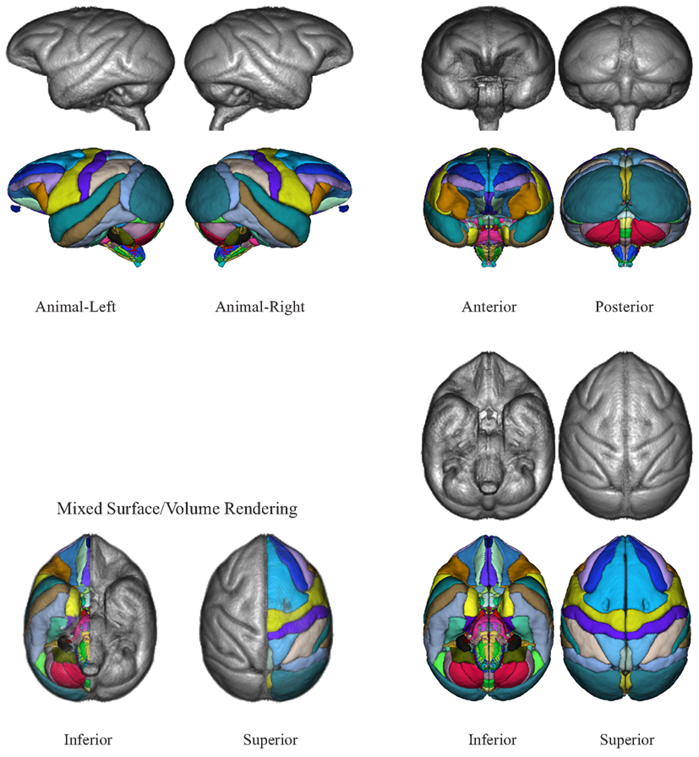
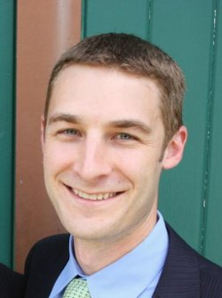
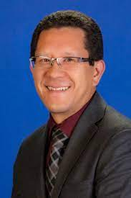
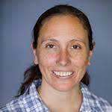

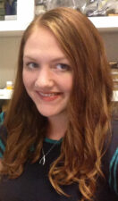
Altered neurodevelopment in MIA-treated nonhuman primate offspring parallel features of neurodevelopmental disorders
Reduced frontal lobe brain volume
Vlasova et al, 2021
Increased striatal dopamine
Bauman et al, 2019
Smucny et al, 2023
Atypical social and cognitive development
Vlasova et al, 2021
Ryan et al., in prep
Increased extracellular free water – putative marker of neuroinflammation
Lesh et al, under reveiw
Tyler Lesh, PhD
Lucy Funk, MD, PhD
Altered DLPFC dendritic morphology
Weir et al., 215
Hanson et al., 2023
Jason Smucny
PhD
Amy Ryan
PhD
Kari Hanson
PhD

Slide 6
2023 STAR Project:
Eye Tracking
New Behavioral Task
Develop a pipeline for processing and analyzing longitudinal eye-tracking data from the initial Conte Center cohort.
Design and pilot a new behavioral task to further probe differences in social attention between MIA and control groups.

Slide 7
Eye Tracking and Social Behavior

Slide 8
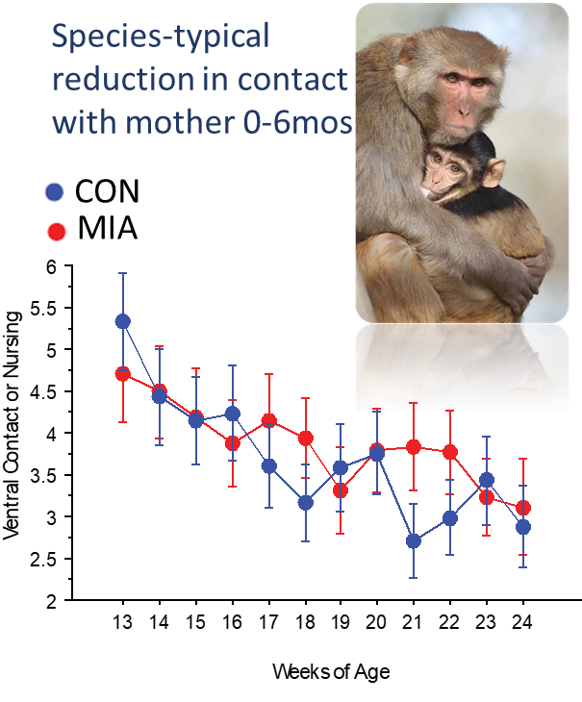
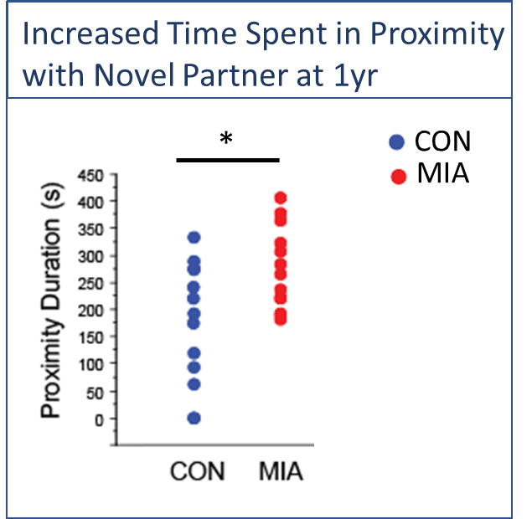
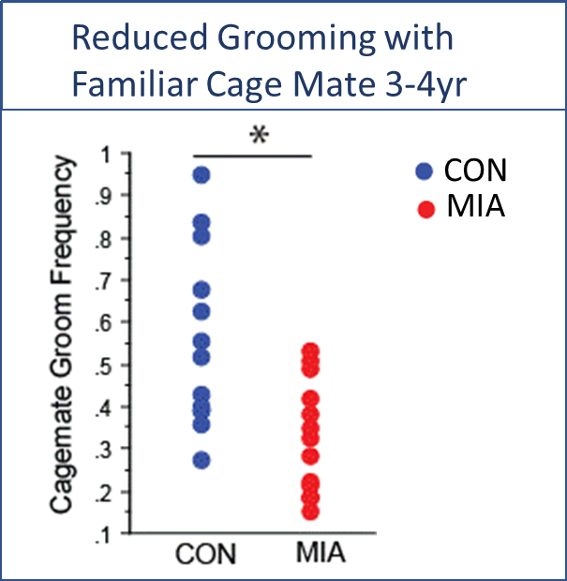
MIA Offspring Social Development
No differences in mother-infant interactions
Replicated finding of atypical interactions with novel partner
Reduction in grooming with familiar partners ~3-4 years of age

Slide 9
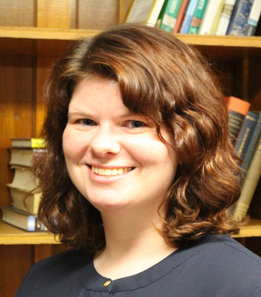

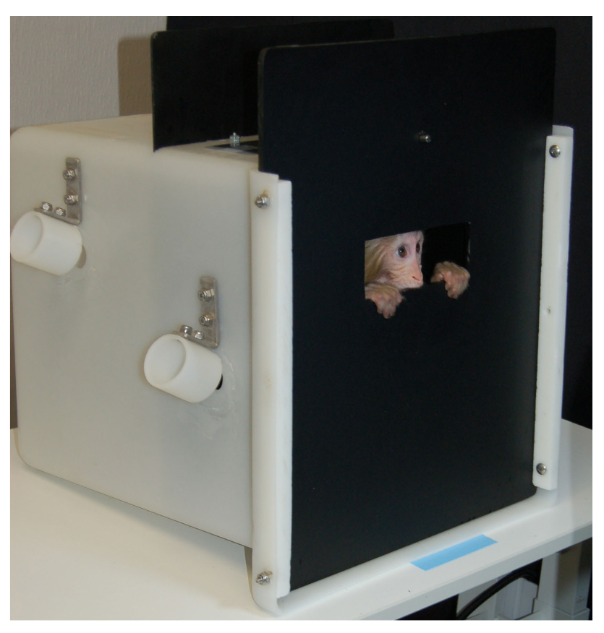

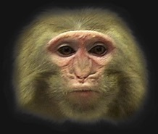
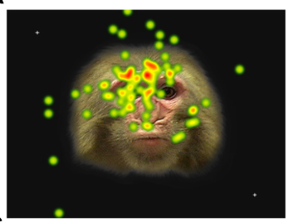

Eye Tracking
Designed a device to collect longitudinal eye tracking data in infant macaque monkeys without restraint
Amy Ryan, PhD
Takeshi Murai, PhD
Ryan et al., 2019
Tobii Pro TX300 eye tracker

Slide 10
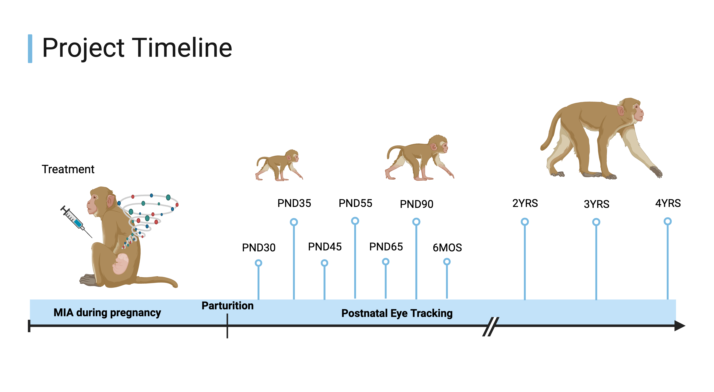
Conte Center 1.0
MIA N=14
Control N=14
Created with BioRender.com

Slide 11
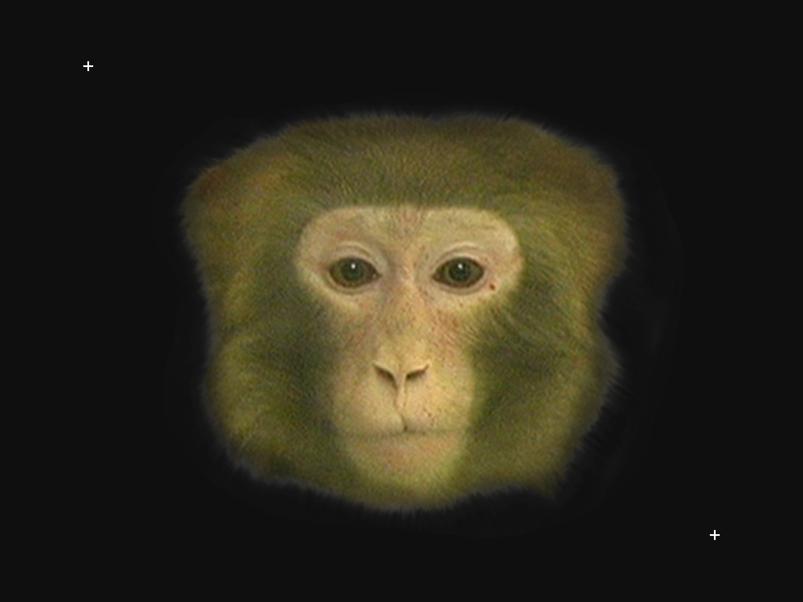
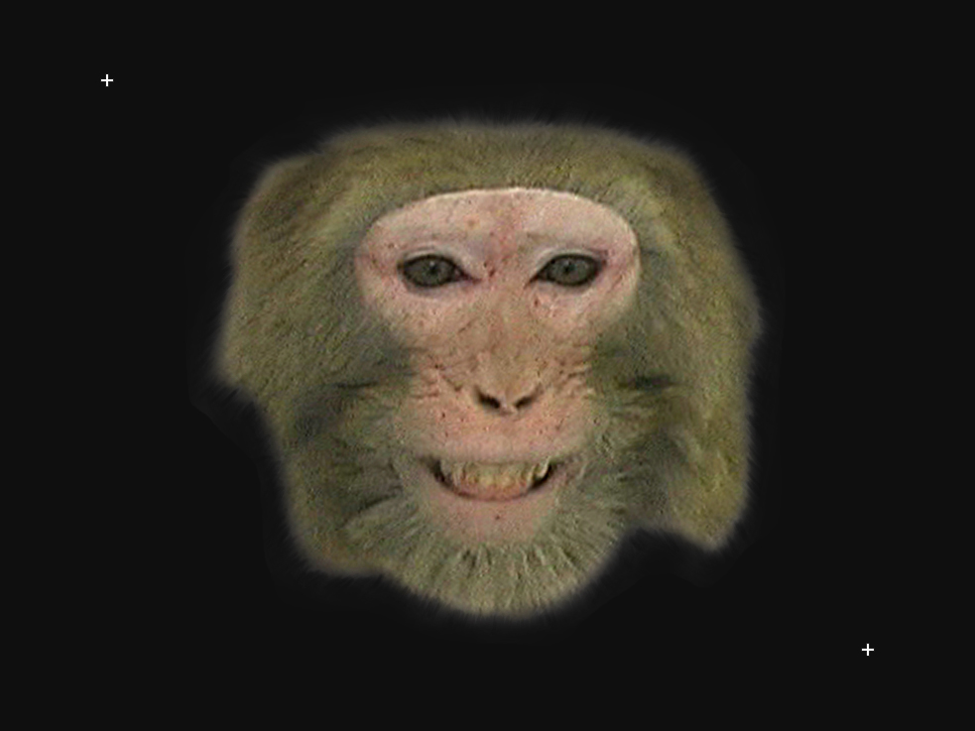
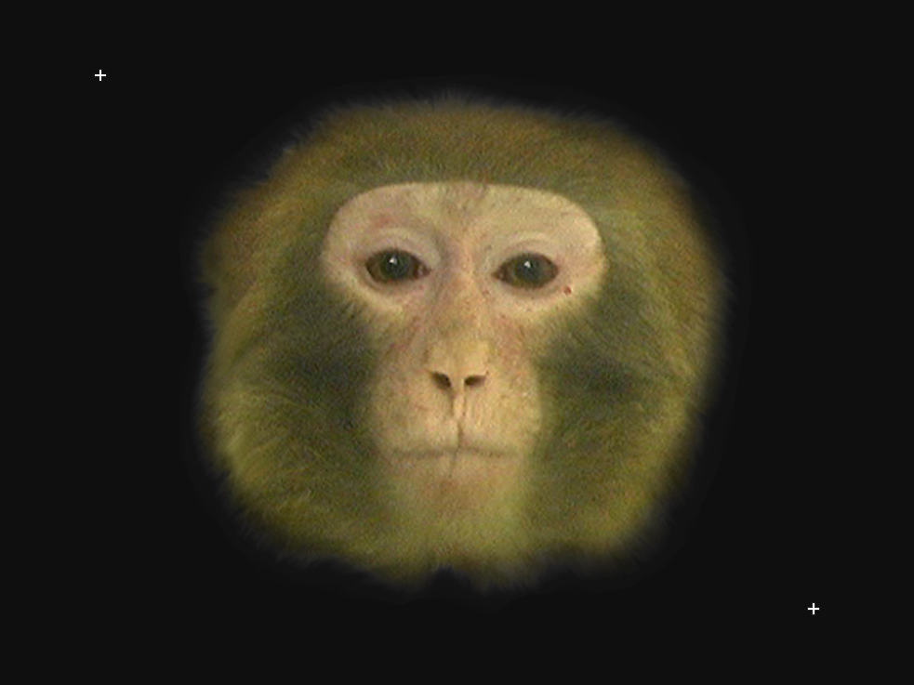
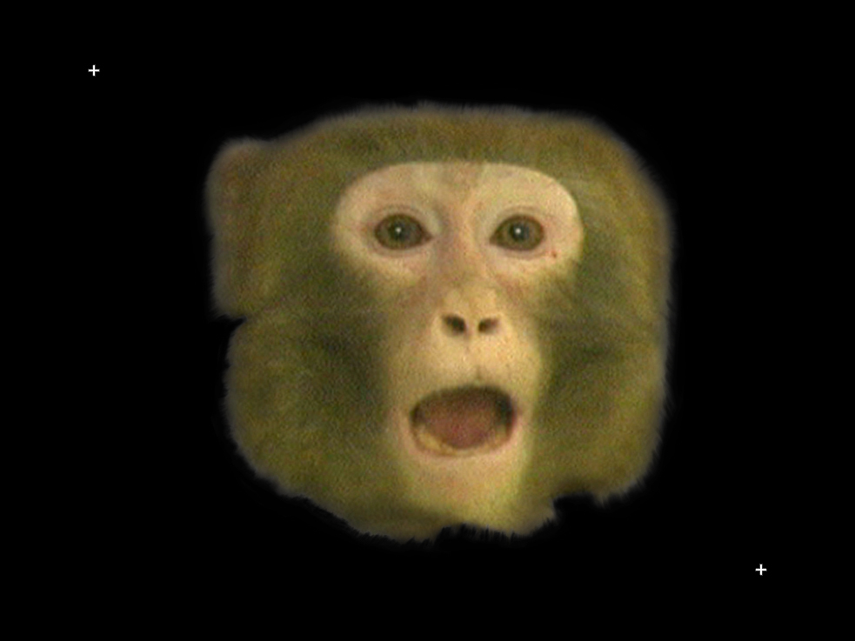

Facial Stimuli Set
Facial expressions images (5 min) | Four expressions (Neutral, Fear Grimace, Lipsmack and Open Mouth Threat) x 3 each
……..
10 sec
15 sec
10 sec
15 sec
10 sec
15 sec
10 sec
15 sec
Facial expressions and areas of interest (AOIs): face, eyes

Slide 12
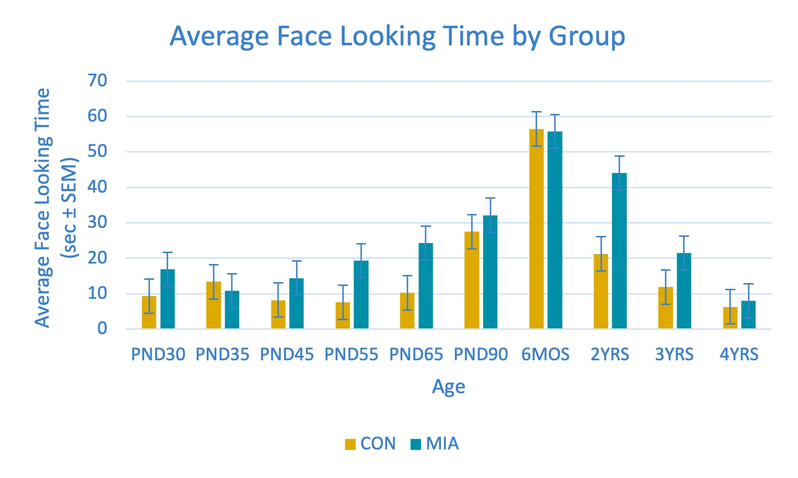

Slide 13
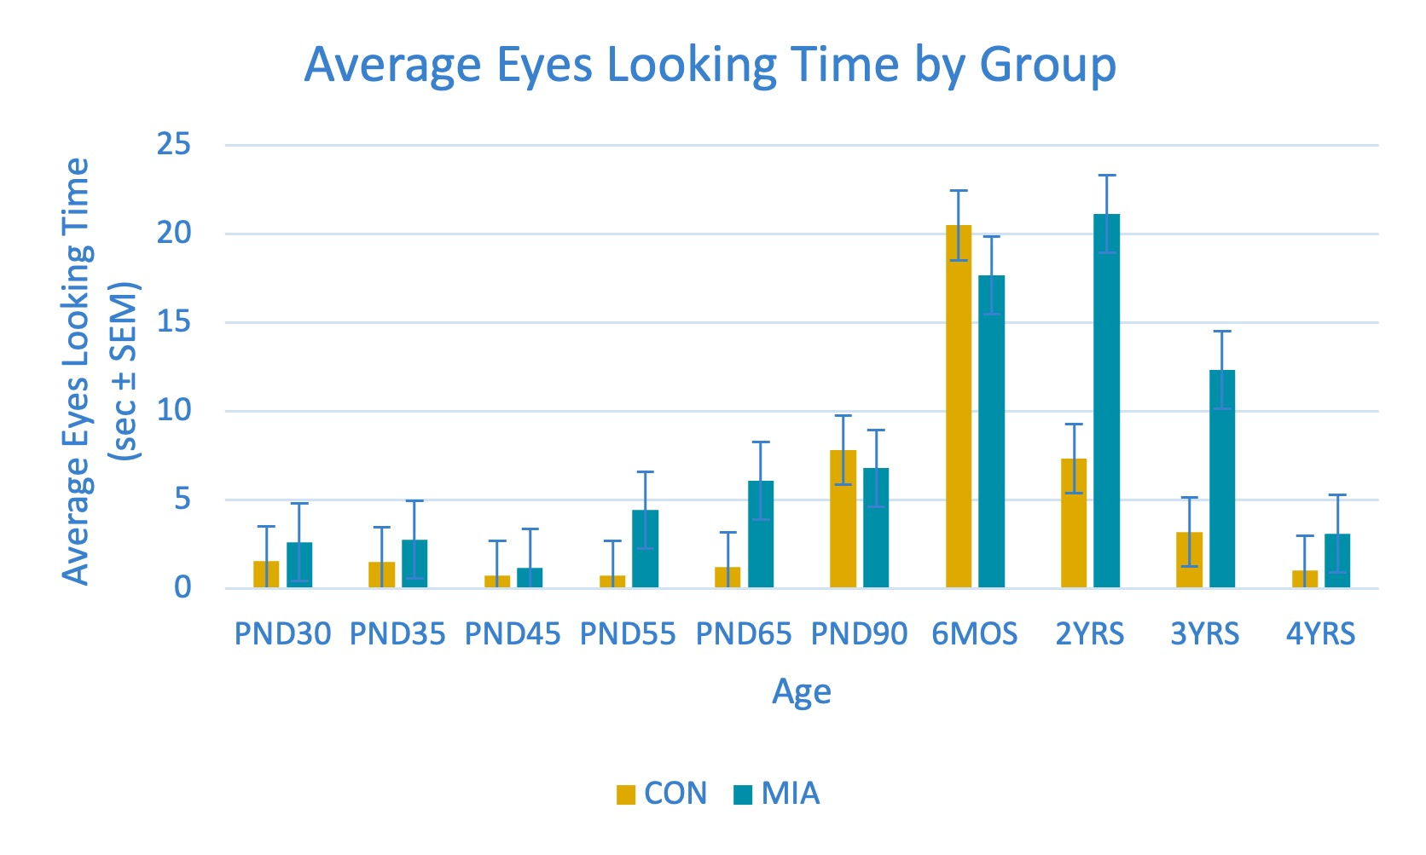

Slide 14
Social Valuation Task Development

Slide 15
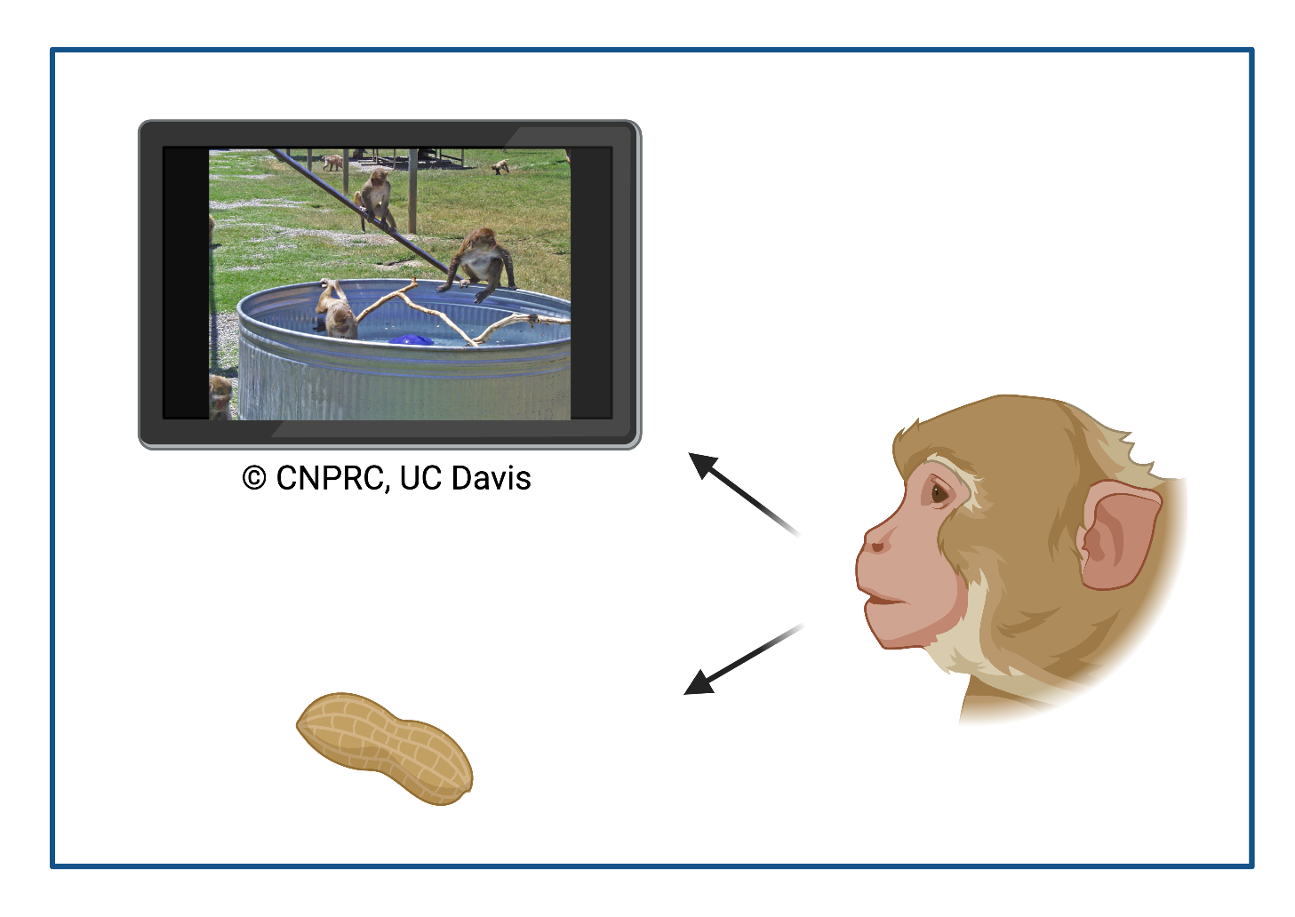
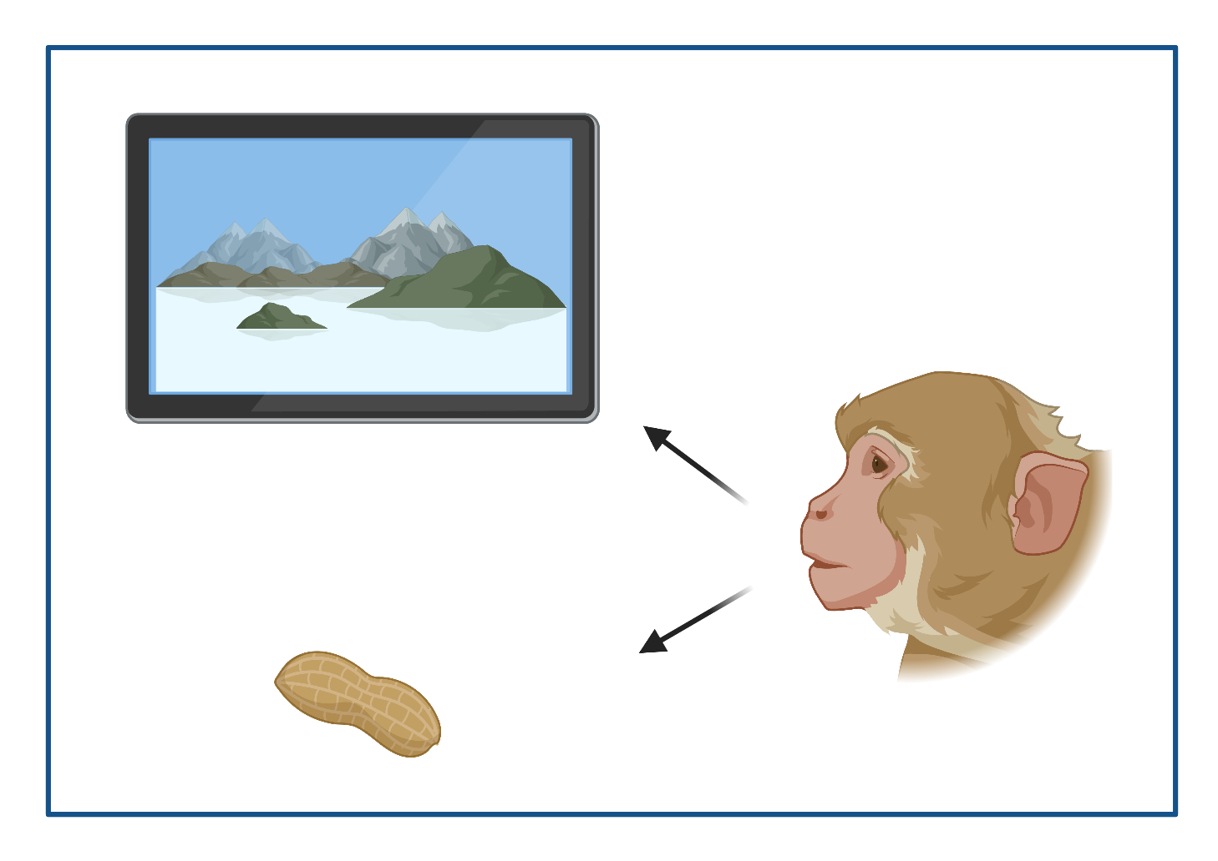
Piloting a Social Valuation Task
Eye Tracking:
Both CON and MIA spend more time looking at social stimuli
Created with BioRender.com
Amy Ryan, PhD

Slide 16

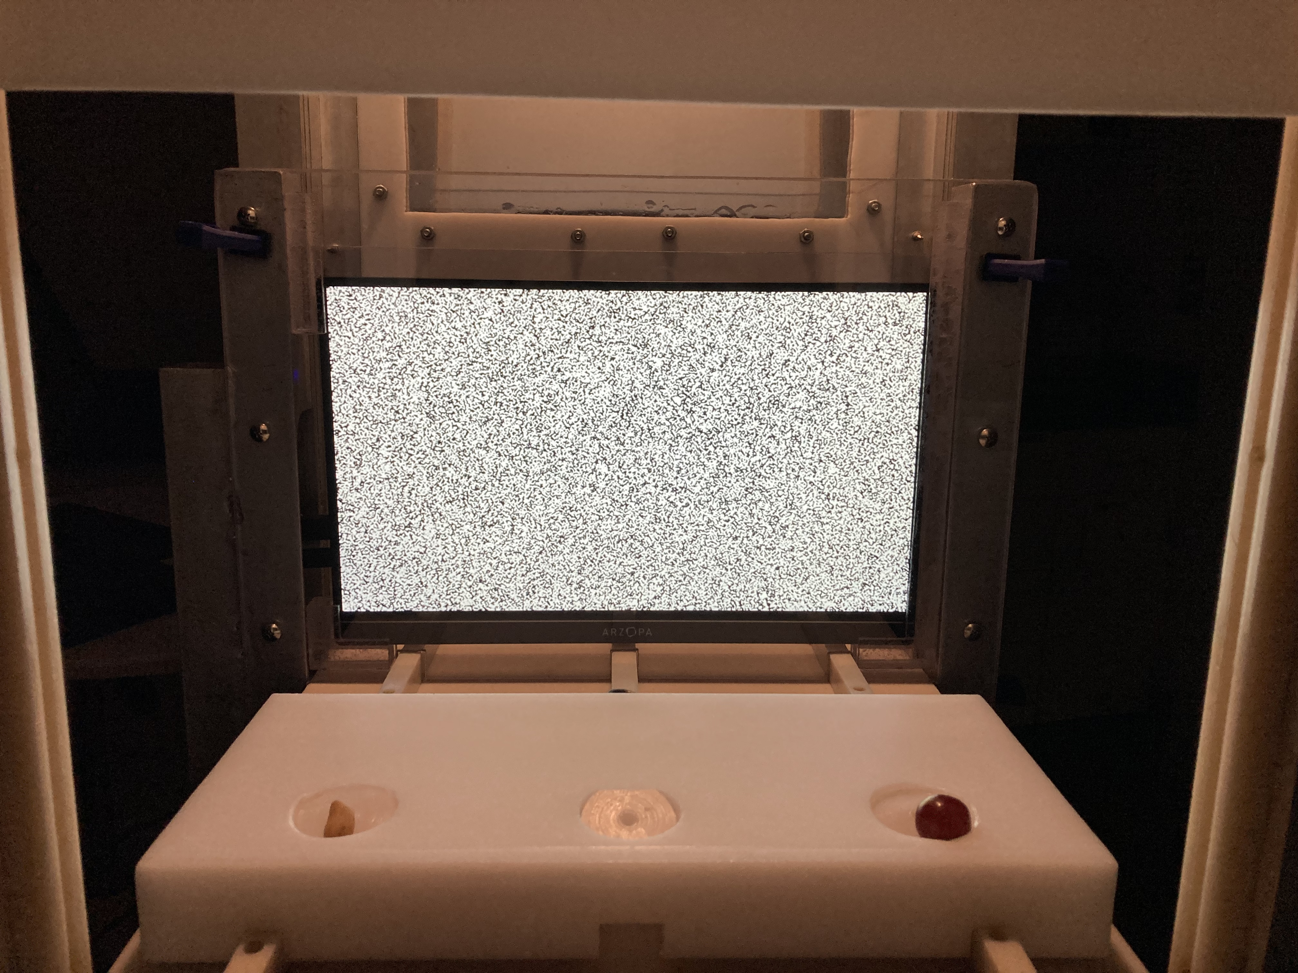
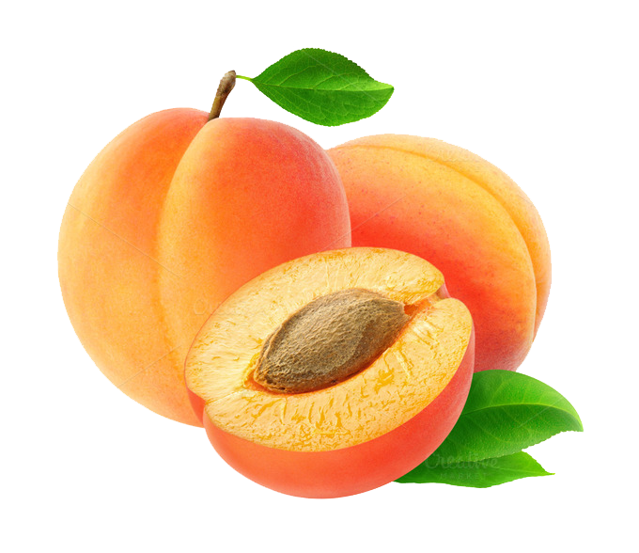
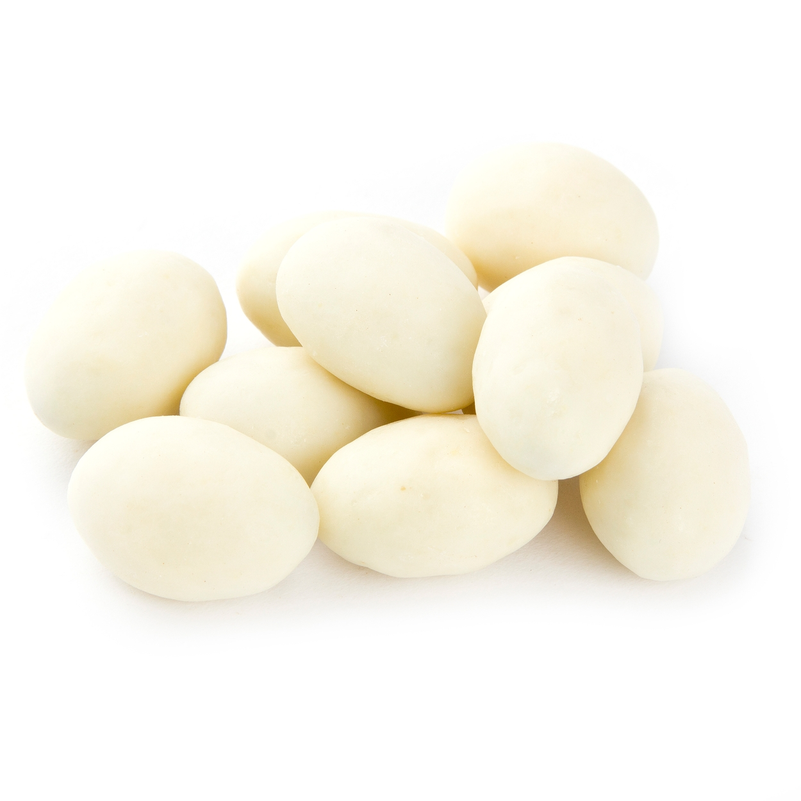
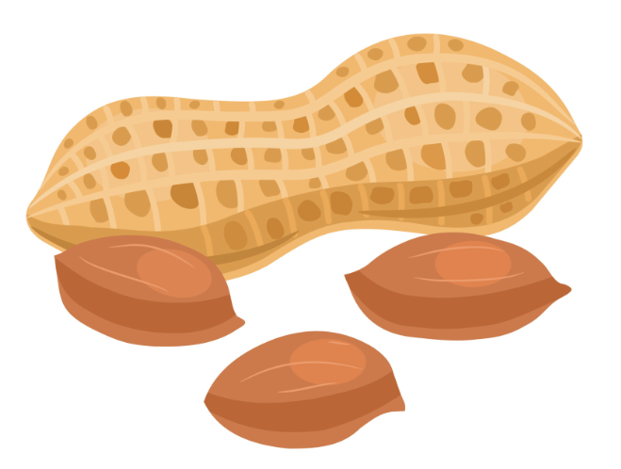

Food Preference Test

Slide 17
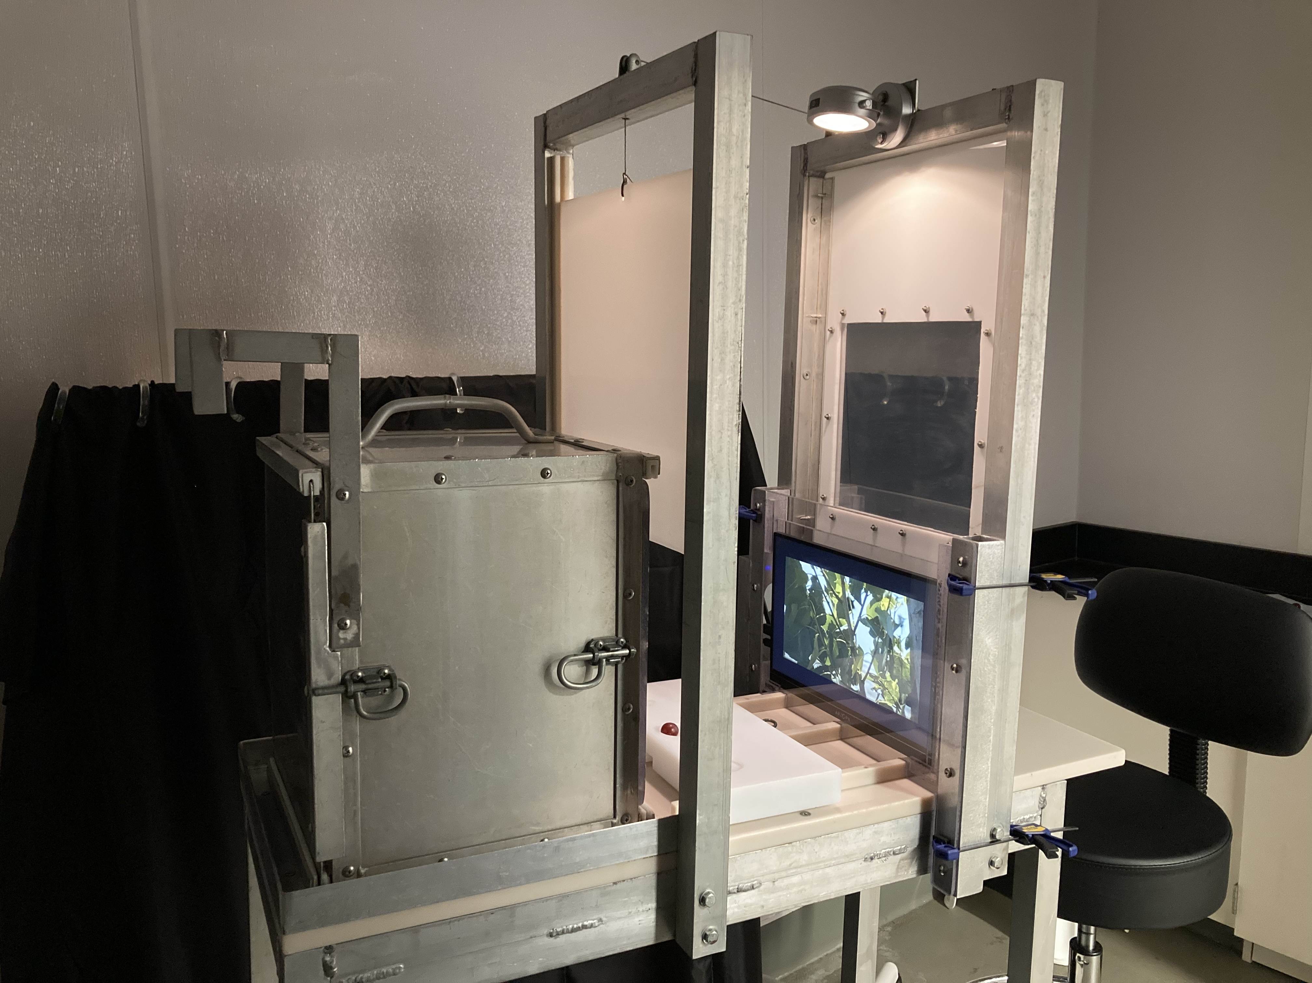
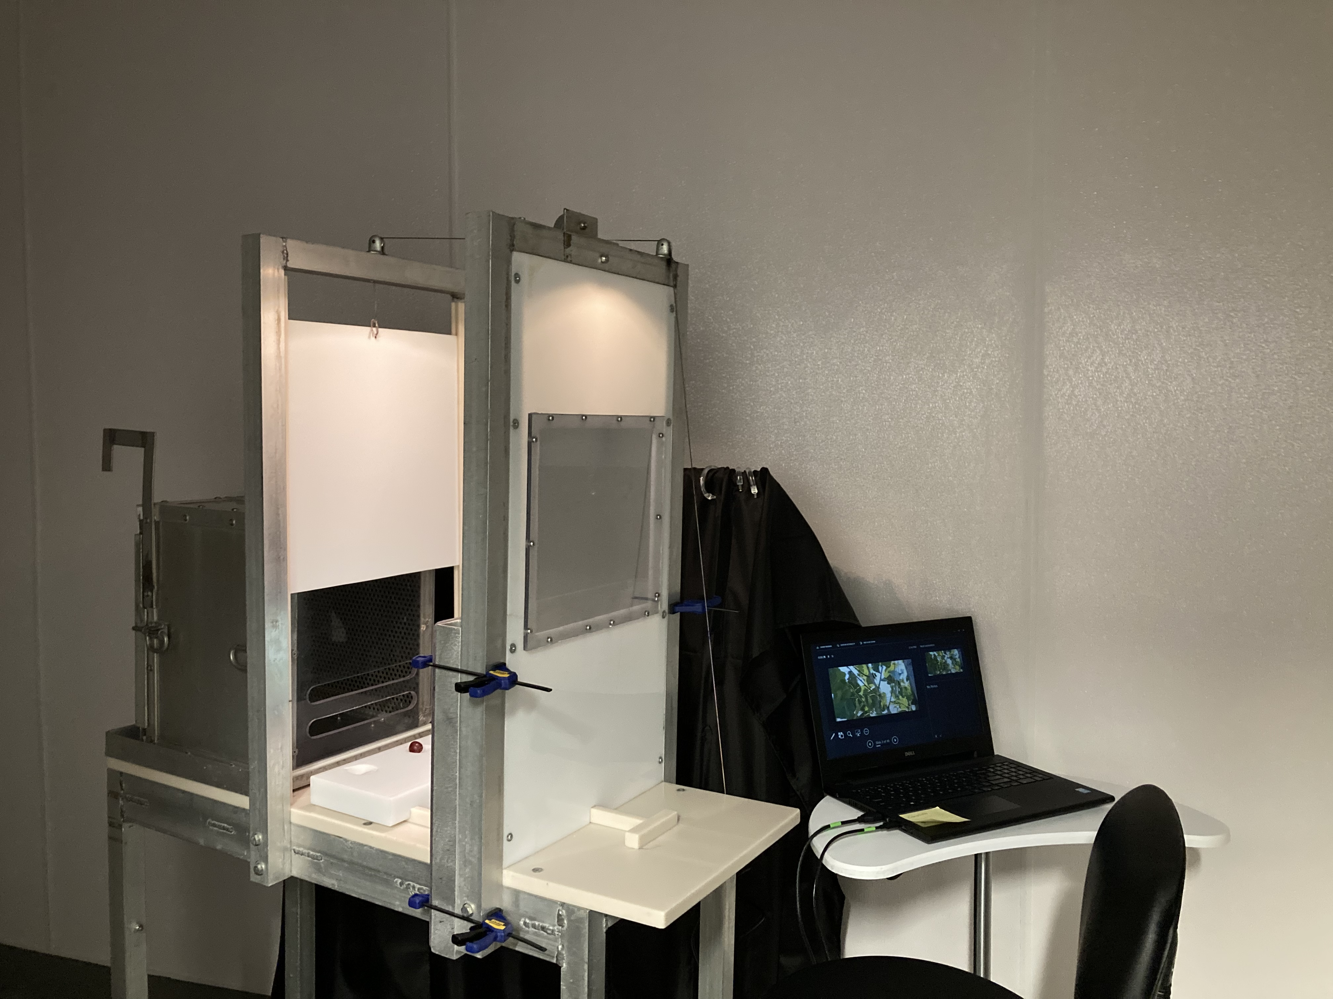
Social Valuation Setup
Modified Wisconsin General Testing Apparatus (WGTA):
Animal transport box
Treat presentation tray
Video presentation
One-way mirror

Slide 18


Slide 19
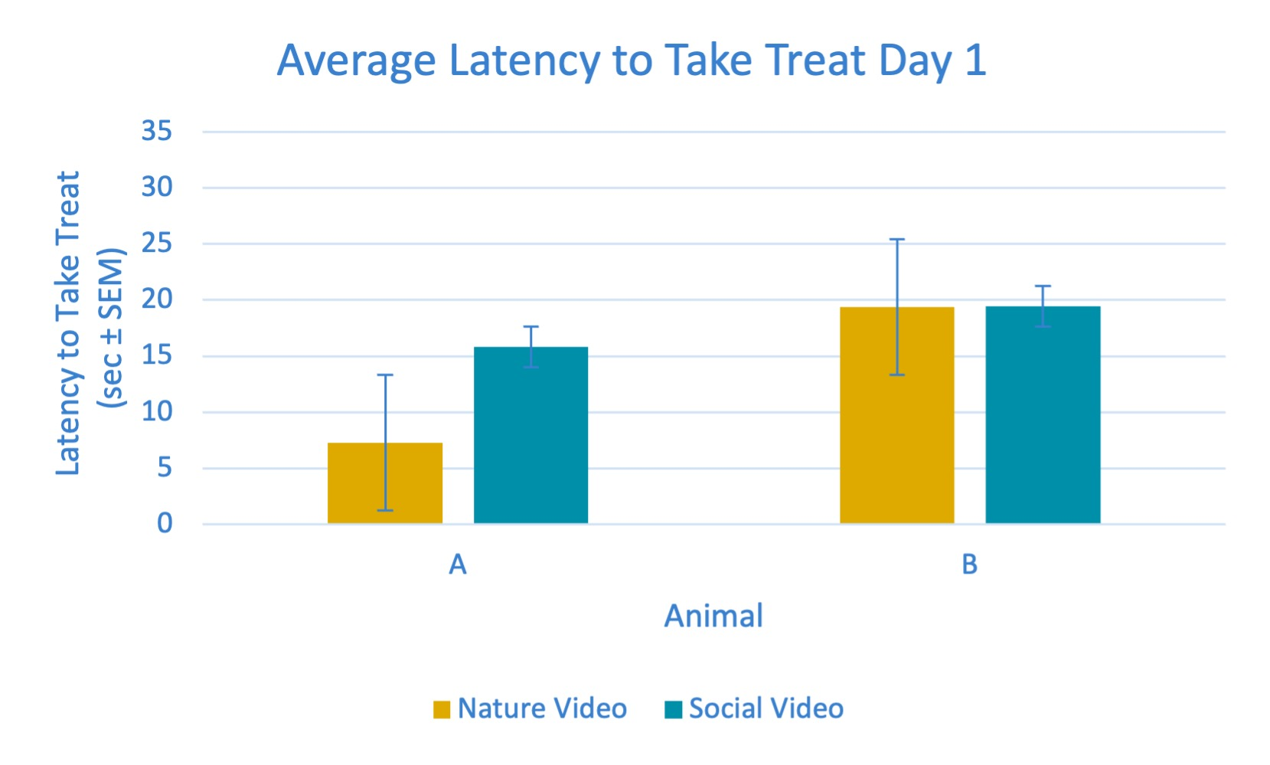
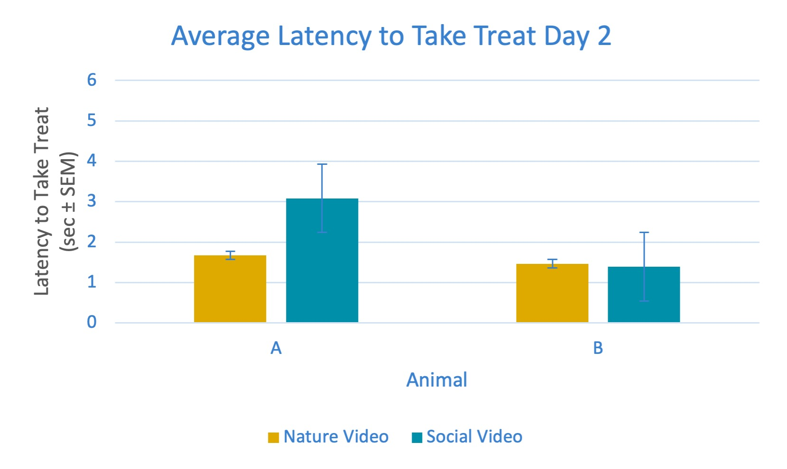
Social Valuation Pilot Results

Slide 20
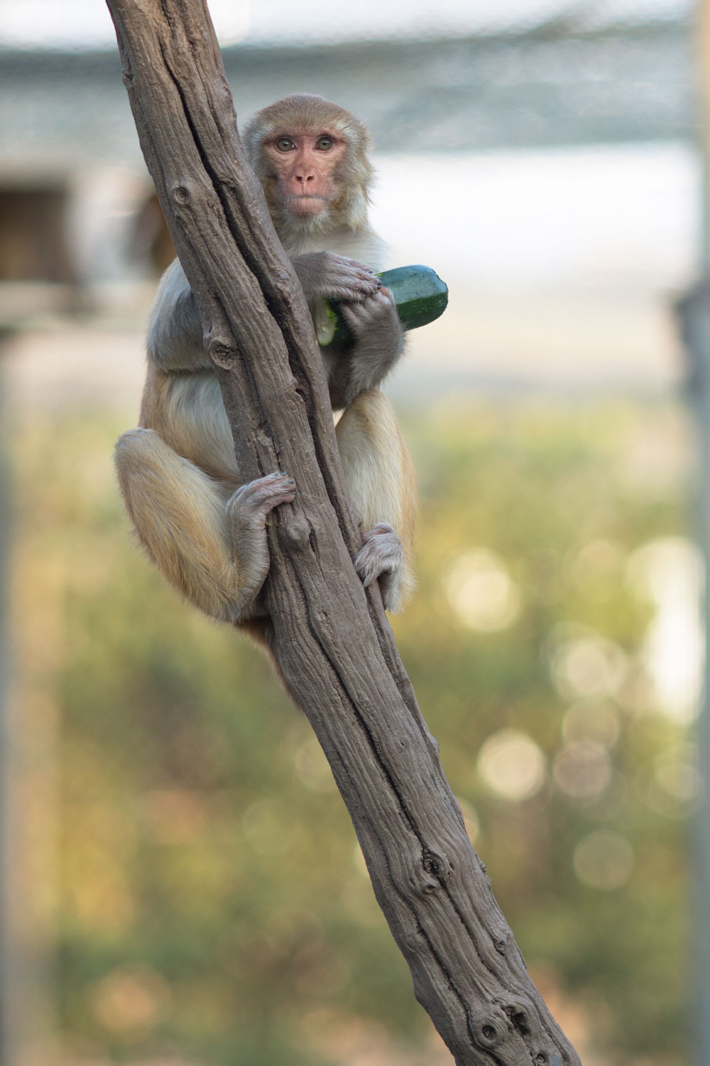
Future Directions
Work with biostatistics team to analyze eye tracking data
Explore eye tracking data specific to facial expression
Compare results of opportunistic eye tracking to previous data collected from more restrained animals
Assess cage side eye tracking methods
Refine social valuation test and incorporate into current cohort’s testing regime
© CNPRC, UC Davis

Slide 21
References
Machado, C. J., Whitaker, A. M., Smith, S. E., Patterson, P. H., & Bauman, M. D. (2015). Maternal immune activation in nonhuman primates alters social attention in juvenile offspring. Biological psychiatry, 77(9), 823–832. https://doi.org/10.1016/j.biopsych.2014.07.035
Ma, X. E., Gu, H., & Zhao, J. (2021). Atypical gaze patterns to facial feature areas in autism spectrum disorders reveal age and culture effects: A meta‐analysis of eye‐tracking studies. Autism Research, 14(12), 2625-2639.
R Core Team (2021). R: A Language and environment for statistical computing. (Version 4.1) [Computer software]. Retrieved from https://cran.r-project.org. (R packages retrieved from MRAN snapshot 2022-01-01).
Ryan, A. M., Freeman, S. M., Murai, T., Lau, A. R., Palumbo, M. C., Hogrefe, C. E., Bales, K. L., & Bauman, M. D. (2019). Non-invasive Eye Tracking Methods for New World and Old World Monkeys. Frontiers in behavioral neuroscience, 13, 39. https://doi.org/10.3389/fnbeh.2019.00039
Ryan AM, Murai T, Lau AR, Hogrefe CE, McAllister AK, Carter CS, Bauman MD. New approaches to quantify social development in rhesus macaques (Macaca mulatta): Integrating eye tracking with traditional assessments of social behavior. Dev Psychobiol. 2020;62:950-962.
The jamovi project (2022). jamovi. (Version 2.3) [Computer Software]. Retrieved from https://www.jamovi.org.
Tobii Technology, Stockholm, Sweden
Vlasova RM, Iosif AM, Ryan AM, Funk LH, Murai T, Chen S, Lesh TA, Rowland DJ, Bennett J, Hogrefe CE, Maddock RJ, Gandal MJ, Geschwind DH, Schumann CM, Van de Water J, McAllister AK, Carter CS, Styner MA, Amaral DG, Bauman MD. Maternal Immune Activation during Pregnancy Alters Postnatal Brain Growth and Cognitive Development in Nonhuman Primate Offspring. J Neurosci. 2021;41:9971-9987.

Slide 22
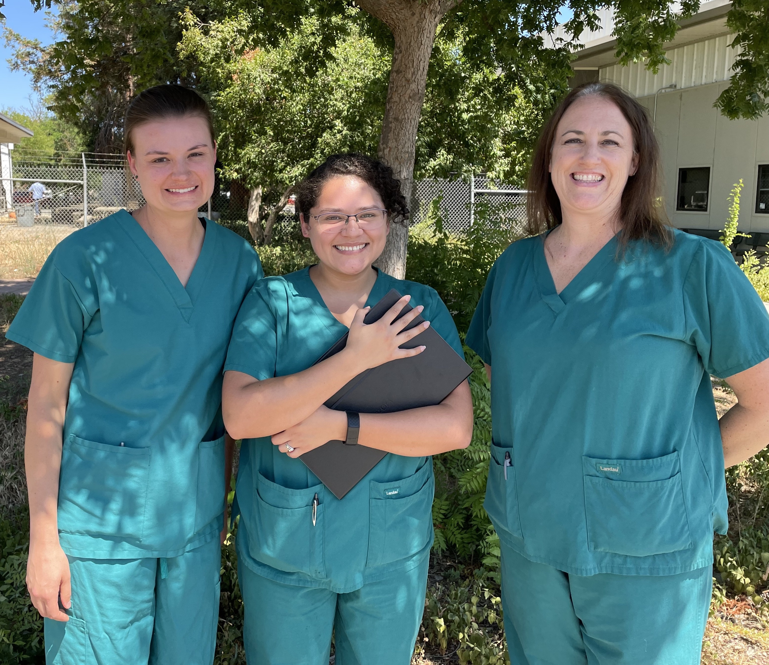

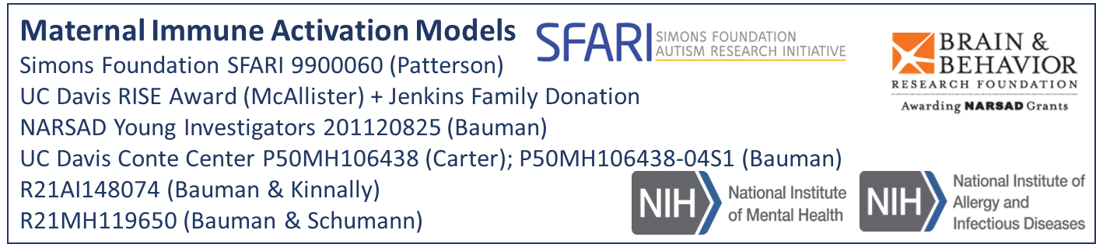

Thank you!
Bauman Lab
Melissa Bauman (mentor)
Felisa Carbajal (lab assistant)
Casey Phi (lab manager)
CNPRC
STAR Program
UC Davis Conte Center
Student Support
STAR Program UCD SVM Endowment Funds
NIH Grant T32GM136559

