Slide 1
Developmental Neurotoxicity of PCB 11
Ashley Batra

Slide 2









What are PCBS?
PCB = Polychlorinated Biphenyls
Anthropogenic origin
Pervasive environmental pollutants despite ban on their production for several decades
Produced through degradation of legacy PCBs or inadvertent byproducts of contemporary pigment production
Long half-life
Frequently detected in environmental samples and human tissues
R Wilson
How PCBs bioaccumulate up the food chain
Notes:
Give estimate of half-life

Slide 3
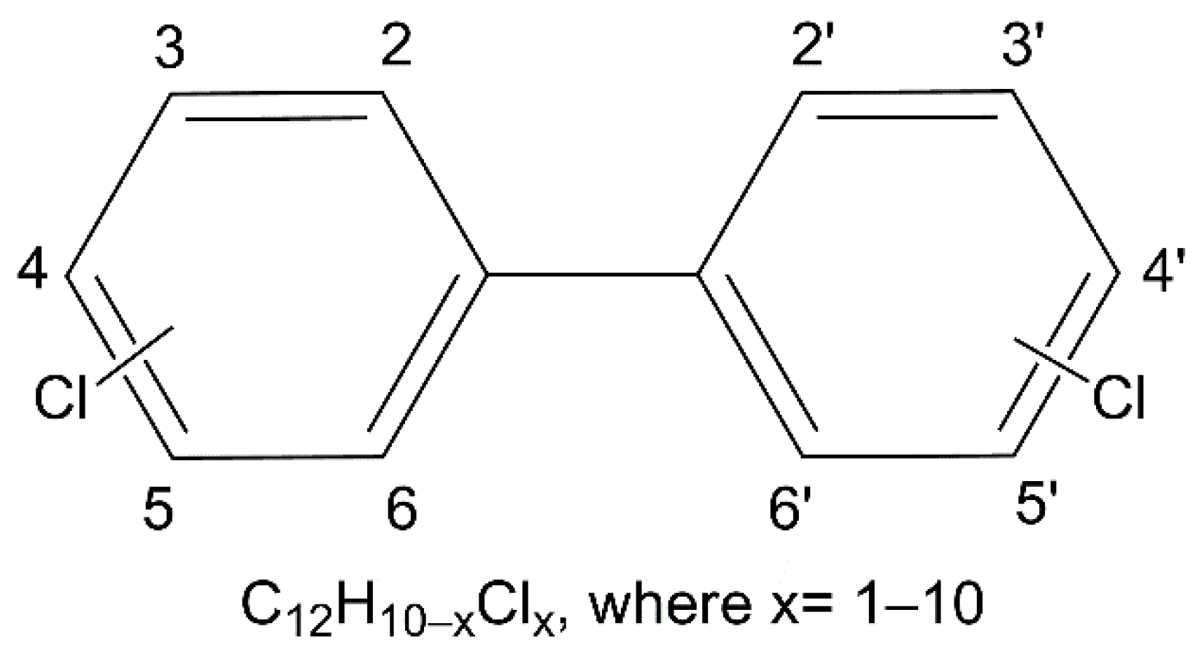
Congeners: HC-PCBs vs. LC-PCBs
meta
ortho
Higher chlorinated (HC)-PCBs:
> 4 chlorine substituents
Lower chlorinated (LC)- PCBS:
< 4 chlorine substituents
Variable chlorine substituents → 209 congeners!
More chlorinated congeners generally more resistant to degradation
Contemporary samples tend to have more LC-PCBS
para

Slide 4
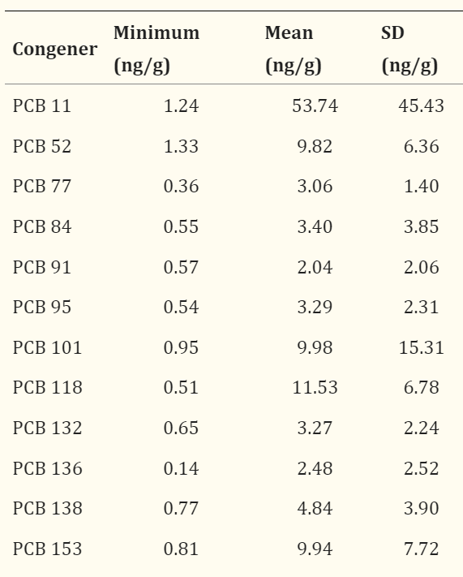
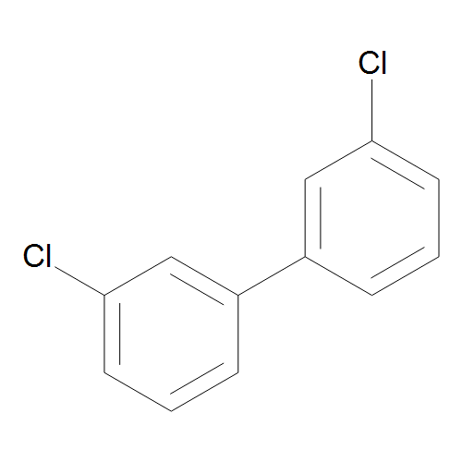
Markers of Autism Risk in Babies Learning Early Signs (MARBLES)
PCB exposure in utero positively associated with increased risk for neurodevelopmental disorders (NDDs), including autism spectrum disorder and attention-deficit/hyperactivity disorder (ADHD)
Impairments in executive function, learning, and memory
PCB 11
Sethi et al. 2019
Notes:
Where is PCB 28 in the list? It is most prevalent in MARBLES mix

Slide 5




PCB Administration
R Wilson
PCB Mixture
PCB 11
PCB 11 + PCB 11 metabolites
Dam
Pups
4 groups: Vehicle, 0.1 mg/kg, 1 mg/kg, 6 mg/kg
Goal: Determine dose-dependent exposure to LC-PCBs relevant to the human gestational environment disrupts neurodevelopment

Slide 6
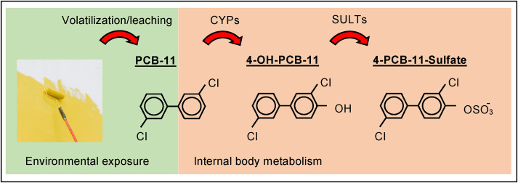
PCB 11 and Cytochrome P450 (CYP) Metabolites
Roy et al. 2020
PCBs are metabolized by human CYP2A6 and CYP2B6 to OH-PCBs
Goal: Compare effects of PCB 11 and its human-relevant metabolites in developing brain

Slide 7
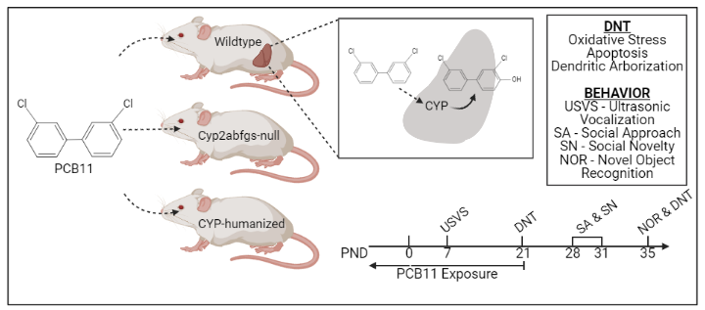
Species Differences in CYP-mediated metabolism: CYP-humanized models
R Wilson

Slide 8
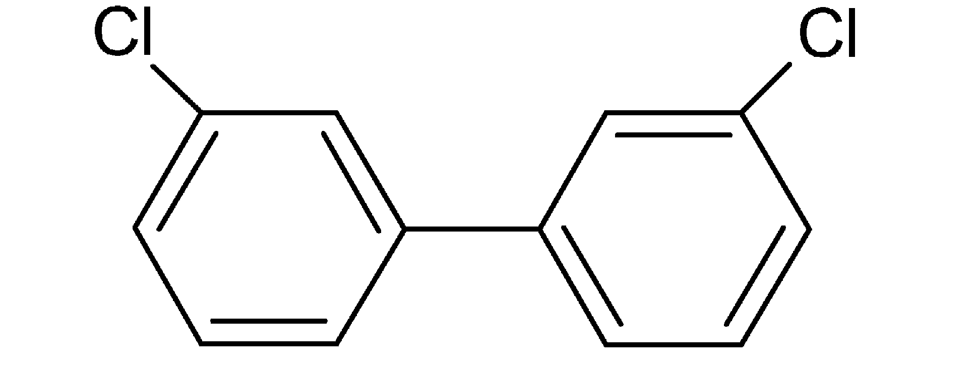








PCB 11
Time
8 weeks
10 weeks
P0
P7
P21
P24
P28- P31
P34
Exposure Periods
Gestation
Lactation
Pup’s Exposure to PCB through Dam’s diet
Behavior
USVs
Y-Maze
SA/SN
OF
R Wilson

Slide 9
General Development and Maternal Care
There were no significant changes in measures for general development including weight gain and anogenital distance at P7
There were also no significant changes in temperatures of pups, indicating no abnormalities in maternal care

Slide 10


Ultrasonic Vocalizations (USVs)
Frequency: 30-90 kHz
Duration: 10-200 ms
Social communication in neonates
R Wilson

Slide 11
Ultrasonic Vocalizations
R Wilson
Not enough data for other groups yet because too few litters in 2A6-Hum and 2B6-Hum

Slide 12


Y-maze: Spontaneous Alternation
Left
Right
Left
Right
TRIAD/
ALTERNATION
INCORRECT
Start
Start
R Wilson

Slide 13
Percent Spontaneous Alternation in Y-Maze Task
Not enough data yet for 2B6-humanized
R Wilson

Slide 14
Number of Entries in Y-Maze Task (Activity Levels)
Not enough data yet for 2B6-humanized
R Wilson

Slide 15
Open Field Task
Surrounding
Center

Slide 16
Open Field Data: Time in Center, Distance Traveled, Velocity
Not enough data yet for CYP null or 2B6
R Wilson

Slide 17
Conclusions and Further Studies
Continue to increase sample size
Quantitative immunohistochemistry (q-IHC)
Quantify oxidative stress in the hippocampus and neocortex of P21 and P35 brains by assessing oxidized proteins and lipids with 3-nitrotyrosine and 4-hydroxynenal, respectively
Quantify microglia, astrocytes, and neurogenesis

Slide 18
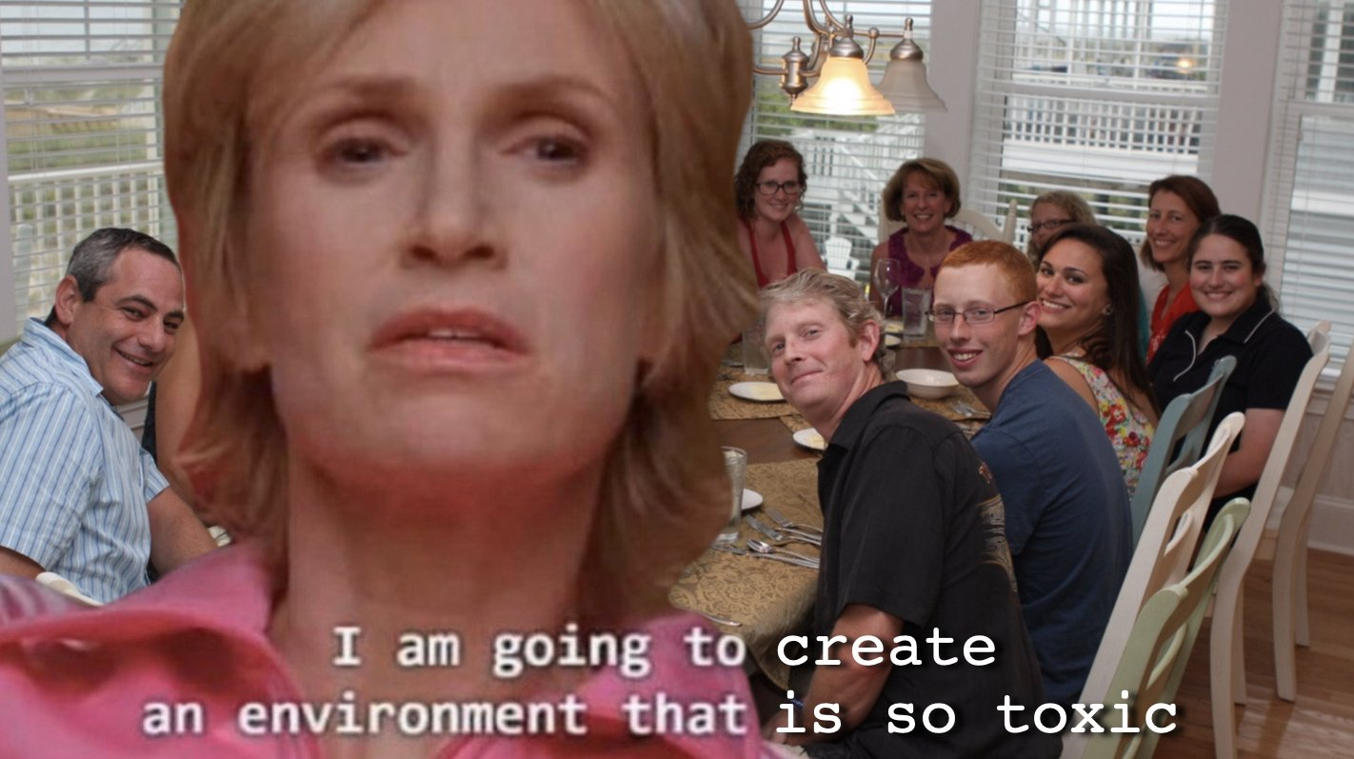
Thank you!!!
Special thanks to Dr. Pam Lein, Rebecca Wilson, Rosalia Mendieta and all other Lein members for helping me throughout the program
PCBs
The world minding its business

