Slide 1
Evaluation of a Continuous Glucose Monitoring System For Use in Goats and Calves
Megan Brobst

Slide 2
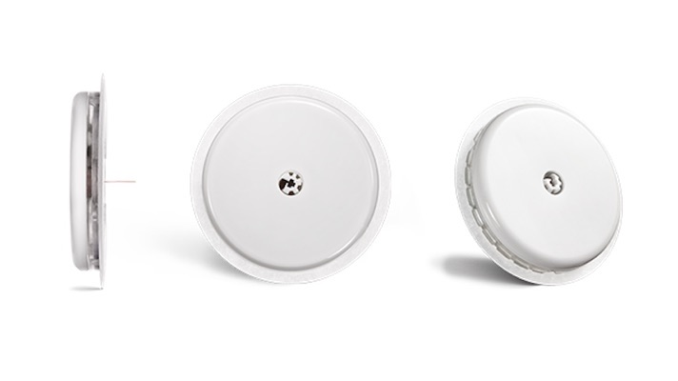
Introduction
Glucose Monitoring
Measurement Options
Pregnancy toxemia
Diarrhea
Test | Price
Chemistry analyzer | $55/test
ICU machine | $40/test
POC glucometer | $7/test
Freestyle Libre (CGMS) Sensor | $94/14 days → $7/day
Freestyle Libre (CGMS) Reader | $0 or $107
Notes:
CGMS: what we are testing, seen in image.
can last 14 days.
1 sensor per reader (one time purchase).

Slide 3
Hypothesis
Glucose measurements determined by Freestyle Libre will be similar to those determined by the chemistry analyzer
Objective 1
Objective 2
To determine the accuracy of a CGMS by comparing glucose concentrations measured over time as determined by the CGMS, the ICU machine, and the POC glucometer as compared to the chemistry analyzer in normoglycemic, hypoglycemic, and hyperglycemic goats and calves
To determine the correlation among the glucose concentrations as determined by the CGMS, the chemistry analyzer, the ICU machine, and the POC glucometer in normoglycemic, induced hypoglycemic, and hyperglycemic goats and calves
Notes:
Our hypothesis is that when we compare those 4 methods “…” which is our reference method

Slide 4
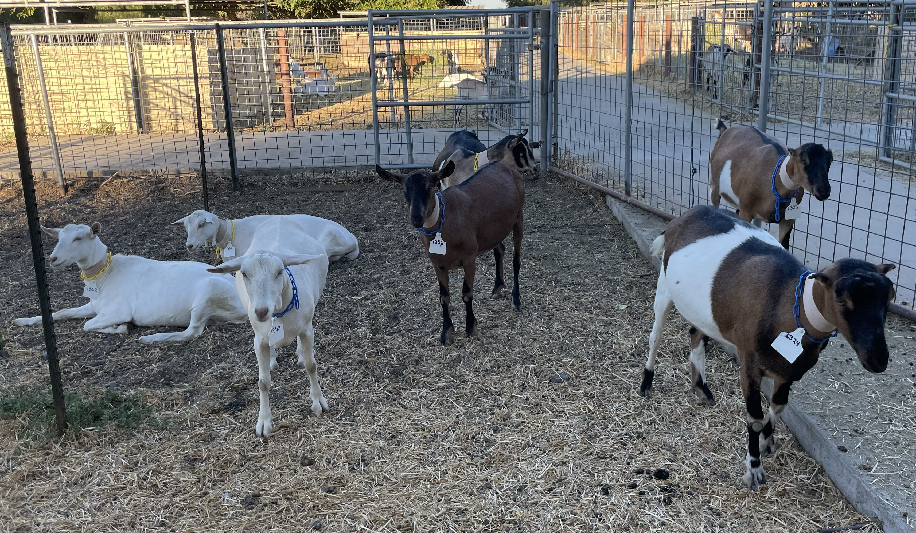
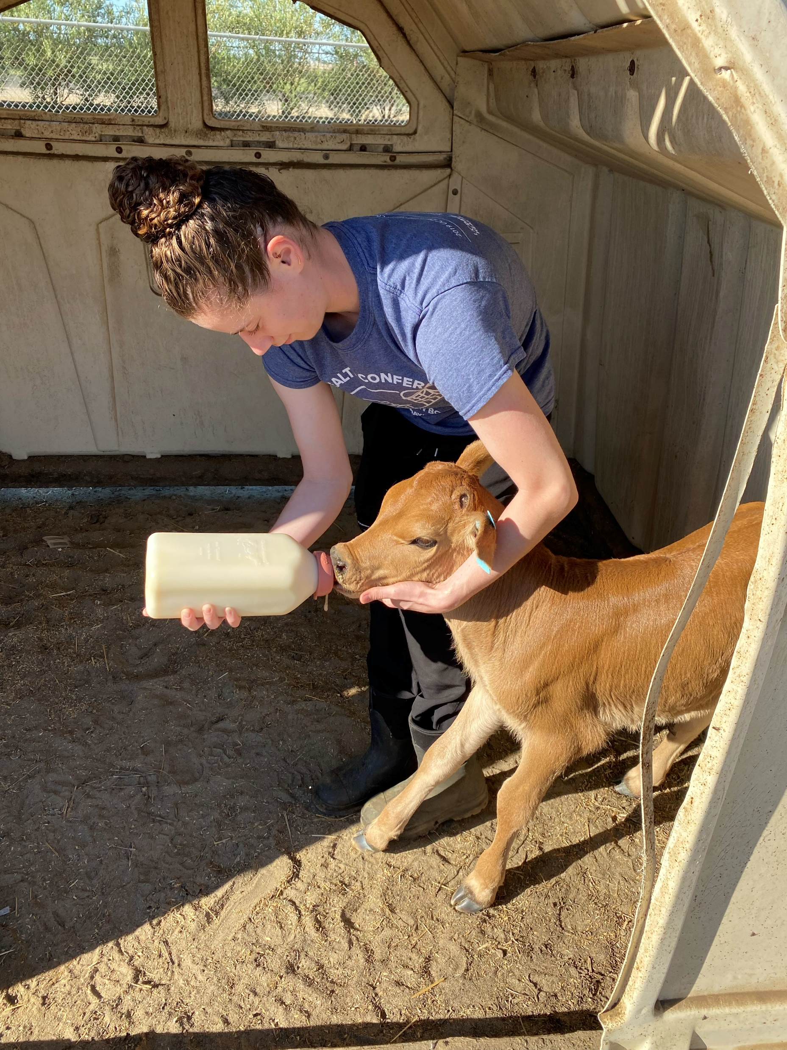
Methods
7 Goats
7 Calves
Female
13-14 months old
63-73 kg
3 Saanen
2 Alpine
2 Lamancha x Alpine
Male
<2 weeks old
Jersey
Notes:
For the rest of this presentation I will be talking about the goat half of the study, but the calf portion will follow the same design.

Slide 5
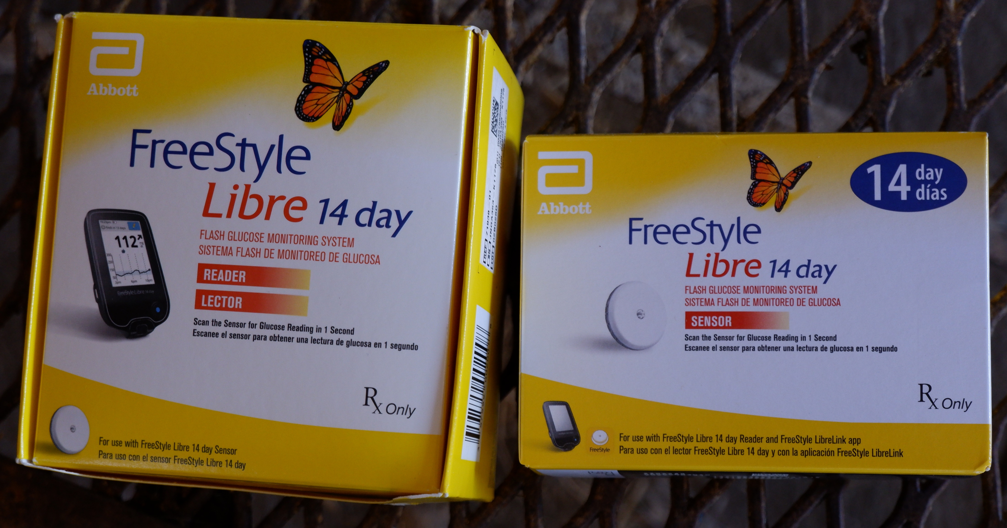
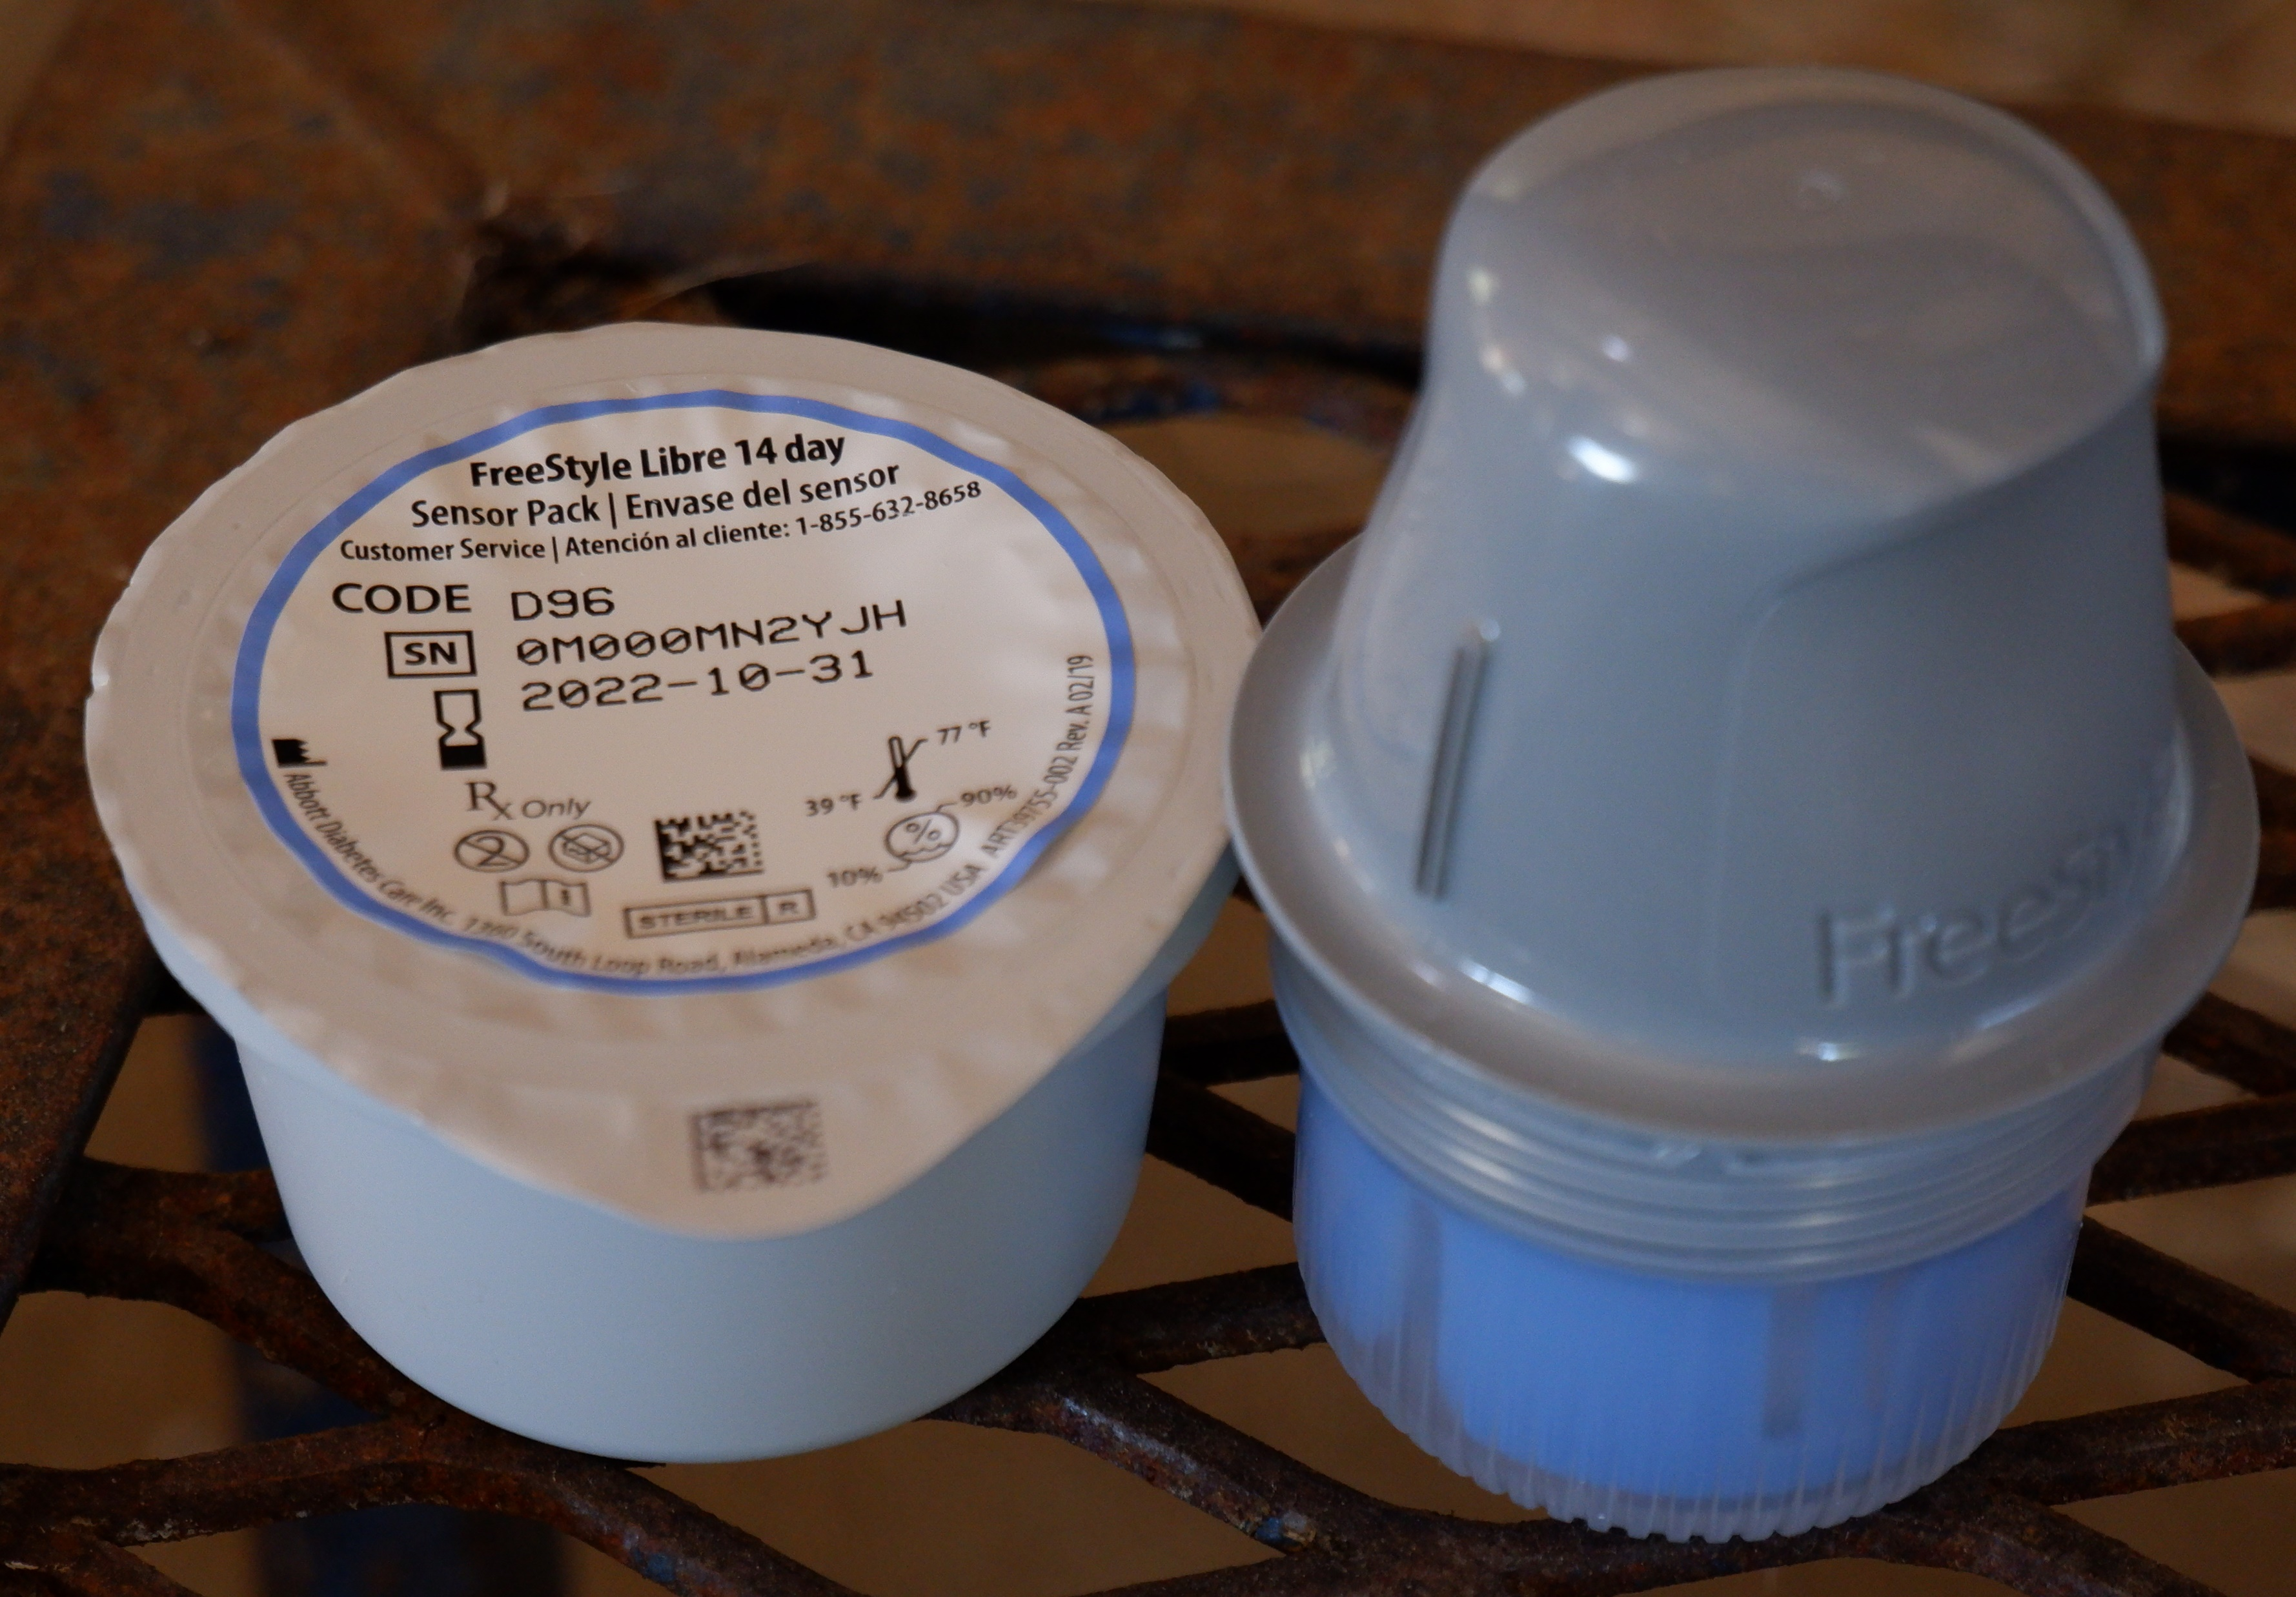
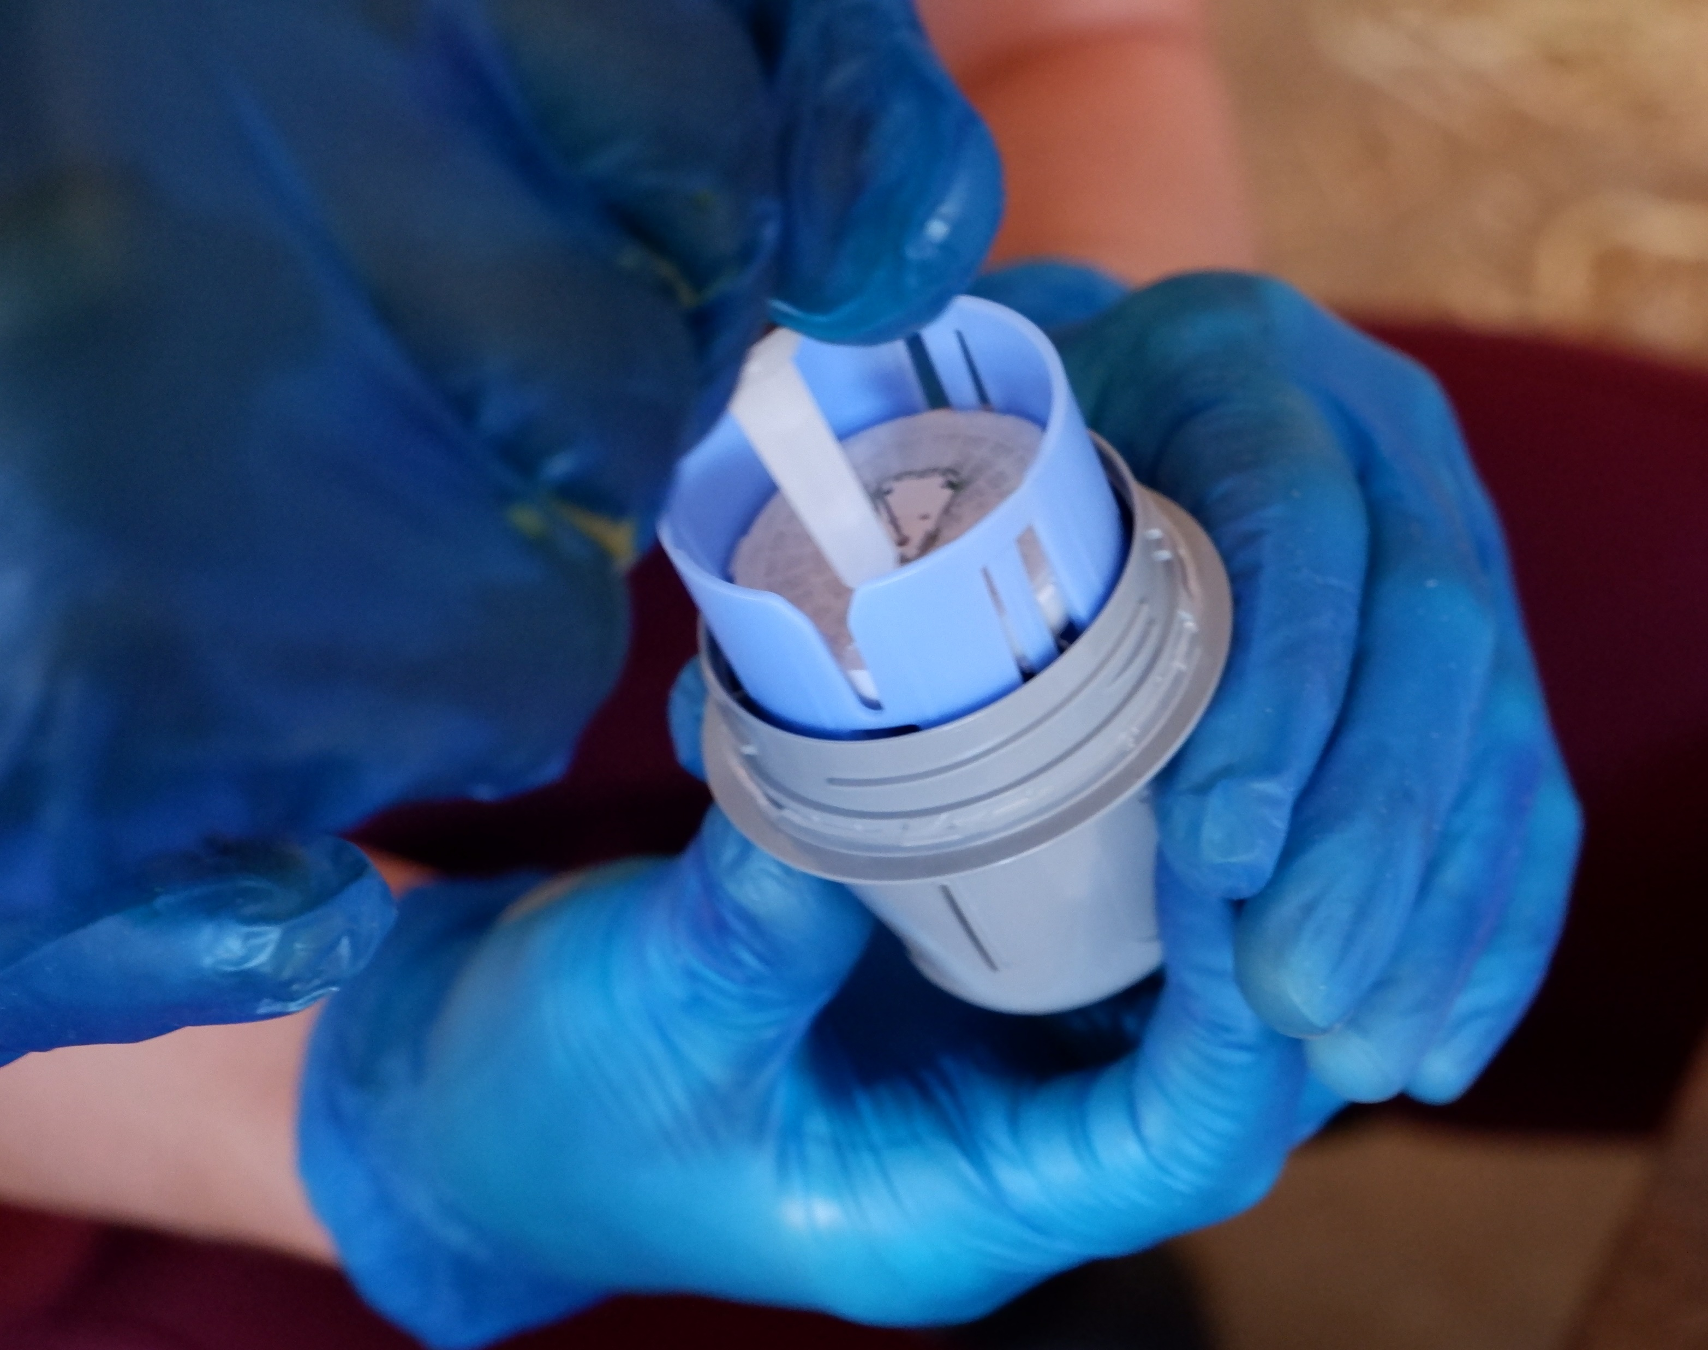
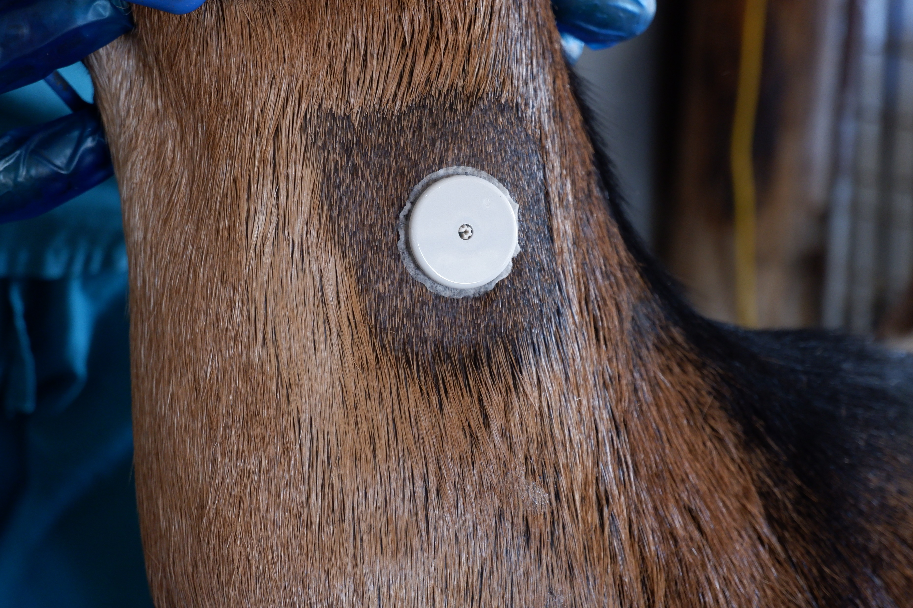
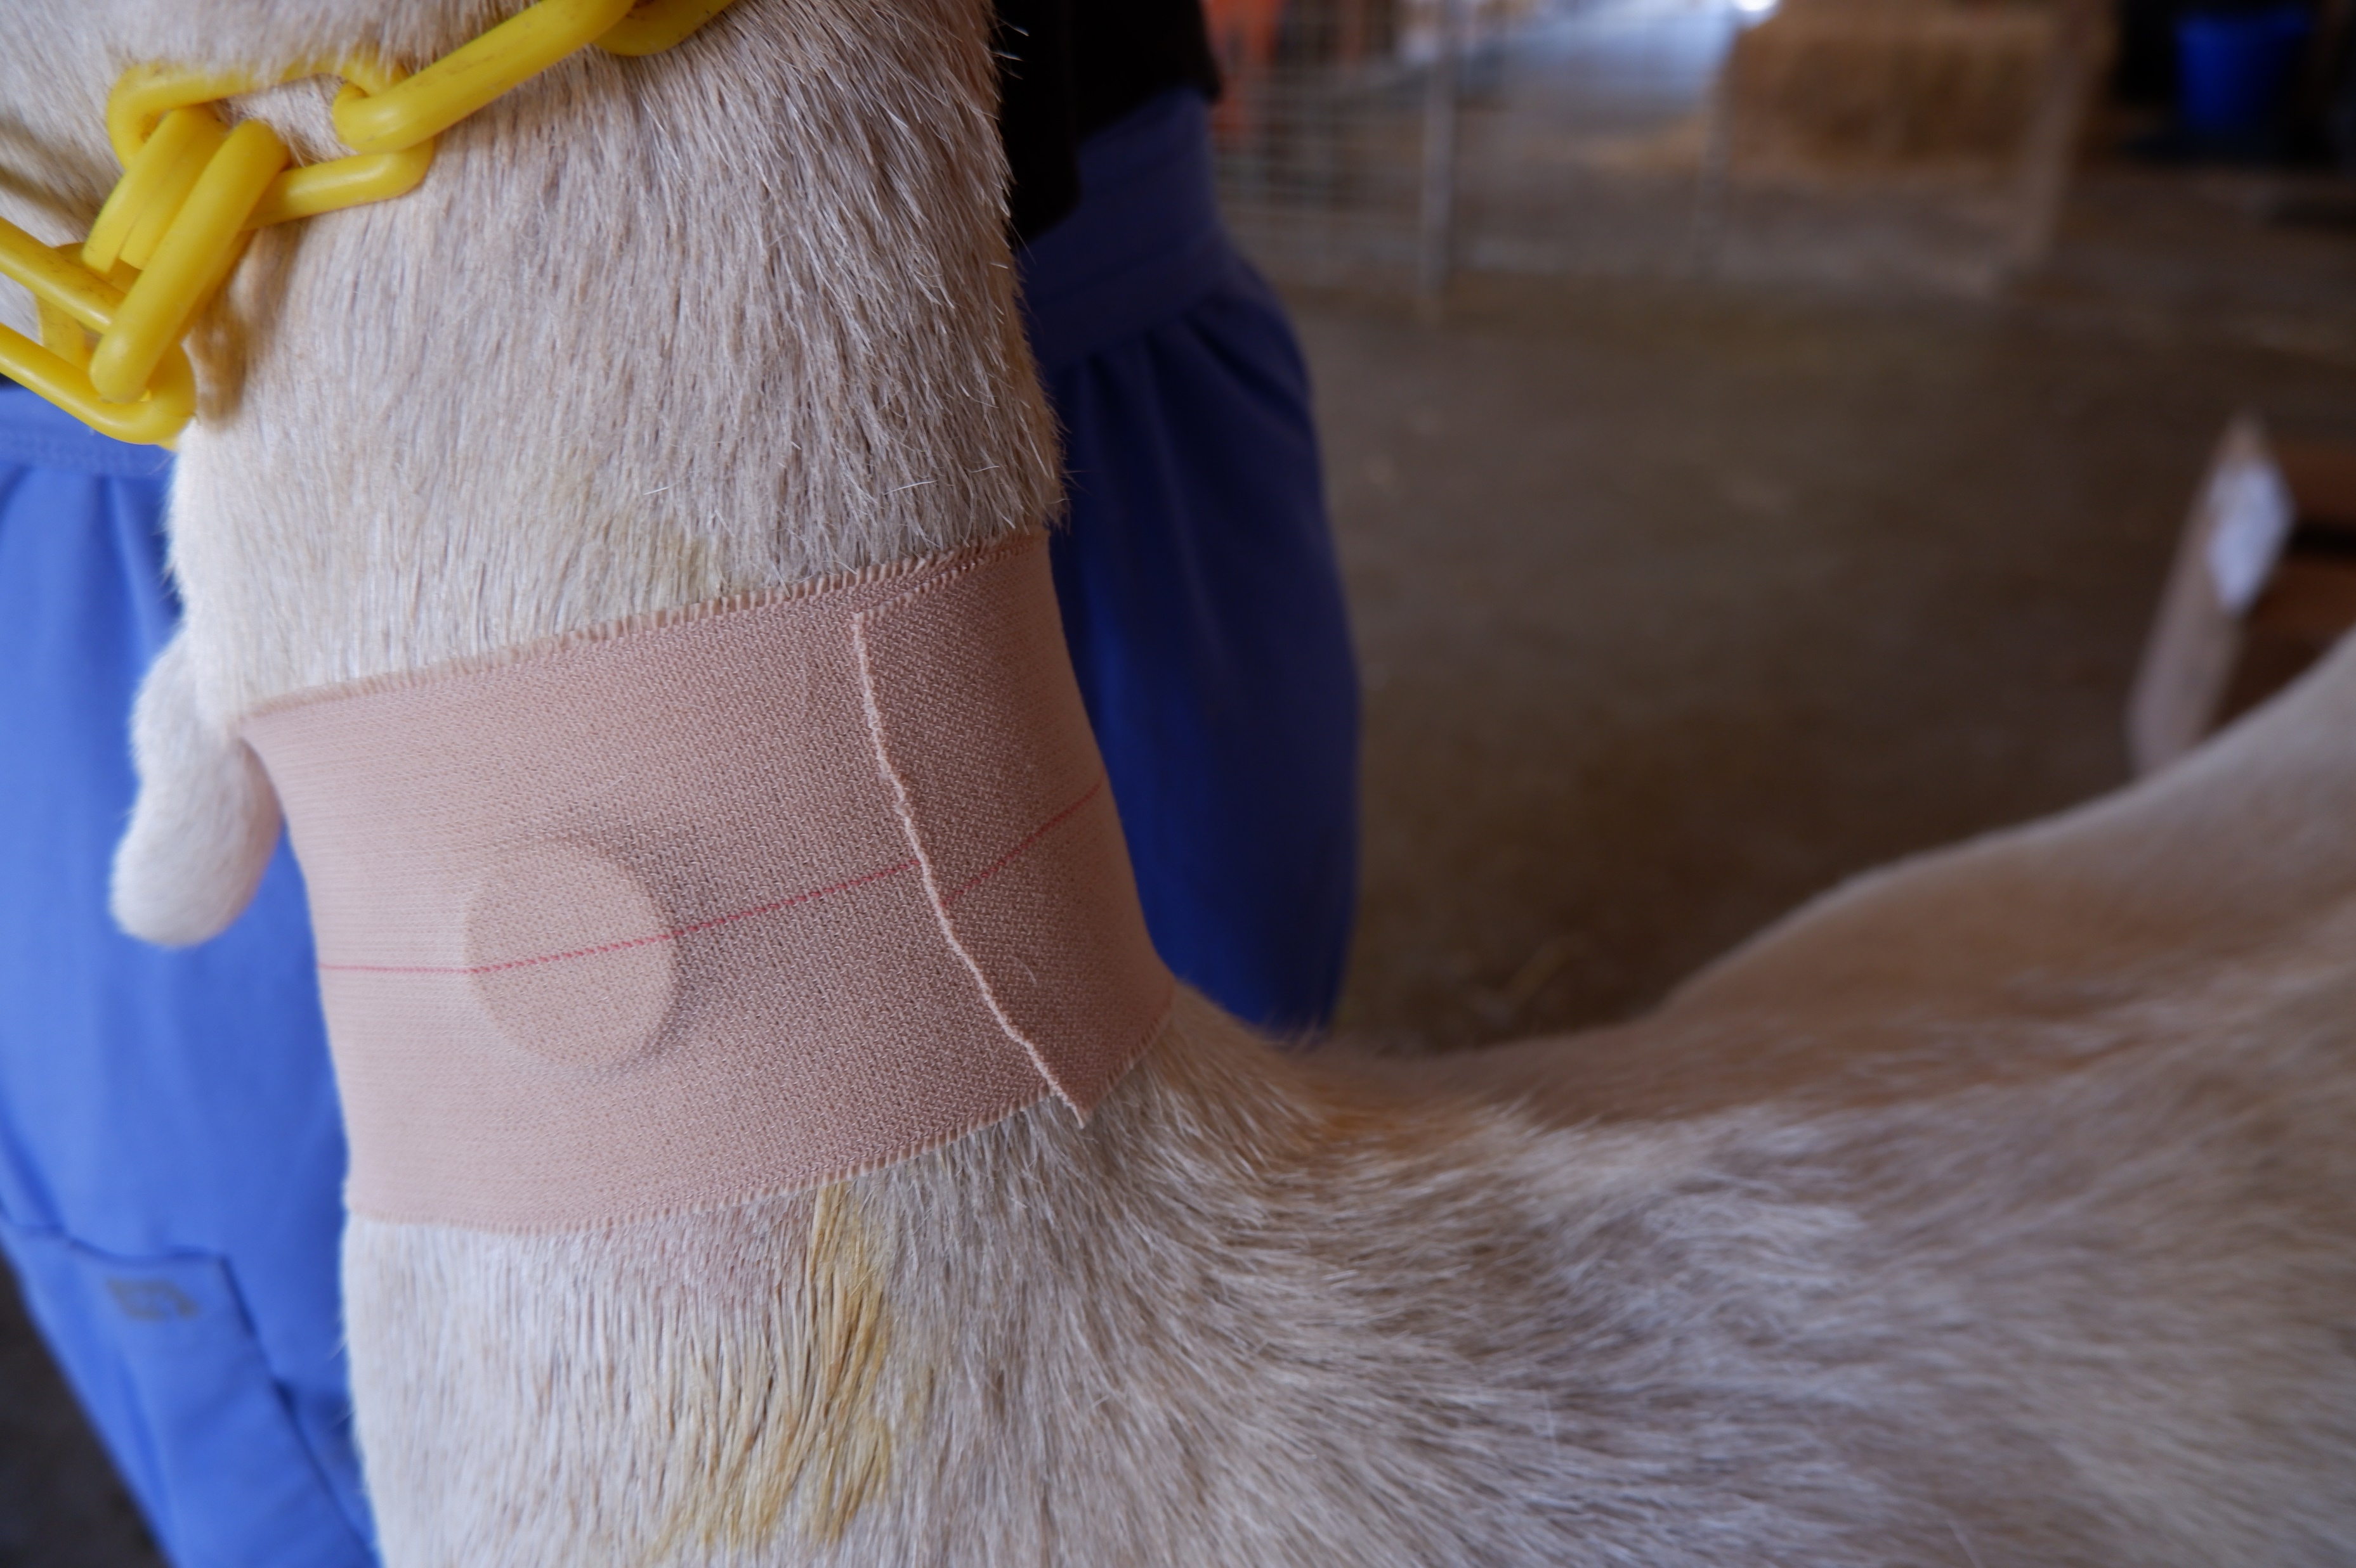
Methods
CGMS Features
14 day use
Unlimited glucose readings
No blood draw
Notes:
Once installed on animal, can be used for up to 14 days, once calibrated → unlimited readings.
Has thin filament that sits under skin and measures glucose concentrations in interstitial fluid, so no blood draws are required → less stress for animals b/c less handling.
Hold scanner w/in 4cm of sensor.
How we installed devices:
Clip area → scrub w betadine → wipe w alcohol → let dry → glue → apply device (press down with applicator), goats didn’t seem to care → elastikon → 1 hr calibration
If the sensors stopped working or came detached during the study, we applied a new one using the same procedure.

Slide 6
Methods
Xylazine
Hyperglycemia
T0
T2
T4
T6
T8
T10
T12
2 day washout
Normoglycemia
T0
T2
T4
T6
T8
T10
T12
2 day washout
Insulin
Hypoglycemia
T0
T2
T4
T6
T8
T10
T12
Notes:
This study uses a randomized crossover design.
The goats went through hyperglycemic, normoglycemic, and hypoglycemic states. In each state we took glucose readings using the CGMS, POC, ICU, and chem every 2 hours for 12 hours.
The first state the cohort of goats went through was hyperglycemia. At T0 we took glucose readings using all 4 methods, and then administered 0.15 mg/kg of xylazine IV to induce hyperglycemia. We then took glucose measurements at T2, 4, 6, 8, 10, and 12 for a total of 7 timepoints.
The goats then had a 2 day washout period to ensure the xylazine was no longer affecting them
We then had our control day where the goats were in a normoglycemic state. We took glucose measurements at the same timepoints using all 4 methods.
The goats got another 2 day washout period, and then went into their hypoglycemia day. After taking our T0 glucose measurements, we attempted to induce hypoglycemia using 0.1 units/kg of insulin IM. After that we took our glucose measurements every 2 hours for a total of 12 hours.

Slide 7
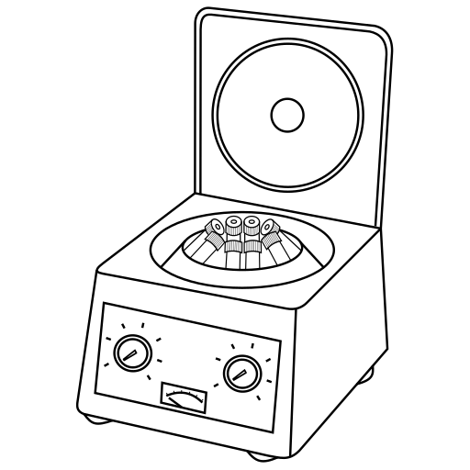
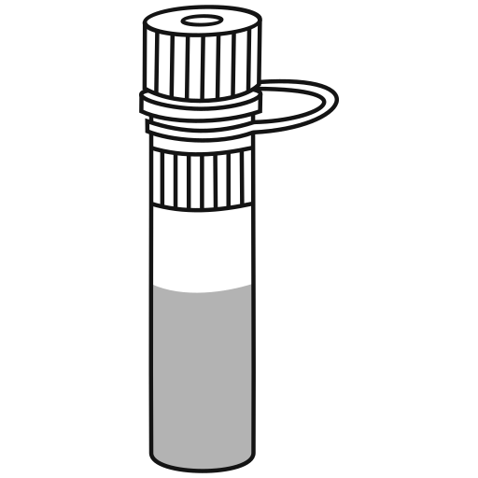
Methods
Goat Facility
CGMS
POC Glucometer
VMTH
ICU Machine
Chemistry Analyzer
Notes:
At each time point where we were measuring glucose we took temp, scanned CGMS over elastikon, collected blood into a heparinized tube, used drop of blood from syringe to get POC reading, put GTT on ice. Repeat until have blood from all 7 goats in cooler. Bring samples to VMTH, run ICU panels, spin down, remove serum, place in -20 freezer, later submitted to clin path to get chemistry analyzer reading.

Slide 8
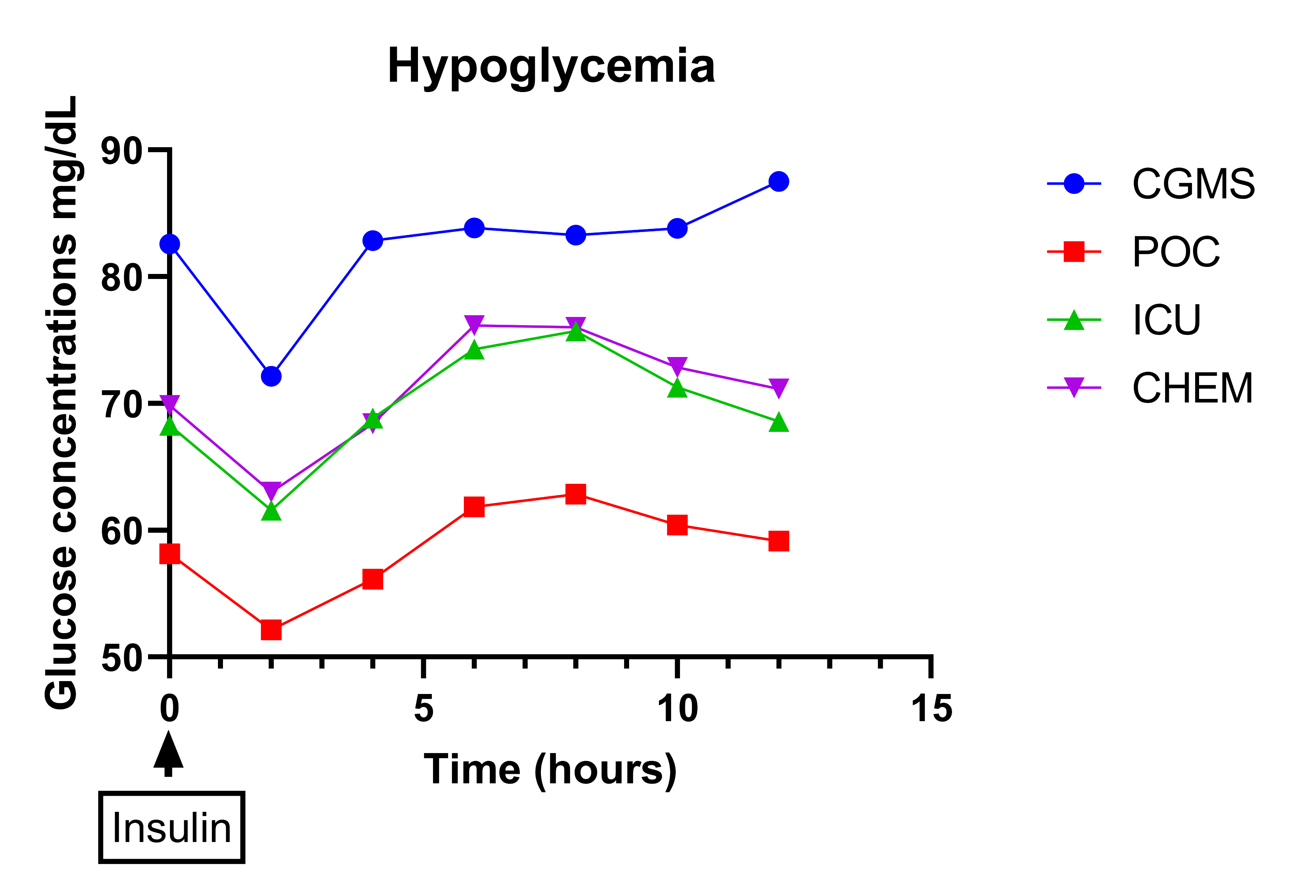
Results
Notes:
y-axis: average glucose concentration of the cohort of goats as determined by each of our 4 methods, and the x-axis shows time.
You can see that all 4 methods picked up on glucose concentration changes after we administered both the xylazine and insulin at T0.

Slide 9
Results
Bland-Altman Analysis
Hyperglycemia
Control
Hypoglycemia
Bias | 95% Limits of Agreement
1.7 mg/dL | -43.5 to 46.8
Bias | 95% Limits of Agreement
10.2 mg/dL | 8.9 to 29.2
Bias | 95% Limits of Agreement
8.8 mg/dL | -13.8 to 31.2
Notes:
To compare the CGMS to the chemistry analyzer, our main aim of this study, we used bland-altman plots for repeated measures.
Positive bias of z means CGMS on average overestimates glucose concentrations by z mg/dL when compared to chem analyzer.
95% limits of agreement – 95% of differences in glucose determination between CGMS and chem are expected to fall within this range.

Slide 10
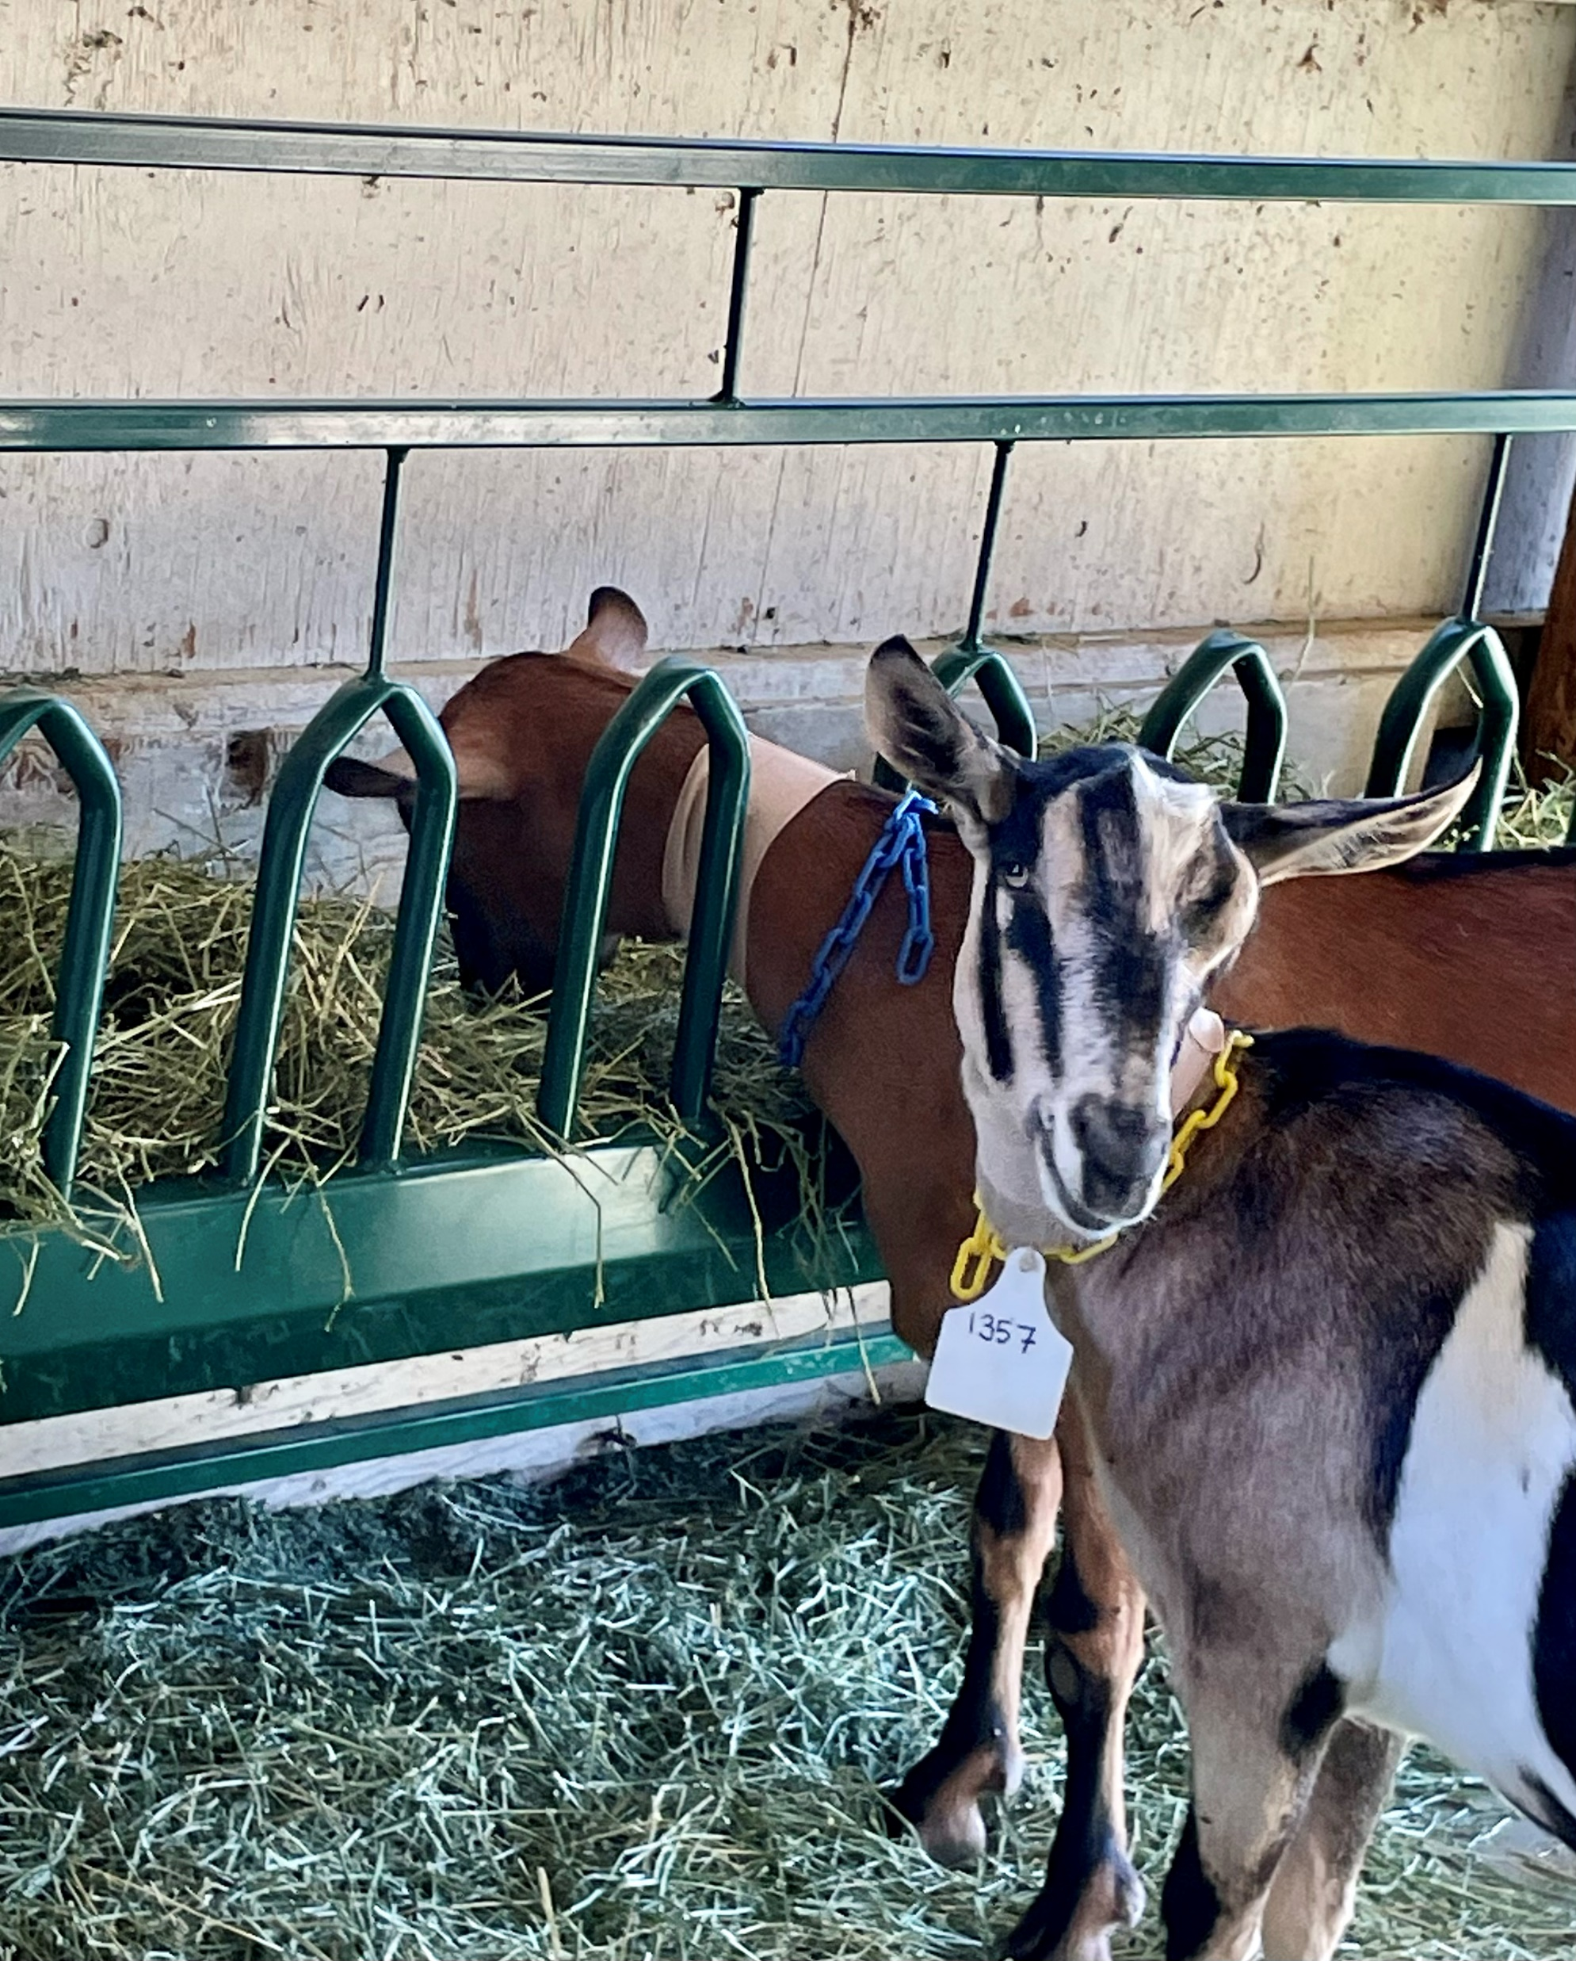
Discussion
Conclusions
Challenges
Further Investigation
CGMS fairly accurate at measuring glucose
In goats, most accurate in hyperglycemic state
Goat feeders
Hypoglycemia
Sick animals
Skin thickness
Notes:
Conclusions:
Accuracy isn’t perfect, but is good enough to be relevant in a clinical setting
Challenges:
Trouble keeping sensors in. Goat feeder rub neck, probably contributed along with goats rubbing against each other. Longest time sensors (2) lasted little over 4 days, were removed because end of study. (because healthy patients in groups)
Didn’t achieve true hypoglycemia in the goats; difficult to do induce in healthy animals because liver kicks in.
Further invest:
We think the devices will stay in place better in sick animals who are moving less and have less things to be rubbing it on in hospital environment. (VARIOUS DZ CONDITIONS AND HYDRATION STATES AFFECTING INTERSTITIAL GLUCOSE)
Dog study showed skin thickness affects accuracy of CGMS (thicker = more accurate)

Slide 11
Acknowledgements
Dr. Munashe Chigerwe
Financial support was provided by the Students Training in Advanced Research (STAR) Program through an endowment in the SVM
Research funding was provided by the
Center for Companion Animal Health

Slide 12
Questions?
Thank you!
Notes:
xylazine is α2-adrenoceptor agonist → inhibits pancreatic B cell release of insulin → increased blood glucose

