Slide 1
Sudden death and cardiomyopathy associated with LMNA in the Nova Scotia Duck Tolling Retriever
Danielle T. Oertle , Kevin L. Batcher, Joshua A. Stern, Indiana E. Madden, Julia Vo, Ronald H.L. Li, and Danika L. Bannasch
Notes:
Sudden death and cardiomyopathy associated with a mutation in the LMNA gene in NSDTR

Slide 2
Outline
Dilated cardiomyopathy phenotype
Pedigree data and mode of inheritance
Genetic mapping and LMNA variant discovery
Genotype verification of LMNA
Functional prediction of effect on Lamin A/C

Slide 3
Echocardiogram Of tOLLER Family
 | Status | WT (kg) | LVIDd | LVIDs | Fractional Shortening (normal >25%) | LVIDDn (normal <1.7) | LA:Ao (normal <1.6)
Sibling | Sudden death | 11.3kg | 3.9cm | 3.4cm | 13.5% | 1.9 | 2.5
Sibling | Sudden death | 15.4kg | 4.5cm | 3.6cm | 20% | 2.0 | 2.4
Sibling | alive | 17.6kg | 3.6cm | 1.7cm | 53% | 1.6 | 1.3
Parent | alive | 19.5kg | 2.8cm | 1.9cm | 35% | 1.2 | 1.0
Parent | alive | 16.3kg | 3.3cm | 1.6cm | 54% | 1.4 | 1.1
Notes:
LVIDd- left ventricle internal dimension diastolic
LVIDs- left ventricle internal dimension systolic
Fractional shortening- measure of the heart's muscular contractility, The reduction of the length of the end-diastolic diameter that occurs by the end of systole
LVIDDn- Is LV size normalized to body weight
LA:AO: left atrial to arotic root ratio looks at pulmonary flow

Slide 4
Pedigree
-unaffected
-affected
Litter 1:
10 months
11 months
Litter 2:
15 months 1 day
15 months 9 days
15months 28 days
Evidence of DCM-MCF
Notes:
Traditionally pedigrees color affected as black and unaffected as white. We questioned the premise on which this was made convention and decided to color our unaffected as black and affected as white w/ red glow.
2necropsy reports, 2 cardiac workups,
The breeder of litter 1 reached out to use about the 2 sudden death puppies
Using our extensive knowledge of Tollers we began making the pedigree and discovered litter 2.
We received a necropsy from one dog in litter 1 and one dog in litter 2 both showed evidence of DCM-MCF
Based on pedigree mutation has a RECESSIVE MODE OF INHERITANCE
We added 11 Tollers from this pedigree to sequence for our genome wide association study
We already had 26 tollers sequenced 26 tollers

Slide 5
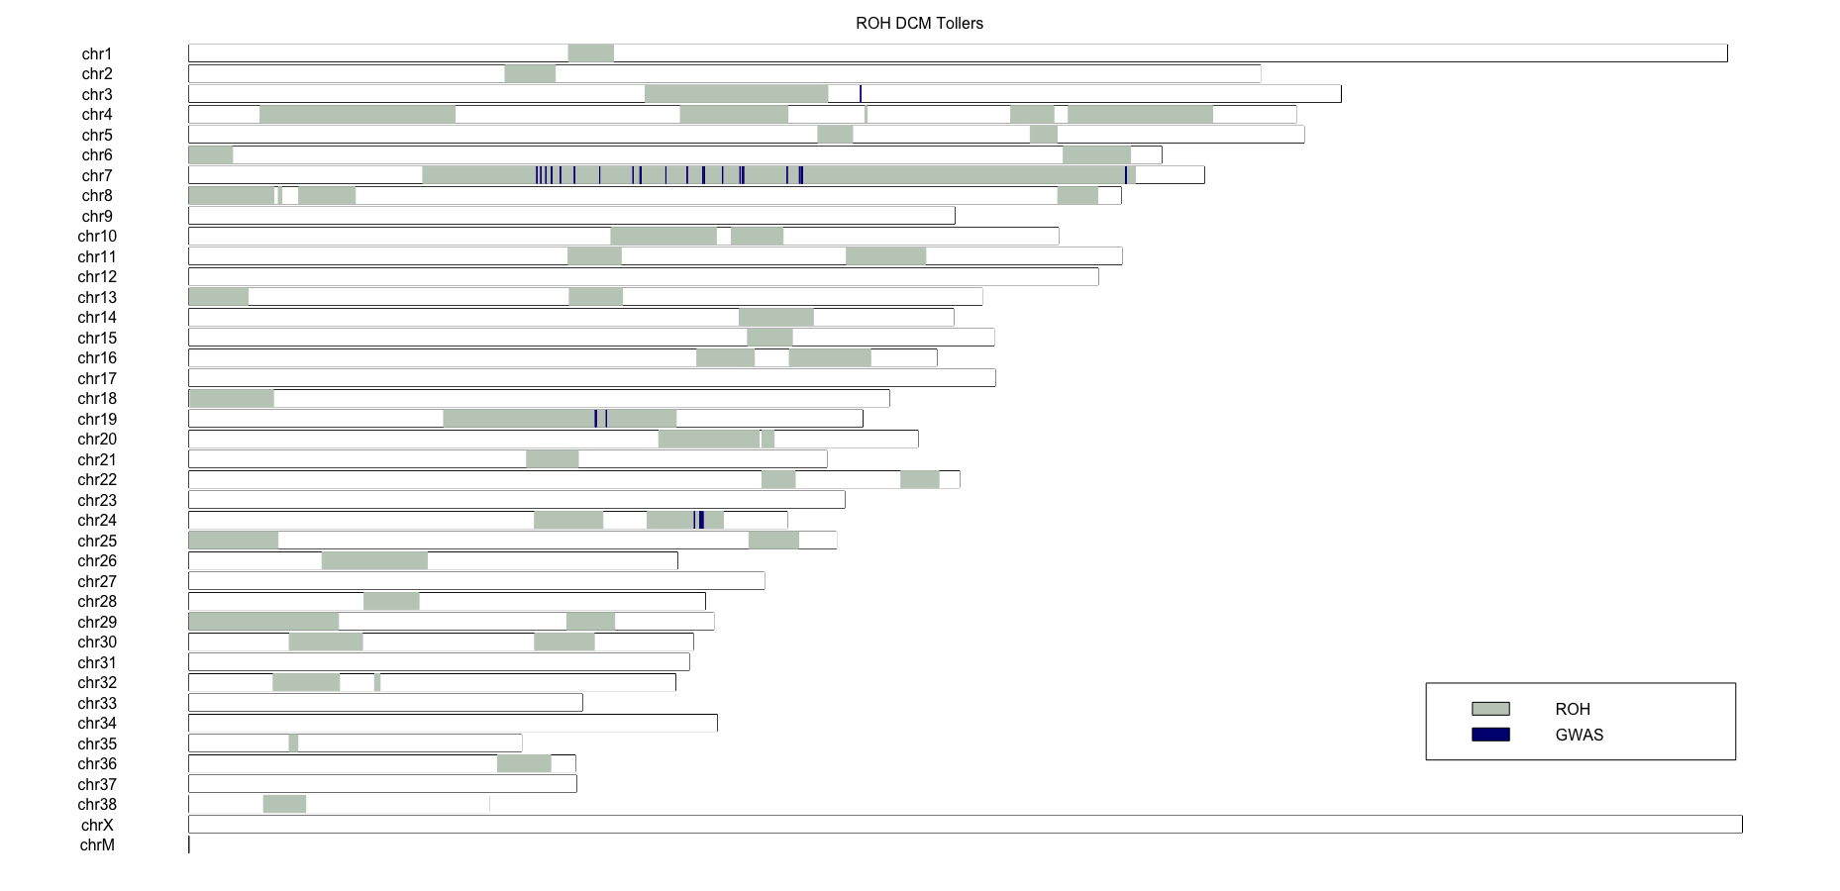
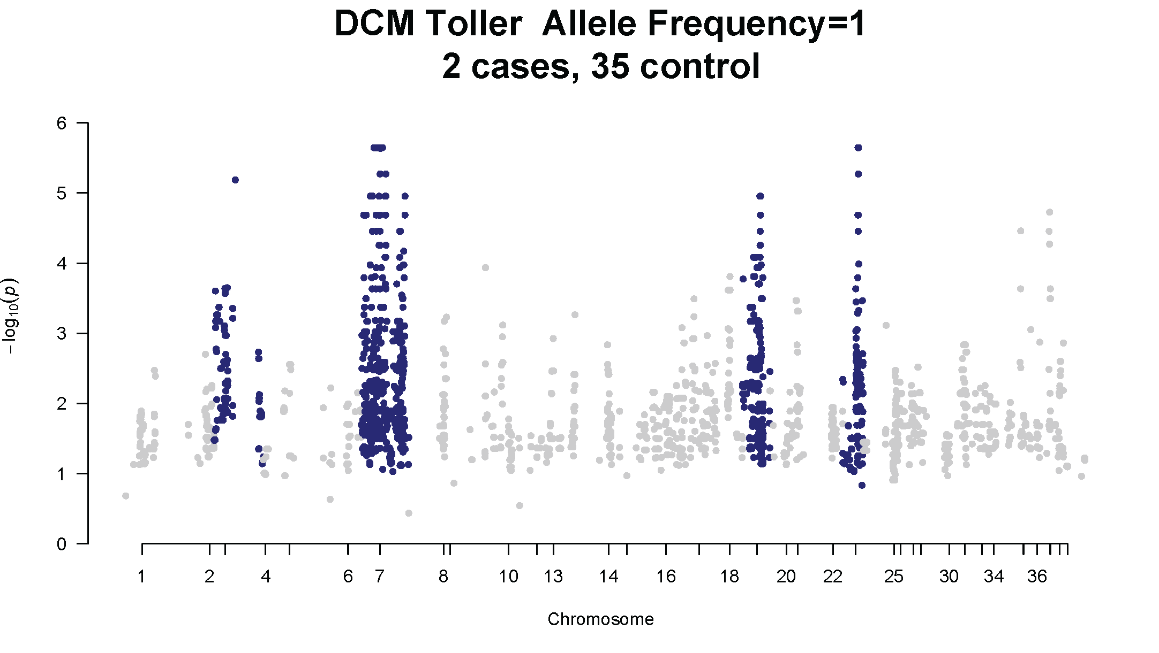
2 cases, 35 related controls Allele Frequency =1 in cases
genome wide association study
AND runs OF homozygosity
Chr 7
Chr 3
Chr 7
Chr 24
Chr 19
Chr 19
Chr 24
Chromosome
Notes:
Association and homozygosity mapping using two cases of DCM-MCF NSDTR and 35 unaffected controls identified four candidate regions homozygous in the two cases on canine chromosome (CFA)3, 7, 24, and 19.
2 cases, 35 related controls. Set criteria to be homozygous in the 2 cases (ie FA=1)
Because mode of inheritance is recessive and the mutations is likely contained to this pedigree we wanted to see what regions of the chromosome were shared with the 2 cases
ROH: contiguous regions of the genome where an indiviudla is homozygous across all sites
-inheritance of identical haplotypes from an ancestor created ROH
-GWAS is usually performed with using unrelated dogs but we used related dogs because we thought the mutation was consolidated to this pedigree and would not be in Tollers outside of this pedigree,
-more likely the region that is causing the sudden death is homozygous in the cases
-p value of 1.37x10-5

Slide 6
Whole Genome Sequencing
39,403,287
623,767
…
129 Dogs
Aligned to reference genome Mishka
All variants
Protein Coding Variants
2
WebGQT recessive pedigree model
Notes:
GATKA- variant analysis

Slide 7
Webgqt Output
Affected
Parent
Grandparent
T898 | T899 | T669 | Chr | Pos | Ref | ALT
1/1 | 0/1 | 0/1 | Chr 1 | 21302952 | GCCCGCCTCC | G
1/1 | 0/1 | 0/1 | Chr 7 | 41688515 | TC | C
Chr 7
Chr 19
Chr 24
Notes:
Whole genome sequencing data from an affected NSDTR, two obligate carriers, and 129 unaffected control dogs were then analyzed for protein-coding variants unique to the affected and carrier dogs. A deletion causing a frameshift mutation in the LMNA gene was identified in the affected NSDTR. Chr 1 variant excluded bases on GWAS and ROH
canFam 4
Chr 1- error-prone DNA polymerase involved in DNA repair
put ROH on slide and arrow label
Chr 7 segrated perfectly in the expanded pedigree of the orginal family and animals homozy for this variant were not found in the other 816 that were sequenced
-I genotyped this variant in a large number of tollers in our databse
722→ available to the public
816-> not published anywhere

Slide 8
Genotyping
+/+
ΔG/+
ΔG/+
 | Number of Samples | Genotype Frequency | Allele Frequency
WT +/+ | 274 | 91.3% | 95.7%
Heterozygous ΔG/+ | 26 | 8.7% | -
Variant ΔG/ΔG | 0 | 0 | 4.3%
ΔG/+
+/+
+/+
ΔG/+
ΔG/+
-unaffected
-affected
ΔG - Variant allele
+ - WT allele
ΔG/ΔG
Notes:
14 months
Necropsy- DCM
1. genotyped orginal pedigree-- segretated as expected; mutation looks older than orginal pedigree
2. used extenseive database to look for sudden death had sample for adrelanilitis--> necropsy DCM w/ mutation
3. link between pedigress is very old
-pending results from another dog form europe

Slide 9
Lamin A/C
Encodes protein Lamin A/C
Type 3 intermediate filament
Scaffolding of the nuclear envelope
Associated with DCM in humans
Over 400 LMNA mutations in humans cause 4 groups of diseases
Diseases of striated muscles
Peripheral neuropathies
Adipose tissue disorders
Accelerated aging disorders
Notes:
-look up how many mutations in humans-get source
-complicated field
-

Slide 10
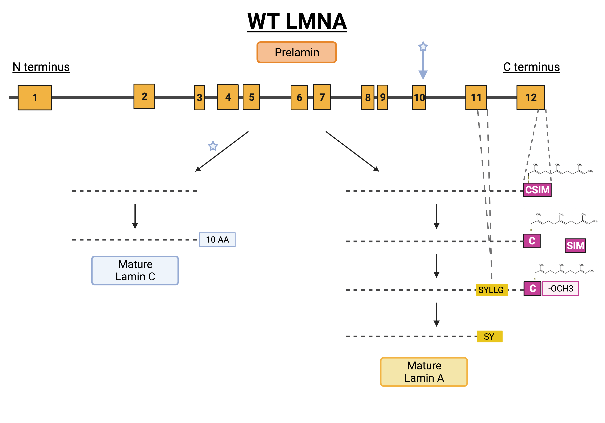
Notes:
-focus on this way to lamin c and this way to a thru a complicated: key exon and 11 and 12 --> processing
LMNA
-take off enzyme names
-simpler steps

Slide 11
Notes:
Position in protein: 576
D to T
Amino acid change: DPAEY...CSIM*(91 aa)/TPPST...MGGA*(125 aa)
-boxes for c and SYLLG

Slide 12
continuing WORK
Immune histochemistry of paraffin embedded heart tissue from a case and multiple control heart tissues
Using antibodies specific to Lamin A and Lamin C residues
As well as looking and comparing fibrosis of heart tissue between cases and controls
Currently writing a manuscript describing the work
Notes:
take out
-what else is pending
IHC--> parafin embedded heart tissue
writing this for publicaiton
antibodies for IHC one case and mulptple to see a difference and fibrosis

Slide 13
Thank you
Thank you to all the owners who sent in samples
Financial support was provided by the Students Training in Advanced Research (STAR) Program UC Davis through NIH T35 OD010956
Research grant was provided by Center for Companion Animal Health Grant 2021-88F

