Slide 1
Determining the impact of GIP receptor signaling on alpha cell GLP-1 production
Catherine Dombroski, Laboratory of Dr. Bethany Cummings
STAR 2022

Slide 2
Diabetes Mellitus (Type II)
Human medicine
  11.3% of the US population suffers from diabetes (CDC)
  The total estimated cost of diagnosed diabetes in 2017 is $327 billion (ADA)

Slide 3
Diabetes Mellitus (Type II)
Human medicine
  11.3% of the US population suffers from diabetes (CDC)
  The total estimated cost of diagnosed diabetes in 2017 is $327 billion (ADA)
Veterinary medicine
  Occurs in about 1/300 pets (Merck)
  Appropriate management can be difficult and lead to euthanasia

Slide 4
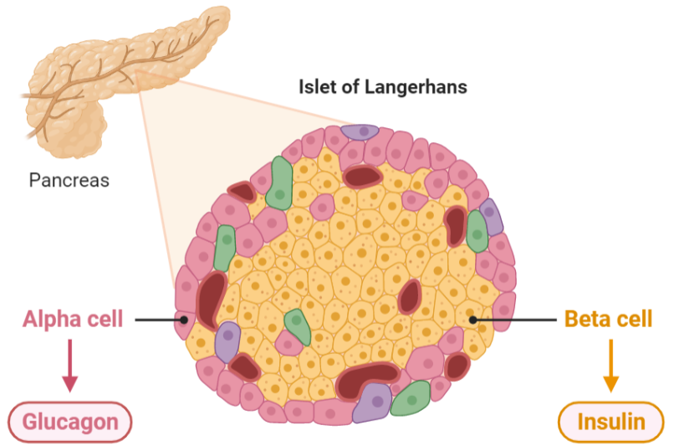

Background

Slide 5
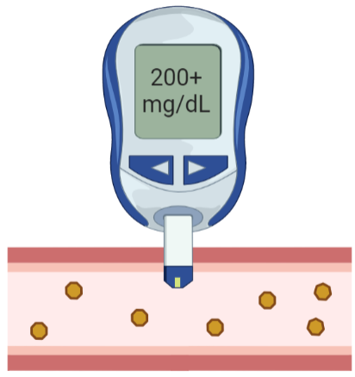
Background

Slide 6
Background

Slide 7

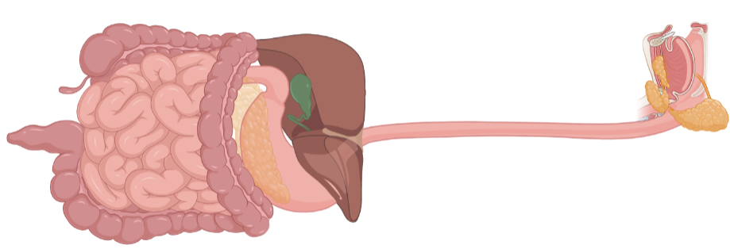
The Incretin Effect

Slide 8
The Incretin Effect
GLP-1
GIP

Slide 9
The Incretin Effect
GLP-1
Glucose-stimulated insulin secretion (GSIS)
GIP

Slide 10
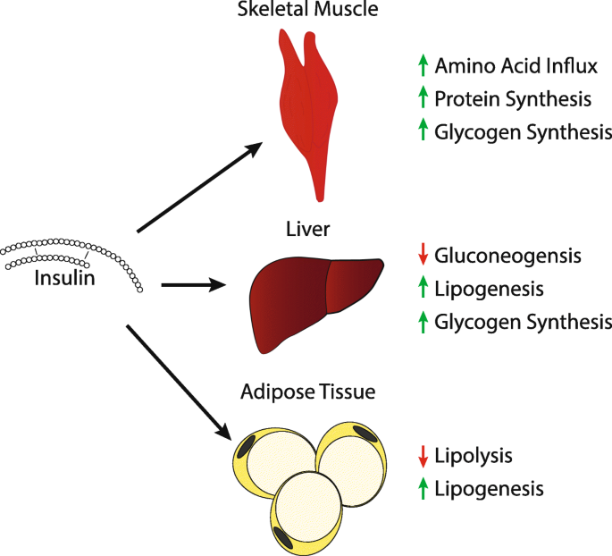
The Incretin Effect
GLP-1
Glucose-stimulated insulin secretion (GSIS)
GIP

Slide 11
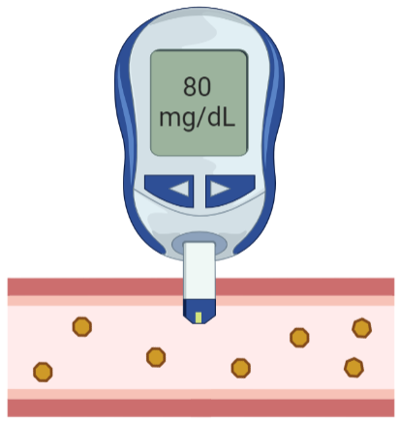
The Incretin Effect
GLP-1
Glucose-stimulated insulin secretion (GSIS)
GIP

Slide 12
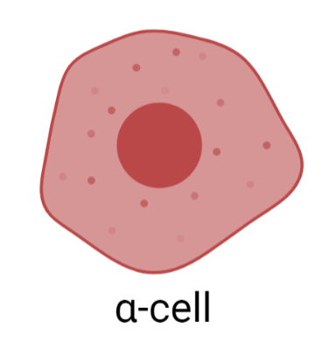
α-cells & GLP-1
PC2
Glucagon
Proglucagon

Slide 13
α-cells & GLP-1
PC2
Glucagon
Proglucagon
PC1/3
GLP-1
α-cells can be stimulated to produce GLP-1 under certain conditions

Slide 14
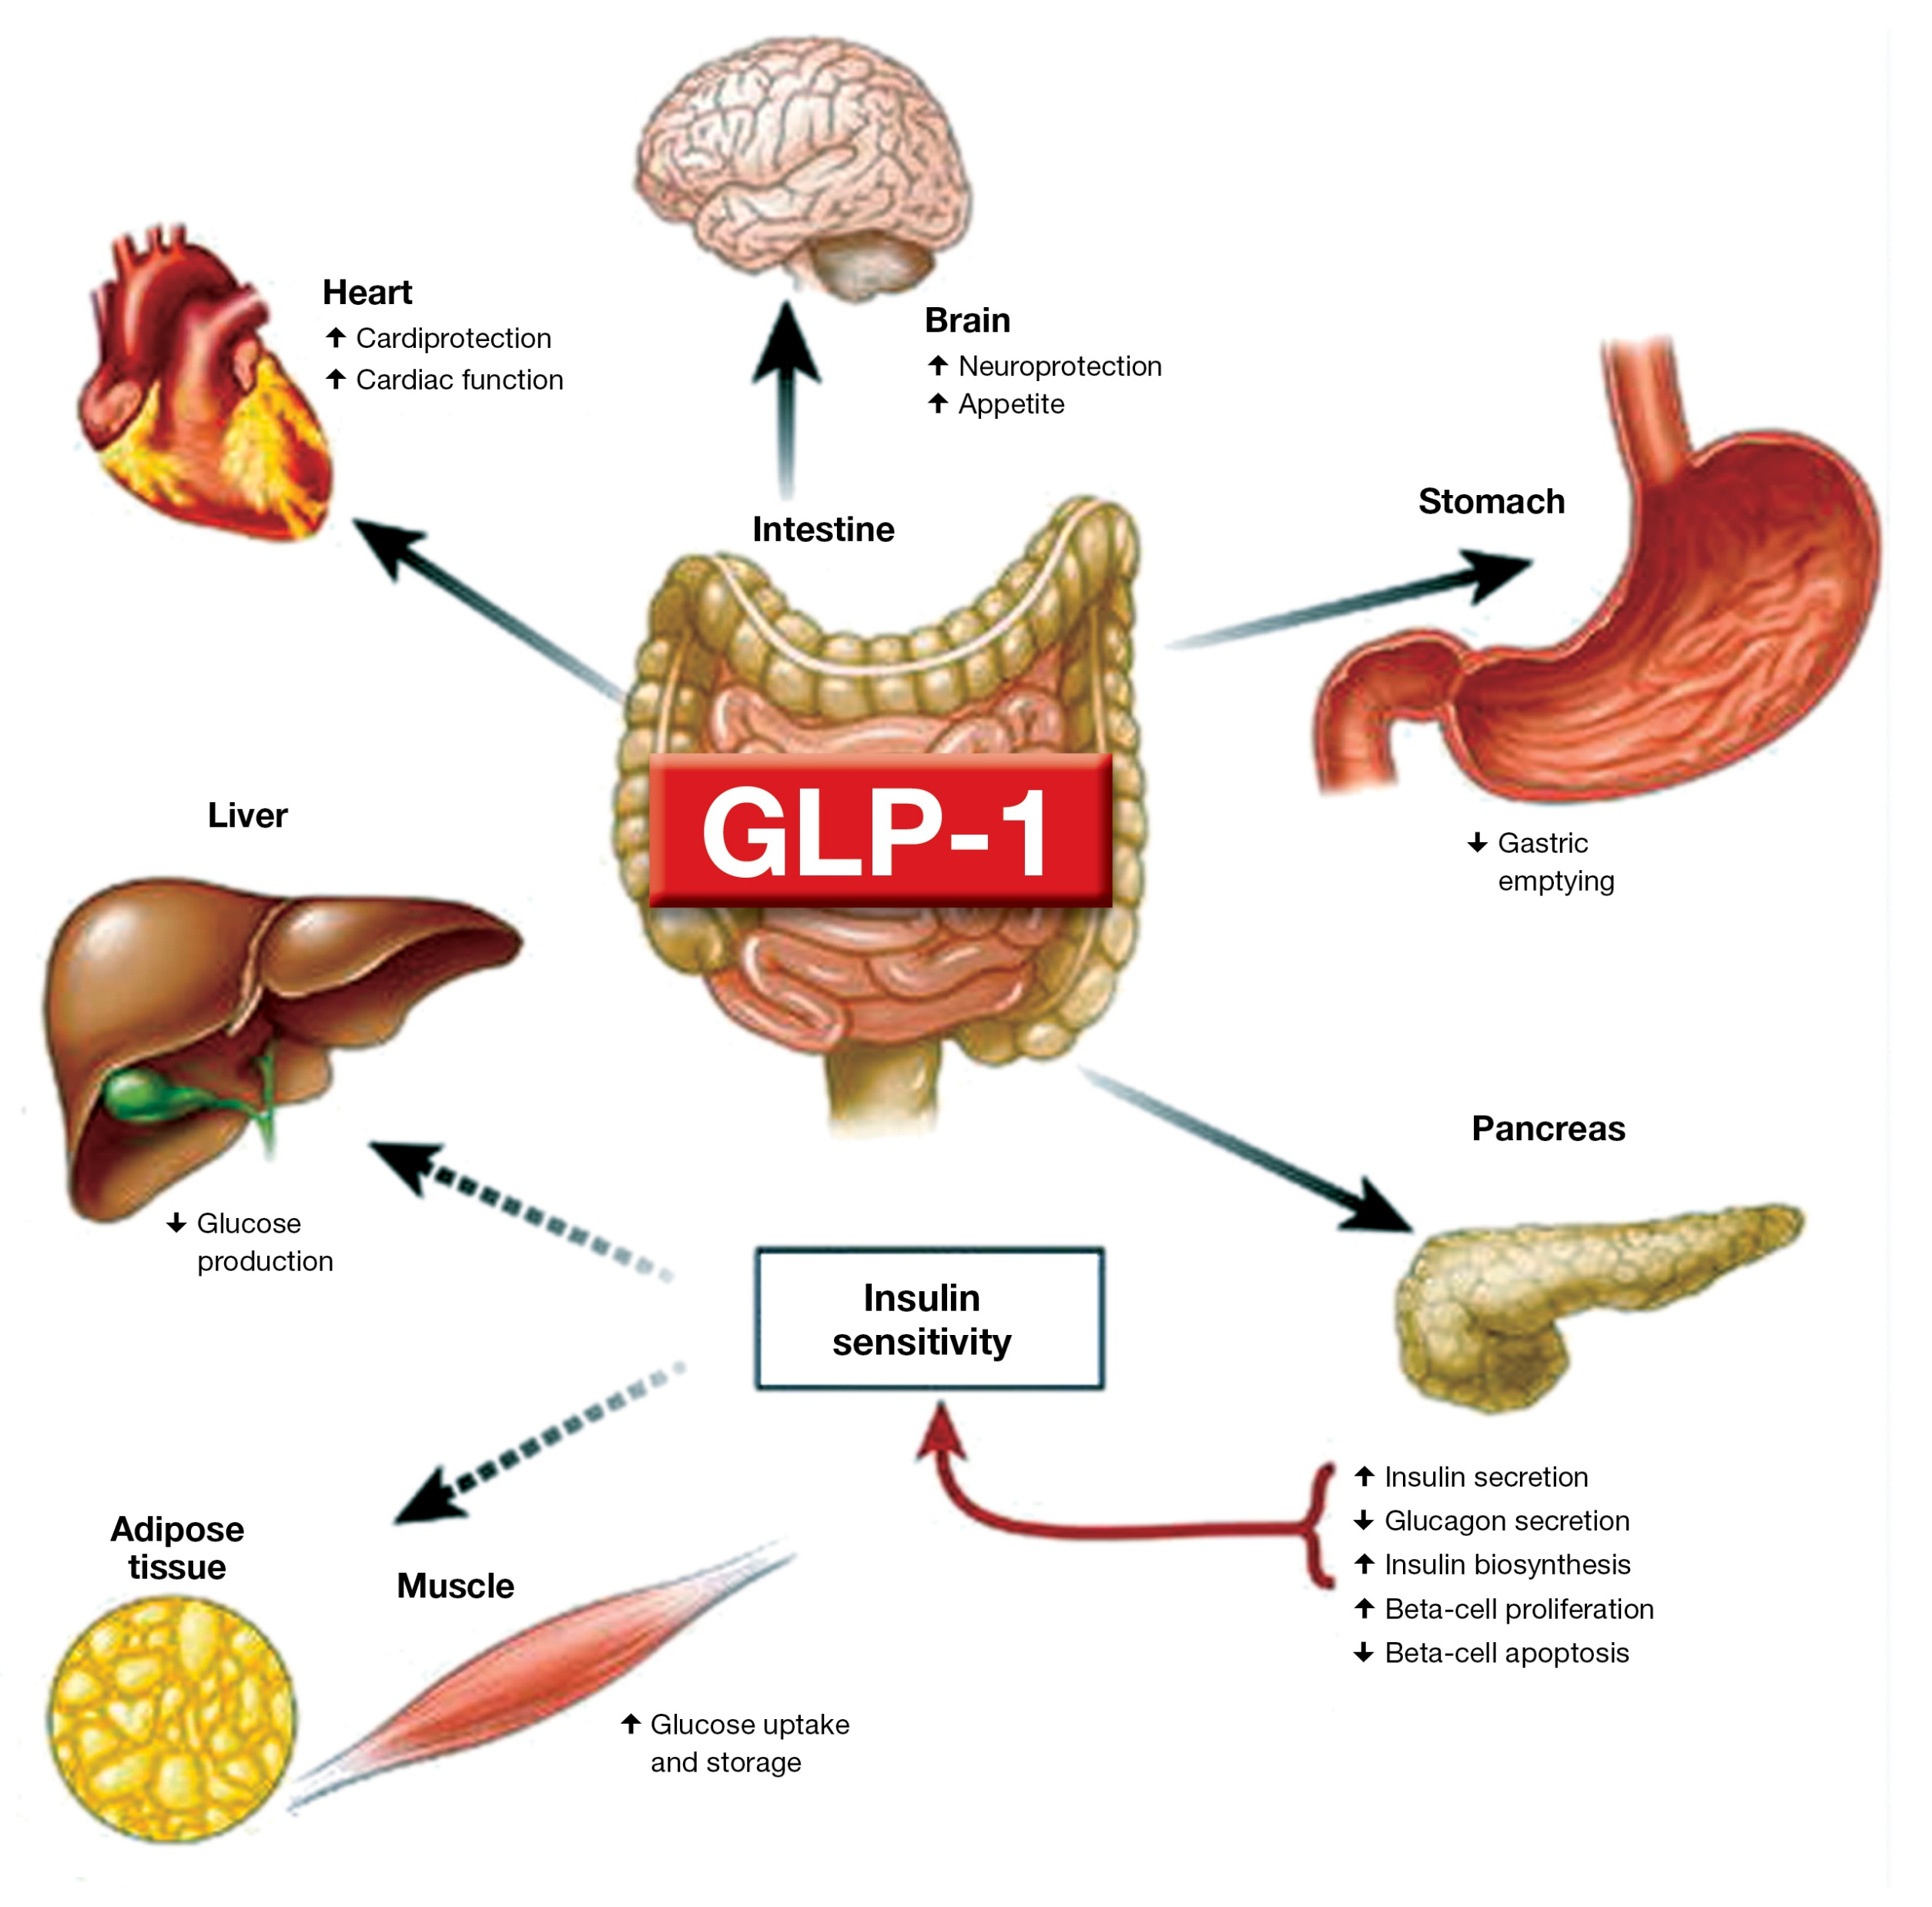
GLP-1 & Diabetes
The effects of GLP-1 are “anti-diabetic”
GLP-1 receptor agonists are effective at promoting insulin secretion in type II diabetics thereby reducing blood glucose levels (A1C)
The dual GLP-1 & GIP receptor agonist tirzepatide (Mounjaro™) has even better efficacy at reducing A1C levels in humans than GLP-1 receptor agonists alone
Notes:
Change to a less busy diagram with similar information

Slide 15
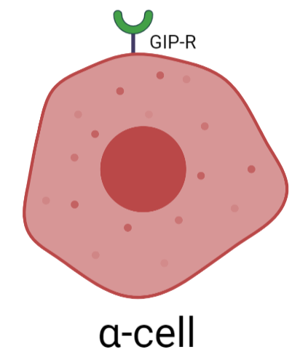
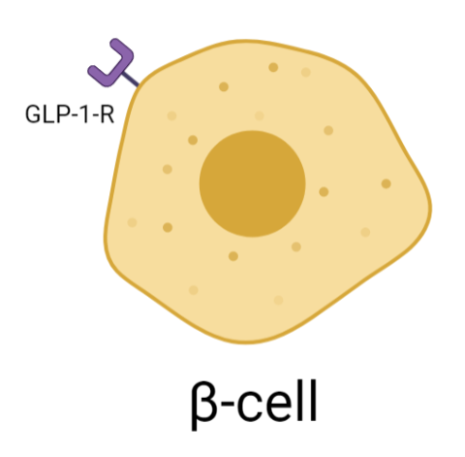
GIP mediates the incretin effect via α-cells
El et al., Sci. Adv. 2021

Slide 16
GIP mediates the incretin effect via α-cells
Glucose-stimulated insulin secretion (GSIS)
El et al., Sci. Adv. 2021

Slide 17
Hypothesis

Slide 18
Hypothesis
GIP administration (endogenous or exogenous)

Slide 19
Hypothesis
GIP administration (endogenous or exogenous)

Slide 20
Hypothesis
GIP administration (endogenous or exogenous)
GLP-1

Slide 21
Hypothesis
GIP administration (endogenous or exogenous)
GLP-1

Slide 22
Hypothesis
GIP administration (endogenous or exogenous)
Glucose-stimulated insulin secretion (GSIS)
GLP-1

Slide 23
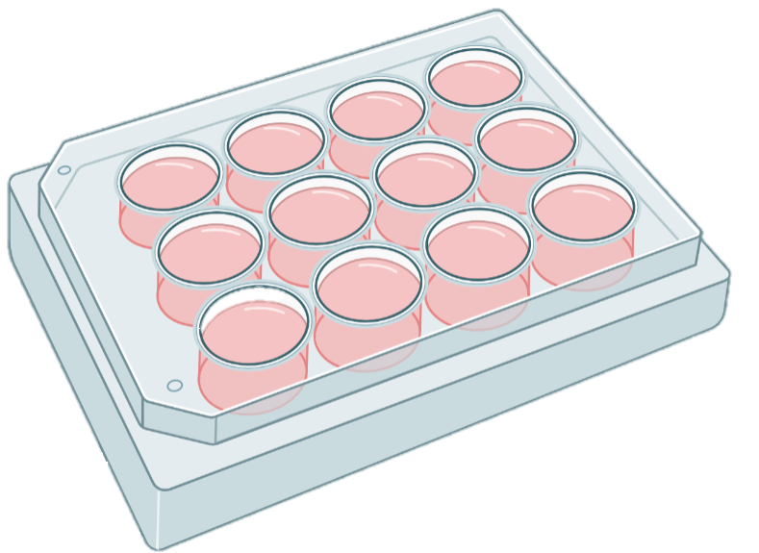

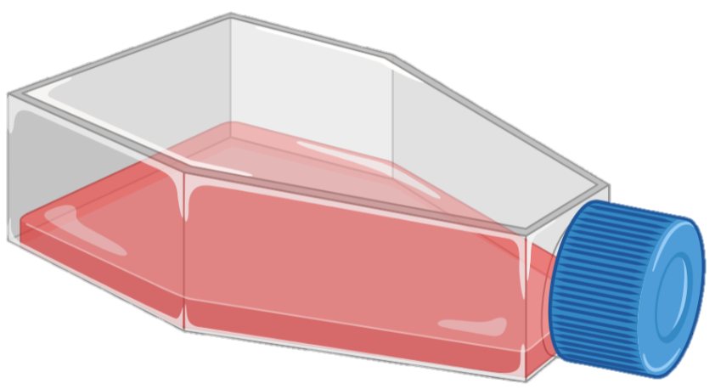
Methods
αTC1-6 cells
(mouse-derived line)
24-hr GIP treatment
(high & low glucose conditions)
Collect samples

Slide 24
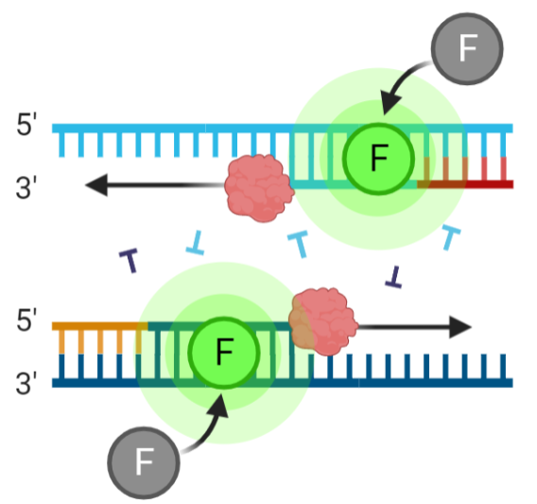
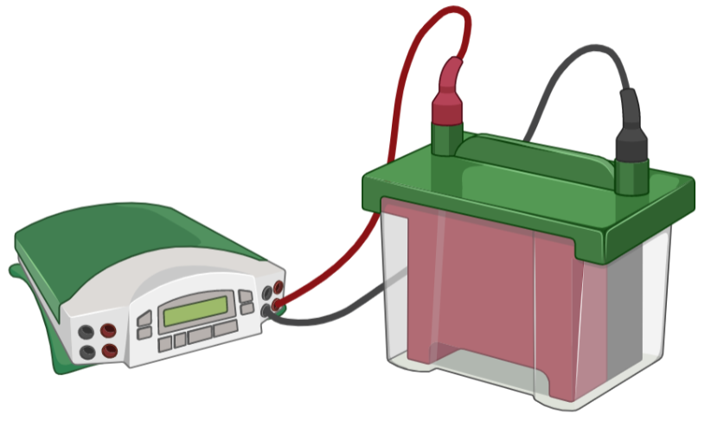
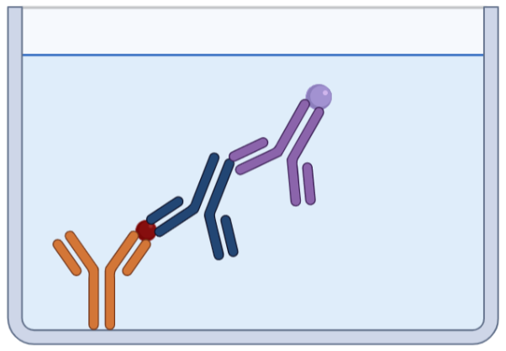
Methods
αTC1-6 cells
(mouse-derived line)
24-hr GIP treatment
(high & low glucose conditions)
Collect samples
Analysis:
ELISA (for active GLP-1 & glucagon)
Western blotting (for PC1/3 & PC2)
qPCR (for Pcsk1 & Pcsk2)

Slide 25
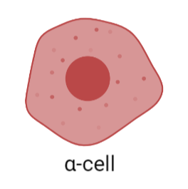
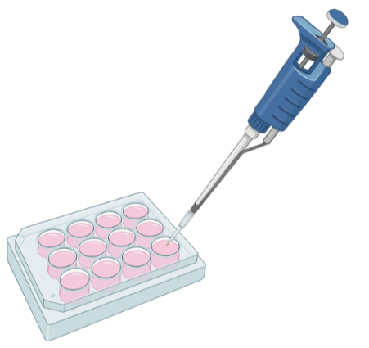
Results: Active GLP-1 ELISA – Secretion
Active GLP-1
Notes:
Make figures in PRISM instead
No significant effect of GIP – talk about trends

Slide 26
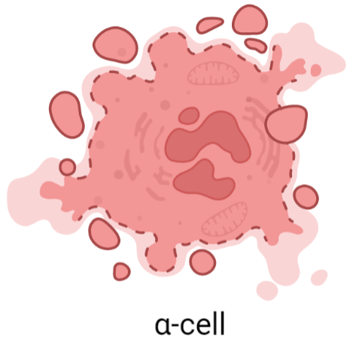
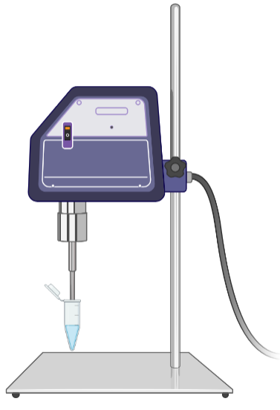
Results: Active GLP-1 ELISA – Expression
Active GLP-1
Notes:
Make figures in PRISM instead

Slide 27
Results
Secretion of active GLP-1 by α-cells trends toward a decrease following GIP treatment under both high & low glucose conditions

Slide 28
Results
Secretion of active GLP-1 by α-cells trends toward a decrease following GIP treatment under both high & low glucose conditions
Overall expression levels of active GLP-1 by α-cells was lower than secretion
Expression of active GLP-1 was lowest in:
  High glucose conditions without GIP treatment
  Low glucose conditions with GIP treatment

Slide 29
Interpretation
Our results do not align with our hypothesis that α-cell GIP-R binding increases active GLP-1 secretion by α-cells
Expression of active GLP-1 is likely lower due to dilution by PBS during sample collection
A larger sample size is needed to determine significance of results

Slide 30
Future Directions
Replicate experimental paradigm in human islets for increased translational and physiological relevance
Explore the role of glucogenic amino acids in glucose-stimulated insulin secretion with GIP administration

Slide 31
Summary
The α-cell GIP-R plays a role in α/β-cell communication
Our current results do not support our hypothesis, but a greater sample size is needed to interpret our data
Human islets would provide greater translational relevance while increasing rigor and reproducibility of our experiment

Slide 32



Funding and Support
Cummings Laboratory
Dr. Bethany Cummings, DVM/Ph.D.
Miranda Bustamante, M.S.
Student Funding
UC Davis SVM Endowment Funds
NIH T32GM136559
Research Funding
Hartwell Foundation
NIH/NIDDK R56DK124853

Slide 33
Questions?

