Slide 1
Investigation of a Drug Interaction Between Omeprazole & Vinblastine in an In Vitro Model
Dominic Baechler, Nick Oldberg, Dayn Godinez, Luke A. Wittenburg

Slide 2
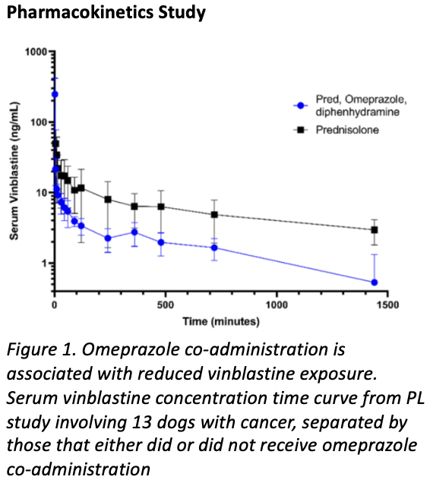
Treatment Protocol for Canine Mast Cell Tumors
Mast Cell Tumors (MCTs) are the the most common malignant skin tumor in dogs, and represent 20% of all cutaneous skin tumors
Vinblastine: chemotherapy agent targeting mast cell tumors
Omeprazole: antacid given in conjunction
PPI helps mitigate excessive histamine release

Slide 3
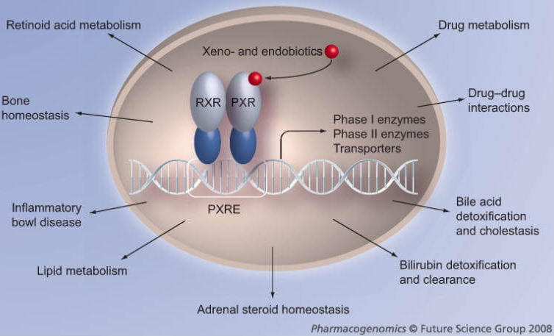
Previous Insights from Human Medicine
Omeprazole has been shown to induce the metabolism of co-administered drugs in humans
Altering pharmacokinetics (ADME) and increasing the rate of elimination of several co-administered drugs
Vinblastine is actively metabolized by CYP isoforms in humans
Mechanism of Action in Human Hepatocytes
Omeprazole binds PXR transcription factor in hepatocytes
PXR translocates and binds promoter region of CYP3A4 & P-glycoprotein (P-gp)
↑ CYP3A4 & P-gp RNA & Protein Expression
↑ Metabolism of Vinblastine

Slide 4
Objectives and Hypothesis
We hypothesize that Omeprazole will activate the canine transcription factor PXR, leading to the increased mRNA & protein expression of CYP450 isoforms and resulting in a faster in vitro metabolism of Vinblastine

Slide 5
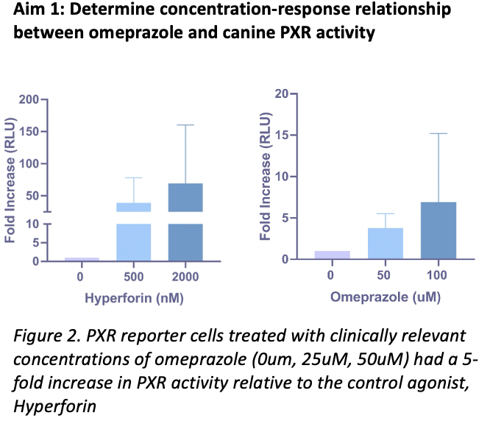
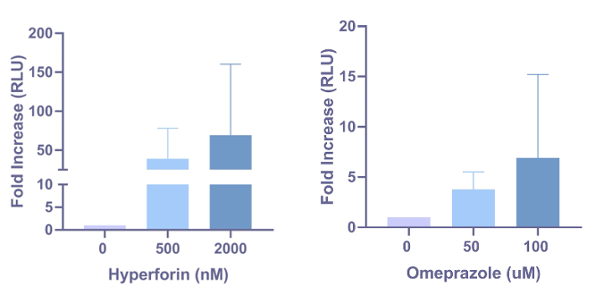
PXR Nuclear Receptor Assay
Reporter cells expressing the canine Pregnane X Receptor were exposed to clinically relevant concentrations of omeprazole (0uM, 50uM, and 100uM)
A dose-dependent increase in PXR activity measured via luminescence after 24-hour incubation with drugs
Omeprazole induced a 5-fold increase in PXR activity
Explanation for smaller activity may be due to alternative xenobiotic drug metabolizing enzyme involvement, such as the Aryl Hydrocarbon Receptor (AhR)

Slide 6
Methods: CYP RNA Induction Assay & Western Blot
Culture Cryopreserved Hepatocytes onto a 96-Well Plate
Administered omeprazole (0uM, 25uM, 50uM) for 48-72hrs
RNA Isolation
Protein Isolation
Culture Cryopreserved Hepatocytes onto a
Culture Cryopreserved Hepatocytes onto a 96-Well Plate
RNA Extraction Kit
Protein Lysate Collection
2. RNA Assessment (Quantification)
2. BCA Analysis (Quantification)
3. Western Blot & Transfer
3. Reverse Transcription (cDNA)
4. Primary & Secondary Antibodies
4. qPCR & Analysis
4. Imaging & Analysis

Slide 7
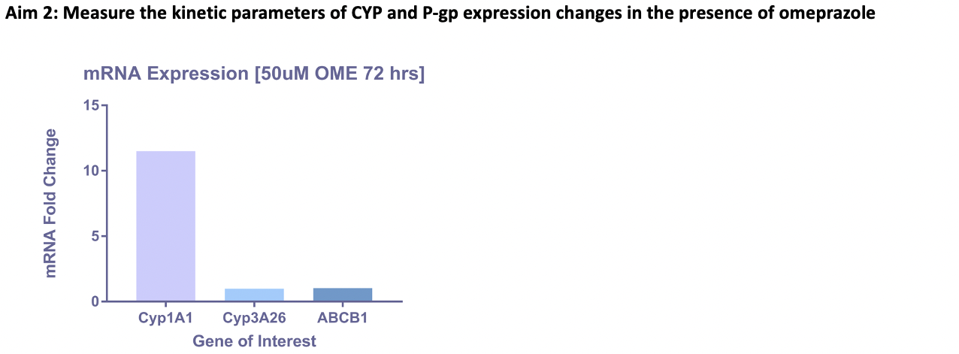
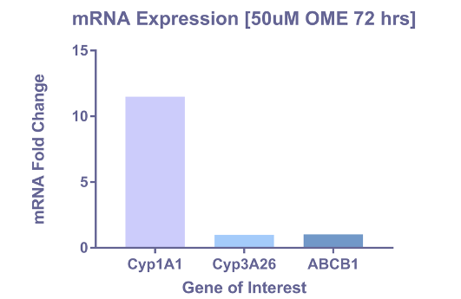
CYP & P-gp RNA Induction Assay
Hepatocytes treated with 50uM omeprazole for 72 hours
Cyp1A1 had an 11-fold increase in mRNA expression relative to the control groups
Cyp3A26 / ABCB1 (P-gp) only increased by 1-fold
We just finished running qPCR on RNA samples collected from a 72hr assay with 0uM, 25uM, & 50uM omeprazole concentrations
Data is currently being analyzed for complete primer set (6)
Figure 3. Quantitative RT-PCR of mRNA expression in canine hepatocytes treated with 50uM omeprazole for 72 hours revealed an 11-fold increase in Cyp1A1 expression and a 1-fold increase in Cyp3A26 / ABCB1 (P-gp) relative to hepatocytes without omeprazole exposure.

Slide 8
CYP Western Blot Data
Hepatocytes treated with 0uM, 25uM, & 50uM of omeprazole for 48 hours
Cyp1A1, Cyp1A2, and Cyp3A1 protein expressions were chosen because they are the only proteins that have verified primary antibodies
There were undetectable changes in protein expressions for Cyp1A1, Cyp1A2, and Cyp3A1
A 72-hour incubation time may be necessary to visualize changes in protein expression, similar to the changes in mRNA
Figure 4. Western blot analysis of canine hepatocytes treated with 0uM, 25uM, and 50uM omeprazole for 48 hours revealed minimal to undetectable changes in CYP1A1, Cyp1A2, and Cyp3A1

Slide 9
In Vitro Metabolism Assay
48-hour treatment of hepatocytes with 0uM, 2.5uM, 25um, and 50uM of omeprazole
On day 3, we removed the omeprazole and exposed the cells to vinblastine for 30 minutes
Liquid Chromatography – Tandem Mass Spectrometry measures the ratio of vinblastine to its active metabolite (4-desacetyl-vinblastine)
Greatest loss of parent drug at 50uM indicates that vinblastine metabolism may depend on the dose of omeprazole given
Future Experiments: the goal is to test varying time points of vinblastine exposure (1 hour, 3 hours, 6 hours, 12, hours, & 24 hours) after 48-72 hours of omeprazole treatment
Figure 5. LC-MS/MS measuring the ratio of parent drug (vinblastine) to active metabolite (4-desacetyl-vinblastine) revealed greater loss of vinblastine among hepatocytes treated with 50uM of omeprazole relative to the other treatment groups.

Slide 10
Notable Obstacles and Future Directions
Obstacles
Future Directions
1) Due to relatively low mRNA yields, we have transitioned to using 12/24-well collagen coated plates for the drug assay
1) Assessing the new qPCR data for the entire primer set: Cyp1A1, Cyp1A2, Cyp2B11, Cyp3A12, Cyp3A26, & ABCB1
2) Incomplete understanding of omeprazole’s affect on protein expression due to limited sample size and non-specific binding of our primary antibody
2) Obtain more reliable data from our LC-MS/MS portion of the experiment to determine whether the increased metabolism of vinblastine at 50uM is consistent.
3) The internal standard for the LC-MS/MS was not consistent during our first large trial run which undermined our data.
3) Use phenobarbital as a control to help us quantify the significance of RNA and protein expression levels. Phenobarbital is a known inducer of Cyp450 enzymes

Slide 11
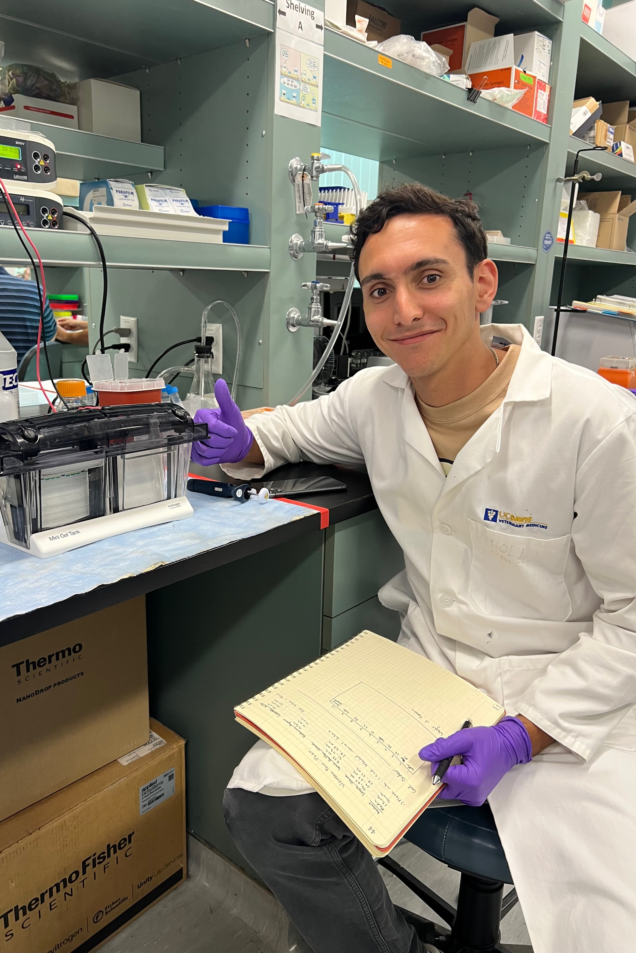
Acknowledgements
1. Dr. Luke A. Wittenburg (DVM, PhD, DACVCP)
2. Nick Oldberg & Dayn Godinez (PhD Students)
3. UC Davis SVM Students in Advanced Training (STAR) Program
4. NIH Research Grant

