Slide 1
Factors Driving Anatomic Distribution of Fibropapillomatosis Tumors in Green Sea Turtles in Espírito Santo, Brazil
Lexi Durant
Project Mentors: Dr. Marcela Uhart and Dr. Ralph Vanstreels

Slide 2
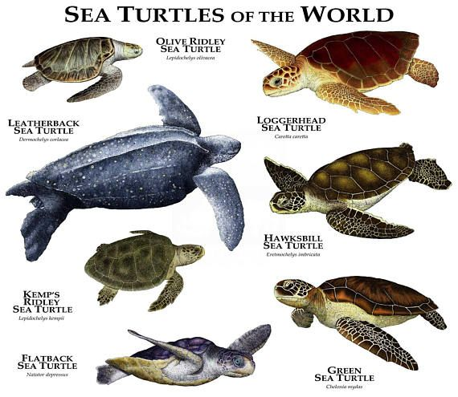
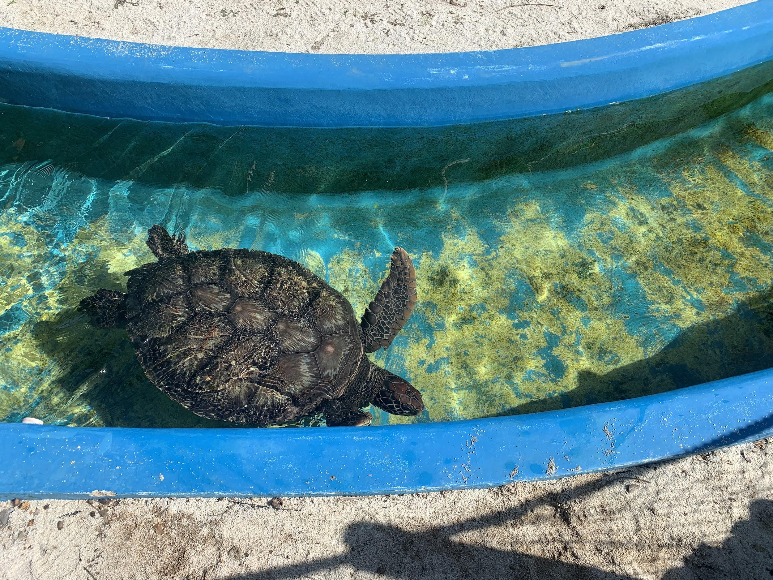
Green sea turtles (Chelonia mydas)
One of seven species
Tropical and subtropical oceans
Classified as “Endangered” as per IUCN Red List
Main threats as per IUCN Red List: intentional harvest, fisheries bycatch, habitat degradation
Roger D. Hall

Slide 3
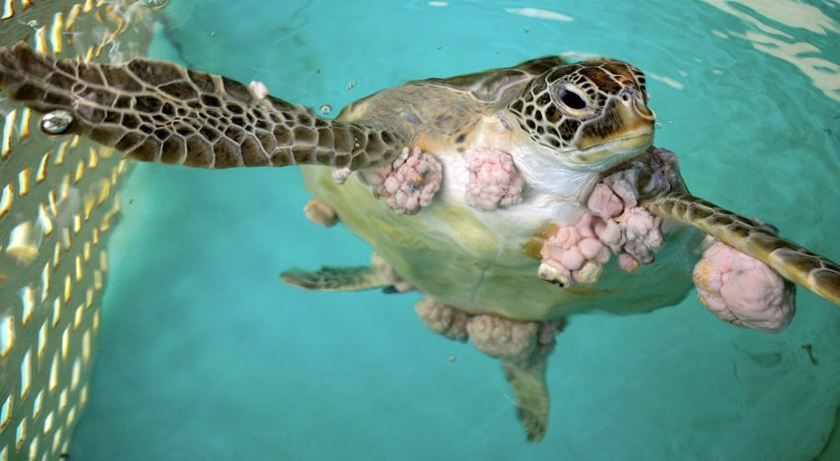
Fibropapillomatosis (FP)
Neoplastic condition involving epithelial tumors
First described in 1938
Prevalence 1−92% depending on region and time
Juvenile green sea turtles in human-impacted environments
Caused by Chelonid Herpesvirus 5 (ChHV5) + other factors
Health outcomes depend on tumor severity and location
Jen Zuber

Slide 4
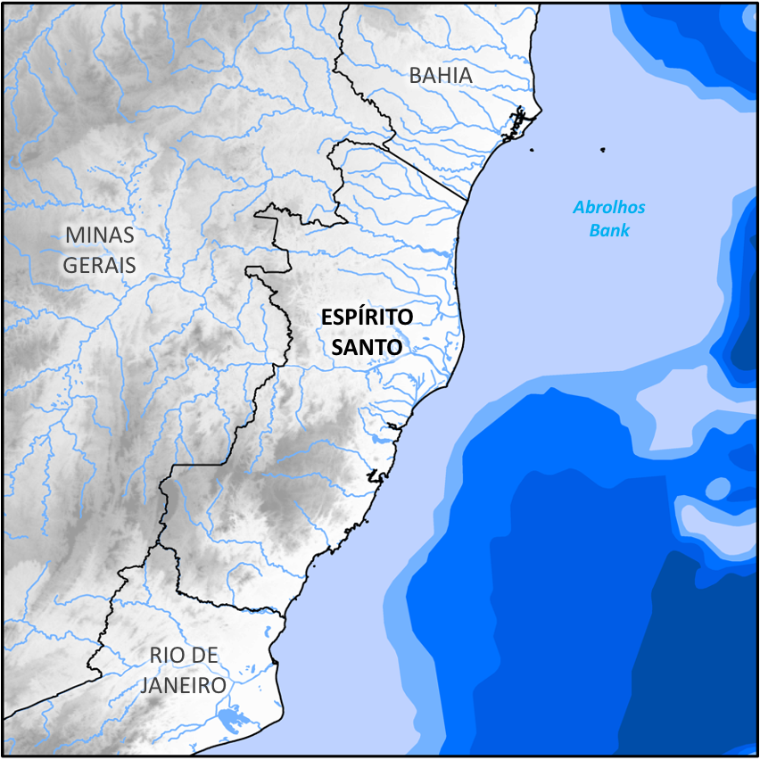
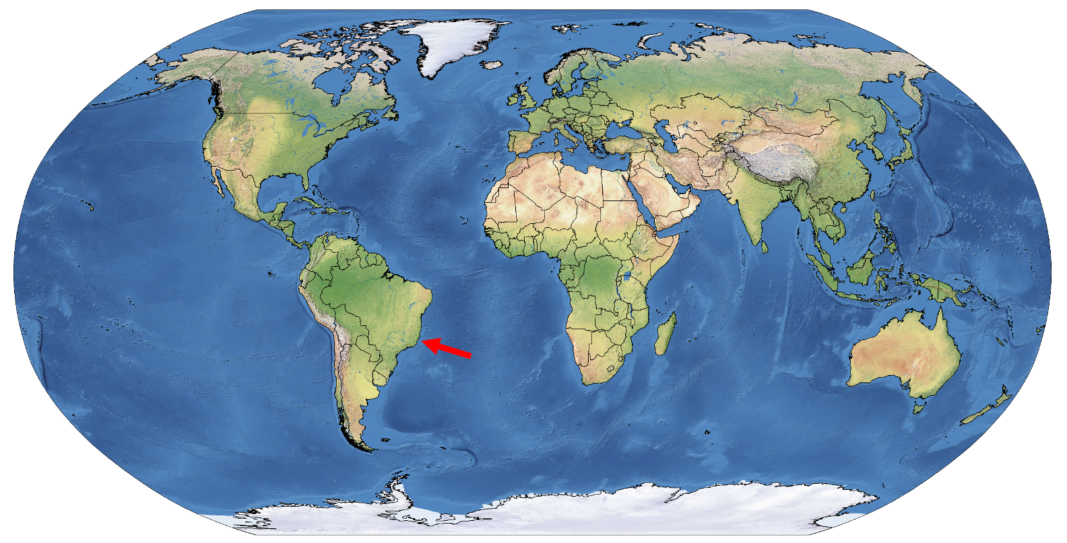
Study Site
Less studied in Brazil
Prevalence of 58.3% in Espírito Santo (coastline 400 km)

Slide 5
Hypotheses and Project Aims
Hypothesis 1: FP has different patterns of anatomic presentation of tumors in green sea turtles
Hypothesis 2: These patterns are triggered by different environmental factors
Specific Project Aims:
Classify patterns of FP presentation in green sea turtles in Espírito Santo, Brazil
Determine individual/environmental factors that explain different patterns

Slide 6
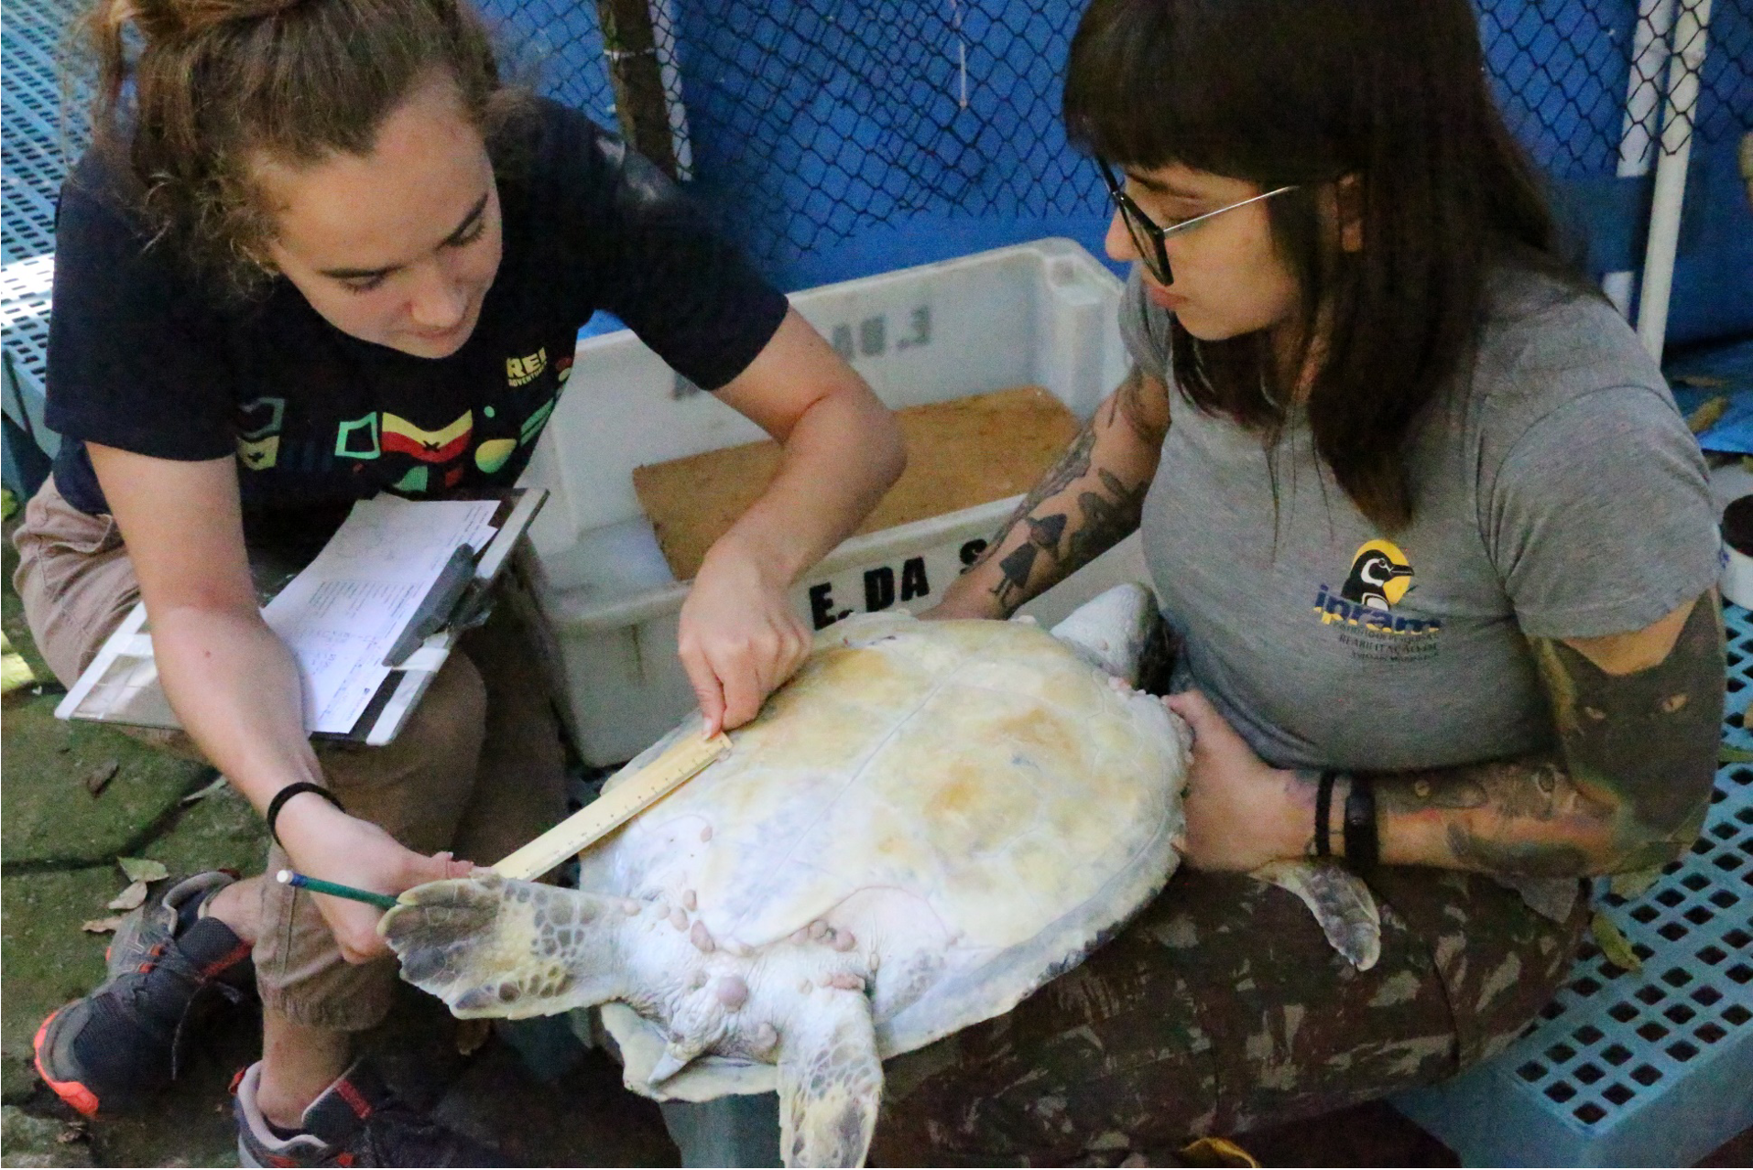
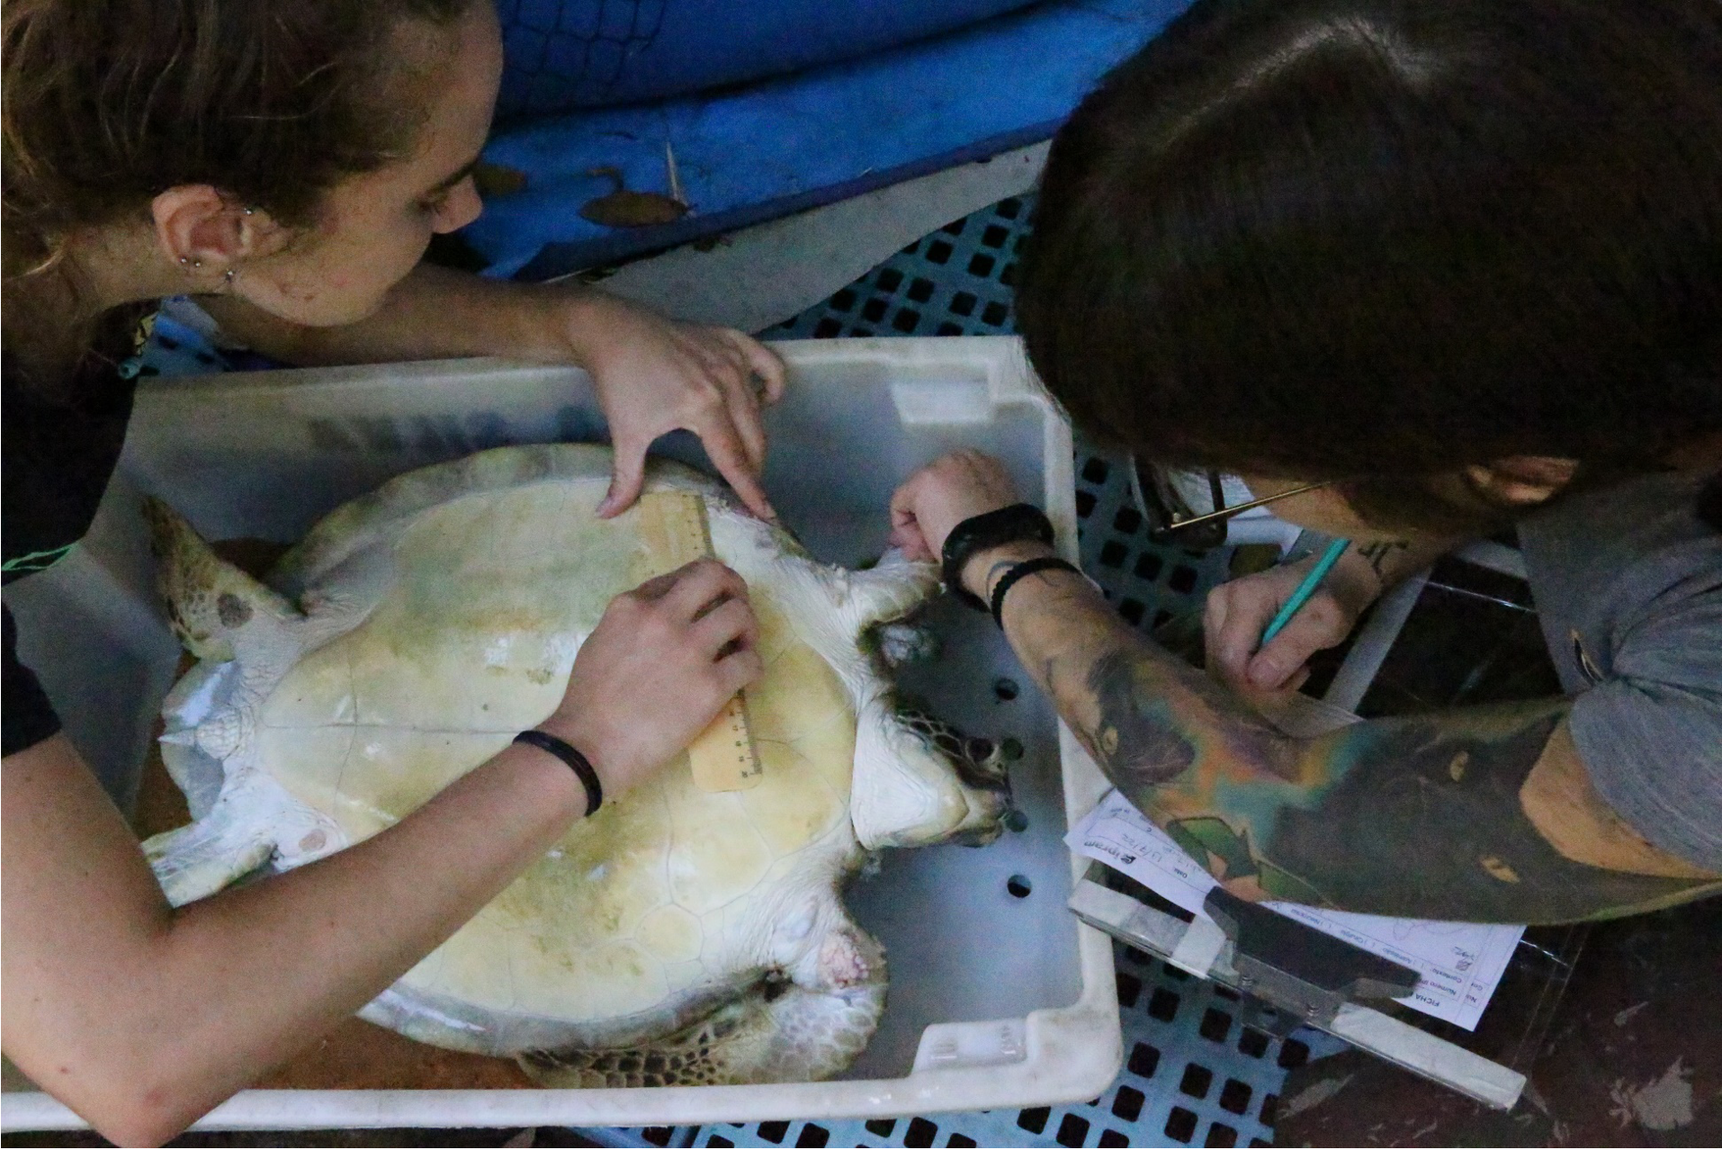
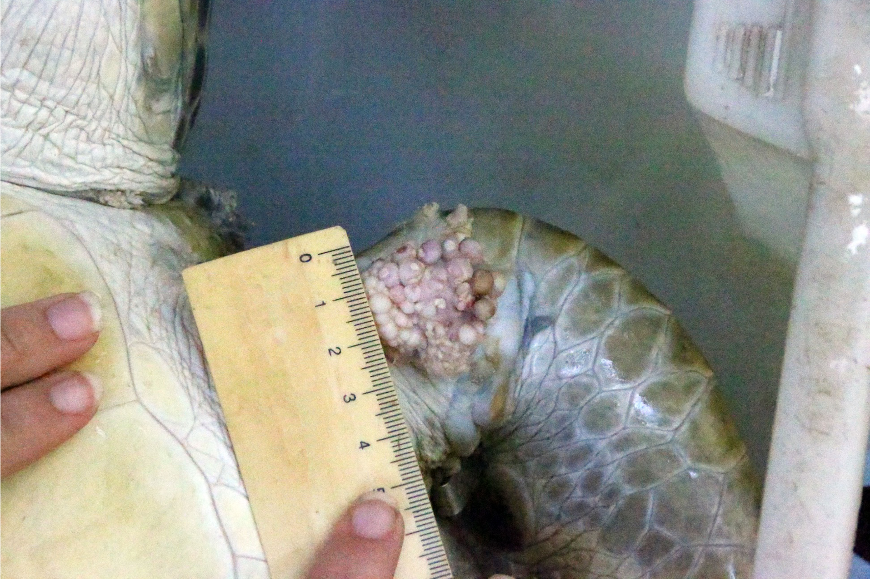
FP in Green Sea Turtles of Espírito Santo
275 green sea turtles with FP stranded in Espírito Santo from 2010-2022
Severity index uses number + size of tumors in different anatomic locations

Slide 7
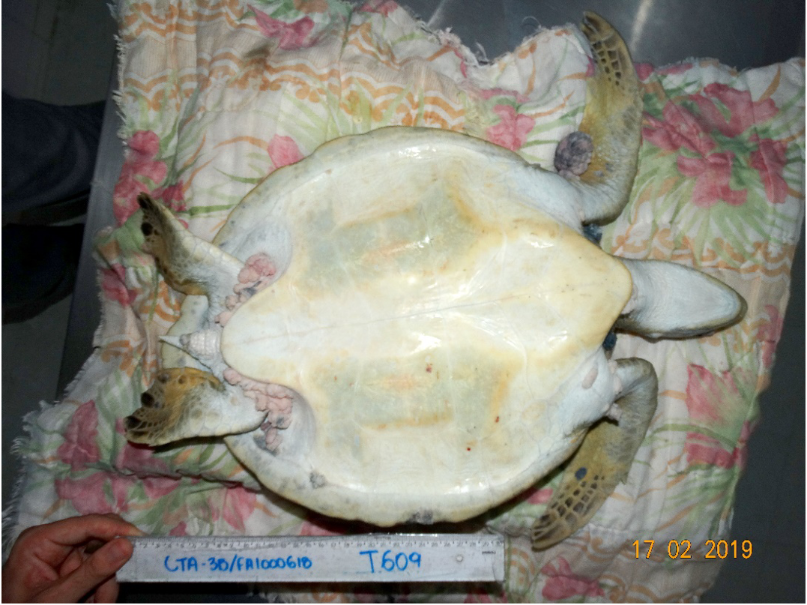
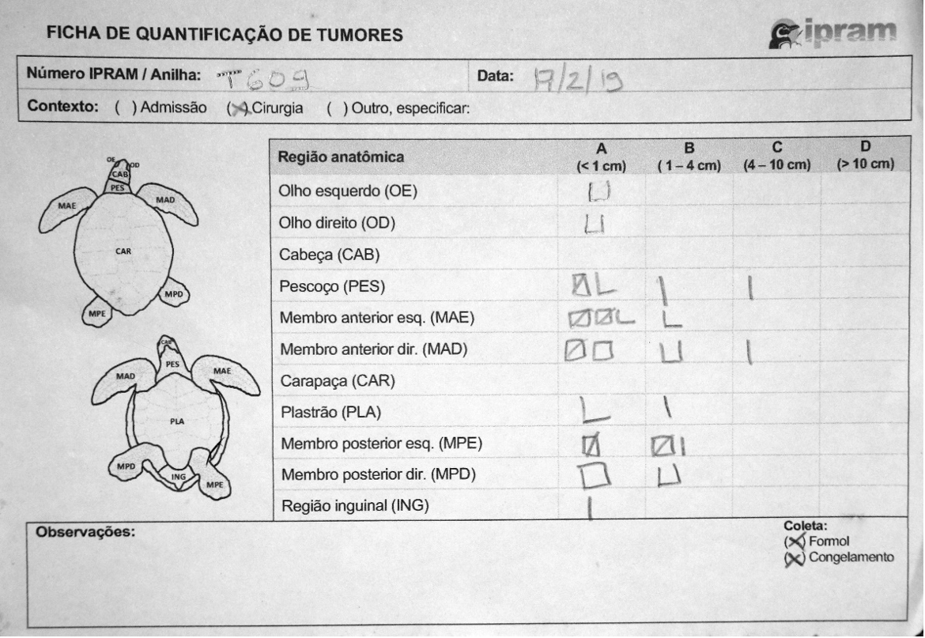
Data Collection Example

Slide 8
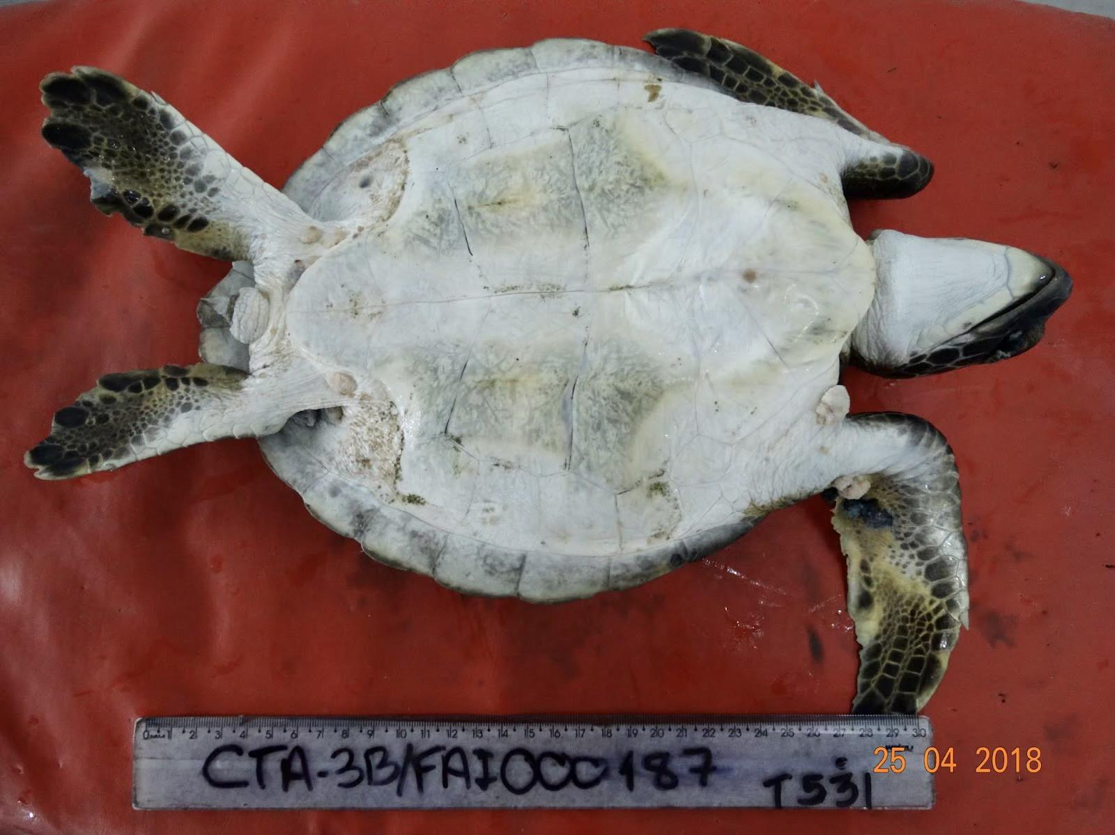
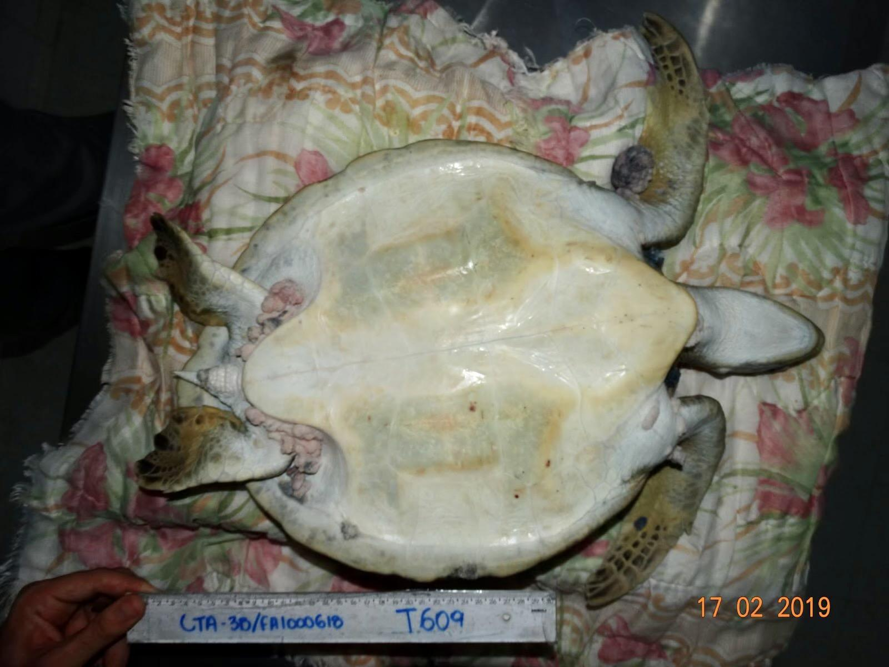
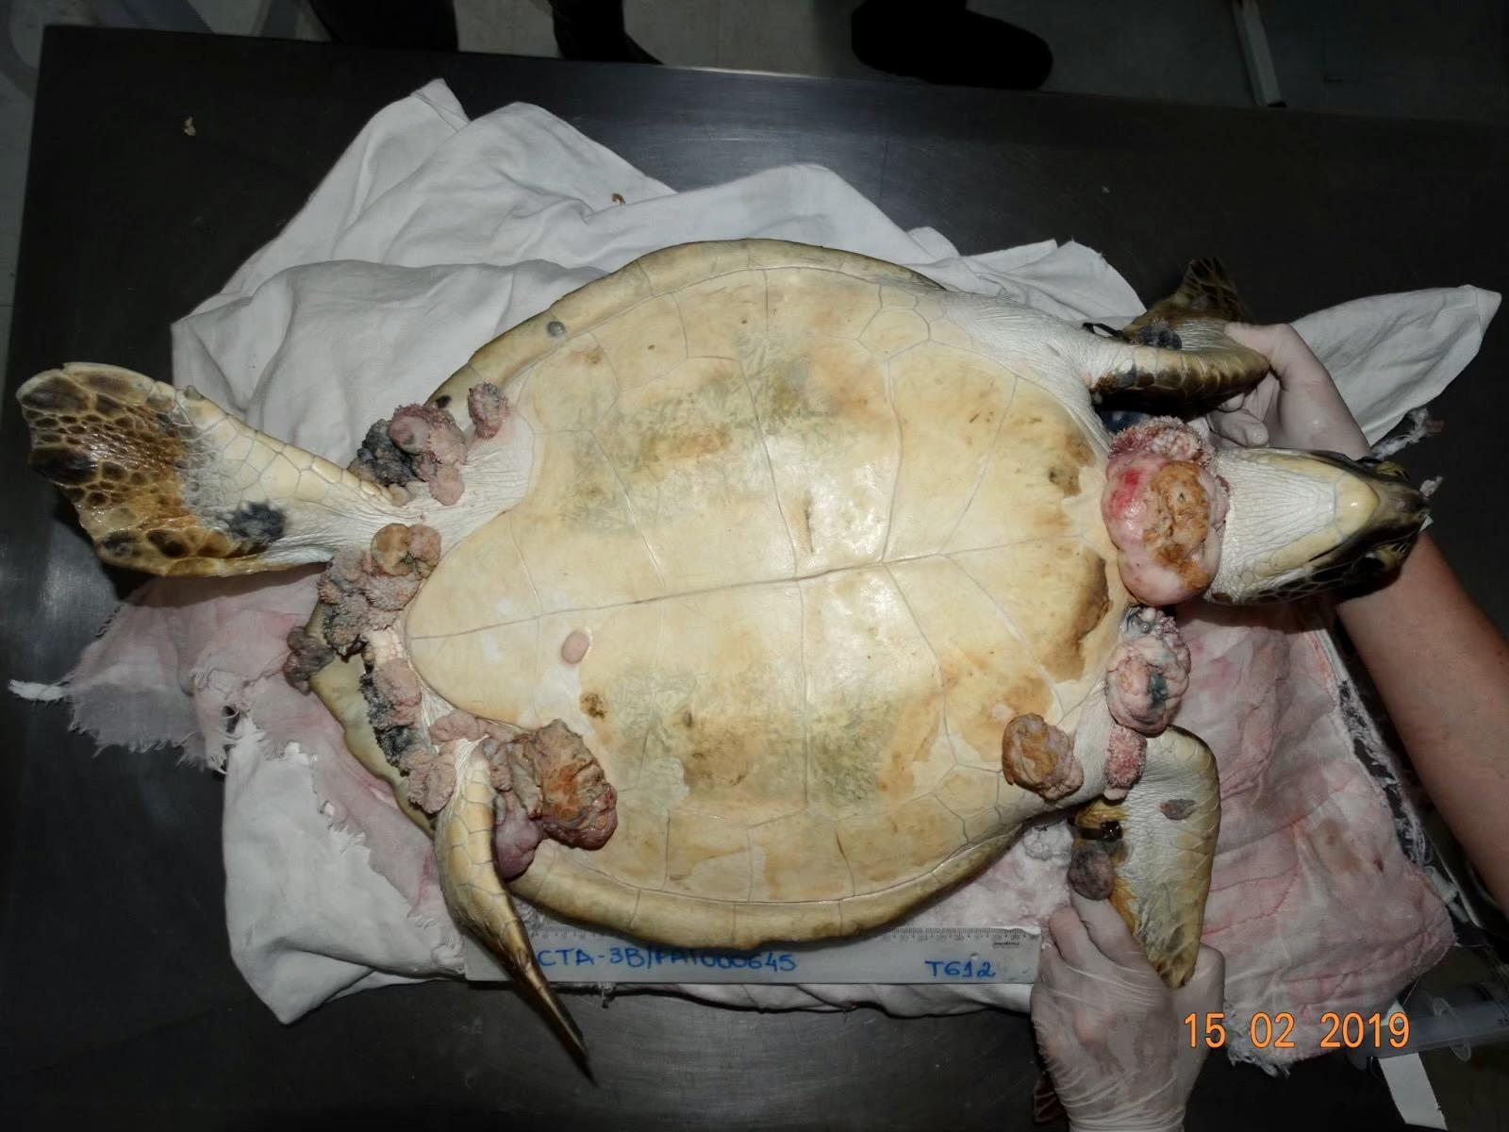
Severity index scoring
Mild FP
Moderate FP
Severe FP

Slide 9
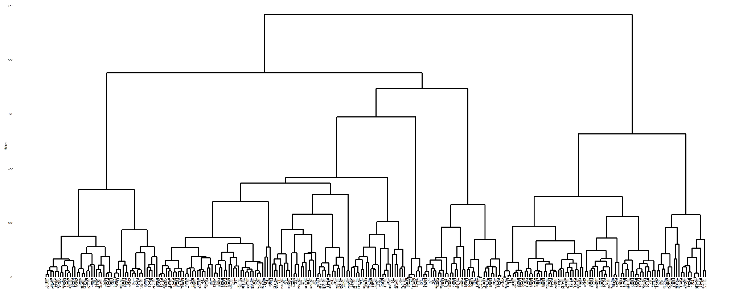
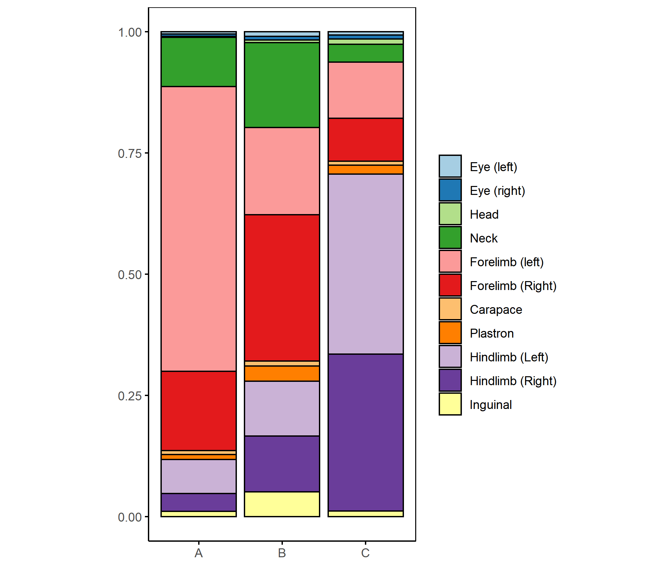
Classifying Patterns of FP Presentation
A
B
C
Used agglomerative nesting analysis (AGNES) to identify clusters of individuals
Identified 3 patterns of FP presentation
Classified each turtle according to its presentation
Group A: 47 individuals
Group B: 143 individuals
Group C: 85 individuals

Slide 10
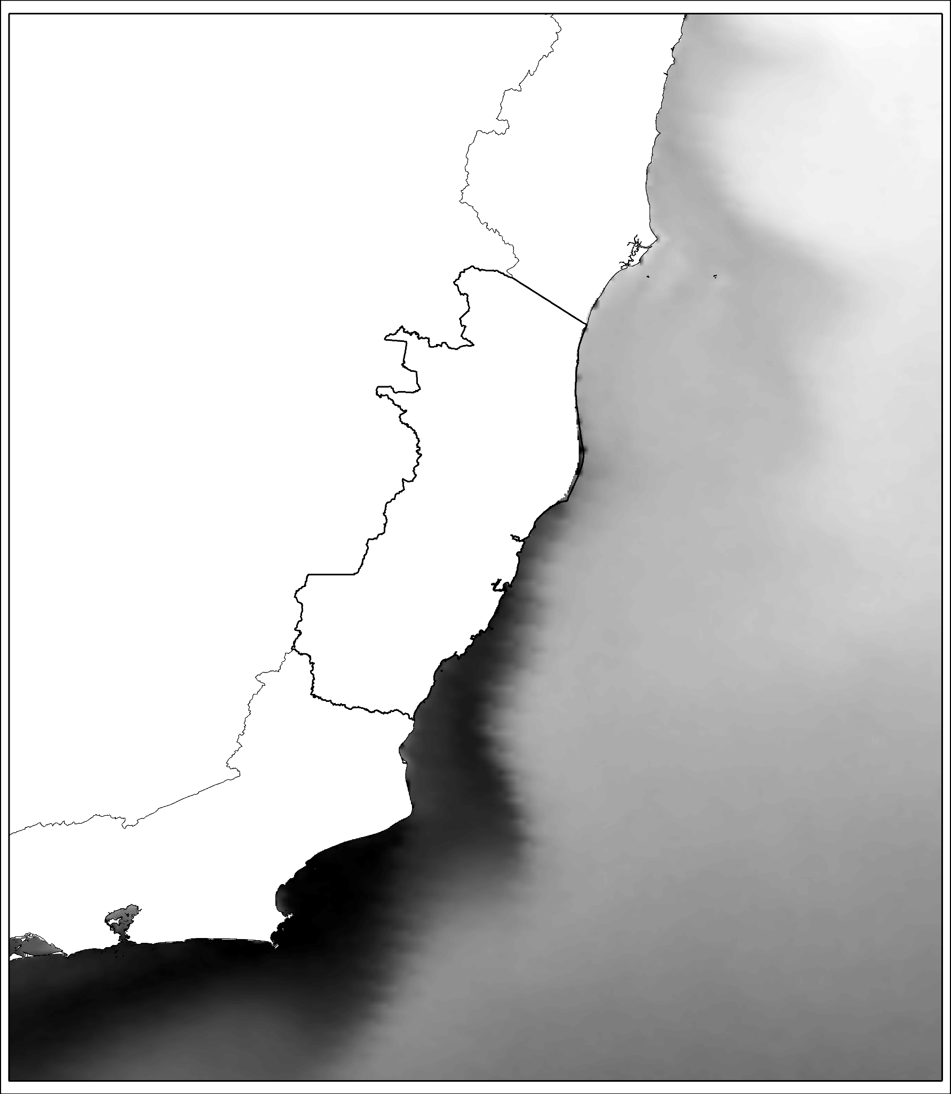
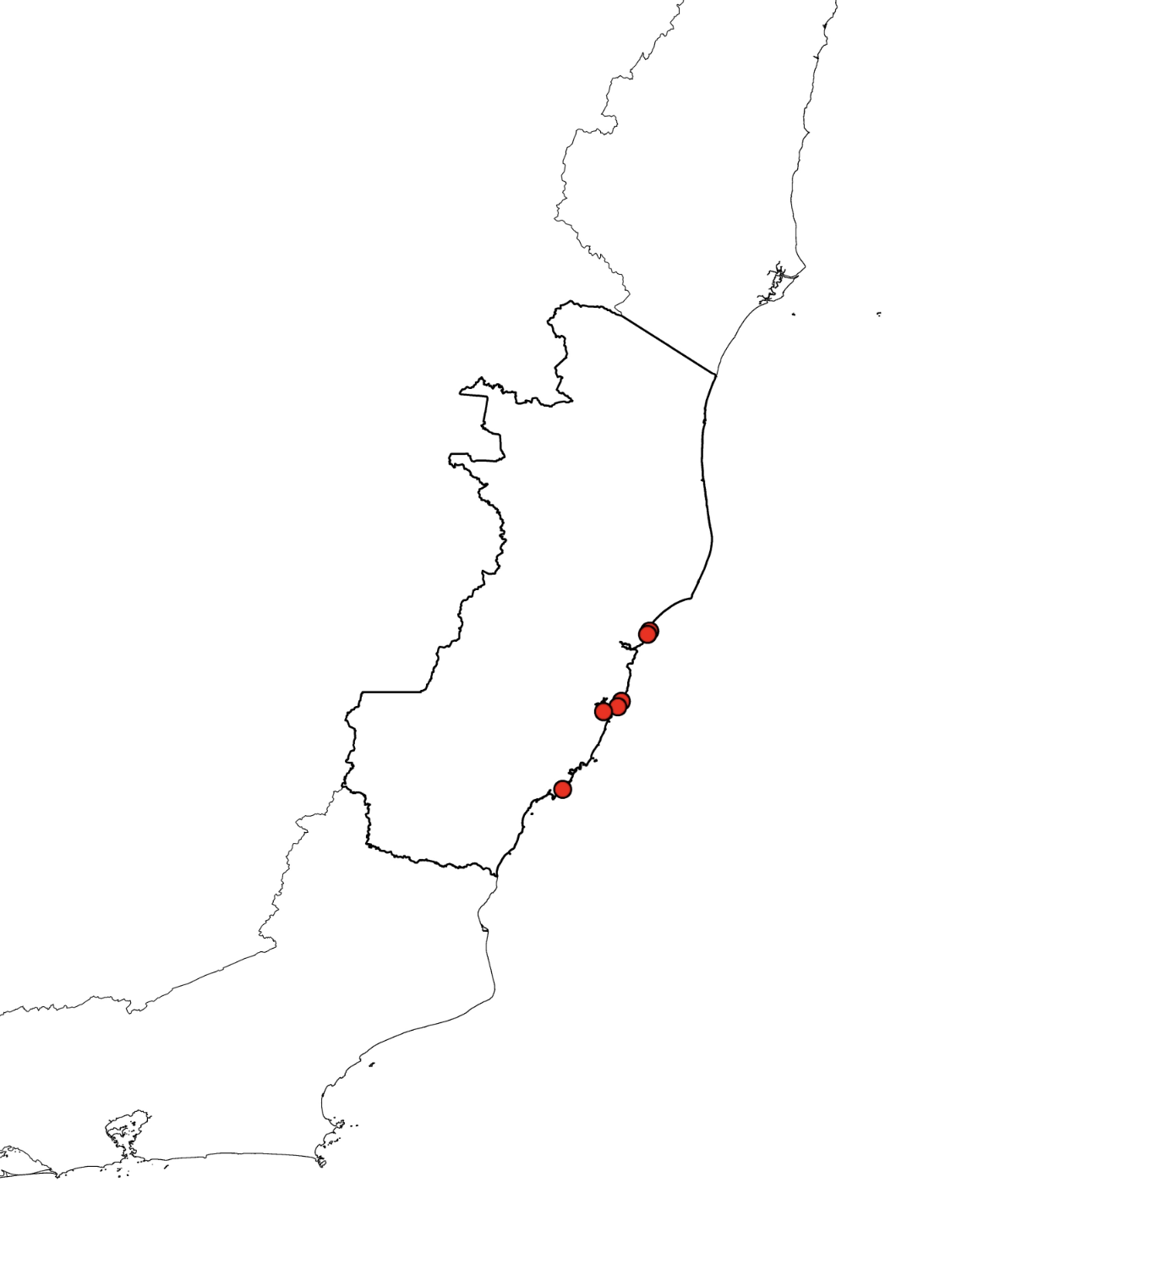
Explaining Variation Between FP Presentations
Use multinomial regression to determine variables explaining variation between FP presentation types
Human impact
Oceanographic conditions
Individual
Sea surface temperature
Metal industries
Human population

Slide 11
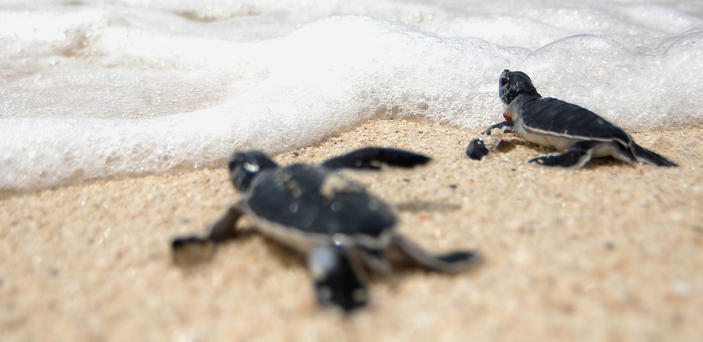
Significance and Future Directions
Results will illustrate different presentations of FP in sea turtles of Espírito Santo as well as if there are different environmental factors driving these differences
Plan to look at how variables relate to FP severity
Can inform future research on FP as well as conservation initiatives

Slide 12
Acknowledgements
Financial support was provided by the Students Training in Advanced Research (STAR) Program through the SVM Endowment Funds
Financial support for travel was provided by UC Davis Office for Global Programs
Special thanks to IPRAM (Instituto de Pesquisa e Reabilitação de Animais Marinhos), Projeto TAMAR, and LAPCOM-USP

