Slide 1
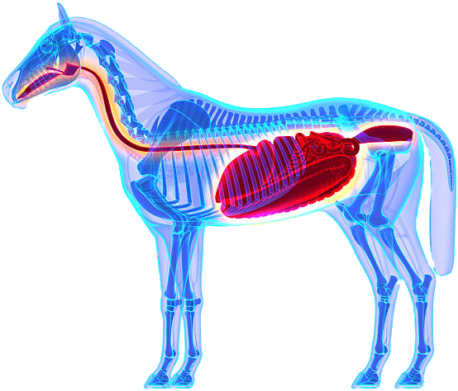
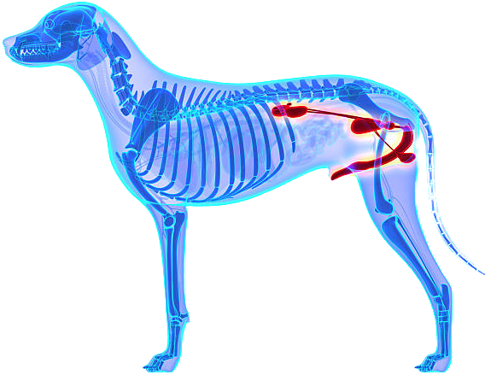
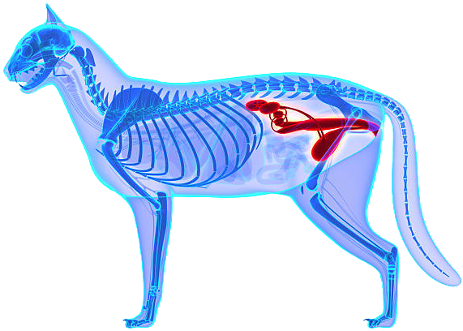
Struvite Stones and the microbiome
Ashleigh Flores, MS, PhD/DVM Student
PI: Bart Weimer, PhD

Slide 2
Outline
Overall Project Significance
Hypotheses and Objectives
Background
  Struvite Chemistry
  Enteroliths in horses
  Struvite Uroliths in Dogs
  Struvite Uroliths in Cats
Enterolith Pilot Study
Struvite Urolith Pilot Study

Slide 3
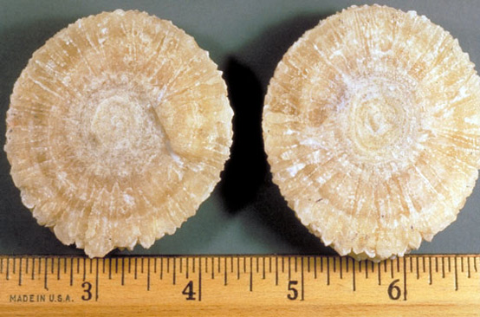
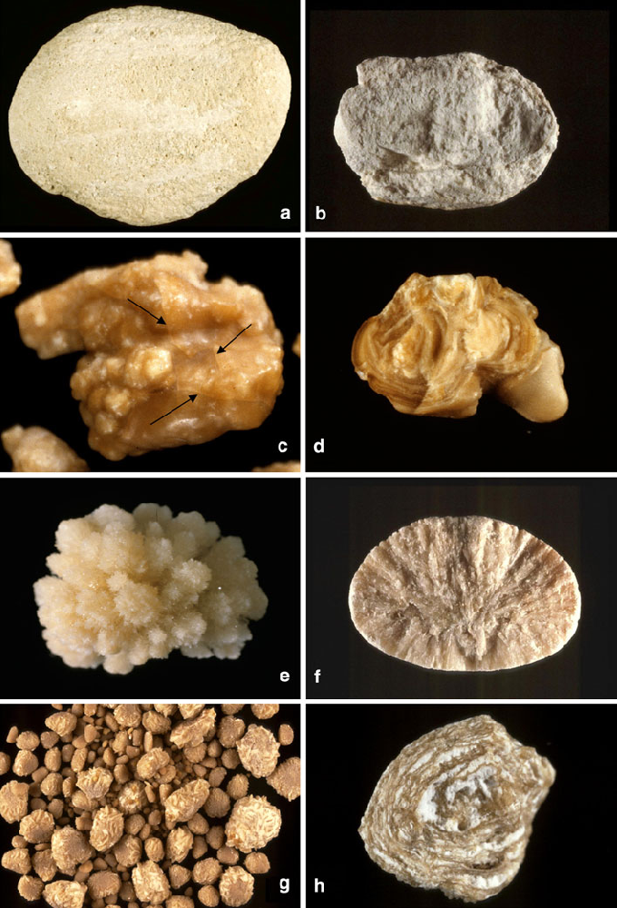
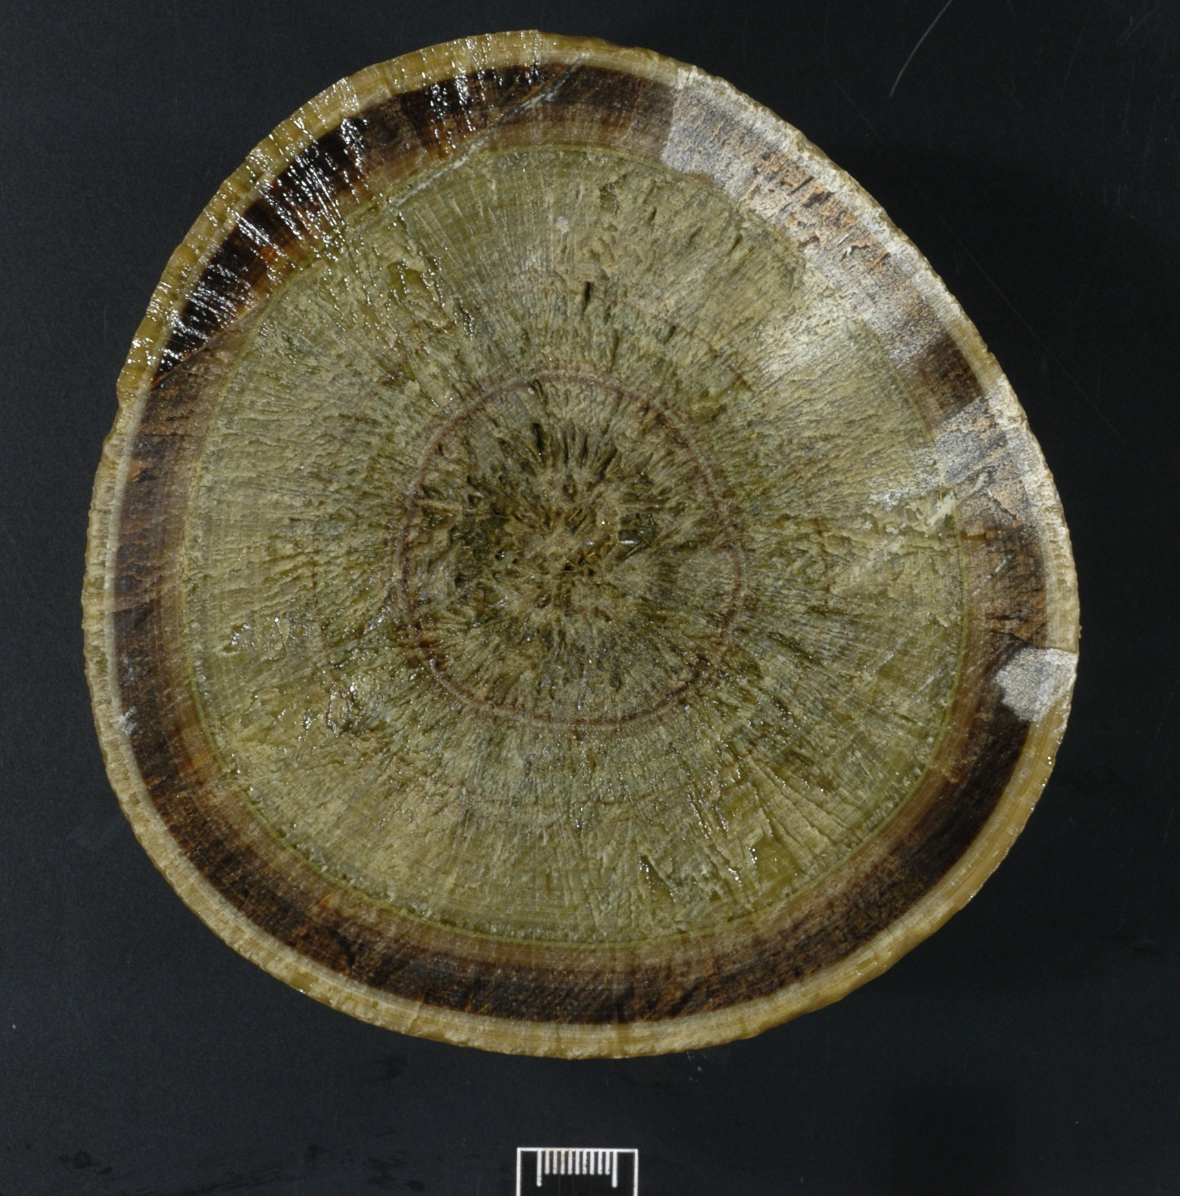
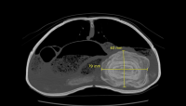
Overall Project Significance
Urolithiasis occurs in a vast array of species
Primary stones that occur are struvite and CaOx
Struvite is the common denominator, but stone similarities and differences have not been investigated in depth.
The link between the microbiome and its role in these diseases has not been studied.
  The presence of a microbiome in the horse GI tract as well as in cat and dog urinary tracts have been reported
Provide insight → improved clinical outcomes
Methods can be applied to other types of urinary stones.
Translational applications exist for both humans and many veterinary species.
Photo credit: Daudon et. al, 2010
Julie Dechant, DVM, DACVECC, DACVS
Burdett et. al, 2010
https://www.vetmed.ucdavis.edu/news/uc-davis-exotic-animal-specialists-treat-80-year-old-desert-tortoise

Slide 4
Hypotheses and Objectives
Hypotheses:
A microbial community exists (microbiome) within struvite urinary stones in both dogs and cats that contributes to stone formation.
Based on previous findings, we postulate that a similar microbiome occurs in equine enteroliths and dog/cat struvite urinary stones. Members of the microbiomes contribute to an environment that favors struvite precipitation and stone formation.
Objective: Identify the microbiome of dog and cat struvite urinary stones using deep RNA metagenomic sequencing.

Slide 5
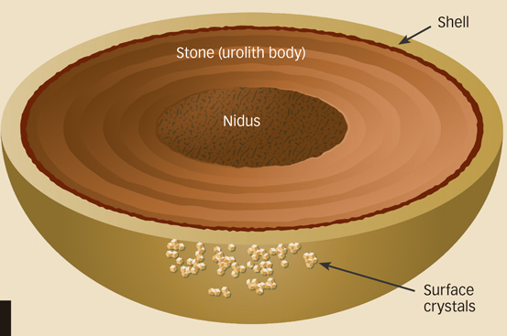
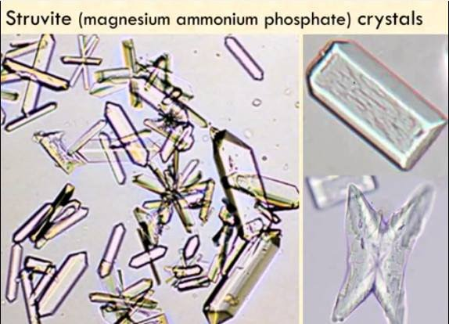
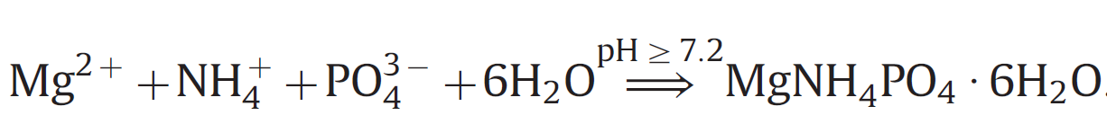
Background: Struvite Chemistry
Struvite:
  The common denominator-main component of enteroliths and struvite urinary stones
  A composite of magnesium ammonium phosphate hexahydrate [(NH4)MgPO4•6H2O)]
  Highly soluble in acidic conditions, not very soluble in alkaline/neutral conditions
  Alkaline pH is favorable for struvite precipitation
https://www.medical-labs.net/struvite-crystals-1279/&ust=1565838546235752
https://www.cliniciansbrief.com/article/urolithiasis-diagnostic-imaging-clinical-signs

Slide 6
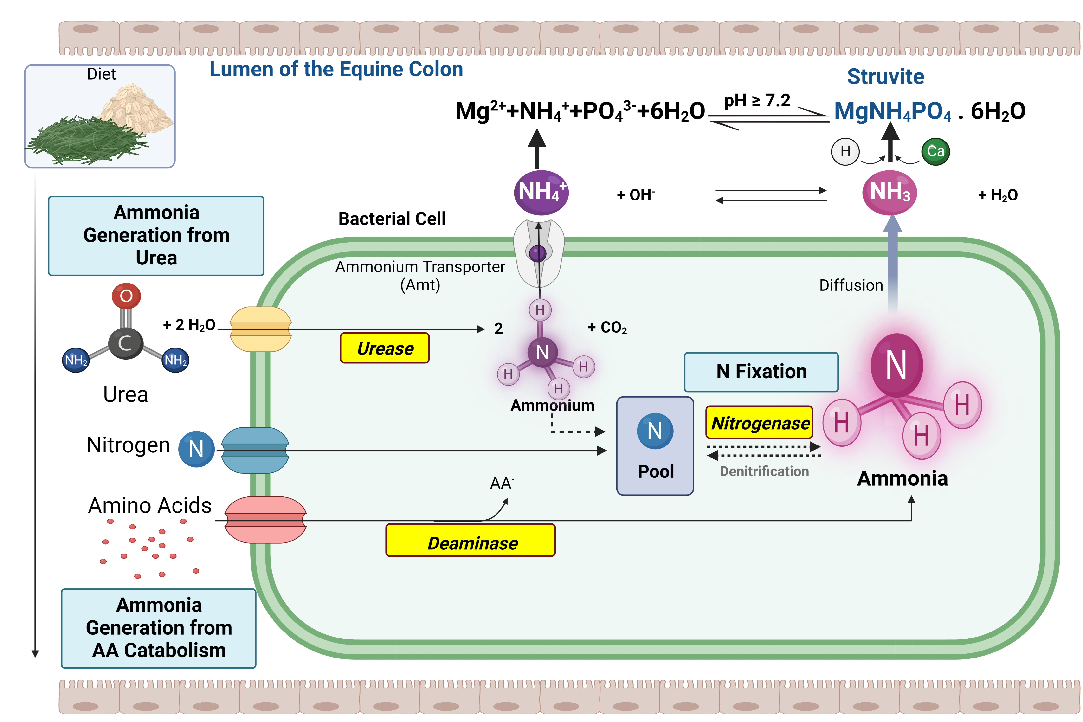
* Diagram also applicable to struvite urinary stones, takes place in the urinary tract
Made using Biorender

Slide 7
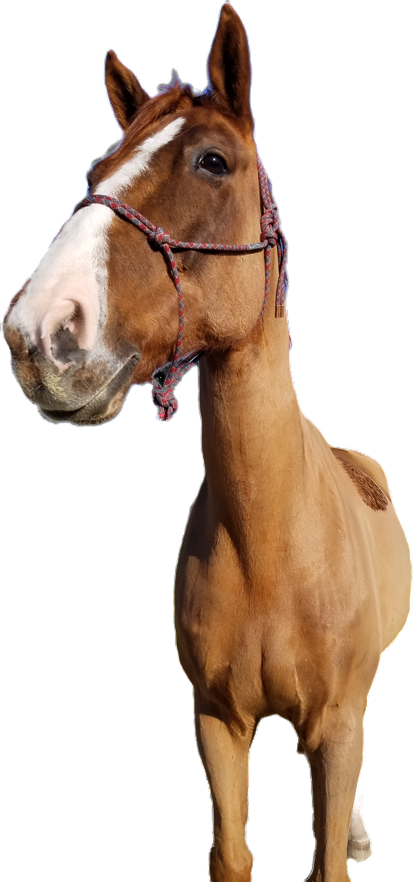
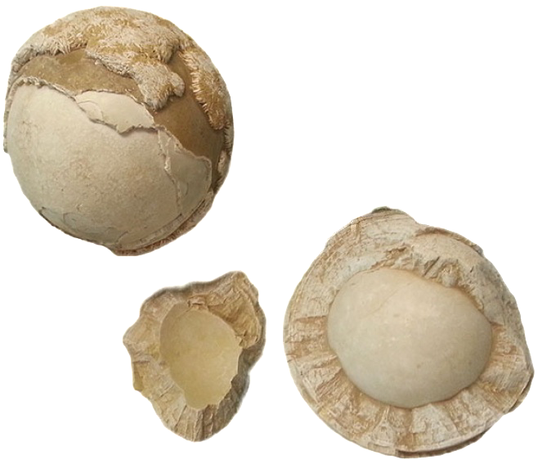
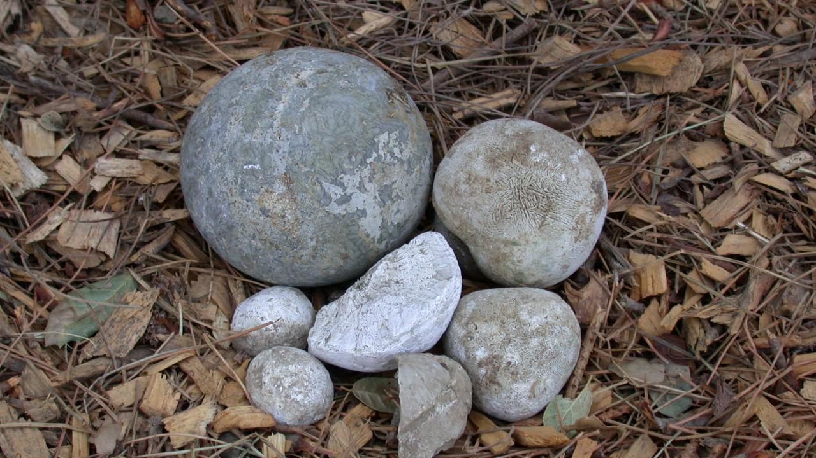
Background: Enterolithiasis
Enteroliths: Endogenously produced mineral concretions, primarily composed of struvite, that form in right dorsal colon of the horse.
Often present for colic, cause complete or intermittent obstruction which can cause pressure necrosis and intestinal rupture.
Enterolithiasis is an understudied disease despite a disproportionately prevalent in CA.
https://fordvetsurgery.com/colic-and-equine-enteroliths/
Photo credits: UC Davis Center for Equine Health
Ashleigh Flores

Slide 8
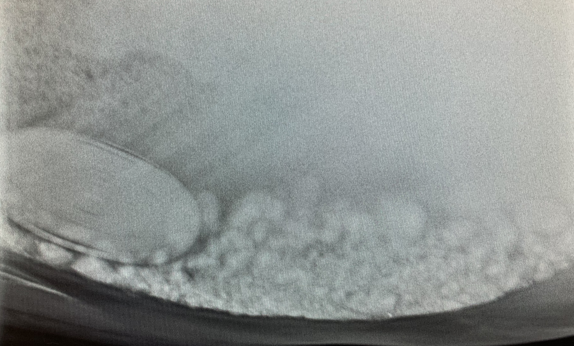
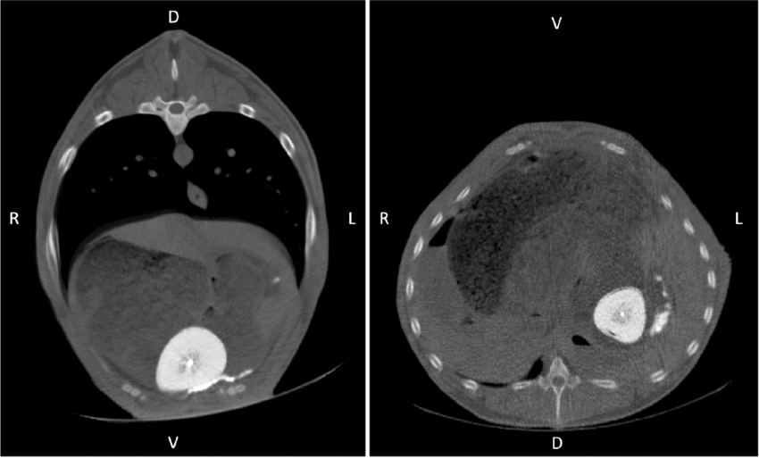
Treatment and Diagnostics for Enteroliths
Diagnostic Methods:
Abdominal radiography
  Most effective and least invasive
  Rarely offered for adult horses outside of referral centers
  Not always visible on radiographs
  CT would be ideal but not practical
Treatment:
Celiotomy needed if horse unable to pass them
Routine follow-up radiographs to check for recurrence
Photo credit: Julie Dechant, DVM, DACVECC, DACVS
Photo credit: Nakamae et. al, 2018
Photo credit: Isabelle Kilcoyne, MVB, DACVS
VET 415: Large Animal Surgical Approaches to the Abdomen
Notes:
CT of a pony

Slide 9
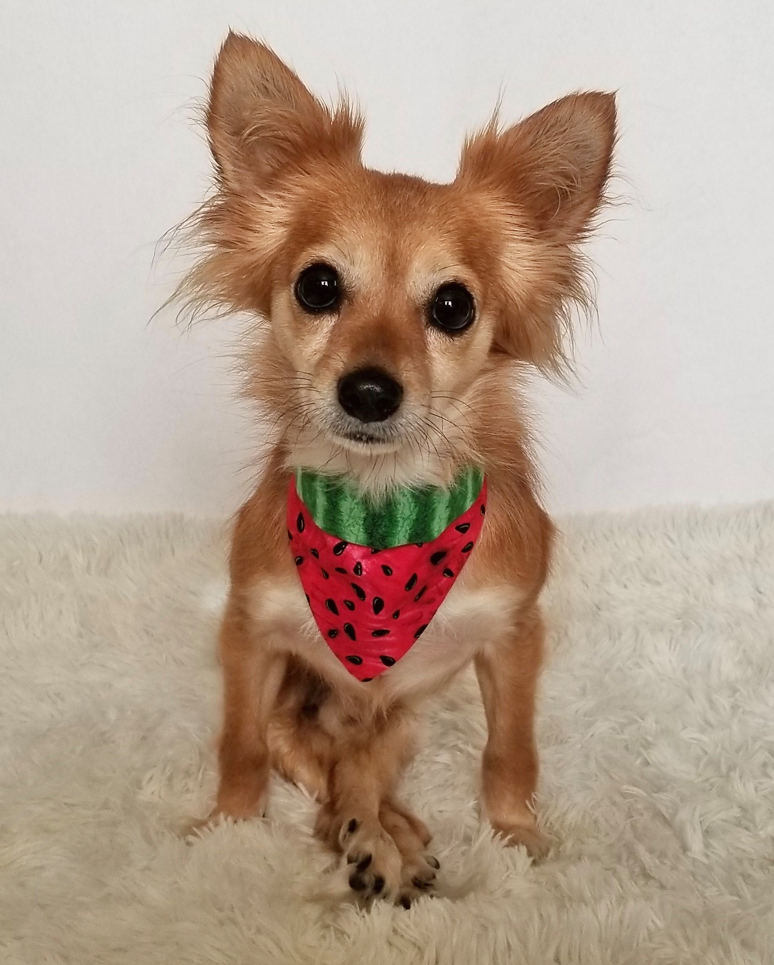
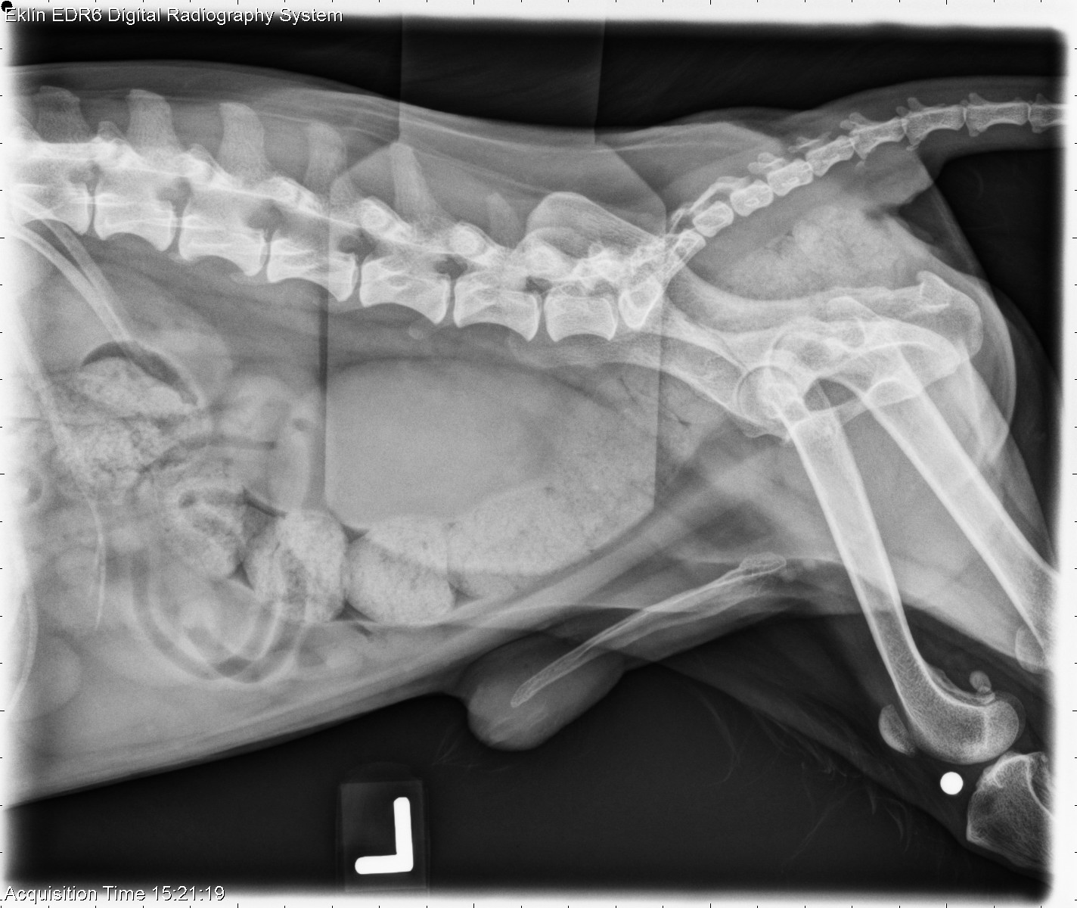
Background: Canine Struvite Uroliths
Most common type of urolith in dogs followed by CaOx
More common in females
Dogs with comorbidities like neurological deficits at higher risk due to increased risk of UTIs
Virtually all infection-induced
  A microbiome has been identified in the canine urinary tract (Burton et al, 2017)
Treatment:
Voiding urohydropropulsion, laser lithotripsy and basket removal, dissolution diets, potential for antibiotics

Slide 10
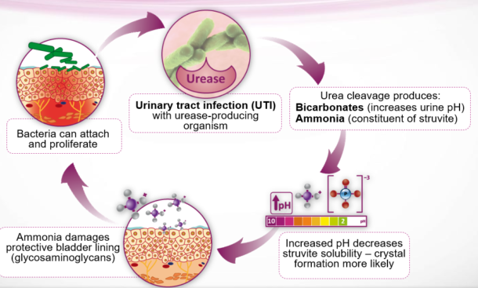
Canine UTIs and Struvite Uroliths
Most common types of bacteria:
  Staphylococcus psuedintermedius
  Proteus mirabilis
  Klebsiella spp. (known N fixer)
Two ways to produce NH₃:
Urease producers- Staph. and Proteus
  Associated with UTIs and struvite formation
  Urease → hydrolysis of urea, forming NH₃ and CO_{2.}
N Fixers-Kelbsiella
  Nitrogenase → microbial production of NH₃
https://www.veterinary-practice.com/article/nutritional-management-canine-uroliths

Slide 11
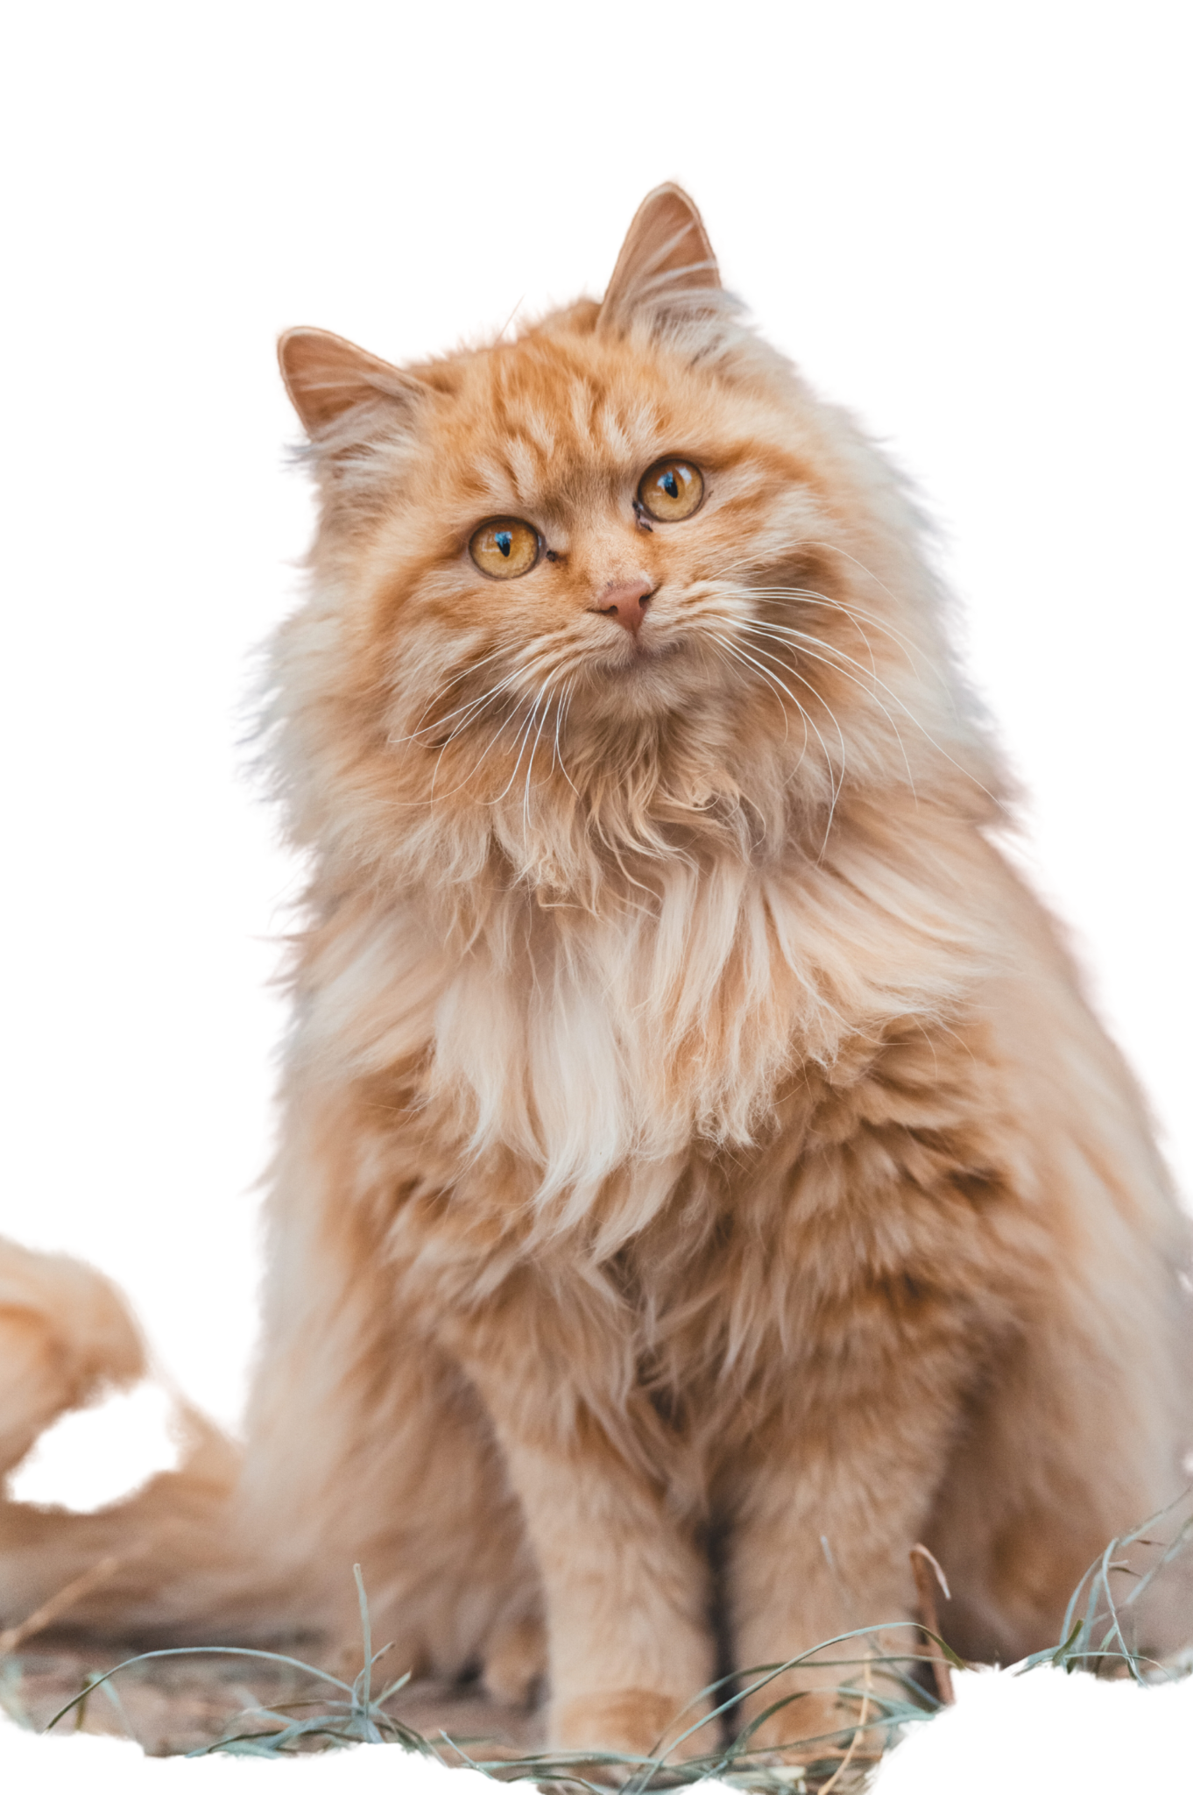
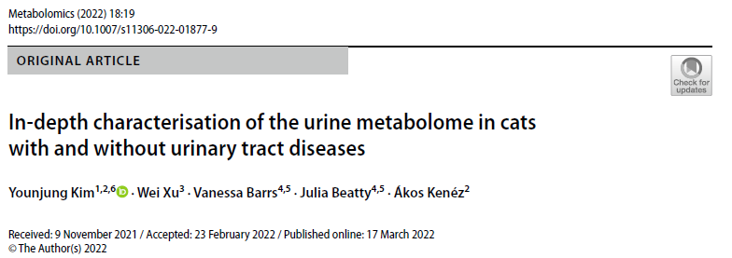
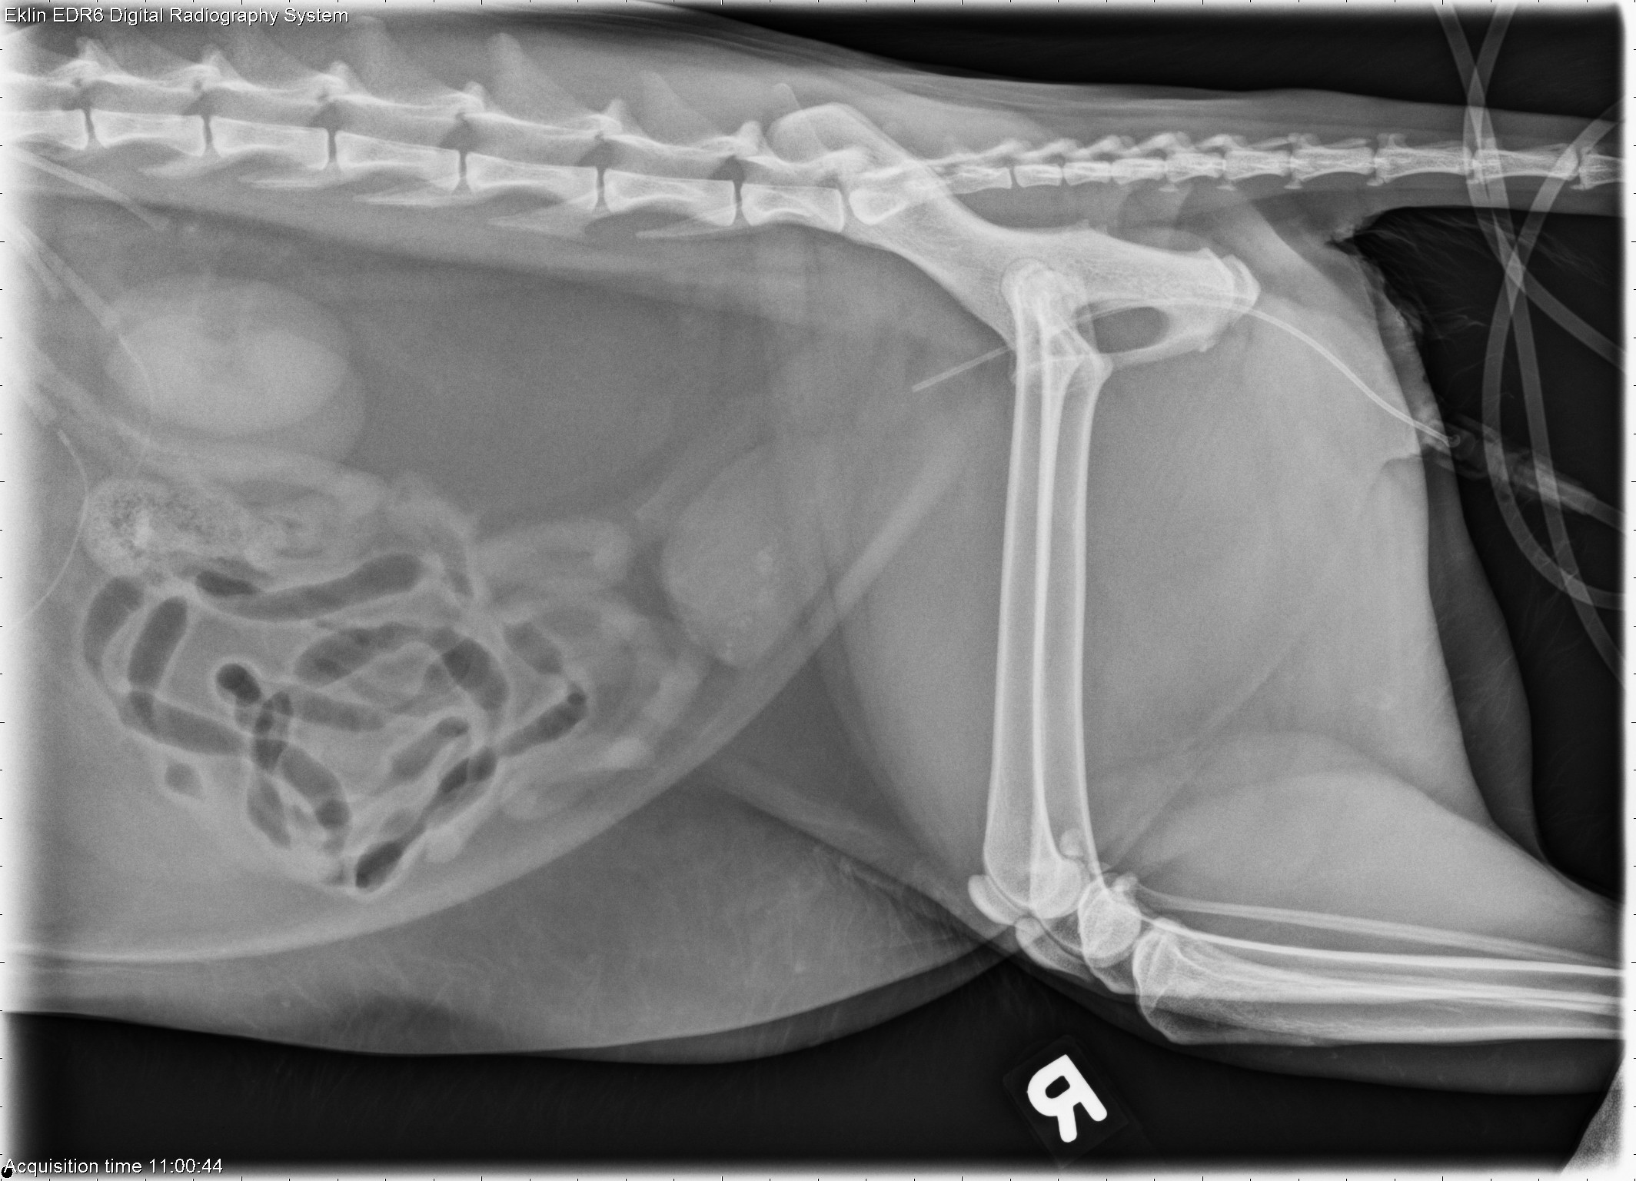
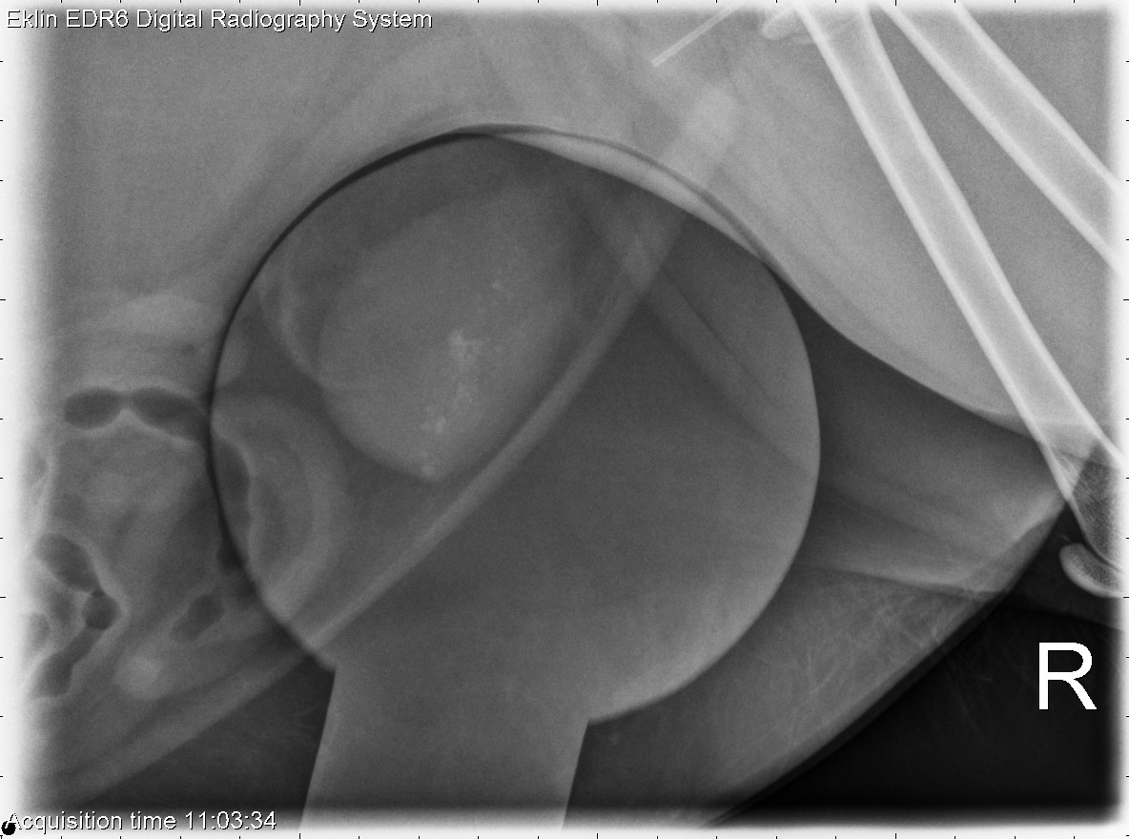
Background: Feline Struvite Uroliths
Second most common next to CaOx stones
Not believed to be associated with UTIs
  However, a urinary microbiome has been identified in cats (Kim et al., 2022)
Stones historically believed to be sterile Treatment:
Dissolution diets and ↑ H₂O

Slide 12
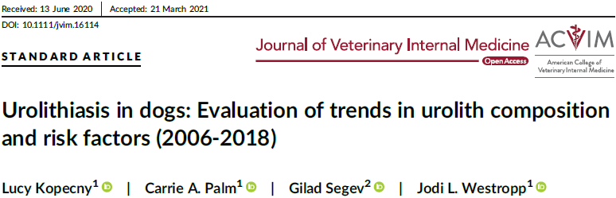
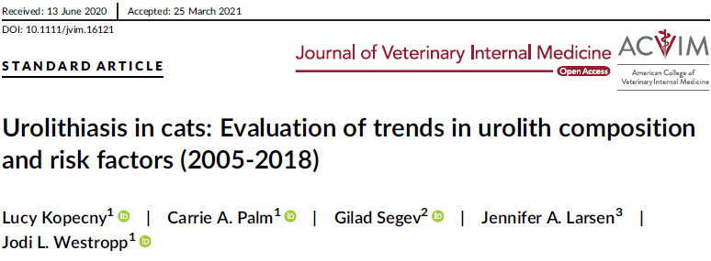
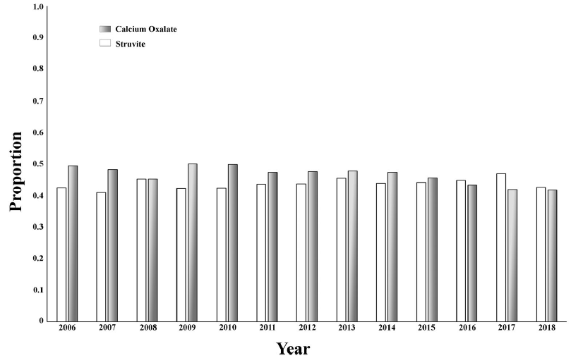

Slide 13
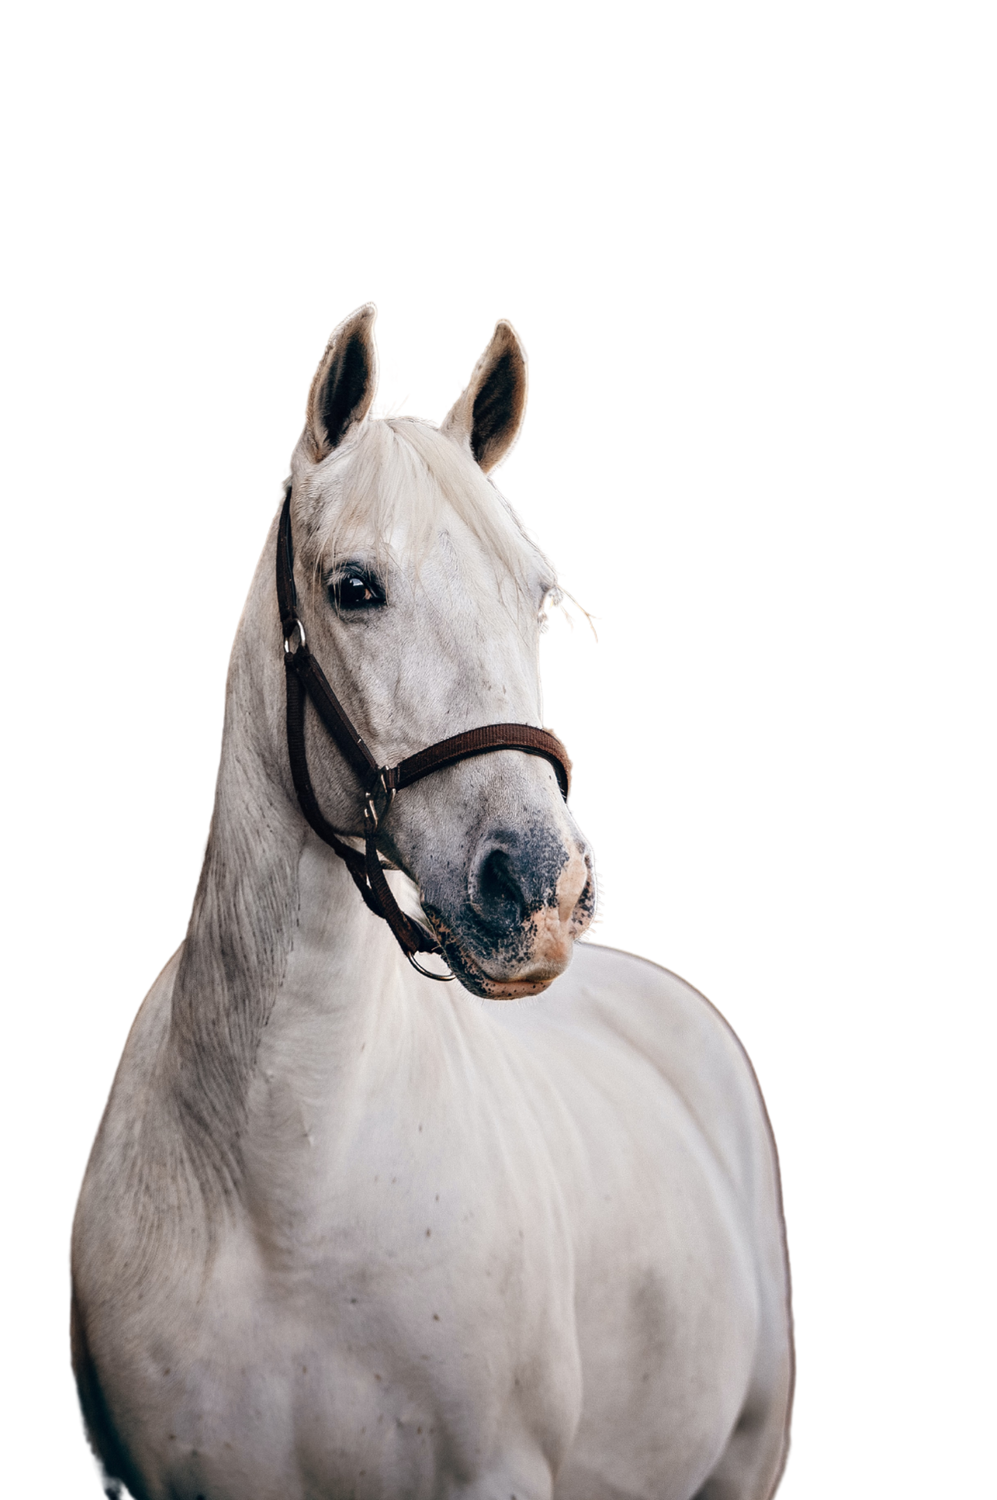

Enterolith Pilot Study

Slide 14
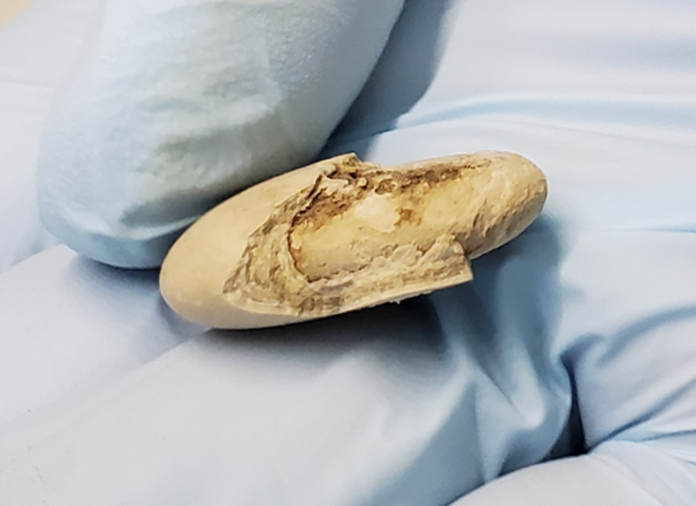
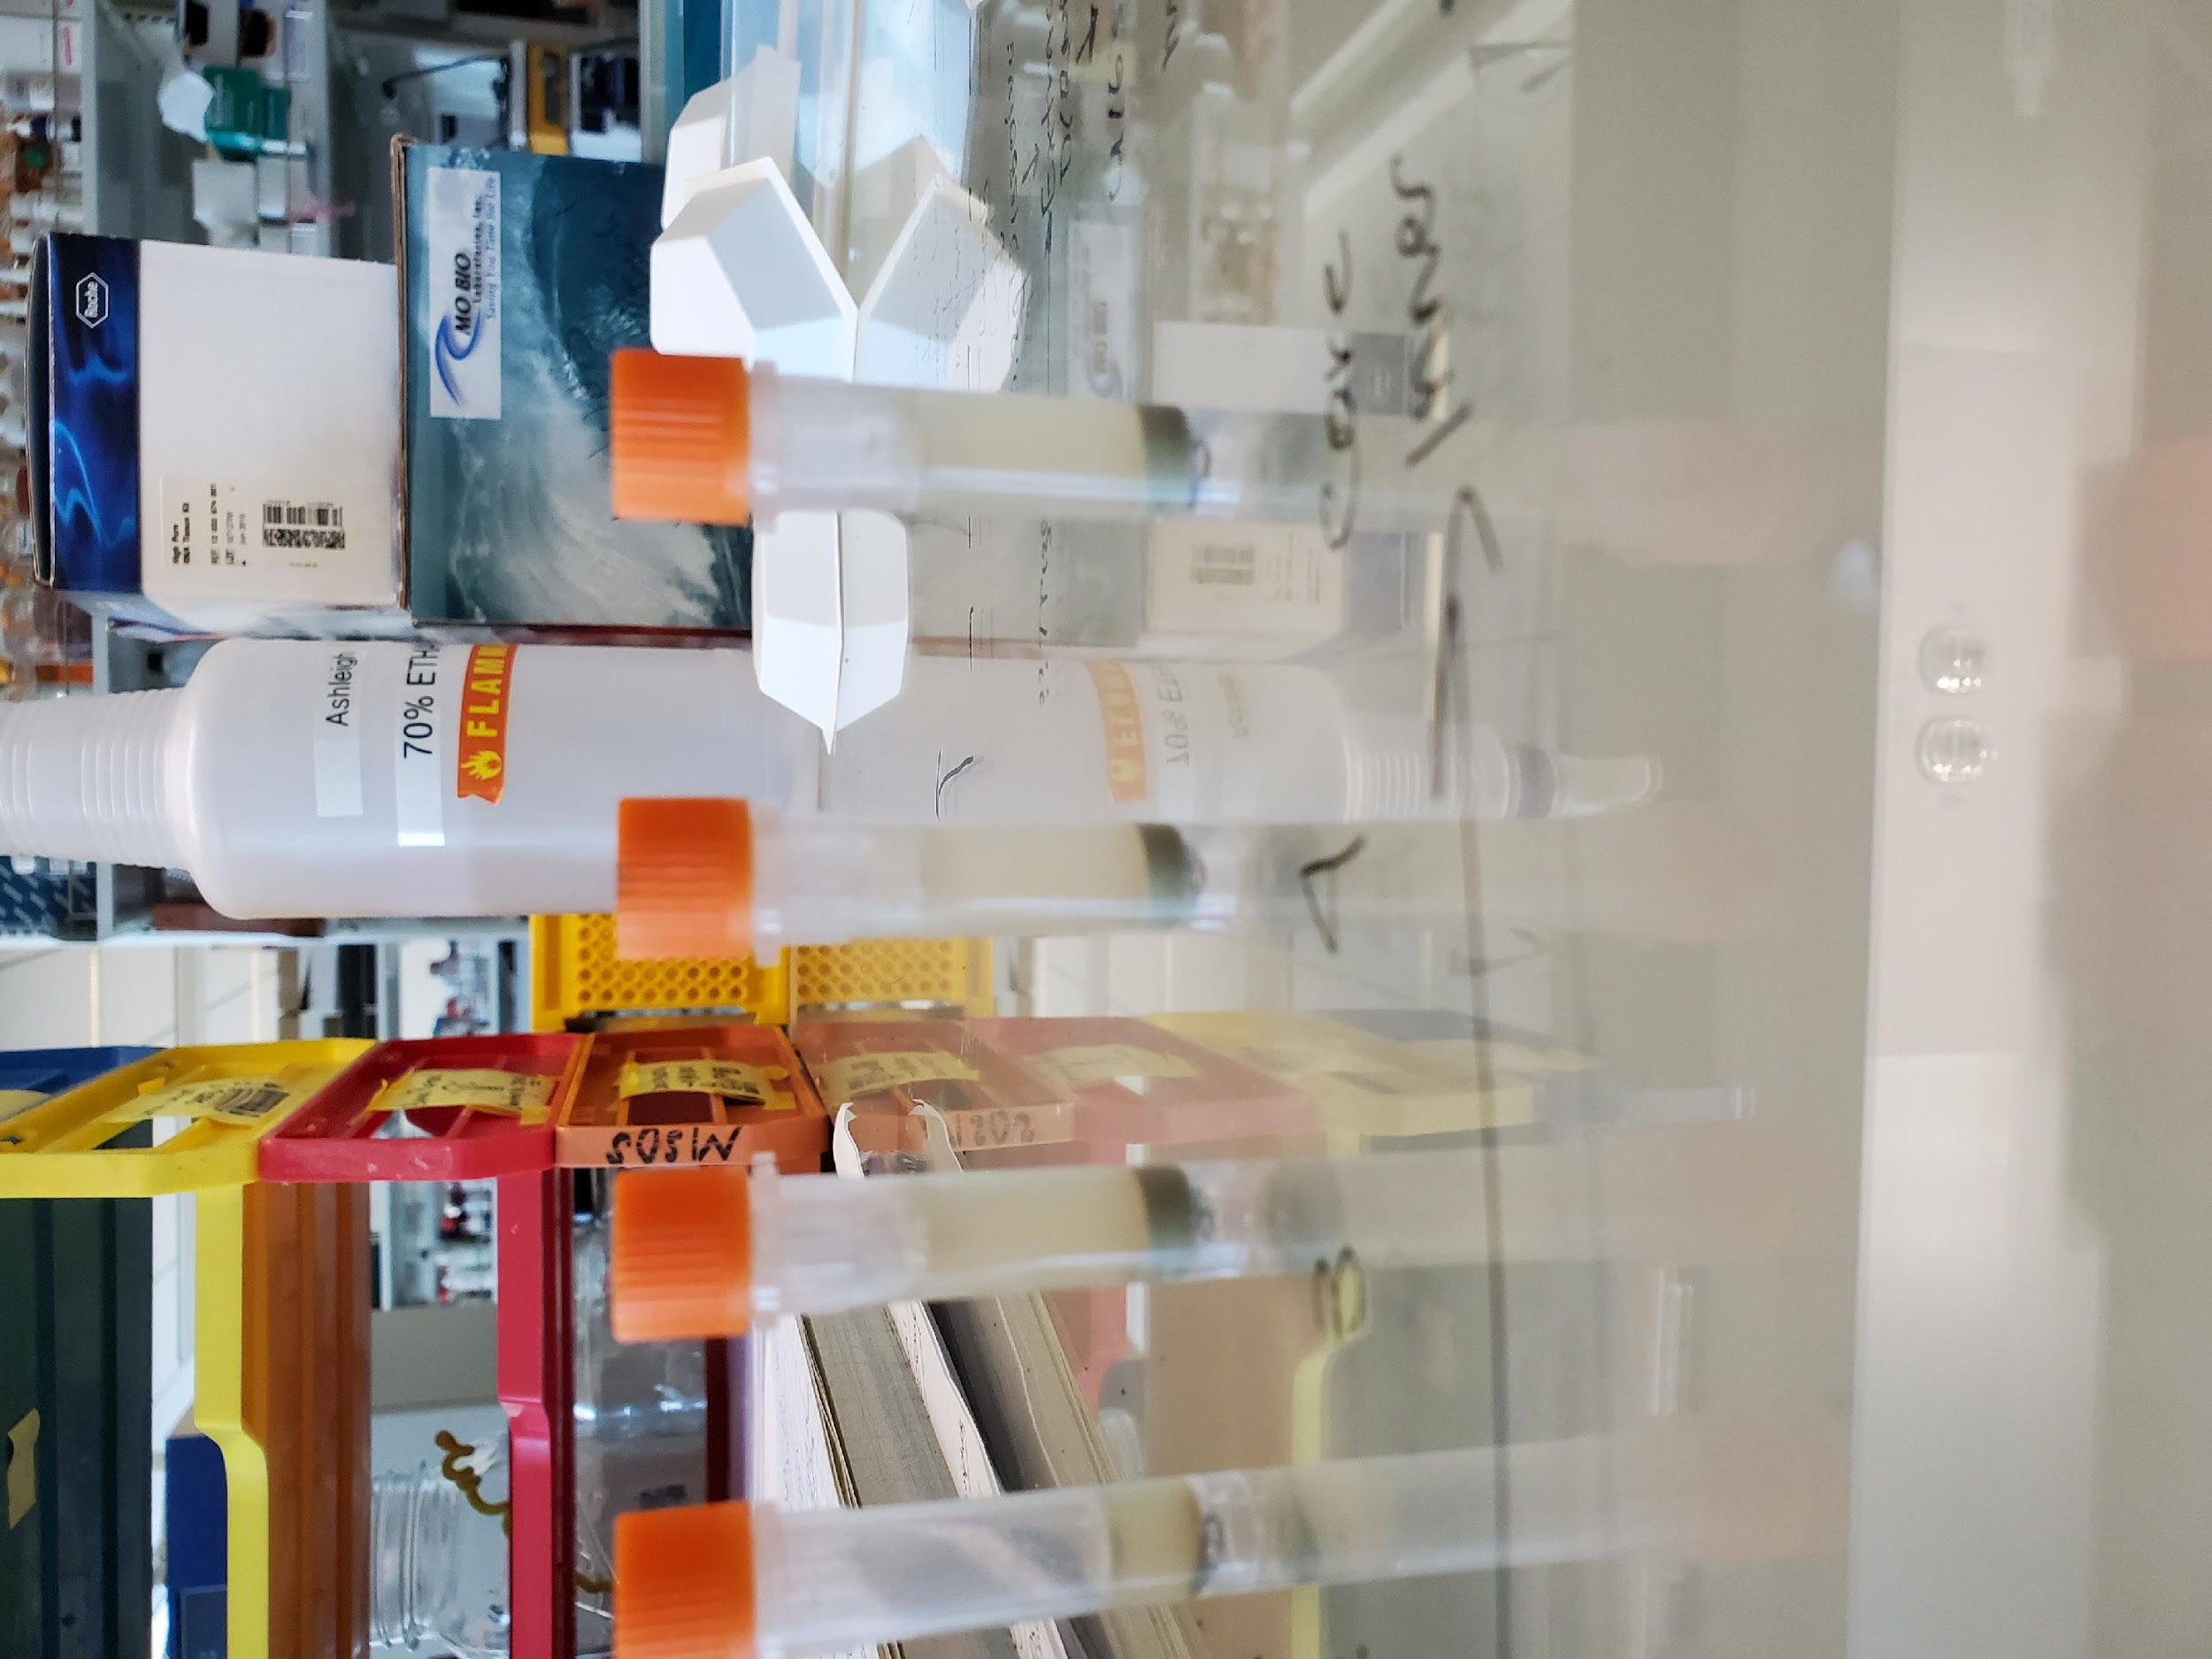
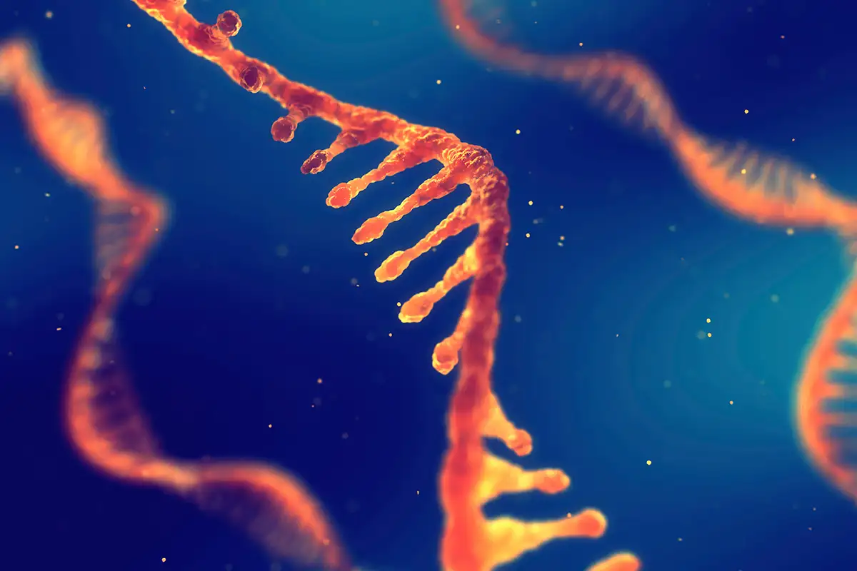

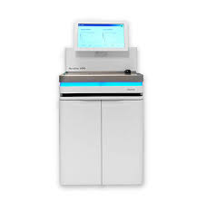
Materials and Methods
1. Enterolith Separation
2. Dissolve in Buffer
3. RNA Isolation
4. Quality Control
5. Metagenome Sequencing

Slide 15
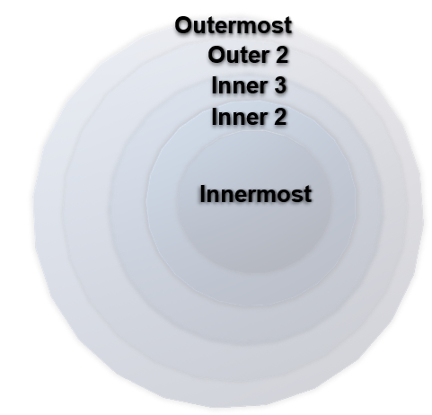
*Additional samples for analysis are in process

Slide 16
Canine and Feline Urolith Pilot Study
In collaboration with:
Jodi Westropp, PhD, DVM, DACVIM and
Sina Marsillo, PhD, DACVIM (SAIM),
DECVIM-CA

Slide 17
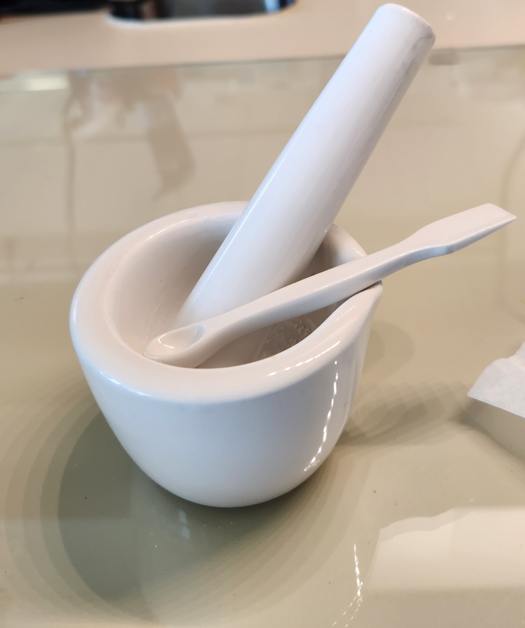
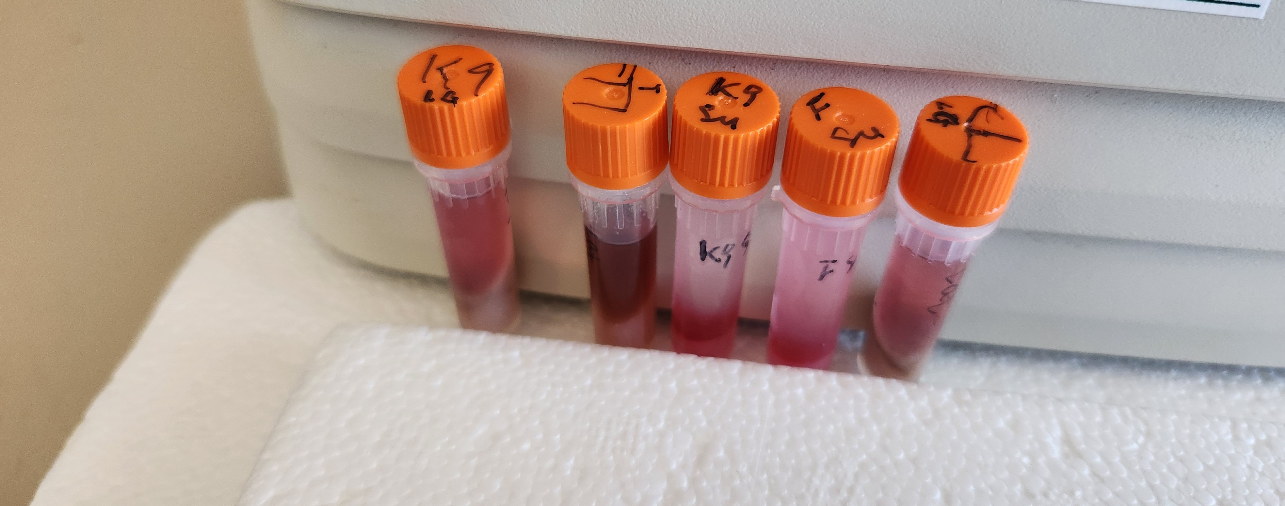
Materials and Methods
Optimization of RNA extraction and processing was successful
1.
Urolith Separation
2. RNA Isolation
3. Quality Control
4. Metagenome Sequencing

Slide 18
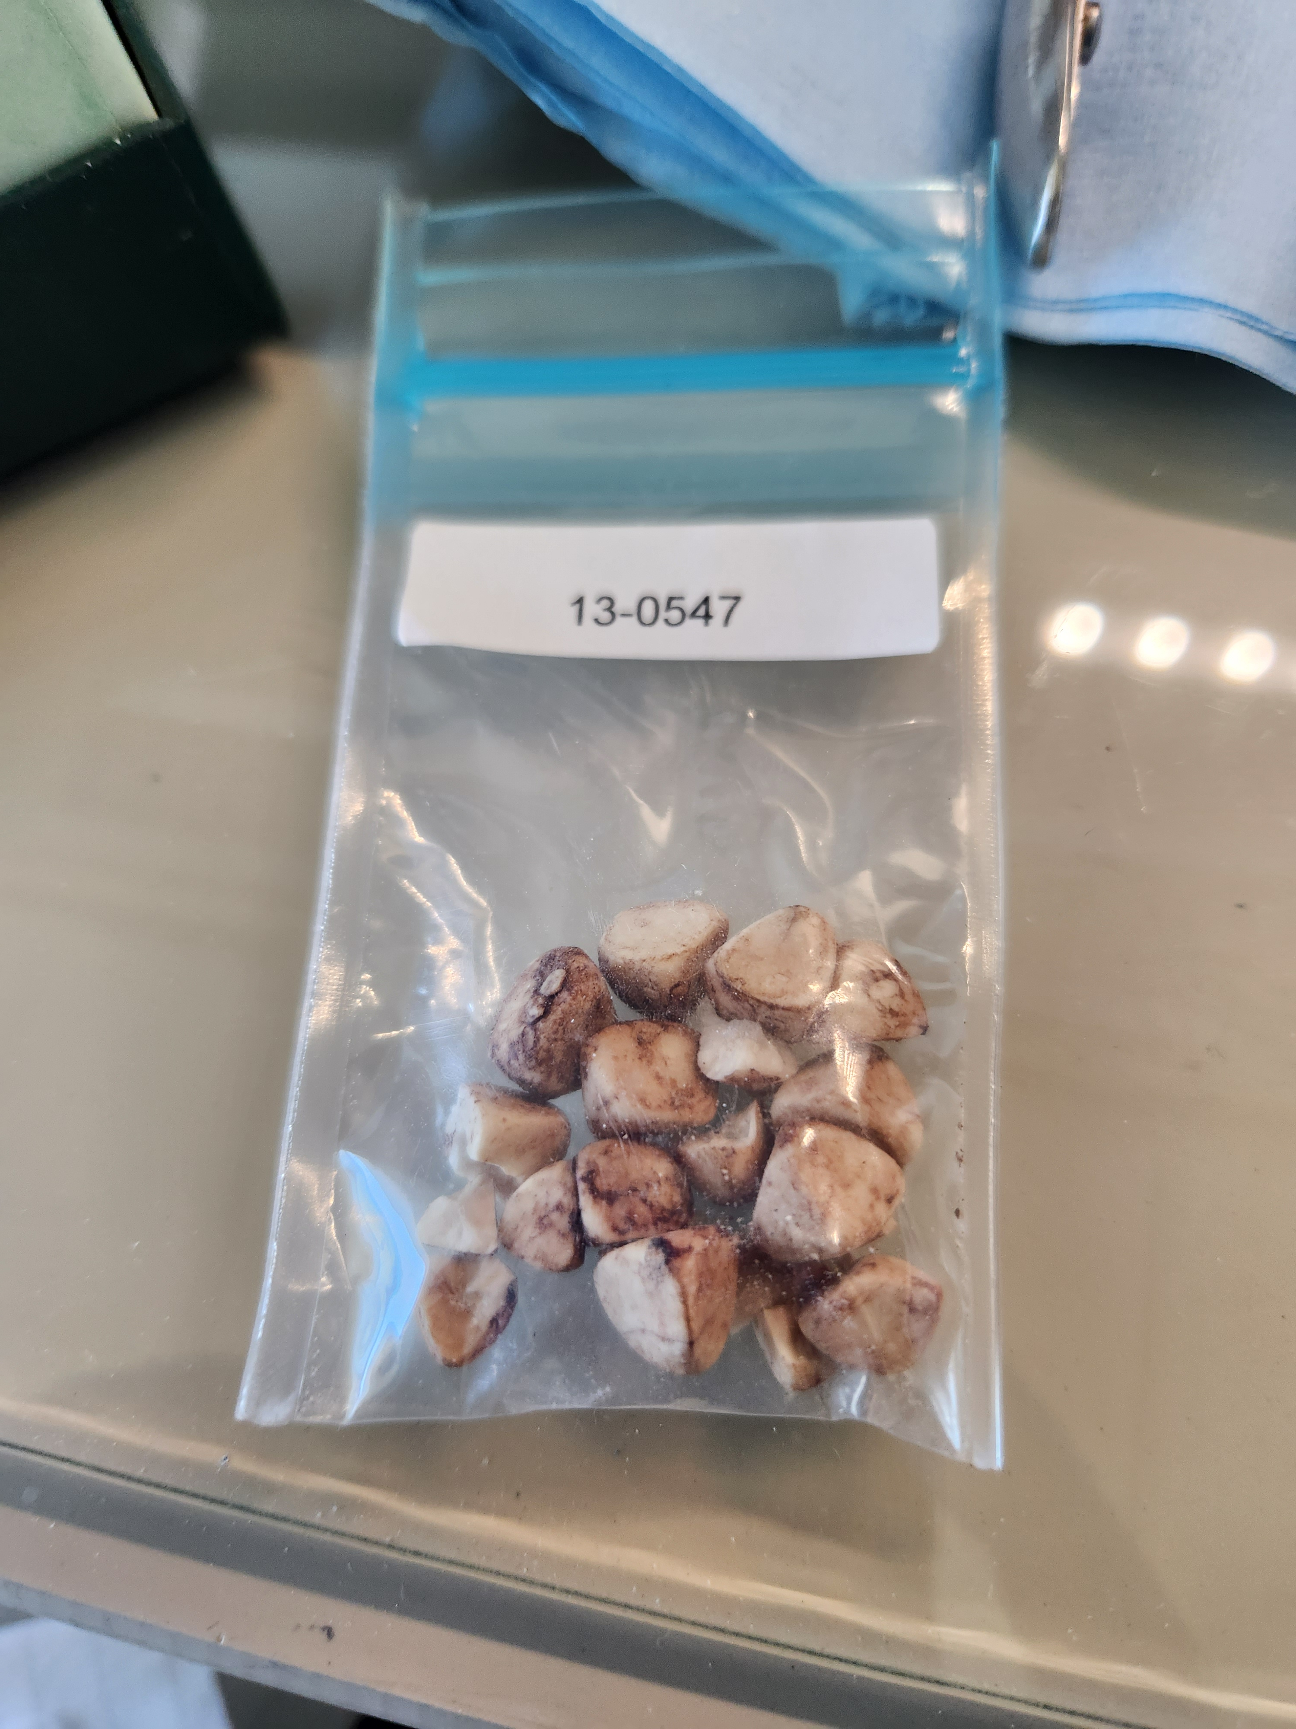
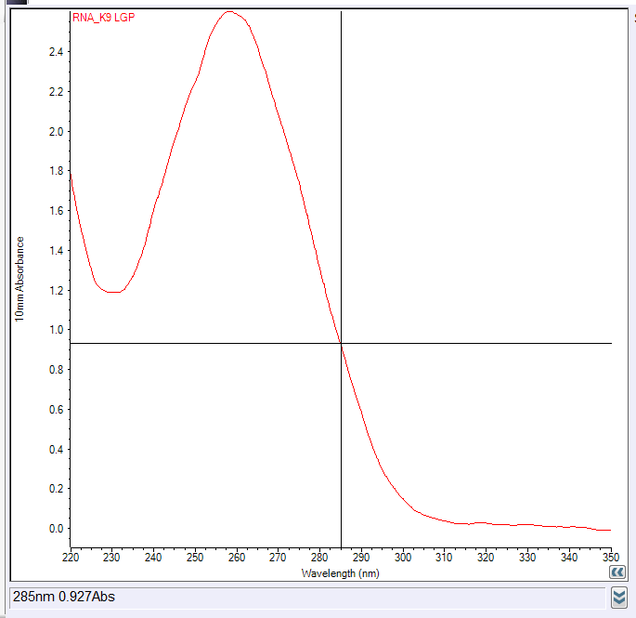
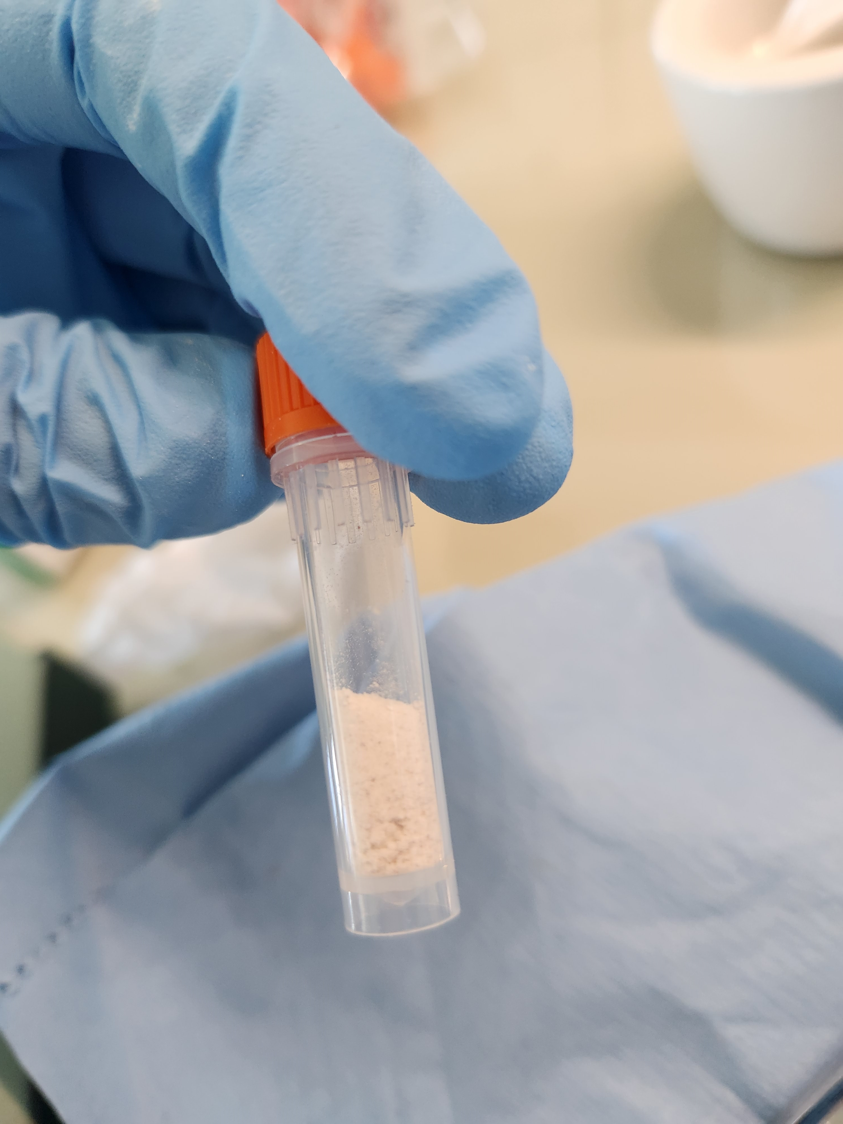
Results-Canine Struvite Urolith Contain Microbial RNA
Using Nanodrop
Conc.= 103.5 ng/μl
260/280= 1.98
260/230= 2.19

Slide 19
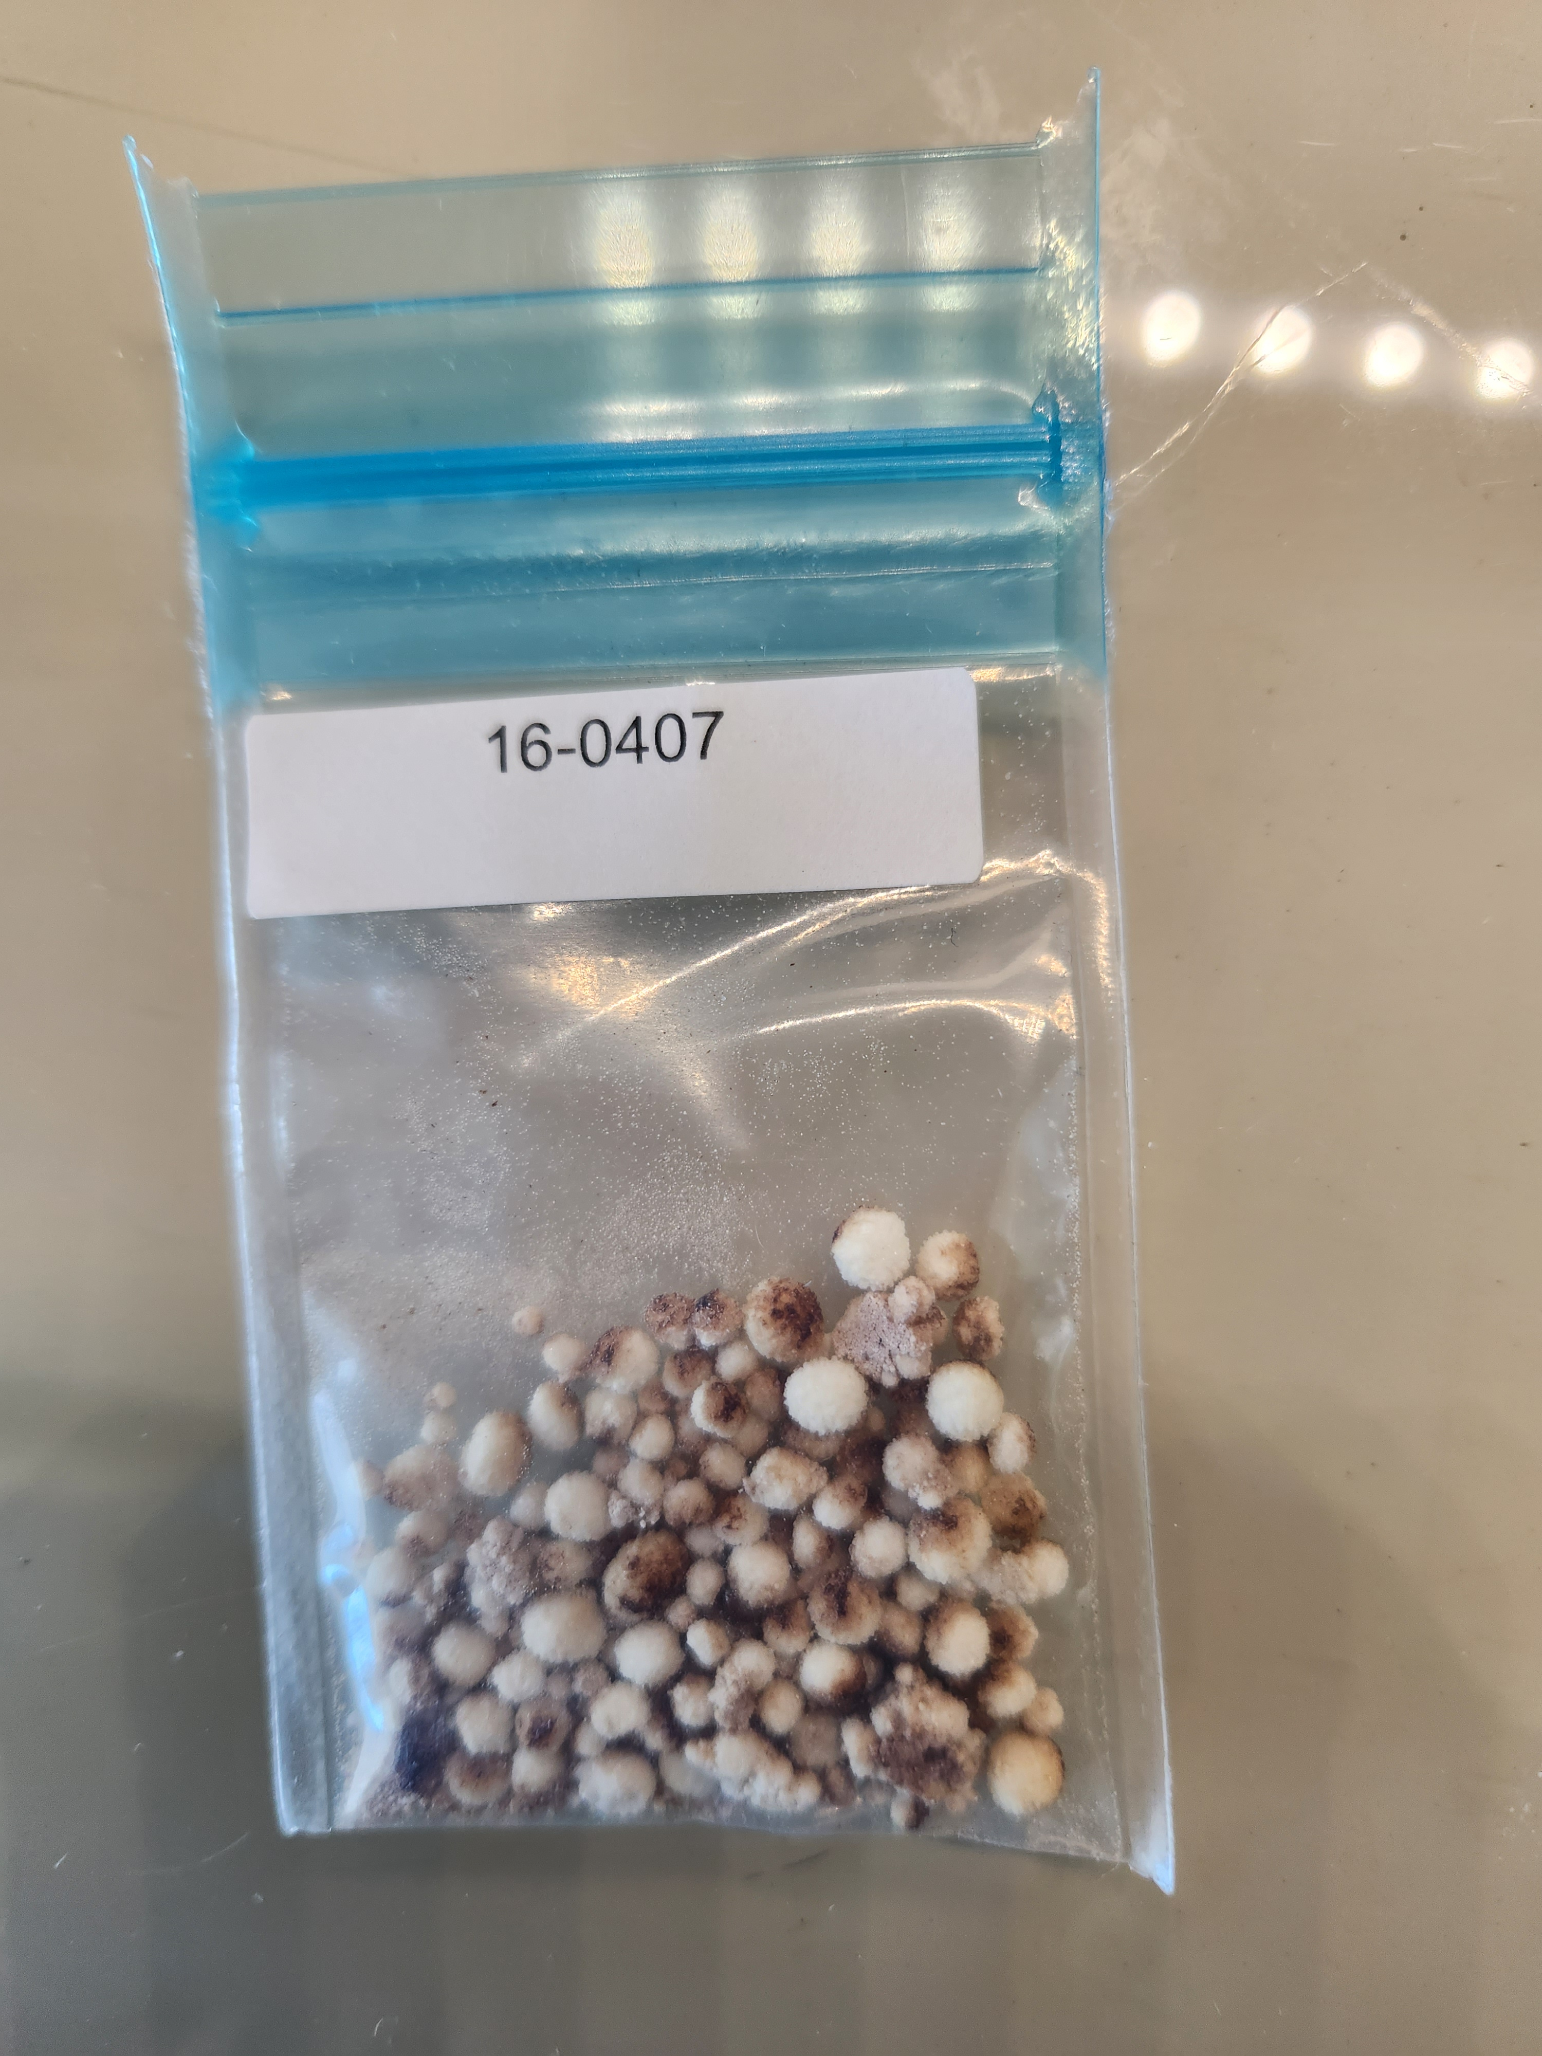
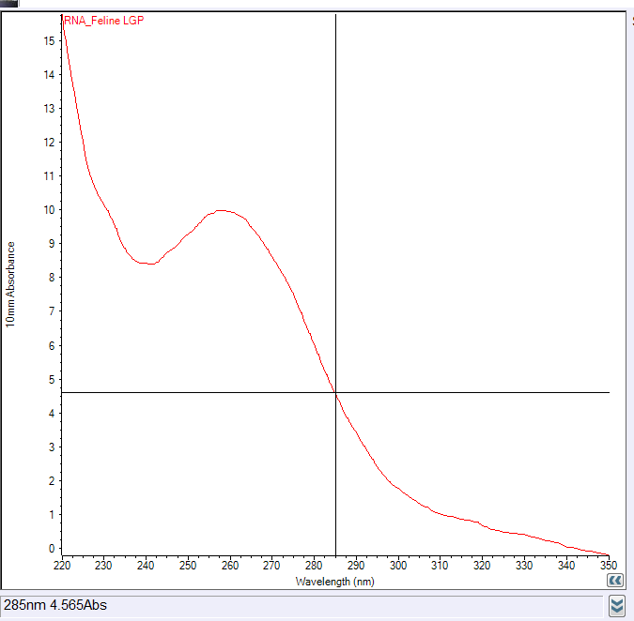
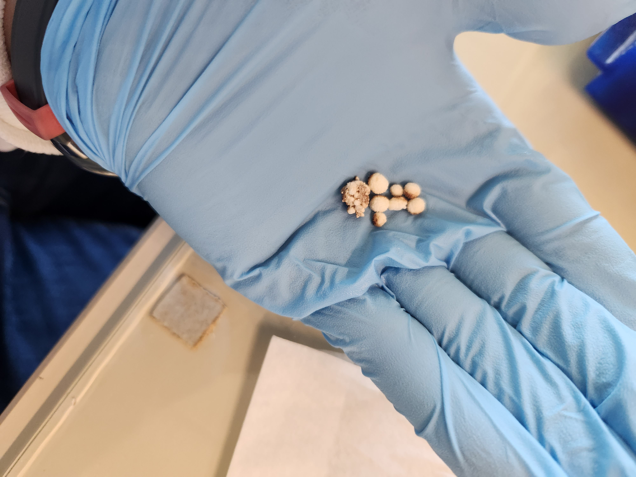
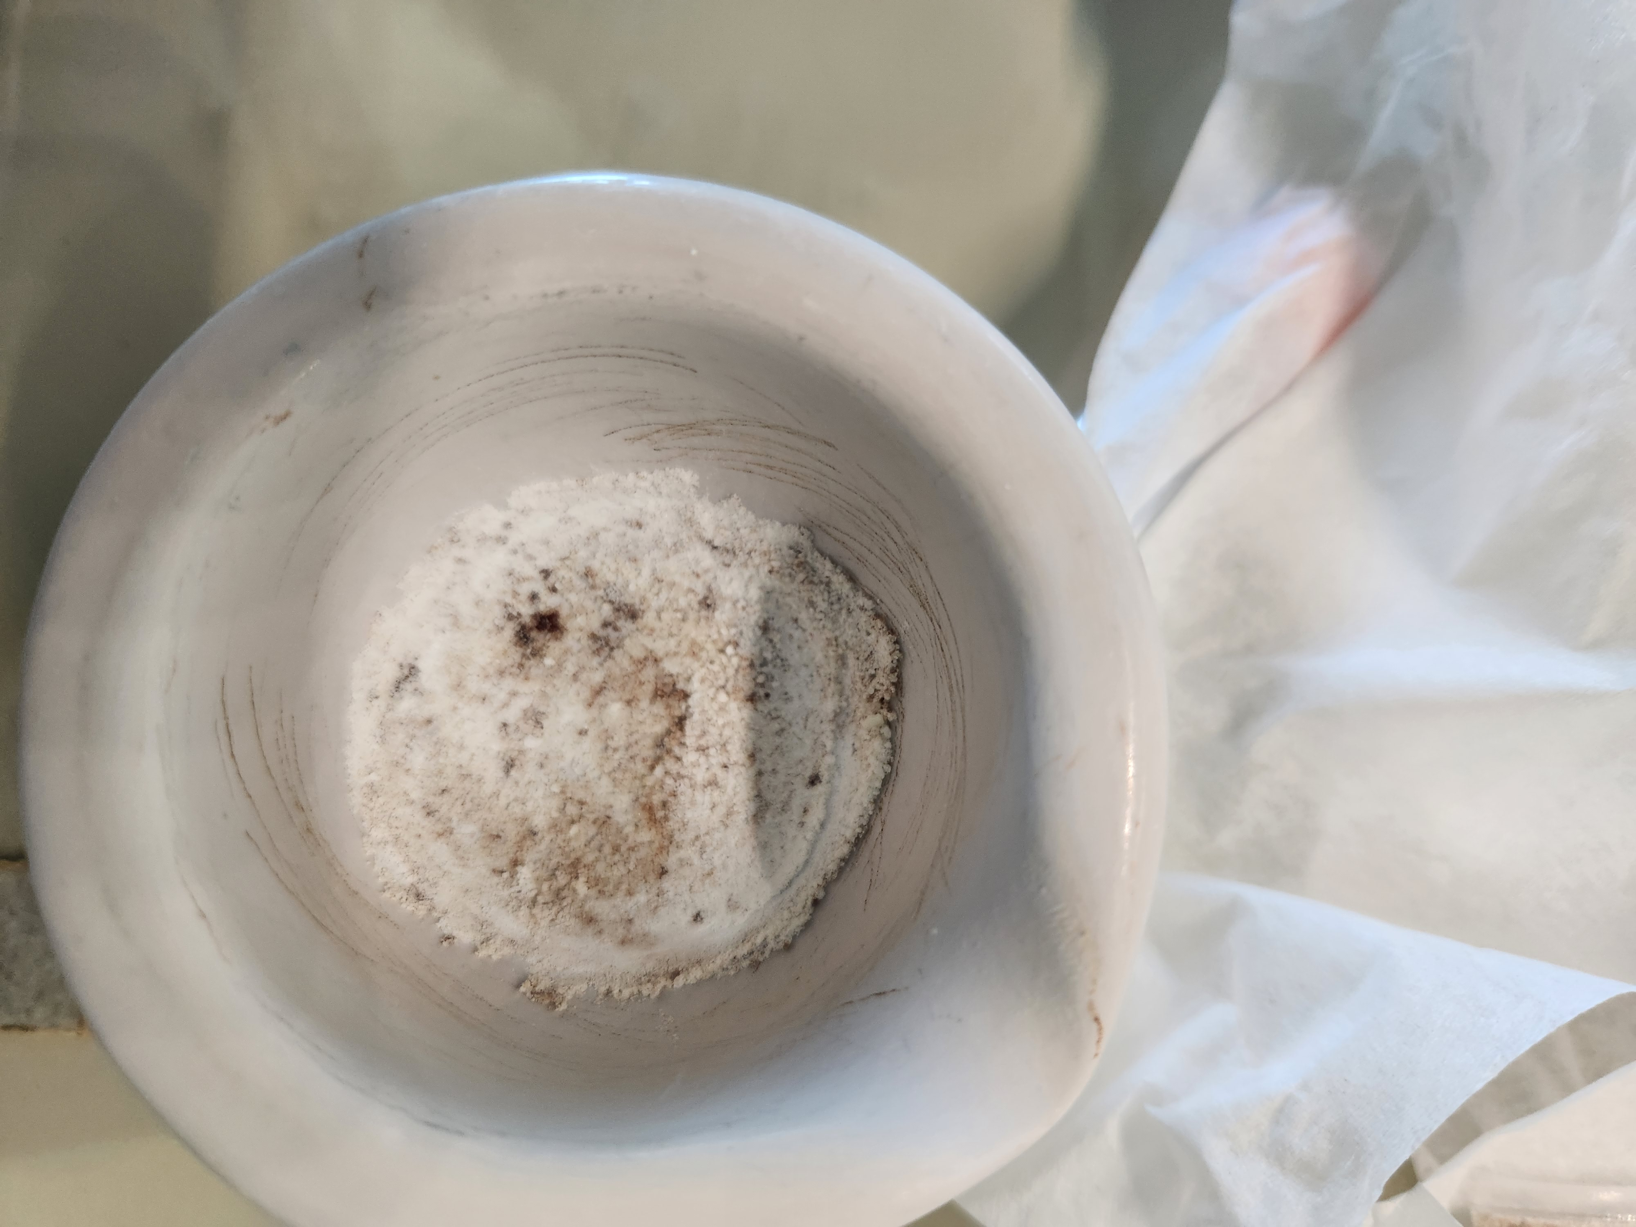
Results-Feline Struvite Urolith Contain Microbial RNA
Using Nanodrop
Conc.= 397.0 ng/μl
260/280= 1.65
260/230= 0.98

Slide 20
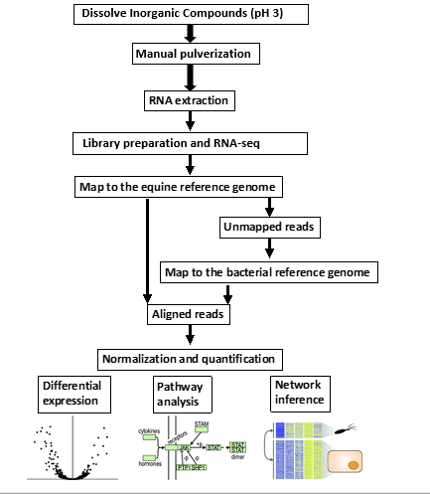
Optimized Processing for Microbiome Analysis
Sequence the urolith samples using deep RNA metagenomic sequencing along with more enterolith samples.
Future Aim: Determine whether struvite production is a result of a microbial catabolism of CH₄N₂O (urea) that ultimately results in excess NH₃ within the colonic environment.
We will work to determine function using transcripts from the metagenome
The transcripts allow identification of genes associated urease, but also broader NH₃ and CO₂ metabolism associated with struvite formation.
We plan to investigate CaOx urinary stones after working with struvite stones

Slide 21

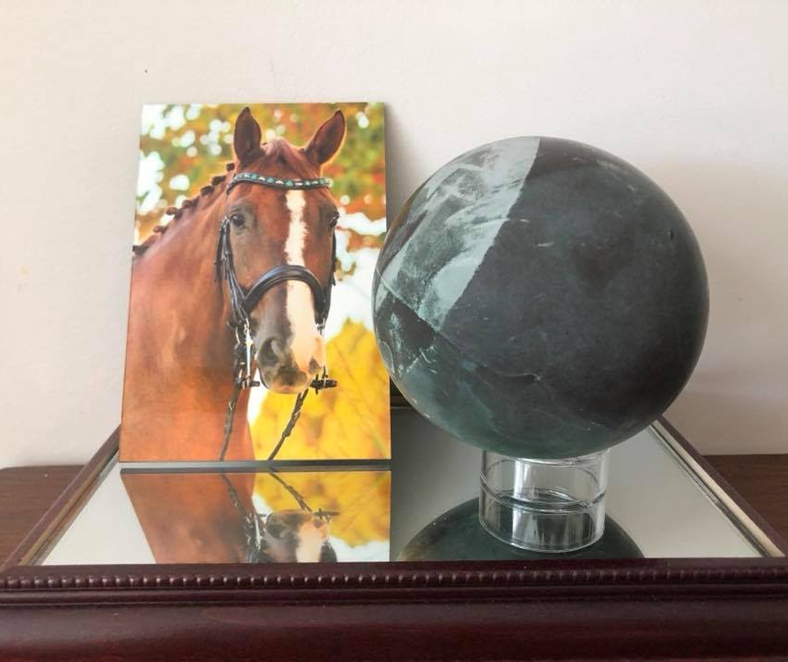
Acknowledgements
Special thanks to:
Bart Weimer, PhD
Jodi Westropp, DVM, PhD, DACVIM
Sina Marsillo, PhD, DACVIM (SAIM), DECVIM-CA
Members of the Weimer MicroLab
  Carol Huang
Financial support was provided by:
SVM Endowment Funds through the Students Training in Advanced Research (STAR) Program

Slide 22
References
Hassel DM, Spier SJ, Aldridge BM, Watnick M, Argenzio RA, Snyder JR. Influence of diet and water supply on mineral content and pH within the large intestine of horses with enterolithiasis. Vet J. 2009;182(1):44-49. doi:10.1016/j.tvjl.2008.05.016
Hassel, D. M., Schiffman, P. S., & Snyder, J. R. (2001). Petrographic and geochemic evaluation of equine enteroliths, American Journal of Veterinary Research, 62(3), 350-358. Retrieved Jul 27, 2022, from https://avmajournals.avma.org/view/journals/ajvr/62/3/ajvr.2001.62.350.xml
Nakamae Y, Ishihara A, Itoh M, Yanagawa M, Sasaki N, Yamada K. Displacement of the large colon in a horse with enterolithiasis due to changed positions observed by computed tomography. J Equine Sci. 2018;29(1):9-13. doi:10.1294/jes.29.9
Dear, J.D., Larsen, J.A., Bannasch, M. et al. Evaluation of a dry therapeutic urinary diet and concurrent administration of antimicrobials for struvite cystolith dissolution in dogs. BMC Vet Res 15, 273 (2019). https://doi.org/10.1186/s12917-019-1992-8
Burton EN, Cohn LA, Reinero CN, Rindt H, Moore SG, Ericsson AC. Characterization of the urinary microbiome in healthy dogs. PLoS One. 2017;12(5):e0177783. Published 2017 May 17. doi:10.1371/journal.pone.0177783
Kim, Y., Xu, W., Barrs, V. et al. In-depth characterisation of the urine metabolome in cats with and without urinary tract diseases. Metabolomics 18, 19 (2022). https://doi.org/10.1007/s11306-022-01877-9
Kopecny L, Palm CA, Segev G, Larsen JA, Westropp JL. Urolithiasis in cats: Evaluation of trends in urolith composition and risk factors (2005-2018). J Vet Intern Med. 2021;35(3):1397-1405. doi:10.1111/jvim.16121
Kopecny, L, Palm, CA, Segev, G, Westropp, JL. Urolithiasis in dogs: Evaluation of trends in urolith composition and risk factors (2006-2018). J Vet Intern Med. 2021; 35: 1406– 1415. https://doi.org/10.1111/jvim.16114
Prywer, Jolanta, Ewa Mielniczek-Brzóska, Marcin Olszynski. Struvite crystal growth inhibition by trisodium citrate and the formation of chemical complexes in growth solution. Journal of Crystal Growth. 2015;418:92-101. doi:10.1016/j.jcrysgro.2015.02.027.
Schwaderer AL, Wolfe AJ. The association between bacteria and urinary stones. Ann Transl Med. 2017;5(2):32. doi:10.21037/atm.2016.11.73
Flannigan RK, Battison A, De S, et al. Evaluating factors that dictate struvite stone composition: A multi-institutional clinical experience from the EDGE Research Consortium. Can Urol Assoc J. 2018;12(4):131-136. doi:10.5489/cuaj.4804
Flores-Mireles AL, Walker JN, Caparon M, Hultgren SJ. Urinary tract infections: epidemiology, mechanisms of infection and treatment options. Nat Rev Microbiol. 2015;13(5):269-284. doi:10.1038/nrmicro3432
Rekha PD, Hameed A, Manzoor MAP, Suryavanshi MV, Ghate SD, Arun AB, Rao SS, Athmika, Bajire SK, Mujeeburahiman M, Young C-C. First Report of Pathogenic Bacterium Kalamiella piersonii Isolated from Urine of a Kidney Stone Patient: Draft Genome and Evidence for Role in Struvite Crystallization. Pathogens. 2020; 9(9):711. https://doi.org/10.3390/pathogens90907111
Parkhomenko E, De Fazio A, Tran T, Thai J, Blum K, Gupta M. A Multi-Institutional Study of Struvite Stones: Patterns of Infection and Colonization. J Endourol. 2017;31(5):533-537. doi:10.1089/end.2016.0885
Daudon M, Bouzidi H, Bazin D. Composition and morphology of phosphate stones and their relation with etiology. Urol Res. 2010 Dec;38(6):459-67. doi: 10.1007/s00240-010-0320-3. Epub 2010 Oct 22. PMID: 20967436.
Burdett LG, Osborne CA. Enterolith with a stingray spine nidus in an Atlantic bottlenose dolphin (Tursiops truncatus). J Wildl Dis. 2010 Jan;46(1):311-5. doi: 10.7589/0090-3558-46.1.311. PMID: 20090051.

Slide 23
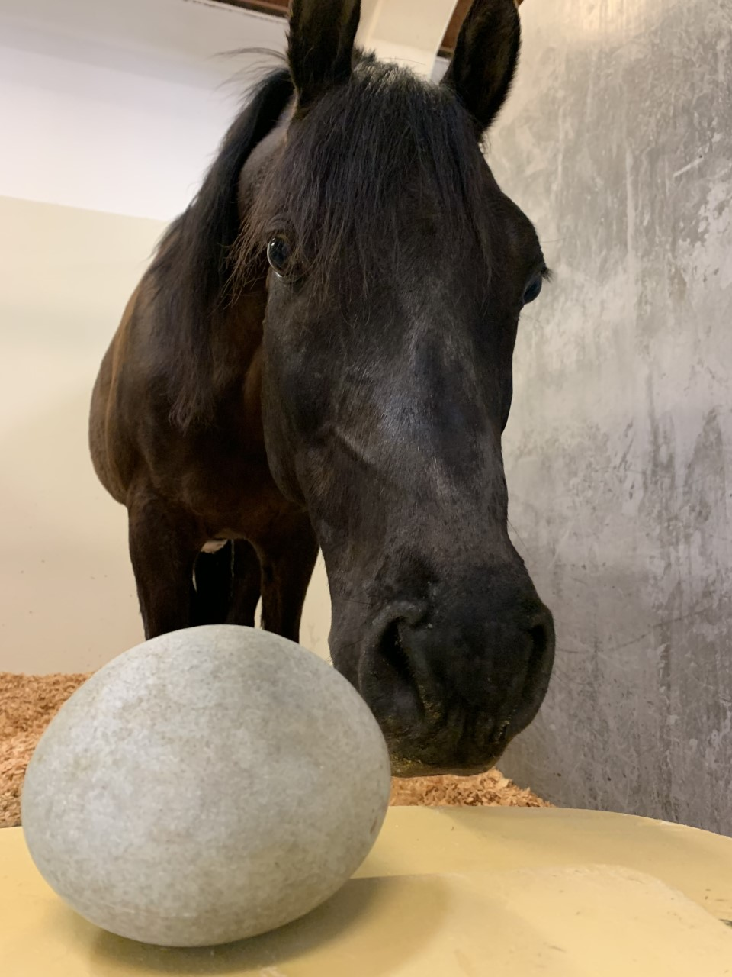

Thank you for your attention!
Any questions?
Photo credit: Julie Dechant, DVM, DACVECC, DACVS
Photo credit: Jodi Westropp, DVM, PhD, DACVIM

