Slide 1
Characterization of a Cardiac Phenotype in a Novel cAMP Reporter Mouse
Sarah Gill
STAR 2022
Ripplinger Lab
Notes:
Hello, my name is Sarah Gill, and I am here to present my STAR project: Characterization of a Cardiac Phenotype in a Novel cAMP Reporter Mouse

Slide 2
BACKGROUND INFORMATION

Slide 3
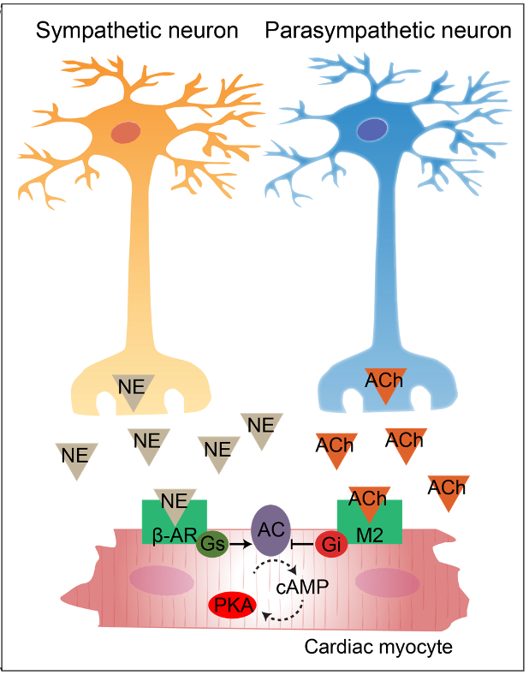
CYCLIC AMP
cAMP is an important 2nd messenger for intracellular signaling
In cardiac myocytes, cAMP is involved with both sympathetic and parasympathetic pathways, and is able to control heart rate and contraction of the heart.
Courtesy of Jessica Caldwell
Notes:
To start off with some background information, cAMP, or CAMP, is an important 2nd messenger for intracellular signaling. CAMP is involved with both sympathetic and parasympathetic pathways, and using these pathways in the cardiac myocyte, camp is able to control heart rate and contraction of the heart

Slide 4
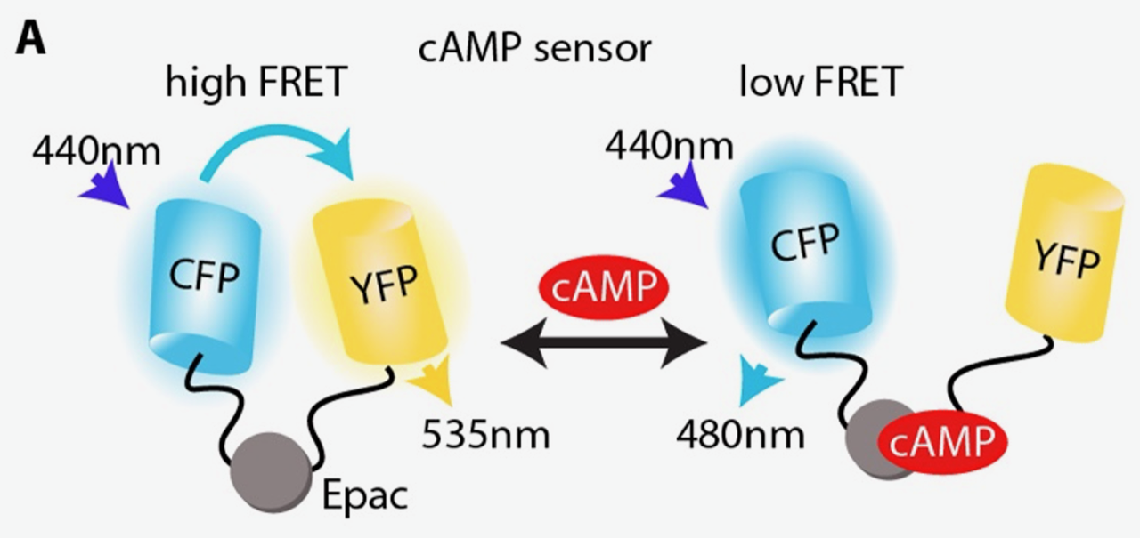
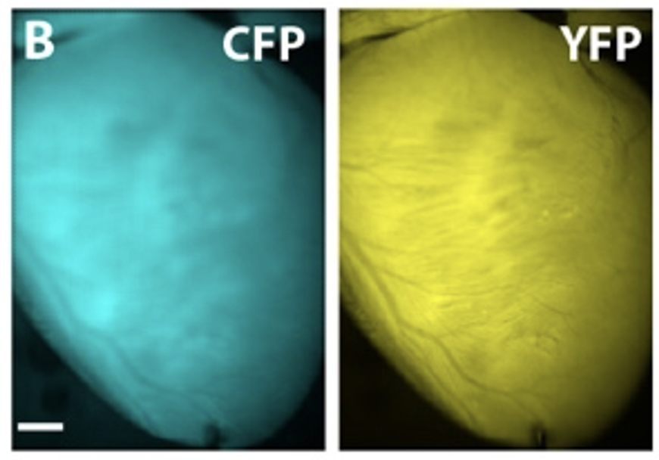
FRET SENSOR
cAMP sensor allows for detection of cAMP binding
CFP represents the donor and YFP represents the acceptor
Epac is the binding domain for cAMP
Courtesy of Jessica Caldwell
Notes:
In order to assess camp signaling in the heart, our lab uses a fluorescence resonance energy transfer or FRET sensor. This sensor contains an EPac protein, which serves as the camp-binding domain and is flanked by the CFP donor and YFP acceptor fluorophores and works on principles of fluorescence. When camp is unbound, CFP and YFP are close together, and light is emitted at a slightly longer wavelength. When camp is bound to the domain, the two fluorophores move apart, causing a change in fluorescence, which allows us to detect the camp activity. Here is an example of this fluorescence seen in the mouse heart.

Slide 5
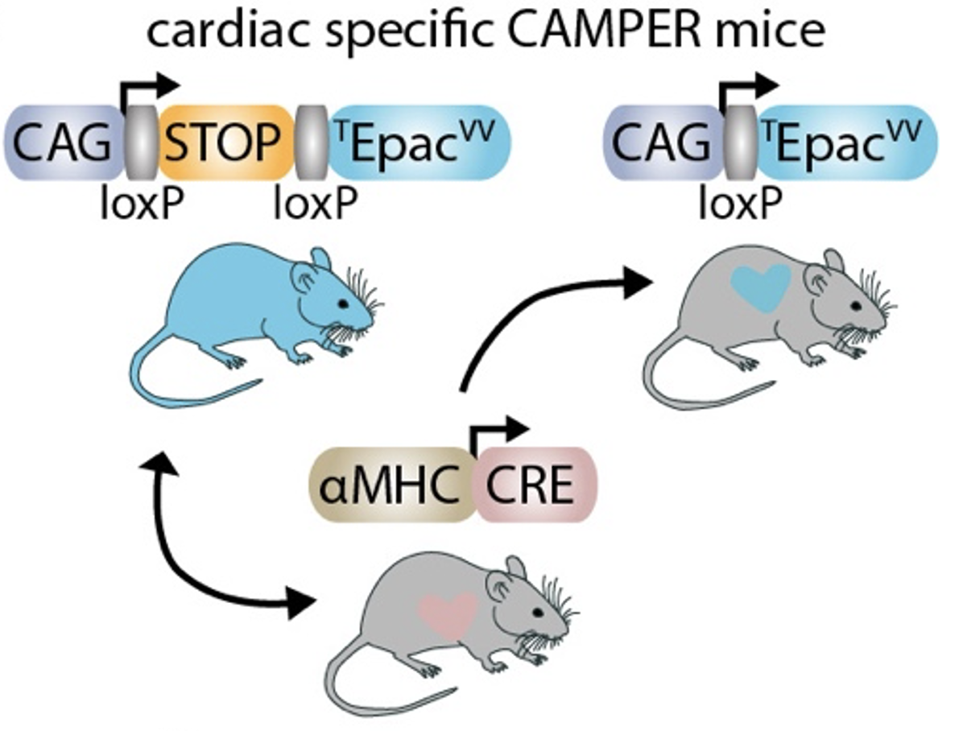
CAMPER MOUSE
Previous mouse line made with genetically encoded TEpacVV gene (CAMPER sensor), preceded by a loxp-Stop-loxp cassette
In order to express the sensor, the CAMPER mouse is crossed with an ɑMHC CRE mouse
A cardiac-specific CAMPER mouse is CRE (+), allowing the expression of the sensor
Courtesy of Jessica Caldwell
Notes:
This now brings us to the CAMPER mouse itself. Previously a mouse line was created with this CAMP sensor, but it is preceded by a stop cassette. In order to express the sensor, the CAMPER mouse needs to be crossed with a Cre mouse, which takes out the stop cassette and allows expression. In our case, since we are using a cardiac-specific CAMPER mouse, we crossed with an alpha myosin heavy chain cre mouse in order to express the sensor in the heart.
Furthermore, because this sensor is able to bind camp, we wanted to know if buffering could occur…

Slide 6
HYPOTHESIS
The buffering of cytosolic cAMP may cause a baseline cardiac phenotype within the CAMPER mouse line.
Notes:
Therefore, our hypothesis is that the buffering of this important 2nd messenger may result in a baseline cardiac phenotype within the Camper mouse

Slide 7
METHODS

Slide 8
Study Design
4 Treatment groups established:
Wild-Type
Cre (-)
Heterozygous CAMPER^{(+/-)} Cre (+)
Homozygous CAMPER^{(+/+)} Cre (+)
1 Echo and 1 ECG+Stress Test for each mouse
Echo ~15 min each
ECG ~30 min each
Notes:
So, to test our hypothesis, we created the following study design. We established 4 treatment groups, which were: wild-type, cre (-), heterozygous camper, and homozygous camper. Then for every mouse, I performed one echo and one ecg, which also included a stress test.

Slide 9
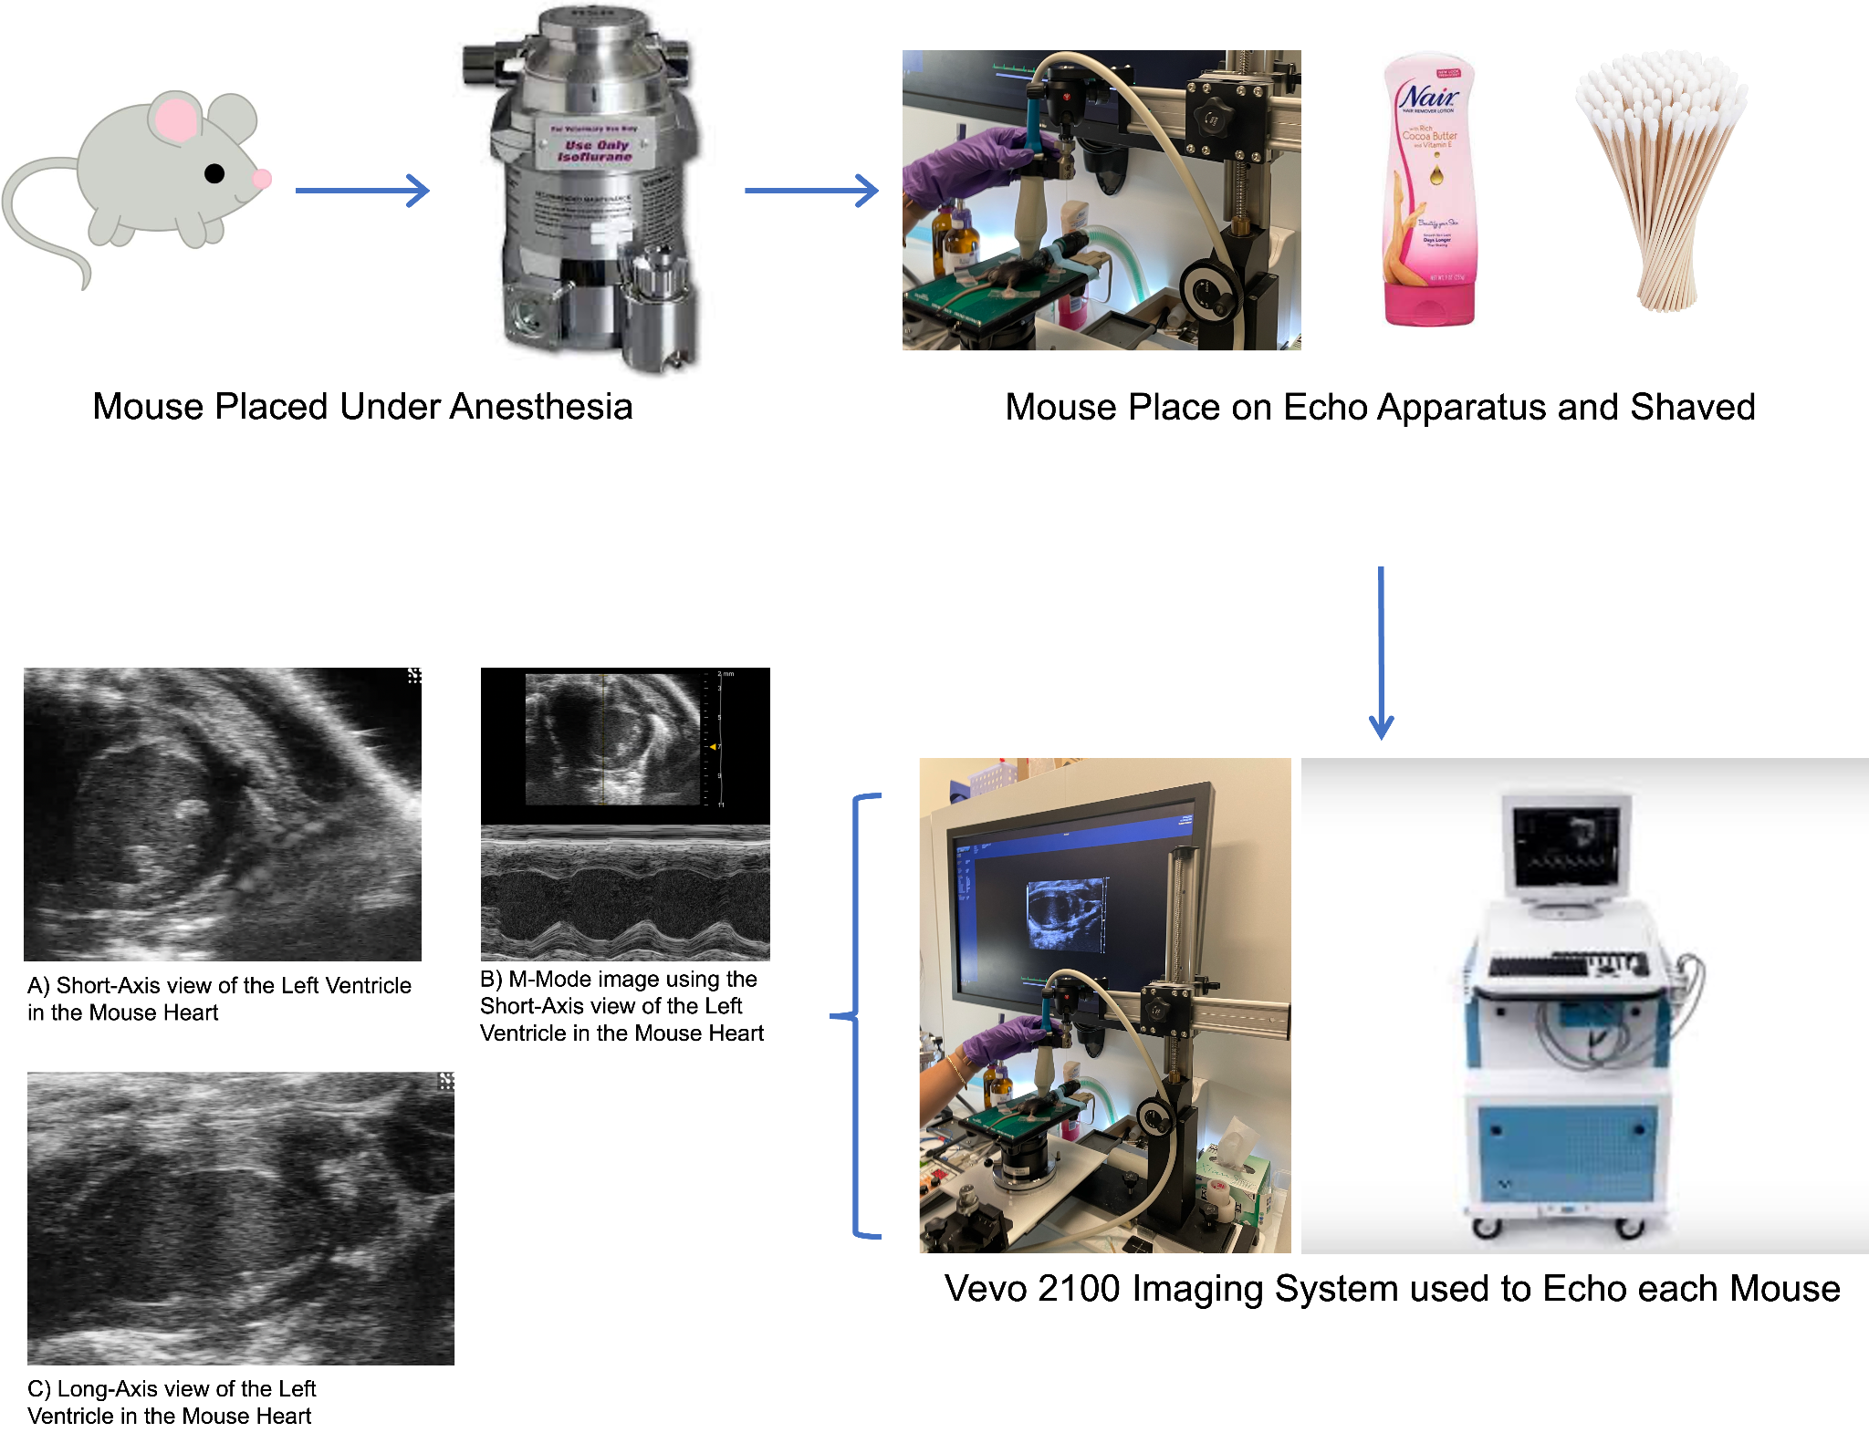
ECHO
Notes:
Starting with echo, each mouse was placed under anesthesia using isoflurane for 5 minutes prior to the start of the procedure. Then each mouse was attached to our echo apparatus which allowed me to monitor their heart rate and keep them under anesthesia while echoing. Additionally, I used nair to remove their chest hair for better contact imaging with the transducer. Then using an imaging machine, I took views of the left ventricle in short axis with MMode and long axis. Each procedure took approximately 15 minutes.

Slide 10
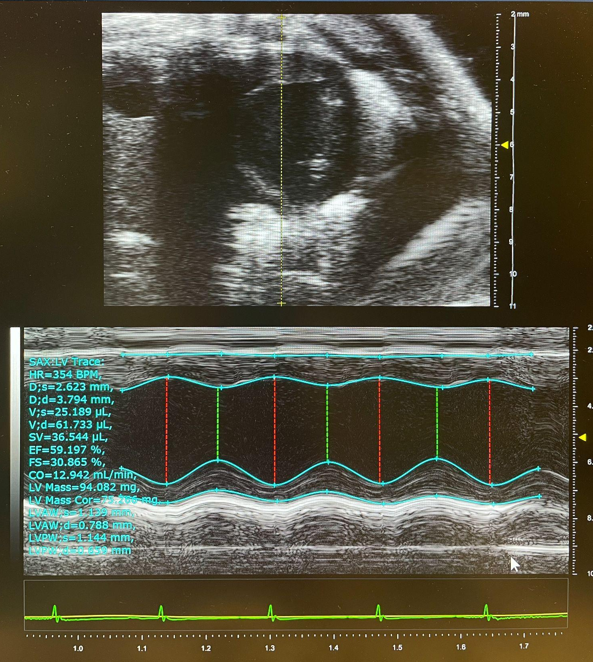
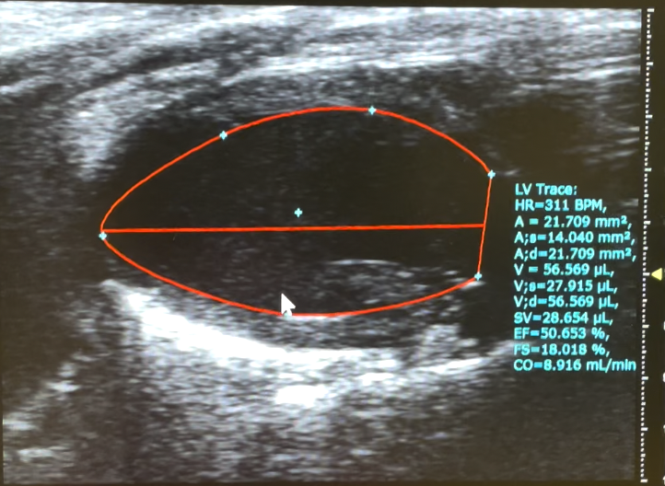
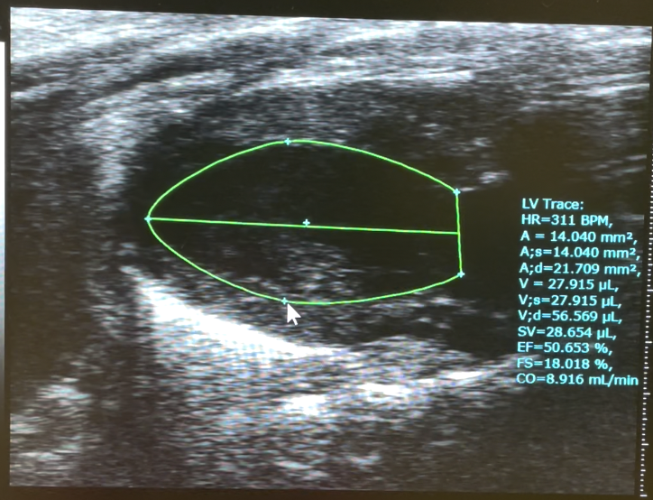
Notes:
Following the echoes, I also performed measurements for data analysis, and here are examples of what that looked like for MMode and Long axis diastole and systole.

Slide 11
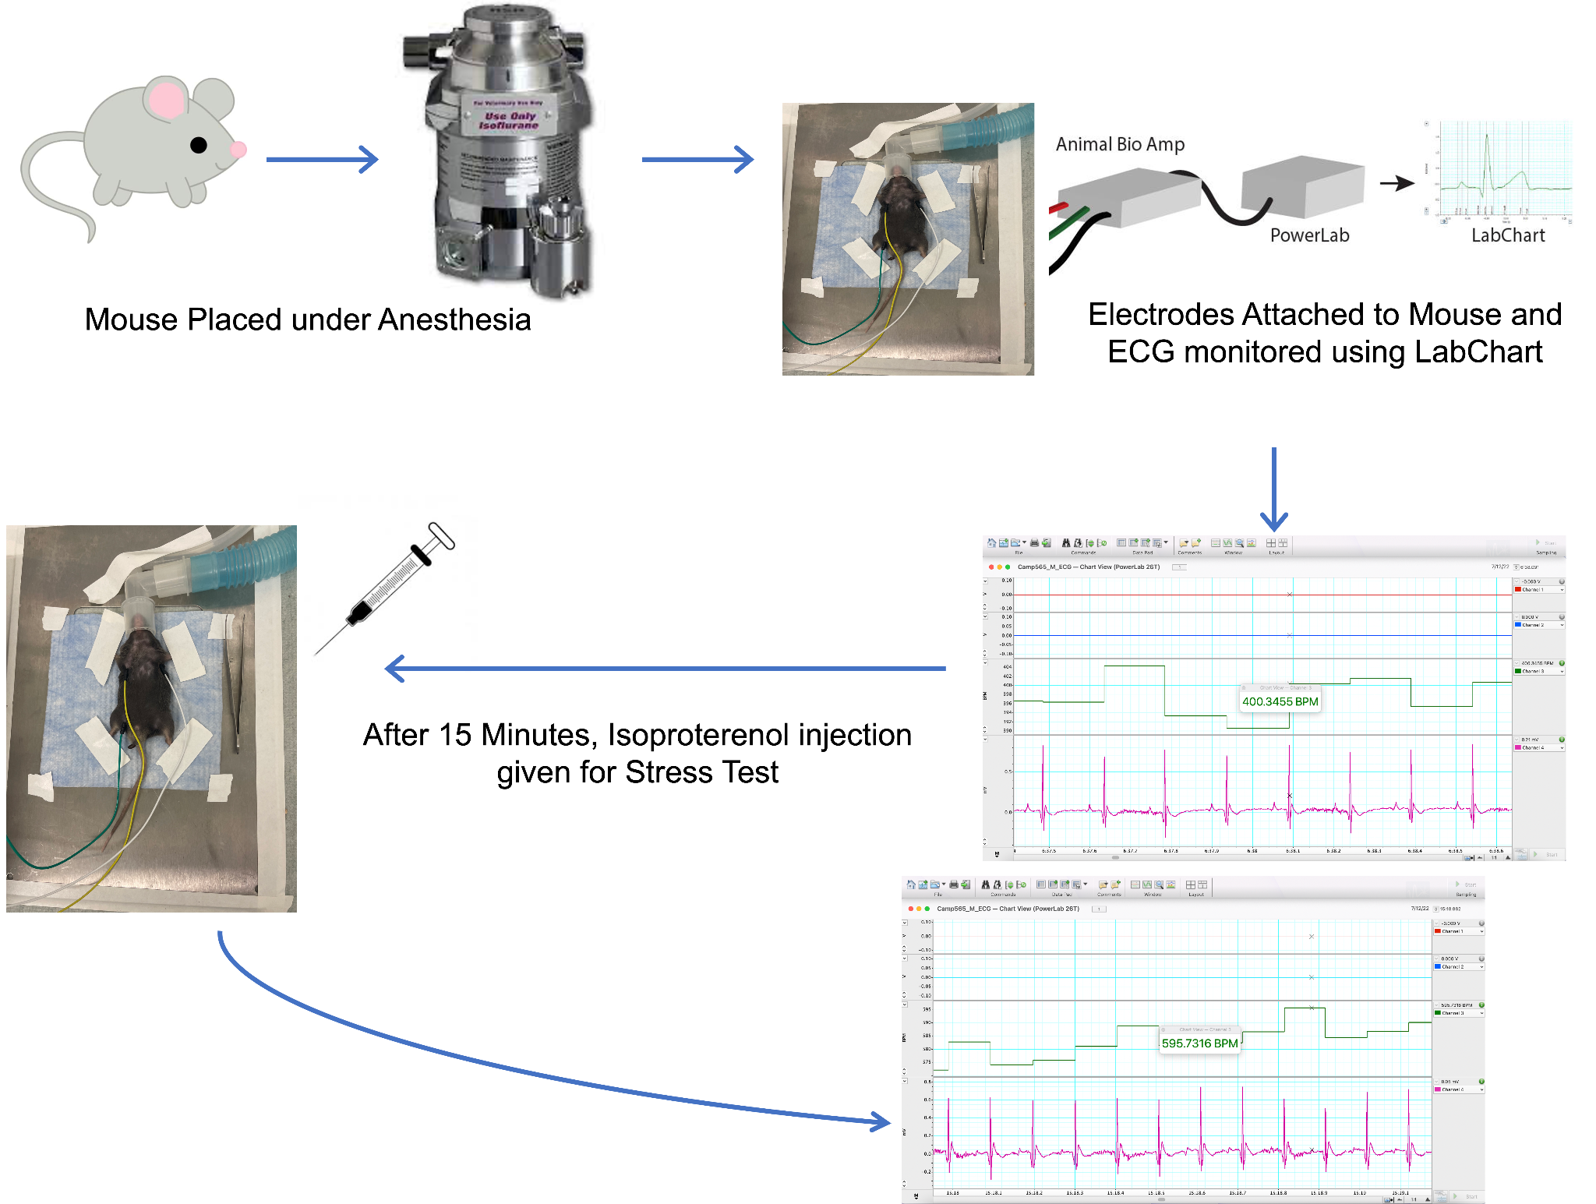
ECG
Notes:
Now for the ECG, again mice were placed under anesthesia, then subsequently attached to electrodes, which ran through a powerlab device and produced an ECG output through a program called Labchart. These procedures took approximately 30 minutes, with the first 15 used as a baseline. After 15 minutes, a dose of isoproterenol was given to each mouse to act as a pharmacological stress test, but also to activate camp within the body.

Slide 12
Statistics
Used Prism GraphPad software to run the statistical analysis and compare treatment groups
Ran One-way ANOVAs for each variable to compare the 4 original treatment groups
Ran unpaired T-test as well as to compare 2 bigger treatment groups
Wild-Type & Cre- (Control)
Heterozygous & Homozygous (CAMPER)
Notes:
Once all the data was collected from these procedures, Prism was used to conduct the statistical analysis. I ran one-way ANOVAs to compare the different variables across treatment groups, and additionally ran unpaired T-test to compare two larger groups as well. I grouped WT with Cre- since the Cre- negative, while having the sensor, are unable to express it and therefore should be similar to the WT, and then I groups HET with HO as these are both Cre+ CAMPER mice.

Slide 13
RESULTS
Notes:
The following are my results.

Slide 14
Assessed 18 different parameters relating to the short axis and long axis views in echo
Assessed 7 different parameters relating to the ECG both before and after the isoproterenol injection
Notes:
I assessed 18 different echo parameters through the different view I obtained, and 7 different parameters relating to the ECG both before and after the isoproterenol injection. Overall, there were few significant differences, so for the sake of time, I will share the more important parameters we looked at.

Slide 15
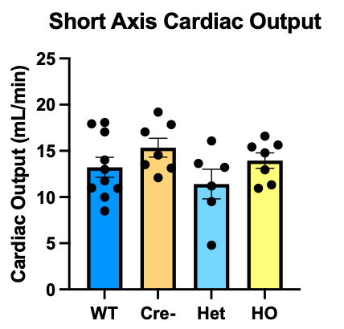
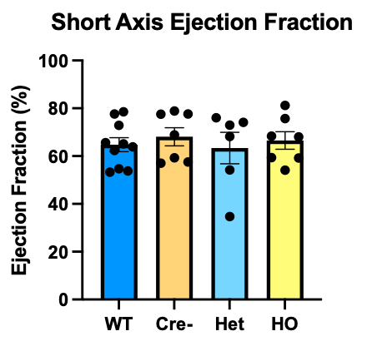
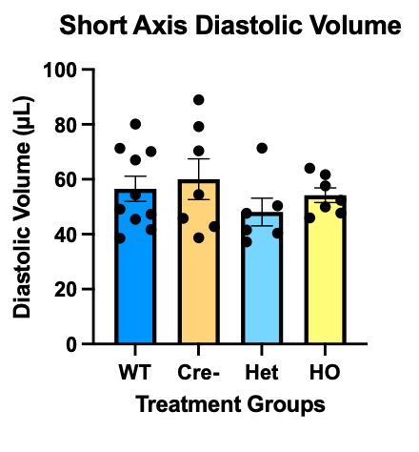
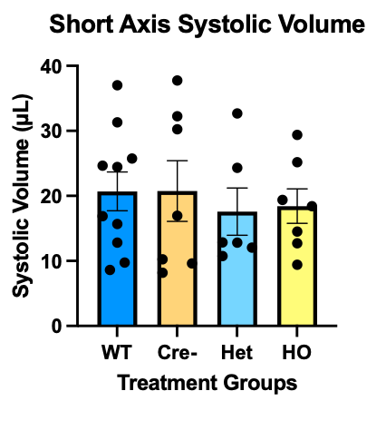
Short Axis Measurements
Notes:
Starting with the short axis measurements, we focused on cardiac output, ejection fraction, diastolic volume, and systolic volume. Each chart here shows the 4 different treatments groups, as well as their individual data points. For each of these variables, no statistical significance was found between the 4 treatment groups, and this was the same result when each variable was analyzed in the 2 larger treatment groups.

Slide 16
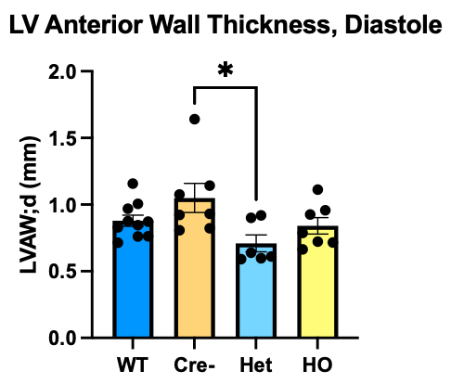
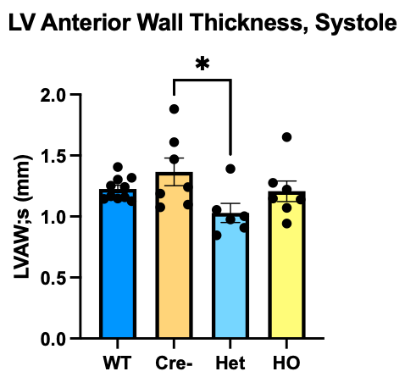
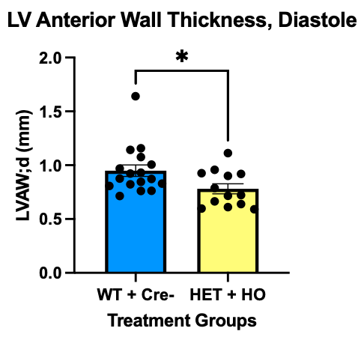
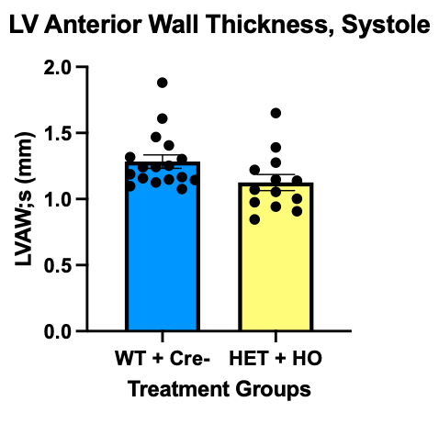
Wall Thickness
n = 4F, 2M for HET
n = 2F, 5M for Cre-
n = 8F, 5M for HET+HO
n = 7F, 10M for WT + Cre-
Notes:
Now looking at wall thickness, we found a statistical significance between the CRE- and Heterozygous CAMPER mice both for the left ventricular anterior wall in diastole as well as systole. Additionally, when analyzed in two larger groups, there was still a difference noted during diastole, but this was not the case for systole.
Based on these results, we believe this significance could be due to an imbalance between males and females within the treatment groups. The groups with the thinner anterior walls included mostly female mice, and from past research, we do know that there are sex differences when it comes to heart size. If we were to continue to investigate, our next goal would be to create more even groups, however in our timeframe, this was the array available to us.

Slide 17
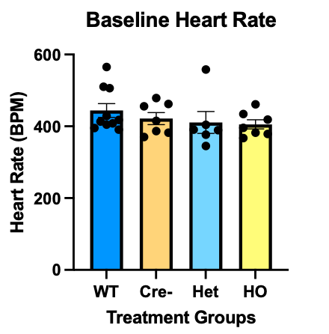
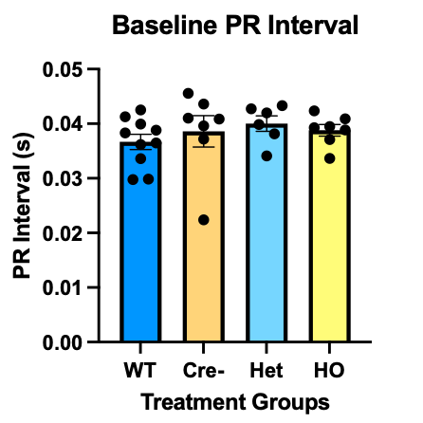
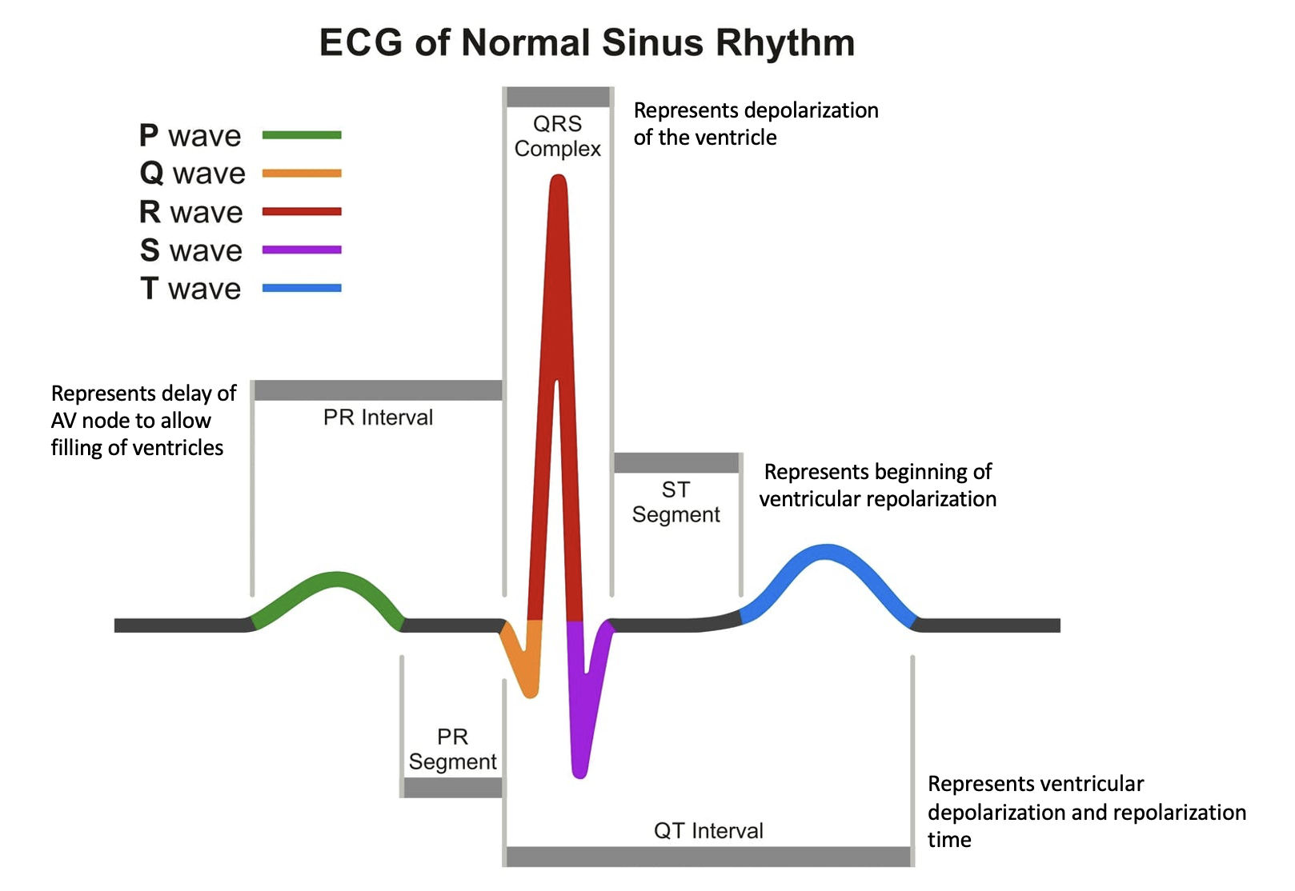
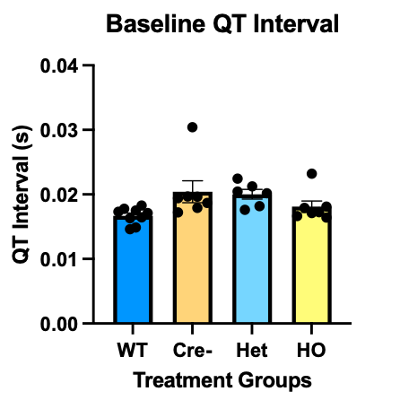
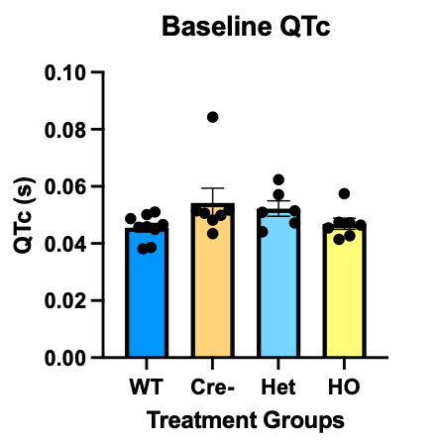
Baseline ECG Measurements
Notes:
Now looking at the ECG measurements, we focused on the Heart Rate, PR interval, which represents the time when the ventricles are filling, the QT interval, which represents ventricular depolarization and repolarization time, and QTc, which represents ventricular repolarization. Here we see the baseline measurements taken for these variables between the treatment groups and determined there was no statistically significant difference either between these groups or between the two larger groups.

Slide 18
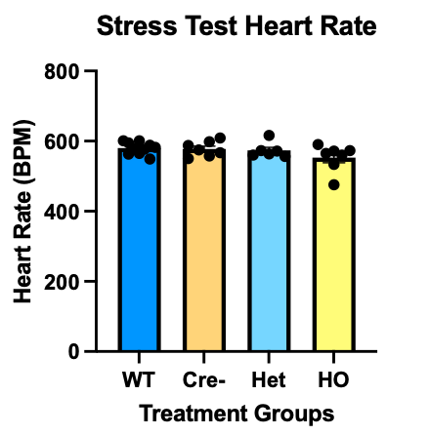
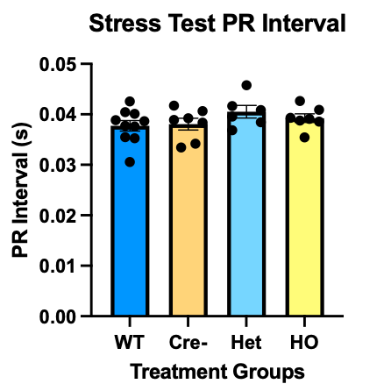
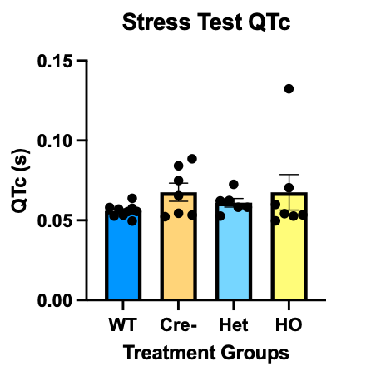
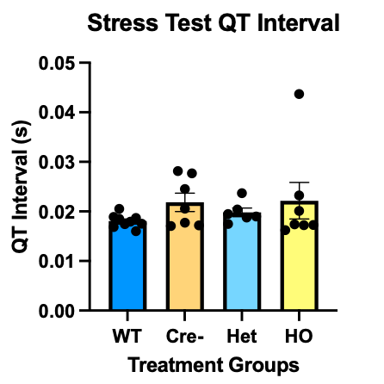
Stress Test ECG Measurements
Notes:
When looking at these same variables for each mouse during the stress test portion of the ECG, again we found no statistically significant difference.

Slide 19
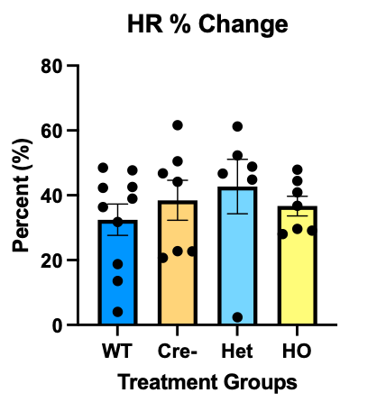
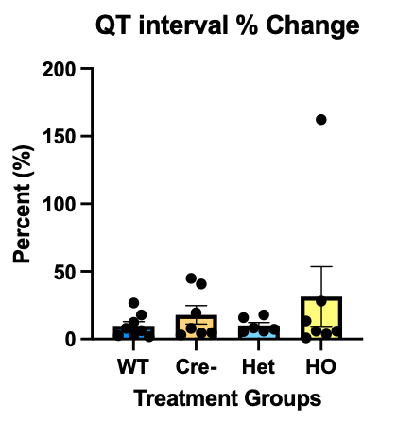
Percent (%) Change
Notes:
Finally, we calculated the percent change of the Heart Rate and QT interval before and after the isoproterenol injection. Again, no significant difference was determined between groups. If there were buffering within the camper hearts, we would expect to see less of a heart rate change, which would be evident in the percent change.

Slide 20
CONCLUSIONS & FUTURE DIRECTIONS

Slide 21
Overall, we were able to characterize the electrophysiology and cardiac function of the CAMPER mouse heart
A baseline cardiac phenotype that is statistically different from that of the Wild-type mouse was not determined
The genetically encoded sensor in the CAMPER mouse may have little to no impact on cardiac function, and therefore can be used as a mouse model for future cardiac studies
Notes:
Now to tie everything together, we were able to characterize the electrophysiology and the cardiac function within the CAMPER mouse. Based on these results, we felt that the lack of statistical differences between the treatment groups indicates that there is no discernable baseline cardiac phenotype within the CAMPER mouse. Despite this outcome, we were able to learn that the genetically encoded sensor does not seem to bear any great impact on cardiac function. Therefore we feel that this cardiac-specific CAMPER mouse may be a good mouse model for future cardiac studies.

Slide 22
Acknowledgements
Thank you to the Ripplinger Lab, especially Dr. Crystal Ripplinger, Jessica Caldwell, and Lily Mott for their help throughout this project.
Financial support was provided by the Students Training in Advanced Research (STAR) Program through the NIH T35 OD010956-22 grant as well as the NIH R01 HL111600 Research Grant.
Notes:
I would like to now say thank you to my PI and Mentor Dr. Crystal Ripplinger, as well as my fellow lab mates Jessica Caldwell and Lily Mott who helped me throughout this project. I am also thankful for the financial support provide by STAR and the NIH, which allowed me to complete this project!

Slide 23
QUESTIONS?
Notes:
Any Questions?

