Slide 1

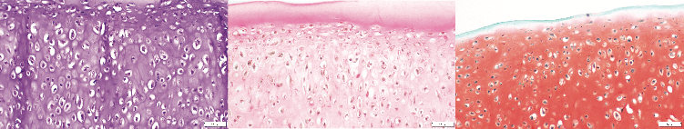
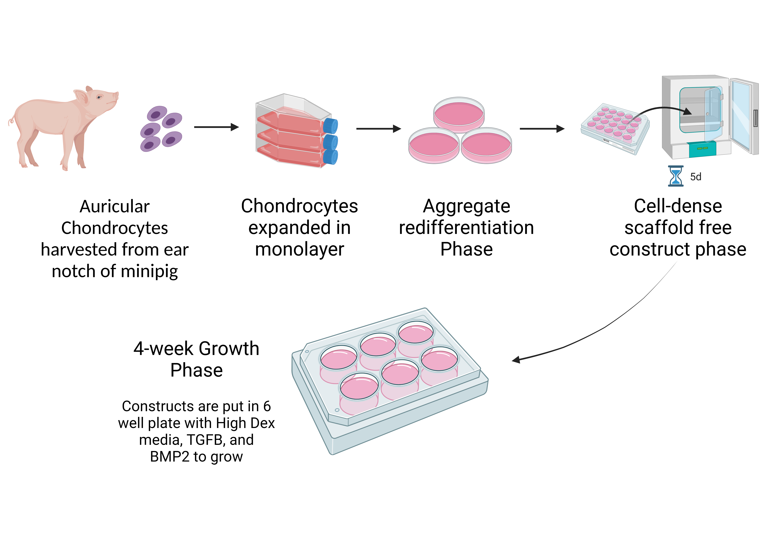
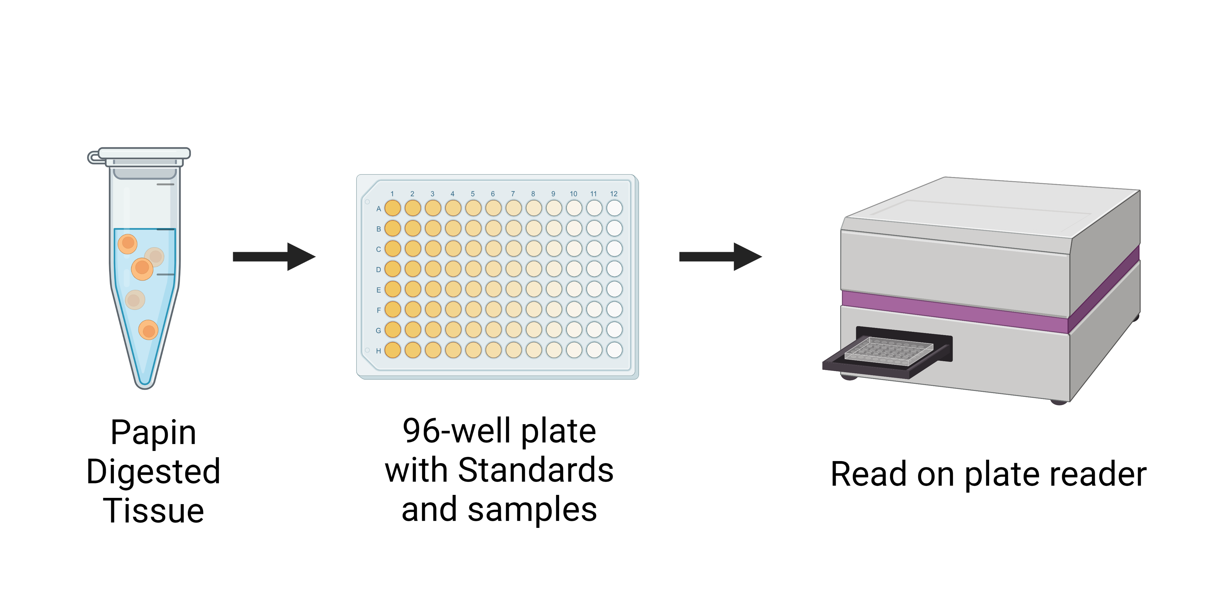
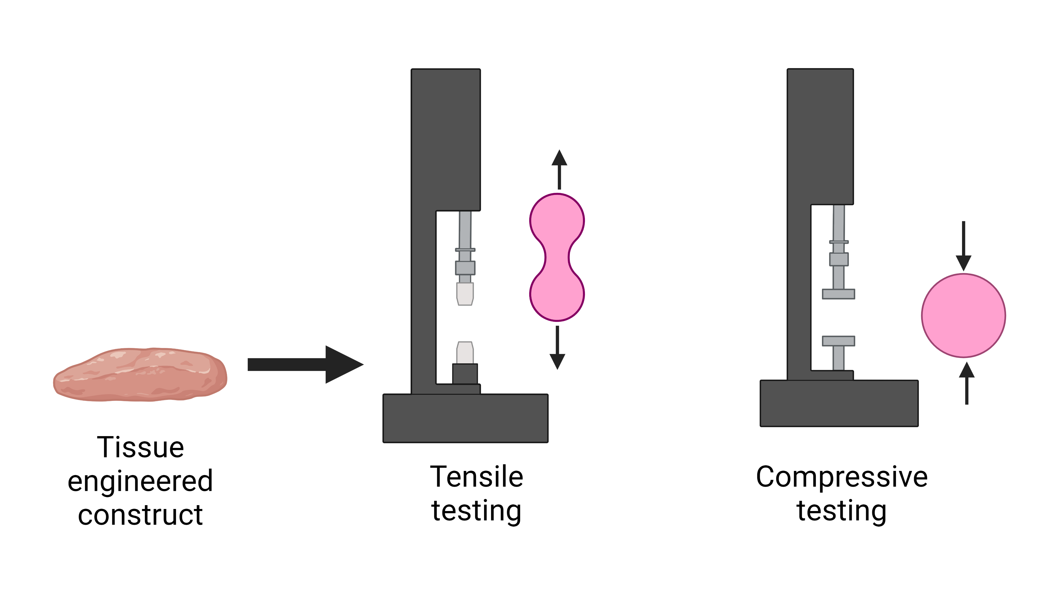
Exploration of Auricular Chondrocytes as a Cell Source of Tissue Engineering of TMJ Disc Cartilage
Nicole L. Gonzales¹, Iris Rivas², and Natalia Vapniarsky-Arzi²
¹University of California, Davis School of Veterinary Medicine
²University of California Davis, School of Veterinary Medicine, Department of Pathology, Microbiology, and Immunology
Background
The temporomandibular joint (TMJ) is a synovial condylar joint capable of translation between the temporal bone and the mandible in humans [1]. TMJ disorder is characterized by the degeneration and perforation of the cartilaginous disc within the joint. [2,3]. This disorder leads to chronic pain and degeneration of all joint components in 20-25% of adults worldwide [4]. Due to the poor regenerative capacity of cartilage, this process is irreversible. Current tissue engineering (TE) therapies can generate biomimetic cartilage constructs derived from costal chondrocytes for implantation; however, there are several limitations to utilizing costal chondrocytes as a primary cell source such as invasiveness of tissue collection and progressive ossification of costal cartilage with age [5]. These limitations have prompted the exploration of novel cell sources that would eliminate both issues. The objective of this study is to determine if auricular cartilage can be used to generate a TE cartilage construct with chondrogenic properties akin to the native TMJ disc.
Main Hypothesis
We hypothesize that chondrocytes harvested from the auricular cartilage of neonatal minipigs will generate an implant with biomechanical and elastic properties akin to that of the native TMJ disc.
Biochemistry
Mechanical Properties
(A) Compressive:
(B) Tensile:
Figure 1: Tissue engineered constructs have higher amounts of DNA expression and glycosaminoglycans (GAG) and less collagen per microgram of tissue. (A): Collagen concentration measured by a OH-proline assay showed constructs to have 6% less collagen. (B): GAG concentrations measured by a colorimetric assay showed a large increase in GAG in auricular constructs versus the native disc. (C): Picogreen measures the cellularity of the tissue, this shows that auricular TE constructs have a similar composition to costal constructs. Statistics was not performed due to an N=1.
Figure 2: Tissue engineered constructs have more compressive strength and less tensile strength than the native TMJ disc. (A): TE constructs have ~3x the relaxation stiffness and ~1.5x the compressive strength. (B): TE constructs have 10x less the tensile strength in both Youngs modulus and ultimate tensile strength (UTS). Youngs Modulus measures stress vs strain while UTS measures how much tensile force the construct can withstand before tearing. Statistics was not performed on these graphs due to N=1.
Methods
Auricular chondrocytes were obtained from the ear notch of 1 minipig
Chondrocytes were cultured in monolayer before seeded into aggregate phase
Spherical aggregates were seeded at high density (8M cells/construct) into custom made agarose plates
Constructs were fed with chondrogenic medium supplemented with dexamethasone, TGFB, and BMP2
At 4 weeks, constructs were evaluated biochemically, mechanically, and histologically and compared to native TMJ disc’s of the Yucatan minipig
A.
Histology of Tissue Engineered Constructs
B.
C.
Construct Fabrication:
Figure 3: Histology of tissue engineered constructs made from auricular cartilage show comparable make up to costal TE constructs. (A): Hematoxylin and Eosin (H&E) staining of the horizontal disc sections shows highly cellular cartilage filled with hypertrophic cells. (B): PicoSirius Red staining of the horizontal disc sections highlights the orientation and concentration of collagen. Here, collagen is increased at the superficial layer with orientations parallel to the surface. (C): Safranin O/Fast Green staining of the horizontal disc sections demonstrates a highly positive staining for glycosaminoglycans throughout the construct.
Literature Cited
Runci A., Michele et al. Articular Disc of a Human Temporomandibular Joint: Evaluation through Light Microscopy, Immunofluorescence and Scanning Electron Microscopy. J of Func. Morph. and Kines. vol. 6,1 22. 25 Feb. 2021, doi:10.3390/jfmk6010022
Farrar W.B., McCarty W.L., Jr. 1979. The TMJ dilemma. J Ala Dent Assoc. 63(1):19-26
Wilkes C.H. 1989. Internal derangements of the temporomandibular joint. Pathological Variations. Arch Orolaryngol Head Neck Surg. 115(4):469-477
Vapniarsky N., et al. 2018. Tissue engineering toward temporomandibular joint disc regeneration. Sci Transl Med. 10(446). PubMed PMID:29925634
Vapniarsky N., Huwe L.W., Arzi B., Houghton M.K., Wong M.E., Wilson J.W., Hatcher D.C, Hu J.C., Athanasiou K.A. 2018. Tissue engineering toward temporomandibular joint disc regeneration. Sci Transl Med. 10 (446):1-28.
Discussion:
Tissue engineered cartilage constructs made from auricular chondrocytes are comparable to those made from costal chondrocytes. Previous studies have elucidated that costal chondrocyte (CC) derived constructs adapt with time in vivo to decrease their glycosaminoglycans (GAG) and cellularity and increase their collagen content [4], therefore since auricular chondrocyte derived constructs have a similar biochemical and histological make-up to CC derived constructs, it is reasonable to conclude that they will adapt in the same way.
Auricular chondrocyte derived constructs showed an increase in compressive strength compared to the native disc. This is most likely due to their marked increase in GAG showed both biochemically and histologically. Additionally, these constructs have a marked decrease in tensile ability compared to the native disc. We have concluded that this is most likely due to the decrease in collagen we see with the OH-proline assay. Future directions should include additional growth factors that can be supplemented to increase the collagen content and fix this issue.
Conclusion:
In conclusion, auricular chondrocytes show tremendous promise for a novel cell source for TMJ disc engineering.
Biochemistry Assays:
Mechanical Testing:
Acknowledgments
We gratefully acknowledge the financial support from Boehringer Ingelheim, the UC Davis School of Veterinary Medicine, the Department of Pathology, Microbiology, and Immunology and the Students Training in Advanced Research Program

