Slide 1




Effects of Panobinostat, a Histone Deacetylase Inhibitor, on NETs Formation and Histone Citrullination in Canine Neutrophils
Student:
Stephanie Han
Mentors:
Dr. Ronald H L. Li, DVM, MVetMed, PhD, DACVECC
Dr. Jennifer Willcox, DVM, DACVIM (Oncology)
Notes:
PI Introduction
-My name
Mentor Name
Study
Funding

Slide 2



Cancer in Veterinary Medicine
Introduction Methods Results Discussion Conclusion
Encountered frequently
  Estimated ~5,300 cancer diagnoses/100,000 dogs (in the US)
  10x the incidence seen in people
    Get many of the same tumors seen in people & same environmental exposure
Notes:
Cancer is encountered frequently in veterinary medicine
Many of the same tumors seen in dogs are seen in people and in the same environmental exposure (same exposures: epigenetics, etc)
This makes the dog a good model for many diseases like cancer

Slide 3
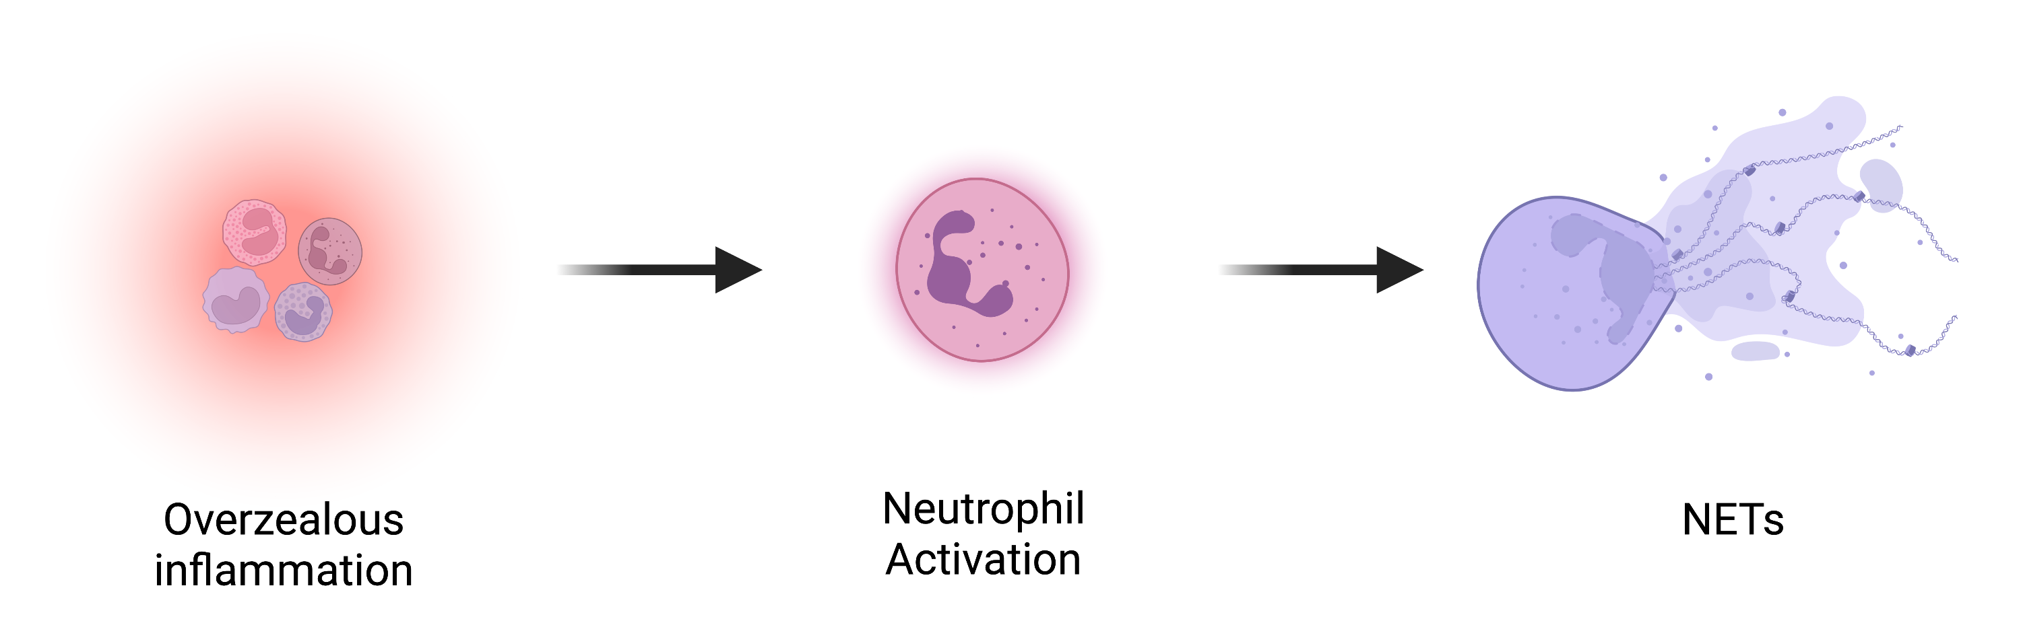
Systemic Effects of Cancer
Introduction Methods Results Discussion Conclusion
Cancer can alter coagulation and inflammation
Notes:
Cancer not only has local effects, but also systemic effects by changing inducing coagulation and inflammation which leads to the activation of neutrophils which leads to the formation of Neutrophil Extracellular Traps or NETs
So What are NETs?

Slide 4
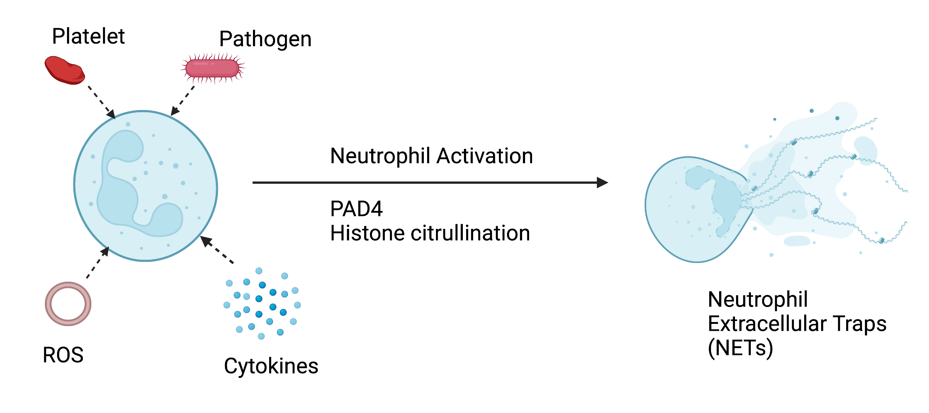
Inflammation & Neutrophil Activation
Introduction Methods Results Discussion Conclusion
An important component of innate immunity
Notes:
So Neutrophils? We all know what those are
Neutrophils play an important part in the innate immune system and normally help defend our bodies against pathogens
When these neutrophils are activated by ROS, PLT, and pathogens, the enzyme PAD4 (peptidylarginine Deaminase 4), causes histones to citrullinate causing NETosis – complex cellular events that lead to the formation of NETs
So what exactly are NETs?
NETs are web like extracellular structures composed of neutrophil DNA, histones, and granular proteins
These degranulate and kill bacteria, keeping our bodies safe ☺

Slide 5
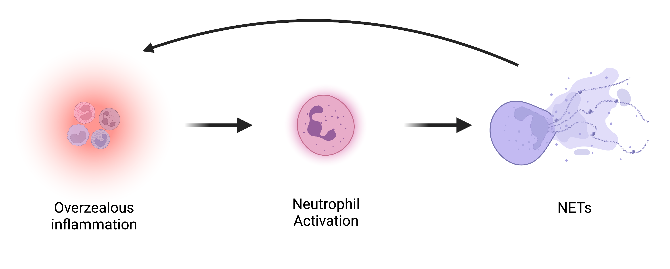
Role of NETs in Cancer
Introduction Methods Results Discussion Conclusion
Role in innate immune system
Entraps pathogens, facilitates phagocytosis and direct killing of pathogens
Cancer
    NET formation is also seen with cancer
    Has been associated with aiding in tumor progression and metastasis
Notes:
But in recent studies, NETs have been seen to aid in tumor progression and metastasis
they have also been known to cause inflammation, thrombosis, and possibly organ dysfunction in systemic diseases like cancer
So we see a feedback loop: If we have more inflammation, activating more neutrophils, making more NETs
And NETs are known to cause more inflammation in systemic diseases → thus adding to more inflammation in a system
Why NETs are bad:
Cancer associated thrombosis as well as aiding to systemic overzealous inflammaion

Slide 6
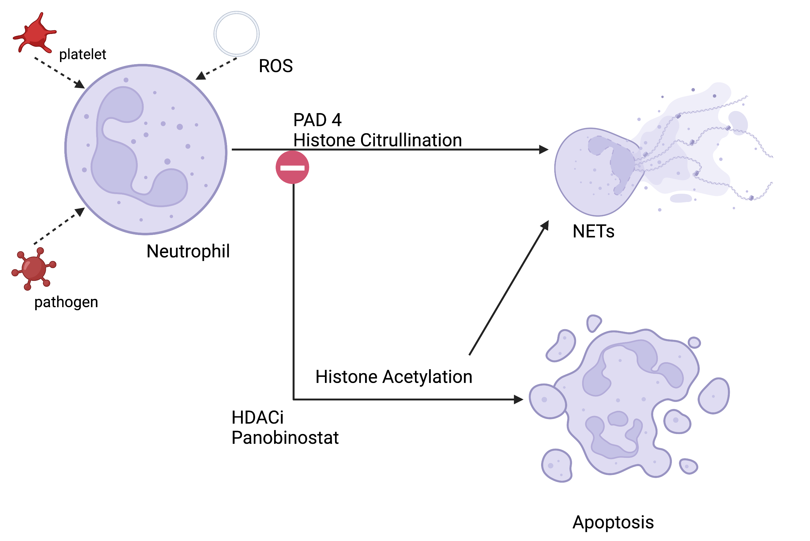
NETs as a Target
Introduction Methods Results Discussion Conclusion
Certain drugs can reduce NET formation
  Histone Deacetylase Inhibitors (HDACi)
    Histone acetylation
    Gene transcriptions causing apoptosis or NETosis
    Effects on PAD4 and histone citrullination are unknown
?
?
(panobinostat)
Notes:
So what if we could target NETs as a therapy??
One class of drugs that may reduce NET formation are Histone Deacetylase Inhibitors or HDACi, a chemotherapeutic drug commonly used in people
HDACi is thought to inhibit the histone citrullination pathway and instead promote histone acetylation ultimately causing apoptosis (competing pathways)
There have only been 2 human studies on HDACis
One says it increases NET formation while the other says it decreases NET formation
It also states that in human medicine, low doses of HDACi caused acetylation to create NETs, it was not until high doses that NETosis was inhibited
So does this occur in dogs?
It is not known whether this occurs in canine neutrophils, so this study will allow us to see if the same effect can be seen in dogs
The original publications did not assess citrullination or inhibition as a mechanism of NET formation inhibition. The changes in histone post translational modification by Panobinostat is our unique hypothesis
In human studies, histone acetylation also results in chromatin decondensation which causes NETosis
In vitro work in rodent models and human cells have shown HDACis AT HIGH DOSES can inhibit NET formation and instead possibly promote apoptosis

Slide 7
Hypothesis
Introduction Methods Results Discussion Conclusion
Hypothesis
In a dose-dependent manner, panobinostat would modulate in vitro NETosis in activated canine neutrophils by decreasing histone citrullination and promoting apoptosis
Notes:
So knowing this, we wanted to test it in canine neutrophils
We hypothesize that in a dose-dependent manner, panobinostat would modulate in vitro NETosis in activated canine neutrophils by decreasing histone citrullination and promoting apoptosis

Slide 8

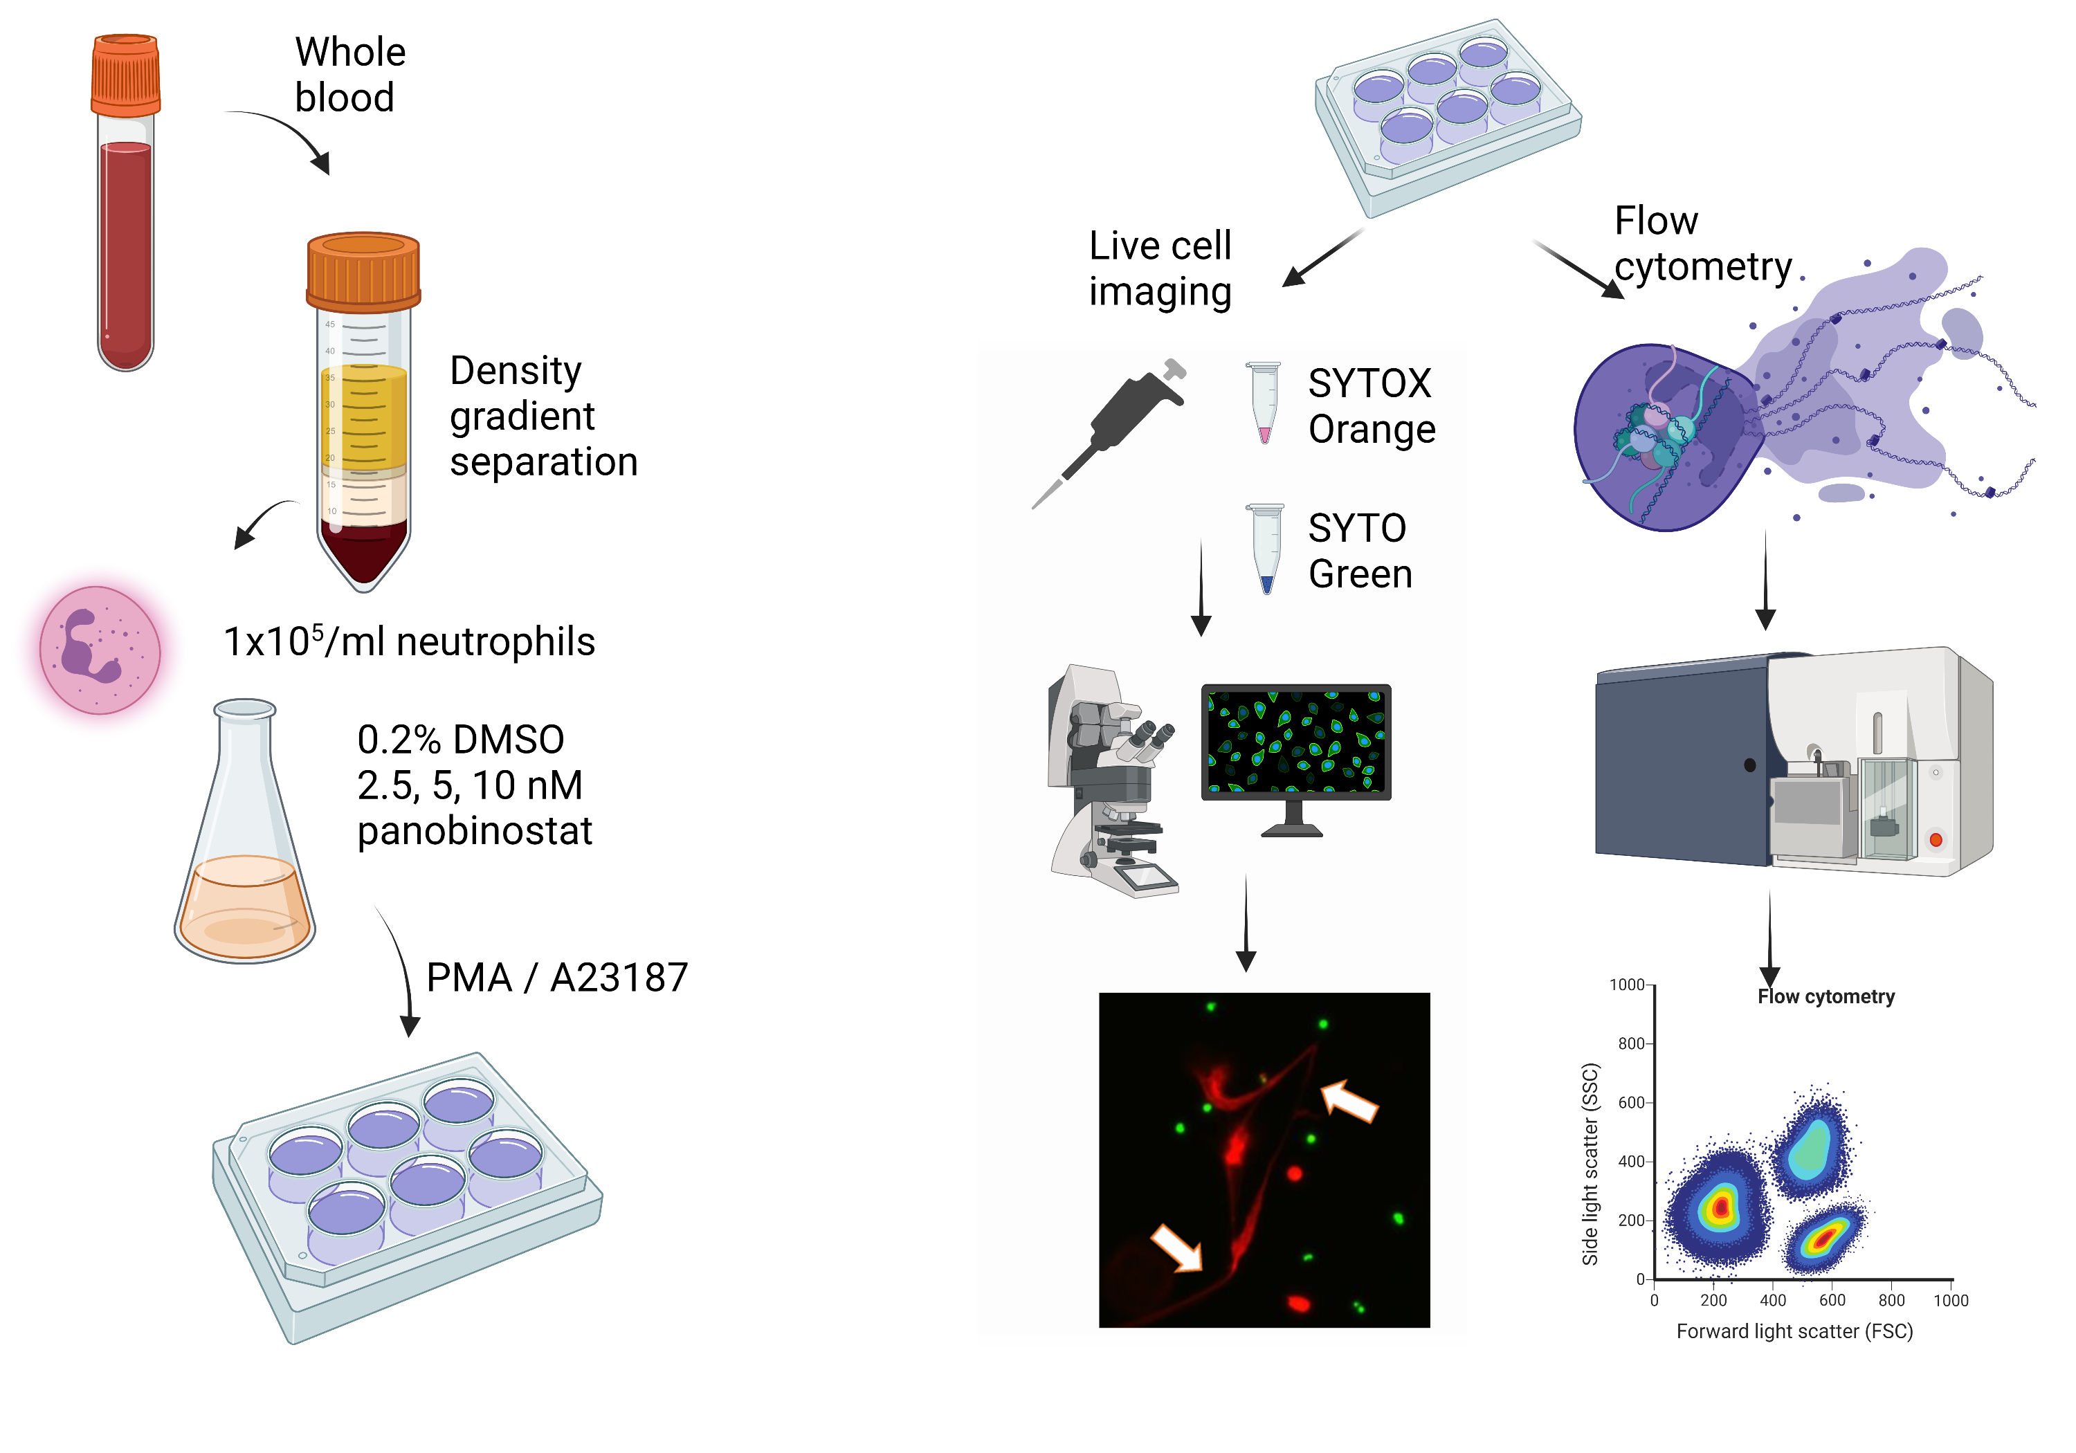
Experiment
Introduction Methods Results Discussion Conclusion
Study Population:
Eligibility Criteria
  Dogs
    >10kg
    >1 year old
    No vaccinations within 30 days
    Considered healthy
    No other medications
Notes:
To test our hypothesis: this is what we did
Our goal was to enroll 8-10 dogs that are greater than 10kg, older than 1 year, had no recent vaccinations within 30 days, considered otherwise healthy (no systemic diseases), and on no other medications
Collect 10-12mls of whole blood, run a CBC
Isolate Neutrophils
In different groups: Pre-treat with Panobinostat: 1 hour
Activate with either PMA (phorbal myristate acetate) or with A23187: both potent activators causing neutrophil activation
PMA is an activator that produces ROS
A23187 is also another activator that is also a calcium ionophore that essentially punches holes into the membrane allowing for neutrophil activation

Slide 9
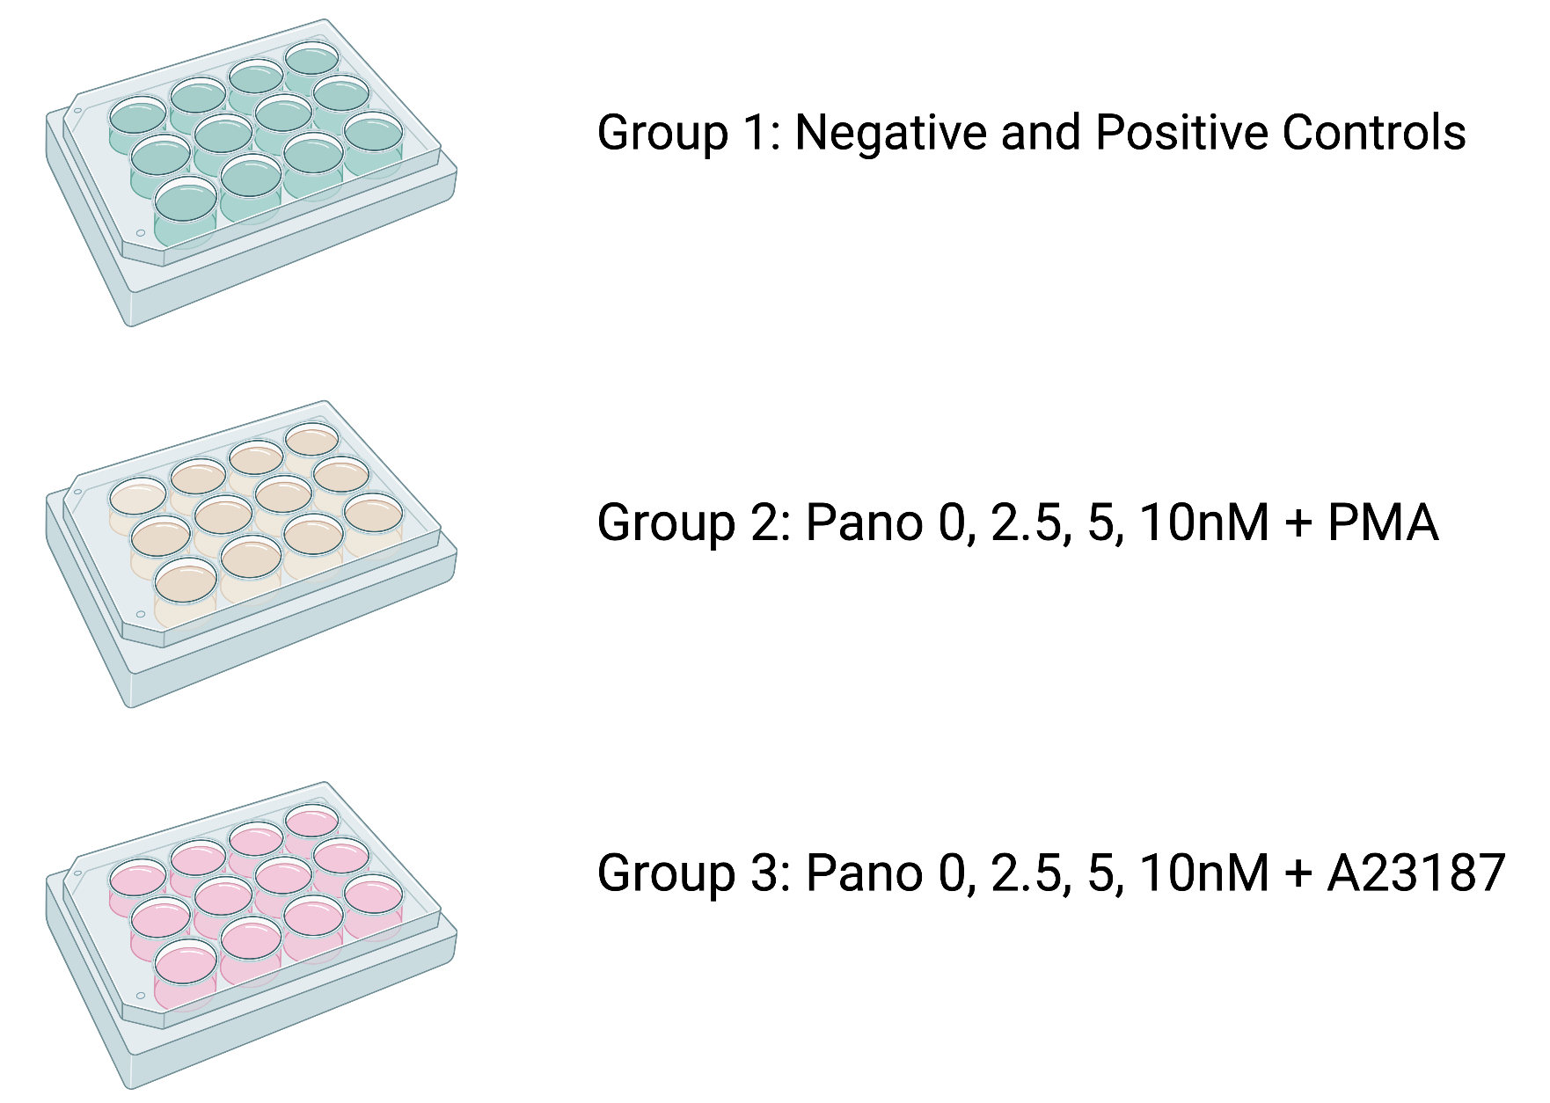
Experiment
Introduction Methods Results Discussion Conclusion
Notes:
We have 3 groups: Group 1 for control, Group 2 for Pano + PMA, and Group 3: Pano + A23187
After being activated by either A23187 or PMA
Stain them with SYTOX orange -→ cell impermeable (necrotic or NETs)
SYTO Green -→ cell permeable (live cells)
Both DNA stains
Then take 5 live images/sample/group on 10x magnification
Then count cells: how do we know it’s a NET?
For the purpose of this study, NETs are identified as cell-free filamentous structures

Slide 10
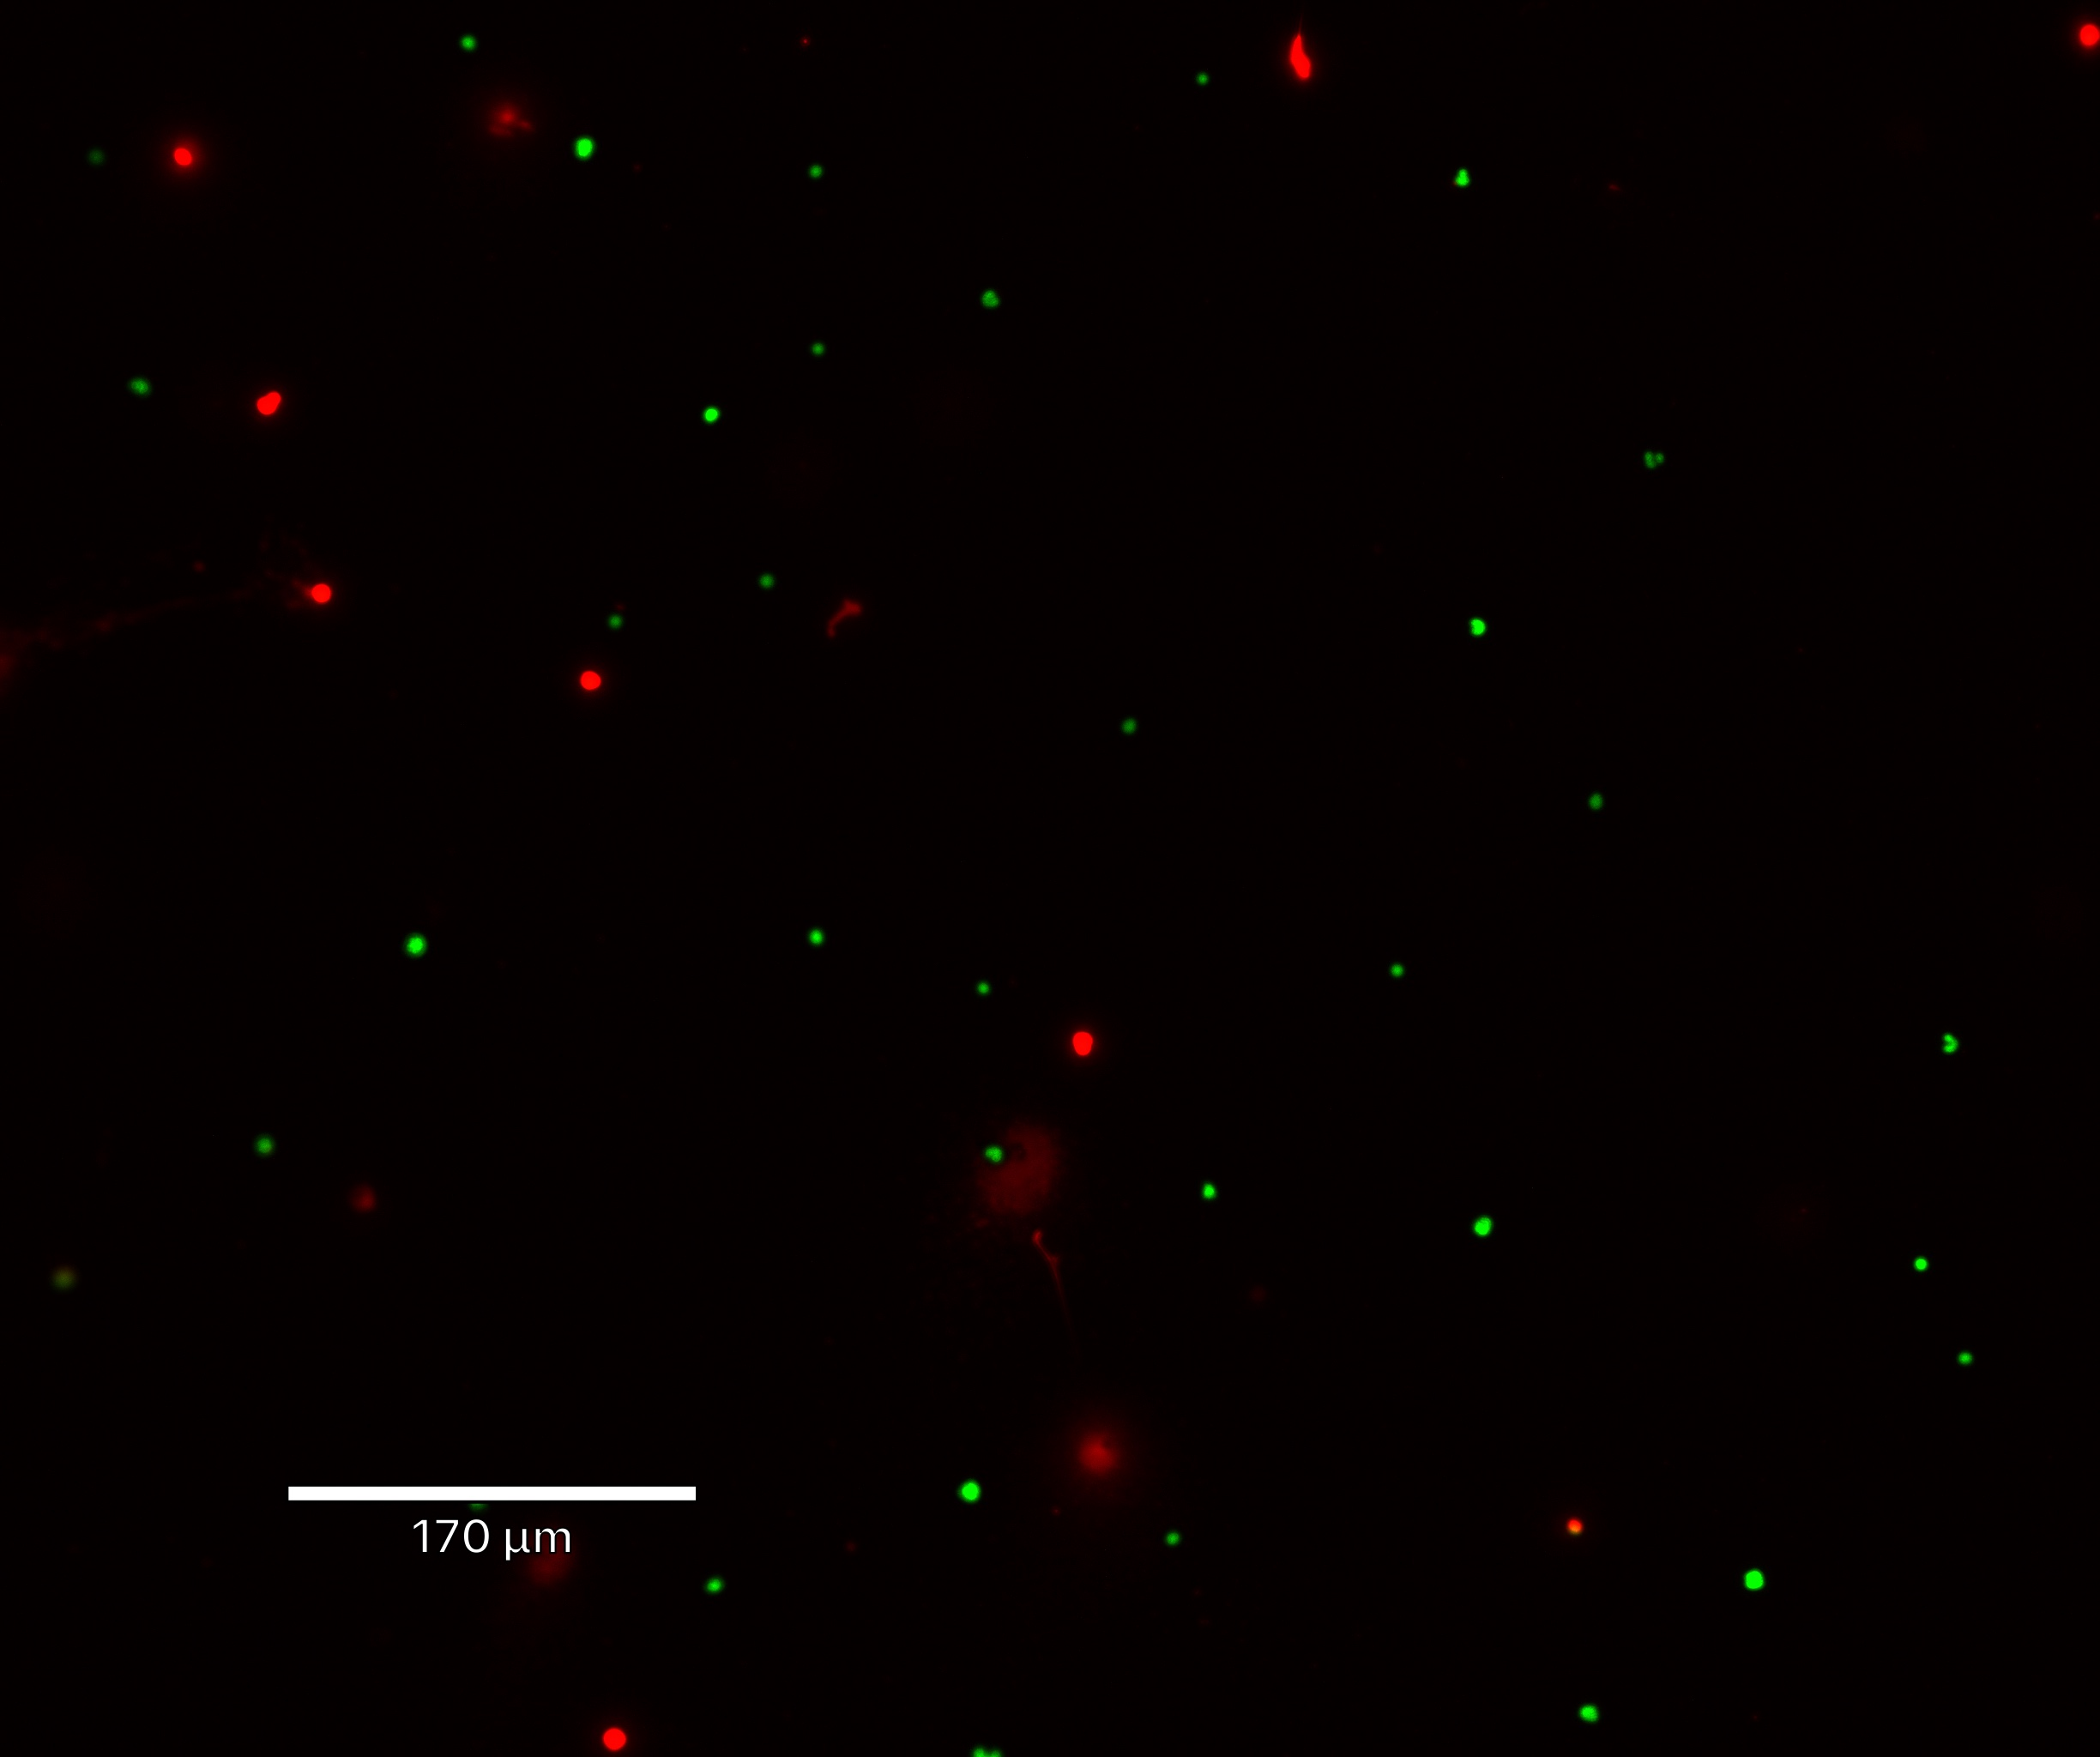
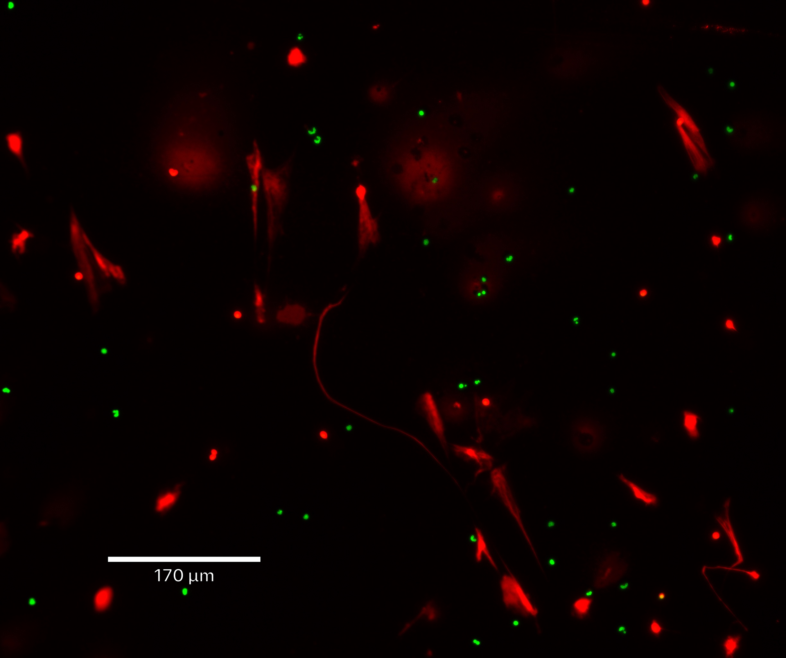
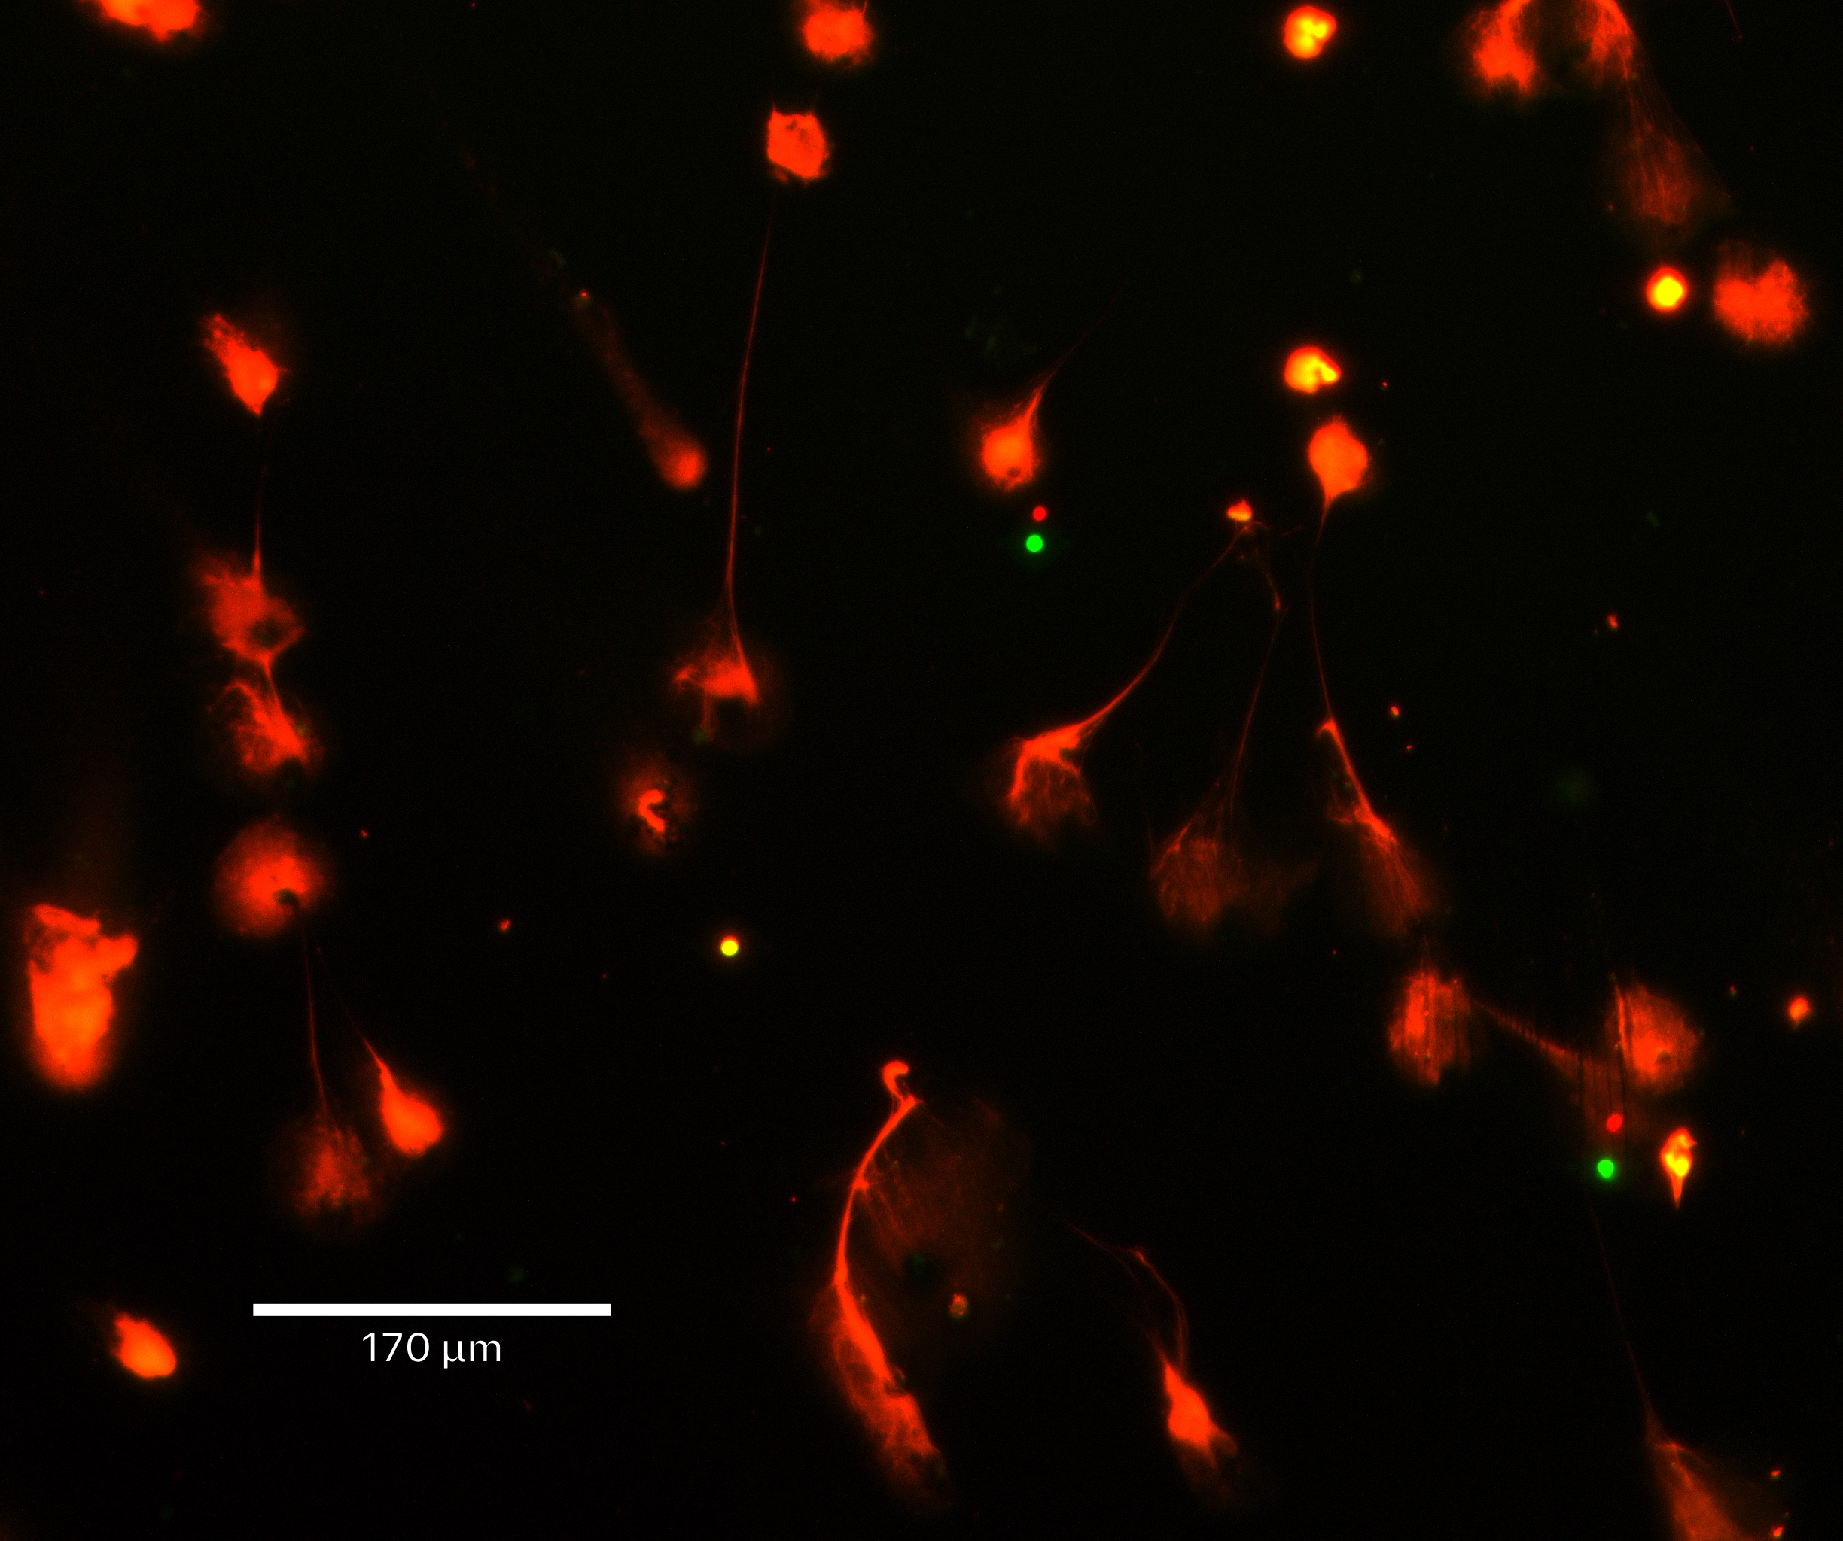
Live Cell Imaging
Introduction Methods Results Discussion Conclusion
*10x Magnification
Negative Control
Positive Controls
Buffer
PMA
A23187
Notes:
White arrows are pointing to NETs
This is HBSS, our negative control/vehicle control
Notice that this is a very “quiet” image with a few number of dead or necrotic cells
We have 2 positive Controls
As you can see, there are a lot of white arrows, indicating NETs
These showcase our positive controls
Notice the difference
Lots of NETs being formed!
How do I know these are NETs??
Filamentous extracellular DNA structures
Note that some are orange:
Why are they orange? Because technically the green stains everything. They could be actively dying
Or there might be some overlap

Slide 11
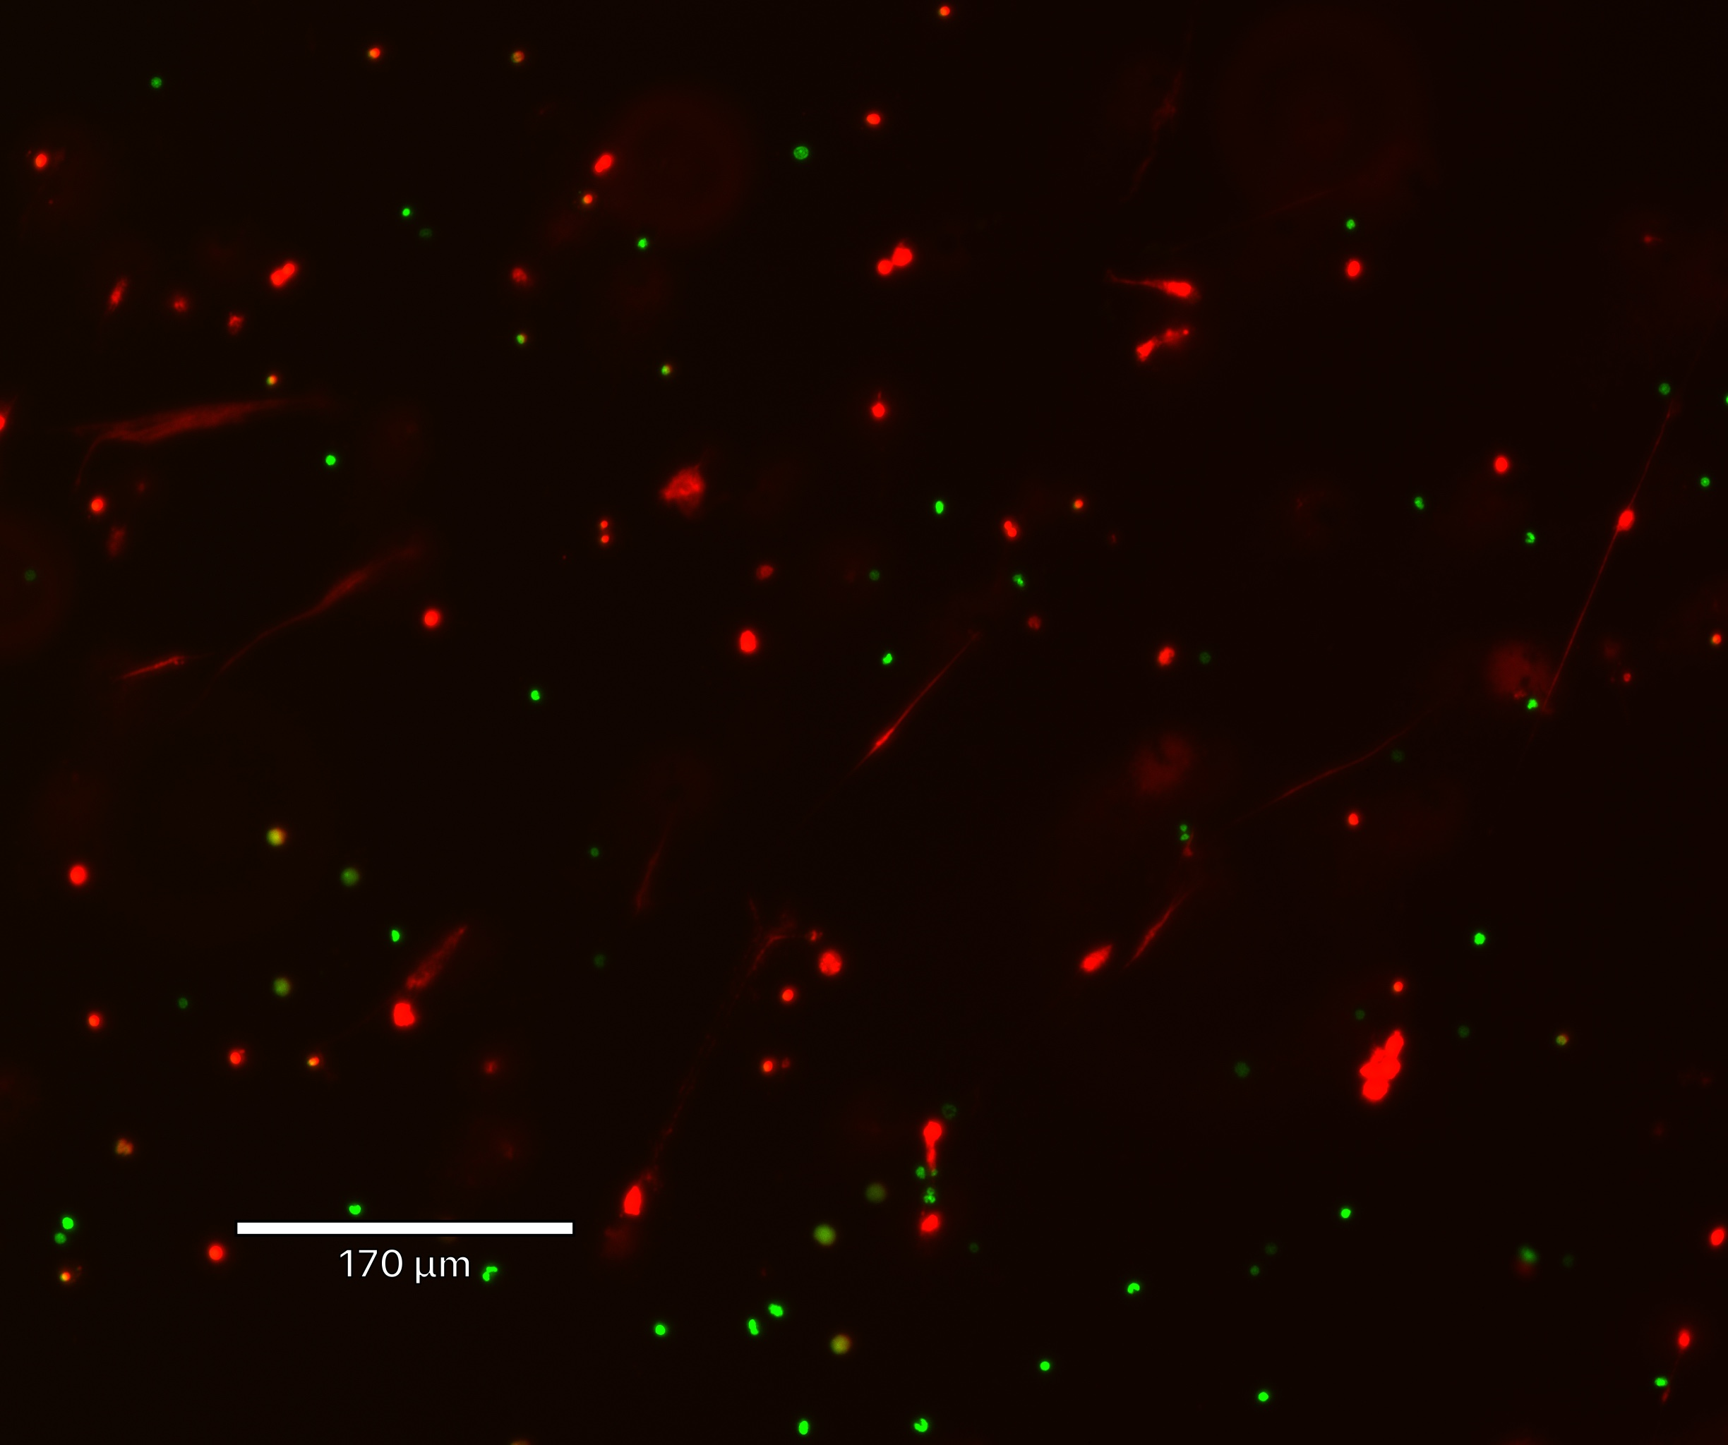
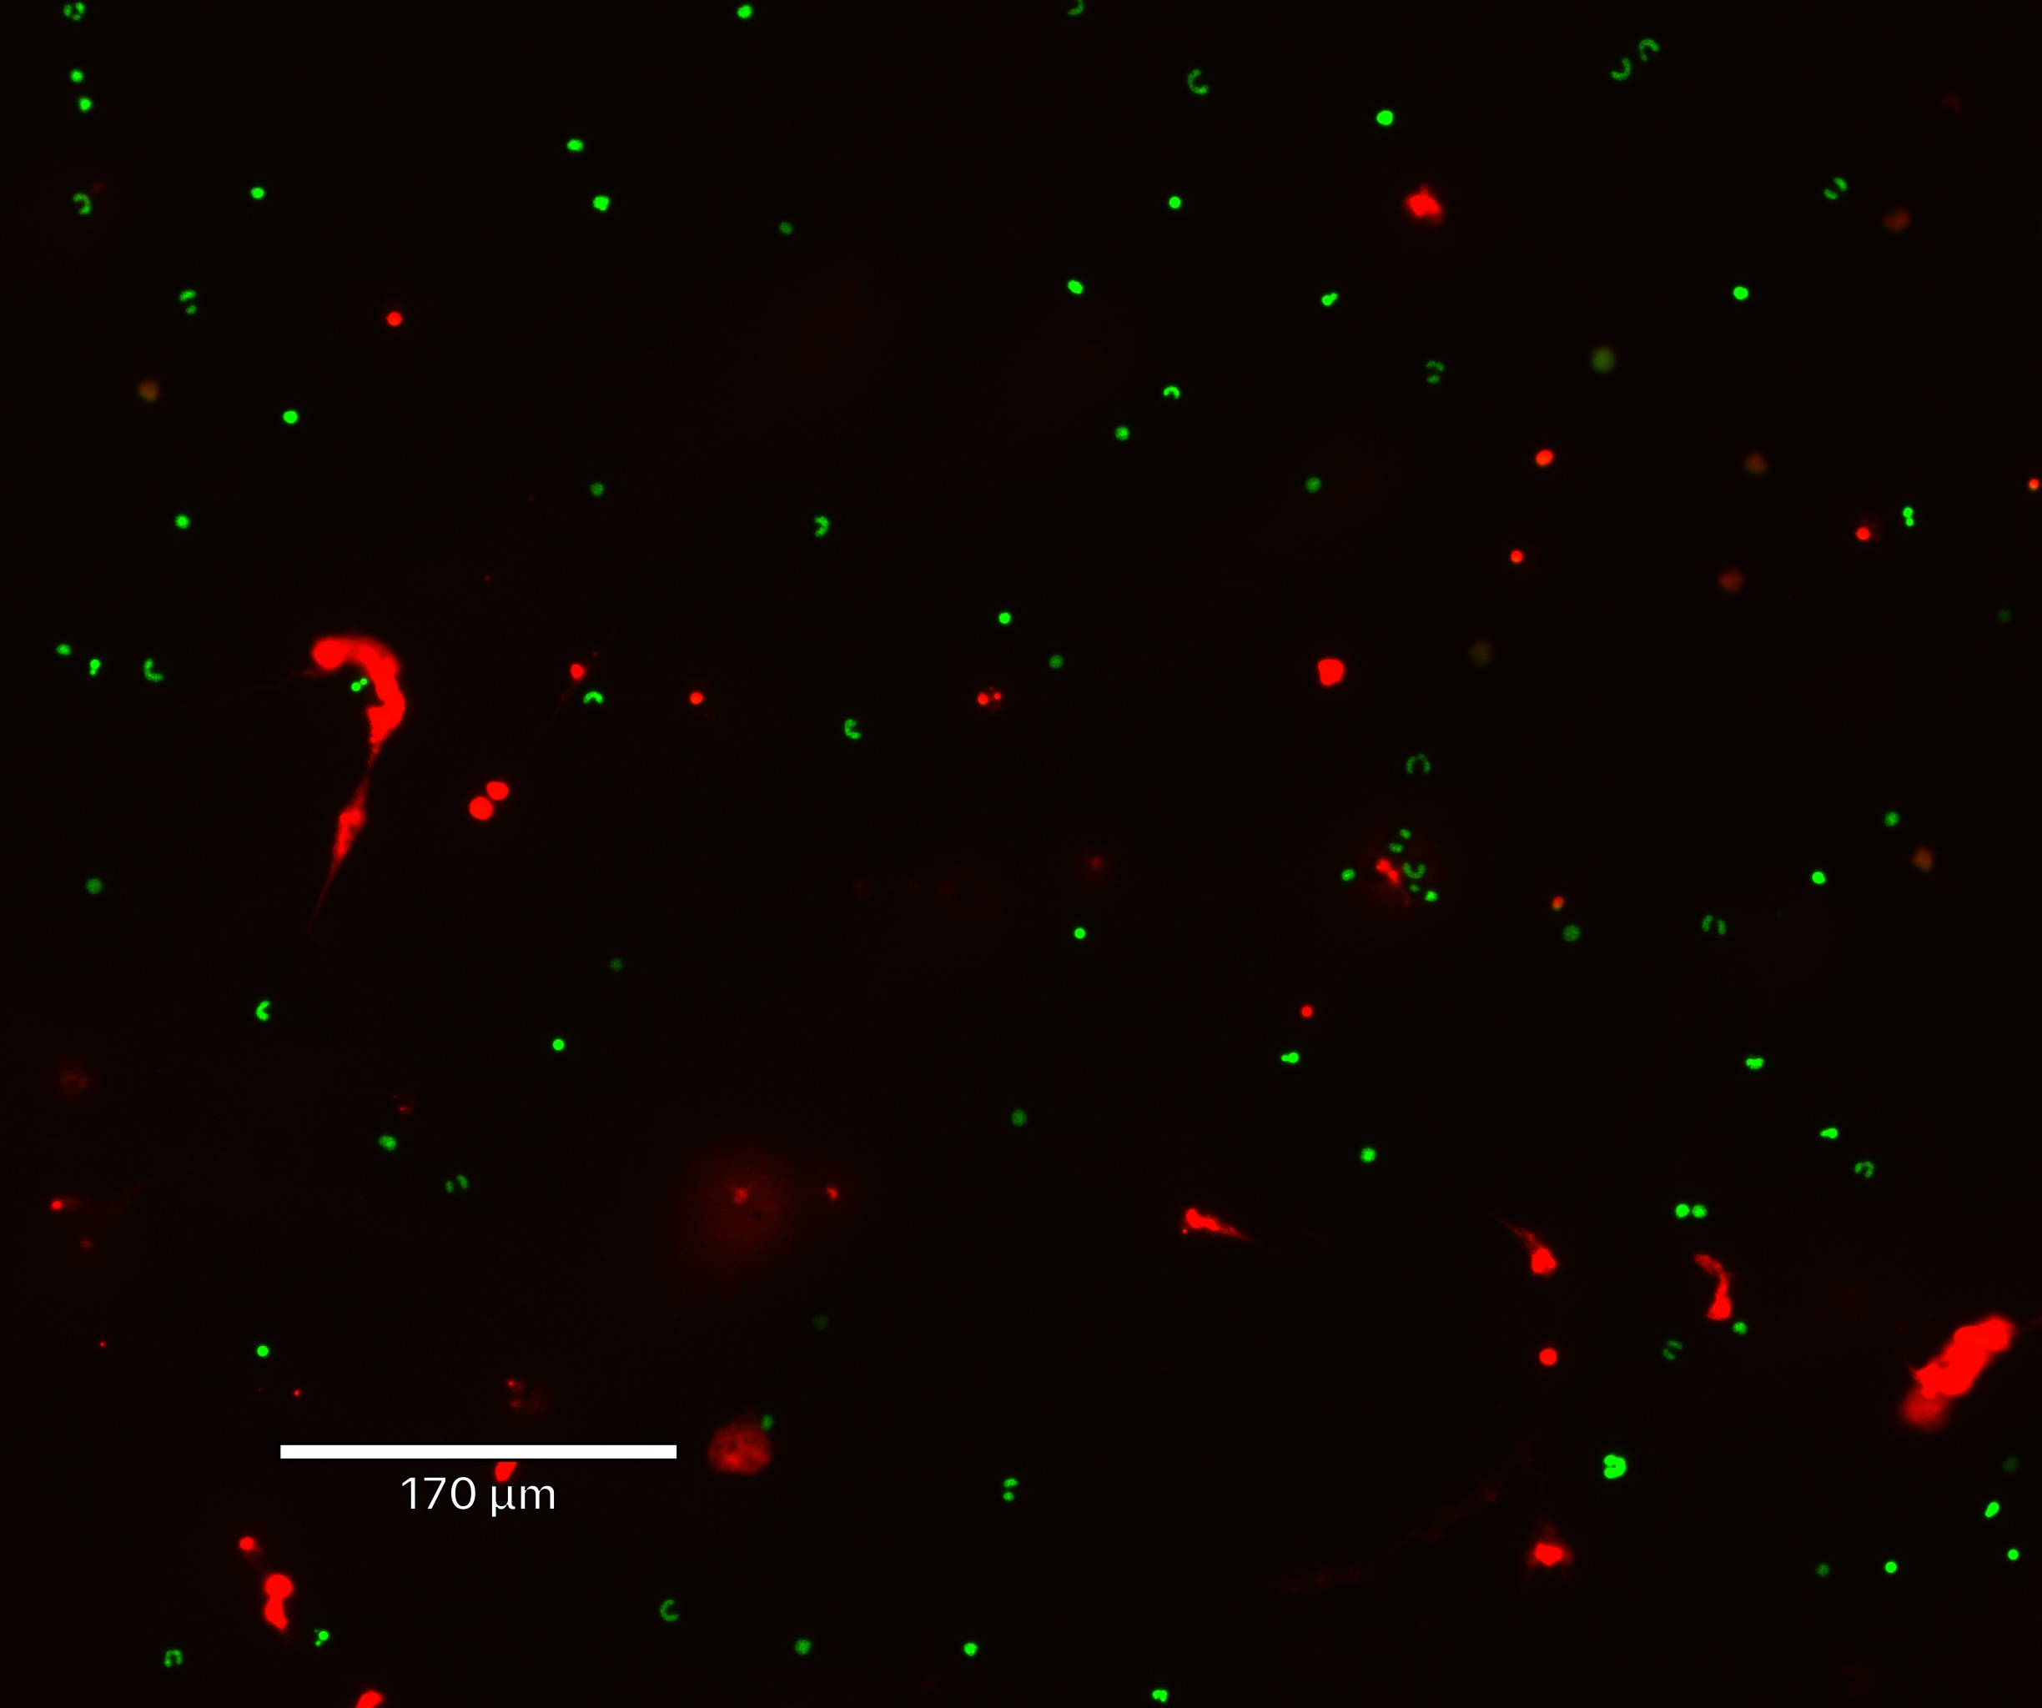
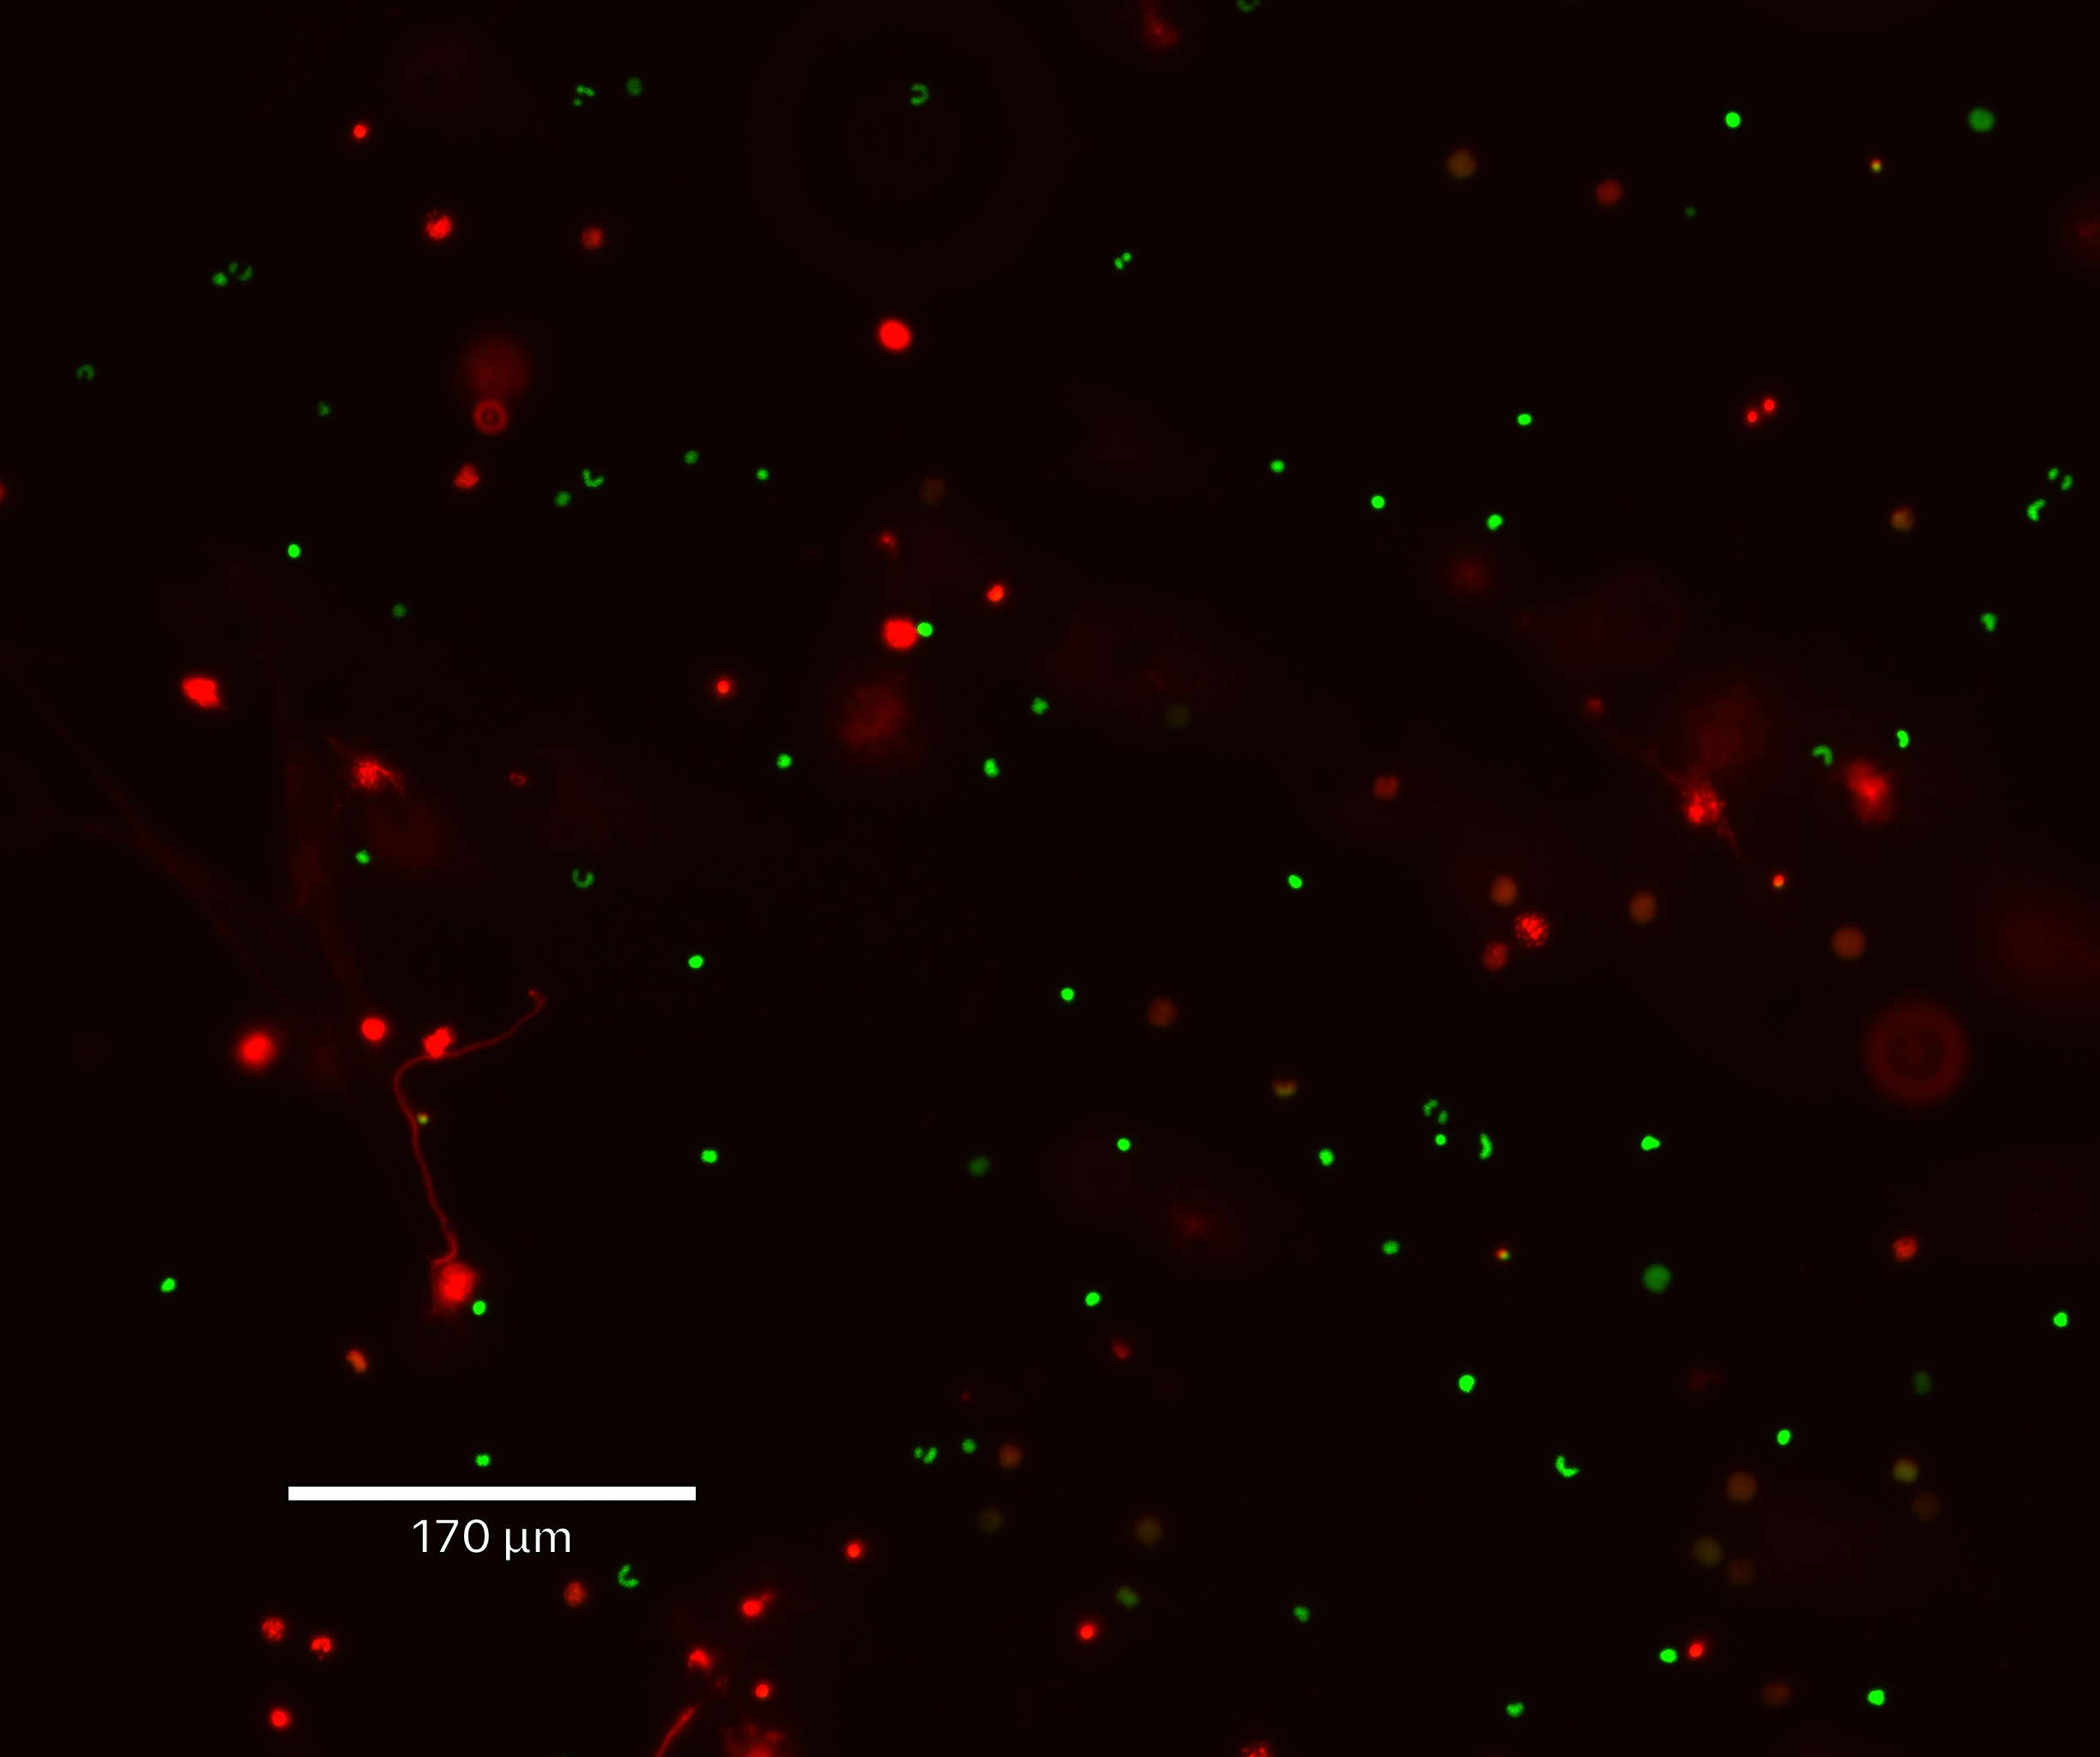
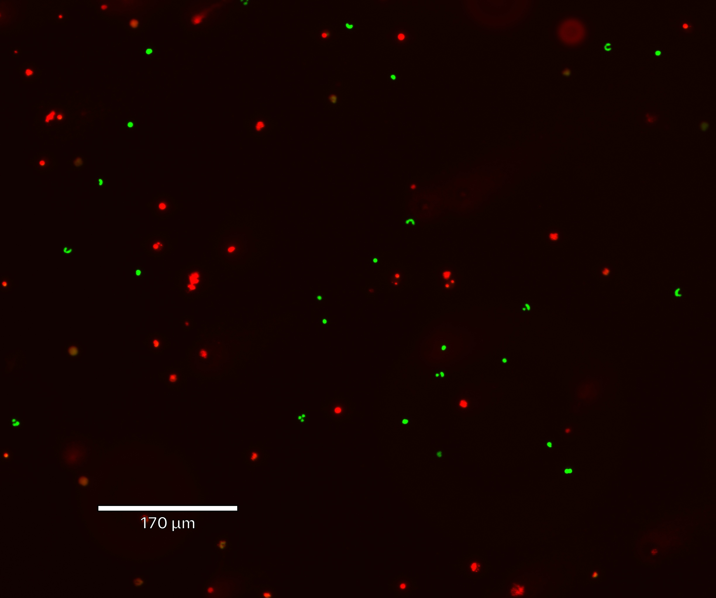
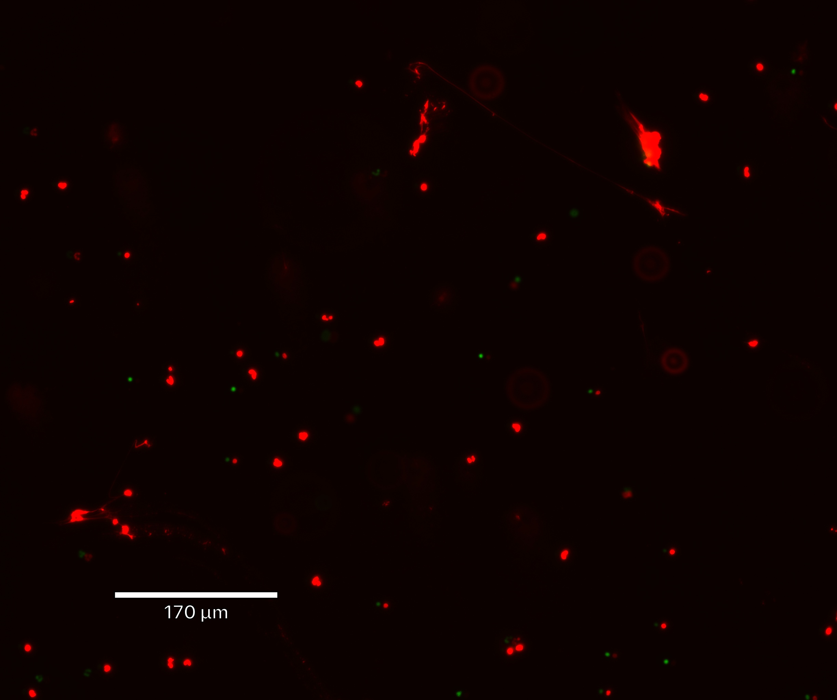
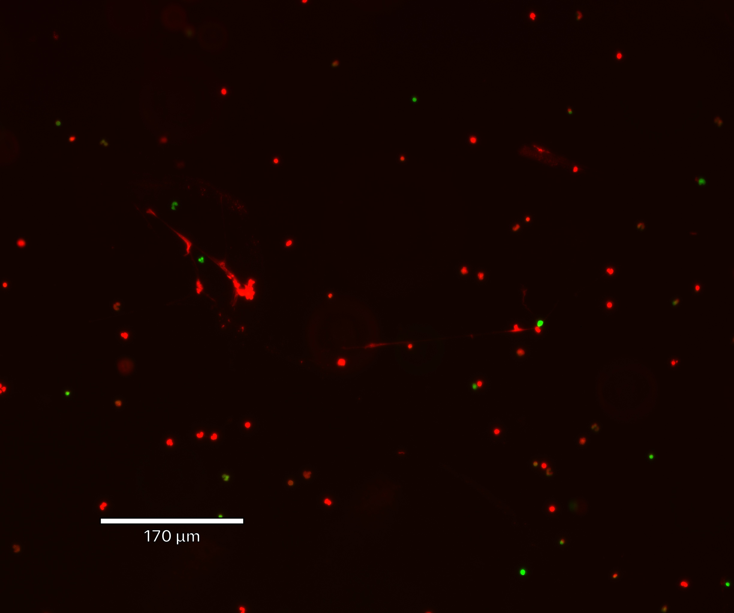
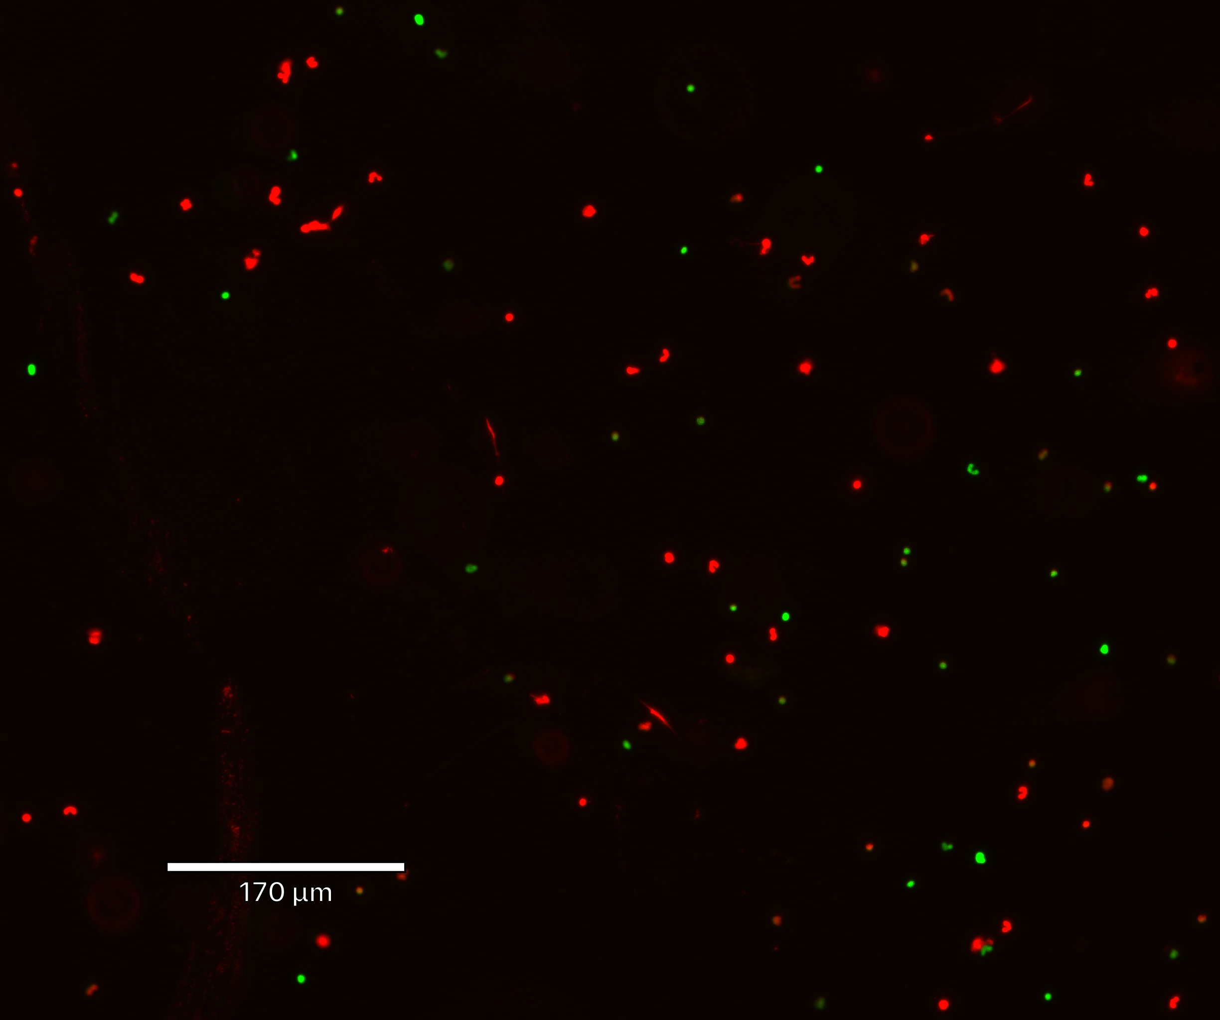
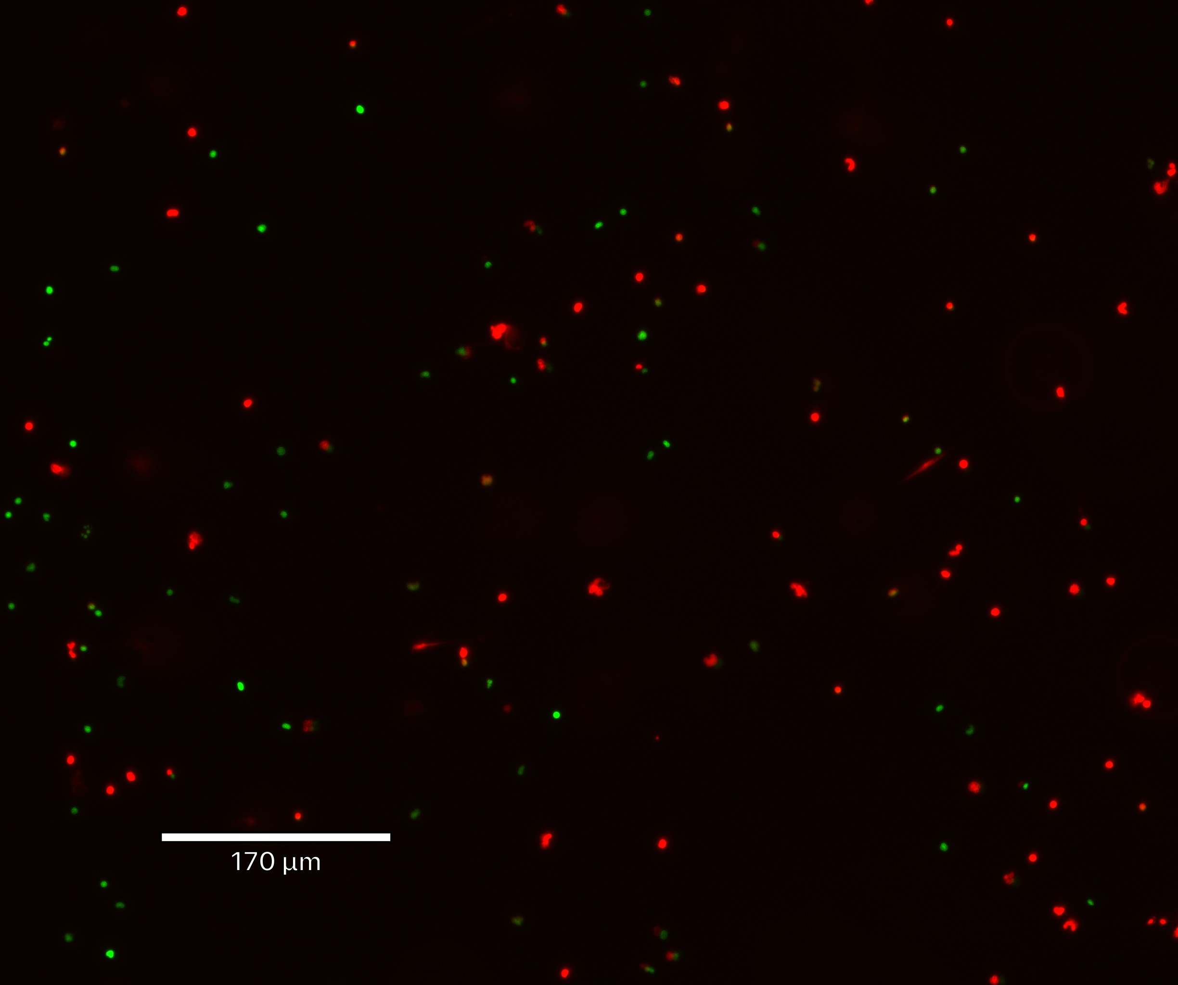
Live Cell Imaging
Introduction Methods Results Discussion Conclusion
0.2% DMSO + PMA
Pano 2.5nM + PMA
Pano 5nM + PMA
Pano 10nM + PMA
0.2% DMSO + A23187
Pano 2.5nM + A23187
Pano 5nM + A23187
Pano 10nM + A23187
Notes:
The first row: is PMA and Pano 0nM
PMA is a potent activator that creates Reactive Oxygen Species
The second row: is A23187 and Pano 0nM
A23187 is a potent activator that is a calcium ionophore
DMSO is our negative vehicle control at 0nM panobinostat = prove that it isn’t the DMSO causing any effects, but it is actually the drug causing these effects
For both potent activators, we can see that as you increase the dose of Panobinostat, you can see less NETs forming or less white arrows!

Slide 12
Panobinostat Dose Response
Introduction Methods Results Discussion Conclusion
Panobinostat causes dose-dependent inhibition in NETs formation in PMA and A23187-activated canine neutrophils (p=0.0002, p=0.002, respectively)
10 nM Panobinostat significantly modulated NETs formation compared to positive controls of PMA (p=0.0007) and A23187 (p=0.007)
Notes:
After 8 dogs! This is our data!
These graphs depict average NETs per field, one activated with PMA the other with A23187
The plus/minuses at the bottom indicate if these reagents were in the sample
In both graphs, it shows statistical significance as indicated by the stars
Overall we see that 10nM of panobinotat significantly modulated NETs formation compared to our positive controls

Slide 13

Conclusion
Introduction Methods Results Discussion Conclusion
Concerns
Panobinostat modulated NETs formation in canine neutrophils in a dose-dependent manner
Unlike human neutrophils, panobinostat did not further stimulate neutrophils to produce NETs
Inhibition of NETosis by panobinostat may be secondary to decrease in histone citrullination
Notes:
So in Conclusion, Panobinostat did modulate NET formation in canine neutrophils in a dose dependent manner
Unlike human neutrophils, pano did not further stimulate neutrophils to produce NETs
Inhibition of NETosis by panobinotat may be secondary to decrease in histone citrullination

Slide 14
Future Directions
Introduction Methods Results Conclusion Discussion
Assessment of apoptosis in panobinostat-treated cells
Western blot analysis to evaluate histone citrullination and acetylation
Future pharmacodynamic studies to assess if panobinostat decreases NETosis in dogs with cancer
Notes:
There are so many different ways to go from here, but we want to make sure that this same concept can now be applied to dogs with cancer

Slide 15

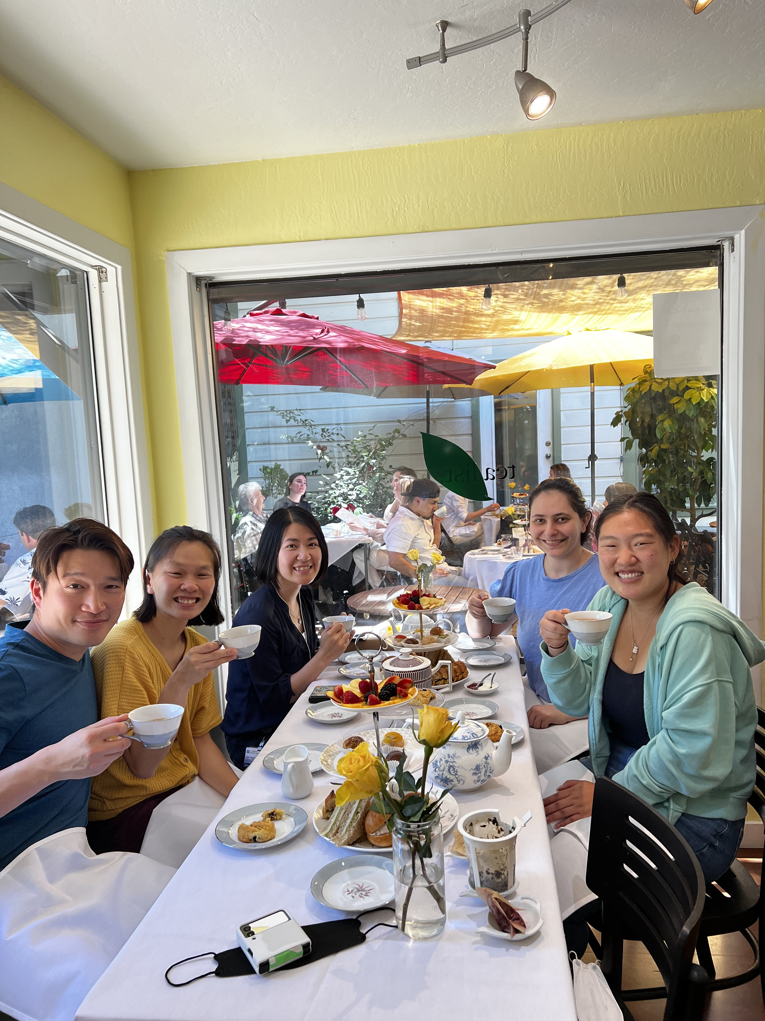


Acknowledgements
Research Funding:
Special Thanks To:
Dr. Ronald Li
Dr. Jennifer Willcox
Dr. Ava Tan
Nghi Nguyen
Mac Han (emotional support)
Student Funding:
Financial support was provided by the Students Training in Advanced Research (STAR) Program through Boehringer Ingelheim

Slide 16


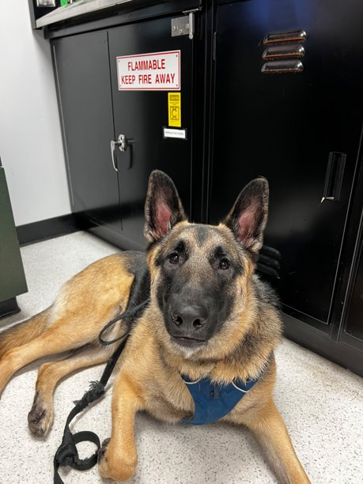

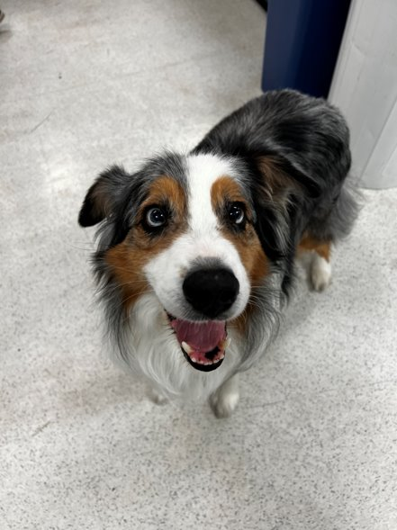
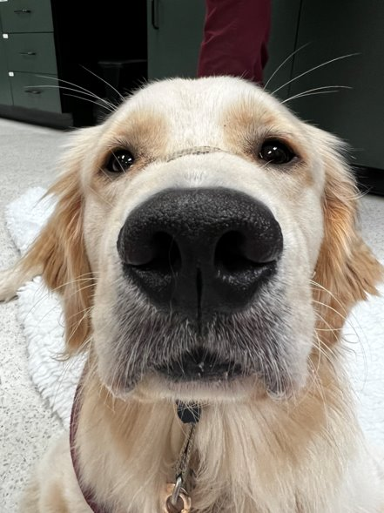


Acknowledgements
Lira, Cade, Deacon, Andie, Hudson, Vesper, Luke, Mac
Dr Li, Dr. Stern, Dyne Hansing, Eric Stubbs, Dr. Elise Lenske, Dr. Kristina Millar, Emily Bingham, Stephanie Han
Notes:
What type of Tumors: epithelial tumors, round cell tumors
Hepatocellular carcinoma
Hodgkin Lymphoma
Pancreatic cancer cells
Does this medication have any bad side effects?
At this time, in canines, we are unsure of the side effects
With cancer in particular, it was shown that NETs aid in tumor progression and metastasis by several different mechanisms (in humans and in mice)
NETs can entrap cancer cells and function as a vehicle to promote metastasis​
Extracellular DNA released by NETs may facilitate metastasis by acting as a chemotactic factor for cancer cells​
NETs may promote metastasis by enhancing angiogenesis, disrupting vascular environment and increasing vascular permeability
Why are we testing PMA and A23187
PMA is specific for PAD4
A23187 is just for calcium ionophore that punches holes into the membrane allowing for NETs to be released
Has this been tested in vivo?
Yes, but it was given orally and it showed that the bioavailability of this drug is low, there are no current injectable studies, and it was a different HDACi → Valproic Acid
Why did we pick Pano?
We did not much about this drug
Is this killing cancer cells?
No, but it has indirect positive effects. Treating the downstream effects of the overzealous inflammation triggered by the cancer cells
How is this implemented in dogs with cancer?

