Slide 1
Subtyping Influenza A Virus Antibodies in Northern Elephant Seals
Julie Baldassano
Coffey Lab
STAR 2020
UC Davis School of Veterinary Medicine

Slide 2
Introduction – Influenza A species
The Ohio State University College of Veterinary Medicine

Slide 3
Introduction – Mixing hosts
Adapted from: Zhao, P., Sun, L., Xiong, J. et al. Semiaquatic mammals might be intermediate hosts to spread avian influenza viruses from avian to human. Sci Rep 9, 11641 (2019).

Slide 4
Introduction – Previous work

Slide 5
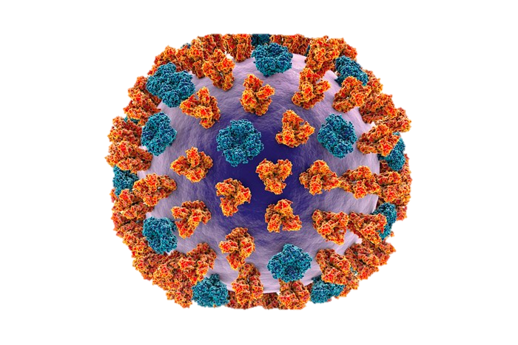
Hypothesis
Northern Elephant Seals are exposed to influenza A virus subtypes known to infect birds and humans.
H1, H3, H5
Birds – potentially by sharing on onshore environment
Humans – human H1N1 isolated from NES, possibly sewage route
Understanding which subtypes are present in seals will help us figure out which routes are transmitting flu

Slide 6
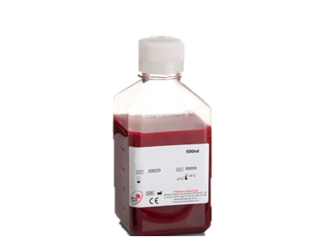
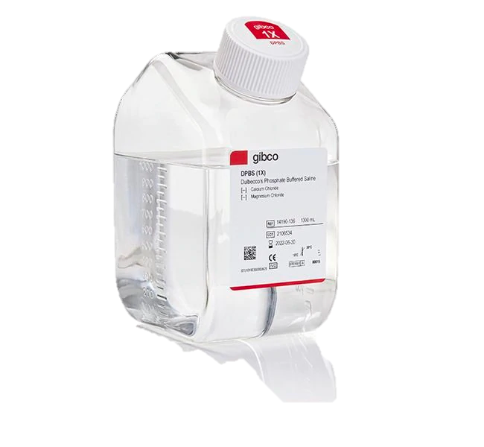
Prepare reagents
H1
H3
H5
Chicken erythrocytes
dPBS
NES serum sample
Isolated virus (3 subtypes)

Slide 7
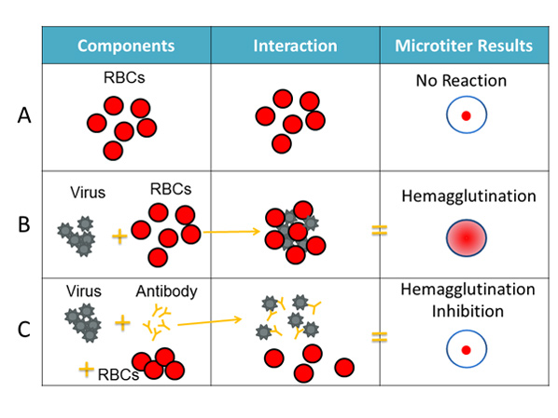
Hemagglutination inhibition assay
Runstadler lab protocol

Slide 8
Hemagglutination inhibition assay interpretation
Titer Interpretation Key
1:8
1:16
1:32
1:64
1:128
1:256
1:512

Slide 9
Seropositivity of Northern Elephant Seals to H1, H3, H5 Subtypes
= Positive control, known H1 exposure
= Negative control
= Cutoff for positive samples
*Each sample measured 2-4 times for average
*
H1
H3
H5

Slide 10
Seropositivity of Northern Elephant Seals to H1 Subtype
= Positive control
= Negative control
= Cutoff for positive samples
1 seal positive control
4 seals negative controls
8 seals < antibody titer cutoff
60 seals > antibody titer cutoff
59/60 with more than 4x difference
1 seal had equal H1 and H3 titers of 26.7
Therefore, 87% (59/68) of ELISA+ seals showed evidence of H1 seropositivity
H1

Slide 11
Seropositivity of Northern Elephant Seals to H3 Subtype
H1 titer was 427
= Negative control
= Cutoff for positive samples
4 seals negative controls
59 seals < antibody titer cutoff
9 seals > antibody titer cutoff
8/9“positive” seals had H1 titer of >128
More than 4x difference
1 seal had equal H1 and H3 titers of 26.7!
Therefore, only one ELISA+ seal showed evidence
of H3 seropositivity
H3

Slide 12
Seropositivity of Northern Elephant Seals to H5 Subtype
= Negative control
= Cutoff for positive samples
4 seals negative controls
63 seals < antibody titer cutoff
5 seals > antibody titer cutoff
But all 5 “positive” seals had H1 titer of >128
More than 4x difference
Therefore, no ELISA+ seals showed evidence
of H5 seropositivity
H5

Slide 13
Interpretation of results
HI titer
“Reciprocal value of the highest dilution of the serum which still completely inhibits the agglutination of the erythrocytes in the presence of influenza virus”
Immunity to multiple subtypes or cross reactivity of antibodies?
Cross reactivity would mean an antibody to one subtype (H1) partially also binds another (such as H3)
Fourfold difference
One seal positive for multiple without fourfold difference (H1: 26.7, H3: 26.7)
These data suggest that most Northern Elephant Seals were infected by and/or possessed maternal antibodies to the H1 but not H3 nor H5 IAV subtypes.
This is consistent with seals having more contact with some H1 transmission hosts (birds and humans) than some hosts of H3 and H5 (horses and pigs).

Slide 14
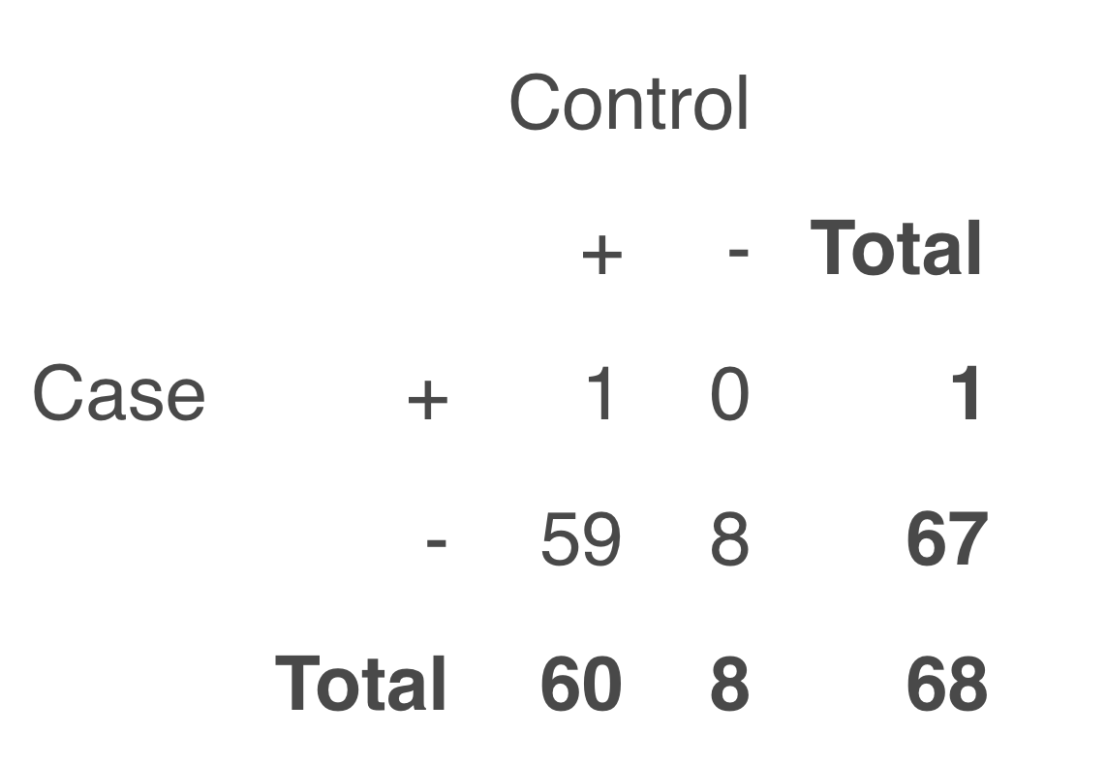
Interpretation of results – Cross reactivity?
H1
H3
McNemar's test for concordance vs discordance
P value < 0.0001
Discordance means there is less cross-reactivity

Slide 15
Next steps
Need positive controls for H3 and H5!
Complete H1, H3, and H5 tests for additional samples
Remote: Phylogenetic analysis of waterfowl influenza data

Slide 16
Overall STAR 2020 experience

Slide 17
Acknowledgements
People
Magdalena Plancarte
Lark Coffey
Isaac Pessah
Eileen English
Philip Kass
Daniele Swetnam
Runstadler culture lab
Coffey lab
Boyce lab
Marine Mammal Center team
Funding
Research Grant: NIAID funded Center of Excellence in Influenza Research and Surveillance award HHSN272201400008C
Student Support: National Institutes of Health T35 OD010956
Financial support was provided by the Students Training in Advanced Research (STAR) Program.
Thank you!!
^Me

Slide 18
Any questions?

