Slide 1
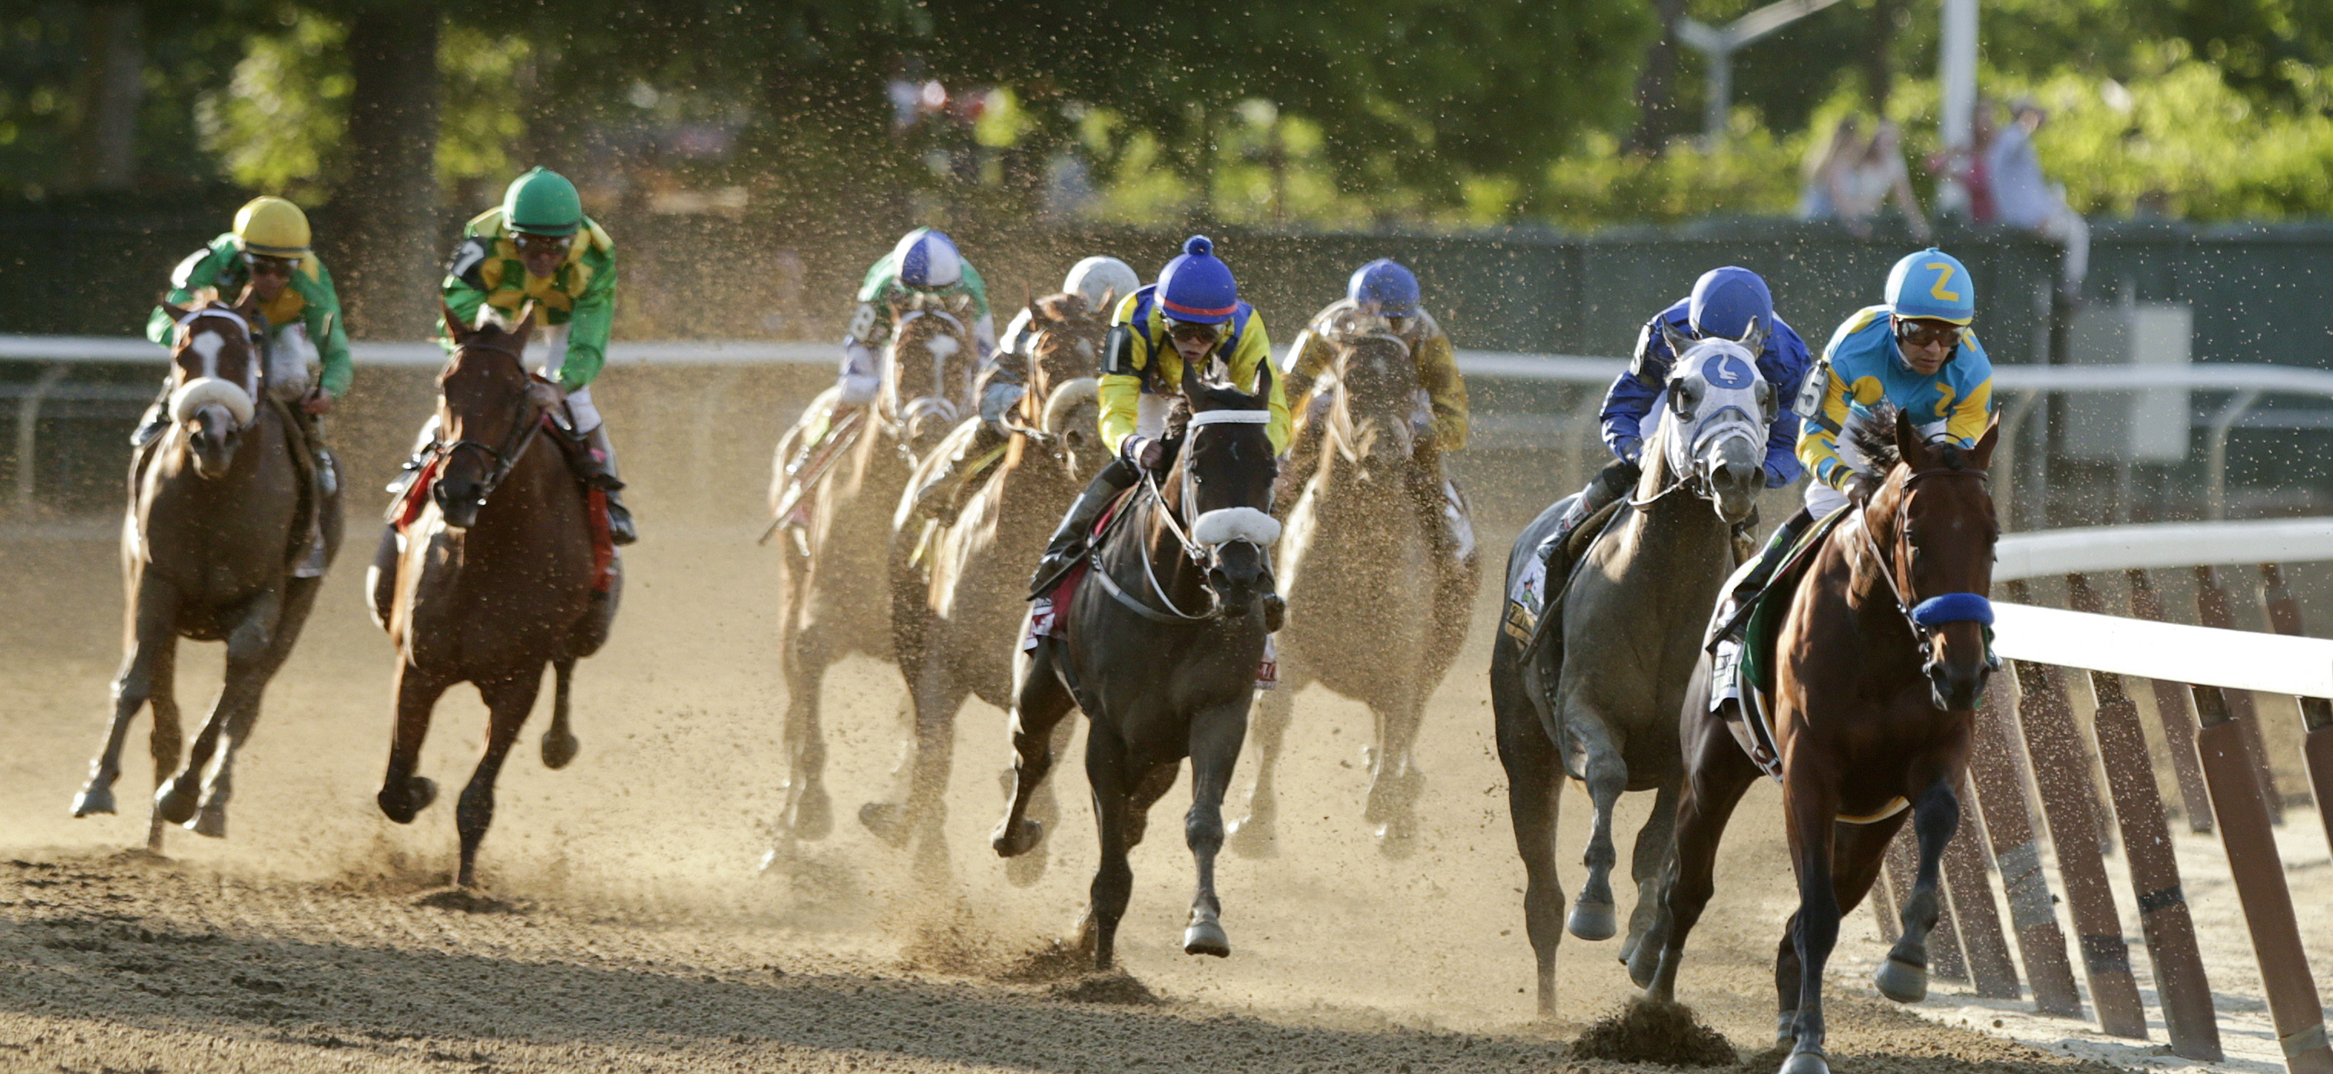
Hyperextension of the fetlock joint as a mechanism of catastrophic fracture of the proximal sesamoid bones in Thoroughbred racehorses
Kassidy Shelly
Sarah Shaffer, Tanya Garcia,
Susan Stover PhD, DVM, DACVS

Slide 2
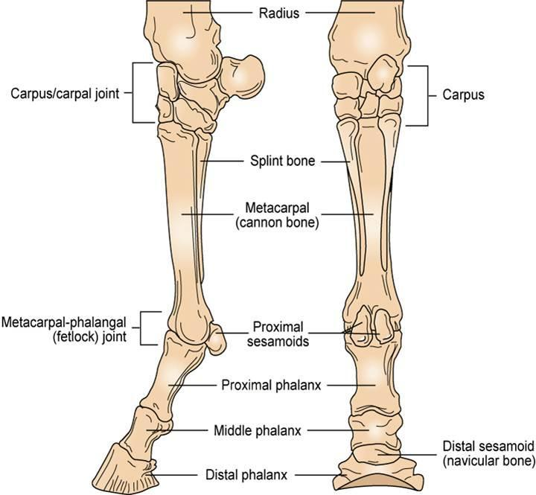
Introduction
3rd Metacarpal = MC3
Proximal Sesamoid Bones = PSBs
Proximal phalanx = P1
https://i.pinimg.com/736x/a4/85/39/a48539d8e5830b90ec91ca8f3a5668b6.jpg

Slide 3
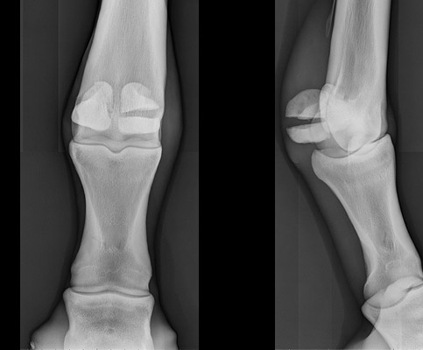
Background
Musculoskeletal injury is the most common cause of death associated with training or racing¹
Proximal sesamoid bone fracture accounts for 45-50% of those injuries¹
https://surgeryreference.aofoundation.org/vet/horse/phalanges/proximal-sesamoid-bones-midbody/definition?searchurl=%2fSearchResults

Slide 4
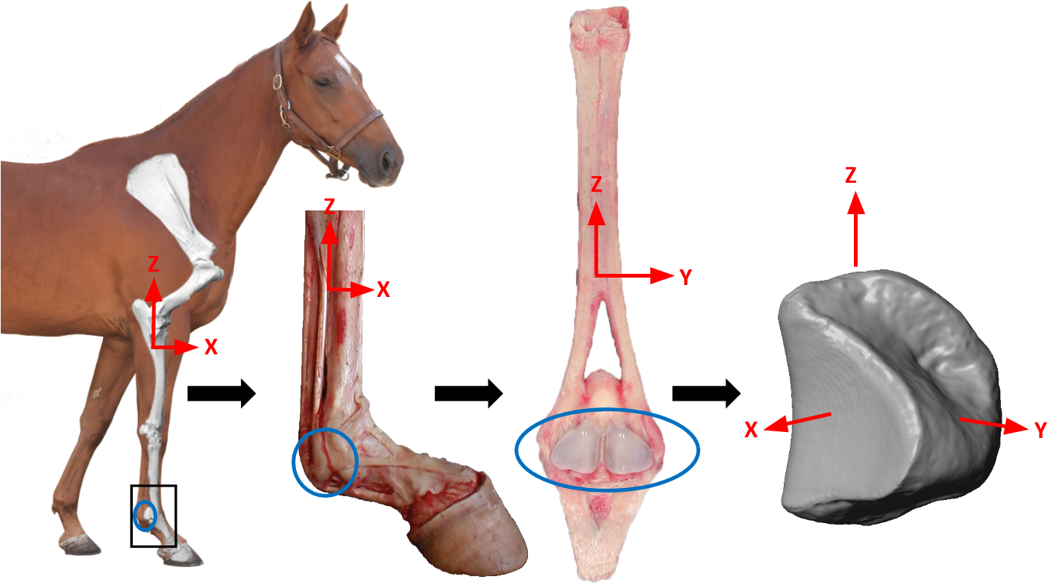
Background
Focal subchondral lesion associated with fracture²
Hyperextension of the fetlock joint causes malarticulation of the PSBs

Slide 5
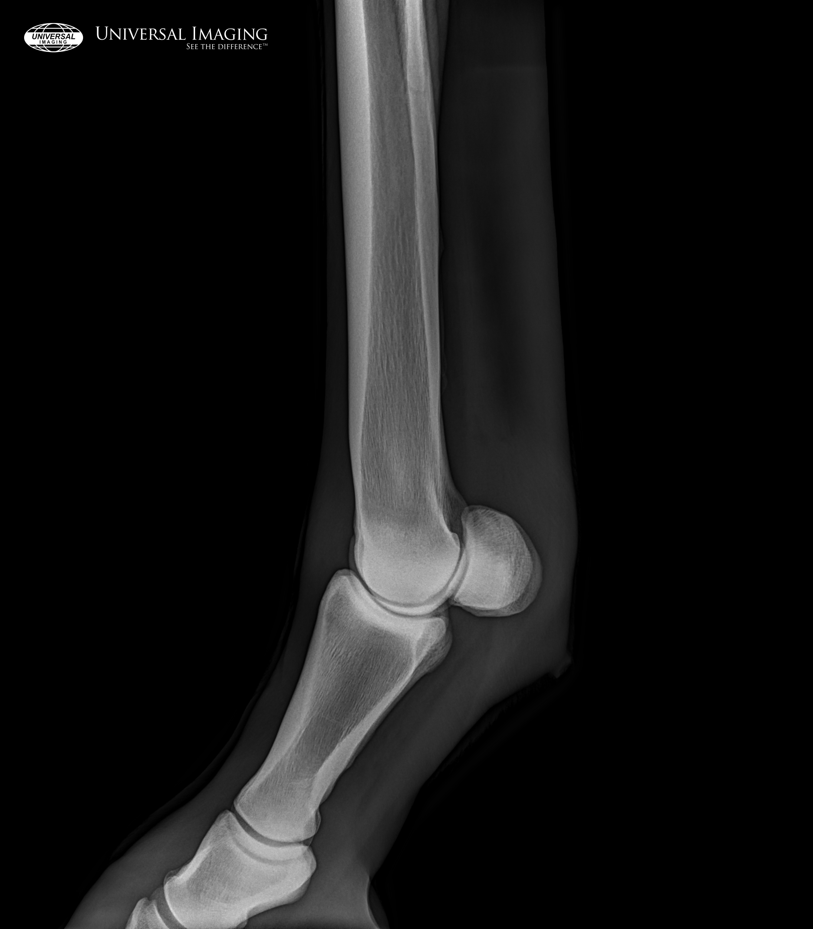
Hypothesis
Loading cadaveric limbs to stimulate a high-speed gallop will cause malarticulation of the PSB with the MC3 condyle in a pattern consistent with the development of the subchondral lesion
https://www.universalimaginginc.com/wp-content/uploads/2015/04/1939.jpg

Slide 6
Materials and Methods
8 cadaveric limbs (6 left, 2 right)
Age 2-21
1 QH, 4 TB, 1 Paint, 1 WB
Track 3D motion of PSBs
Placed kinematic markers
Precondition with instruments
Mechanical testing system
0.25 Hz, 200 cycles, 700-1800N
Loaded to gallop loads
10.5 KN in mechanical testing system

Slide 7
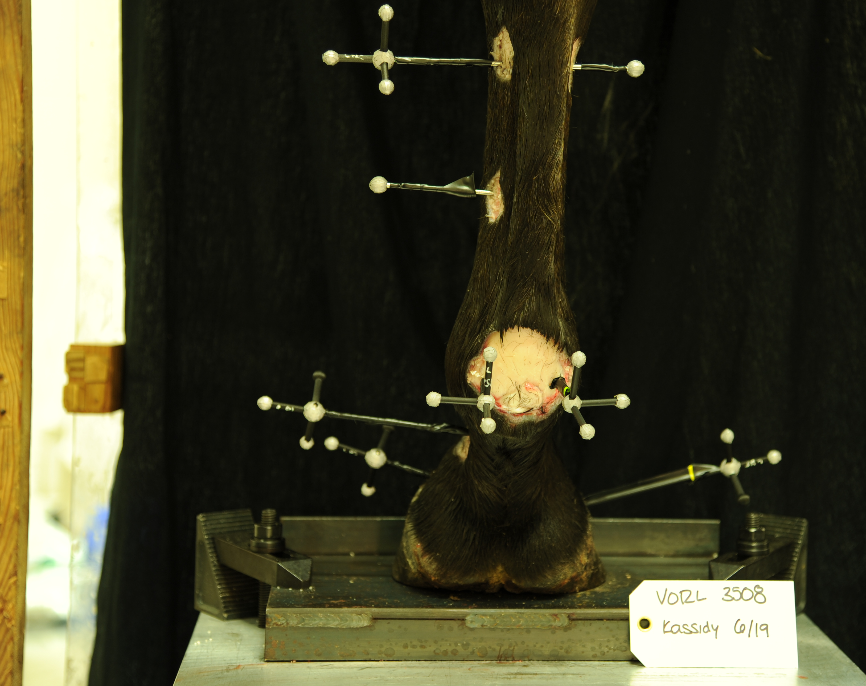
Materials and Methods (Contd)
Collected data at following loads:
Stance – 1800N
Walk – 3600 N
Trot – 4500 N
Gallop – 10,500N

Slide 8
Materials and Methods (contd)
Loaded with markers and recorded with high speed video with 2 different camera angles
10mm/sec load from 700N to 10.5KN
Hold at 10.5KN for ½ second
Unload 5 mm/sec
Repeated twice
Vicon Motus Software to track markers
Statistical analysis with ANOVA

Slide 9
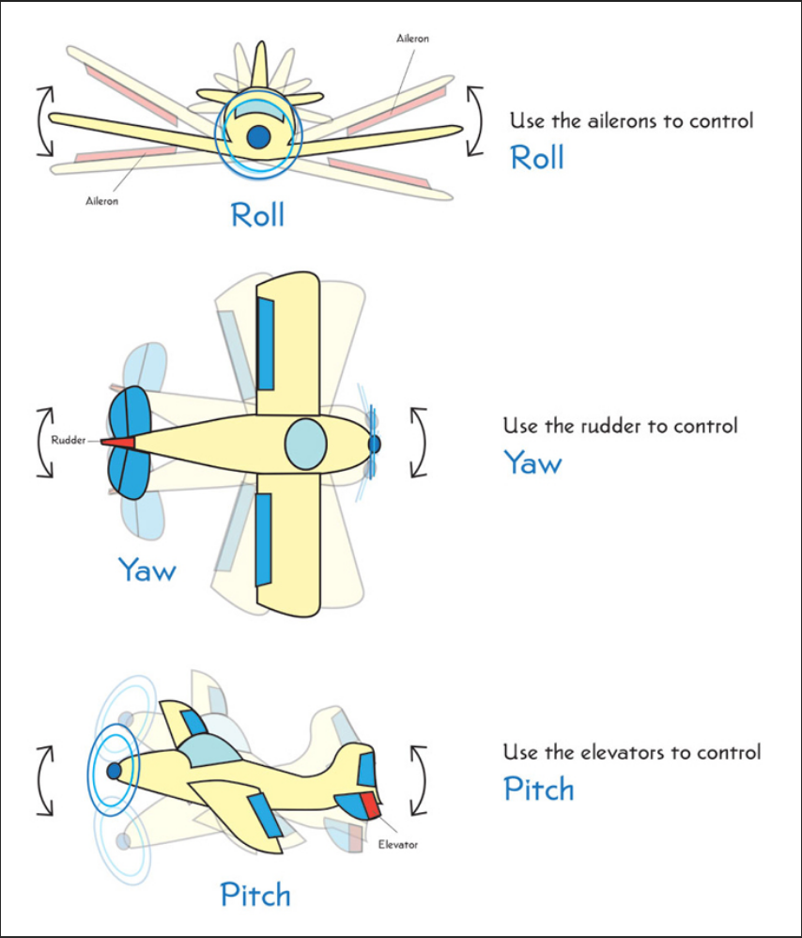
3D Motion Tracking
Roll
Yaw
https://howthingsfly.si.edu/flight-dynamics/roll-pitch-and-yaw

Slide 10
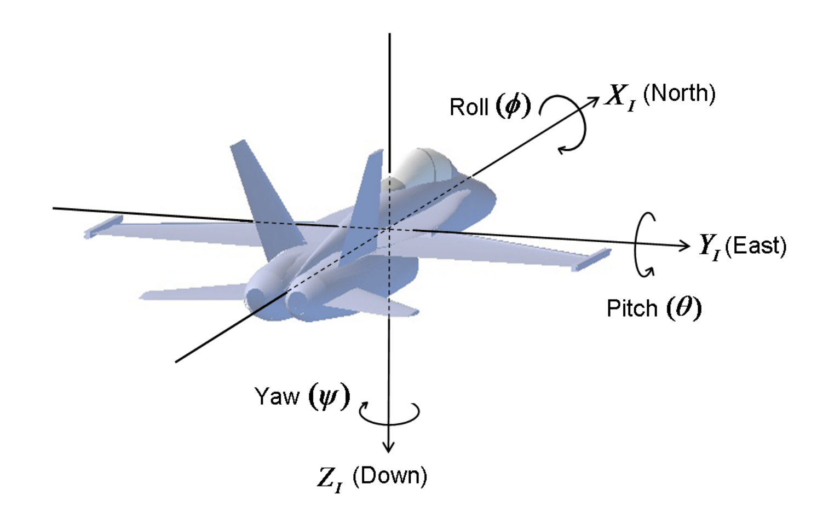
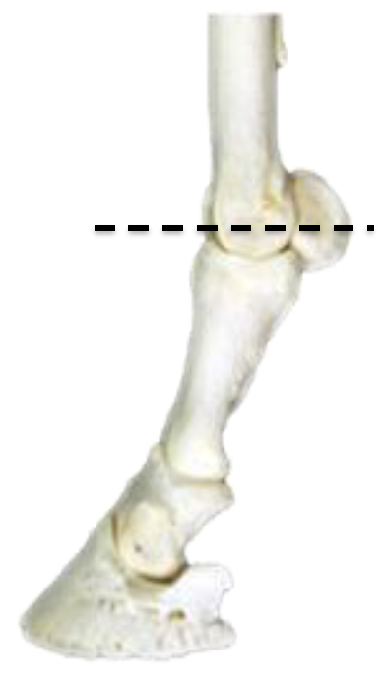
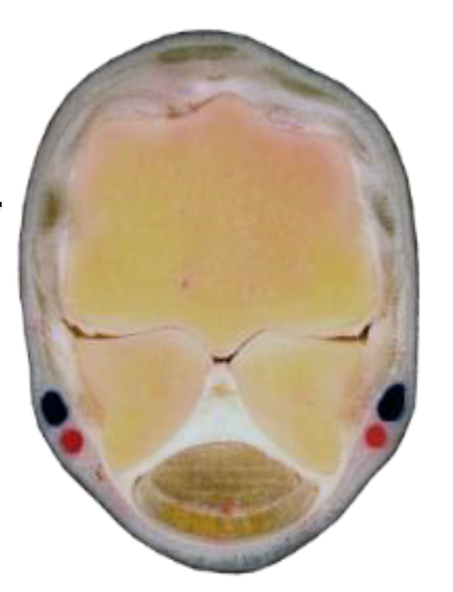
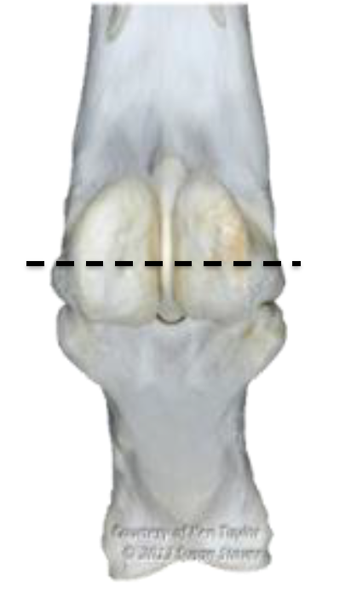
Roll
How the medial-lateral axis of PSB is aligned with medial-lateral axis of MC3
http://www.chrobotics.com/library/understanding-euler-angles
Notes:
If the angle is getting larger then the abaxial tip is moving towards midline

Slide 11
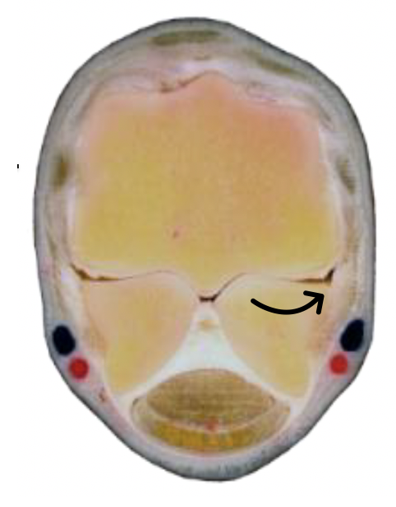
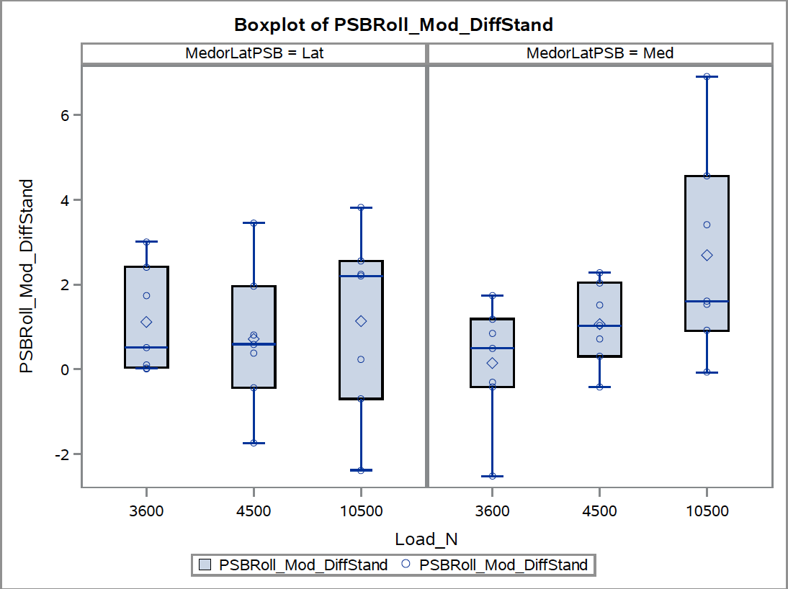
Preliminary Results
Walk/Gallop: p = 0.0154
Roll
Walk Trot Gallop
Walk Trot Gallop
Notes:
No significant difference in roll for the lateral PSB but there was a significant difference between the walk (3600N) load and gallop (105000N) load. This suggests that the medial PSBs abaxial side is moving towards midline. This movement towards midline is consistent with the subchondral lesion that is found on the abaxially on the medial PSB.

Slide 12
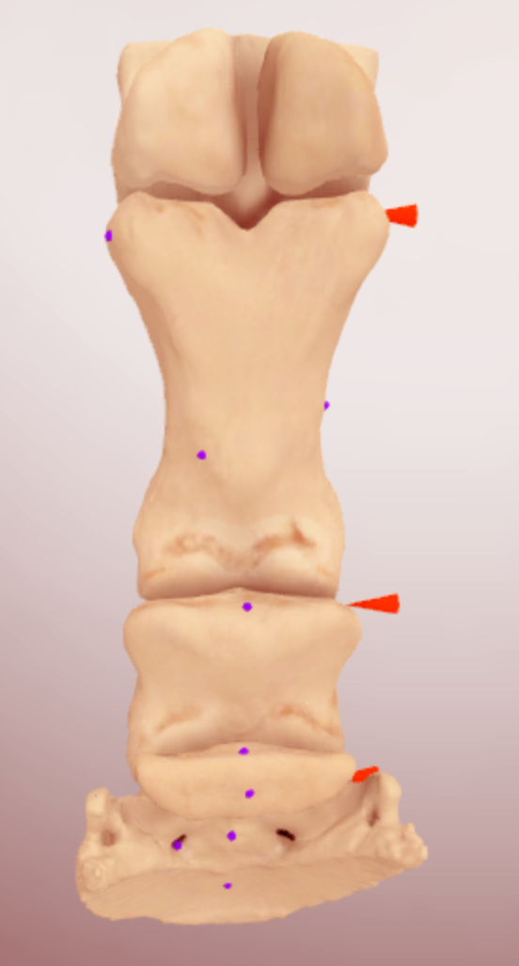
Yaw
How the proximo-distal axis of the PSB is aligned with the proximo-distal aspect of MC3
https://www.vin.com/members/3DLearning
Notes:
As the angle gets more negative the tip of the PSB is moving away from midline of the PSB

Slide 13
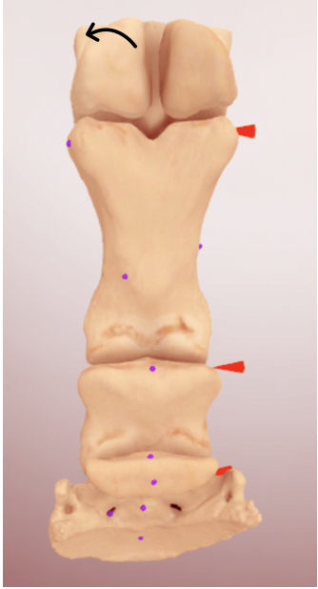
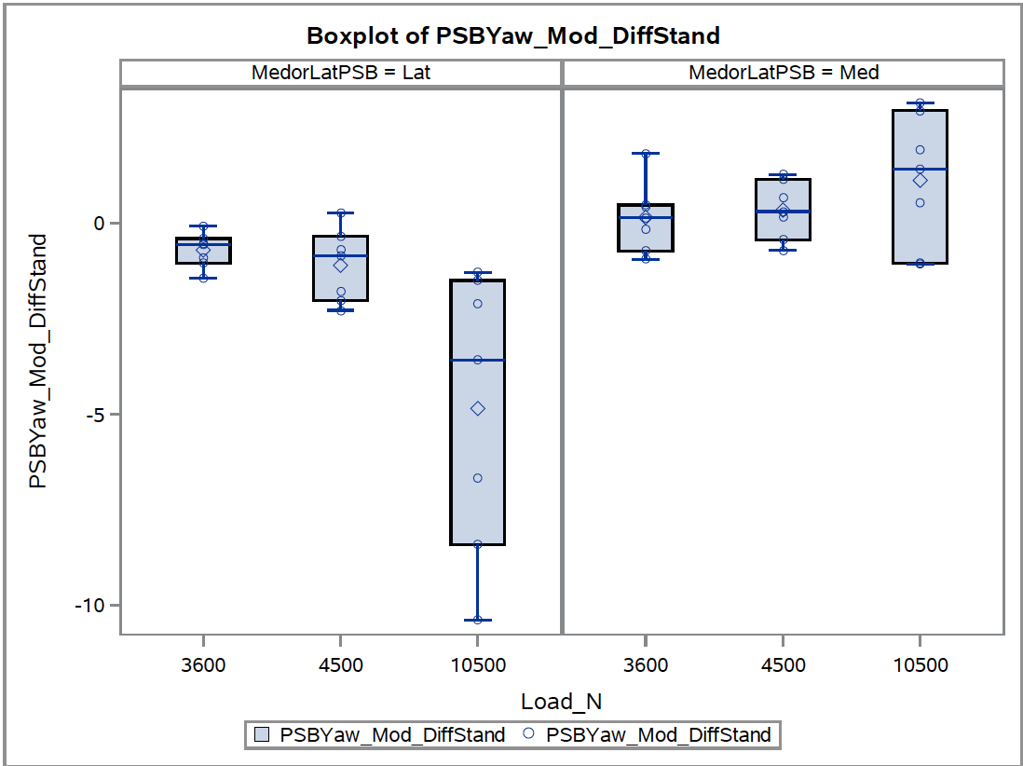
Preliminary Results
Yaw
Walk/Gallop: p = 0.0054
Trot/Gallop: p = 0.0078
Walk Trot Gallop
Walk Trot Gallop
Notes:
Data suggested that there was no significant difference in yaw for the medial PSB. There was a significant difference in yaw for the lateral PSB for gallop compared to both walk and trot. The negative change in angle suggests the tip of the lateral PSB is moving abaxially from MC3

Slide 14
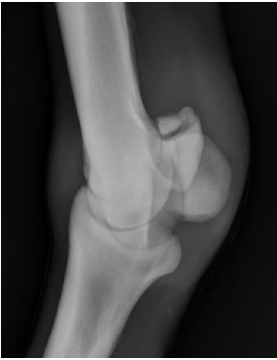
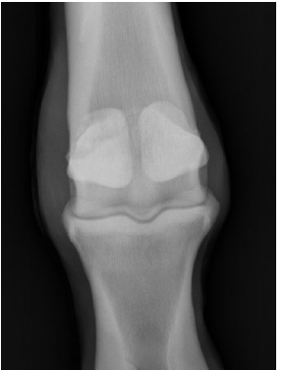
Significance
Apex of lateral PSB is moving abaxially
Apical avulsion fractures seen on the lateral PSB

Slide 15
Significance
Medial PSB abaxial side is moving towards MC3 condyle
Subchondral lesion found abaxially on the medial PSB

Slide 16
Acknowledgments
Financial Support:
Provided by the Students Trained in Advanced Research (STAR) program and the Center for Equine Health
Thank you:
Sarah Shaffer
Tanya Garcia-Nolen
Dr. Susan Stover

Slide 17
Questions?
Thank you!

Slide 18
References
Stover, S. M. (2003). The Epidemiology of Thoroughbred Racehorse Injuries. Clinical Techniques in Equine Practice (Vol 2, No 4, pp. 312-322).
Shaffer, S, Stover, SM, Fyhrie, DP (2019-2020) Unpublished work –Finite Element Modeling of PSBs for Injury Prevention

Slide 19
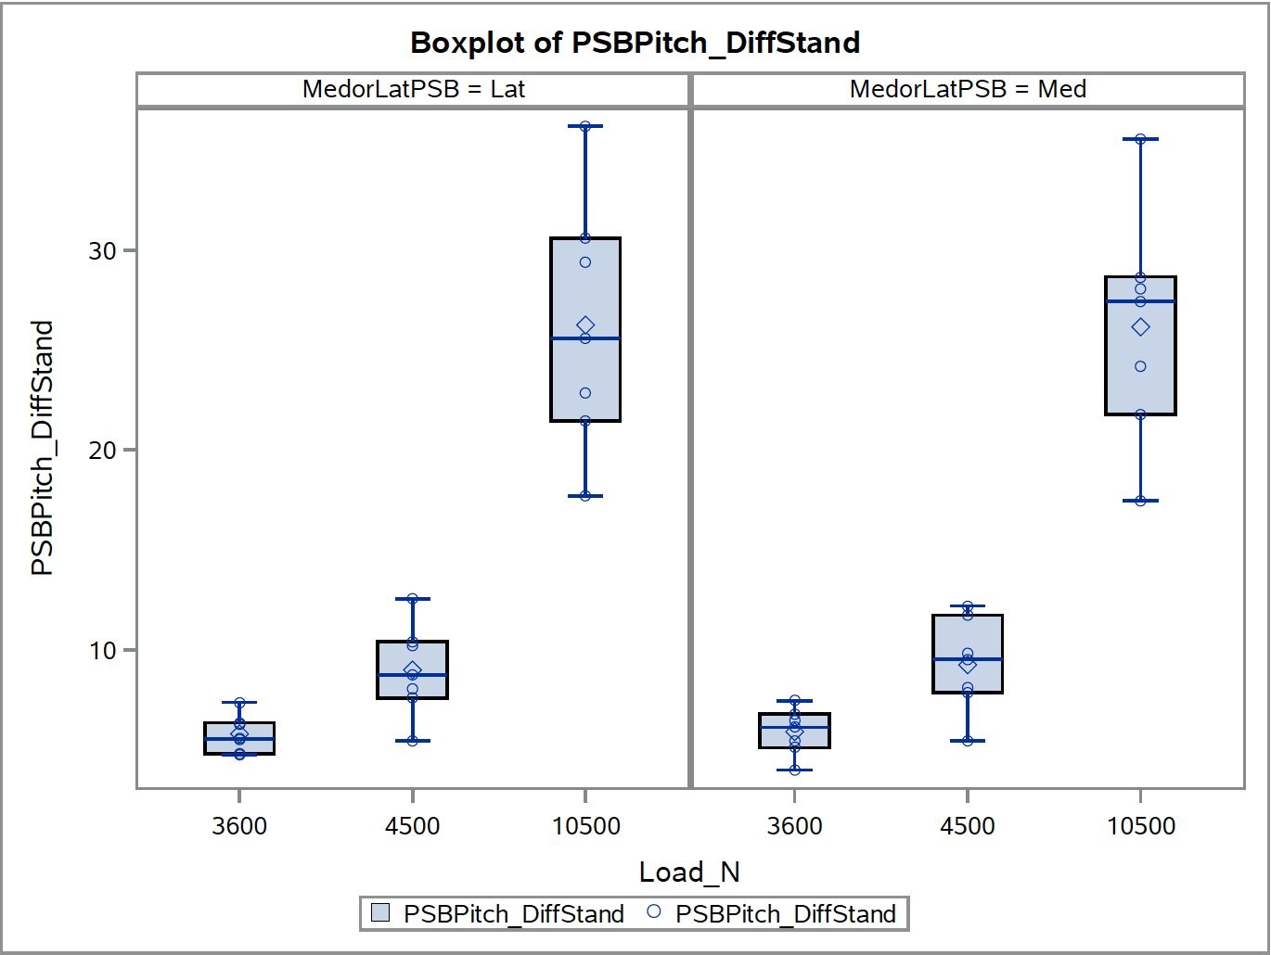
Preliminary Results
Pitch

