Slide 1
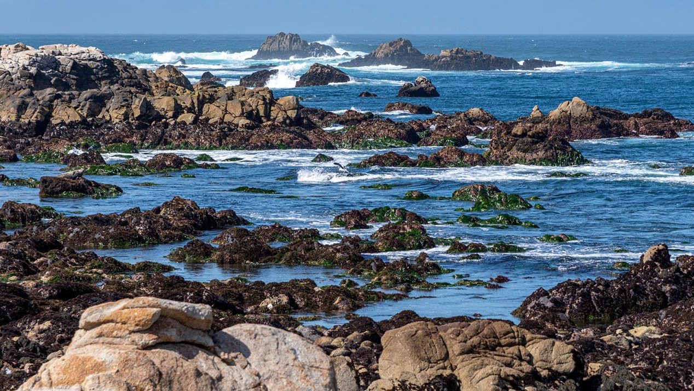
Evaluating Sarcocystis neurona genotypes as drivers of mass mortality events in southern sea otters
Lizzy Ashley, Devinn Sinnott, Melissa Miller, and Karen Shapiro

Slide 2
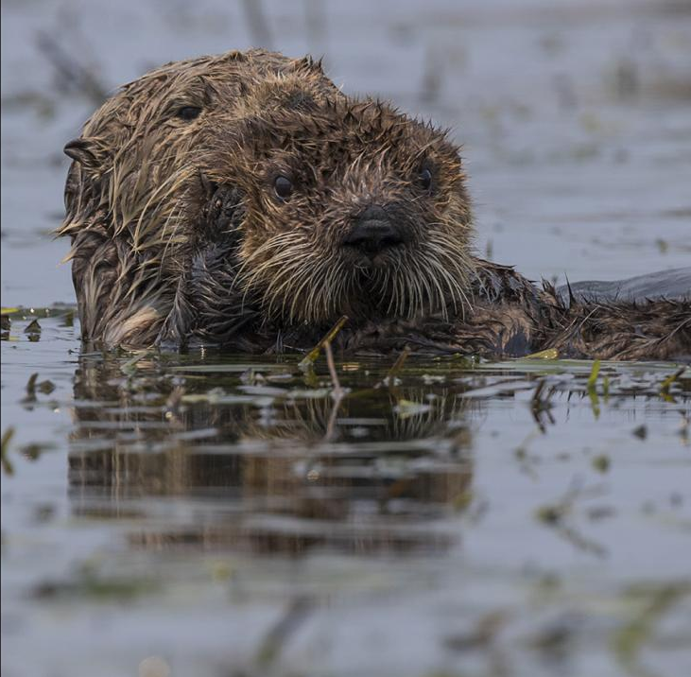
Southern Sea Otters (Enhydra lutris nereis)
Keystone predator and sentinel species found along the CA coast
Population below historical size and in fragment of former range
High mortality rates due largely to infectious disease
Recent study utilizing 14 years of necropsy data found protozoal disease = 20% of all mortalities (Miller et al., 2020)
Trina Wood/UC Davis
Notes:
When primary and contributing COD were combined, the most prevalent COD was infectious disease (affecting 63% of
otters), especially fatal infections by acanthocephalans (Profilicollis spp.) and protozoa
(e.g., Sarcocystis neurona and Toxoplasma gondii).

Slide 3
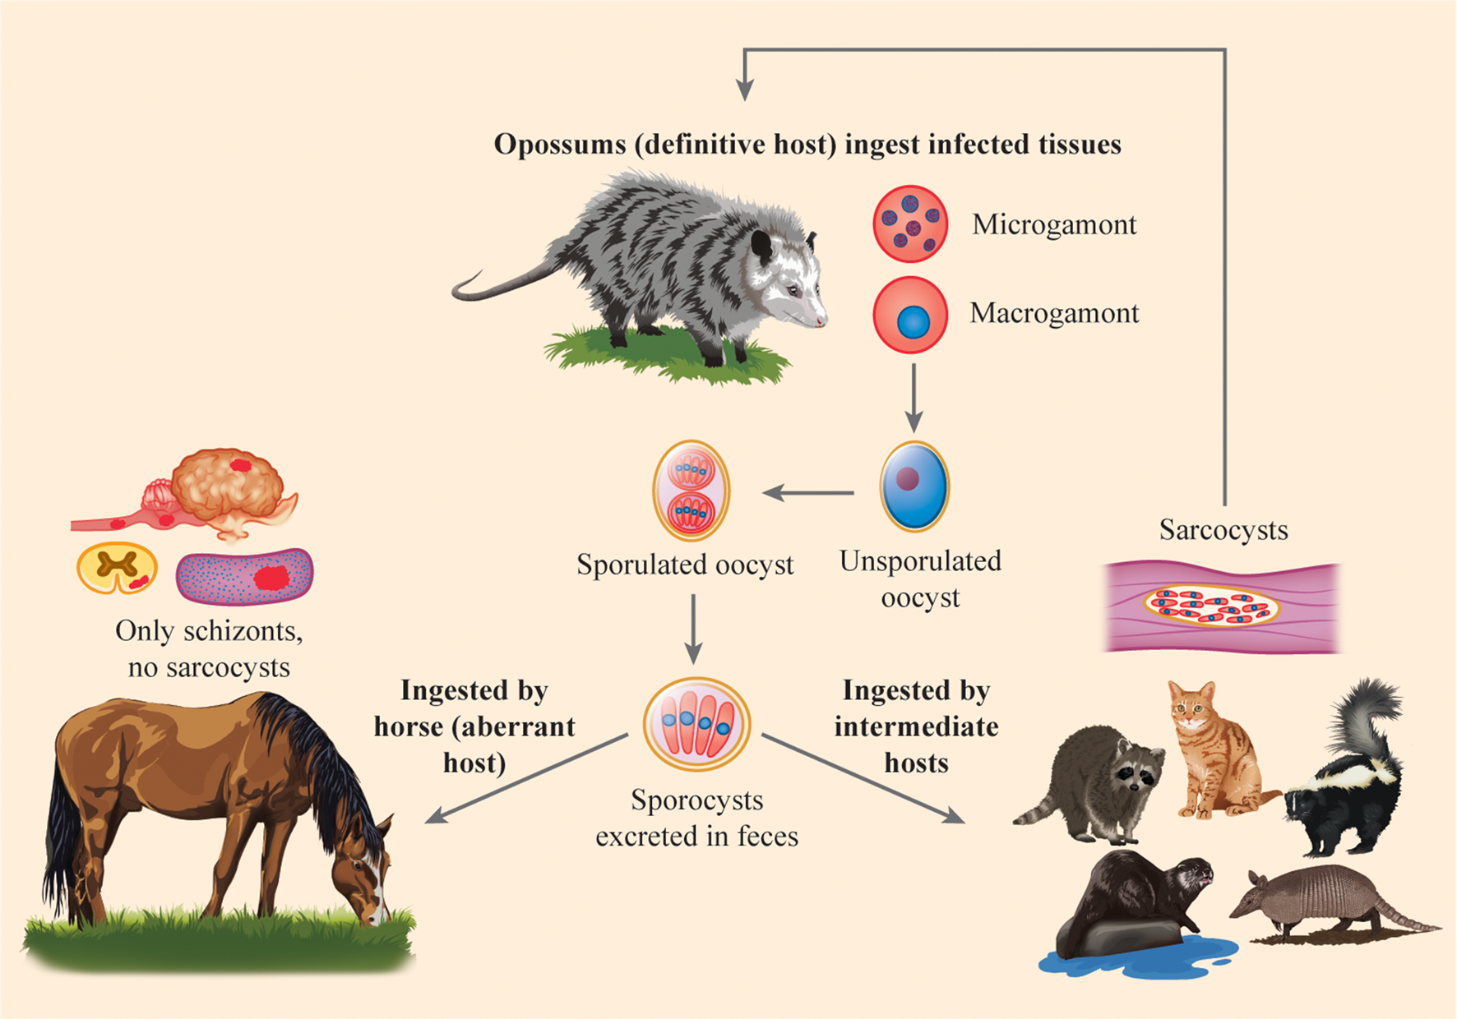
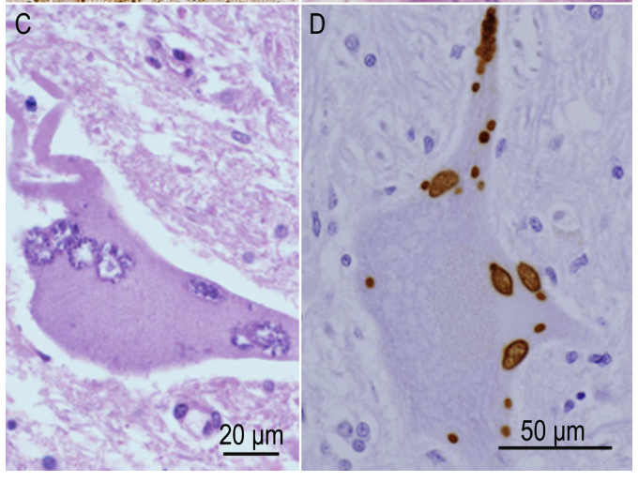
Sarcocystis neurona infects domestic and wild mammals
*
Dubey, 2022
Schizonts and sarcocysts
Notes:
https://doi.org/10.1017/S0031182021002055
Histo is also from Dubey et al. showing schizonts within neurons + IHC for S. neurona
EPM

Slide 4
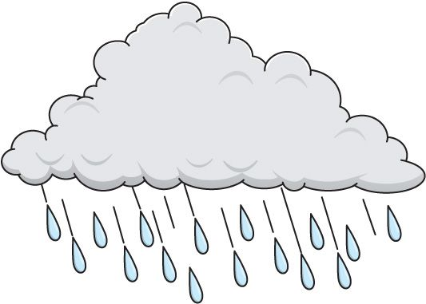
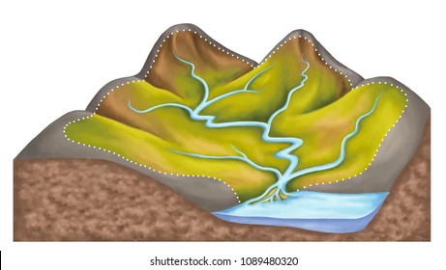
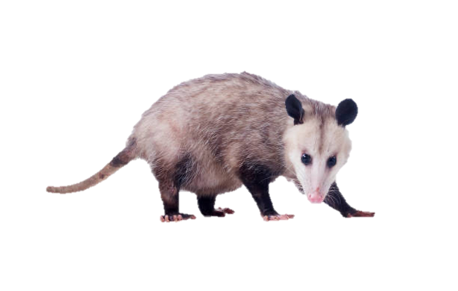
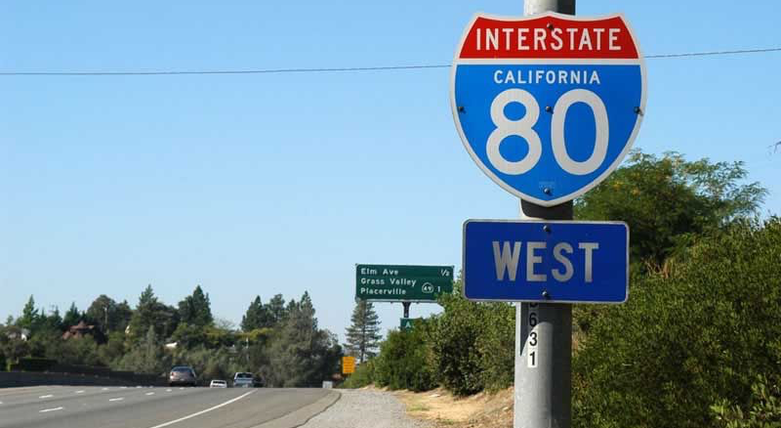
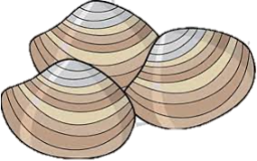
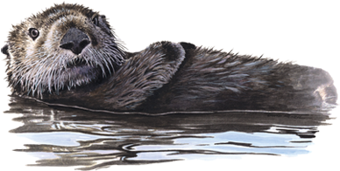
Sarcocystis neurona in sea otters
Didelphis virginiana
Walsh & Tucker, 2017
Notes:
Walsh and Tucker 2017 http://dx.doi.org/10.1139/cjz-2017-0071
Rainy season, not spring

Slide 5
Sarcocystis neurona in sea otters
Incidental infections with no apparent clinical signs
Sporadic morbidity and mortality
Severe seizures and tremors
Meningoencephalitis
Myocarditis and myositis
Mass mortality events, or epizootics, over 4-week periods
Spring 2004: ~40 otters
Spring 2021: ~30 otters
Notes:
Mention Estero Bay – ask audience if anyone can guess where in California this photo was taken?
Inset map or mention where in CA estero bay is

Slide 6
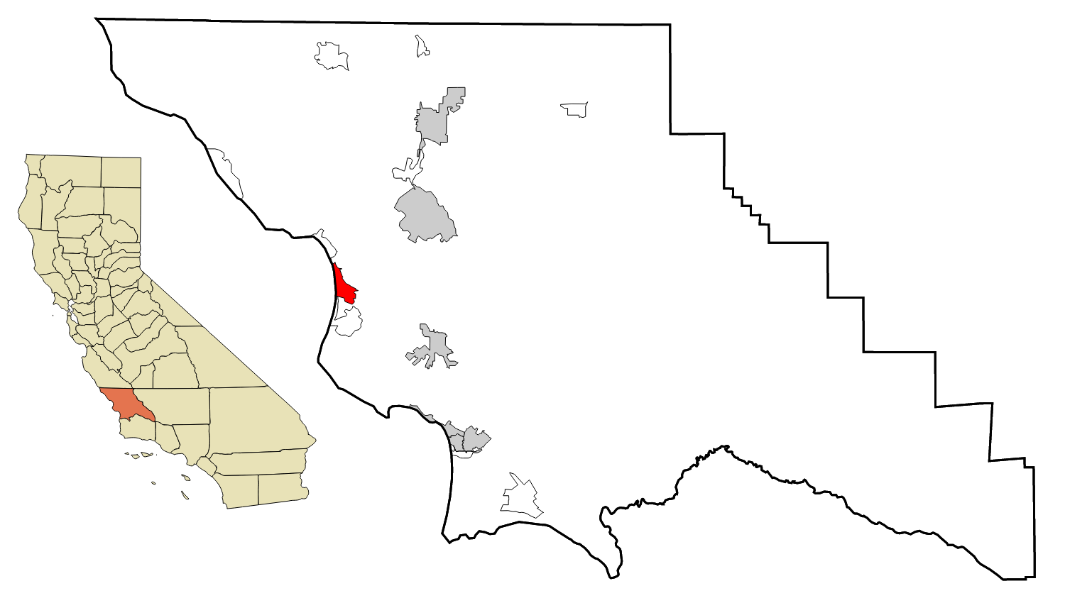
Sarcocystis neurona in sea otters
Estero Bay
Sporadic morbidity and mortality
Severe seizures and tremors
Meningoencephalitis
Myocarditis and myositis
Mass mortality events, or epizootics, over 4-week periods
Spring 2004: ~40 otters
Spring 2021: ~30 otters
Incidental infections with no apparent clinical signs
Notes:
Mention Estero Bay – ask audience if anyone can guess where in California this photo was taken?

Slide 7
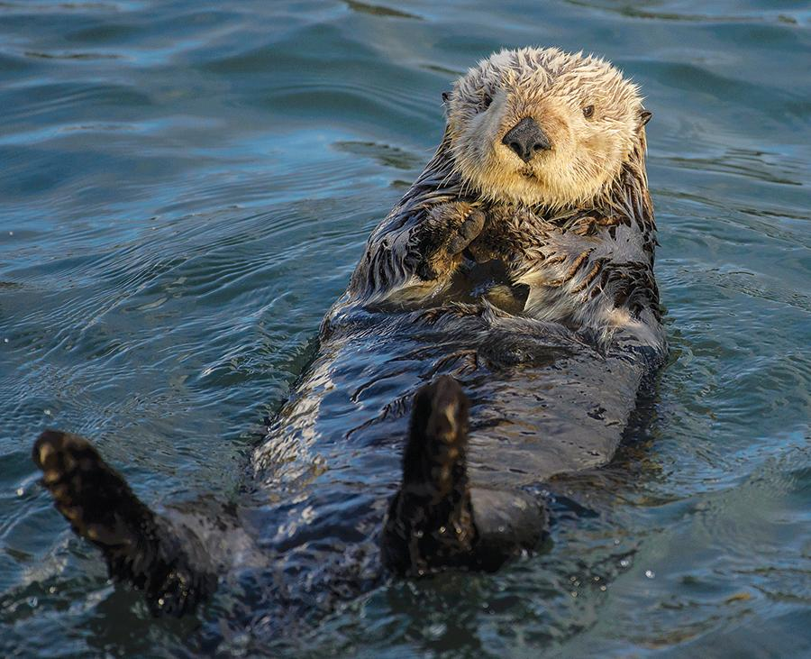
S. neurona mass mortality events
What possible factors act synergistically to induce epizootics?
Host - Sea otters
Environment - Estero Bay
Pathogen - S. neurona
Notes:
host: age, sex, nutritional condition, diet, home range, comorbidities, immune status
Environment: rainfall, river flow, surface runoff, watershed structure, temperature, season, environmental quality
S. neurona: virulence, persistence in the environment, infectivity

Slide 8
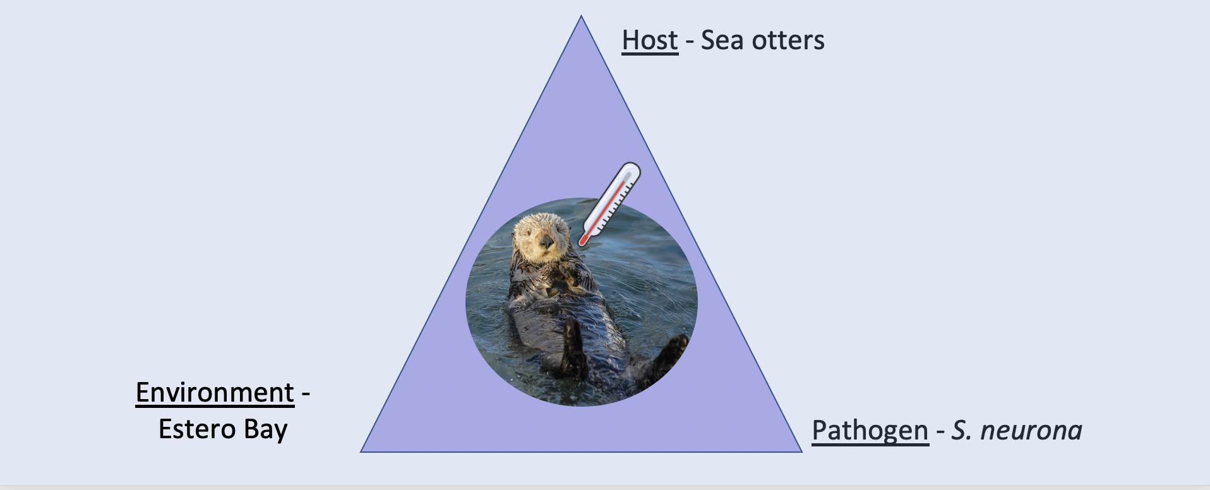
S. neurona mass mortality events
What possible factors act synergistically to induce epizootics?
Are certain genotype(s) overrepresented in epizootics vs. sporadic deaths?
Hypothesis: Unique S. neurona genotype(s) are associated with fatal infections in mass mortality events as compared with parasite genotypes implicated in sporadic S. neurona deaths.
Pathogen - S. neurona

Slide 9
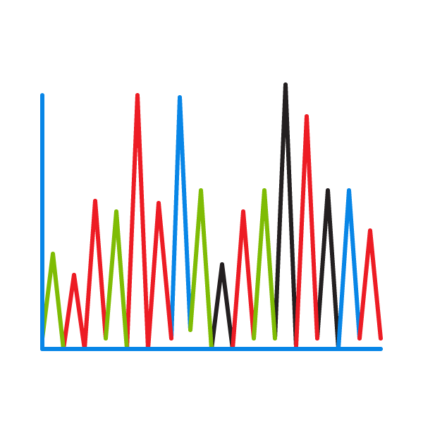
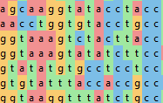
Project aims
Extract S. neurona DNA from brain tissue of seropositive otters that died in the 2021 epizootic
(n=12)
Use MLST to genotype known Sn surface antigens (3) and microsatellite markers (3)*
Combine results with published genotyping data from the 2004 epizootic*
(n=24 epizootic cases in total)
Compare S. neurona genotypes implicated in epizootics to those of sporadic deaths in sea otters (n=45)
*O’Byrne et al. 2021; Rejmanek et al. 2010; Wendte et al. 2010
Notes:
Say MLST
genotype=unique combo of surface antigens + MS markers
Aims:
Extract and amplify S. neurona DNA from brain tissue of seropositive otters that died in the 2021 epizootic (n=12)
Use multi-locus sequence typing to genotype known S. neurona surface antigens and microsatellites (O’Byrne et al., 2021; Rejmanek et al., 2010)
Combine results with published genotyping data from the 2004 epizootic (n=24 epizootic cases in total)
Compare S. neurona genotypes implicated in epizootics to those of sporadic deaths in sea otters and other susceptible species

Slide 10
Results: 19 unique S. neurona genotypes
Deaths associated with mass mortality events
(n=24)
Notes:
Ihh is very closely related genotype

Slide 11
Preliminary results: Quantifying risks to sea otters
Odds of epizootic-associated death for Ib-infected otters is 77x that of otters infected with other genotypes (Fisher’s exact test, p < 0.001, 95% CI = 13.5 - 870)
Otters infected with the Ib genotype of S. neurona were 88x as likely to have died in an epizootic event (logistic regression, p < 0.001, 95% CI = 15.7 - 491)
 | Infection Type
 | Epizootic | Sporadic | Total
Genotype Ib | 22 | 5 | 27
Other | 2 | 40 | 42
Total | 24 | 45 | 69
Notes:
What is the risk of death in an epizootic for Sn-Ib infected sea otters compared to those infected with other genotypes?

Slide 12
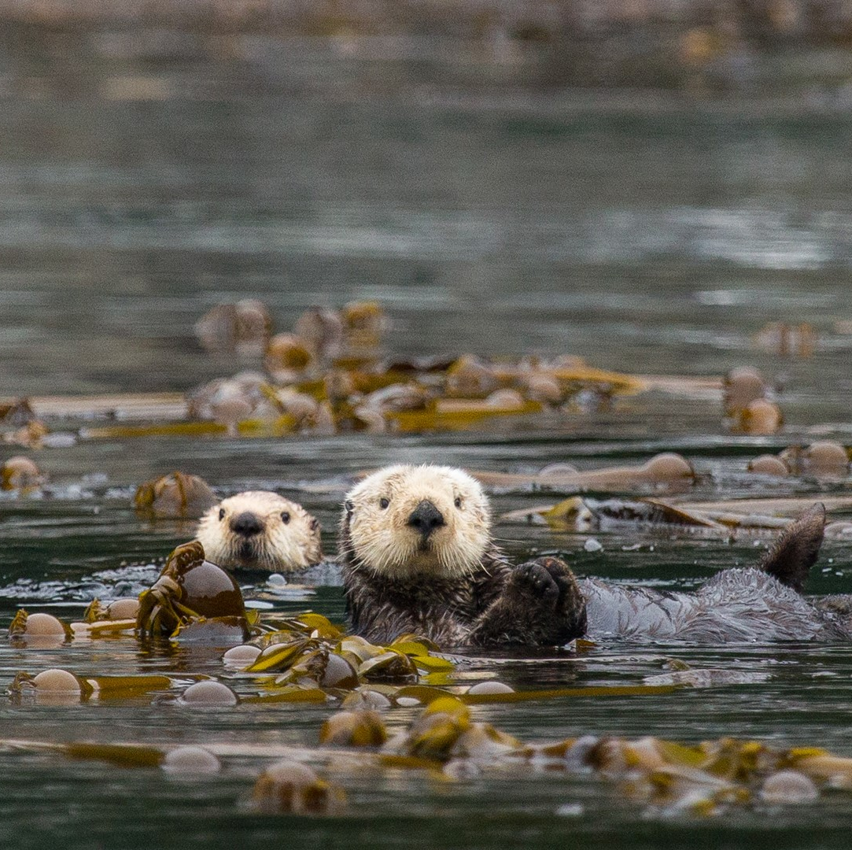
Moving forward…
Explore relatedness among genotypes with additional loci and genotypic data from other susceptible host species
Identify mechanisms driving the association between epizootics and the Ib genotype
Initial step of larger effort to investigate role of S. neurona genotype in disease severity and develop diagnostic and prognostic tools for otters
Incorporate demographic and environmental variables of interest into multivariate models

Slide 13
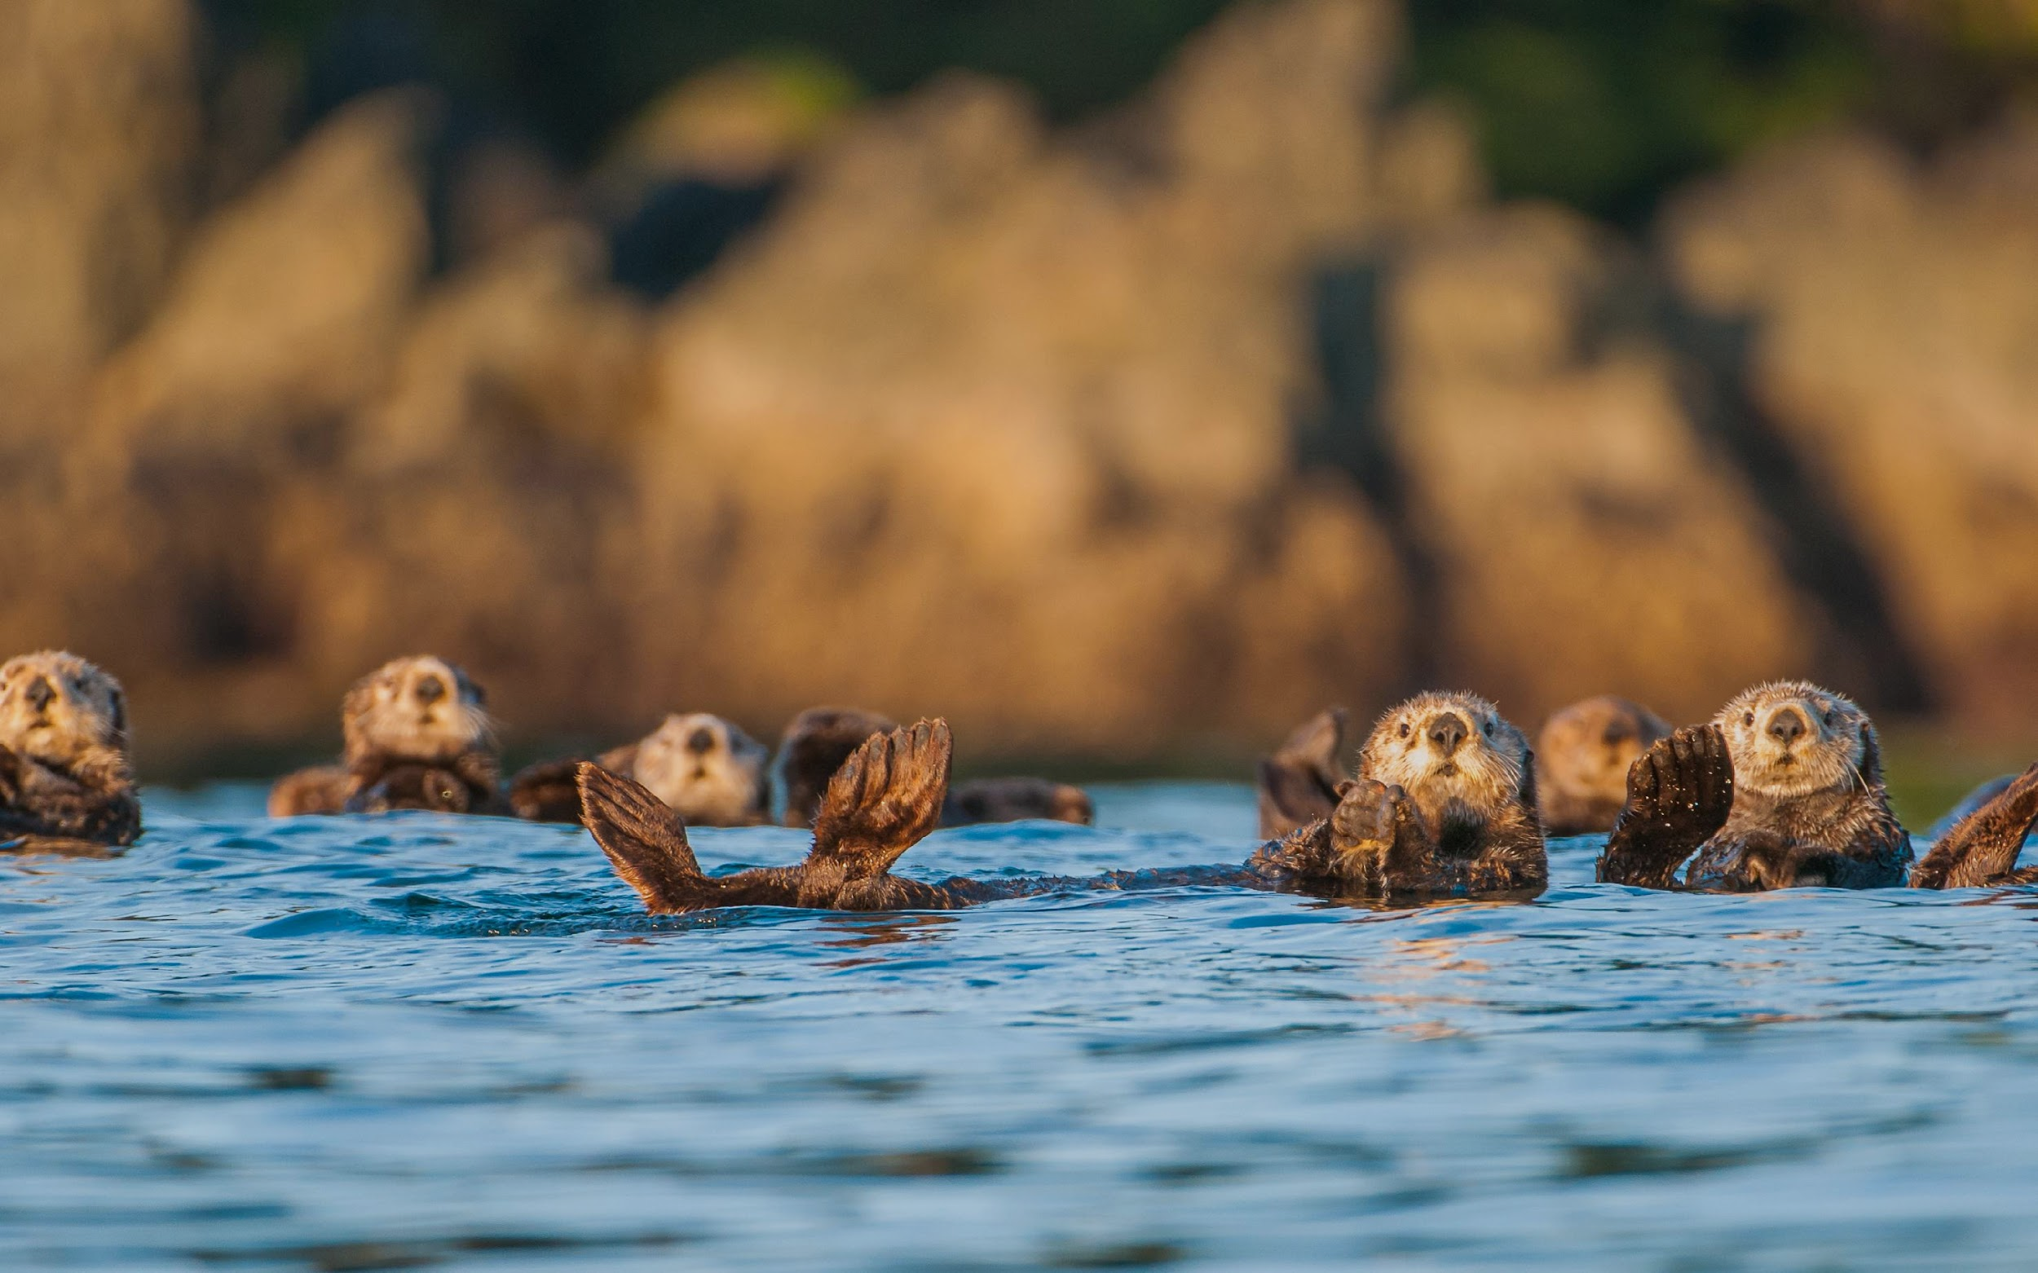
Acknowledgments
Dr. Karen Shapiro, Dr. Devinn Sinnott, and the Shapiro Laboratory
Thank you for an amazing summer!
Dr. Melissa Miller and the CDFW MWVCRC team
UC Davis DNA Sequencing Facility
STAR Program & NIH T35 #10956-23
Morris Animal Foundation Grant #D22ZO-409
AAZV Wild Animal Health Fund

Slide 14
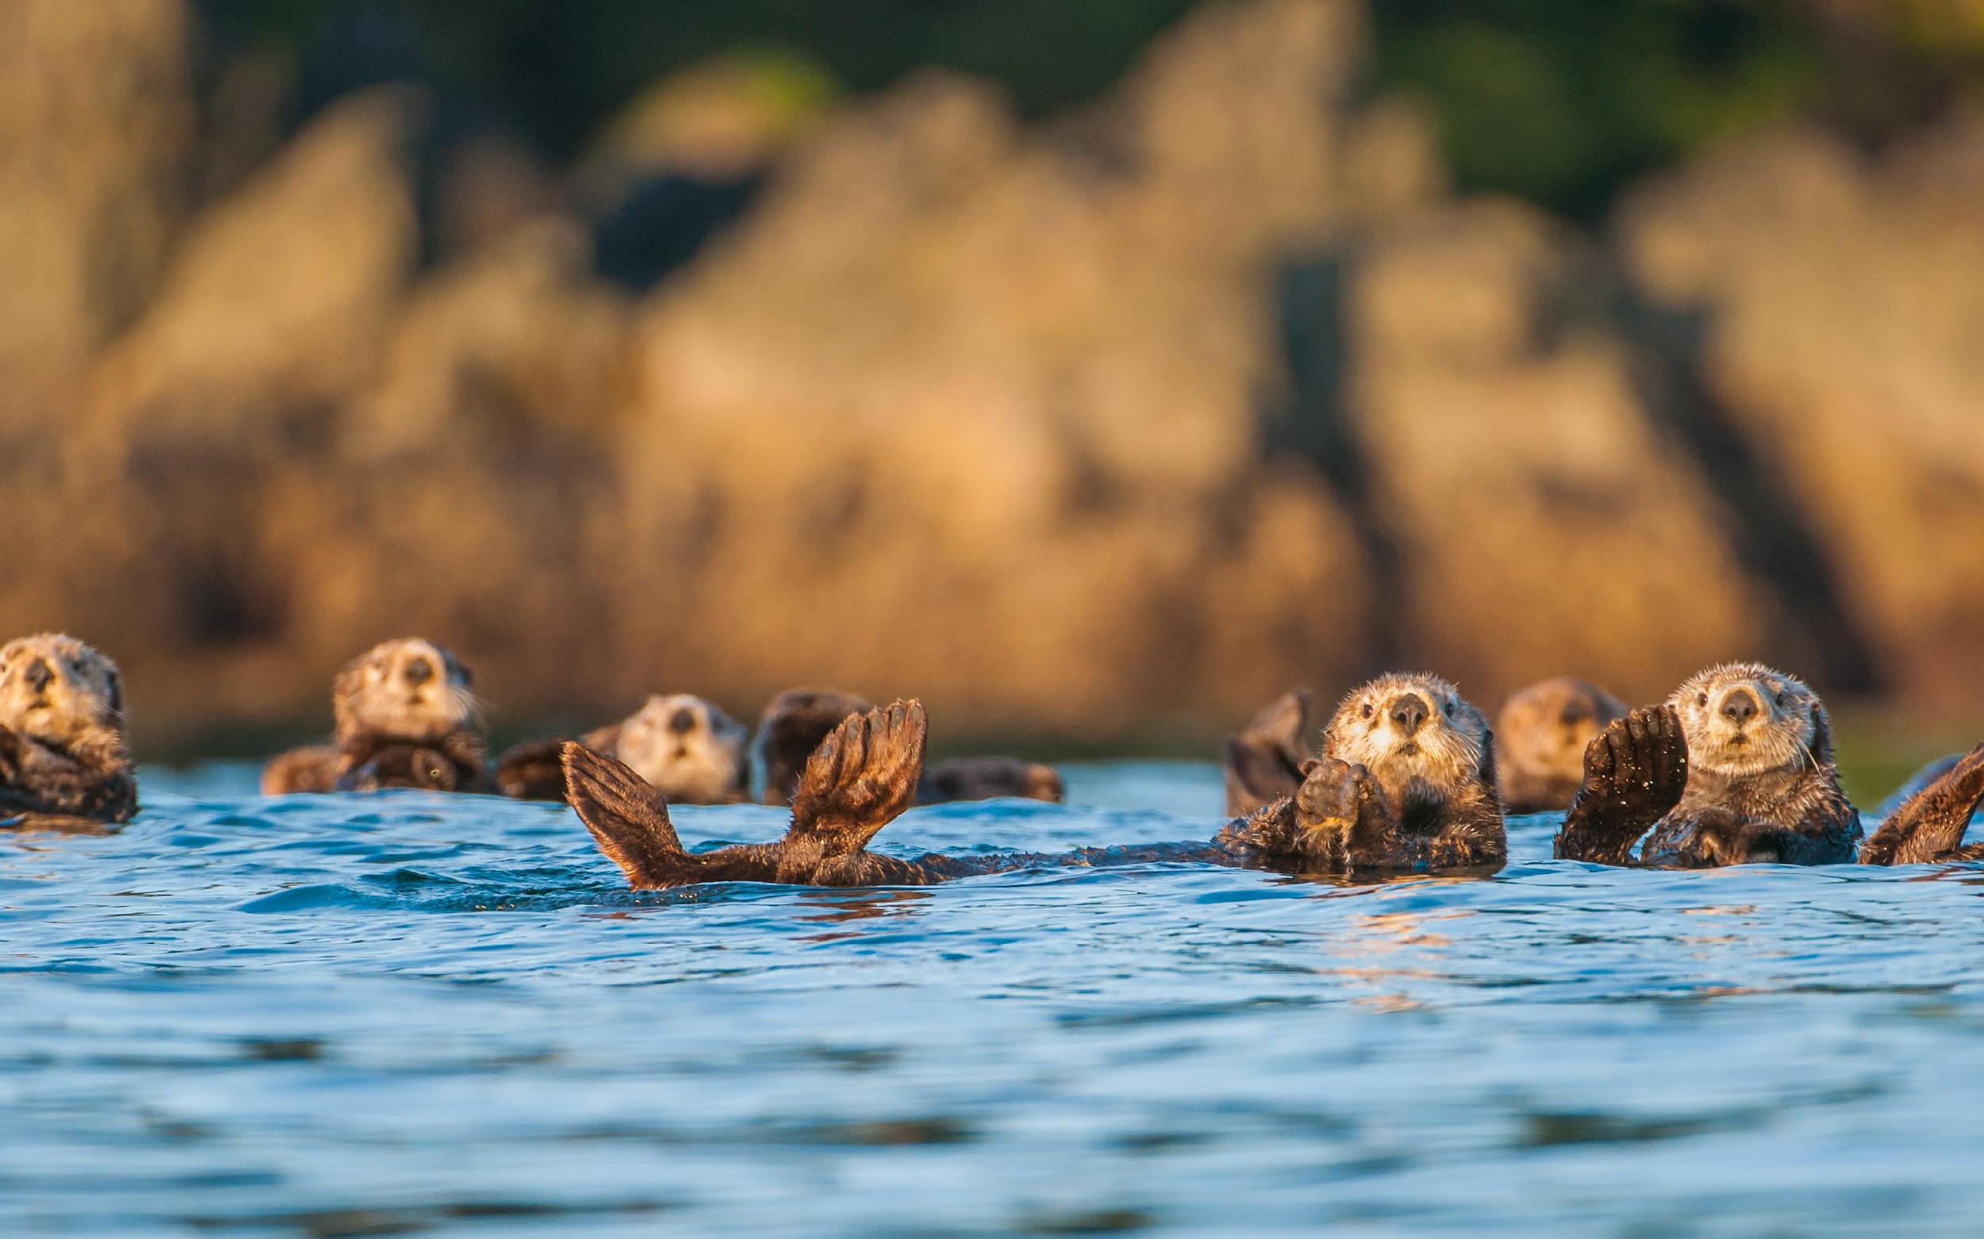
Thank you! Any questions?

