Slide 1

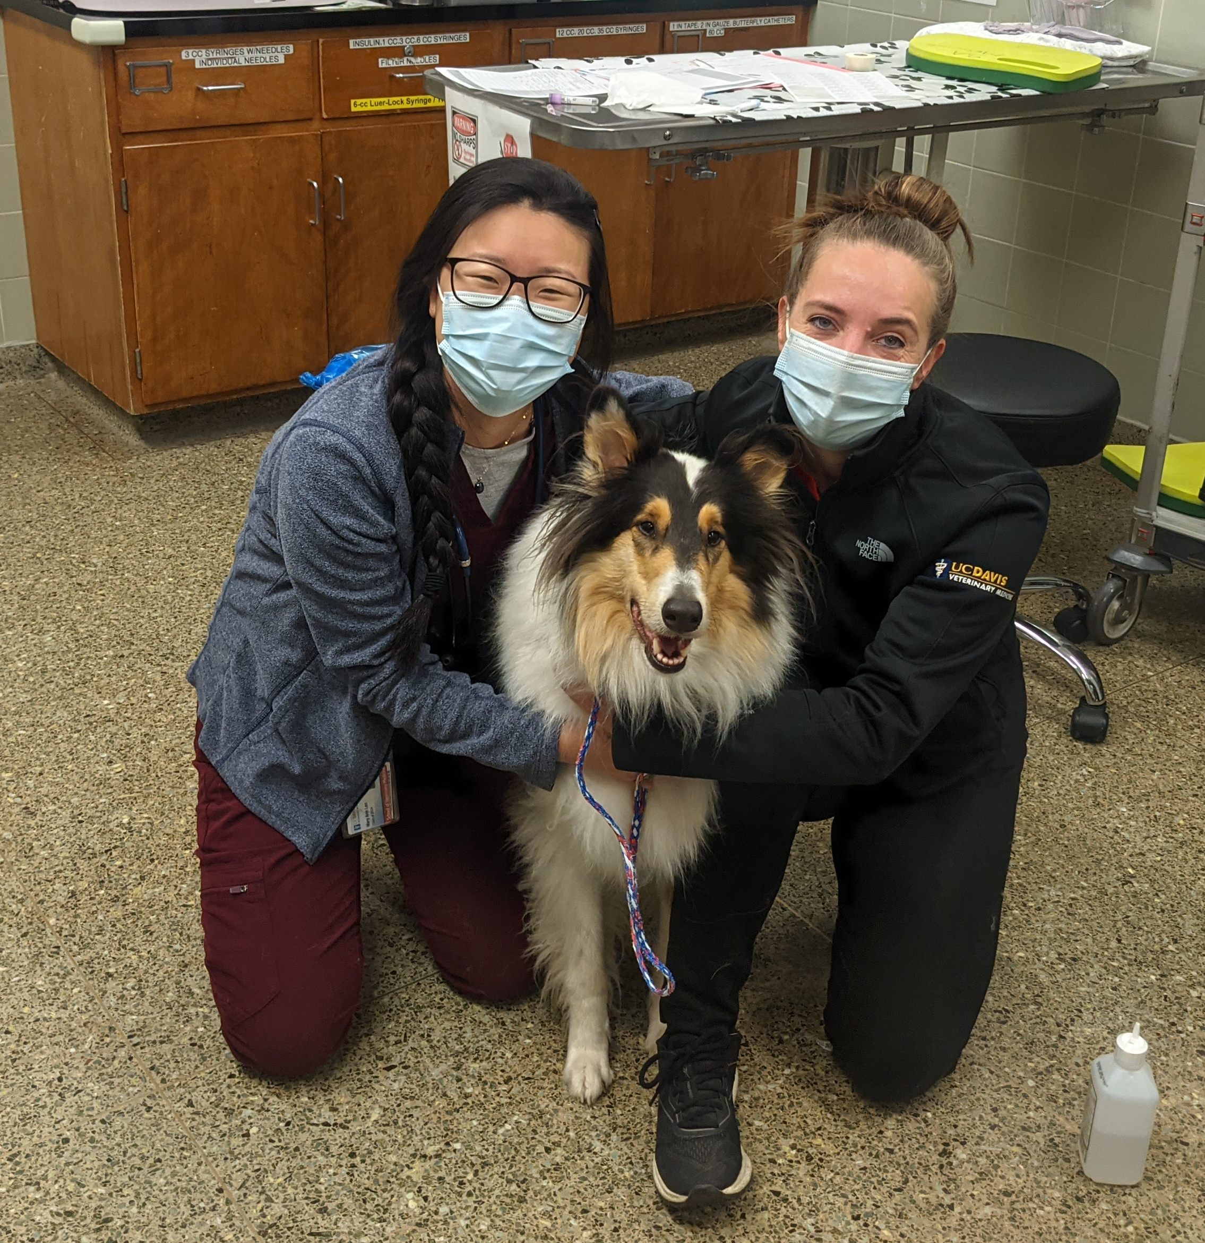
Peripheral immune modulation, temporal dynamics, and community shifts of the healthy canine gut microbiome after fecal microbiota transplantation
M. Lee¹, M. Questa¹, B. Weimer¹, J. Lidbury², J. Steiner², J. Suchodolski², S. Marsilio¹
¹UC Davis School of Veterinary Medicine, Davis, California
²Texas A&M Gastrointestinal Laboratory
Notes:
Pilot study

Slide 2

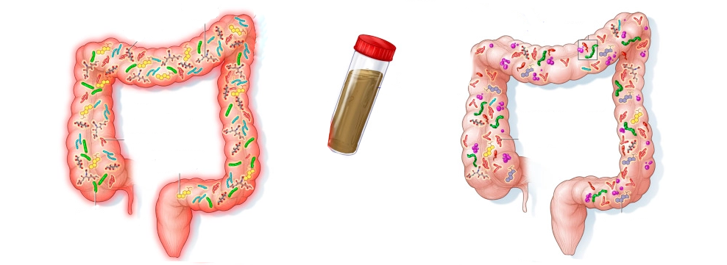
Background
Fecal Transplant
from Donor
Diseased Gut
Dysbiosis
Healthy Gut
Normobiosis
Fecal Microbiota Transplantation (FMT)
Kelly et al. Gastroenterology. 2015
Notes:
Microbiome is an organ; metabolic activity of a liver; like an organ, we wonder about engraftment
FMT – a targeted therapeutic approach to alter the microbial composition

Slide 3
Background
ACG strongly recommends FMT treatment for recurrent C. difficile
Placebo controlled study in canine parvovirus FMT superior to standard treatment alone
FMT performed in sick patients and ill-defined disease groups (IBD)
Poorly understood mechanisms of action, determinants of engraftment, and immune modulation
Whole metagenomic sequencing (WGS) allows species and strain level analysis to track microbial alterations and engraftment
Smillie, et al. Cell host & microbe 2018
Chaitman & Gaschen Vet. Clin. N. Am. 2021
Kelly et al. Am J Gastroenterol 2021
Notes:
Parvo – resolution of diarrhea faster, earlier hospital discharge; Anecdotal evidence for IBD and acute diarrhea
While the immune system may modulate FMT, FMT may also have impacts on the immune system (cross talk between the two)

Slide 4
Aims
Characterize the microbial community shifts, temporal dynamics, and peripheral immune modulation following FMT in healthy dogs
Identify factors within the microbiome predicting FMT engraftment in healthy dogs
Notes:
Local immunity (human and mouse studies) does FMT have an effect beyond the gut local (into peripheral immune system)
Talking points 1) Does the microbiome have an effect on the immune system outside of the gut (systemic/peripheral), how safe is it to give do we see any SE
Interested in understanding the mechanisms of engraftment following FMT in healthy canines
Characterize microbial community shifts, temporal dynamics, peripheral immune modulation following FMT in healthy dogs
Any drugs are tested in healthy individuals first and then diseased animals – FMT as a therapeutic, necessary step that hasn’t been performed

Slide 5
Material and Methods
Inclusion criteria
Recipients: 10 clinically healthy, client-owned dogs
Donors: 2 clinically healthy, client-owned dogs
Exclusion criteria
GI signs (vomiting, diarrhea, hyporexia, weight loss) past six months
Known microbiome-altering medications past six months
Other systemic diseases

Slide 6
Material and Methods
Day 0 FMT |  | Day 1 post-FMT |  | Day 4 post-FMT |  | Day 10 post-FMT |  | Day 28 post-FMT
Feces (DI, WGS) Blood (CBC, chemistry, Flow cytometry CRP, cytokines) |  | Feces (DI, WGS) Blood (CBC, chemistry, Flow cytometry CRP, cytokines) Clinical survey
10 clinically healthy dogs received 5g/kg FMT via rectal enema
Notes:
Start with day 0
Days 0, 1, 4, 10, 28: fecal and blood collection
CBC, serum biochemistry
Months 3, 6, 9, 12: fecal collection
Whole genome sequencing using Kapa library and Illumina HiSeq XTEN PE150 protocols
Flow cytometry for CD4+ and CD8+T cells, Tregs, B cells
C Reactive Protein and cytokine panel
Verbal shotgun metagenomics
Verbal mention flow + cytokine panel
WGS and metabolomics after 3 months - enhanced detection of bacterial species, increased detection of diversity, enhanced accuracy
Paired end 150 base pair
Whole flow panels: CD4, CD8, CD25 (Treg), CD45 (all blood cells), CD3 (T cells), FoxP3 (Treg), CD79a (B)
IL10 production in mice following FMT (major anti inflammatory cytokine) - Burello
Cytokines – measuring IL2, 6, 8, 10, TNFa)

Slide 7
Results: Clinical
FMT well tolerated with no known major side effects
Normal appetite
3 animals experienced transient diarrhea post-FMT
3 cases of vomiting (2 on day 1, 1 on day 28 post-FMT)
1 case of vomiting and 1 case of diarrhea due to dietary indiscretion
Notes:
Fecal score before FMT was 2 and remained 2 (no change)
Diarrhea thought to be due to dietary indiscretion

Slide 8
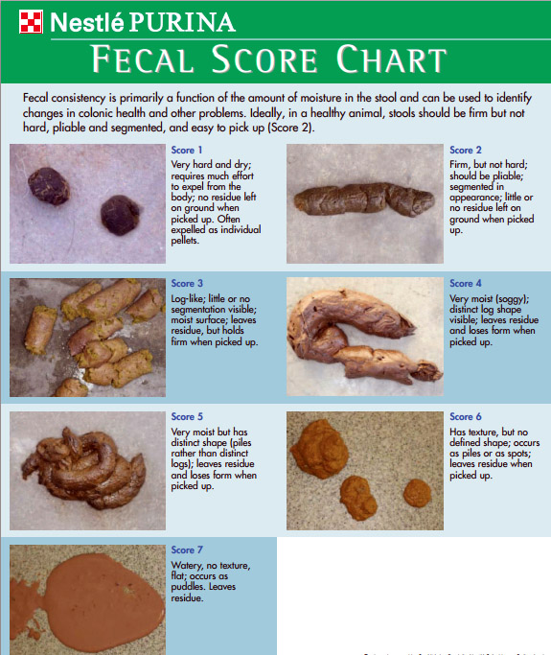
Results: Clinical

Slide 9
Results: Peripheral Immune Modulation
Statistical analysis
D’Agostino & Pearson, Mixed effects model ANOVA
Complete Blood Count
All values not significantly different between days 0, 1, 4, 10, 28
Serum biochemistry
Anion Gap (p = 0.0057) & bicarbonate (p = 0.016) statistically significant
False Discovery Rate adjustment via Benjamini-Hochberg method
Adjusted p values: Anion Gap (p = 0.13), bicarbonate (p = 0.18)

Slide 10
Results: Peripheral Immune Modulation
CBC
Chemistry panel
C-Reactive Protein
Cytokines
No change
Notes:
ADD: Unchanged after FMT

Slide 11
Results: Peripheral Immune Modulation

Slide 12
Results: WGS
Whole metagenomic shotgun sequencing
Engraftment
6289 Bacteria (89%)
424 Viruses (6%)
280 Archaea (4%)
58 Fungi (0.8%)
29 Chromista (0.4%)
7093 SPECIES
Donor | Recipient | FMT |  | Recipient
Pre-FMT Day 0 |  |  |  | Post-FMT Days 1, 4, 10, 28
Notes:
Engraftment: species unique to the donor not present in the recipient D0; and present after as a surrogate for engraftment
Example; 4 dogs that received fecal sample from donor 1; 2 already had PC and 2 didn’t, day 28 everyone has PC; this species engrafted in the 2 dogs
Another bacterial strain in donor 2
How many OTUs are found with 16S sequencing

Slide 13
Results: WGS
Notes:
Only talk about prevotella copri

Slide 14
Results: WGS
Notes:
Proportional changes in 24 most abundant bacteria
Just 1 donor and 1 recipient
Decrease in E coli, increase in Faecalibacterium prausnitzii (known beneficial bacteria)

Slide 15
Discussion
One-time rectal enema FMT in healthy dogs is relatively safe
FMT in healthy dogs do not lead to significant changes in the peripheral immune system markers measured in the study
CRP
Cytokines
CBC
Serum biochemistry
Species level engraftment seen but factors not yet known
Notes:
We do see engraftment but don’t in all dogs, don’t know the engraftment factors currently

Slide 16
What’s next + Limitations
Multivariate statistics for population diversity and taxonomy
Compare pre- and post-FMT shifts, ID engraftment factors
Flow cytometry analysis on lymphocyte population
Future FMT study in dogs with chronic enteropathy
Small sample size, some dogs with mild clinical and/or laboratory abnormalities
Notes:
Pilot study to see if we can find changes, if we find changes can extend study to more patients
Plan is to translate this study to FMT study in dogs with chronic enteropathy

Slide 17

Acknowledgement
Special thank you to:
Comparative Gastroenterology Society and IDEXX Laboratories, Inc. for Veterinary Summer Student Scholar Award
Texas A&M GI Lab for their generous help in measuring blood and fecal samples

Slide 18
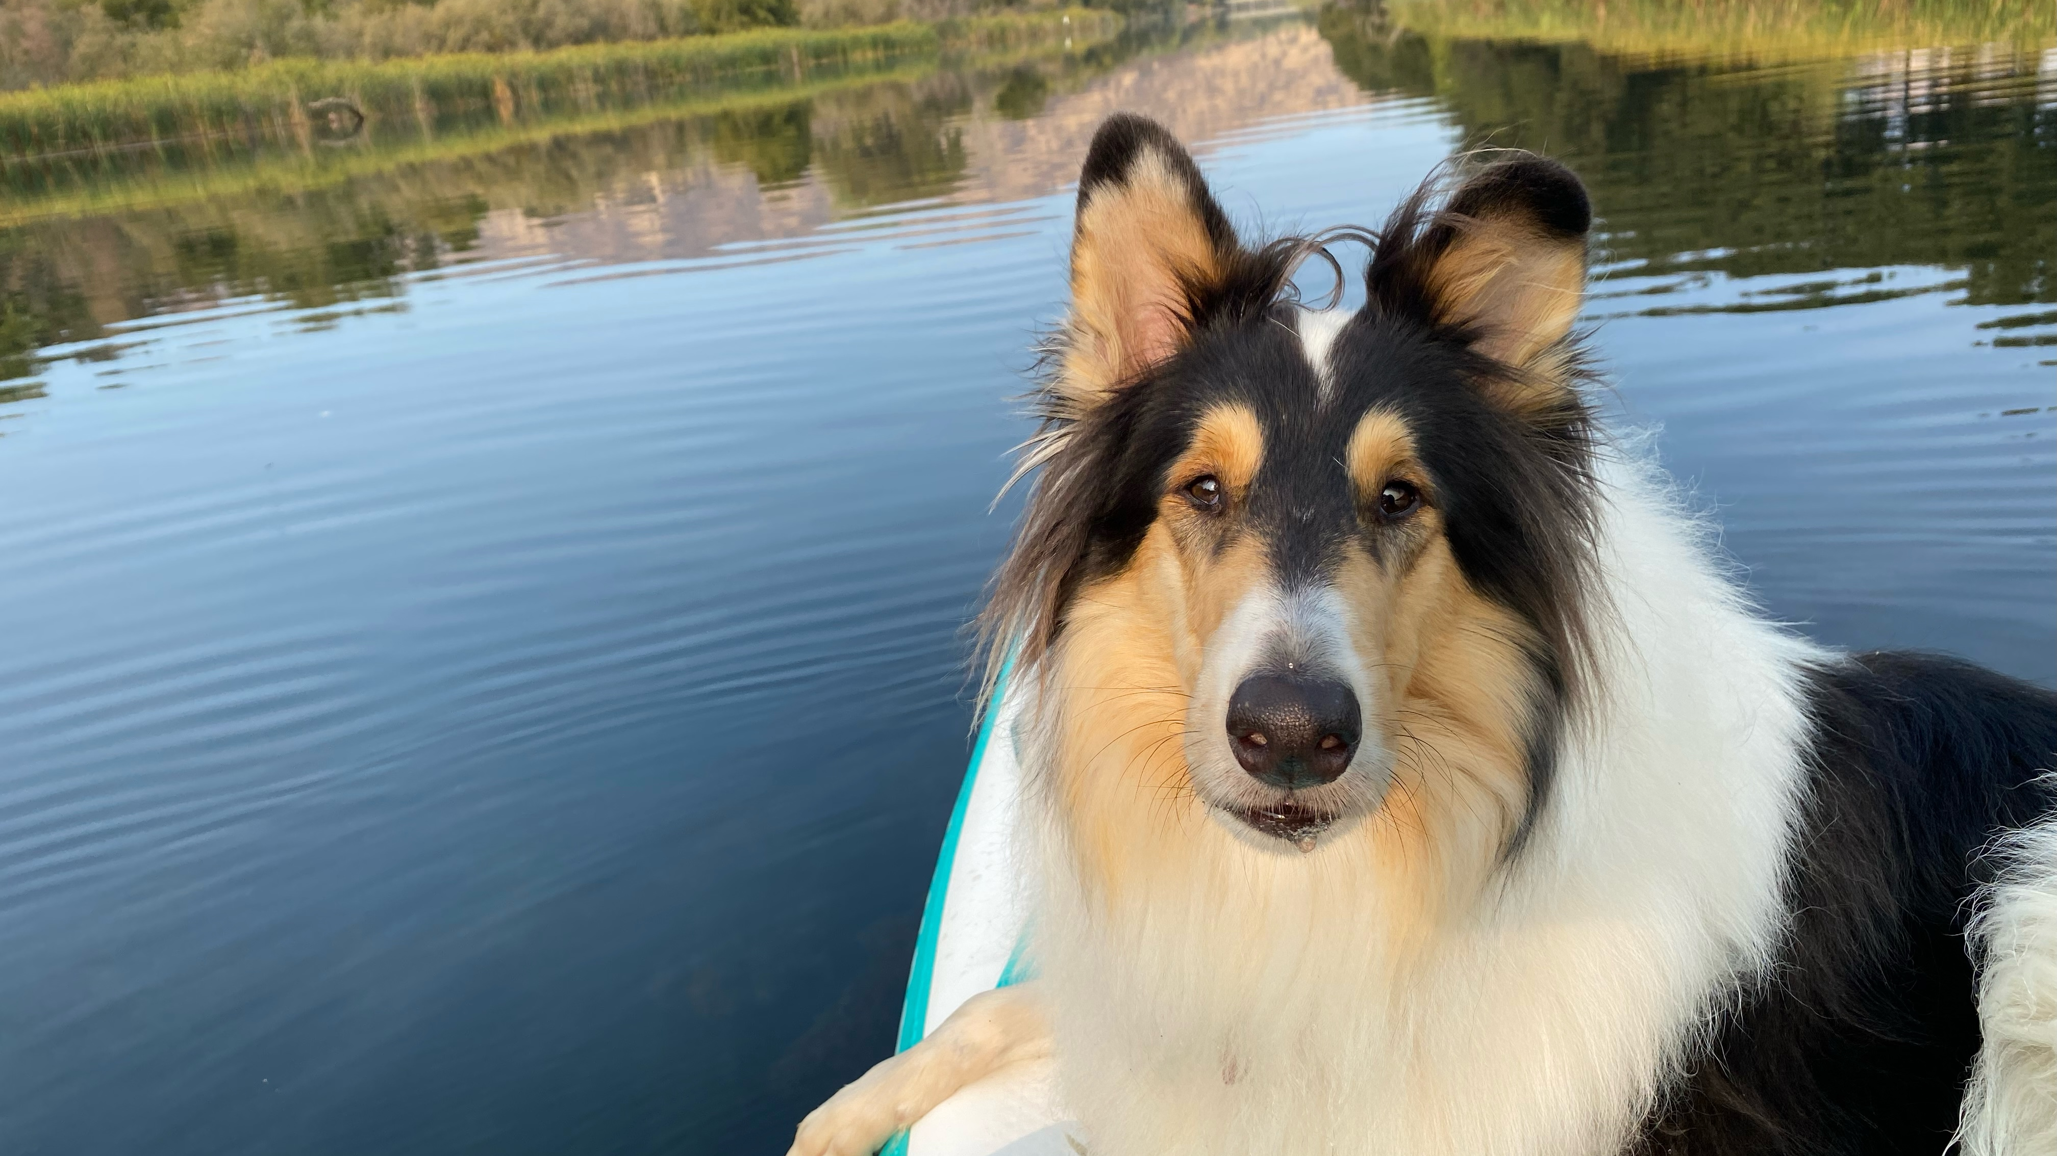
Questions?

Slide 19
Contact
Mary Ann Lee
Doctor of Veterinary Medicine Candidate
UC Davis School of Veterinary Medicine
1 Garrod Drive
Davis, CA 95616
Email: mjrlee@ucdavis.ed

