Slide 1
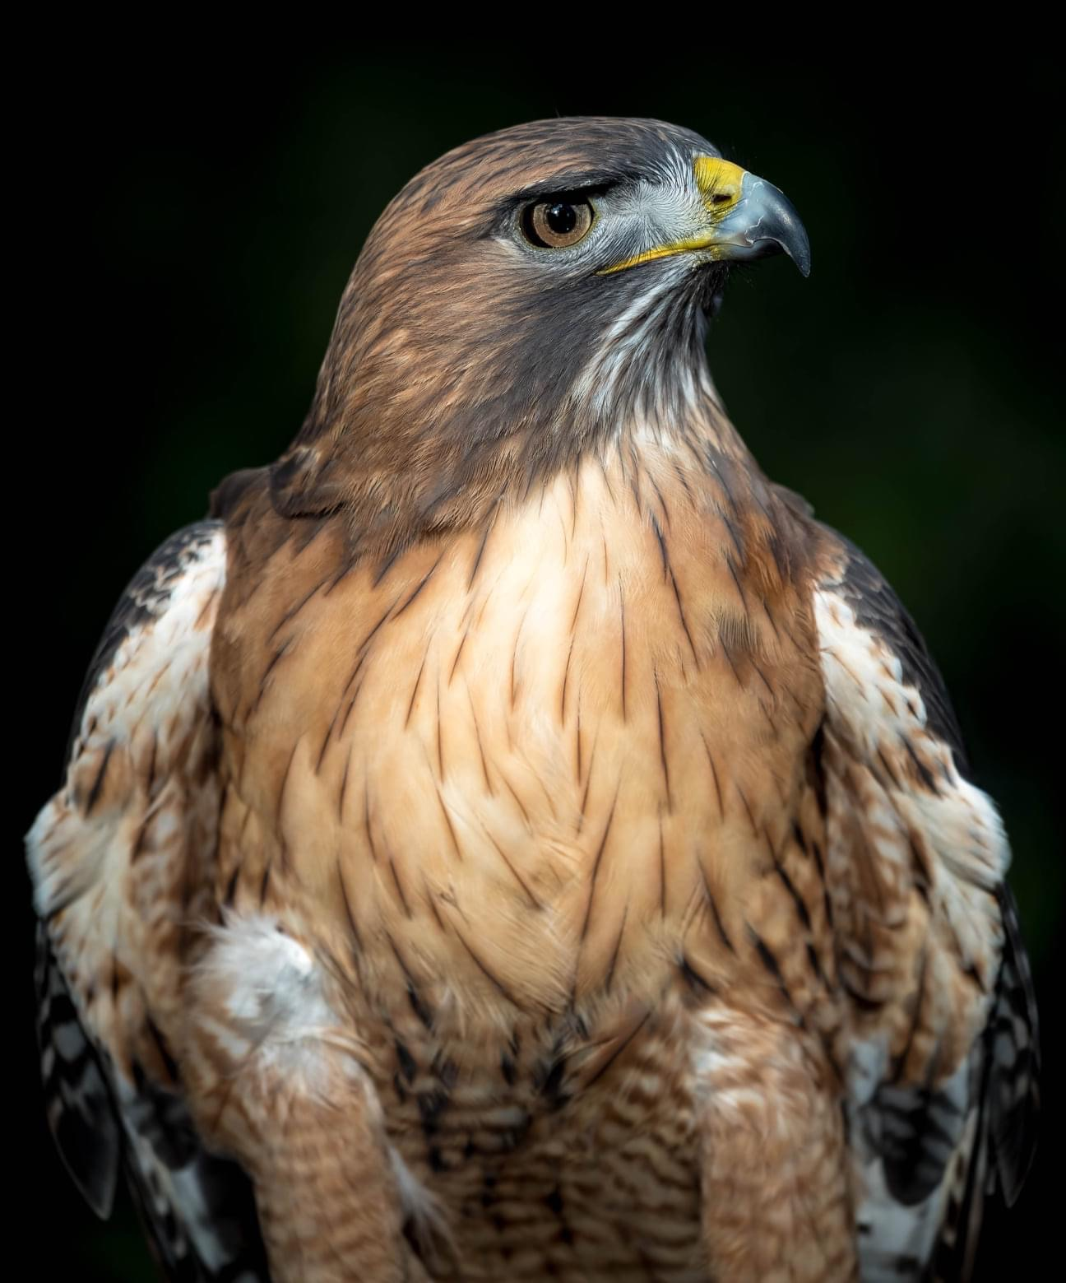

Antinociceptive Effects of Hydromorphone In Red-tailed Hawks (Buteo jamaicensis)
Lexi Durant
D. Sanchez-Migallon Guzman, LV, MS, Dipl. ECZM (Avian & Small Mammal), Dipl. ACZM
M. Hawkins, VMD, DABVP (Avian)

Slide 2
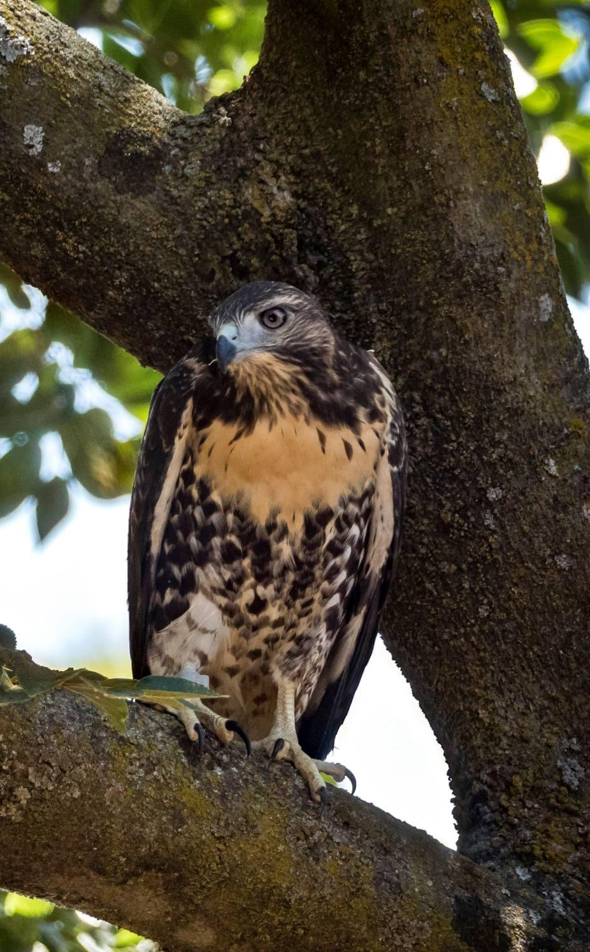
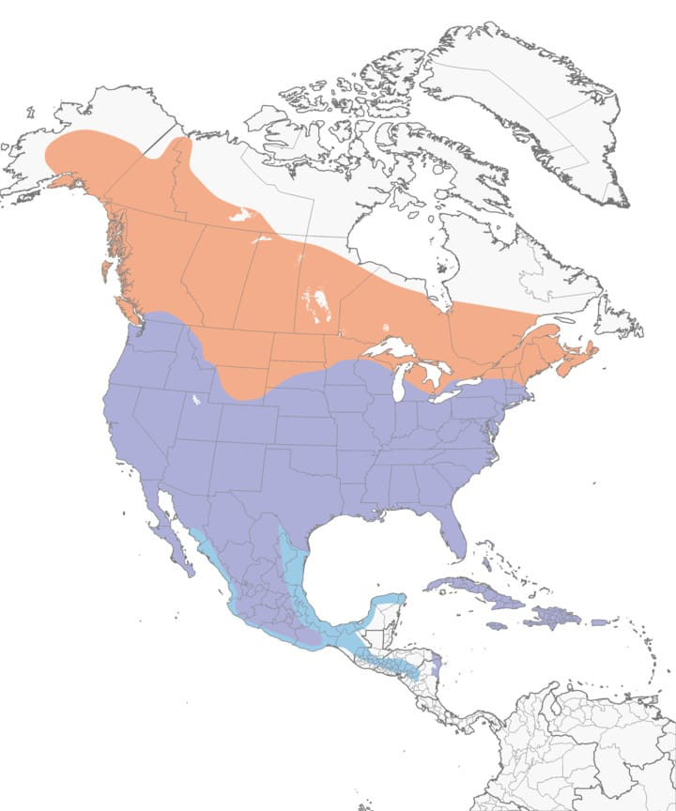
Red-tailed Hawks
Commonly present to vets across North America
Typically present with traumatic injuries
Few studies on opioids in hawks

Slide 3
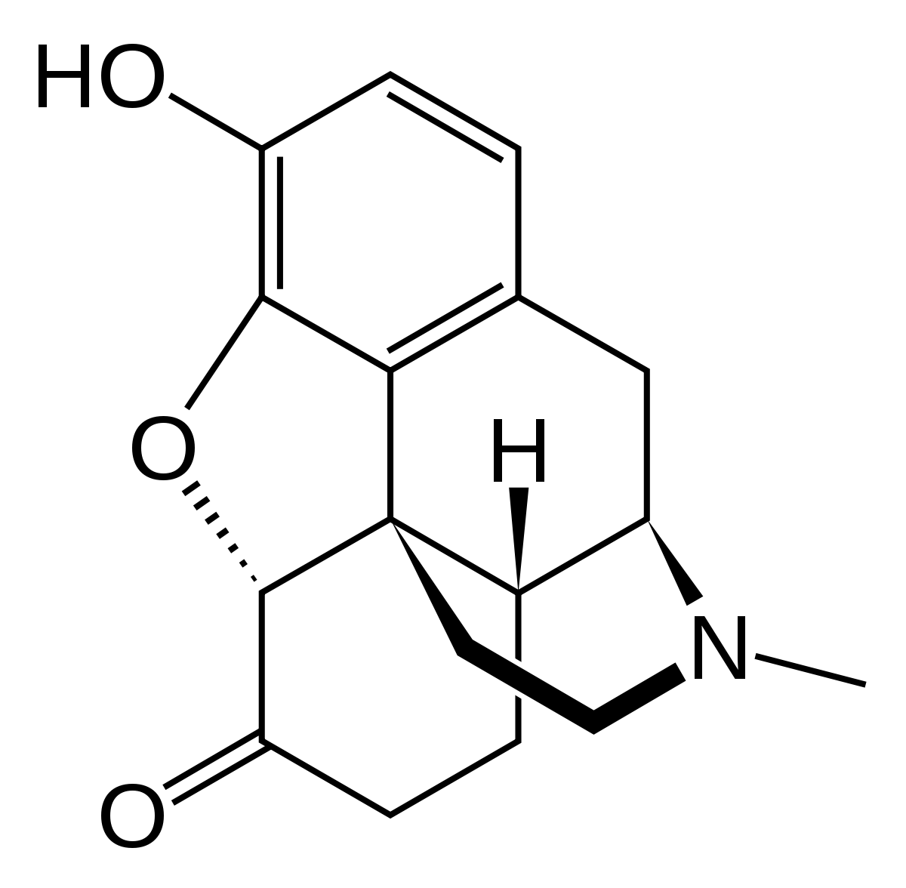
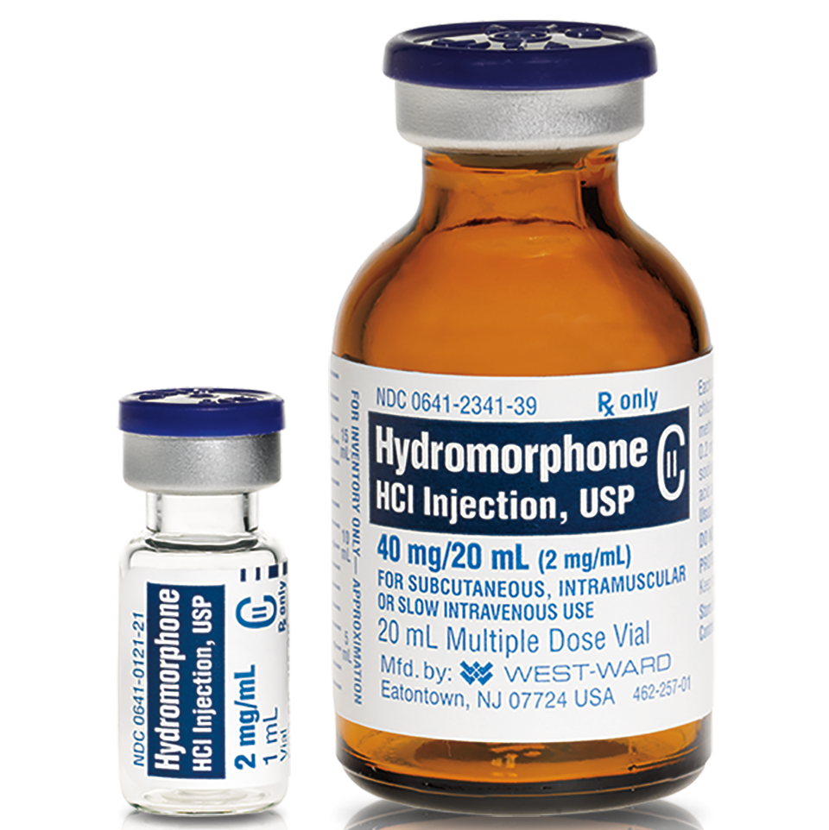
Hydromorphone
Full mu opioid agonist
5x the potency of morphine
Differences between raptor species

Slide 4
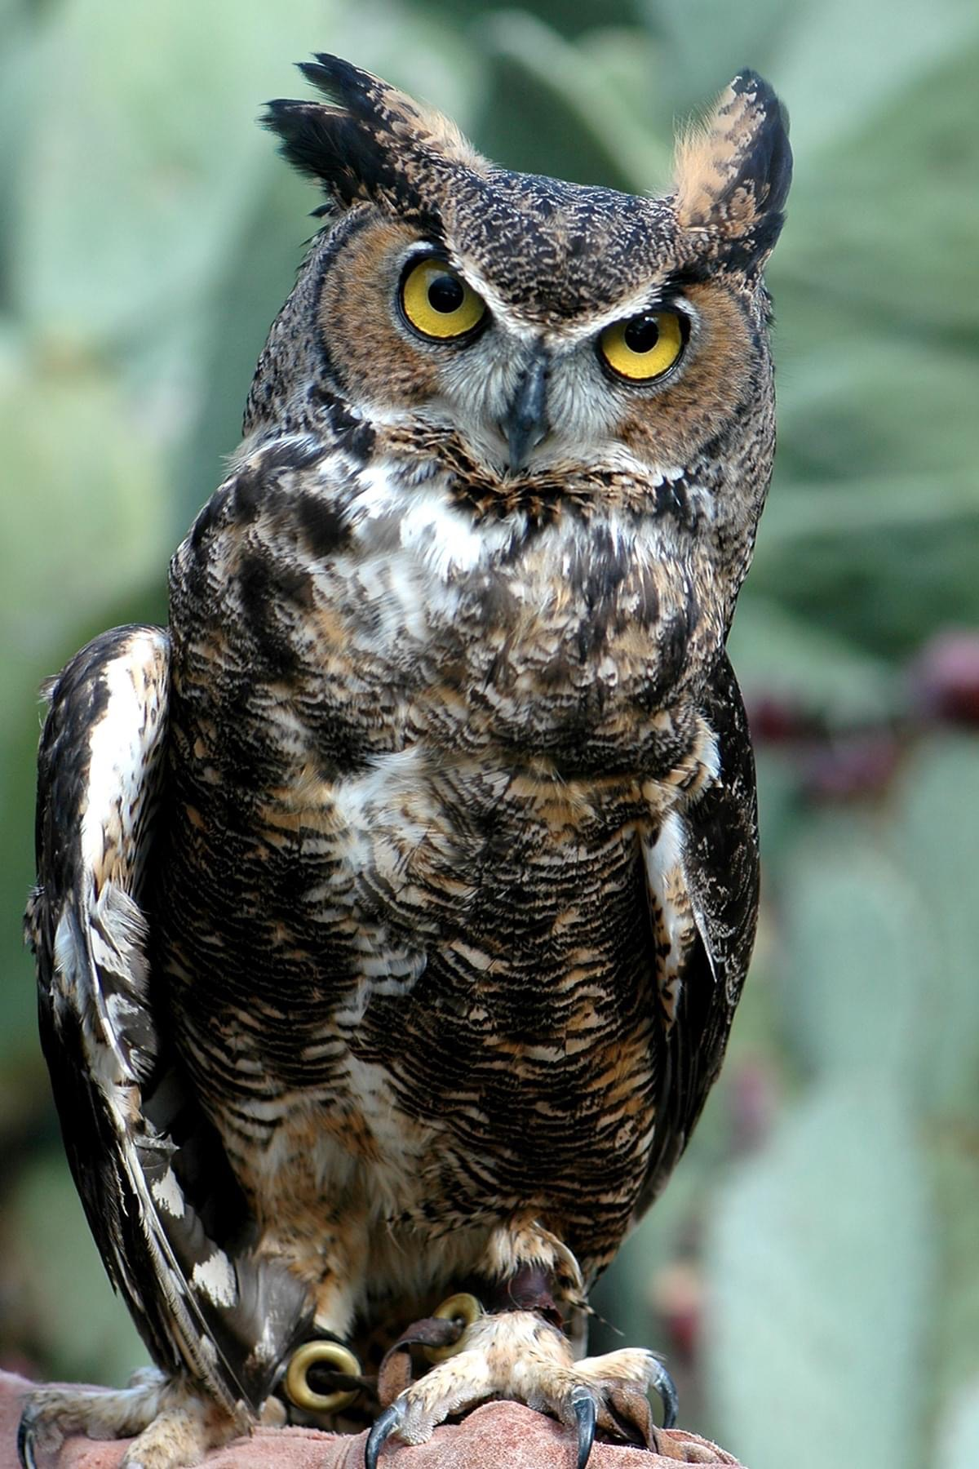
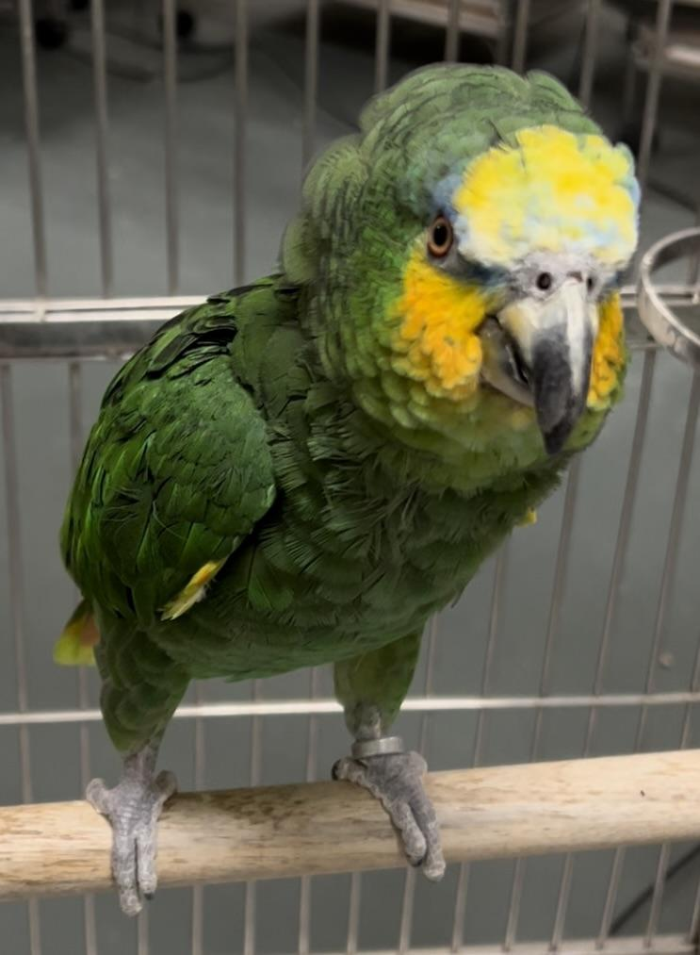
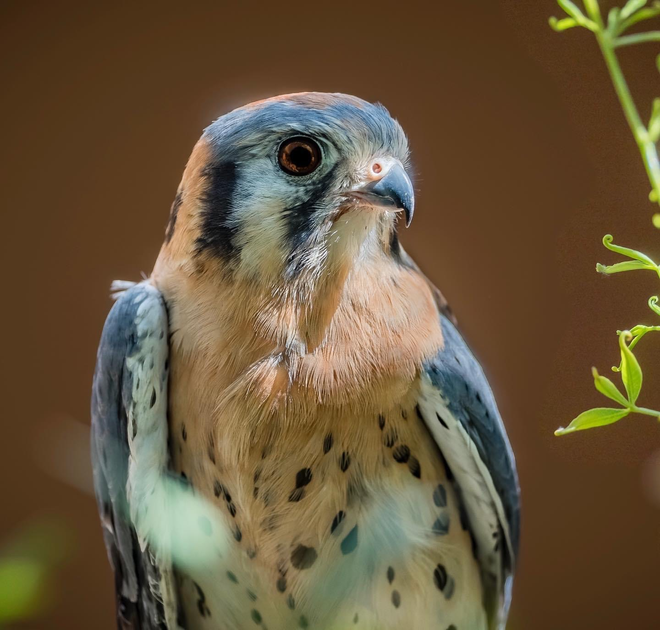
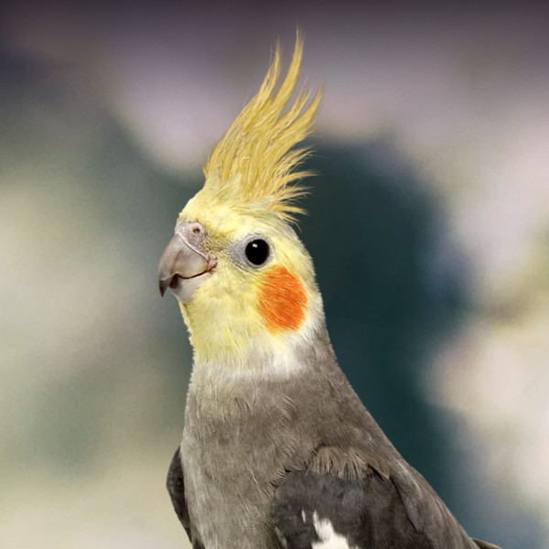
Thermal Antinociception
Nociception: the neural processing of noxious stimuli
Evaluation of antinociceptive effects done by assessing tolerance of discomfort
Thermal antinociceptive model

Slide 5
Project Aims and Hypothesis
Project aim: Determine the thermal antinociceptive effects and duration of action of hydromorphone in red-tailed hawks
Hypothesis: Hydromorphone will cause dose-dependent thermal antinociception and sedation when given IM in red-tailed hawks

Slide 6
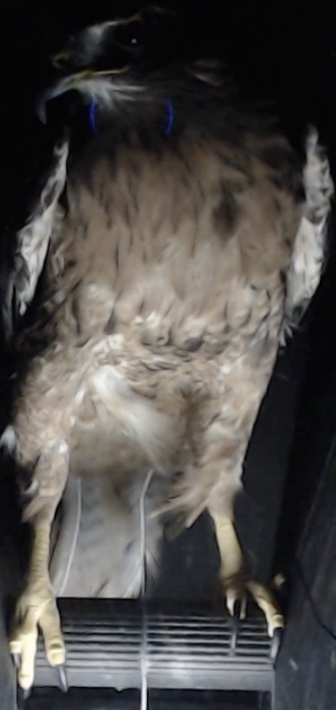
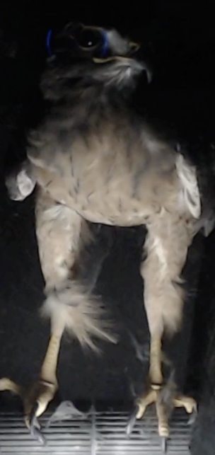
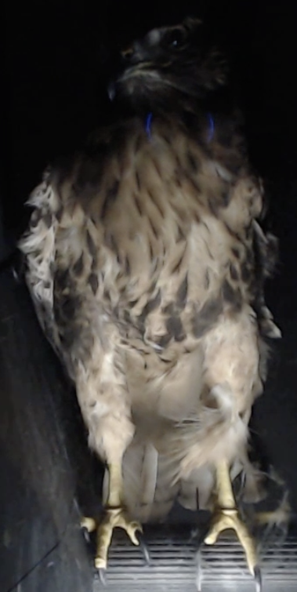
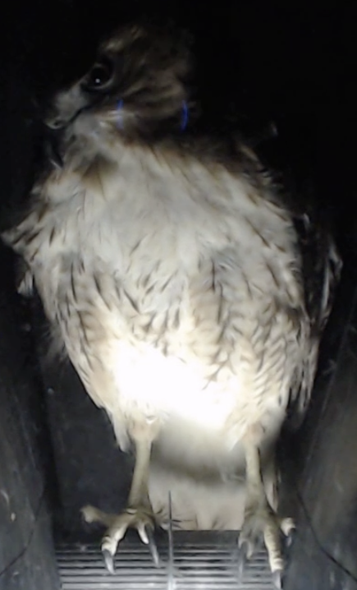
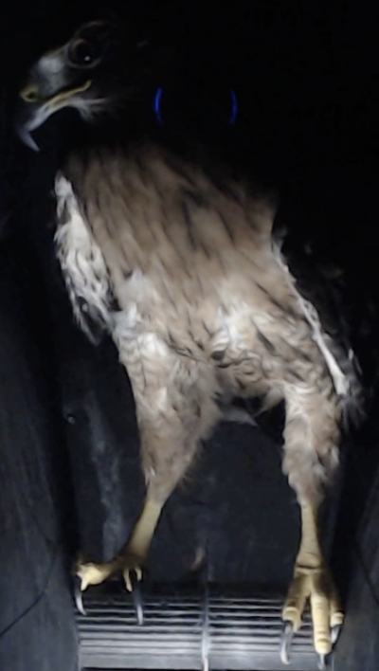
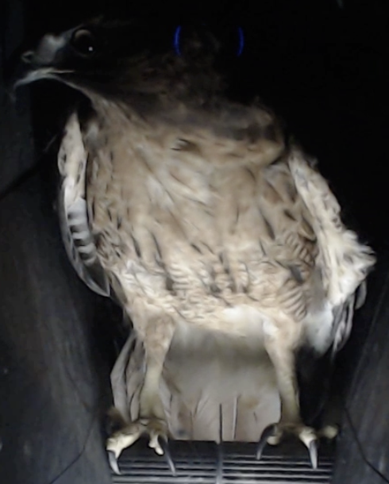
Study Population
6 red-tailed hawks at the California Raptor Center
Adults of unknown age
Weights ranging 880g - 1454g
4 female + 2 male
Non-releasable due to orthopedic injury, ocular injury, or feather dystrophy
Bird #1
Bird #2
Bird #3
Bird #4
Bird #5
Bird #6

Slide 7
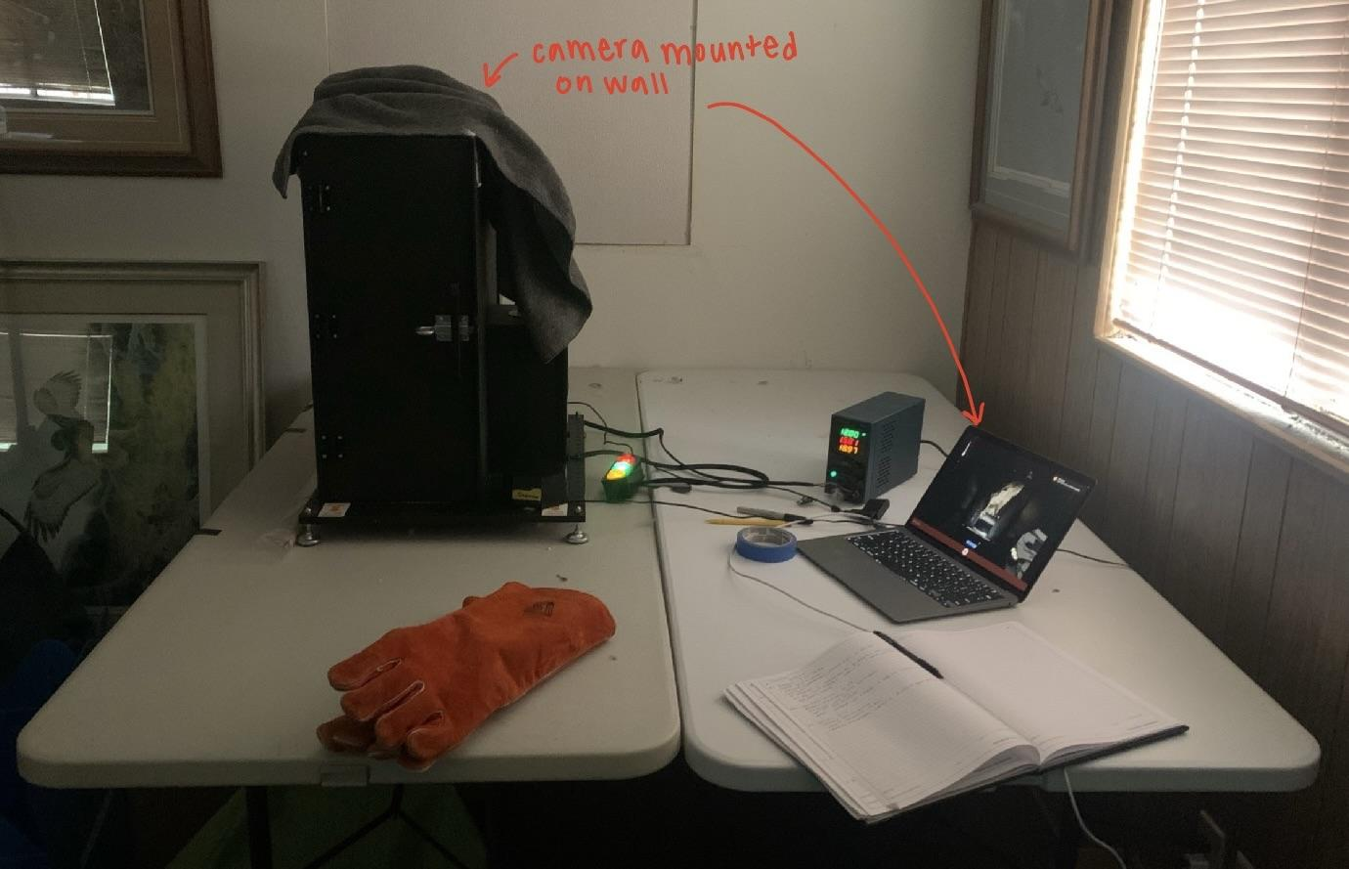
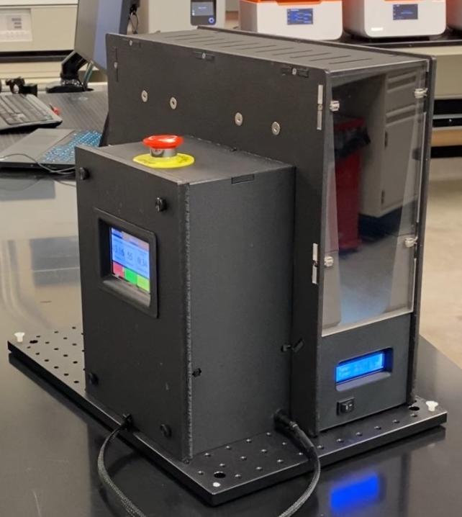
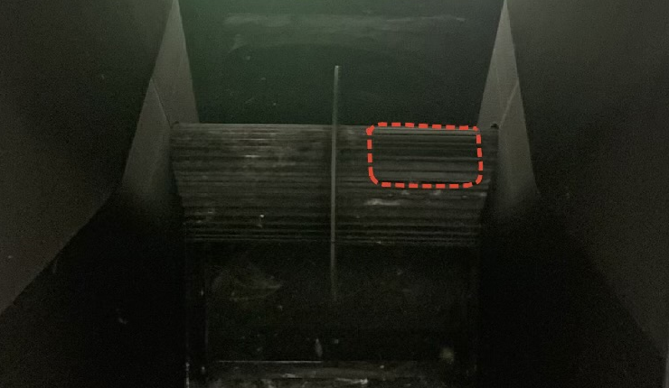
Thermal Testing Box

Slide 8
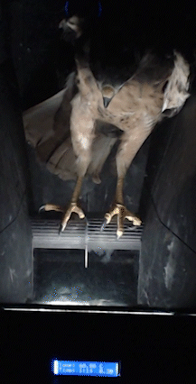
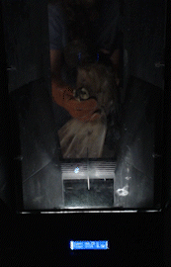
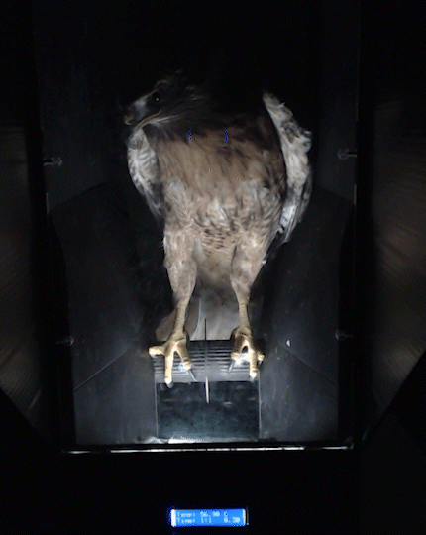
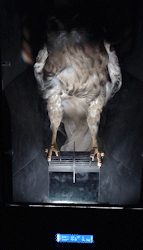
Thermal Testing Box Functions
3. Bird lifts foot at thermal withdrawal threshold
4. Turn off box, perch rotates
5. Remove bird from box
1. Place bird in box preheated to 40℃
2. Turn on heating function (increases to 62℃ at .3℃/sec)

Slide 9
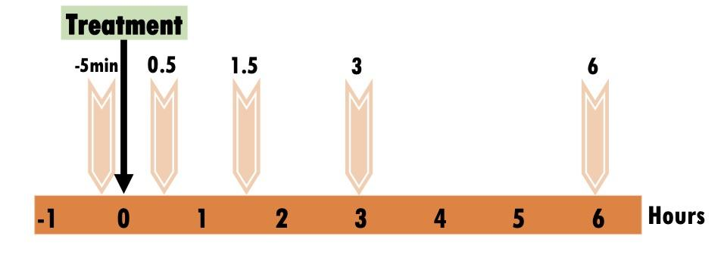
Study Design
3 testing periods
hydromorphone at 0.3 mg/kg and 0.6 mg/kg compared to saline (NaCl 0.9%)
All subjects receive each treatment in a masked randomized complete crossover Latin square design
Treatment A
Treatment B
Treatment C

Slide 10
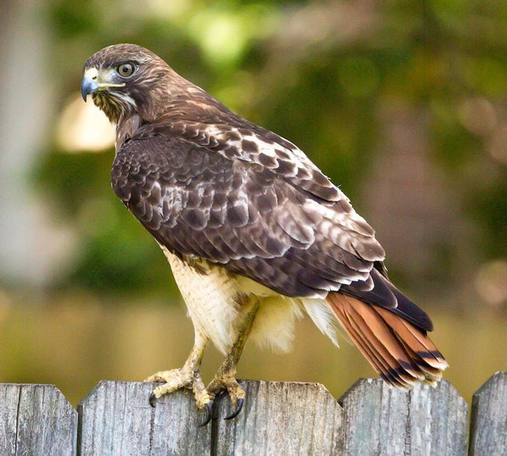
Statistical Analysis
R 4.2.3, significance at P < 0.05
Antinociception assessed via linear mixed modeling

Slide 11
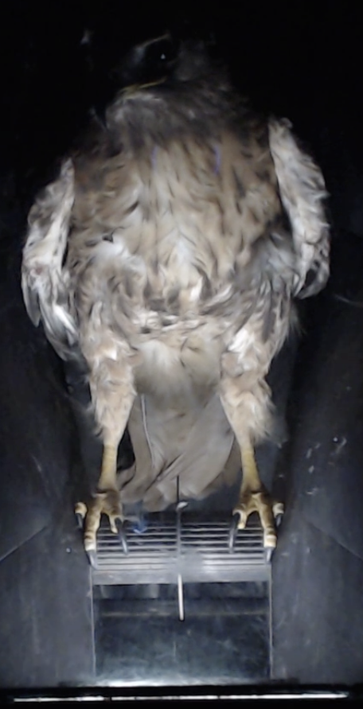
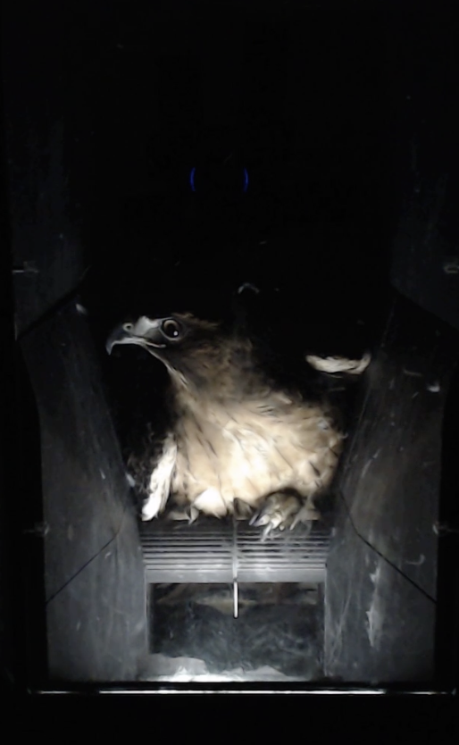
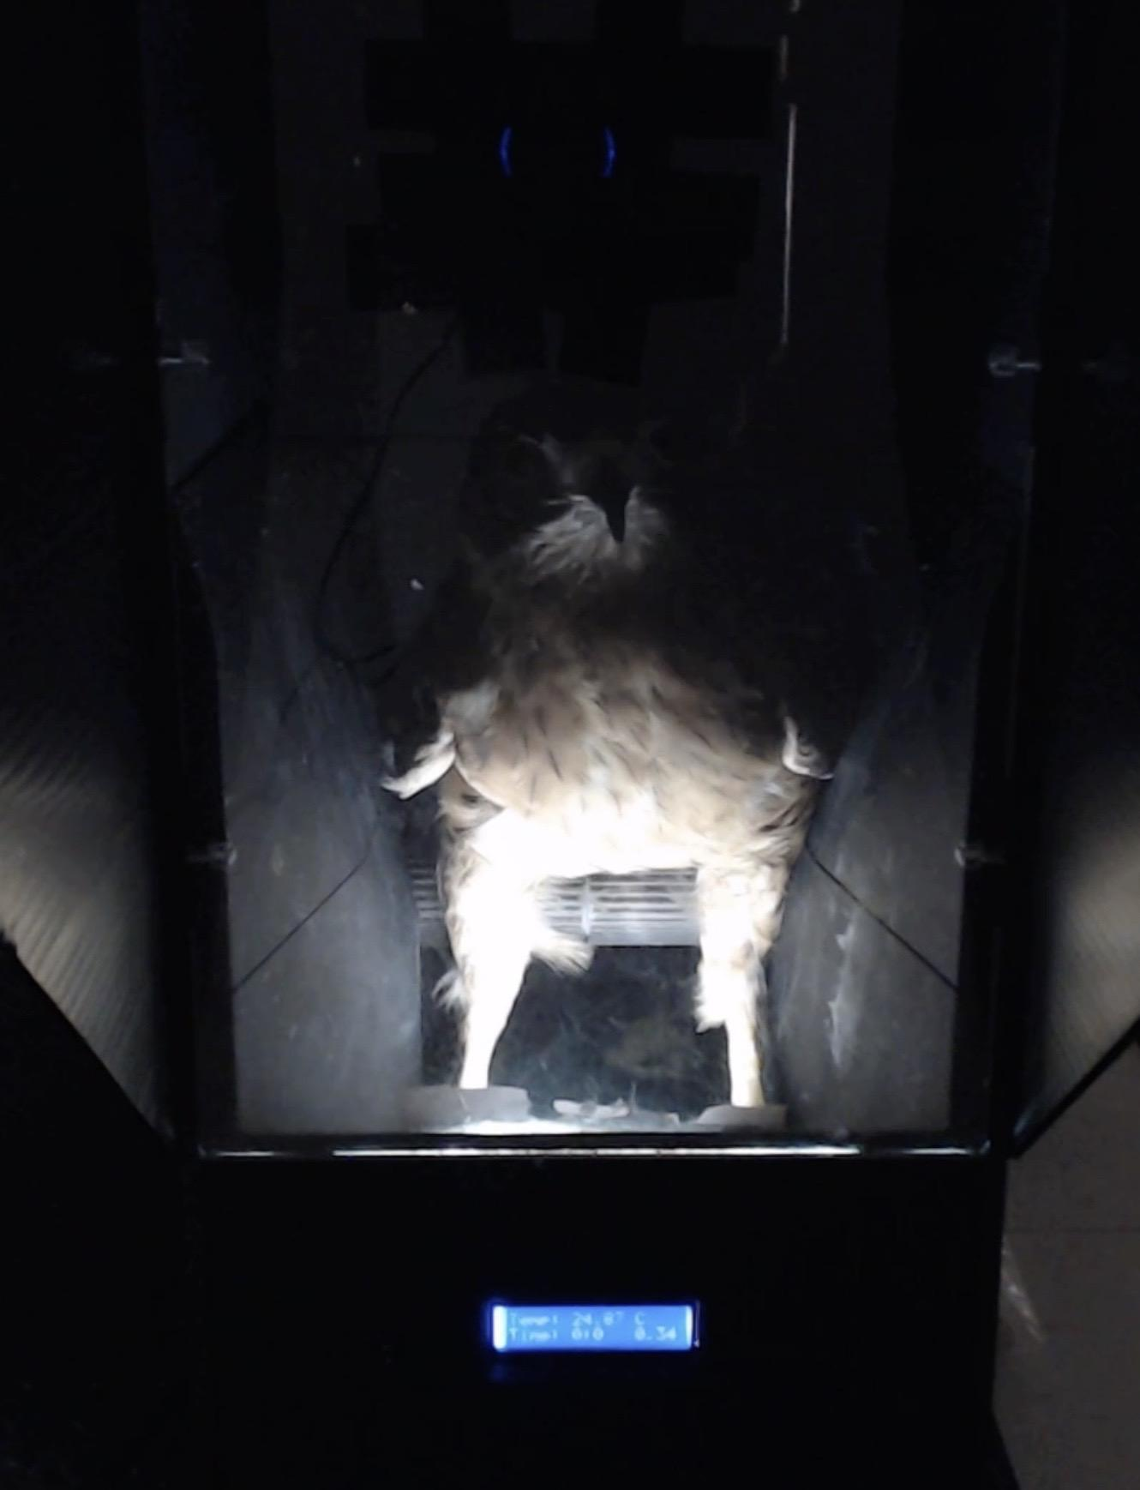
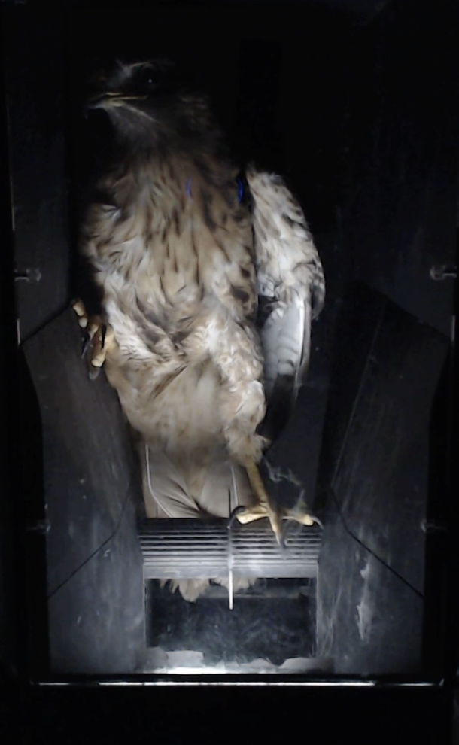
Preliminary Results -Acclimation Period
Put birds in testing box at increasing time points without thermal stimulus and drug
Problem #1: Abnormal Perching

Slide 12
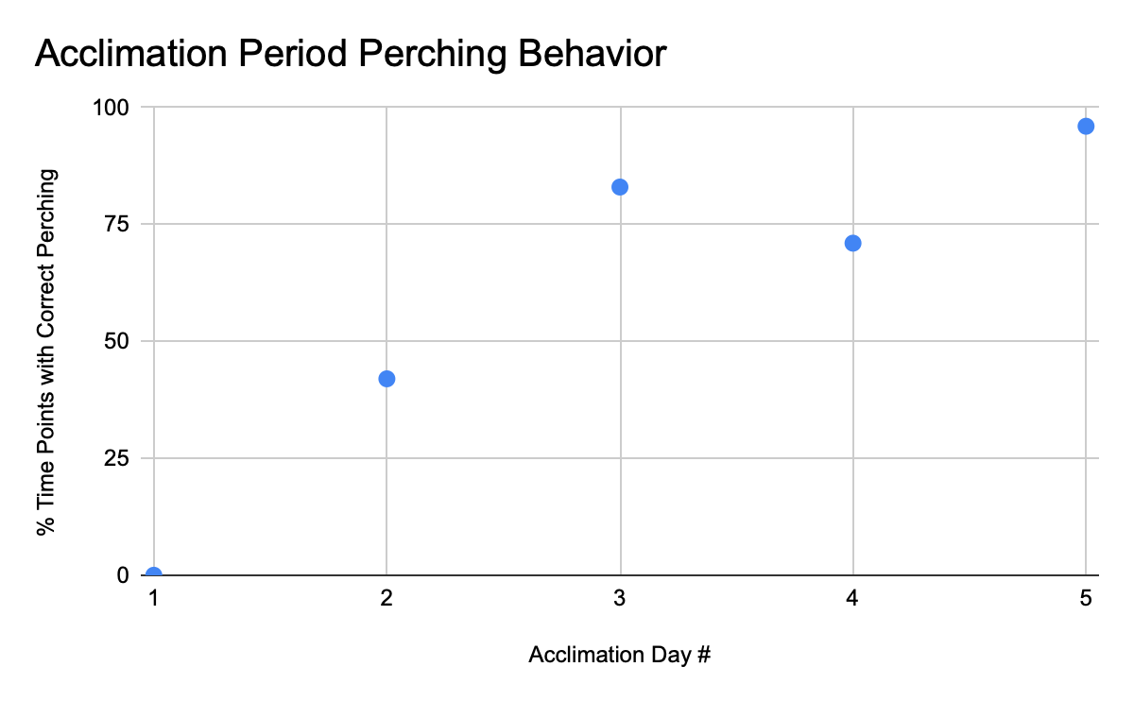
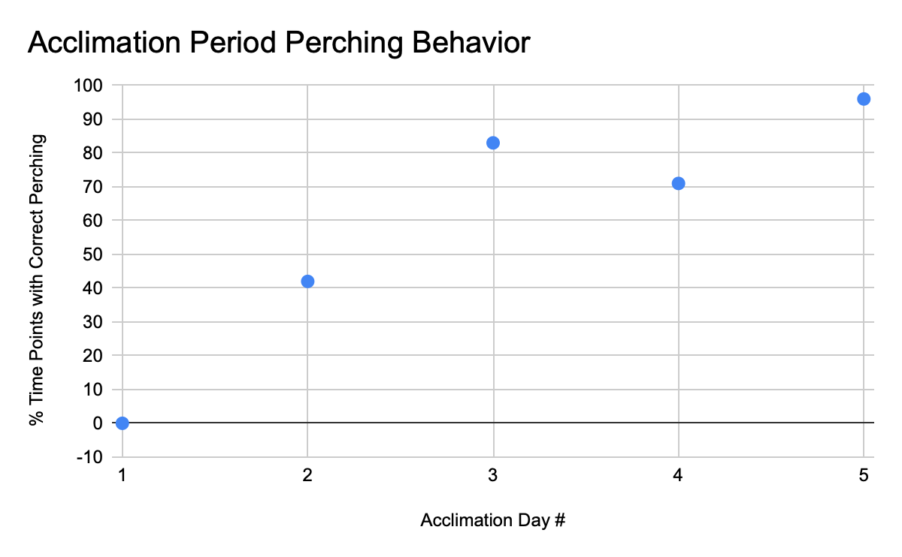
Preliminary Results - Acclimation Period

Slide 13
Preliminary Results - Training Period
Sample size adjustment
Put birds in testing box at increasing time points with thermal stimulus, but without drug
Problem # 2: Inconsistent Responses
Bird | Bird #1 | Bird #2 | Bird #3 | Bird #4
Response Rate (%) | 55 | 82 | 91 | 18

Slide 14
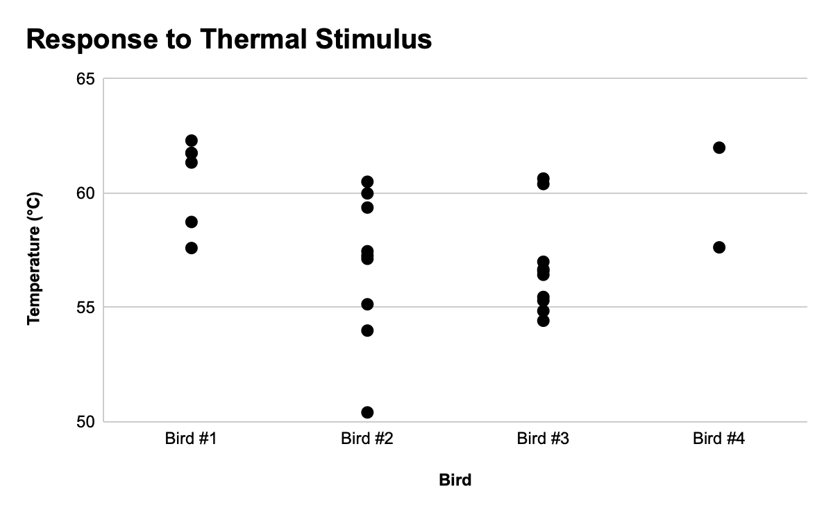
Preliminary Results - Testing Period
Problem #2: Inconsistent Responses

Slide 15
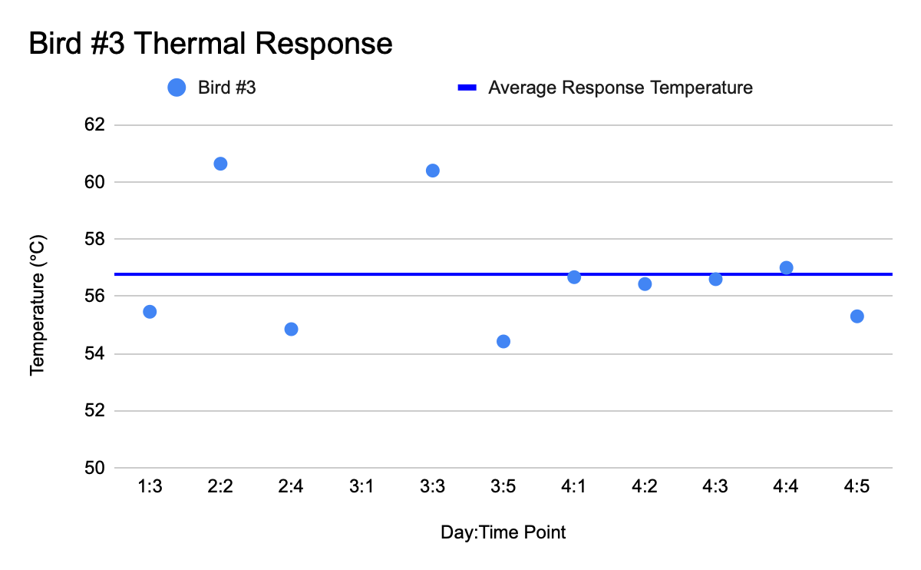
Preliminary Results - Testing Period
Problem #2: Inconsistent Responses

Slide 16
Why the Inconsistency?
Wide stance
Rotational instability
Bird grip strength overpowering box motor

Slide 17
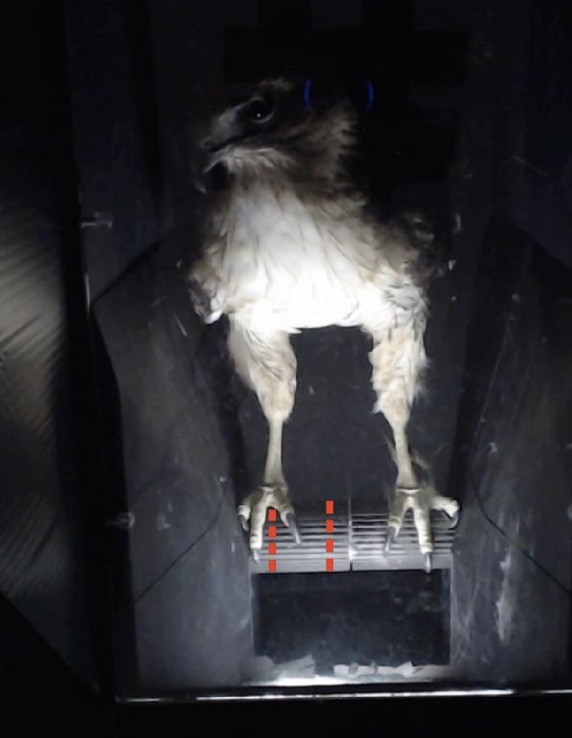
Problem #2: Wide Stance

Slide 18
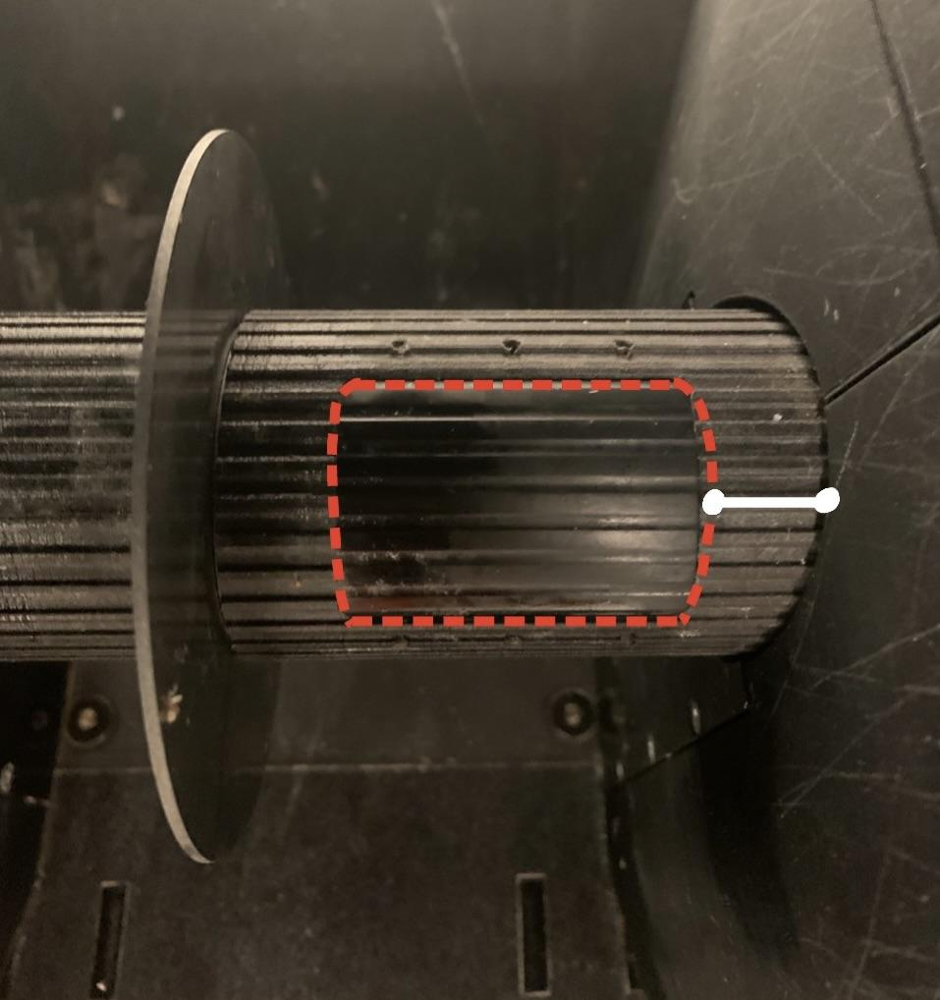
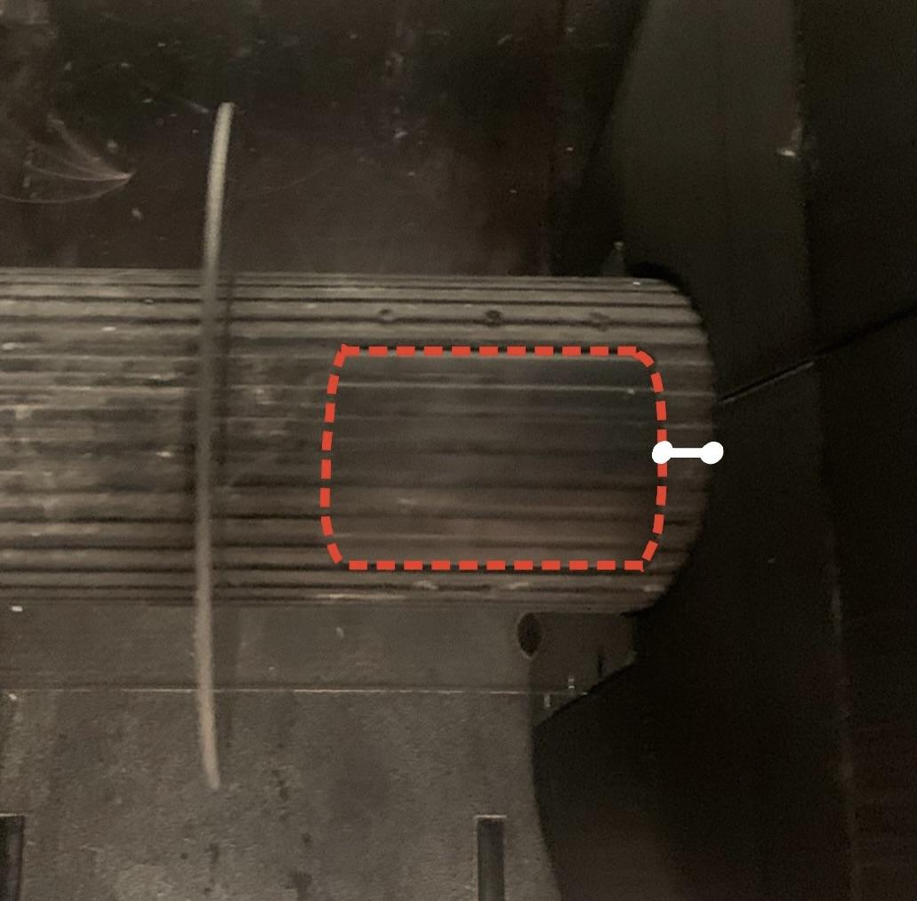
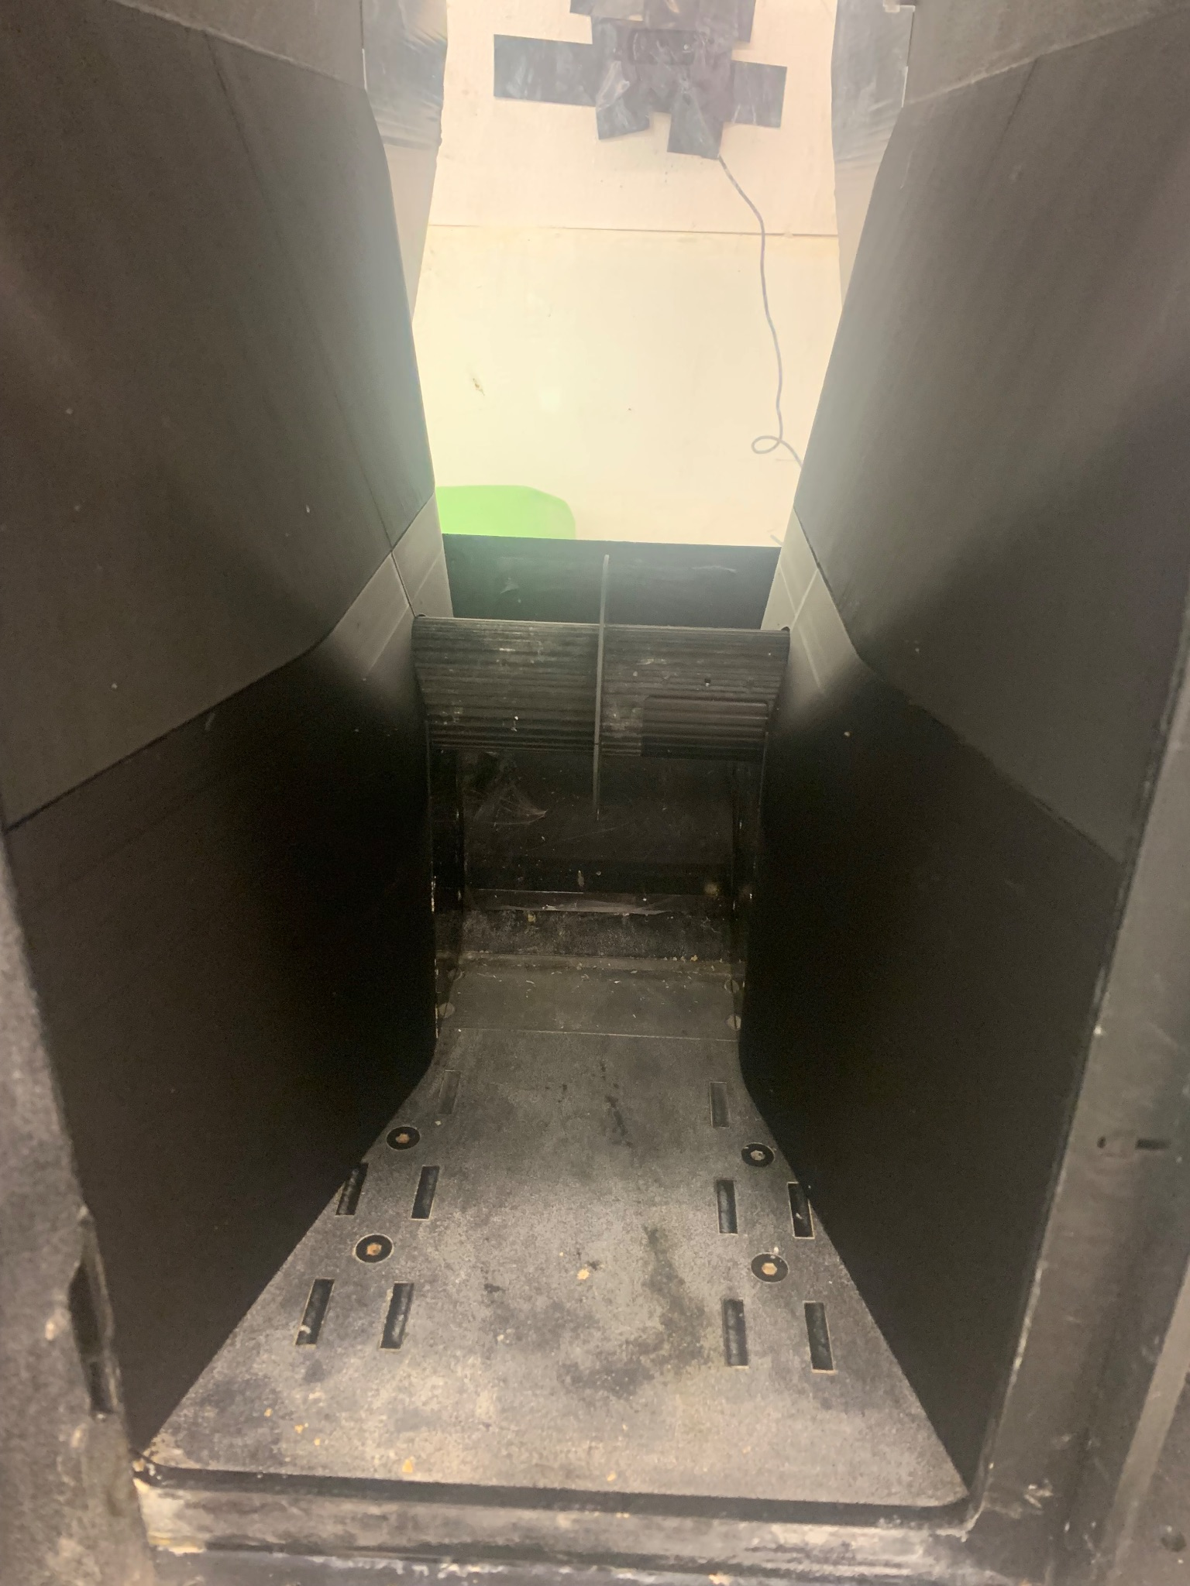
First Box Adjustment
New walls to narrow box
Before
After

Slide 19
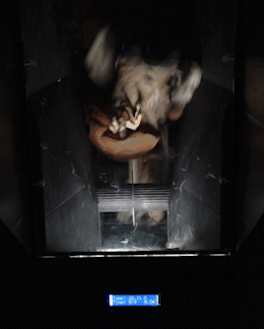
Problem # 3: Rotational Instability

Slide 20
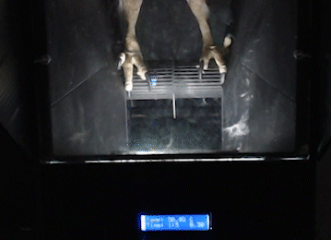
Problem #4: Grip Strength Overpowering Motor

Slide 21
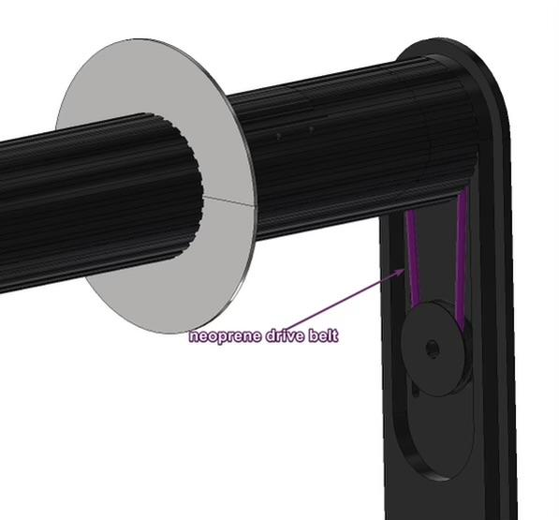
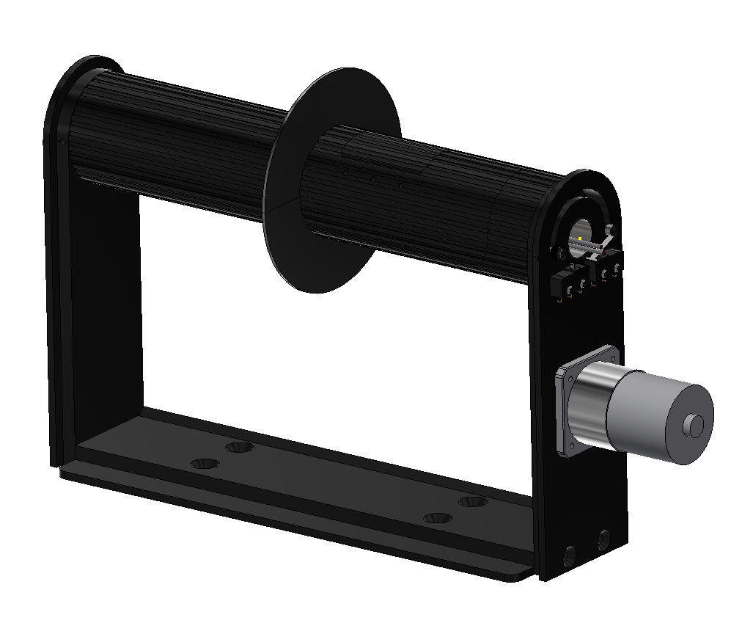
Second Box Adjustments
Change drive belt (connects perch and motor) material to something stiffer
Install stronger motor

Slide 22
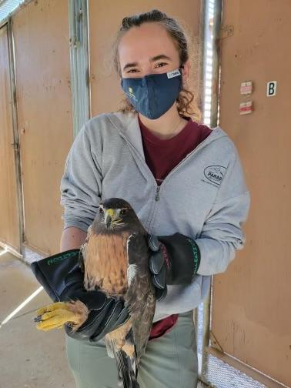
Next Steps
Continue training
Select birds displaying reliable responses
Recruit additional birds

Slide 23
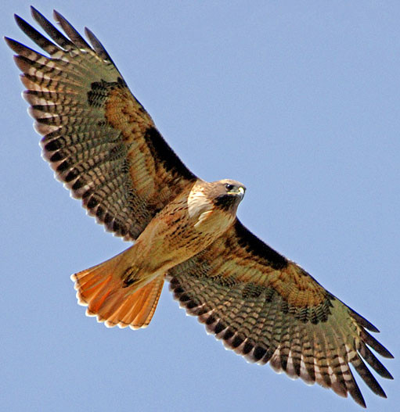
Thank You!

