Slide 1
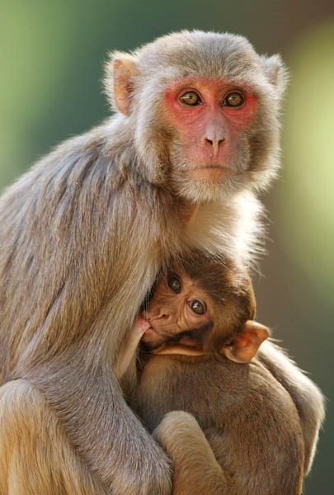
Utilization of electroretinography and advanced retinal imaging to monitor development of retinal abnormalities in nonhuman primates with homozygous or heterozygous mutations in PDE6C
Lily Nguyen
Dr. Ala Moshiri M.D., Ph.D.
Notes:
my project is called Utilization of Electroretinography and Advanced Retinal Imaging to monitor development of retinal abnormalities in nonhuman primates with homozygous or heterozygous mutations in PDE6C.
I want to start by defining the significance of the PDE6C gene. This gene is involved in the phototransduction pathway in cone cells of the retina. And when this gene is mutated, it results in a condition known has achromatopsia, which afflicts both humans and animals.

Slide 2
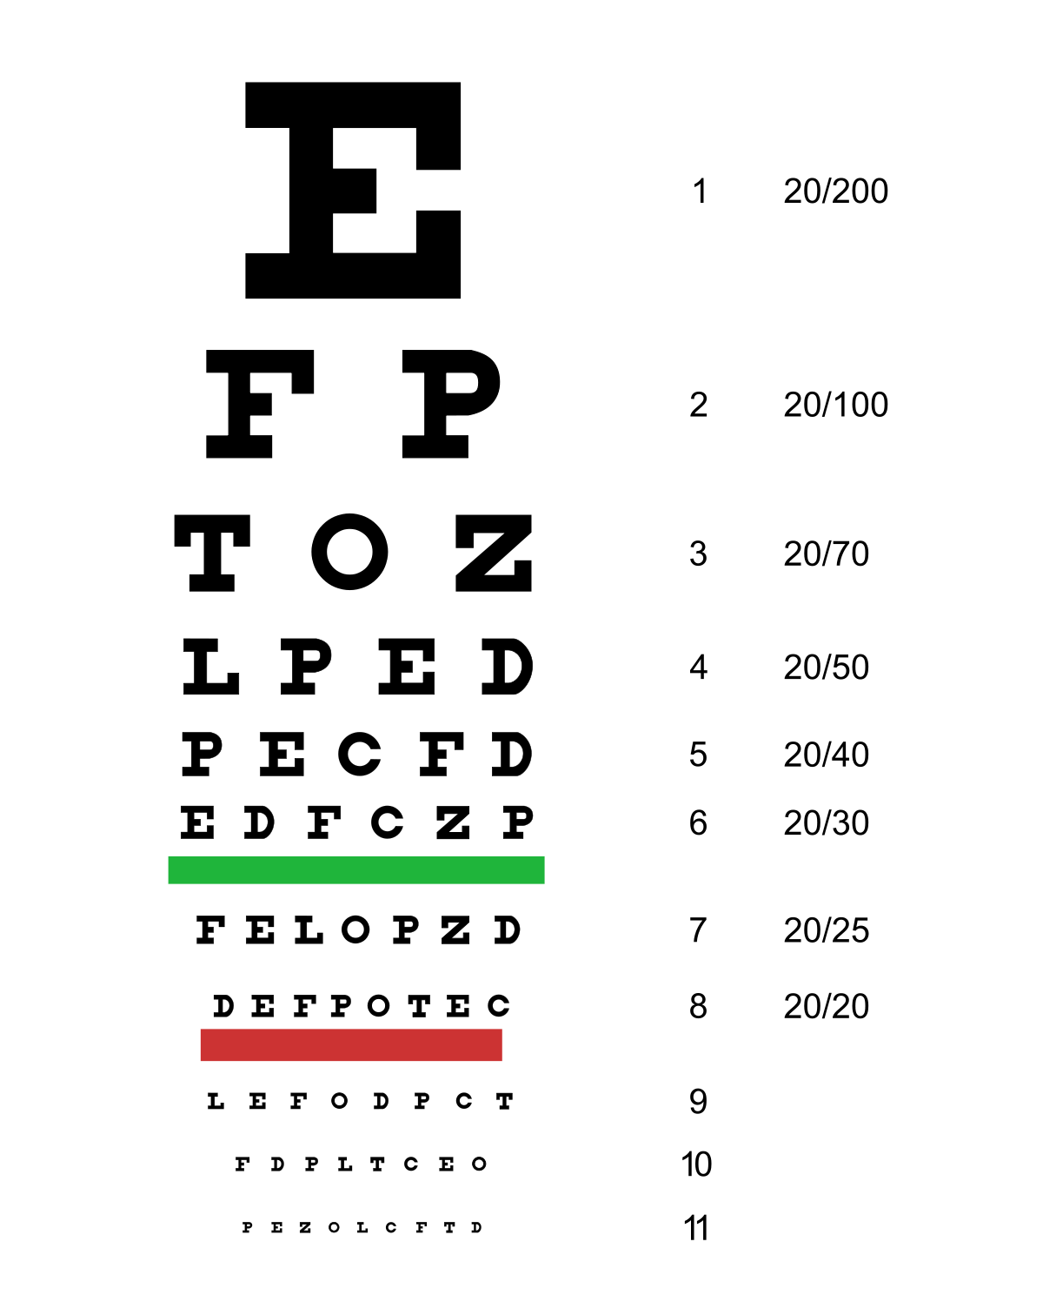
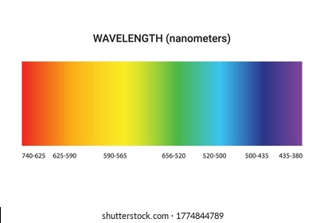
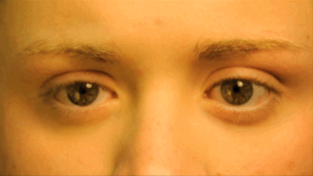
What is Achromatopsia?
Notes:
What is achromatopsia? Achromatopsia is a disease that results when you have dysfunctional cone receptors in the retina. Those with achromatopsia have poor visual acuity, poor color vision, photophobia, and nystagmus. There is currently no cure for this disorder, BUT researchers are working on developing gene and cell therapies that might show some promise.

Slide 3
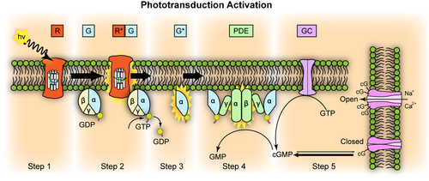
What Causes Achromatopsia?
Notes:
This here is the phototransduction pathway, which converts light to electrical signals which we experience as vision. The PDE6C gene encodes for phosphodiesterase 6 alpha enzyme, which hydrolyzes cGMP to GMP. When the phosphodiesterase enzyme is nonfunctional, this can lead to achromatopsia. But actually, within people with achromatopsia, only a small percentage are due to mutations in PDE6C. The majority are from mutations in CNGA3 and CNGB3, which results in dysfunctional cyclic nucleotide-gated ion channels

Slide 4
Aims of this study
Determine when retinal abnormalities associated with homozygous R565Q mutation in PDE6C appear in rhesus macaques and whether these abnormalities are stationary or progressive over time.
Determine whether retinal abnormalities on electroretinography or multimodal retinal imaging are present in rhesus macaques with heterozygous R565Q mutation in PDE6C
Notes:
Aims of this study. The first aim is to determine WHEN retinal abnormalities associated with this mutation appear in rhesus macaques and whether these abnormalities are stationary or progress over time. The 2nd aim is to determine whether retinal abnormalities on electroretinography or multimodal retinal imaging are present in rhesus macaques with a HETEROZYGOUS mutation in PDE6C

Slide 5
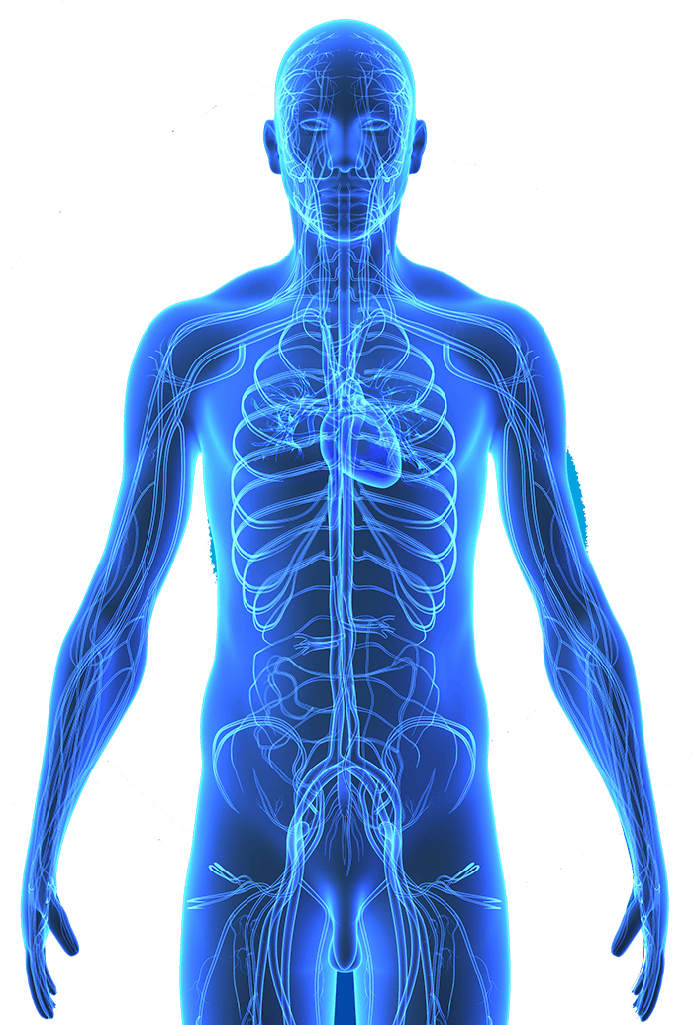
Why Do We Care?
Establish a therapeutic window for future treatment options
Identification of subclinical disease
Translation to human medicine
Notes:
Why do we care? We want to know whether this disease is stationary or progresses over time so we can establish a therapeutic window for future treatment options, such as the gene and cell replacement therapies that are currently in development. Also, by studying those with heterozygous mutations we might be able to identify some sort of intermediate phenotype of the disease. In a previous study its been found that rhesus macaque eyes are proportional and highly similar to the human eye compared to other animal models used in the past like mice, sheep, and dogs, so performing these studies on nonhuman primate models can result in better translation to human medicine

Slide 6
Hypothesis
Rhesus macaques with homozygous R565Q mutations in PDE6C show reduced cone photoreceptor function and macular abnormalities from birth and have slowly progressive macular disease over their lifetime.
Furthermore, rhesus macaques with heterozygous R5656Q mutations in PDE6C show no discernible retinal abnormalities on electroretinography or retinal imaging.
Notes:
Our hypothesis for this study was that rhesus macaques with the homozygous mutation will show reduced cone receptor function and macular abnormalities from birth and have slowly progressive macular disease over their life time. Also, we hypothesized that rhesus macaques with the heterozygous mutations will show no discernible retinal abnormalities on electroretinography or retinal imaging.

Slide 7
Methods

Slide 8
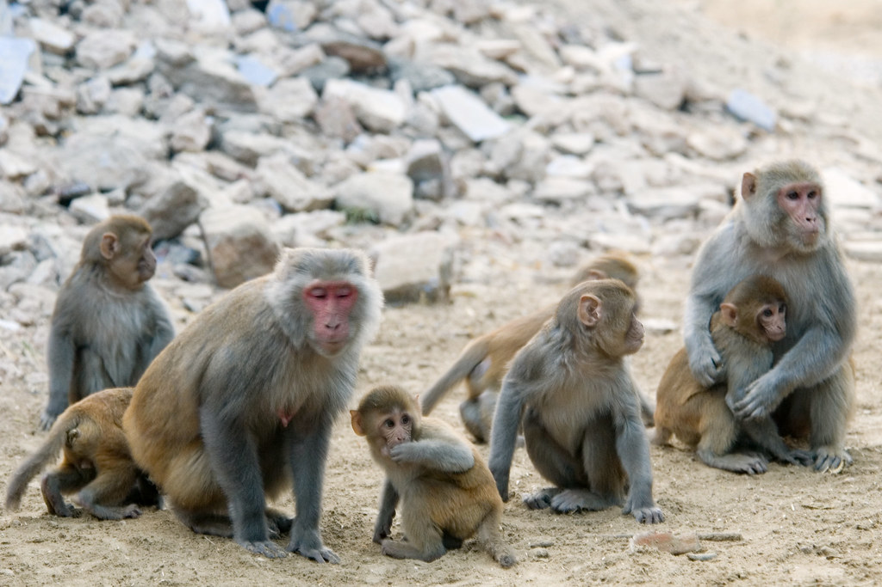
Subjects
5 affected, homozygous adult primates with 5 age and sex-matched controls
4 affected, homozygous baby primates with 4 age and sex-matched controls
3 heterozygous primates: 3-month-old baby, 4-month-old baby, 12-year-old adult.
California National Primate Research Center
Notes:
Our study was comprised of 5 affected homozygous adult primates ranging from 4-13 years old with 5 age and sex-matched controls. 4 affected homozygous baby primates ranging from a few months to 1 years old, with controls. And 3 heterozygous primates, which were 3 months, 4 months, and 12 years old. These primates were recruited from the California national primate research center

Slide 9
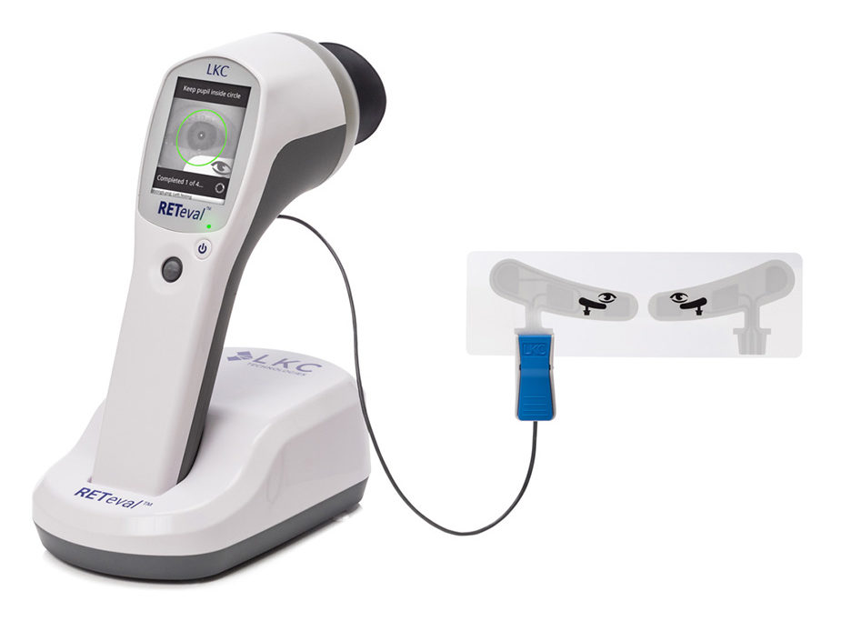
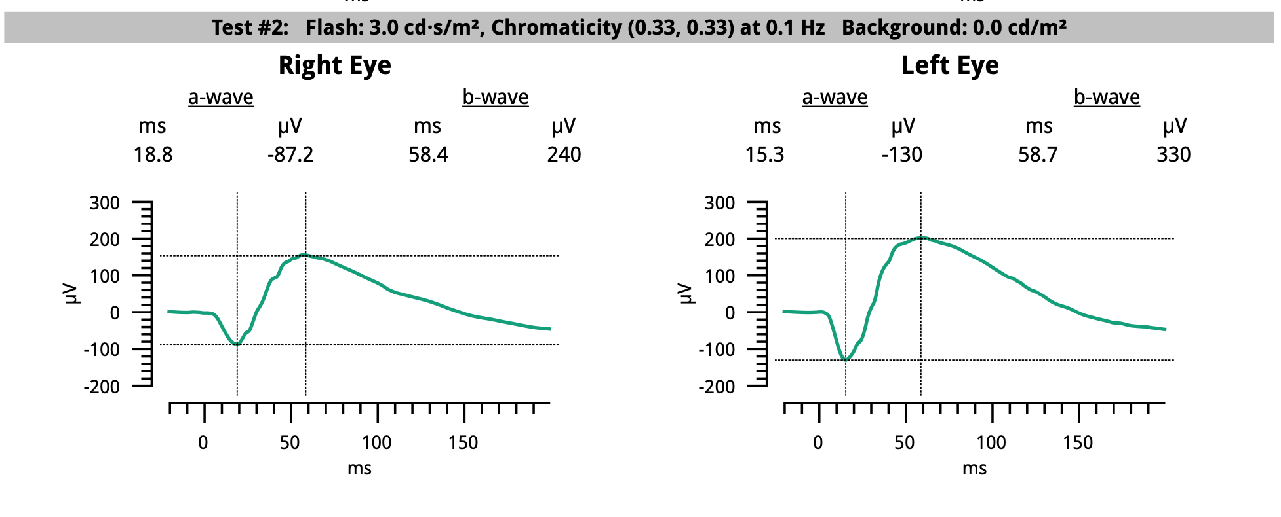
Electroretinography (ERG)
Notes:
For each primate we measured the amount of electrical activity produced by the cone and rod photoreceptors of each eye when it was stimulated under different conditions, using electroretinography, which is sort of like an EKG but for the eye

Slide 10
Retinal Imaging

Slide 11
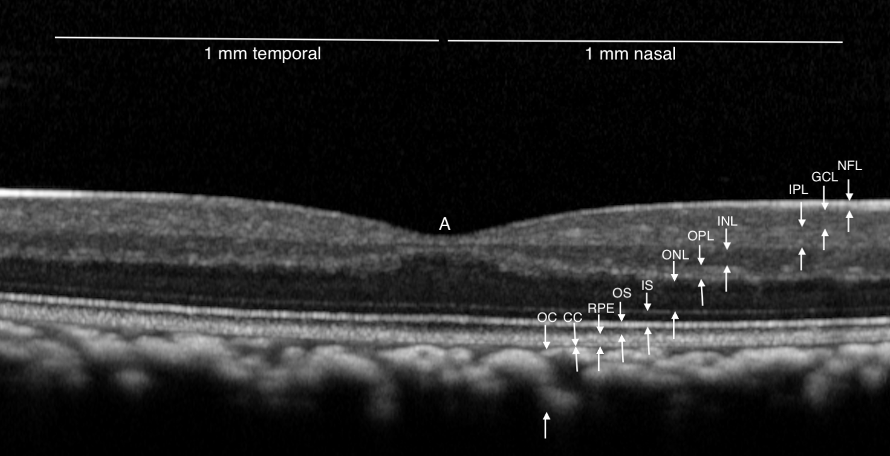
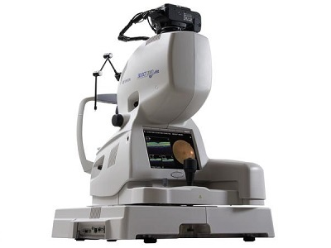
Spectral Domain Optical Coherence Tomography (SD-OCT)
Notes:
SD-OCT is like an ultrasound, but for the eye, but instead of sound waves it uses light waves. This form of imaging gives us high resolution, magnified, horizontal scans of the retina, allowing us to measure the thickness of each layer

Slide 12
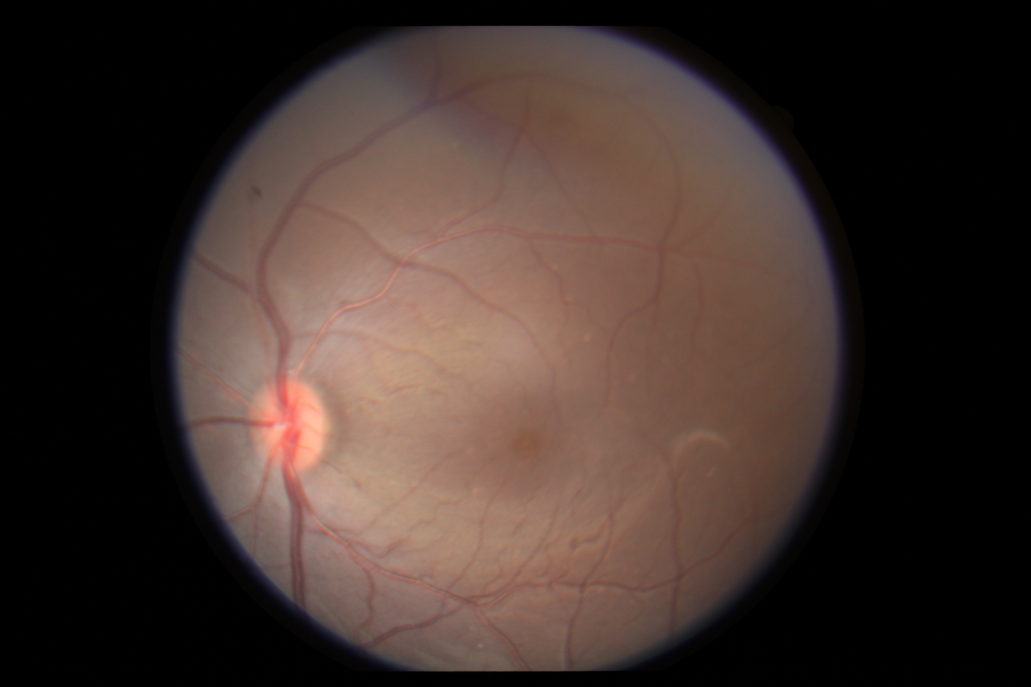
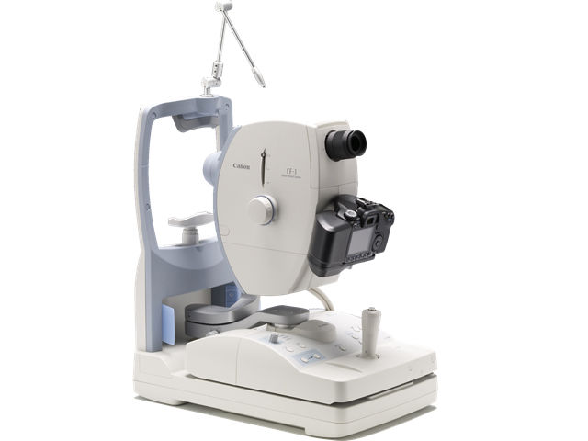
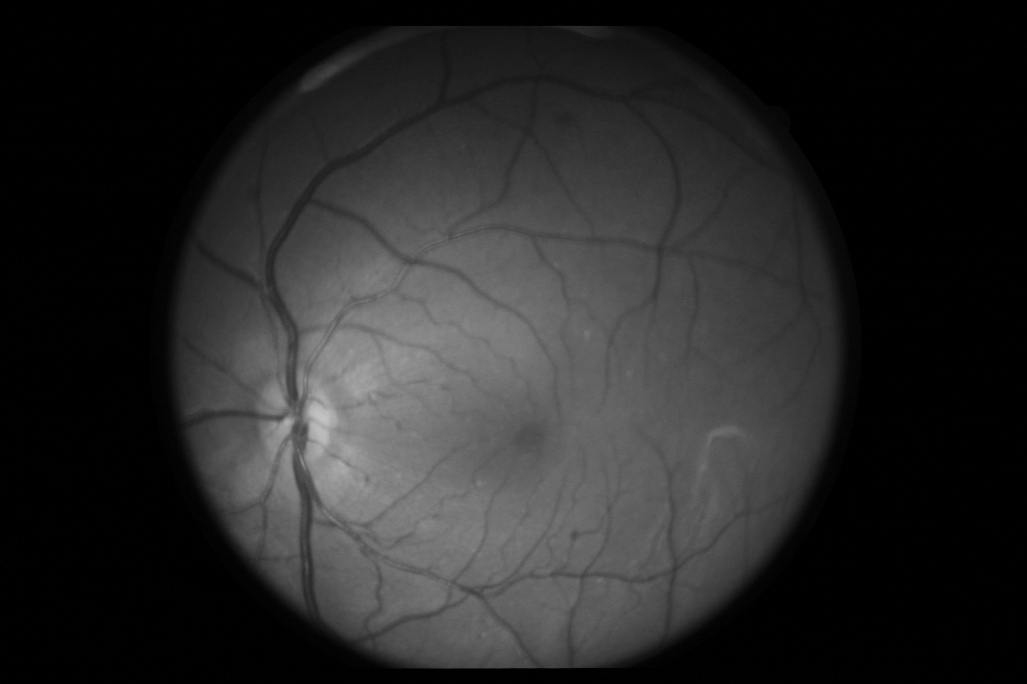
Color Fundus Photography
Notes:
We also took photos of the fundus and macular structure and we examined them in color and also red-free

Slide 13
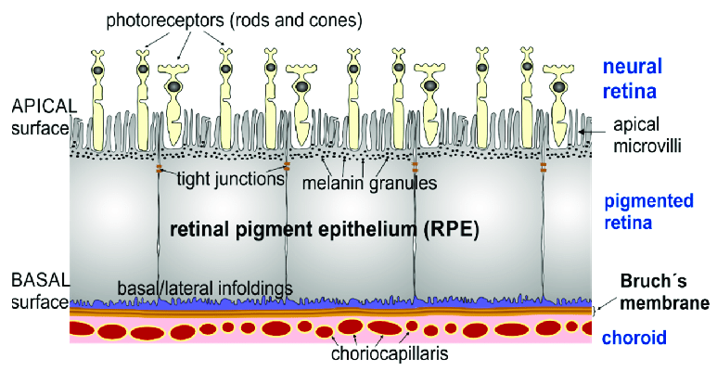
Fundus Autofluorescence
Notes:
To obtain fundus autofluorescence images, we used the same SD-OCT device. Fundus autofluorescence detects fluorophores, which are mainly in the retinal pigment epithelium.

Slide 14
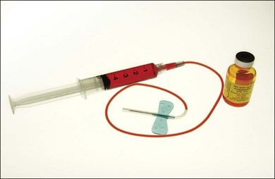
Fluorescein Angiogram
Notes:
Finally we captured fluorescein angiograms which highlights the retinal blood vessels. We don’t have finalized data on these images so far since Im currently in the process of obtaining control primate angiograms.

Slide 15
Statistical Analysis
Two-Sample t-test
P < 0.05
Notes:
For the statistical analysis, we used a two sample t test, and data was considered statistically significant if our P value was less than 0.05.

Slide 16
Results

Slide 17
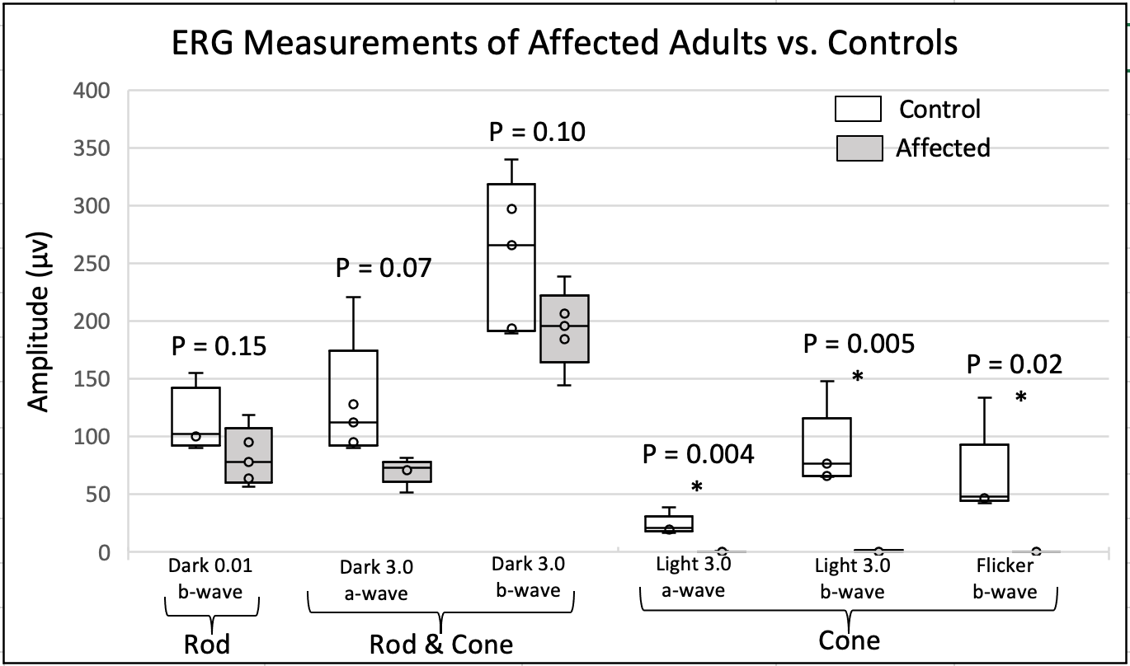
Notes:
Here we see the ERG measurements of affected adults vs. controls. In our original publication, we saw that the rod ERGs in the adults were mostly preserved while the cone responses were absent. This is also evident here – the rod responses seem to be preserved, whereas the cone responses are pretty much absent.

Slide 18
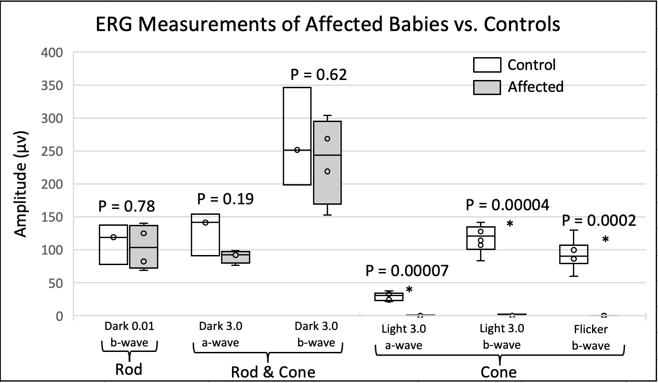
Notes:
For this study, we wanted to see how early these changes took place, so we measured the ERGs in affected babies. We get the same results for the babies. Rod function seems to be similar between affected babies and their controls, but again the cone function is dramatically decreased, with P values significantly less than 0.05. With this we can conclude that cone dysfunction in these affected primates are congenital.

Slide 19
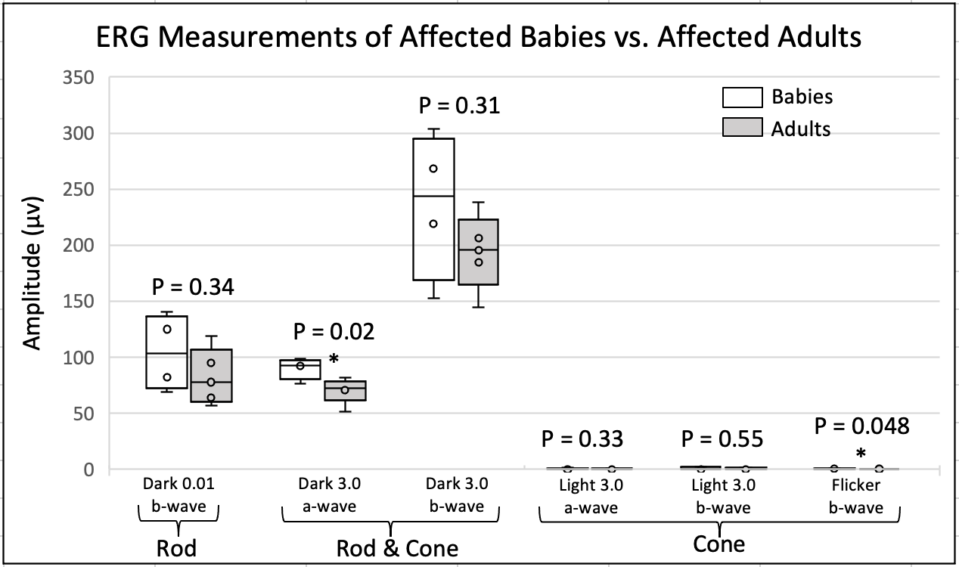
Notes:
In this boxplot you see the ERG measurements of affected babies vs the adults. As you can see there is a noticeable difference between the two, but the results were not statistically significant except for the dark adapted a wave, and the flicker b wave. THIS.. makes us suspicious of a progressive rod dysfunction, and the flicker test, which best isolates cone function out of all the other tests, does significantly decline, so we can appreciate some progression of disease as these primates age, although subtle.
maybe progressive rod dysfunction? Only noticable with bright flash dark adaptive + bright flash - tests large number of rods. More functional in babies than adults
Flicker = purest cone test. Works during light adaptation, flickering light - only cone photo receptors can sense this. Rods are slower to respond not significant. Flicker voltage is almost 0
A wave = shows health of the photoreceptor cells of outer retina. B wave reflects health of inner retinal cells like bipolar cells and muller cells

Slide 20
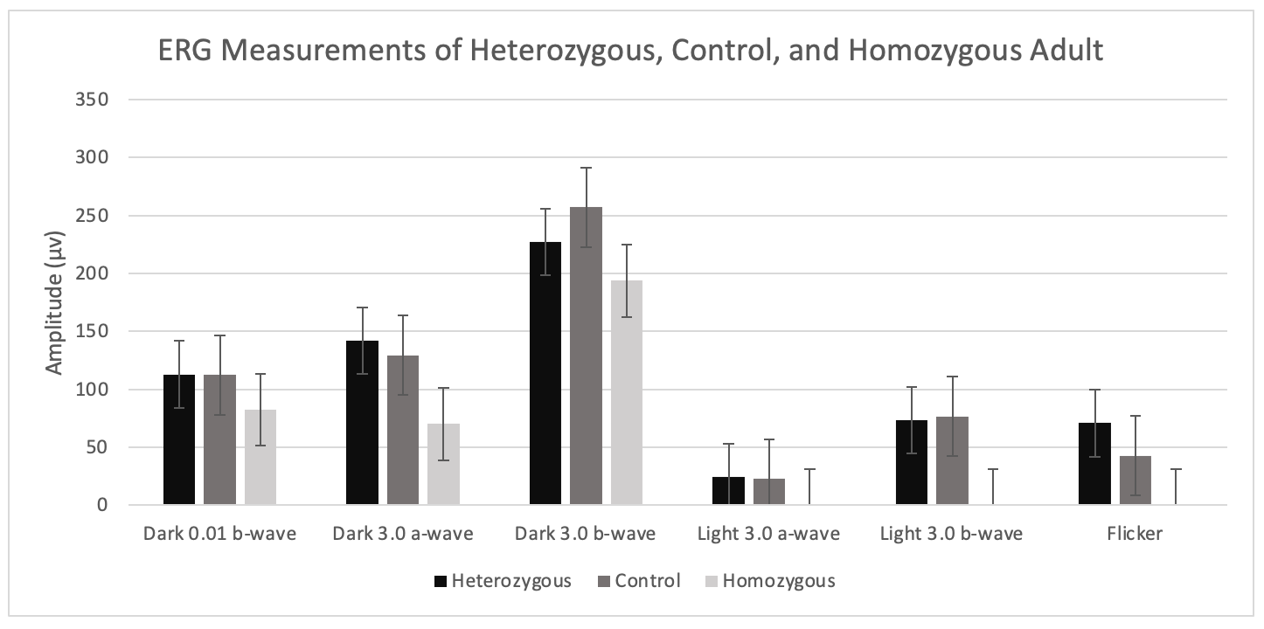
Notes:
For this study, we only had 3 heterozygotes, but only 2 of them had available ERG measurements. Because of the limited sample we couldn’t make any meaningful analyses or any definitive conclusions.
But as you can see on this graph though, the heterozygote values are pretty similar in height to the controls in all tests.

Slide 21
Notes:
And here are the heterozygote measurements again but for the babies

Slide 22
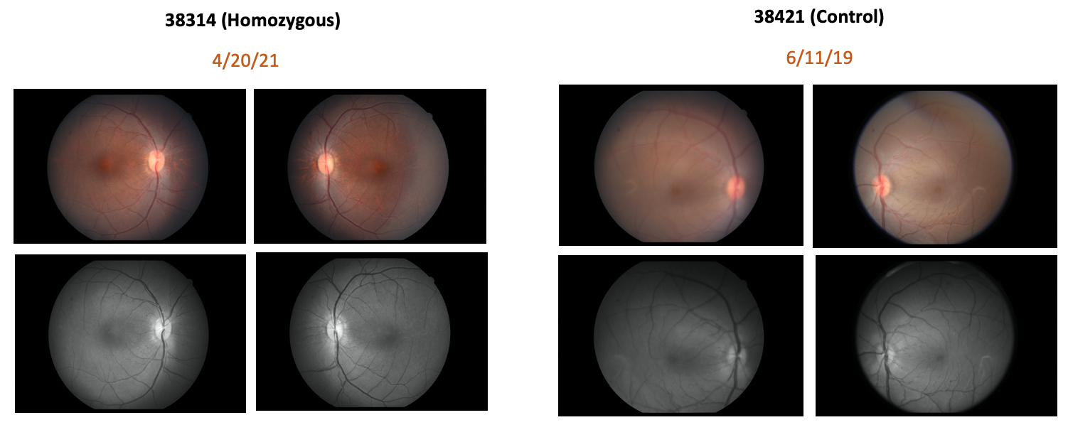
Adults
Color and Red-Free Fundus Photos
Notes:
Here we have the color and the red-free fundus photos. And as you can see there’s no obvious difference between the affected adults and controls.

Slide 23
Babies
Color and Red-Free Fundus Photos
Notes:
And then same with the affected babies and their controls – no obvious difference

Slide 24
Heterozygotes
Color and Red-Free Fundus Photos
6/11/19
Notes:
These here are the fundus photos for the heterozygotes; again no obvious difference.

Slide 25
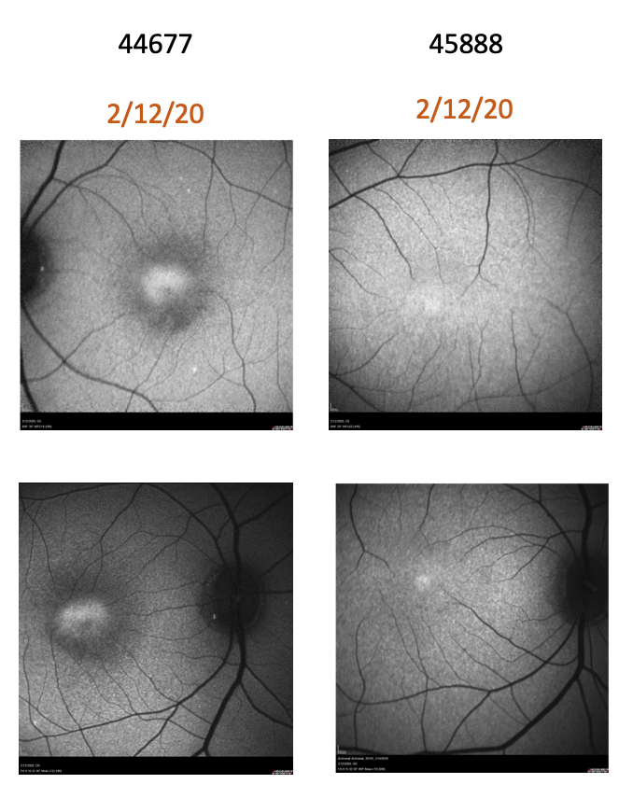
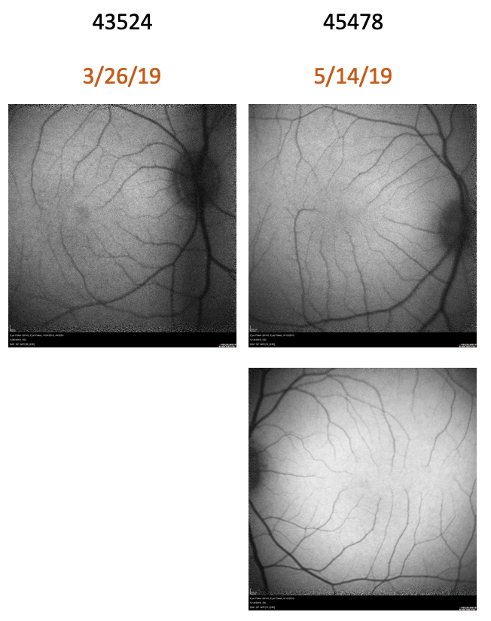
Adults
Fundus Autofluorescence Photos
Homozygous Adults
Control Adults
Notes:
However, on the fundus autofluorescence images, we see that the affected adults have a hyperfluorescent foci surrounded by hypofluorescence, which indicates that the RPE cells of the retina are unhealthy; where as in the controls, we don’t see that

Slide 26
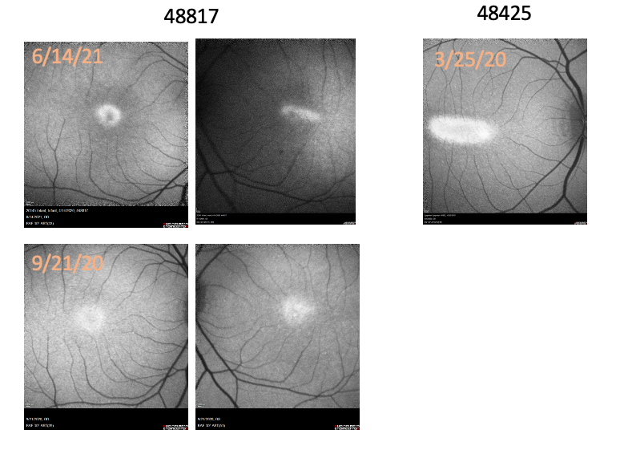
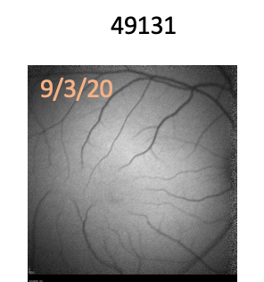
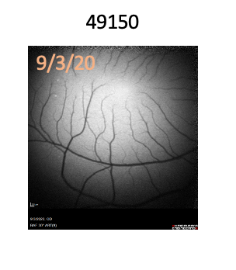
Babies
Fundus Autofluorescence Photos
Homozygous Babies
Control Babies
Notes:
Same with the affected babies, we see the hyperfluorescence and the hypofluoresence in the autofluorescence images.

Slide 27
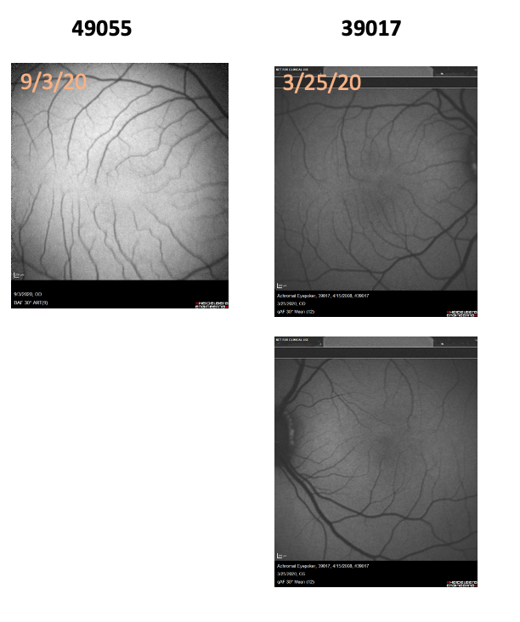
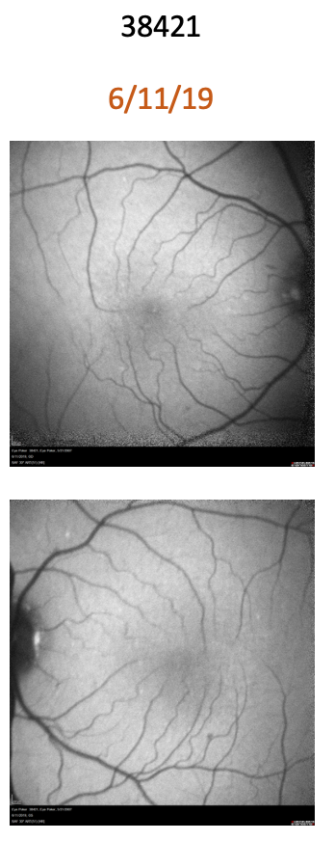
Heterozygotes
Fundus Autofluorescence Photos
Heterozygotes
Controls
49131
Notes:
In the heterozygotes, only 2 out of the 3 had fundus autofluorescence images; but from these two you can see that again there’s no obvious difference between the heterozygotes and the controls.

Slide 28
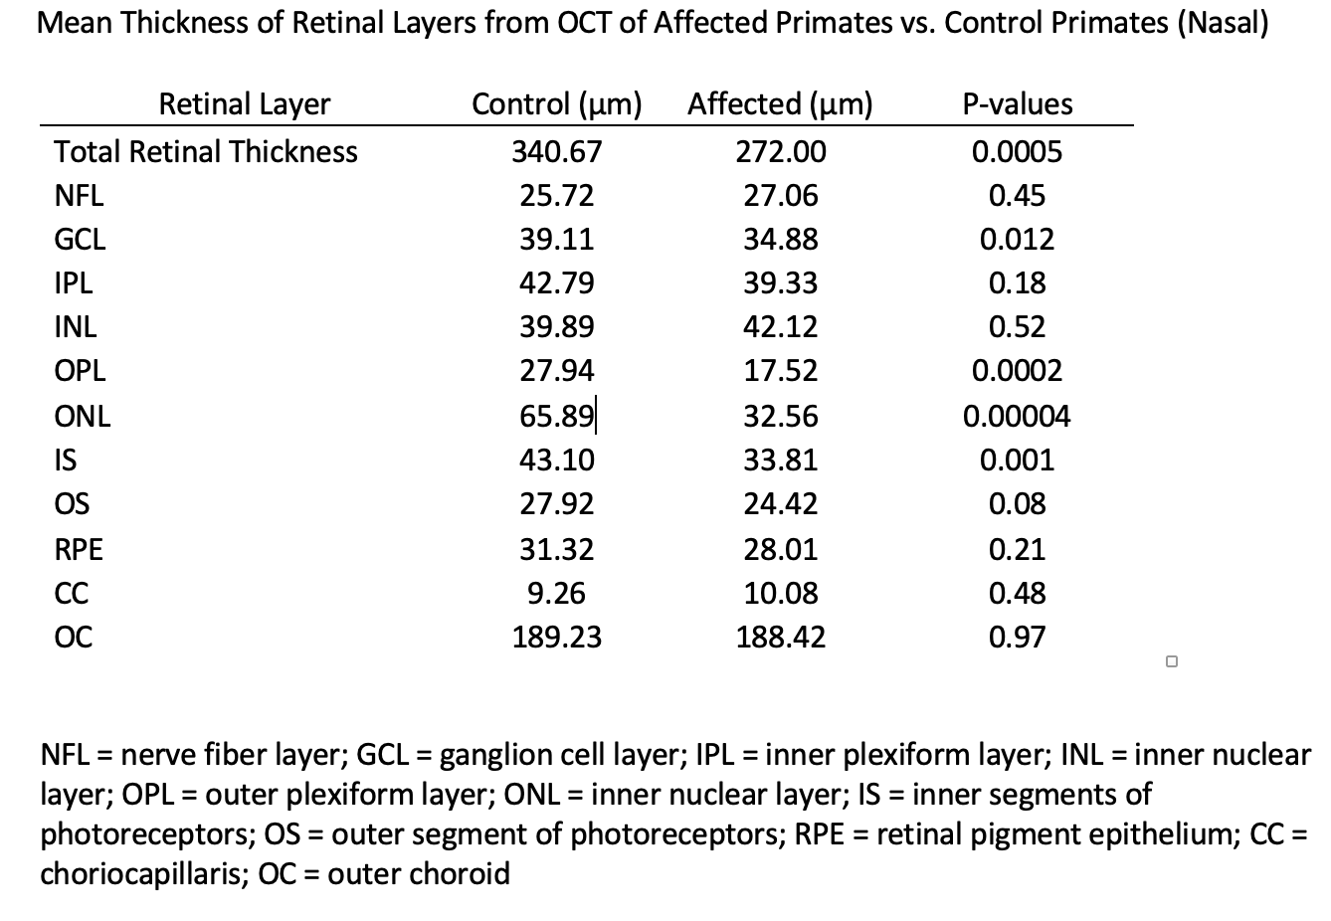
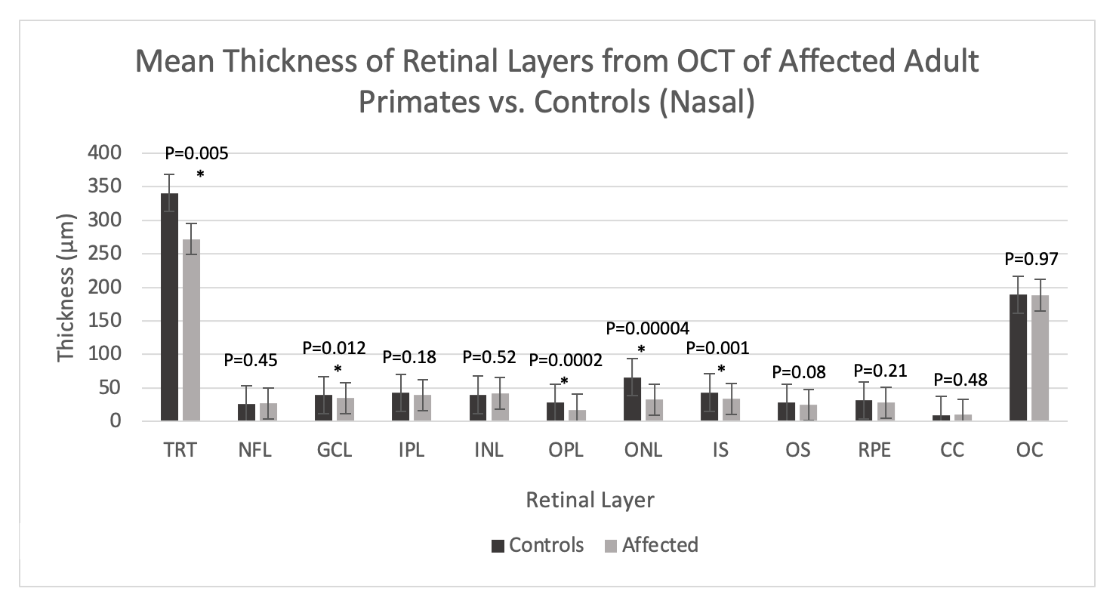
SD-OCT (Adults)
Notes:
For the SD-OCT images, we measured each retinal layer and compared the averages between the controls and the affected. Here, on the nasal side we see that some of the layers have significantly decreased in thickness. Parts of the cone receptors are located in the outer nuclear layer, the inner segment, and the outer segment, so these layers should decrease in thickness in primates with achromatopsia. In this data table, the outer nuclear layer and inner segment have significantly decreased, but the outer segment, whose average did seem to decrease, was only almost statistically significant.
Outer nuclear layer – photoreceptor cell bodies
Inner Segment – contains photoreceptor axon, organelles
Outer Segment – photoreceptor outer segments contain disks called opsins which absorbs photons

Slide 29
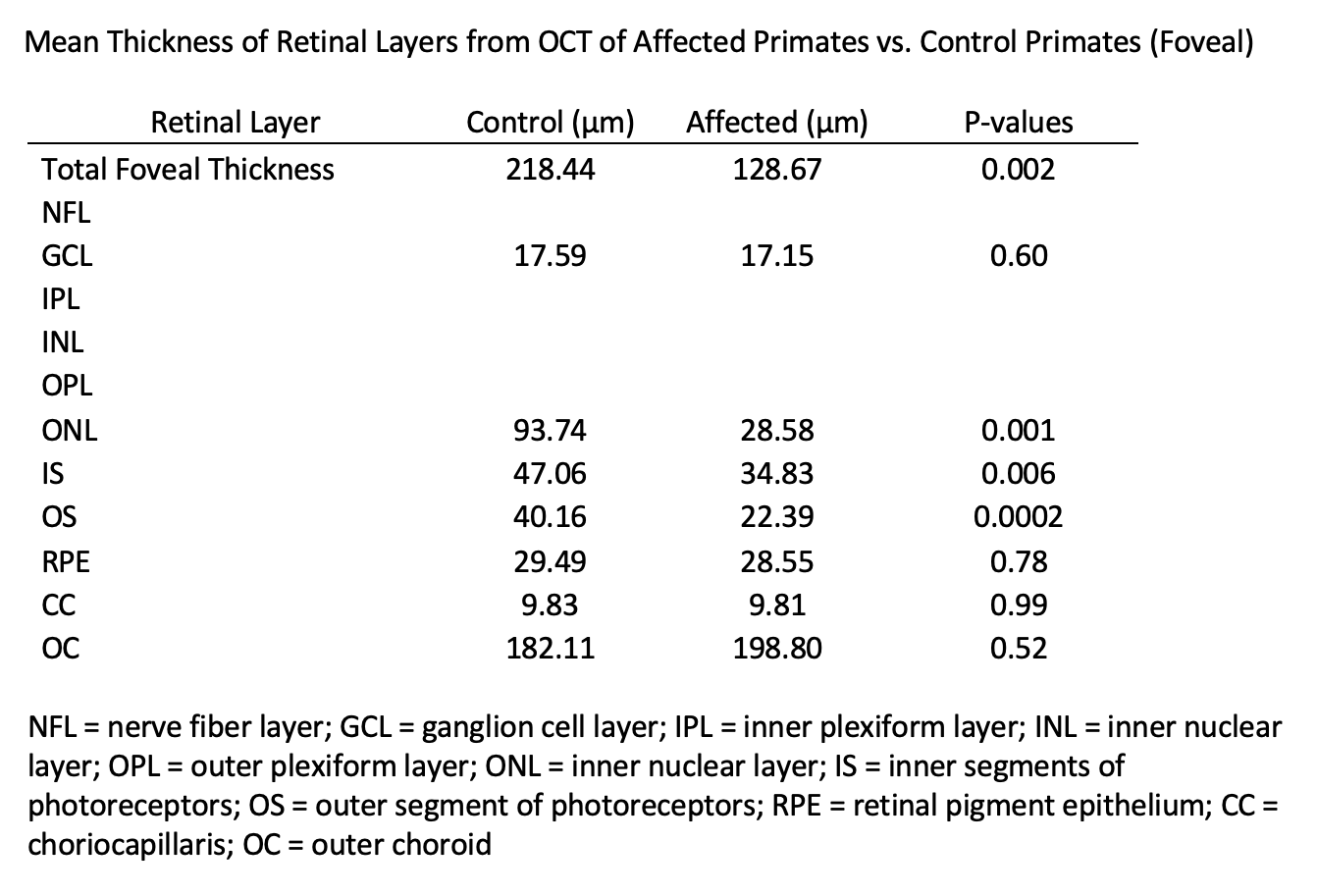
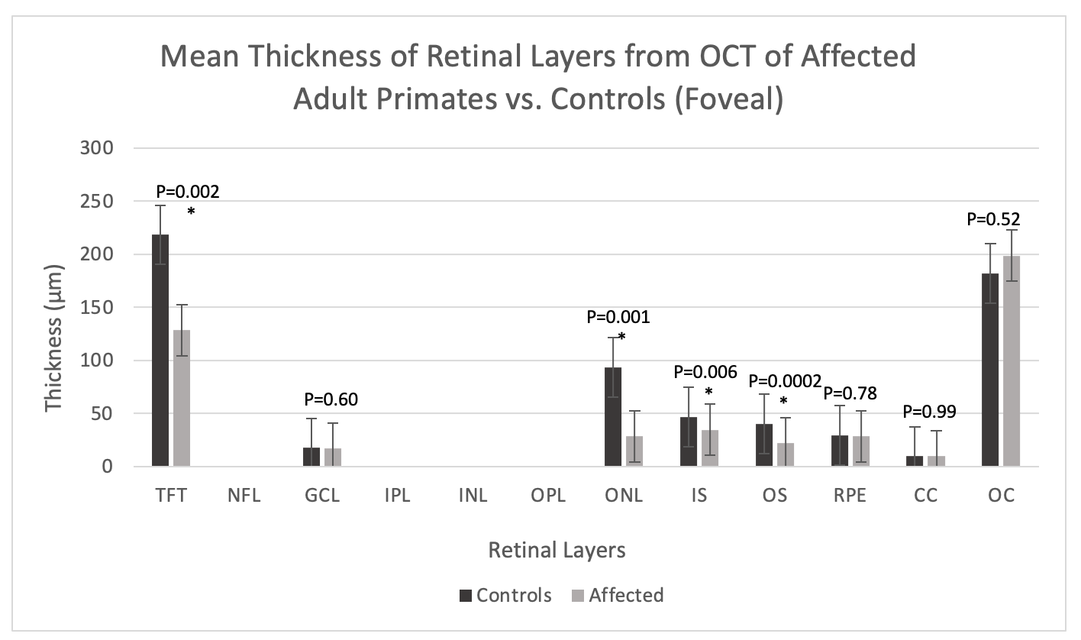
SD-OCT (Adults)
Notes:
You can see the same thing here in the adult primates but in the fovea: all the layers containing parts of the cone photoreceptors (the ONL, IS, OS) have decreased

Slide 30
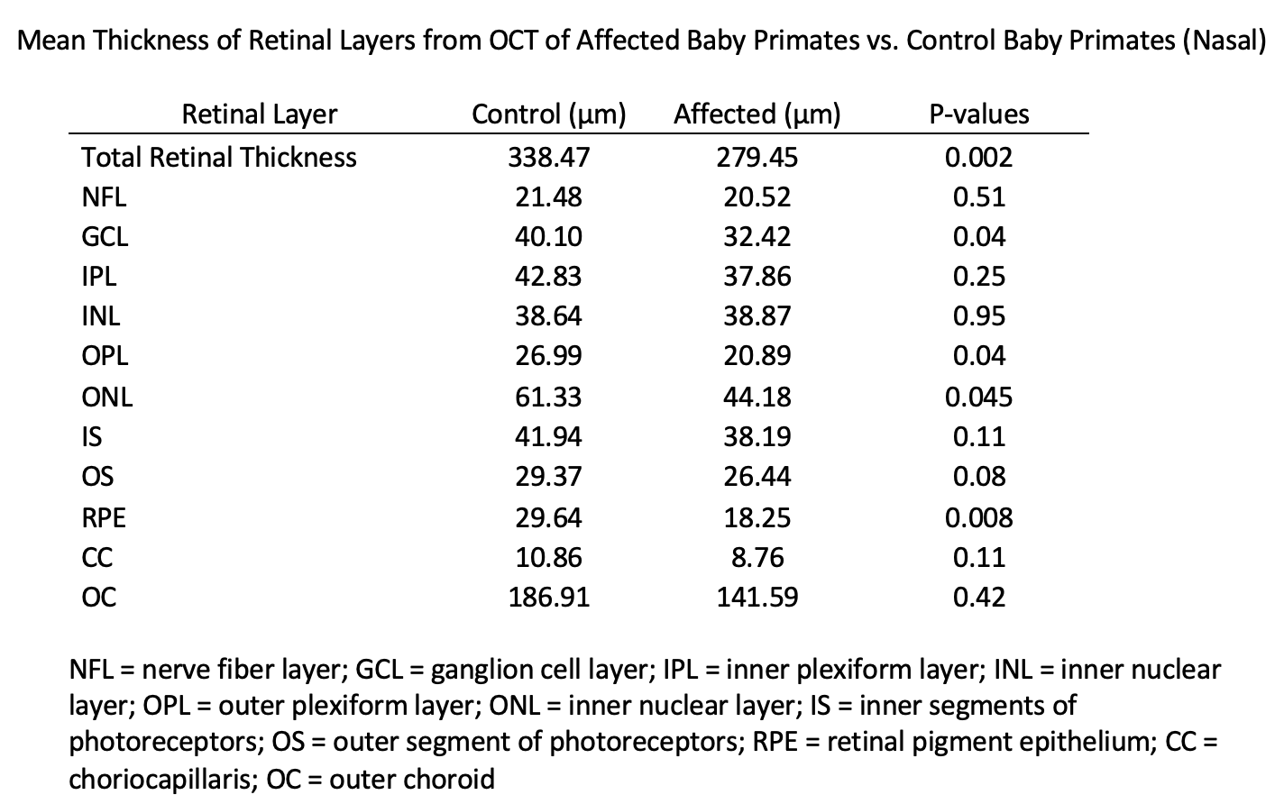
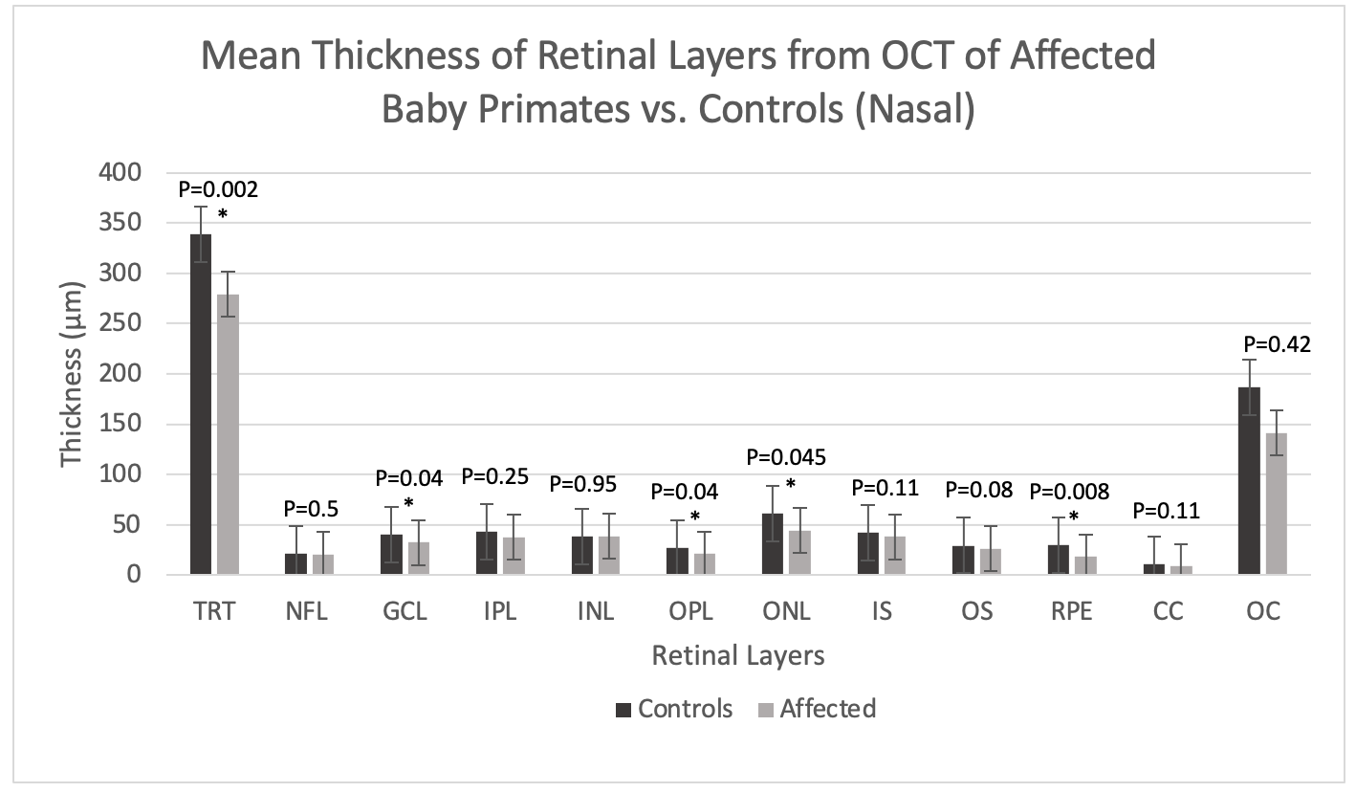
SD-OCT (Babies)
Notes:
For the baby primates you can see a similar pattern in the total retina layer thickness and the outer nuclear layer. The babies seemed to have a thinner RPE layer, and were not sure why yet, but what we can conclude from this data is that these retinal abnormalities are present at birth

Slide 31
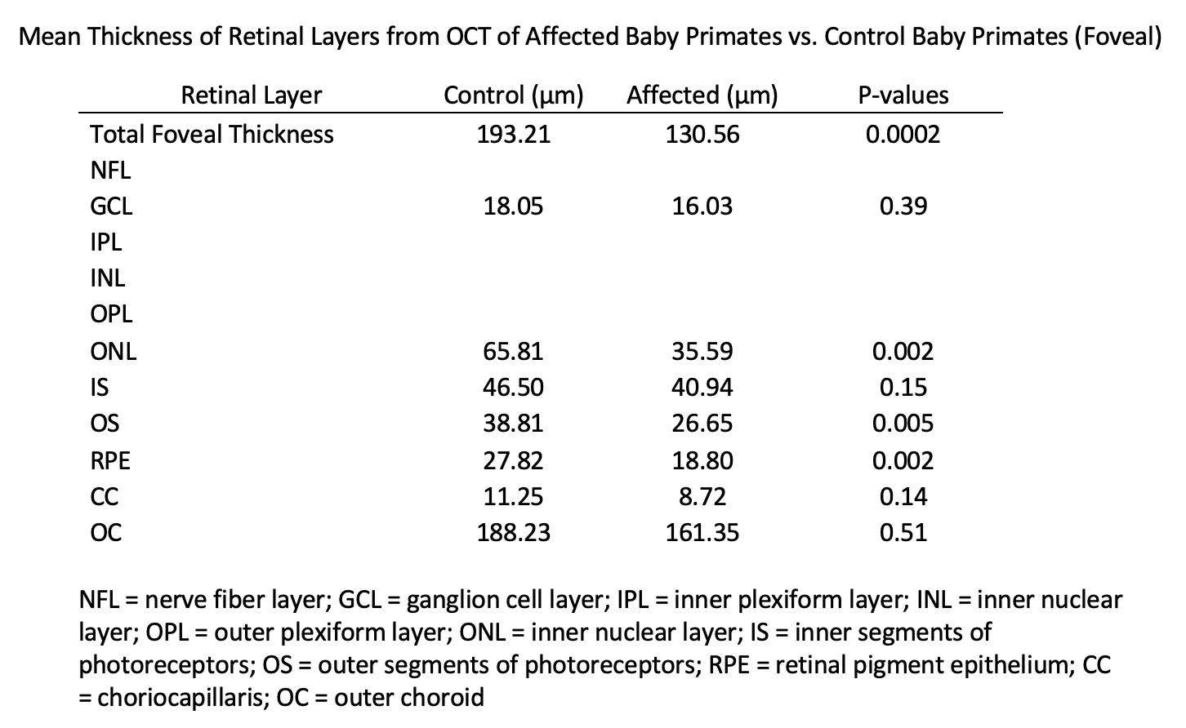
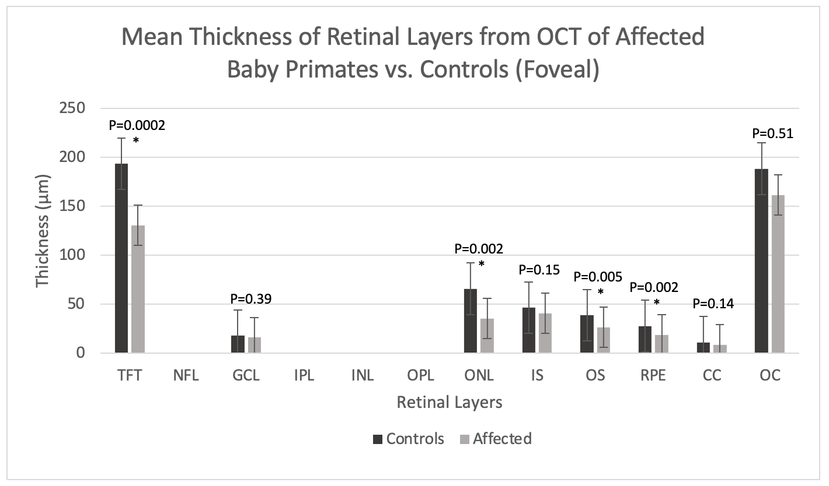
SD-OCT (Babies)
Notes:
And here’s the data in the fovea, again you see the total foveal thickness, ONL, and RPE are thinner. But also the outer segment

Slide 32
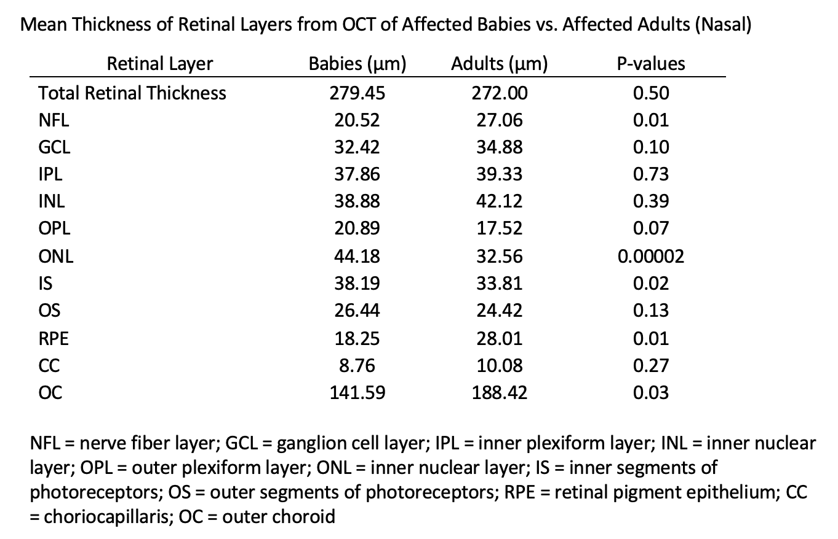
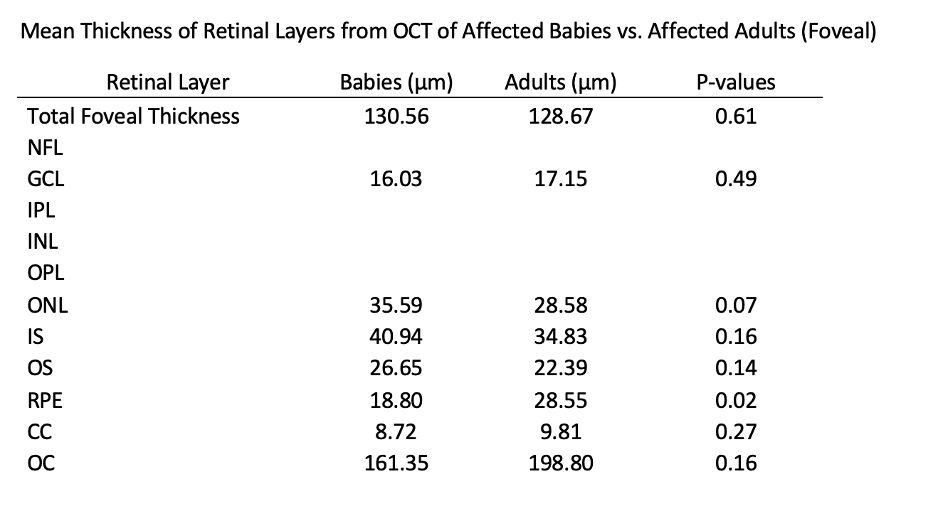
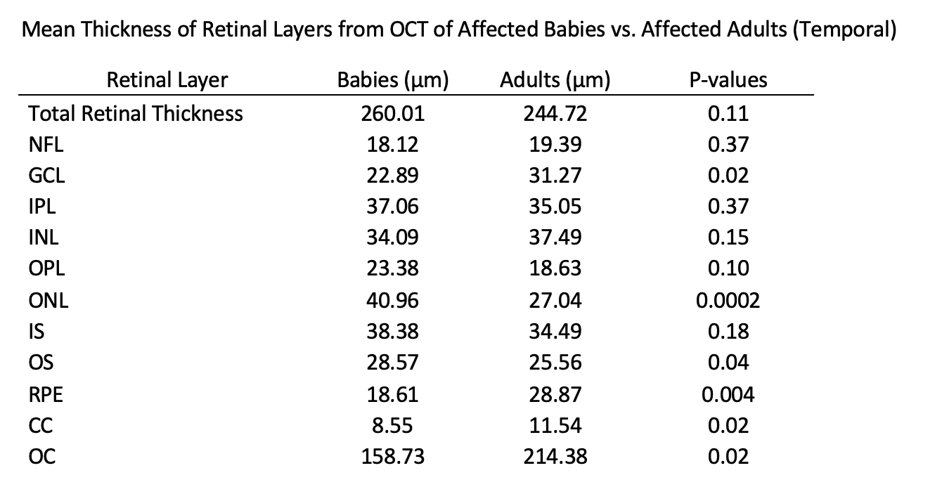
SD-OCT (Babies vs. Adults)
Notes:
Here we compared babies vs. affected adults. As you can see there is statistically significant decrease in thickness of some of these layers. We’re still trying to figure out why these specific layers are affected. But overall this data does suggest that there’s some progression of macular disease as these primates age

Slide 33
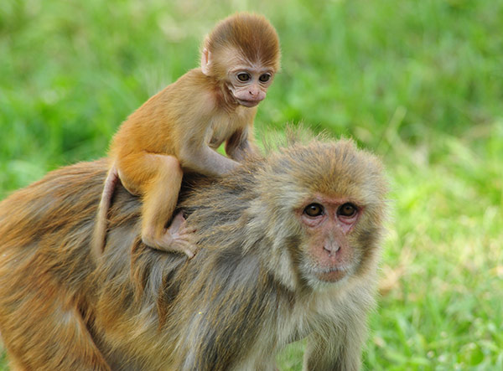
Summary
Reduced cone photoreceptor function from birth
Macular abnormalities from birth
Progression over time
Do heterozygotes have an intermediate phenotype? Stay tuned…
Notes:
In summary, our data suggests that the rhesus macaques with the homozygous mutation PDE6C, do indeed show reduced cone photoreceptor function at birth based on the ERG, and that the macular abnormalities, seen in the fundus autofluorescence and OCT images, are also present at birth. In both the ERG and the imaging data, we can appreciate a progression of the disease over their lifetime. As for the heterozygotes, stay tuned. Until we are able to increase our sample size and data, we can’t make any strong arguments.

Slide 34
Pitfalls
Small sample size
Missing data on some primates (mainly heterozygotes)
Notes:
Our sample size was fairly small, so in order to get more statistical power, we would need to find or breed more homozygous and heterozygous primates for our study. Also there was some missing data on some of our primates, so we had to exclude them from the study.

Slide 35
What next?
Breed affected primates to increase sample sizes
Test gene and cell replacement therapies on nonhuman primate models (in process)

Slide 36
Acknowledgements
Financial support was provided by the Students Training in Advanced Research (STAR) Program
Dr. Ala Moshiri
Murphy-Russell-Leonard-Thomasy Laboratory
California National Primate Research Center

Slide 37
References
Google Images
Moshiri, A., Chen, R., Kim, S., Harris, R. A., Li, Y., Raveendran, M., ... & Garzel, L. (2019). A nonhuman primate model of inherited retinal disease. The Journal of clinical investigation, 129(2), 863-874.

