Slide 1
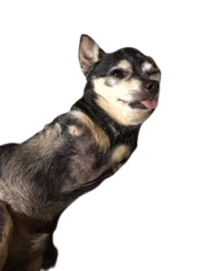
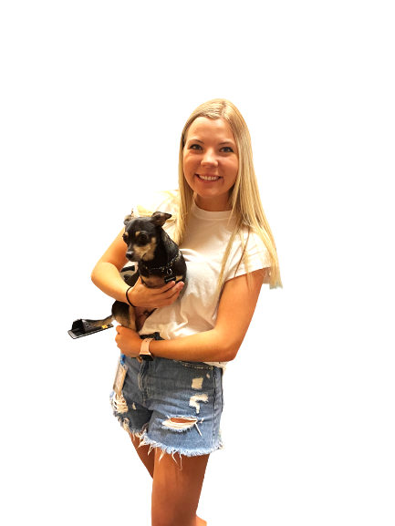
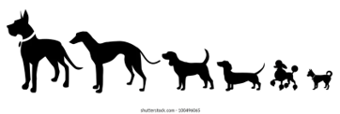
Hemimelia in Chihuahuas
Marin Green
Bannasch Lab
STAR 2023

Slide 2
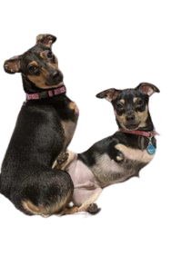
Background
Bilateral Anterior Hemimelia- the absence of front legs
First reported in Mexico (Alonso. (1982). An autosomal recessive form of hemimelia in dogs. The Veterinary Record., 110(6), 128–129.)
We suspect it has a recessive mode of inheritance because it is seen in cases of inbreeding
Other diseases typically affect all limbs, not solely the thoracic limbs, making this a disease of interest
Affected dogs often relinquished to shelters

Slide 3
DNA Sample Collection
13 dogs collected that were affected with BAH
GWAS
Identifies chromosomal location of BAH
Whole Genome Sequencing
Identifies candidate variants
Sanger Sequencing & Genotyping
366 control dogs with 4 limbs from Bannasch laboratory DNA database
Identify causative variant

Slide 4
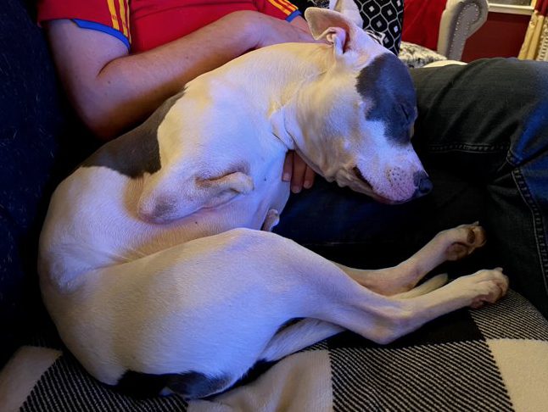
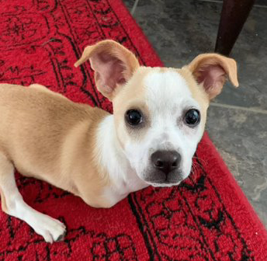
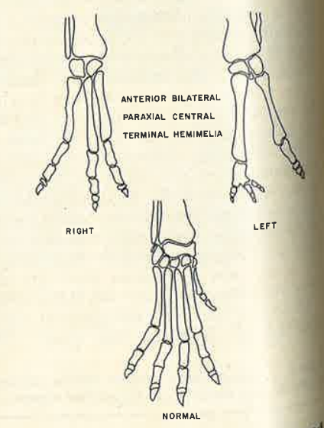
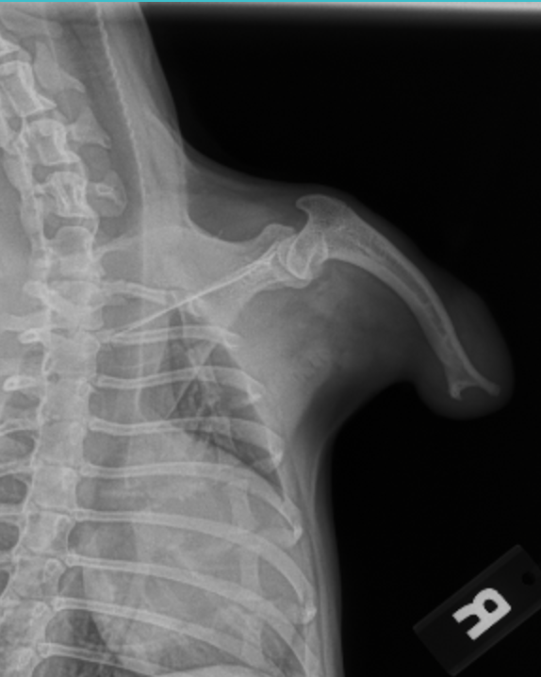
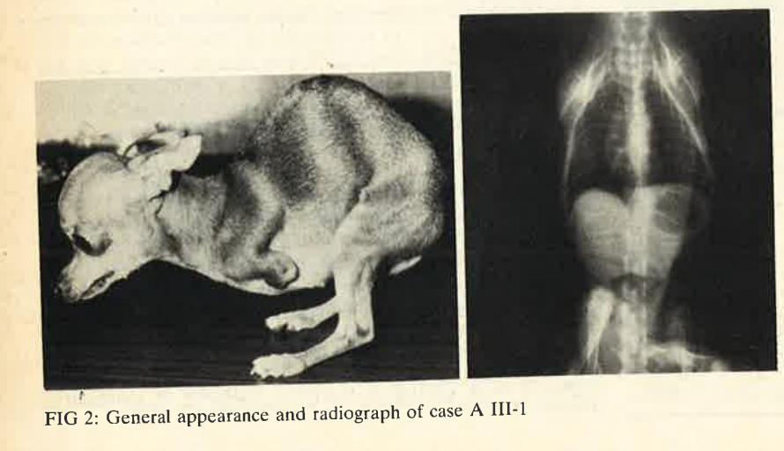
Phenotype and Expressivity
Notes:
Variable expressivity, Explain that there are variations in phenotype, some animals have no limb at all, some are just missing toes, some are missing half of limb, ADD ALONSO TABLE,

Slide 5
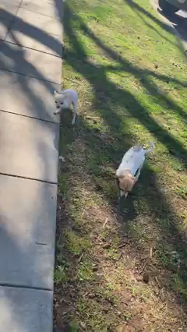
Phenotype

Slide 6
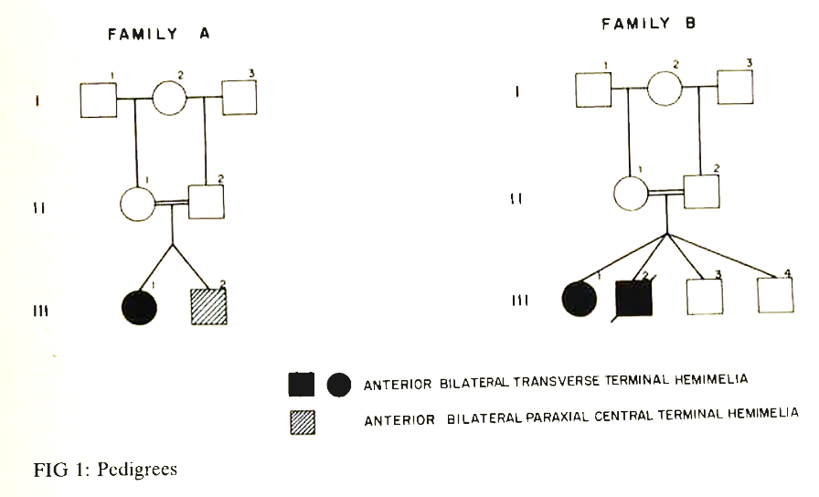
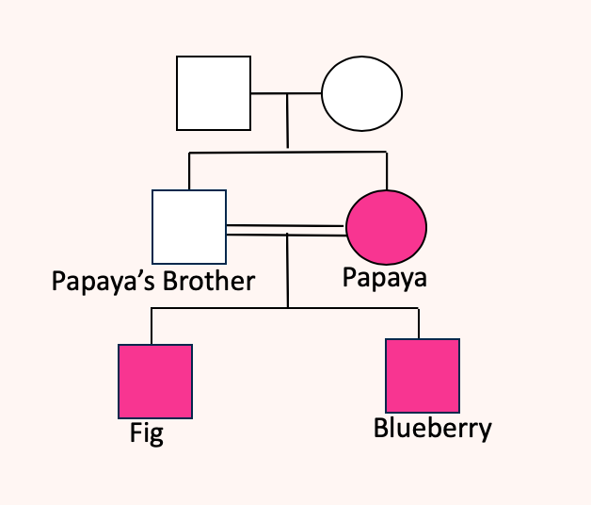
Pedigrees
Alonso. (1982). An autosomal recessive form of hemimelia in dogs. The Veterinary Record., 110(6), 128–129.
Notes:
Make pedigree smaller

Slide 7
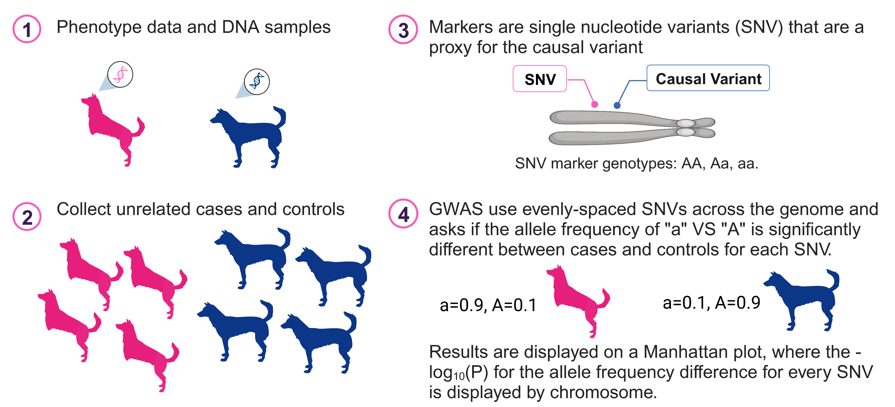
GWAS Overview
Notes:
So now that we have our cases and controls collected, the main question we want to ask is if there is an allel frequency difference between those two groups. This is evaluated with a GWAS. The cases and control groups are genotyped across many SNVs (single nucleotide variants) across their genomes. These SNVs are run on a chi squared test and each P value for the SNV is plotted relative to the SNV chromosomal location and visualized here on a Manhattan plot. The P value difference in allele frequencies can be seen in this Manhattan plot. A high peak suggests that there is a significant difference in allel frequencies in cases and controls at that chromosomal location.

Slide 8
GWAS Results
10 cases, 61 controls -220,853 markers on Canine Illumina SNP Array
187,273 variants​ passed variant filtering based on genotyping rate and minor allele frequency
Gemma- (Zhou, X., Stephens, M., (2012). Genome-wide efficient mixed-model analysis for association studies. Nature Genetics 44, 821–824.) was used to control for population stratification
Corrected lambda value: 1.14​
Notes:
Genotype 220,000 SNVs across the dog genome (canine Illumina HD array )
Command line computer program called GEMMA to perform association
Determine allele frequency of all variants in cases and controls
Determine statistically significant differences in allele frequency
Visualize results by generating a Manhattan plot in R

Slide 9
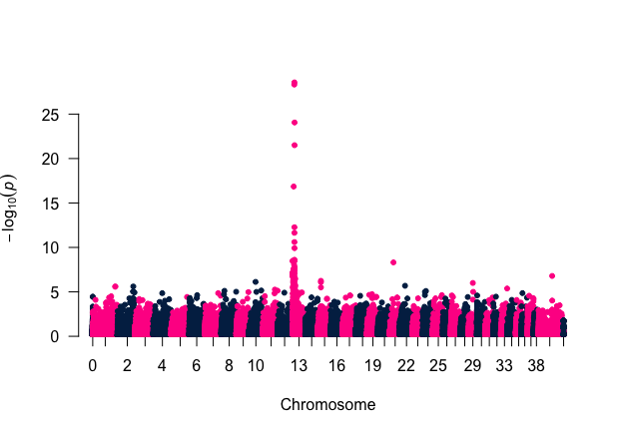
Manhattan Plot

Slide 10
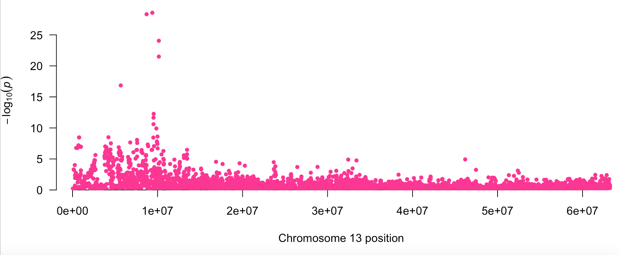
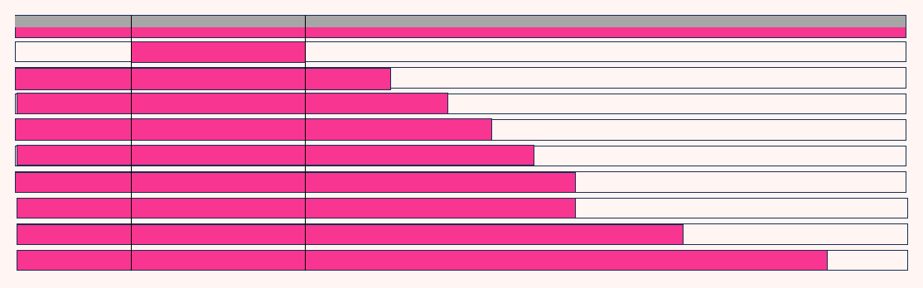
Critical Interval: chr13:8073324-10190940
0 Mb 10 Mb 20 Mb 30 Mb 40 Mb 50 Mb 60 Mb

Slide 11

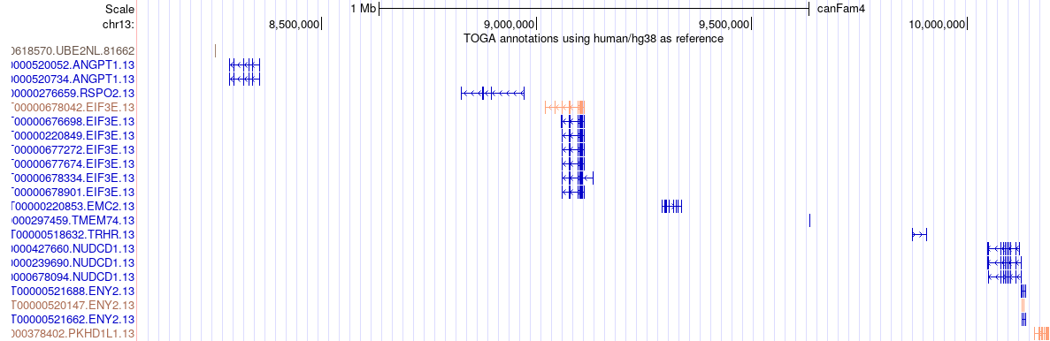
9 Genes in Critical Interval
One heterozygote case (Wheeler)
Critical interval: 8073324-10190940
ANGPT1
RSPO2
EIF3E
EMC2
TMEM74
TRHR
NUDCD1
ENY2
PKHD1L1

Slide 12
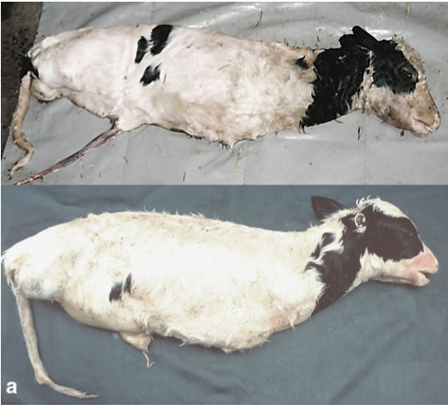
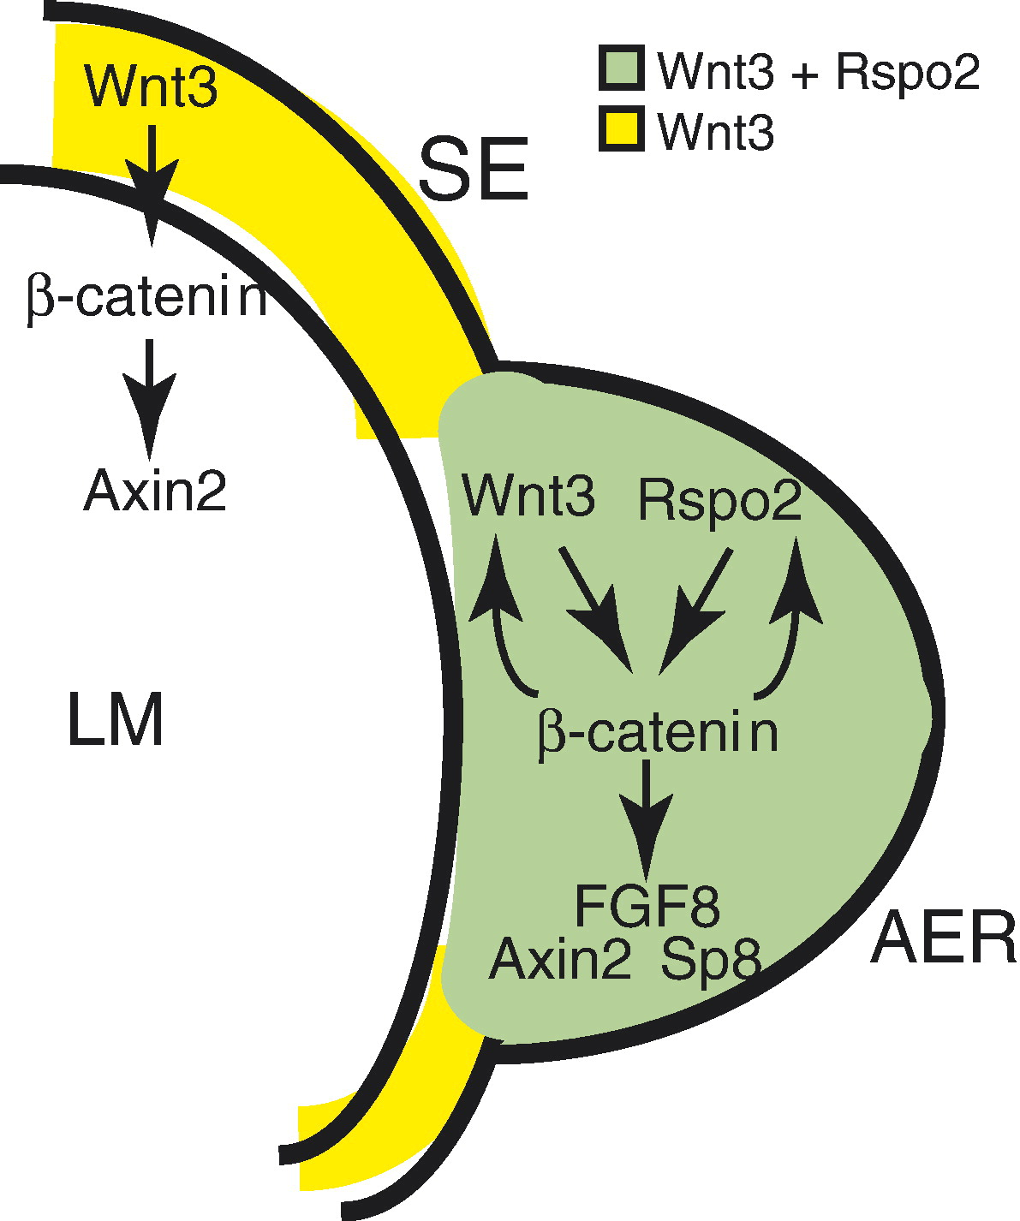
RSPO2 in other animals
Mouse: RSPO2 homozygous knockout mice, died at birth, alterations in all limbs but hindlimbs affected more severely
Humans: many variants, tetramelia, lung aplasia and cleft palate and lethal.
Cattle: 50-kb deletion of 3 exons of RSPO2, tetramelia, died at birth, no evidence of lung aplasia
References: (Becker D, Weikard R, Schulze C, Wohlsein P, Kühn C. A 50-kb deletion disrupting the RSPO2 gene is associated with tetradysmelia in Holstein Friesian cattle. Genet Sel Evol. 2020 Nov 11;52(1):68. doi: 10.1186/s12711-020-00586-y. PMID: 33176673; PMCID: PMC7661195.)(Nam, Ju-Suk, et al. “Mouse R-Spondin2 Is Required for Apical Ectodermal Ridge Maintenance in the Hindlimb.” Developmental Biology, vol. 311, no. 1, 2007, pp. 124–135, https://doi.org/10.1016/j.ydbio.2007.08.023.) Szenker-Ravi, E., Altunoglu, U., Leushacke, M. et al. RSPO2 inhibition of RNF43 and ZNRF3 governs limb development independently of LGR4/5/6. Nature 557, 564–569 (2018). https://doi.org/10.1038/s41586-018-0118-y), (Aoki M, Kiyonari H, Nakamura H, Okamoto H. R-spondin2 expression in the apical ectodermal ridge is essential for outgrowth and patterning in mouse limb development. Dev Growth Differ. 2008 Feb;50(2):85-95. doi: 10.1111/j.1440-169X.2007.00978.x. Epub 2007 Dec 7. PMID: 18067586)
Notes:
kitligand Bannasch weich for coverage, Leeb goats coverage/color patterns pubmed, look into lung phenotype, rspondin 2

Slide 13
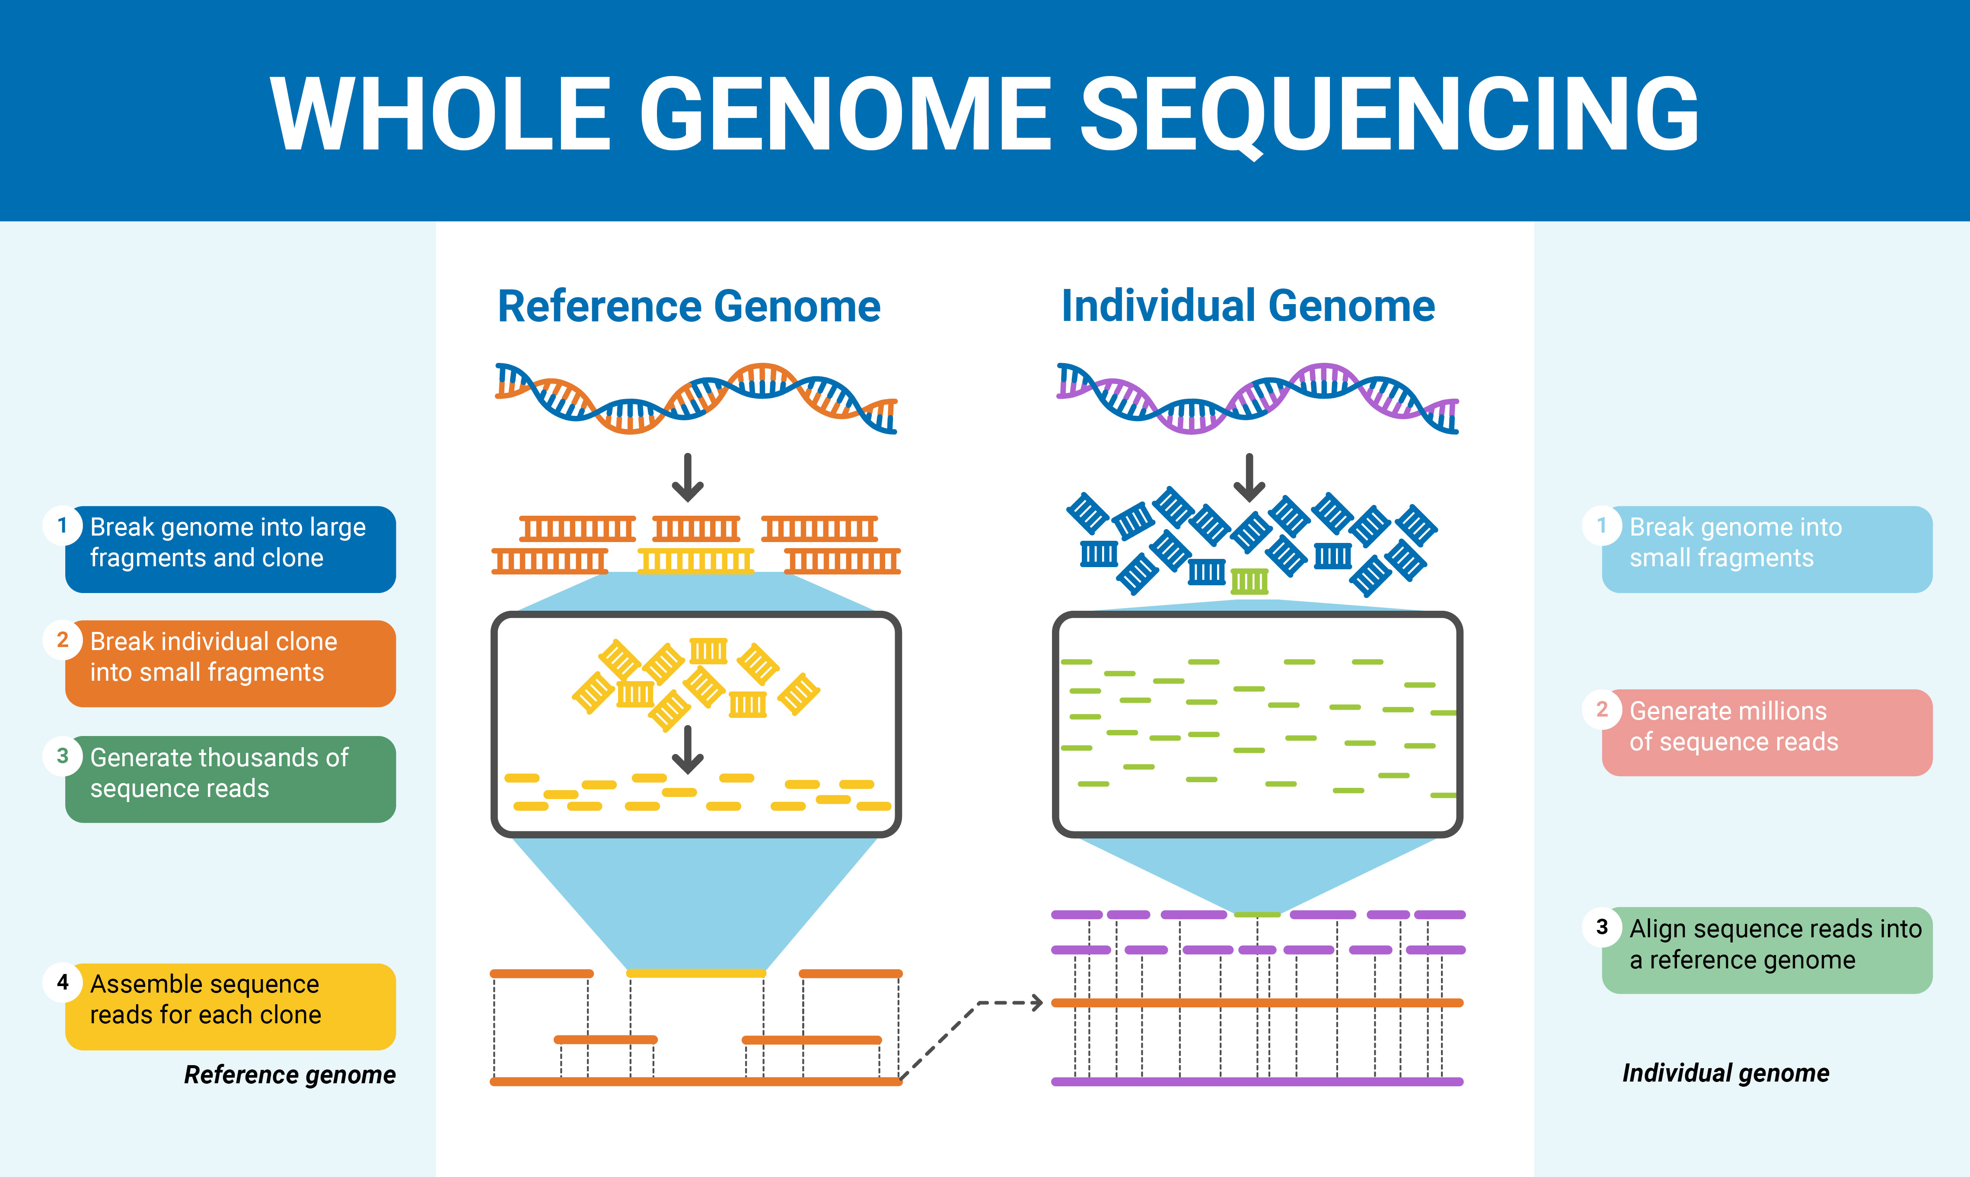

Slide 14
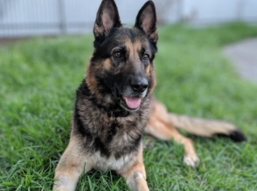
Whole Genome Sequencing
161 control dogs with 4 legs and 6 cases with BAH
Aligned to canfam4 (German Shepherd Dog)
Variants (SNV and small indel)
40,102,010 variants

Slide 15
Are any variants protein coding?
0 protein coding variants found in critical interval in cases ☹
Notes:
Animate

Slide 16
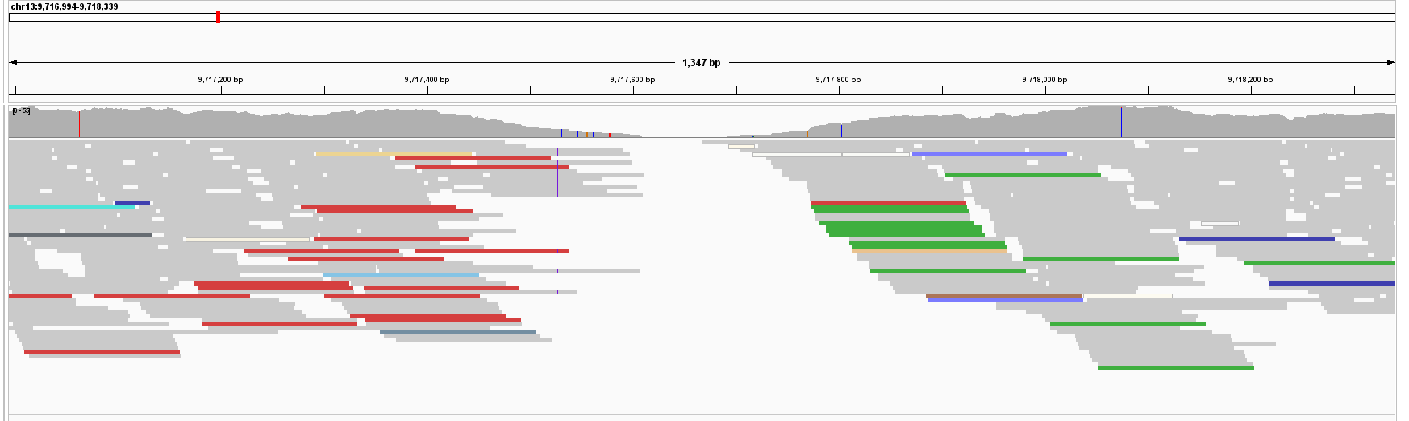
Are there any large structural variants in the interval?
Visually inspected the critical interval in IGV
A 43,000 bp inversion was found outside RSPO2… but
chr13:9,716,994-9,718,339
Notes:
NEED TO UPDATE WITH CLEANER IGV READS

Slide 17
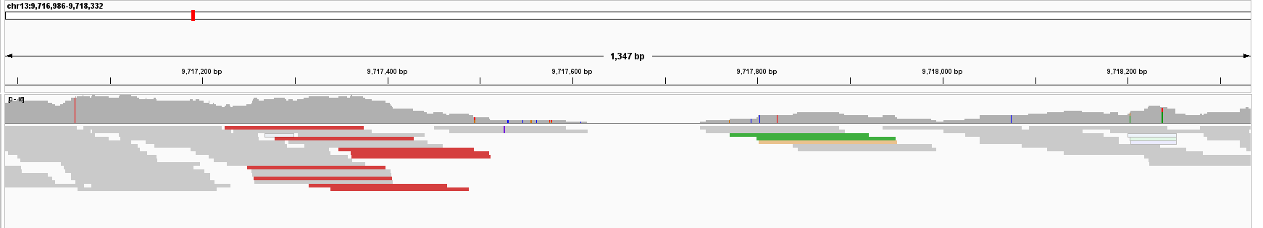
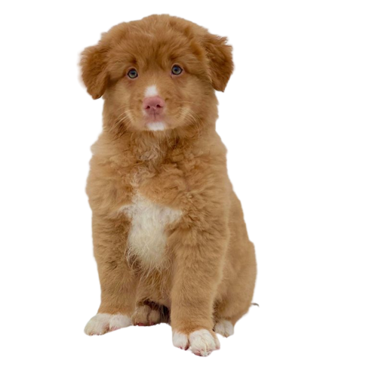
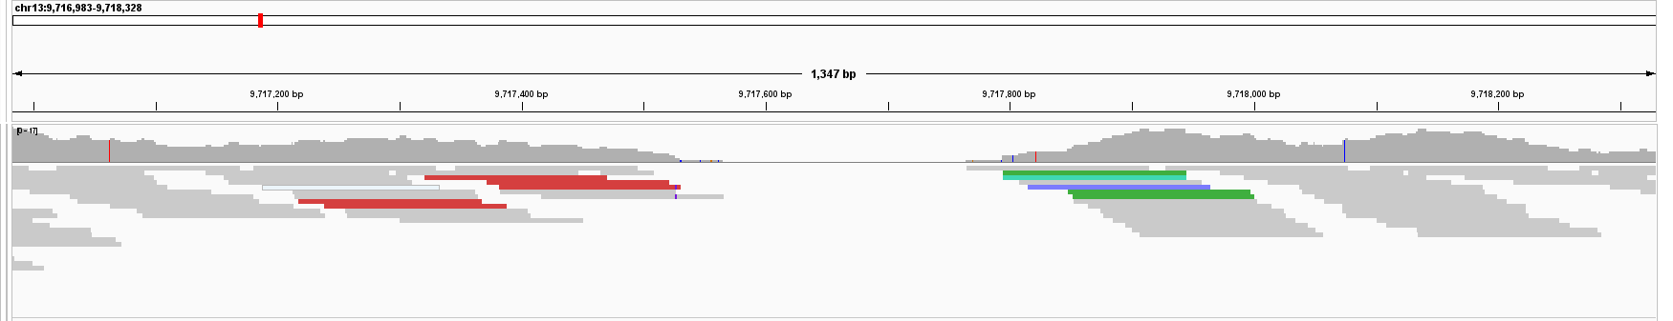
It was also found in Nova Scotia Duck Tollers with 4 legs

Slide 18
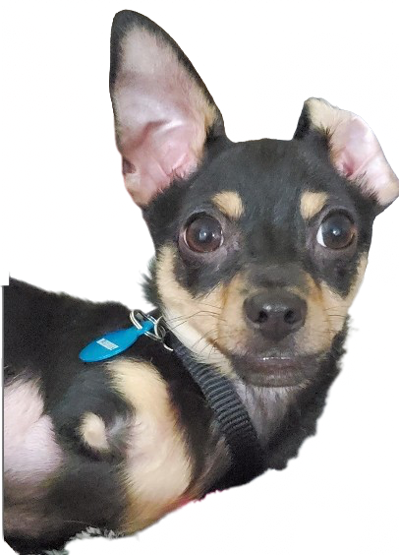
Other Structural Variants?
No other structural variants were identified that segregated in cases and controls ☹

Slide 19
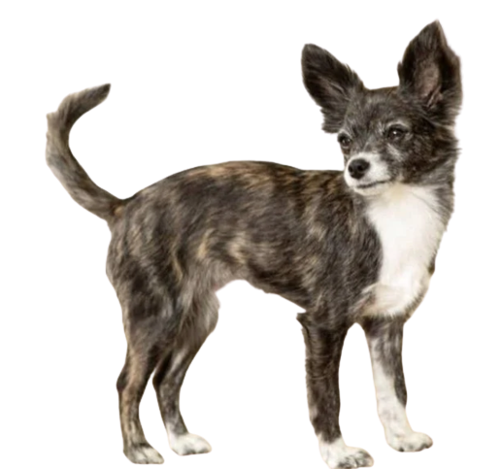
Whole Genome Sequence Data within Critical Interval
Looking for SNVs and small indels
6 cases, 161 controls
39,739 total variants
32 variants of interest: determined by case homozygosity and controls
  2 variants homozygous in 5 cases, heterozygous in Wheeler only
  30 variants homozygous in 5 cases, heterozygous in Wheeler and a poodle
Control 283 (1.9 kg poodle, no photos)

Slide 20
Additional Variant Filtering
Genotype top variants in silico in additional controls
1987 dogs – (Ostrander EA, Wang GD, Larson G, vonHoldt BM, Davis BW, Jagannathan V, Hitte C, Wayne RK, Zhang YP; Dog10K Consortium. Dog10K: an international sequencing effort to advance studies of canine domestication, phenotypes and health. Natl Sci Rev. 2019 Jul;6(4):810-824. doi: 10.1093/nsr/nwz049. Epub 2019 Apr 10. PMID: 31598383; PMCID: PMC6776107.)
813 dogs - (Jagannathan V, Drögemüller C, Leeb T; Dog Biomedical Variant Database Consortium (DBVDC). A comprehensive biomedical variant catalogue based on whole genome sequences of 582 dogs and eight wolves. Anim Genet. 2019 Dec;50(6):695-704. doi: 10.1111/age.12834. Epub 2019 Sep 5. PMID: 31486122; PMCID: PMC6842318.)
7 variants -> 4 variants because 3 were found in Cocker Spaniels from the 813 database

Slide 21
Relative Location to RSPO2
Primers are made and ordered and we will be genotyping 7 additional cases and 200 more control chihuahuas

Slide 22


Acknowledgements
Dr. Bannasch
Julia Vo
STAR Program
NIH Funding: National Institutes of Health T35-OD010956
Maxine Adler Endowed Chair Fund
Owners who submitted samples

Slide 23
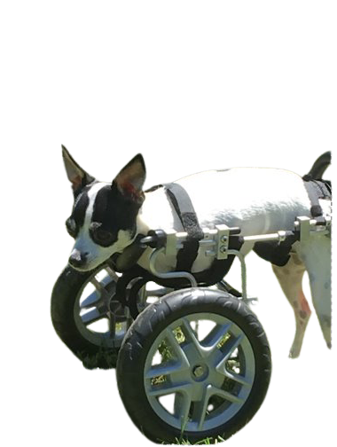
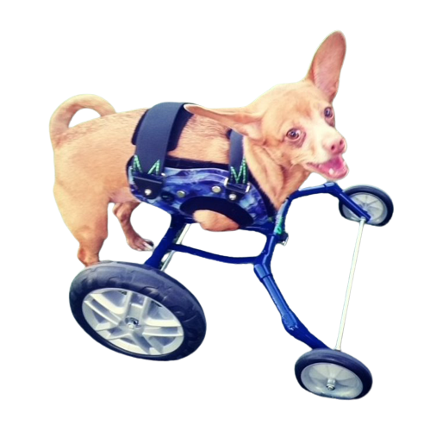
Thank you!
Now is a WHEELY good time for questions if you have any!

Slide 24
Remaining SNPS for genotyping
Chromosome Location | RSPO2 Location | Conserved regulatory region in humans
chr13:8891861 | Intron 2 of RSPO2 | Yes
chr13:8974204 | 2,359 bp upstream from TSS of RSPO2 | Yes
chr13:9084398 | ~ 100,000 bp upstream of TSS of RSPO2 | Yes
chr13:9789424 | ~ 700,000 bp upstream of TSS of RSPO2 | Yes
Primers are made and ordered and we will be genotyping 7 additional cases and 200 more control chihuahuas

Slide 25
Defining the critical interval

Slide 26
DNA Sample Collection
13 dogs collected that were affected with BAH
GWAS
10 samples genotyped on Illumina canine HD SNP array–220,853 markers
Whole Genome Sequencing
6 cases, 161 controls
Sanger Sequencing & Genotyping
366 control dogs with 4 limbs from Bannasch laboratory DNA database
Population structure analysis- GEMMA
Filtering variants
Cases: homozygous for allele
Controls: homozygous for alternate allele
13 cases, 200 controls
Case-Control X² analysis of genotypes
61 controls

Slide 27
Variant Filtering
40,102,010
23,059
32
7
4
167 dogs, variants from entire genome
167 dogs, variants within Critical Interval
Homozygous in 5 cases and not in 161 controls
Homozygous in 5 cases and not present in 929 controls
Homozygous in 5 cases and not present 2911 in any controls

Slide 28
References for poster
Alonso. (1982). An autosomal recessive form of hemimelia in dogs. The Veterinary Record., 110(6), 128–129.
Aoki M, Kiyonari H, Nakamura H, Okamoto H. R-spondin2 expression in the apical ectodermal ridge is essential for outgrowth and patterning in mouse limb development. Dev Growth Differ. 2008 Feb;50(2):85-95. doi: 10.1111/j.1440-169X.2007.00978.x. Epub 2007 Dec 7. PMID: 18067586.
(Becker D, Weikard R, Schulze C, Wohlsein P, Kühn C. A 50-kb deletion disrupting the RSPO2 gene is associated with tetradysmelia in Holstein Friesian cattle. Genet Sel Evol. 2020 Nov 11;52(1):68. doi: 10.1186/s12711-020-00586-y. PMID: 33176673; PMCID: PMC7661195.)
Diarra N, Mame, et al. “A Report of 2 Cases of Tetra-Amelia Syndrome.” Gynecology &amp; Obstetrics Case Report, vol. 06, no. 01, 2020, https://doi.org/10.36648/2471-8165.6.1.85.
Nam, Ju-Suk, et al. “Mouse R-Spondin2 Is Required for Apical Ectodermal Ridge Maintenance in the Hindlimb.” Developmental Biology, vol. 311, no. 1, 2007, pp. 124–135, https://doi.org/10.1016/j.ydbio.2007.08.023.
Plassais J, Kim J, Davis BW, Karyadi DM, Hogan AN, Harris AC, Decker B, Parker HG, Ostrander EA. Whole genome sequencing of canids reveals genomic regions under selection and variants influencing morphology. Nat Commun. 2019 Apr 2;10(1):1489. doi: 10.1038/s41467-019-09373-w. PMID: 30940804; PMCID: PMC6445083.
Rosenak D, Ariel I, Arnon J, Diamant YZ, Ben Chetrit A, Nadjari M, Zilberman R, Yaffe H, Cohen T, Ornoy A. Recurrent tetraamelia and pulmonary hypoplasia with multiple malformations in sibs. Am J Med Genet. 1991 Jan;38(1):25-8. doi: 10.1002/ajmg.1320380107. PMID: 2012129.
Szenker-Ravi, E., Altunoglu, U., Leushacke, M. et al. RSPO2 inhibition of RNF43 and ZNRF3 governs limb development independently of LGR4/5/6. Nature 557, 564–569 (2018). https://doi.org/10.1038/s41586-018-0118-y
Zhou, X., Stephens, M., (2012). Genome-wide efficient mixed-model analysis for association studies. Nature Genetics 44, 821–824.

