Slide 1

Altered serotonergic and GABA signaling in the gut in a mouse model of impaired maternally inherited UBE3A
Hyun Min Shin, Jelissa Reynoso-Garcia, and Melanie G Gareau
University of California, Davis

Slide 2
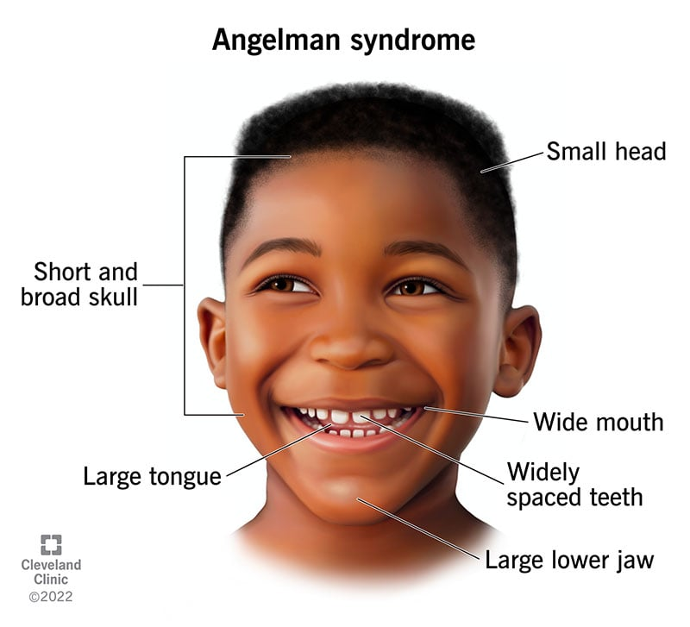
Overview I- Angelman Syndrome
Loss of function mutation of maternal Ubiquitin Ligase E3A (UBE3A)
Genomic imprinting of paternal chromosome in neurons
  Deficient neuronal UBE3A
UBE3A codes for ubiquitin ligase E6-Associated Protein (E6-AP) critical for ubiquitin-proteasome pathway function
  Impaired degradation of proteins

Slide 3
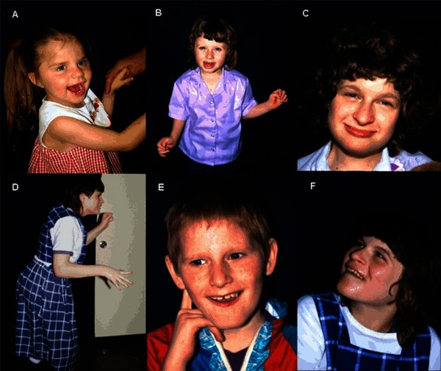
Overview II - AS
Neurological impairments
  Neurodevelopmental delays
  Deficits in movement and coordination
  Seizures
Concurrent Gastrointestinal issues
  Constipation
  Poor feeding due to hypotonia of throat
  Reflux

Slide 4
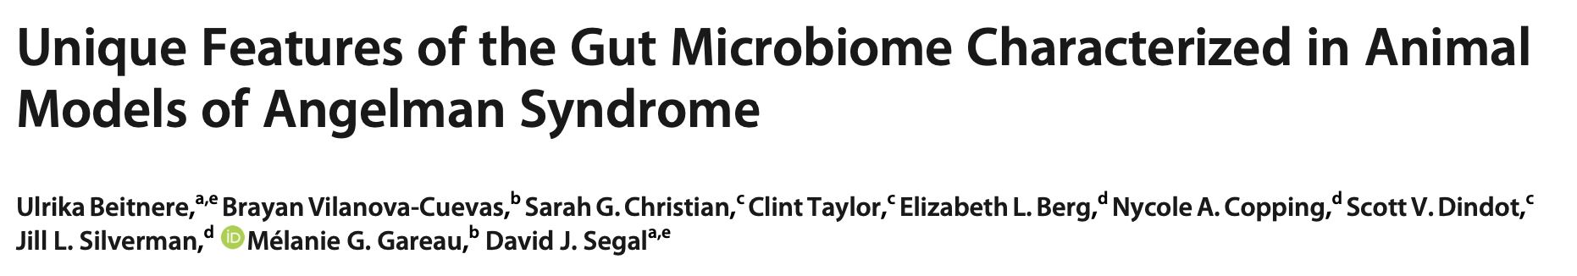
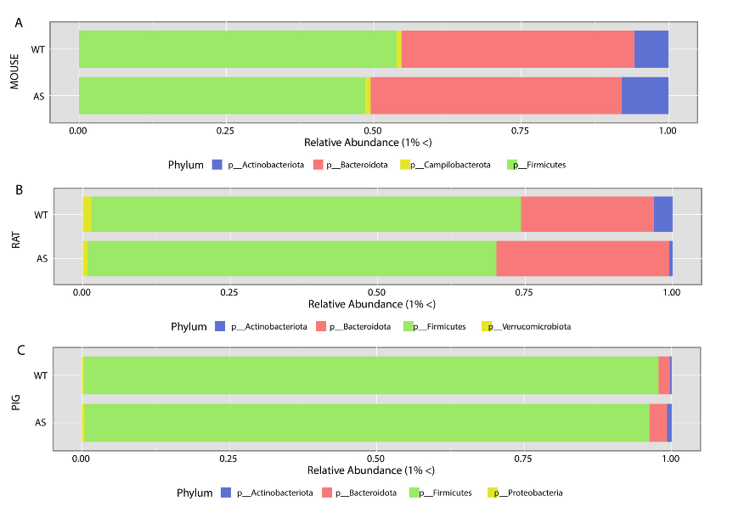
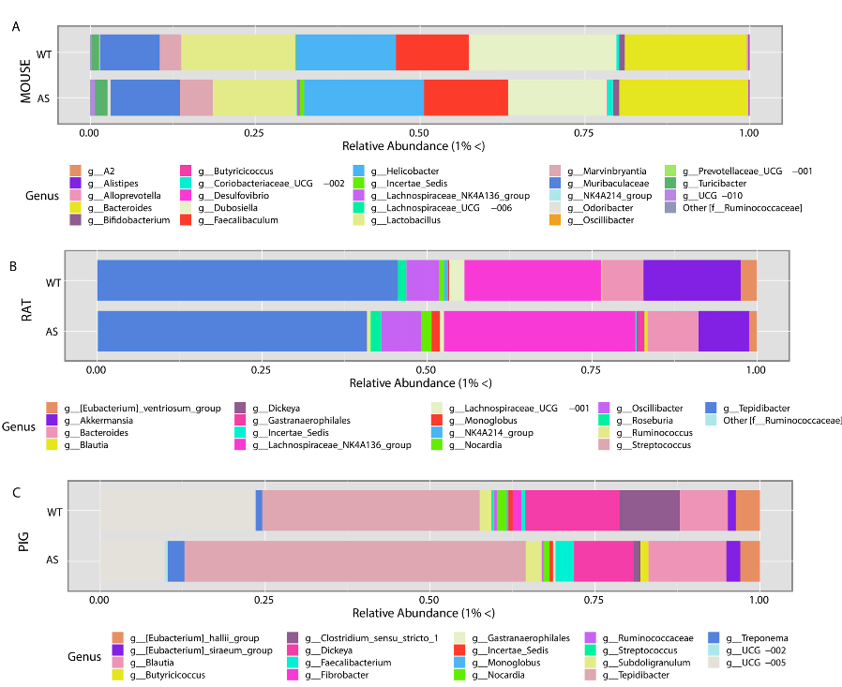
Gut microbiota dysbiosis
Notes:
Phylum level differences between AS and WT microbial compositions in mouse rat and pig; all showed similar decrease of Firmicutes and incrase of Bacteroides
Genus-level differences btwn AS & WT microbial composition by animal model
Fold change analysis showed significantly different bacterial groups associated with AS across the microbiome of all animal models; main differences between AS and WT dec of Bifidobacterium & inc of Bacteroides obs → consistent with patients with chronic constipation; no consensus whether changes are causal or result of side effect of condition
Constipation commonly seen in AS patients, findings support microbiota dysbiosis associated w/AS genotype across three different animal models support differences arise due to genetic deletions resulting in AS

Slide 5
Hypothesis:
Gut-brain impairments, including gastrointestinal motility and altered serotonergic and GABA signaling, will be present in AS-modeled mice
Notes:
To determine whether alterations in the gut microbiome contributed to GI pathophysiology, Ussing chamber studies and qPCR for genes associated with GI physiology were assessed.

Slide 6
Serotonin and GABA
Serotonin
Most of 5-hydroxytryptamine (5-HT) released by enterochromaffin cells in the gut
5-HT is important in gut propulsive and segmentation motility & epithelial secretion
Synthesized by Tph1 & Tph2 (tryptophan hydroxylases) and recycled by serotonin reuptake transporter (SERT)
5-HT producing enteric bacteria
GABA
Main inhibitory neurotransmitter in the body
Widespread distribution of GABA receptors throughout gut
Role in gastrointestinal motility, gastric emptying, & gastric acid secretion
GABA producing enteric bacteria

Slide 7



Mouse model of AS: Ube3a^{m-/p+}
Parents
F1
F2
♀︎
♀︎
WT: Ube3a^{m+/p+}
F1- HET: Ube3a^{m+/p-}
F2- AS: Ube3a^{m-/p+}
♂︎
♂︎
AS: Ube3a^{m-/p+}
WT: Ube3a^{m+/p+}
WT: Ube3a^{m+/p+}

Slide 8
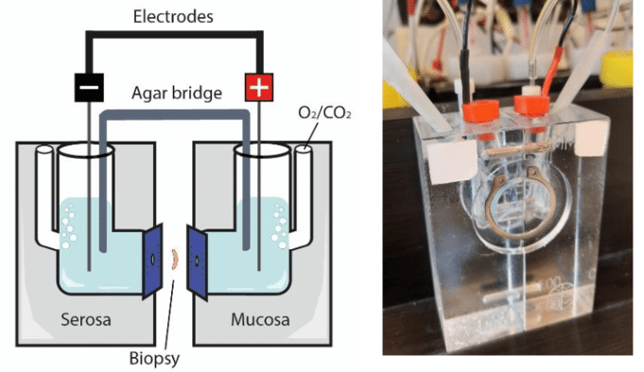
Methods
Ussing Chamber
Gut tissues (ileum & distal colon) of AS & WT mice analyzed for
  Isc- active ion transport
  G- tight junction permeability
  FITC- macromolecular permeability
qPCR
Ileum, distal colon, HC, PFC tissues of AS & WT mice analyzed for
  Serotonergic signaling
  GABA signaling
Notes:
basal short circuit current [Isc], basal conductance [G] and FITC dextran flux

Slide 9
Decreased active ion transport in AS mice in the colon
Jelissa Reynoso-Garcia
Notes:
Significant decrease in Ion transport in AS modeled mice

Slide 10
Increased tight junction permeability in AS mice in the ileum
Jelissa Reynoso-Garcia
Notes:
Significant increase in the ileum of AS mice

Slide 11
Macromolecular permeability was increased in AS mice in both ileum and colon
Jelissa Reynoso-Garcia

Slide 12
Altered serotonergic and GABA signaling in the distal colon of AS mice
Serotonin
GABA
Notes:
5HTR2c involved in secretion, gastric emptying, and inflammation
5HTR3 involved in motility and peristaltic reflex
- GABAb- inhibit serotonin release, regulate gastric emptying; GABAa release serotonin
Increased expression of SERT, contributing to a decrease in enteric serotonin concentrations, is a consistent finding with previous research on chronic constipation. Decreased Tph1 is reflective of decreased enteric serotonin concentration, also consistent with constipation. GABAa receptor activation in ENS results in excitatory effect, while GABAb activation reduces Acetyl choline release, leading to inhibition of GI motility. GABA receptors and its effects still remain to be further investigated.

Slide 13
Altered GABA signaling in the ileum of AS mice
Serotonin
GABA
Notes:
Increased GABA signaling in the gut

Slide 14
Altered serotonergic and GABA signaling in the hippocampus of AS mice
Serotonin
GABA
Notes:
Increased Tph2, Sert signaling in HC; dec GABA signaling in HC

Slide 15
Evidence of neuroinflammation and increased neurogenesis in the hippocampus of AS mice
Notes:
Iba1- neuroinflammation
Bdnf- neurotransmitter modulator

Slide 16
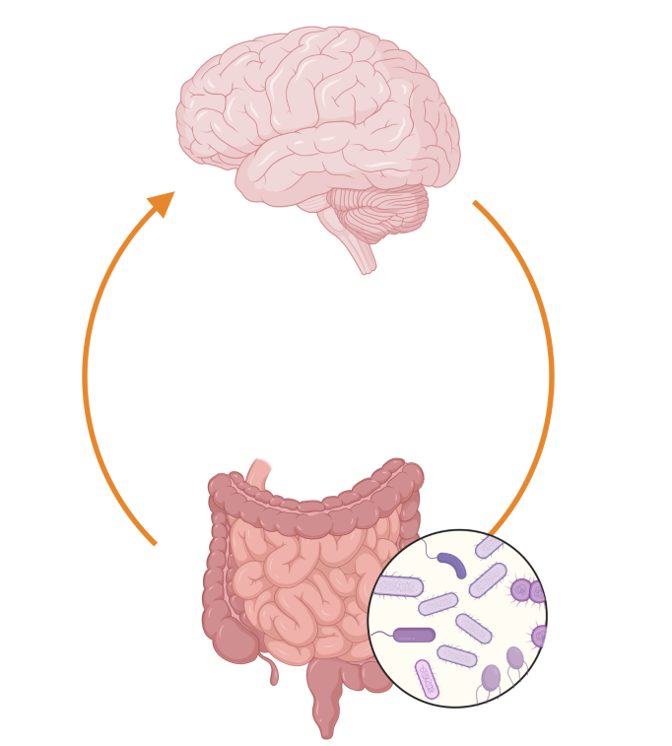
Summary
Decreased secretory state in colon coupled with increased permeability in colon & ileum in AS mice is suggestive of altered motility and permeability in the gut
Altered serotonin and GABA gene expression in the gut and brain in AS mice is suggestive of altered neuronal signaling

Slide 17
Conclusion
AS mice show evidence of constipation mediated by altered enteric nerves, which may provide insight to the mechanisms of constipation in AS patients.

Slide 18
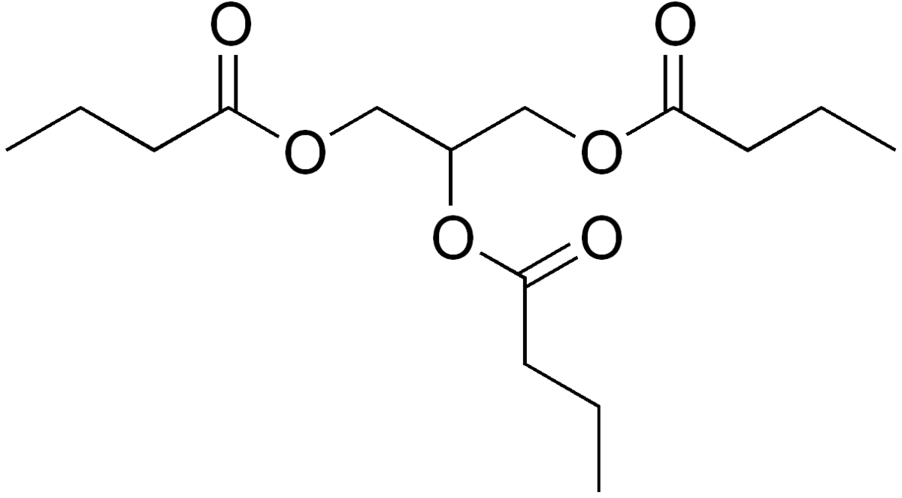
Future directions and speculations
Administration of Tributyrin (butyrate) as a therapeutic strategy to improve GI symptoms and MGB axis signaling by beneficially modulating the gut microbiome in AS
  Short-chain fatty acid (SCFA) that beneficially modulates the gut microbiome
Determine whether these findings are common across other neurodevelopmental/degenerative diseases
Provide a better understanding of the signaling pathways involved in constipation across species
Notes:
MGB axis impairments are common in many human and animal disorders, better understanding the signaling patterns in neuronal-induced altered motility has the potential to serve a larger patient population

Slide 19



Acknowledgements
Research Funding:
Student Funding:
Special Thanks to-
Melanie Gareau, PhD
Jelissa Reynoso-Garcia, PhD
Olivia Orahood
FT2022-007
Students Training in Advanced Research (STAR) Program
T35 OD010956

Slide 20
Questions?

