Slide 1
Correlation between Cobalamin and Small Intestinal Histopathologic Changes in Cats with Chronic Enteropathy
Mina Park¹, Paula Giaretta², Chee-Hoon Chang², Stefan Keller³, Judit Magnusson Wulcan³, Valerie Freiche⁴, Sina Marsilio¹
¹University of California SVM, Davis, Department of Medicine & Epidemiology, Davis, CA, USA
²Texas A&M School of Veterinary Medicine and Biomedical Sciences, College Station, TX , USA
³University of California Davis SVM, Department of Pathology, Microbiology & Immunology, Davis, USA
⁴L'école nationale vétérinaire d'Alfort, Maisons-Alfort, France

Slide 2
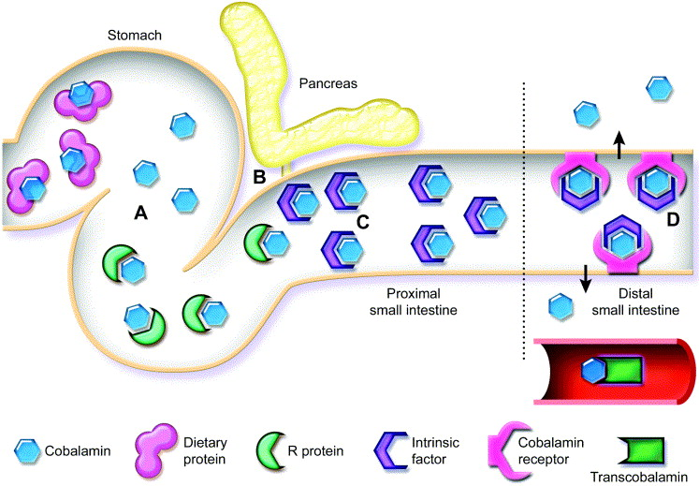
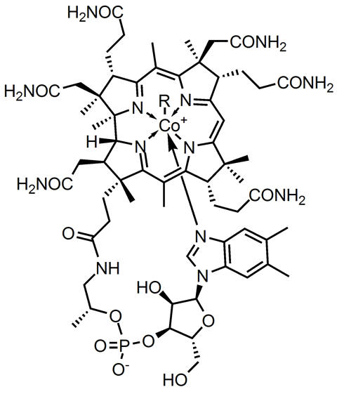
Background
Cobalamin (Vitamin B12)
Figure 1. Normal mechanism of cobalamin absorption by cobalamin carriers in the distal small intestine¹
Suchodolski and Steiner , 2003, Clin Tech Small Anim Pract.
Notes:
Cobalamin is obtained from dietary animal source, binds to intrinsic factor secreted by pancreas, gets absorbed in the ileum
3 sources of hypocobalaminemia:
Exocrine pancreatic insufficiency – can rule out w fTLI values
Receptor defect- usually present in younger animals- has not been described in younger cats
Chronic enteropathy- lesions in surface epithelium prevents absorption and processing of cobalamin
IF important for receptor binding

Slide 3
Background
Hypocobalaminemia has been linked to intestinal dysbiosis in humans and dogs³⁻⁴, and the degree and outcome of chronic enteropathy in dogs⁵
A recent study found a correlation between the degree of ileal histopathologic lesions and serum cobalamin concentrations in dogs with chronic enteropathy⁶
Dukowicz et al., 2007, Gastroenterol Hepatol (N Y).
Toresson et al., 2023, Animals
Allenspach et al., 2007, J Vet Internal Med
Pérez-Merino et al., 2022, J Vet Intern Med

Slide 4
Background
ACVIM Consensus Statement
Chronic enteropathy: Cats with chronic (at least 3 weeks' duration) signs of gastrointestinal disease where extragastrointestinal, metabolic, and infectious causes have been ruled out.
Lymphoplasmacytic enteritis (LPE) (Inflammatory)
Low-grade intestinal T-cell lymphoma (LGITL) (Neoplastic)
Marsilio et al., 2023, J Vet Intern Med
Notes:
Hypocobalaminemia can be surrogate marker for intestinal absorption and chronic enteropathy

Slide 5
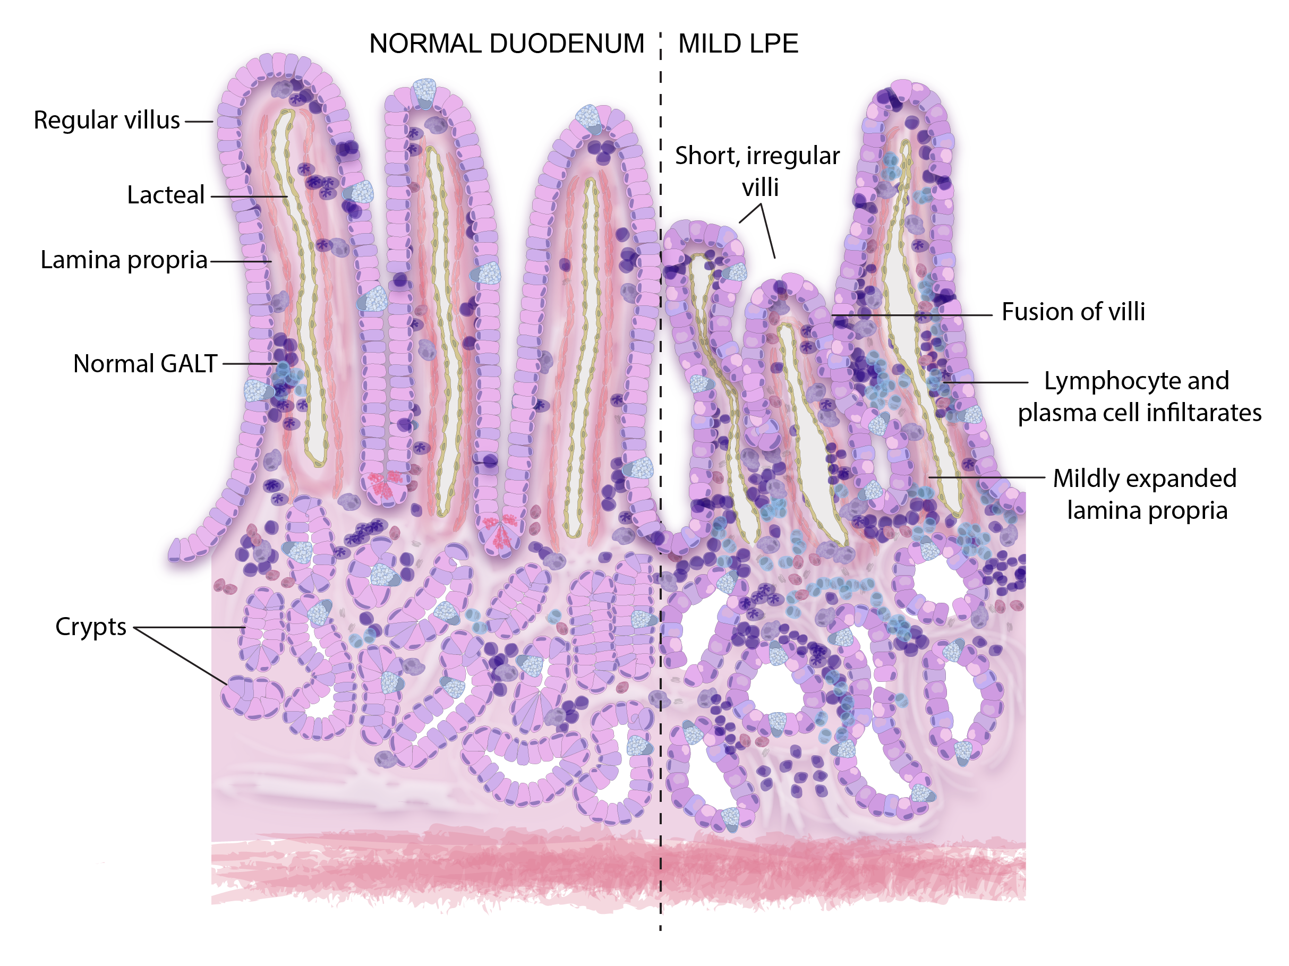
Background
World Small Animal Veterinary Association guideline for assessment of Small Intestinal Mucosa⁷
Architectural changes
Surface epithelium
Villus stunting
Crypt dilation/distortion
Lacteal dilation
Mucosal fibrosis
Normal = 0
Mild = 1
Moderate= 2
Marked= 3
Figure 2. Hematoxylin and eosin (H&E) stained biopsy specimen of a normal feline intestine and mild LPE and their schematic views²
Marsilio et al., 2023, J Vet Intern Med
Day et al., 2008, J Comp Pathol
Notes:
Histological standpoint: how we determine severity of lesions

Slide 6
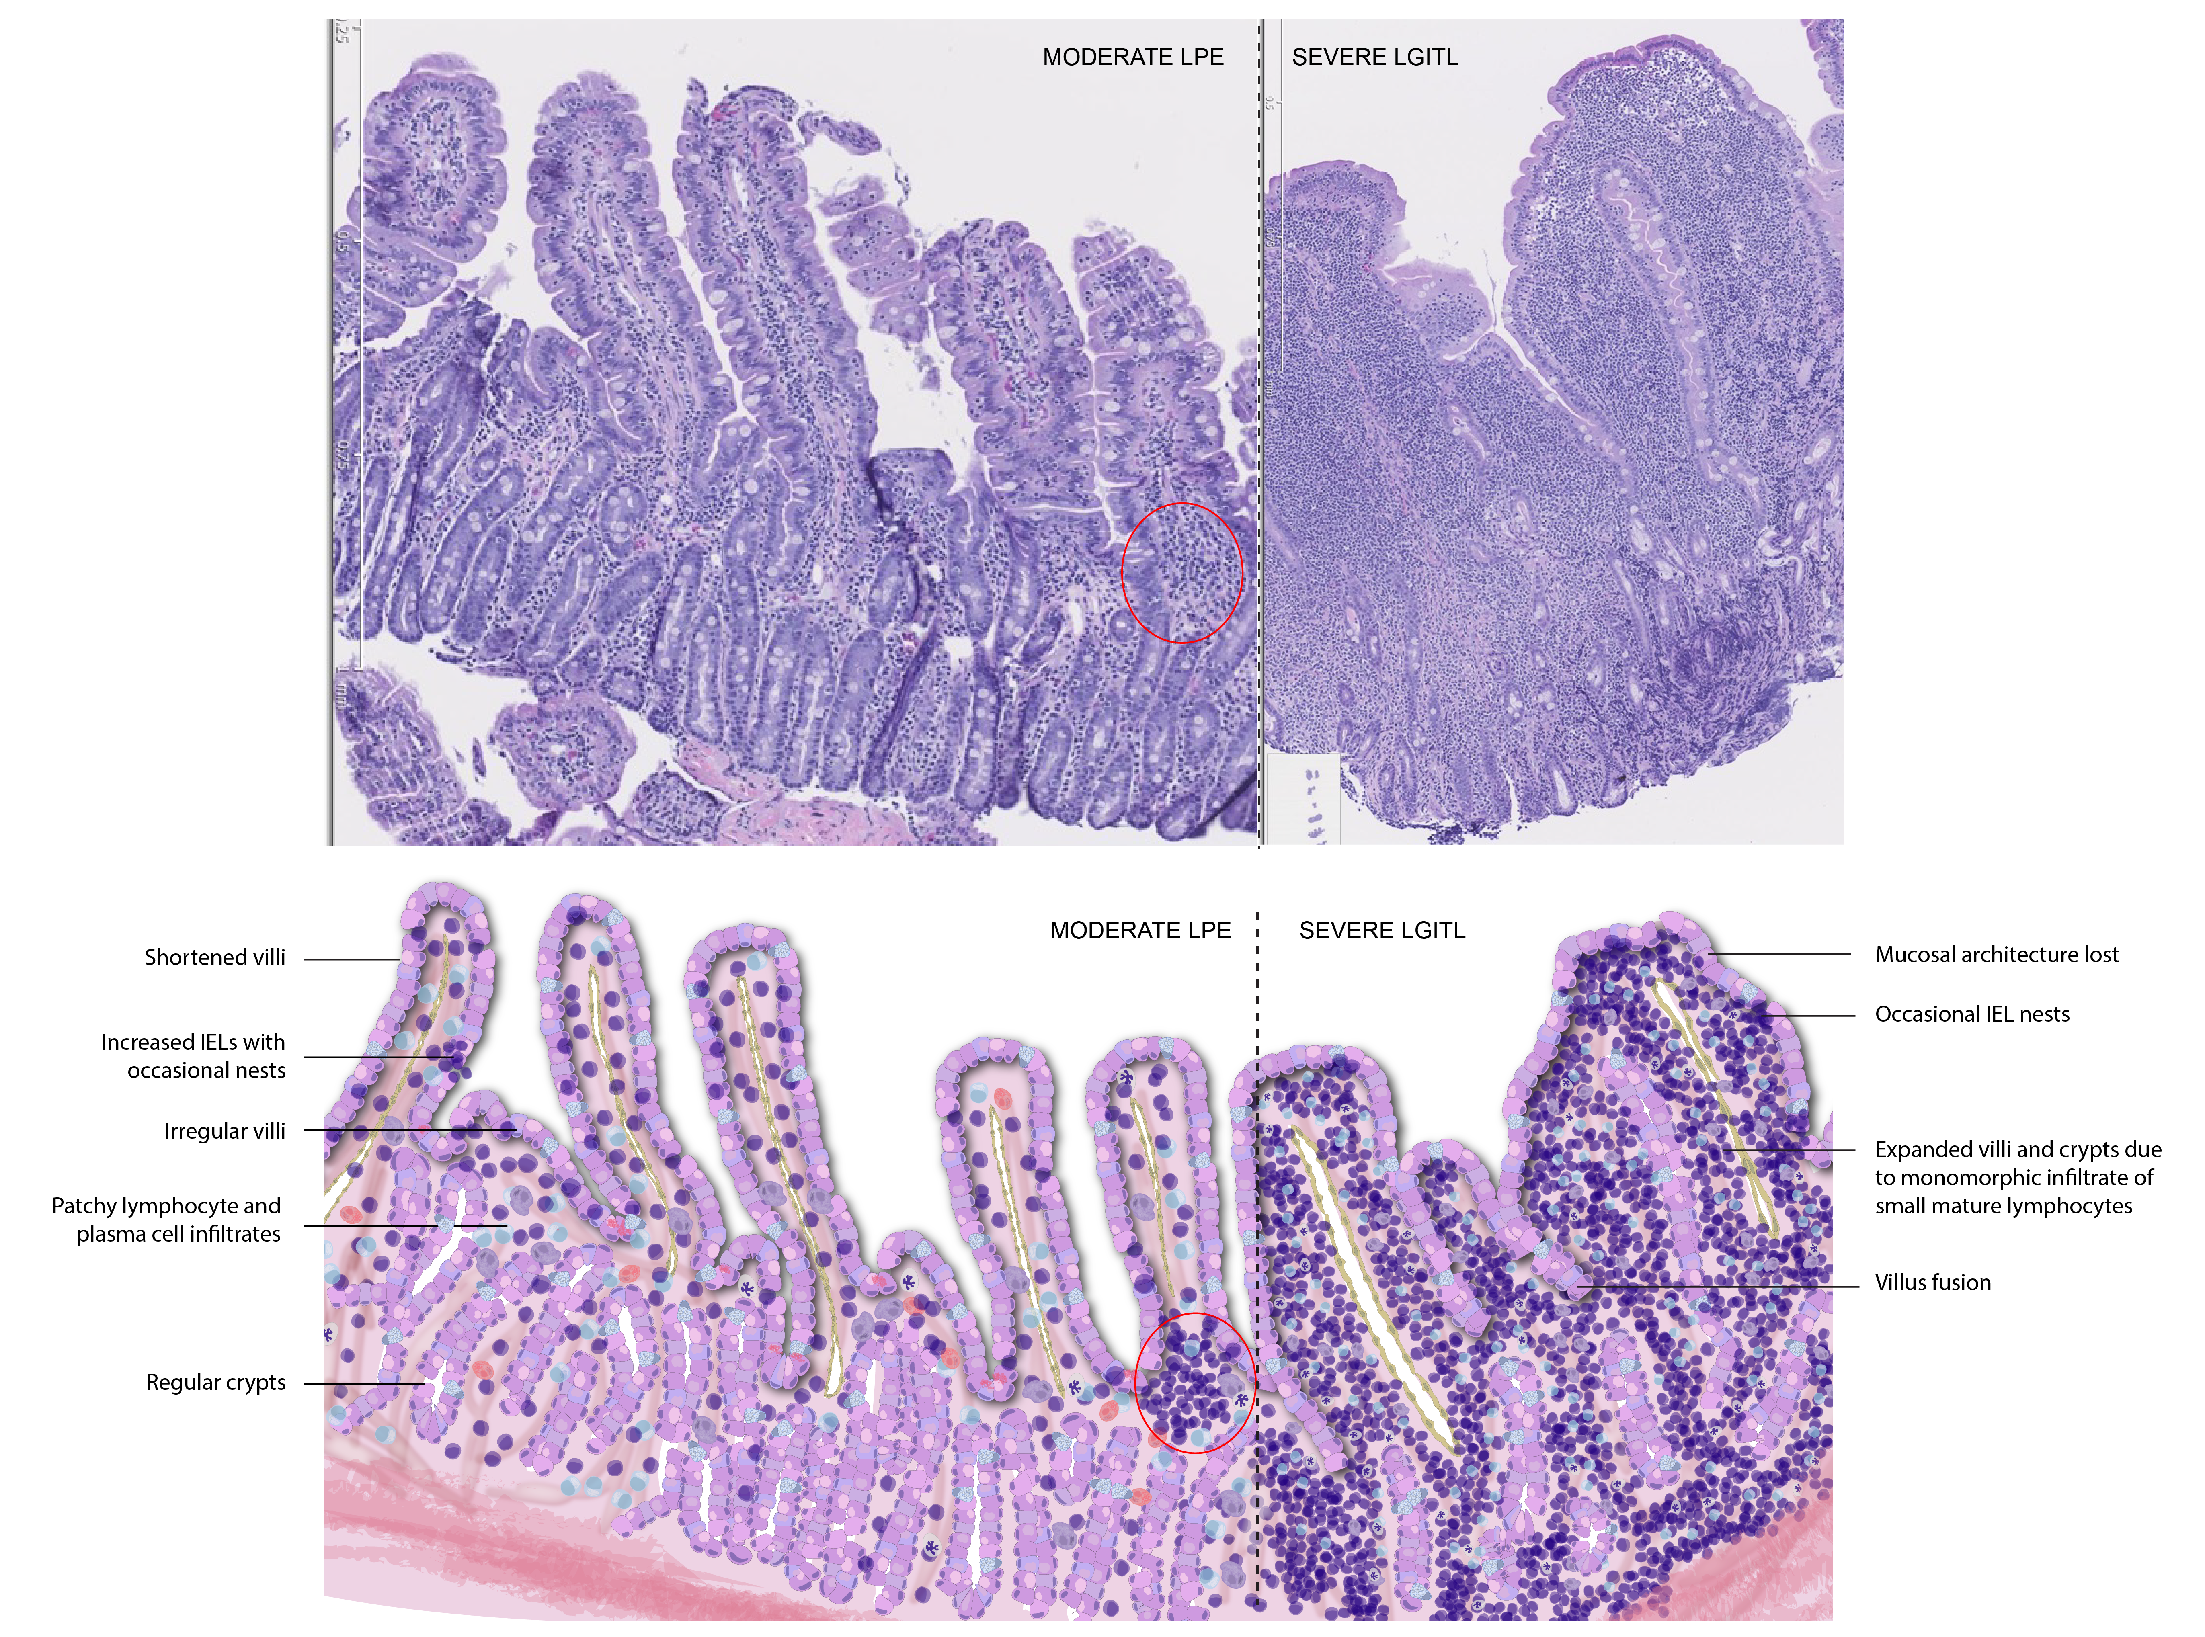
Background
World Small Animal Veterinary Association guideline for assessment of Small Intestinal Mucosa⁷
Cellular infiltrates
Intraepithelial lymphocytes
Lamina propria lymphocytes and plasma cells
Lamina propria eosinophils
Lamina propria neutrophils
Lamina propria macrophages
Normal = 0
Mild = 1
Moderate= 2
Marked= 3
Figure 3. H&E-stained duodenal biopsy specimen from a cat with moderate LPE and marked LGITL and their schematic view²
Marsilio et al., 2023, J Vet Intern Med
Day et al., 2008, J Comp Pathol

Slide 7
Background
Cobalamin is commonly used as a surrogate marker for the presence of chronic enteropathy
The correlation between systemic cobalamin deficiency and the degree of histopathologic lesions in the small intestine has not yet been investigated in cats

Slide 8
Hypotheses
Serum cobalamin concentration will be negatively correlated with the degree of histopathologic lesions in upper small intestinal and ileal biopsy specimens from cats with chronic enteropathy
Serum cobalamin concentration will correlate with disease severity and outcome in cats with chronic enteropathy
Notes:
Unpublished data that suggest B12 receptor is widespread

Slide 9
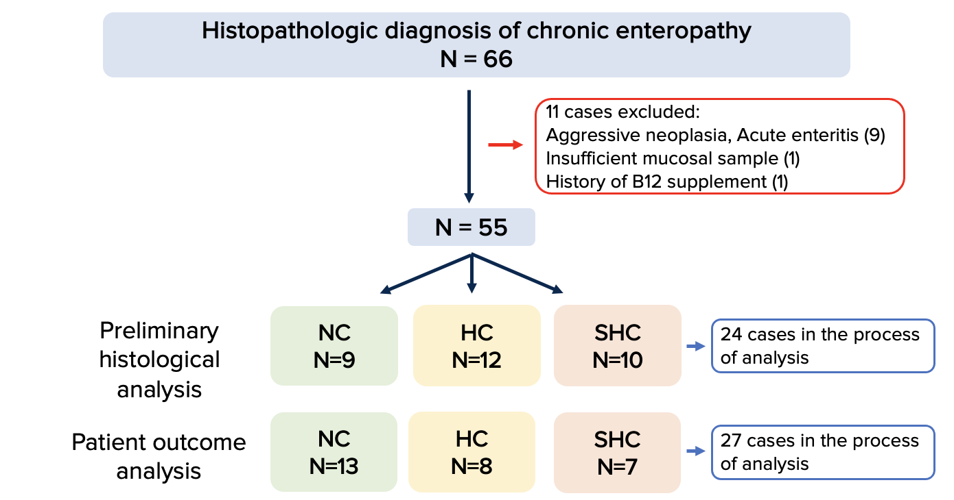
Sample Selection
Databases of the Veterinary Teaching Hospitals at UC Davis, Texas A&M University, and the National Veterinary School of Alfort searched
Notes:
Mention that analysis will be defined later

Slide 10
Outcome Analysis
Modified Feline Chronic Enteropathy Activity Index
(FCEAI)⁸
Modified FCEAI
Hyperoxia
Polyphagia
Diarrhea
Constipation
Vomiting
Lethargy
Weight loss
Outcome categorization
Clinical Remission
Clinical Response
No change
Worse
General data
Age of death/ date of last follow-up
Current (or latest) treatment regimen
Diet
Concurrent extraintestinal diseases
Not Present= 0
Present= 1
Jergens et al., 2008, J Vet Intern Med

Slide 11
Results
 | NC | HC | SHC | P value
Median age (Range) | 11.7y (0.5-16.2) | 11.35y (1.7-17.8) | 14y (9.7-15) | 0.6814
Median cobalamin (Range) | 632 ng/L (409-955 ng/L) | 223ng/L (156-399ng/L ) | ≤150 ng/L* (149-150 ng/L)
Breed | DSH (12), DLH (2), Persian (2), Siamese (1) Himalayan (1) | DSH (6), DLH (7), DMH (1), mix (2), Persian (1), Bengal (1), Rex (1) | DSH (12), DLH (3), DMH (2), mix (1)
Sex | MC (9), M (1), FS (7), unknown (1) | MC (8), M (1), FS (10) | MC (12), M (1), FS (3), unknown (2)
Median modified FCEAI score (Range) | Initial: 3 (1-5) | Initial: 2.5 (2-5) | Initial: 3 (1-4) | 0.9026
 | Follow-up: 3 (0-5) | Follow-up: 3 (0-5) | Follow-up: 1 (0-4) | 0.3557
Symptom management/ Treatment outcome
Clinical remission | 15.4% | 11.1% | 42.8%
Clinical response | 23.1% | 33.3% | 14.3%
No change | 23.1% | 33.3% | 14.3%
Worse | 38.4 % | 22.2% | 28.6%
Notes:
explain first column: parameters we measured

Slide 12
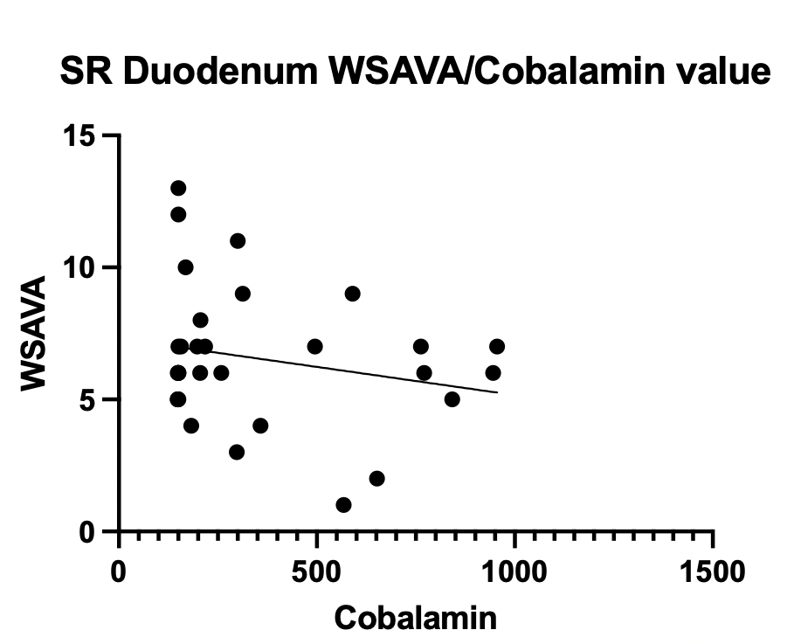
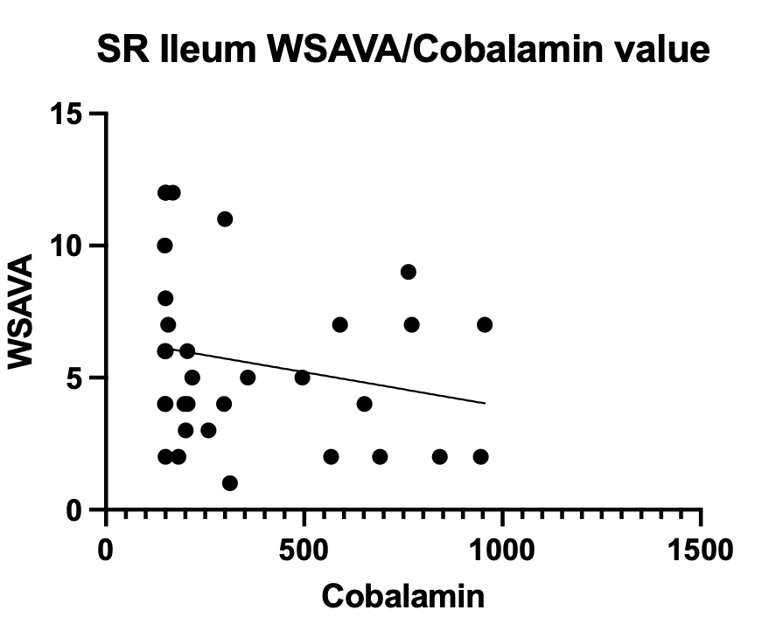
Results
Duodenum:
Simple linear regression: P=0.2437
Spearman rank: P>0.9999
Logistic regression: P= 0.4107
Ileum:
Simple linear regression: P=0.2287
Spearman rank: P= 0.15
Logistic regression: P= 0.4594
Notes:
We have ran Linear regression, spearman rank, and logistic regression test, but found no statistical significance- spearman rank might be the best option for the final analysis as it is hard to do linear regression with all of our SHC being <150ng/L
Differences in P values for spearman's rank for duodenum and ileum-> makes sense based on physiology
cobalamin "bottoming out" at the lower detection range -> regression might not be the best model
Power problem

Slide 13
Key Results (Preliminary)
Cats with SHC had the highest rate of clinical remission at follow-up (42.8%) compared to NC (15.4%) and HC (11.1%) cats.
Possibly due to a bigger benefit of the correction of their hypocobalaminemia with a B12 supplement⁹
No statistical significance in the difference between the NC, HC, and SHC groups for WSAVA and FCEAI scores
Ruaux, 2005, J Vet Internal Med
Notes:
wonder if adding extra sample data would help, will do final analysis
mention the difference in spearman rank for duodenum and ileum
could be not a good predictor of histopathologic lesions as much as it was for dogs

Slide 14
Discussion
Retrospective study n=68 dogs
Serum cobalamin was negatively correlated with the endoscopic and histologic score
Key differences for our study:
WSAVA score
Include upper small intestinal biopsy samples (duodenum/jejunum)
Include patient outcome data
Notes:
Study by Perez-merino was able to find statistical significance with 68 dogs, and once we are looking to get more sample size
wondering if the study is underpowered: currently in process of adding more case+ power analysis

Slide 15
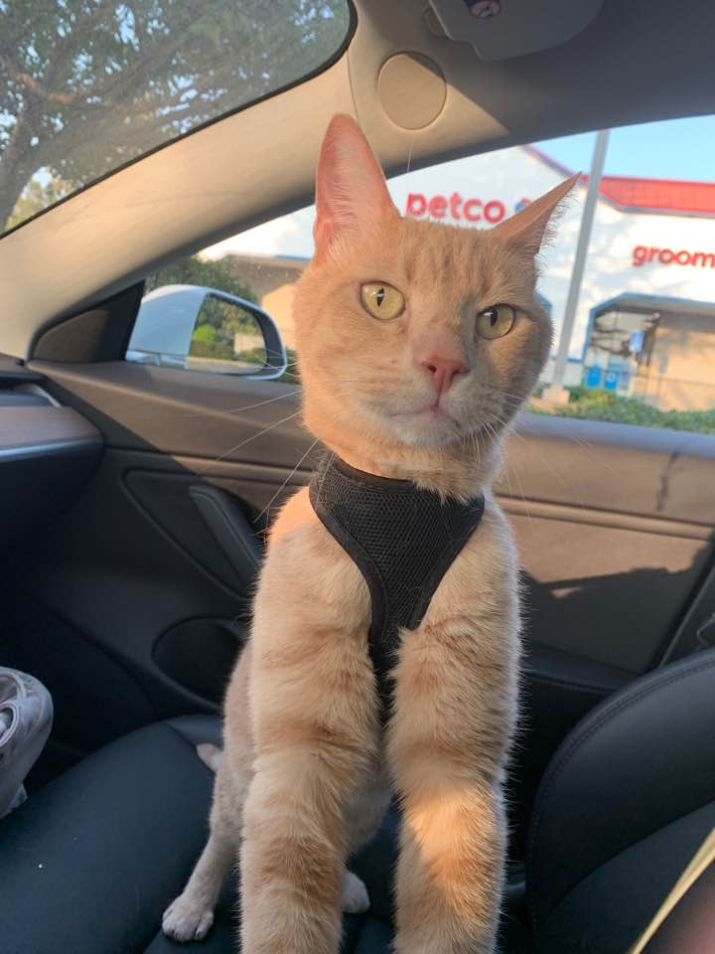
Limitation/Future Direction
Small samples size after stratification into different groups
Data is mostly extracted from patient files and not prospectively collected
Limited follow-up data due to some cases with no response to client questionnaires and limited records

Slide 16
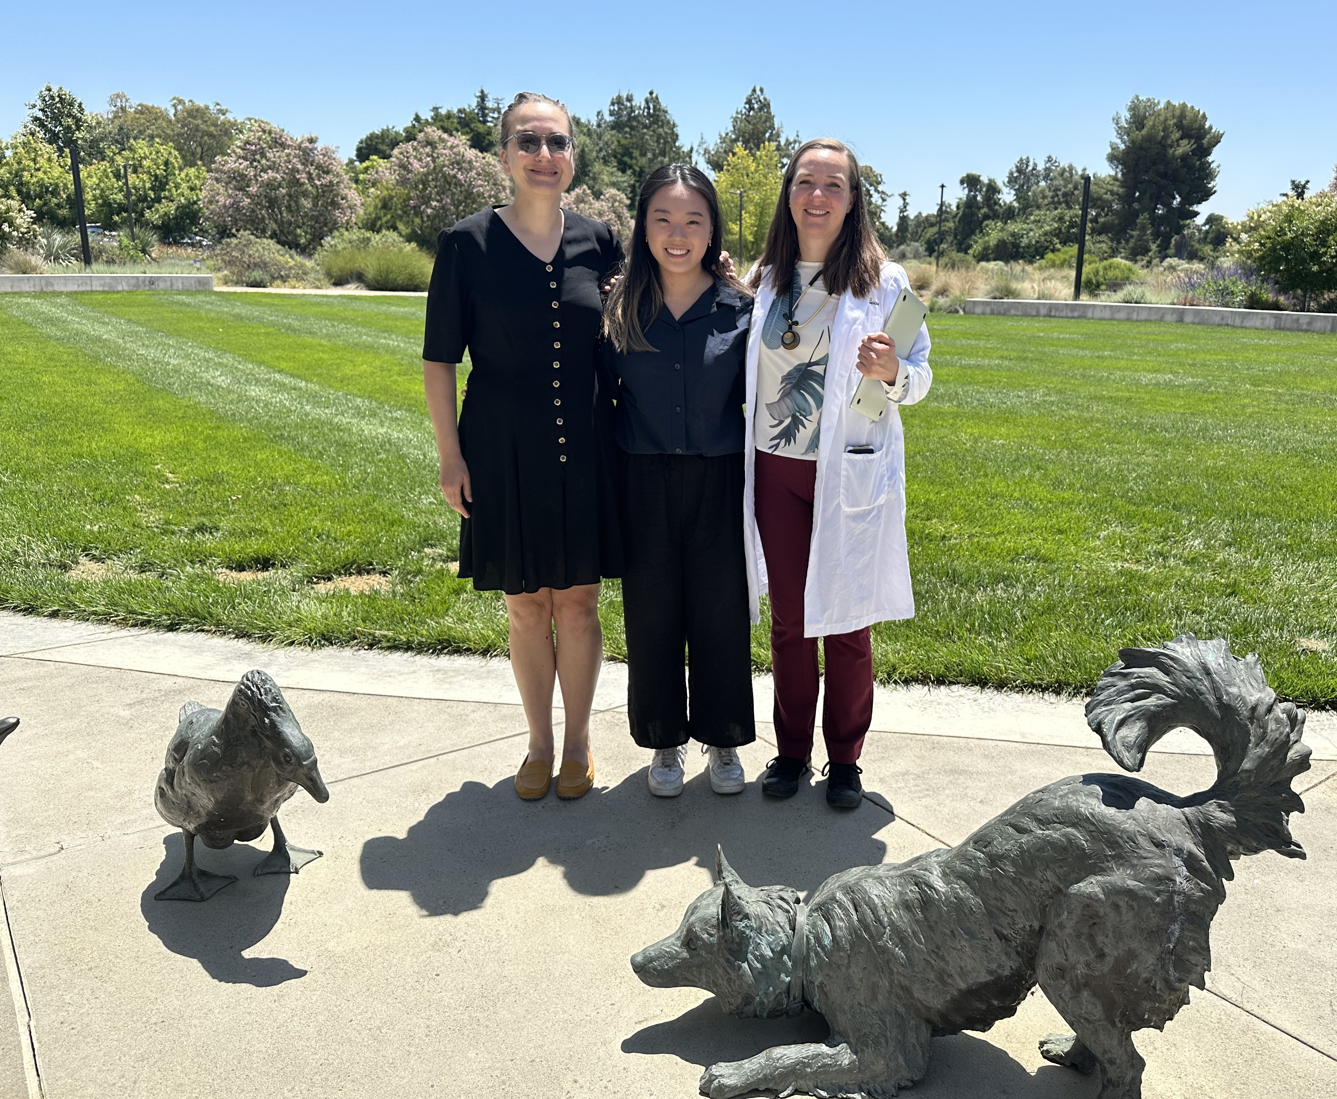
Acknowledgement
Special thank you to:
My mentor Dr. Marsilio for guidance and support
Dr. Giaretta and Dr. Chang from Texas A&M University
Dr. Keller and Dr. Magnusson Wulcan from the UC Davis Department of Pathology, Microbiology, and Immunology
Research Funding: Comparative Gastroenterology Society, IDEXX Laboratories Inc
Student Support: Comparative Gastroenterology Society, IDEXX Laboratories Inc, Students Training in Advanced Research (STAR) program

Slide 17
Questions?
Notes:
MMA (methylmalonic acid)

Slide 18
References
¹ Suchodolski JS, Steiner JM. Laboratory assessment of gastrointestinal function. Clin Tech Small Anim Pract. 2003;18(4):203-210. doi:10.1016/S1096-2867(03)00075-6
²Marsilio S, Freiche V, Johnson E, et al. ACVIM consensus statement guidelines on diagnosing and distinguishing low-grade neoplastic from inflammatory lymphocytic chronic enteropathies in cats. J Vet Intern Med. 2023;37(3):794-816. doi:10.1111/jvim.
³ Dukowicz AC, Lacy BE, Levine GM. Small Intestinal Bacterial Overgrowth. Gastroenterol Hepatol (N Y). 2007;3(2):112-122.
⁴Toresson L, Suchodolski JS, Spillmann T, et al. The Intestinal Microbiome in Dogs with Chronic Enteropathies and Cobalamin Deficiency or Normocobalaminemia-A Comparative Study. Animals (Basel). 2023;13(8):1378. doi:10.3390/ani13081378
⁵Allenspach K, Wieland B, Gröne A, Gaschen F. Chronic Enteropathies in Dogs: Evaluation of Risk Factors for Negative Outcome. Journal of Veterinary Internal Medicine. 2007;21(4):700-708. doi:10.1111/j.1939-1676.2007.tb03011.x
⁶Pérez-Merino EM, Cristóbal-Verdejo I, Duque-Carrasco FJ, Espadas-González L, Pastor-Sirvent N, Usón-Casaús JM. Relationship between serum cobalamin concentration and endoscopic ileal appearance and histology in dogs with chronic inflammatory enteropathy. J Vet Intern Med. 2022;36(3):957-965. doi:10.1111/jvim.16436
⁷Day MJ, Bilzer T, Mansell J, et al. Histopathological standards for the diagnosis of gastrointestinal inflammation in endoscopic biopsy samples from the dog and cat: a report from the World Small Animal Veterinary Association Gastrointestinal Standardization Group. J Comp Pathol. 2008;138 Suppl 1:S1-43. doi:10.1016/j.jcpa.2008.01.001
⁸Jergens AE, Crandell JM, Evans R, Ackermann M, Miles KG, Wang C. A clinical index for disease activity in cats with chronic enteropathy. J Vet Intern Med. 2010;24(5):1027-1033. doi:10.1111/j.1939-1676.2010.0549.x
⁹Ruaux CG, Steiner JM, Williams DA. Early biochemical and clinical responses to cobalamin supplementation in cats with signs of gastrointestinal disease and severe hypocobalaminemia. J Vet Intern Med. 2005;19(2):155-160. doi:10.1892/0891-6640(2005)19<155:ebacrt>2.0.co;2

Slide 19
Contact information
Mina Park
UC Davis School of Veterinary Medicine, Class of 2026
mvpark@ucdavis.edu

