Slide 1
Cerebrospinal fluid proteomic profiling using mass spectrometry for biomarker discovery in canine non-infectious meningoencephalitis
Lynsey Petersen, Dr. Luke Wittenburg and Dr. Christine Toedebusch

Slide 2
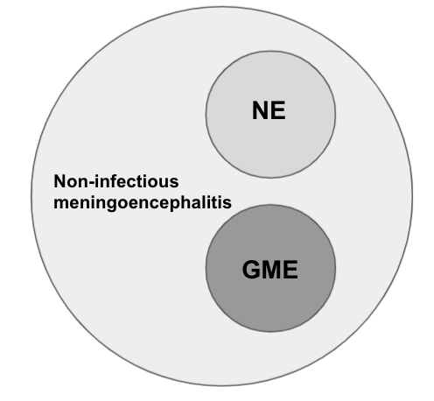
Diagnostic and therapeutic shortcomings of canine non-infectious meningoencephalitis
Canine non-infectious meningoencephalitis
  25% of all CNS disease in dogs
  Presumably immune-mediated
Histological subtypes
Diagnosis only by histopathology
  No gold standard of treatment
Critical need for diagnostic and therapeutic biomarker!

Slide 3
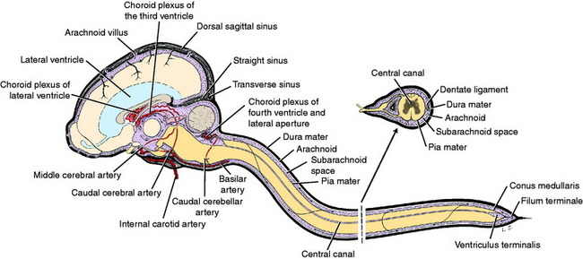
Rationale for our hypothesis
Proteomics mass spectrometry
  Identification of peptides by mass:charge ratio
  Has revealed thousands of potential biomarkers in human medicine
Cerebrospinal fluid (CSF) is the window to the brain
Hypothesis
CSF proteomic profiling using mass spectrometry will reveal a unique, readily detectable peptide signature that will aid in ante-mortem disease diagnosis and therapeutic monitoring of canine non-infectious menginencephalitits

Slide 4
Specific aims we will use to test our hypothesis
Specific Aim 1: Determine whether there is a unique peptide signature in the CSF of dogs with non-infectious meningoencephalitis
Specific Aim 1A:
  Determine the CSF peptide signature of dogs with non-infectious meningoencephalitis relative to healthy controls using unbiased tandem mass spectrometry

Slide 5
First steps to biomarker discovery...
Centrifuge samples and remove cellular materials
Cleave proteins into peptides
Archived CSF samples from histopathologically confirmed cases:
  Normal (n=6)
  GME (n=6
  NME (n=6
Label samples with tandem mass tags (TMTs)
Submit samples for mass spectrometry
Peptides aligned to canine proteome for protein ID

Slide 6
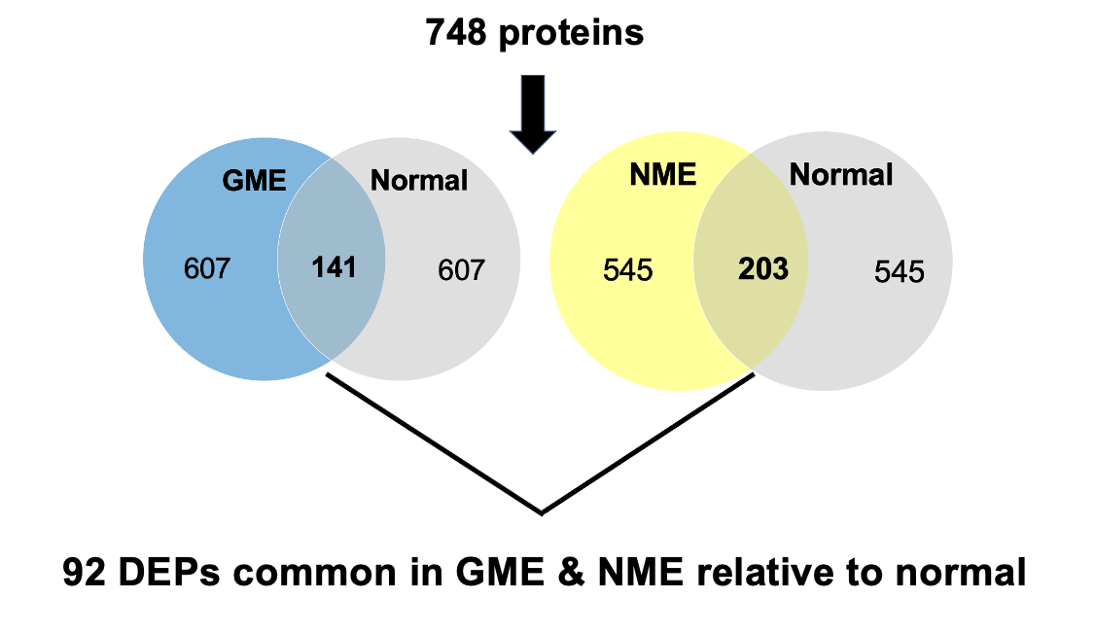
There are 92 differentially expressed proteins (DEPs) common in GME & NME relative to normal
748 proteins
92 DEPs

Slide 7
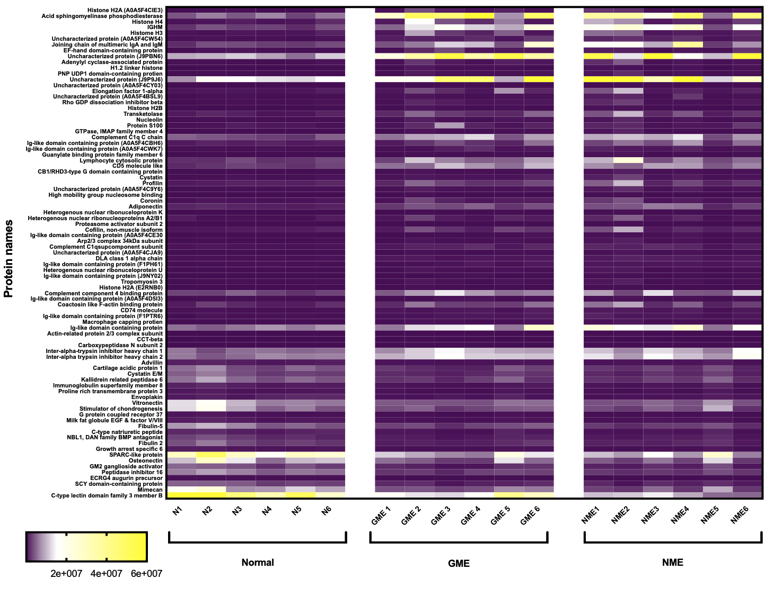
Heatmap of 92 DEPs common in GME & NME relative to normal

Slide 8
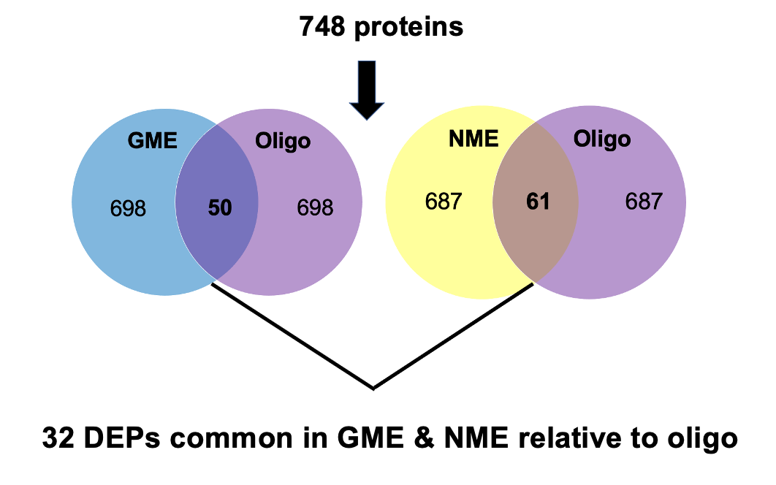
There are 32 differentially expressed proteins common in GME & NME relative to oligodendroglioma
748 proteins
32 DEPs

Slide 9
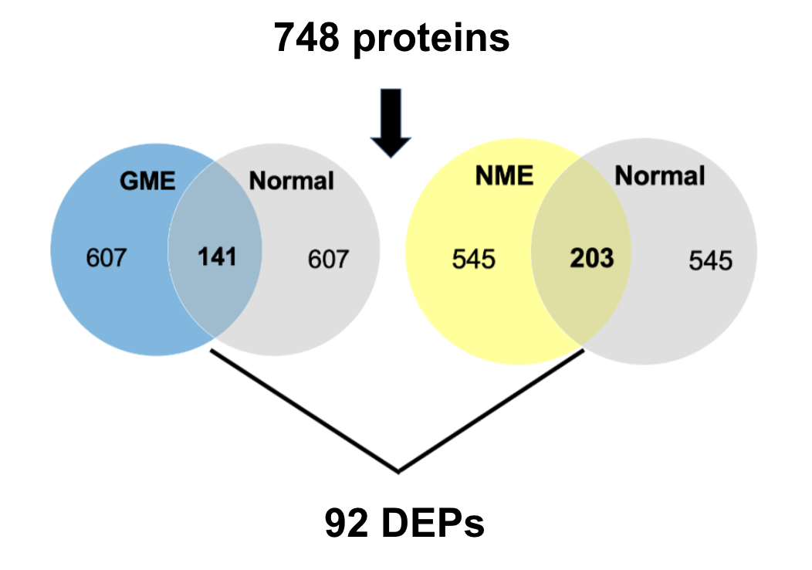
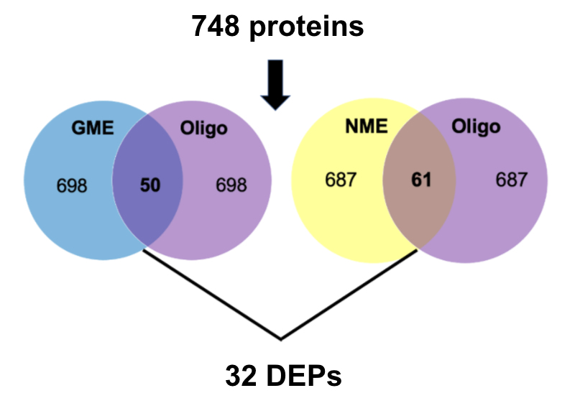
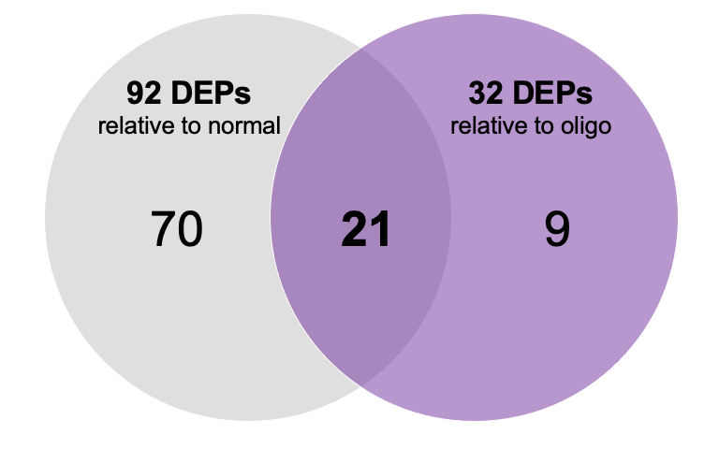
There are 21 DEPs upregulated in both GME & NME relative to normal and oligodendroglioma
There are 21 DEPs upregulated in both GME & NME relative to normal and oligodendroglioma
21 biomarker candidates!
21 biomarker candidates!

Slide 10
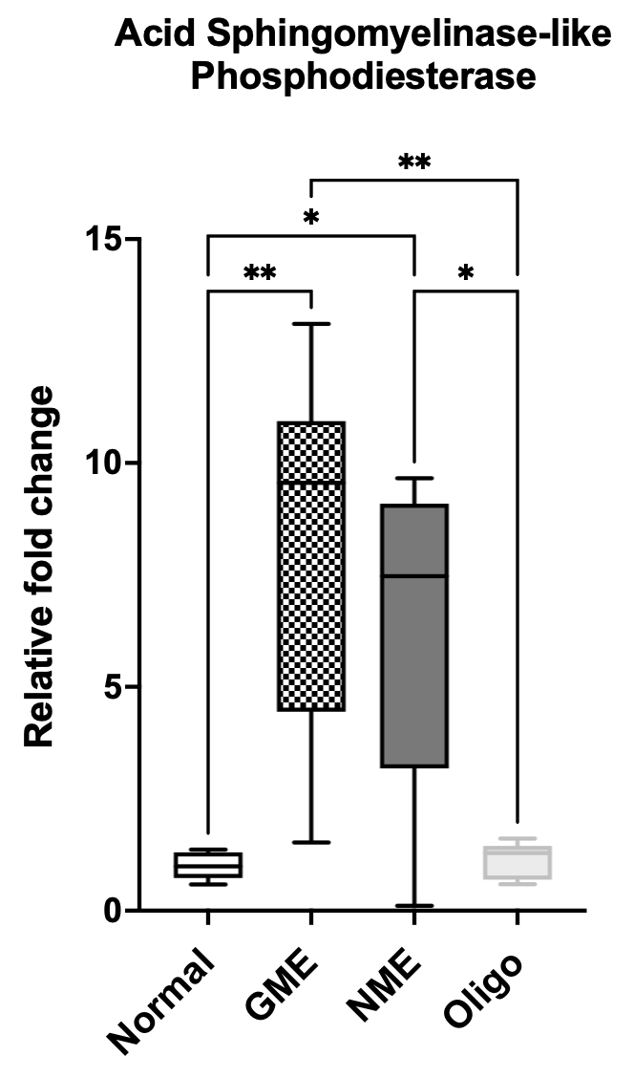
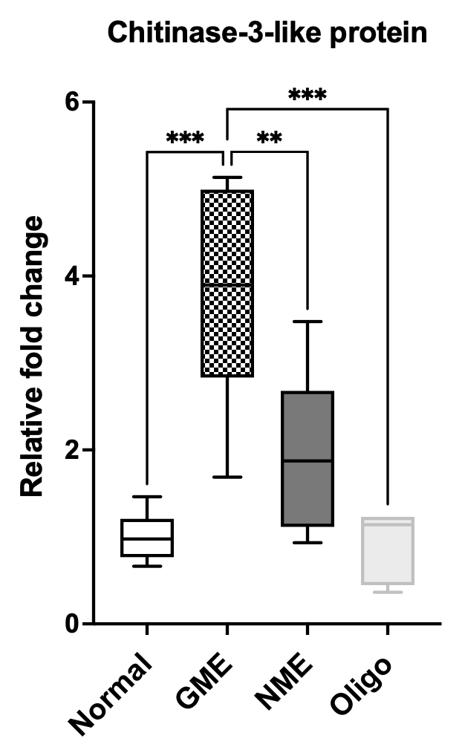
Top biomarker candidates
A
Acid sphingomyelinase-like phosphodiesterase
B
Chitinase-3-like protein

Slide 11
Next step towards biomarker discovery...
Top biomarker candidates:
Acid sphingomyelinase-like phosphodiesterase
Chitinase-3-like protein
Specific Aim 1B: Validation of biomarker candidates in original and new CSF samples via ELISA
  Normal (n=4)
  GME (n=4)
  NME (n=4)
  Infectious meningoencephalitis (n=4)
  Idiopathic epilepsy (n=4)

Slide 12
Summary
Reference library of the canine CSF proteome
21 DEPs upregulated in both GME & NME relative to normal and oligodendroglioma
Acid sphingomyelinase-like phosphodiesterase and chitinase-3-like protein are top biomarker candidates for canine non-infectious meningoencephalitis

Slide 13
Conclusion
Canine CSF proteomic profiling using mass spectrometry is a viable biomarker discovery platform!
Rationale for:
  Biomarker validation using larger cohorts
  Prospective studies to determine diagnostic utility

Slide 14



Acknowledgements
Student funding support
Students Training in Advanced Research (STAR) Program
NIH T35 Training Grant 5T35OD010956-22
Research Grant
Center for Companion Animal Health (2020-6-G)
NIH 5-K01 OD026526-03
Toedebusch Laboratory
Christine Toedebusch, DVM, PhD, DACVIM
Ryan G. Toedebusch, PhD
Blaire Consales, VMIII
Eshetu Debebe, CURE Scholar
Wittenburg Laboratory
Luke Wittenburg, DVM, PhD, DACVCP

Slide 15
Questions?

Slide 16
Protein name | Protein function | Fold change (GME:normal) | Fold change (NME:normal)
Acid sphingomyelinase-like phosphodiesterase | Nucleotide phosphodiesterase activity | 8.0 (p=2.0e-8) | 6.5 (p-4.6e-7)
Chitinase 3-like protein | Carbohydrate binding | 3.7 (p=4.0e-6) | 2.0 (p=0.01)

