Slide 1
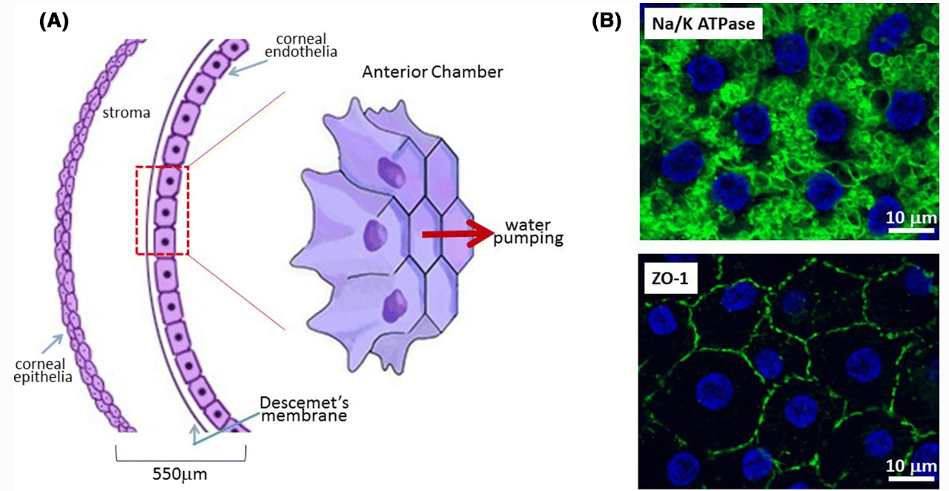
Single Cell Transcriptomics of the TAZ-deficient Murine Corneal Endothelium
Raneesh Ramarapu
Mentor: Dr. Sara Thomasy
Comparative Ophthalmology and Vision Sciences Laboratory (COVSL)

Slide 2
Corneal Endothelium
Hexagonal single cell layer
Non-proliferative in most species
Active cells that constantly pump out water – maintain corneal transparency
Ref [1]
Notes:
[] Meir, Y.-J. J., Chen, H.-C., Chen, C.-C. & Ma, H.-K. D. Revisiting Existing Evidence of Corneal Endothelial Progenitors and Their Potential Therapeutic Applications in Corneal Endothelial Dysfunction. Adv. Ther. 37, 1034–1048 (2020)

Slide 3
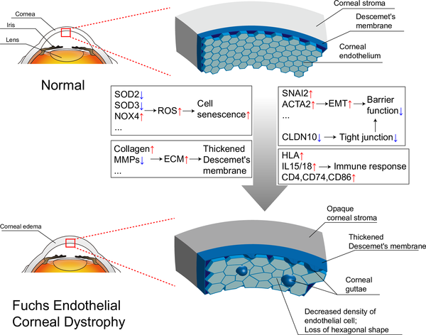
The Pathology of Interest: Fuchs Endothelial Corneal Dystrophy (FECD)
Ref [2]
Notes:
Aiello F, Gallo Afflitto G, Ceccarelli F, Cesareo M, Nucci C. Global Prevalence of Fuchs Endothelial Corneal Dystrophy (FECD) in Adult Population: A Systematic Review and Meta-Analysis. J Ophthalmol. 2022;2022: 3091695.
Matthaei M, Hribek A, Clahsen T, Bachmann B, Cursiefen C, Jun AS. Fuchs Endothelial Corneal Dystrophy: Clinical, Genetic, Pathophysiologic, and Therapeutic Aspects. Annu Rev Vis Sci. 2019;5: 151–175.
Xia D, Zhang S, Nielsen E, et al. The ultrastructures and mechanical properties of the Descement's membrane in Fuchs endothelial corneal dystrophy. Sci Rep. 2016; 6: 23096.
Cui, Z. et al. Pathological molecular mechanism of symptomatic late-onset Fuchs endothelial corneal dystrophy by bioinformatic analysis. PLoS One 13, e0197750 (2018)

Slide 4
The Pathology of Interest: Fuchs Endothelial Corneal Dystrophy (FECD)
Polygenic Disease
>300 million human patients globally under the age of 30 [3]
Ref [2]
Notes:
Aiello F, Gallo Afflitto G, Ceccarelli F, Cesareo M, Nucci C. Global Prevalence of Fuchs Endothelial Corneal Dystrophy (FECD) in Adult Population: A Systematic Review and Meta-Analysis. J Ophthalmol. 2022;2022: 3091695.
Matthaei M, Hribek A, Clahsen T, Bachmann B, Cursiefen C, Jun AS. Fuchs Endothelial Corneal Dystrophy: Clinical, Genetic, Pathophysiologic, and Therapeutic Aspects. Annu Rev Vis Sci. 2019;5: 151–175.
Xia D, Zhang S, Nielsen E, et al. The ultrastructures and mechanical properties of the Descement's membrane in Fuchs endothelial corneal dystrophy. Sci Rep. 2016; 6: 23096.
Cui, Z. et al. Pathological molecular mechanism of symptomatic late-onset Fuchs endothelial corneal dystrophy by bioinformatic analysis. PLoS One 13, e0197750 (2018)

Slide 5
The Pathology of Interest: Fuchs Endothelial Corneal Dystrophy (FECD)
Polygenic Disease
>300 million human patients globally under the age of 30 [3]
Characterized by [4,5]
Accelerated Loss of CEn
Altered Descemet Membrane (DM) stiffness
Aberrant ECM accumulation
Guttae
Ref [3]
Notes:
Aiello F, Gallo Afflitto G, Ceccarelli F, Cesareo M, Nucci C. Global Prevalence of Fuchs Endothelial Corneal Dystrophy (FECD) in Adult Population: A Systematic Review and Meta-Analysis. J Ophthalmol. 2022;2022: 3091695.
Matthaei M, Hribek A, Clahsen T, Bachmann B, Cursiefen C, Jun AS. Fuchs Endothelial Corneal Dystrophy: Clinical, Genetic, Pathophysiologic, and Therapeutic Aspects. Annu Rev Vis Sci. 2019;5: 151–175.
Xia D, Zhang S, Nielsen E, et al. The ultrastructures and mechanical properties of the Descement's membrane in Fuchs endothelial corneal dystrophy. Sci Rep. 2016; 6: 23096.
Cui, Z. et al. Pathological molecular mechanism of symptomatic late-onset Fuchs endothelial corneal dystrophy by bioinformatic analysis. PLoS One 13, e0197750 (2018)

Slide 6
The Pathology of Interest: Fuchs Endothelial Corneal Dystrophy (FECD)
Only treatment is corneal transplant
Low accessibility
Need for alternative non-surgical therapeutics!
Ref [3]
Notes:
Aiello F, Gallo Afflitto G, Ceccarelli F, Cesareo M, Nucci C. Global Prevalence of Fuchs Endothelial Corneal Dystrophy (FECD) in Adult Population: A Systematic Review and Meta-Analysis. J Ophthalmol. 2022;2022: 3091695.
Matthaei M, Hribek A, Clahsen T, Bachmann B, Cursiefen C, Jun AS. Fuchs Endothelial Corneal Dystrophy: Clinical, Genetic, Pathophysiologic, and Therapeutic Aspects. Annu Rev Vis Sci. 2019;5: 151–175.
Xia D, Zhang S, Nielsen E, et al. The ultrastructures and mechanical properties of the Descement's membrane in Fuchs endothelial corneal dystrophy. Sci Rep. 2016; 6: 23096.
Cui, Z. et al. Pathological molecular mechanism of symptomatic late-onset Fuchs endothelial corneal dystrophy by bioinformatic analysis. PLoS One 13, e0197750 (2018)

Slide 7
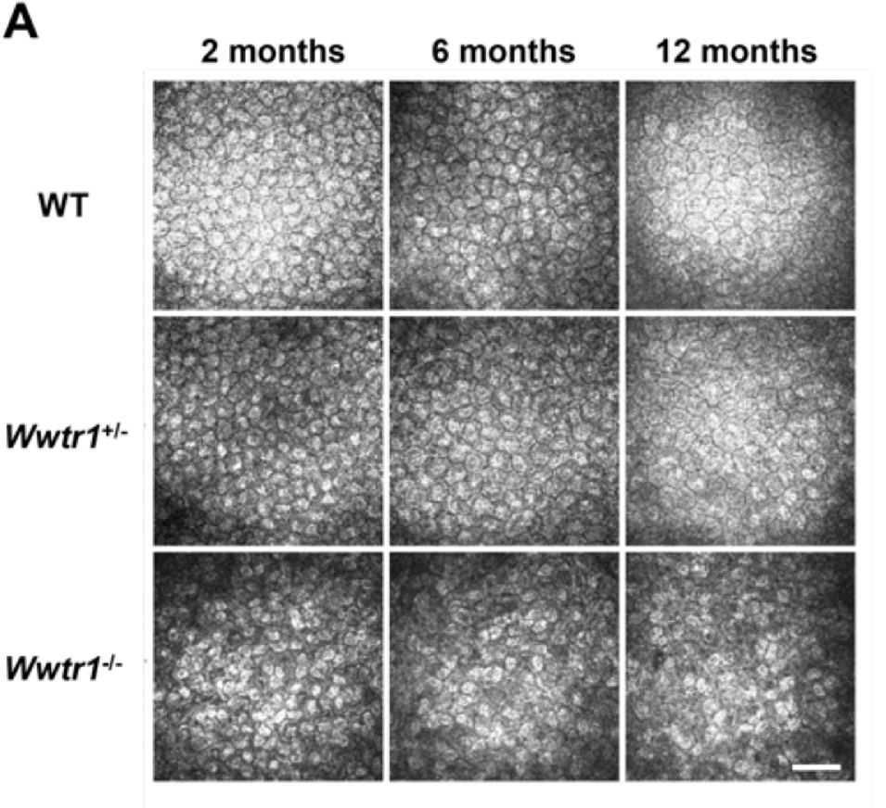
Our Model of FECD: TAZ-deficient mice
COVSL modelled late-onset FECD using Wwtr1 deficient mice [6]
Notes:
Park S, Leonard B, Kim S, Mccorkell ME, Murphy CJ, Raghunathan V, et al. Evaluation of function-related corneal endothelial markers in TAZ deficient mice over time. Invest Ophthalmol Vis Sci. 2021;62: 840–840.

Slide 8
Our Model of FECD: TAZ-deficient mice
COVSL modelled late-onset FECD using Wwtr1 deficient mice [6]
Reduced CEn density
abnormal CEn morphology
Softer DM
Thinner corneas
Altered expression and localization of Na/K-ATPase and ZO-1
Notes:
Park S, Leonard B, Kim S, Mccorkell ME, Murphy CJ, Raghunathan V, et al. Evaluation of function-related corneal endothelial markers in TAZ deficient mice over time. Invest Ophthalmol Vis Sci. 2021;62: 840–840.

Slide 9
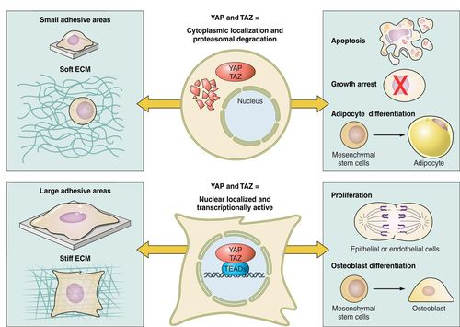
Wwtr1 (TAZ)
Encodes transcriptional co-activator with PDZ-binding motif (TAZ)
Multifunctional Gene [7-13]
Mechanotransducer of DM stiffness
Ref [7]
Notes:
Varelas X, Sakuma R, Samavarchi-Tehrani P, Peerani R, Rao BM, Dembowy J, et al. TAZ controls Smad nucleocytoplasmic shuttling and regulates human embryonic stem-cell self-renewal. Nat Cell Biol. 2008;10: 837–848. 9. Dupont S, Morsut L, Aragona M, Enzo E, Giulitti S, Cordenonsi M, et al. Role of YAP/TAZ in mechanotransduction. Nature. 2011;474: 179–183. 10. Okumura N, Nakamura T, Kay EP, Nakahara M, Kinoshita S, Koizumi N. R-spondin1 regulates cell proliferation of corneal endothelial cells via the Wnt3a/β-catenin pathway. Invest Ophthalmol Vis Sci. 2014;55: 6861–6869. 11. Morgan JT, Murphy CJ, Russell P. What do mechanotransduction, Hippo, Wnt, and TGFβ have in common? YAP and TAZ as key orchestrating molecules in ocular health and disease. Exp Eye Res. 2013;115: 1–12. 12. Okumura N, Hashimoto K, Kitahara M, Okuda H, Ueda E, Watanabe K, et al. Activation of TGF-β signaling induces cell death via the unfolded protein response in Fuchs endothelial corneal dystrophy. Sci Rep. 2017;7: 6801. 13. Okumura N, Minamiyama R, Ho LT, Kay EP, Kawasaki S, Tourtas T, et al. Involvement of ZEB1 and Snail1 in excessive production of extracellular matrix in Fuchs endothelial corneal dystrophy. Lab Invest. 2015;95: 1291–1304. 14. Losick VP, Jun AS, Spradling AC. Wound-Induced Polyploidization: Regulation by Hippo and JNK Signaling and Conservation in Mammals. PLoS One. 2016;11: e0151251

Slide 10
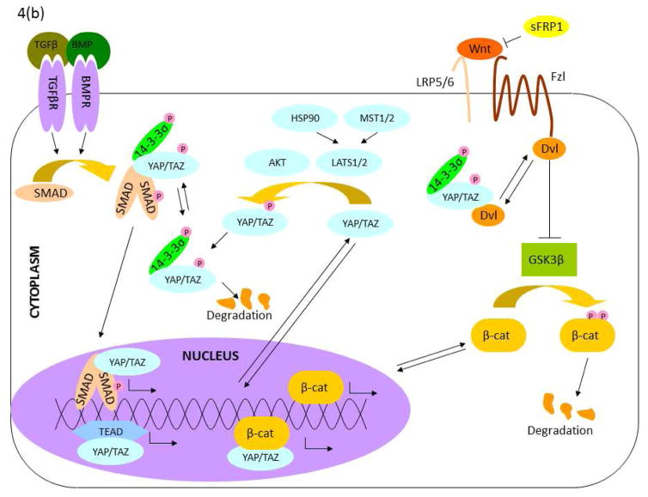
Wwtr1 (TAZ)
Encodes transcriptional co-activator with PDZ-binding motif (TAZ)
Multifunctional Gene [7-13]
Mechanotransducer of DM stiffness
Central orchestrator of multiple pathways
Hippo
Wnt
TGF-Beta
NF-kB
Notes:
Varelas X, Sakuma R, Samavarchi-Tehrani P, Peerani R, Rao BM, Dembowy J, et al. TAZ controls Smad nucleocytoplasmic shuttling and regulates human embryonic stem-cell self-renewal. Nat Cell Biol. 2008;10: 837–848. 9. Dupont S, Morsut L, Aragona M, Enzo E, Giulitti S, Cordenonsi M, et al. Role of YAP/TAZ in mechanotransduction. Nature. 2011;474: 179–183. 10. Okumura N, Nakamura T, Kay EP, Nakahara M, Kinoshita S, Koizumi N. R-spondin1 regulates cell proliferation of corneal endothelial cells via the Wnt3a/β-catenin pathway. Invest Ophthalmol Vis Sci. 2014;55: 6861–6869. 11. Morgan JT, Murphy CJ, Russell P. What do mechanotransduction, Hippo, Wnt, and TGFβ have in common? YAP and TAZ as key orchestrating molecules in ocular health and disease. Exp Eye Res. 2013;115: 1–12. 12. Okumura N, Hashimoto K, Kitahara M, Okuda H, Ueda E, Watanabe K, et al. Activation of TGF-β signaling induces cell death via the unfolded protein response in Fuchs endothelial corneal dystrophy. Sci Rep. 2017;7: 6801. 13. Okumura N, Minamiyama R, Ho LT, Kay EP, Kawasaki S, Tourtas T, et al. Involvement of ZEB1 and Snail1 in excessive production of extracellular matrix in Fuchs endothelial corneal dystrophy. Lab Invest. 2015;95: 1291–1304. 14. Losick VP, Jun AS, Spradling AC. Wound-Induced Polyploidization: Regulation by Hippo and JNK Signaling and Conservation in Mammals. PLoS One. 2016;11: e0151251

Slide 11
Goal of the project
Define the transcriptomic landscape of TAZ deficiency

Slide 12
Goal of the project
Define the transcriptomic landscape of TAZ deficiency
We have single cell transcriptomic data of 3 genotypes of 3 age groups:
Wildtype (WT): 2-, 6-, 11-month-old
Wwtr1 Heterozygous knockout (TAZ HET): 2-, 6-, 11-month-old
Wwtr1 Homozygous knockout (TAZ KO): 2-, 6-, 11-month-old

Slide 13
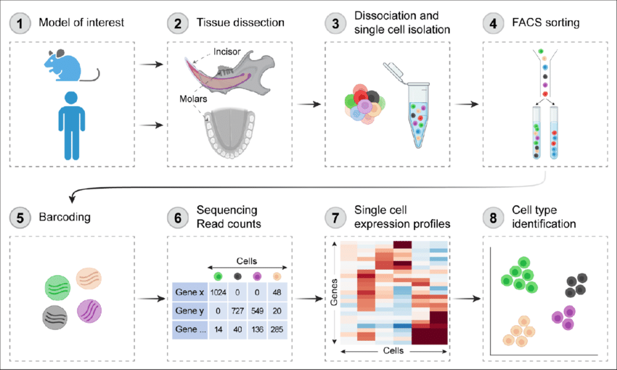
Single Cell RNA-sequencing
High dimensionality data analysis
Sequence all the RNA from individual cells
Allows us to assess heterogenous tissues such as the cornea

Slide 14
ScRNA-seq Analysis in a nutshell
Allows us to engage with and interpret multidimensional complex data by

Slide 15
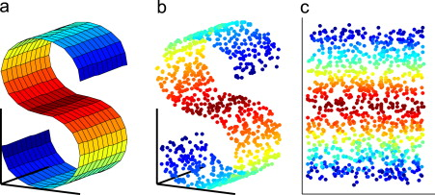
ScRNA-seq Analysis in a nut shell
Allows us to engage with and interpret multidimensional complex data by
Dimensionality reduction
Ref [14]

Slide 16
ScRNA-seq Analysis in a nut shell
Allows us to engage with and interpret multidimensional complex data by
Dimensionality reduction
But how do we define cell types?
Ref [14]

Slide 17
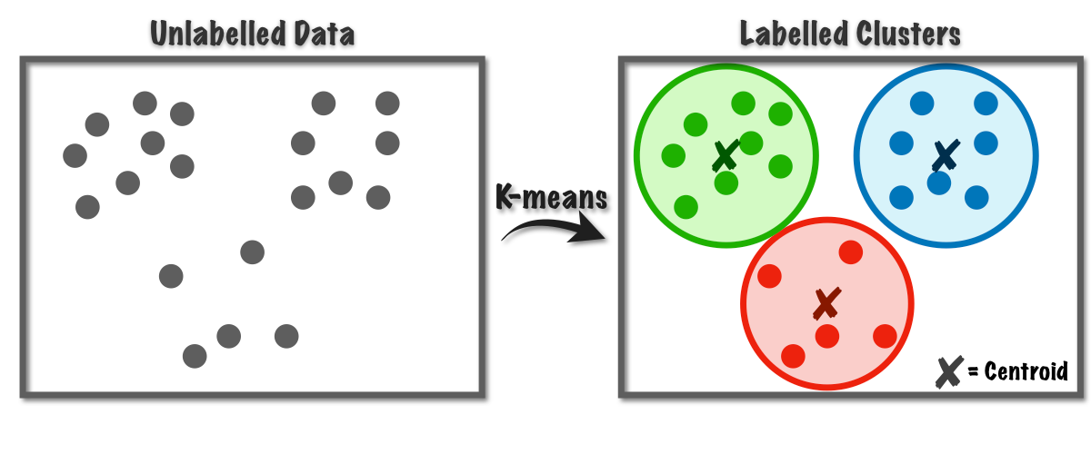
ScRNA-seq Analysis in a nut shell
Allows us to engage with and interpret multidimensional complex data by
Dimensionality reduction
But how do we define cell types?
K-means Clustering
Ref [14]
Ref [15]

Slide 18
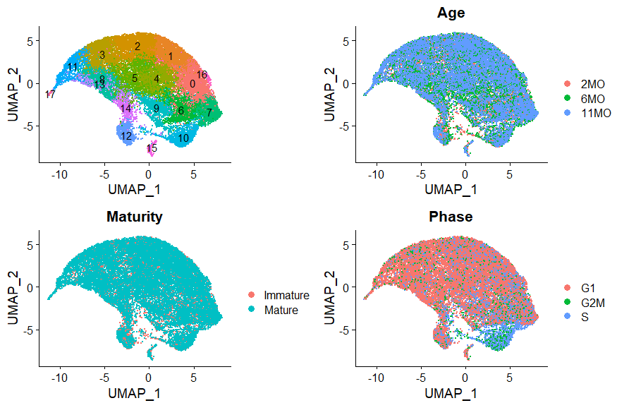
ScRNA-seq Analysis in a nut shell
Allows us to engage with and interpret multidimensional complex data by
Dimensionality reduction
But how do we define cell types?
K-means Clustering
We now have statistically defined cell types that can be further analyzed

Slide 19
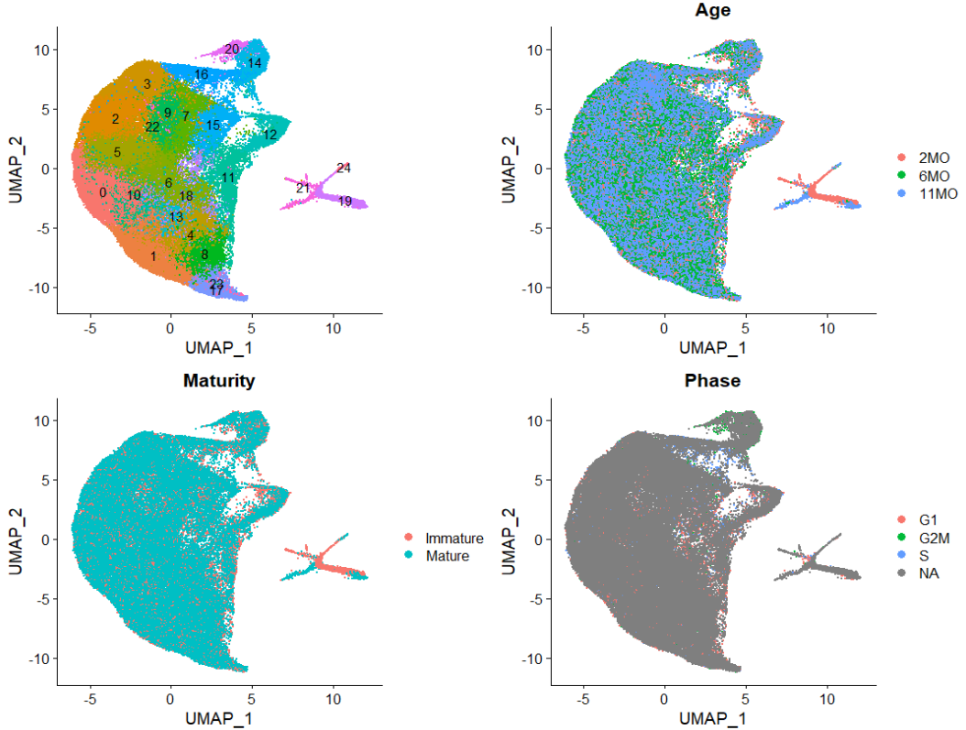
WT, TAZ HET and TAZ KO
CEn cells clustered separately from the CEp and Limbus
These were validated with previously described markers

Slide 20
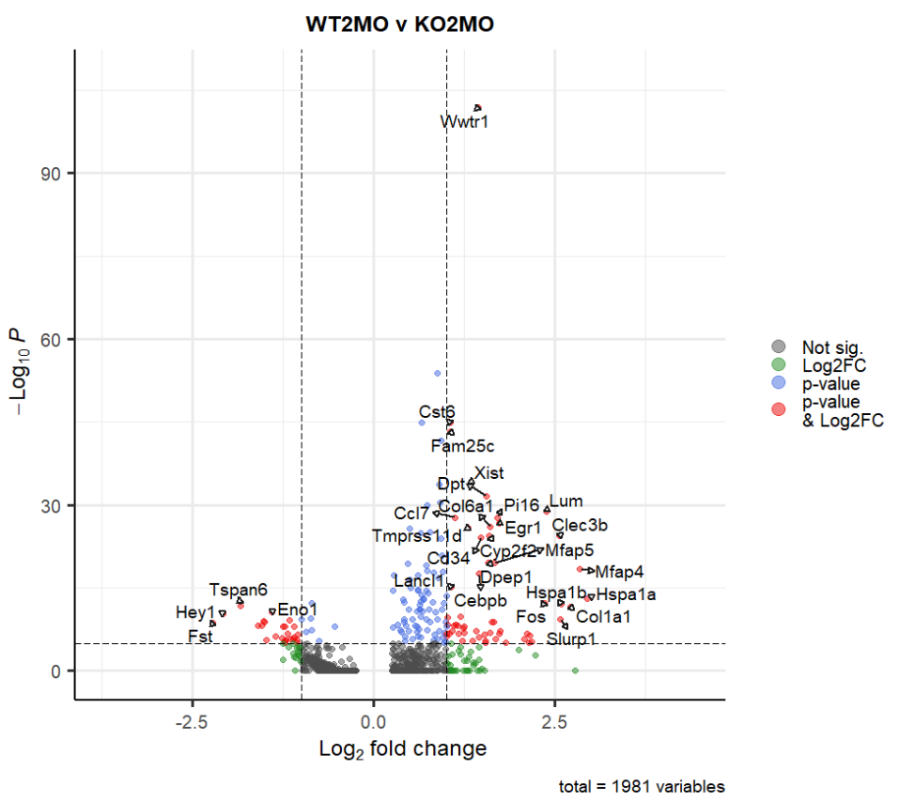
WT 2MO versus KO 2MO CEn
KO
WT

Slide 21
Gene Ontology
Compiles the 1000s of upregulated genes between WT and KO
Compares it to a database of genes categorized and labelled by function and networks

Slide 22
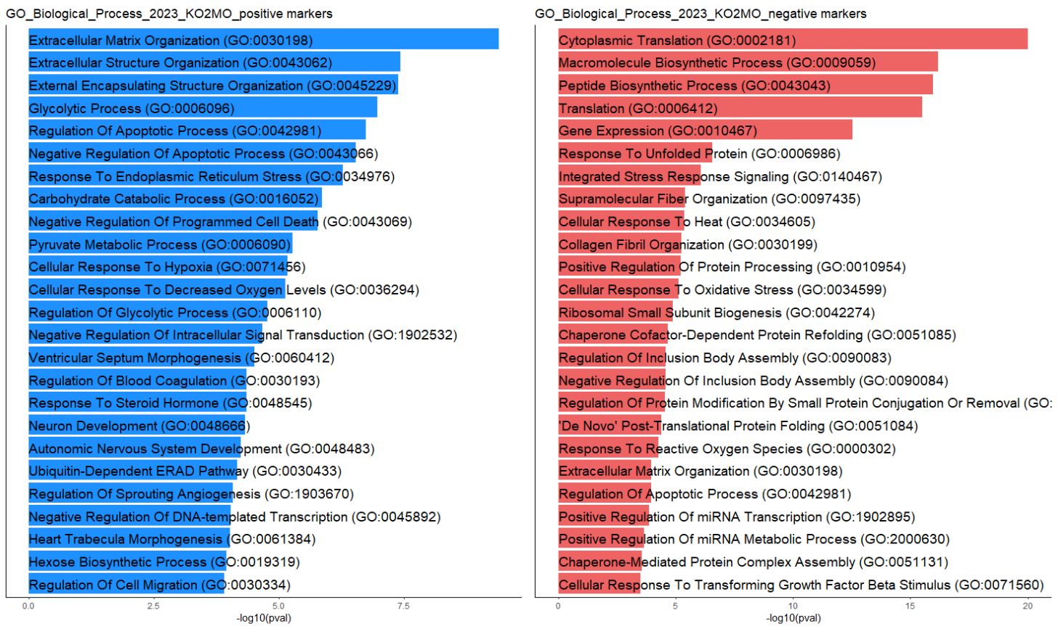
Gene Ontology

Slide 23
Gene Ontology
Based on comparisons to multiple databases and Electron microscopy work, we focused on
Endoplasmic reticulum stress
Mitochondrial function

Slide 24
WT2MO v KO2MO
KO downregulated functional markers
Slc4a11 – anion exchanger
Slc4a4 – Na/bicarbonate transporter
Aqp1/5 – Aquaporins

Slide 25
WT2MO v KO2MO
KO downregulated functional markers
Interestingly it downregulates type I collagens responsible for DM stiffness

Slide 26
WT2MO v KO2MO
KO downregulated functional markers
Interestingly it downregulates type I collagens responsible for DM stiffness
Although fibroblastic marker fibronectin is upregulated

Slide 27
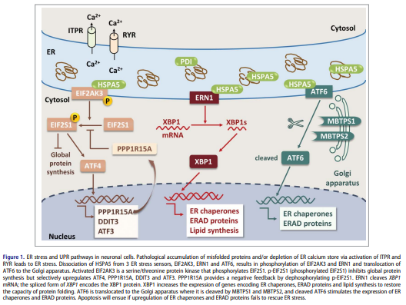
WT2MO v KO2MO
KO downregulated functional markers
KO upregulates ER Stress transcripts
Hspa5 is integral to the ER stress response [16]
Notes:
Cai, Yu, Jyothi Arikkath, Lu Yang, Ming-Lei Guo, Palsamy Periyasamy, and Shilpa Buch. 2016. “Interplay of Endoplasmic Reticulum Stress and Autophagy in Neurodegenerative Disorders.” Autophagy 12 (2): 225–44.

Slide 28
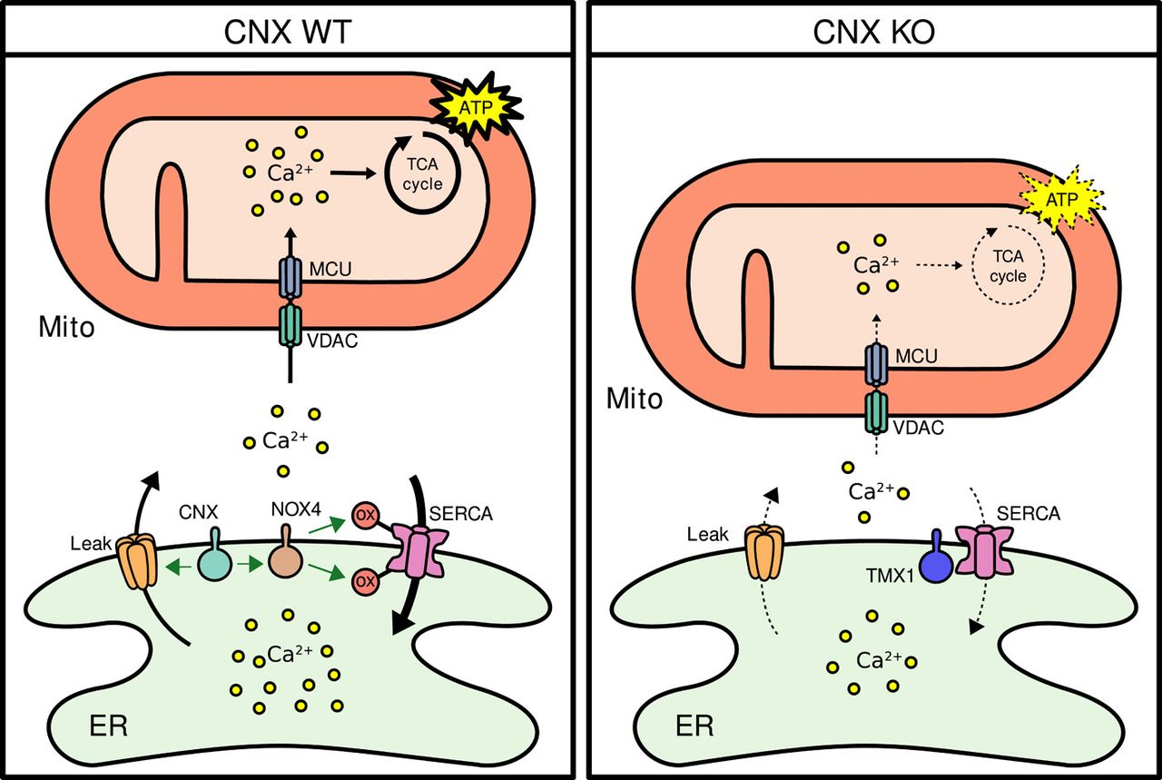
WT2MO v KO2MO
KO downregulated functional markers
KO upregulates ER Stress transcripts
Calnexin regulates mitochondrial function with ER stress, calcium movement and ER stress associated cell death [17,18]
Notes:
Guérin, R., Arseneault, G., Dumont, S. & Rokeach, L. A. Calnexin is involved in apoptosis induced by endoplasmic reticulum stress in the fission yeast. Mol. Biol. Cell 19, 4404–4420 (2008)
Gutiérrez, T. et al. The ER chaperone calnexin controls mitochondrial positioning and respiration. Sci. Signal. 13, (2020)

Slide 29
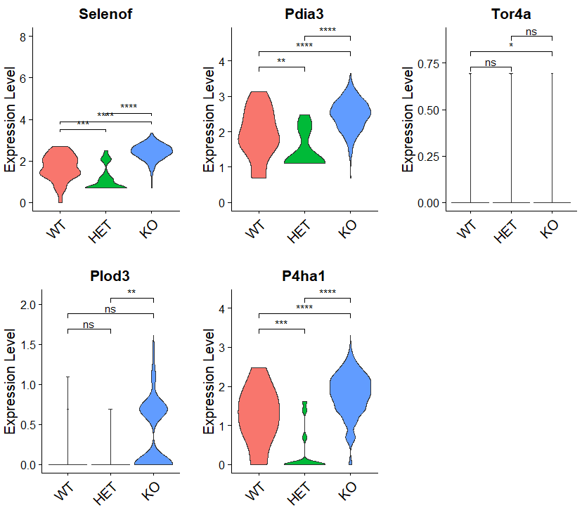
WT2MO v KO2MO
KO downregulated functional markers
KO upregulates ER Stress transcripts
KO upregulates calcium binding genes
These genes are upregulated with ER stress and calcium binding [19, 20]
Notes:
Ren, Bingyu, Yanmei Huang, Chen Zou, Yingying Wu, Yuru Huang, Jiazuan Ni, and Jing Tian. 2019. “Transcriptional Regulation of Selenoprotein F by Heat Shock Factor 1 during Selenium Supplementation and Stress Response.” Cells 8 (5). https://doi.org/10.3390/cells8050479.
Shin, Young-Hee, Hana Cho, Bo Young Choi, Jonghoon Kim, Jaeyoung Ha, Sang Won Suh, and Seung Bum Park. 2021. “Phenotypic Discovery of Neuroprotective Agents by Regulation of Tau Proteostasis via Stress-Responsive Activation of PERK Signaling.” Angewandte Chemie 60 (4): 1831–38.

Slide 30
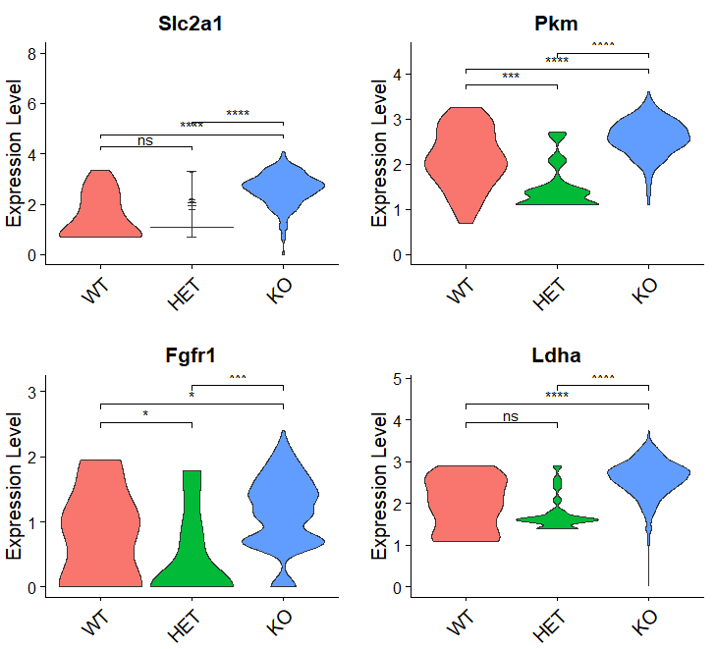
WT2MO v KO2MO
KO downregulated functional markers
KO upregulates ER Stress transcripts
KO upregulates calcium binding gene
KO upregulates genes associated with stress metabolism

Slide 31
WT2MO v KO2MO
KO downregulated functional markers
KO upregulates ER Stress transcripts
KO upregulates calcium binding gene
KO upregulates genes associated with stress metabolism
Slc2a1 – glucose transporter
Pkm – Phosphofructokinase
Fgfr1 – associated with metabolic changes in stress [21]
Ldha – lactate dehydrogenase
Notes:
Nies VJ, Sancar G, Liu W, van Zutphen T, Struik D, Yu RT, Atkins AR, Evans RM, Jonker JW, Downes MR. Fibroblast Growth Factor Signaling in Metabolic Regulation. Front Endocrinol (Lausanne). 2016 Jan 19;6:193. doi: 10.3389/fendo.2015.00193. PMID: 26834701; PMCID: PMC4718082.

Slide 32
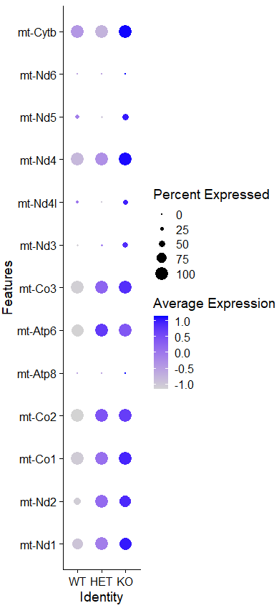
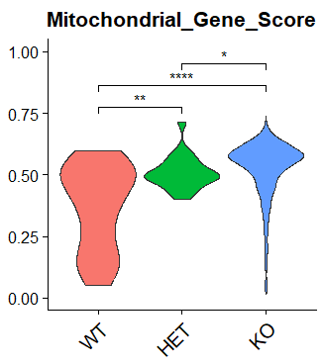
WT2MO v KO2MO
KO downregulated functional markers
KO upregulates ER Stress transcripts
KO upregulates calcium binding gene
KO upregulates genes associated with stress metabolism
KO upregulates mitochondrial genes

Slide 33
Putting it together
Improper TAZ signaling negatively impacts the CEn healing response due to cytoplasmic retention
This coupled with TAZ’s key role in orchestrating multiple pathways likely causes the trifecta of ER stress, change in metabolism and mitochondrial upregulation

Slide 34
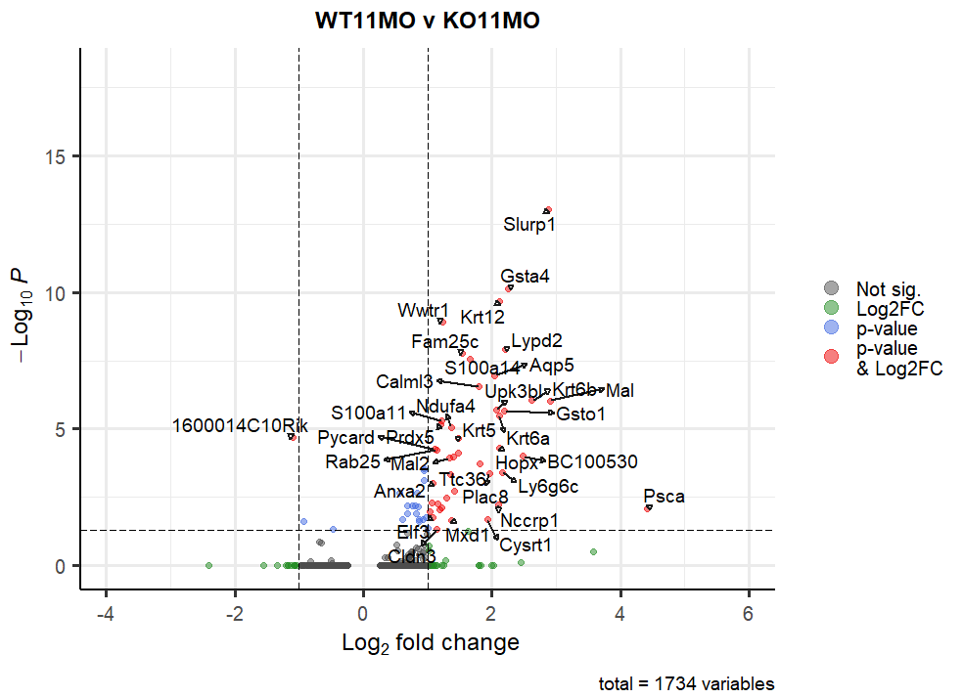
WT11MO vs KO11MO
KO
WT

Slide 35
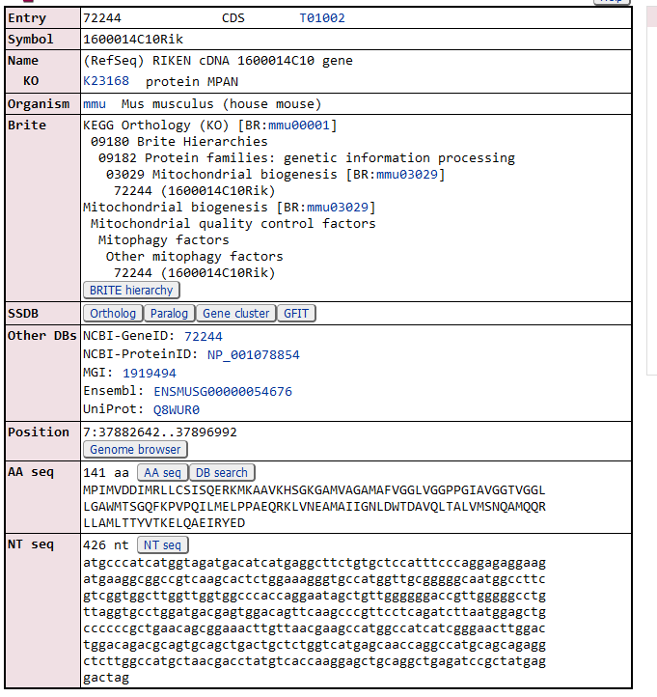
WT11MO vs KO11MO
KO11MO has only downregulated genes except RIK gene (unknown function, maybe associated with mitophagy/mitochondrial function)
GO indicates KO11MO are likely low functioning WT11MO cells (downregulation of protein synthesis and regulation of apoptosis)

Slide 36
Conclusions
We have a greater understanding of the mechanisms driving CEn dysfunction in FECD in the TAZ model
With age, TAZ dysfunction causes a reduction in cell function (at least at the transcriptomic level)

Slide 37
Future direction
Validate these transcriptomic differences through qPCR and localization through fluorescent in situ hybridization
Functionally validate the pathways of interest using immunohistochemistry

Slide 38
Acknowledgements
I’d like to thank Drs. Sara Thomasy and Brian Leonard for their incredible support both in and outside the lab
I would like to thank the members of the wet lab portion (Sangwan Park, Nayeli Echeverria, Michelle Ferneding, Sophie Le and Monica Ardon) for procuring this data
I would also like to thank Dr. Vijay Raghunathan for his critical comments that improved these projects
Financial support was provided by the Students Training in Advanced Research (STAR) Program through the NIH T35 OD010956-22 grant

Slide 39
References
Meir, Y.-J. J., Chen, H.-C., Chen, C.-C. & Ma, H.-K. D. Revisiting Existing Evidence of Corneal Endothelial Progenitors and Their Potential Therapeutic Applications in Corneal Endothelial Dysfunction. Adv. Ther. 37, 1034–1048 (2020)
Aiello F, Gallo Afflitto G, Ceccarelli F, Cesareo M, Nucci C. Global Prevalence of Fuchs Endothelial Corneal Dystrophy (FECD) in Adult Population: A Systematic Review and Meta-Analysis. J Ophthalmol. 2022;2022: 3091695.
Xia D, Zhang S, Nielsen E, et al. The ultrastructures and mechanical properties of the Descement's membrane in Fuchs endothelial corneal dystrophy. Sci Rep. 2016; 6: 23096.
Matthaei M, Hribek A, Clahsen T, Bachmann B, Cursiefen C, Jun AS. Fuchs Endothelial Corneal Dystrophy: Clinical, Genetic, Pathophysiologic, and Therapeutic Aspects. Annu Rev Vis Sci. 2019;5: 151–175.
Cui, Z. et al. Pathological molecular mechanism of symptomatic late-onset Fuchs endothelial corneal dystrophy by bioinformatic analysis. PLoS One 13, e0197750 (2018)
Park S, Leonard B, Kim S, Mccorkell ME, Murphy CJ, Raghunathan V, et al. Evaluation of function-related corneal endothelial markers in TAZ deficient mice over time. Invest Ophthalmol Vis Sci. 2021;62: 840–840.
Varelas X, Sakuma R, Samavarchi-Tehrani P, Peerani R, Rao BM, Dembowy J, et al. TAZ controls Smad nucleocytoplasmic shuttling and regulates human embryonic stem-cell self-renewal. Nat Cell Biol. 2008;10: 837–848.
Dupont S, Morsut L, Aragona M, Enzo E, Giulitti S, Cordenonsi M, et al. Role of YAP/TAZ in mechanotransduction. Nature. 2011;474: 179–183.
Okumura N, Nakamura T, Kay EP, Nakahara M, Kinoshita S, Koizumi N. R-spondin1 regulates cell proliferation of corneal endothelial cells via the Wnt3a/β-catenin pathway. Invest Ophthalmol Vis Sci. 2014;55: 6861–6869.
Morgan JT, Murphy CJ, Russell P. What do mechanotransduction, Hippo, Wnt, and TGFβ have in common? YAP and TAZ as key orchestrating molecules in ocular health and disease. Exp Eye Res. 2013;115: 1–12.
Okumura N, Hashimoto K, Kitahara M, Okuda H, Ueda E, Watanabe K, et al. Activation of TGF-β signaling induces cell death via the unfolded protein response in Fuchs endothelial corneal dystrophy. Sci Rep. 2017;7: 6801.
Okumura N, Minamiyama R, Ho LT, Kay EP, Kawasaki S, Tourtas T, et al. Involvement of ZEB1 and Snail1 in excessive production of extracellular matrix in Fuchs endothelial corneal dystrophy. Lab Invest. 2015;95: 1291–1304.
Losick VP, Jun AS, Spradling AC. Wound-Induced Polyploidization: Regulation by Hippo and JNK Signaling and Conservation in Mammals. PLoS One. 2016;11: e0151251
https://www.jkobject.com/blog/umap-explanation/
https://towardsdatascience.com/k-means-a-complete-introduction-1702af9cd8c
Cai, Yu, Jyothi Arikkath, Lu Yang, Ming-Lei Guo, Palsamy Periyasamy, and Shilpa Buch. 2016. “Interplay of Endoplasmic Reticulum Stress and Autophagy in Neurodegenerative Disorders.” Autophagy 12 (2): 225–44.
Guérin, R., Arseneault, G., Dumont, S. & Rokeach, L. A. Calnexin is involved in apoptosis induced by endoplasmic reticulum stress in the fission yeast. Mol. Biol. Cell 19, 4404–4420 (2008)
Gutiérrez, T. et al. The ER chaperone calnexin controls mitochondrial positioning and respiration. Sci. Signal. 13, (2020)
Ren, Bingyu, Yanmei Huang, Chen Zou, Yingying Wu, Yuru Huang, Jiazuan Ni, and Jing Tian. 2019. “Transcriptional Regulation of Selenoprotein F by Heat Shock Factor 1 during Selenium Supplementation and Stress Response.” Cells 8 (5). https://doi.org/10.3390/cells8050479.
Shin, Young-Hee, Hana Cho, Bo Young Choi, Jonghoon Kim, Jaeyoung Ha, Sang Won Suh, and Seung Bum Park. 2021. “Phenotypic Discovery of Neuroprotective Agents by Regulation of Tau Proteostasis via Stress-Responsive Activation of PERK Signaling.” Angewandte Chemie 60 (4): 1831–38.
Nies VJ, Sancar G, Liu W, van Zutphen T, Struik D, Yu RT, Atkins AR, Evans RM, Jonker JW, Downes MR. Fibroblast Growth Factor Signaling in Metabolic Regulation. Front Endocrinol (Lausanne). 2016 Jan 19;6:193. doi: 10.3389/fendo.2015.00193. PMID: 26834701; PMCID: PMC4718082.

