Slide 1

Regulation of folate metabolism by microRNA-34a identifies a potential combination therapy against osteosarcoma
Madison Luker
STAR Mentor:
Dr. Luke Wittenburg

Slide 2
Osteosarcoma (OS): Primary malignant bone tumor
The Problem
OSA is highly aggressive and prone to metastasize to the lungs, yielding a poor prognosis for dogs and humans with OSA
Less than 20% of canine OSA patients survive more than 2 years after diagnosis
Current treatment options ~ Amputation + Chemotherapy
Humans: Methotrexate
Dogs: Doxorubicin, carboplatin
There is a clear need for alternative treatment strategies to combat the poor prognosis OSA presents with current treatment options.

Slide 3
miRNA Therapeutics
miRNAs: small, single-stranded, noncoding RNAs that regulate gene expression
miRNA
Activate mRNA translation
Inhibit mRNA translation
Induce mRNA degradation
Oncogenic
Tumor suppressive
Tumor suppressive miRNAs are
downregulated in cancer
mRNA
miRNAs = anticancer treatment strategy
miR-34a = tumor suppressive miRNA
Downregulated in several cancer types including OS
Human and canine OS cells treated with miR-34a increases tumor cell death
What does miR-34a target? What is its anti-tumor function in OS?

Slide 4
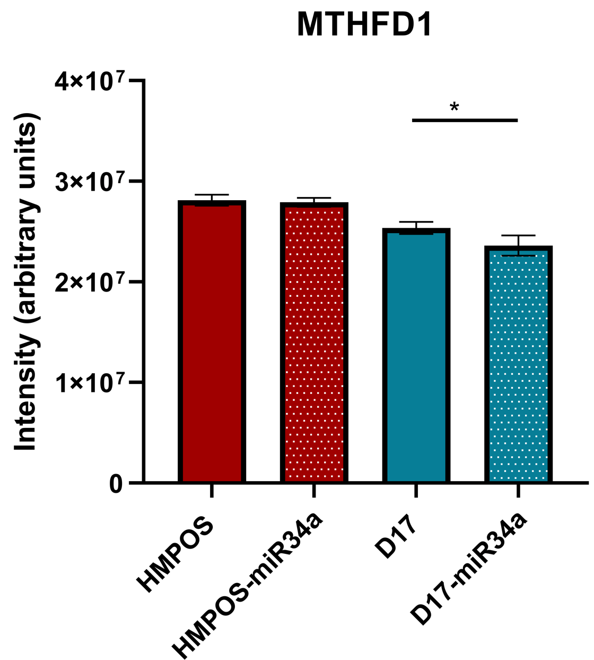
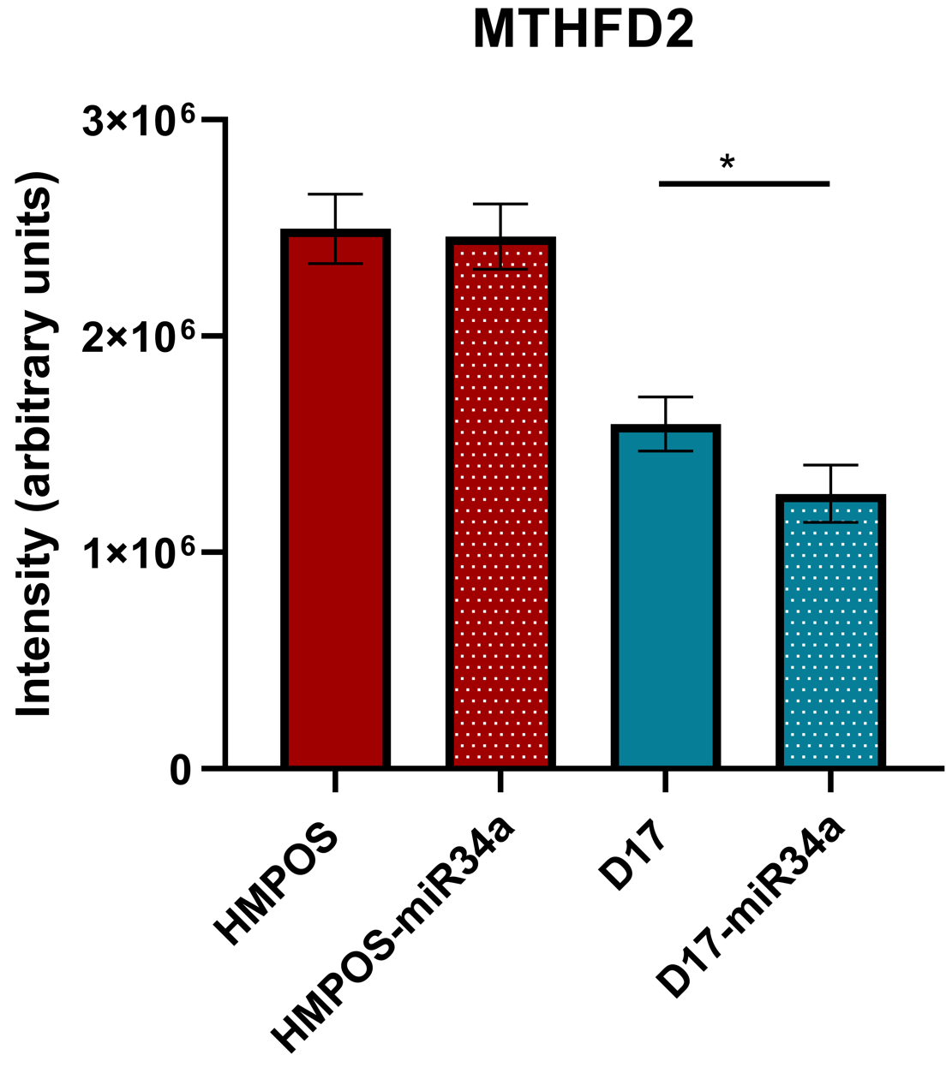
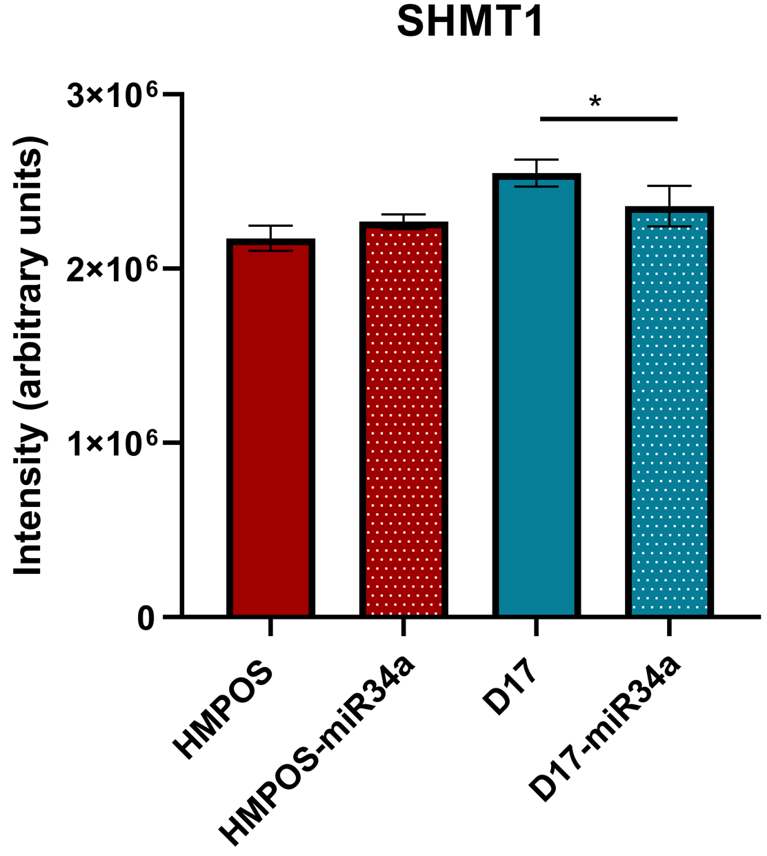
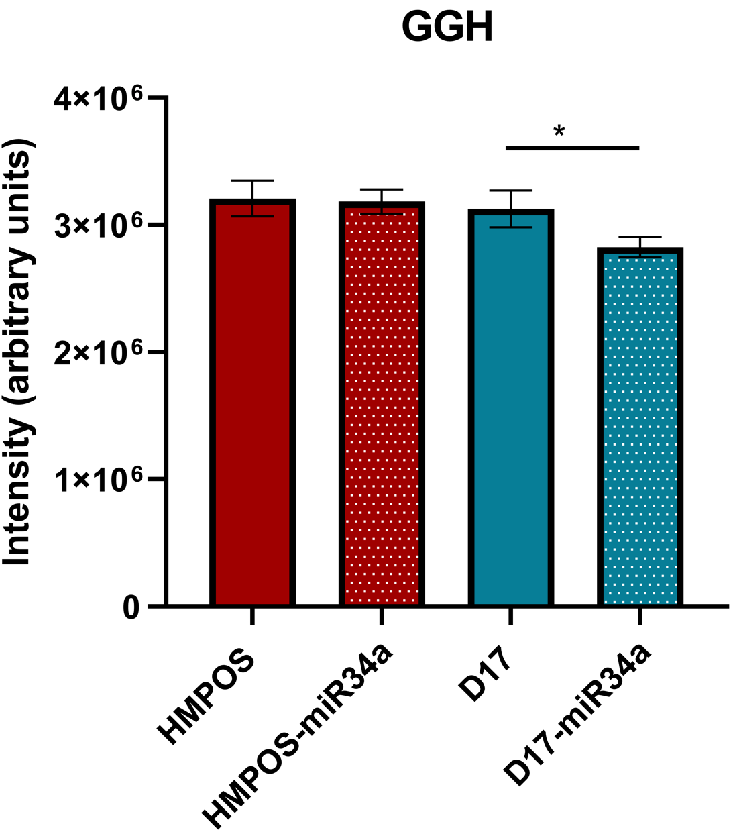
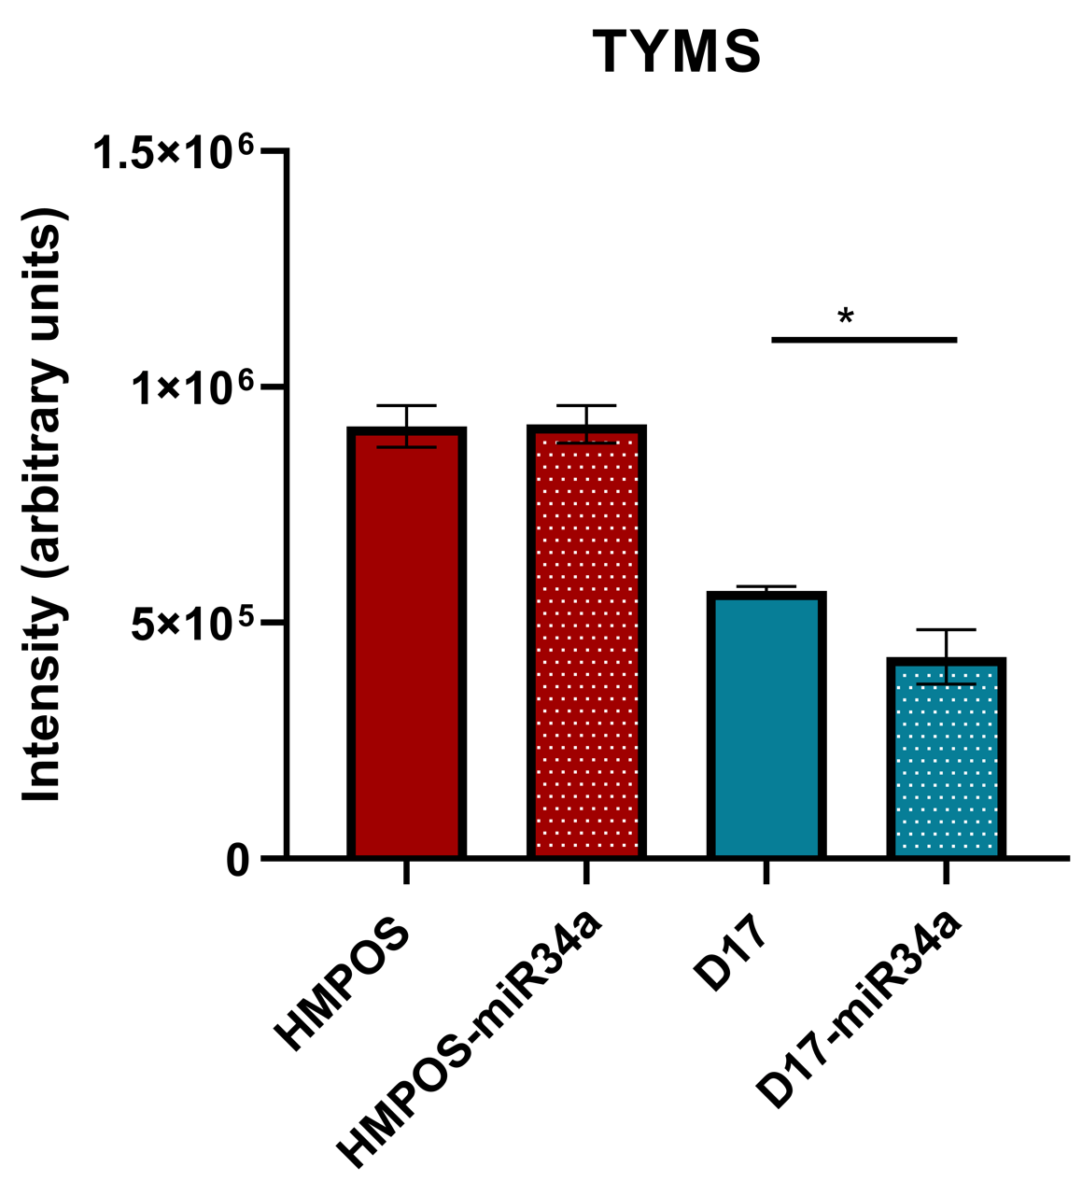
Proteomics: Large-scale protein analysis via Mass Spec
Decreased expression of folic acid pathway proteins in canine OS cells treated with miR-34a
Proteins downregulated by miR-34a: MTHFD1, MTHFD2, SHMT1, GGH, TS
Folic acid pathway → purine nucleotide synthesis, an important pathway for cell survival
Anti-folates (drugs that target the folate pathway) are a commonly used class of chemotherapy
Notes:
Mutant p53 cell type red p53
Wild type
Same in humans but not the knock out p53 in canine
Same 2 canine cell lines, human cell lines p53 wt and p53KO to give similar situation to canine and human

Slide 5
Aims
Aim 1: Validate the functional role of miR-34a in modulating the folate pathway
Hypothesis: Treatment of canine and human OSA cells with miR-34a will decrease expression of folate metabolism mediators GGH, MTHFD1, MTHFD2, SHMT1, and TS.
Aim 2: Elucidate the anti-tumor effect of miR-34a with methotrexate
Hypothesis: Methotrexate combined with miR-34a will result in greater anti-tumor effects in canine and human OSA cells compared to either treatment alone.

Slide 6


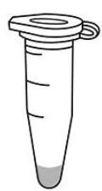
Aim 1: Does miR-34a function as an anti-folate in human and canine OS cells?
OS cells transfected with miR-34a (JetPrime protocol)
Canine OS cell lines: HMPOS, D17
Human OS cell lines: U2OS wt, U2OS p53KO
Cells harvested and protein isolated
Western blot analysis of folic acid pathway proteins
48 hrs

Slide 7
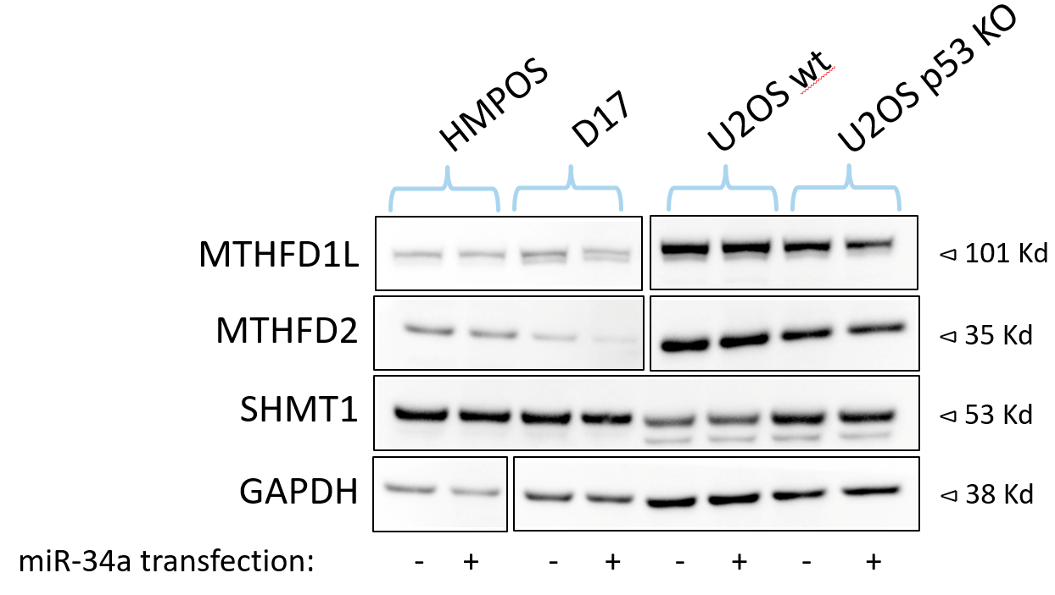
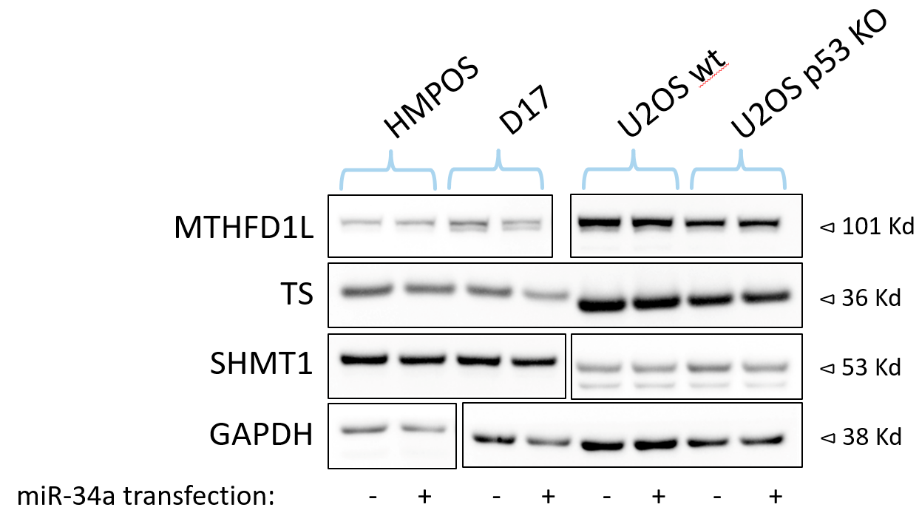
Aim 1: Western Blot Results
Densitometry analysis revealed no statistically significant difference between control cells and miR transfected cells – why?
miR inefficient at entering and transfecting cells (investigated further in qPCR)
Western blot is less sensitive to small changes in protein expression than mass spec
Notes:
Slight decrease not drastic
D17 is the cell line we saw decrease
5 nm may need higher concentration to show those differences, but the proteokics was at 5nM
Qpcr do you erally see the mature miRNA
Slightly different from proteomics
- Used miR carried by bacterial tRNA, this one was fully humanized miRNA (mature sequence is that same, how it is configured to help RNAses from breaking it down)
Hoping to see wb same thin
We do still think true byt wb

Slide 8
Aim 1: Western Blot Results
Densitometry analysis revealed no statistically significant difference between control cells and miR transfected cells – why?
miR inefficient at entering and transfecting cells (investigated further in qPCR)
Western blot is less sensitive to small changes in protein expression than mass spec

Slide 9
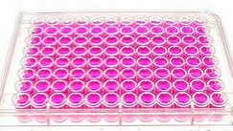
Aim 2: Will there be a greater anti-tumor effect in OS cells if treated with miR-34a and a routinely used anti-folate MTX?
OS cells transfected/treated with increasing concentrations of miR-34a (JetPrime protocol) or MTX
miR (nM): 0 , 1, 2, 10, 20, 30 nM
MTX (uM): 0, 1.4, 4.1, 12.3, 37, 111, 333 uM
Resazurin-based fluorometric assay (Proliferation assay)
Measures metabolic activity to quantify number of live cells
48 hrs

Slide 10
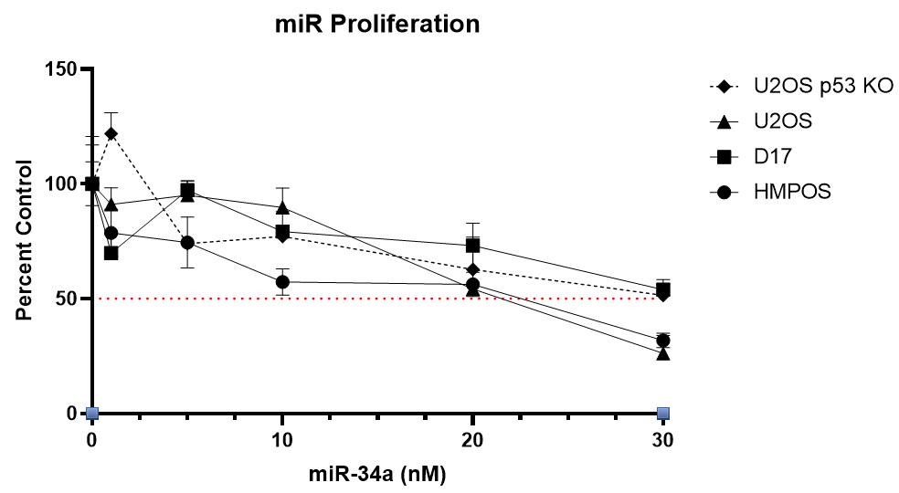
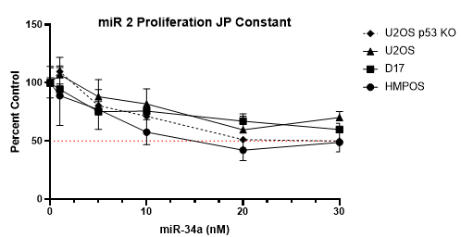
Aim 2: miR-34a Proliferation Assays
OS cells treated with a higher concentration of miR-34a have lower cell viability
This anti-tumor effect can be attributed to the increasing concentration of miR-34a and not the increasing volume of JetPrime reagent
Notes:
As I add more of the miR, supposed to be adding more of the jet prime to help get in
Make sure the increase in miR is whats causing the decreased cell viability

Slide 11
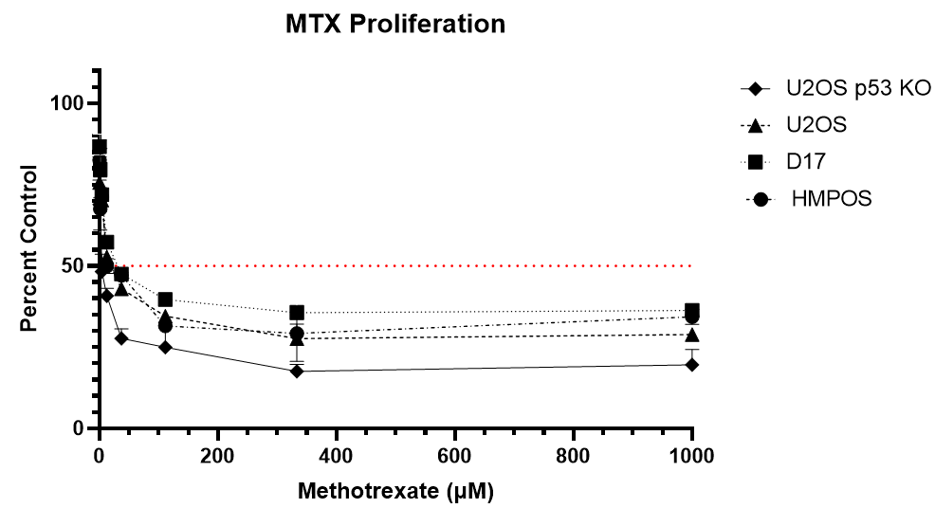
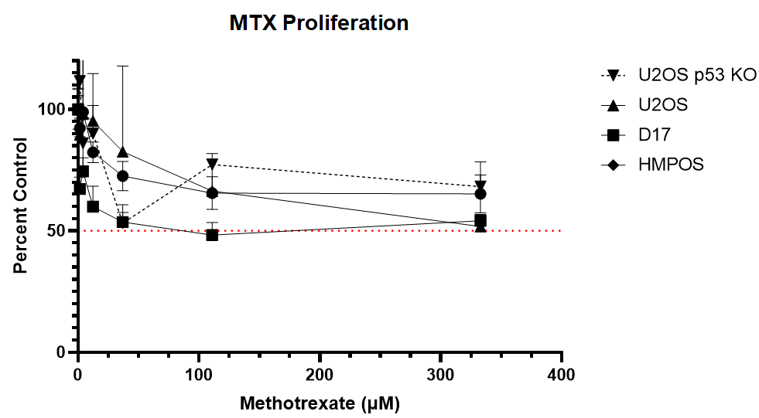
Aim 2: MTX Proliferation Assays
OS cells treated with a higher concentration of MTX have lower cell viability
MTX very effective in decreasing OS cell viability
Second run of proliferation plate demonstrated a higher IC50 than the first – need to repeat experiment
Notes:
Low ic50 - effective
Concentrations we picked were concentration used in human patients – these are clinically achievable concentrations
Not the same ic 50 on the second run

Slide 12
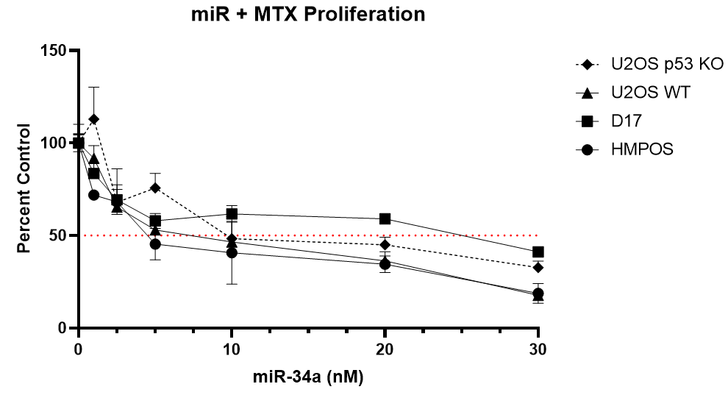
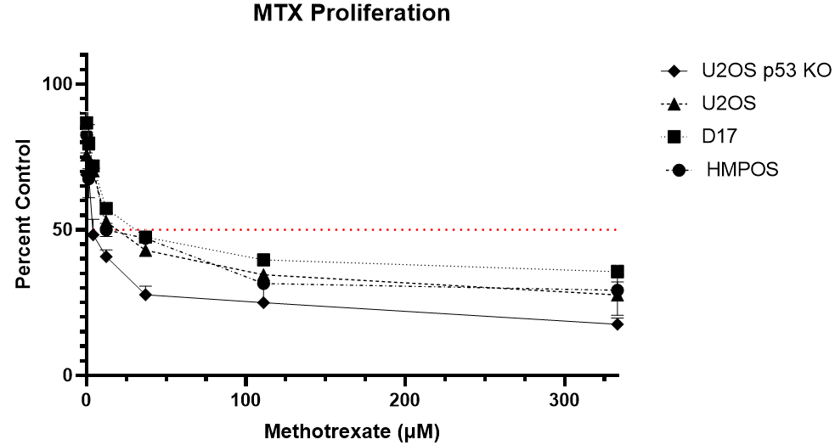
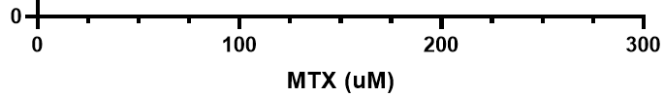
Aim 2: Proliferation Assays
Notes:
How it compares to the second MTX run that I did?
This was an individual run
Ran MTX again didn’t look quite as good and will need to repeat it again

Slide 13

Conclusions
Anti-folate action not quantifiable by western blot
Dose-dependent decrease in OS cell viability with miR and MTX treatment
miR + MTX treatment resulted in lower cell viability than miR treatment alone, but had a higher cell viability than MTX treatment alone
Future Directions
Real-time qRT-PCR of transfected cells to evaluate for levels of mature miR-34a.
CompuSyn analysis of single compound and combination treated cells to allow for statistical determination of synergistic, additive or antagonistic activity of combined miR-34a and MTX.
Western blot analysis of OS cells transfected with increased concentrations of miR (10 nM, 20 nM) based on proliferation assay results.
Apoptosis assays (fluorometric activated caspace 3/7 assay) with miR, MTX, and both drugs combined.

Slide 14
References
1. Simpson, S., Dunning, M. D., de Brot, S., Grau-Roma, L., Mongan, N. P., & Rutland, C. S. (2017). Comparative review of human and canine osteosarcoma: morphology, epidemiology, prognosis, treatment and genetics. Acta Veterinaria Scandinavica, 59(1), 71. https://doi.org/10.1186/s13028-017-0341-9
2. Wilk, S. S., & Zabielska-Koczywąs, K. A. (2021). Molecular Mechanisms of Canine Osteosarcoma Metastasis. International Journal of Molecular Sciences, 22(7). https://doi.org/10.3390/ijms22073639
3. Zhang, L., Liao, Y., & Tang, L. (2019). MicroRNA-34 family: a potential tumor suppressor and therapeutic candidate in cancer. Journal of Experimental & Clinical Cancer Research, 38(1), 53. https://doi.org/10.1186/s13046-019-1059-5
4. Alegre, F., Ormonde, A. R., Snider, K. M., Woolard, K., Yu, A.-M., & Wittenburg, L. A. (2018). A genetically engineered microRNA-34a prodrug demonstrates anti-tumor activity in a canine model of osteosarcoma. PLOS ONE, 13(12), e0209941. https://doi.org/10.1371/journal.pone.0209941
5. Shuvalov, O., Petukhov, A., Daks, A., Fedorova, O., Vasileva, E., & Barlev, N. A. (2017). One-carbon metabolism and nucleotide biosynthesis as attractive targets for anticancer therapy. Oncotarget, 8(14), 23955–23977. https://doi.org/10.18632/oncotarget.15053

Slide 15
Thank you!
Questions?
Financial support was provided by the UC Davis SVM Students Training in Advanced Research (STAR) Program and NIH grant: 5T35OD010956-22.
Puppy support and images were provided by my dog, Ellie (shown here)

