Slide 1
Heat Stress Intolerance in Wild Type & Malignant Hyperthermia Susceptible Mice
Ryan Gluck, DVM Candidate ’23
Dr. Isaac Pessah
Dr. Monica Aleman

Slide 2
Background - Malignant Hyperthermia (MH)
Inducible pharmacogenetic clinical syndrome
Heritable, rare disease affecting skeletal muscle metabolism
Clinical signs associated with hypermetabolic state:
Muscle rigidity
Elevated core body temperature
Tachypnea & tachycardia
Respiratory and metabolic acidosis
Volatile anesthetics & depolarizing muscle relaxants
Also, exertional and environmental stress

Slide 3
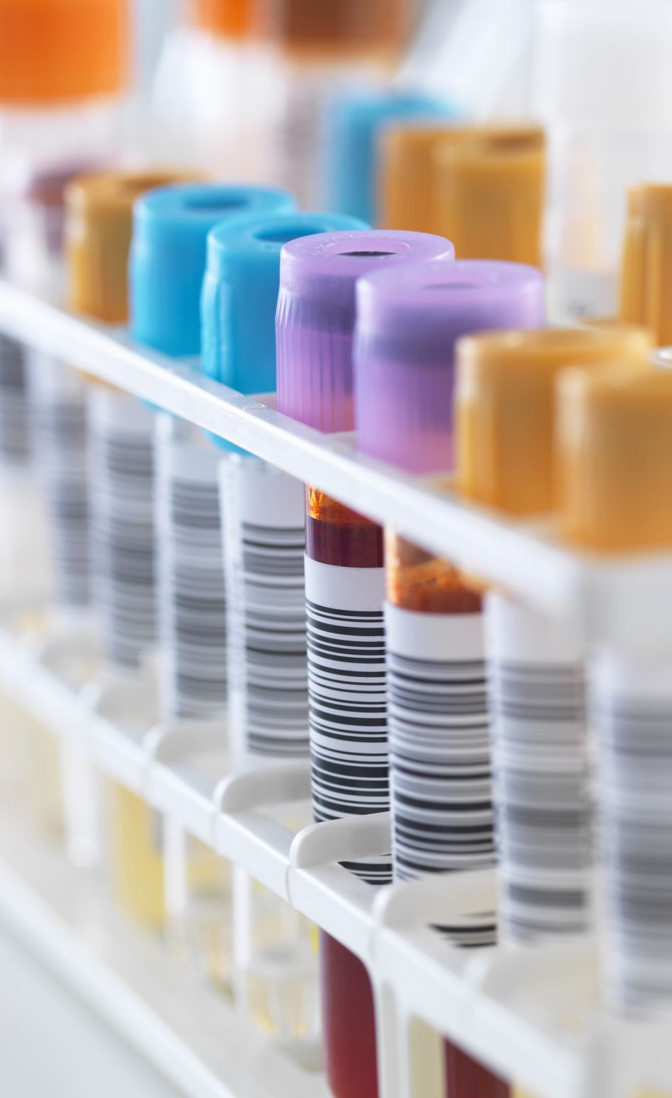
Background Cont. – MH Susceptibility
Ryanodine receptor type I (RYR1)
Triggering muscle contractions – mediating Ca²⁺ release
Many causative mutations in gene encoding RYR1
RYR1 channels open more easily, close more slowly
Massive release of intracellular Ca²⁺ ions → hypermetabolic state
Evaluation includes in vitro contracture testing of muscle biopsies with halothane and caffeine
Caffeine sensitizes response to anesthesia
Notes:
∆Channel: In response to appropriate stimuli (e.g., drugs, stress)
Caffeine aggravates adverse response to anesthesia

Slide 4
Rationale & Approach
Knock-in mouse model with RYR1 mutation, conferring genetic intolerance to stress-triggered MH
Heterozygous MH susceptible mouse line “R136C-RYR1” (HET)
Differential responses to a moderate heat stress protocol
HET & wild type (WT)
Male and female
With and without dietary caffeine (CAF)
Continuous electrophysiological measurements of brain, heart, respiration, and core temperature
Blood, muscle, and brain tissue samples collected
Notes:
Halothane and heat stress intolerance
Prevalent inherited pathogenic gene variant in humans (R136C)

Slide 5
Hypotheses
HET mice will be more sensitive to heat stress intolerance than WT
Male > Female
Dietary caffeine will aggravate adverse responses to heat stress

Slide 6
Methods
Treatment Groups: ≥6 mice each (8 subgroups in total)
HET/WT & Male/Female & CAF/Sucrose (e.g.. M HET CAF)
Mice delivered to lab; habituate for 60 min
Placed in restraint & instrumented with rectal thermometer probe
Rest for 5 min (baseline)
Enter thermostatic chamber set at 38 ºC (100.4 ºF)
Recordings continue until adverse outcome or 60 min, whichever first
Direct cardiac puncture for blood collection
Dissection of skeletal muscle and brain tissues for histology

Slide 7
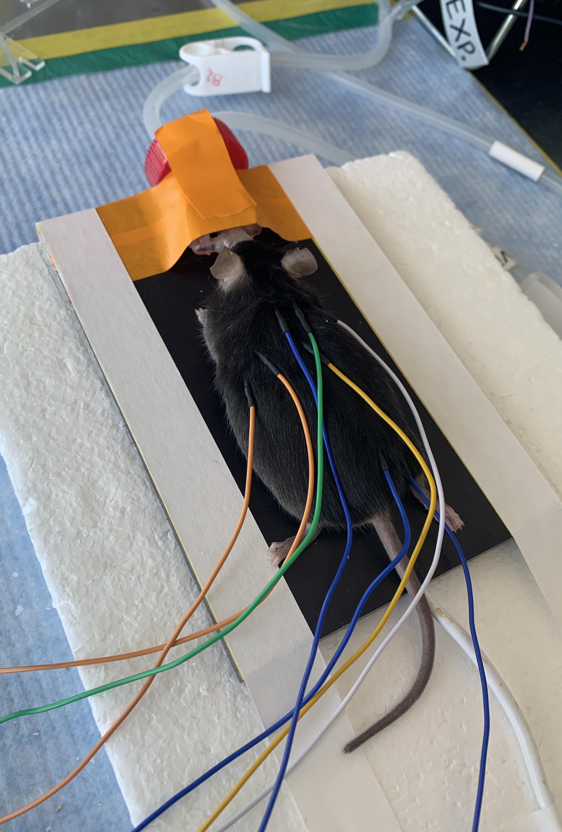
Methods – Electrographic Study
Anesthetic induction in chamber (~3 min)
Transfer to nosecone and temperature-controlled plate
Electrographic electrodes [8] (~5 min)
Electroencephalogram (EEG)
Electrocardiogram (ECG)
Electromyogram (EMG)
Rectal thermometer probe
Allow to habituate in restraint & recover from light anesthesia (10 min)
Incubator temperature settings (39, 37, 35 ºC)
Notes:
2% Halothane
32 ºC to prevent fulminant MH in HET
Powered off to reduce electrical interference

Slide 8
Results
HET mice are exquisitely sensitive to heat stress intolerance
Median survival = 36.7 min
All WT mice survived 60 minutes of heat stress exposure at 38 ºC

Slide 9
Results Cont. – Survival
HET median survival time:
Male (34.5 min) & Female (37.7 min)
CAF (37.7 min) & Sucrose (35.7 min)
No statistically significant difference in survival between:
Male and Female HET mice
p = 0.14
CAF and Sucrose HET mice
p = 0.51

Slide 10
Results -Temperature
HET > WT
∆Temperature (T_{f} -T_{i}):
HET (7.2 ºC) & WT (5.3 ºC)
P < 0.001
Temperature_{final}
HET (42.7 ºC) & WT (41.0 ºC)
P < 0.001

Slide 11
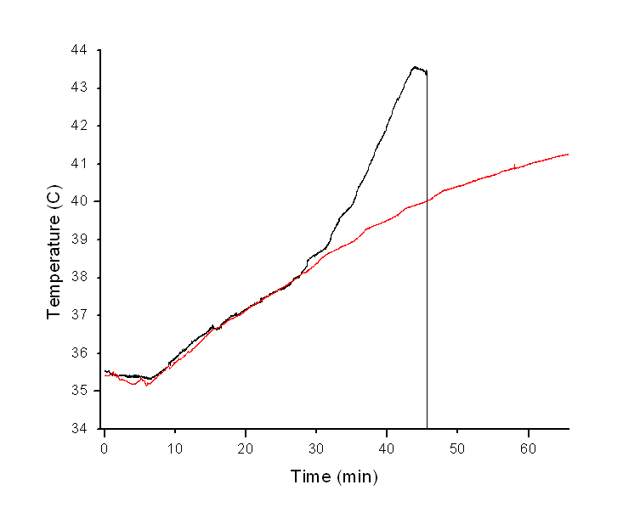
Results Cont.
WT mice
Monotonic rise in core body temperature (0.124 ºC/min)
HET mice
Biphasic rise in core body temperature
Steep second phase (0.366 ºC/min)
Not seen in WT animals

Slide 12
Significance
MH susceptible mice (HET) are highly sensitive to heat stress
Dietary caffeine does not appear to influence heat stress intolerance
Individuals with RYR1 mutations likely represent an underappreciated population with a genetic predisposition to heat stress intolerance
Further investigation into dysregulation of thermoregulation is extremely relevant to climate change

Slide 13
Ongoing Analysis
Blood - Clinical Chemistry
Electrolytes, metabolic analytes, creatine kinase, stress response biomarkers
Brain – Histology
Muscle – Histology
Electrophysiological Data Analysis – central contribution
Electroencephalogram (EEG)
Electrocardiogram (ECG)
Heart rate and respiratory rate
Electromyogram (EMG)

Slide 15
Muscle Staining
Hematoxylin and Eosin (H&E)
Periodic acid-Schiff (PAS)
Succinic Dehydrogenase (SDH)
Esterase
ATPase
Gomori’s modified trichrome

Slide 16
Acknowledgments
Dr. Isaac Pessah
Dr. Monica Aleman
Shane Antrobus
Gennady Cherednychenko
UC Davis
National Institutes of Health (NIH) T-35
National Science Foundation (NSF)
Financial support was provided by the Students Training in Advanced Research (STAR) Program

