Slide 1
Prevalence of the RAPGEF5 c.2624C>A Variant Associated with Equine Familial Isolated Hypoparathyroidism (EFIH) in the Thoroughbred Population
Megan Elcombe

Slide 2
Equine Familial Isolated Hypoparathyroidism
Thoroughbred foals
First documented by Beyer et al (1997)
Originally termed “idiopathic hypocalcemia”
4 to 35 days old
Severe hypocalcemia
Hyperphosphatemia
Seizure activity
Tetany, muscle rigidity
Death from severe hypocalcemia or euthanasia
Genetic basis?
Video courtesy of Dr. Daniela Leuthy
Notes:
Font big

Slide 3
Equine Familial Isolated Hypoparathyroidism
Genetic basis identified in 2019 at UC Davis
RAPGEF5 (c.2624C>A p.Ser875) nonsense variant
Results in loss of function, direct mechanism unknown
Highly expressed in parathyroid tissue
Role in early embryonic development
Autosomal recessive mode of inheritance
Allele frequency previously estimated at 1.8%
82 Thoroughbreds
Non-random sample population
Notes:
Font bigger
Reference
Expand upon with random sample population
Picture of publication

Slide 4
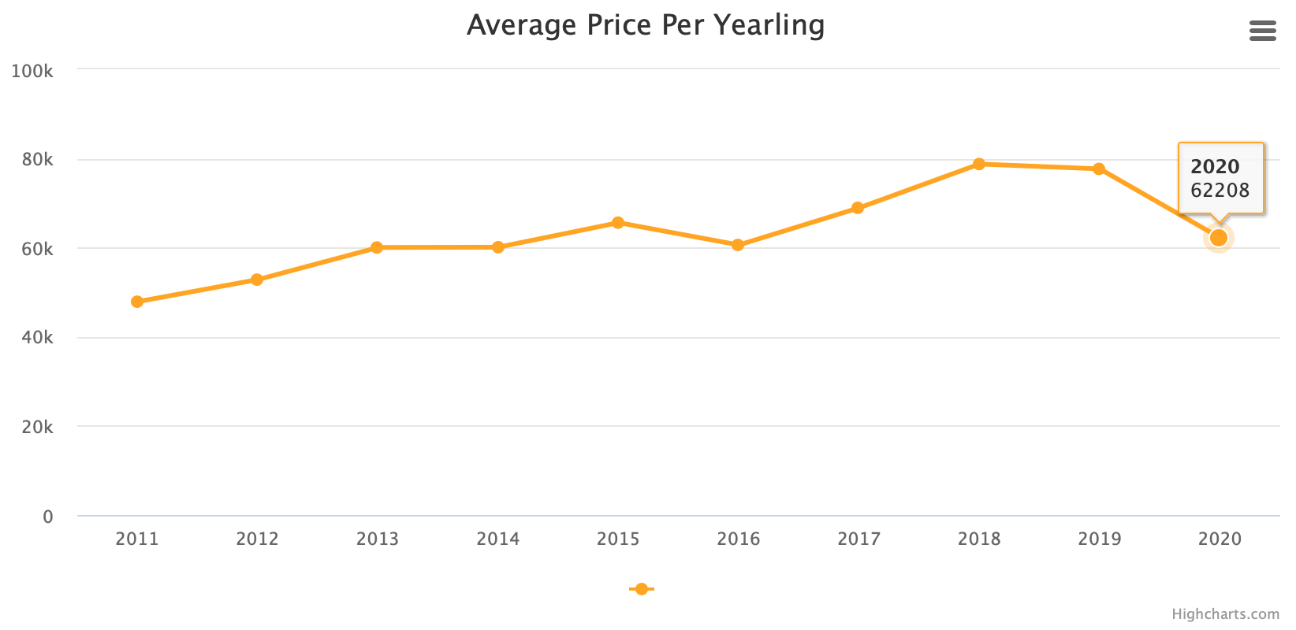
Economic Impact
$
The Jockey Club (2021). 2021 Fact Book. http://www.jockeyclub.com/default.asp?section=FB&area=14

Slide 5
Hypothesis
The RAPGEF5 c.2624C>A genetic variant has a low allele frequency in the United States Thoroughbred population and dates back to the first archived DNA sample.

Slide 6
Specific Aims
Determine the allele frequency of the RAPGEF5 variant in a large random cohort of Thoroughbred horses
Across the 7 geographical regions of the US
Between 1988-2000 and 2001-2019
Determine if this is a recent variant in the Thoroughbred population and if this variant is undergoing positive selection by comparing the allele frequency of these two time points
Notes:
DNA samples banked at the VGL for registration purposes. Jockey club granted permission to utlize samples for this purpose.

Slide 7
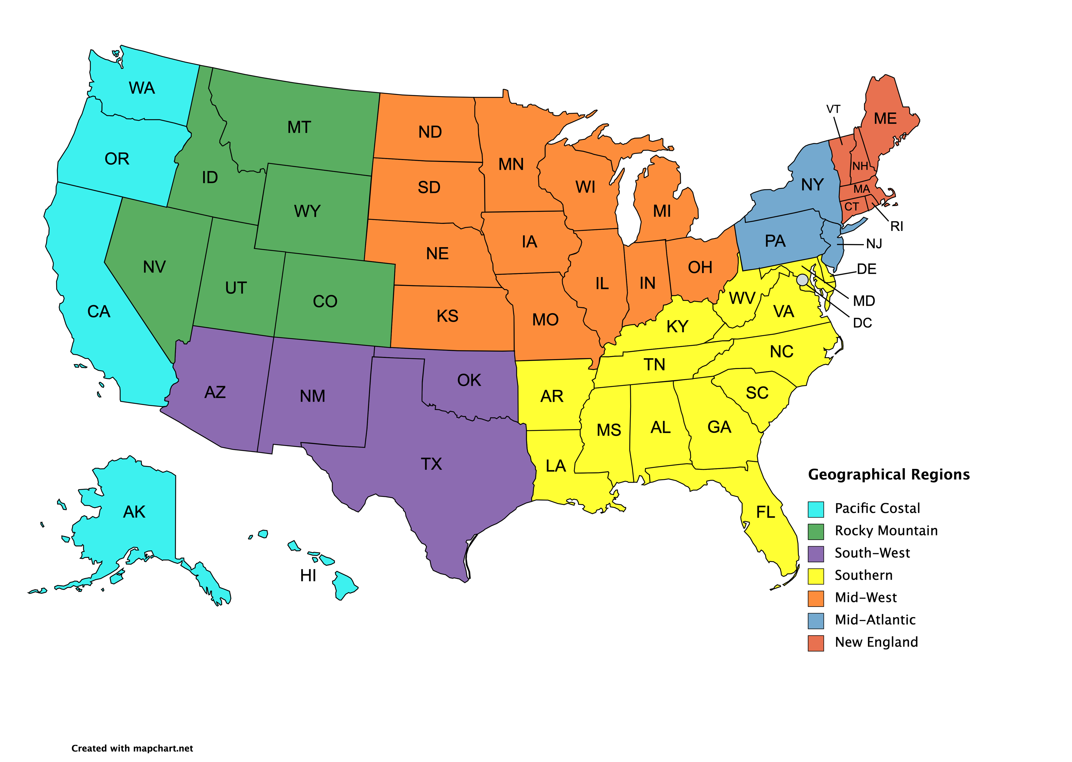
Methods
Randomly generated large cohort
7 geographical regions of the United States
4 males
4 females
56 samples per year
Genotyping of samples through mass array
1988-2000 (n=728)
2001-2019 (n=1064)
Hair or purified serum samples
3 positive controls and 1 negative control

Slide 8
Methods
Mass array
PCR amplification → further amplification with extension primer
Extension product classified based on molecular weight difference of base
Genotyped
Homozygous unaffected (N/N)
Heterozygous carrier (N/H)
Homozygous affected (H/H)

Slide 9
Analysis
Allele frequencies
# of variant alleles (H) ÷ total alleles in sample population (2n)
Carrier frequencies
# of carriers (NH) ÷ sample population (n)
95% Confidence Intervals
Fischer’s exact test for allele frequencies
Significance at P<0.05
 | N | H
N | NN | NH
H | NH | HH

Slide 10
Results

Slide 11
Results
1988-2000 (n=728)
Allele frequency = 0.82% (95% CI, 0.46% to 1.47%)
Carrier frequency = 1.65% (95% CI, 0.92% to 2.90%)
2001-2019 (n=1064)
Allele frequency = 0.75% (95% CI, 0.46% to 1.25%)
Carrier frequency = 1.50% (95% CI, 0.92% to 2.47%)
P=0.84

Slide 12
Results
No significant differences

Slide 13
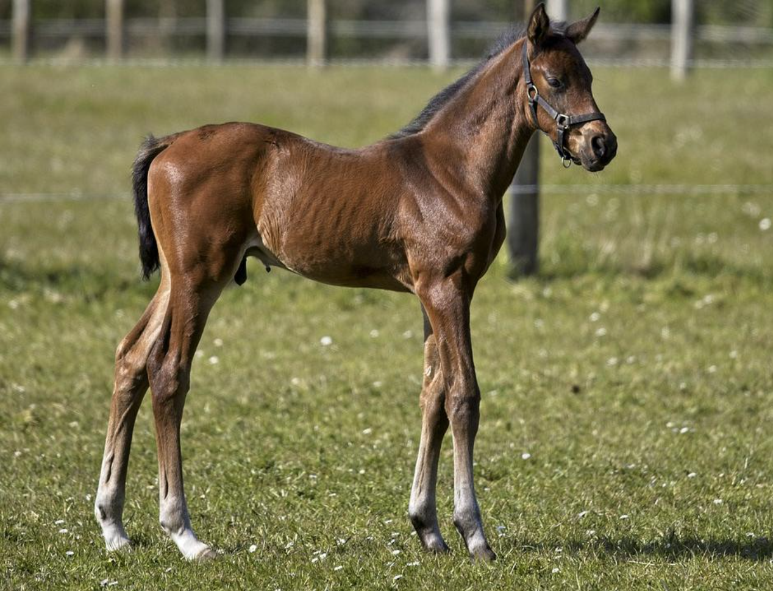
Discussion
Present at low frequency
Allele frequency of 0.75% - estimates 300 out of 20,000 foals as carriers
First sample detected was 1992
No EFIH homozygotes detected
Recommend genetic testing within breed
Monitor trend of variant frequency
Avoid mating of carriers

Slide 14
Acknowledgements
Dr. Carrie Finno
Dr. Rebecca Bellone
Dr. Gary Magdesian
Finno Laboratory
Bellone Laboratory
Veterinary Genetics Lab
Financial support was provided through an NIH T35 Training Grant

Slide 15
Questions

