Slide 1
PPAR induction of Angiopoietin-like 4 in osteoblasts and its interaction with hypoxia
Emily Shelton

Slide 2
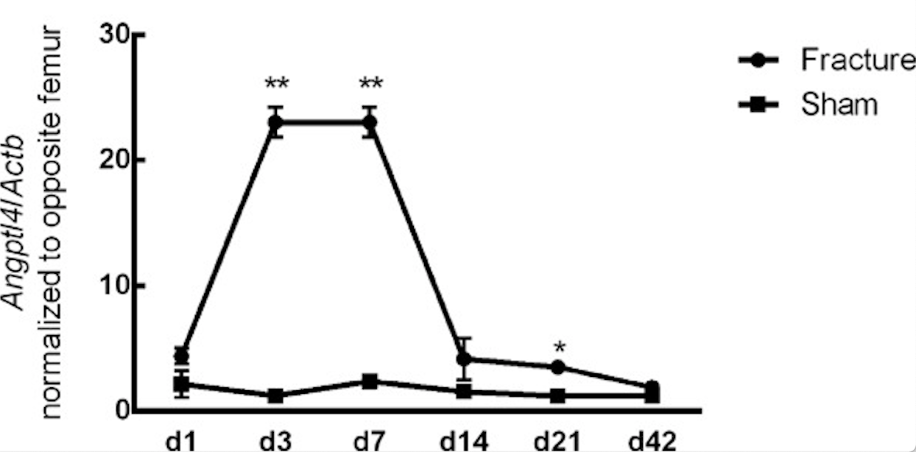
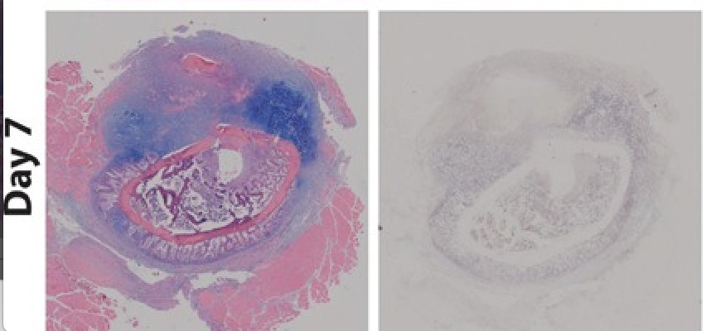
Introduction
Fracture repair; anabolic bone formation
Main Goal/Rational:
Background:
Angptl4 is upregulated during fracture healing
H&E
Angptl4 mRNA
Figures 1&2: Wilson et al., JOR, 2015.
Notes:
So, as a general overview the main purpose of my study is to find genes that we can manipulate to increase fracture repair and promote anabolic bone formation. We have decided to focus on a specific protein called angiopoietin-like 4, which is an adipocytokine involved in energy homeostasis and angiogenesis, because we know it is increased during fracture healing. We also know that the beta delta subtype of the peroxisome proliferator-activated receptor family, otherwise known as PPAR, is increased in the fracture environment and increases Anptl4. And lastly, we know that the fracture callus creates a hypoxic environment due to disruption of blood vessels and that hypoxia increases Angptl4.
We know Angptl4 is upregulated because previous studies used in situ hybridization and quantitative PCR to show increased mRNA expression day 3, returning to baseline day 14
- histological slides used to actually visualize
- increased in callus cartilage, areas of new bone formation, condensing mesenchymal cells, especially high in mineralizing osteoblasts in areas of new bone formation

Slide 3
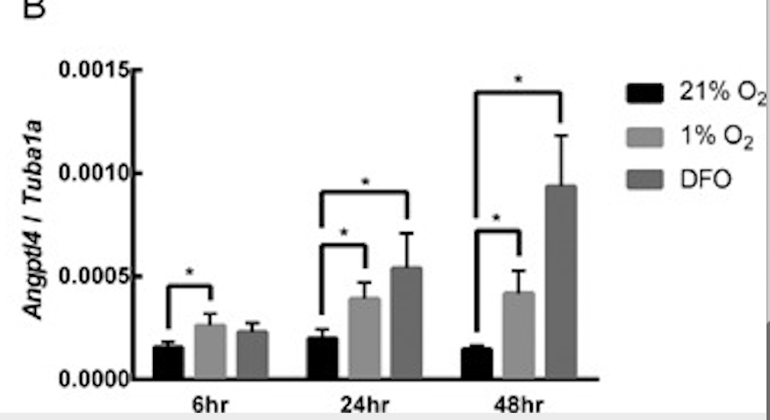
Background (continued)
Angptl4 expression is regulated by hypoxia
Angptl4 is also upregulated by PPARβ/δ agonist
Subtype most highly expressed in osteoblasts
Figure 3: Wilson et al., JOR, 2015.
Figure 4: Yellowley lab, unpublished data.

Slide 4
Hypothesis:
PPARβ/δ agonism and hypoxia synergistically enhance Angptl4 expression in osteoblasts
Background:
Angptl4
Hypothesis for mRNA expression:
 | 1% | 21%
control
PPARβ/δ
O₂
PPARβ/δ
Notes:
So, putting this all together, we know that the protein angiopoietin-like 4 is upregulated during fracture healing. Now, a lot of things happen in the fracture callus, including decreased oxygen due to disruption of blood vessels and increased PPARb/d, which is a transcription factor w/ major roles in energy homeostasis and metabolism. Interestingly, both decreased oxygen and increased PPAR have been shown to increase Angplt4. The literature also suggests that the hypoxia response elements and PPAR response elements lie in close proximity to each other and that the two might talk to each other to amplify downstream signaling
Therefore, my hypothesis is that MC3T3-E1 cells exposed to the PPARβ/δ agonist in the presence of hypoxia will show enhanced expression of Angptl4 when compared to cells exposed to the agonist or hypoxia alone

Slide 5
Methods
Cell Culture:
Murine pre-osteoblast cells (MC3T3-E1)
Cell treatment:
PPARβ/δ agonist GW0742 normoxic (21% O2) incubator
PPARβ/δ agonist GW0742 hypoxic incubator (1% O2 using N2 supplementation)
In some experiments, desferrioxamine was used as a hypoxic mimetic
qPCR performed 24 hours post exposure
Quantitative PCR:
qRT-PCR was performed to amplify Angptl4, Vegf, and Rpl32 with Quantifast Probe PCR Kit (Qiagen)
Results were normalized to Rpl32 to generate ΔC_{T}
Notes:
To carry out this experiment, we are using cell culture and quantitative PCR. So, basically we grow the murine pre-osteoblasts in media, plate the cells by exposing a certain number of wells to the PPAR agonist and leave a certain number of wells without exposure. And then we place these wells in either a 21% O2 incubator representing normoxia or a 1% O2 incubator representing hypoxia.
After 24 hours, we begin the steps of quantitative PCR which begins with RNA isolation. Then we perform a reverse transcriptase reaction to yield cDNA, which is then used for PCR for which we are amplifying Angptl4, Vegf which is a control for hypoxia, and Rpl32 which is our housekeeping gene. Results are then normalized to the housekeeping gene to generate deltaC.

Slide 6
Data
Notes:
So, this is an n=1 but is representative of my data throughout the summer. On the left, we have our Angptl4 levels. On the x-axis is oxygen levels and the y axis represents gene expression of Angptl4. (Explain what the bars represent). The grey bars represent samples without the PPAR agonist and the black are those with the PPAR agonist. On the right, is the graph for Vegf which has a consistent response to hypoxia and therefore is the hypoxia control. So, the vegf graph shows that our hypoxia is working as proven by the higher levels of gene expression of Vegf under hypoxia and DFO which is a hypoxic mimetic that I will explain in more detail on a later slide.
Unfortunately, the 21% v 1% without the PPAR agonist angptl4 gene expression is not what we expect to see, in fact it is the opposite (see these 2 bars). Therefore, it is difficult to interpret our other data as this is a response that has been shown multiple times in different labs and different cell types. Because of this, I have put quite a bit of effort into troubleshooting.

Slide 7
Troubleshooting
Lower passage (mid-30s to early 20s)
Different hypoxic incubators
Use hypoxic mimetic, desferrioxamine (DFO)
Notes:
So, each week we have made a small change to see if it will make any difference with our results. We started by trying younger cells and even tried a new cell line in the last couple weeks. We have used different controls because we were using DMSO and thought maybe that could be interfering with the response. We compared 2 hypoxic incubators to make sure the incubator we were using wasn’t somehow miscalibrated. And because we weren’t seeing a consistent hypoxic response, we decided to also run PCR with cells that have been exposed to DFO, which acts as a hypoxic mimetic by chelating iron. Unfortunately, none of these things showed any significant differences.

Slide 8
Going Forward
New primers
Additional housekeeping gene
Western blot
Notes:
So, the last thing we are going to troubleshoot is the primers used for PCR. We are seeing angptl4 amplify about 4 cycles later than previous experiments, so we purchased a new angptl4 primer. Also, tubulin was used as a housekeeping gene in previous experiments, so we are going to try that in addition to Rpl32 to see if there is a difference. We also decided to run a Western blot to change things up a bit. Similar to the PCR, we expect to see increased protein in the hypoxia sample and PPAR agonist sample and a synergistic response in the hyppoxia and PPAR agonist sample.
So, hopefully we get some good results this week, but overall I have learned so much this summer. This was my first introduction to this type of research and although it didn’t’ go quite as planned, I gained some technical skills and was exposed to the other side of veterinary medicine, which I am very thankful for. I also want to thank Dr. Yellowley and Dr. Alice Wong for creating a fun and supportive atmosphere in the lab.

Slide 9
Acknowledgements
Financial support was provided by the STAR NIH T35 Trainee Grant

