Slide 1
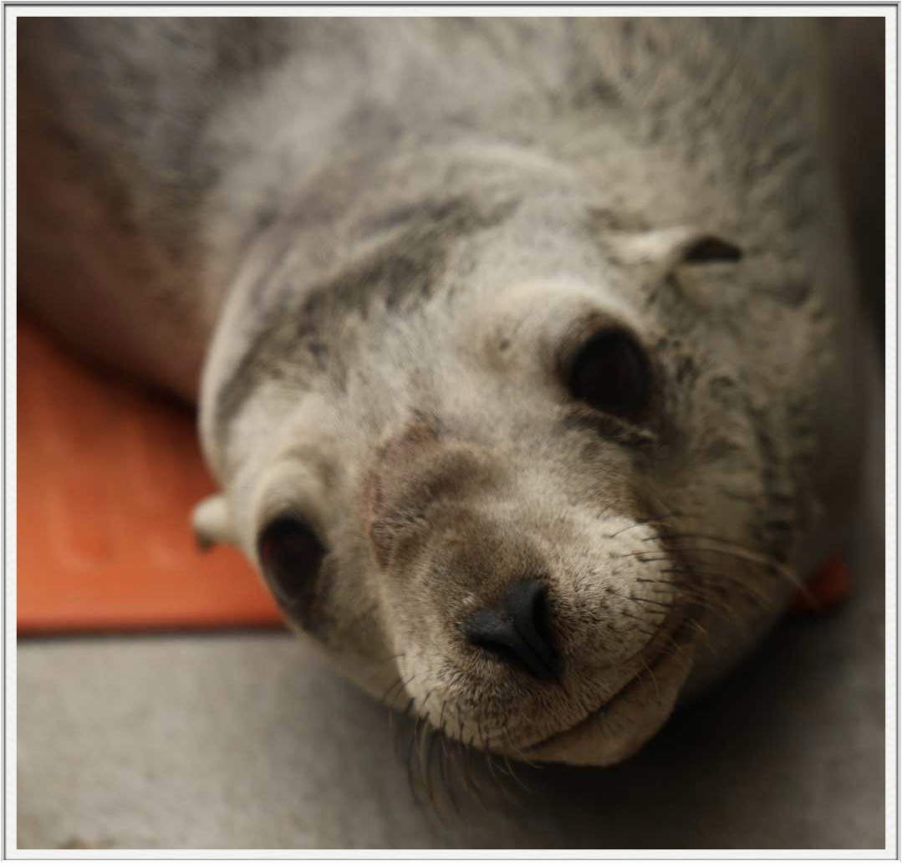

In-vitro virulence and genetic diversity of hypermucoviscous K2 serotype Klebsiella pneumoniae isolates from California sea lions (Zalophus californianus)
Madeleine Thompson¹, Zeinab Yazdi¹, Kim Li Jacobsen¹, Taylor Heckman¹, Carlos Rios², Pádraig Duignan², and Esteban Soto¹
¹Aquatic Animal Health Laboratory, Department of Medicine and Epidemiology, School of Veterinary Medicine, University of California, Davis, CA
²The Marine Mammal Center
“Akee” - Photo by Bill Hunnewell © TMMC

Slide 2




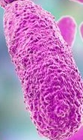

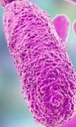
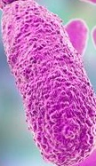







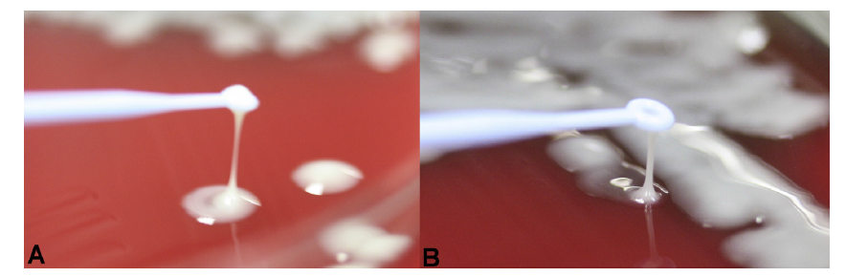

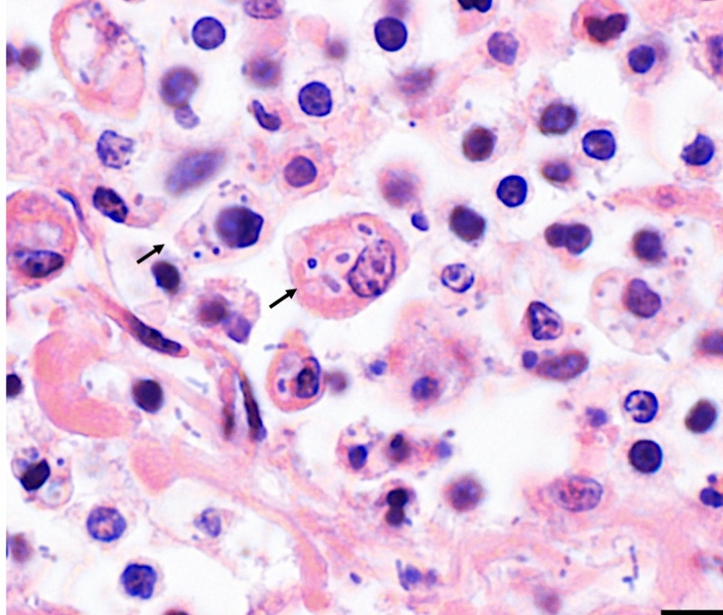
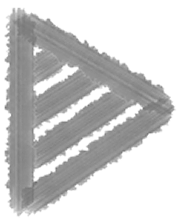
Klebsiella pneumoniae
Enterobacteriaceae bacillus
Genetically diverse
Encapsulated
Broad host range
Cox et al., 2015; Soto et al., 2012; 2016
Non-motile
Hypervirulent strains
Gram-negative
Hypermucoviscous strains
Aerobic
Diverse capsular serotypes
Janda and Abbott, 2006
Southern sea otter
Photo courtesy of Dr. Melissa Miller

Slide 3

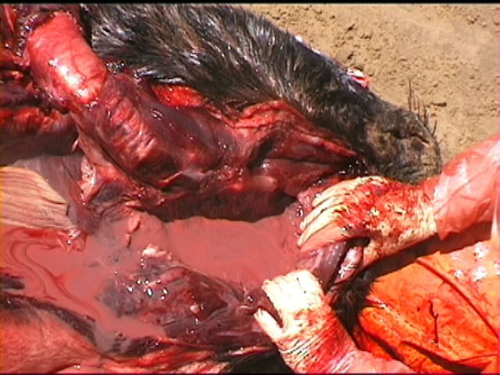
Klebsiella pneumoniae
Emerging pathogen: next superbug?
Perilaryngeal abscess
Causes widespread infection, including pleuritis, suppurative pneumoniae, and abscesses, contributing to disease and stranding
Jang et al. 2010
Sudden unexplained increase in incidence in California sea lions (CSLs) within the last decade, from 0.92% in 2017 to 7.2% in 2022
Photo courtesy of Dr. Pádraig Duignan
Johnson et al. 2023

Slide 4

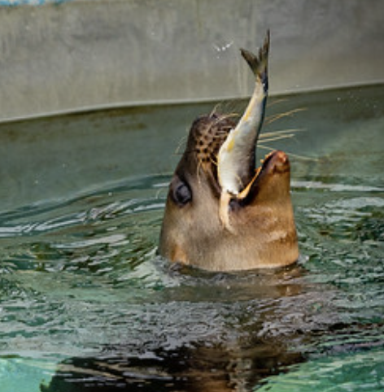
Project aims
Photo by Bill Hunnewell © TMMC
AIM 1
Characterize genetic profiles of hypermucoviscous (HMV) K2 capsular serotype K. pneumoniae isolates recovered from diseased California sea lions (CSLs)
AIM 2
Investigate the virulence of representative HMV K2 K. pneumoniae genotypes through in-vitro challenge models
HYPOTHESIS
HMV K2 K. pneumoniae isolates from CSLs are genetically diverse
HYPOTHESIS
HMV K2 K. pneumoniae isolates from CSLs are significantly more cytotoxic than non-HMV strains

Slide 5

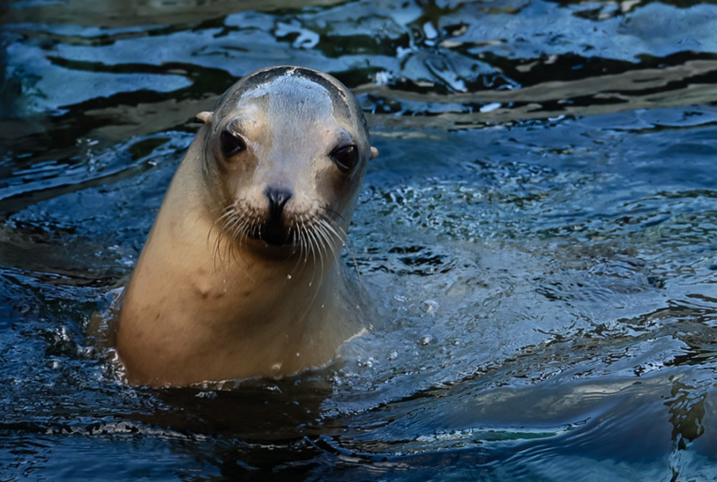






Project Flow
Photo by Bill Hunnewell © TMMC
DNA extraction
Multiplex-PCR
Next genome sequencing (NGS)
Phylogenetic analysis
Colony morphology assessment
Antimicrobial resistance gene analysis
String test
Representative isolate selection
In-vitro: Vero cells
Virulence assays
In-vitro testing validation
In-vitro: J774A.1 macrophages
Notes:
gent + triton to eval/kill EC bact
triton: lyse cells to investigate IC survival
virulence assays prior to in vitro

Slide 6

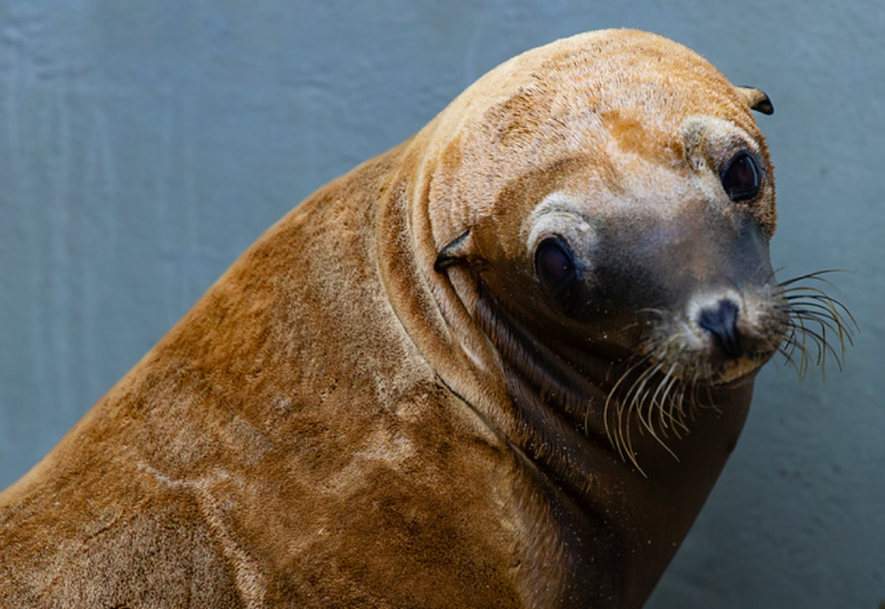
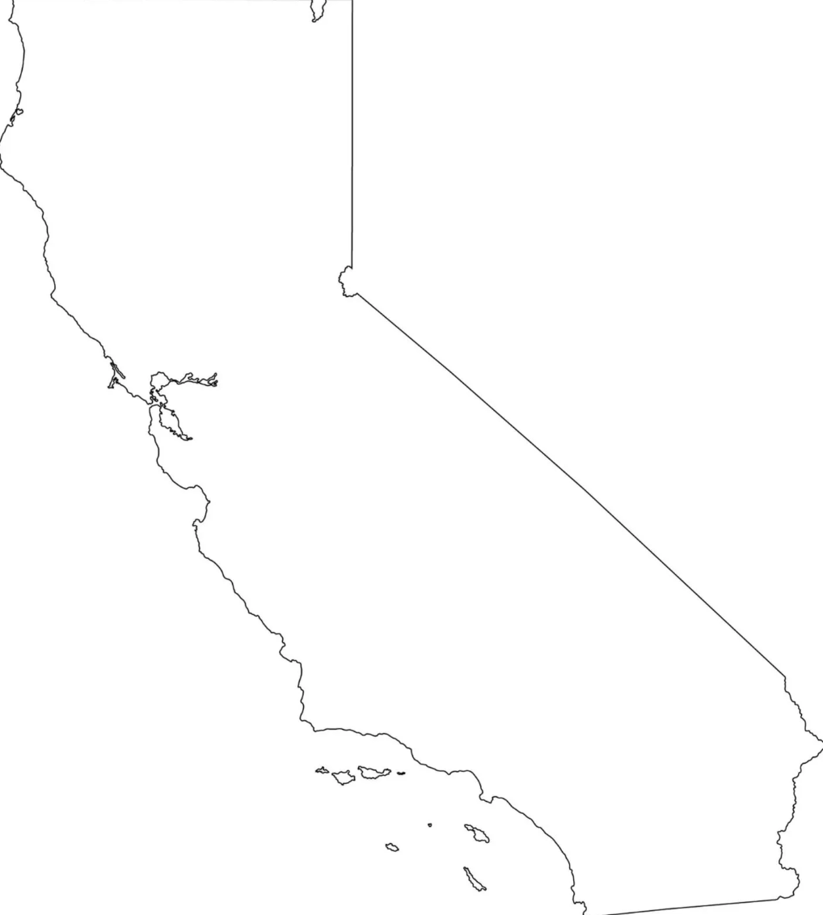
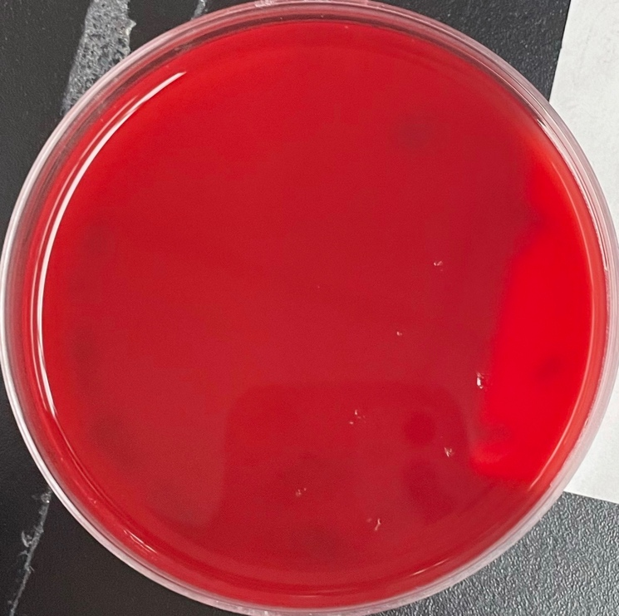
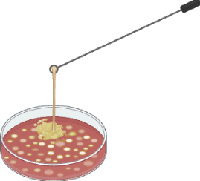
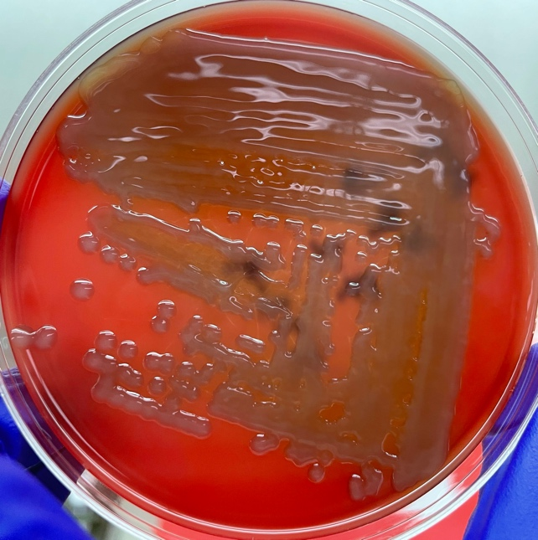
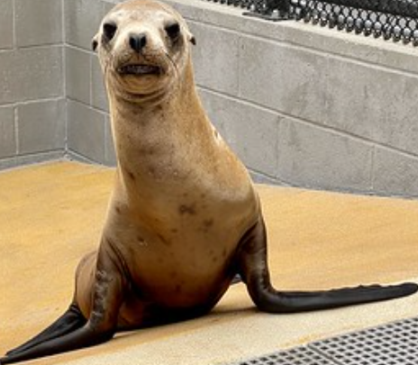












Bacterial isolates
Photo by Bill Hunnewell © TMMC
Collected K. pneumoniae isolates from 37 patients at The Marine Mammal Center (TMMC), Sausalito, CA during 2020-2023
Marin: 1
San Francisco: 1
Sonoma: 3
San Mateo: 1
Grew isolates on sheep blood agar and documented colony color/turbidity and size
Santa Cruz: 5
Monterey: 14
Performed string test on each isolate to assess for hypermucoviscosity
San Luis Obispo: 11
Notes:
map from TMMC

Slide 7

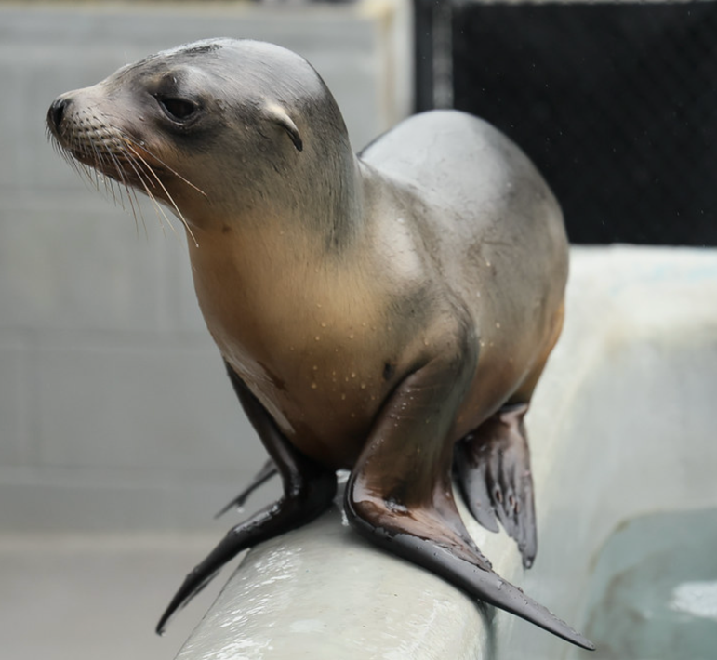







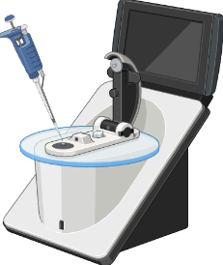
DNA Extraction
Grew colonies on blood agar then expanded in Brain Heart Infusion broth
Photo by Bill Hunnewell © TMMC
Centrifuged expanded bacterial suspension to collect a concentrated pellet
Isolated genomic DNA (gDNA) from pellet using DNeasy® Blood and Tissue kit (Qiagen)
Assessed quality and quantity of recovered gDNA using a Spectrophotometer
Notes:
Colonies from isolates grown on blood agar were used to inoculate 5ml aliquots of Brain Heart Infusion (BHI) broth and were incubated overnight at 37ºC with shaking
1ml aliquot of expanded bacterial suspension was centrifuged to collect a concentrated pellet
Genomic DNA was isolated from pellet using DNeasy® Blood and
Tissue kit (Qiagen) following manufacturer recommendations
with some modifications
Quality and quantity of recovered DNA was assessed using a NanoDrop™ One Microvolume UV-Vis Spectrophotometer (Thermo Scientific™)

Slide 8

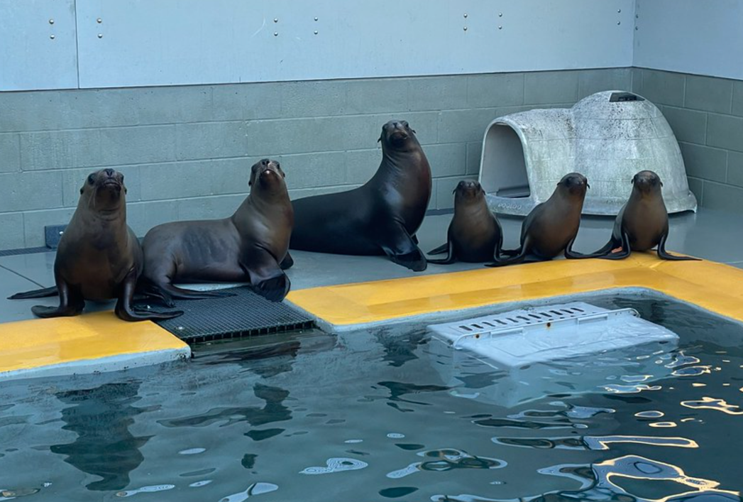


Multiplex-PCR
Photo by Bill Hunnewell © TMMC
Multiplex | Name | Size | Factor | Function | Advantage
 | kpnP | 130 bp | Kp rRNA spacer | Unique to K. pneumoniae
I | magA | 797 bp | Capsular serotype K1 | K1 capsular polysaccharides | HMV capsule
 | K2wzy | 641 bp | Capsular serotype K2 | K2 capsular polysaccharides | HMV capsule
 | K5wzx | 280 bp | Capsular serotype K5 | K5 capsular polysaccharides | HMV capsule
 | iroD | 556 bp | Salmochelin | Iron acquisition | Increases virulence
 | allS | 508 bp | Allantoin metabolism | Carbon and nitrogen source | Increases virulence
 | rmpA | 321 bp | RmpA/RmpA2 | Mucoid phenotype regulation | Increases virulence
II | iutA | 1115 bp | Aerobactin | Iron acquisition | Increases virulence
 | fyuA | 845 bp | Yersiniabactin | Iron acquisition | Increases virulence
 | cldB | 665 bp | Colibactin | Genotoxic molecule | Damages host cell DNA
 | mrkB | 514 bp | Type 3 fimbriae | Promotes biofilm formation | Increases survival
 | fimH | 369 bp | Type 1 fimbriae | Adhesion to host epithelial cells | Promotes pathogenicity
Chang et al. 2022
Notes:
Ictalize all genes

Slide 9





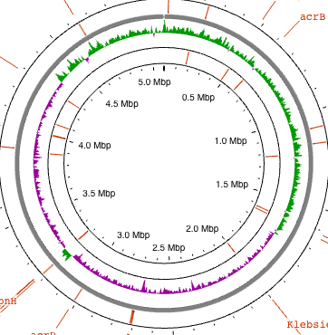
Phylogeny + Genome analysis
Photo by Bill Hunnewell © TMMC
Using multiplex-PCR results, selected 17 of 37 isolates to send to Plasmidsaurus for next generation sequencing (Nanopore long read sequencing)
Schwengers et al., 2021
Used whole genome sequences to generate phylogenetic trees via the Interactive Tree of Life (iTOL)
Identified antimicrobial resistance genes using the CARD Resistance Gene Identifier via Proksee
Letunic and Bork, 2021
Alcock et al., 2023; Grant et al., 2023

Slide 10

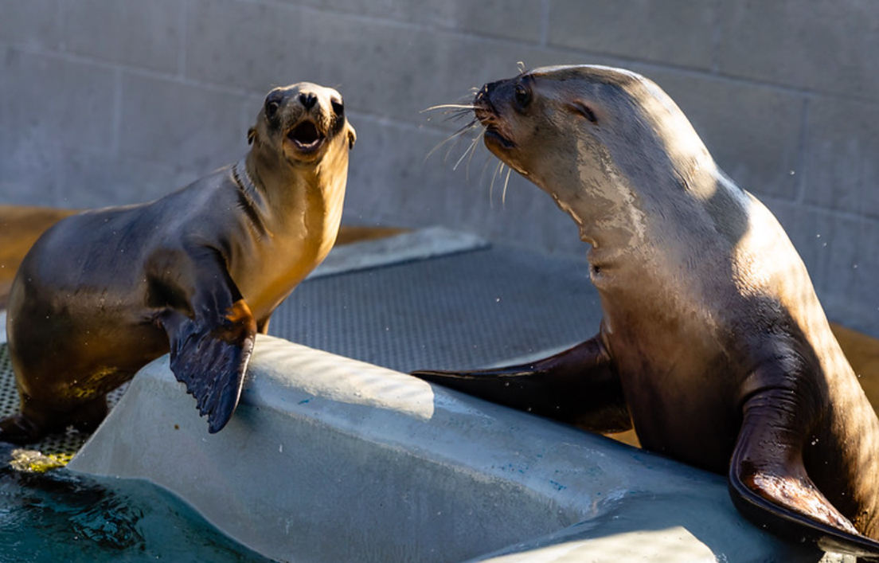
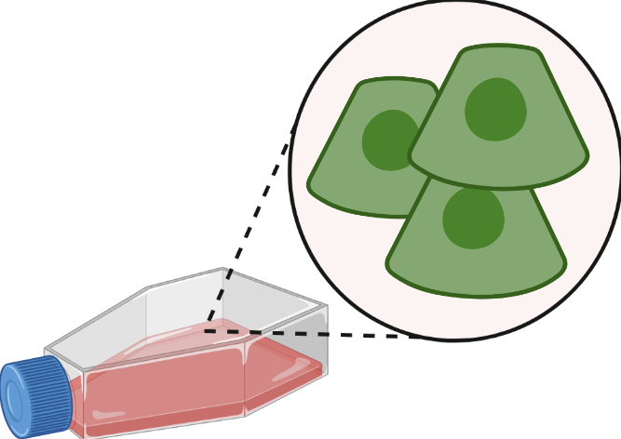

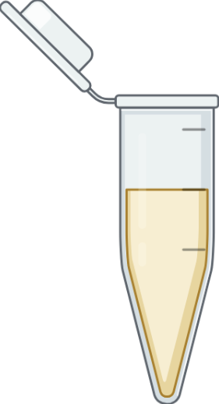
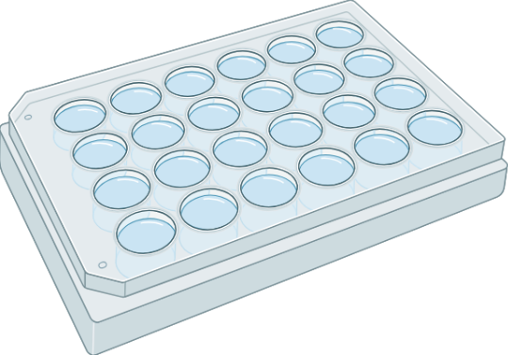





















In-vitro cytotoxicity assay
Photo by Bill Hunnewell © TMMC
Using Vero cells as target cells, a kidney epithelial cell line from the African green monkey (Chlorocebus sabaeus), a known susceptible host for K. pneumoniae
Soto et al., 2016
Using the CytoTox 96® Non-Radioactive Cytotoxicity Assay (Promega) to quantitate release of the stable cytosolic enzyme lactate dehydrogenase (LDH)
(LDH)
(LDH)
(LDH)
pyruvate
lactate
NAD+
NADH
Promega, 2016
INT
formazan

Slide 11
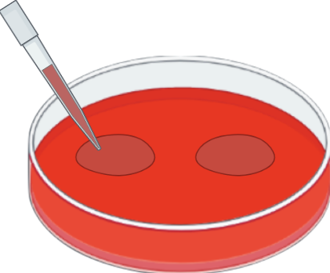
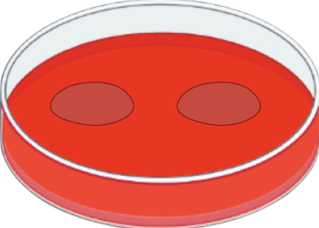

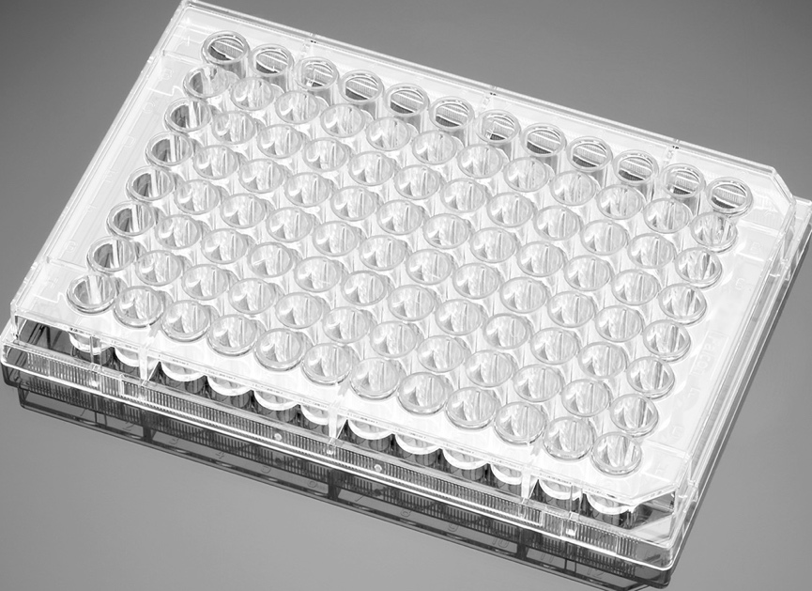



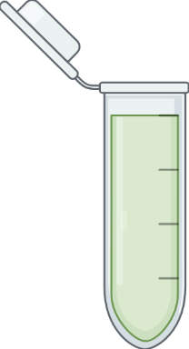
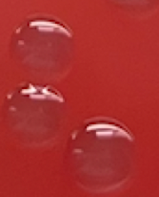





In-vitro cytotoxicity assay:
Testing Validation
Photo by Bill Hunnewell © TMMC
K. pneumoniae growth curve
Antibiotics required for assay if bacteria grows in cell culture media
Minimum inhibitory concentration (MIC)
Concentration yielding no proliferation
MBC
MIC
Minimum bactericidal concentration (MBC)
Concentration yielding no growth
Target cell concentration & incubation optimization
Maximize LDH release from positive control cells upon lysis
Multiplicity of infection (MOI) & exposure period optimization
Concentration of bacteria to Vero cells and time exposed to bacteria yielding detectable levels of LDH release
Notes:
how to study virulence in animals:
in vitro: cell lines
grow line -> add bact (grows in CO2-I)
Kp grows well in CO2-I: req gent MBC to kill EC bact,
models (in vivo: mice, fish)
Minimum bactericidal concentrations (MBC) have been determined for 4/5 representative isolates from each genetic grouping: #1, 4, 16, 21, and 35
25µl of gentamicin concentrations between 300µg/ml and 0.5µg/ml were inoculated with 175µl of a 1:1000 dilution of a 0.5 McFarland Standard [1.5•108 colony forming units per milliliter (CFU/ml)] in a 96-well flat bottom untreated sterile plate, in duplicate and incubated at 37ºC with shaking for 1 hour
20µl aliquots from each well and serial dilutions of the initial inoculum in Mueller Hinton (MH) broth were spot-plated onto sheep blood agar plates in duplicate and incubated at 37ºC for 24 hours
The lowest concentration yielding 0 CFU/ml after 24 hours incubation was determined as the MBC

Slide 12

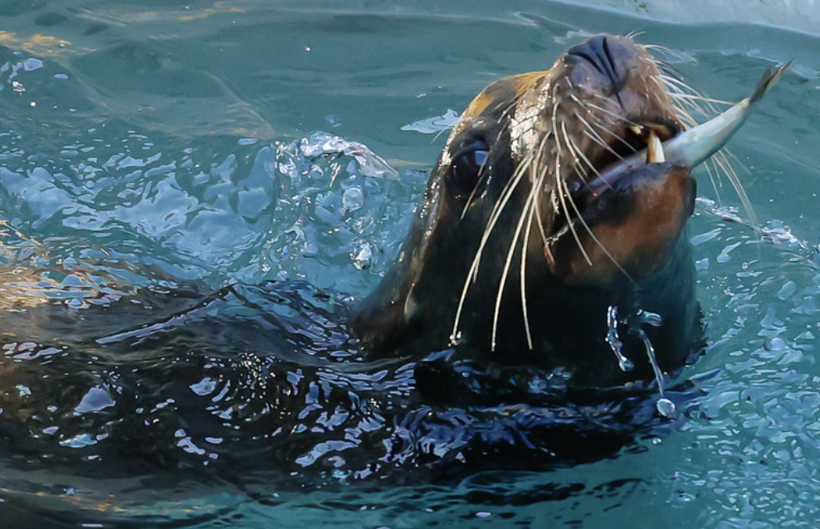
Results so far…
Photo by Bill Hunnewell © TMMC

Slide 13
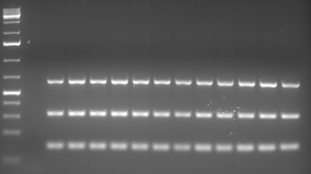



Multiplex-PCR I: results
Photo by Bill Hunnewell © TMMC
5000
NC 1 2 3 4 5 6 7 8 9 10 11 12 13 14 15 16 17 18 19 20 21 22 23 24 25 26 27 28 29 30 31 32 33 34 35 36 37 PC8 PC12
4000
3000
2000
1000
K1 — 797bp
700
K2 — 641bp
500
iroD — 556bp
400
allS — 508bp
300
rmpA — 321bp
200
K5 — 280bp
kpnP — 130bp
75
All isolates positive for the kpnP gene, indicating all isolates are K. pneumoniae
33/37 isolates positive for K2wzy gene, indicating K2 capsular serotype

Slide 14
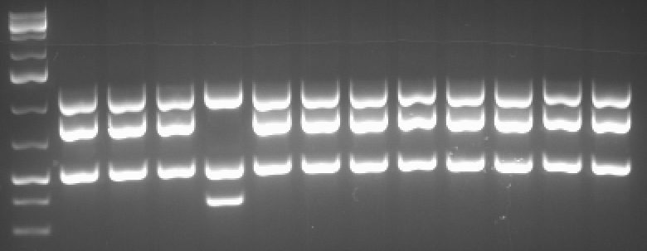
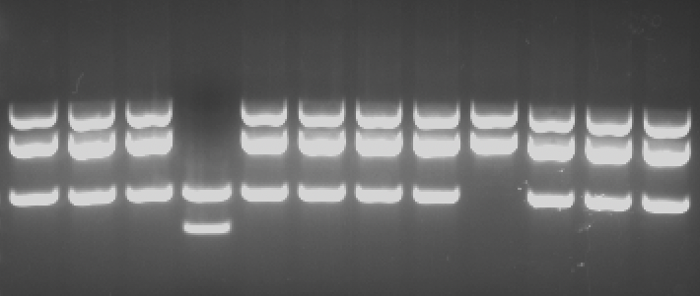
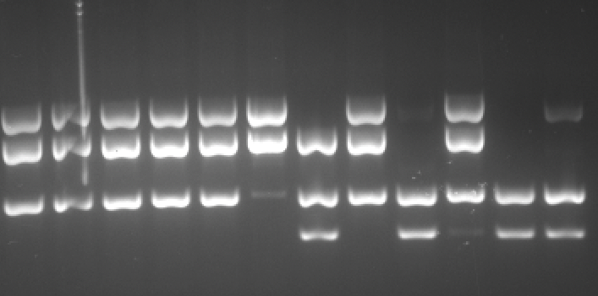
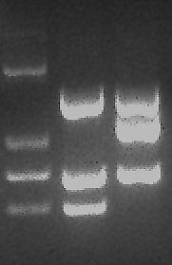
Multiplex-PCR II: results
Photo by Bill Hunnewell © TMMC
5000
1 2 3 4 5 6 7 8 9 10 11 12 13 14 15 16 17 18 19 20 21 22 23 24 25 26 27 28 29 30 31 32 33 34 35 36 37 PC9 PC12
37 PC9 PC12
4000
3000
iutA - 1115bp
2000
fyuA - 845bp
1000
iutA — 1115bp
mrkB - 514bp
700
fyuA — 845bp
fimH - 369bp
cldB — 665bp
500
mrkB — 514bp
400
fimH — 369bp
300
iutA+ / fyuA+ / mrkB+ / fimH-
iutA- / fyuA- / mrkB+ / fimH+
iutA+ / fyuA- / mrkB+ / fimH+
iutA+ / fyuA+ / mrkB- / fimH-

Slide 15

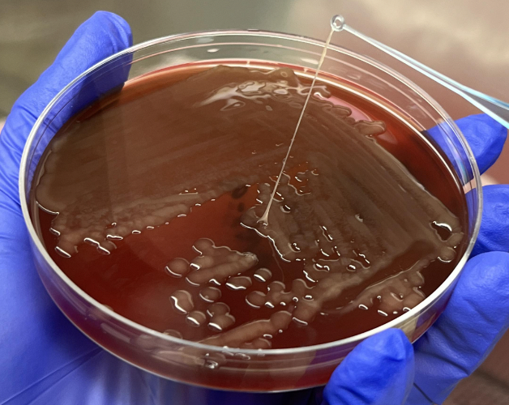

String test: results
31/33 K2 capsular serotype isolates positive for string test (>5mm string) indicating HMV phenotype
Photo by Bill Hunnewell © TMMC
HMV K2 K. pneumoniae Isolate #9 - Clade I
37 PC9 PC12
iutA - 1115bp
Shon et al., 2013
fyuA - 845bp
K2 strings were generally longer than K1 and K5 capsular serotype strings
mrkB - 514bp
fimH - 369bp
5mm
HMV K1 and HMV K5 K. pneumoniae isolates - Cox et al. 2015; Soto et al. 2012; 2016

Slide 16


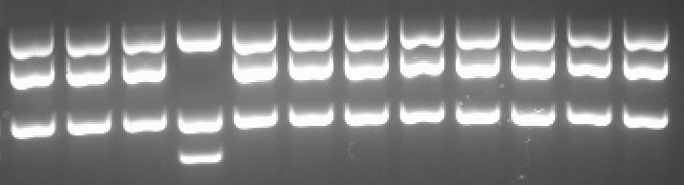
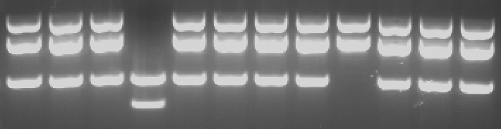
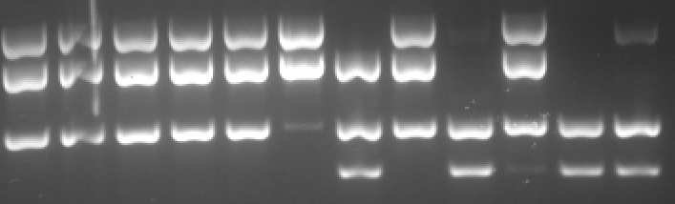
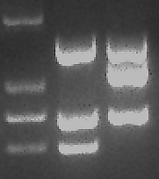
Isolate characterization
Photo by Bill Hunnewell © TMMC
NC 1 2 3 4 5 6 7 8 9 10 11 12 13 14 15 16 17 18 19 20 21 22 23 24 25 26 27 28 29 30 31 32 33 34 35 36 37 PC8 PC12
HMV; iutA+ / fyuA+ / mrkB+ / fimH-
non-HMV; iutA- / fyuA- / mrkB+ / fimH+
HMV; iutA+ / fyuA- / mrkB+ / fimH+
HMV; iutA+ / fyuA+ / mrkB- / fimH-

Slide 17
WHOLE GENOME PHYLOGENY:
results
Photo by Bill Hunnewell © TMMC
non-HMV
Homogeneity within Clade I
& similarity with Clade IV
HMV

Slide 18


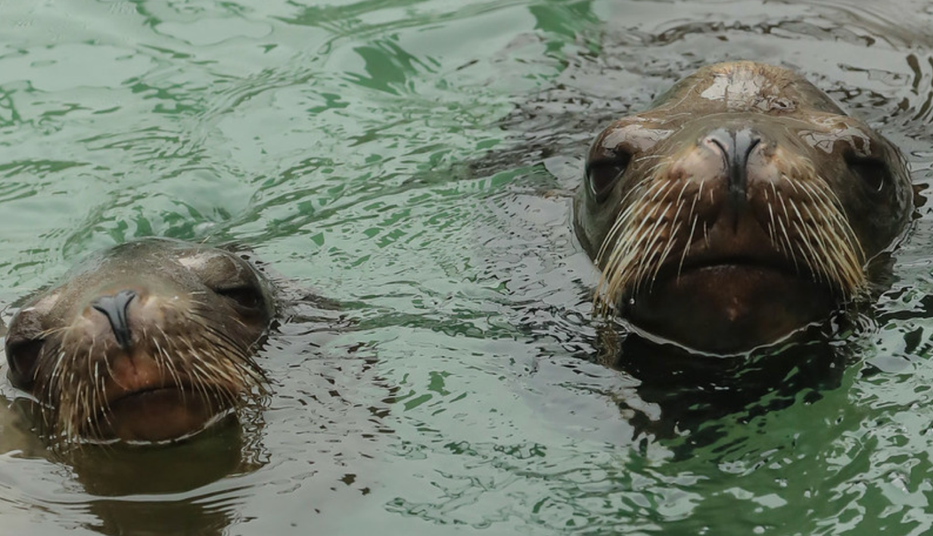
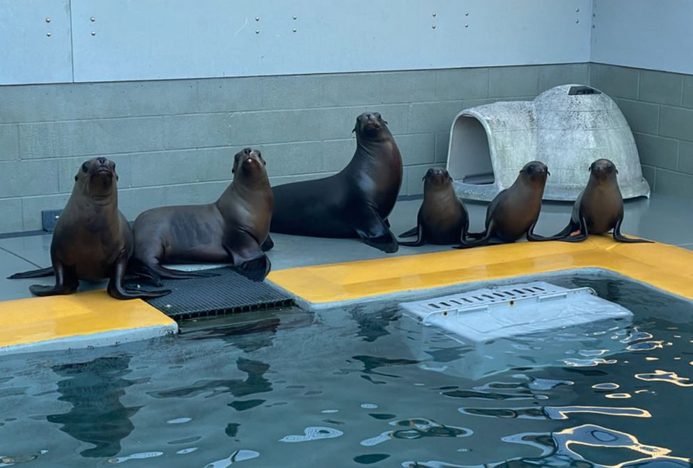
Representative isolates
Photo by Bill Hunnewell © TMMC
Isolate | Host | HMV | kpnP | magA | K2wzy | K5wzy | iroD | iutA | fyuA | rmpA | cldB | mrkB | fimH | Clade
PC8/9 | CSL | + | + |  | + |  |  | + |  | + |  | + | + | II
PC12 | CSL | + | + |  | + |  |  | + | + | + |  | + |  | I
1 | CSL | + | + |  | + |  |  | + | + | + |  | + |  | I
4 | CSL | + | + |  | + |  |  | + |  | + |  | + | + | II
16 | CSL |  | + |  | + |  |  |  |  |  |  | + | + | III
21 | CSL | + | + |  | + |  |  | + | + | + |  |  |  | IV
31 | CSL |  | + |  |  |  |  |  | + |  |  | + | +
35 | SO |  | + |  |  |  |  |  |  |  |  | + | +
36 | CSL |  | + |  |  |  |  | + |  |  |  | + | +
37 | HS |  | + |  |  |  |  |  |  |  |  | + | +
 | Whole genome analysis confirmed each multiplex-PCR finding

Slide 19

Antimicrobial resistance gene analysis: results
Photo by Bill Hunnewell © TMMC
 | vanG | msbA | E. coli EF-Tu mutants | CRP | Kp KpnE | Kp KpnF | Kp KpnH | Kp KpnG | mphA | mdtB | mdtC | E. coli mdfA | tet(A) | E. coli UhpT | FosA6 | fosA5 | E. coli AcrAB-TolC + MarR | acrB | marA | rsmA | emrR | oqxB | oqxA | adeF | AAC(6’)-lb-cr6 | QnrB1 | MCR-9.1 | OmpA | ArnT | eptB | PmrF | LptD | Kp OmpK37 | OXA-1 | SHV-11 | SHV-1 | SHV-27 | SHV-28 | SHV-76 | H. influenzae PBP3 | TEM-1 | baeR | acrD | CrcB | AAC(3)-Ile | APH(3’’)-lb | APH(6)-ld | aadA2 | dfrA12 | dfrA14 | sul1 | sul2 | LEN-16 | qacEdelta1
1
4
16
21
36
35
31

Slide 20
In-vitro cytotoxicity assay:
Validation In progress
Photo by Bill Hunnewell © TMMC
Growth curve
K. pneumoniae grew well in CO₂-Independent cell culture media, necessitating use of antibiotics in cytotoxicity assay
Vero cell concentration & incubation optimization
Seeding 10⁵ cells/ml and incubating at 37ºC for 24 hours prior to infection
Notes:
how to study virulence in animals:
in vitro: cell lines
grow line -> add bact (grows in CO2-I)
Kp grows well in CO2-I: req gent MBC to kill EC bact,
models (in vivo: mice, fish)
Minimum bactericidal concentrations (MBC) have been determined for 4/5 representative isolates from each genetic grouping: #1, 4, 16, 21, and 35
25µl of gentamicin concentrations between 300µg/ml and 0.5µg/ml were inoculated with 175µl of a 1:1000 dilution of a 0.5 McFarland Standard [1.5•108 colony forming units per milliliter (CFU/ml)] in a 96-well flat bottom untreated sterile plate, in duplicate and incubated at 37ºC with shaking for 1 hour
20µl aliquots from each well and serial dilutions of the initial inoculum in Mueller Hinton (MH) broth were spot-plated onto sheep blood agar plates in duplicate and incubated at 37ºC for 24 hours
The lowest concentration yielding 0 CFU/ml after 24 hours incubation was determined as the MBC
Minimum inhibitory concentrations (MIC) have not yet been determined for any representative isolates
Testing representative isolates at a 1:1000 dilution of 1.5x108 colony forming units per milliliter (CFU/ml) against multiple gentamicin concentrations ranging from 4µg/ml to 0.03µg/ml
Incubated at 37ºC with shaking for 24 hours and 48 hours, then spot-plated aliquots from each well onto sheep blood agar plates and incubated at 37ºC for 24 hours
The lowest concentration yielding no proliferation on the plate after both 24 hours and 48 hours incubation will be determined as the MIC

Slide 21
In-vitro cytotoxicity assay:
Validation In progress
Photo by Bill Hunnewell © TMMC
MBCs
Determined for all representatives
MICs
NOT yet determined for any representatives
Isolate | gentamicin MBC (µg/ml)
1 | 5 µg/ml
4 | 5 µg/ml
16 | 5 µg/ml
21 | 5 µg/ml
31 | 1000 µg/ml
MOIs
NOT yet determined for any representatives
Vero-bacterial exposure period
NOT yet determined for any representatives
Notes:
how to study virulence in animals:
in vitro: cell lines
grow line -> add bact (grows in CO2-I)
Kp grows well in CO2-I: req gent MBC to kill EC bact,
models (in vivo: mice, fish)
Minimum bactericidal concentrations (MBC) have been determined for 4/5 representative isolates from each genetic grouping: #1, 4, 16, 21, and 35
25µl of gentamicin concentrations between 300µg/ml and 0.5µg/ml were inoculated with 175µl of a 1:1000 dilution of a 0.5 McFarland Standard [1.5•108 colony forming units per milliliter (CFU/ml)] in a 96-well flat bottom untreated sterile plate, in duplicate and incubated at 37ºC with shaking for 1 hour
20µl aliquots from each well and serial dilutions of the initial inoculum in Mueller Hinton (MH) broth were spot-plated onto sheep blood agar plates in duplicate and incubated at 37ºC for 24 hours
The lowest concentration yielding 0 CFU/ml after 24 hours incubation was determined as the MBC
Minimum inhibitory concentrations (MIC) have not yet been determined for any representative isolates
Testing representative isolates at a 1:1000 dilution of 1.5x108 colony forming units per milliliter (CFU/ml) against multiple gentamicin concentrations ranging from 4µg/ml to 0.03µg/ml
Incubated at 37ºC with shaking for 24 hours and 48 hours, then spot-plated aliquots from each well onto sheep blood agar plates and incubated at 37ºC for 24 hours
The lowest concentration yielding no proliferation on the plate after both 24 hours and 48 hours incubation will be determined as the MIC

Slide 22

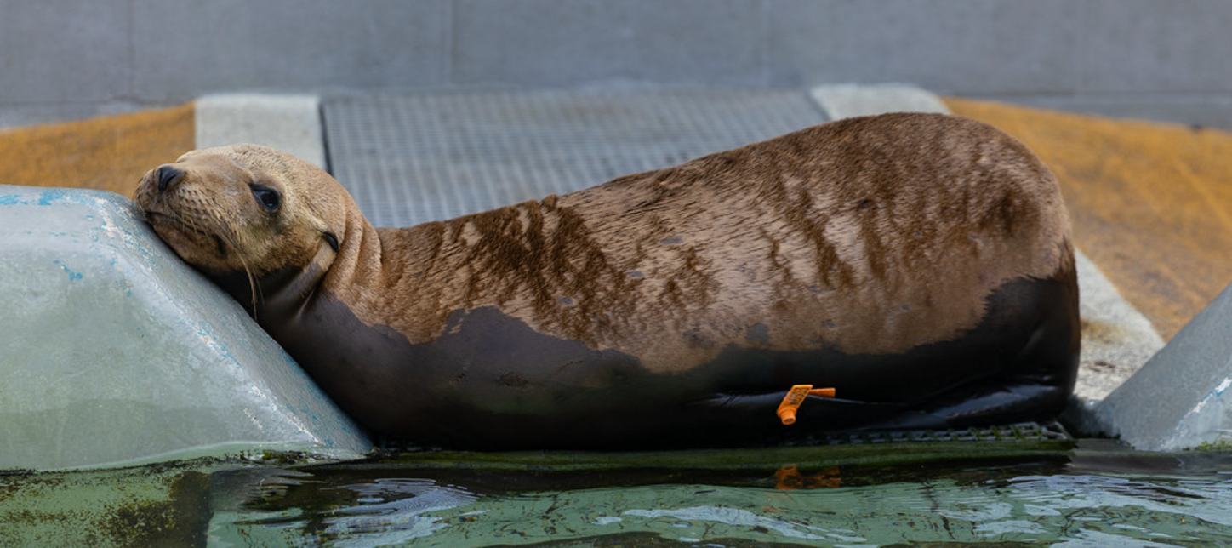

Roadblocks
!
Photo by Bill Hunnewell © TMMC
Issue
Unable to get consistently reliable data from MIC assays, potentially due to inaccuracy in gentamicin dilutions
Issue
J477A.1 macrophage cell line did not grow well in CO2-independent media
Issue
Maximum LDH release upon first trial of Vero cells was much lower than expected
Solution
Rather than diluting stock to target concentration, dilute to a larger concentration then serially dilute
Solution
Run the cytotoxicity assay with just the Vero cells
Solution
Optimized Vero cell concentration and incubation period
Notes:
add:
next steps
current finding summary
overrepresented clade: 1
bact photos
string test photos

Slide 23

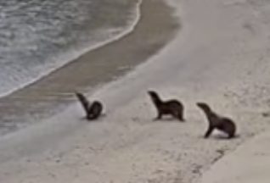
Next steps…
Photo courtesy of TMMC Livestream Channel on YouTube
Continue validation assays in order to run cytotoxicity assay in the future
Buoyant density assay to quantify capsular polysaccharides
Phylogenetic analysis against isolates from New Zealand sea lions and other host species, including humans
Multilocus sequence analysis for virulence factors
In-vivo cytotoxicity challenges with Zebrafish (Danio rerio)

Slide 24

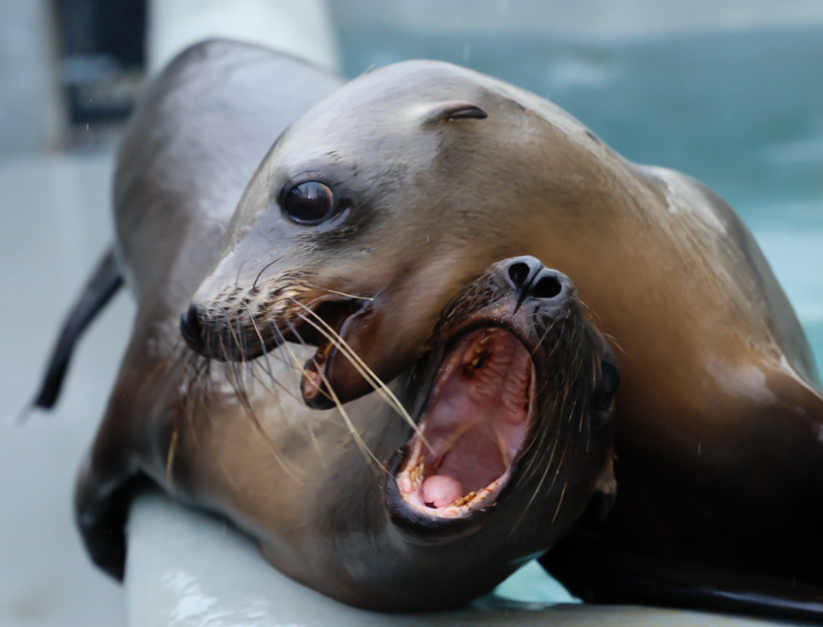


Acknowledgments
Photo by Bill Hunnewell © TMMC
Aquatic Animal Health Lab
Dr. Esteban Soto
Zeinab Yazdi
Susan Yun
Kim Li Jacobsen
Taylor Heckman
Renata Egger
Miku Kawahara
Eva Marie Quijano Cardé
Claudio Murgia
Isabella Medina Silva
Kelsey Anenson
Collin Meyer
The Marine Mammal Center
UC Davis SVM
Financial support provided by the Students Training in Advanced Research (STAR) Program through the UC Davis School of Veterinary Medicine Endowment Funds

Slide 25



Questions?
Photo by Bill Hunnewell © TMMC

Slide 26

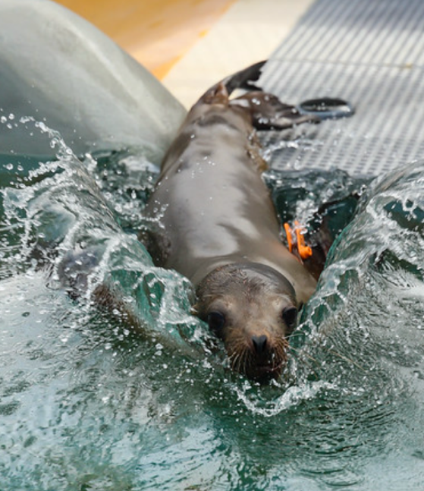
References
Photo by Bill Hunnewell © TMMC
Alcock BP, Huynh W, Chalil R, Smith KW, Raphenya AR, Wlodarski MA, Edalatmand A, Petkau A, Syed SA, Tsang KK, Baker SJC, Dave M, McCarthy MC, Mukiri KM, Nasir JA, Golbon B, Imtiaz H, Jiang X, Kaur K, Kwong M, Liang ZC, Niu KC, Shan P, Yang JYJ, Gray KL, Hoad GR, Jia B, Bhando T, Carfrae LA, Farha MA, French S, Gordzevich R, Rachwalski K, Tu MM, Bordeleau E, Dooley D, Griffiths E, Zubyk HL, Brown ED, Maguire F, Beiko RG, Hsiao WWL, Brinkman FSL, Van Domselaar G, McArthur AG. CARD 2023: expanded curation, support for machine learning, and resistome prediction at the Comprehensive Antibiotic Resistance Database. Nucleic Acids Res. 2023 Jan 6;51(D1):D690-D699. doi: 10.1093/nar/gkac920.
Cox BL, Schiffer H, Dagget G Jr, Beierschmitt A, Sithole F, Lee E, Revan F, Halliday-Simmonds I, Beeler-Marfisi J, Palmour R, Soto E. Resistance of Klebsiella pneumoniae to the innate immune system of African green monkeys. Vet Microbiol. 2015 Jan 13. 176(1-2):134–142. doi: 10.1016/j.vetmic.2015.01.001.
Chang EC, Miller M, Shahin K, Batac F, Field CL, Duignan P, Struve C, Byrne BA, Murray MJ, Greenwald K, Smith WA, Ziccardi M, Soto E. Genetics and pathology associated with Klebsiella pneumoniae and Klebsiella spp. isolates from North American Pacific coastal marine mammals. Vet Microbiol. 2022 Feb; 265. doi: 10.1016/j.vetmic.2021.109307.
Grant JR, Enns E, Marinier E, Mandal A, Herman EK, Chen C, Graham M, Van Domselaar G, Stothard P. Proksee: an in-depth characterization and visualization of bacterial genomes. Nucleic Acids Res. 2023. doi: 10.1093/nar/gkad326.
Janda JM and Abbott SL. The Genera Klebsiella and Raoultella. In The Enterobacteria (eds J.M. Janda and S.L. Abbott). 2005. doi: 10.1128/9781555817541.ch9.
Jang S, Wheeler L, Carey RB, Jensen B, Crandall CM, Schrader KN, Jessup D, Colegrove K, Gulland FM. Pleuritis and suppurative pneumonia associated with a hypermucoviscosity phenotype of Klebsiella pneumoniae in California sea lions (Zalophus californianus). Vet Microbiol. 2010 Feb 24;141(1-2):174-7. doi: 10.1016/j.vetmic.2009.07.032.
Johnson S, Dunkin RC, Limon JD, Smith MS, Byukusenge M, Jayarao BM, Kuchipudi SV, Duignan PJ, Field CL, Hortensius L, Martinez M, Soto E, Whitaker D, Kinsley AC. Klebsiella pneumoniae in California sea lions of central California. Abstract for International Association for Aquatic Animal Medicine Conference. 2023 May.
Letunic I and Bork P. Interactive tree of life (iTOL) v5: an online tool for phylogenetic tree display and annotation. Nucleic Acids Res. 2021 Apr 22; 49(W1):W293-6. doi: 10.1093/nar/gkab301.
Schwengers O, Jelonek L, Dieckmann M A, Beyvers S, Blom J, Goesmann A. Bakta: rapid and standardized annotation of bacterial genomes via alignment-free sequence identification. Microbial Genomics. 2021. 7(11). doi: 10.1099/mgen.0.000685.
Shon, AS, Bajwa, RPS, Russo, TA. Hypervirulent (hypermucoviscous) Klebsiella pneumoniae. Virulence. 2013. 4:107–18. doi: 10.4161/viru.22718.
Soto E, LaMon V, Griffin M, Keirstead N, Beierschmitt A, Palmour R. Phenotypic and genotypic characterization of Klebsiella pneumoniae isolates recovered from nonhuman primates. 2012 Jul. J Wildl Dis 48(3):603–11. doi: 10.7589/0090-3558-48.3.603.
Soto E, Marchi S, Beierschmitt A, Kearney M, Francis S, VanNess K, Vandenplas M, Thrall M, Palmour R. Interaction of non-human primate complement and antibodies with hypermucoviscous Klebsiella pneumoniae. Vet Res. 2016 Mar 8. 47(40). doi: 10.1186/s13567-016-0325-1.
Images created with BioRender.com.

