Slide 1
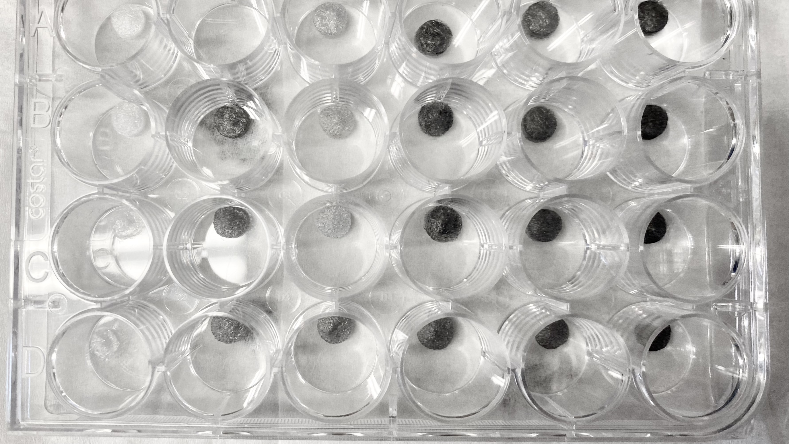
Interrogating the role of hydrogel electrical and physical properties on neural cell behavior
Nicole Wegrzyniak

Slide 2
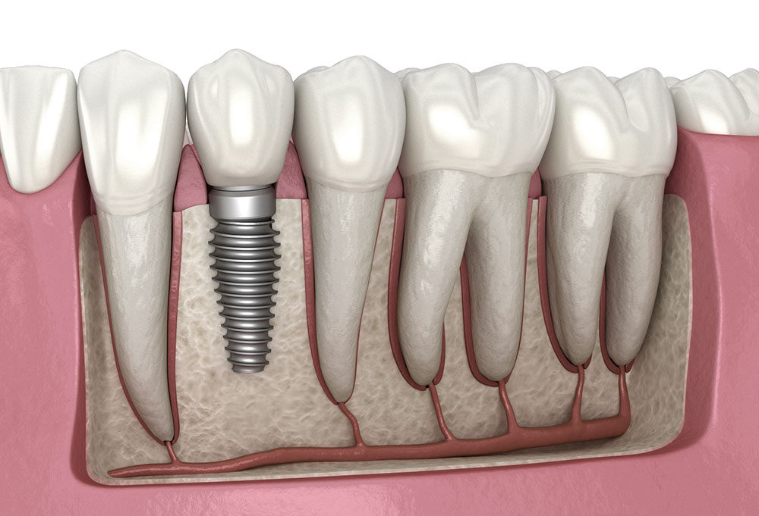
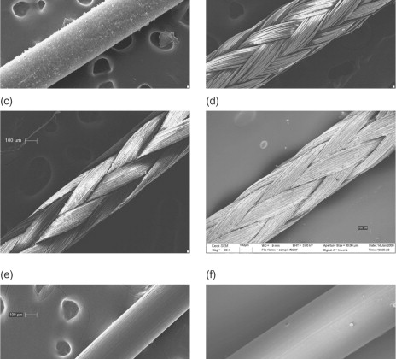
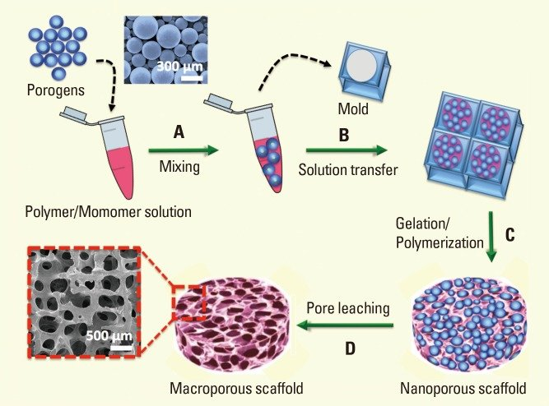
What are biomaterials?
Sutures
$1.79 per monofilament absorbable suture stitch
$19.96 per barbed suture stick
Titanium tooth implant
$1,000-3,000
Macroporous scaffold
Bencherif, Sidi & Braschler, Thomas & Renaud, Philippe (2013)
Chu, C. C. (2013)
Mit, A. (2021)

Slide 3
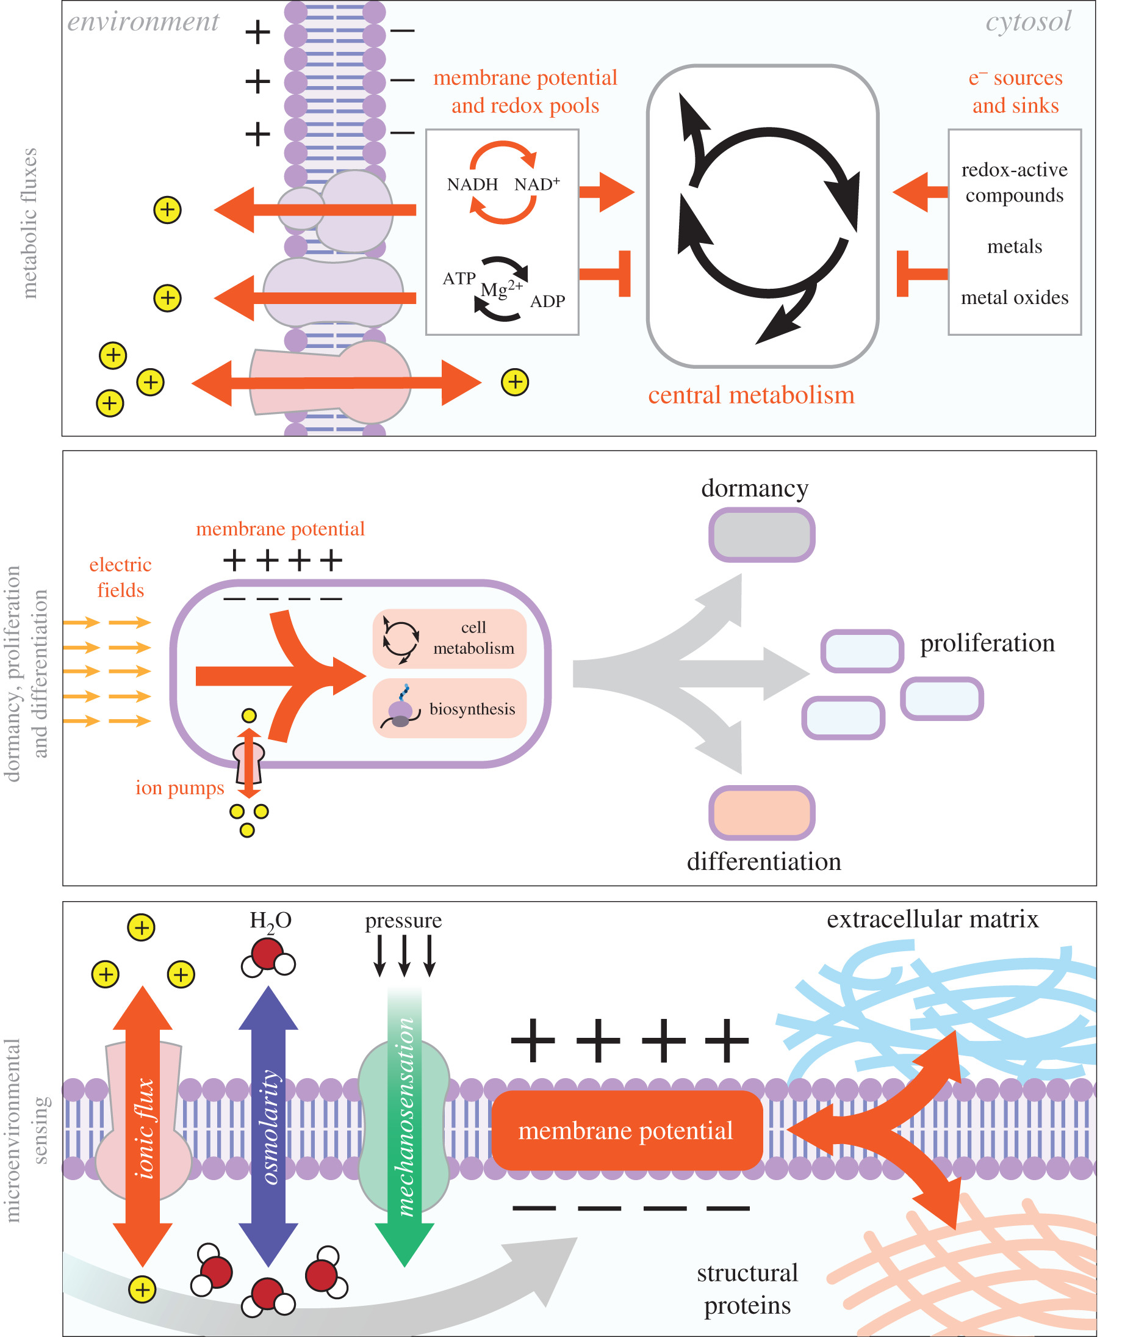
Why USE Conductive Biomaterials?
Schofield et al. (2020)

Slide 4
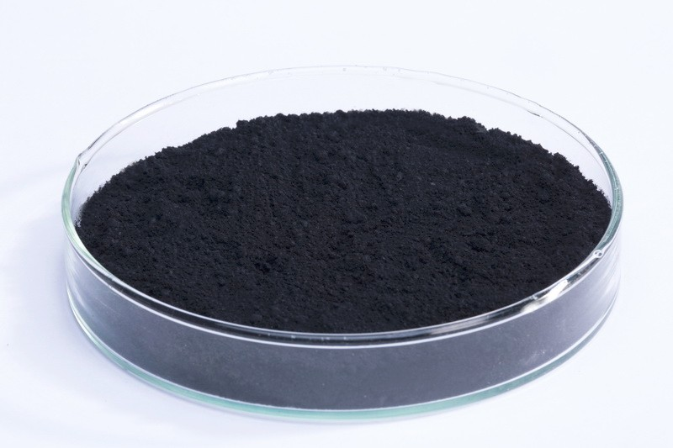
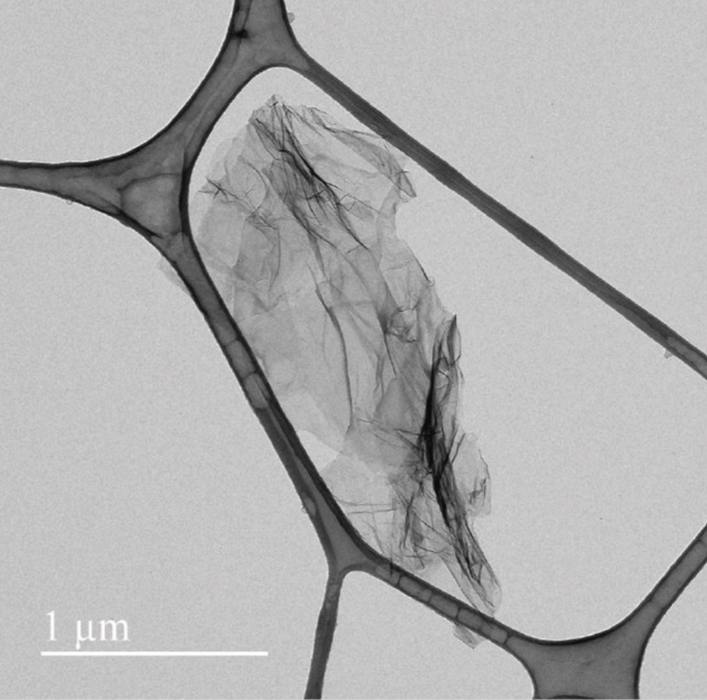
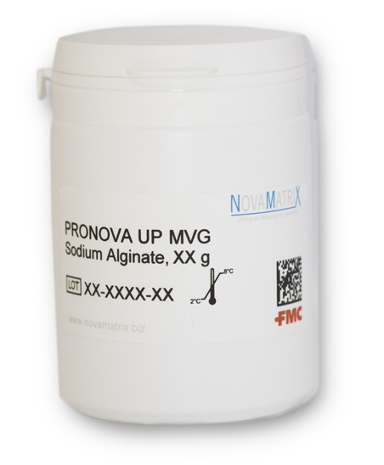
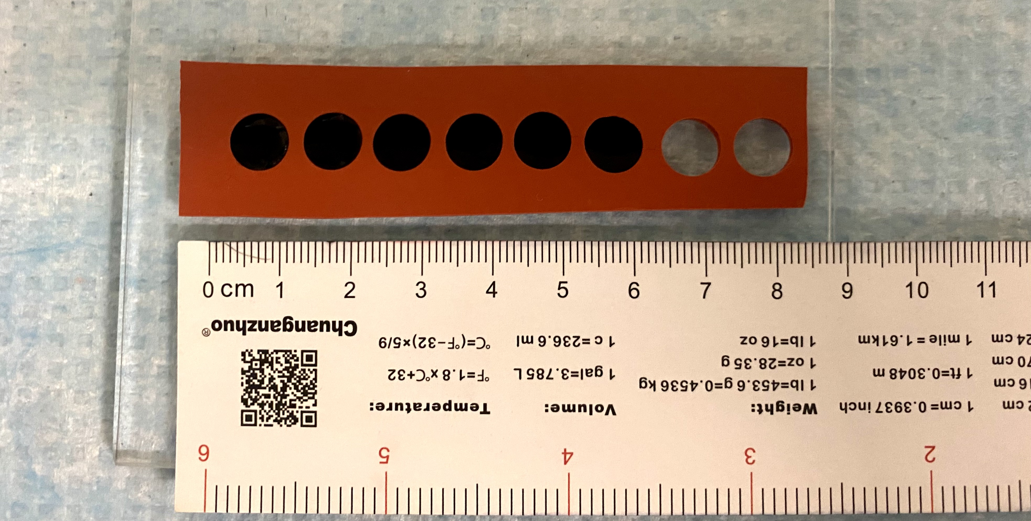
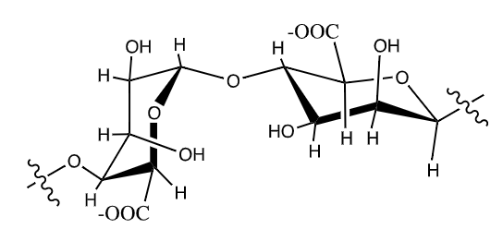
Background
Graphene
Alginate
PEDOT:PSS
Schofield et al. (2020)

Slide 5
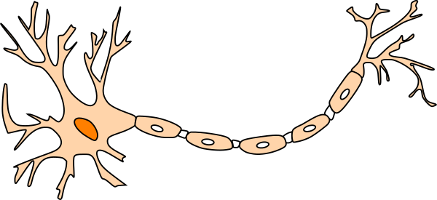
Hypothesis
The interplay of hydrogel electrical and physical properties, including conductivity, storage modulus, and degradation, influences cell adhesion and viability and promotes neural cell morphology and behavior.

Slide 6
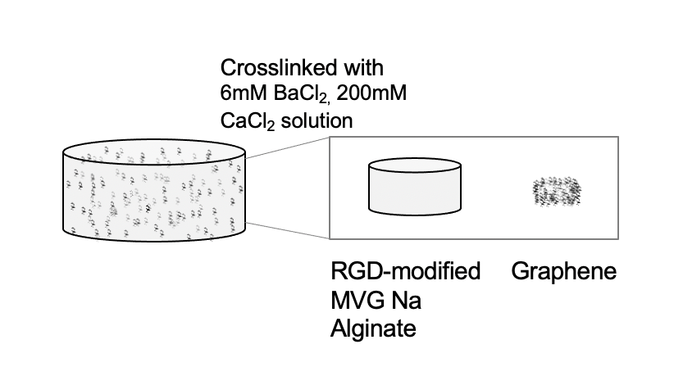
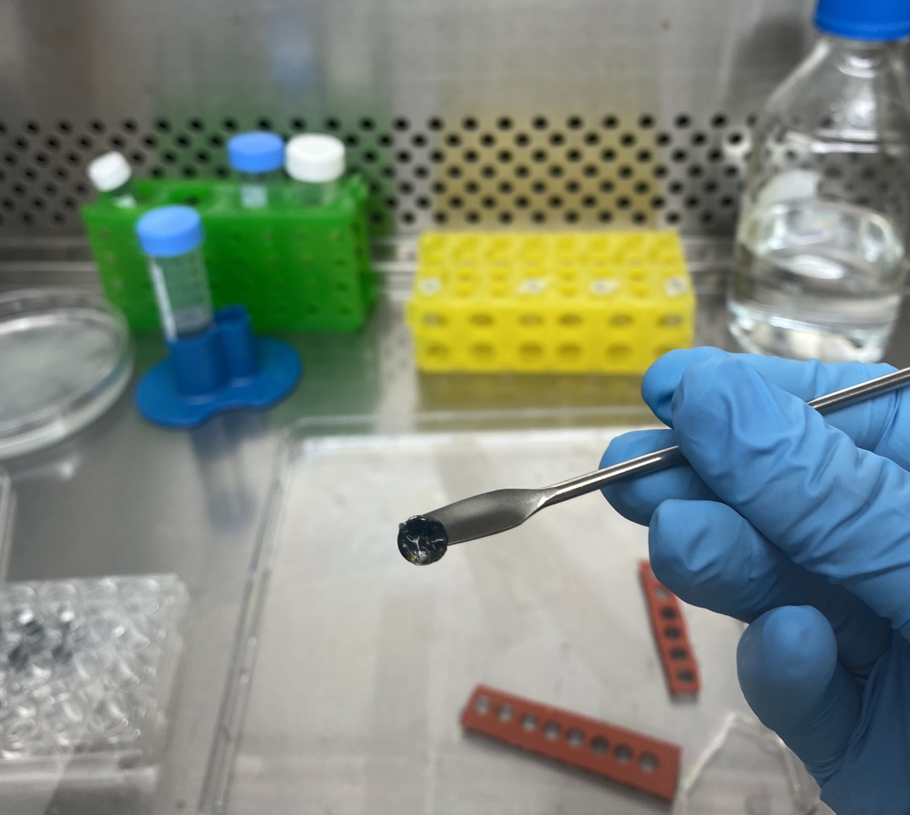
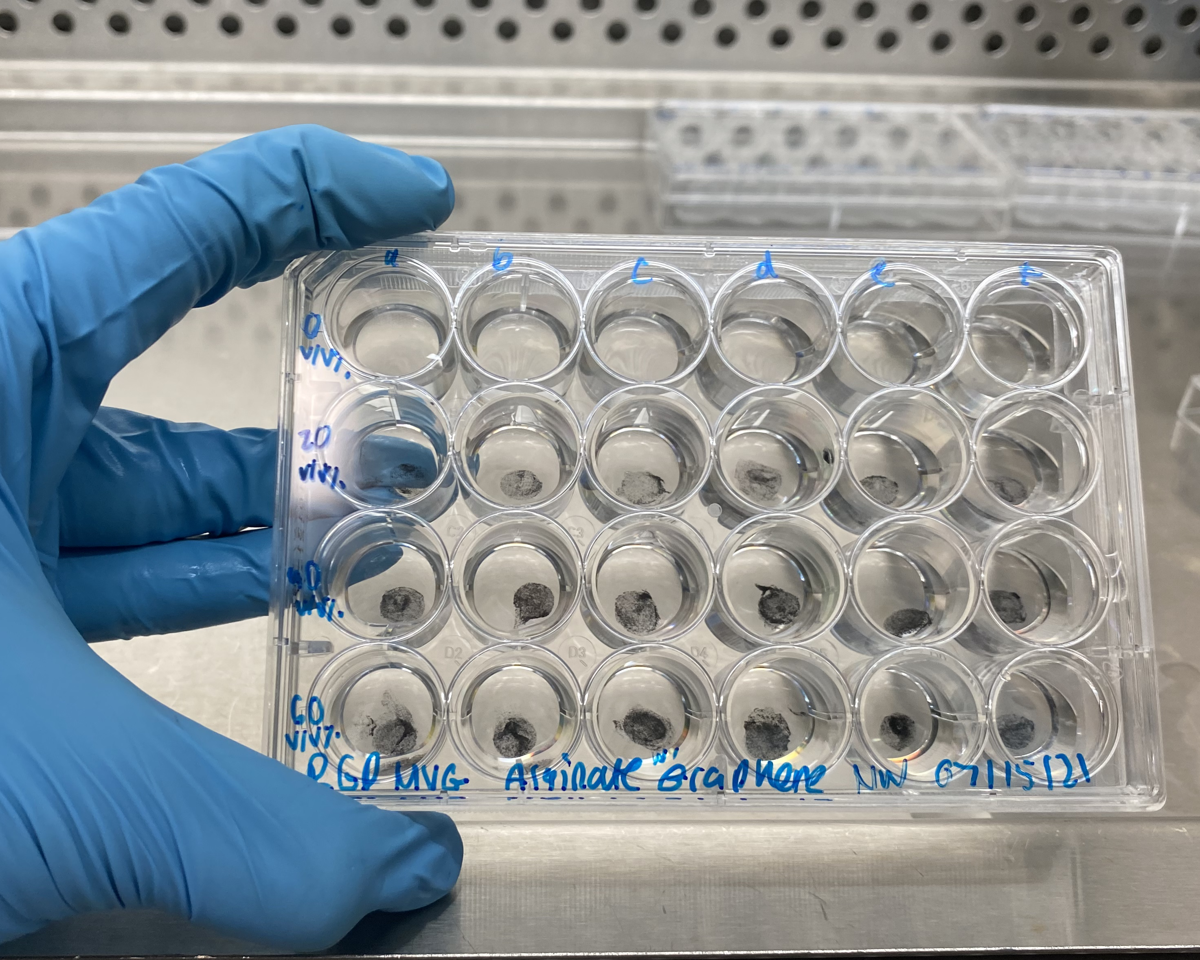
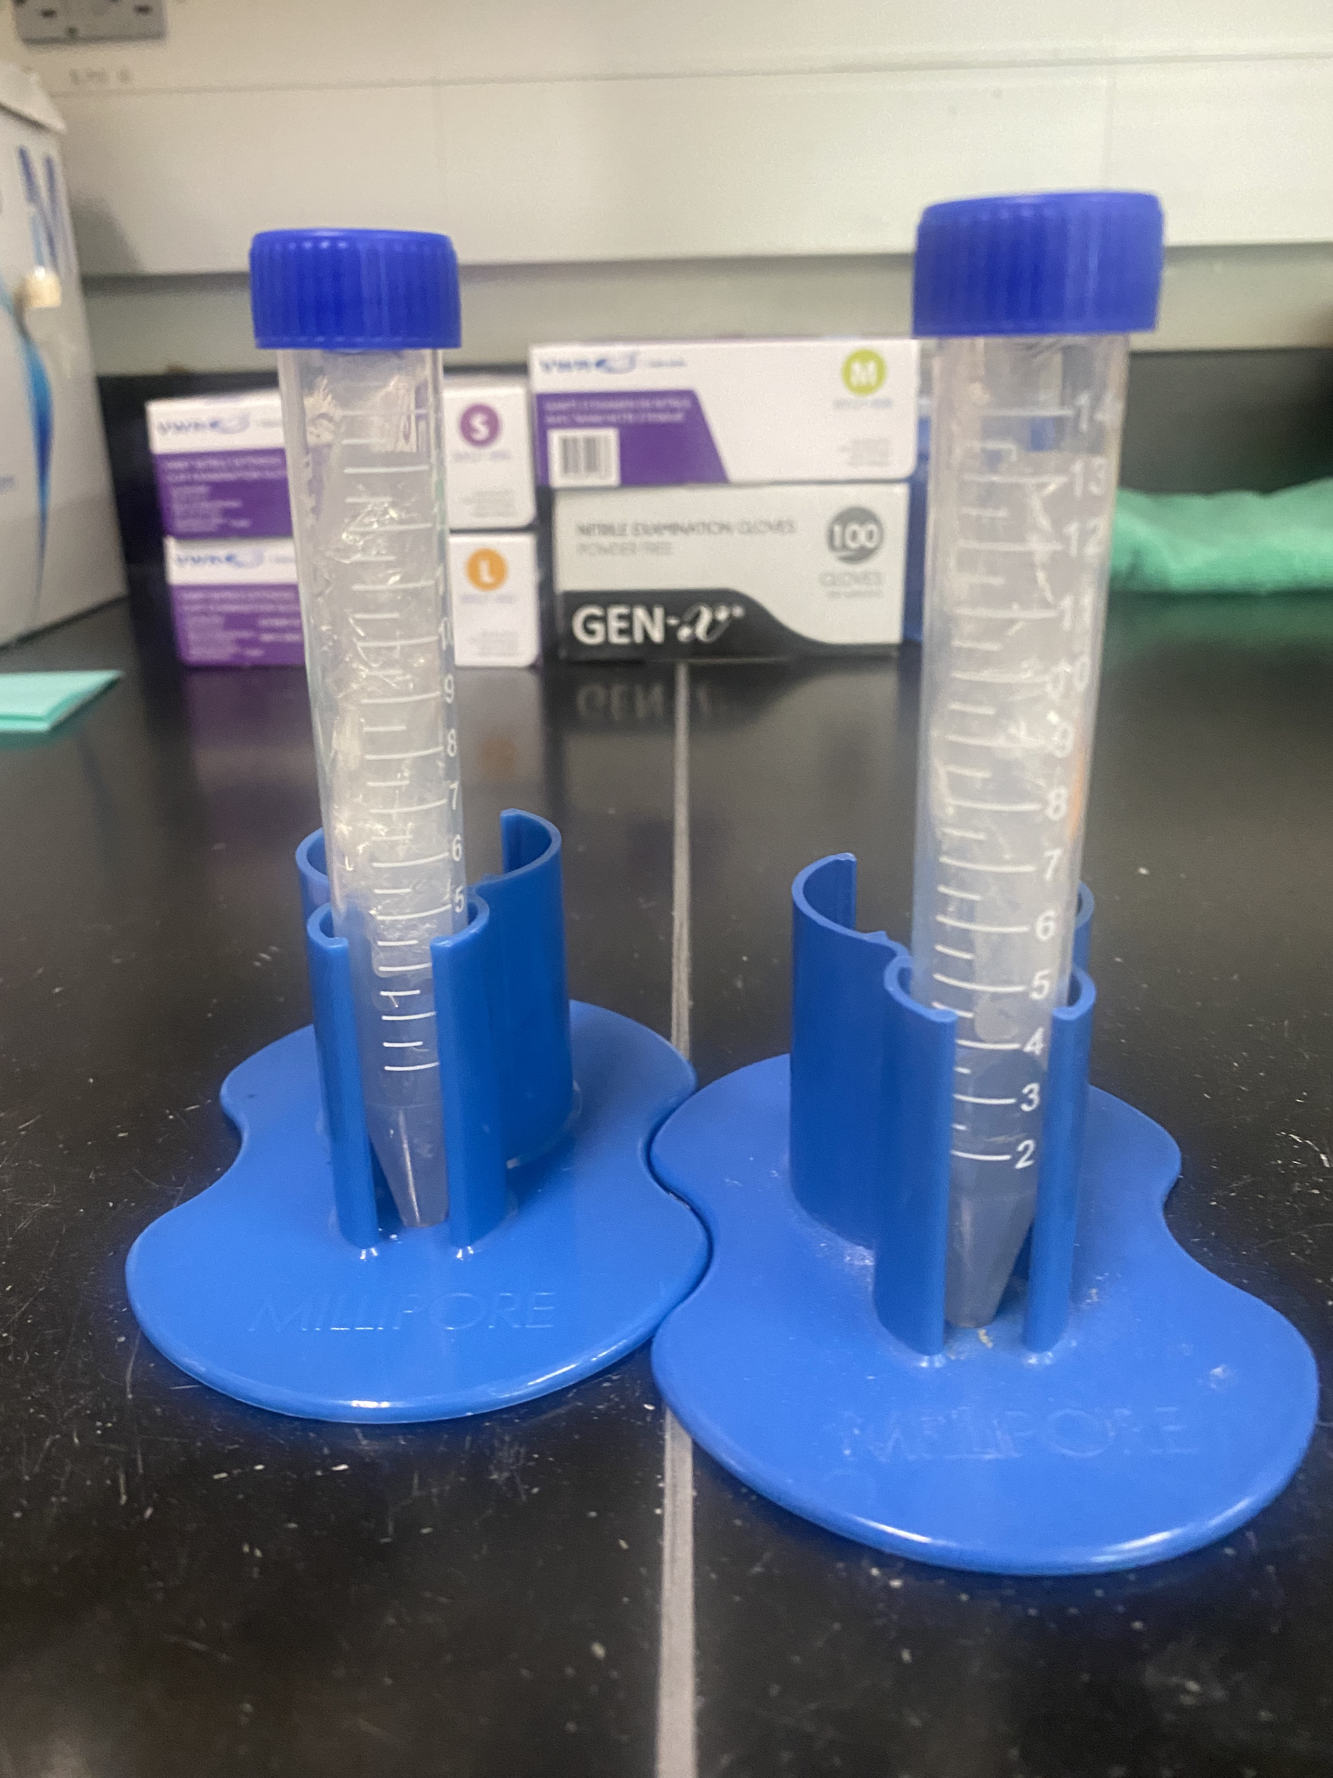
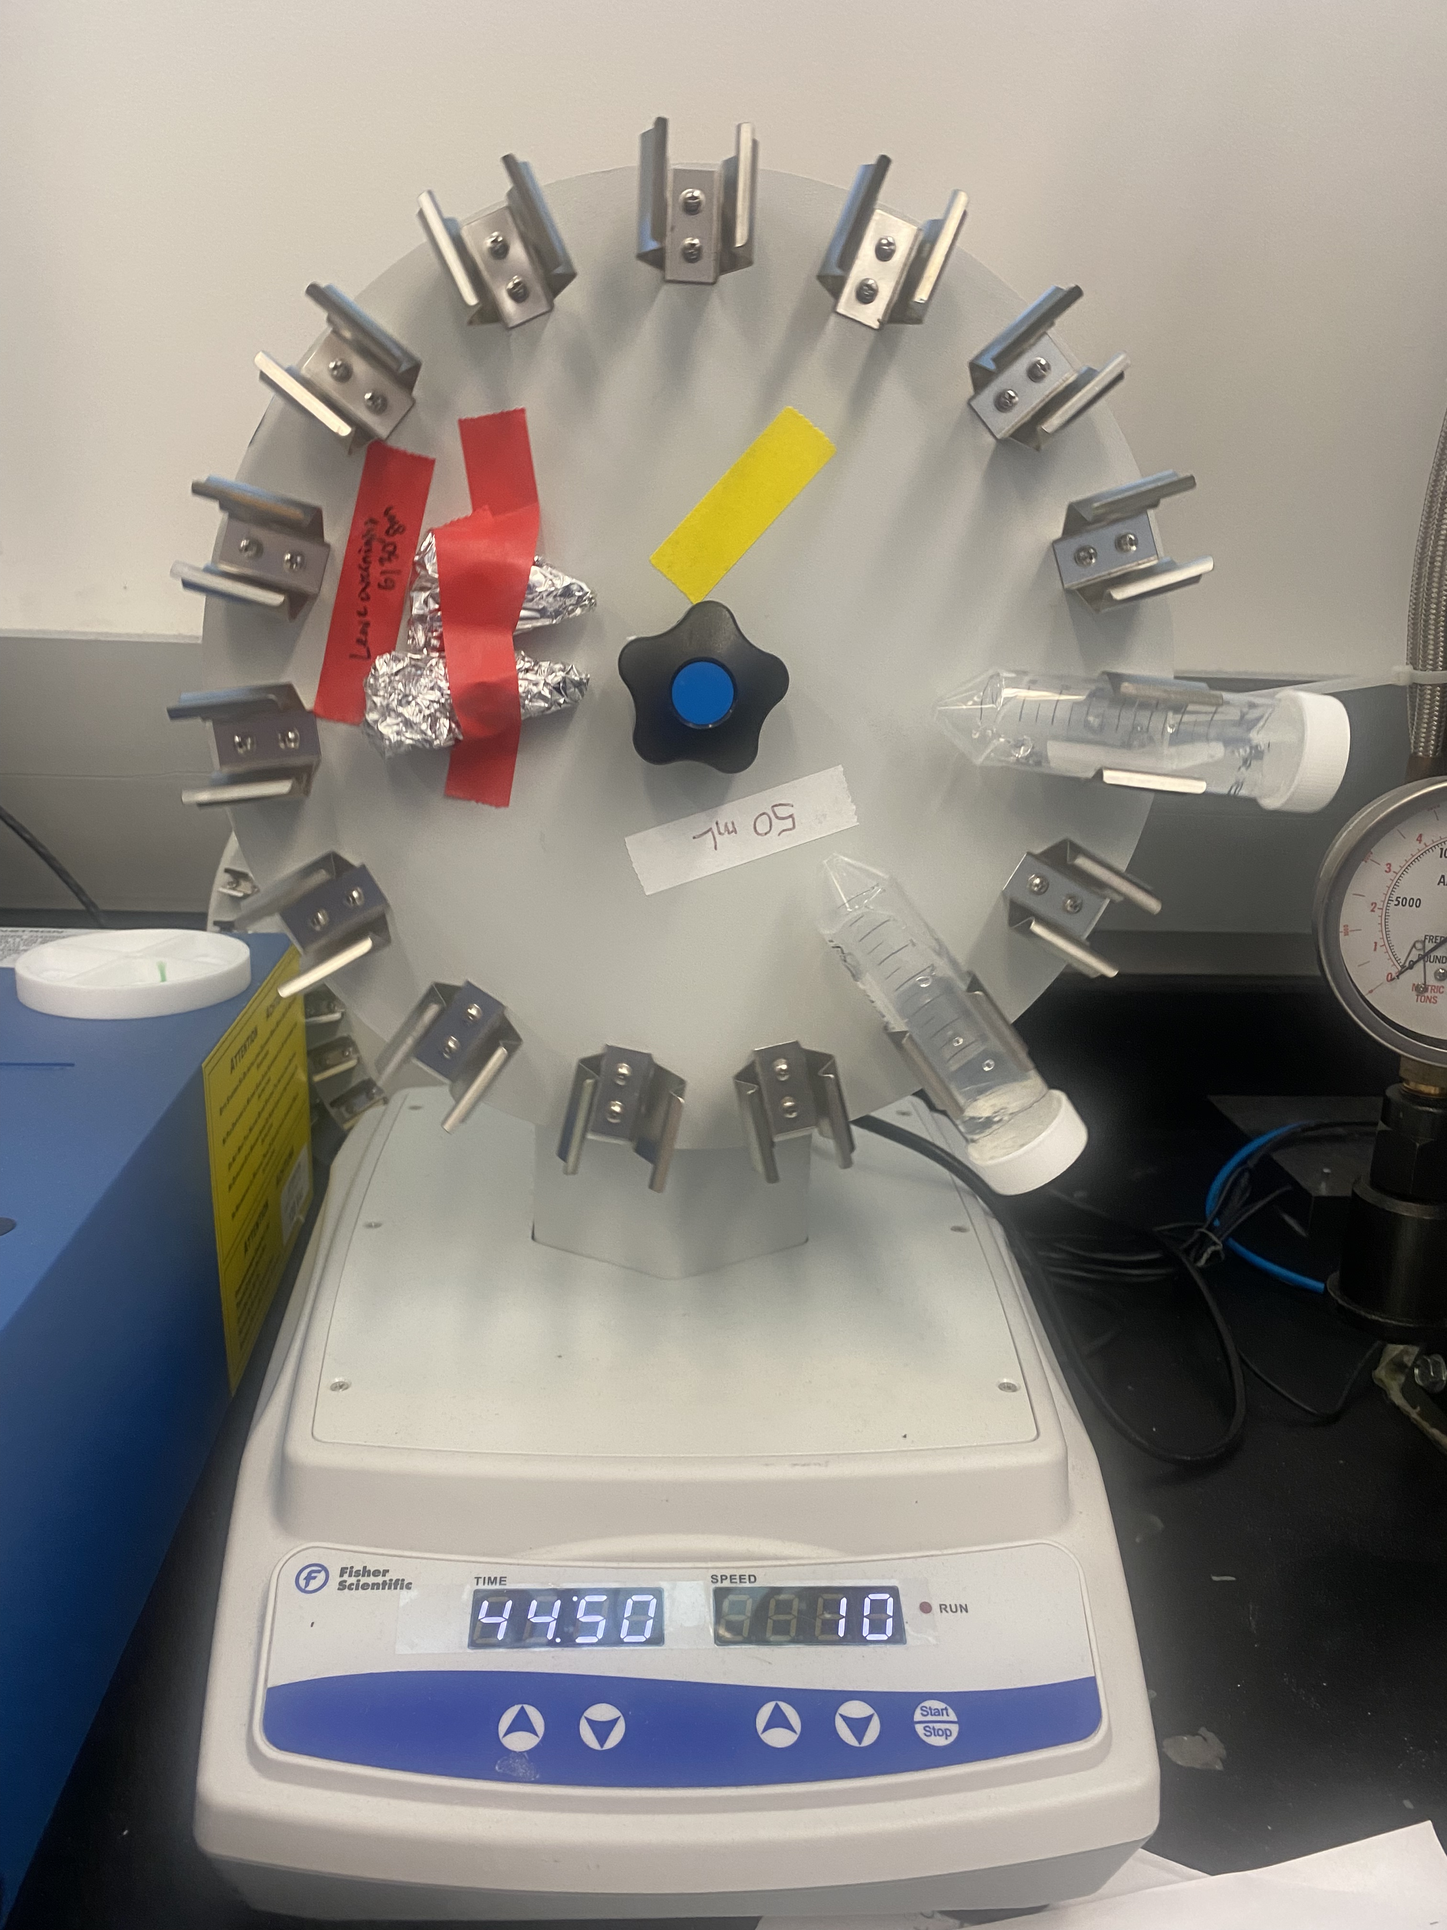
Methods
2) Crosslink the hydrogels with 6mM BaCl₂, 200mM CaCl₂ solution
1) Preparation of Oxidized, RGD-modified MVG Na Alginate
3) Identify maximum graphene concentration for gelation

Slide 7
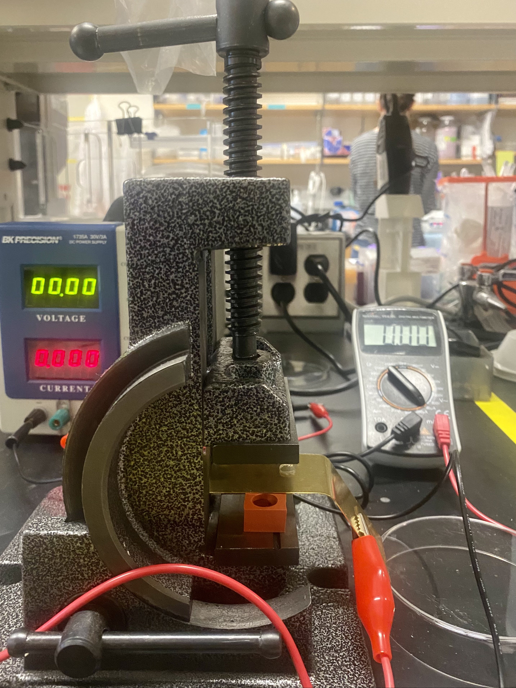
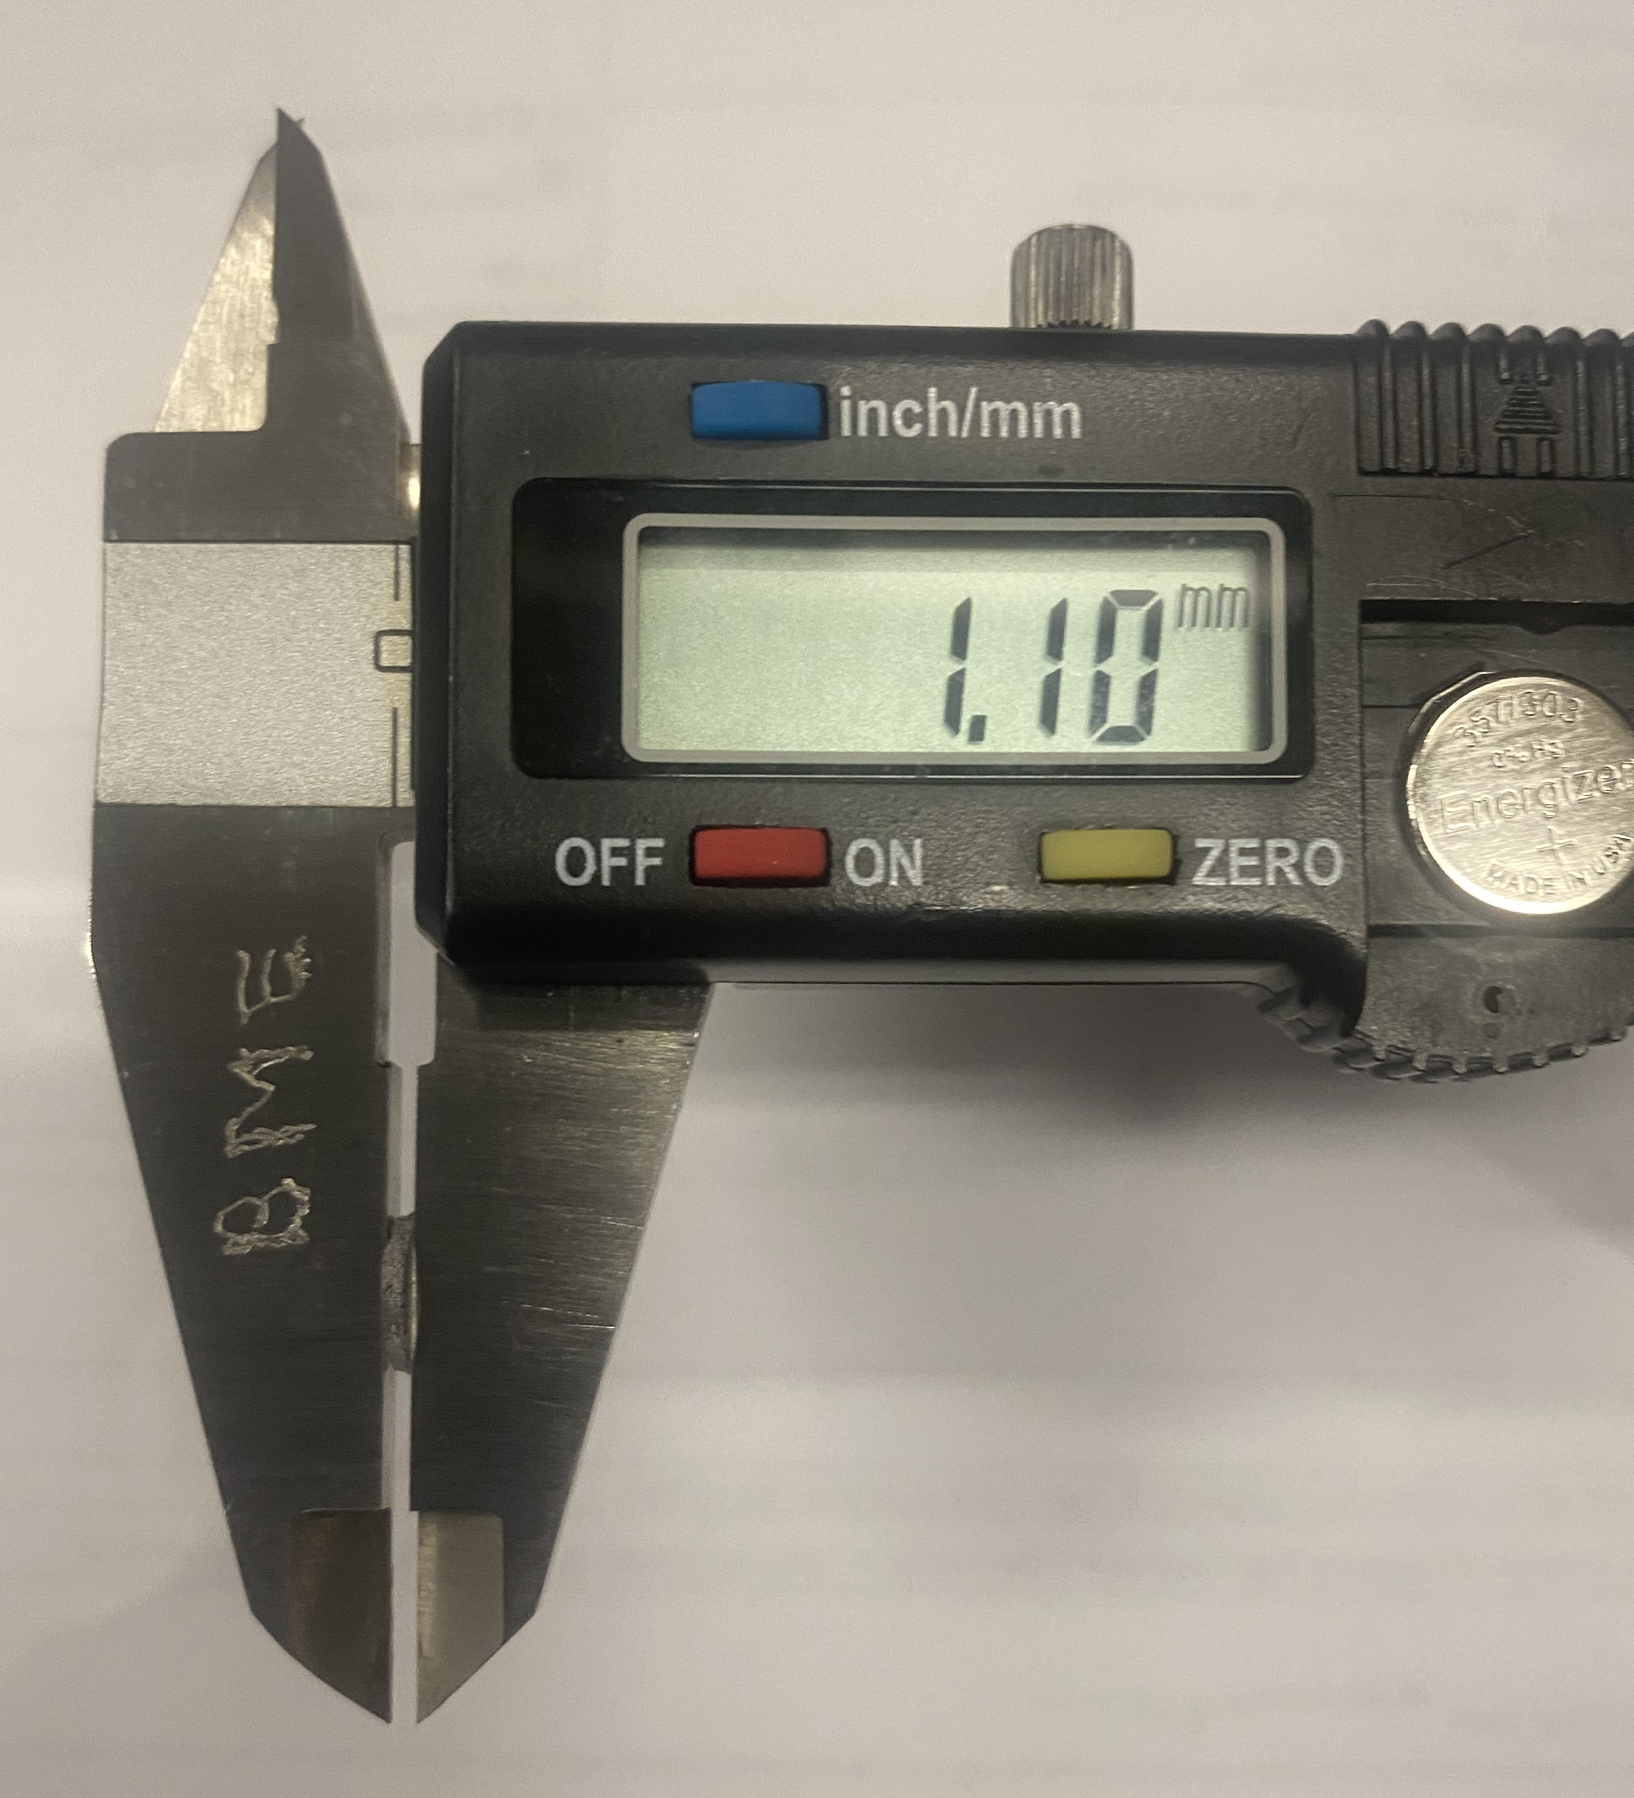
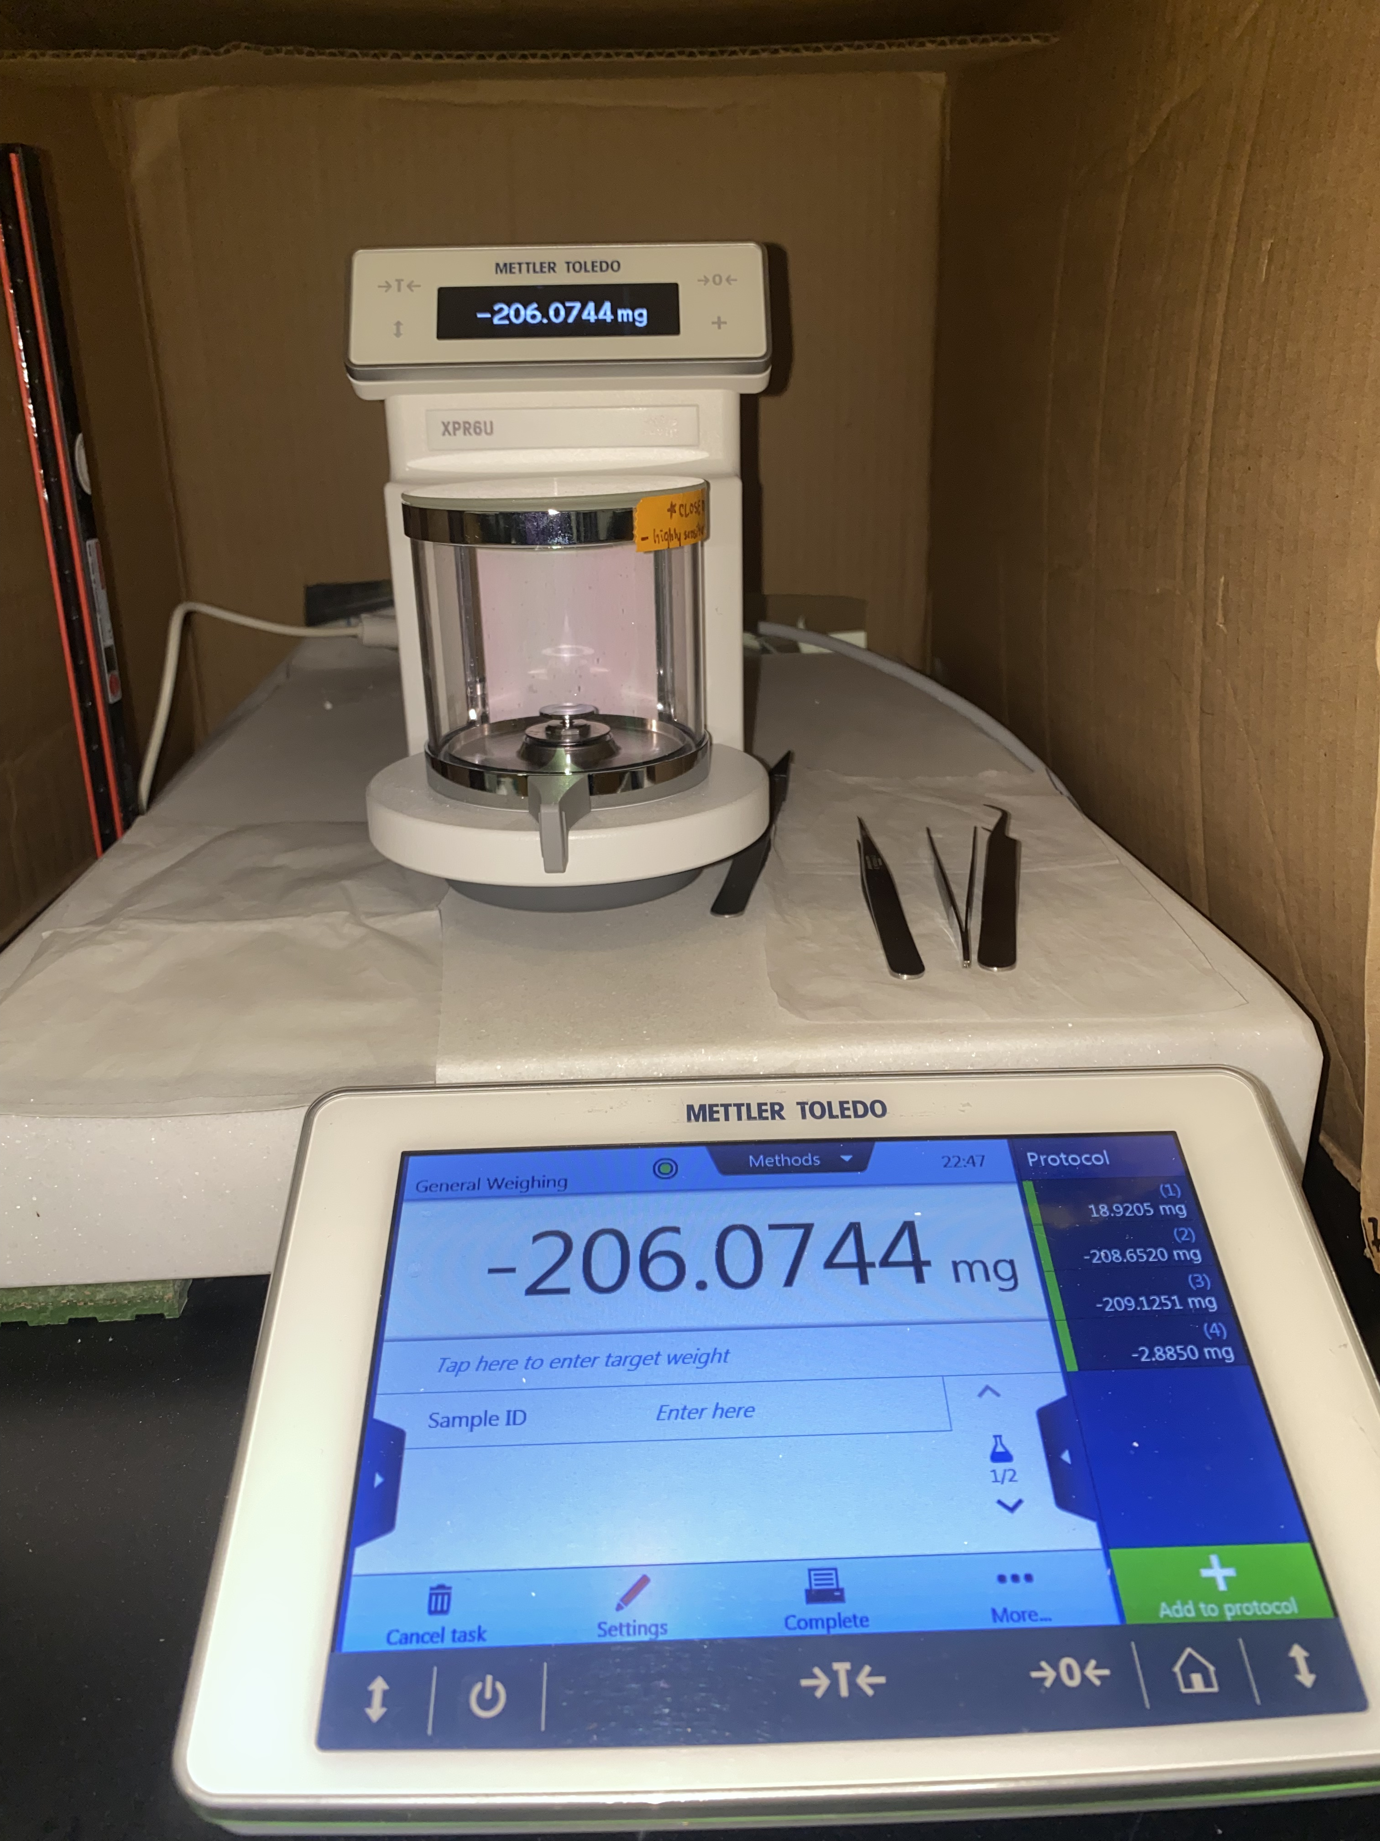
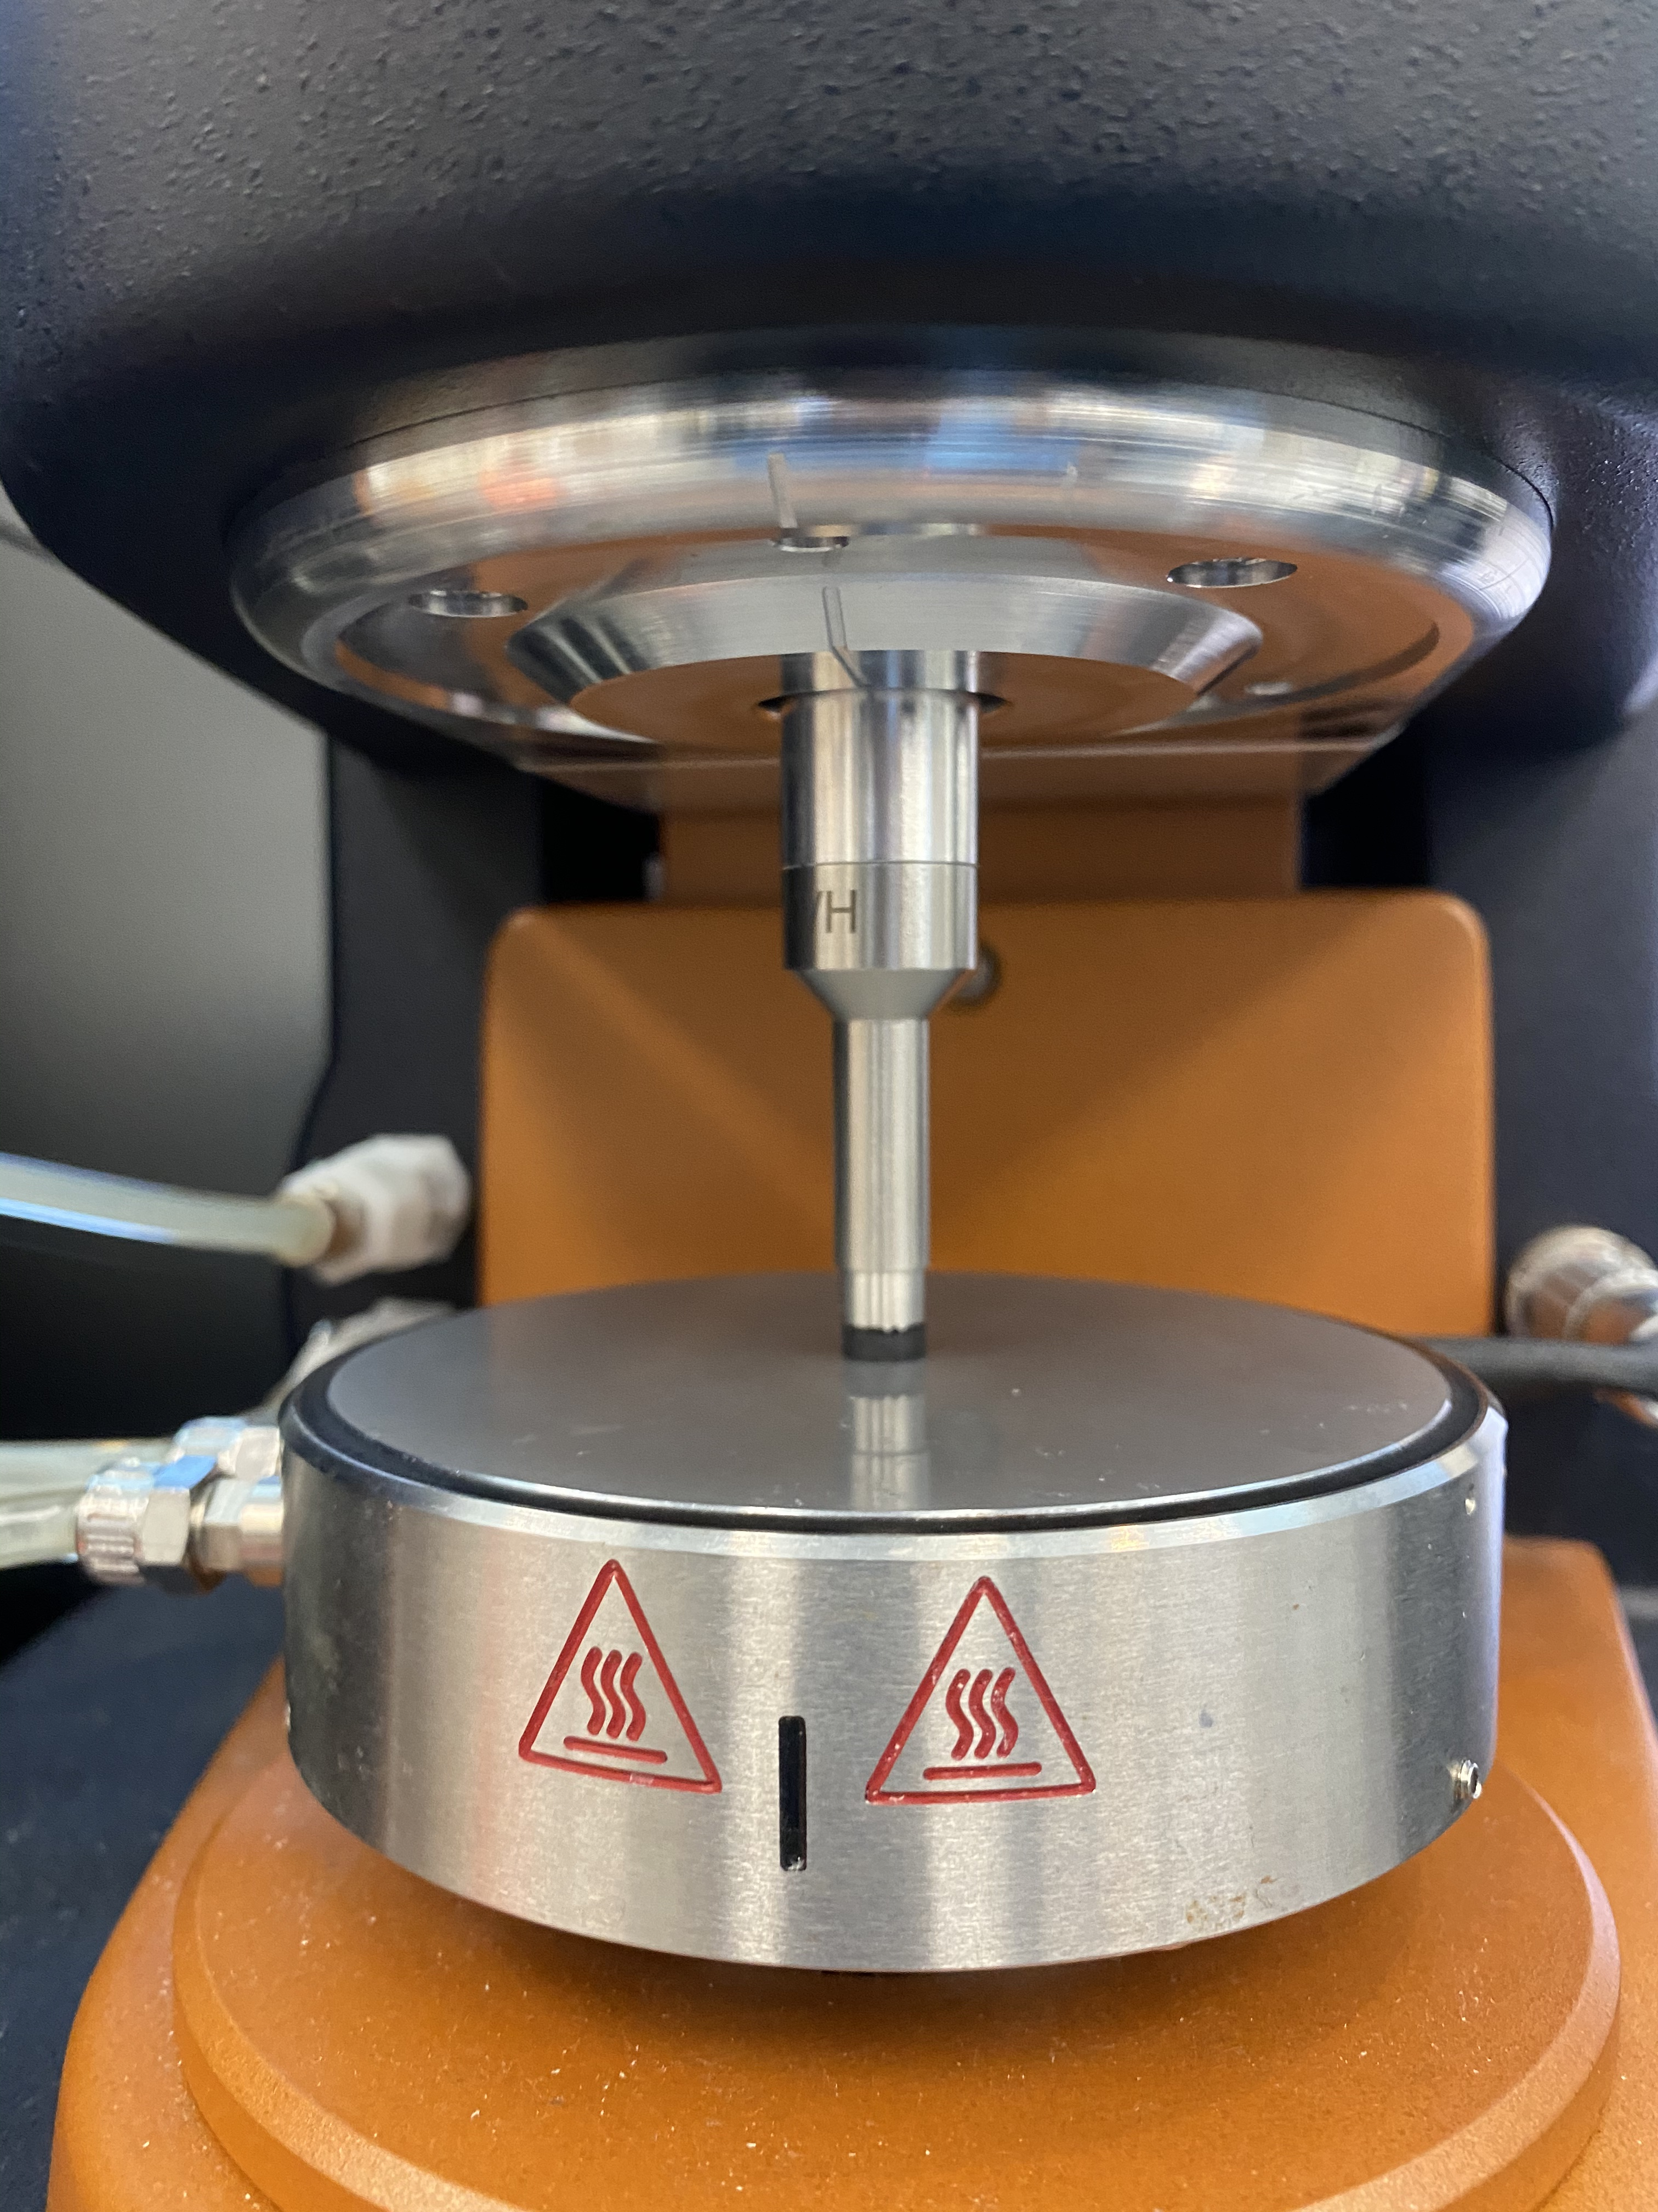
Mechanical Testing
Degradation Storage Modulus Conductivity

Slide 8
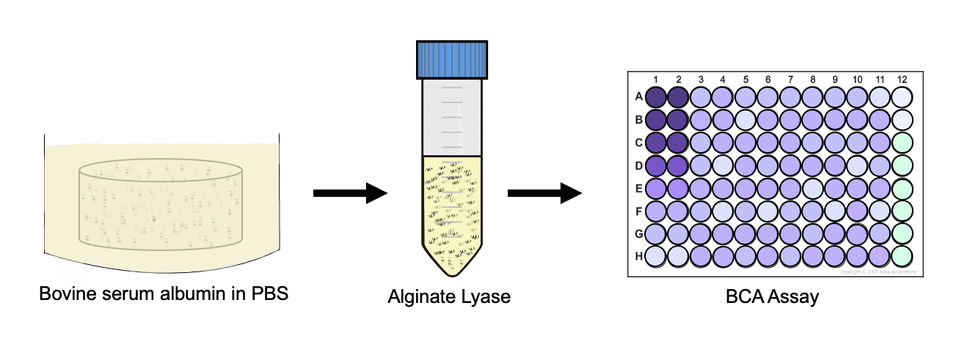
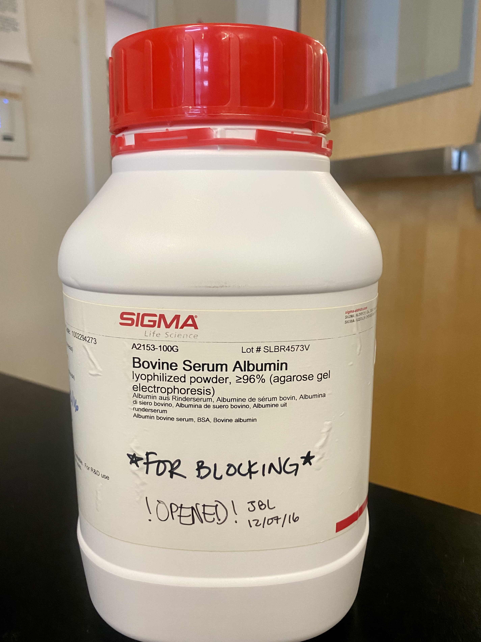
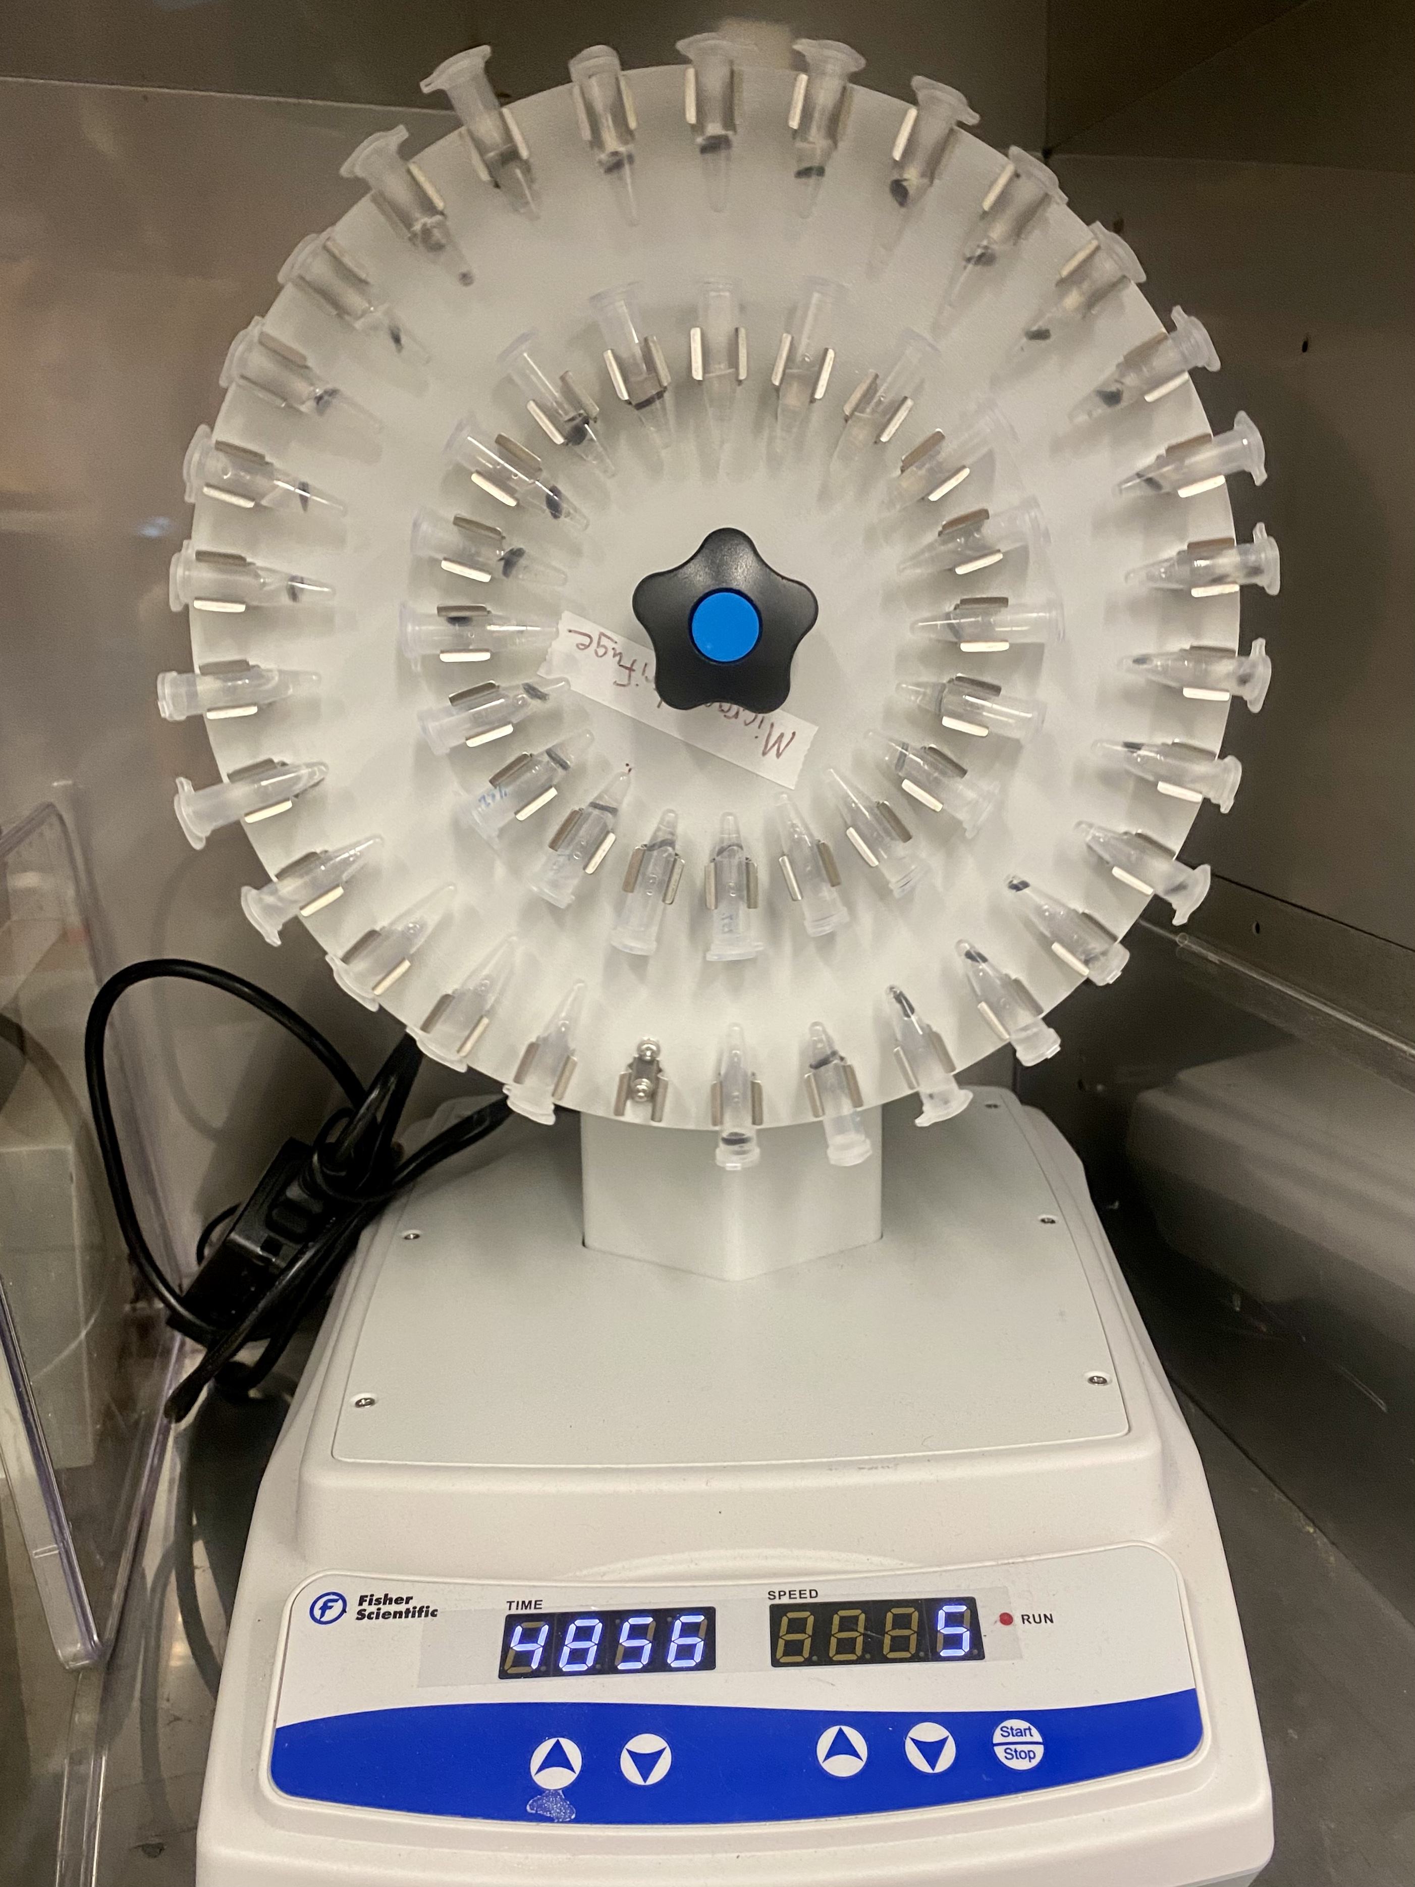
Protein aDsorption
1 mg/1 mL Bovine serum albumin in PBS
Incubate gels for 24 hours at 37°C
Degrade gels with alginate lyase
Complete BCA assay to analyze protein content

Slide 9
Results

Slide 10
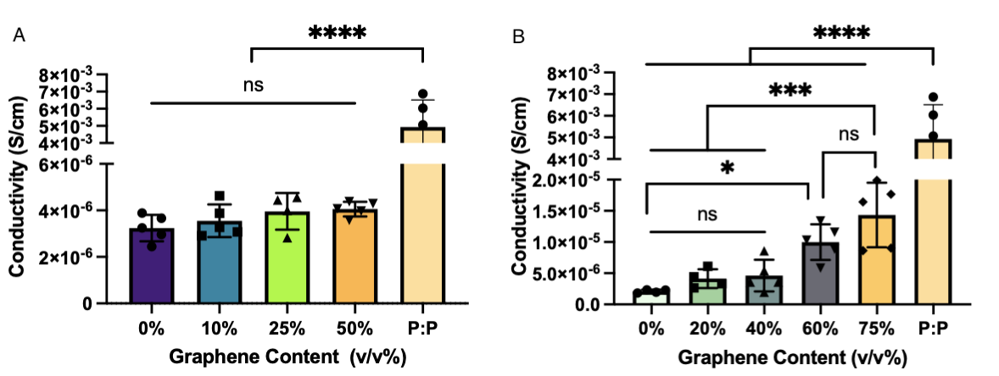
Increased Graphene Can Lead to Increased Conductivity

Slide 11
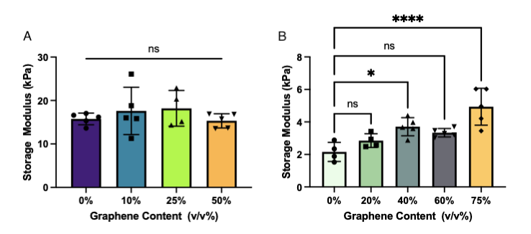
Similar Storage Modulus Among Most Graphene Concentrations

Slide 12
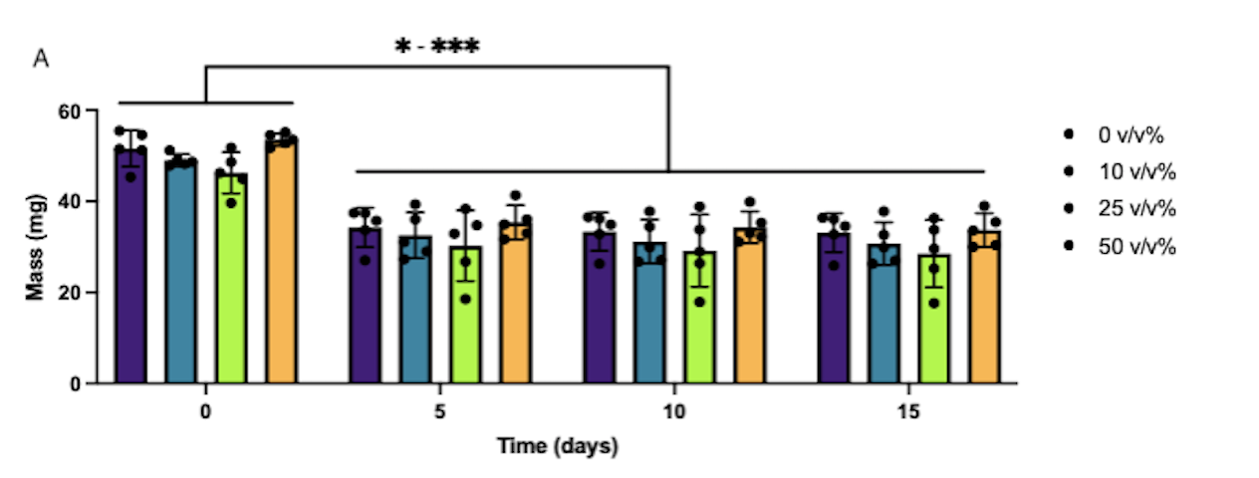
No Degradation from Day 5 to Day 15

Slide 13
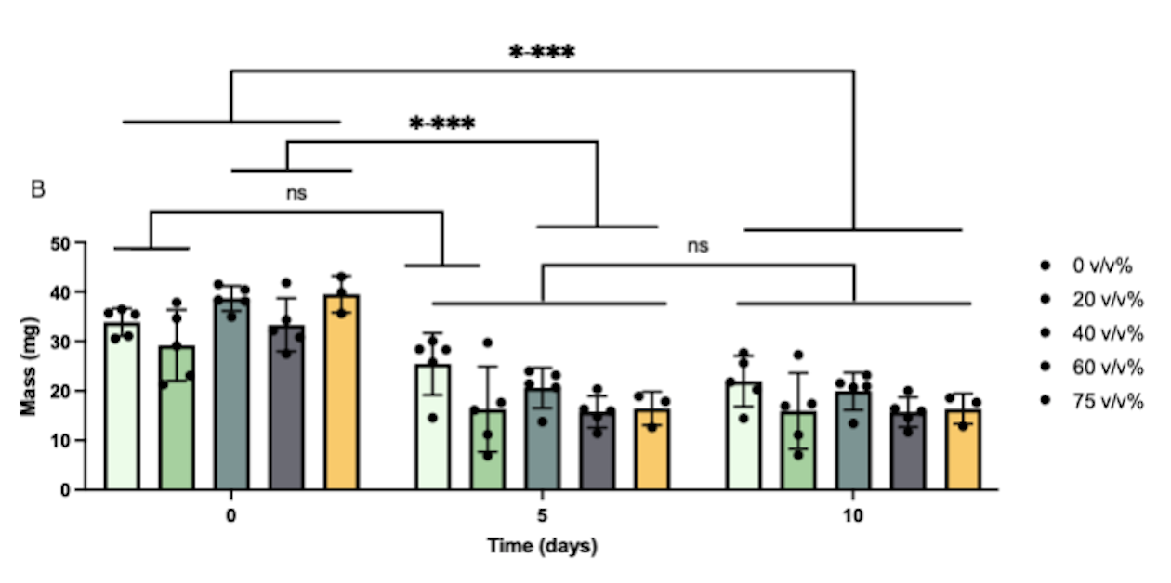
No Degradation from Day 5 to Day 10

Slide 14
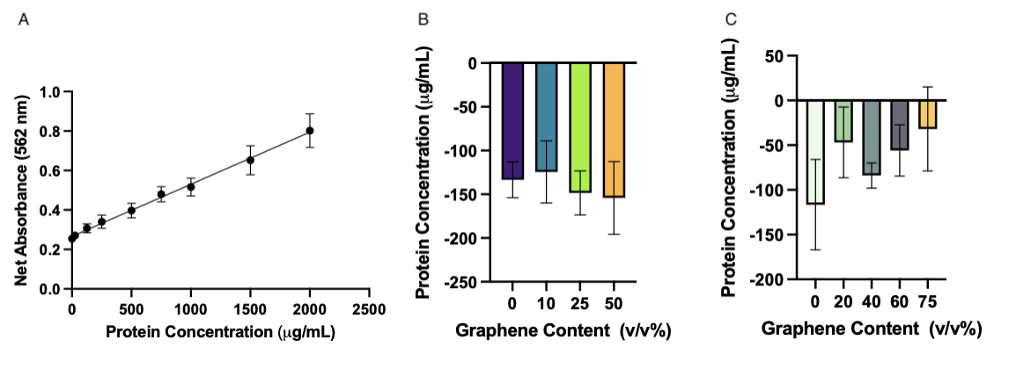
Inconclusive Protein Quantification

Slide 15
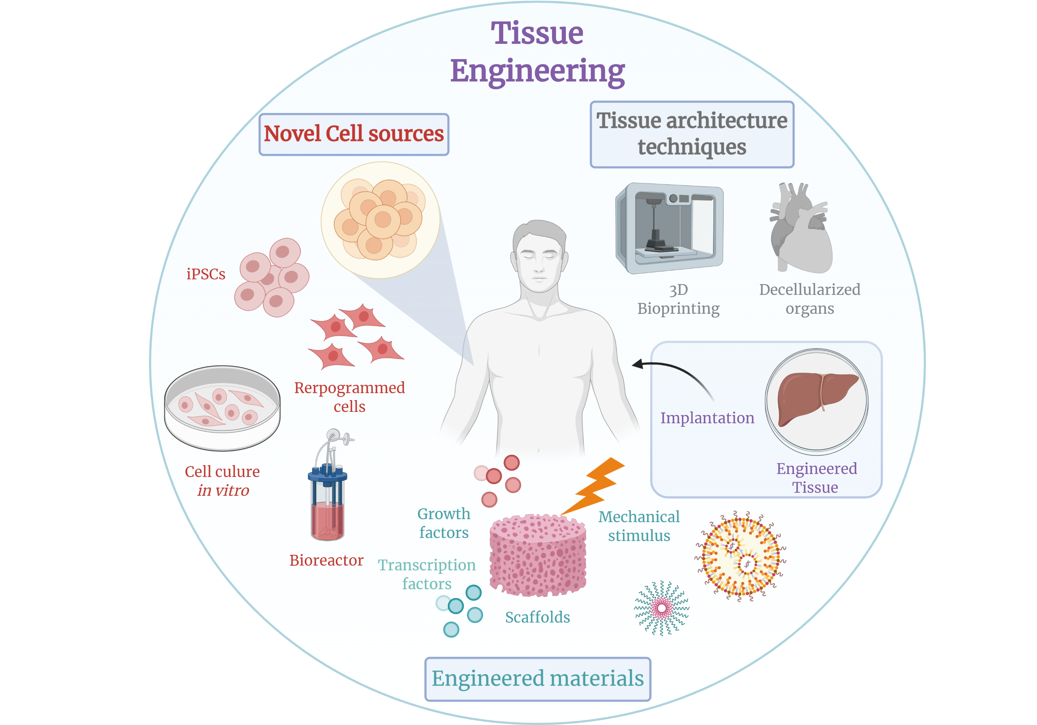
Conclusion and Significance
Annaisasp. (2019)

Slide 16
What’s Next?
Relate conductive additive concentration to hydrogel surface charge with protein adsorption assays.
Evaluate how surface charge influences cell culture media protein adsorption and nerve cell adhesion.
Measure cell viability and metabolic activity in response to conductive hydrogels.
Characterize the effect of substrate conductivity on neurite extension and neuronal gene expression.
…REPEAT

Slide 17
Acknowledgments
Dr. Kent Leach
Alena Casella
Leach Lab
Financial support was provided by the Students Training in Advanced Research (STAR) Program.

Slide 18
Works Cited
Chu, C. C. (2013). 10—Types and properties of surgical sutures. In M. W. King, B. S. Gupta, & R. Guidoin (Eds.), Biotextiles as Medical Implants (pp. 231–273). Woodhead Publishing. https://doi.org/10.1533/9780857095602.2.232.
Mit, A. (2021). 3D Dental Illustrations. https://alexmit.com/.
Bencherif, Sidi & Braschler, Thomas & Renaud, Philippe. (2013). Advances in the design of macroporous polymer scaffolds for potential applications in dentistry. Journal of periodontal & implant science. 43. 251-261. 10.5051/jpis.2013.43.6.251.
Schofield, Z., Meloni, G. N., Tran, P., Zerfass, C., Sena, G., Hayashi, Y., Grant, M., Contera, S. A., Minteer, S. D., Kim, M., Prindle, A., Rocha, P., Djamgoz, M. B. A., Pilizota, T., Unwin, P. R., Asally, M., & Soyer, O. S. (2020). Bioelectrical understanding and engineering of cell biology. Journal of The Royal Society Interface, 17(166), 20200013. https://doi.org/10.1098/rsif.2020.0013.
Annaisasp. (2019). Tissue Engineering Schematic. BioRender. BioRender.com.

