Slide 1
Characterizing cellular topography and molecular signatures of immune cell populations in the canine brain
Daniela A. Jimenez, Ryan G. Toedebusch, Christine M. Toedebusch
STAR 2022 Oral Presentation
Notes:
Ultimately want to study glioma

Slide 2

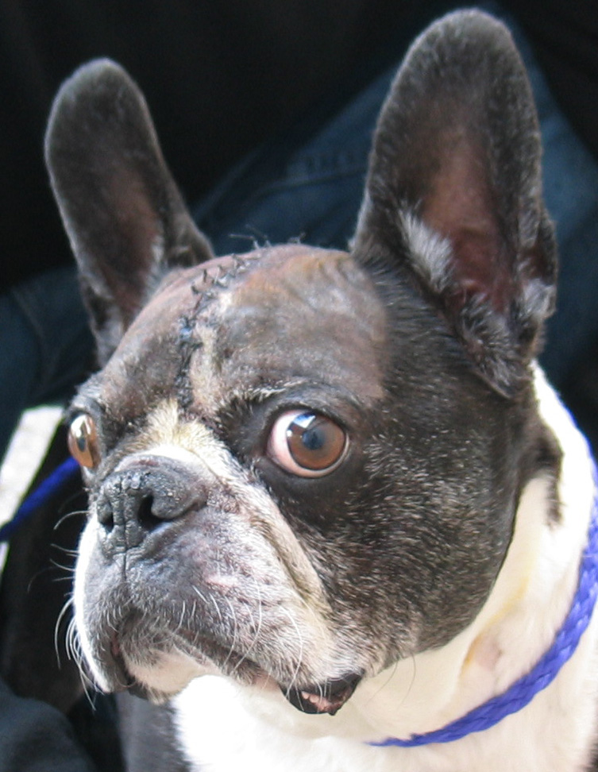
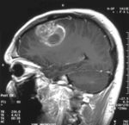
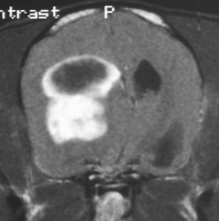
Glioma is uniformly fatal for both humans and canines
Human Glioblastoma (aka high-grade glioma)
Canine Glioma
Most common primary brain tumor
Median age at diagnosis: 64 years
Median survival time: 15-20 months
Second most common primary brain tumor
Median age at diagnosis: 7-8 years
Median survival time: 9-14 months
Russo et al, 2017
Bentley et al, 2016;
Thakkar et al, 2014
Notes:
Canine and human gliomas have similar appearances on MRI (contrast enhancing)

Slide 3
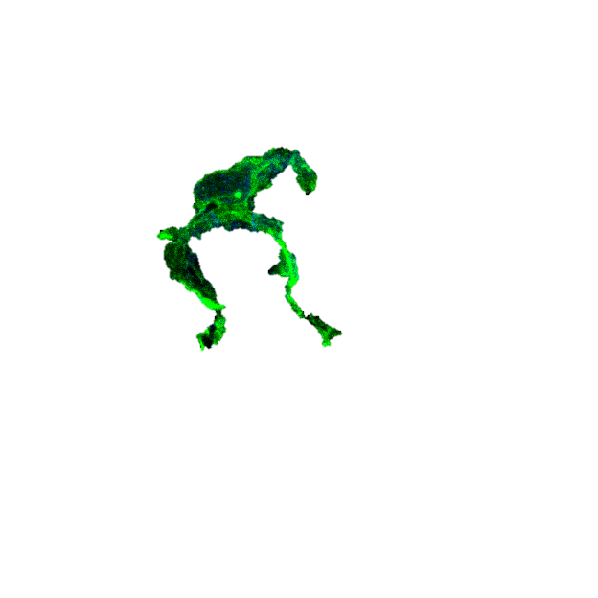
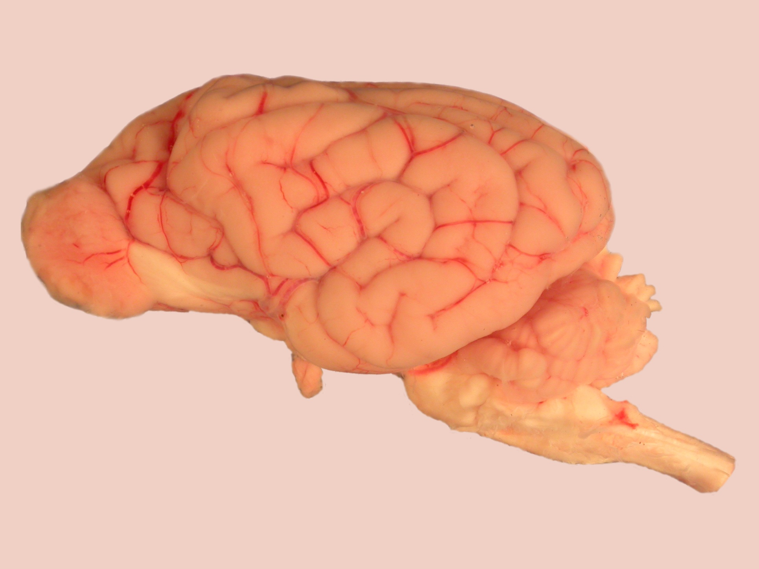
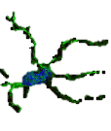

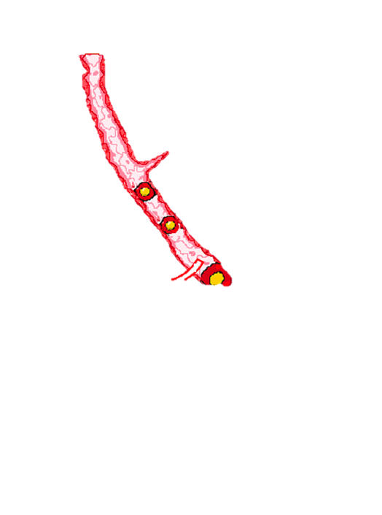
Glioma-associated microglia (GAM) infiltrate
the tumor microenvironment
Glioma-associated microglia
Actively recruited into glioma microenvironment
Largest population of tumor-infiltrating cells
- 30-50% tumor mass
Degree of GAM invasion ∝ tumor grade
Zhang et. al., 2015; Watters et. al., 2005; Badie et. al., 2001

Slide 4
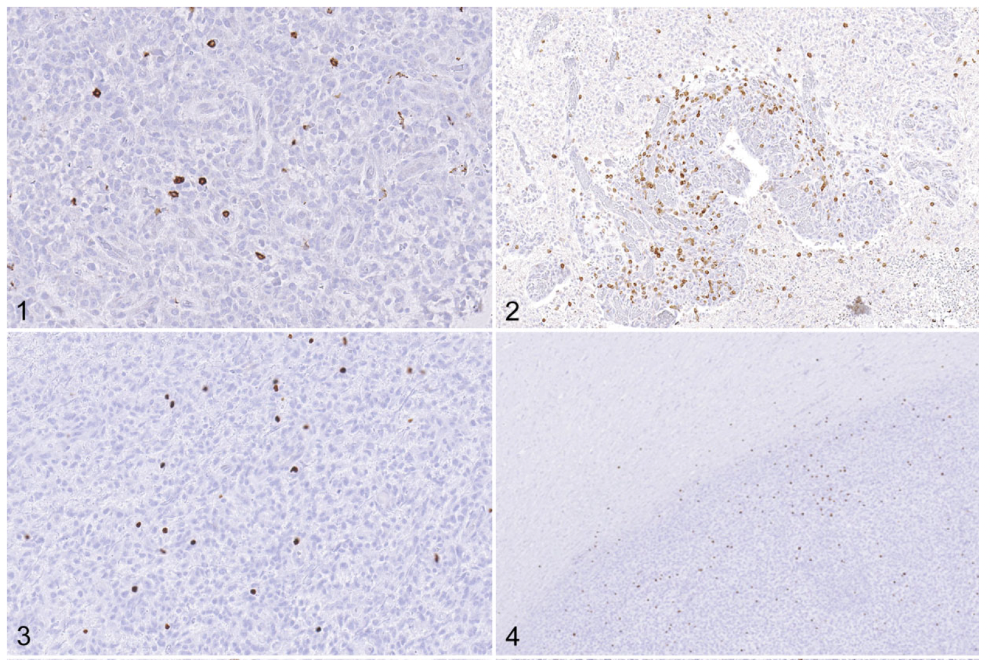
Multiple immune cells infiltrate canine glioma
Cell types identified:
Microglia (Iba1+)
Macrophages (Iba1+, Mac387+, CD163+)
Lymphocytes
T cells (CD3+)
T regulatory cells (FoxP3+)
B cells (CD20+)
T cells
T regs
What are these cells doing in the tumor microenvironment (TME)?
Krane, Gregory A., et al. 2021
Notes:
Lymphocytes
T cells (CD3+)
T regulatory cells (FoxP3+)
B cells (CD20+)
Microglia (Iba1+
Macrophages (Iba1+, Mac387+, CD163+)

Slide 5
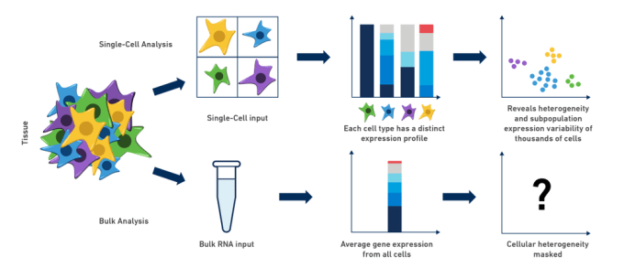
Single cell RNA sequencing provides advantages over bulk RNA sequencing
Image adapted from 10X Genomics Website
Bulk Analysis
Single-cell Analysis
Bulk sequencing can show major transcriptional changes occurring within the tumor
Single cell sequencing can identify rare subpopulations and their relative proportions
Bulk RNA input
Single-cell input
Average gene expression from all cells
Each cell type has a distinct expression profile
Cellular Heterogeneity Masked
Heterogeneity and subpopulation expression variability
Notes:
Dissecting the TME composition and functional heterogeneity of tumor infiltrating immune cells (via single cell RNA sequencing) would extend the understanding to glioma immune microenvironment and allow to modulate functions of distinct subpopulations for therapeutic benefits. “
https://www.10xgenomics.com/blog/single-cell-rna-seq-an-introductory-overview-and-tools-for-getting-started
i.e. – hard to separate out important changes vs. individual variation

Slide 6
Characterizing the Normal Canine Brain
Confirm that single cell RNA sequencing will work with our archived samples
Define normal. Comprehensive analysis of normal canine brain immune cells is lacking
Define changes to the transcriptome that occur with brain tumor pathology
Notes:
Before we see the changes occurring with pathology, we have to define the normal canine brain.
Comprehensive analysis of normal canine brain immune cells is lacking.
And before that… we have to see if this technique will work with our archived samples.

Slide 7
Characterizing the Normal Canine Brain
Hypothesis: single cell RNA sequencing (scRNA-seq) will define distinct mononuclear cell populations and corresponding transcriptomic profiles across different brain regions in the normal canine brain.
Aim 1A: Define the immune composition across four distinct canine brain regions.
Aim 1B: Characterize the transcriptome of mononuclear cell subpopulations in canine brain.
Notes:
This work will provide a preliminary analysis of normal canine brain immune cell composition and function, a necessary first step to begin to define how these signatures are altered in canine brain disease, specifically canine glioma.
Previous studies have found that there is heterogeneity among cells across brain regions.

Slide 8
Feasibility Pilot Study Design
Archived mononuclear cells from two normal dog brains:
Canine 1 - “Cooper” MC Lab Mix ~8yrs
Canine 2 - “Gemma” FS Chihuahua ~7yrs
Cells sorted using Fluorescence Activated Cell Sorting (FACS) – to enrich live cell proportion
Four brain regions per dog:
Left Frontal Cortex
Left Temporal Cortex
Left Mesencephalon
Left Occipital Cortex
Notes:
archived mononuclear cell layers – pre-sorted using FACS/flow cytometry to enrich the proportion of live cells and collect more cd11b populations

Slide 9
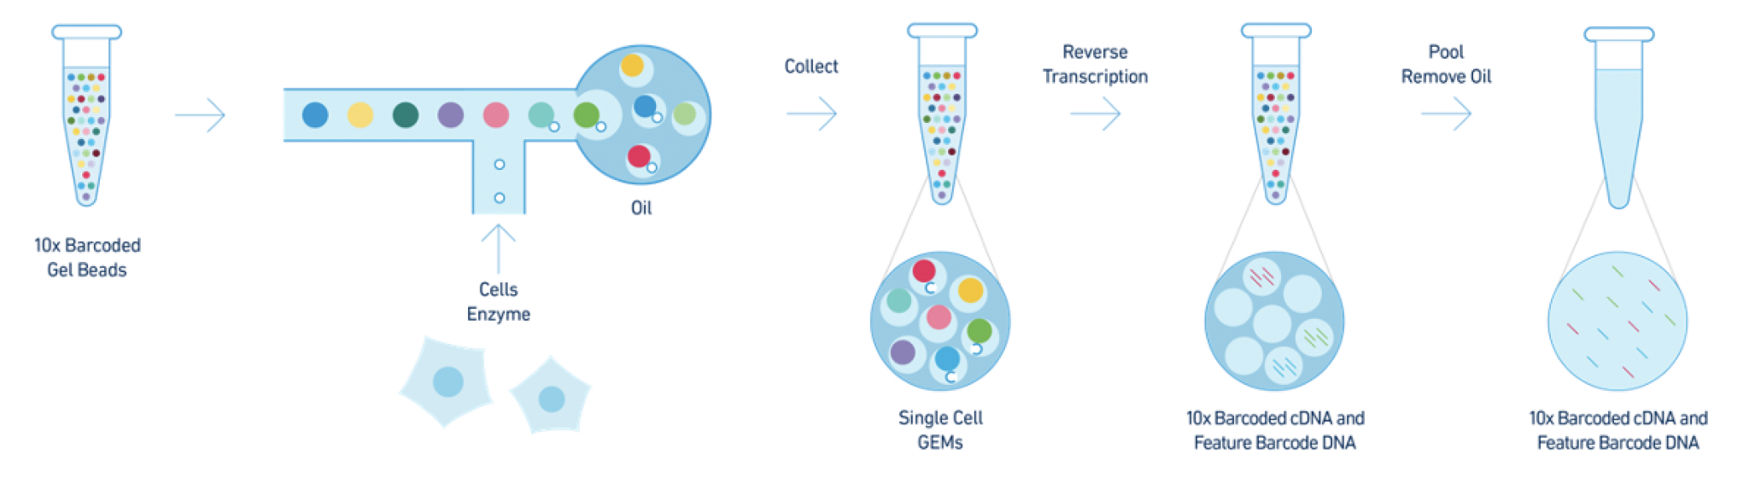

Sequencing and Pre-Processing
Canine reference genome created using 10X CellRanger pipeline - CanFam3.1 assembly
Sequencing reads were aligned to reference transcriptome
Each cell is attached to a gel bead containing a unique barcode
Every transcript read can be traced back to an individual cell
<- me during STAR 2022

Slide 10
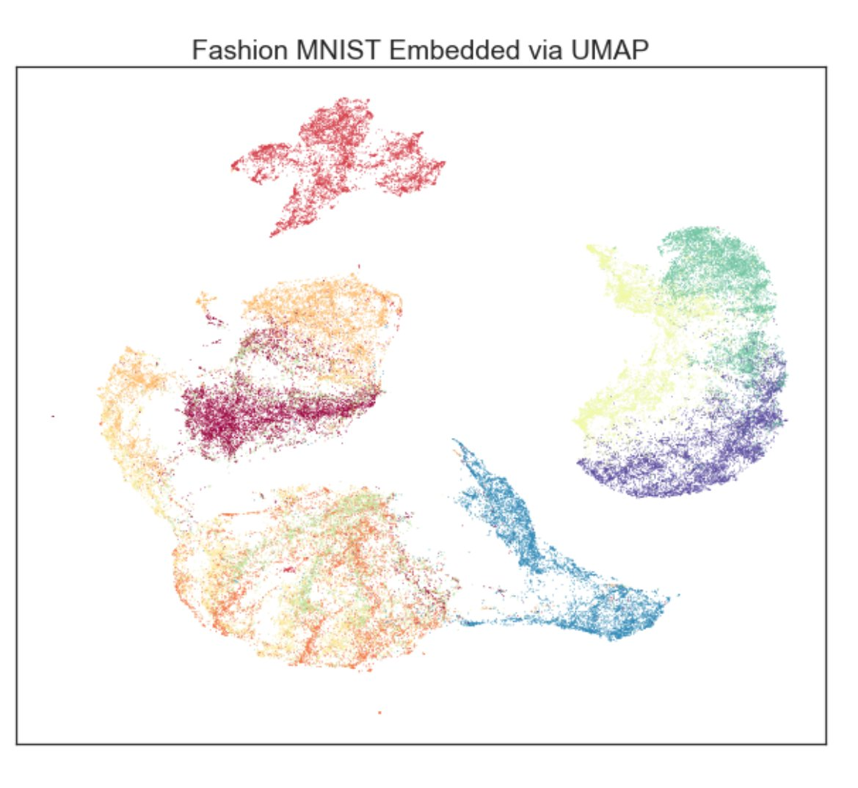

Secondary Analysis with R Package: Seurat
Trouser
Identify cell clusters and visualize with UMAP plots
Sneaker
Sandal
Identify cell types
Tshirts, Pullovers, Shirts, Coats
Ankle boot
Bag
Identify differentially expressed genes
Painting by Georges Seurat (https://www.britannica.com/biography/Georges-Seurat)
Notes:
dimension reduction technique that can be used for visualisation
Increase font size

Slide 11

Canine 1 - Cooper
Reference Genome: CanFam3.1

Slide 12
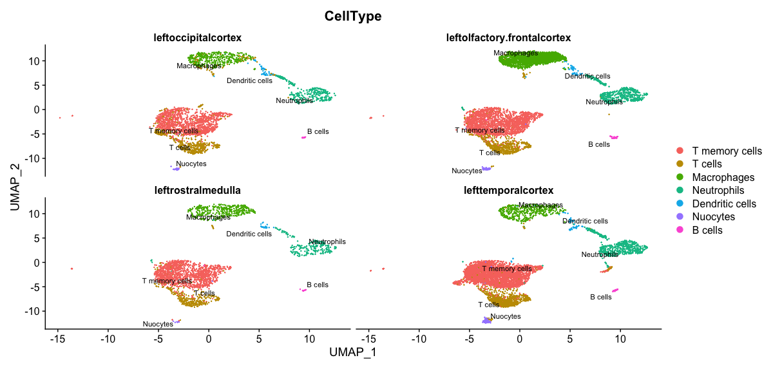
Similar cell types are present across brain regions
Occipital Cortex
Olfactory/Frontal Cortex
Rostral Medulla
Temporal Cortex

Slide 13
Proportion of cell types are similar across brain regions

Slide 14
Canine 1 (Cooper) vs. Canine 2 (Gemma)
Reference Genome: CanFam3.1

Slide 15
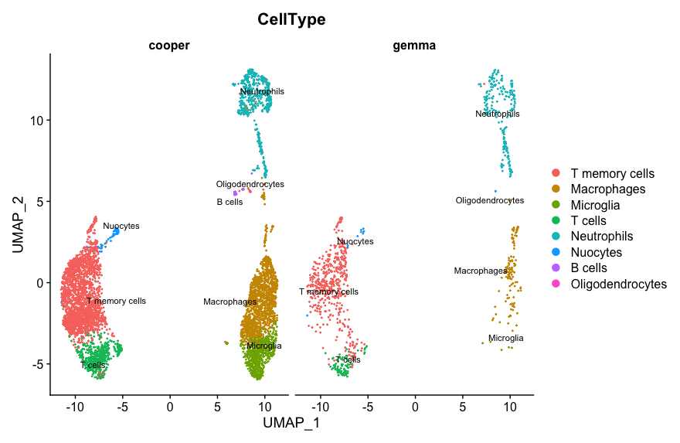
Cell populations within the same brain region are similar between dogs
Left Olfactory/Frontal Cortex
T memory cells 2548
Macrophages 1535
Microglia 672
T cells 616
Neutrophils 769
Nuocytes 82
B cells 48
Oligodendrocytes 10
Notes:
T memory cells 2548
Macrophages 1535
Microglia 672
T cells 616
Neutrophils 769
Nuocytes 82
B cells 48
Oligodendrocytes 10

Slide 16
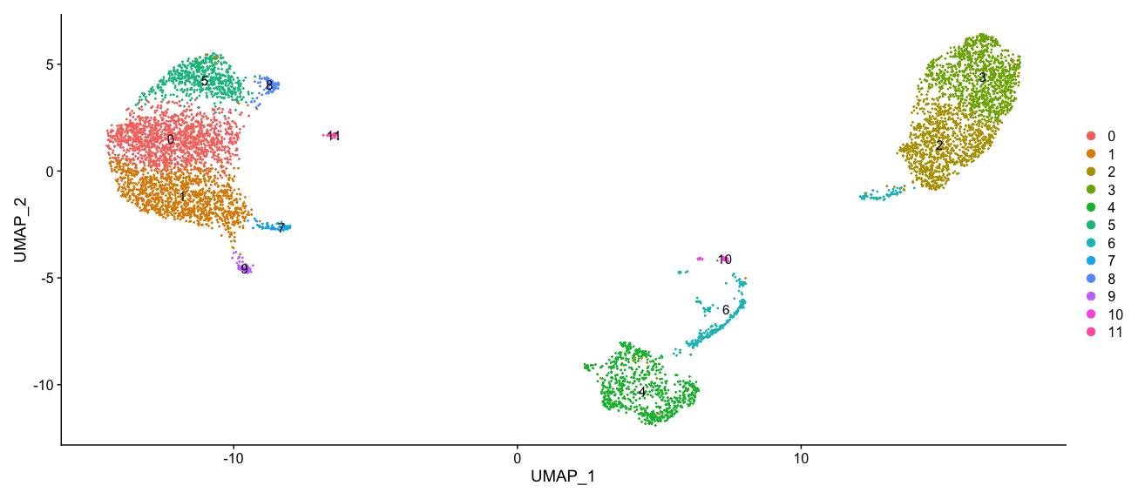
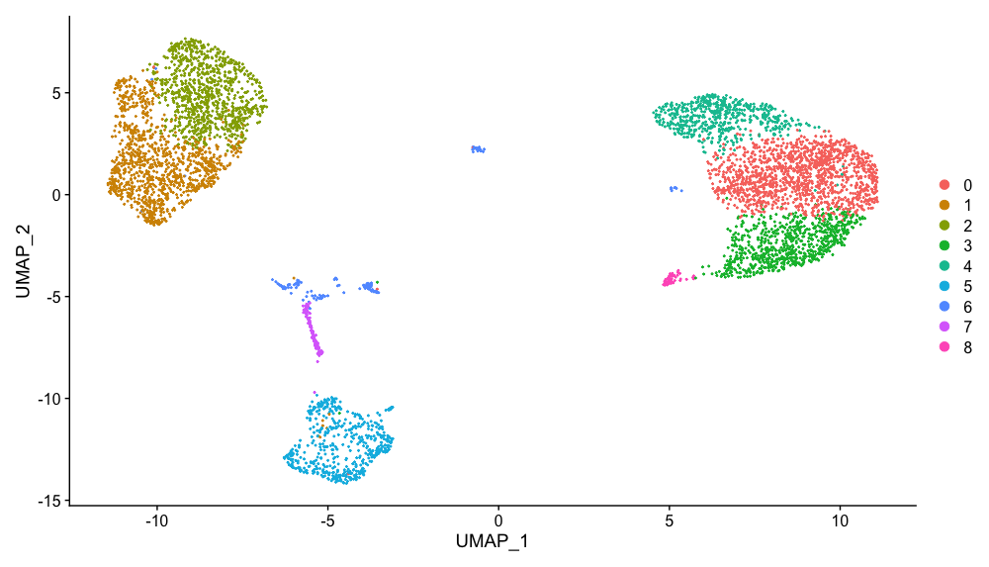
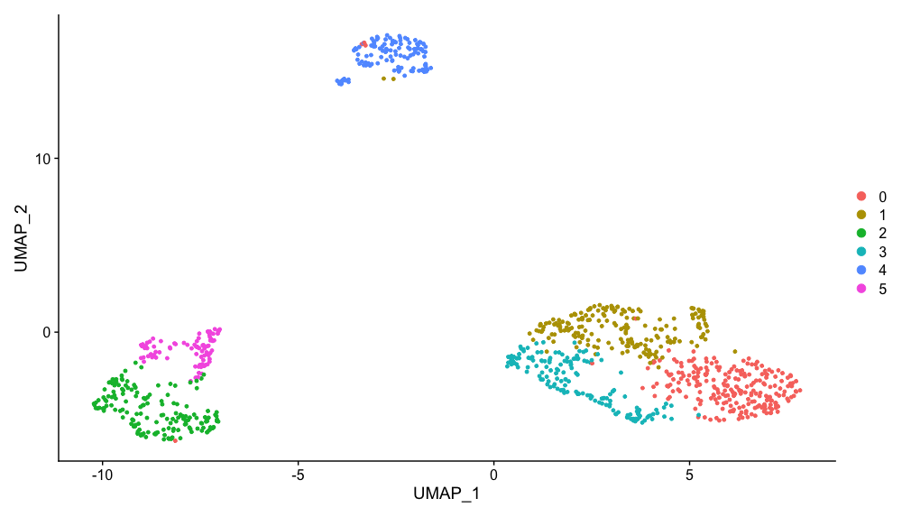
Cell populations cluster differently between dogs
Integrated
Cooper
Gemma
Possible functional differences?
Notes:
Cell populations cluster differently between dogs

Slide 17
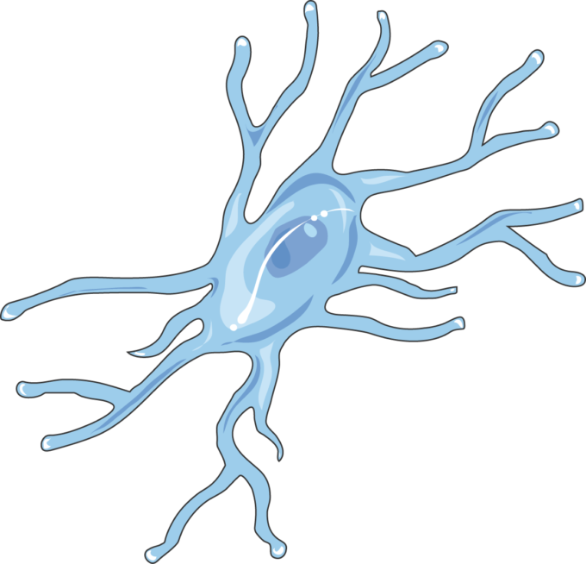


Unexpected Results/Pitfalls
Lack of myeloid cells – cryopreservation method likely not microglia/macrophage friendly
Clinical cases randomly arrive – cannot avoid archiving samples
More neutrophils than anticipated in normal dog brains
Nuocytes?
Newly discovered innate leukocyte important for Type II response (helminth immunity)

Slide 18
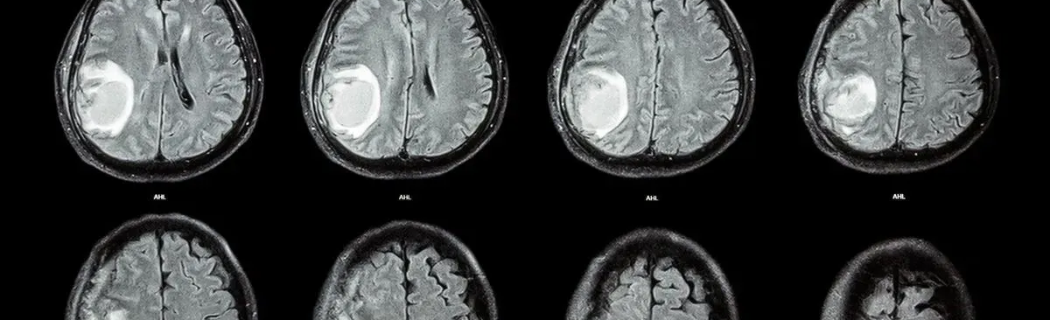
Conclusions
scRNA sequencing is feasible on our cryopreserved samples!
However, we may be losing most of our myeloid cell populations.
There are distinct cell populations within the canine brain.
There are similar cell types between different brain regions.
There are functional differences between cell types (to be further explored)
Image from: https://www.the-scientist.com/news-opinion/immune-activating-gene-therapy-for-glioblastoma-66273
Notes:
https://www.the-scientist.com/news-opinion/immune-activating-gene-therapy-for-glioblastoma-66273

Slide 19
Future Directions
Refine secondary analysis – continue to explore differences between brain regions and between dogs.
Identify differentially expressed genes within the clusters identified.
Submit more samples for scRNA sequencing – including brain tumor patients to see how the immune cell transcriptome changes with pathology.
Image from: https://www.the-scientist.com/news-opinion/immune-activating-gene-therapy-for-glioblastoma-66273
Notes:
https://www.the-scientist.com/news-opinion/immune-activating-gene-therapy-for-glioblastoma-66273

Slide 20





Acknowledgements
Students Training in Advanced Research (STAR) Program – UC Davis SVM Endowment Funds (DJ)
NCI/NIH UC Davis Paul CalabresiK12 #2K12CA138464-11 (CT)
UC Davis Health Comprehensive Cancer CenterCANCERCOP2-WT (CT)
10X Genomics, UCD DNA Technology Core, UCD Bioinformatics Core - Hong Qiu, Hannah Lyman, Blythe P Durbin-Johnson
UCD Flow Cytometry Core – Bridget McLaughlin, Jonathan Van Dyke
Toedebusch Lab: Christine Toedebusch, Ryan Toedebusch, Eshetu Debebe, Jennie Furth-Jacobus, Kulani Simafranca, Shafee Syed-Quadri

Slide 21

Questions?

Slide 22
References
Bentley, R. Timothy, et al. “Dogs Are Man’s Best Friend: In Sickness and in Health.” Neuro-Oncology, June 2016, p. now109. DOI.org (Crossref), https://doi.org/10.1093/neuonc/now109.
Thakkar, Jigisha P et al. “Epidemiologic and molecular prognostic review of glioblastoma.” Cancer epidemiology, biomarkers & prevention : a publication of the American Association for Cancer Research, cosponsored by the American Society of Preventive Oncology vol. 23,10 (2014): 1985-96. doi:10.1158/1055-9965.EPI-14-0275
Dello Russo, Cinzia et al. “Exploiting Microglial Functions for the Treatment of Glioblastoma.” Current cancer drug targets vol. 17,3 (2017): 267-281. doi:10.2174/1568009616666160813191240
Zhang, Z., Yang, Z., Zhang, Z."Distribution and characterization of tumor-associated macrophages/microglia in rat C6 glioma". Oncology Letters 10.4 (2015): 2442-2446.
Watters, Jyoti J et al. “Microglia function in brain tumors.” Journal of neuroscience research vol. 81,3 (2005): 447-55. doi:10.1002/jnr.20485
Badie, Behnam, and Jill Schartner. “Role of Microglia in Glioma Biology.” Microscopy Research and Technique, vol. 54, no. 2, July 2001, pp. 106–13. DOI.org (Crossref), https://doi.org/10.1002/jemt.1125.
Toedebusch, Ryan, et al. “Glioma-Associated Microglia/Macrophages Augment Tumorigenicity in Canine Astrocytoma, a Naturally Occurring Model of Human Glioma.” Neuro-Oncology Advances, vol. 3, no. 1, Jan. 2021, p. vdab062. DOI.org (Crossref), https://doi.org/10.1093/noajnl/vdab062.
Krane, Gregory A., et al. “Immunohistochemical Evaluation of Immune Cell Infiltration in Canine Gliomas.” Veterinary Pathology, vol. 58, no. 5, Sept. 2021, pp. 952–63. DOI.org (Crossref), https://doi.org/10.1177/03009858211023946.

Slide 23
Sequencing Method
Each cell is attached to a gel bead containing a unique barcode sequence
Each transcript read can be traced back to an individual cell

Slide 24
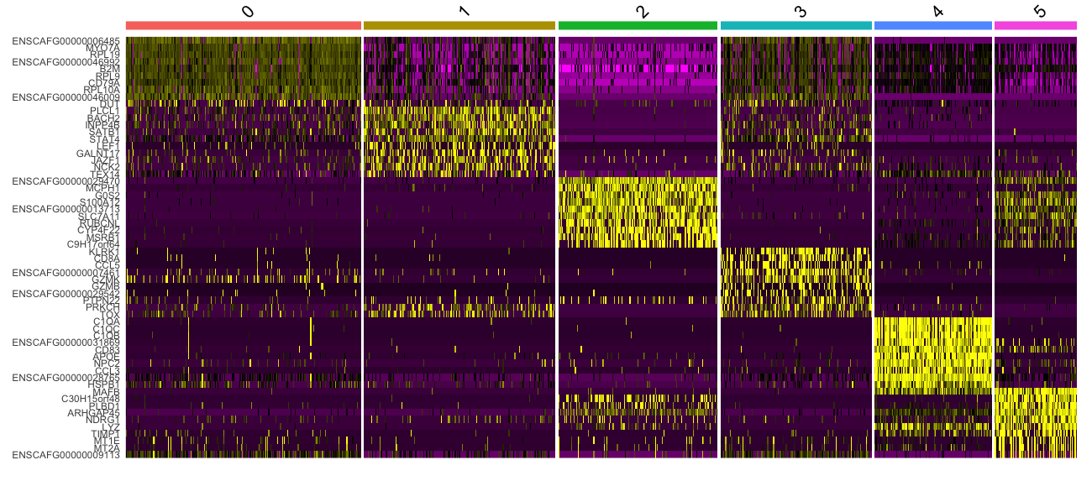
Preliminary Data: Gemma Heatmap

Slide 25
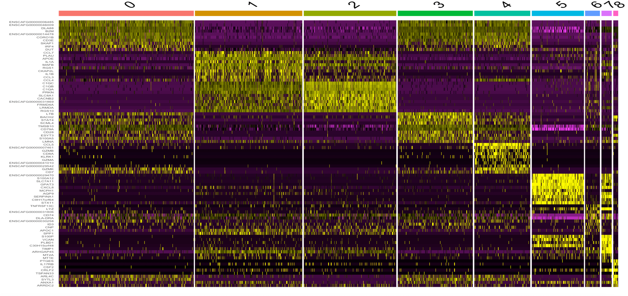
Preliminary Data: Cooper Heatmap

