Slide 1
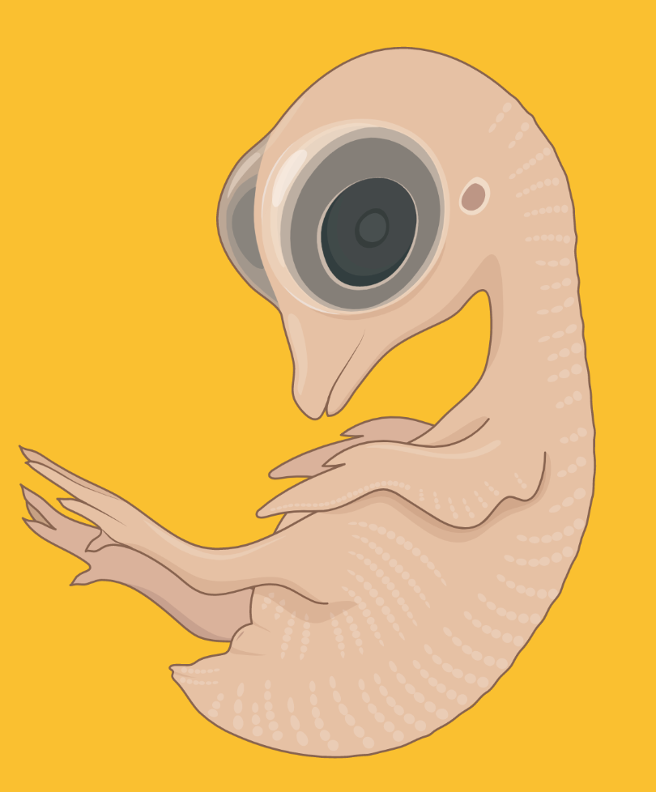
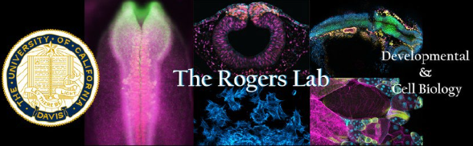
Determining the role of SOX9 in avian beak development and morphogenesis
Juliann Hallum, Heddy R. Menendez, Hannah Herron, and Crystal D. Rogers

Slide 2
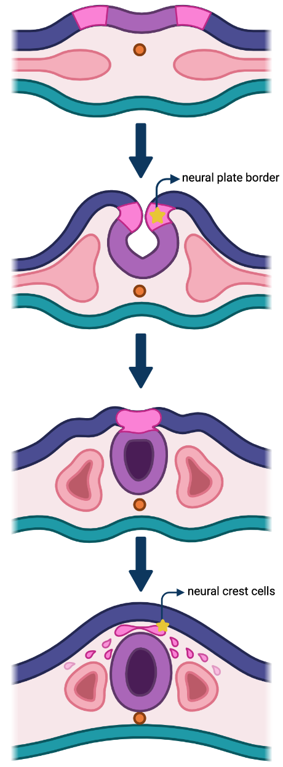
Formation of neural crest cells
SOX9
BioRender

Slide 3
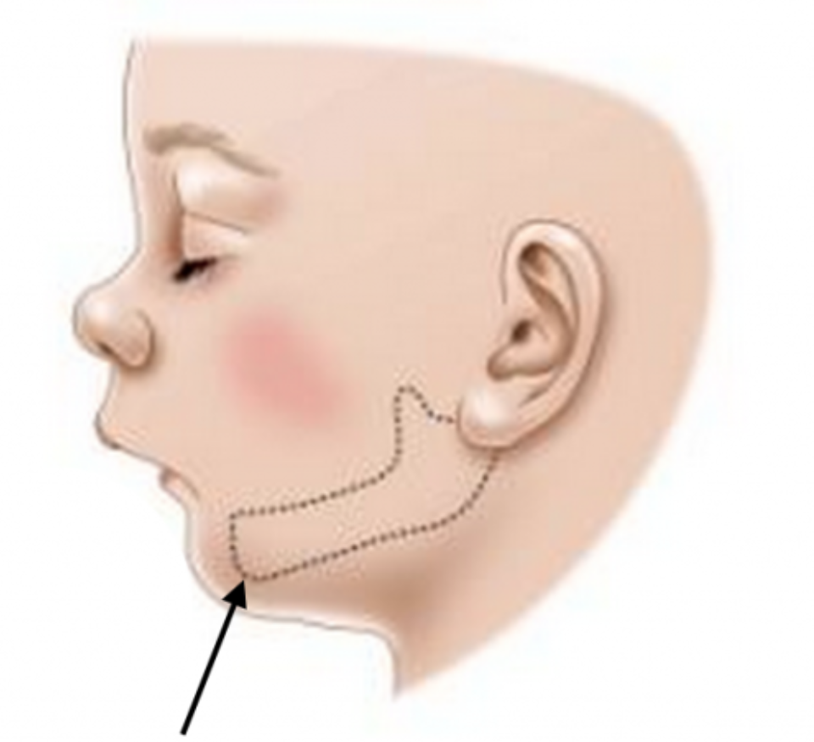
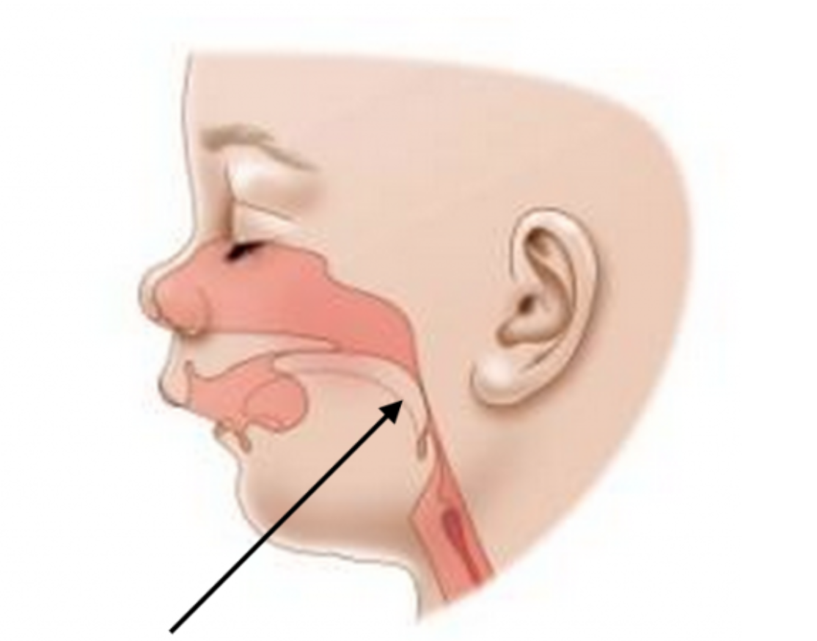

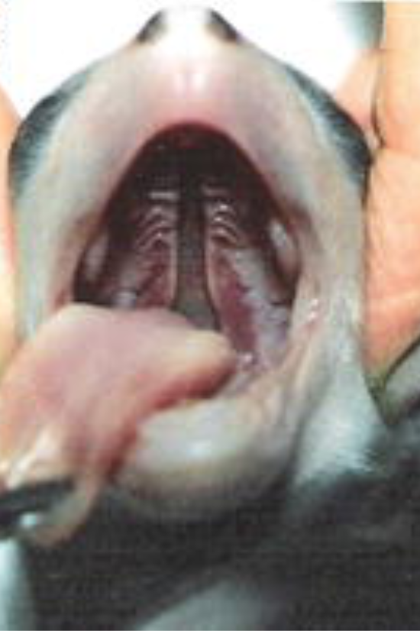
Abnormal neural crest development causes neurocristopathies
SOX9
Neurocristopathies: abnormal generation, migration, or differentiation of NCCs
Cleft Palate
Micrognathia
Airway Obstruction
Moura, 2016.
Dell Children’s Craniofacial and Pediatric Plastic Surgery Program

Slide 4
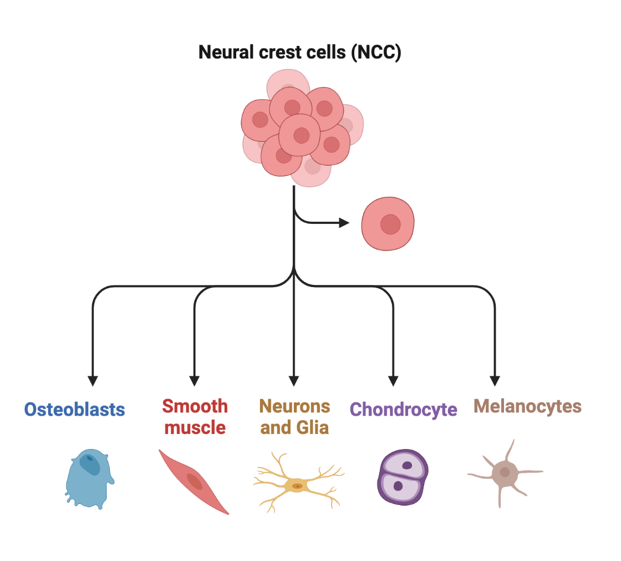
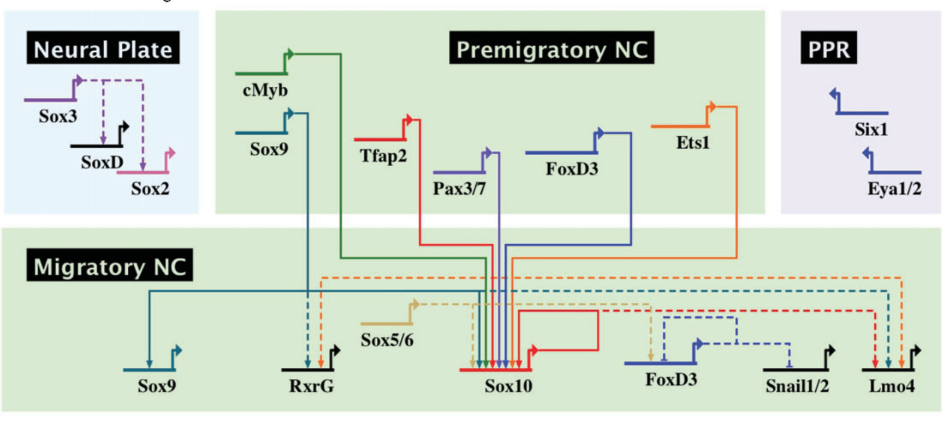

Gene regulatory networks drive differentiation
SOX9
Simoes-Costa, 2015.
BioRender

Slide 5
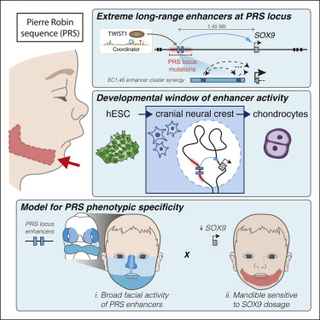
SOX9 is necessary for cartilage and bone formation
SOX9
SOX9 gene mutations: congenital abnormalities
  Campomelic Dysplasia (CD)
  Pierre Robin syndrome (PRS)
    Phenotype: Craniofacial Defects
Long et. al, 2020.

Slide 6
Hypothesis:
Loss of SOX9 prior to NC EMT will inhibit NC cell migration and differentiation, leading to abnormal beak morphogenesis

Slide 7
Summer Project Aims:
Aim 1:
To define the role of SOX9 in beak formation in Gallus gallus (chicken) to determine the specific mechanisms regulating beak morphogenesis
Embryo dissection (18-31 SS, & day 5 incubation)
IHC
HCR
Wholemount
Section
Light sheet

Slide 8
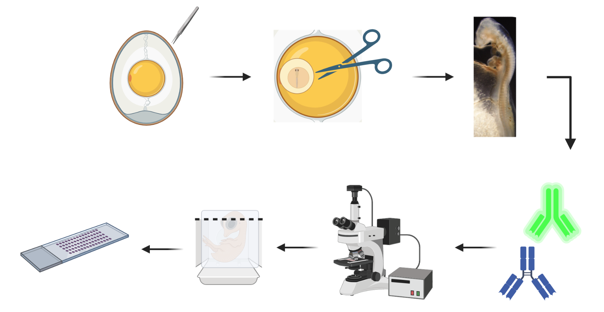
Methods: Embryo dissection and imaging
BioRender

Slide 9
Methods: Markers used
Marker | Protein Type | Associated Cell Type/ Structure
SOX9 SOX10 PAX7 | Transcription Factors | Neural crest
RUNX2 |  | Developing lateral line organs and osteogenic NCCs
Olig2 |  | Oligodendrocyte precursors and developing motor neurons
BMP4 |  | Cell lineage regulation and inducing osteogenic differentiation
TUBB3 | Cytoskeletal Components | Protein component of microtubules in neurons
GFAP |  | Intermediate filament protein associated with astrocytes and ependymal cells of the CNS
CAD11 |  | Calcium dependent cell adhesion protein
4E23G23 |  | Schwann cell associated antigen and neuromuscular junctions
Col2a1 | Extracellular Matrix-Associated | Extracellular matrix protein secreted by chondrocytes during cartilage formation and endochondral ossification
Collagen Type IX |  | Fibril associated and distinct component of cartilage
FGF |  | Cell signaling proteins that regulate cell proliferation and differentiation
P0 | Membrane Bound | Schwann cell progenitors
SOX9
BMP4
TUBB3
IHC
HCR
Sections/Images
Col2a1

Slide 10
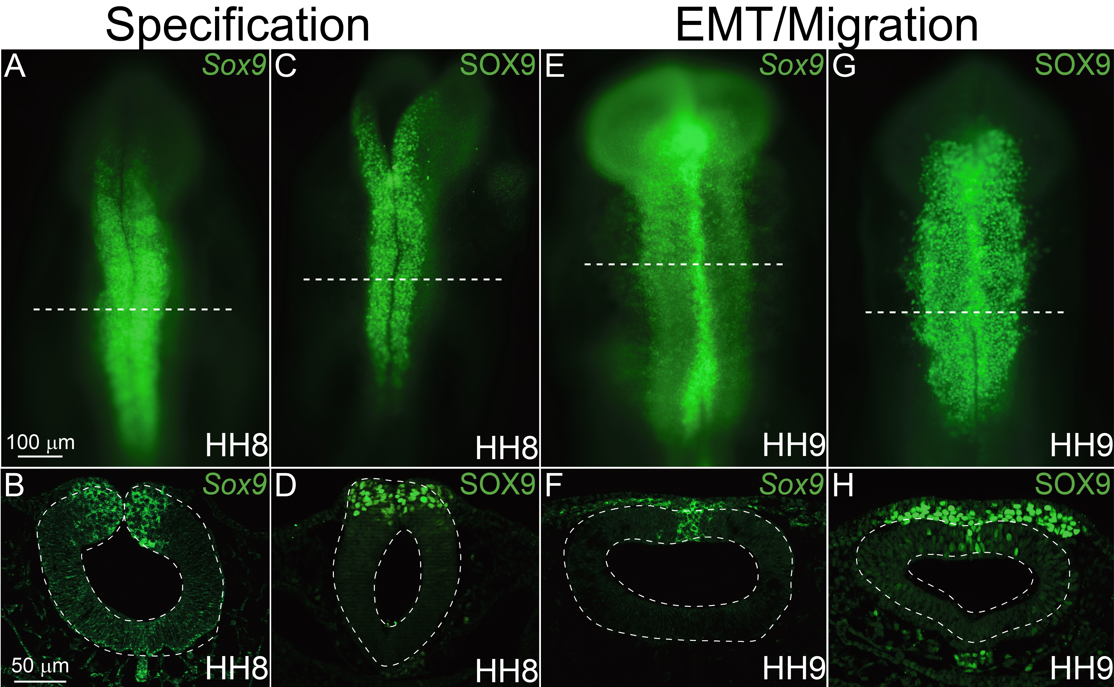
SOX9 is expressed at the onset of neural crest formation
Monroy et al., 2022

Slide 11
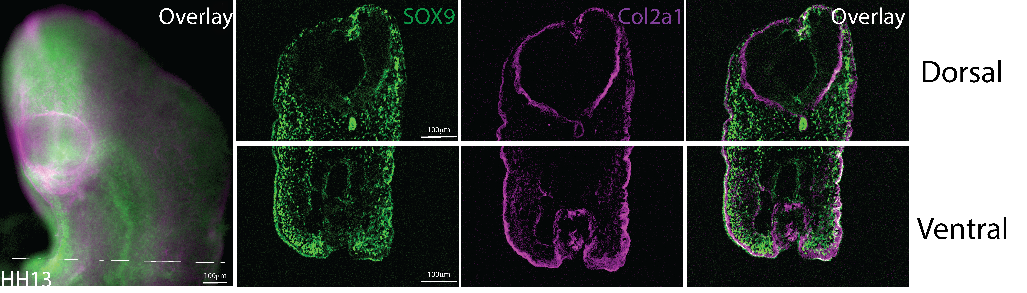
SOX9 expression is maintained during migration into branchial arches that will form craniofacial cartilage

Slide 12
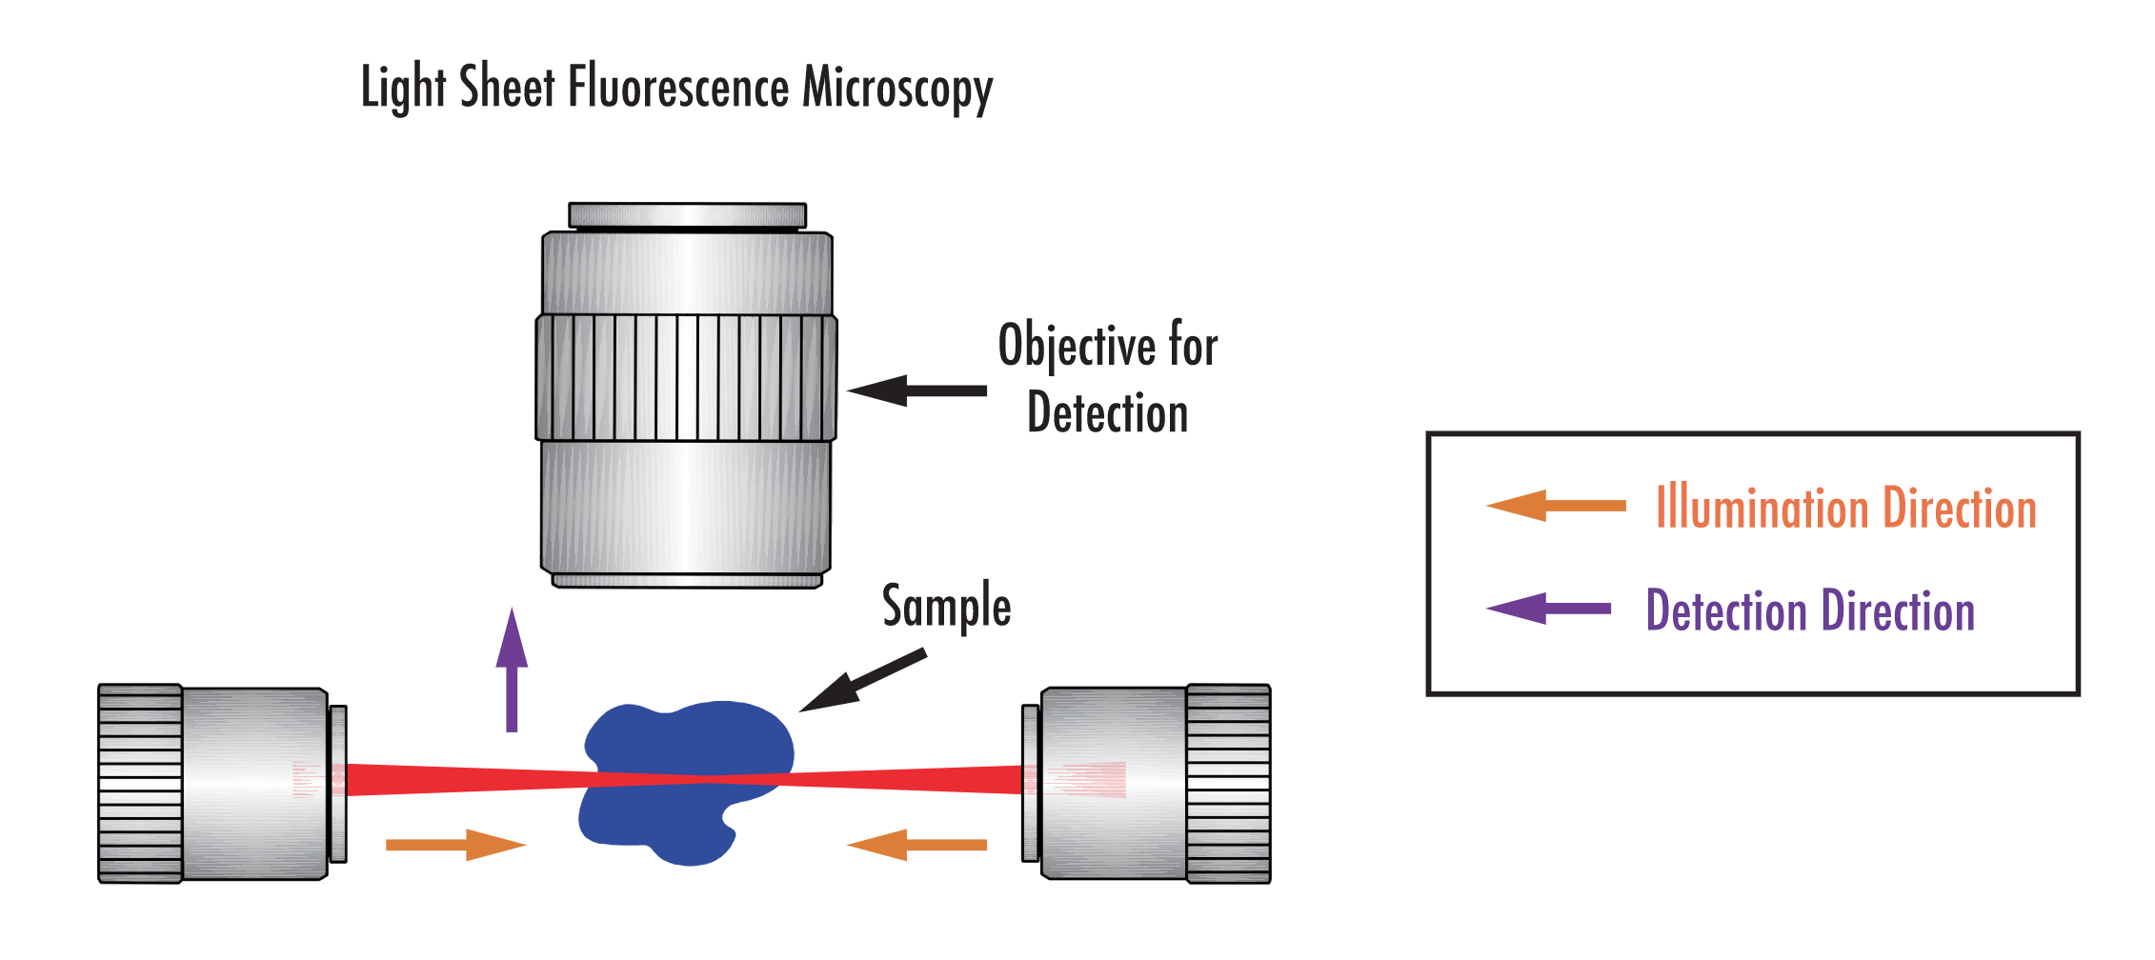
Light sheet fluorescent microscopy (LSFM)
Francis, Light Sheet Microscopy, Edmund Optics

Slide 13
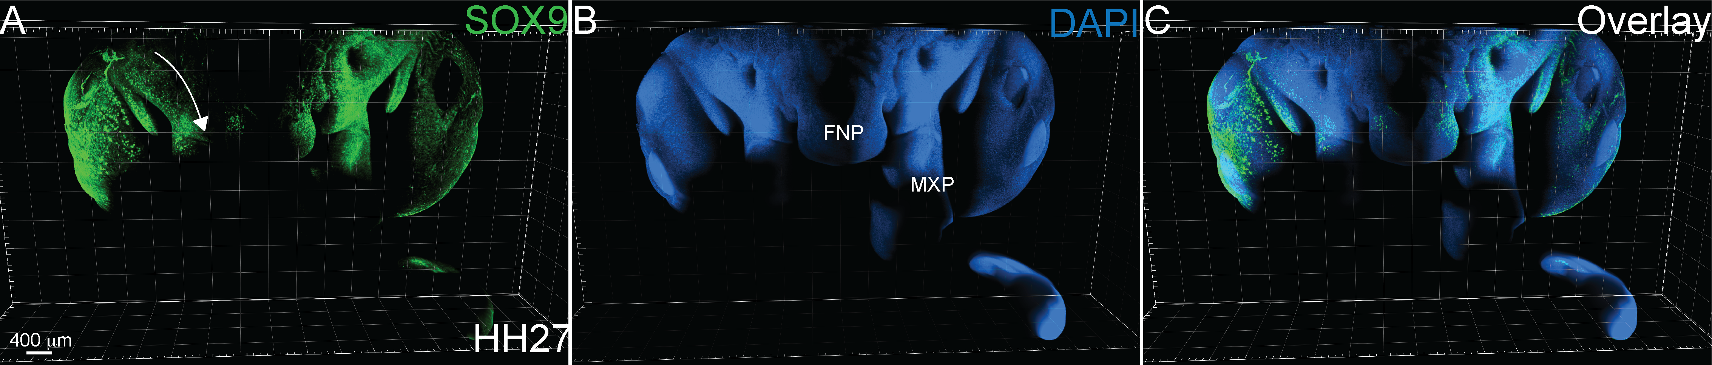
SOX9 expression is maintained in cells colonizing craniofacial prominences

Slide 14
Summer Project Aims:
Aim 2:
To identify molecular changes in NC- derived tissues after loss of SOX9
SOX9 Morpholino (MO)
KD (HH4)
IHC
HCR
Wholemount
Section
Lightsheet
Re-incubate to HH13

Slide 15
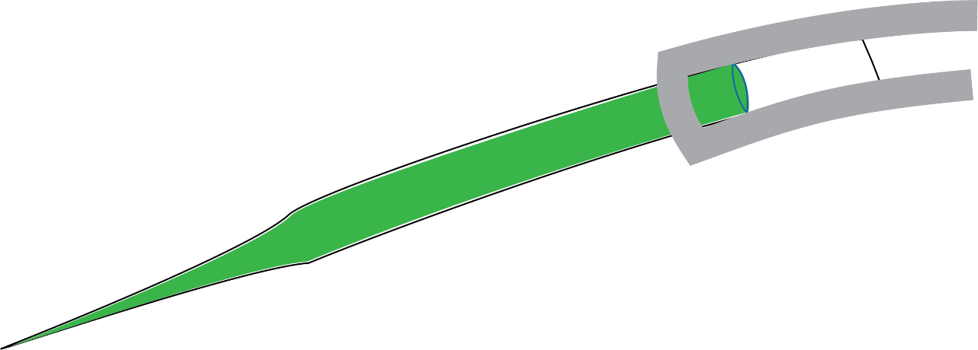
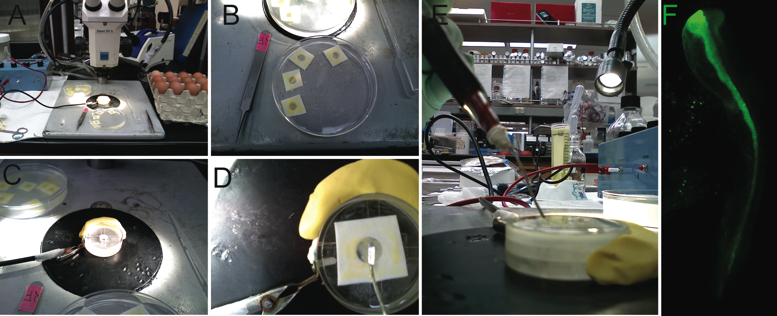
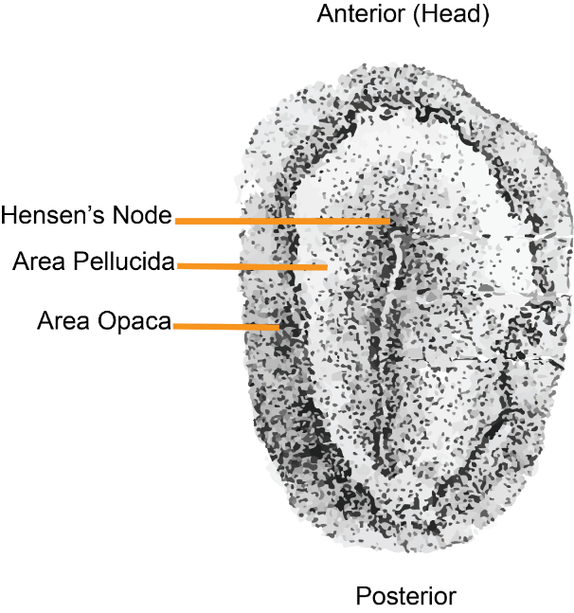
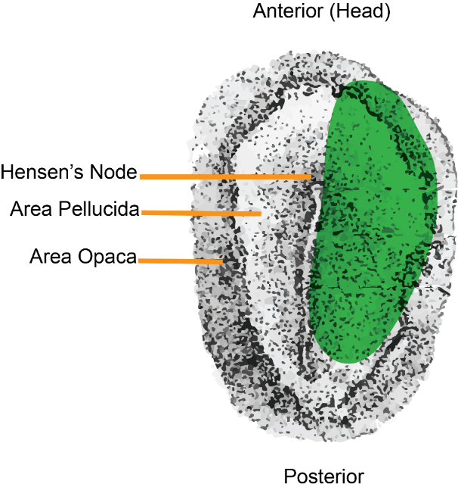
Methods: Gain and loss of function
Stage 4 avian embryo
(Gastrula Stage)
14-18 hours
Rogers, Vertiz, 2022.

Slide 16
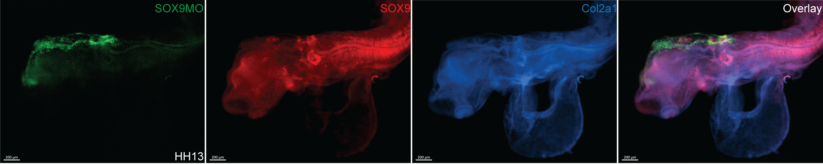

Unilateral injection of SOX9MO causes developmental defects

Slide 17
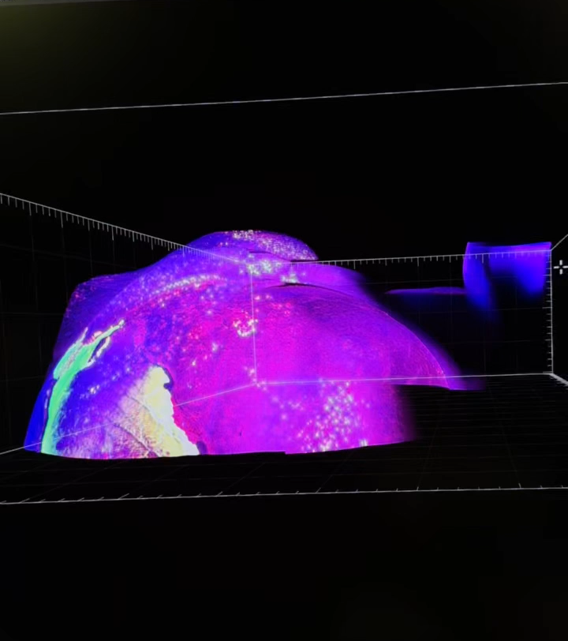
Future Directions:
Determine the effects of excess and reduced SOX9 on avian beak formation:
Characterize co-localization of collagen secreting SOX9+ cells into the craniofacial structures
Identify if loss of SOX9 alters later beak development
Visualize wildtype and SOX9-deficient embryos using light-sheet Imaging

Slide 18


THANK YOU!!!!!
Rogers Lab <3
Dr. Crystal D. Rogers, PhD.
Heddy R. Menendez
Hannah Herron
Camilo Echeverria
+The Lab
Funding
Research Grant - NSF CAREER grant #21437 .
Boehringer Ingelheim (STAR)
NIH T32 Comparative Oncology (VSTP)
STAR Programming & Admin
+ Erin Kent!

Slide 19
References
Cheung, M. and J. Briscoe, Neural crest development is regulated by the transcription factor Sox9. Development, 2003. 130(23): p. 5681-93.
Yamazaki, Y., et al., Whole-mount bone and cartilage staining of chick embryos with minimal decalcification. Biotech Histochem, 2011. 86(5): p. 351-8.
Geetha-Loganathan, P., et al., Ectodermal Wnt6 is an early negative regulator of limb chondrogenesis in the chicken embryo. BMC Dev Biol, 2010. 10: p. 32.
Liu, J.A., et al., Phosphorylation of Sox9 is required for neural crest delamination and is regulated downstream of BMP and canonical Wnt signaling. Proc Natl Acad Sci U S A, 2013. 110(8): p. 2882-7.
Yamashita, S., et al., Comparative analysis demonstrates cell type-specific conservation of SOX9 targets between mouse and chicken. Sci Rep, 2019. 9(1): p. 12560.
Chen, Q., J. Dai, and Q. Bian, Integration of 3D genome topology and local chromatin features uncovers enhancers underlying craniofacial-specific cartilage defects. Sci Adv, 2022. 8(47): p. eabo3648.
Jo, A., et al., The versatile functions of Sox9 in development, stem cells, and human diseases. Genes Dis, 2014. 1(2): p. 149-161.
Lefebvre, V., M. Angelozzi, and A. Haseeb, SOX9 in cartilage development and disease. Curr Opin Cell Biol, 2019. 61: p. 39-47.
Rogers, C.D., J.L. Phillips, and M.E. Bronner, Elk3 is essential for the progression from progenitor to definitive neural crest cell. Dev Biol, 2013. 374(2): p. 255-63.
Rogers, C.D., A. Saxena, and M.E. Bronner, Sip1 mediates an E-cadherin-to-N-cadherin switch during cranial neural crest EMT. J Cell Biol, 2013. 203(5): p. 835-47.
Chacon, J. and C.D. Rogers, Early expression of Tubulin Beta-III in avian cranial neural crest cells. Gene Expr Patterns, 2019. 34: p. 119067.
Manohar, S., et al., Cadherin-11 Is Required for Neural Crest Specification and Survival. Frontiers in Physiology, 2020. 11(1383).
Wu, P., et al., Molecular shaping of the beak. Science, 2004. 305(5689): p. 1465-6.
Nagakura, R., et al., Switching of Sox9 expression during musculoskeletal system development. Sci Rep, 2020. 10(1): p. 8425.
Naqvi, S., et al., Precise modulation of transcription factor levels reveals drivers of dosage sensitivity. bioRxiv, 2022: p. 2022.06.13.495964.
Rogers, C.D., L.K. Sorrells, and M.E. Bronner, A catenin-dependent balance between N- cadherin and E-cadherin controls neuroectodermal cell fate choices. Mech Dev, 2018. 152: p. 44-56.
Nimmagadda, S., et al., Identification and functional analysis of novel facial patterning genes in the duplicated beak chicken embryo. Dev Biol, 2015. 407(2): p. 275-88.
Schock, E.N. and C. LaBonne, Sorting Sox: Diverse Roles for Sox Transcription Factors During Neural Crest and Craniofacial Development. Front Physiol, 2020. 11: p. 606889.
MacDonald, M.E., U.K. Abbott, and J.M. Richman, Upper beak truncation in chicken embryos with the cleft primary palate mutation is due to an epithelial defect in the frontonasal mass. Dev Dyn, 2004. 230(2): p. 335-49.

Slide 20
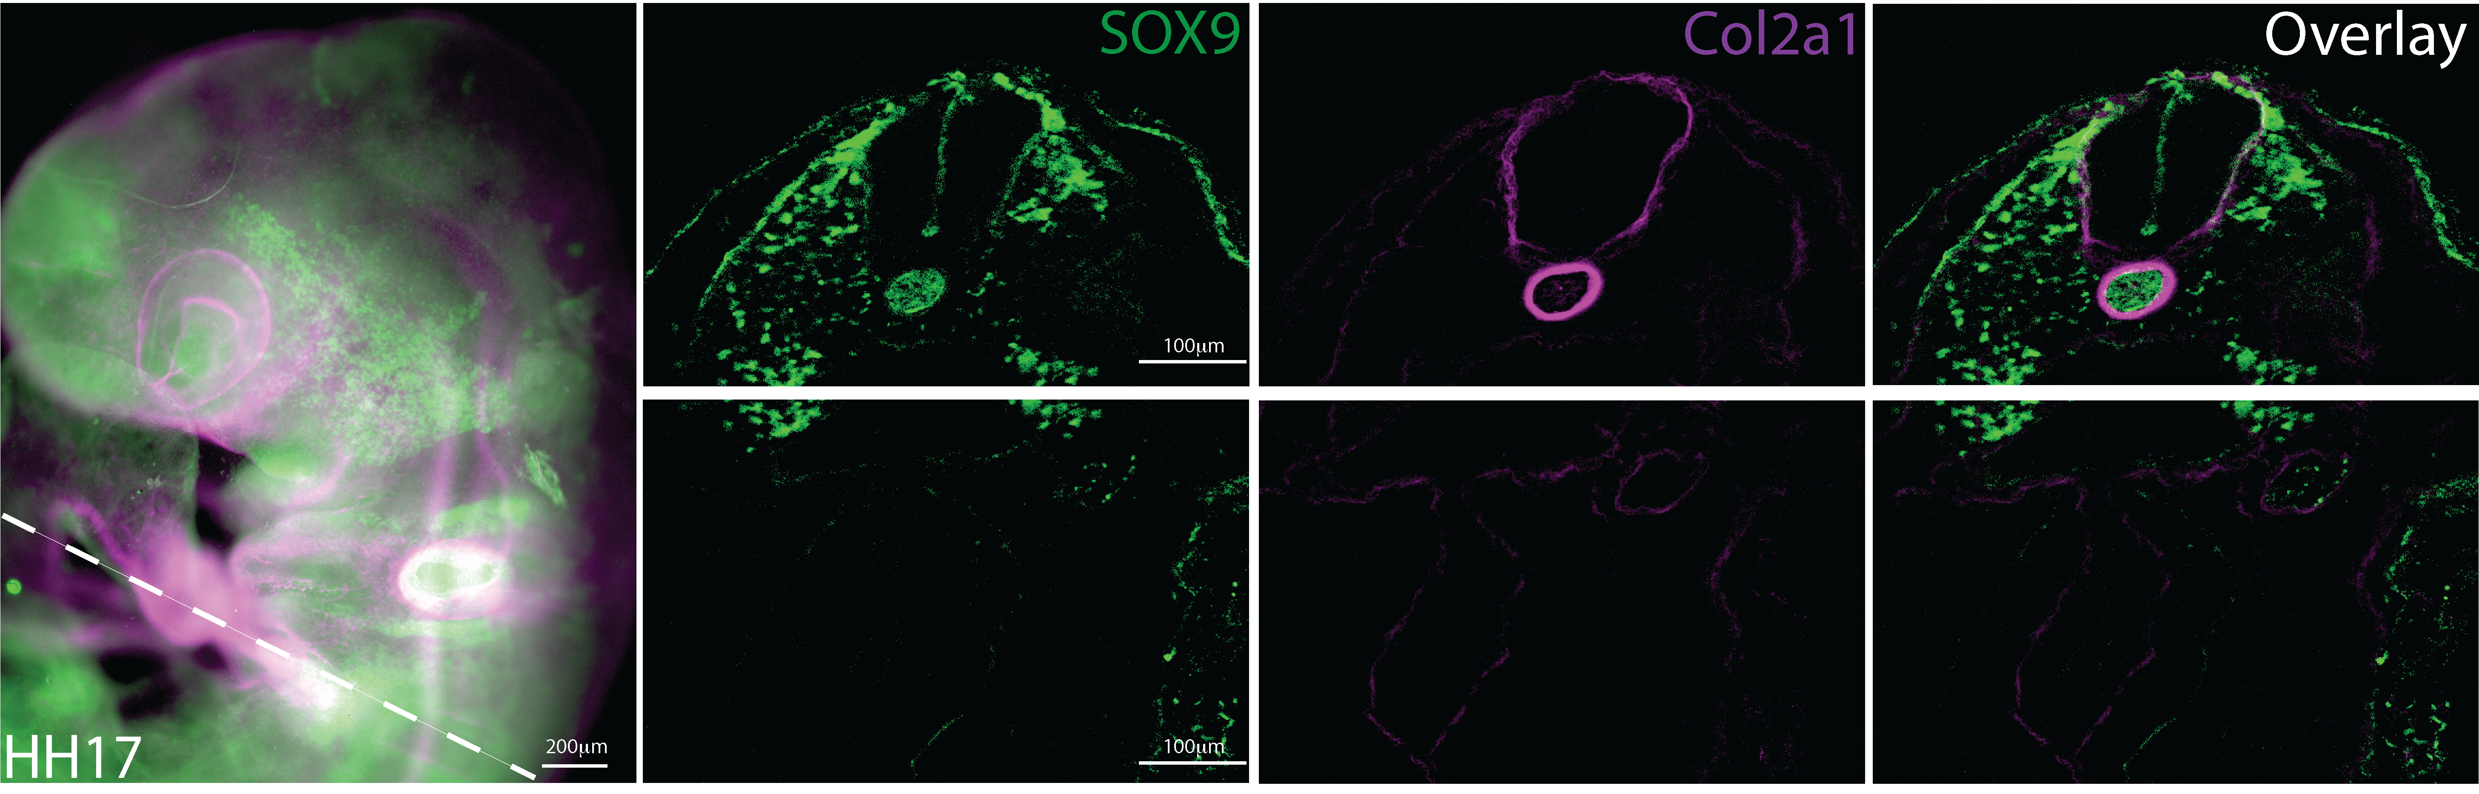
SOX9 is localized to sclerotome that will form the axial skeleton

