Slide 1
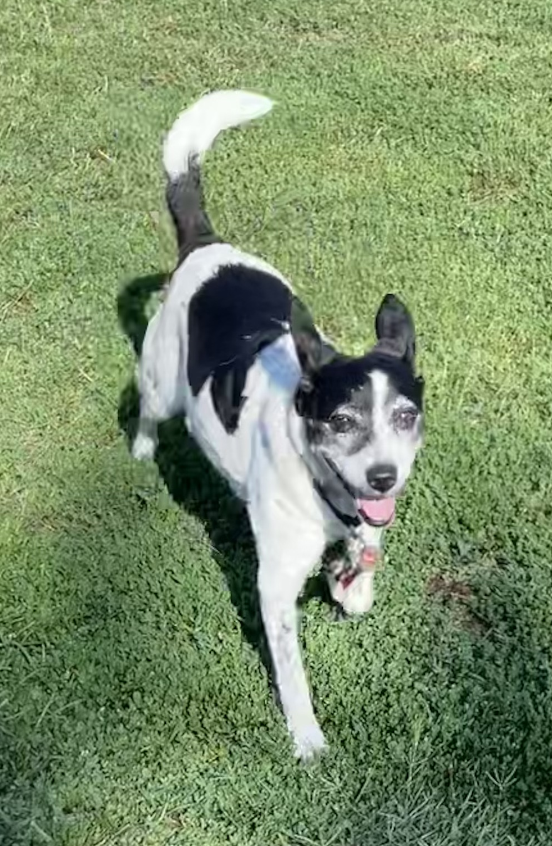
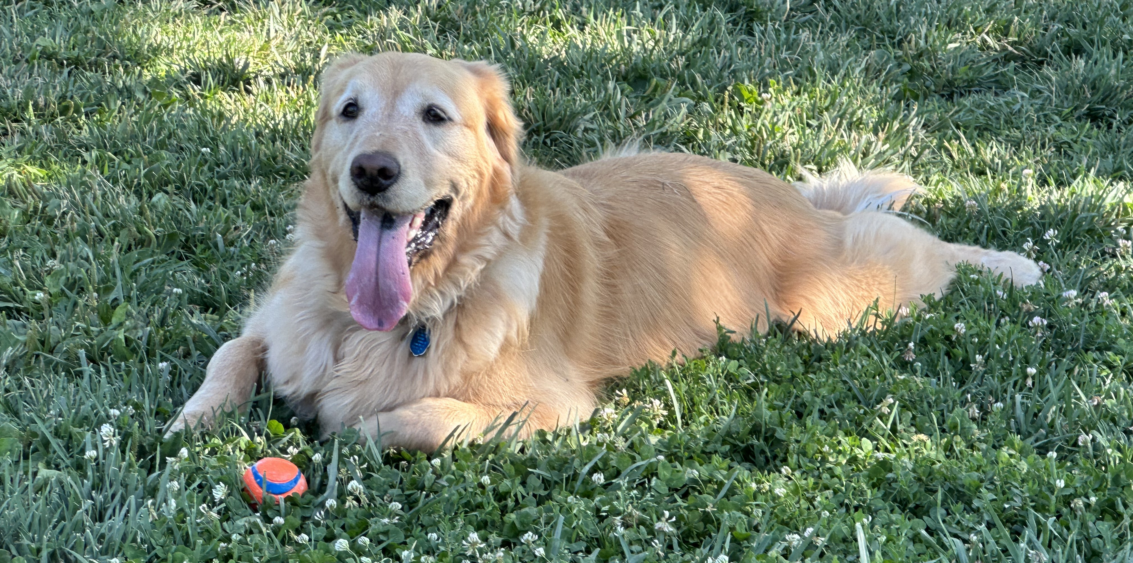




Prevalence of Bacterial, Viral, and Parasitic Enteropathogens in Dogs Frequenting Dog Parks
Sadie Scott
Class of 2026

Slide 2
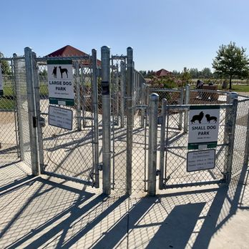
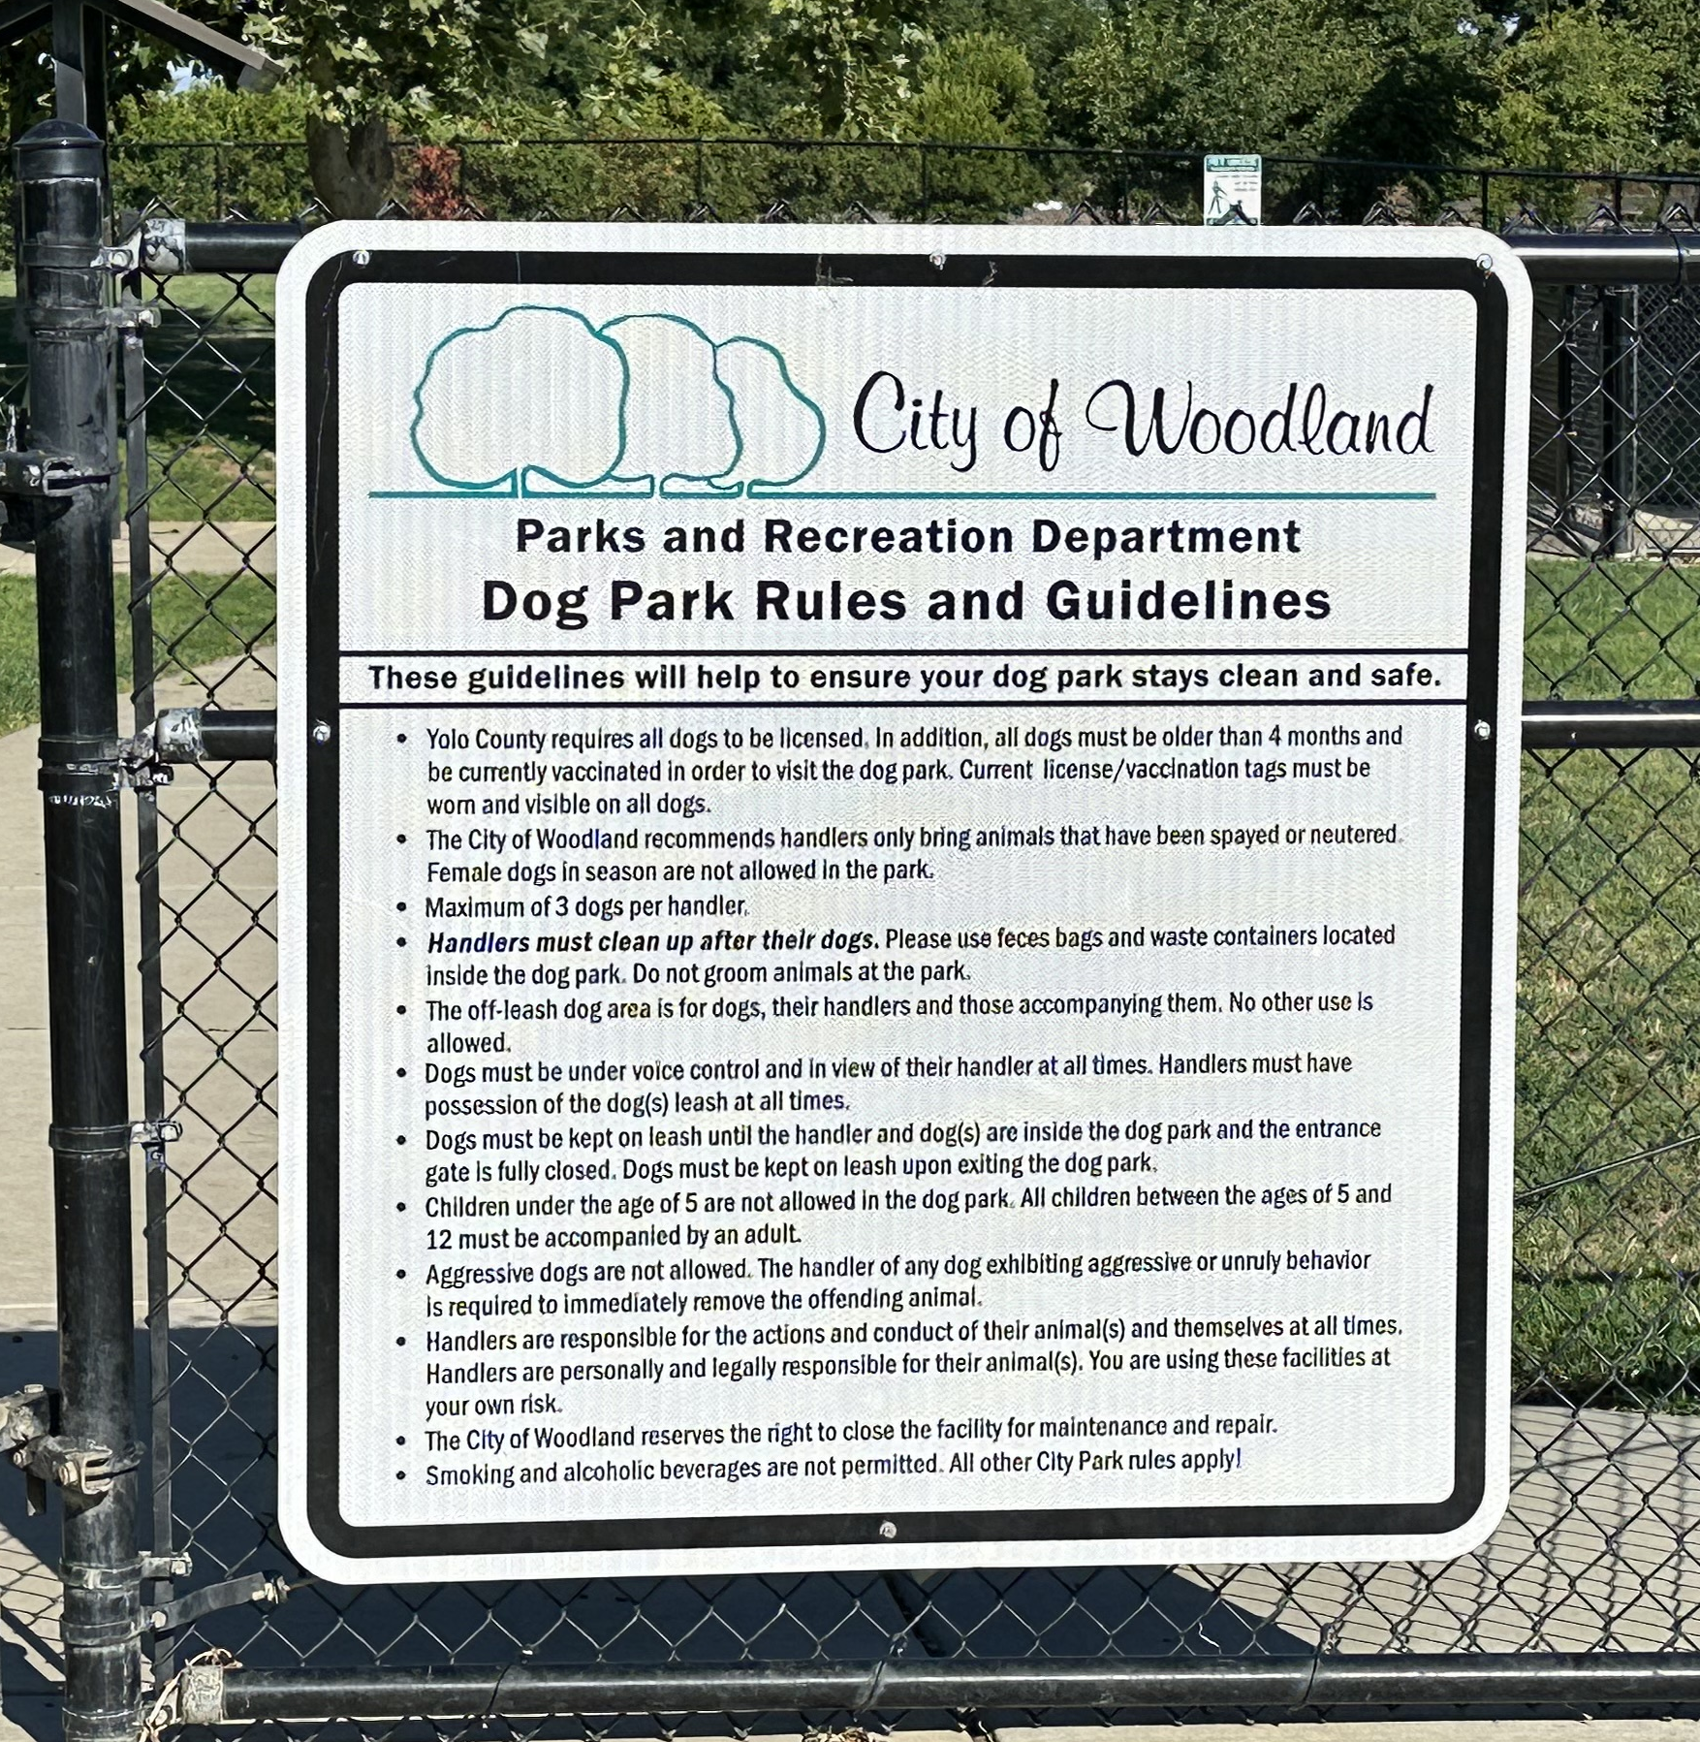
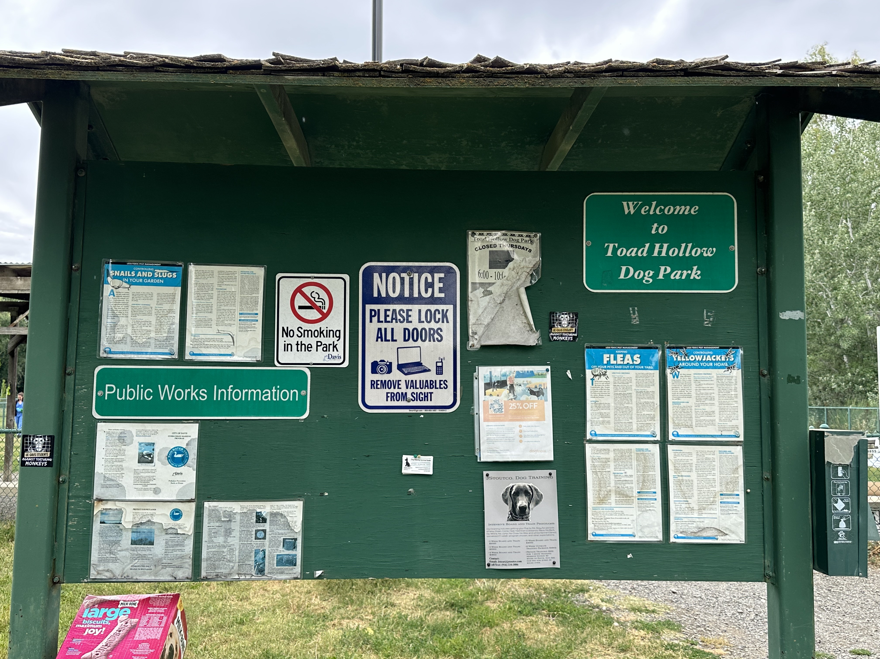
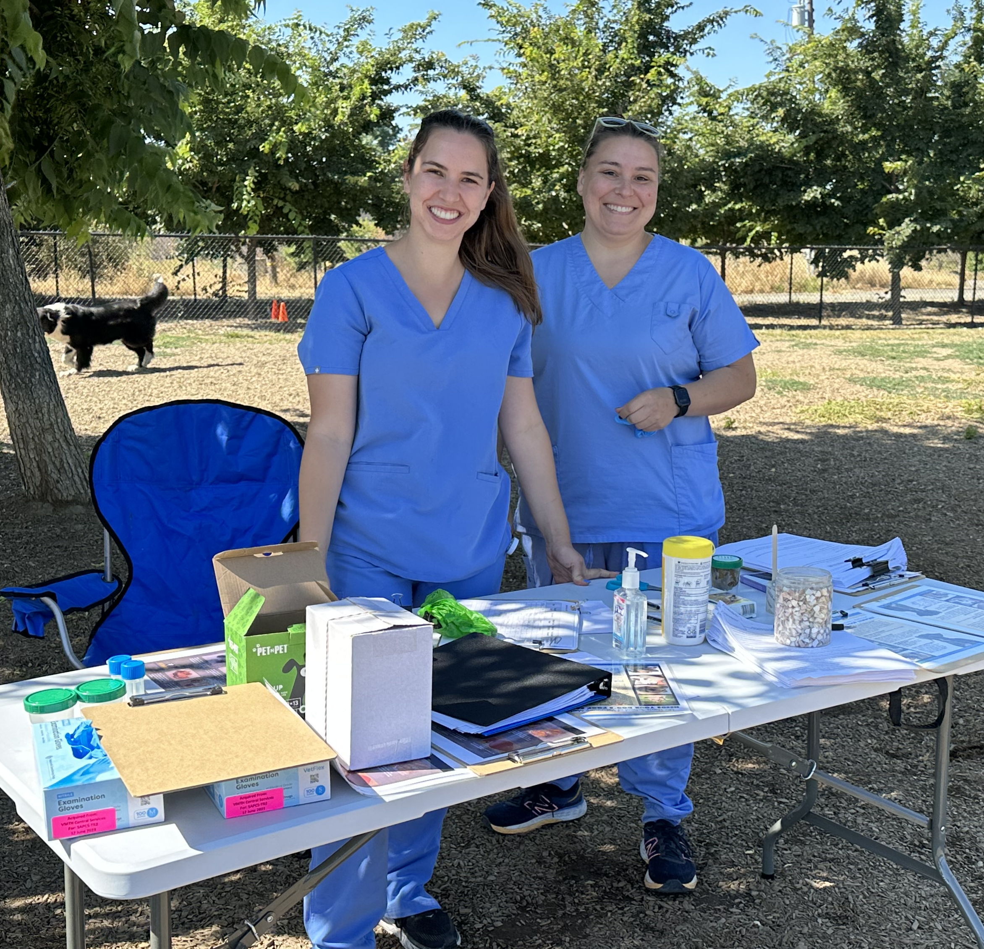
Background
The human-animal bond augments human physical and psychological health
Dogs attending dog parks represent a different population than those in veterinary settings
Dog parks are a socially interactive environment

Slide 3

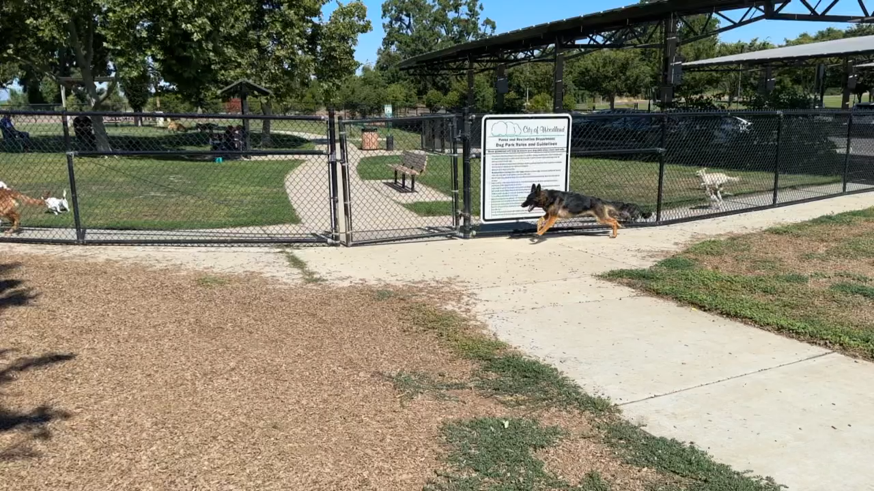
Background
Contact with other dogs, humans, and environmental features facilitates the transmission of enteropathogens
  Dog-dog, dog-human, human-dog transmission
  Increasing prevalence of parasitic enteropathogens, particularly hookworms
  Zoonotic ramifications – Giardia, Salmonella, Campylobacter jejuni
www.theguardian.com/lifeandstyle/2016/oct/31/should-i-let-my-dog-lick-my-face

Slide 4
Hypotheses
Apparently healthy dogs will be frequently infected with a variety of bacterial, viral, and parasitic enteropathogens
There will be no correlation between infection with one or more enteropathogens and stool consistency
Zoonotic enteropathogens will be detected in a subset of apparently healthy, non-diarrheic dogs

Slide 5
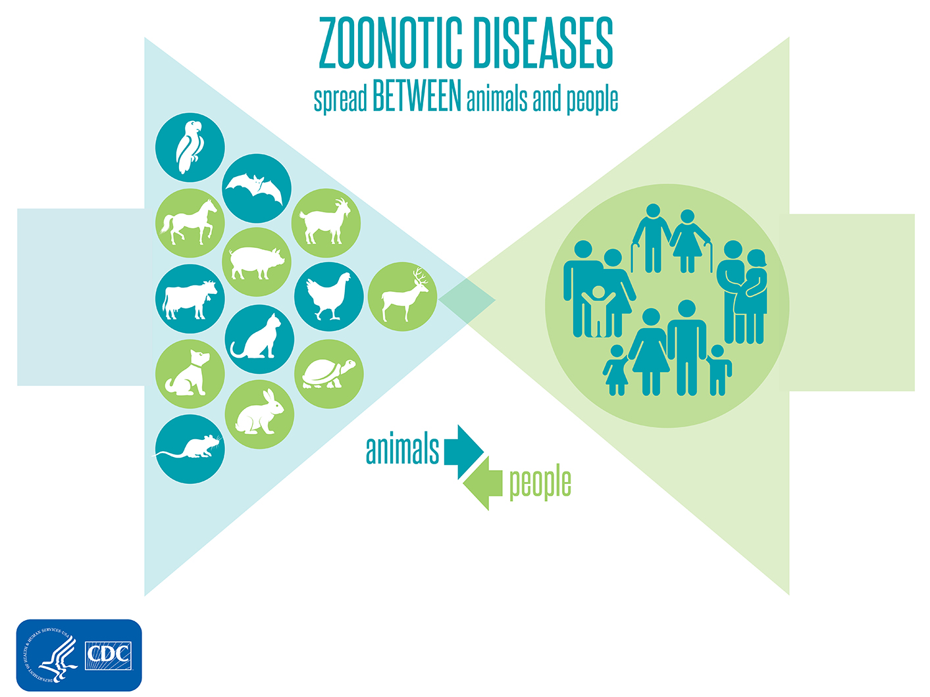

Specific aims
1
Determine the prevalence of bacterial, viral, and parasitic enteropathogens in 300 privately-owned dogs frequenting 3 dog parks in Northern CA
2
Investigate risk factors associated with infection with enteropathogens and shedding
3
Determine the prevalence of multidrug resistant hookworms and zoonotic Giardia
Giardia duodenalis

Slide 6
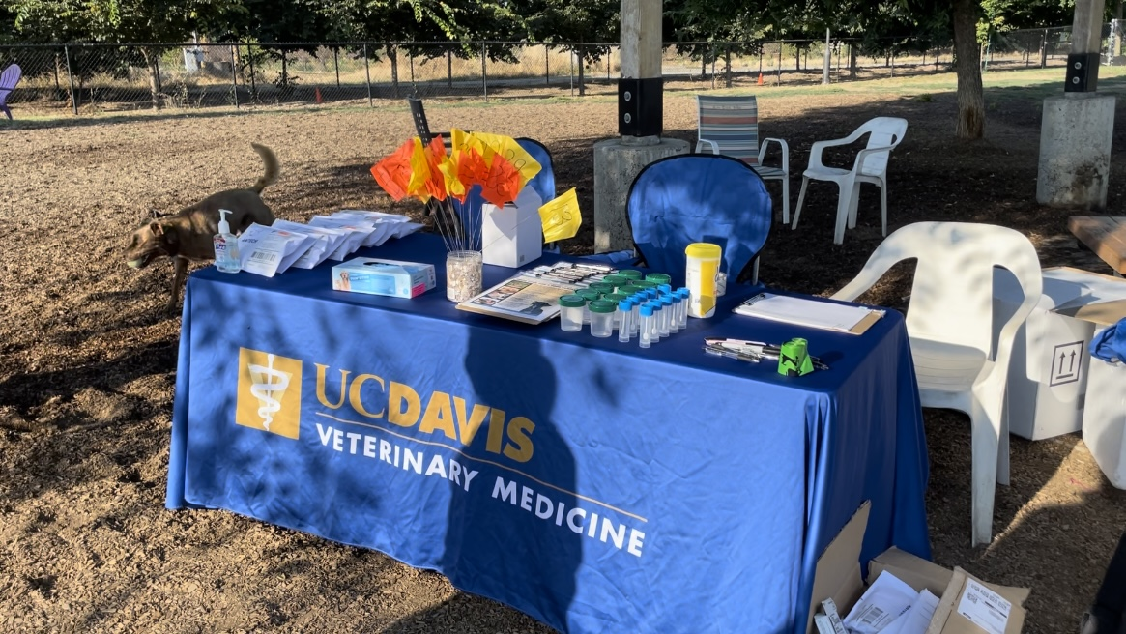
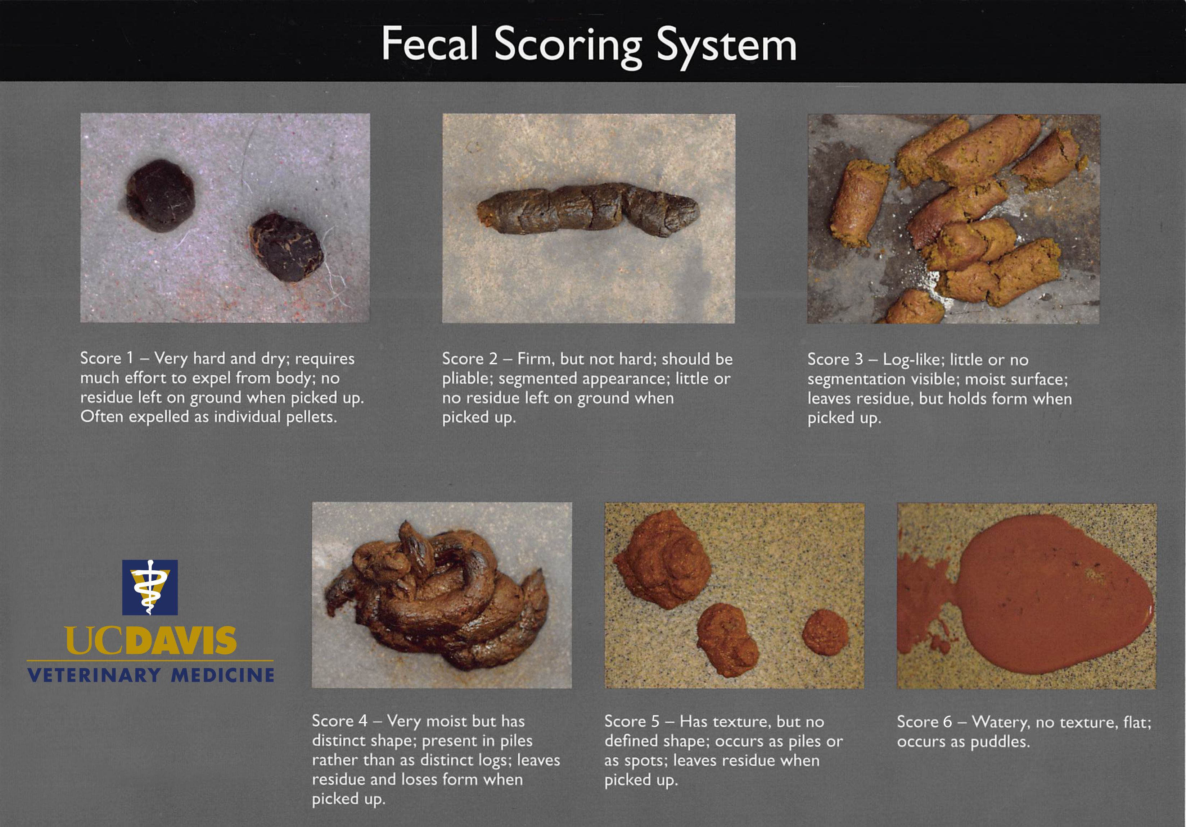
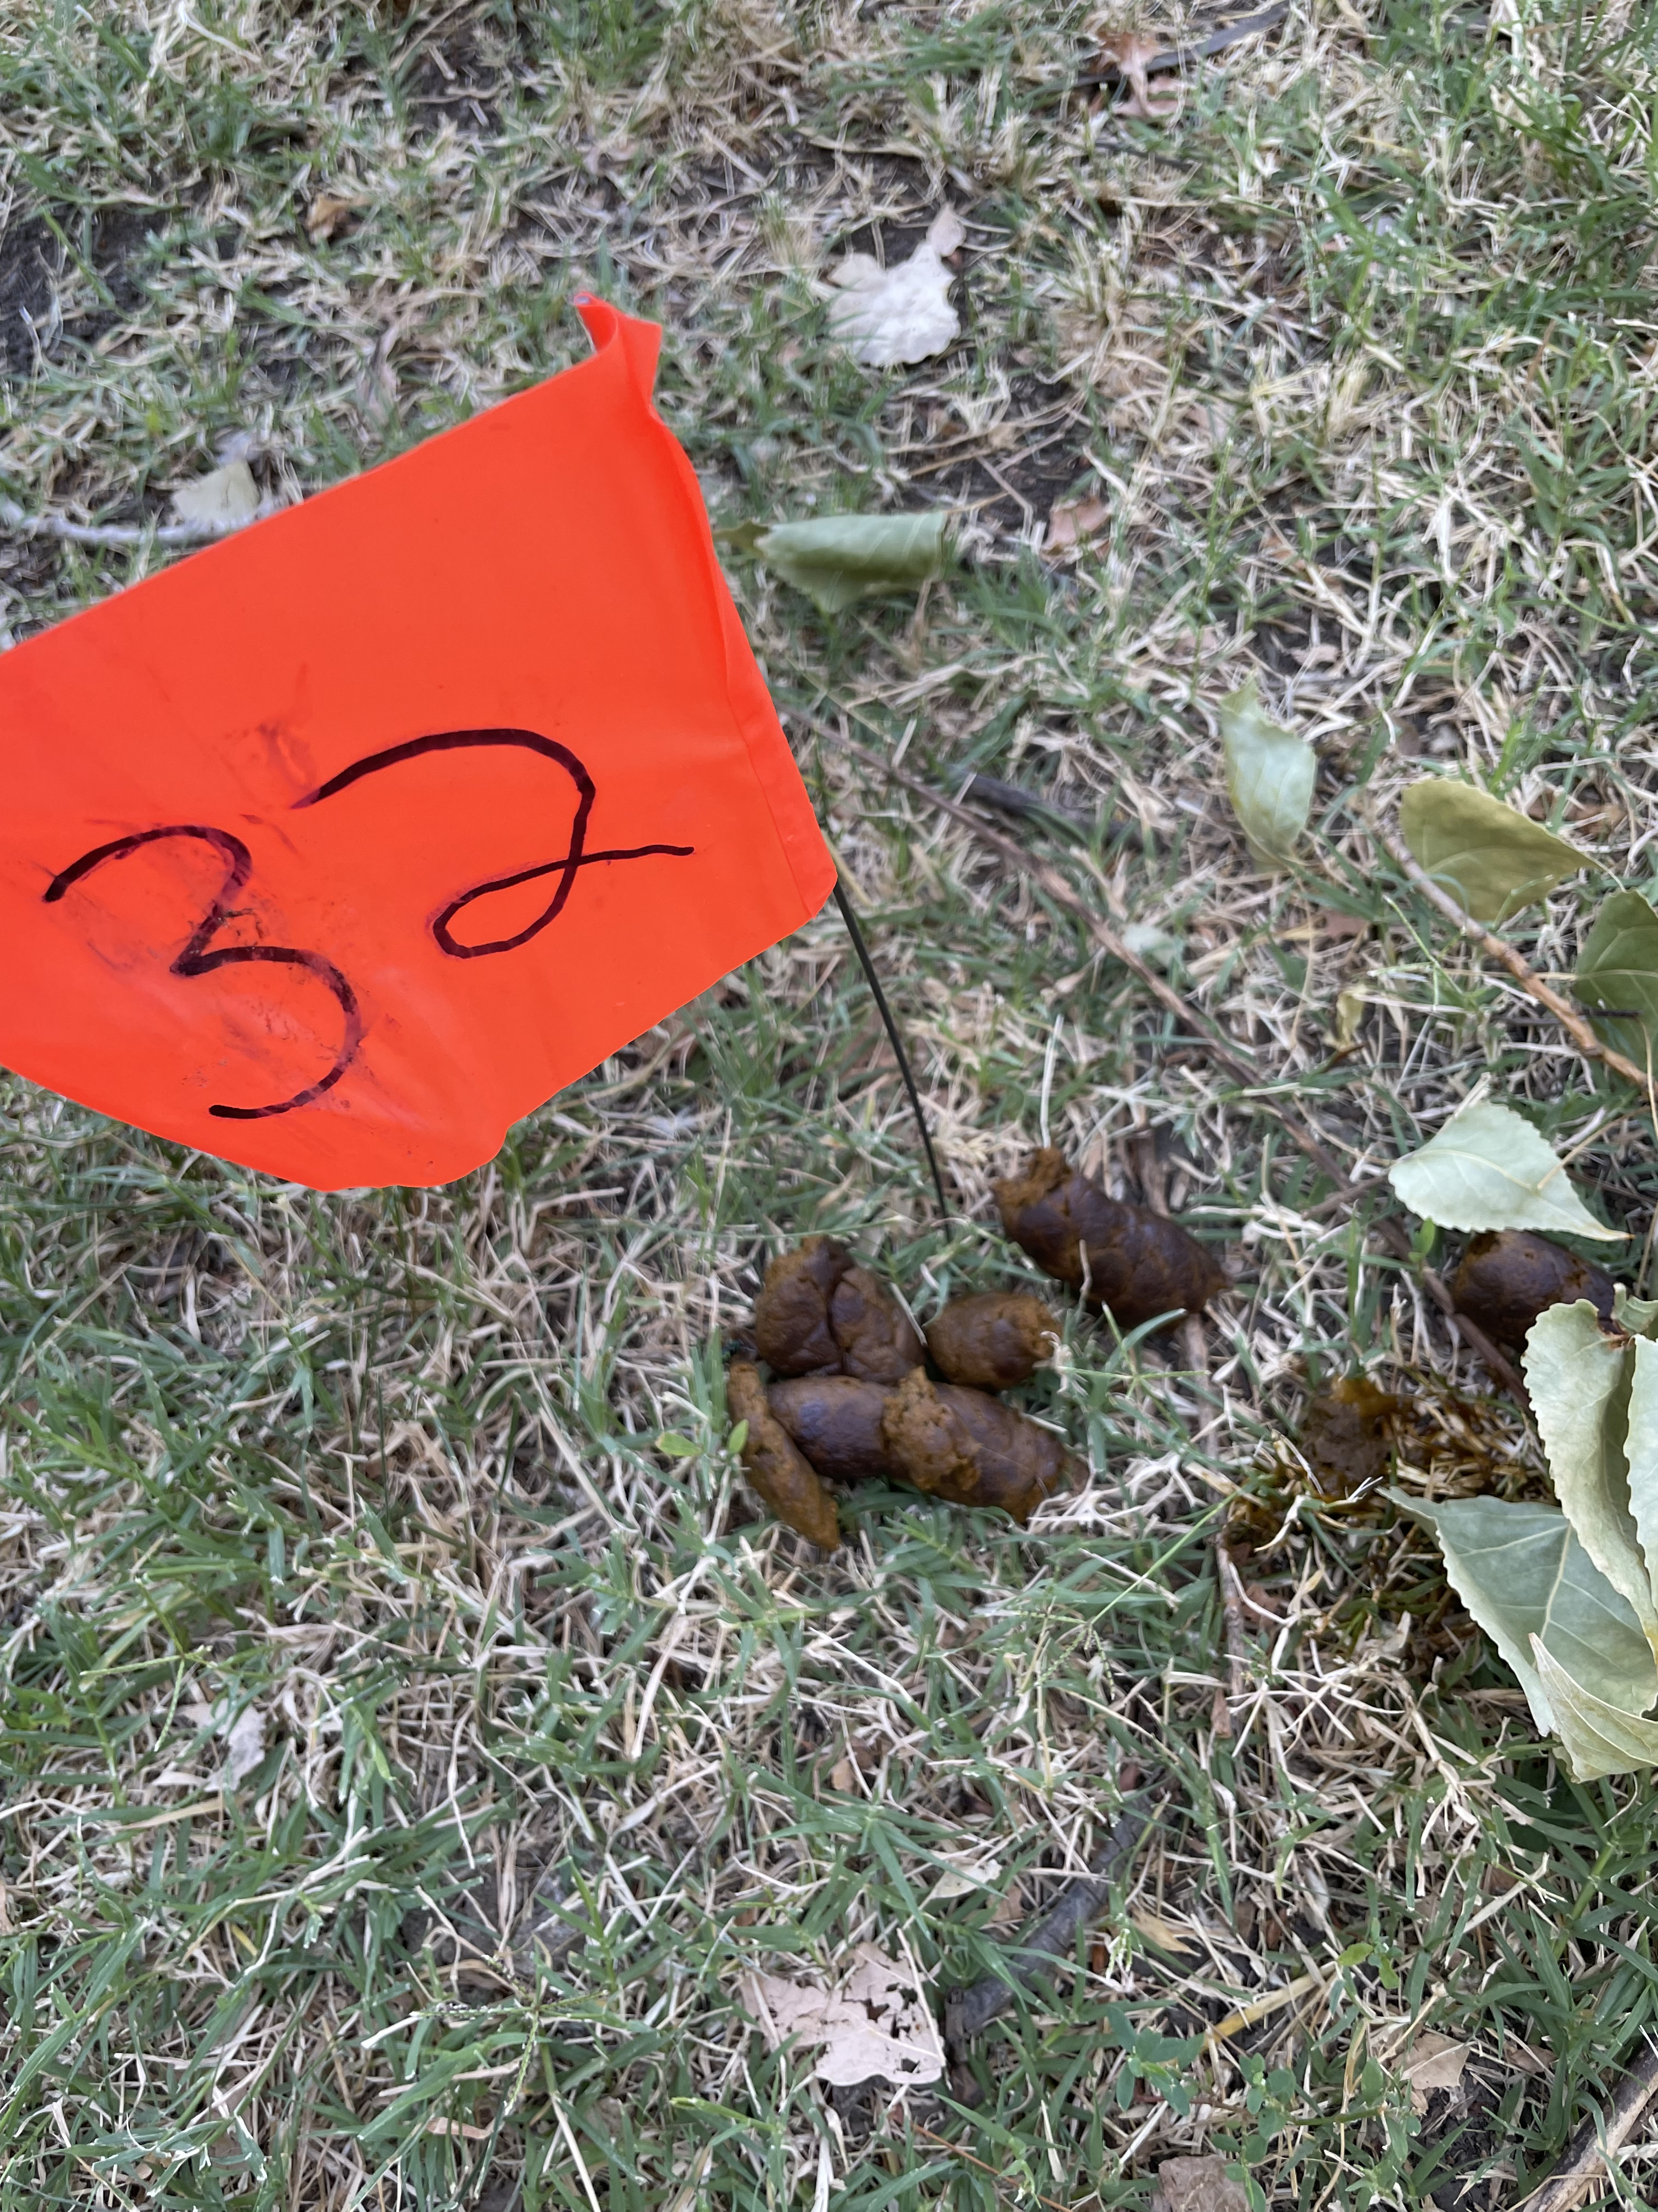
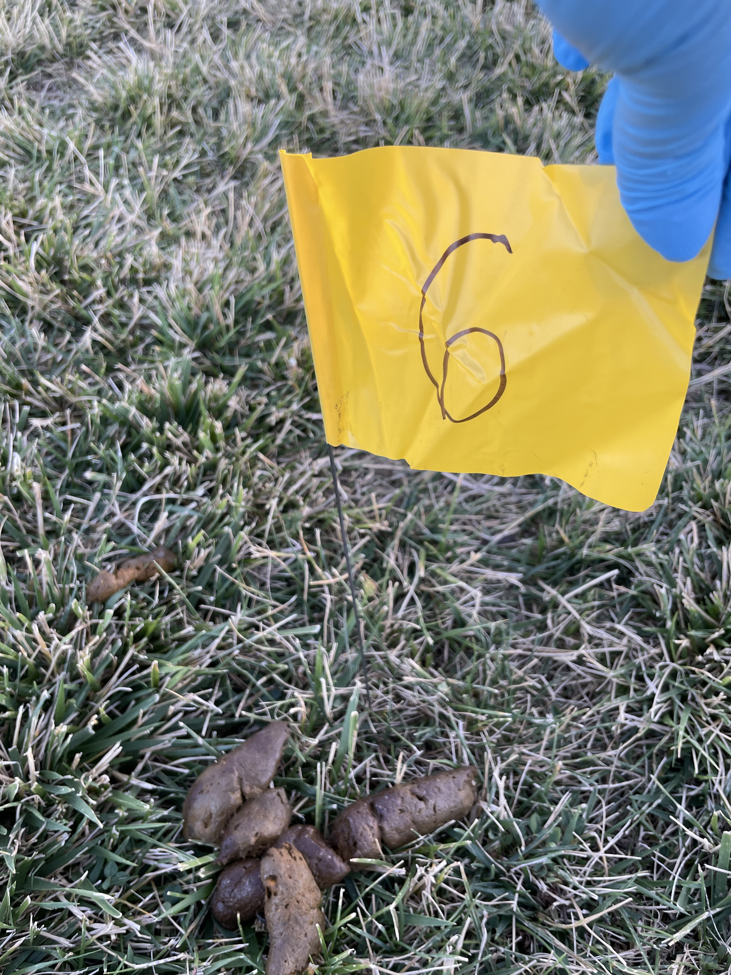
Materials and methods
Flag identification system
Questionnaire to assess risk factors
Fecal scoring (Modified Purina [1-6])
Follow-up at-home collection kits

Slide 7
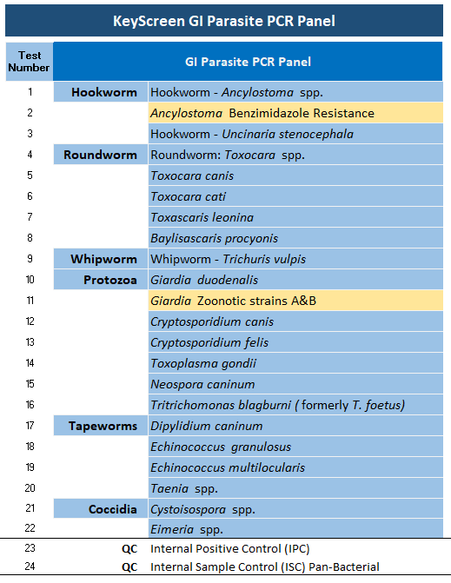
Diagnostic approach
Zinc sulfate double centrifugation flotation
Giardia ELISA
KeyScreen PCR

Slide 8
RESULTS
Demographics
n = 269 dogs
Age
 | Davis | Natomas | Woodland
Range (years) | 0.5-13 | 0.25-16 | 0.5-15
Median (years) | 3 | 2 | 3

Slide 9
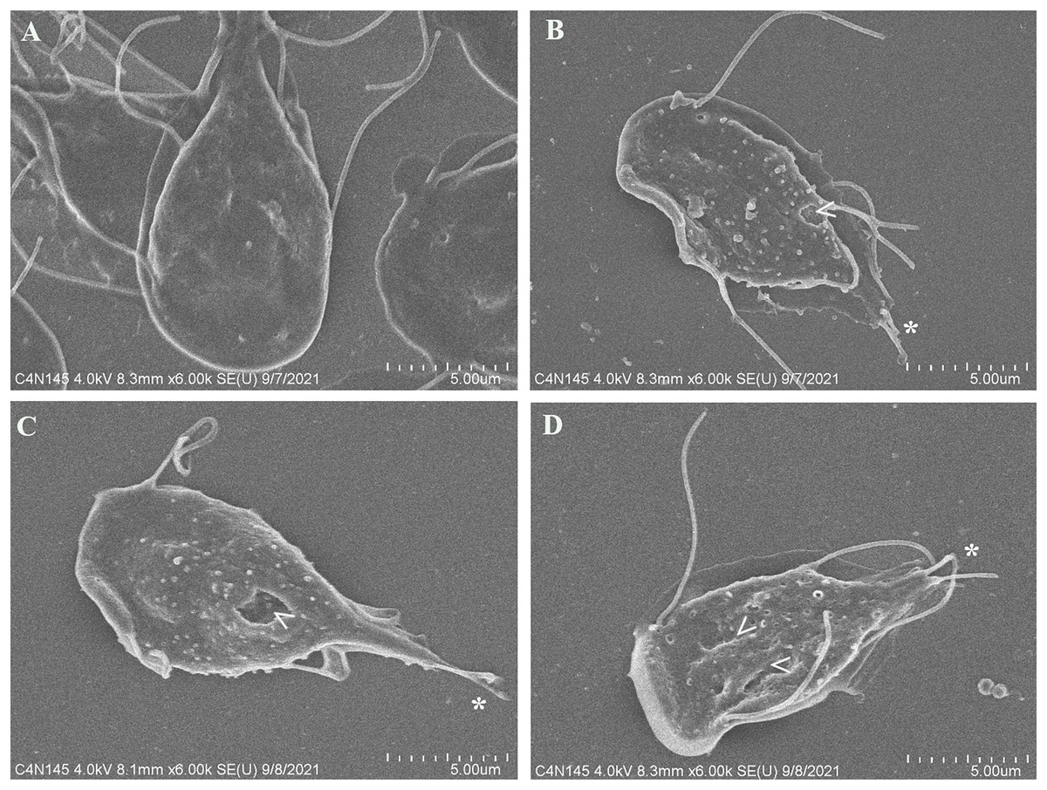
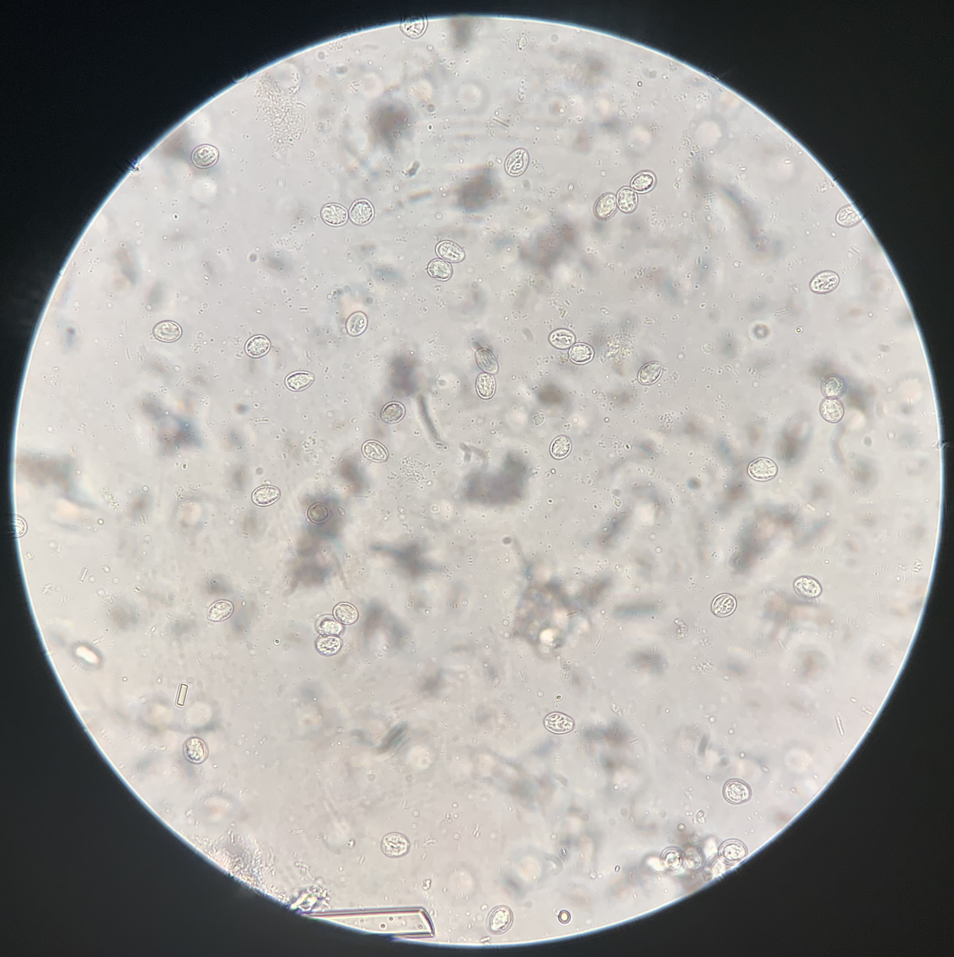
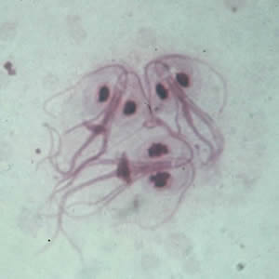
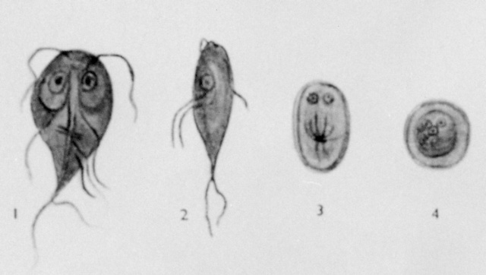
PREVALENCE OF Giardia
Comparison of 3 Testing Methods for the Diagnosis of Giardia
Stool Consistency of Dogs with Giardia Infection (n = 33)
n=29
17
n=4
(n = 191 dogs)

Slide 10
PREVALENCE OF All parasites
Identified Parasitic Enteropathogens n=51
n=1
n=1
n=2
n=1
n=3
12% co-infection with ≥2 parasites
No Hookworm infections identified
n=5
n=26
n=1
n=11

Slide 11
RESULTS - FECAL SCORING
Median Fecal Score for Giardia and Cryptosporidium Infections
Contact with dogs outside the house yielded similar median fecal scores

Slide 12
Risk Factors
n = 72
n = 119
 | Raw Diet | Commercial/Home Cooked Diet
Fecal Score Range | 1-5 | 1-5
Fecal Score Median | 3 | 3
% Infection with ≥1 Enteropathogens | 43% | 37%

Slide 13
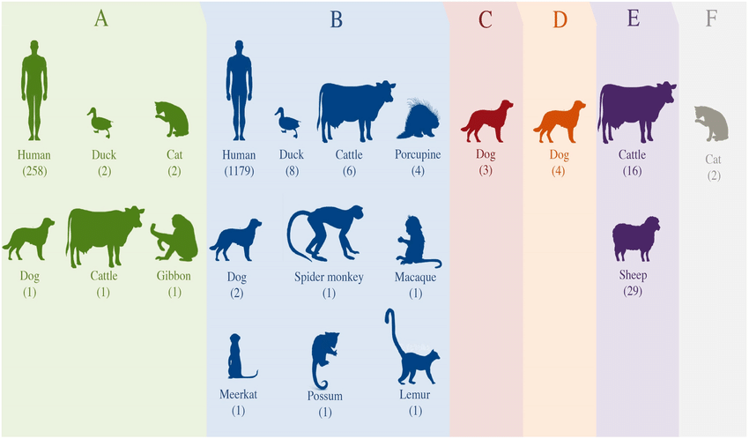
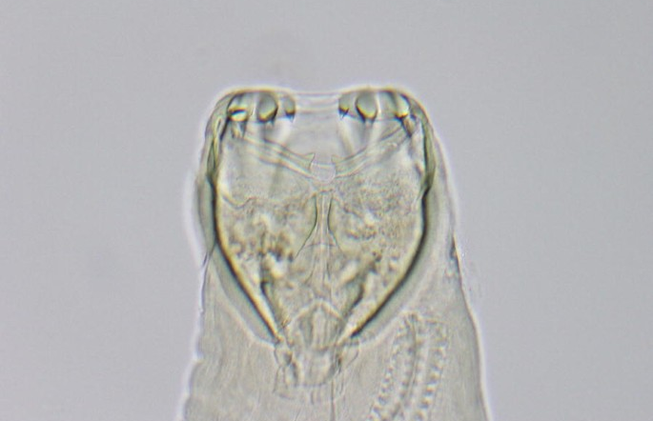
Discussion
All Giardia assemblages were non-zoonotic
  (Assemblages C and D)
No hookworms identified on flotation or PCR
  Similar results in comparison to a 2016 dog park study (2/300 dogs) by Hascall KL, et al.
  Hascall KL, et al. J Vet Intern Med 30(6):2016
Ancylostoma caninum

Slide 14
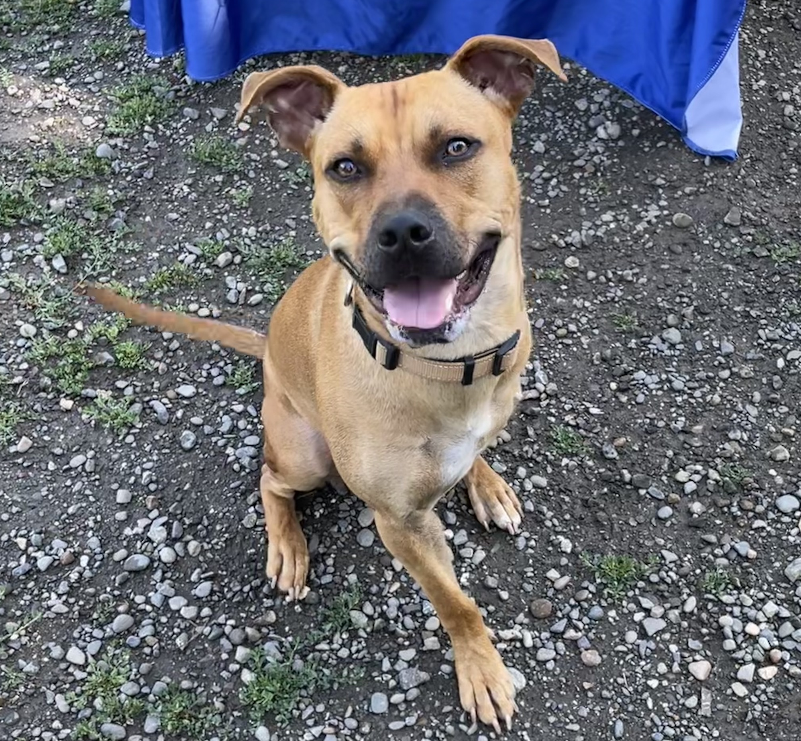
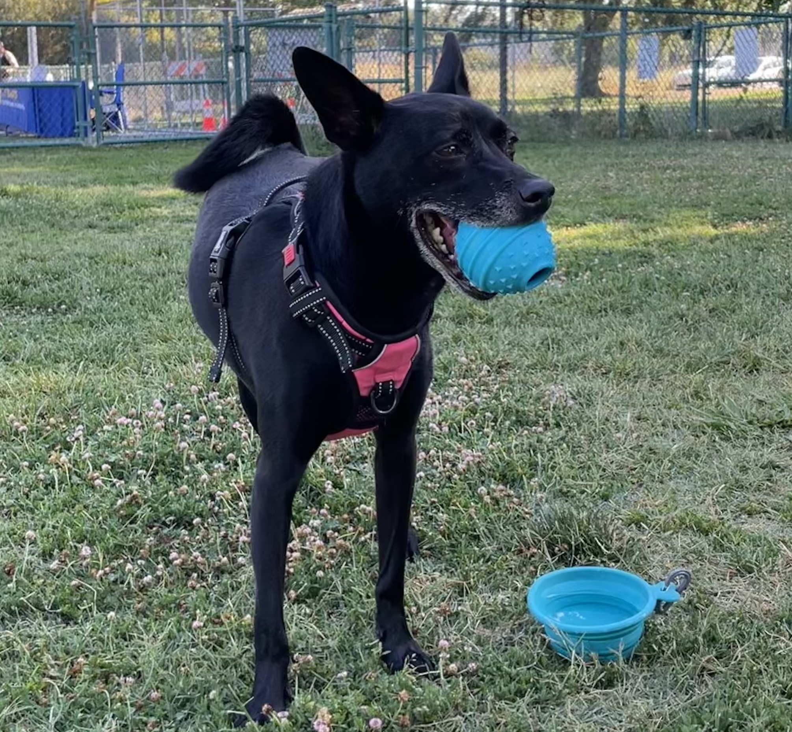
Discussion
No apparent correlation between fecal score and infection with ≥1 enteropathogens
  Many socially active dogs are infected yet asymptomatic with normal stools
Future considerations
  Bacterial/viral PCR is in progress – determine the presence of zoonotic enteropathogens, e.g., Campylobacter jejuni and Salmonella spp.
  Other risk factors are being analyzed
  At-home collection kits collected 4-5 weeks post-dog park visit will shed further light on the presence of Giardia and Cryptosporidium canis in asymptomatic dogs that tested positive earlier at dog parks

Slide 15



Acknowledgements
Thank you to my incredible team for making this project possible!
Dr. Stanley Marks (Faculty Mentor)
Dr. Lauren Camp (Parasitologist in VMTH)
Min Shin, Hannah Pham, Bo Olivieri, and Kim Aguirre (Student helpers extraordinaire)
ANTECH Diagnostics
STAR Program and funding from CCAH

