Slide 1
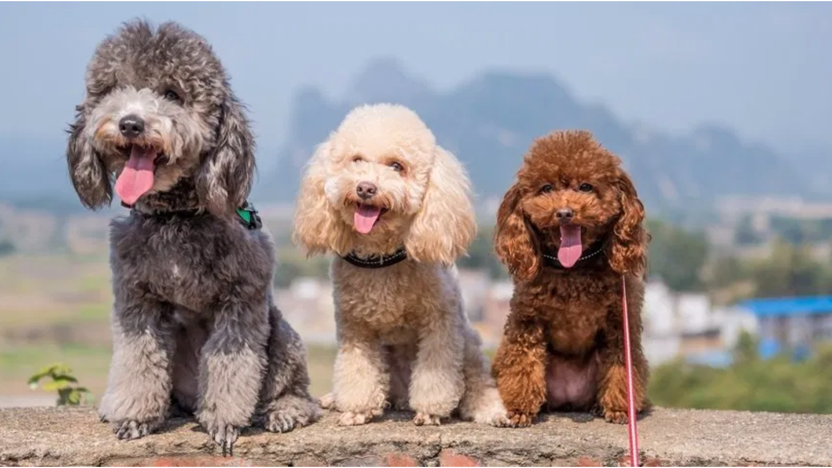
The role of selected genetic variants in poodle body size
Presenter: Scarlett Varney
Authors: Scarlett Varney, Kevin Batcher, Leigh Anne Clark, Robert Rebhun, Danika Bannasch
Image from Tarah Schwartz, The Complete Guide to Poodles

Slide 2
Why does size matter?
Hip Dysplasia
Elbow Dysplasia
Intrahepatic Portosystemic Shunt
Osteoarthritis
Gastric Dilation and Volvulus
Osteosarcoma
Type II IVDD
Aortic Stenosis
Avg. lifespan 6.5 years
Patellar Luxation
Extrahepatic Portosystemic Shunt
Type I IVDD
Tracheal Collapse
Mitral Valve Disease
Avg lifespan 12.4 years
Image from Guinnessworldrecords.com, 2007 Information from Adams et al. Methods and mortality results of a health survey of purebred dogs in the UK. Journal of Small Animal Practice. 2010.
Notes:
Size is relevant to veterinary medicine for a number of reasons. It has a significant and strong affect on lifespan and on health.
CLICK here you can see the average lifepspans of the two extremes – a Great Dane with an average lifespan of 6 and a half years, and a chihuahua with an average life span of 12.4 years
In veterinary medicine there are disease predispositions that are based on dog size.
CLICK
In a large dog, you are more likely to see diseases such as hip dysplasia, osteoarthritis, and osteosarcoma, while in smaller dogs, CLICK you’re more likely to see patellar luxation, type I IVDD, and tracheal collapse.
Transition: The data that the lab had available for me to perform this analysis…

Slide 3
Materials and Methods
78 Poodles with weights from owner or VMACS
Review medical records
Literature review for size variants
Illumina HD Array genotype data
220,000 variants
Genotypes for Chondrodystrophy and Chondrodysplasia, two mutations associated with dwarfism
GWAS
Multidimensional scaling plots
Statistical analysis – Prism and R
Univariate and multivariate linear regression
How much size variation can be explained by known variants within a single breed?
Notes:
Included a database of 78 Poodles samples with their weights, either owner provided or from VMACS. I reviewed each poodle’s medical records to determine body condition score and any medical conditions. I also reviewed literature to compile a list of mutations associated with growth changes in dogs.
My 78 poodles had previously been run on the Illumina HD Array, which contains 220,000 variants. I also had genotyping data from two known dwarfism genes, chondrodystrophy and chondrodysplasia.
This summer I learned how to do genome wide association, I became proficient at statistical analysis, and I learned to run univariate and multivariate linear regression.
Ultimately the question I was trying to answer was, how much size variation can be explained by known variants within a single breed?
Transition: The lab has genotype data from thousands of samples across many breeds but Poodles provide an opportunity to ask some interesting questions about size because -

Slide 4
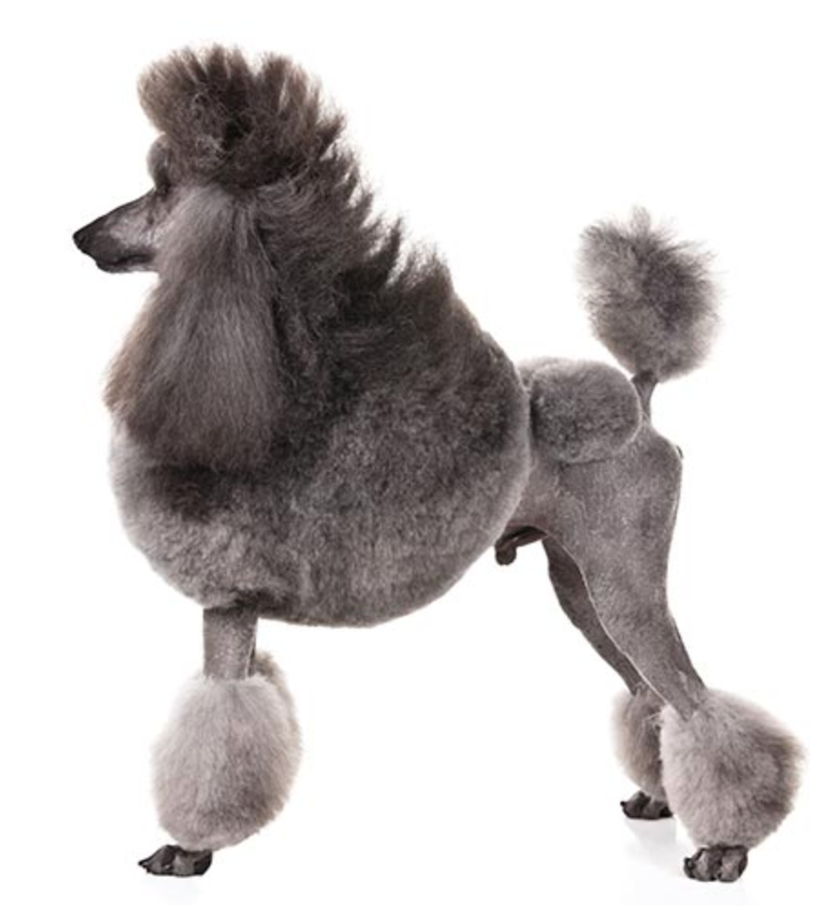
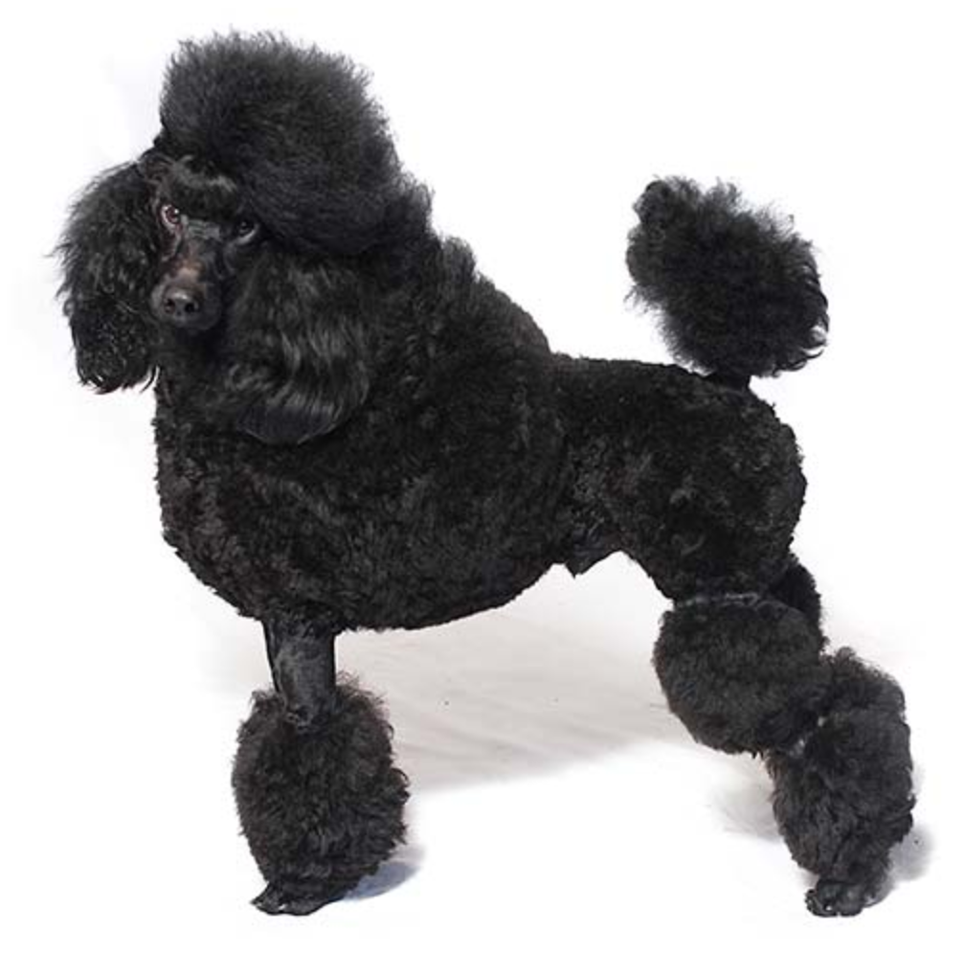
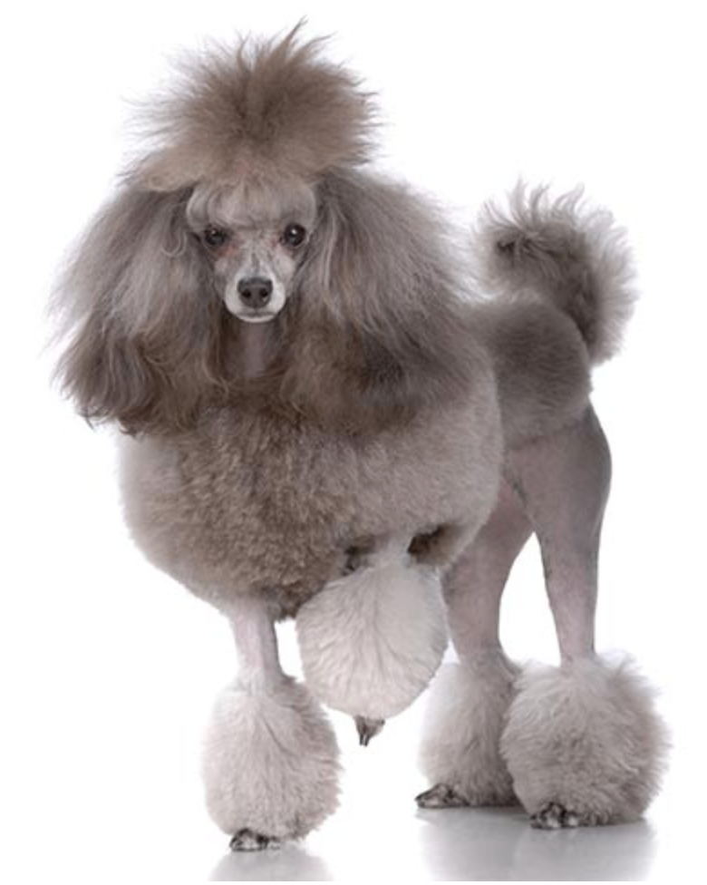
Standard Poodle
Weight: Males 27.2-31.8kg
Females 18.1-22.7kg
Height: over 15 inches
Lifespan: 12 years
Miniature Poodle
Weight: 4.5-6.8kg
Height: 10-15 inches
Lifespan: 13.92 years
Toy Poodle
Weight: 1.8-2.7kg
Height: No more than 10 inches
Lifespan: 14.63 years
Large Poodles
Small Poodles
Information and images from AKC.org and Adams et al. Adams et al. Methods and mortality results of a health survey of purebred dogs in the UK. Journal of Small Animal Practice. 2010.
Notes:
They come in three varieties, but they are all one breed and interbreed between the sizes to some extent. The original was the large standard poodle that was used as a retriever. The miniature and toy sizes were created later from the original standard Poodle. Technically they all should just have the breed name Poodle.
On this figure I show you the average weights, heights, and lifespans typical of these varieties. We can see the inverse relationship between size and lifespan I mentioned previously, with standard poodles living an average of 12 years, miniature poodles an average of 13.9, and toy poodles living the longest with 14.6 years.
VMACS has many different ways to describe a poodle, so while I was looking at medical records for these poodles, I came across “Standard,” “mini,” “toy,” “French poodle,” “teacup poodle,” or simply “poodle.” For this reason, I ran a multidimensional plot of my poodles to see how they were related.
CLICK
I found there were two groups of poodles that clustered independently, rather than three. Moving forward, I analyzed my data in these two groups – Large, defined as larger than 11kg, and small, defined as less than 11kg, rather than by their variety.

Slide 5
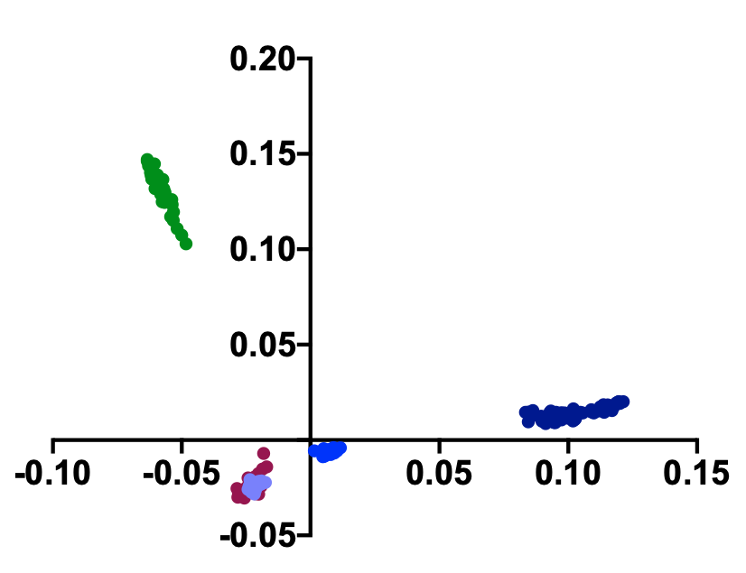
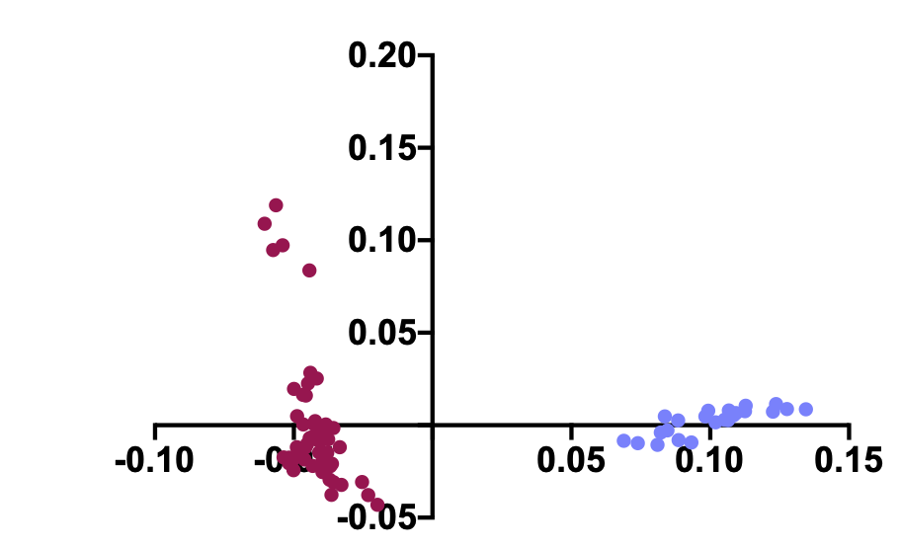
Multidimensional Scaling Plot
A. Poodles clustered together when compared to other breeds.
B. Poodles clustered by size when compared alone.
Notes:
This is the multidimensional scaling plot (or MDS) I mentioned on the last slide. An MDS allows you to see the overall genetic similarities or differences between groups of animals. As you can see here, when multiple breeds are considered, breeds cluster together, while CLICK when small poodles are only compared with large poodles, they cluster independently of one another.
Transition: I wanted to see if the weights of my poodles also clustered into two discrete groups and I found -

Slide 6
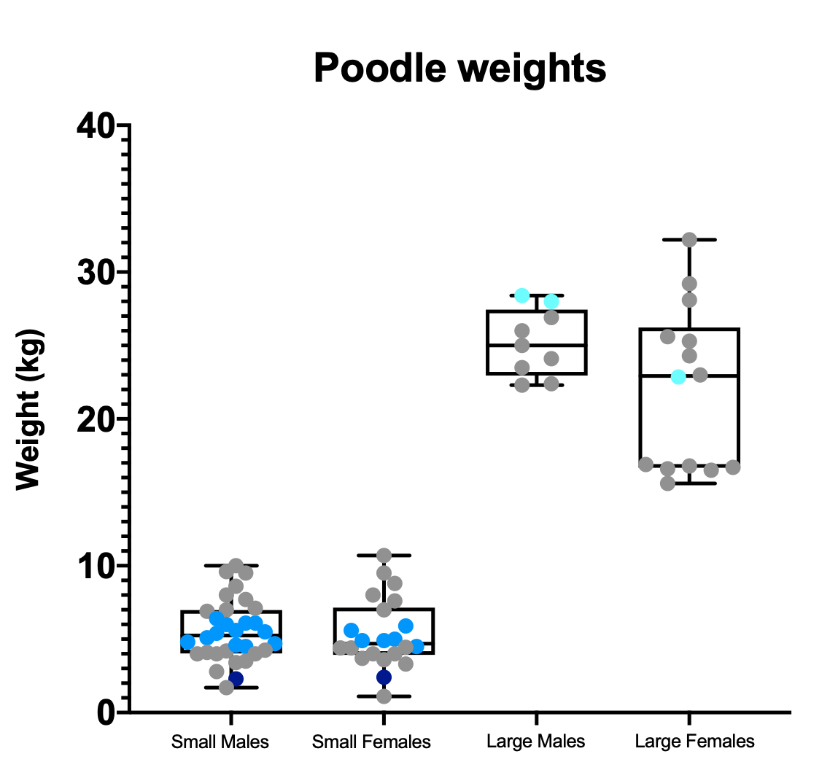
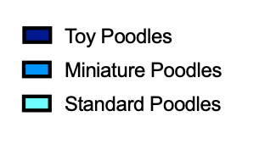
Notes:
-that they did.
Weight is shown on the Y axis and the groups from MDS are shown on the X axis, divided by sex.
Transition: Previous studies to identify size variants in dogs used breed average weights and compared breeds to each other. When I looked at my own poodles, I found that very few poodles actually fit into their respective breed weight category, which I indicated with blue dots. My goal this summer was to look within breeds to determine if these same variants identified across breeds were also important within a breed

Slide 7
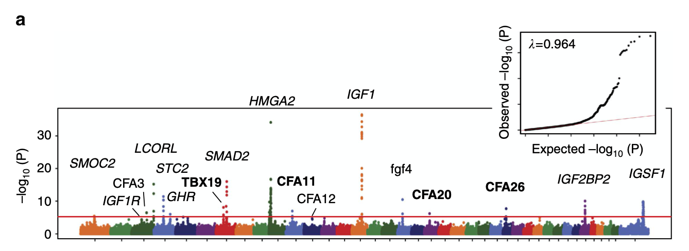
Previous experiments identified variants that have a significant influence on body size
GWAS using male average breed weight, highlighting 17 significant loci
6 variants are responsible for 60% of body size variance in dogs with SBW < 41kg
Figure from Hayward et al. Complex disease and phenotype mapping in the domestic dog. Nature, 2015.
Information from:
Bannasch DL, Baes CF, Leeb T. Genetic Variants Affecting Skeletal Morphology in Domestic Dogs. Trends Genet. 2020
Plassais, J. et al. Analysis of large versus small dogs reveals three genes on the canine X chromosome associated with body weight, muscling and back fat thickness. PLoS genetics, 2017.
Rimbault, M. et al. Derived variants at six genes explain nearly half of size reduction in dog breeds. Genome research, 2013.
Sutter et al. A Single IGF1 Allele is a Major Determinant of Small Size in Dogs. Science, 2007.
Notes:
This is a genome-wide association study, which is a study used to identify genetic variants associated with a risk of disease or a condition. This plot is from a 2015 paper that did a GWAS using male average breed weight to assess genetic contributions to size across breeds. This plot shows 17 significant loci that are associated with male average breed weights.
CLICK
A different study found these 6 variants were responsible for around 60% of body size variance in dogs that had a standard body weight of less than 41kg, these same variants predicted less than 5% of the variance in dogs with a standard body weight of greater than 41kg.
Transition: Many of the variants identified by these experiments are in the growth hormone pathway.

Slide 8
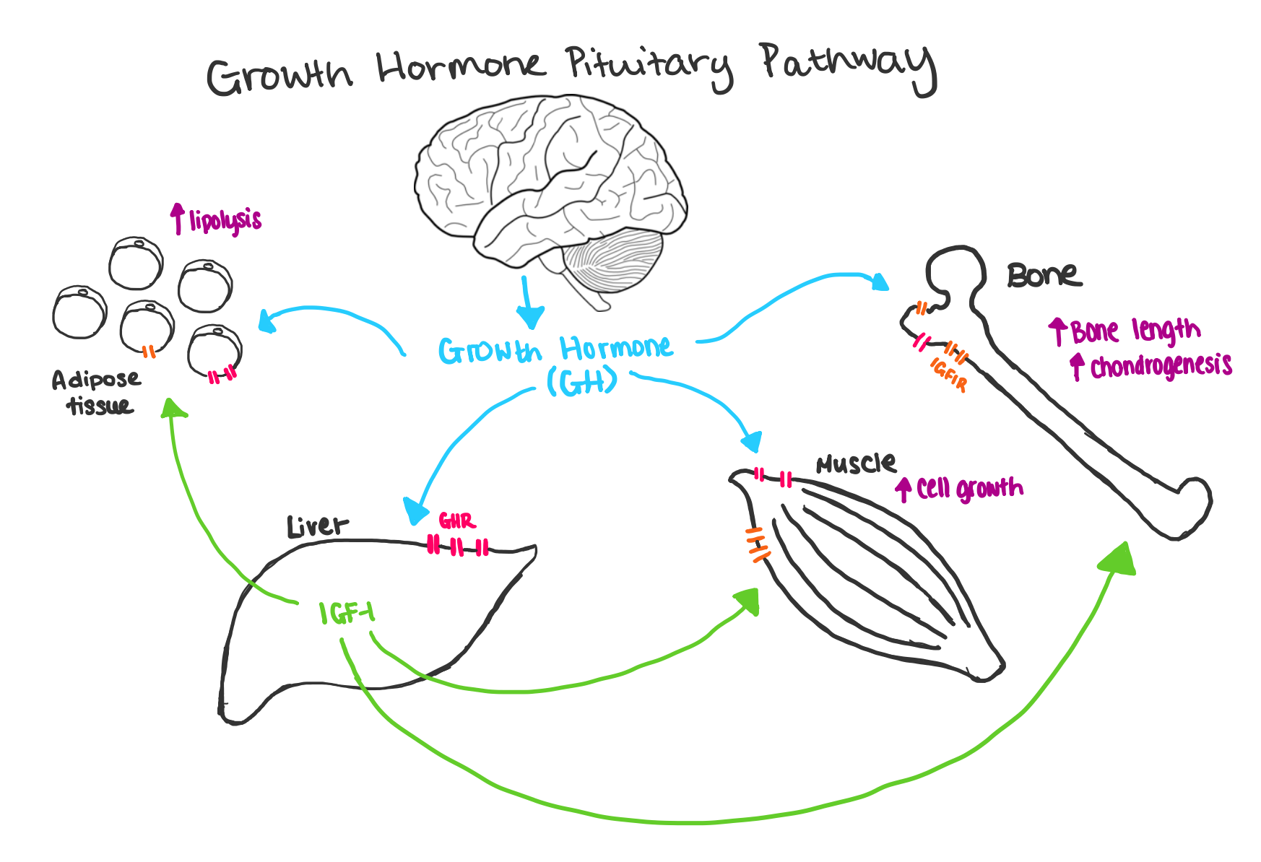
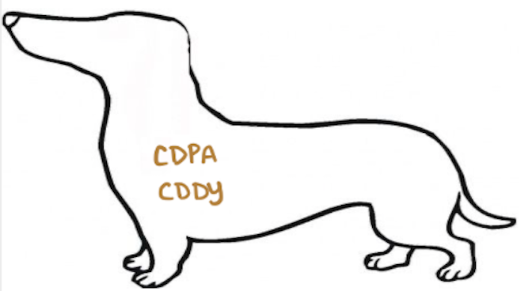
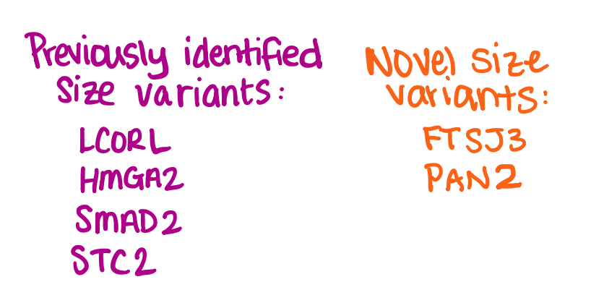
Notes:
This is a brief overview of that pathway: growth hormone is released from the anterior pituitary in the brain and acts on several target tissues around the body. One of the most important interactions is with the liver, which prompts IGF1 expression and circulation, which leads to longer bones, bigger muscles, and ultimately leads to larger organisms.
CLICK
Some of the size variants I chose to focus on are involved in this pathway.
CLICK
I also analyzed chondrodysplasia and chondrodystrophy, two known dwarfism genes.
I also wanted to include these size variants that have been described previously in literature, although their exact relationship to the growth hormone pathway has yet to be determined. These four SNPs are in linkage disequilibrium with the true mutations, whereas the array I used had the true mutations for all of the other genes. Finally, I was interested in these novel size variants, FTSJ3 and PAN2, so I kept those in my analysis as well.
Transition: I plotted each poodle using their weight with their genotype call at each of these SNPs and compared the weights between the genotype categories. -

Slide 9
Genotypes by Body Weight Using All Poodles
A/A: Ancestral
A/D: Heterozygous
D/D: Derived
Notes:
And found that each SNP was significant in poodles.
This graph is with both large and small poodles. I graphed their weight in kilograms versus their genotype call for each gene. A/A is ancestral, as determined from looking at the grey wolf. A/D is heterozygous and D/D is derived. The numbers along the x axis are how many poodles fall into each category. An asterisk next to the gene name indicates that the gene is in linkage disequilibrium with the mutation.
Beause I am comparing two discrete groups of poodles, my data was not normally distributed. Because of this, I used the Kruskal-Wallis testing function in Prism to determine significance.
If you look at LCORL, you can see that small poodles were mostly ancestral, with a few heterozygotes, while mutant poodles were larger. Looking at GHR1, you can see that larger poodles were wild-type, or ancestral, while even a single mutant allele made small poodles. This is a good example of a dominant trait, as the heterozygote and mutant groups are very similar in their average weights.
Transition: As you can see, all of these variants are significant to some degree when looked at independently. I wanted to look at the combined effects of these variants, so I generated a heat map -

Slide 10
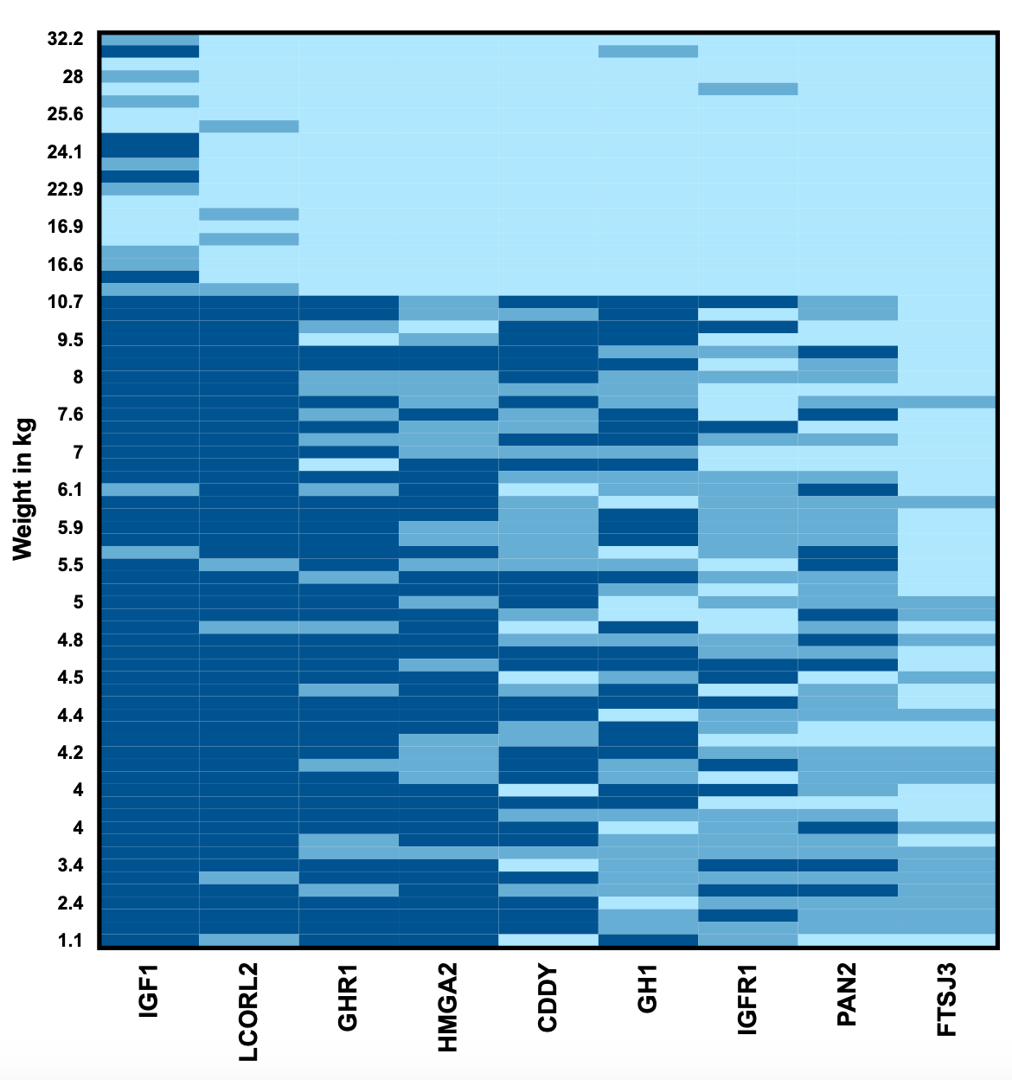
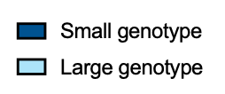
Accumulated Genetic Influence of Size Variants in Poodles
Notes:
Which color codes genotype calls of a single dog across multiple SNPS. My samples ranged in weight from 1.1kg to 32.2kg, and I removed the less significant SNPs to better reflect my data. Here, you can see that these genes play a bigger role determining size in poodles 11kg or less, while only 1, maybe 2 of the genes segregate in larger poodles.
Here you can also see that IGF1 is virtually homozygous in smaller poodles, indicating that it is important in making poodles smaller, but we are unable to assess the exact contribution in poodles since our combined data (small and large poodles) is not normally distributed.
Transition: However, our small poodle data is normally distributed, so I was able to run multivariate linear analysis and found these three SNPs to be significant indicators of size in small poodles. Incorporating this data,

Slide 11
Miniature Poodle
*** HMGA2 A/D: + 1.6kg
D/D: + 3.2kg
Toy Poodle
** GHR1 A/D: - 2.8kg
D/D: - 2.8kg
*** FTSJ3 A/D: - 1.8kg
Average weight: 8.1kg
Large Poodles
Small Poodles
LCORL STC2
GH1 HMGA2
IGF1R GHR1 FTSJ3
PAN2 IGF1 CDDY
Images from AKC.org
Notes:
Looking at large poodles, you would expect to find mutant SNPs in LCORL, STC2, GH1, and HMGA2. Small poodles would typically have mutant IGFR1, GHR1, FTSJ3. PAN2, IGF1, and CDDY.
Based on my multivariate linear regression results, I was able to further differentiate between miniature and toy poodles. Each mutant copy of HMGA2 added 1.6kg of weight to a small poodle, which has an average starting weight of 8.1kg. FTSJ3 is a novel SNP that has been found in other toy breeds. None of my poodles were homozygous for the mutant, which may represent a balancing selection, but a single copy of the mutation makes poodles 1.8kg smaller, on average. GHR1 is a dominant mutation (indicated on this slide with a *), so even a single copy of the GHR1 mutation makes a small poodle 2.8kg smaller than WT.
I am hoping to be able to assign specific values to these other SNPs, but for now that remains a work in progress.
HMGA2***
FTSJ3***
GHR1**

Slide 12
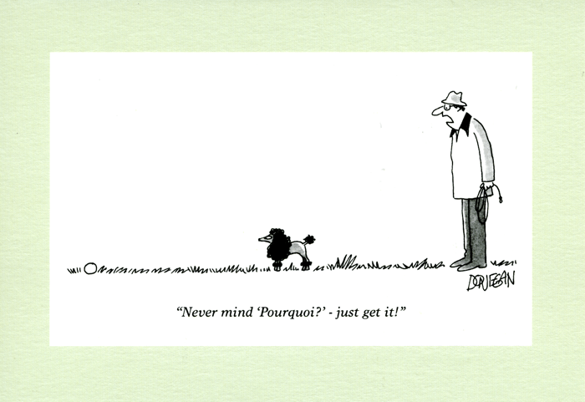
Questions?
Notes:
I want to thank STAR, NIH, and the Poodle Club of America for funding, and Dr. Bannasch for her mentorship. And with that, I thank you for your time and I am happy to take any questions.

Slide 13
References
V.J. Adams, K.M. Evans, J. Sampson, J.L.N. Wood. Methods and mortality results of a health survey of purebred dogs in the UK. Journal of Small Animal Practice, 51 (2010), pp. 512-524
American Kennel Club, Akc.org
Bannasch DL, Baes CF, Leeb T. Genetic Variants Affecting Skeletal Morphology in Domestic Dogs. Trends Genet. 2020;36(8):598-609. doi:10.1016/j.tig.2020.05.005
Dekhoda, F., Lee, CMM., Medina, J., Brookes, AJ. (2018). The Growth Hormone Receptor: Mechanism of Receptor Activation, Cell Signaling, and Physiological Aspects. Frontiers in Endocrinology, 9(35). Doi:10.3389/fendo.2018.00035.
O'Neill DG, Church DB, McGreevy PD, Thomson PC, Brodbelt DC. Longevity and mortality of owned dogs in England. Vet J. 2013;198(3):638-643. doi:10.1016/j.tvjl.2013.09.020
Plassais, J., Rimbault, M., Williams, F. J., Davis, B. W., Schoenebeck, J. J., & Ostrander, E. A. (2017). Analysis of large versus small dogs reveals three genes on the canine X chromosome associated with body weight, muscling and back fat thickness. PLoS genetics, 13(3), e1006661. https://doi.org/10.1371/journal.pgen.1006661
Rimbault, M., Beale, H. C., Schoenebeck, J. J., Hoopes, B. C., Allen, J. J., Kilroy-Glynn, P., Wayne, R. K., Sutter, N. B., & Ostrander, E. A. (2013). Derived variants at six genes explain nearly half of size reduction in dog breeds. Genome research, 23(12), 1985–1995. https://doi.org/10.1101/gr.157339.113

