Slide 5
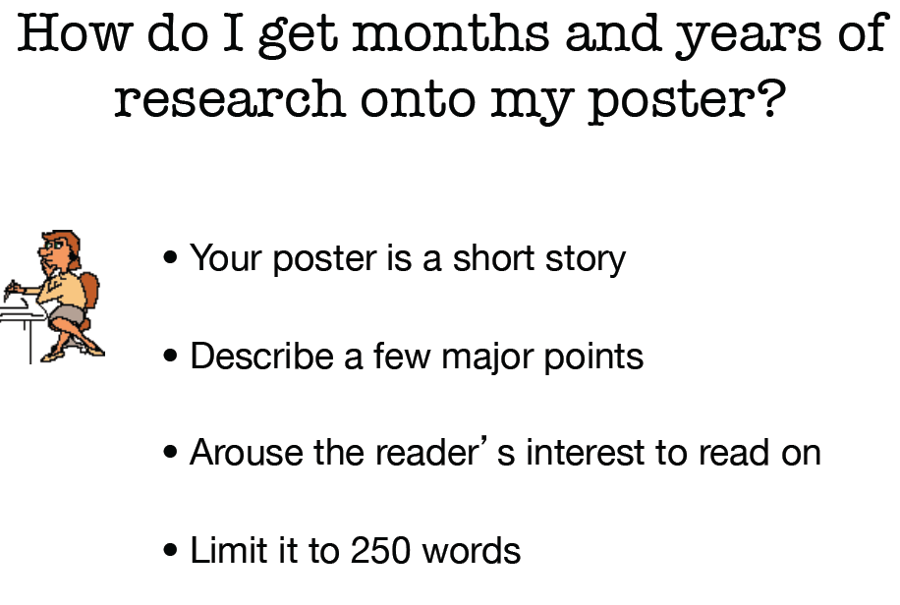

Slide 8
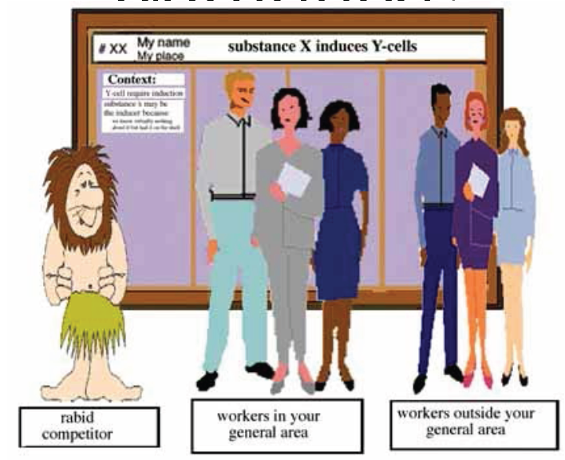
WHO IS MY AUDIENCE?

Slide 10
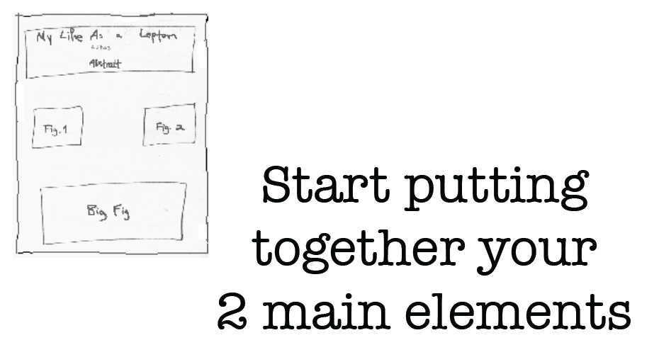
Start with a sheet of paper or digital sketch
TITLE/ABSTRACT
FIGURE LAYOUT

Slide 12
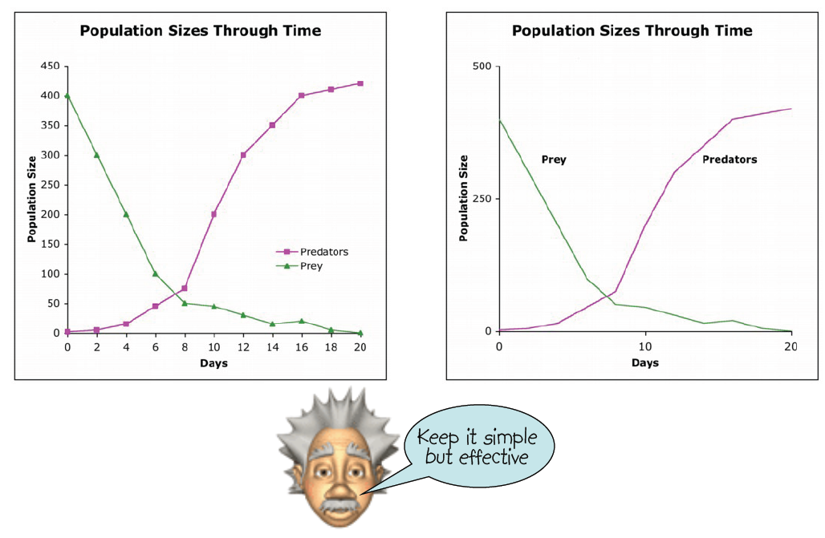

Slide 14
Why?
What did
I find?
What did
I find?
What am
I adding?
What did
I find?
Discussion
Sflf…
Methods
1…
2...
3...
Conclusions
Vdfkvds…
Dlkngegp...
What did
I find?

Slide 15
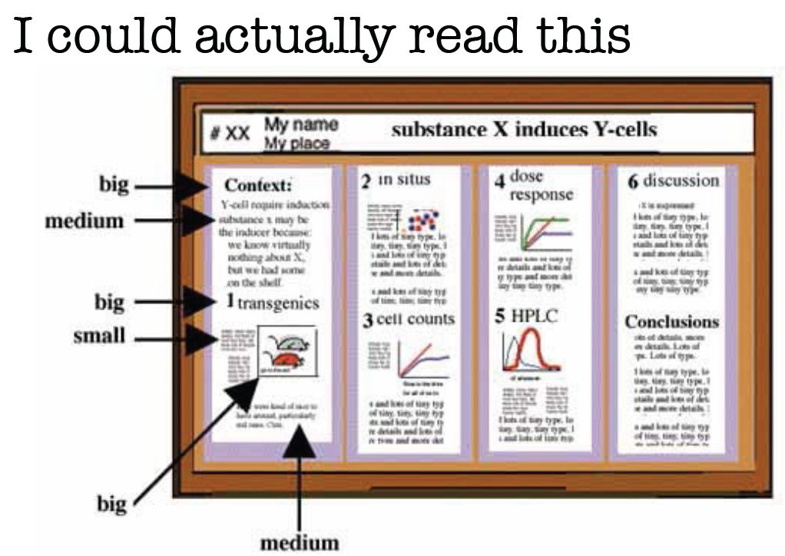

Slide 18
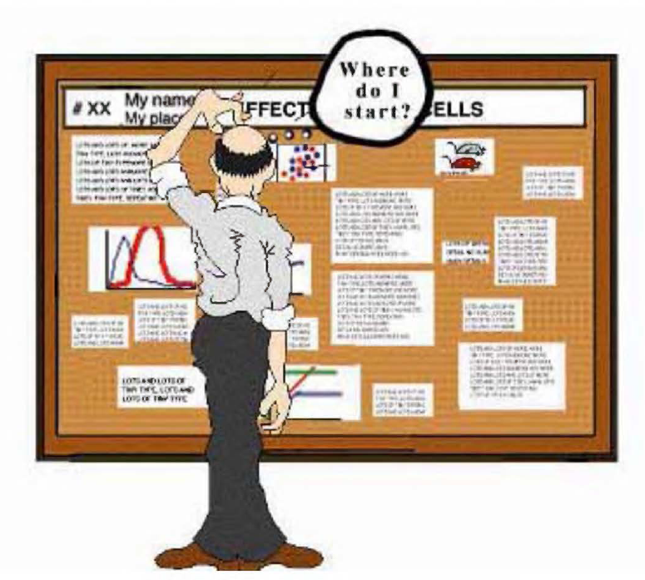

Slide 19
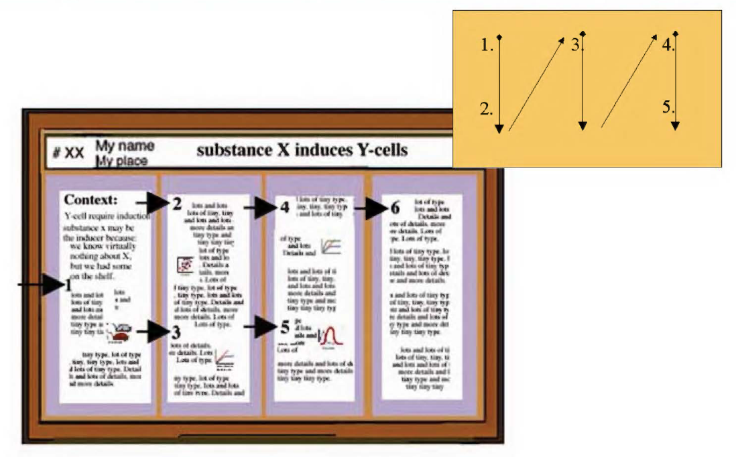

Slide 23
