Slide 1
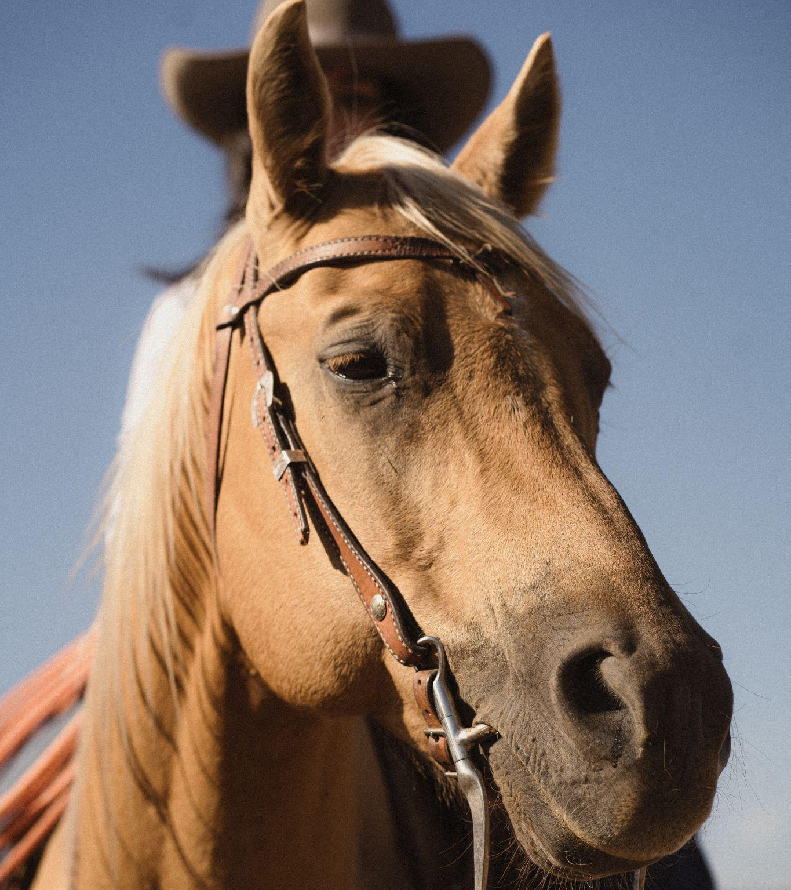
Pharmacokinetics & Anti-inflammatory Effects of Intramuscular Corticosteroids
Juliana Sullivan
Heather K. Knych

Slide 2
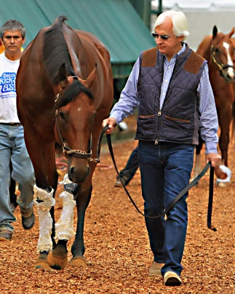
Introduction and Rationale
Betamethasone is a potent anti-inflammatory medication used for musculoskeletal inflammation
Commonly used, but pharmacokinetic/ pharmacodynamic reports are limited
Studies characterizing Intramuscular (IM) administration are especially limited
This project aims to describe the pharmacokinetic and anti-inflammatory effects of betamethasone following IM administration

Slide 3
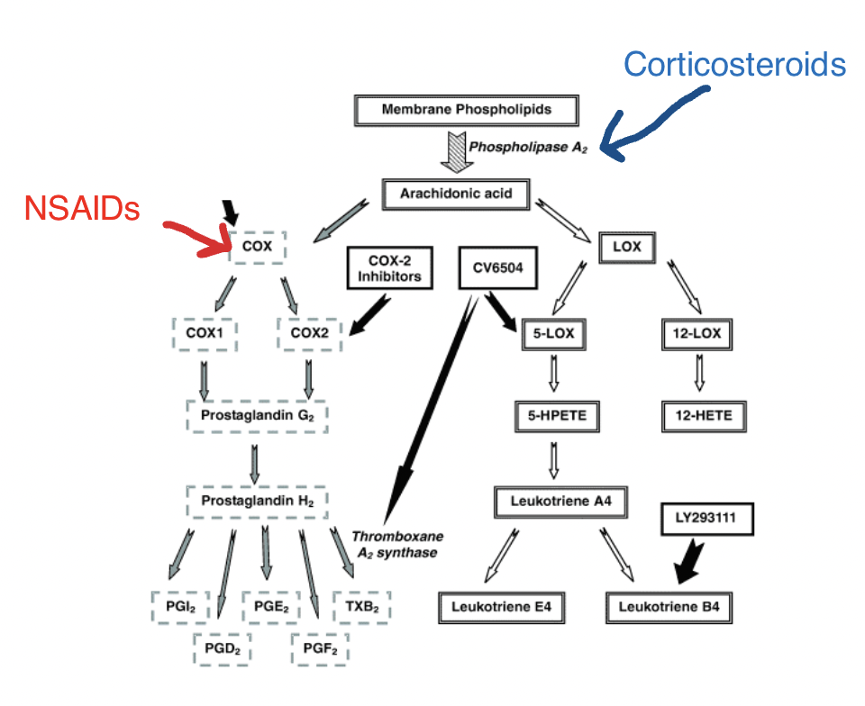
Introduction and Rationale Cont.
Terms to Know:
Betamethasone = Corticosteroid, which prevents conversion of phospholipids to arachidonic acid and subsequent production of eicosanoids
Eicosanoids = responsible for perpetuating the inflammatory process
Thromboxane B2 = Inactive metabolite of Thromboxane A2, which is a vasoconstrictor that stimulates platelet aggregation and is made by Thromboxane A2 Synthase
Cortisol = stress hormone suppressed by corticosteroids
GOOGLE SLIDES
Notes:
Thromboxane B2 is the inactive metabolite of Thromboxane A2, which is a vasoconstrictor that stimulates platelet aggregation. Thromboxane A2 synthase, which makes Thromboxane A2, is shown on this diagram where the star is.

Slide 4
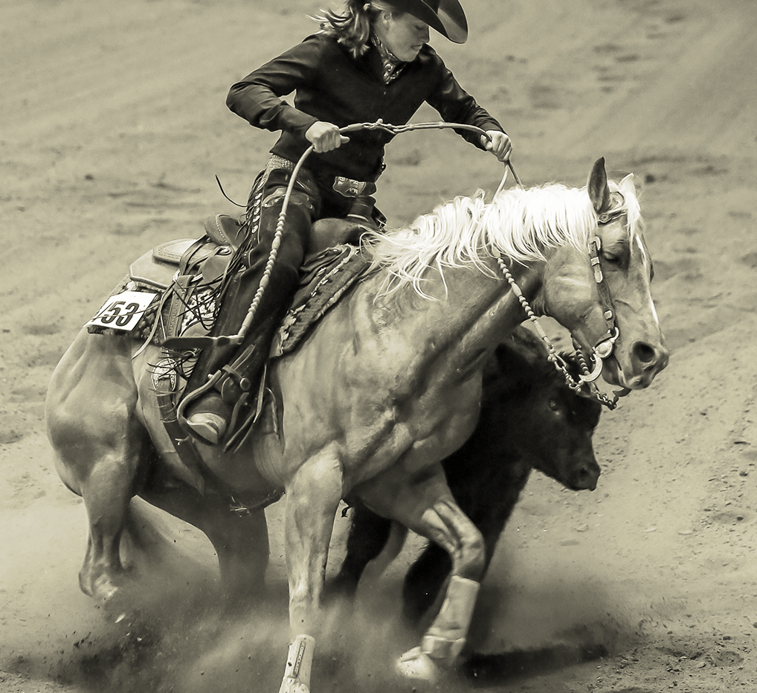
Hypothesis
Intramuscular (IM) administration of betamethasone will result in sustained plasma concentrations and a prolonged anti-inflammatory effect warranting an extended withdrawal time prior to competition in performance horses.

Slide 5
Specific Aims
1.
2.
Describe plasma and urine concentrations and pharmacokinetics and clearance of betamethasone following intramuscular administration.
Describe the duration of the pharmacodynamic effects of betamethasone by assessing concentrations of hydrocortisone and inflammatory biomarkers in an ex vivo model of inflammation.

Slide 6
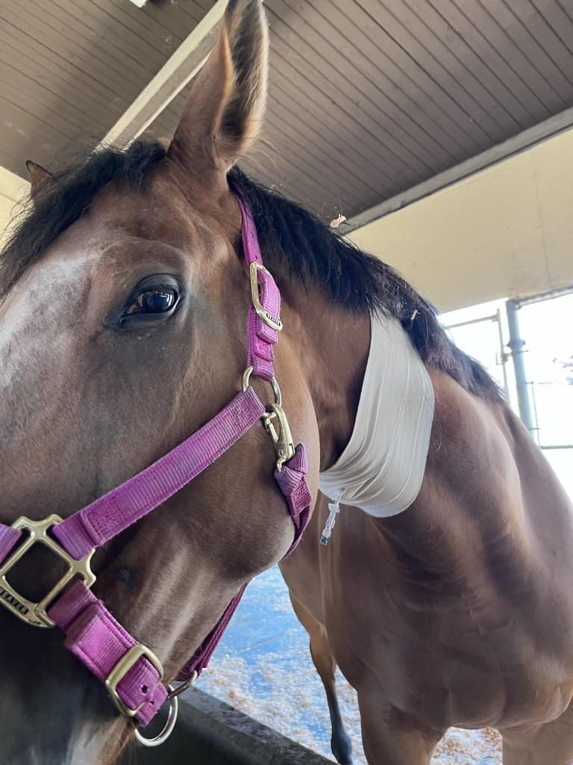
Methods
12 horses
University owned, treadmill horses
12 mg betamethasone
Administered intramuscularly in the neck
Sample Collection
Urine collected via free catch
Blood collected via catheter and direct stick

Slide 7
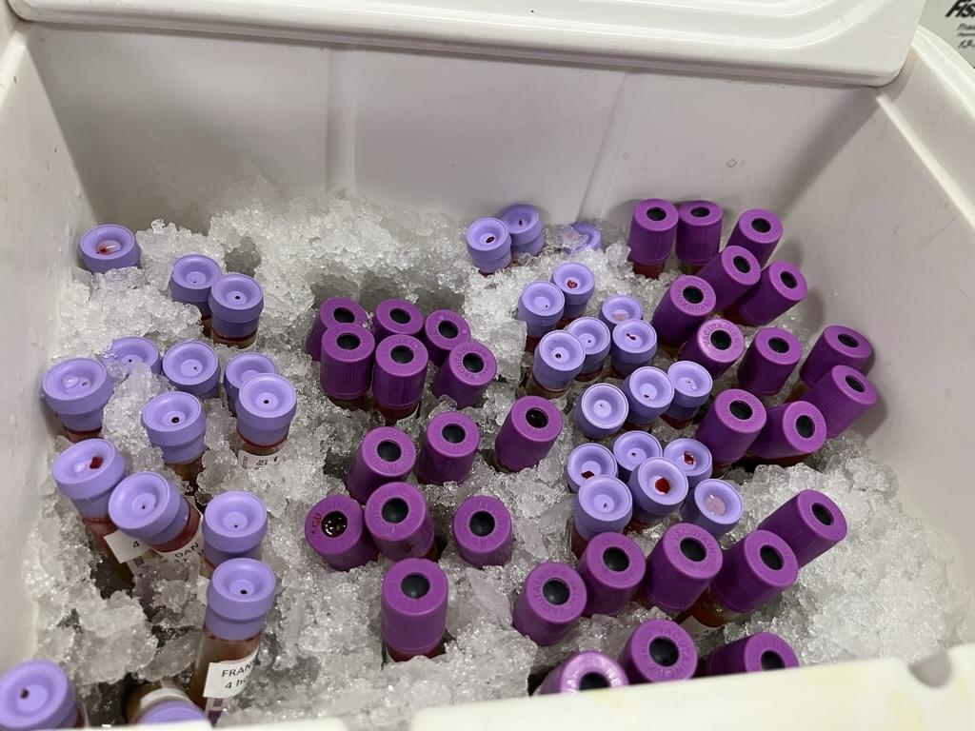
Methods: Blood Collection Timeline
36 Hr Timepoint:
120 Hr Timepoint:
Blood collected every 12 hrs from 36-72 hrs
120-264 hours - every 48 hours
24 hr
48 hr
72 hr
96 hr
120 hr
264 hr
360 hr
408 hr
24 Hr Timepoint:
72 Hr Timepoint:
5 collections within 1 hr
Hourly from 1-8 hrs, then every 6 hrs from 12-36 hrs
72-120 - every 24 hours

Slide 8
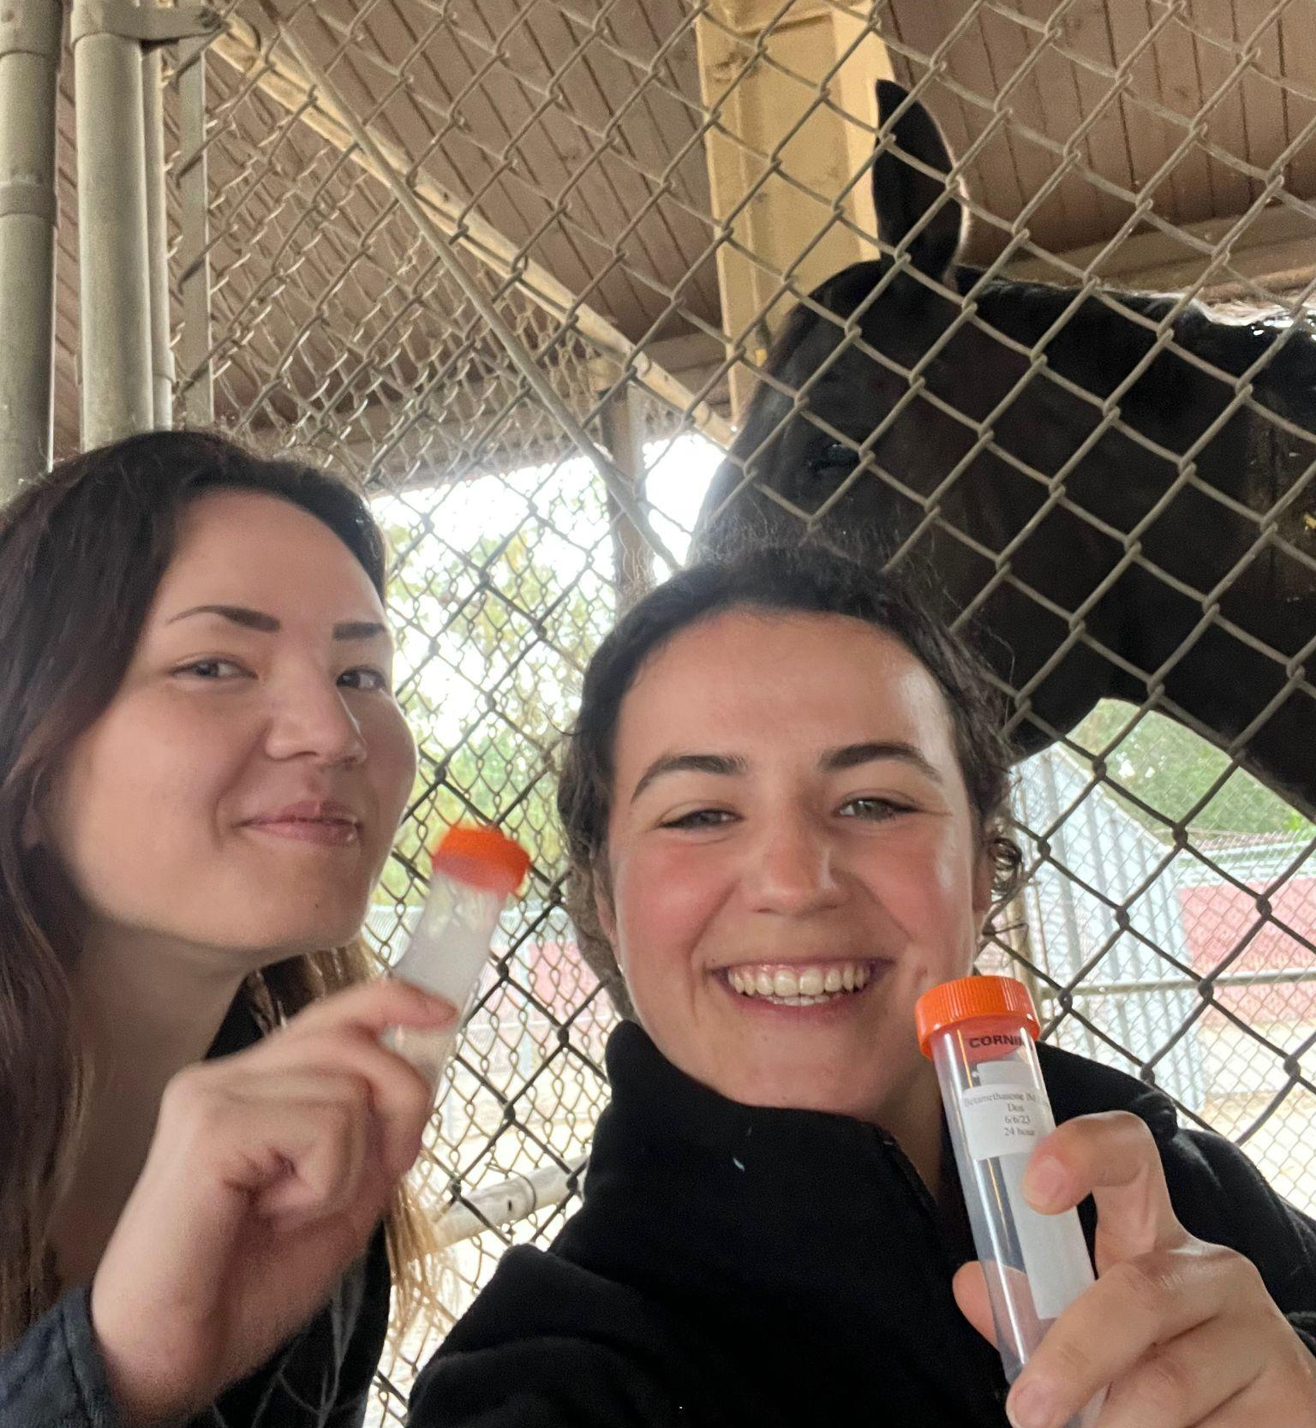
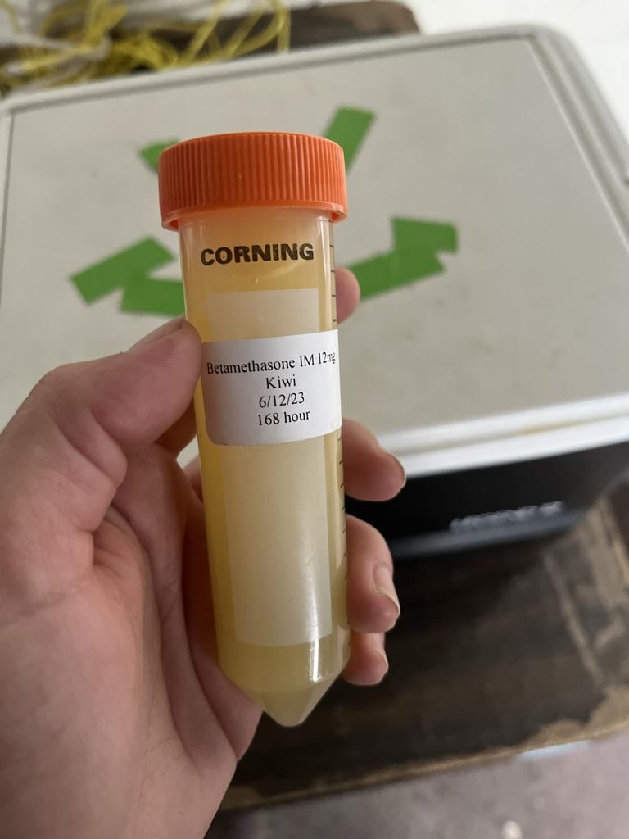
Methods: Urine Collection Timeline
24 hr
48 hr
72 hr
96 hr
168 hr
216 hr
264 hr
360 hr
408 hr

Slide 9
Methods: From barn to lab
The samples are then brought to the lab for determination of:
Drug Concentration
Hydrocortisone Concentration
Thromboxane B2 Concentration
Eicosanoid Concentration

Slide 10
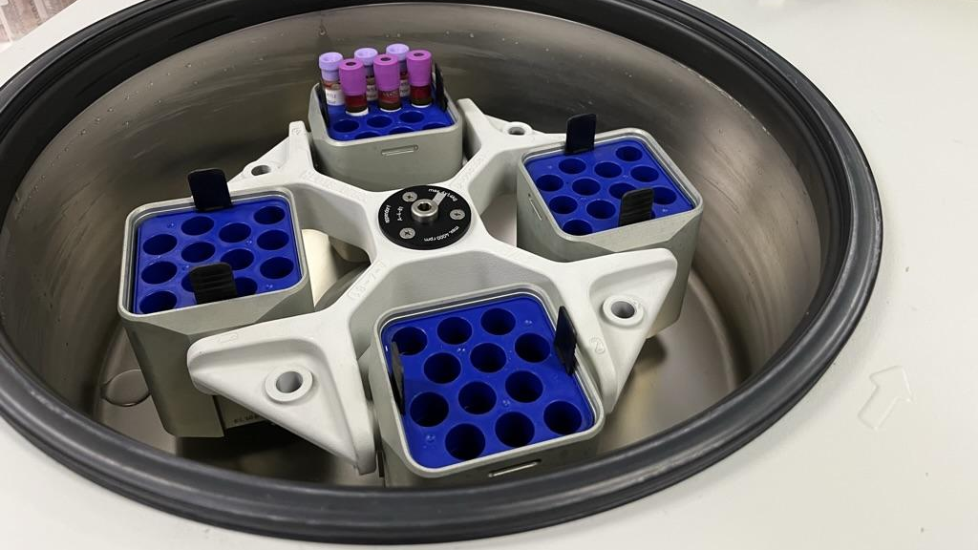
Methods:
Drug Concentration
EDTA
(Anticoagulant) blood tubes
3000 x g
Centrifuge speed for 10 minutes at 4°C
LC-MS/MS
Liquid Chromatography-Tandem Mass Spectrometry

Slide 11
Methods:
Hydrocortisone Concentration
EDTA
(Anticoagulant) blood tubes
3000 x g
Centrifuge speed for 10 minutes at 4°C
LC-MS/MS
Plasma harvested for Liquid Chromatography-Tandem Mass Spectrometry

Slide 12
Methods:
Thromboxane B2 Concentration
Non-Heparinized
Blood tubes
37°C
Samples are incubated at this temperature for 1 hr and then centrifuged
LC-MS/MS
Serum harvested for Liquid Chromatography-Tandem Mass Spectrometry

Slide 13
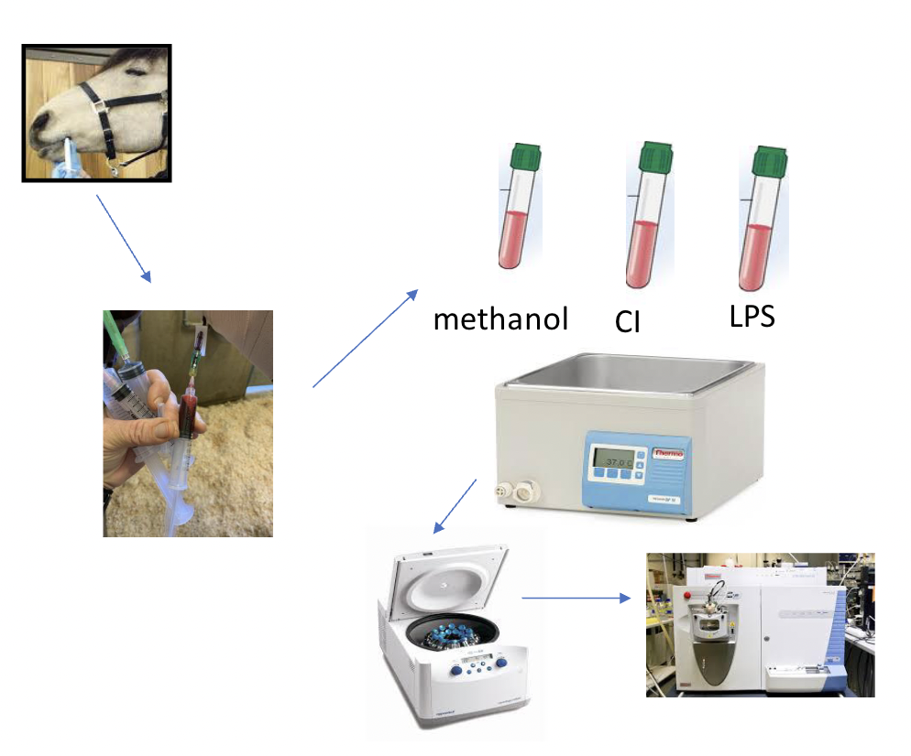
Methods:
Eicosanoid Concentration
Whole blood sample in EDTA tube is separated into 3 aliquots
Aliquot 1: Stimulated with calcium ionophore
Aliquot 2: Stimulated with lipopolysaccharide (LPS)
Aliquot 3 (Control): Stimulated with methanol (ME)
All 3 aliquots incubated at 37°C, centrifuged, and plasma harvested
Plasma is then analyzed with LC-MS/MS
Notes:
These first two stimulants are intended to trigger the arachidonic acid cascade and subsequent production of eicosanoids. Betamethasone will likely be more effective at higher concentrations, leading to decreased levels of eicosanoids.

Slide 14
Methods:
Drug Concentration in Urine
24 hr
48 hr
72 hr
96 hr
168 hr
216 hr
264 hr
360 hr
408 hr
Analysis
Liquid Chromatography Tandem Mass Spectrometry (LC-MS/MS)

Slide 15
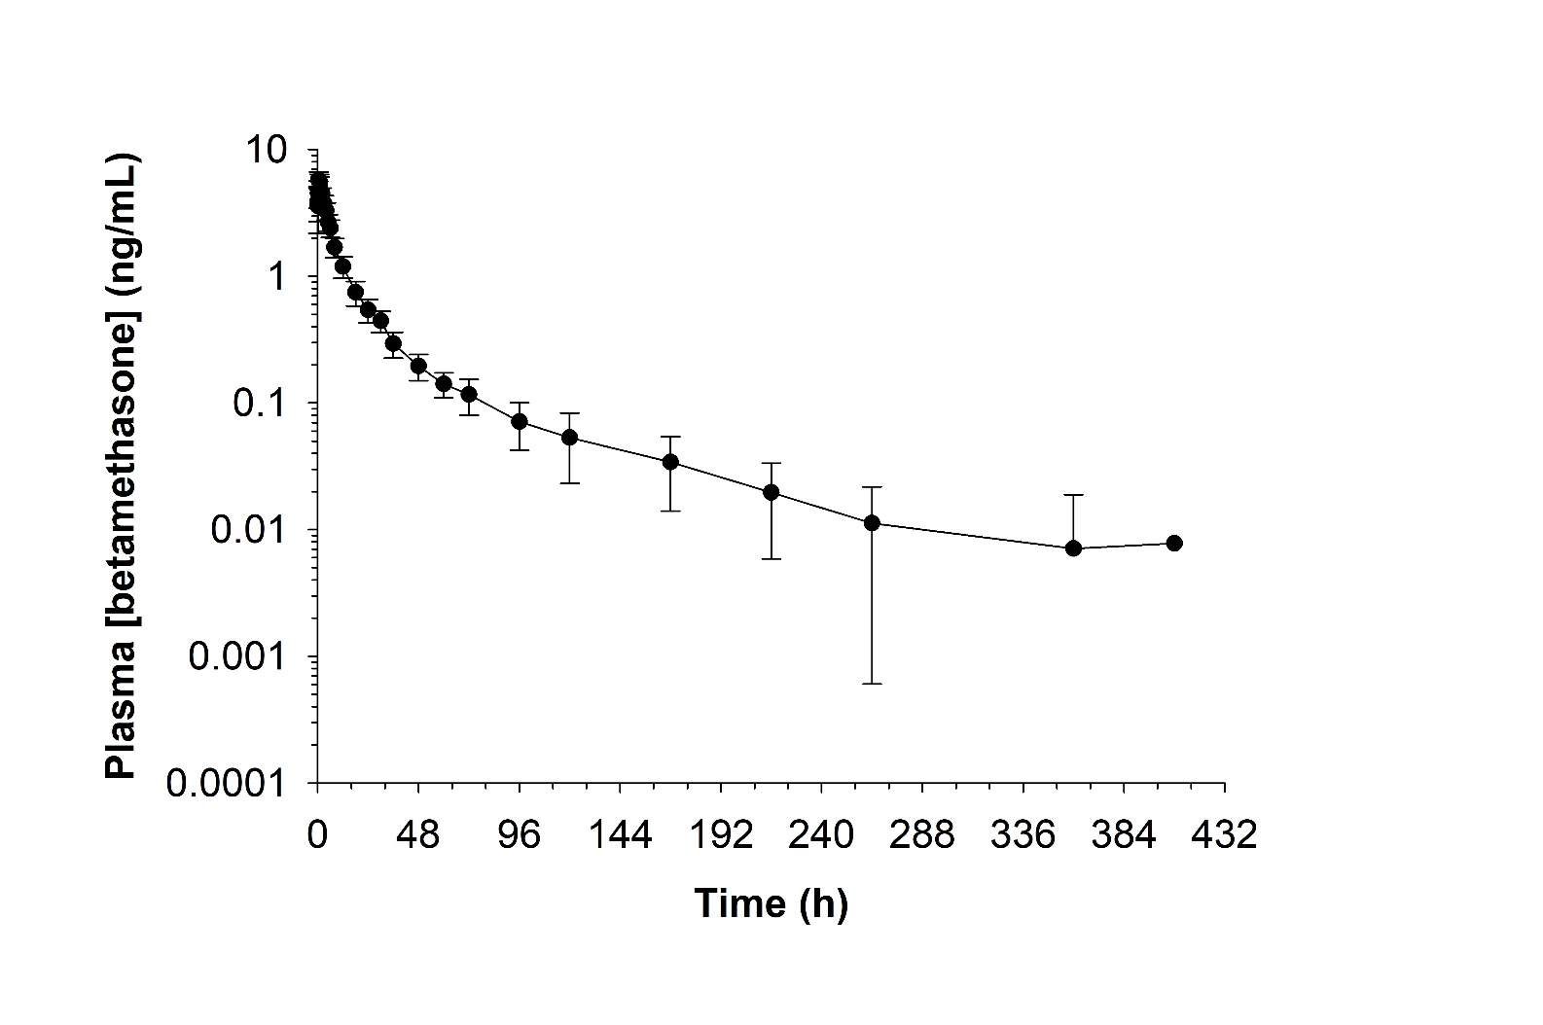
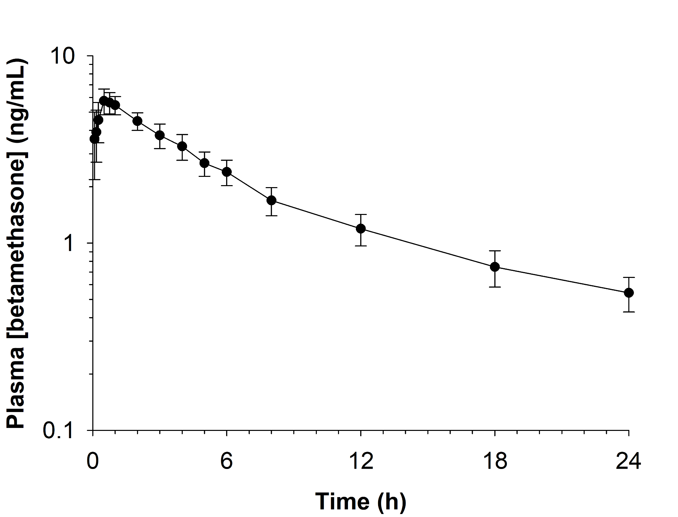
Results: Plasma Concentrations
Betamethasone All Time Points
Variable | Mean and Range
C_{max} (ng/mL) | 5.92 (4.57-7.00)
T_{max} (h) | 0.75 (0.5-2.0)
AUC_{0-∞} (h*ng/mL) | 61.7 (49.5-74.0)
Lambda_z (1/h) | 0.02 (0.007-0.043)
HL_Lambda_z (h) | 44.3 (16.1-97.8)
Betamethasone 24 Hours
For Reference:
Plasma LOQ: 0.0025 ng/mL
Plasma LOD: approximately 0.001 ng/mL
Notes:
HL Lambda Z: call it ½ life lambda z or terminal half life. DO not call it elimination half life. “flip flop kinetics”
formulated to be slow release, so rate of absorption is really slow, may be slower than the rate of elimination. for most drugs, rate of elimination is slower than rate of absorption. so that last portion of the curve is influenced by absorption.
You can see from these graphs that it stayed in the system for a long period of time
AUC from 0 to infinity is a measure of the body's exposure to the drug

Slide 16
Results: Urine Collection
24 hr
48 hr
72 hr
96 hr
168 hr
216 hr
264 hr
360 hr
408 hr
216 hours (9 days)
408 hours (17 days)
4 / 12 horses had a non-detectable (ND) drug concentration result
11 / 12 horses were ND or less than the limit of quantification (LOQ)
For Reference:
Urine LOQ: 0.05 ng/mL
Urine LOD: 0.02 ng/mL

Slide 17
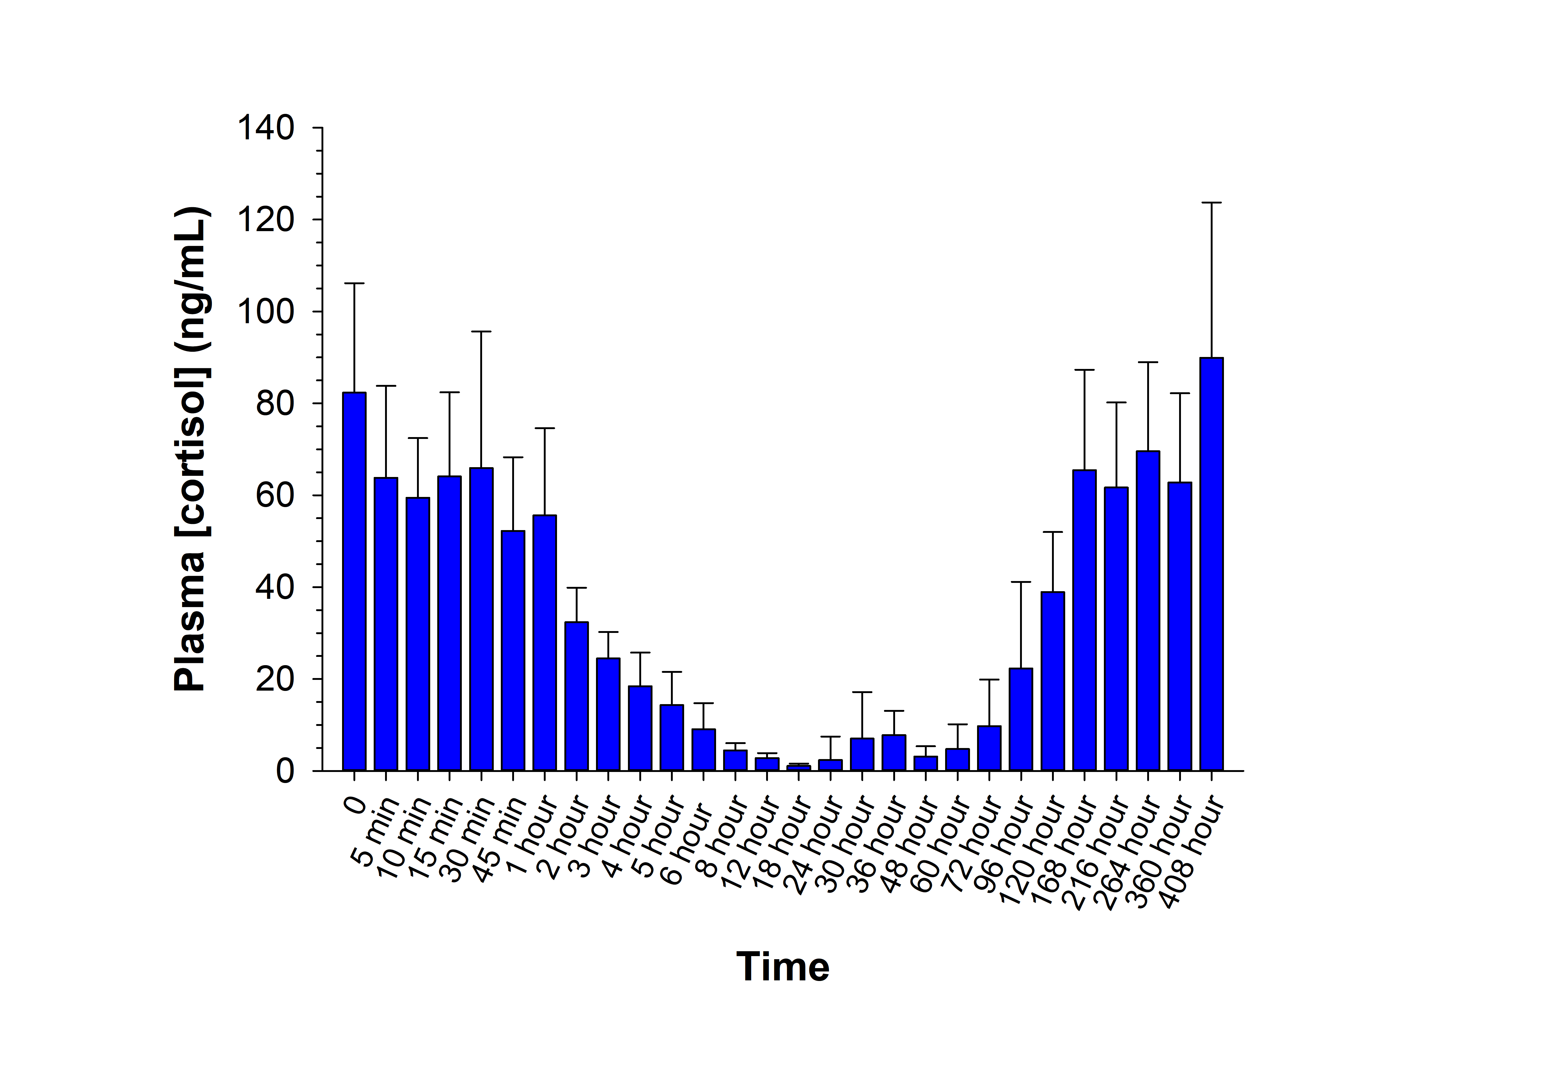
Results: Cortisol Concentrations
Betamethasone All Time Points
Notes:
This graph shows that we did see suppression of endogenous cortisol production, however we have yet to statistically analyze the data.

Slide 18
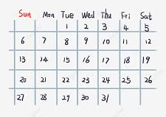
Betamthasone IM Injection - Urine Clearance Calendar
Summary of Findings
When administered intramuscularly, betamethasone stays in the horse’s system for a long time
We are still analyzing data to find out how long the anti-inflammatory effects last
Betamthasone IA Injection- Urine Clearance Calendar

Slide 19
What are the implications?
Bob Baffert: Trainer for 2021 Kentucky Derby winner Medina Spirit, who tested + for betamethasone.
$3 million in winnings, $7,500 fine
Remember him from the 2nd slide of this presentation?
Notes:
Baffert claimed that betamethasone containing ointment should not be counted as +.

Slide 20
Acknowledgements
Dr. Heather Knych
Stacy Steinmetz, Kirsten Kanarr, Meghan Traynham
Dan, Sandy, & Jayanti
Gabby Nelson
Megan, Nicole, Ye
STAR funding provided by Center for Equine Health Endowment Funds
Funding for this study provided by the AQHA and the California Horse Racing Board
Notes:
Funding provided by AQHA, California Horse Racing Board

Slide 21
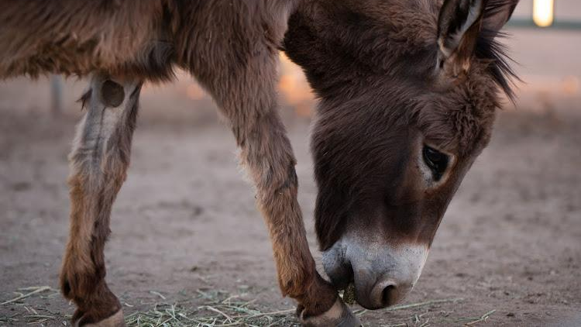
Questions

