Slide 1
Vitamin B6 in Cats
Vy Chu

Slide 2
Hypothesis
Vitamin B6 levels are negatively correlated with age and body condition score in cats

Slide 3
What is vitamin B6?
Essential vitamin
Wide variety of function including protein metabolism, immune function, gluconeogenesis, and more

Slide 4
Why does it matter?
Prevalence of vitamin B6 deficiencies in elderly human population
Lack of data on vitamin levels in cats despite increasing life expectancy
If and when nutritional interventions may be necessary

Slide 5
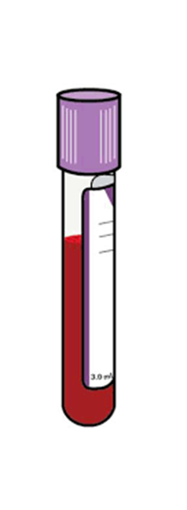
Methods
01.
Blood collection
60 cats from cat colony
Age 1-17 years old
Body condition score 4-8
44 females and 16 males
All consuming same diet for all life stages

Slide 6
Methods
02
Sample preparation
Centrifugated
Plasma removed
Packed red blood cells washed in phosphate buffer saline
Suspended in triton-X solution to lyse cells
Diluted with phosphate buffer to measure enzymatic activity
Notes:
Vitamin B6 found inside of RBC is a more relevant marker of vitamin status than plasma vitamin B6

Slide 7
Measuring AST activity as a functional biomarker for vitamin B6
L-aspartate + alpha-ketoglutarate Oxaloacetate + L-glutamate
Oxaloacetate + H⁺ + NADH Malate + NAD⁺
Vitamin B6 is a cofactor for aspartate aminotransferase (AST)
AST
MDH

Slide 8
L-aspartate + alpha-ketoglutarate Oxaloacetate + L-glutamate
Oxaloacetate + H⁺ + NADH Malate + NAD⁺
AST
MDH

Slide 9
Slope is enzymatic activity of AST
Measure decrease in NADH

Slide 10
Primary activation ratio (PAR)
Activity of AST with added vitamin B6 divided by activity of AST without added vitamin B6
1 sample has 2 measurements: one without additional B6 and one with B6
Good indicator of vitamin B6 status
Higher PAR reflects lower vitamin B6 status

Slide 11
Blank has same reagents except alpha-ketoglutarate

Slide 12
BCA Protein Assay
Quantification of total protein in samples
Enzyme activity will be expressed in units per mg of protein
Protein concentration causes color change which is measured and compared to protein solutions of known concentration

Slide 13
Calculations
Beer-Lambert Law
Solve for concentration
Divide by protein concentration
Calculate PAR
A = aborbance
ε= molar absorptivity
B= length of light path
C = concentration

Slide 14
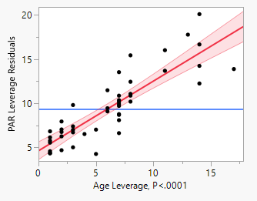
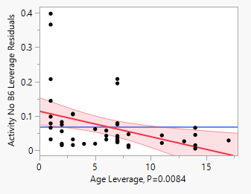
Statistics
Used JMP for linear regression
Y-variable as activity with no B6, activity with B6, and PAR
X-variable as age, sex, BCS
Only activity with no B6 and PAR was statistically significant
Equation for age: PAR = 4.63 + 0.789xage

Slide 15
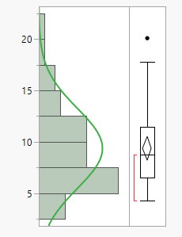
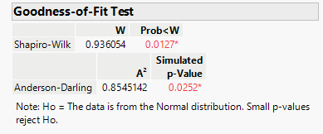
What’s next?
Normal Distributed?
JMP analyzed distribution of PAR values to see if it is normally distributed
Shapiro-Wilk test: how close does the data fit to normal distribution?
Notes:
The null hypothesis is that the data is from normal distribution. The P value here is 0.0127 so it is smaller than 0.05 therefore the null hypothesis is rejected, meaning it does not follow normal distribution. Which you can already kinda tell by the picture on the right

Slide 16
What’s next?
Blood samples from VMTH cases
Enzymatic activity and PAR values already calculated for 57 samples
Convert data to normal distribution to identify cut off values for deficiency
Use to find if any VMTH cases are deficient and if so, does the patient have any symptoms associated with vitamin B6 deficiency?
Notes:
Such as anemia, slow growth, muscle weakness, seizures

Slide 17
References
Limpert E, Stahel WA. Problems with using the normal distribution – and ways to improve quality and efficiency of data analysis. PLoS ONE. 2011;6(7). doi:10.1371/journal.pone.0021403
Marriott BP, Birt DF, Stalling VA, Yates AA. Present Knowledge in Nutrition. London: Academic Press; 2020.
Sechi GP, Sechi E, Fois C, Kumar N. Advances in clinical determinants and neurological manifestations of B vitamin deficiency in adults. Nutrition Reviews. 2016;74(5):281-300. doi:10.1093/nutrit/nuv107
Spinneker A, Sola R, Lemmen V, Castillo MJ, Pietrzik K, González-Gross M. Vitamin B6 status, deficiency and its consequences--an overview. Nutr Hosp. 2007;22(1):7-24.
Ueland PM, Ulvik A, Rios-Avila L, Midttun Ø, Gregory JF. Direct and functional biomarkers of vitamin B6 status. Annual Review of Nutrition. 2015;35(1):33-70. doi:10.1146/annurev-nutr-071714-034330
Notes:
Such as anemia, slow growth, muscle weakness, seizures

