Slide 1
The Effect of Clodronate on Gene Expression in the Horse
Callie Wilcox
STAR Mentor: Dr. Carrie Finno
Notes:
In collaboration with Dr. Knych’s lab

Slide 2
Bisphosphonates (BPs)
Created with BioRender.com

Slide 3
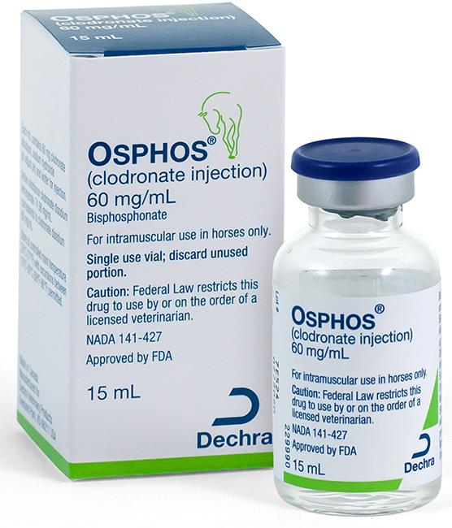
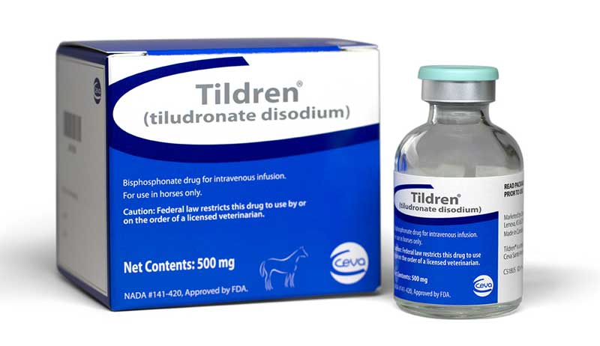
Background
Two FDA approved BPs for horses over 4 years of age
Osphos® (clodronate)
Tildren® (tiludronate)
Treatment of navicular syndrome
Growing concern about use in young exercising horses
dechra-us.com
veterinarypracticenews.com
Notes:
Navicular syndrome
Specific type of lameness that involves inflammation or degeneration of the navicular bone and its surrounding tissues, usually on the front feet

Slide 4
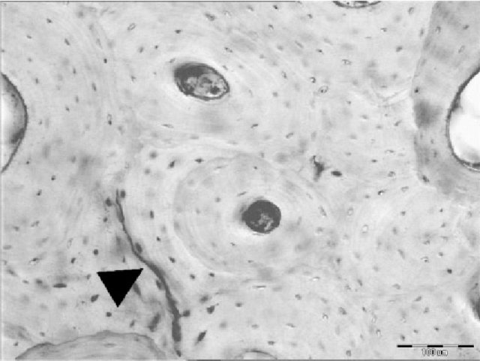
Adverse Effects
Young exercising horses
↑ bone growth and remodeling
↑ normal microcracks in bone
With BPs
↓ osteoclast activity
↓ remodeling of microcracks
↑ analgesia that may mask bone injuries
Augat and Schorlemmer, Age Ageing, 2006
Notes:
Because of the increased awareness of these possible adverse effects in young exercising horses, there is a growing need for a reliable drug test for racehorses on the track to prevent catastrophic injury.

Slide 5
Current Challenges
BPs have a very short detection window in the blood before sequestering to the bone
BPs cause adverse effects that may lead to catastrophic injury in young, exercising horses
Reliability of current drug tests is questionable, and the ideal method of bone biopsy is not viable
Notes:
Current challenges with drug detection
(1) Quantifiable only for 24 hours after administration
(3) Liquid-Chromatography Tandem Mass Spectrometry Testing for the drug over extended period of time is difficult

Slide 6
Hypothesis
There are one or more differentially expressed transcripts detectable in the peripheral blood of horses following administration of the bisphosphonate, clodronate
These differentially expressed genes will be involved in bone growth, bone remodeling, or analgesia
This gene list will provide subsequent biomarkers for drug testing

Slide 7
Aims
Using transcriptomics, determine differentially expressed genes following the administration of the bisphosphonate, clodronate, to healthy exercising Thoroughbreds
Validate the top differentially expressed transcripts using RT-qPCR

Slide 8
Methods
11 healthy exercising Thoroughbreds
7 administered clodronate
4 administered saline
Single dose
clodronate (1.8 mg/kg IM) or saline
Day 0
Day 1
Day 6
Day 28
Day 56
Day 182
PBMC RNA isolation time points
Notes:
RNA was then sent for RNA sequencing
BP = 4 mares, 3 geldings
Controls = 2 mares, 2 geldings
Ages "3"(4)-7

Slide 9
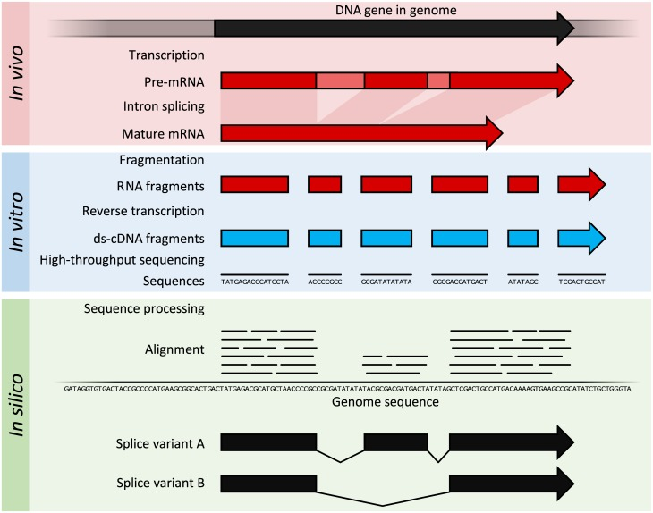
RNA-seq
Lowe et al., PLoS Comput. Biol., 2017

Slide 10
RNA-seq Analysis
Raw RNA-seq data
Quality control
FastQC
Differentially expressed transcripts
Quantify
Salmon
Mixed linear model
Limma-Voom (R)
Trim adapters Trimmomatic
Align to reference genome
STAR Aligner
Visualize reads in areas of interest
IGV
Notes:
Algorithm in light blue
Mixed linear model – fixed effects include sex, treatment, and time (and interactions of these variables) and random effect of horse
Gene, LogFC, Avg. Expr., P Value, Adj. P Value
Interested in Adj. P Value because adjusted more multiple testing
Significant Adj. P Value tells us – on a certain day, that gene is significantly differentially expressed between controls and bisphosphonate horses
Salmon – quasi-mapping – aligns to index and quantifies in one step - doesn’t make any intermediate alignment files
Used transcript to gene-level counts, not TPM → limma-voom normalizes for library and transcript size

Slide 11
Pathway
Analysis
All annotated genes
from mixed linear model
Unadjusted
P < 0.05
Upregulated in BP
+LogFC
Downregulated in BP
-LogFC
Pathway Analysis
PANTHER
Pathway Analysis
PANTHER
Notes:
& Repeat for each Day
PANTHER Pathway analysis tells us if there are cellular pathways that are over or underrepresented in our list of genes with P < 0.05

Slide 12
Results
RNA-seq Analysis
No transcripts were differentially expressed with a Benjamini-Hochberg FDR adjusted P < 0.05
Pathway Analysis (Day 1)
Pathway | Dysregulation | Raw P Value | FDR P Value
p38 MAPK | ↑ | 0.0005 | 0.04
Ras | ↑ | 0.0003 | 0.04
Cadherin | ↓ | 0.0003 | 0.02
Notes:
It is interesting that we see pathway dysregulation only on Day 1, because we know that BPs are only detectable in the blood for about 24 hours, so it makes sense that they would affect blood cells for only that period of time.

Slide 13
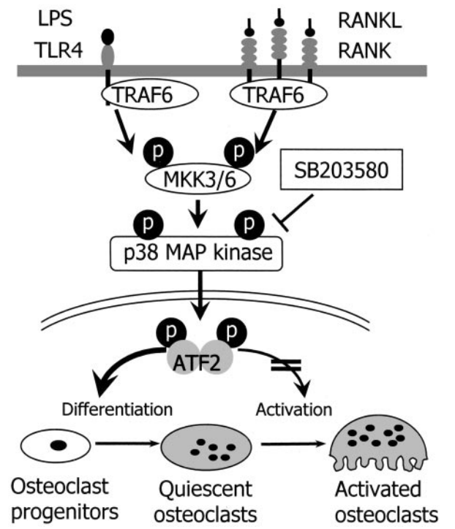
↑ p38 MAPK
↑Ras
Osteoclast apoptosis from BP use
?
Ras
Adapted from Li et al., Endocrinology, 2002
Notes:
P38 MAPK and Ras are implicated in osteoclast differentiation
We hypothesize that since osteoclasts are undergoing apoptosis, there is a need for an increase in differentiation of osteoclast progenitors to become activated osteoclasts to compensate for the loss
Not much of a connection between cadherin and BPs/bone, but something to look further into.

Slide 14
Aim 2
Potential protein biomarkers – Knych et al., 2022
CTX-1 protein is activated by Cathepsin K (CTSK)
Type 5 Acid Phosphatase (ACP5)
RT-qPCR for CTSK and ACP5 genes
In Progress
Notes:
Aim 2 is to confirm differential expression of transcripts from RNA-seq analysis, but alternative plan was to look at potential protein biomarkers from newly published Dr. Knych's study
Both have been used as markers for bone resorption and BP efficacy in horses and humans
CTX-1 is a cross-linked protein activated by Cathepsin K
Carboxy-terminal cross-linking telopeptide of type 1 collagen
Did not see reduction in CTX-1 in horses given clodronate
ACP5 changes in serum are not seen

Slide 15
Limitations
BP mechanism of action is not directly on PBMCs
Sample distribution
Minimum single dose for effect on navicular syndrome
Notes:
We know the mechanism of action is not directly on PBMCs, but we wanted to see if there was a way to use blood like many drug tests do
Had 5 saline, one coliced
Minimum AND single dose → higher dose? Multiple doses?

Slide 16
Conclusion
No detectable differentially expressed transcripts in peripheral blood of horses following administration of clodronate
With acute clodronate use on Day 1
Upregulation of p38 MAPK and Ras pathways
Downregulation of cadherin pathway
Notes:
Transcriptomics may not be a viable way to detect bisphosphonates

Slide 17
Future Directions
Confirm expression of CTSK and ACP5 with RT-qPCR
Further research significant pathways of interest and their role in osteoclast function
Continue work on other methods of bisphosphonate detection, such as urine (LC-MS/MS) and hair
Notes:
Liquid Chromatography-tandem mass spectrometry

Slide 18
Acknowledgements
Finno Lab
Dr. Carrie Finno
Veronika Rodriguez
Sichong Peng
Dr. Sharmila Ghosh
K. L. Maddy Equine Analytical Pharmacology Laboratory
Dr. Heather Knych
Dr. Rick Arthur
Dr. Scott Katzman
Funding Sources
STAR Program through the NIH T35 OD010956-22 Grant
Grayson Jockey Club Research Foundation
The Viola Foundation

Slide 19
Citations
Li, X, Udagawa, N, Itoh, K, Suda, K, Murase, Y, Nishihara, T, Suda, T, Takahashi, N. p38 MAPK-Mediated Signals Are Required for Inducing Osteoclast Differentiation But Not for Osteoclast Function, Endocrinology 2002; 143(8): 3105–3113. https://doi.org/10.1210/endo.143.8.8954
Augat, P, Schorlemmer, S. The role of cortical bone and its microstructure in bone strength. Age Ageing. 2006; 35 Suppl 2:ii27-ii31. https://doi.org/10.1093/ageing/afl081
Krueger, CR, Mitchell, CF, Leise, BS, Knych, HK. Pharmacokinetics and pharmacodynamics of clodronate disodium evaluated in plasma, synovial fluid and urine. Equine Vet J. 2020; 52: 725– 732. https://doi.org/10.1111/evj.13244
Knych, HK, Finno, CJ, Katzman, SA, Ryan, D, McKemie, DS, Kass, PH, Arthur, RM. Clodronate detection and effects on markers of bone resorption are prolonged following a single administration to horses. 2022. In Review.
Lowe, R, Shirley, N, Bleackley, M, Dolan, S, Shafee, T. Transcriptomics technologies. PLoS Comput Biol. 2017; 13(5):e1005457. https://doi.org/10.1371/journal.pcbi.1005457
Chen, G, Hitomi, M, Han, J, Stacy, D. The p38 Pathway Provides Negative Feedback for Ras Proliferative Signaling. Journal of Biological Chemistry. 2000; 275(50):P38973-38980. https://doi.org/10.1074/jbc.M002856200
Kanno, T., Takahashi, T., Tsujisawa, T., Ariyoshi, W. and Nishihara, T. (2007), Mechanical stress-mediated Runx2 activation is dependent on Ras/ERK1/2 MAPK signaling in osteoblasts. J. Cell. Biochem., 101: 1266-1277. https://doi.org/10.1002/jcb.21249

