Slide 1




Junior STAR – Students Training in Advanced Research
BASIC LABORATORY SAFETY & PRACTICES
Notes:
How many people have worked in a lab before? For some this might be a refresher, for others a good starting point

Slide 2
Important Documents to Review/Sign
Injury Illness & Prevention Program (IIPP)
Emergency Action Plan (EAP)
  Know locations of fire alarms, sprinklers, eye washes/showers
  Know your egress routes, exits, assembly areas
Never jeopardize your safety and become a victim –
  you take priority over property and animals
Know who to contact
Be aware of your surroundings
  Never work alone!
Notes:
Again- make sure you have your PPE on before you being your work
Each lab should have a spill kit and safety net for handling spills

Slide 3
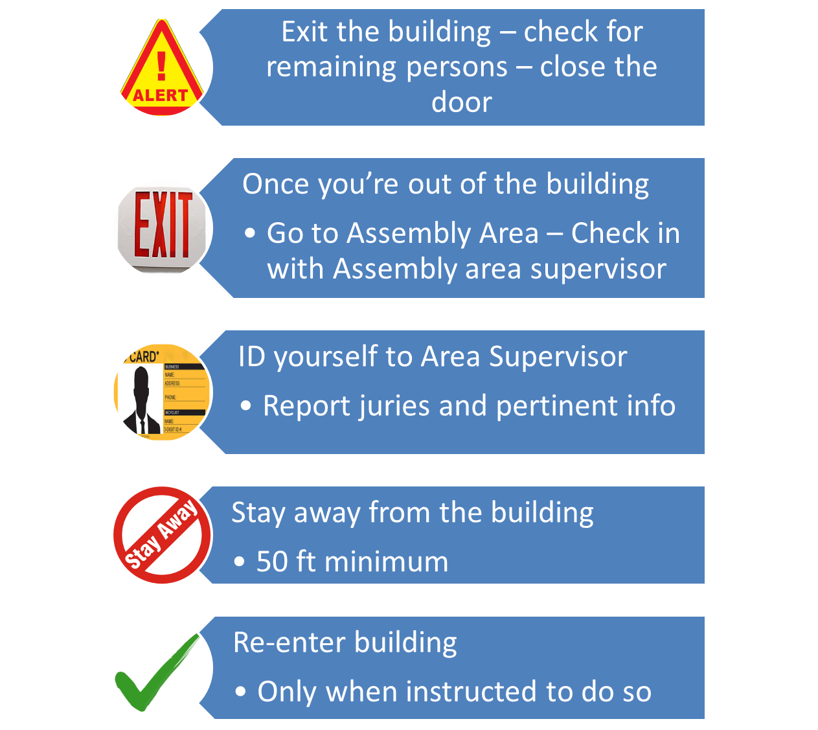
Building Evacuation
Notes:
Part of the emergency action plan is the steps for a building evacuation
Account for all workers – don’t take off and get coffee or go home without checking in

Slide 4
Hazard System of Communication
(HAZCOM)
Hazards Awareness
Door Signs Posted in Hazard Areas
Important for First Responders
Contact Info
Notes:
Know your lab’s specific hazards!! These are posted on Lab Notice Signs outside the lab
These notice signs utilize the HazCom system we will talk about soon
No Eating or Drinking, Gum Chewing, Cosmetics
Room number
Hazard
Special precautions & PPE
Lab notices are very important for first responders
Contact information
Infectious Disease Control you need to be aware of

Slide 5
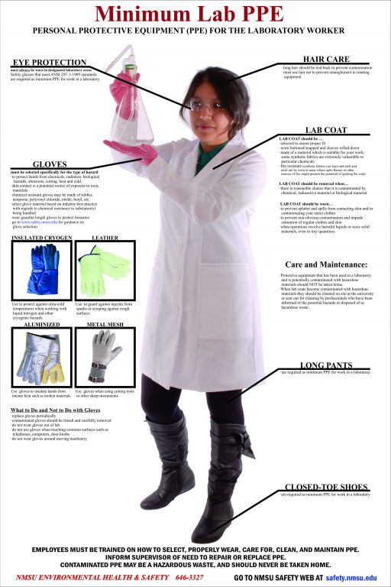




Personal Protective Equipment (PPE)
What is considered PPE?
Safety glasses/goggles
Face shields
Respirators (N95,half mask/full)
Nitrile/chemical resistant gloves
Lab coats/gowns
Closed toe/heel shoes
Ear plugs
Notes:
Referenced from safety.nmsu.edu
The types of lab coat you will wear will depend on what you are working with: blue for flame resistance/chem work; barrier for biohazard spill prevention
What is the minimum you need to wear?
Full length pants (or equivalent) – no skin showing!
Closed toe/heel shoes attire
Must be worn at all times by all workers who are occupying or entering a laboratory/technical area
Laboratory coats (or equivalent protective garments) and protective eyewear are required to be worn by all workers.
But I’m working in summer you say! Keep a spare change of clothes in lab and some tennis shoes. Scrubs can easily fit over shorts while you do your benchwork and you can put your flip-flops back once you leave lab – remember – your PPE is your #1 method of protecting you

Slide 6
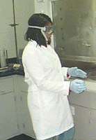
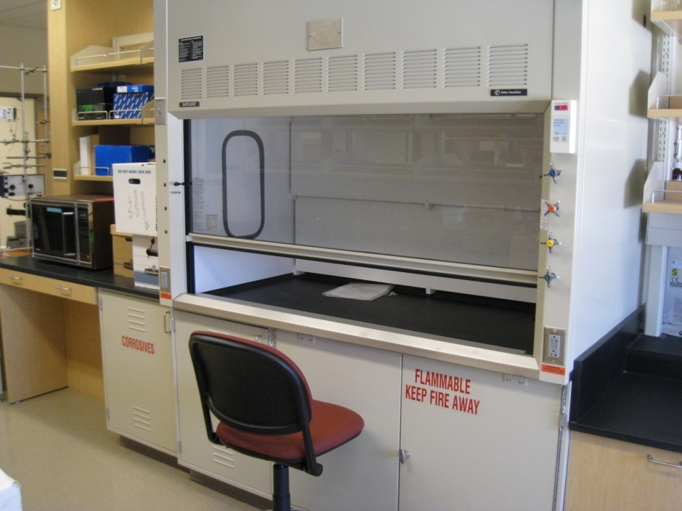
Working with Chemicals
Proper PPE (gloves, lab coat, protective eyewear)
Utilize a fume hood
Disposal of chemicals properly
Know location of spill kit (Safety Net #13)
Notes:
Each lab should have a spill kit and safety net for handling spills- ask you PI or safety officer if you aren’t sure

Slide 7
Working with Biohazards
What steps to take:
Proper PPE (gloves, lab coat, protective eyewear)
Hand Washing
Handle sharps appropriately
Limited Access
Procedures performed to minimize aerosols
(use a Biosafety Cabinet)
Cleaning and decontamination of worksite(s)
Proper disposal and clean up (Safety Net #127)
Notes:
Again- make sure you have your PPE on before you being your work
Each lab should have a spill kit and safety net for handling spills

Slide 8
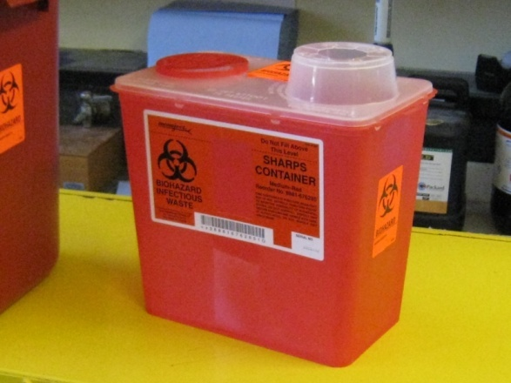
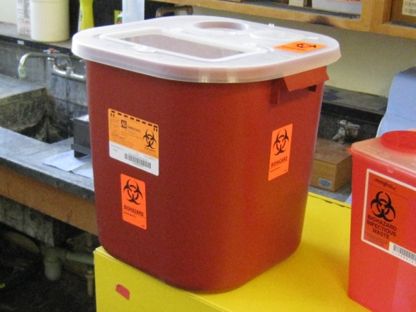
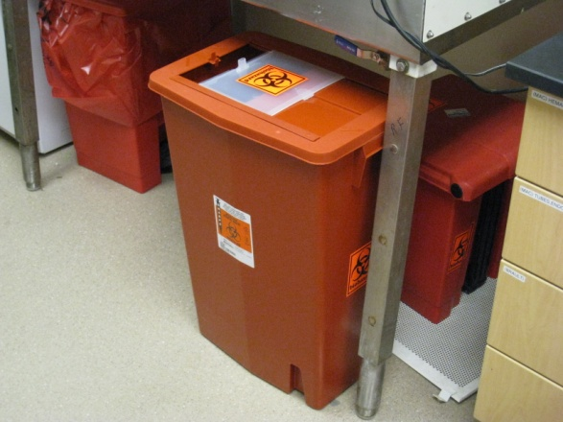
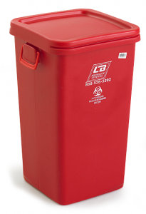

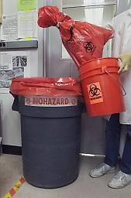
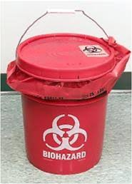
SHARPS CONTAINERS
BENCHTOP
LARGE BENCHTOP
FLOOR
MED WASTE CONTAINERS
Notes:
There are a few ways to dispose of biohazardous material – depending on what it is
Disposing of sharps and med waste – variety of containers – place anything that can poke a hole in a bag into a sharps container – ex: swabs with wooden handles, pipettes, needles, scalpels, glass blood tubes, etc.
Red, hardwalled containers with biohazard symbols – always transport biohazardous materials in secondary containment and closed bags
Containers will be hardwalled, clear biohazard symbol – things like gloves, empty cell culture flasks, etc will be placed into two red bags and secured with a single knot or ziptied
Make sure you aren’t wearing gloves when touching doors, or elevator buttons – it’s the perception that you have been working with something bad – we want to avoid spreading anything and handle everything conscientiously

Slide 9
TRAINING
UC Learning Center (LMS)
eCourses:
Login using your Kerberos
Search:
UC LABORATORY SAFETY FUNDAMENTALS
SAFE USE OF BIOLOGICAL SAFETY CABINETS
FUME HOOD TRAINING
ANIMAL CARE AND USE 101
Safety Nets, Chem Waste Pickup :
UC Davis Safety Services
Notes:
Many course are available online that are part of standard lab safety training – many which I understand you have already taken prior to coming to this talk

Slide 10
RESPONSIBILITY
“RESEARCHERS” – That’s you!!!
Read all training documents
  BUA, MWMP, CHP, SAFETY NETS, SOP’s, EMERG PROC
Safety training – Documented
  FORMAL CLASSES, IN HOUSE TRAINING, REQ’D READING
Report all injuries/accidents (PI, Lab Mgr)
Know/Use proper safety equipment
  BSC, PPE, FUME HOOD, SAFETY SHIELDS, CONTAINMENTS
Properly dispose of waste
  BIOHAZARDOUS, CHEMICAL, RADIOLOGICAL, PHARMACEUTICAL, ETC
Notes:
While the PI is ultimately responsible for what happens, you need to be your own advocate and review the documents and be aware of the work you are doing and be safe

