Slide 1

Normative Electroretinographic Data for Equine Patients
Jenna Acutt, Michelle Ferneding, Brett Story, Monica Motta, Rebecca Bellone, Sara Thomasy
UC Davis School of Veterinary Medicine STAR 2022

Slide 2
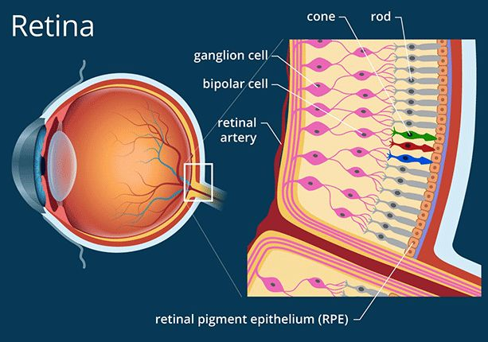
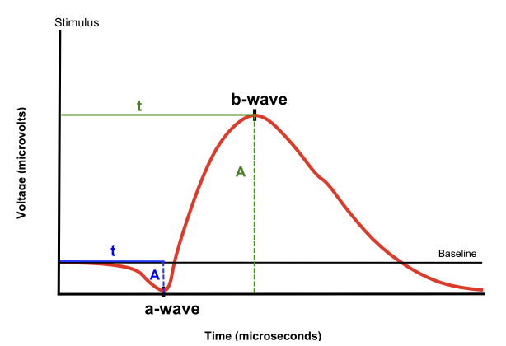
Notes:
Introduction: The retina is the layer of cells lining the back wall inside the eye. This layer senses light and sends signals to the brain so you can see. Rods and cones are distributed through the retina. Rods are responsible for vision at low light levels (scotopic vision). Cones are active at higher light levels (photopic vision) and are capable of color vision.
Standard flash erg measures the outer retinal function, not the ganglion cells as well. Ganglion cells carry information from the photoreceptors on the retina to the brain. Here is an example of a normal ERG reading. The first dip in the reading is known as the a wave and reflects the overall health of the photoreceptors in the outer retina. The b wave is the first peak following the a wave and reflects the health of the inner retina, including the bipolar (provide main pathway from photoreceptors to ganglion cells).
Doesn’t capture ganglion cells well.

Slide 3
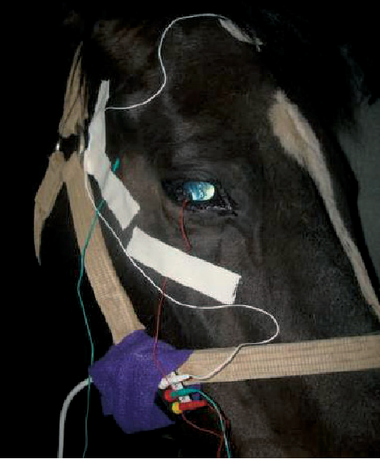
Introduction
Electroretinography is a diagnostic tool that measures the electrical activity of the outer retina in response to light stimulus, thus measuring its function
Notes:
To perform an ERG you first dark adapt the patient to prime the rods for activity. Then a series of light flashes are directed towards the eyes at different intensities and the retina’s electrical activity is then measured.
Commonly used to diagnose a number of retinal diseases such as CNSB which I will be discussing on the next slide
It is severely underutilized in equine medicine due to the fact that it requires heavy sedation, is unsafe, and inaccurate.

Slide 4
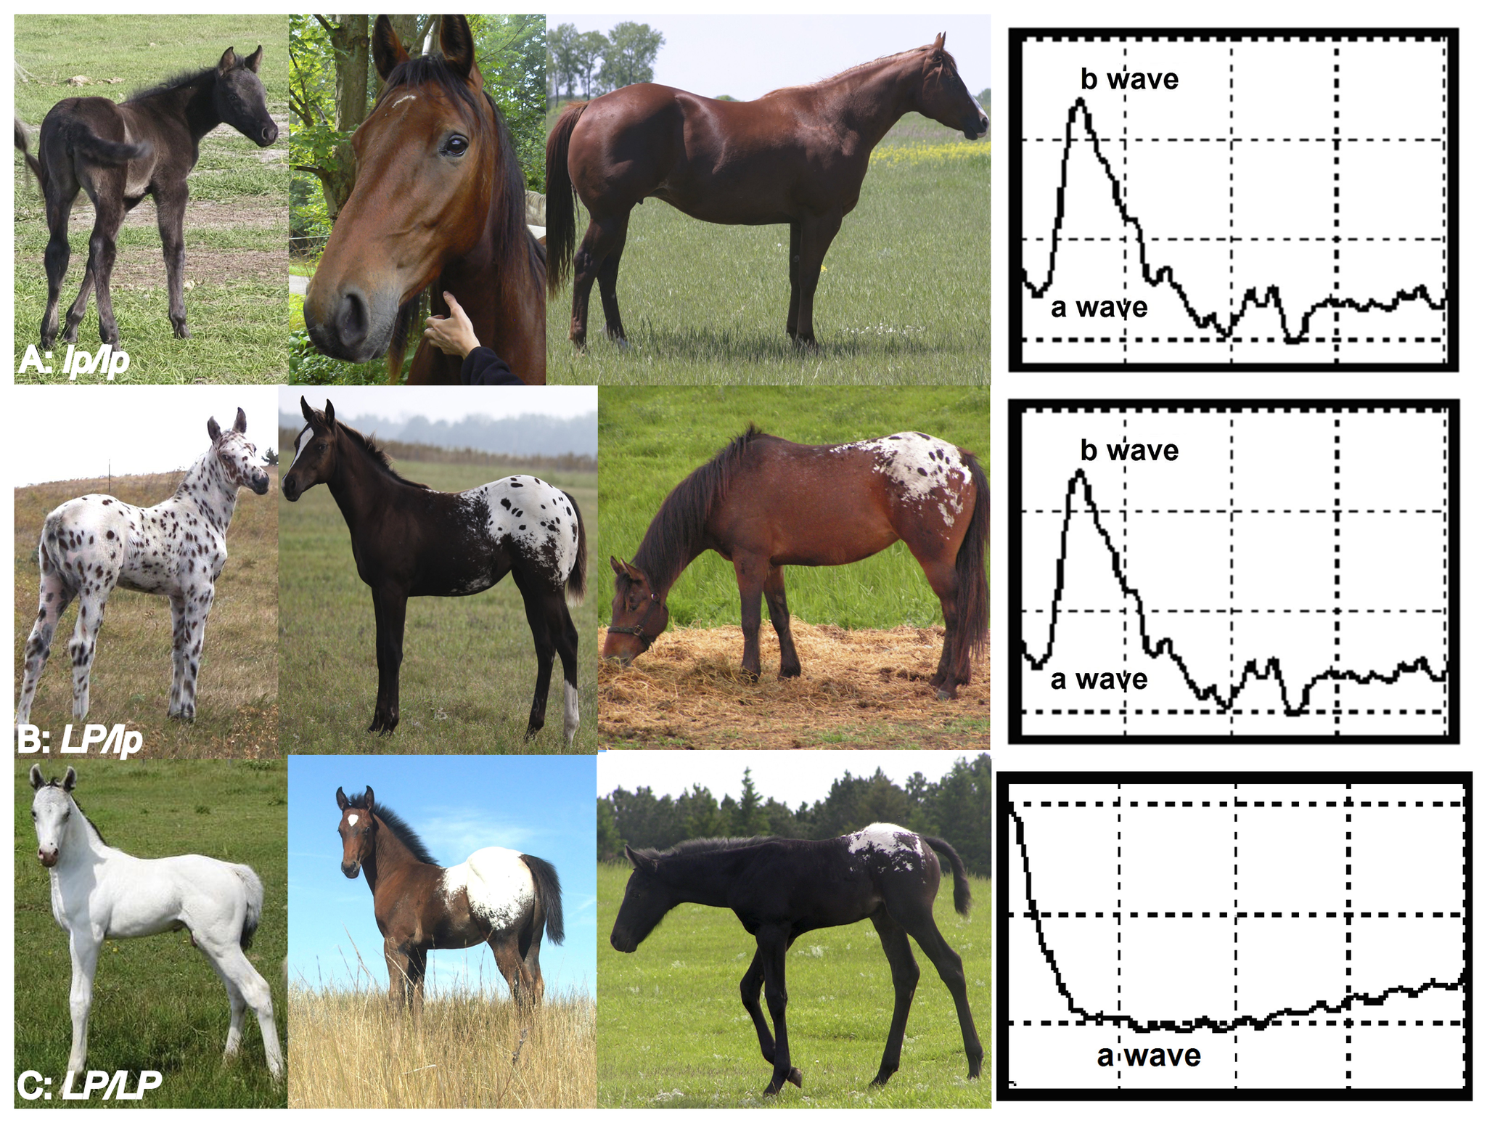
Congenital Stationary Night Blindness
Notes:
CSNB is a hereditary retinal disease in horses that is the inability to see in low to no light conditions. It is commonly found in appaloosas and other horses with a leopard white spotting pattern.
Horses with CSNB have an absent b wave on their ERG.

Slide 5
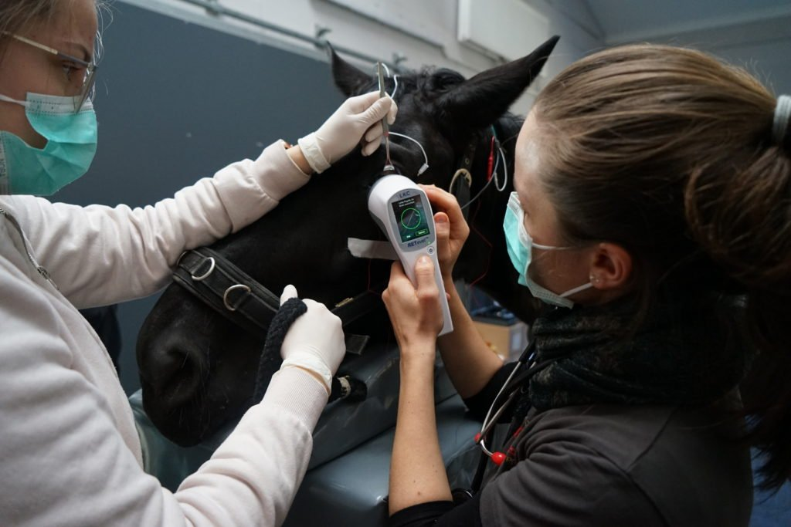
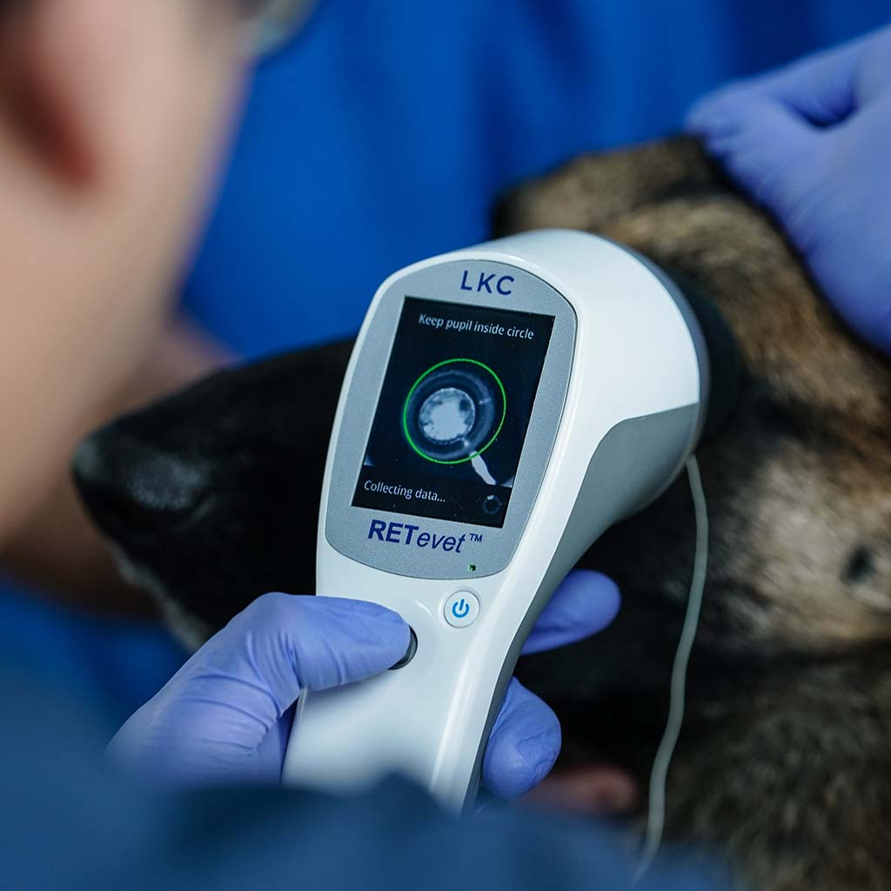
LKC RETevet
Notes:
LKC RETevet: new, portable electroretinographic device. Can be used on a number of different species.

Slide 6
Aim and Hypothesis
Aim: Determine normative scotopic and photopic electroretinographic data using the LKC RETevet in 48 normal horses.
Hypothesis: By evaluating the RETevet electroretinogram data from 48 horses, reference data will be established for future equine patients who will undergo electroretinograms using this technology.

Slide 7
Methods
ERGs from 45 horses from the Pioneer Horse Health Project and 3 client-owned horses
Automated values were generated with the LKC RETevet software
a and b-wave amplitudes and implicit times were manually extracted for the 48 horses
  Statistically compared to values generated by LKC technology

Slide 8
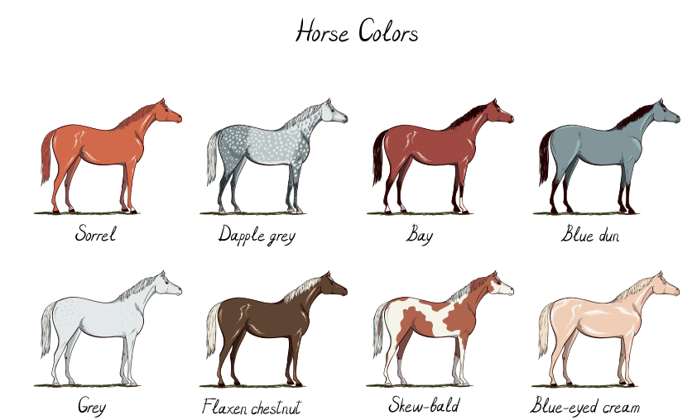
Methods
Mean age of horses tested was 13 years
  Range: 5 to 29 years
29 Females, 19 Males
Coat Colors:
  28 Bay
  2 Sorrel
  12 Chestnut
  1 Roan
  4 Grey

Slide 9
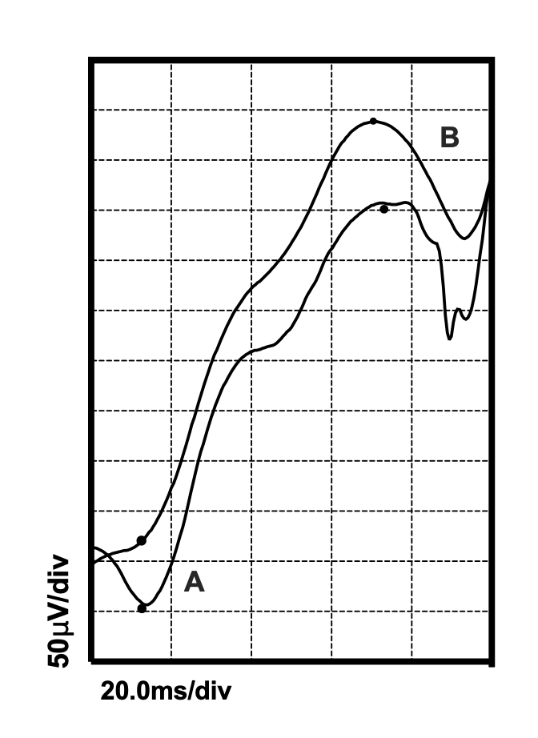
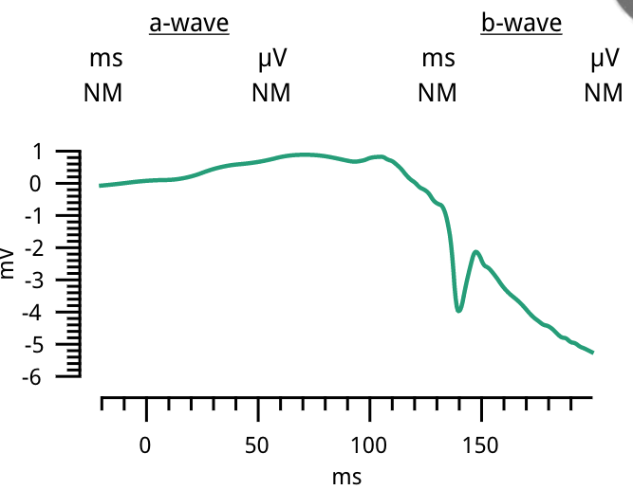
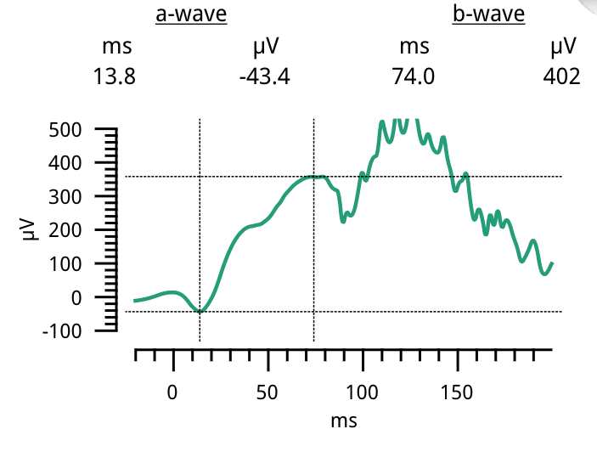
Results
Horse 1 and 2 OS Manual
Horse 2 OS Automated
Horse 1 OS Automated
Notes:
Note in millivolts for horse 1

Slide 10
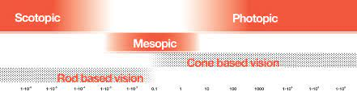
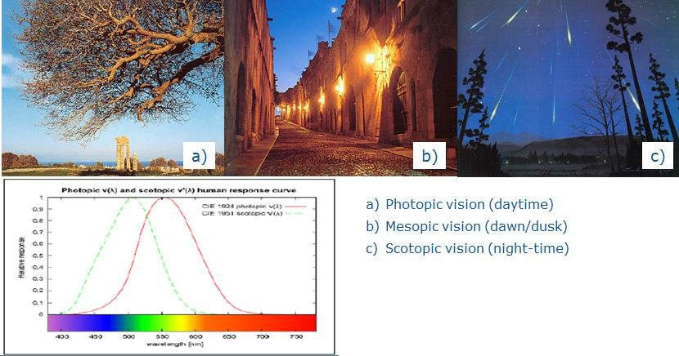
Scotopic vs. Photopic
Notes:
The ERG is divided up into 6 tests: 4 scotopic and 2 photopic tests. Scotopic represents rod based vision and photopic represents color based vision.

Slide 11
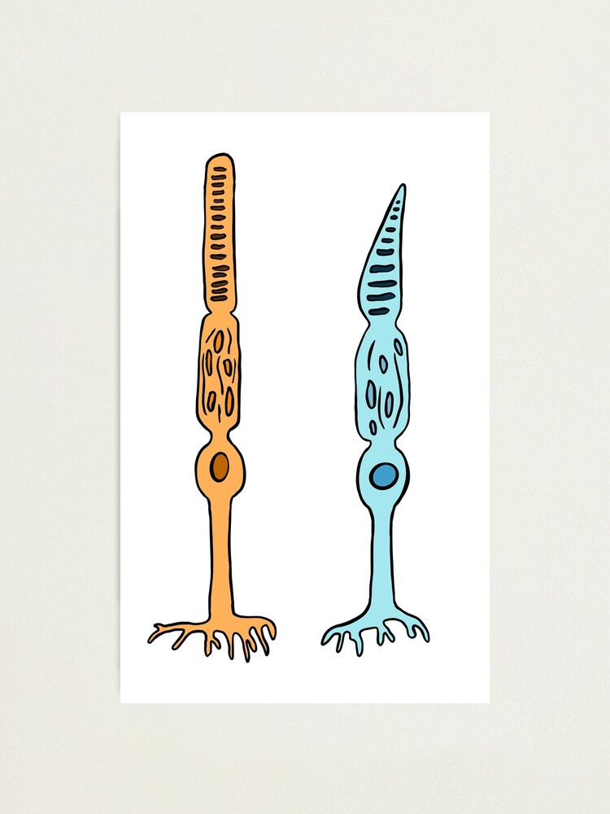
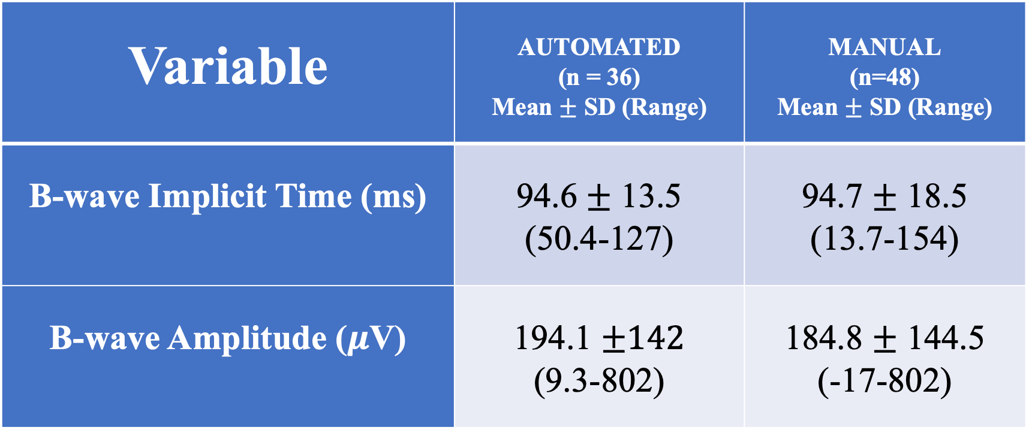
Scotopic 1: Flash 0.010 cd s/m² at 0.5 Hz
Variable | AUTOMATED (n = 36) Mean $±$ SD (Range) | MANUAL (n=48) Mean $±$ SD (Range)
B-wave Implicit Time (ms) | 94.6 $±$ 13.5 (50.4-127) | 94.7 $±$ 18.5 (13.7-154)
B-wave Amplitude ($μ$V) | 194.1 $±142$ (9.3-802) | 184.8 $±$ 144.5 (-17-802)
Rod
Notes:
Horses were dark adapted for 20 minutes prior to scotopic tests.
The candela per square metre (symbol: cd/m²) is the derived SI unit of luminance
Rods
Lowest luminence-seperates rods out

Slide 12
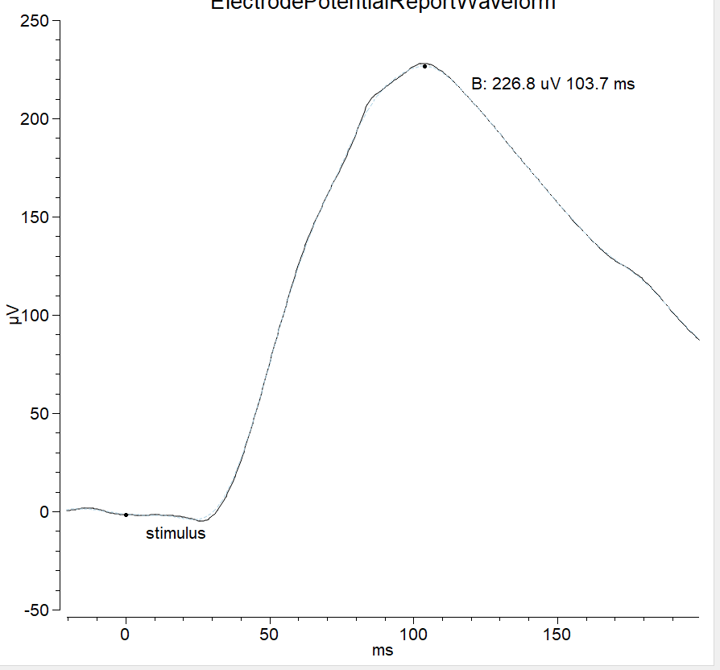
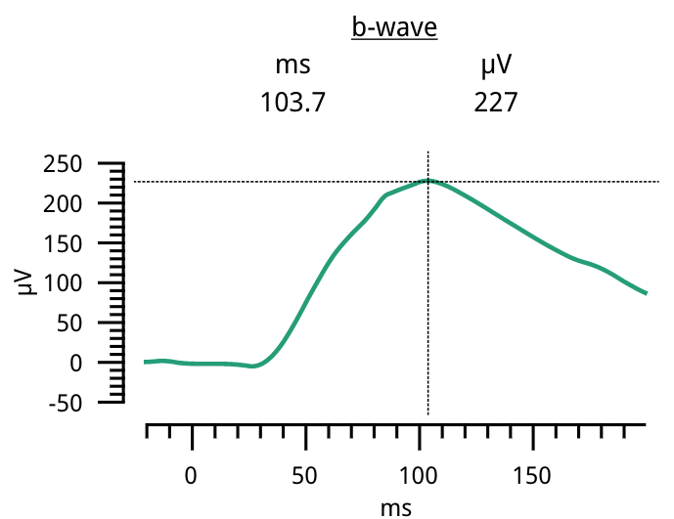
Scotopic 1: Flash 0.010 cd s/m² at 0.5 Hz
Rod
Notes:
Very broad waveform (rod response)

Slide 13
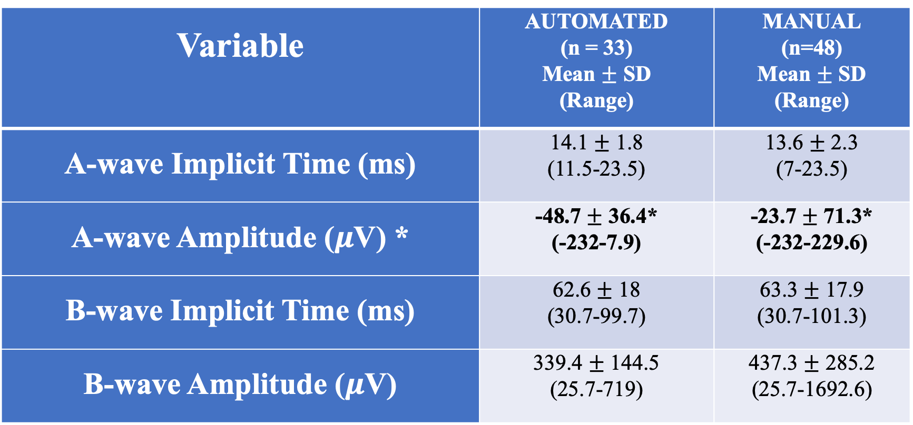
Scotopic 2: Flash 3.0 cd s/m² at 0.1 Hz
Variable | AUTOMATED (n = 33) Mean $±$ SD (Range) | MANUAL (n=48) Mean $±$ SD (Range)
A-wave Implicit Time (ms) | 14.1 $±$ 1.8 (11.5-23.5) | 13.6 $±$ 2.3 (7-23.5)
A-wave Amplitude ($μ$V) * | -48.7 $±$ 36.4* (-232-7.9) | -23.7 $±$ 71.3* (-232-229.6)
B-wave Implicit Time (ms) | 62.6 $±$ 18 (30.7-99.7) | 63.3 $±$ 17.9 (30.7-101.3)
B-wave Amplitude ($μ$V) | 339.4 $±$ 144.5 (25.7-719) | 437.3 $±$ 285.2 (25.7-1692.6)
Rod
Cone
* = P > 0.05
Notes:
Rods and cones
P>0.05
continuing to review the data to look for why these trends are occurring, and these numbers may change

Slide 14
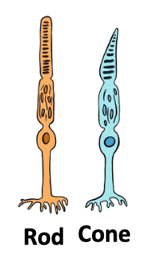
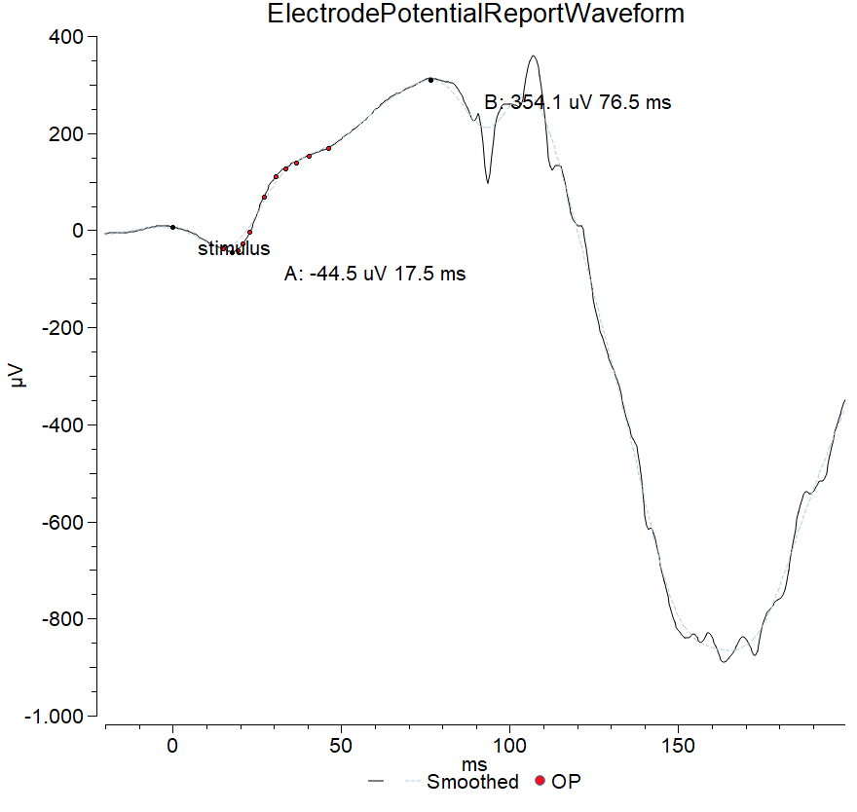
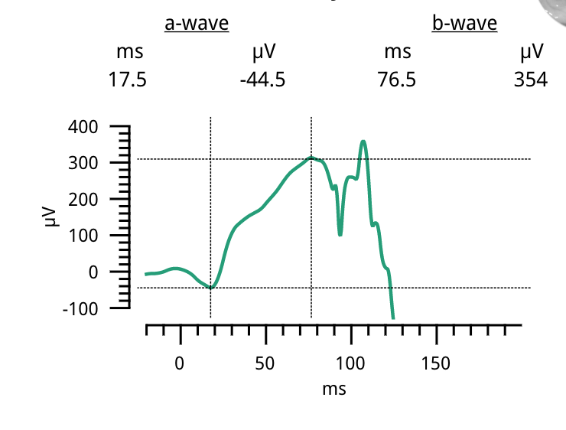
Scotopic 2: Flash 3.0 cd s/m² at 0.1 Hz
Notes:
This represents a mixed rod and cone response. As you can see there’s a relatively steeper peak compared to the rod only response.

Slide 15
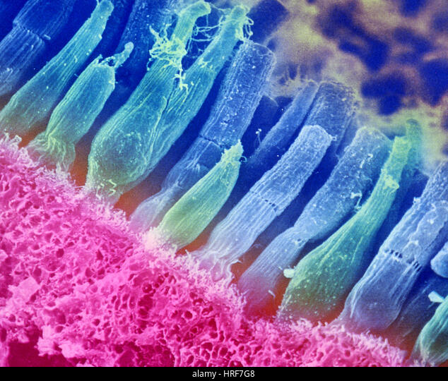
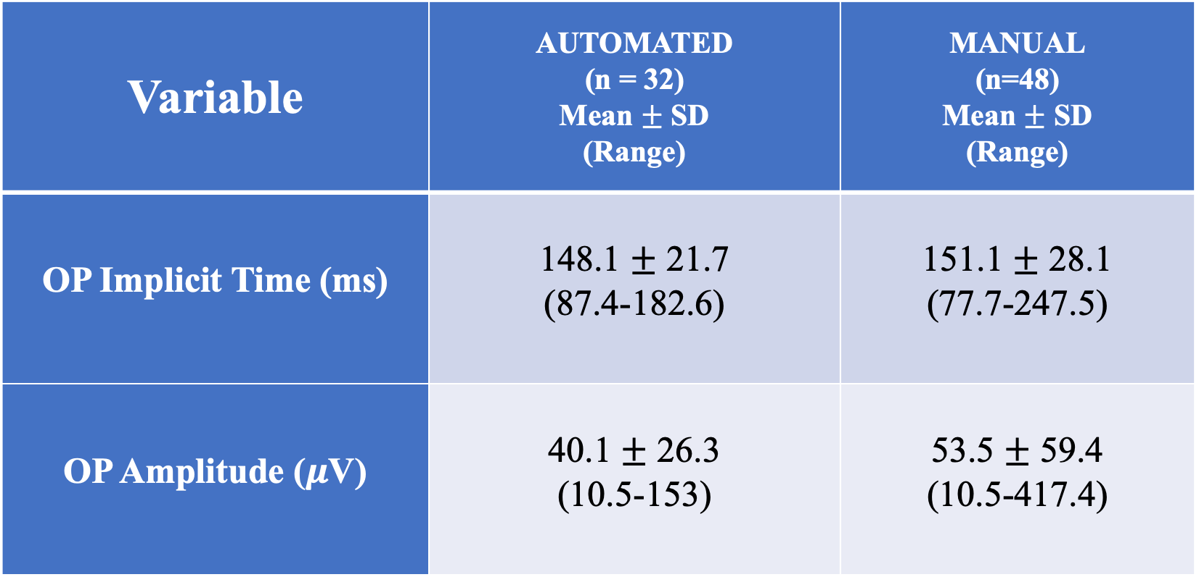
Scotopic 3 (Oscillatory Potential): Flash 3.0 cd s/m² at 0.1 Hz
Variable | AUTOMATED (n = 32) Mean $±$ SD (Range) | MANUAL (n=48) Mean $±$ SD (Range)
OP Implicit Time (ms) | 148.1 $±$ 21.7 (87.4-182.6) | 151.1 $±$ 28.1 (77.7-247.5)
OP Amplitude ($μ$V) | 40.1 $±$ 26.3 (10.5-153) | 53.5 $±$ 59.4 (10.5-417.4)
Notes:
Oscillatory potentials are small wavelets on the rising phase of the b-wave using a high intensity stimulus. They appear to be generated by the inner retinal cell layers, which are supplied by the retinal vascular system.
Amacrine cells?
Rods and cones

Slide 16
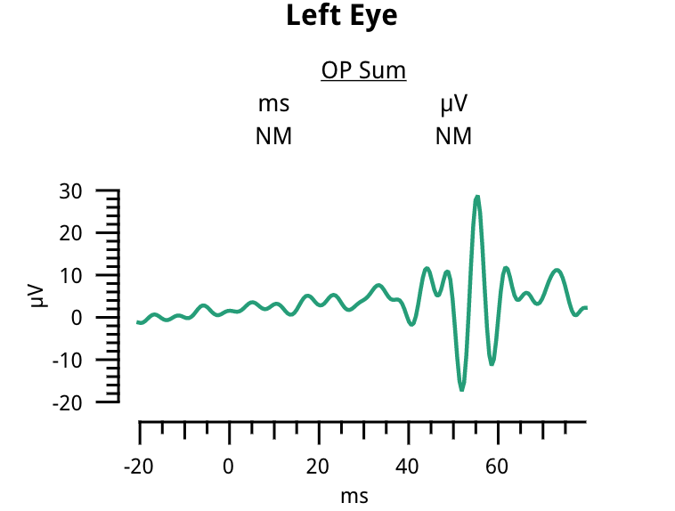
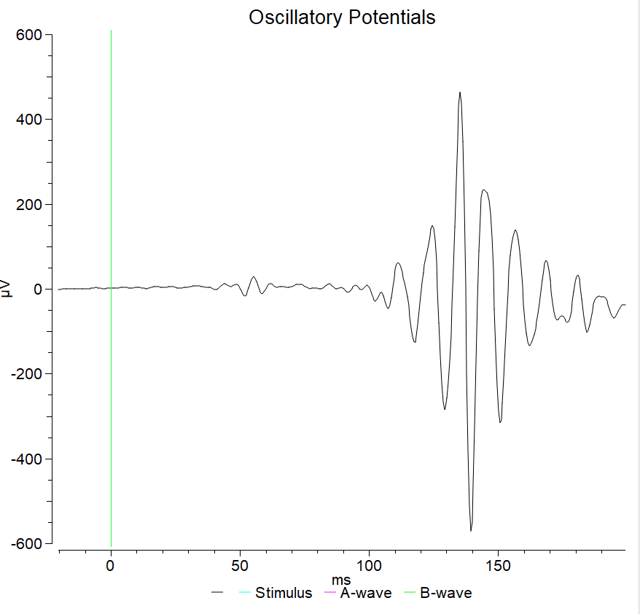
Notes:
With values

Slide 17
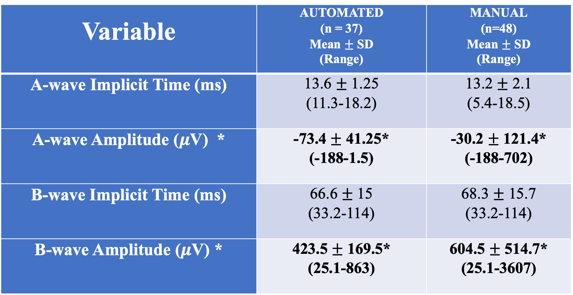
Scotopic 4: Flash 10 cd s/m² at 0.05 Hz
Variable | AUTOMATED (n = 37) Mean $±$ SD (Range) | MANUAL (n=48) Mean $±$ SD (Range)
A-wave Implicit Time (ms) | 13.6 $±$ 1.25 (11.3-18.2) | 13.2 $±$ 2.1 (5.4-18.5)
A-wave Amplitude ($μ$V) * | -73.4 $±$ 41.25* (-188-1.5) | -30.2 $±$ 121.4* (-188-702)
B-wave Implicit Time (ms) | 66.6 $±$ 15 (33.2-114) | 68.3 $±$ 15.7 (33.2-114)
B-wave Amplitude ($μ$V) * | 423.5 $±$ 169.5* (25.1-863) | 604.5 $±$ 514.7* (25.1-3607)
Notes:
Rods and cones
Round to one digit

Slide 18
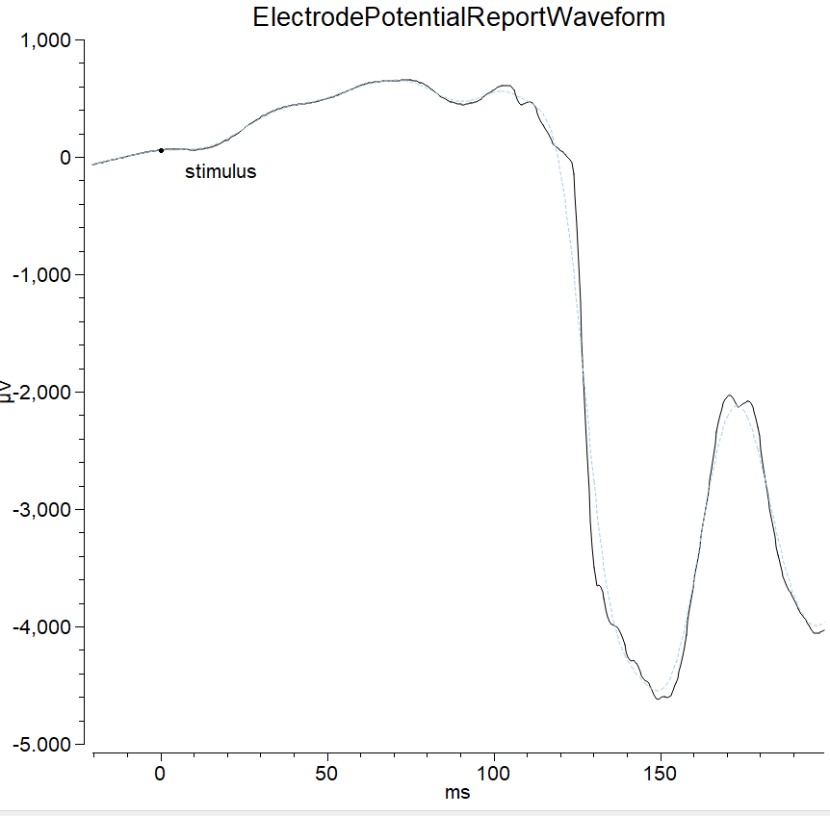
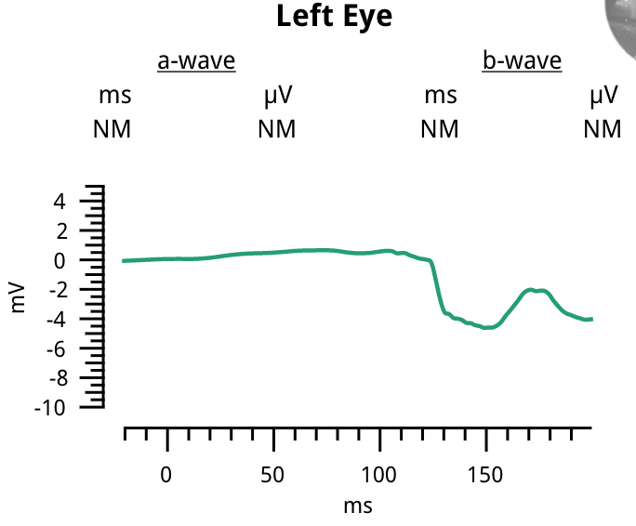

Slide 19
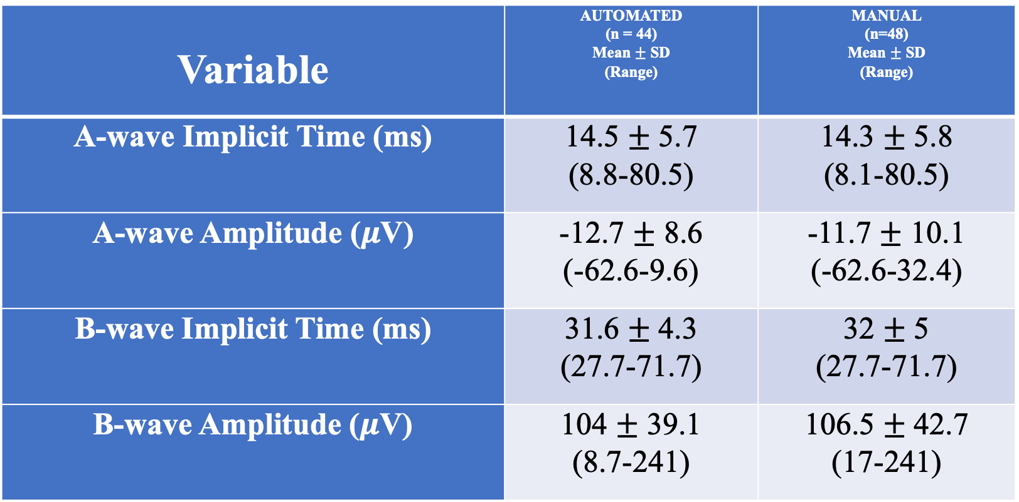
Photopic 1: Flash 3.0 cd s/m² at 2 Hz
Variable | AUTOMATED (n = 44) Mean $±$ SD (Range) | MANUAL (n=48) Mean $±$ SD (Range)
A-wave Implicit Time (ms) | 14.5 $±$ 5.7 (8.8-80.5) | 14.3 $±$ 5.8 (8.1-80.5)
A-wave Amplitude ($μ$V) | -12.7 $±$ 8.6 (-62.6-9.6) | -11.7 $±$ 10.1 (-62.6-32.4)
B-wave Implicit Time (ms) | 31.6 $±$ 4.3 (27.7-71.7) | 32 $±$ 5 (27.7-71.7)
B-wave Amplitude ($μ$V) | 104 $±$ 39.1 (8.7-241) | 106.5 $±$ 42.7 (17-241)
Cone
Notes:
Cone only response

Slide 20

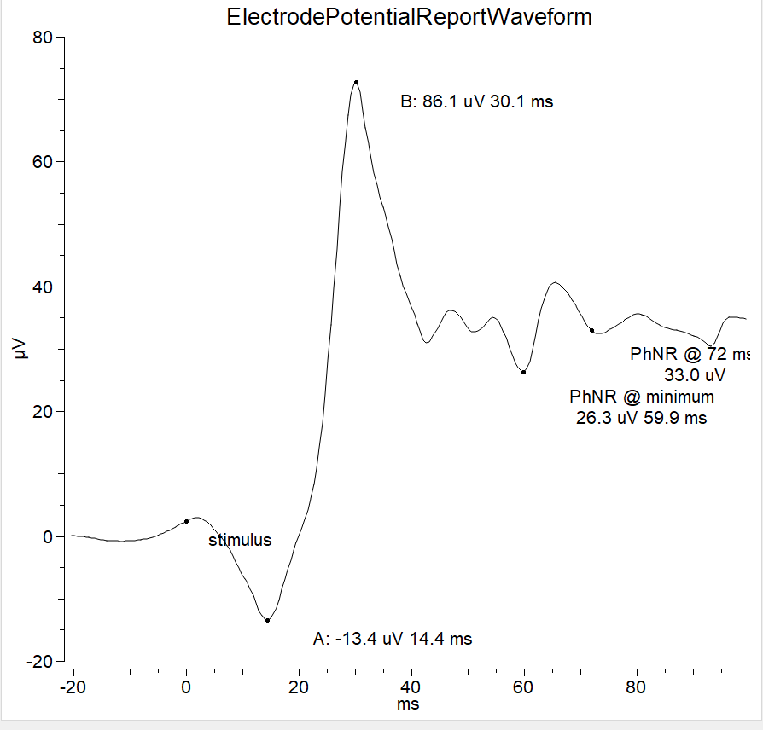
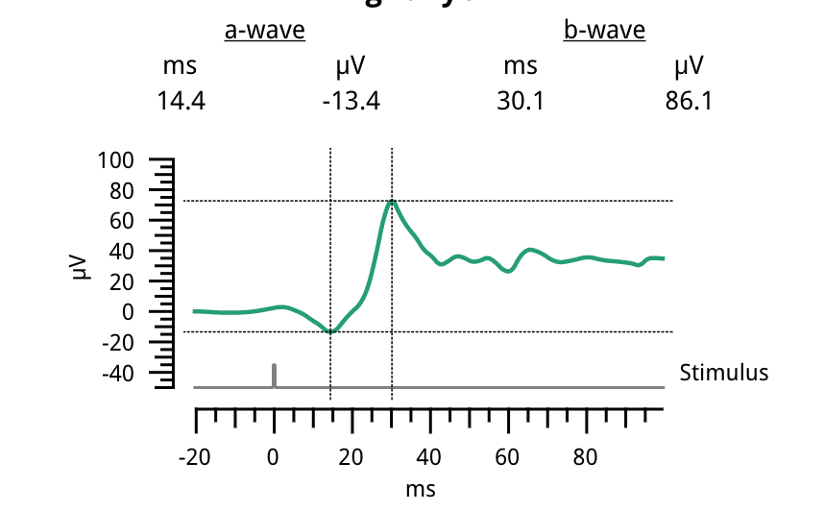
Photopic 1: Flash 3.0 cd s/m² at 2 Hz
Notes:
Cone only-relatively steeper peak than the rod only response

Slide 21
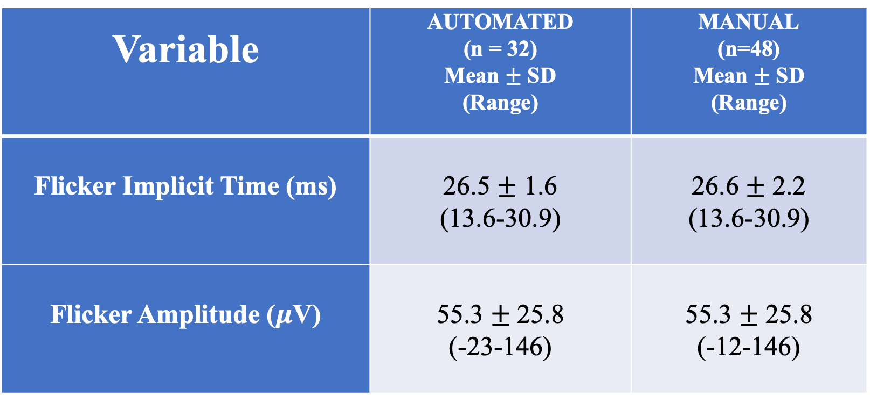
Photopic 2 (Flicker): Flash 3.0 cd s/m² at 28.3 Hz
Variable | AUTOMATED (n = 32) Mean $±$ SD (Range) | MANUAL (n=48) Mean $±$ SD (Range)
Flicker Implicit Time (ms) | 26.5 $±$ 1.6 (13.6-30.9) | 26.6 $±$ 2.2 (13.6-30.9)
Flicker Amplitude ($μ$V) | 55.3 $±$ 25.8 (-23-146) | 55.3 $±$ 25.8 (-12-146)
Notes:
The flicker test measures cone pathway function.

Slide 22
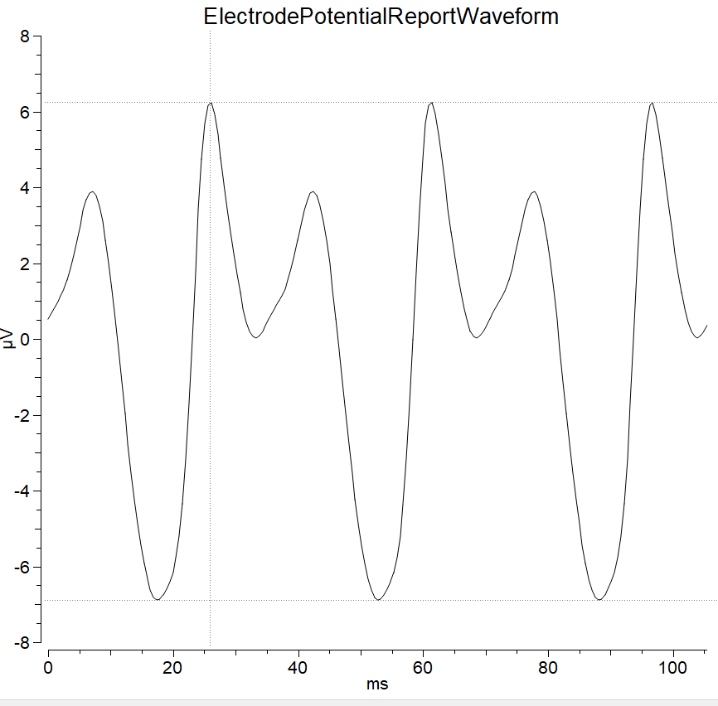
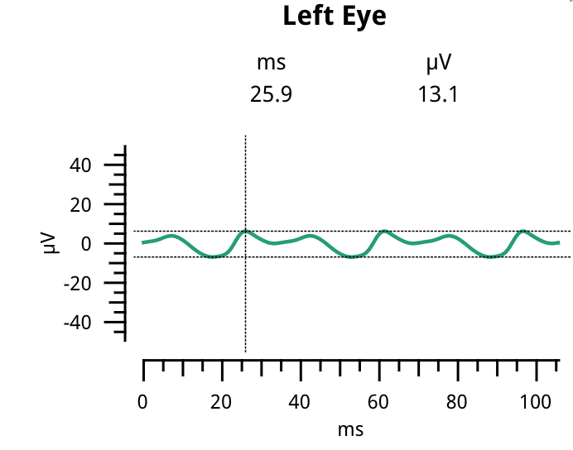
Photopic 2 (Flicker): Flash 3.0 cd s/m² at 28.3 Hz

Slide 23
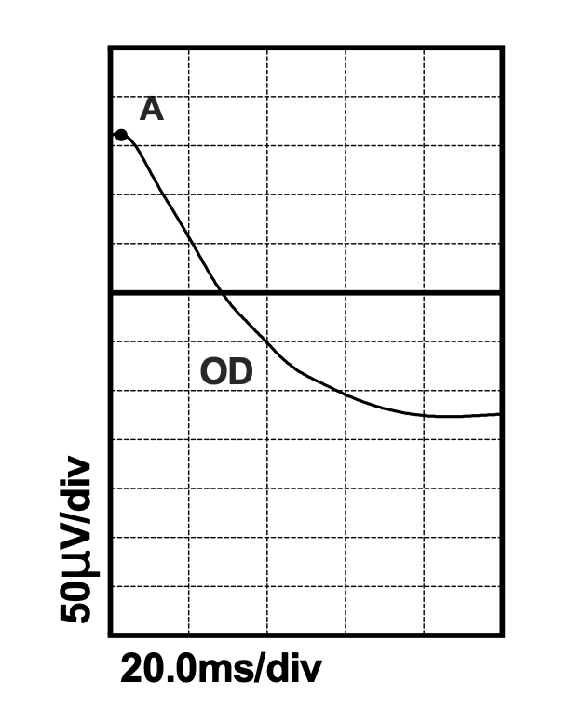
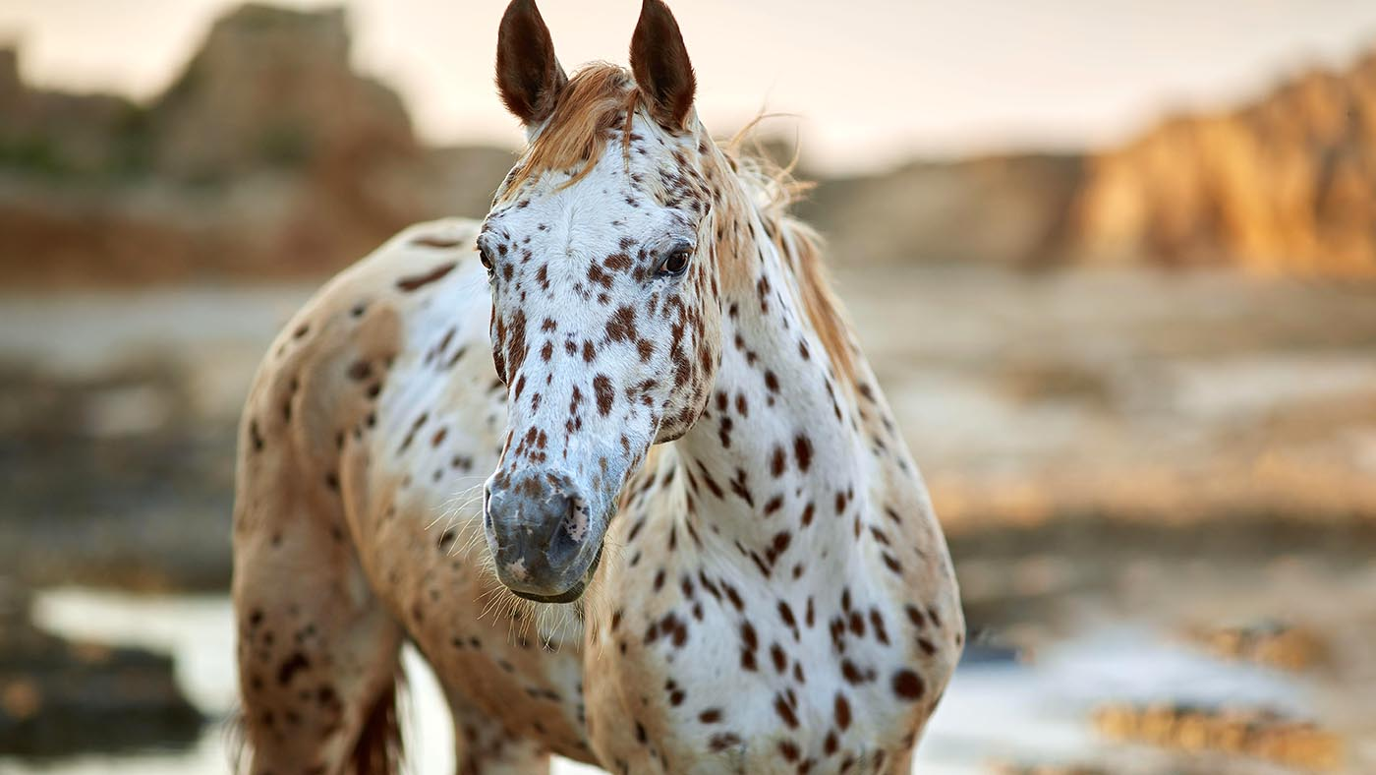
Results
Notes:
Isabel CSNB-show at end
Appaloosa
3 CSNB and continued collection of data from CSNB horses is ongoing

Slide 24
Summary
Reference data was established for the LKC RETevet electroretinogram device from 48 normal Pioneer Horse Health Project and client owned horses
There was no significant difference between the machine generated data and the manually extracted data, except for Scotopic 2 a-wave amplitude OD, Scotopic 4 a-wave amplitude OD, Scotopic 4 b-wave amplitude OU
Notes:
Add retevet horse pic

Slide 25
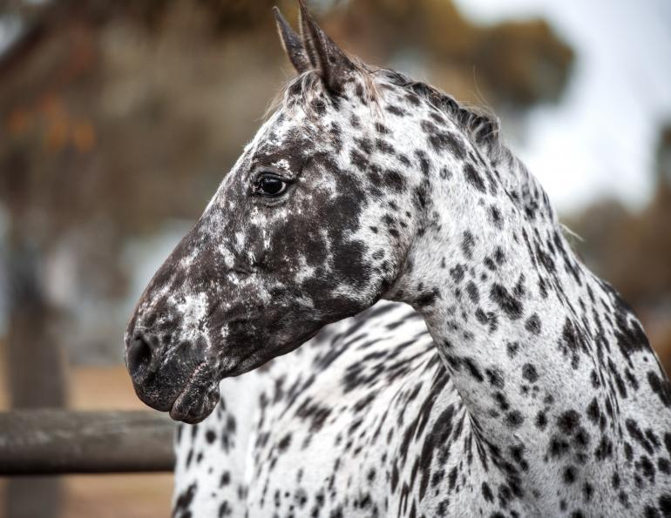
Future Directions
Communicate findings with LKC Technologies to help fine tune the ERG device
Establish a protocol for diagnosing CSNB with the LKC RETevet
Examine other retinal diseases to establish protocols for diagnosing other conditions

Slide 26


Funding/Acknowledgements
UC Davis School of Veterinary Medicine Students Training in Advanced Research (STAR) Program
NIH T35 Training grant 5T35OD010956-23
MRLT Animal Team
UC Davis Veterinary Medicine Center for Equine Health
Genetic Investigation of Coat Color and Ocular Phenotypes for the Pioneer Horse Precision Medicine Project
Notes:
CEH and pioneer grant
Mrlt last

Slide 27
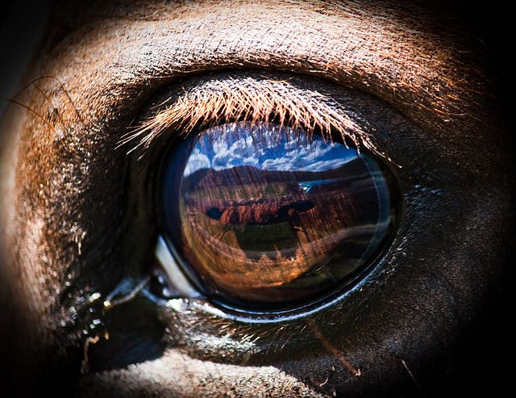
Questions?

