Slide 1
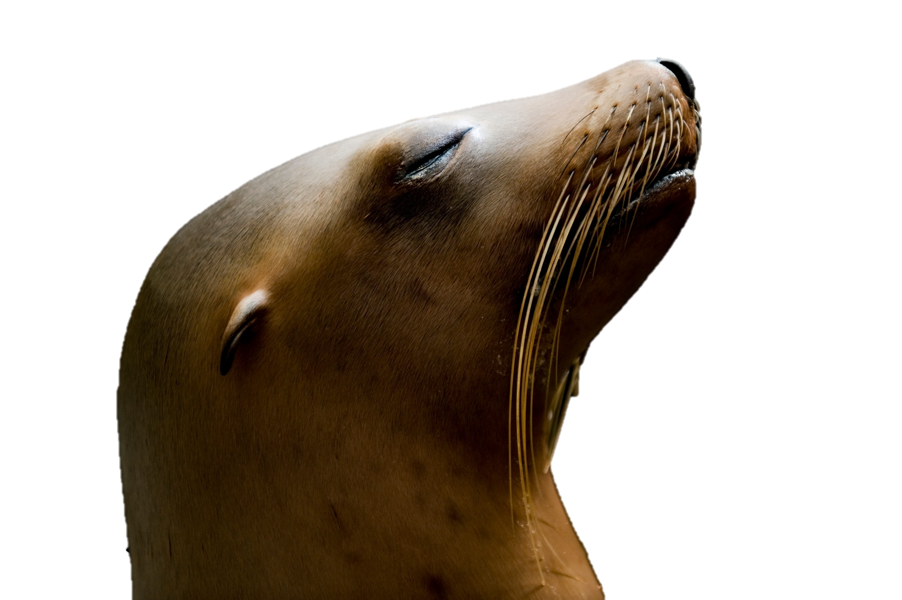
Validation of an Indirect Fluorescent Antibody Test for Sarcocystis neurona infection in California sea lions
Amalie Luneng Solli, Cara Field, Pádraig Duignan, Andrea Packham, Magdalena Plancarte, Karen Shapiro, Devinn Sinnott, Woutrina Smith
PC: Joel Sartore
Notes:
Abbreviations

Slide 2
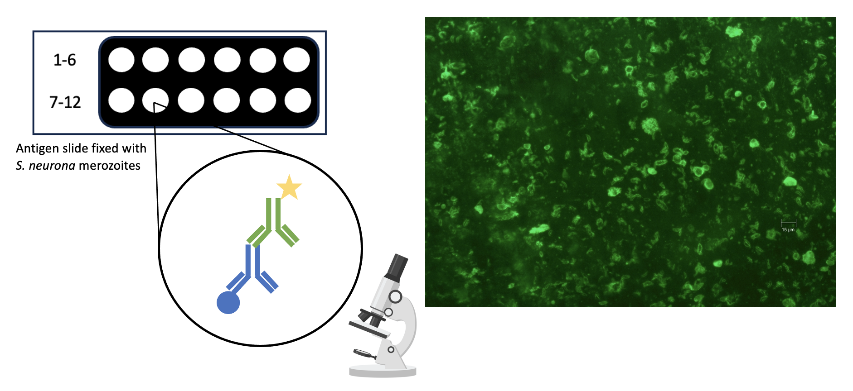
Indirect Fluorescent Antibody Test (IFAT)
Packham 2023, unpublished

Slide 3
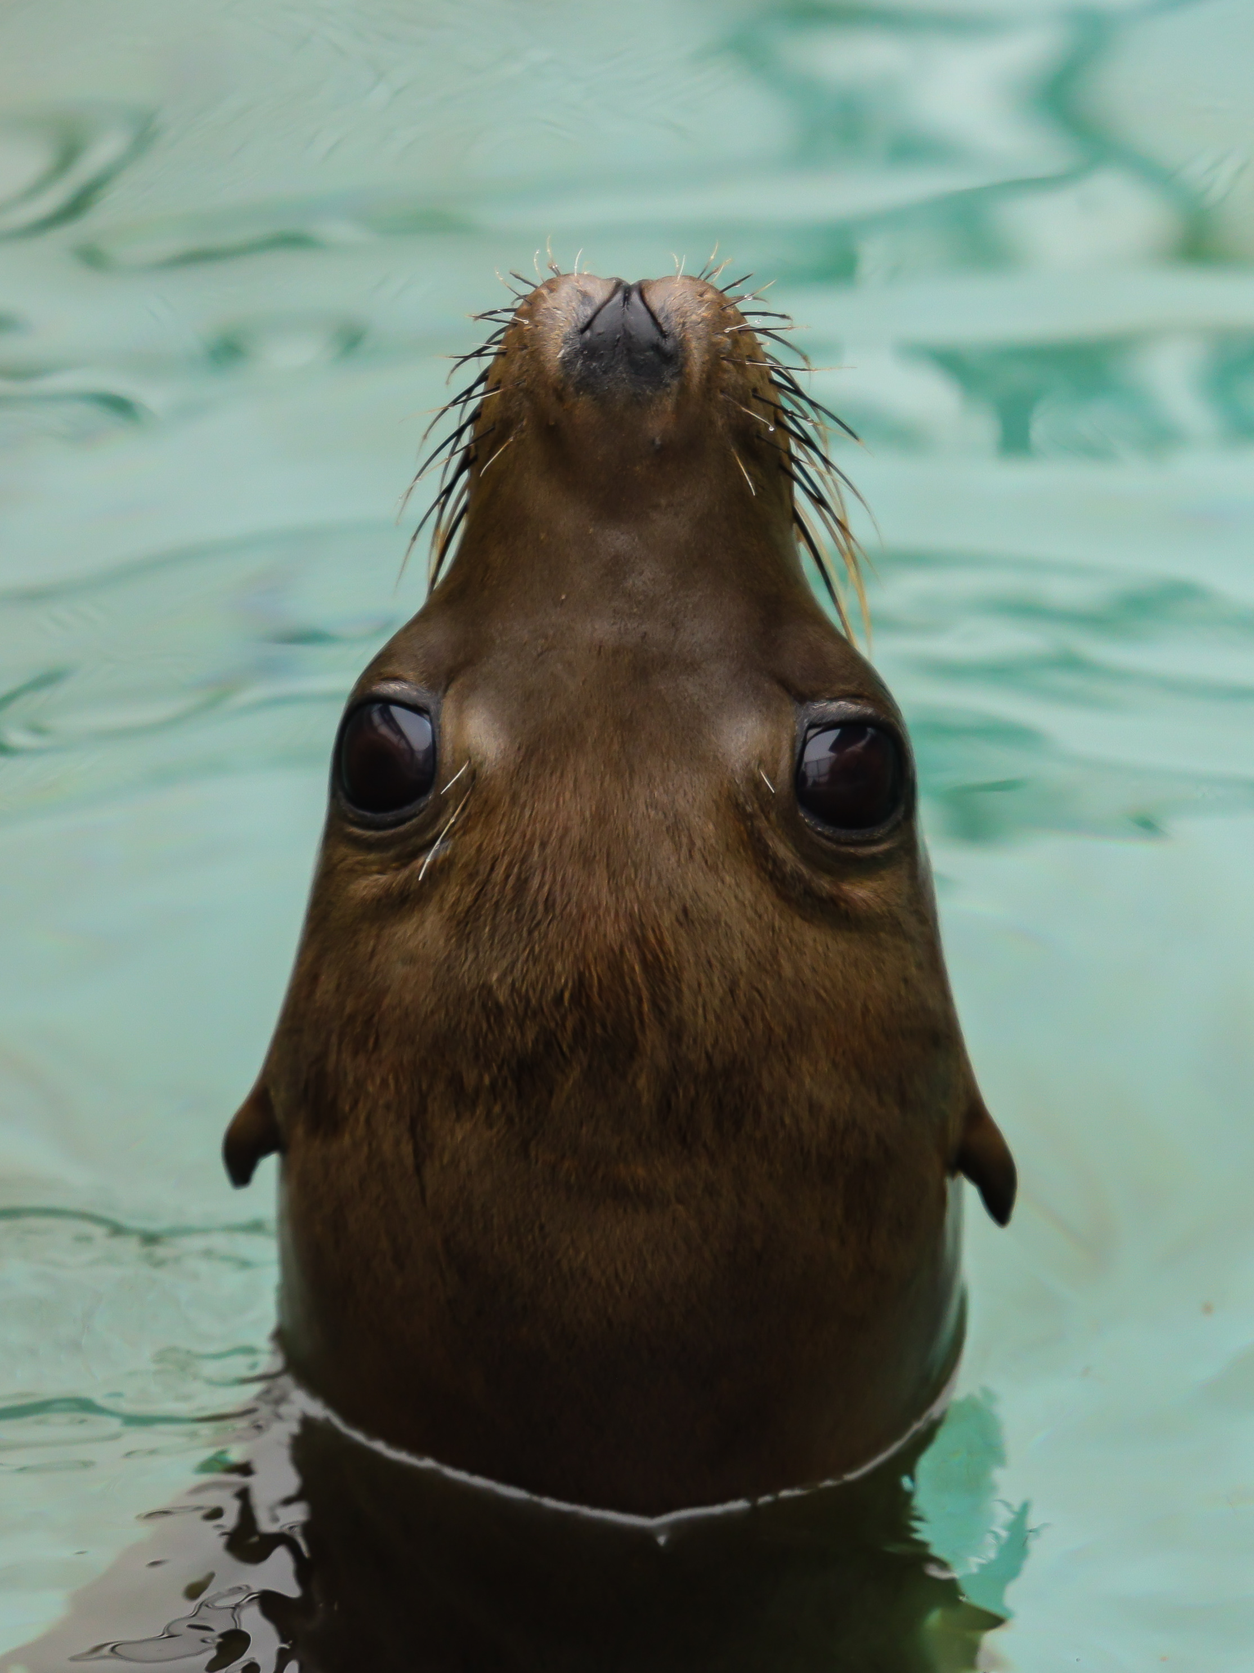
Objective
Evaluate IFAT performance but how?
Identify cases and controls based on the gold-standard testing approach (histopathology and molecular sequencing)
Compare IFAT serology results to confirmed cases and controls
PC: Cara Field
Notes:
Evaluate IFAT test performance in two steps

Slide 4
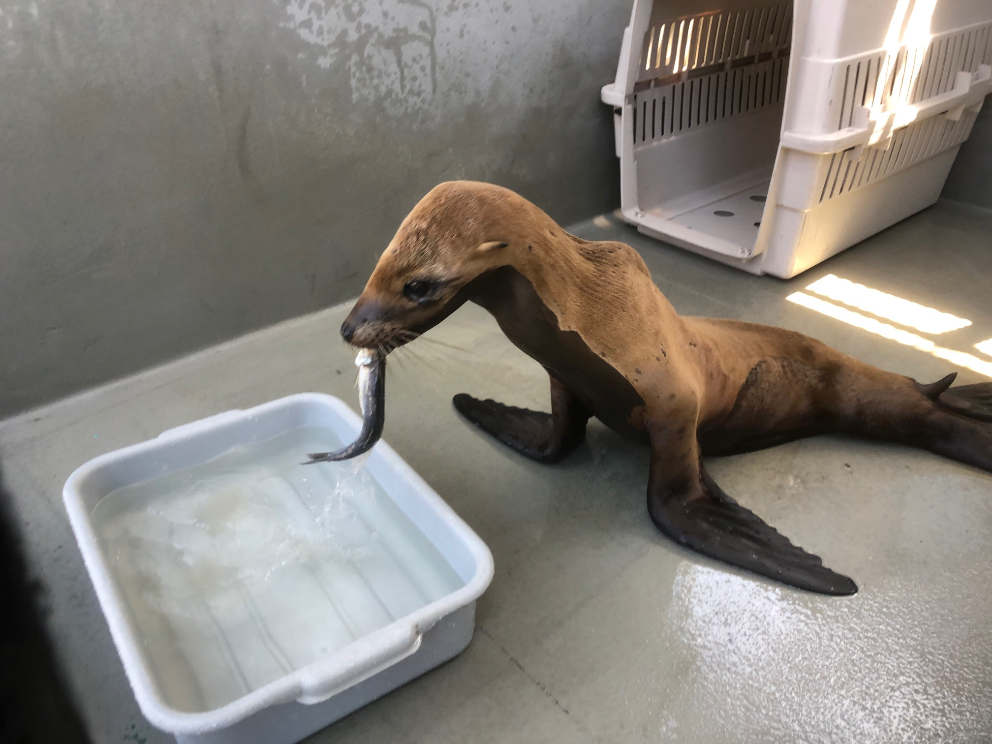
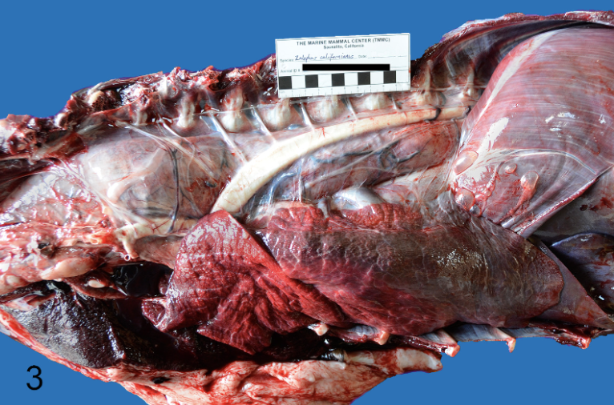
Rationale
Infection can result in polyphasic rhabdomyositis and death; prognosis is guarded even with treatment in CSL
PC: Cara Field
Seguel et al. 2019
Notes:
This brings up the question of why is the IFAT an important diagnostic tool to validate?
First reason: protozoa!! severe outcome, explain muscle breakdown, in this diagram, death, prognosis is uncertain

Slide 5
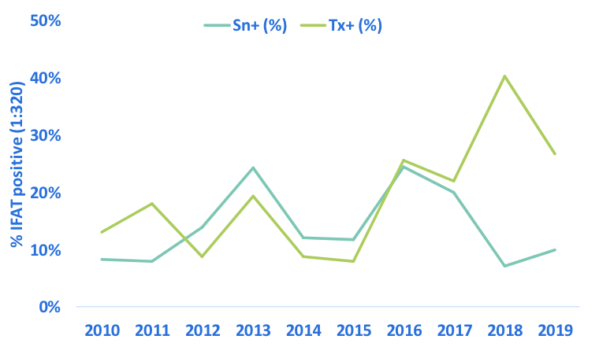
Rationale
Seroprevalence in CSL has increased from 5-6% (1998-2009) to 14% (2010-2019)
Taylor et al. 2023
Notes:
From Dr. Smith’s previous STAR student we can see that another reason this validation is important is because:

Slide 6
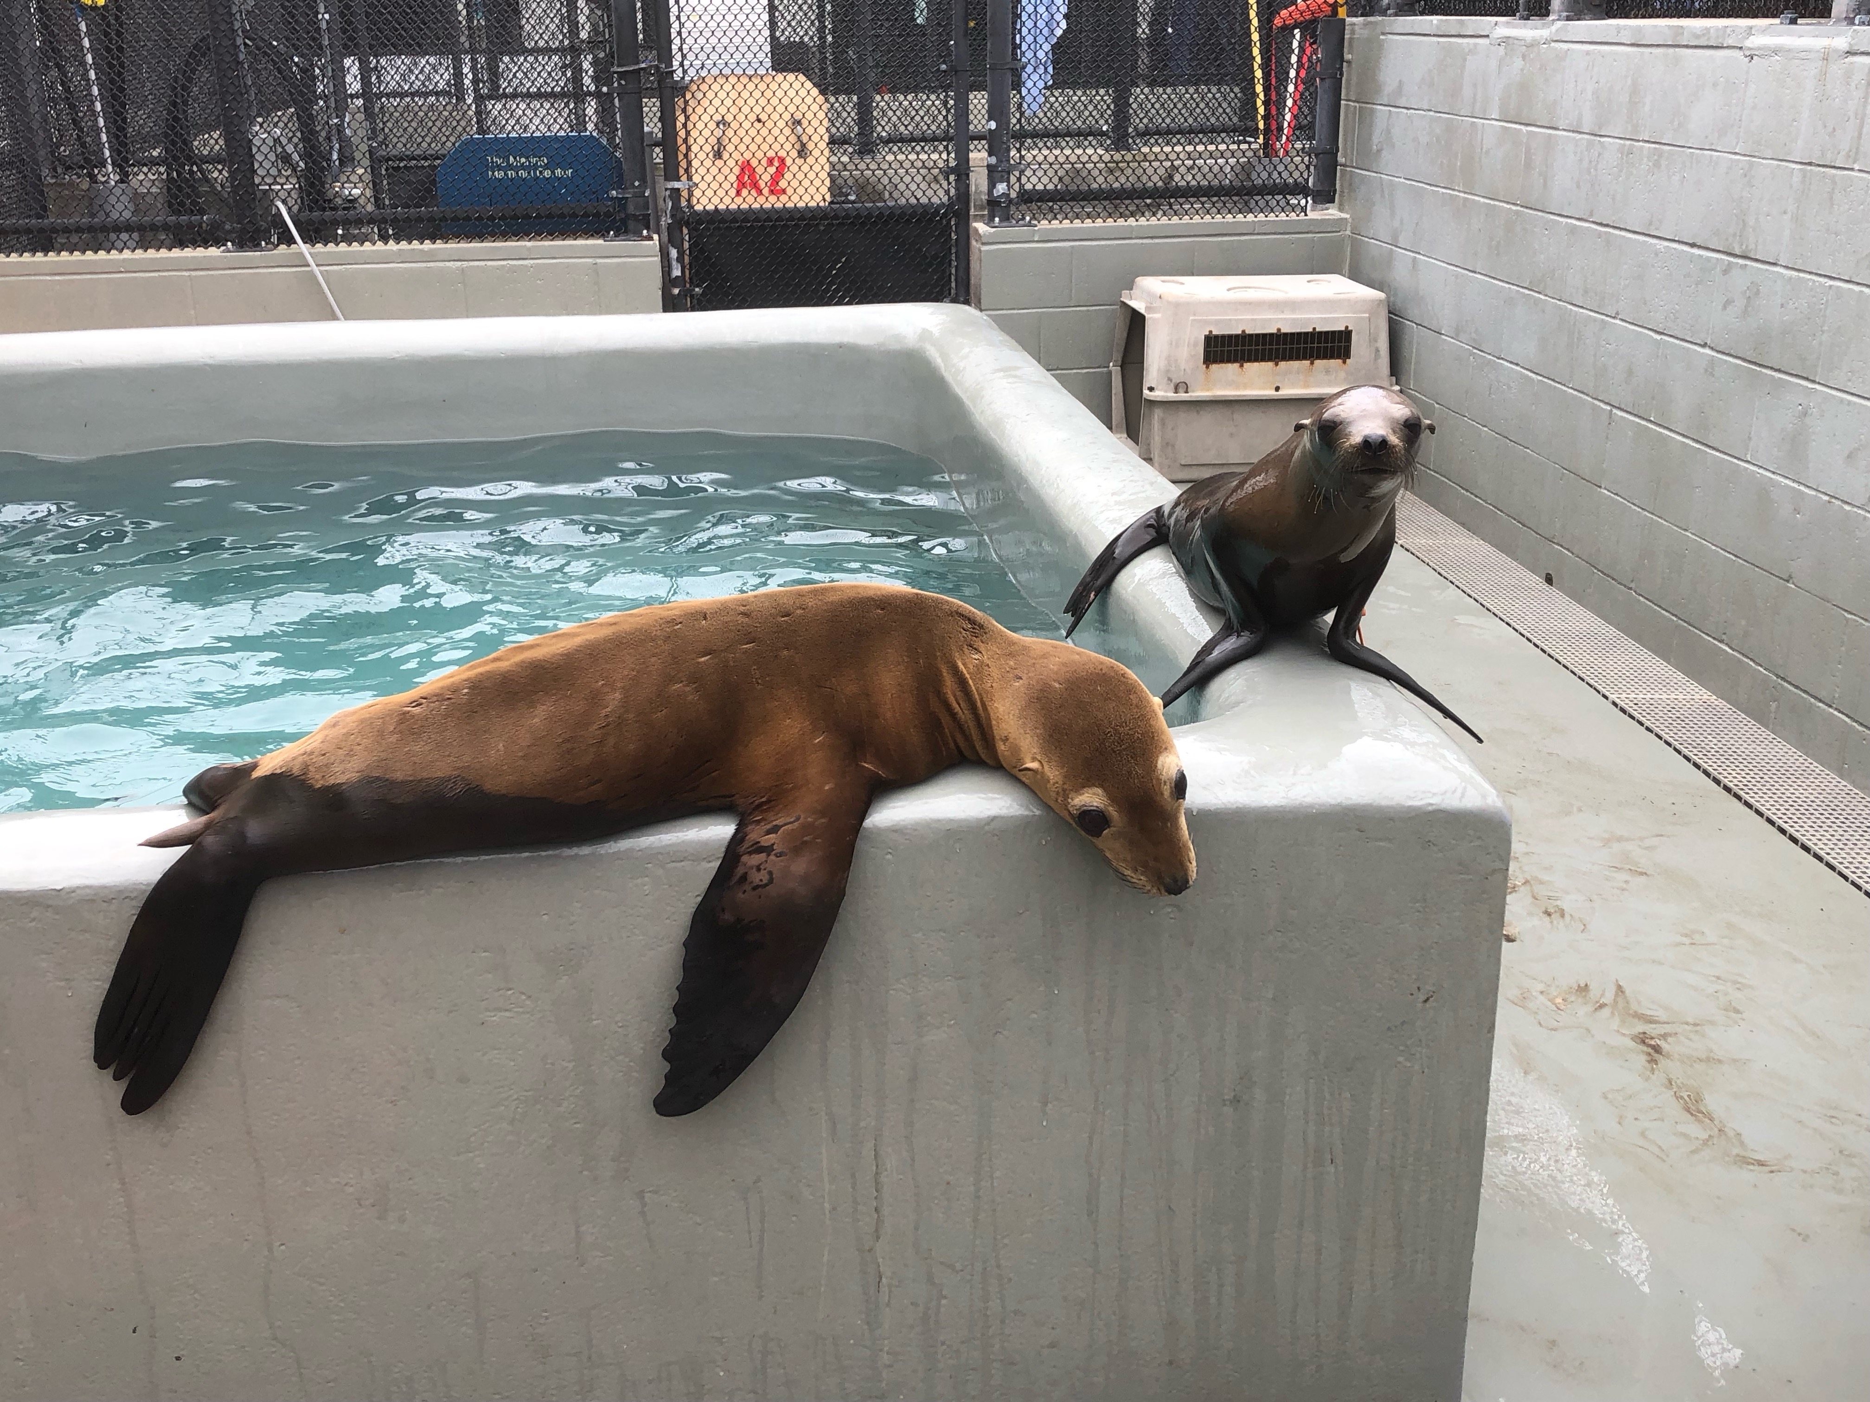
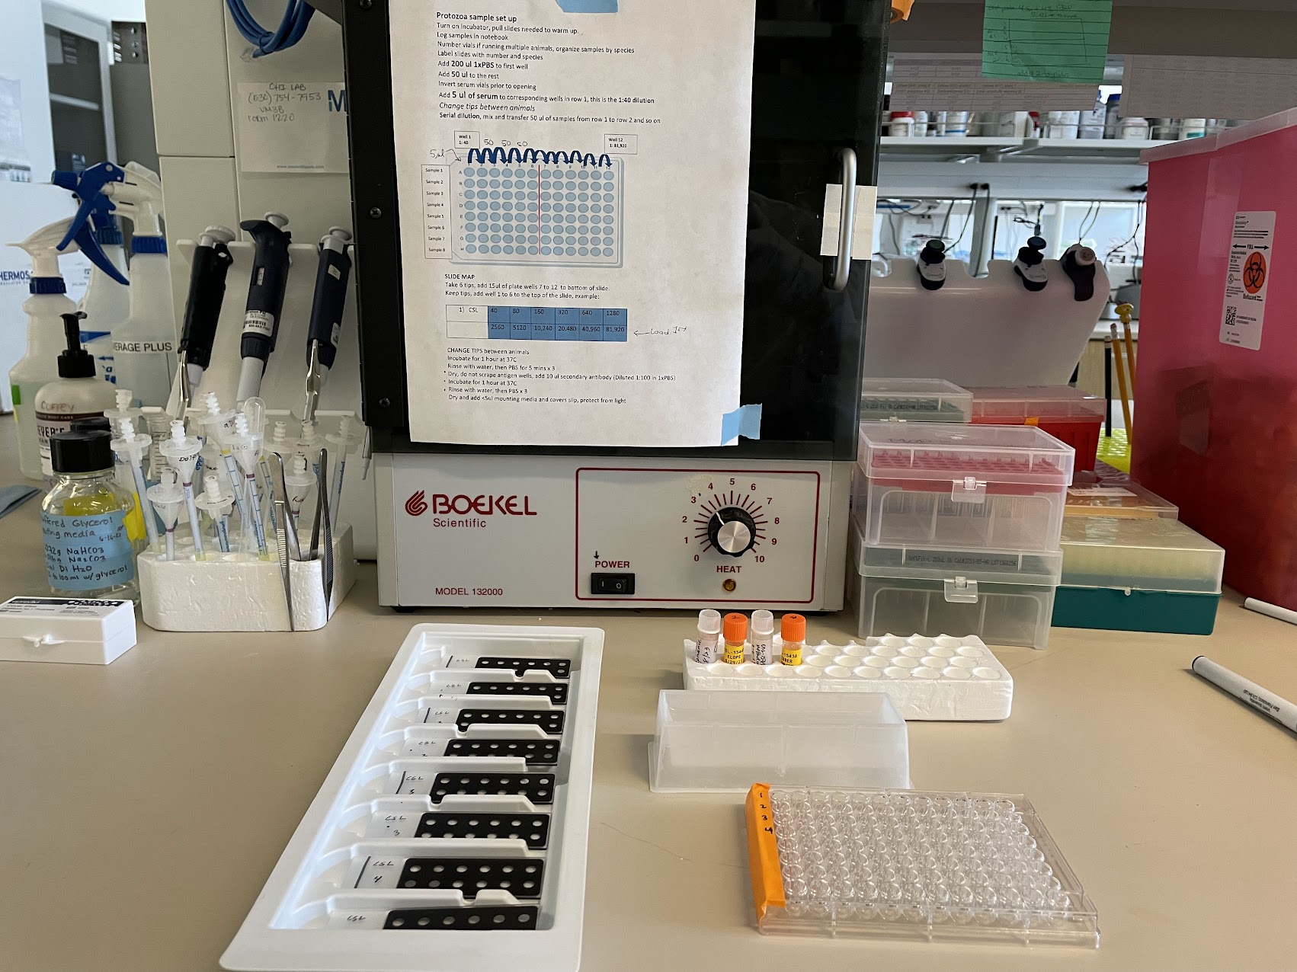
Rationale
IFAT diagnostic test advantages: low-cost, quick, better informs treatment plans but not yet validated in CSL
PC: Cara Field
Notes:
Lastly

Slide 7
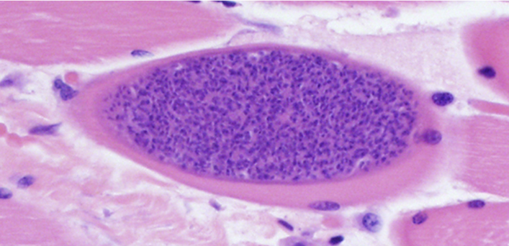
Gold-standard Testing Approach
Histopathology
Molecular Sequencing
Seguel et al. 2019
Sinnott 2023, unpublished
Notes:
Thinking back to the steps to accomplish our objective to evaluate IFAT performance, we first need to identify cases and controls based on the gold-standard testing approach which gives us high confidence in calling animals positive or negative for S. neurona infection.
1. For Histopathology, Dr. Duignan collects brain or skeletal muscle at necropsy, fixes them in formalin, sends the tissues out for trimming which are then stained with H&E
2. For molecular sequencing, DNA is amplified by Dr. Karen Shapiro's lab to target S. neurona genes which are then cleaned up and then sent out for sequencing

Slide 8
Results
20 sea lion cases identified based on suspected myopathy confirmed by necropsy and evidence of S. neurona cysts on histopathology
31 sea lion controls identified based on a non-protozoal cause of death and no evidence of cysts on histopathology
Target sample size: 40 cases and 80 controls
Kappa statistic on comparing test performance is 0.92
Notes:
Over the past month, I visited TMMC and used their patient database identifying 20 cases based on ... in addition to 31 controls based on .... The target sample size we calculated estimated that we need 40 cases and 80 controls to have a rigorous validation of the IFAT therefore I compiled a list of animals that are missing one or multiple components for future studies.
Based on progress to date, I calculated a Kappa statistic which compares the agreement between histopathology and IFAT with a cutoff of 1:320. A value of 0.92 is significantly close to 1 suggesting that there is good agreement.
43 cases
36 controls
need 13 more controls

Slide 9
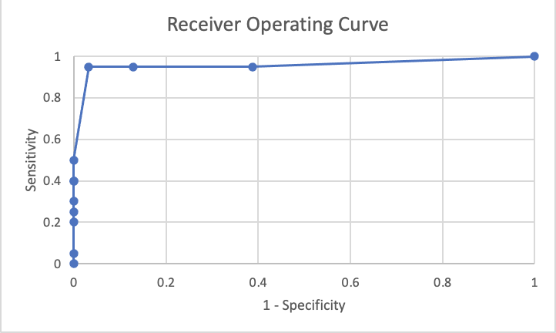
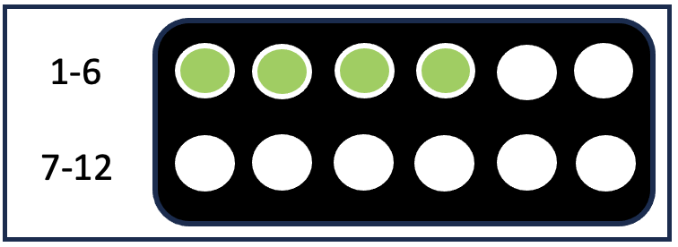
Results
1:320 IFAT titer to call a sample positive
Sensitivity 95%
Specificity 96.8%
Area under the receiver-operating curve 0.98
Notes:
The 1:320 IFAT titer threshold that I used for the Kappa statistic is based on a receiver-operating curve which optimizes sensitivity and specificity.
Report findings

Slide 10
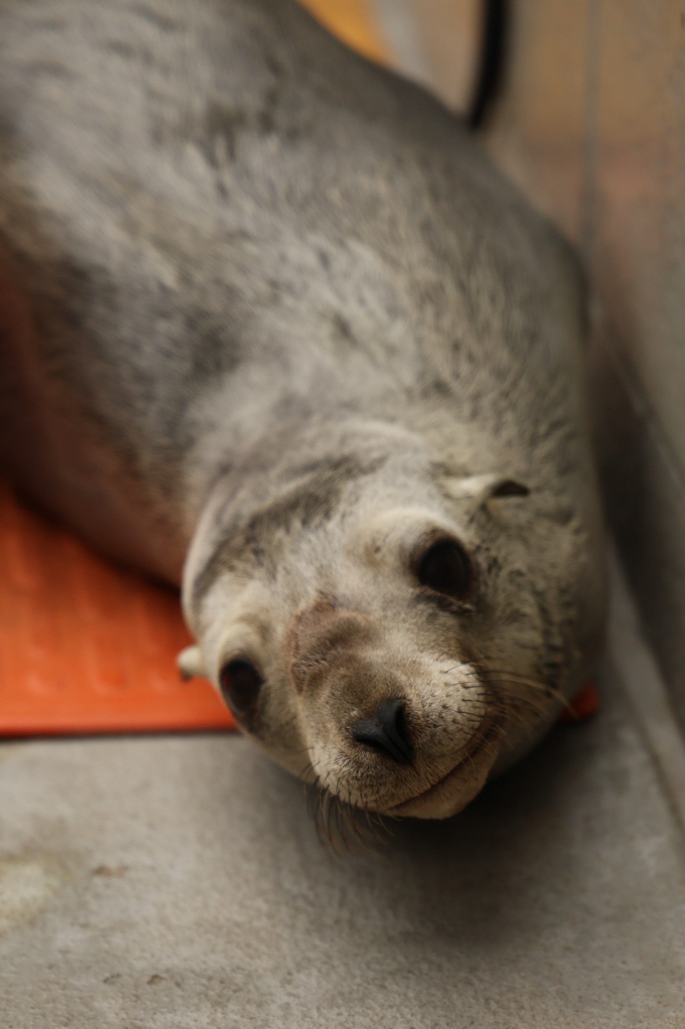
Discussion
Validation of the low-cost, ante-mortem IFAT diagnostic tool is important due to the increase of sarcocystosis cases in stranded CSL at The Marine Mammal Center (TMMC) and other stranded marine mammal facilities.
Postulated factors contributing to increased S. neurona infections in CSL:
Increase in parasite prevalence associated with changing environmental conditions
Shift in prey consumption based on altered historic prey availability
PC: Cara Field

Slide 11
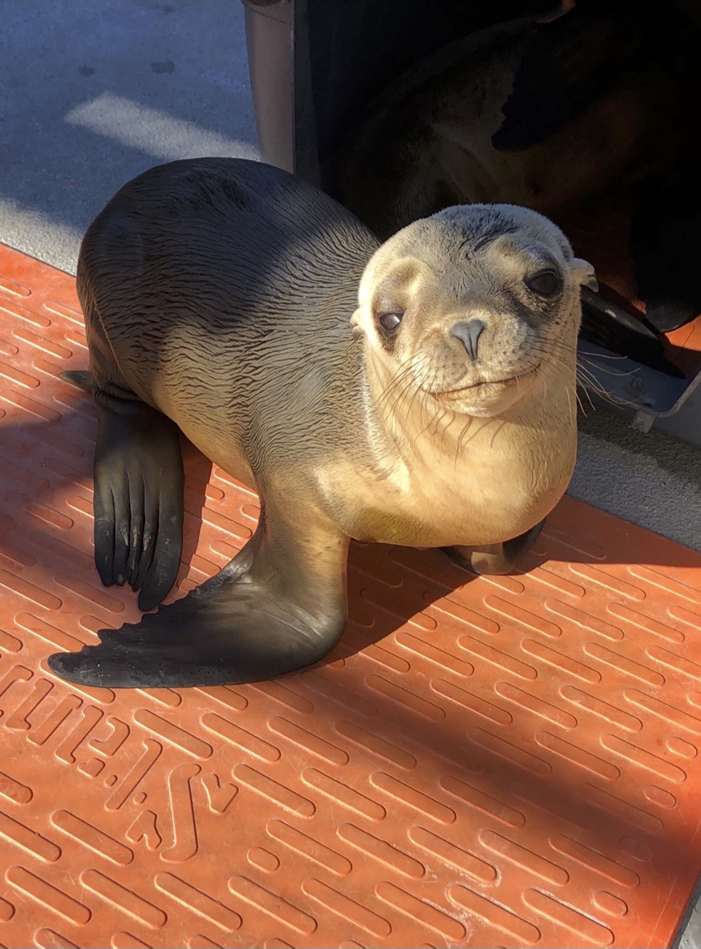
Discussion
Limitations
Serologic antibody titer does not equal active disease
Time constraints on TMMC and UCD labs with high-volume case loads
Financial restraints in studying wildlife diseases
PC: Cara Field

Slide 12
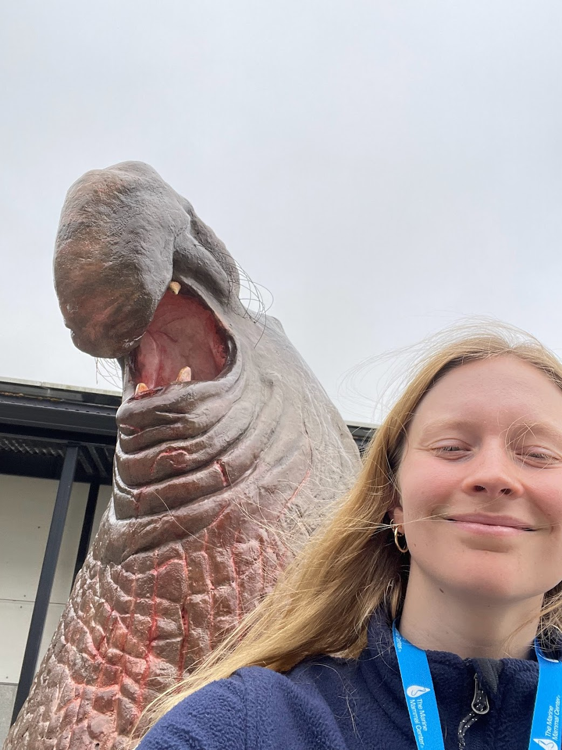
Discussion
Future Directions
Risk factors associated with clinical disease and outcome
Environmental source of infection (e.g. food source, microplastics, etc.) and time until symptom onset in CSL

Slide 13
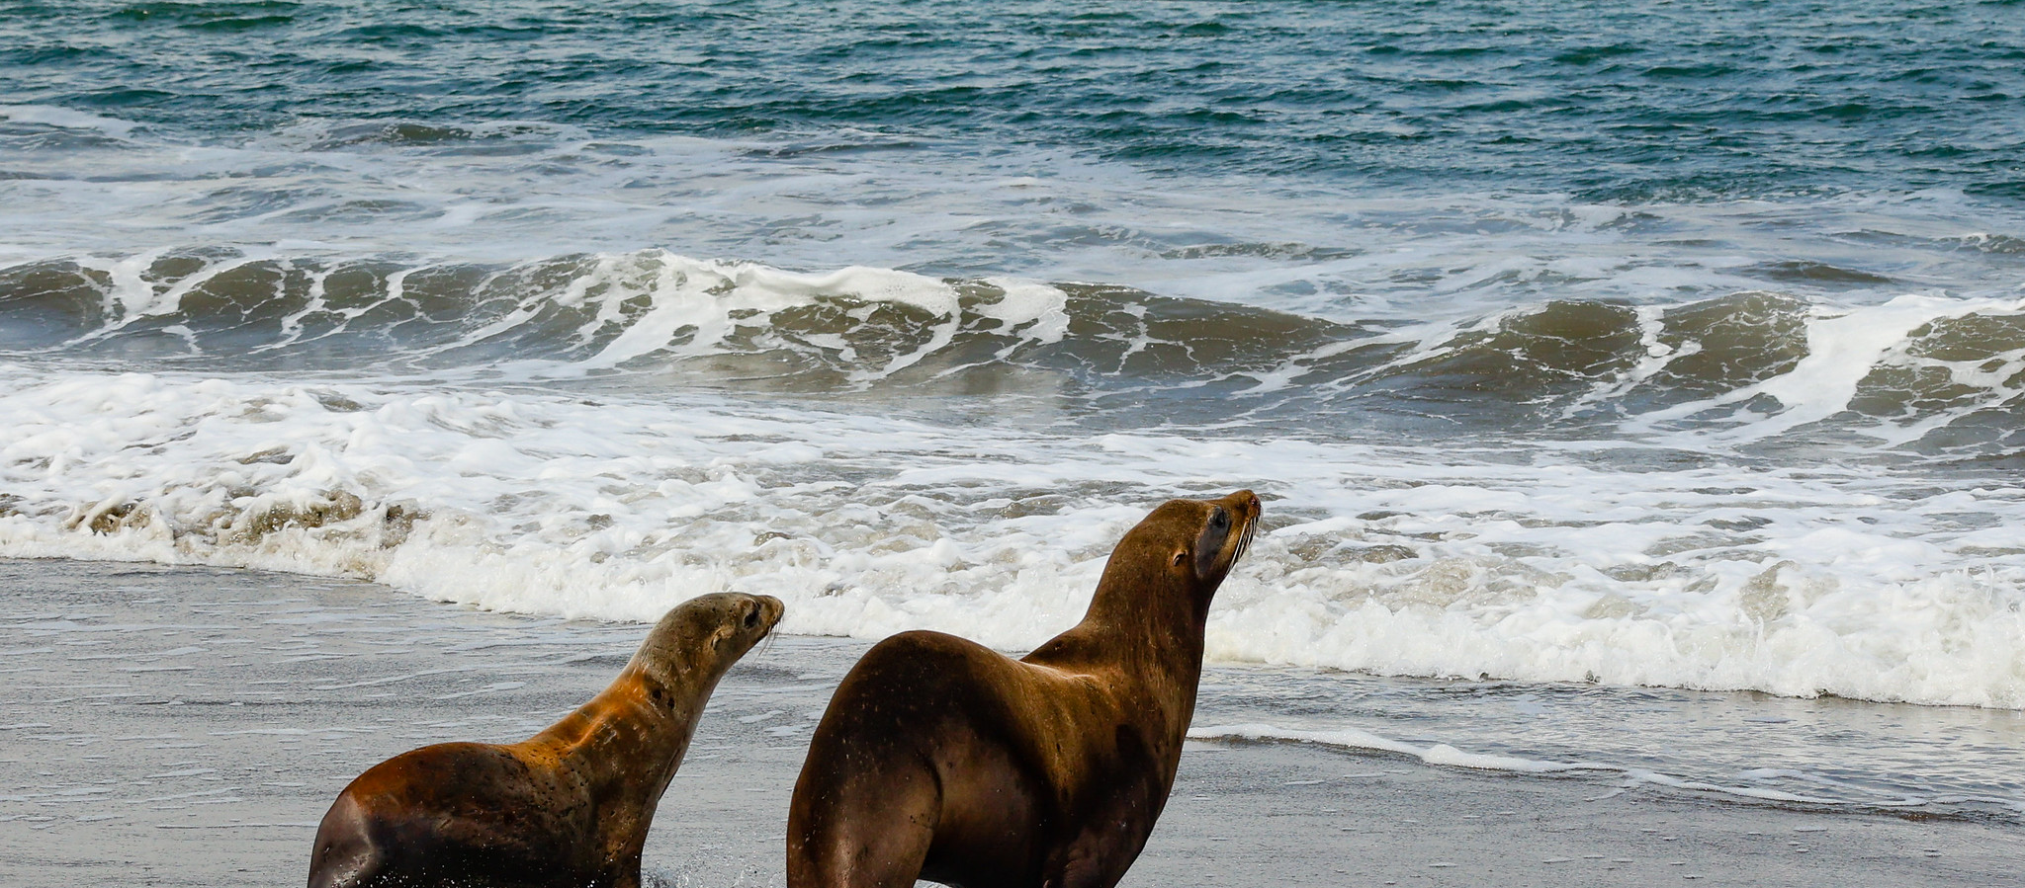
Acknowledgements
A big thank you to The Marine Mammal Center for their continued collaboration with the UC Davis One Health Institute and to the SVM Endowment Fund for their support of the STAR Program.

