Slide 1
Predicting Antimicrobial Resistant Bacteriuria in Dogs Using Machine Learning
Amanda Gonzalez
STAR Program 2022
Mentor: Dr. Krystle Reagan

Slide 2
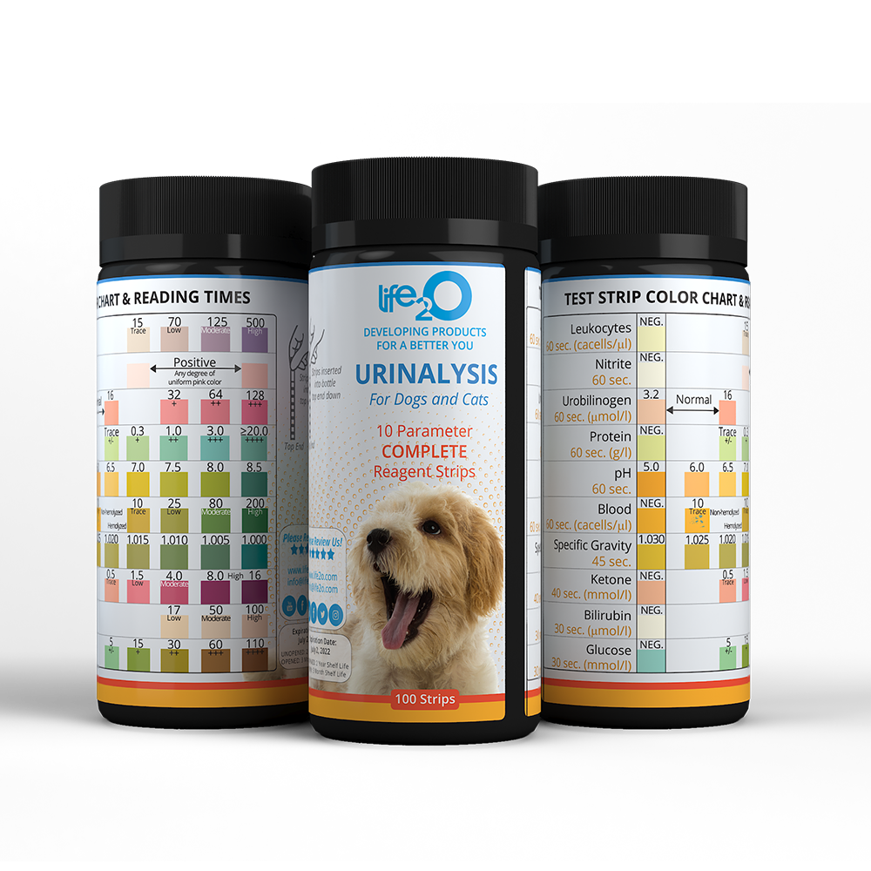
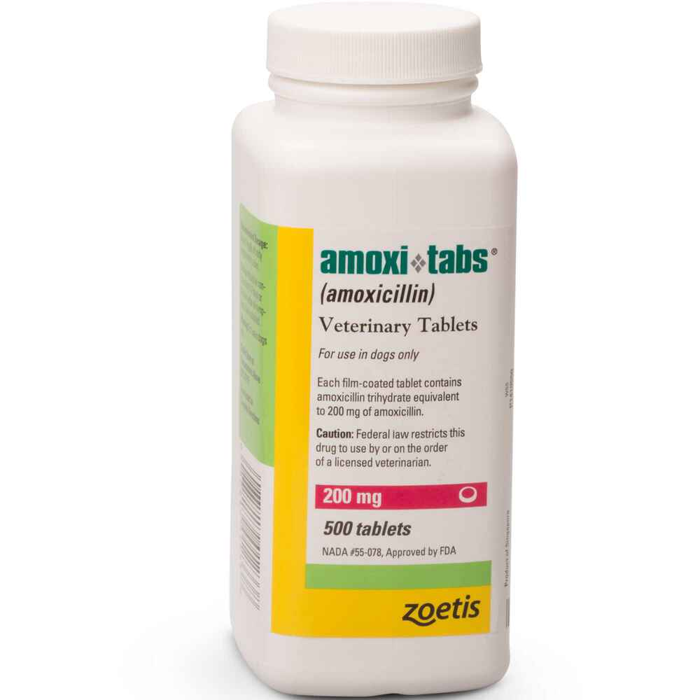
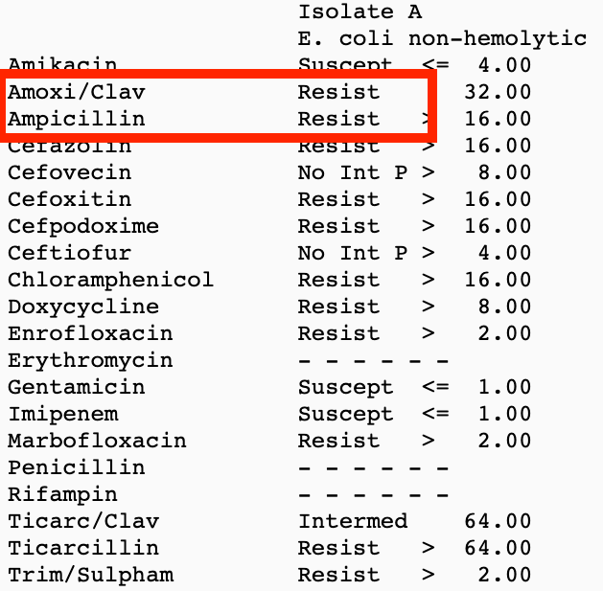
Relevance to Veterinary Medicine
Dog showing signs of a UTI
Urinalysis
Start empiric antimicrobials
Shows evidence of bacteria
Clinical signs persist
Urine Culture
Notes:
Published veterinary guidelines (ISCAID) advise Amoxicillin as the empiric drug of choice for treatment of UTIs.

Slide 3
Relevance to Veterinary Medicine
Dog showing signs of a UTI
Urinalysis
Start empiric antimicrobials
Shows evidence of bacteria
Clinical signs persist
Urine Culture
Notes:
There’s currently no solid guideline as to when empiric therapy would be appropriate versus when to culture. My project aims to address this by intervening before the decision is made to start empiric therapy with a drug that is becoming more ineffective due to resistance.

Slide 4
Introduction &
Significance
Antimicrobial resistance is increasing
Human medicine
2.8 million resistant infections
35,000 deaths from resistance
Veterinary medicine
S. pseudintermedius resistance increased by 25%
E. coli resistance to Clavamox increased 3-fold
Notes:
Microbes have developed mechanisms to extend their survival and this has substantial impacts on both human and animal health. In 2019, a report from the CDC estimated that…. On the veterinary side, a study show that resistance among S. pseudintermedius isolates from dogs increased from less than 5% to near 30% in a six year period. Regarding UTIs in companion animals, a separate study looking at data over a 16 year period, showed that E. Coli had a 3-fold increase in resistance to Clavamox and a 4-fold increase in resistance to third generation Cephalosporins. Other bacterial organisms, including Proteus and Enterobacteriaceae, also showed significant increases in resistance over time.

Slide 5
Machine Learning
in Veterinary Medicine
Can aid in clinical decision making
Prediction of kidney disease in cats 2 years before clinical diagnosis^{[2]}
Accurate screening for Addison’s disease in dogs^{[7]}
Prediction of fecal shedding of MDR bacteria in cows^{[6]}
Accurate calculate of dog heart size from radiographs^{[4]}
Notes:
A machine learning model is a series of statistical models that can learn from patterns in data to make predictions about a new piece of data.

Slide 6
Hypothesis
Patient risk factors and clinical data can be incorporated into a machine learning model that can predict the presence of an antimicrobial resistant (AMR) bacteriuria in dogs.
Notes:
The hypothesis is that patient factors and clinical diagnostic data can be incorporated into a machine learning algorithm that can predict the presence of an amoxicillin resistant organism as the causative agent of a UTI as well as a MDR organism as the causative agent.
*Mention why it is clinically important - how it can help the clinician make decisions on day 1 of presentation*

Slide 7
Study Design
Urinalysis
Positive Urine Culture & Susceptibility
Dogs presenting to the VMTH with:
Retrospective study
January 5, 2015 - February 8, 2021
Notes:
Use “target sample size”

Slide 8
Methods & Procedures
PHASE 1: Data Curation and Labeling
All dogs labeled as present or absent for:
Amoxicillin resistance
Multidrug resistance
Signalment
Patient Factors
Urinalysis Results
Urine Culture & Susceptibility Data
Hospitalization Status
Underlying conditions
Urinary Catheter in past 30 days
Number of vet visits in past 30 days
Antimicrobial administration in past 90 days

Slide 9
Methods & Procedures
Patient Data
Model 1: Predict Amoxicillin Resistance
Model 2: Predict MDR Status
70% training ML model
30% testing performance ML model
70% training ML model
30% testing performance ML model
PHASE 2: Training ML models & assessing performance
Notes:
Two ML models were trained. The first is a supervised ML model that was trained to assess for MDR status, the second to assess for amoxi resistance. The python library PyCaret was utilized for model training. 80% of the data was randomly utilized for training, and the model performance was assessed on the remaining 20%. 10-fold cross validation was utlized to reduce overfitting

Slide 10
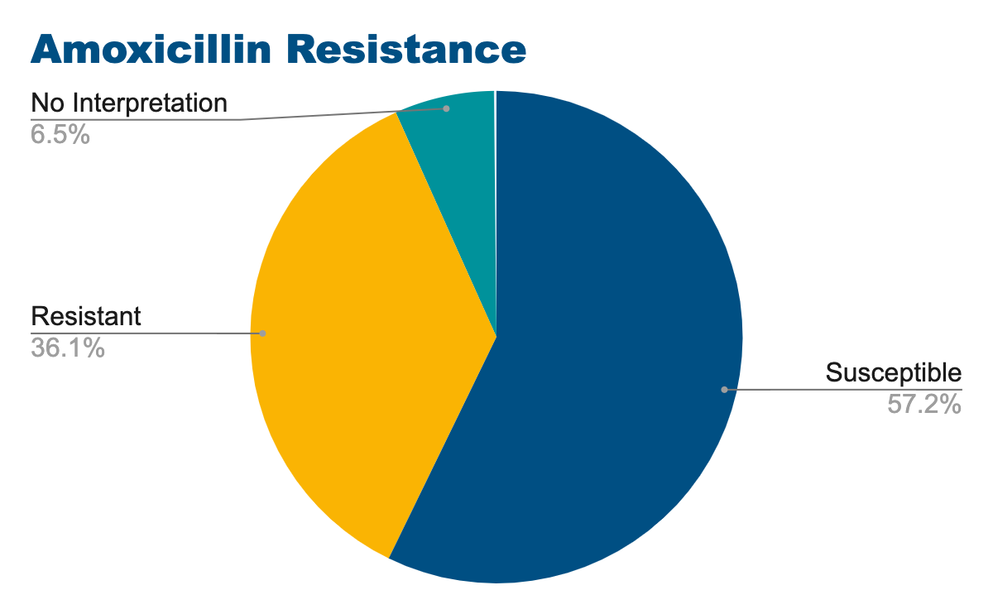
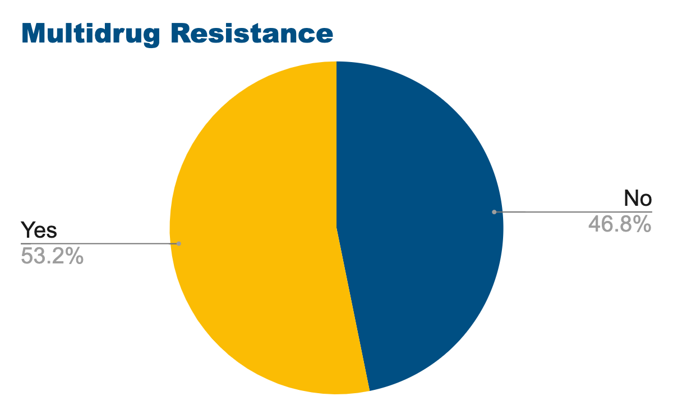
Population Data
1,192 patients
36% Amoxicillin resistant
(430/1192)
53% MDR
(634/1192)

Slide 11
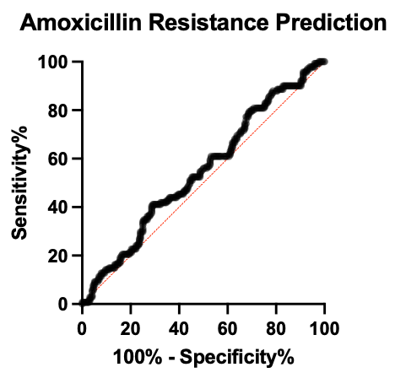
Amoxicillin Resistance Prediction Model
Random Forest Classifier Model
Total: 357 | Amoxicillin resistant (+) | Amoxicillin resistant (-)
Prediction (+) | 20 | 24
Prediction (-) | 121 | 192
TP
FP
FN
TN
AUC = 0.56
141
216
Accuracy
Sensitivity
Specificity
82%
14%
89%
Notes:
I would have a 2x2 table on the left, ROC curve on the right
Add AUC on the ROC curve

Slide 12
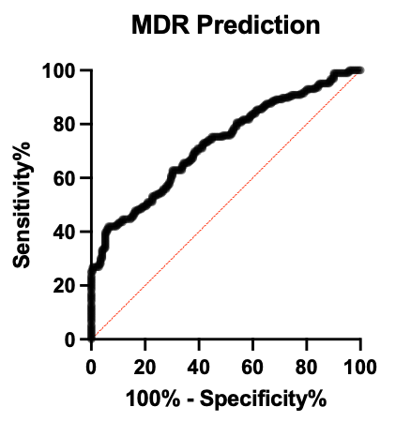
Multidrug Resistance Prediction Model
Gradient Boosting Classifier Model
Total: 358 | MDR (+) | MDR (-)
Prediction (+) | 122 | 62
Prediction (-) | 64 | 110
TP
FP
FN
TN
186
172
AUC = 0.73
Accuracy
Sensitivity
Specificity
65%
66%
64%
Notes:
I would have a 2x2 table on the left, ROC curve on the right, with sens/spec/accuracy and AUC

Slide 13
Future Work
Bias
Sample size
Utilize outside database
Increase population size
Additional model tuning
Notes:
Started with a conservative sample size estimate, and since there does appear to be some pattern in the data as demonstrated by your models performance, additional sample size may improve the models performance.

Slide 14
Clinical Application
Patterns present in patient and clinical data can be utilized to predict MDR bacterial organisms as the cause of UTIs in dogs.
Model 1: Amoxicillin Resistance Prediction
Poor predictive performance
Model 2: Multidrug Resistance Prediction
Fair predictive performance
Notes:
How does this impact things in the clinic?

Slide 15
Acknowledgements
Dr. Krystle Reagan
STAR administration
Financial support was provided by the Students Training in Advanced Research (STAR) Program

Slide 16
Thank you!
Questions?

Slide 17
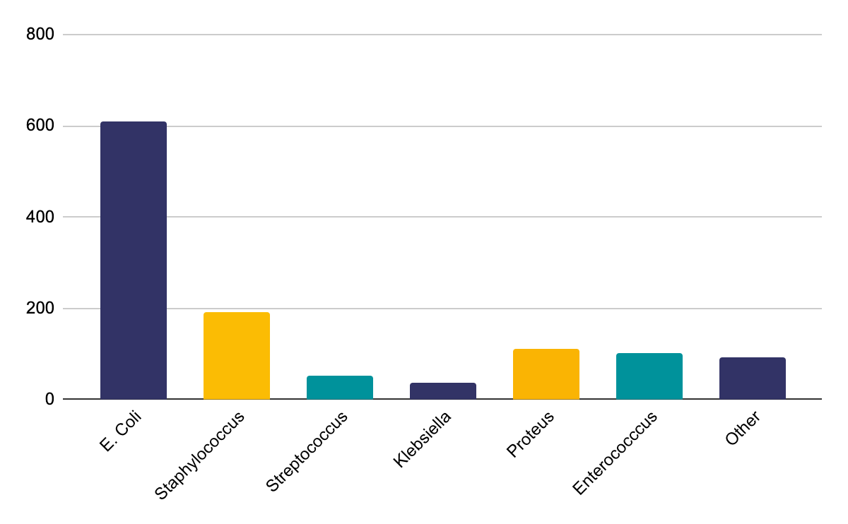
Data
One organism grown | 983
Multiple organisms grown | 209
Notes:
In the extra slides I would have a table that lists every input column you used to train the models and the feature importance graphs for each of the models.

Slide 18
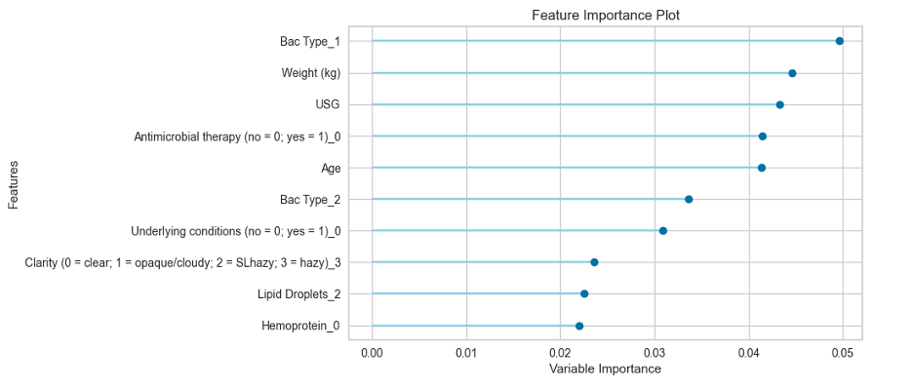
Data
AMR - RF Model
Notes:
In the extra slides I would have a table that lists every input column you used to train the models and the feature importance graphs for each of the models.

Slide 19
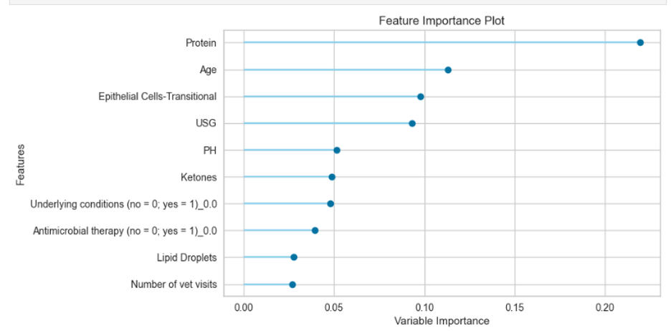
Data
MDR - GBC Model
Notes:
In the extra slides I would have a table that lists every input column you used to train the models and the feature importance graphs for each of the models.

Slide 20
Data
AMR - RF Model
1) Sex | 2) Neuter status | 3) Age | 4) Weight (kg)
5) Urine color | 6) Urine clarity | 7) USG | 8) pH
9) Protein | 10) Bilirubin | 11) Hemoprotein | 12) Lipid layer
13) WBC | 14) RBC | 15) Crystals | 16) Epithelial (transitional) cells
17) Epithelial (squamous) cells | 18) Hyaline casts | 19) Bacteria quantity | 20) Bacteria type
21) Lipid droplets | 22) Underlying conditions | 23) Number of vet visits in previous 30 days | 24) Hospitalization status
25) U-Cath placement in previous 30 days | 26) Antimicrobial therapy | 27) Ampicillin resistant (yes/no)
Notes:
In the extra slides I would have a table that lists every input column you used to train the models and the feature importance graphs for each of the models.

Slide 21
Data
MDR - GBC Model
1) Sex | 2) Neuter status | 3) Age | 4) Urine color
5) Urine clarity | 6) USG | 7) pH | 8) Protein
9) Glucose | 10) Ketones | 11) Bilirubin | 12) Hemoprotein
13) Lipid layer | 14) WBC | 15) RBC | 16) Crystals
17) Epithelial (transitional) cells | 18) Bacteria quantity | 19) Bacteria type | 20) Lipid droplets
21) Underlying conditions | 22) Number of vet visits in previous 30 days | 23) Hospitalization status | 24) U-Cath placement in previous 30 days
25) Antimicrobial therapy | 26) MDR (yes/no)
Notes:
In the extra slides I would have a table that lists every input column you used to train the models and the feature importance graphs for each of the models.

Slide 22
Works Cited
Bemis, D. A., Jones, R. D., Frank, L. A., & Kania, S. A. (2009). Evaluation of Susceptibility Test Breakpoints Used to Predict mecA-Mediated Resistance in Staphylococcus Pseudintevmedius Isolated from Dogs. Journal of Veterinary Diagnostic Investigation, 21(1), 53-58.
Bradley, R., Tagkopoulos, I., Kim, M., Kokkinos, Y., Panagiotakos, T., Kennedy, J., ... & Elliott, J. (2019). Predicting early risk of chronic kidney disease in cats using routine clinical laboratory tests and machine learning. Journal of veterinary internal medicine, 33(6), 2644-2656.
CDC. (2019). Antibiotic Resistance Threats in the United States 2019. 2019 AR Threats Report.
Li, S., Wang, Z., Visser, L. C., Wisner, E. R., & Cheng, H. (2020). Pilot study: application of artificial intelligence for detecting left atrial enlargement on canine thoracic radiographs. Veterinary radiology & ultrasound, 61(6), 611-618.
Marques, C., Belas, A., Franco, A., Aboim, C., Gama, L. T., & Pomba, C. (2018). Increase in antimicrobial resistance and emergence of major international high-risk clonal lineages in dogs and cats with urinary tract infection: 16 year retrospective study. Journal of Antimicrobial Chemotherapy, 73(2), 377-384.
Pandit, P. S., Williams, D. R., Rossitto, P., Adaska, J. M., Pereira, R., Lehenbauer, T. W., ... & Aly, S. S. (2021). Dairy management practices associated with multi-drug resistant fecal commensals and Salmonella in cull cows: a machine learning approach. PeerJ, 9, e11732.
Reagan, K. L., Reagan, B. A., & Gilor, C. (2020). Machine learning algorithm as a diagnostic tool for hypoadrenocorticism in dogs. Domestic Animal Endocrinology, 72, 106396.
Weese, J. S., Blondeau, J., Boothe, D., Guardabassi, L. G., Gumleyg, N., Papich, M., ... & Sykes, J. (2021). International Society for Companion Animal Infectious Diseases (ISCAID) guidelines for the diagnosis and management of bacterial urinary tract infections in dogs and cats. Journal of Japanese association of veterinary nephrology and urology, 13(1), 46-63.

