Slide 1
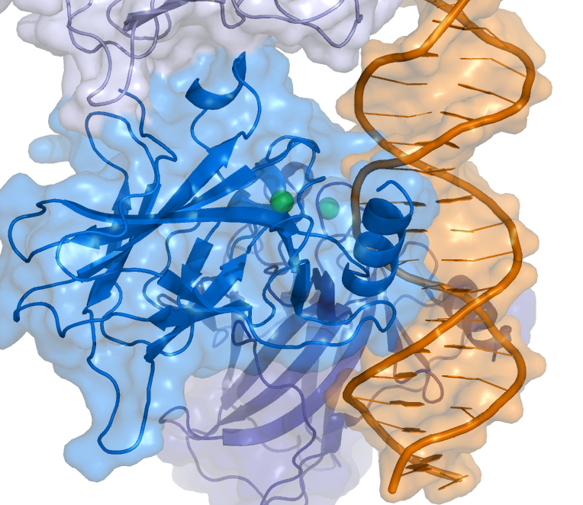

A Comprehensive Review of p53 Mutations and Cancer Incidence in Companion Animals
Presented by:
Amit Levi
Class of 2022
Mentor:
Dr. Xinbin Chen
Department of Surgical & Radiological Sciences

Slide 2
Background on P53
P53 is a major tumor suppressor known as the “guardian of the genome”.
P53 mutations often lead to loss of important regulatory functions and were found to be involved in many cancer processes.
Somatic p53 mutations occur in almost every type of human cancer.
P53 mutations have been discovered in many species and are important in veterinary medicine just as they are in human medicine.

Slide 3
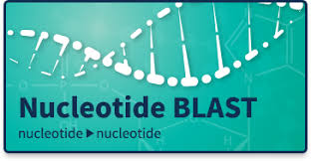
Methods
Focus was primarily on dog (canis lupus familiaris) and cat (felis catus) p53 mutations.
Comparative sequence alignment between canine to human and feline to human p53 gene via “Blast”.
Searched through all known literature on p53 in these species and organized the known data.
Compiled into cohesive figures for both dogs and cats, germline and somatic.
Analyzed mutational data - observation of associations.

Slide 4
Figure

Slide 5
Results
249 canine somatic mutations overall, 175 different mutations
47 feline somatic mutations overall, 41 different mutations
6 canine germline mutations
No feline germline mutations!

Slide 6
Some interesting human and animal findings/associations - Germline
Li-Fraumeni syndrome in people – a multi-cancer heritable syndrome.
  13-year-old English Setter multi-cancer like syndrome – found germline mutation in a melanoma, Arg236Gln.
  The human equivalent mutation is located at codon 248 which is one of the most frequently mutated p53 hotspots in humans.
  Same mutation in people is associated with Li-Fraumeni syndrome.
Two germline mutations discovered in one canine mammary adenoma tumor - deletion of exons 3-7 + Pro69Leu.
  Both mutations observed in human breast cancers.
  Interesting association between canine mammary tumors and human breast cancer has been noted before.

Slide 7
Somatic
Similar frequency of canine hotspots and corresponding human hotspots – both ~30% mutational frequencies of total mutations.
P53 mutations in all 3 species - dogs, cats and humans – most commonly occur in the DNA binding domain.
Compared to humans, dogs seem to have a much greater frequency of mutations in the tetramerization domain.
  Essential for several p53 functions: DNA binding, protein–protein interactions, post-translational modifications, and p53 degradation.
  Mutations in this domain can inactivate protein function.
  Less then 3% mutational frequency in humans.
  We found close to 10% of all p53 mutations in dogs.

Slide 8
 |  | CANINE |  |  |  | HUMAN
 | Exon | Canine mutation amino acid codon | # of canine cases containing mutation | # of cases out of 250 N (%) | Overall canine mutations found in codon | Human mutation amino acid codon | # of human cases containing mutation | # of cases out of 21,700 N (%)† | Overall human mutations found†
1) | 5 | 145 | Arg145His = 3 Arg145Cys = 2 | 3 (1.20%) 2 (0.80%) | 5 | 158 | Arg158His = 113 Arg158Leu = 103 | 113 (0.52%) 103 (0.47%) | 216
2) | 5 | 150 | Tyr150SerfsX8 = 26 Tyr150Ser = 1 Tyr150Cys = 1 | 26 (10.4%) 1 (0.40%) 1 (0.40%) | 28 | 163 | Tyr163Cys = 168 | 168 (0.77%) | 168
3) | 5 | 162 | Arg162His = 5 Arg162fs = 1 | 5 (2.0%) 1 (0.40%) | 6 | 175 | Arg175His = 1215 | 1215 (5.6%) | 1215
4) | 7 | 229 | Ser229Phe = 4 Ser229fs = 1 Ser229Tyr = 1 | 4 (1.60%) 1 (0.40%) 1 (0.40%) | 6 | 241 | Ser241Phe = 120 | 120 (0.55%) | 120
5) | 7 | 233 | Gly233Asp = 3 (1 CL) Gly233Ala = 2 (1 CL) Gly233Val = 1 | 3 (1.20%) 2 (0.80%) 1 (0.40%) | 6 | 245 | Gly245Ser = 457 Gly245Asp = 163 Gly245Cys = 92 Gly245Val = 87 | 457 (2.11%) 163 (0.75%) 92 (0.42%) 87 (0.4%) | 799
6) | 7 | 236 | Arg236Gln = 4 (1 CL) Arg236Trp = 1 | 4 (1.60%) 1 (0.40%) | 5 | 248 | Arg248Gln = 949 Arg248Trp = 765 B-Arg248Leu = 130 | 949 (4.37%) 765 (3.53%) 130 (0.6%) | 1844
7) | 7 | 237 | Arg237Trp = 9 (1 CL) Arg237Leu = 2 Arg237Pro = 1 | 9 (3.60%) 2 (0.80%) 1 (0.40%) | 12 | 249 | Arg249Ser = 442 | 442 (2.04%) | 442
8) | 8 | 261 | Arg261Cys = 3 Arg261Ser = 1 Arg261His = 3 Arg261Gln = 2 (1 CL) | 3 (1.20%) 1 (0.40%) 3 (1.20%) 2 (0.80%) | 9 | 273 | Arg273His = 856 Arg273Cys = 717 B-Arg273Leu = 155 | 856 (3.95%) 717 (3.31%) 155 (0.71%) | 1728
Total |  |  | 77 | 77 (30.8%) | 77 |  | 6532 | 6532 (30.1%) | 6532
†The 50 most common somatic mutations in TP53 from IARC R18: most of the common mutations in p53 are predicted to disrupt protein structure, having highly deleterious VIPUR scores (>0.5) taken from https://www.nature.com/articles/cdd2017180/tables/1
Bold = positions of methylated CpG transitions due to mutation of 5’-methylated cytosine
Italicized = likely influenced by environment mutagens

Slide 9
Lessons from the Animal Kingdom
Elephants:
  'Peto's Paradox: high BMI high cancer risk, but elephants are unique.
  Only very rarely develop cancer.
  Have 19 additional p53 copies known as retrogenes.

Slide 10
Summary of Significant Findings
Many p53 mutations in dogs have corresponding mutations in humans
  Veterinary cancer research can be influential to human research and vise versa
  Potential therapeutics discovered to be efficacious in dogs may be considered for treatment in human cancers.
Where differences are identified, therapeutics can be adjusted accordingly
  For example, mutational frequencies in the different functional domains of p53

Slide 11
Future Directions
Identification of driver mutations where multiple p53 mutations are discovered in one tumor – could direct targeted therapies
Comparative analysis of other p53 family proteins and the roles they play in cancer development – p63, p73…
Can p53 germline mutations indicate dog breed cancer susceptibility? – further research necessary

Slide 12

Acknowledgments:
Financial support was provided by the Students Training in Advanced Research (STAR) Program.
Research Grant: RO1 CA250338-01
Student Support: National Institutes of Health T35 OD010956
Thanks
Thank you to Dr. Xinbin Chen for mentoring me through the grant writing, research process and paper writeup.
Thank you to my family and friends who support me in my passions every day.

Slide 13
References
Vousden KH, Prives C. Blinded by the Light: The Growing Complexity of p53. Cell. 2009;137(3):413-431. doi:10.1016/j.cell.2009.04.037
Marfe G, De Martino L, Tafani M, et al. A multicancer-like syndrome in a dog characterized by p53 and cell cycle-checkpoint kinase 2 (CHK2) mutations and sirtuin gene (SIRT1) down-regulation. Res Vet Sci. 2012;93(1):240-245. doi:10.1016/j.rvsc.2011.07.030
Veldhoen N, Watterson J, Brash M, Milner J. Identification of tumour-associated and germ line p53 mutations in canine mammary cancer. British Journal of Cancer. 1999;81(3):409-415. doi:10.1038/sj.bjc.6690709
Baugh EH, Ke H, Levine AJ, Bonneau RA, Chan CS. Why are there hotspot mutations in the TP53 gene in human cancers? Cell Death and Differentiation. 2018;25(1):154-160. doi:10.1038/cdd.2017.180
Chène P. The role of tetramerization in p53 function. Oncogene. 2001;20(21):2611-2617. doi:10.1038/sj.onc.1204373
Rivlin N, Brosh R, Oren M, Rotter V. Mutations in the p53 Tumor Suppressor Gene: Important Milestones at the Various Steps of Tumorigenesis. Genes Cancer. 2011;2(4):466-474. doi:10.1177/1947601911408889
Haupt S, Haupt Y. P53 at the start of the 21st century: Lessons from elephants. F1000Research. 2017;6(0):1-8. doi:10.12688/f1000research.12682.1
Sulak M, Fong L, Mika K, et al. TP53 copy number expansion is associated with the evolution of increased body size and an enhanced DNA damage response in elephants. eLife. 2016;5. doi:10.7554/eLife.11994
Puente XS, Velasco G, Gutiérrez-Fernández A, Bertranpetit J, King MC, López-Otín C. Comparative analysis of cancer genes in the human and chimpanzee genomes. BMC Genomics. 2006;7:1-9. doi:10.1186/1471-2164-7-15

Slide 14
Questions?
?
?
?
?
?
?
?

