Slide 1
Characterization of microglia in canine brain metastatic melanoma
Blaire Consales, Toedebusch Laboratory

Slide 2
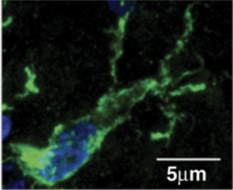
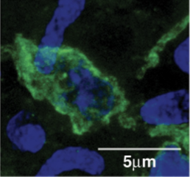
Microglia may aid in melanoma metastasis to the brain
Melanoma: tumor of melanocytes that accounts for 7% of all malignant tumors and is the most common oral tumor in canines
High propensity to metastasize to the brain
1/3 of all human and canine patients
Microglia help maintain homeostasis in the brain
Cytotoxic- fight foreign invaders
Neurotrophic- support neurons
Dynamic cells with multiple morphologies
Pro-tumorigenic role in human metastatic melanoma
Also canine astrocytoma
What is the role of microglia in canine brain metastatic melanoma?
Toedebusch, et al., 2021
Smith et al. 2002
Izraely et al., 2019
Razmara et al., unpublished
Qiao et al., 2019
Toedebusch, et al., 2021

Slide 3
Hypothesize that microglia play a role in canine brain metastatic melanoma
Increased density of microglia within the metastatic melanoma foci
Infiltrating microglia will demonstrate a pro-tumorigenic phenotype

Slide 4
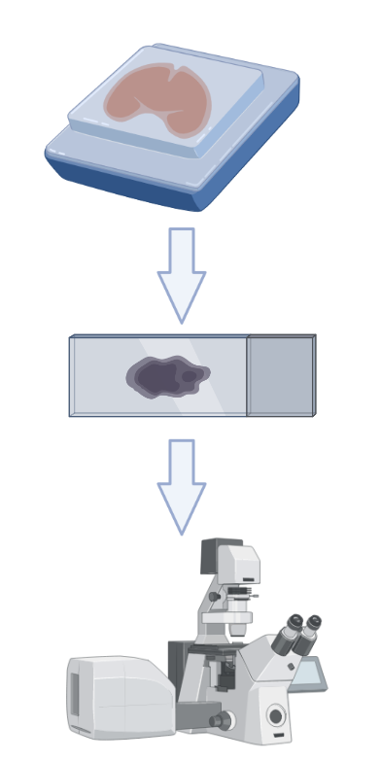
Specific Aims and Methodology
Define the microglial response in canine brain metastatic melanoma.
Determine the density of microglia associated with 1) metastatic melanoma foci (n=5), 2) non-tumor bearing brain from dogs with metastatic disease (n=6) and 3) normal canine brain (n=4).
Determine the phenotype of microglia within the tumor microenvironment.
Dapi/Iba1
10 representative fields of view per dog, per condition
5 µM
Manually count cells
10 µM
Single field of view

Slide 5
Microglial morphology is distinctly different from normal to metastatic melanoma
Normal Brain
CNS MM
10 µM
10 µM

Slide 6
Heterogenous infiltration of microglia into the metastatic melanoma foci
Normal Brain
CNS MM High
CNS MM Low
10 µM
10 µM

Slide 7
Low density areas of microglia show significantly fewer microglia when compared to high density and nonCNS MM
Microglial Density = $\frac{Microglia}{Total cells}$ x 100
Microglial Density (%)
Normal Brain: 3.4%
CNS MM High: 7.8%
CNS MM Low: 2.6%
nonCNS MM: 7.3%
Comparison by Kruskal-Wallis with post-hoc Dunn’s
*= p<0.05, **=p<0.005, ***=p<0.0005

Slide 8
Quantification of microglial phenotype
Quantify expression of
Arg-1 (arginase-1): pro-tumorigenic
iNOS (inducible nitric oxide synthase): cytotoxic
Previously published markers of microglial phenotype in humans and canines
Calculated as a percentage of total microglia
Domanskyi & Regnier-Vigouroux et al., 2020
Toedebusch et al., 2018
Notes:
why did we pick these

Slide 9
Representative images of colocalization of iNOS with microglia
Dapi/Iba1
Dapi/iNOS
Merge
10 µM
10 µM
10 µM

Slide 10
Tumor associated microglia demonstrate very low iNOS expression
iNOS Expression
= $\frac{Microglia expressing iNOS}{Total microglia}$ x 100
iNOS Expression (%)
Normal Brain: 14.5%
CNS MM High: 1.8%
CNS MM Low: 2.9%
nonCNS MM: 4.3%
Comparison by Kruskal-Wallis with post-hoc Dunn’s
*= p<0.05, **=p<0.005, ***=p<0.0005

Slide 11
Tumor associated microglia demonstrate very low Arg-1 expression
Arg-1 Expression
= $\frac{Microglia expressing Arg1}{Total microglia}$ x 100
Arg-1 Expression (%)
Normal Brain: 22.7%
CNS MM High: 0%
CNS MM Low: 0%
nonCNS MM: 12.1%
Comparison by Kruskal-Wallis with post-hoc Dunn’s
*= p<0.05, **=p<0.005, ***=p<0.0005
Notes:
y axis: arg1 positive microglia
mention median values
vast majority of cells did not express

Slide 12
Summary
Heterogenous infiltration of microglia into the metastatic melanoma foci
While no statistical difference was observed, Arg-1 and iNOS expression within the tumor was negligible compared to the other groups

Slide 13
Conclusions
Microglia do infiltrate the brain metastatic melanoma foci
Tumor associated microglia do not appear to express Arg-1 or iNOS
A more comprehensive study needs to be done in order to elucidate the function of these tumor associated microglia

Slide 14
Acknowledgements
Toedebusch Laboratory
Christine M. Toedebusch, DVM, PhD, DACVIM
Ryan G. Toedebusch, PhD
Lynsey Petersen, VMIII
Eshetu Debebe, UC Davis
Health Sciences District Advanced Imaging Facility
Ingrid Brust-Mascher, PhD
Funding Support
Student Training in Advanced Research (STAR) Program
NIH T35 Grant 5T35OD010956-22

