Slide 1
The impact of netarsudil on endothelial regeneration in a murine model of Fuch’s endothelial corneal dystrophy
Madeline C Bradford, Sangwan Park, Sara M Thomasy
UC Davis School of Veterinary Medicine STAR 2021

Slide 2
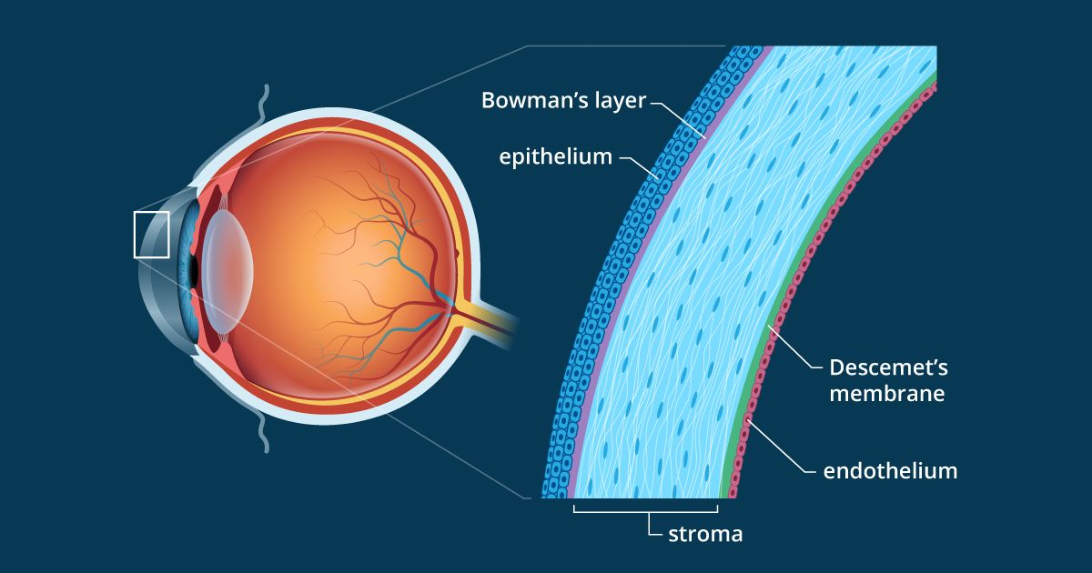
Introduction
Cornea
Notes:
Castro, Nileyma & Gillespie, Stephanie & Bernstein, Audrey. (2019). Ex Vivo Corneal Organ Culture Model for Wound Healing Studies. Journal of Visualized Experiments. 10.3791/58562.

Slide 3
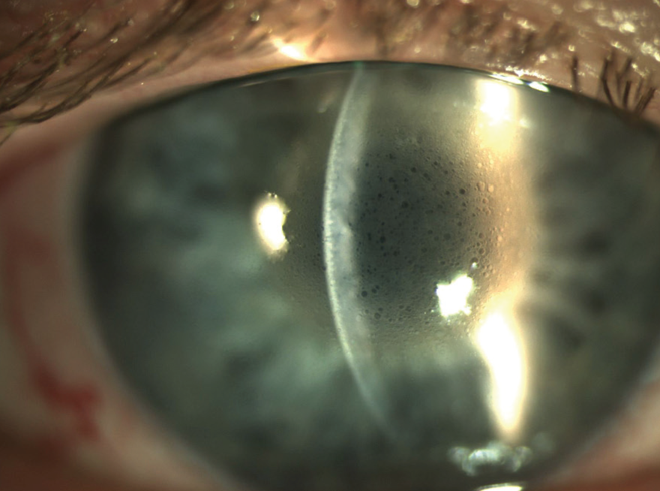
Introduction
Fuch’s endothelial corneal dystrophy (FECD) is a degenerative disease of the cornea
Corneal transplantation is the only current treatment
Notes:
FECD affects 4% of the US population over 40 years of age
Corneal transplantation is the only current treatment
Hallmarks of FECD include loss of corneal endothelial cells (CEC), softening of Descemet’s membrane (DM), and guttae formation
Disruption of the endothelium results in fluid accumulation in the corneal stroma over time and loss of corneal transparency
Corneal transplantation - donor shortage, invasive procedure, risk of graft rejection
Guttae, Latin for "drops," are excrescences of collagen produced by stressed corneal endothelial cells.

Slide 4
Introduction
Netarsudil (Rhopressa®) is a topical ROCK inhibitor FDA approved for treating glaucoma
ROCK inhibition has been associated with corneal endothelial cell (CEC) proliferation and migration in healthy animal injury models
There is a lack of studies evaluating ROCK inhibition in diseased animal injury models
Notes:
TAZ mechanotransducer

Slide 5
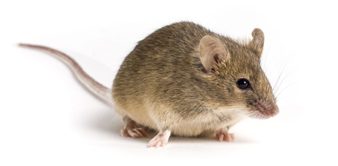
Introduction
Mice deficient in TAZ, encoded by Wwtr1, express the clinical phenotype of late-onset FECD
guttae formation
corneal endothelial cell loss
softening of Descemet’s membrane

Slide 6
Aim and Hypothesis
SA 1: Determine the effect of netarsudil on CEC regeneration following cryoinjury in TAZ deficient mice.
Hypothesis: Netarsudil treatment will increase CEC density, proliferation, and migration over the wound center, following cryoinjury in Wwtr1^{+/-} mice.

Slide 7
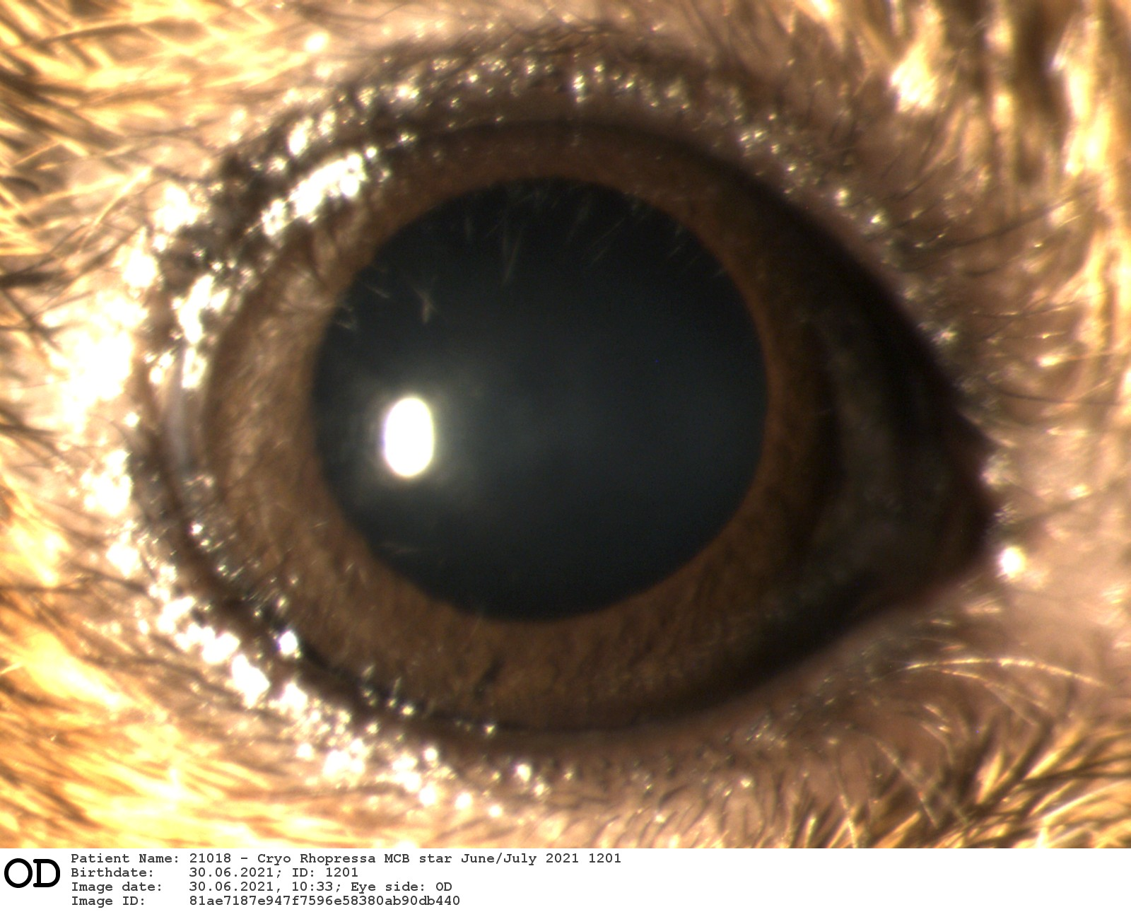
Methods - Baseline Imaging
in vivo Confocal Microscopy
Slit Lamp Photography
Ocular Coherence Tomography
Notes:
OCT - uses similar technology to ultrasound, but using light instead of sound waves to produce a higher resolution image of the cornea
Confocal - laser microscopy to image cell layers of the cornea
Slit Lamp - uses different beams of light to analyze cornea surface, transparency, and anterior chamber

Slide 8
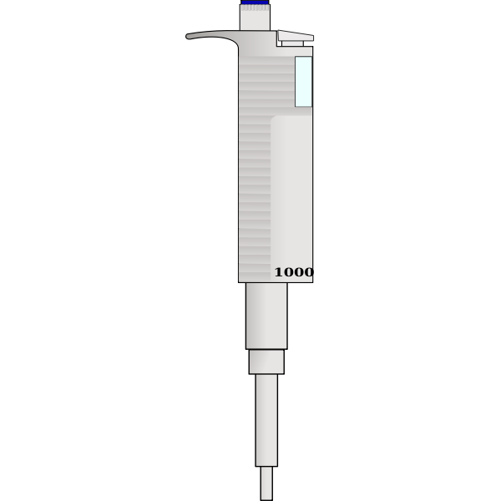
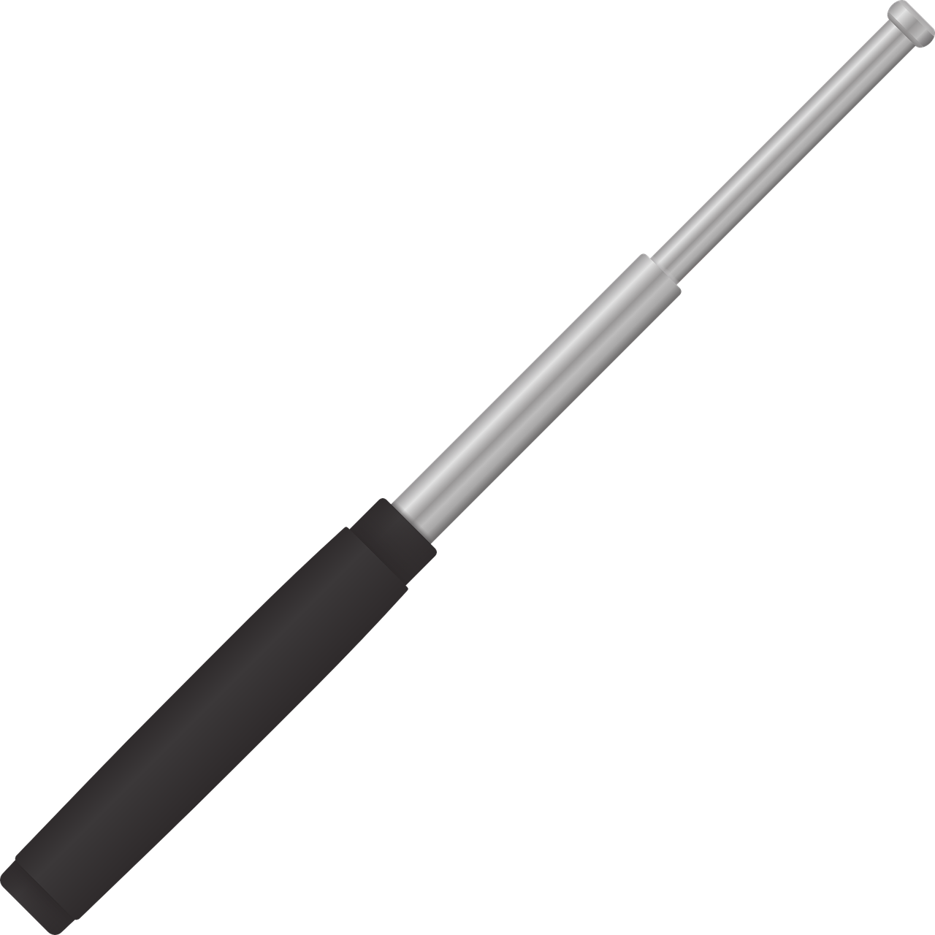
Cryoinjury Procedure
Cryoinjury 10s per cornea
Topical Rhopressa or vehicle applied 2x daily
Notes:
Steel probe dipped in liquid nitrogen

Slide 9
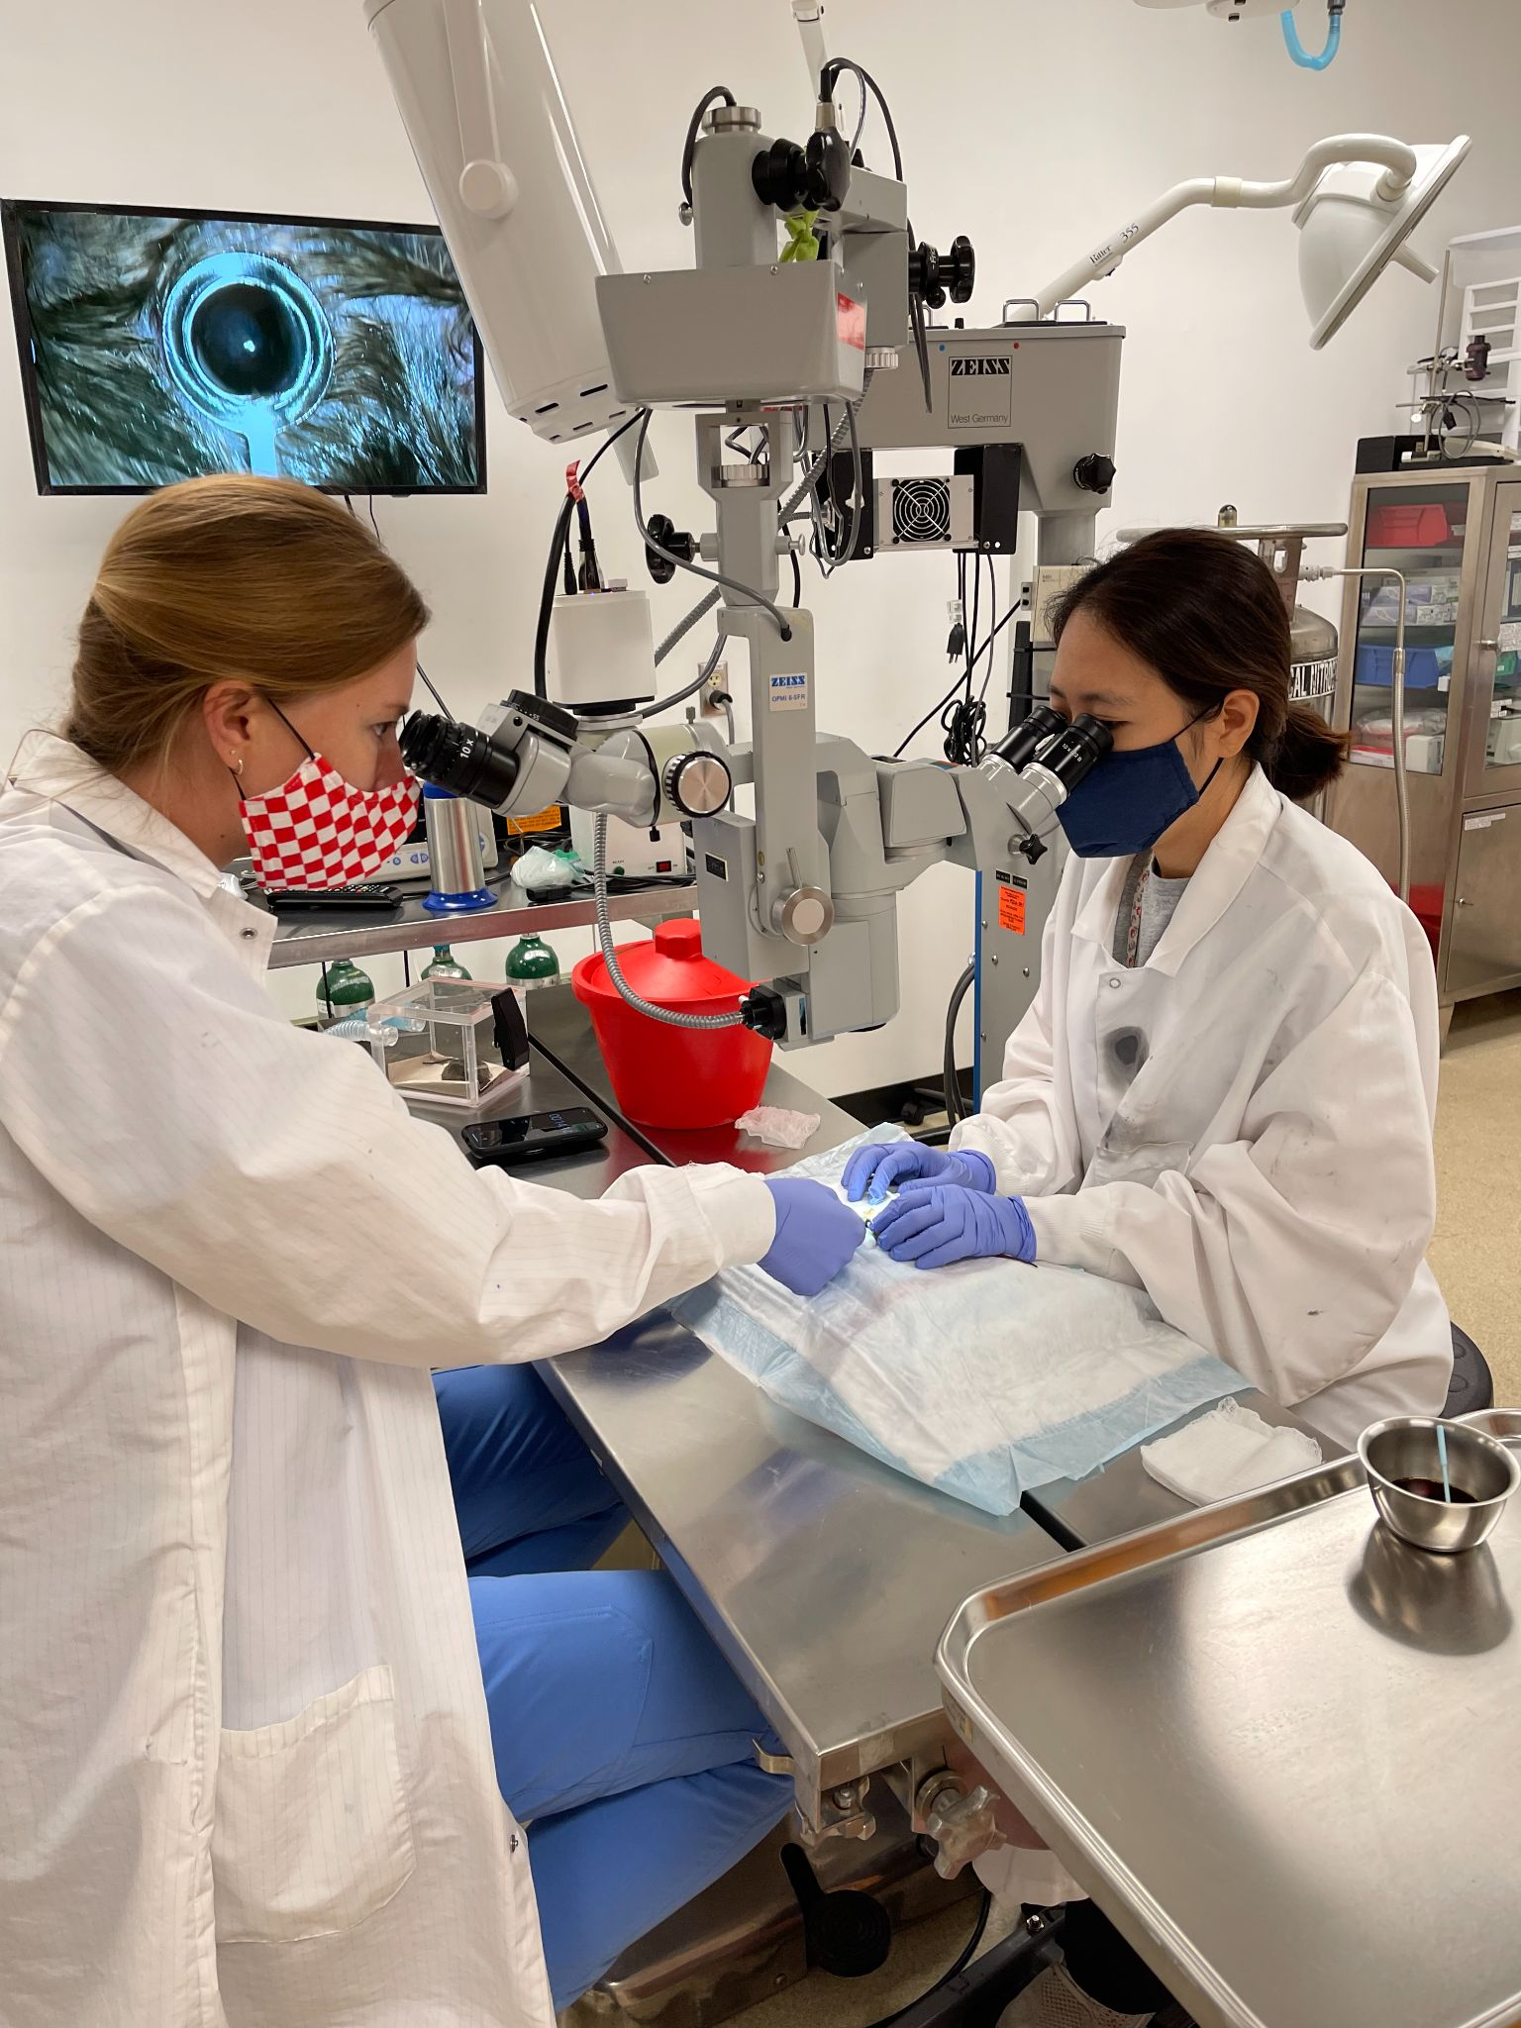
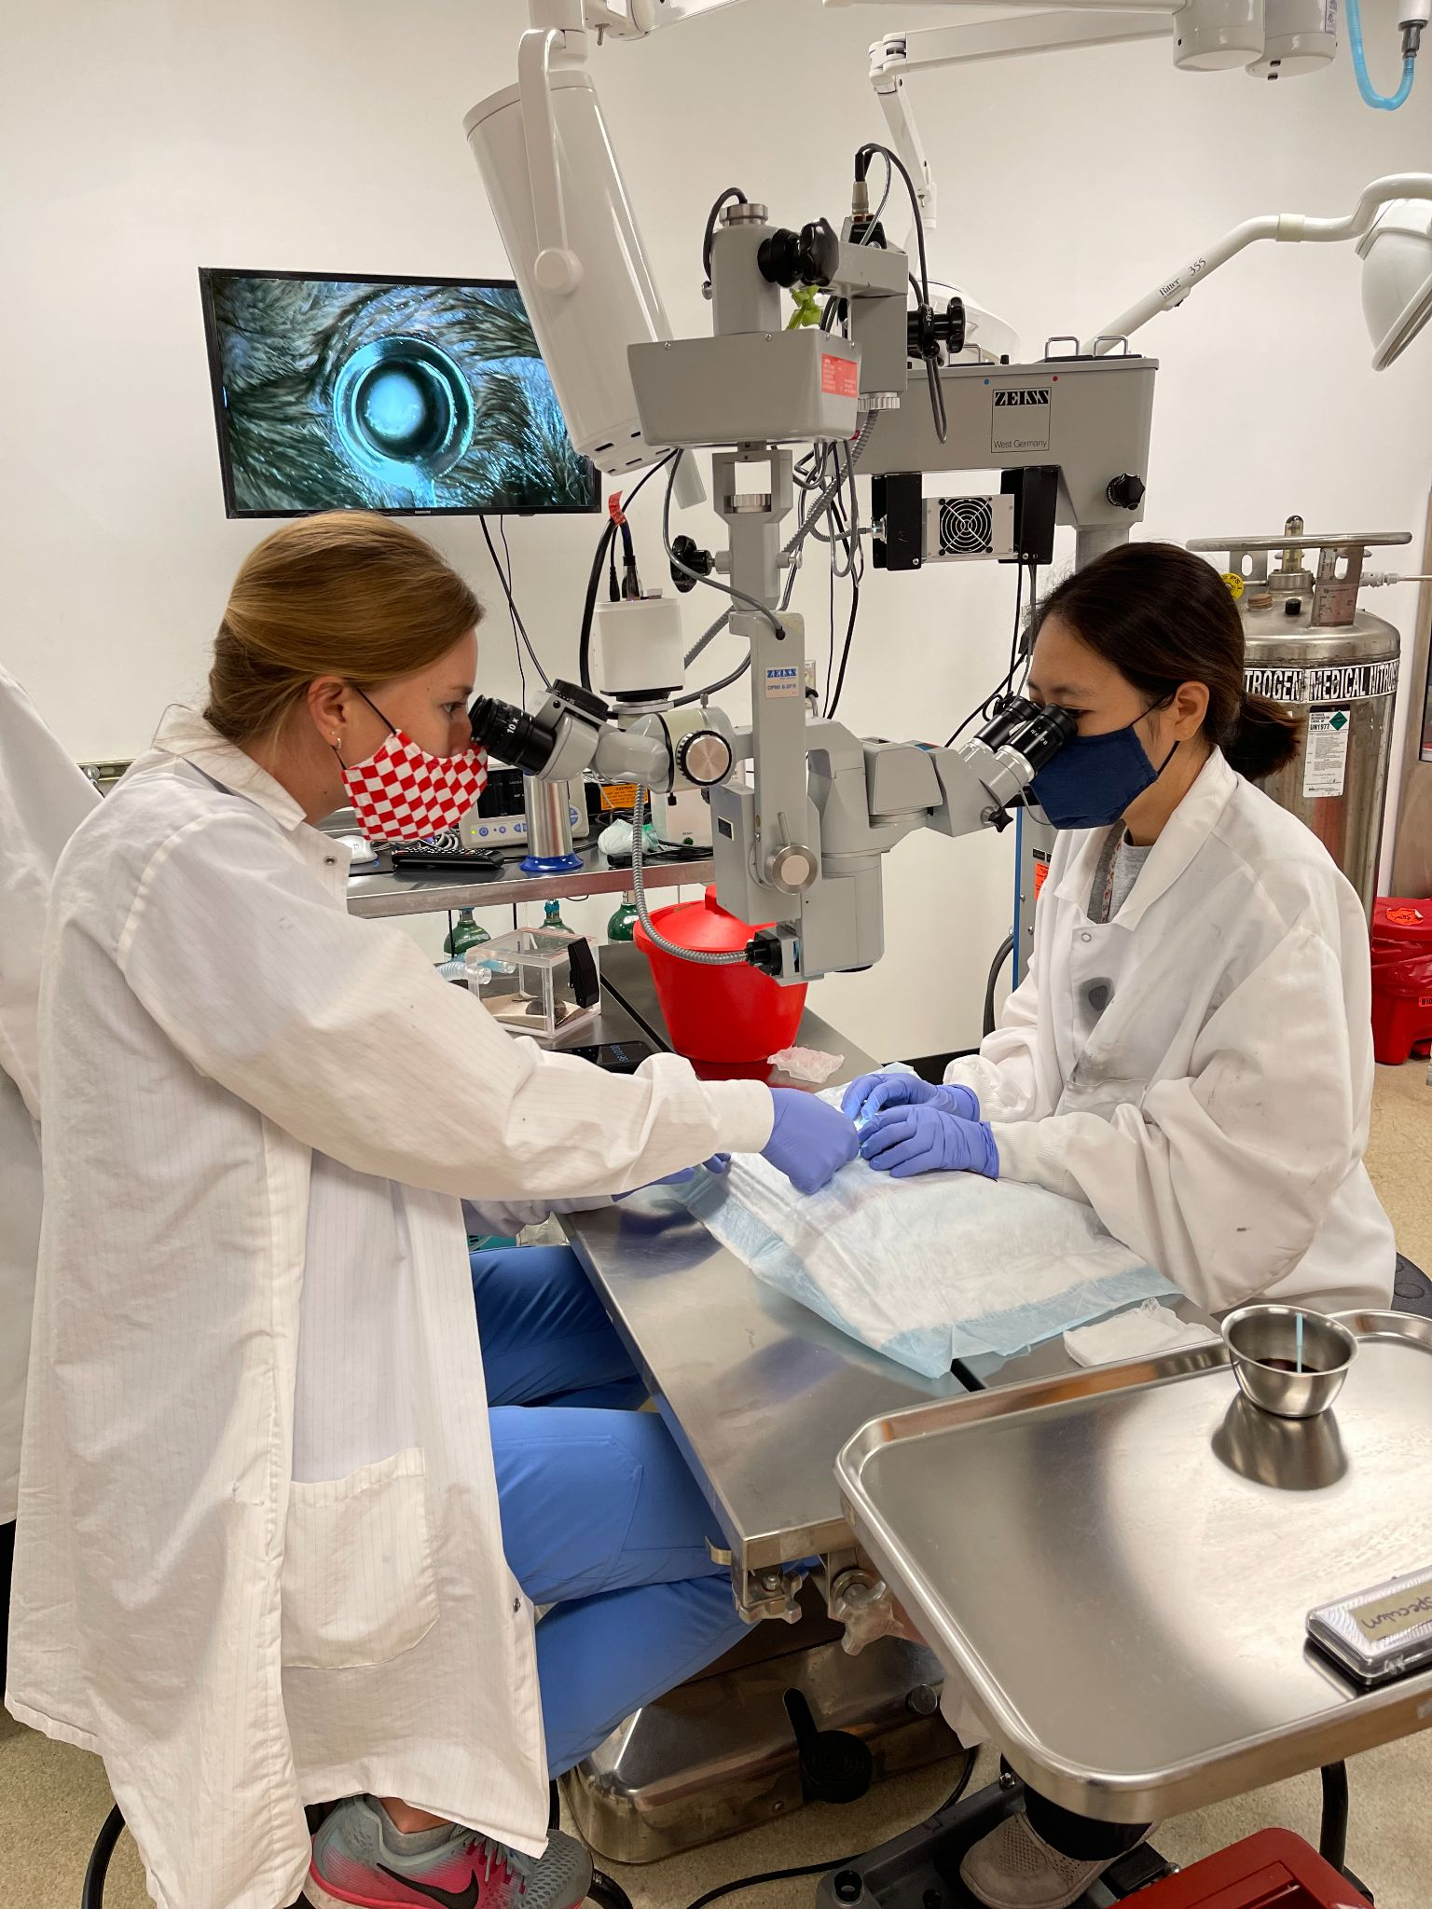

Slide 10
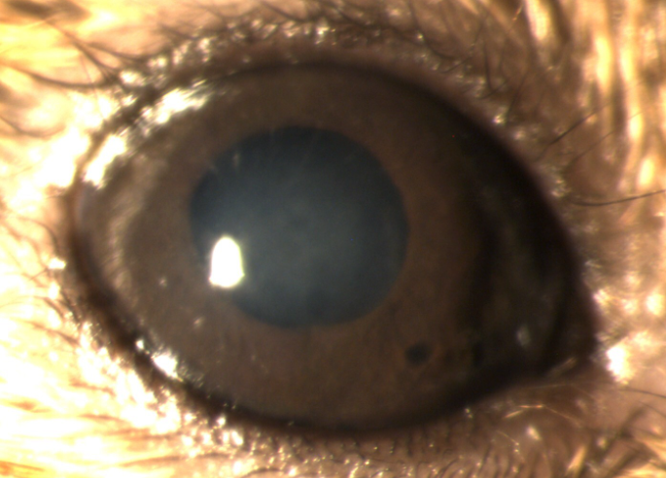
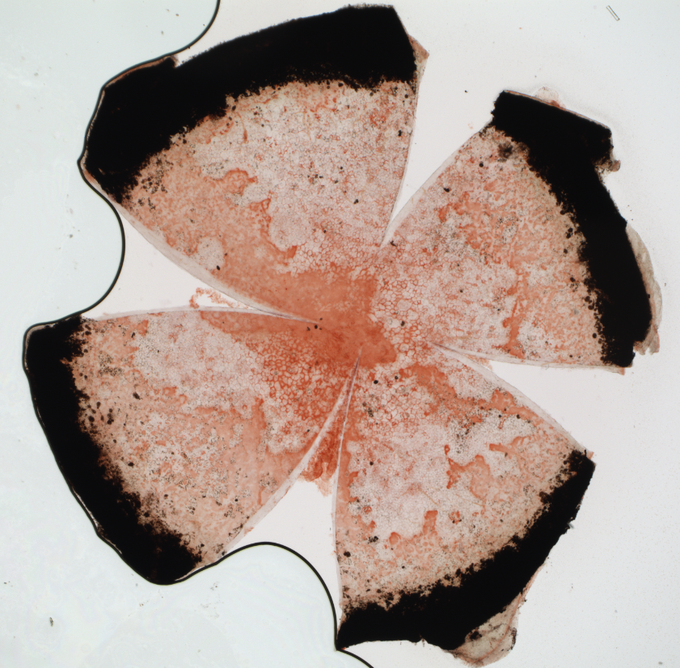
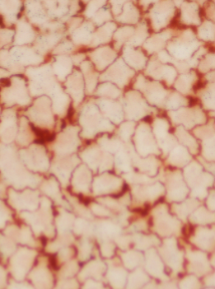
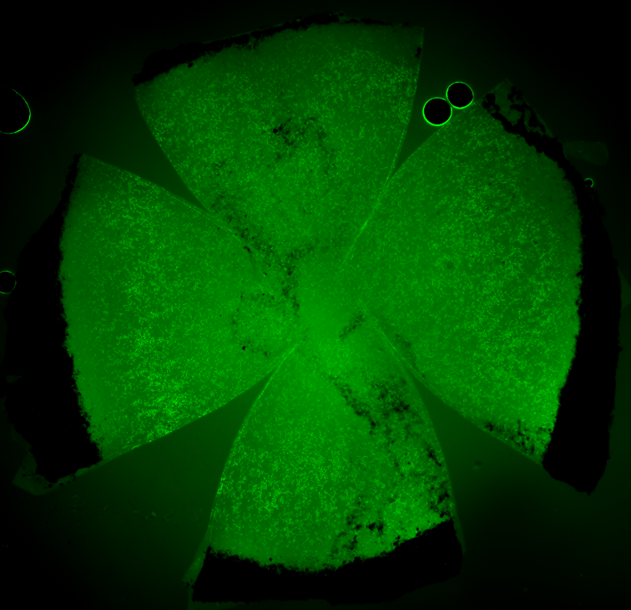
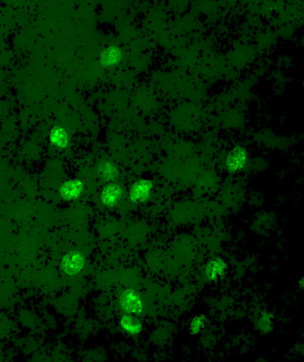
Day 1, 3, 7, 14 Imaging
Ocular Coherence Tomography
in vivo Confocal Microscopy
Slit Lamp Photography
Alizarin Red Staining
EdU Cell Proliferation Assay
Notes:
Alizarin red - intercellular stain
EdU - incorporated into newly synthesized DNA → glows green in fluorescent light

Slide 11
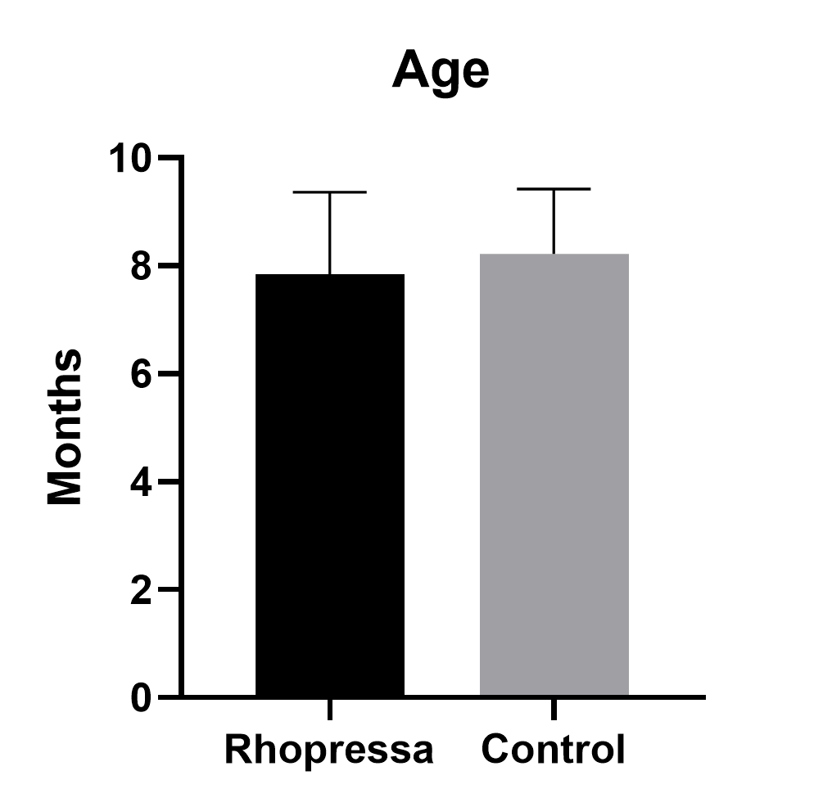
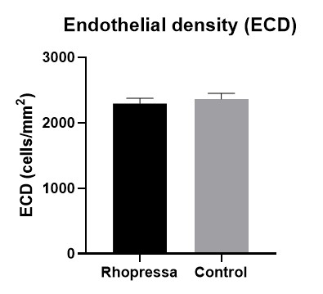
Results
n=24 mice, 6-9 months old
No significant difference in age or baseline ECD between groups
 | Rhopressa | Control
Male | 6 | 2
Female | 7 | 7
Mean Age +/- SD | 7.8 +/- 1.5 | 8.2 +/- 1.2
Mean Baseline ECD +/- SD | 2293.5 +/- 82.4 | 2364.8 +/- 87.3

Slide 12
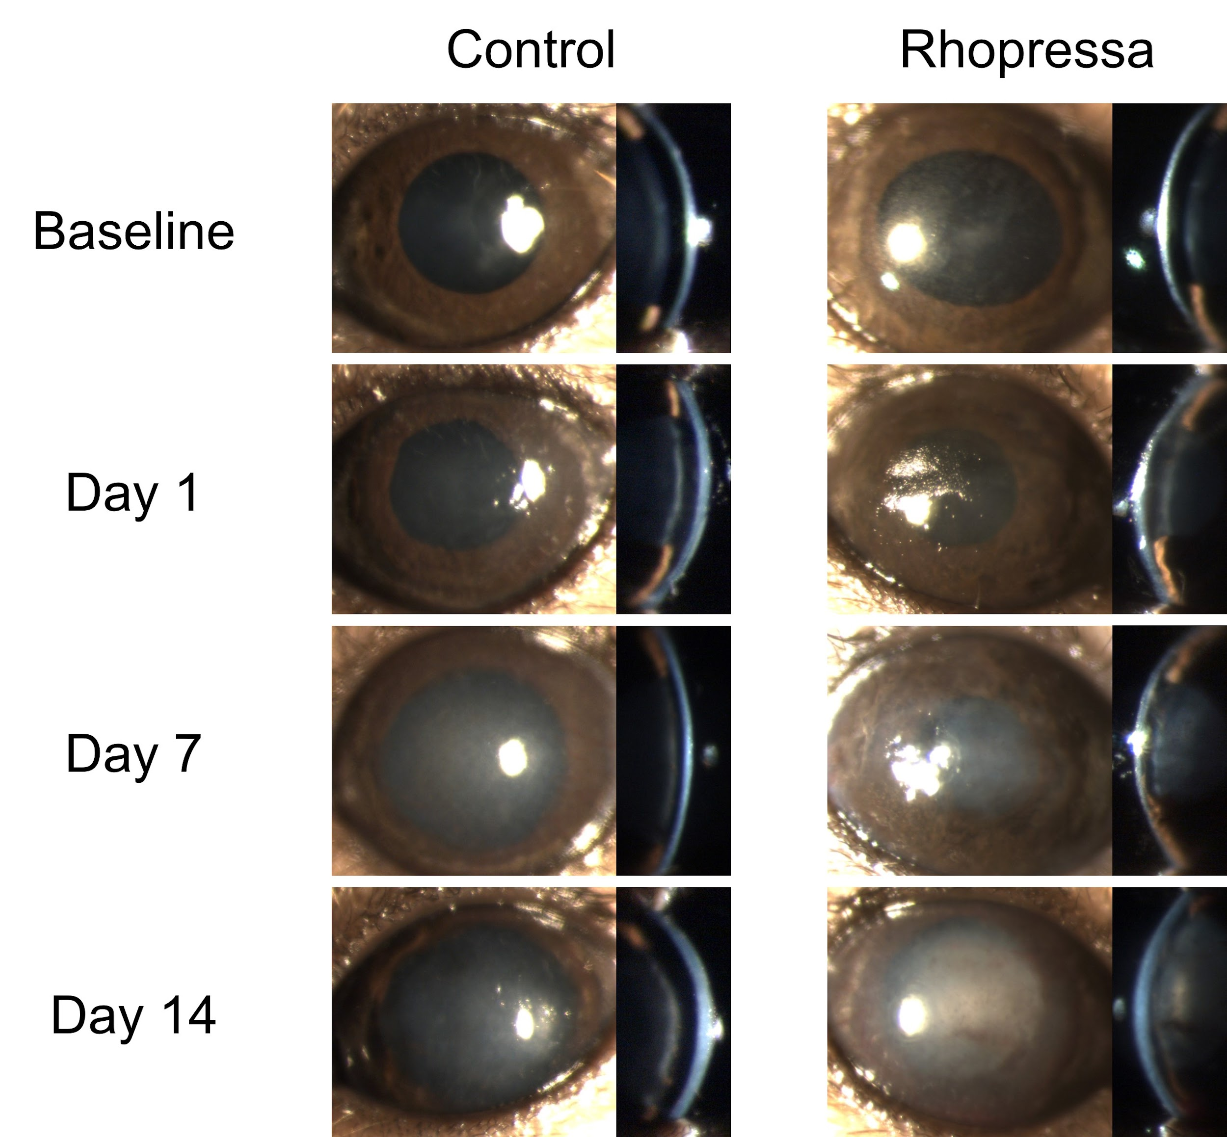
Slit Lamp
CRYOINJURY

Slide 13
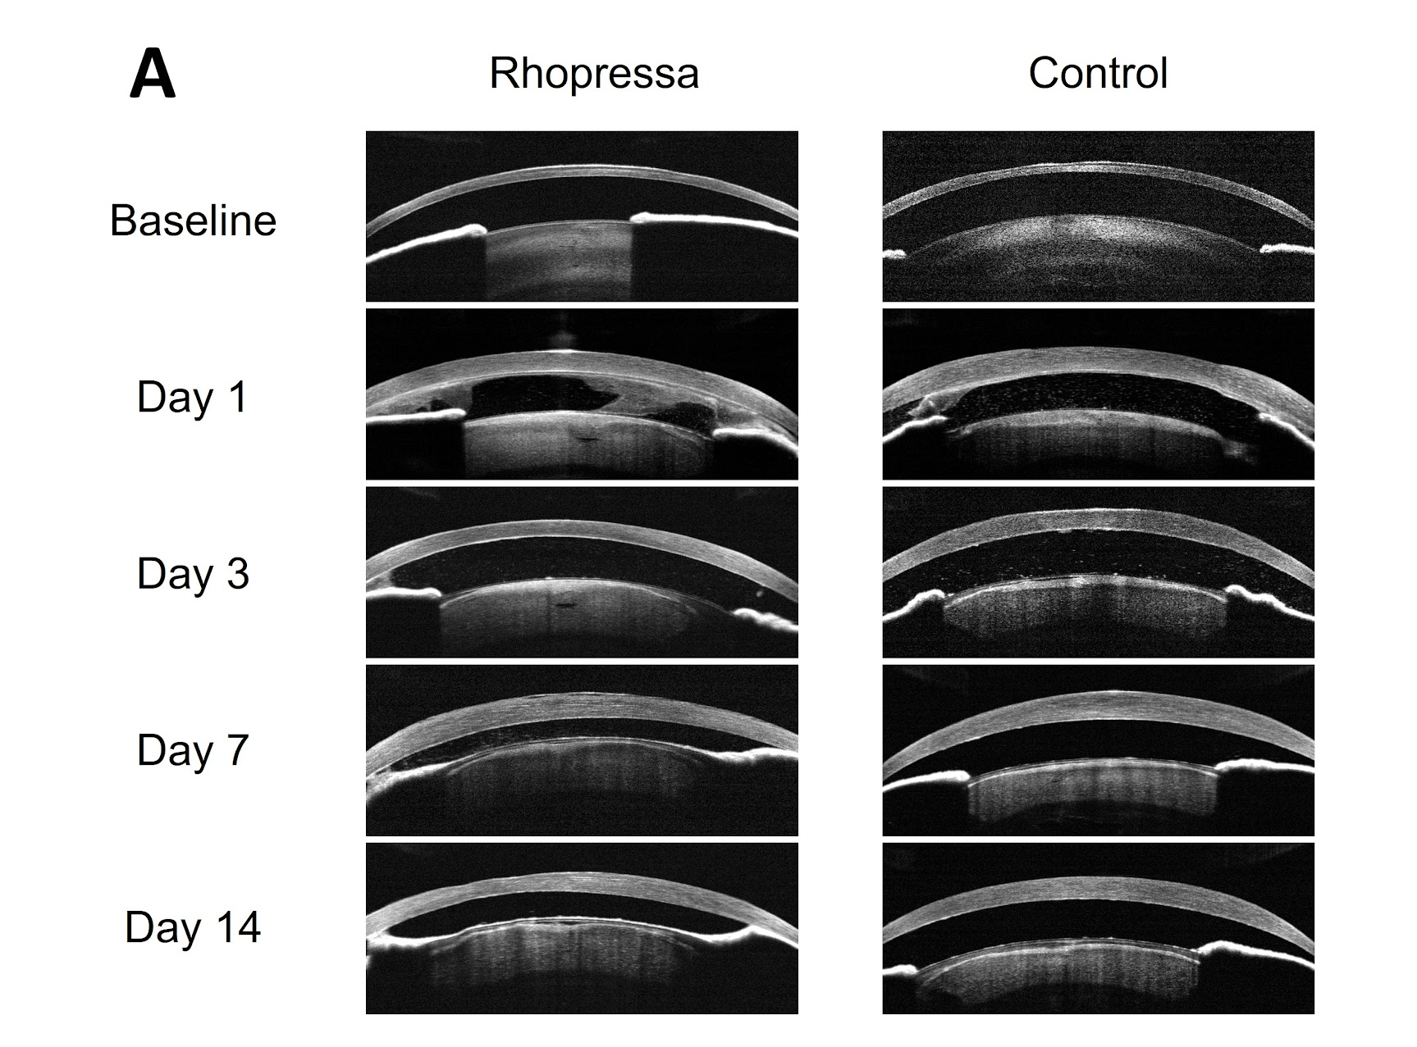
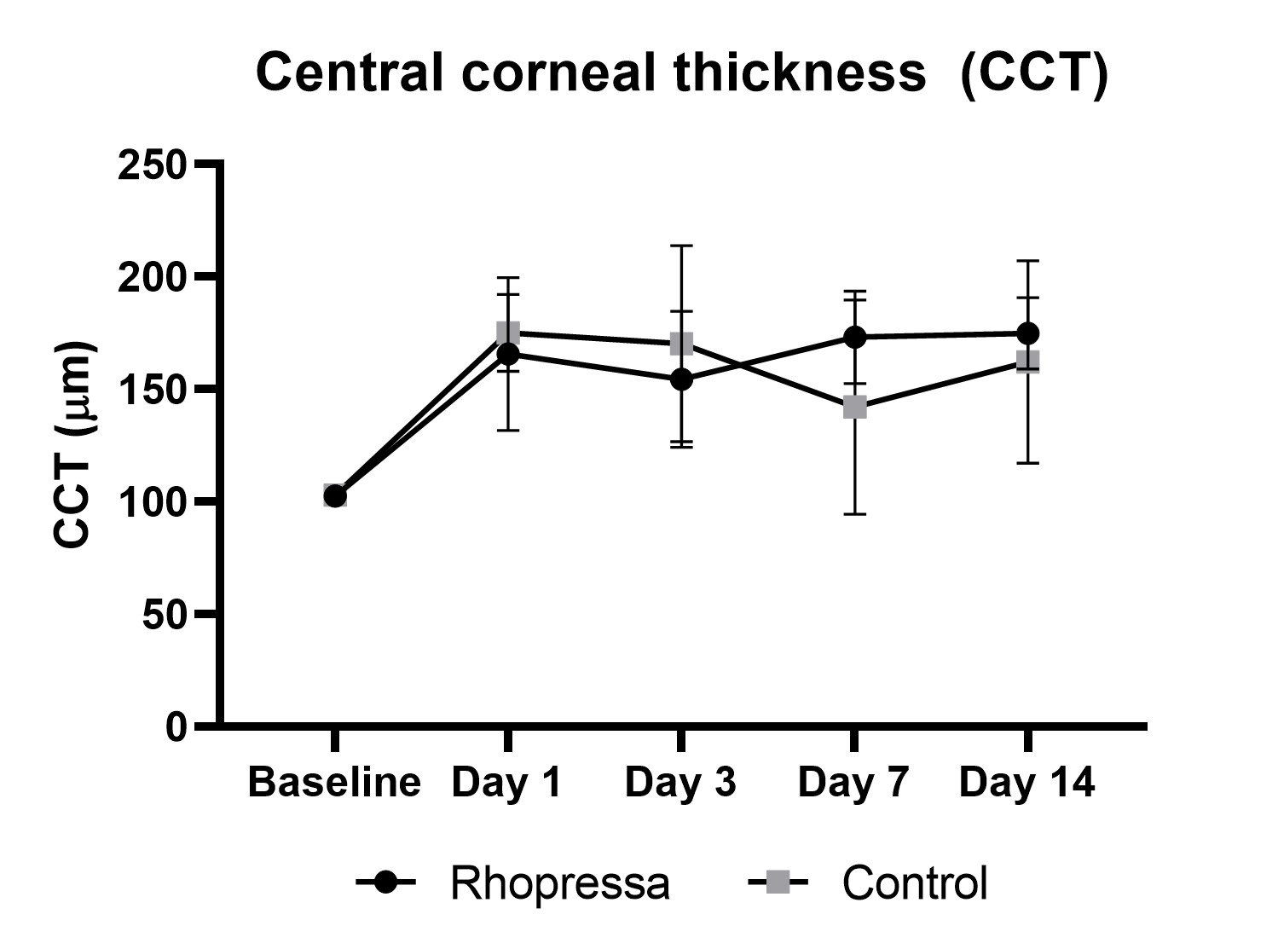
OCT
CRYOINJURY
[
[
[
[

Slide 14
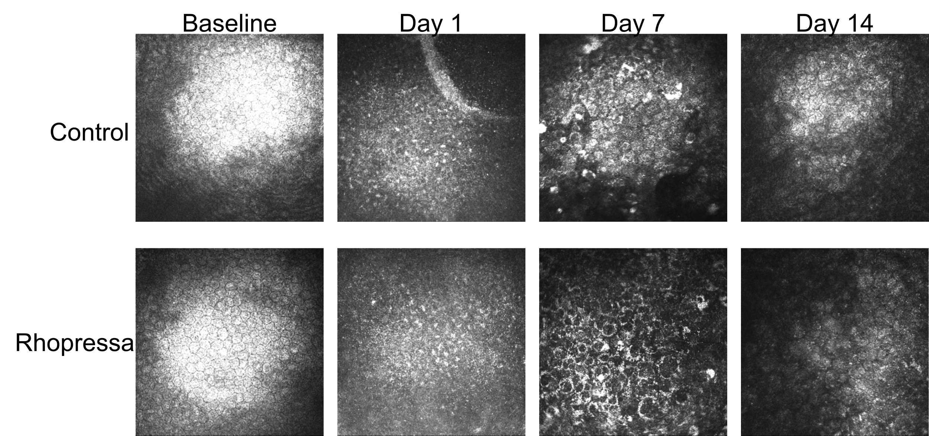
in vivo Confocal Microscopy (HRT3)

Slide 15
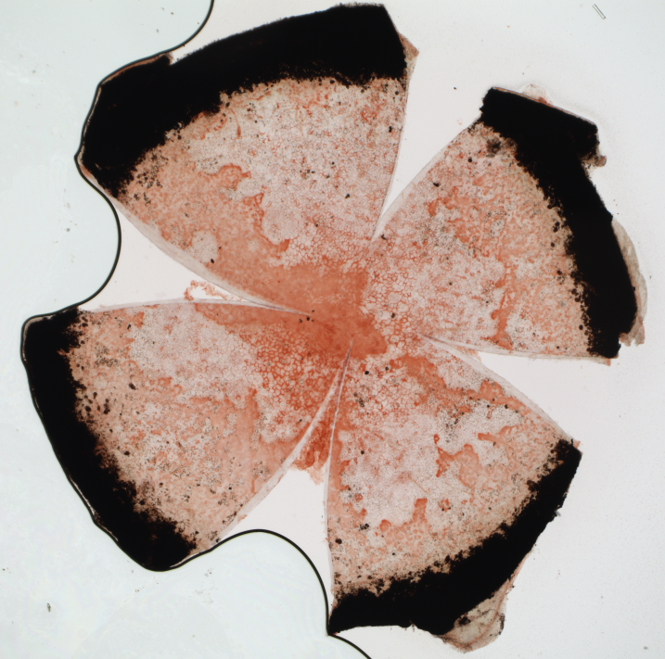
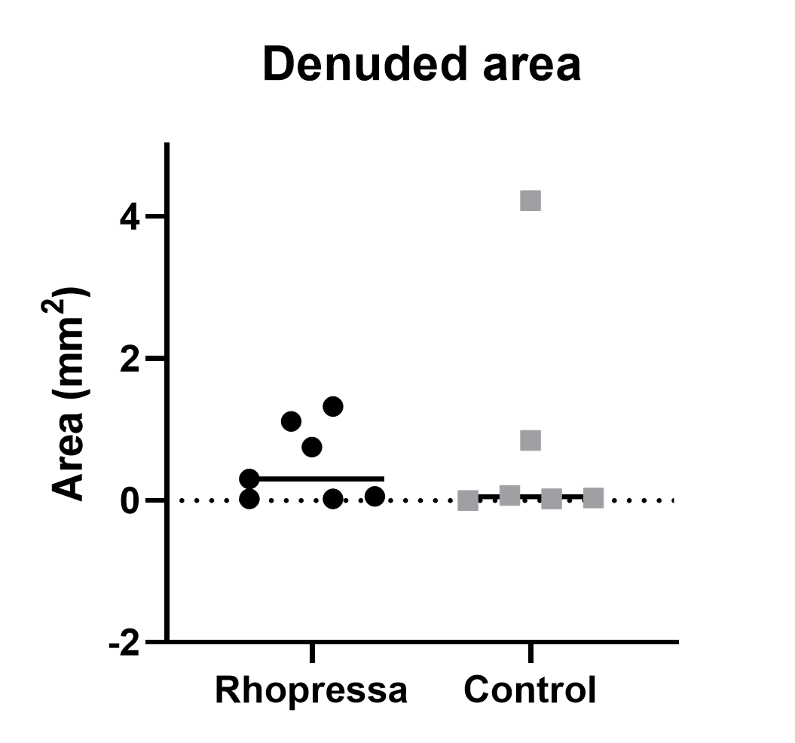
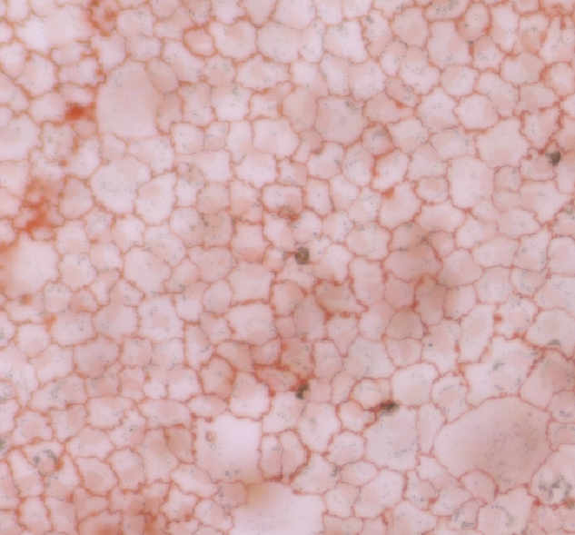
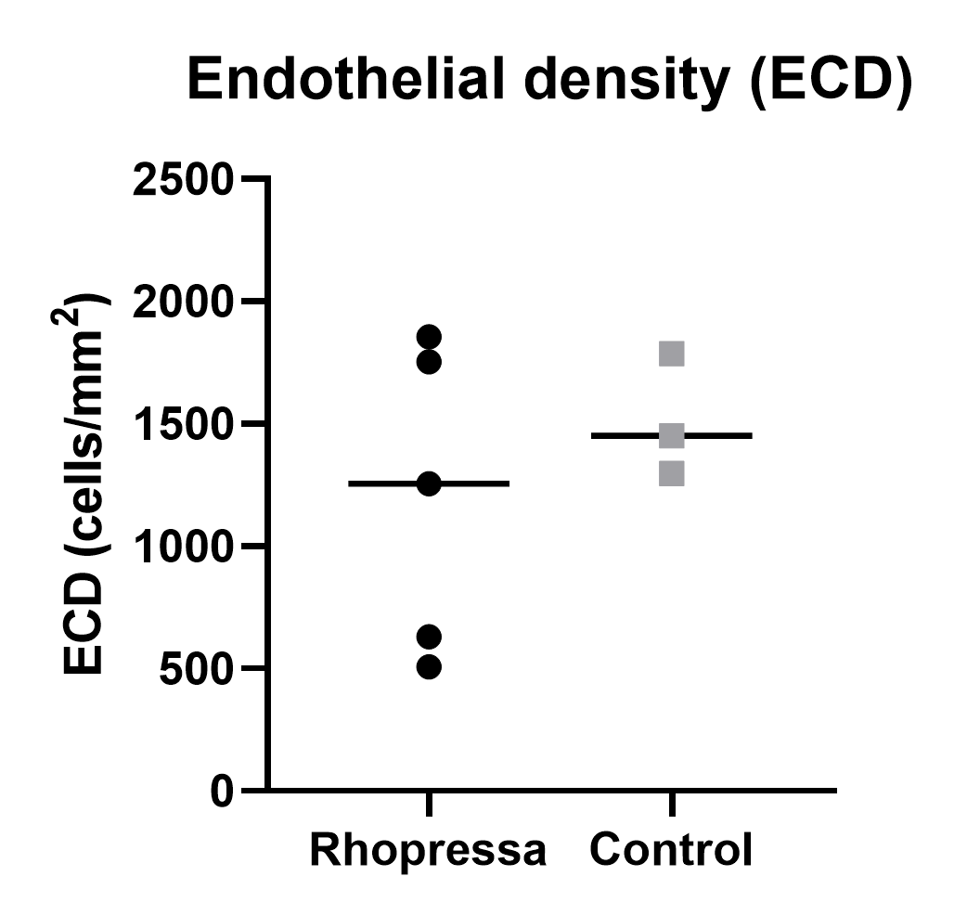
Alizarin Red

Slide 16
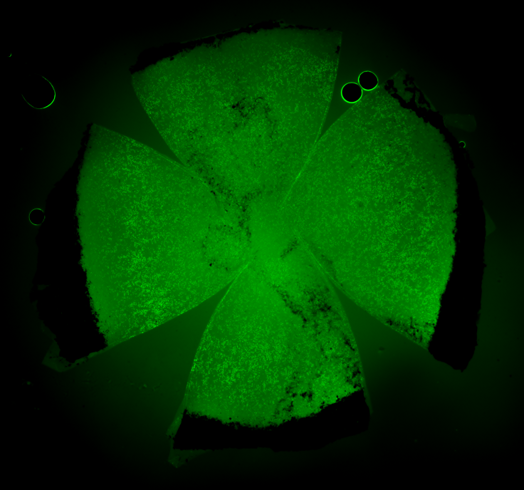
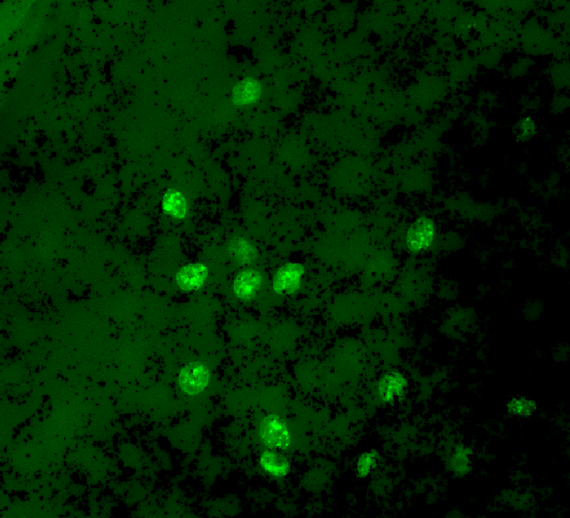
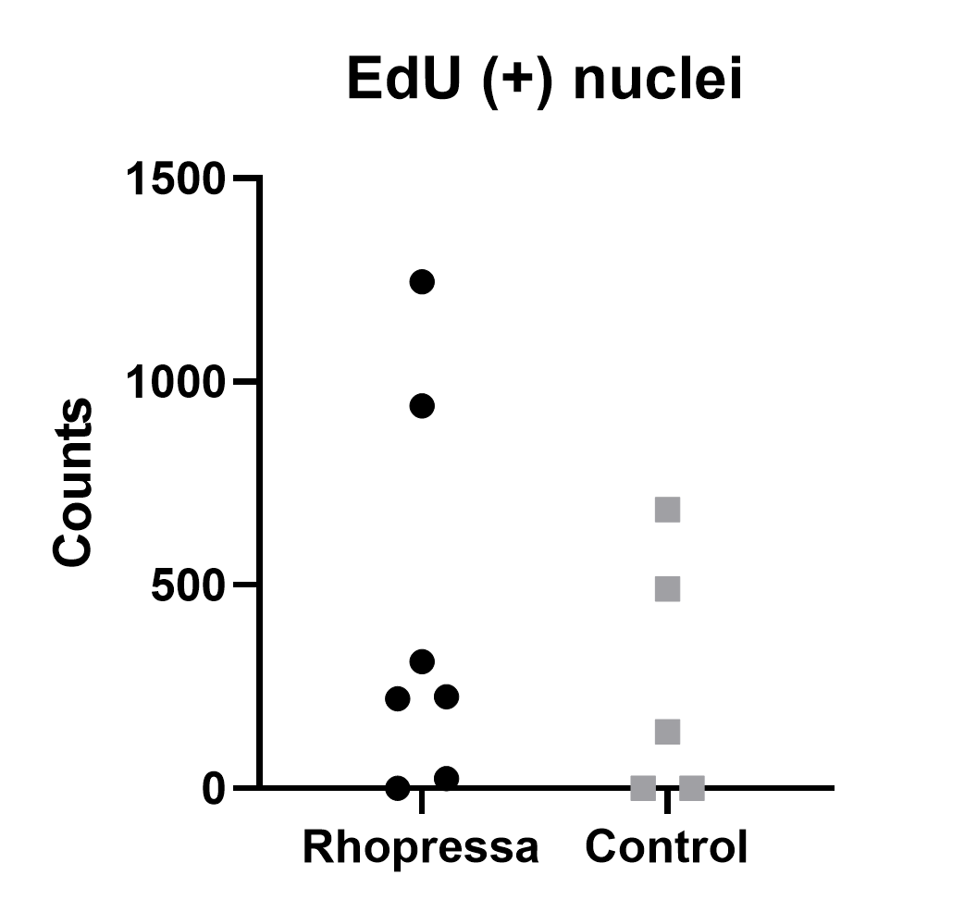
EdU Cell Proliferation Assay

Slide 17
Summary
Mice were age-matched with no significant difference in endothelial cell density between groups prior to cryoinjury
No significant difference in CEC density, CCT, denuded area, or cell proliferation between Rhopressa treated and control mice

Slide 18
Conclusion
Netarsudil (Rhopressa®) did not have an effect on endothelial cell regeneration following cryoinjury in TAZ deficient mice

Slide 19
Future Directions
Increase sample size
Attempt alternative, less inflammatory method of corneal injury
Incorporate Day 2 time-point to catch early healing (EdU assay)
Explore other FECD disease models including Col8a2 mice

Slide 20
Funding and Support
UC Davis School of Veterinary Medicine Students Training in Advanced Research (STAR) Program
NIH T35 Training grant 5T35OD010956-22, R01EY01634 (SMT) and P30EY12576
MRLT Animal Team

