Slide 1
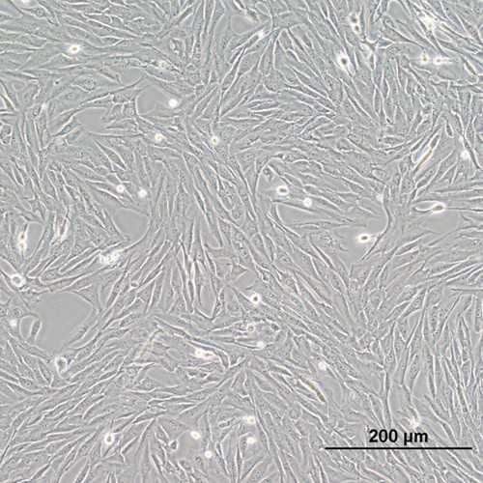
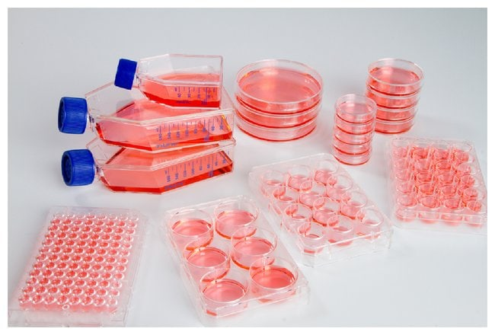
Effects of MTORC-1 Inhibition by Meclizine on Canine Osteosarcoma Cells
Student:
Brandon Lao
Mentors:
Dr. Michael S Kent, DVM, DACVIM (Oncology), DACVR (Radiation Oncology)
Dr. Gino A Cortopassi, PhD (Biochemistry)

Slide 2
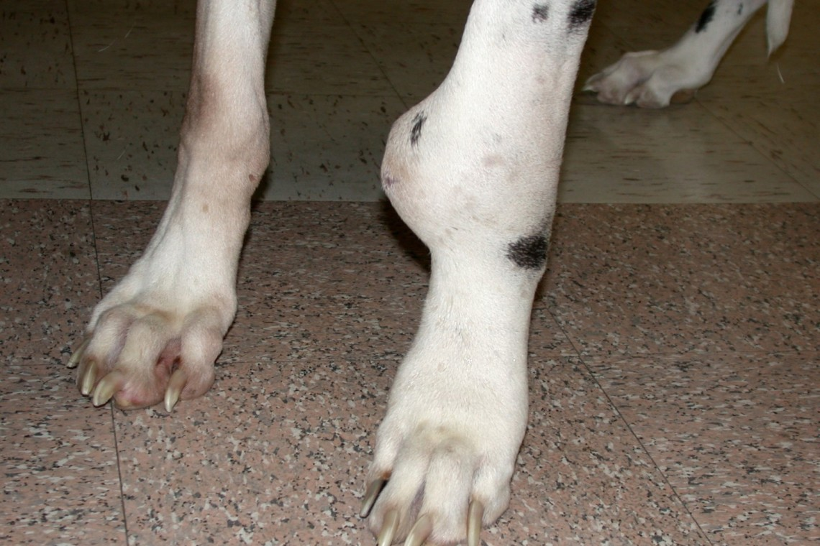
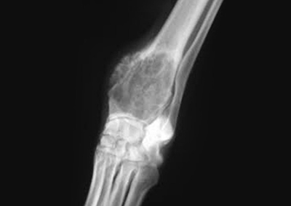
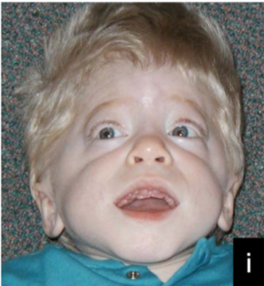
Canine Osteosarcoma
Introduction Methods Results Discussion Conclusion
Affects canines and humans as a bimodal occurrence with a difference in dogs being that it is more prominent in older dogs age >7 years.
Osteosarcoma accounts for >80% of primary bone tumors in dogs. Dogs have a higher incidence of osteosarcoma than humans in addition to breed influence.
Simpson S, Rizvanov AA, Jeyapalan JN, de Brot S, Rutland CS. Canine osteosarcoma in comparative oncology: Molecular mechanisms through to treatment discovery. Front Vet Sci. 2022;9:965391. doi:10.3389/fvets.2022.965391
Notes:
Although development of chemotherapy has improved the survival rates across many cancer types, mortality rates for OSA is still high and especially poor for dogs. 1 and 2 year survival rates with only amputation have been published to be ~11% and 2%. Addition of chemotherapy increases the 2 years rate to around 20%

Slide 3
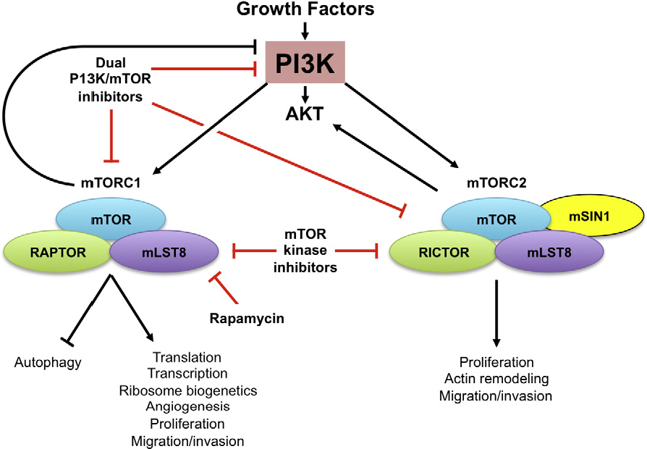
Mechanism
Introduction Methods Results Discussion Conclusion
Meclizine
Notes:
Meclizine specifically inhibits mTORC-1 (Mammalian/mechanistic target of rapamycin complex 1 by binding onto raptor)

Slide 4
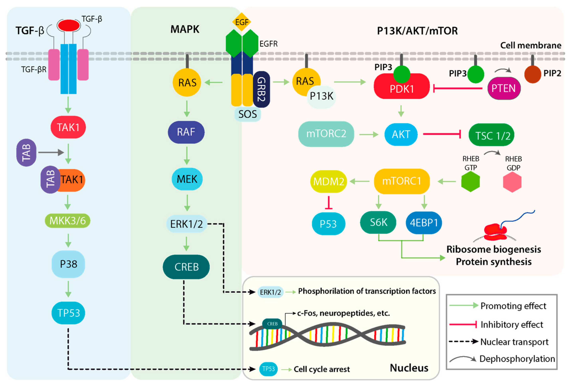
Mechanism
Introduction Methods Results Discussion Conclusion
Notes:
Osteosarcoma is a genomically heterogenous which tend to converge in terms of pathways but not a genomic locus. Genomic studies have shown that alterations in TP53/RB, PI3K/AKT, and MAPK pathways. In a study comprising of OSA tumors from 59 dogs alteration frequency was 37% PI3K, 71% TP53, and 17% MAPK.
Preclinical and clinical studies on osteosarcoma have demonstrated that the PI3K (phosphatidylinositol 3-kinase) is constitutively active. PTEN a tumor suppressor that regulates the PI3K pathway has been shown to be loss in a large majority of canine osteosarcomas.

Slide 5
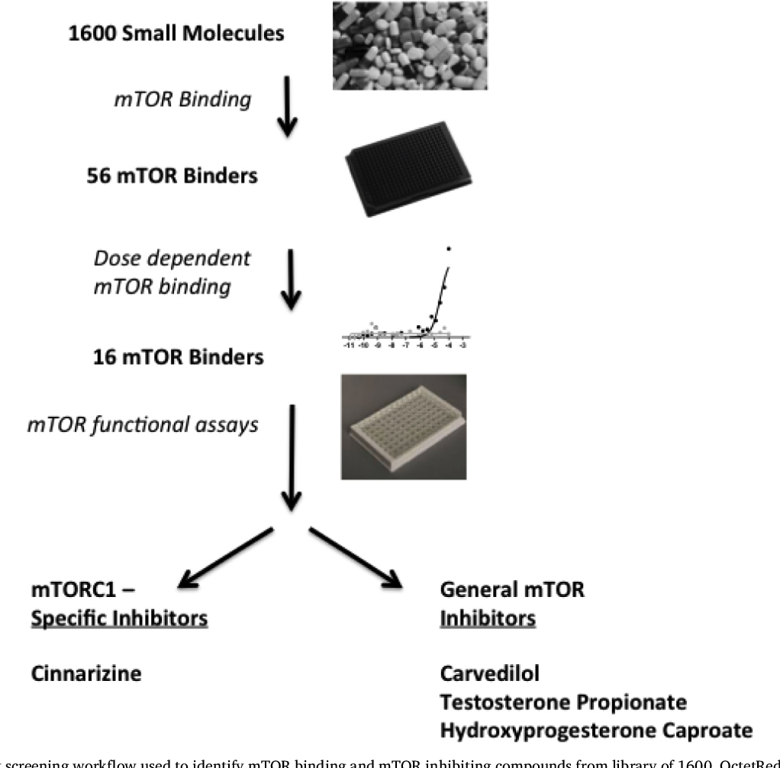
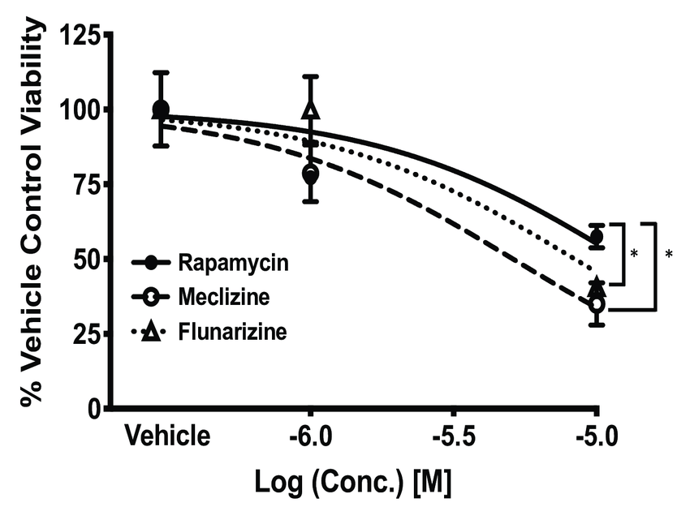
Past Research Findings
Introduction Methods Results Discussion Conclusion
Discovery of existing drugs that dose-dependently bind to mTOR one of those being Meclizine
Meclizine has been shown to dose-dependently kill human glioblastoma cells (which also have been shown to have PI3K/mTOR pathway upregulated) better than rapamycin
Preclinical studies of osteosarcoma cell lines have shown that rapamycin decreased colony growth
Rapamycin has shown severe toxicity resulting in ulcers, diarrhea, death, etc
Sandoval JA, Tomilov A, Datta S, et al. Novel mTORC1 Inhibitors Kill Glioblastoma Stem Cells. Pharmaceuticals (Basel). 2020;13(12). doi:10.3390/ph13120419

Slide 6
Hypothesis
Introduction Methods Results Discussion Conclusion
Inhibition of mTORC-1 by meclizine will result in a decrease in phosphorylated mTORC-1 and phosphorylated 70S6K. Meclizine in a dose-dependent manner will decrease canine osteosarcoma cell viability.
These findings will hopefully mimic that observed in the experiment done with human glioblastoma cells and support further investigation for the usage of meclizine as an anti-neoplastic drug for the treatment of osteosarcoma.

Slide 7
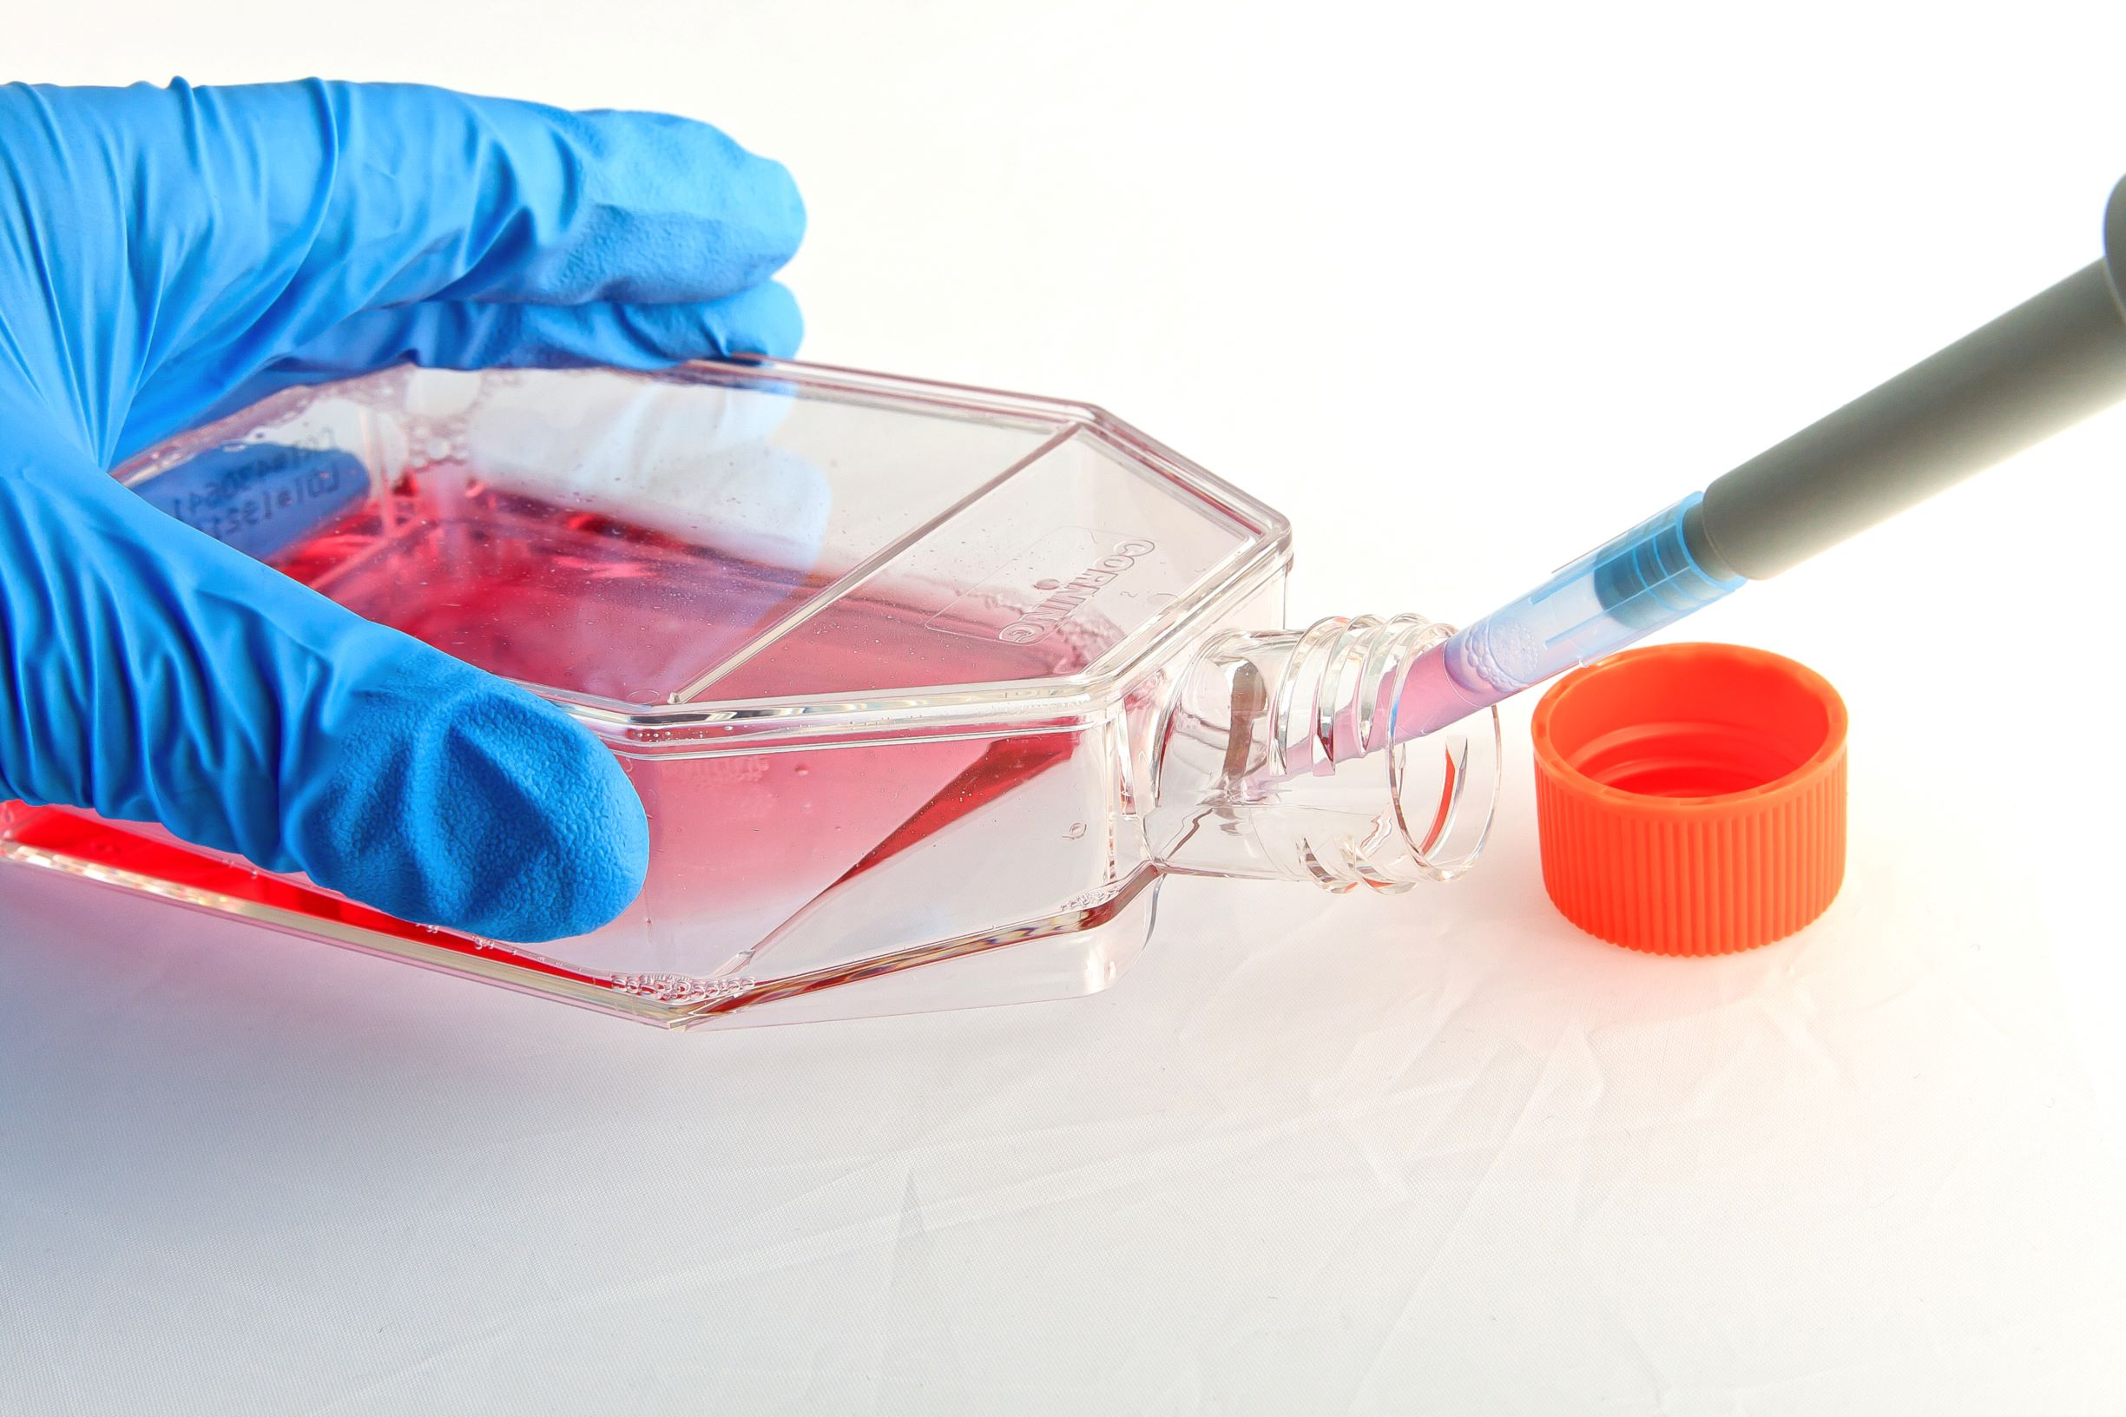
Aim 1: Determine the effects of meclizine on canine osteosarcoma cell survival
Introduction Methods Results Discussion Conclusion
3 Osteosarcoma Cell Lines:
OSA17
OSA29
OSA484
1 Negative Control:
FL83B (Mouse Hepatocyte mTORC inhibition resistant)
Received 3 canine osteosarcoma cell lines derived from patients at the VMTH from Dr. Kent’s lab.
Cells were thawed, cultured in t-75 flasks, and tested for mycoplasma.
Optimal cell number was determined utilizing cell titration with control killing drug.
Notes:
Optimal cell number is the number of cells that must be seeded to ensure that the cells will be in the logarithmic growth phase for the actual experiment as cells in the plateau phase will die due out growing the monolayer affecting killing results.

Slide 8
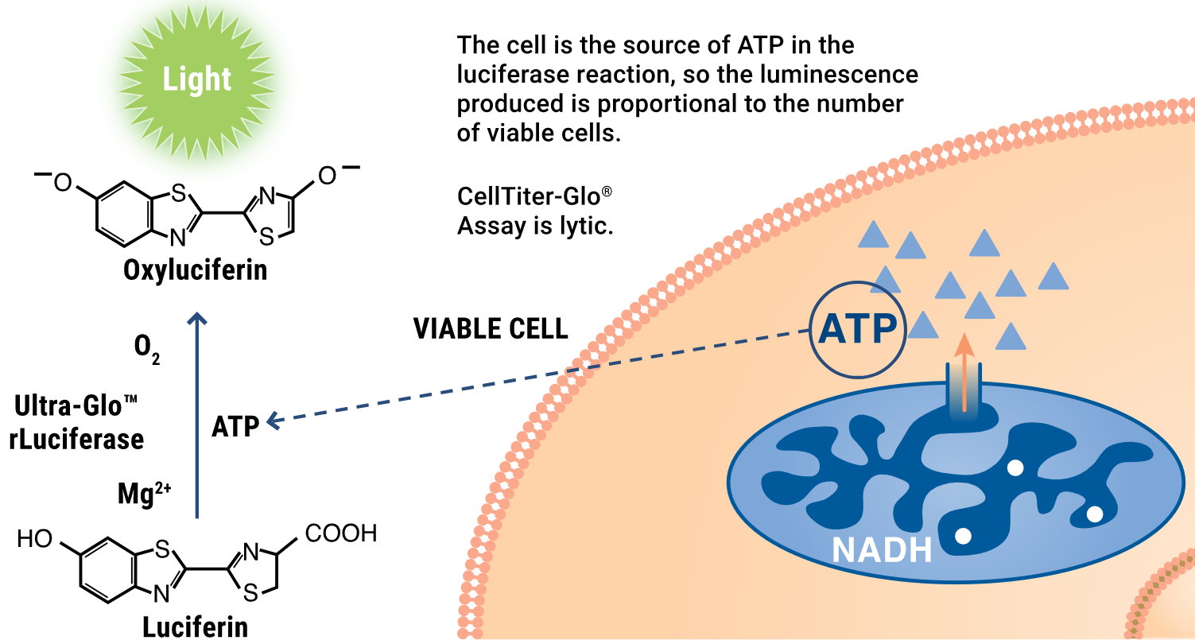
Preparation for Drug Assay
Introduction Methods Results Discussion Conclusion
Cell Titer Glo
Notes:
Cells were seeded into 384 well plates. There were 2 plates for each cell line, one plate where the cells were treated with titration of drugs and another with DMSO concentration equivalent to that contained drug solution. There needs to be a comparison to be able to account for the effects DMSO has on cell growth as the drugs come in a lyophilized powder that are dissolved using DMSO as a solvent.
After incubation, media will be aspirated with a robotic aspirator and a lysing buffer will be added. And the reagent will be added and then the plates will be read using a luminometer. The reagent is luciferin which will take ATP from the lysed cells cause this reaction which will provide a luminescence signal. Luminescence reading is proportional to the number of viable cells as the viable cells produce ATP to drive cellular functions whereas dead cells would not contain or produce ATP.
We first obtained data for 48 hour drug treatments analyzed the data and repeated the assays for a 96 hour drug treatment.

Slide 9
Analyzing the Data
Introduction Methods Results Discussion Conclusion
Plot Datapoints
Regression
% Toxicity
Above is an example of how luminescence data is analyzed with our positive control rapamycin.
Notes:
Datapoints were calculated taking the drug luminescence as a % of DMSO control plate luminescence. We performed a regression using a software solver tool where we calculated p-values, rsquared, etc. % Toxicity was calculated as the difference between the Rmin and Rmax

Slide 10
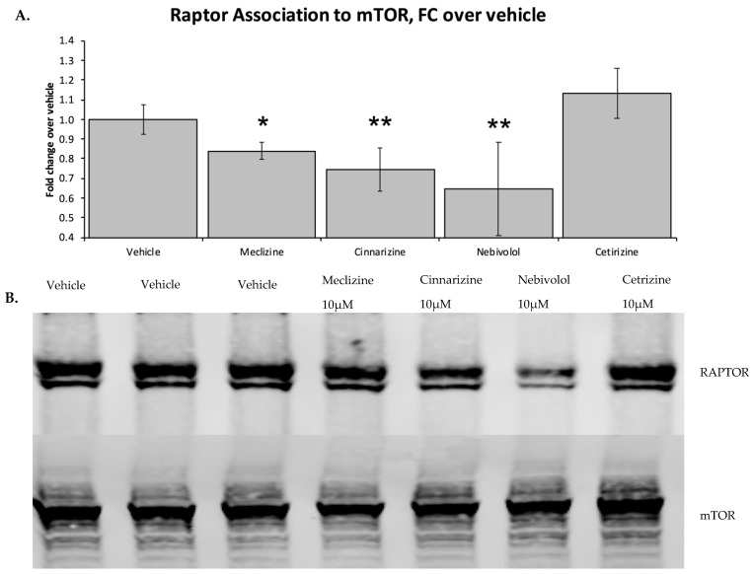
Verification of mTORC-1 inhibition by meclizine in our cell lines
Aim 2: Determine meclizine’s Effects on P-mTOR and P-70S6K
Introduction Methods Results Discussion Conclusion
Sandoval JA, Tomilov A, Datta S, et al. Novel mTORC1 Inhibitors Kill Glioblastoma Stem Cells. Pharmaceuticals (Basel). 2020;13(12). doi:10.3390/ph13120419
Notes:
Our next aim after obtaining and analyzing the killing/viability data would be to analyze how meclizine would affect the phosphorylation of mTOR and its downstream effectors utilizing Western Blot Analysis. Since some of the cell lines seem to be resistant to meclizine or mTOR inhibition in general, we decided to perform a western blot analysis on the most resistant cell line comparing meclizine, rapamycin, and DMSO at varying concentrations. We are still in the process of running and analyzing the westerns.
Verifying that meclizine is in fact inhibiting mTORC-1 in our cells is important as it provides us insight in relation to our cell killing data. If there is or is not any mTORC-1 inhibition then we can proceed to determining why whether it’s a cell type or species difference as mTOR itself has never been shown to be mutated.

Slide 11
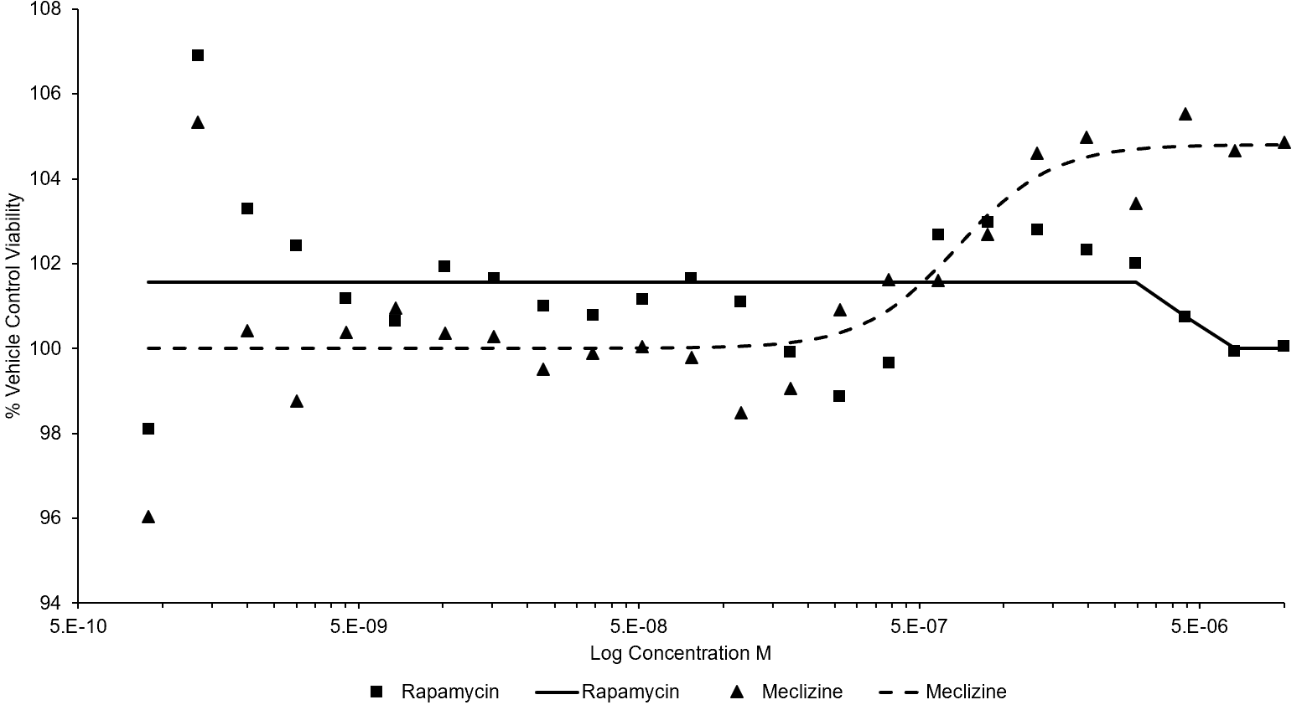
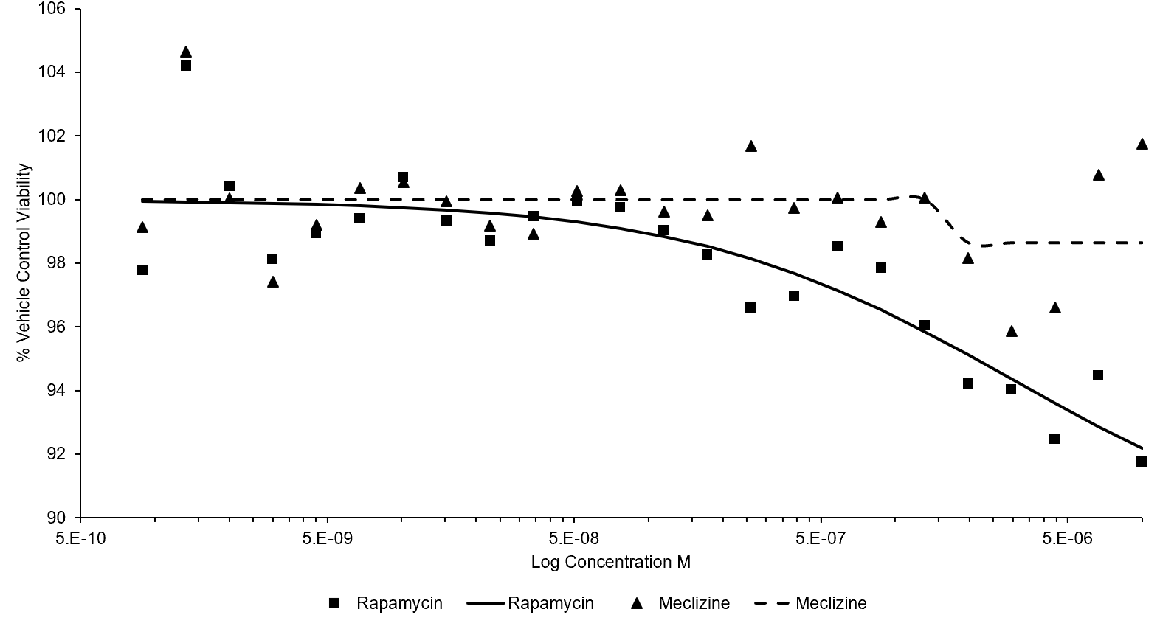
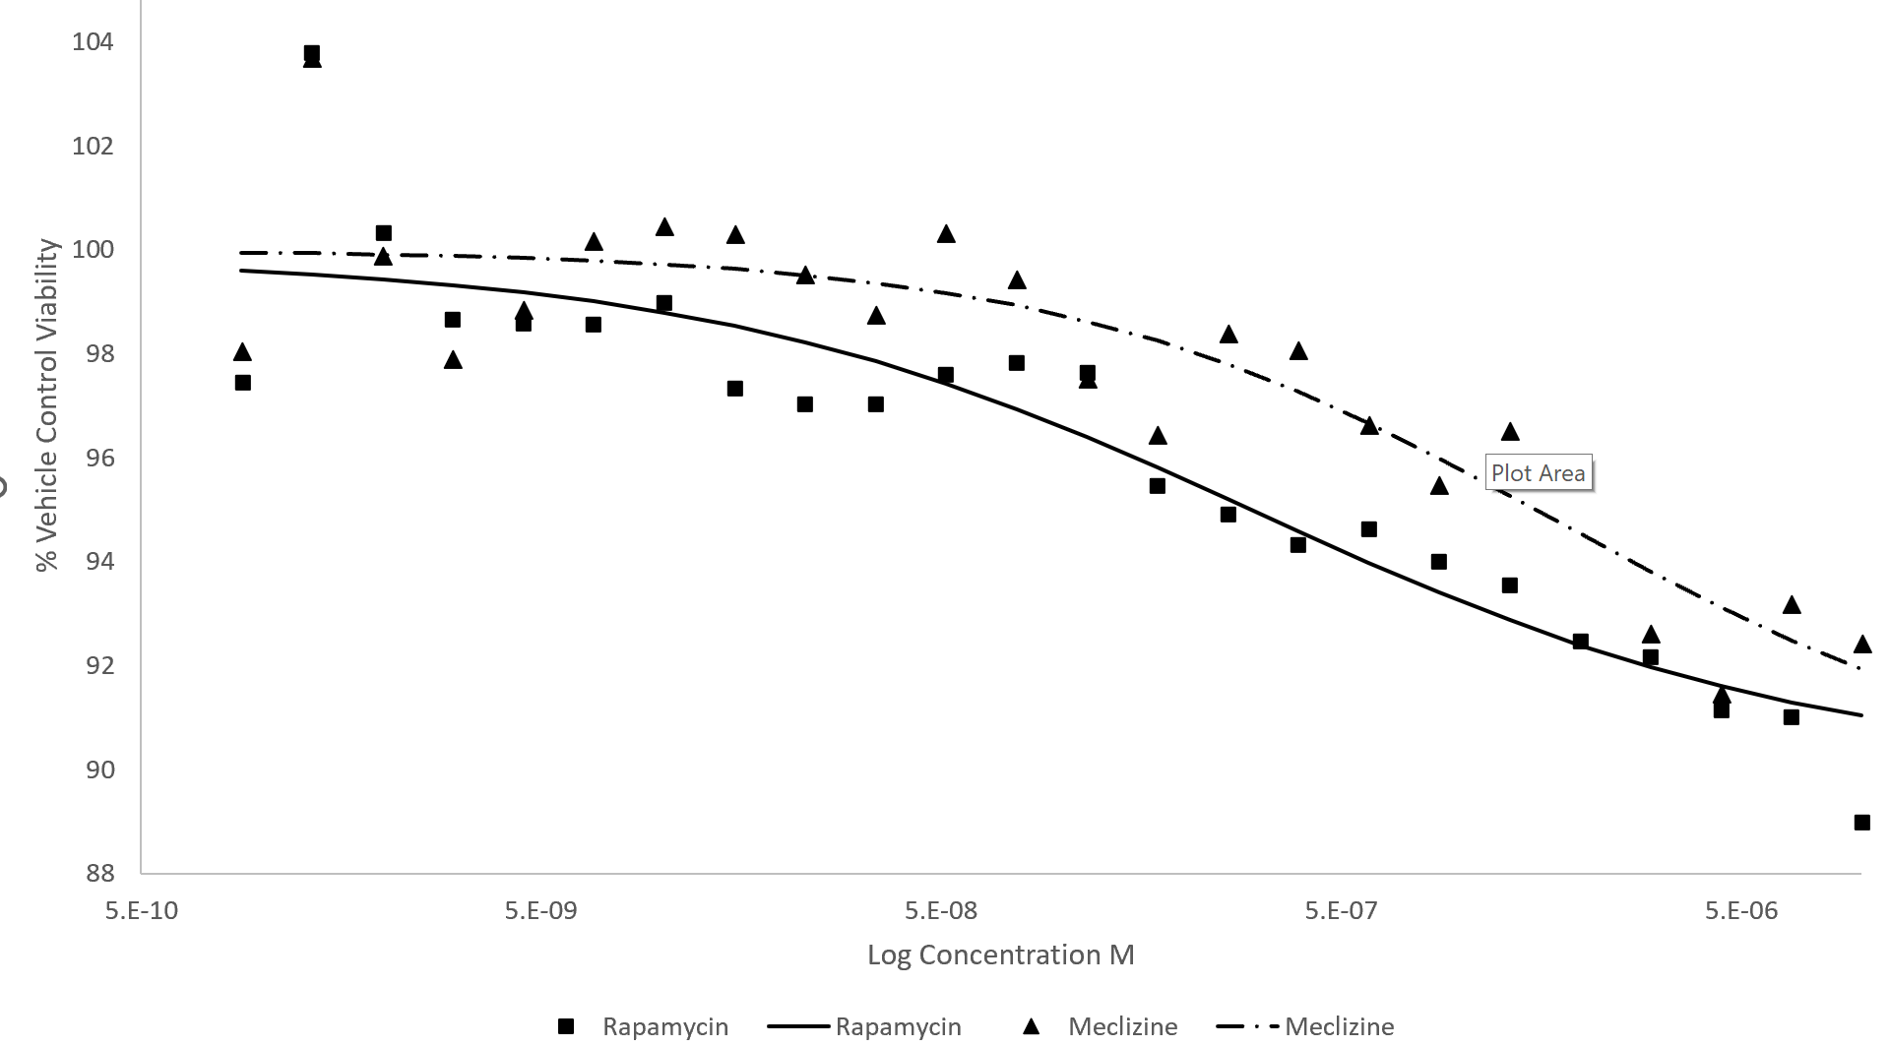
Cell Viability Meclizine vs Rapamycin
Introduction Methods Results Discussion Conclusion
OSA17
Most resistant
OSA29
Intermediate
OSA484
Most Susceptible

Slide 12
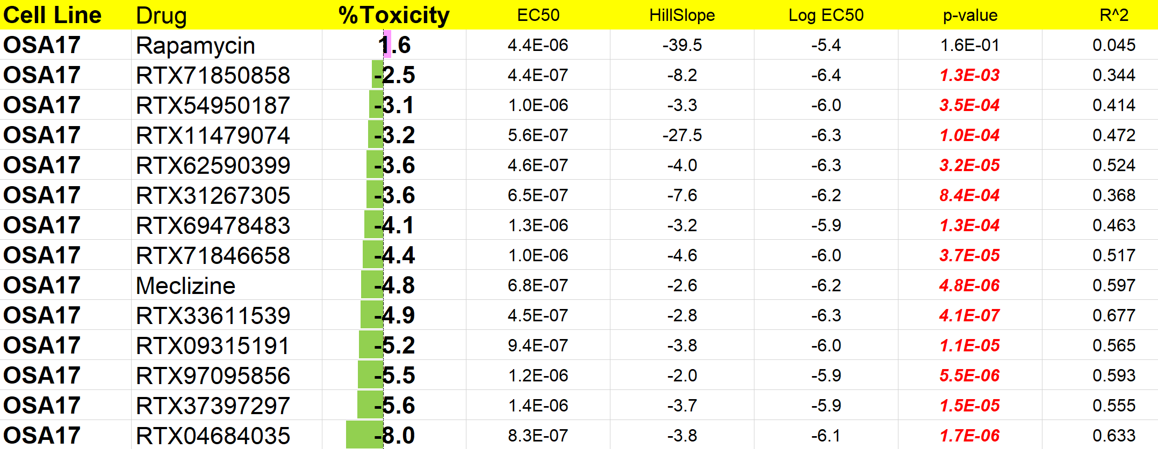
% Toxicity OSA17 96 hours
Introduction Methods Results Discussion Conclusion
Notes:
In addition to rapamycin and meclizine, we also assayed 12 other small molecules that have been shown to bind and interact with raptor/mTORC-1. P-values highlighted in red are significant.

Slide 13
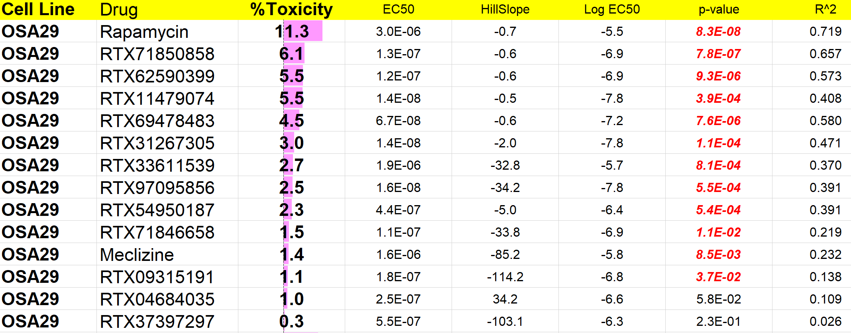
% Toxicity OSA29 96 hours
Introduction Methods Results Discussion Conclusion
Notes:
In addition to rapamycin and meclizine, we also assayed 12 other small molecules that have been shown to bind and interact with raptor/mTORC-1.

Slide 14
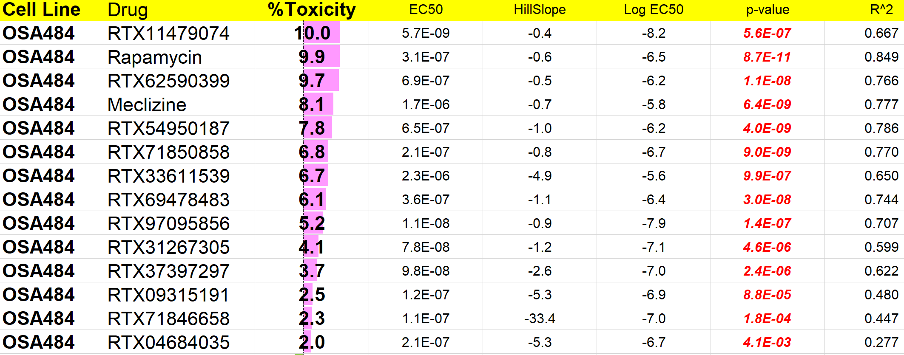
% Toxicity OSA484 96 hours
Introduction Methods Results Discussion Conclusion
Notes:
In addition to rapamycin and meclizine, we also assayed 12 other small molecules that have been shown to bind and interact with raptor/mTORC-1.

Slide 15
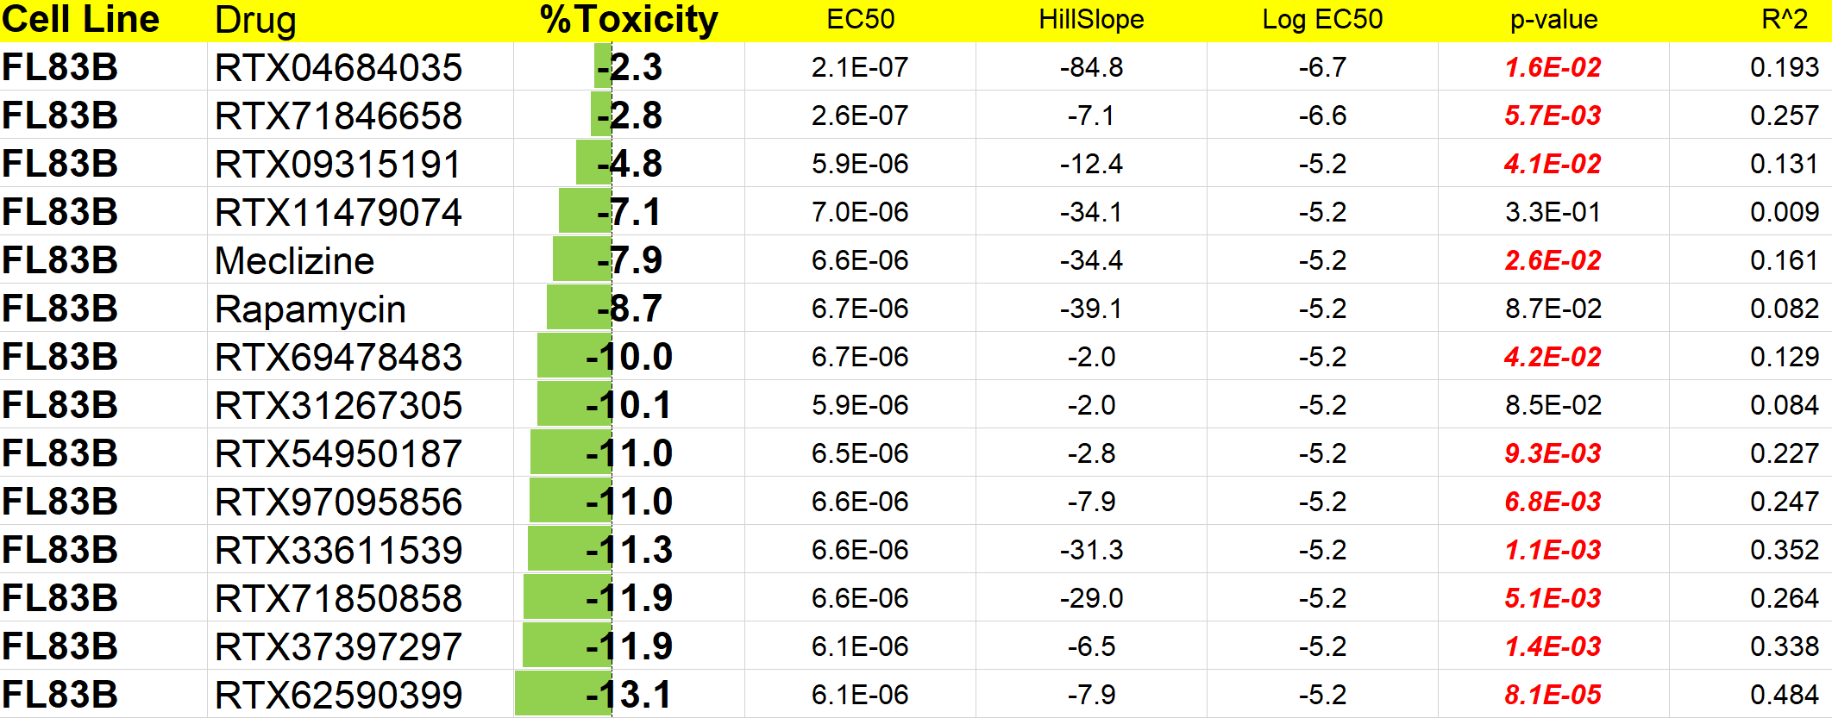
% Toxicity FL83B (NC) 96 hours
Introduction Methods Results Discussion Conclusion
Notes:
In addition to rapamycin and meclizine, we also assayed 12 other small molecules that have been shown to bind and interact with raptor/mTORC-1.

Slide 16
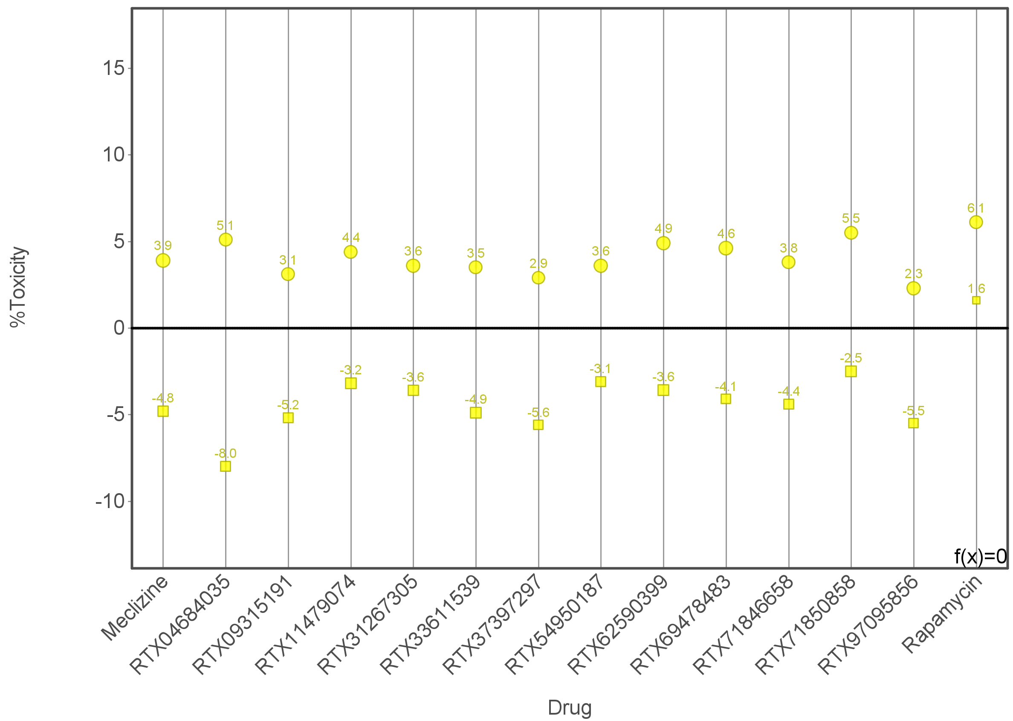
Comparing Toxicity 48 vs 96 hours
Introduction Methods Results Discussion Conclusion
OSA17 (Circles are 48 hours Squares are 96 hours)
Notes:
For this cell line which is recognized as the most resistant at 96 hours for all drugs toxicity decreases over the course of 96 hours

Slide 17
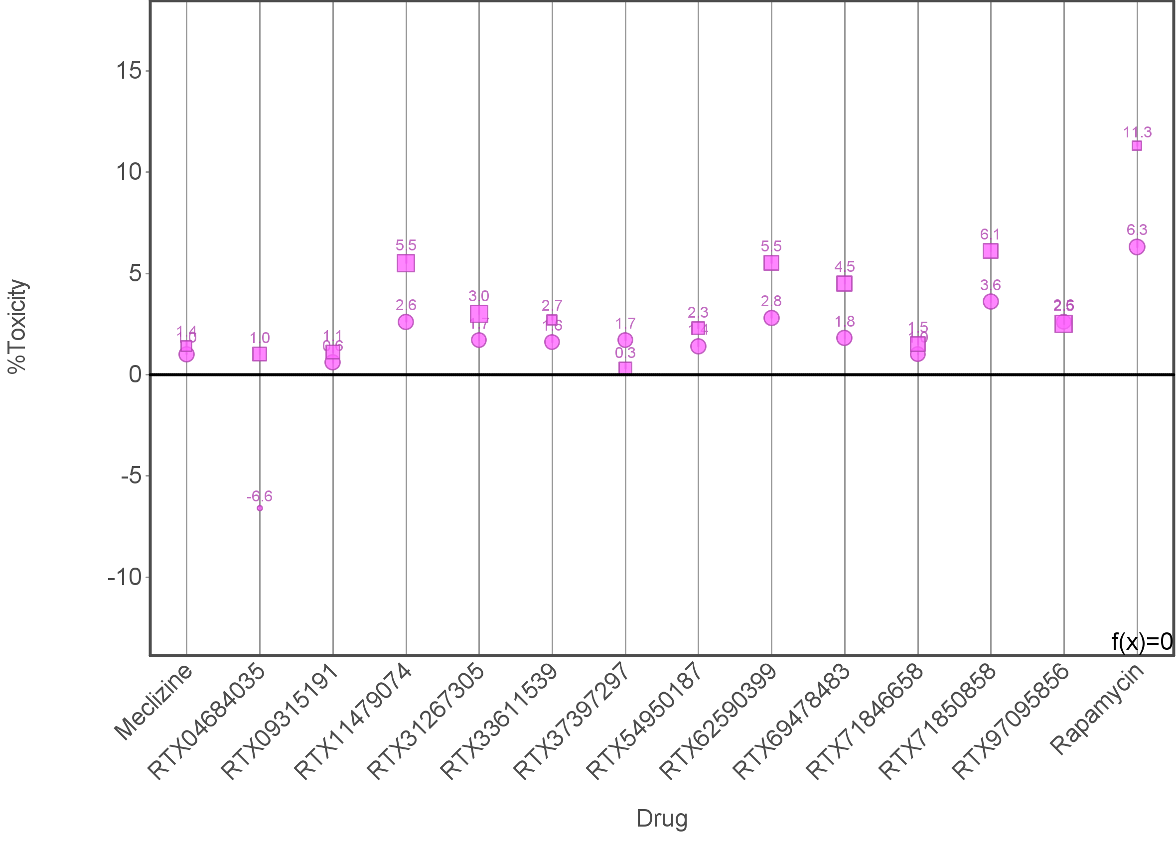
Comparing Toxicity 48 vs 96 hours
Introduction Methods Results Discussion Conclusion
OSA29 (Circles are 48 hours Squares are 96 hours)
Notes:
For this cell line which is intermediately affected, majority of the drugs did not have much change or increased at drug exposure for 96 hours. Meclizine in particular stayed the same and was less toxic than rapamycin with rapamycin becoming more toxic at 96 hours.

Slide 18
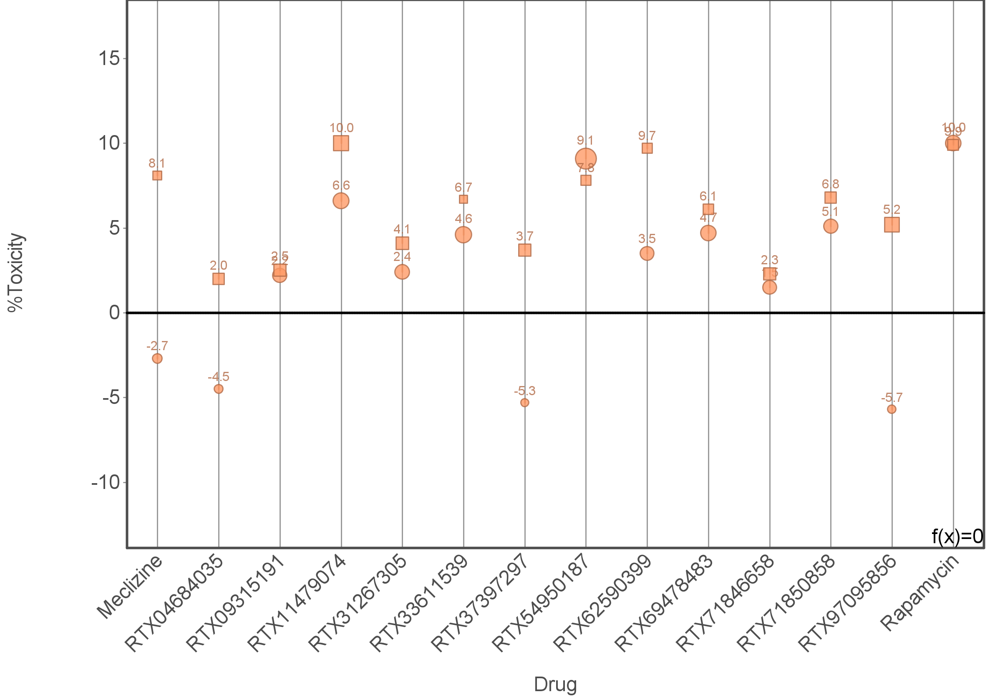
Comparing Toxicity 48 vs 96 hours
Introduction Methods Results Discussion Conclusion
OSA484 (Circles are 48 hours Squares are 96 hours)
Notes:
Most susceptible cell line. Drug toxicity either stayed close to the same or increased toxicity after drug exposure for 96 hours. Meclizine increased in toxicity from not being toxic to toxic while rapamycin stayed relatively similar.

Slide 19
Is meclizine promising?
Introduction Methods Results Discussion Conclusion
Although our cell viability data showed that meclizine seemed to kill osteosarcoma cells less than rapamycin, further investigation must be done before ruling it out completely as an anti-neoplastic.
Western blot analysis can give further insight as to what is going on biochemically in our drug assays.
Past studies have produced mixed results with rapamycin killing canine osteosarcoma cells: may reduce colony growth but not necessarily kill cells, reduced negative feedback of p-70S6K on AKT, etc
Notes:
Although this summer we were unable to show a substantial amount of killing of canine osteosarcoma cells with meclizine, further studies need to be performed. Meclizine is far less toxic of a drug than rapamycin and even though it may be less effective at killing osteosarcoma cells, their difference in terms of toxicity is also an important factor.
Results from our western blot assays will dictate our plans moving forward, this is an ongoing process.

Slide 20
Plans Moving Forward
Introduction Methods Results Discussion Conclusion
Await results from western assays.
Analyze the western results and determine if meclizine is inhibiting mTORC-1 and 70S6K.
Ultimately, this will likely help us understand if our drugs are truly working the way we think they are. Additionally, if rapamycin does not show to inhibit mTOR in our cell lines like it should, then we can investigate why.
Notes:
All in all, depending on the results of our westerns there are various directions that we can take.

Slide 21
Potential Future Directions
Introduction Methods Results Discussion Conclusion
mTOR Inhibited?
Yes
No
No
Kill?
Yes
2 Possibilities: 1.Study as to why meclizine does not inhibit mTORC-1 in Canine osteosarcoma
2. Screen drugs that will bind to canine osteosarcoma mTOR
No
PS6K Inhibited?
Yes
Why S6K is not being inhibited when mTOR is being inhibited
Combination therapy study rapamycin vs meclizine in combination with standard of care (carboplatin, doxorubicin)
Notes:
These studies will provide functional and biochemical readouts in which to later evaluate the efficacy of therapies.
We can investigate further in a variety of ways depending on the results of the westerns that we should get on Wednesday later this week. In addition to all this, we can also test meclizine on canine glioblastoma cells to have a same cancer cell type comparison to the human glioblastoma study.

Slide 22
Acknowledgements
Introduction Methods Results Discussion Conclusion
Special Thanks To:
Dr. Michael S Kent, DVM, DACVIM, DACVR
Dr. Gino A Cortopassi, PhD
Alexey A Tomilov, PhD, Project Scientist
Chase Alejandro Garcia, DVM/PhD Candidate
Student Funding:
Students Training in Advanced Research (STAR) Program
T35 OD010956

Slide 23
Questions?
Introduction Methods Results Discussion Conclusion

