Slide 1
Development and validation of a self-prepared phenol red thread test
Bryan Puentes
Comparative Ophthalmology and Vision Sciences Lab
STAR Summer Research 2023

Slide 2
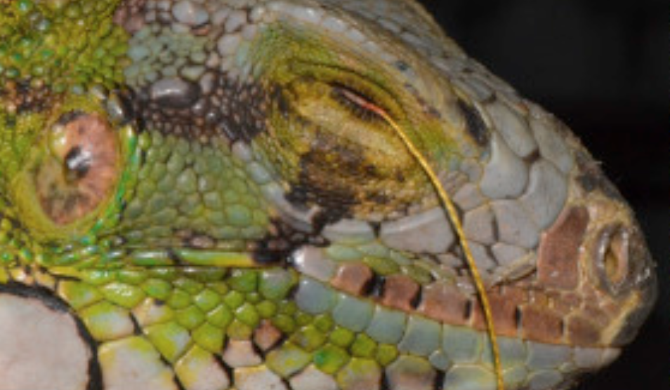
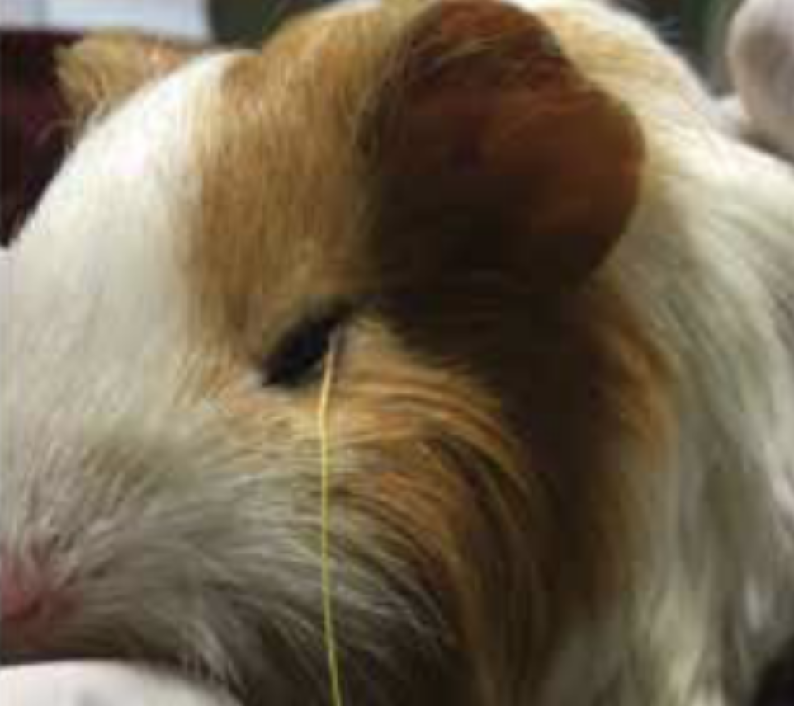
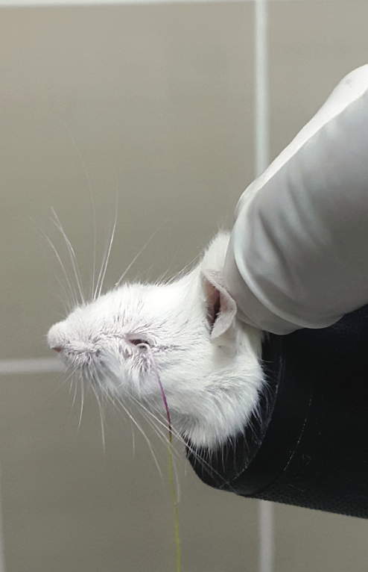
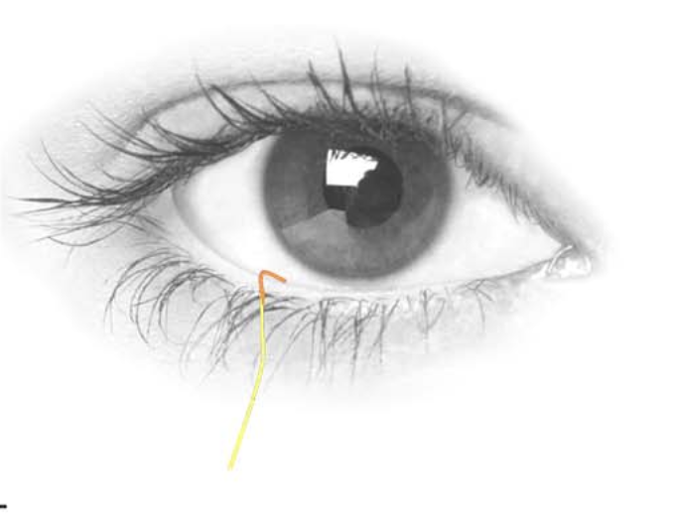
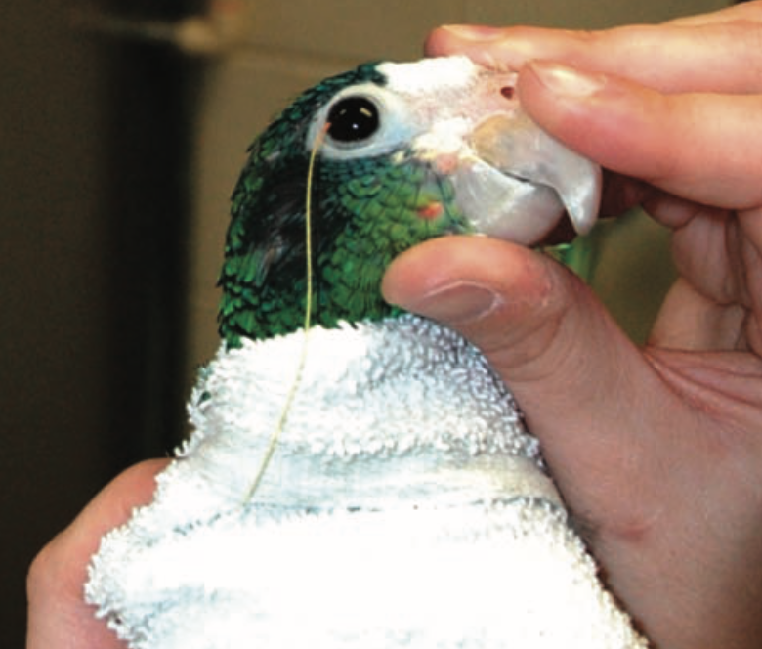
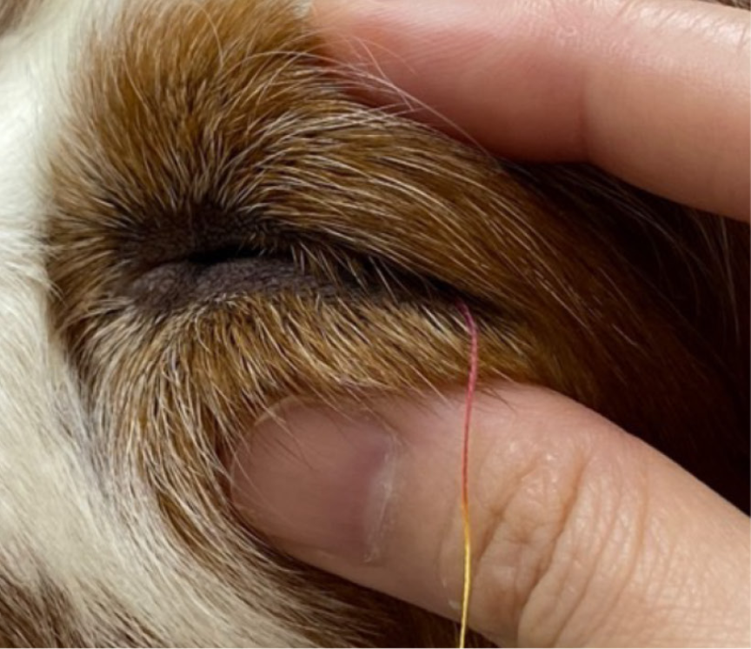
Phenol Red Thread Test (PRTT)
Introduction Methods Results Conclusion Future Directions
Notes:
For those of you do no know what that is, here we have an illustration of the PRTT being performed on human eye
The thread is impregnated with phenol red (a pH indicator) giving it a yellow looking appearance and when you place it at the lower eyelid margin there is a color change from yellow to pink/red when it wicks the alkaline tears. And by measuring this color change is how clinicians and researchers are able to quantify aqueous tear production
The phenol red thread test is the preferred diagnostic tool in veterinary ophthalmology to measure aqueous tear production in small mammals, birds, and reptiles.
Here it is being used on a green iguana, amazon parrot, guinea pig, a mouse, and a dog

Slide 3
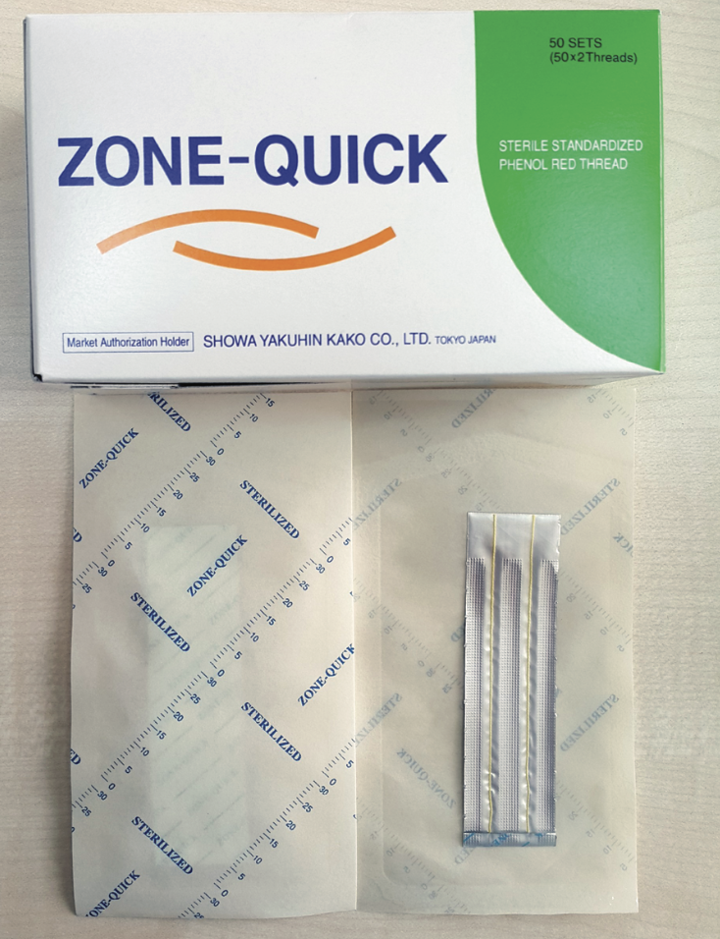
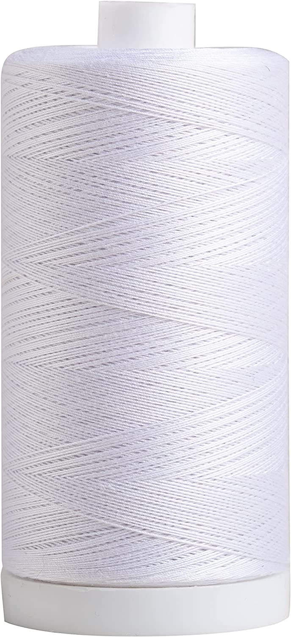
Phenol Red Thread Test (PRTT)
Introduction Methods Results Conclusion Future Directions
Notes:
Unfortunately, the once commercially-available PRTT has be discontinued for almost a year now. This obviously creates a void and a need for an alternative source for the PRTT.
So why not make our own using commercially available cotton thread and see if it holds up against the commercial PRTT.

Slide 4
Hypothesis & Aims
Introduction Methods Results Conclusion Future Directions
Hypothesis: A self-prepared PRTT will measure aqueous tear production with high reproducibility and reliability, similar to the commercial PRTT.
Aim 1: To develop and validate a self-prepared PRTT in solutions of varying pH
Aim 2: To compare the self-prepared PRTT with the commercial PRTT in wildtype mice
Notes:
Aim 1 - will be carried out in vitro
Aim 2- will be carried out in vivo
Why varying pH?
Diurnal patterns of pH change- tears tend to be more acidic in the morning and alcalize as the day progresses; acid byproducts associated with the relative anaerobic conditions during sleep increase the pH of the tear film during prolonged eyelid closure
pH can change in a diseased state
C57BL/6 mice

Slide 5
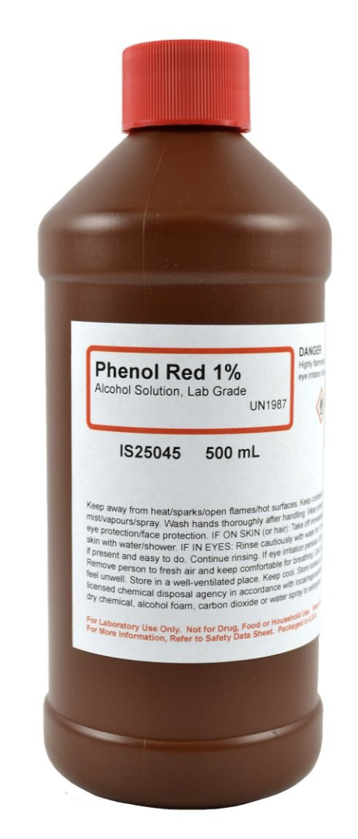
Fabricating the thread
Introduction Methods Results Conclusion Future Directions
Notes:
Methods
Here are the materials we used:
All white, 100% cotton thread – standard and commercially available on Amazon (measures 1,200 yards that has a diameter of 0.25 mm- Connecting Threads®, item model #20869)
We dyed the thread in a 1:10 dilution of the 1% phenol red (Aldon Corp., 213000) and placed it a 1 L glass cylinder
We cut the bottoms of 50ml conical tubes, stacked them together to make a tower comprising of 4 conical tubes, and wrapped the thread around them doing our best to have thread overlap with one another. We were able to wrap 110 m of string around the tubes.
We submerged the thread in the cylinder containing the 0.1% phenol red solution for 48 hrs

Slide 6
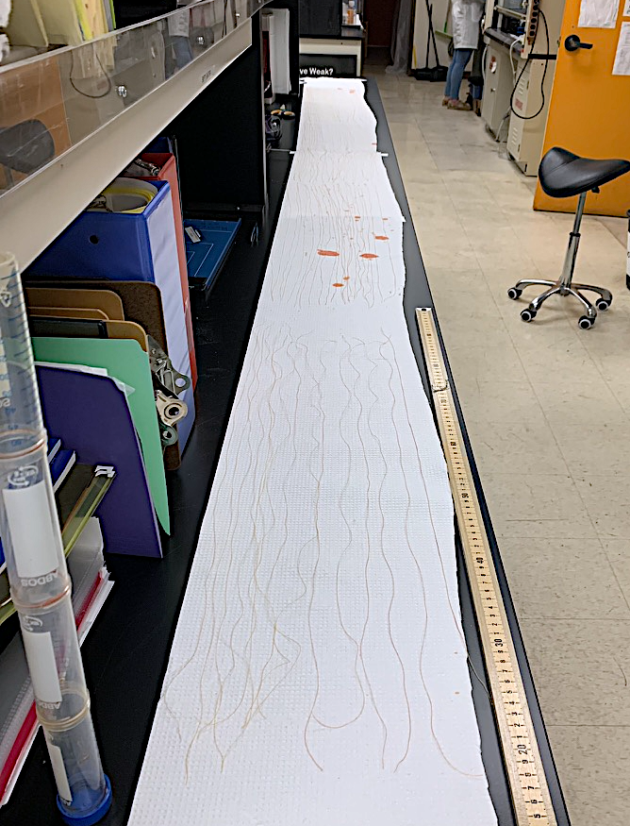
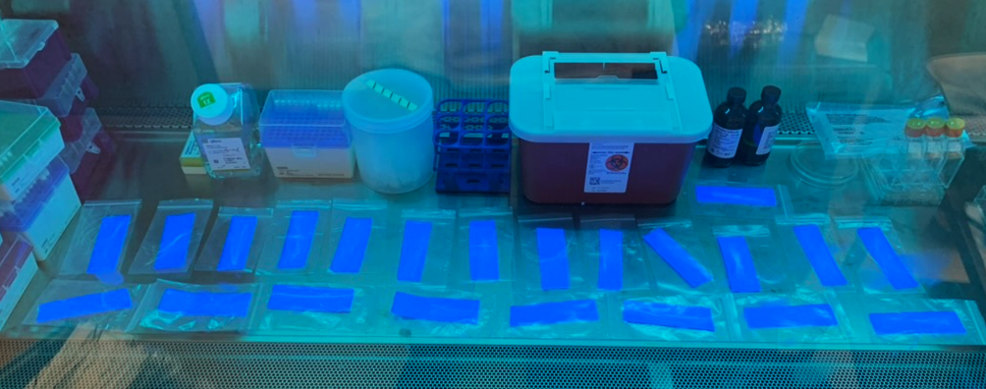
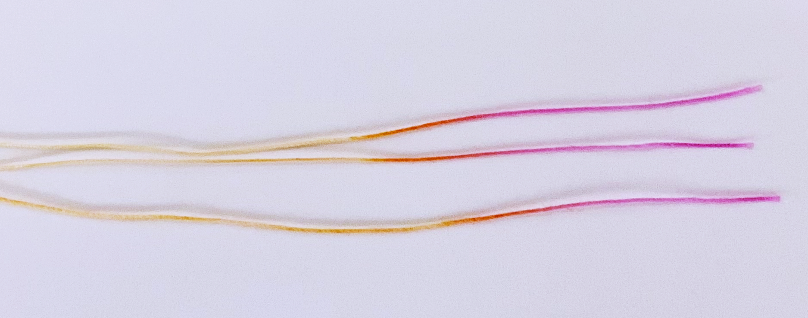
Fabricating the thread
Introduction Methods Results Discussion Conclusion
Introduction Methods Results Conclusion Future Directions
Notes:
We then removed the conical tower, unwound the thread, cut it more manageable lengths and laid it out to dry overnight (8hrs) at room temperature
Once dried, we cut the phenol red infused thread into 75mm segments and sealed them in clear plastic baggies with a paper slip
We then UV sterilized them in the biosafety cabinet for 1 hr.
After sterilization, they are ready for use
You can see the distinct color change of the PRT after it was used.
Batch 1: 122 bags x 10 tests in each x 3 tests per 75mm thread = roughly 3,600 tests

Slide 7
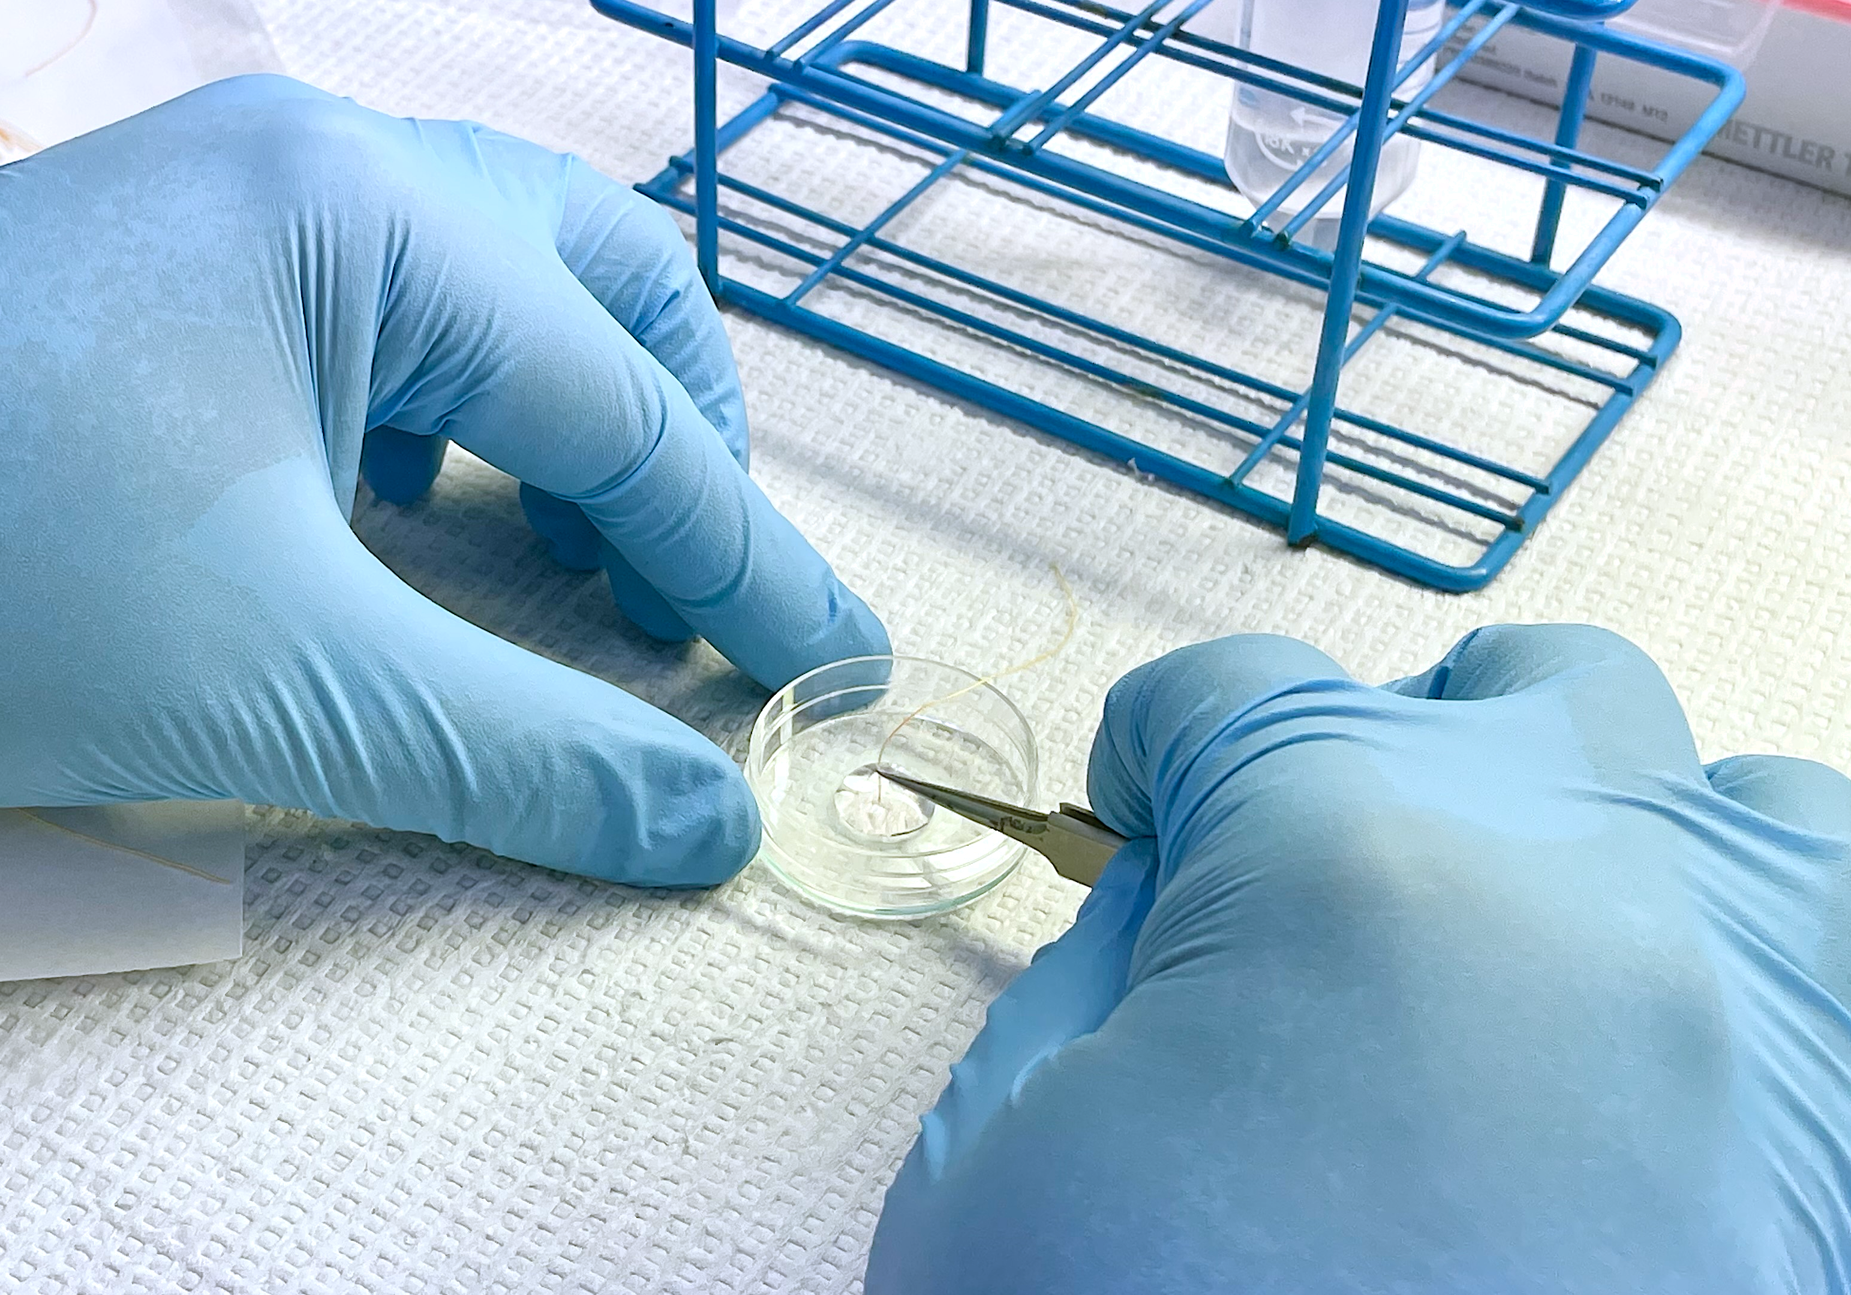
Aim 1- In vitro testing of self-prepared PRT
Introduction Methods Results Discussion Conclusion
Introduction Methods Results Conclusion Future Directions
Our goal:
To assess the wicking properties of our thread and see if it gave us consistent measurements across time and across different pH solutions
Notes:
After generating our self-made PRT, we tested it in vitro by inserting the 3 mm tip of the thread into PBS solutions ranging from a pH of 7.2- 8.0 (5 total pH solutions) between 5 and 40 second time intervals (8 total time intervals)
We used digital calipers to measure the length of color change on the thread
10 trials were performed at each time interval for a total of 80 PRTTs per pH solution
The goal for this part of the experiment was to assess the wicking properties of our thread and see if it gave us consistent measurements across time and across different pH solutions

Slide 8
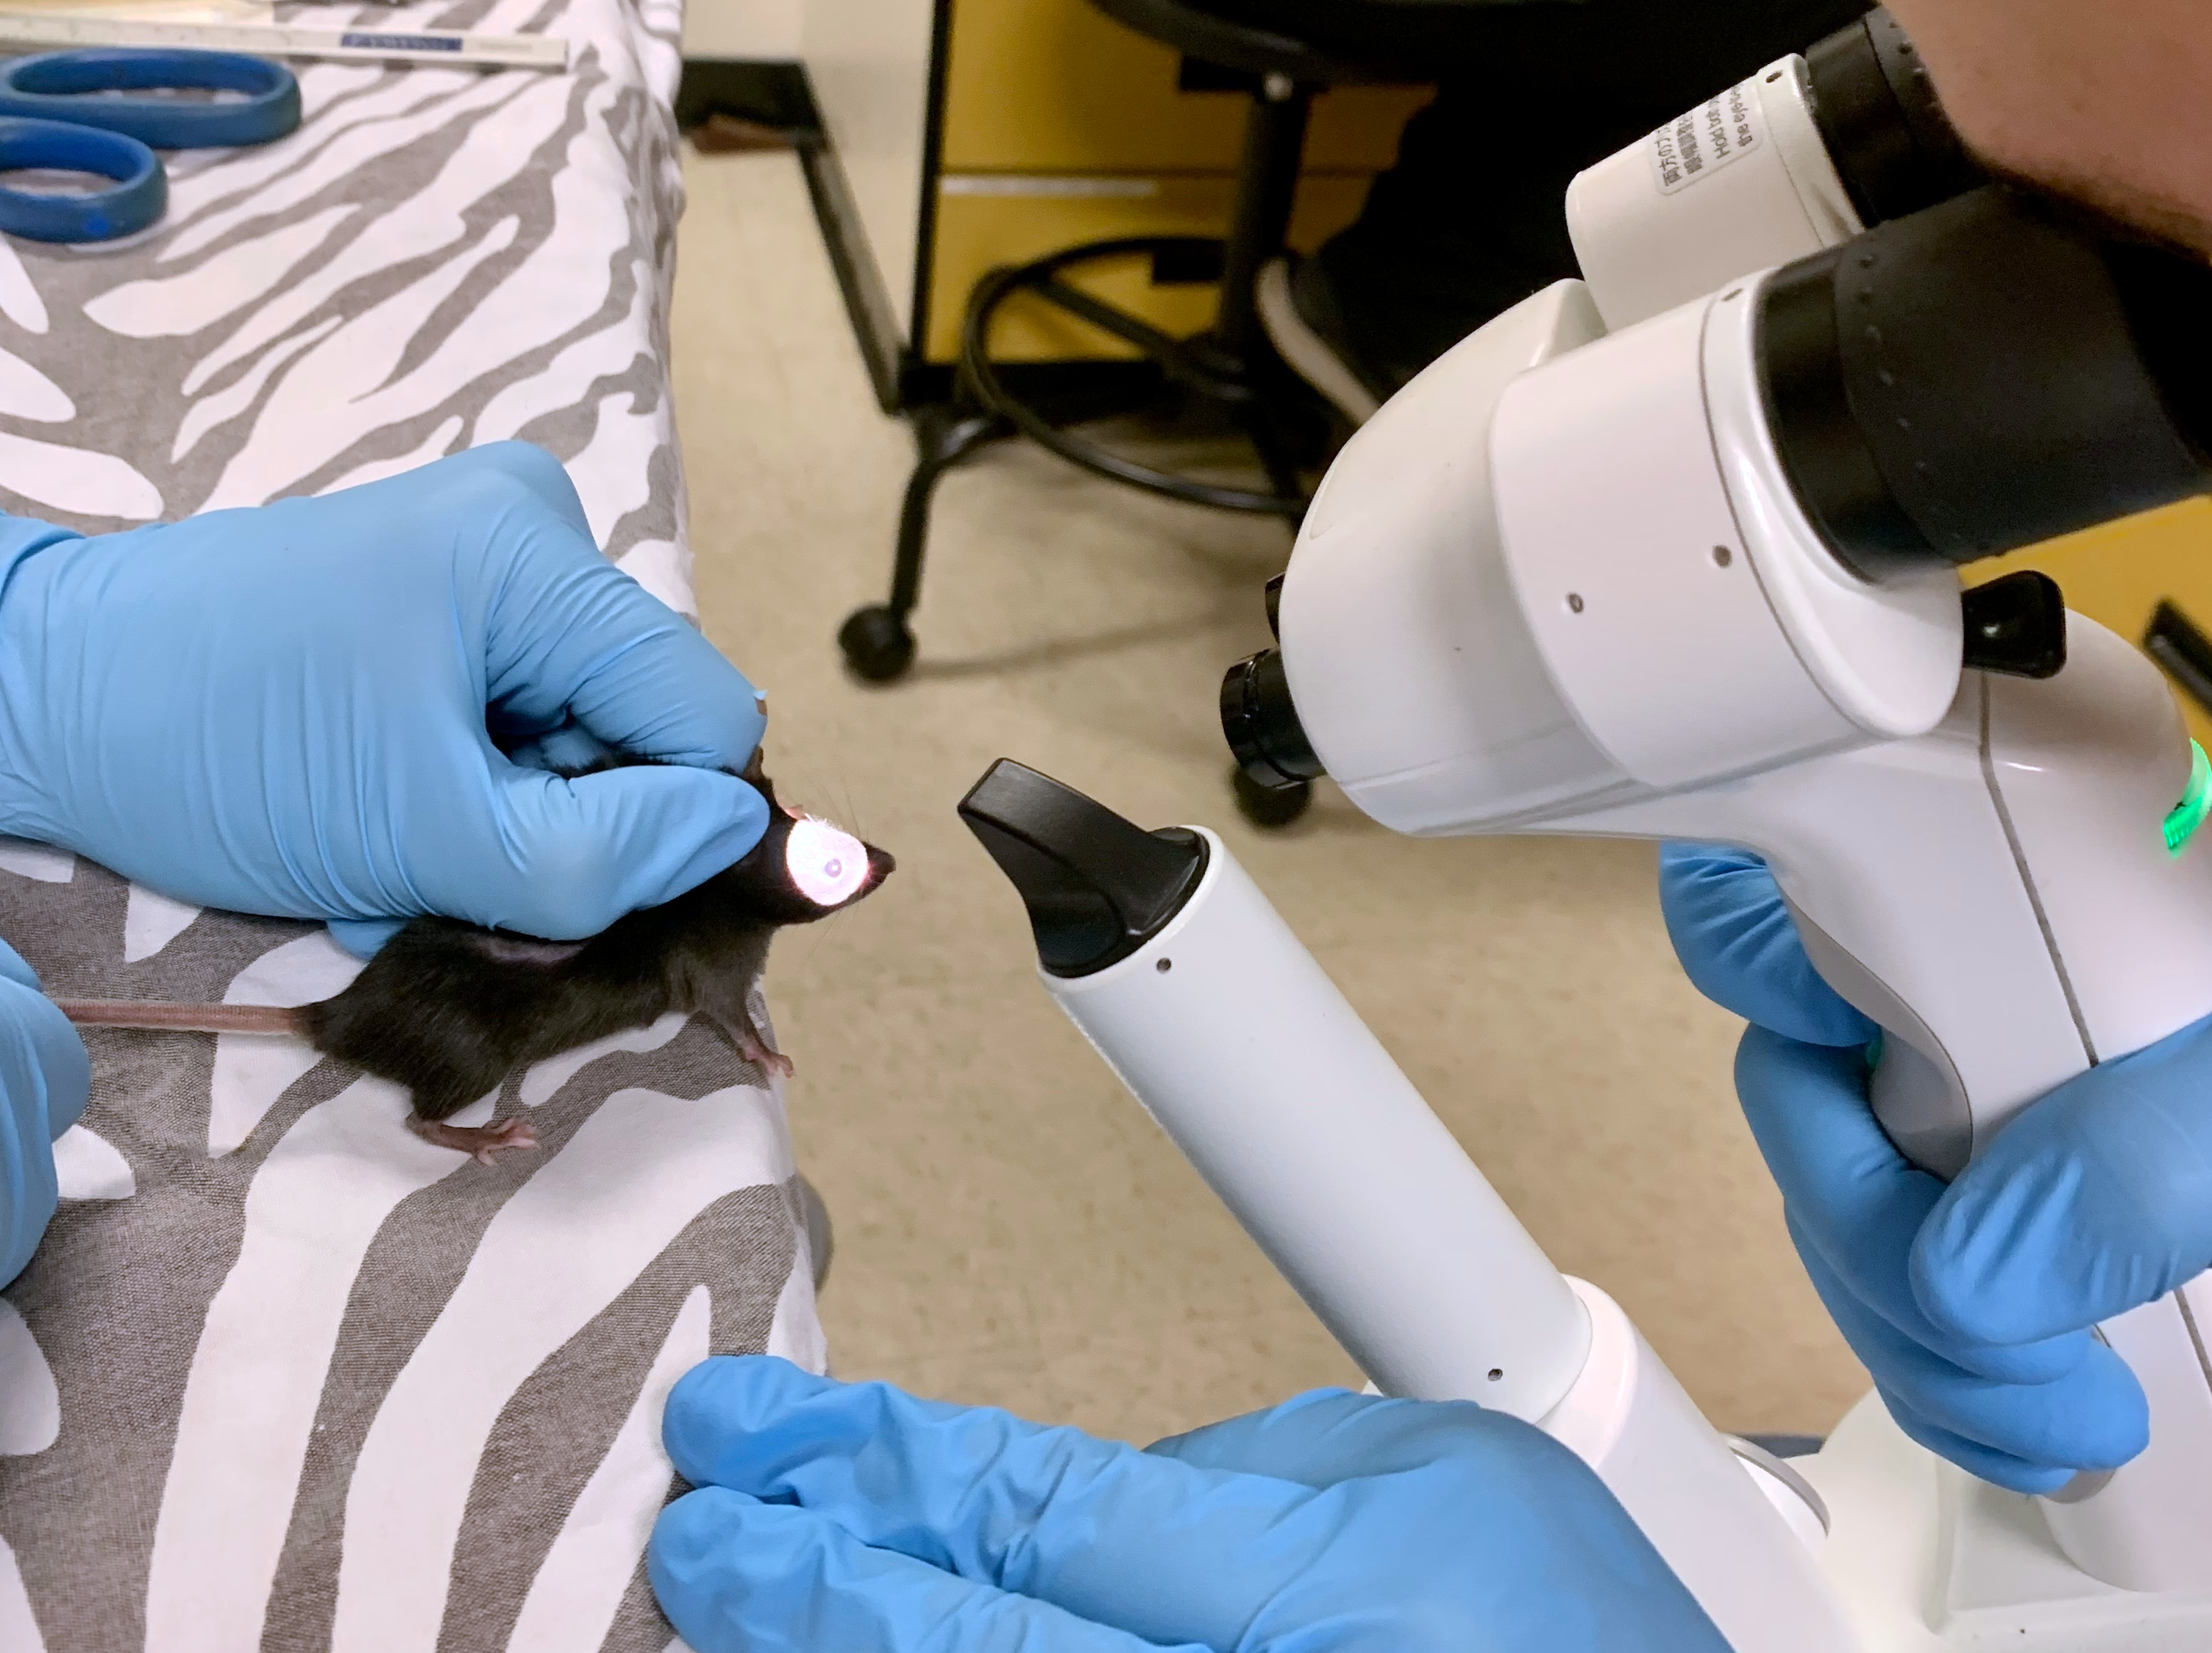
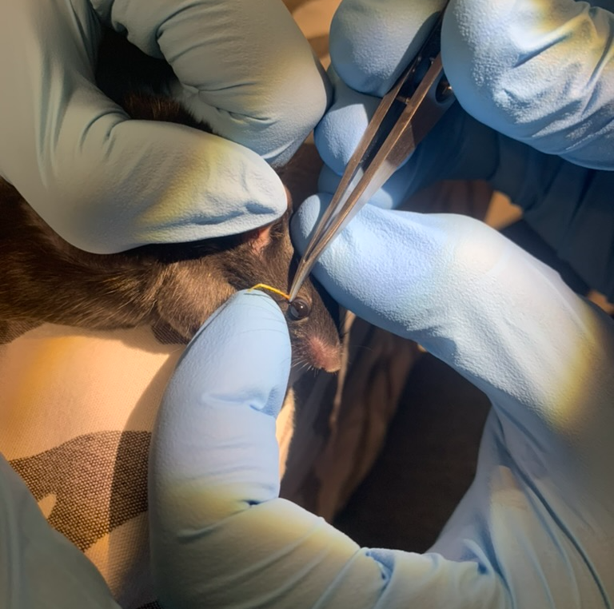
Aim 2- In vivo testing of commercial vs self-prepared PRT
Introduction Methods Results Discussion Conclusion
Introduction Methods Results Conclusion Future Directions
Our goal:
Compare the PRTT values using our self-prepared PRT with the commercial PRTT values
Notes:
We performed PRTTs on 10 mice (strain: C57BL/6- 5 females, 5 males) at 8 weeks of age in both eyes 3x/week using the commercial PRT for one week, then using our own self-prepared PRT the subsequent week
Mice were physically restrained without sedation
Inclusion in the study required normal eyelid and ocular surface phenotype so ocular exams were performed via slit lamp biomicroscopy
Lower eyelid of each mouse was gently everted and the tip (1mm) of the PRTT was placed into the lateral aspect of lower eyelid margin with forceps and allowed to wick for 15s.
The color change on the thread was measured using digital calipers
All PRTTs were performed by the same examiner between the hours of 9-11am to minimize the effect of diurnal variations associated with aqueous tear production, and at a constant, ambient temperature (ranging from 68-73F) and humidity (55-60%) since large fluctuations in temperature and humidity can alter aqueous tear production ocular surface and wicking of the thread.

Slide 9
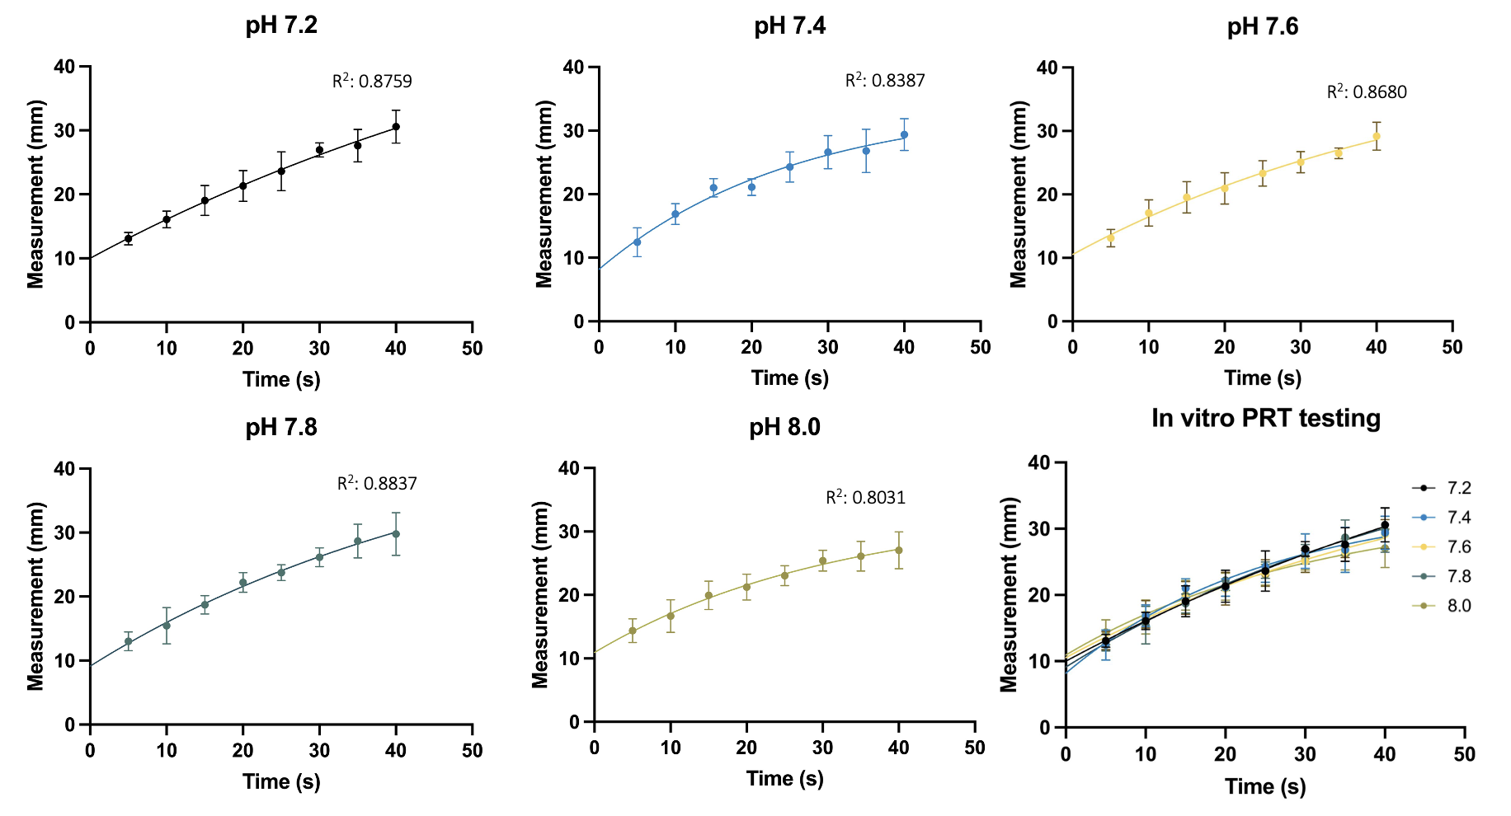
Aim 1: Self-prepared PRT wicking characteristics
Introduction Methods Results Conclusion Future Directions
Notes:
Results of in vitro testing of self-prepared PRTT
On the x-axis, we have time
On the y-axis, we have PRTT measurement
Mean and standard deviations for each time point are shown.
A one phase association regression was used to identify the best fit line for each pH value assessed.
The best fit line at each pH comes close to the all the data points (R² value is substantial) and the curves look pretty similar and follow the same trend in which the increase starts at time 0 and eventually plateau (reach equilibrium) at a certain time point
And this is even more evident when we place them all together
Based on a mixed effect analysis (Tukey test), we found no significant differences in the wicking kinetics of our self-prepared PRT (p=0.2831).
The coefficient of determination (R²) for each data set indicates that the curves fit the data well.
R² determines the goodness of fit. If R² is greater than 0.9 in all cases, indicating a good fit to the equation, R squared values of >0.8 required.
When we constrain the y intercept to 0, the fit of the curve to the data is worse.

Slide 10
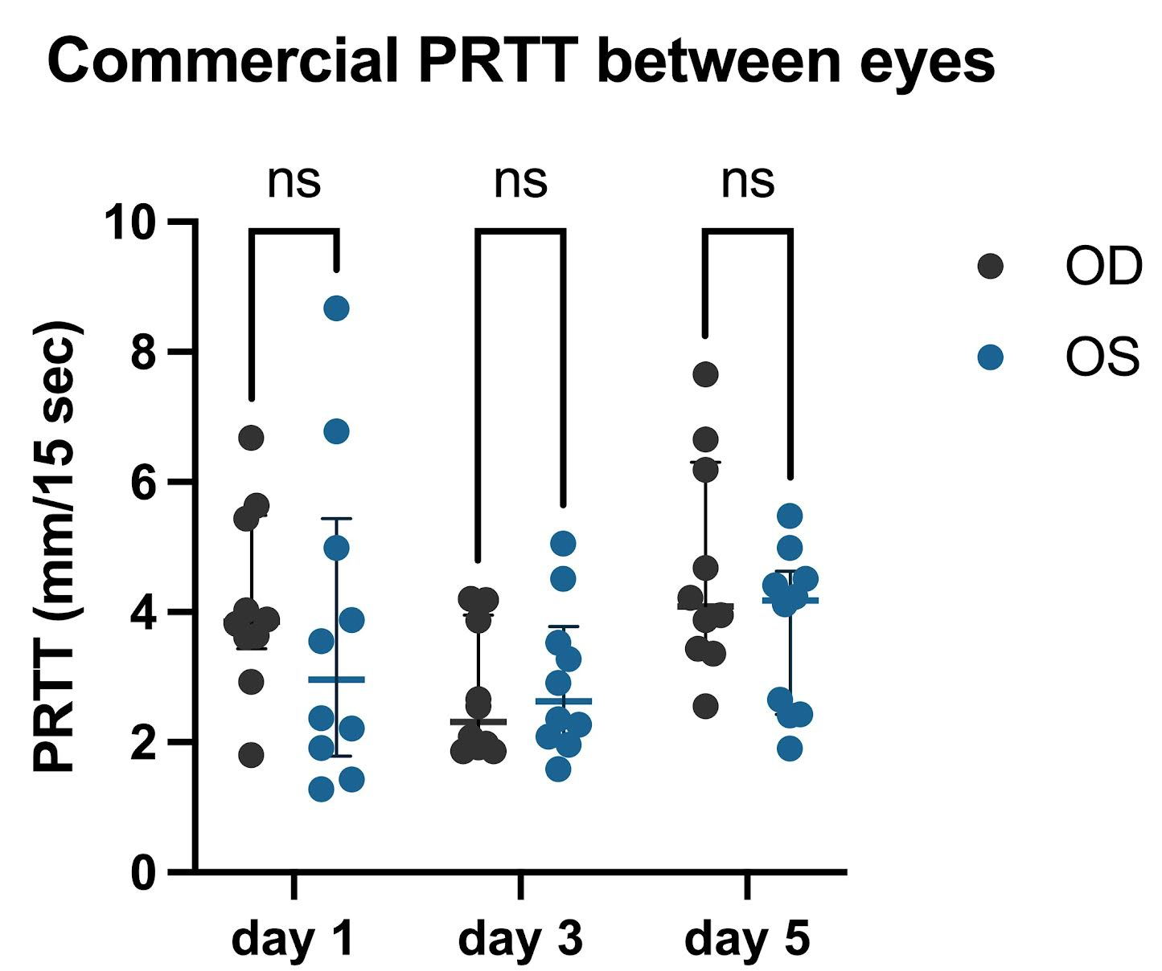
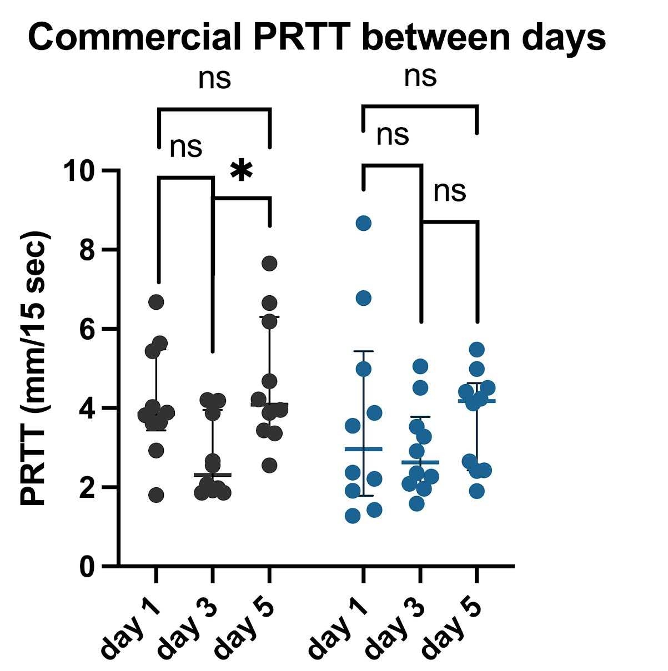
Aim 2: Commercial PRTT
Introduction Methods Results Conclusion Future Directions
Notes:
In vivo testing results using commercial PRTT:
For both graphs the x axis is time as three different testing sessions and on the y axis are PRTT values and the points represent the raw data that we collected in the 10 mice that were used. This data was not distributed normally so you are seeing median and interquartile ranges.
We wanted to ask the question is there a significant difference in the PRTT values between eyes or between days- in this case according to the thread type used (commercial vs self-prepared PRTT).
A post-hoc Tukey test was performed, which identified no significant differences between eyes at each testing session (graph on the left)
However, there was a significant difference between days 3 and 5 for the right eye only identified (p=0.0144) (graph on the right)
And we think that can be explained by the presence of biological variation (specifically stress which is known to increase tear production)

Slide 11
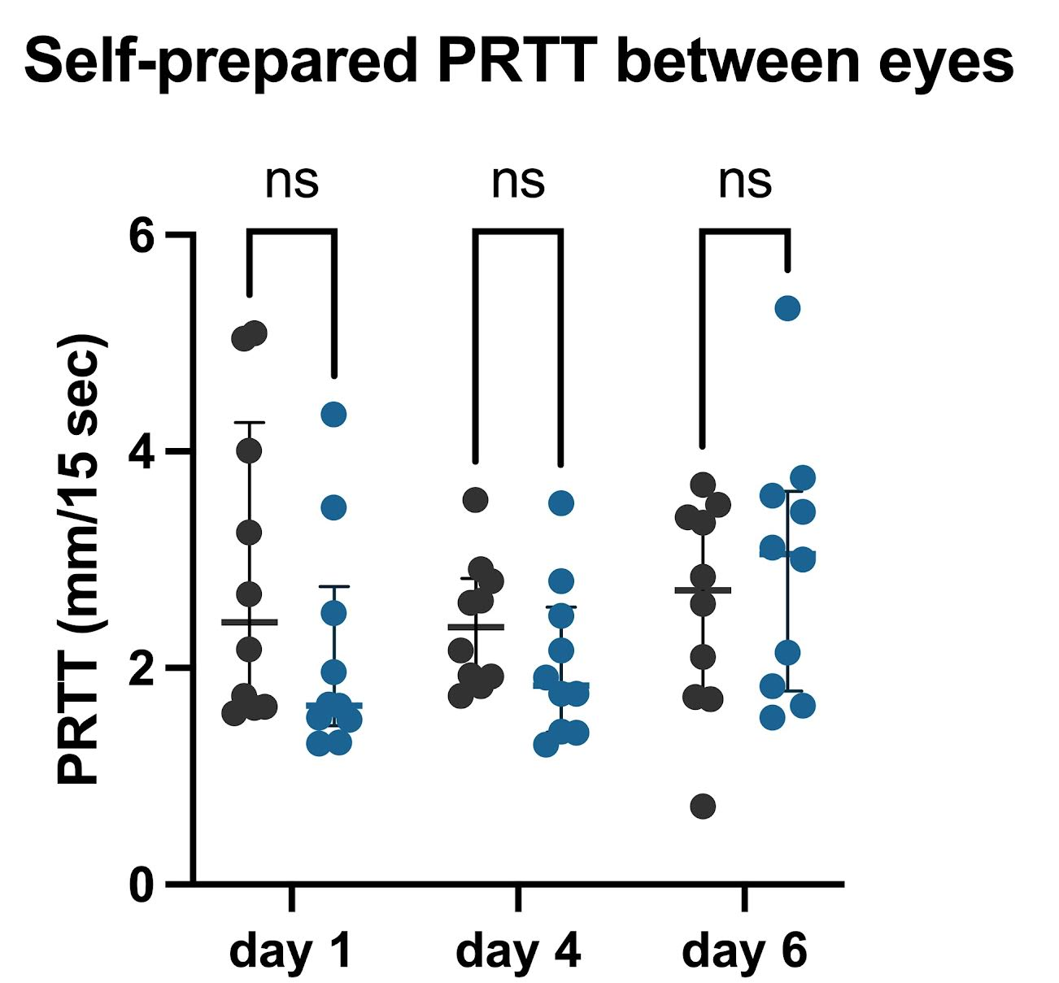
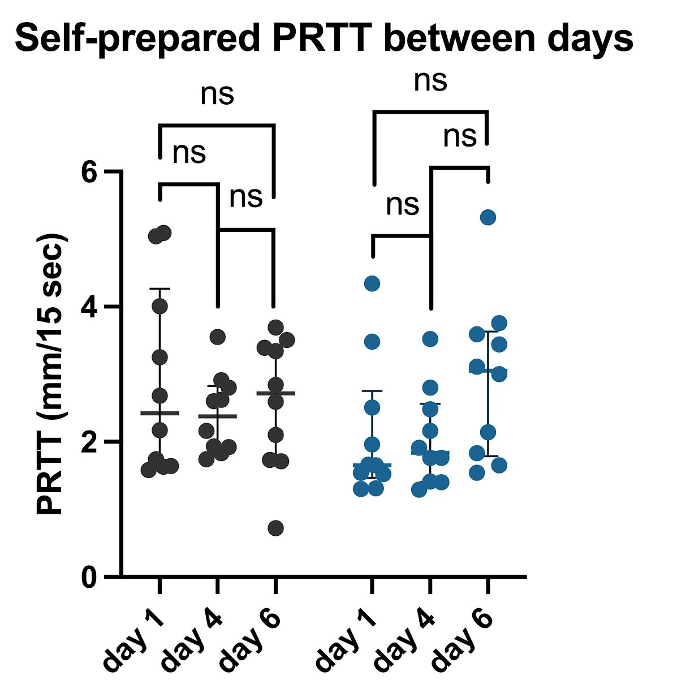
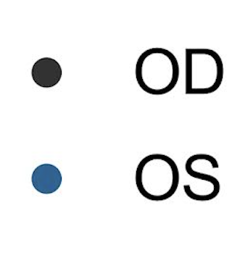
Aim 2: Self-Prepared PRTT
Introduction Methods Results Conclusion Future Directions
Notes:
In vivo testing results using our self-prepared PRTT
Again, for both graphs we have time as three different testing sessions on the x-axis and PRTT values on the y-axis
We wanted to ask the same question: if there is a significant difference in the PRTT values between eyes or between the 3 testing sessions according to the thread type used (commercial vs self-prepared PRTT)
A post-hoc Tukey test was performed, which identified no significant differences between eyes at each testing session (graph on the left)
And no significant differences were identified between days for the same eye (graph on the right)
A post-hoc Tukey was performed on the self-prepared PRTT, which identified no significant differences between the right and left eyes at each testing session as well as no significant differences for the same eye across testing sessions. Median and interquartile ranges are shown.

Slide 12
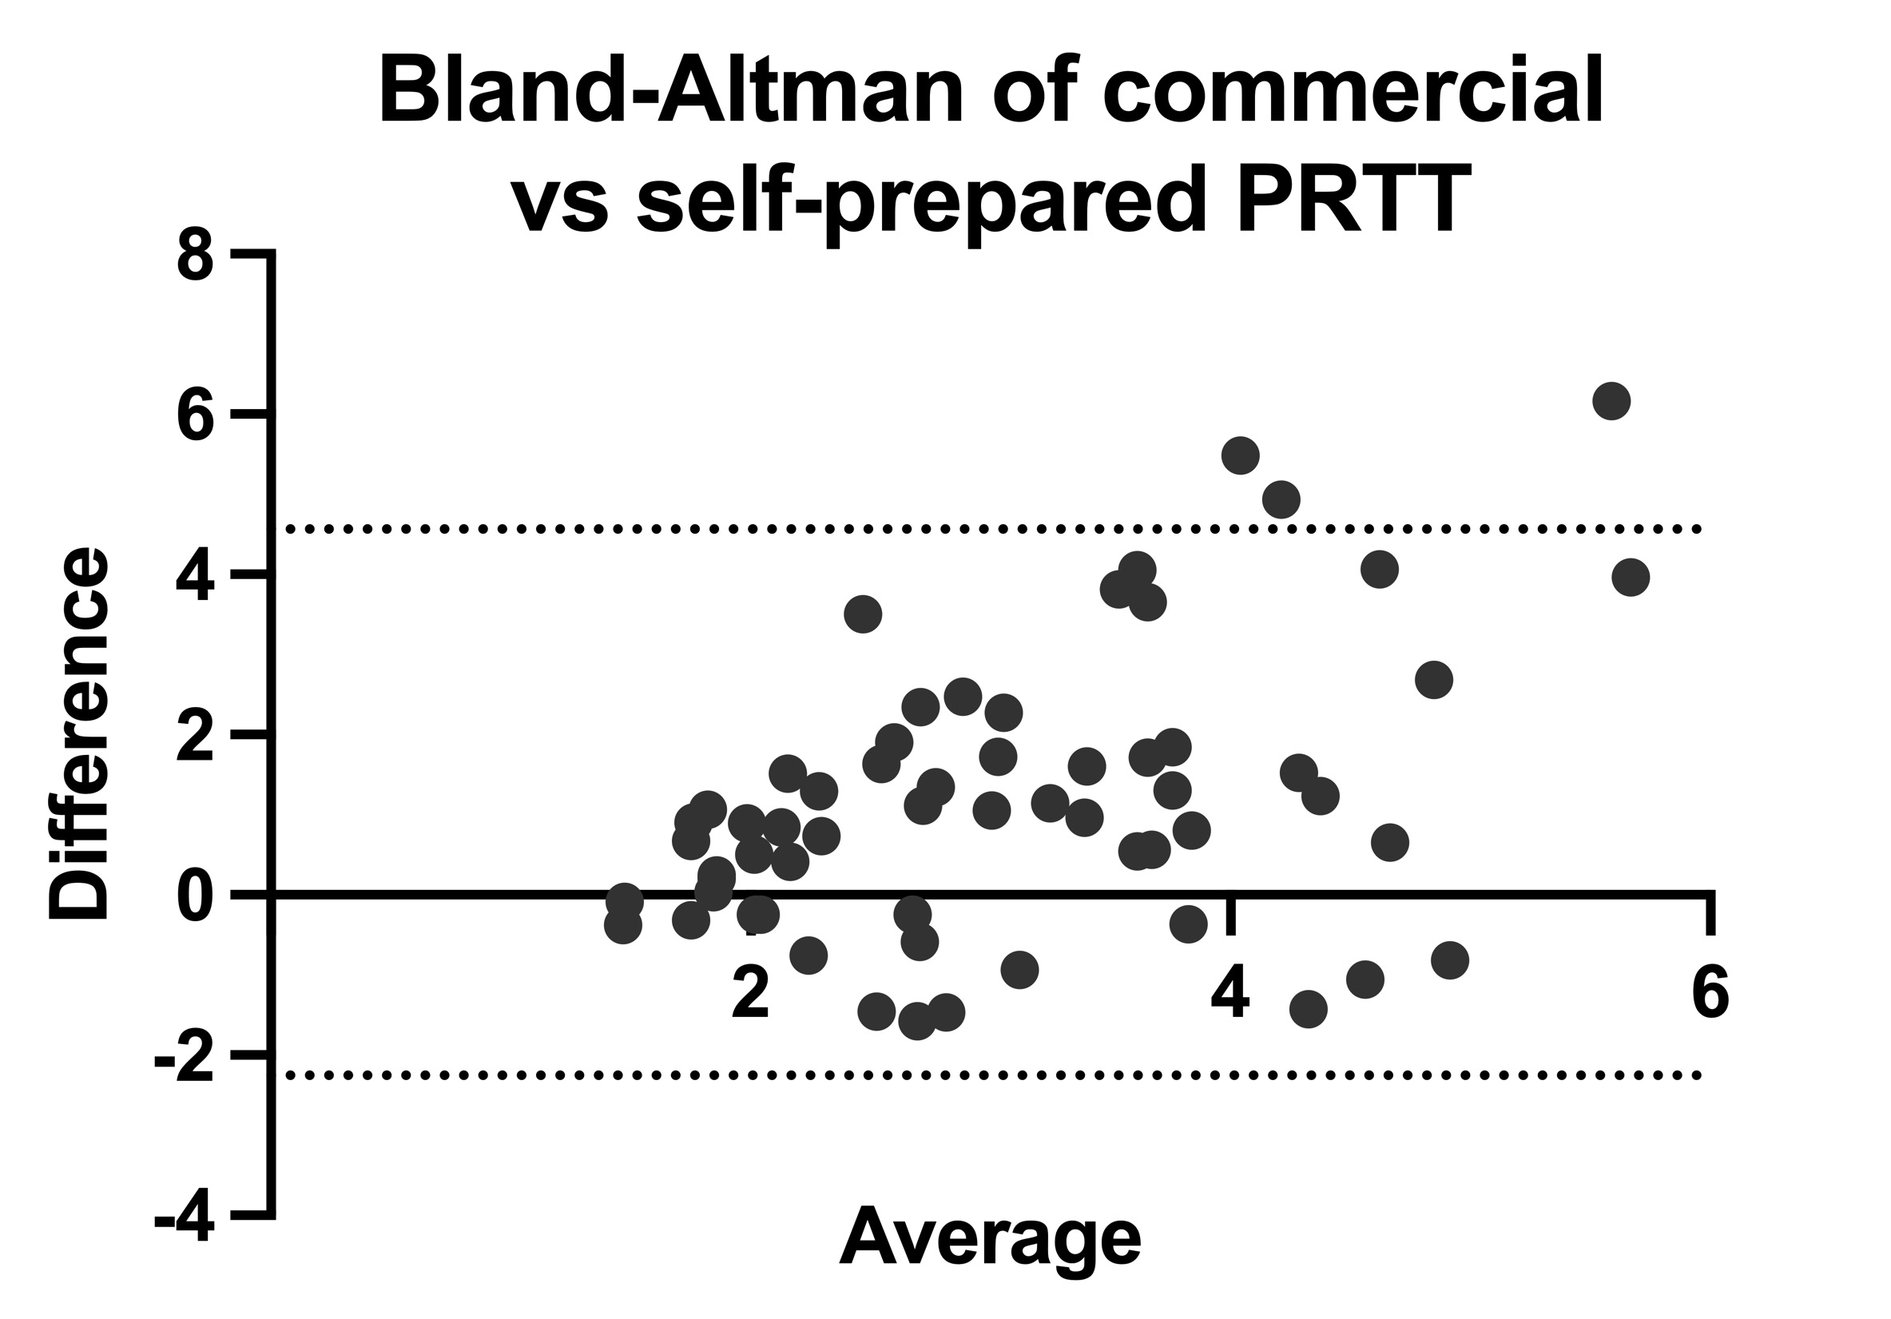
Aim 2: Test Comparison
Introduction Methods Results Conclusion Future Directions
Commercial PRTT measurements tended to have higher values compared with the self-prepared PRTT
However, since majority of the data points are close a mean difference of 0, this suggests there is a good level of agreement between the two diagnostic methods
Notes:
We performed a Bland-Altman analysis which allows us compare two different diagnostic methods and see how they perform together
We used this analysis to compare the PRTT measurements on the same eye on the same relative day (measurement from the first day using commercial vs measurement of first day using self-prepared).
On the x-axis we have the average of the two diagnostic methods and on the y-axis we have difference between the two diagnostic methods
Commercial PRTT measurements tended to have higher values compared with the self-prepared PRTT however, since majority of the data points are close a mean difference of 0, this suggests there is a good level of agreement between the diagnostic methods (meaning the the commercial PRTT and our self-prepared PRTT can be used interchangeably)
Line of agreements= mean difference plus and minus 1.96 times the standard deviation of the differences.
Bias (average difference in the values, it’s the systematic error/variation related to a measurement) was 1.155
SD of the bias was 1.739
95% limits of agreement was between -2.253 to 4.564.

Slide 13
Conclusion
Introduction Methods Results Conclusion Future Directions
Aim 1: To develop and validate a self-prepared PRTT in solutions of varying pH
- Self-prepared thread had the appropriate color after dyeing and appropriate color change after being used.
- No significant differences in the wicking kinetics of our self-prepared PRT were identified in vitro.
Notes:
We were able to develop self-prepared thread that had the appropriate color after dyeing and appropriate color change after being used and show that it had no significant differences in the wicking kinetics across time and across pH solution

Slide 14
Conclusion
Introduction Methods Results Conclusion Future Directions
Aim 2: To compare the self-prepared PRTT with the commercial PRTT in wildtype mice
- Commercial PRTT results revealed no significant differences between eyes at each testing session. There was only one significant difference identified between day 3 and 5 for the right eye (due to stress response)
- Self-prepared PRTT values revealed no significant differences between eyes at each testing session or the the same eye between days.
- Although commercial PRTT measurements tended to have higher values compared with the self-prepared PRTT, the data demonstrated a good agreement between the two tests.

Slide 15
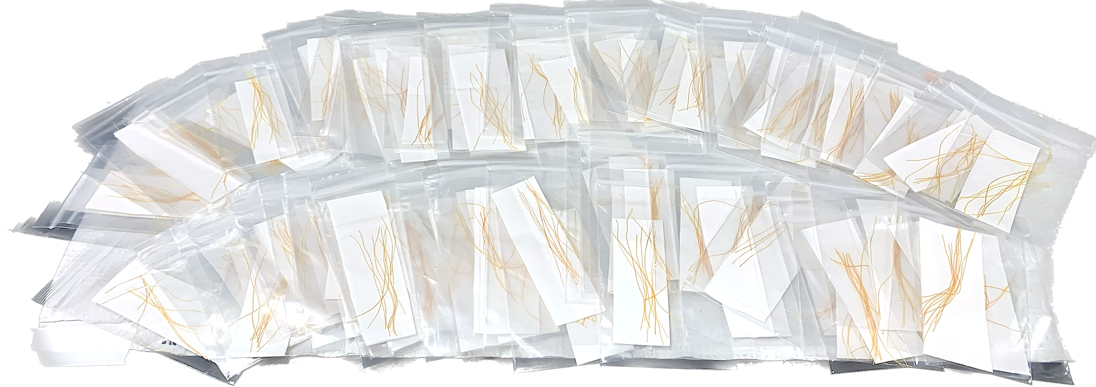
Future Directions
Introduction Methods Results Discussion Conclusion
Introduction Methods Results Conclusion Future Directions
Determine whether our self-prepared PRTT can accurately discriminate between wildtype and mutant mice with known differences in aqueous tear production.
Determine whether there are any significant differences between batches of self-prepared PRT

Slide 16
Funding & Acknowledgements
Financial support provided by:
Students Training in Advanced Research (STAR) Program
National Institutes of Health (NIH)
NIH Training Grant (T35 OD010956)
T35 OD010956
Special thanks to:
Erin Hisey
Dr. Brian Leonard
Comparative Ophthalmology and Vision Sciences Lab
Notes:
Thank you to the Students Training in Advanced Research (STAR) Program and National Institutes of Health (NIH) for providing funding for this project.
I would also like to thank the Comparative Ophthalmology and Vision Sciences Lab at UC Davis for providing immensely valuable training and support for this research.
My sincere gratitude to Erin Hisey and Brian Leonard for their invaluable mentorship.

