Slide 1
Dental and Temporomandibular Joint Pathology of the Red Fox (Vulpes vulpes)
Audrey L. Chou, Katherine M. K. Luong, Frank J. M. Verstraete

Slide 2
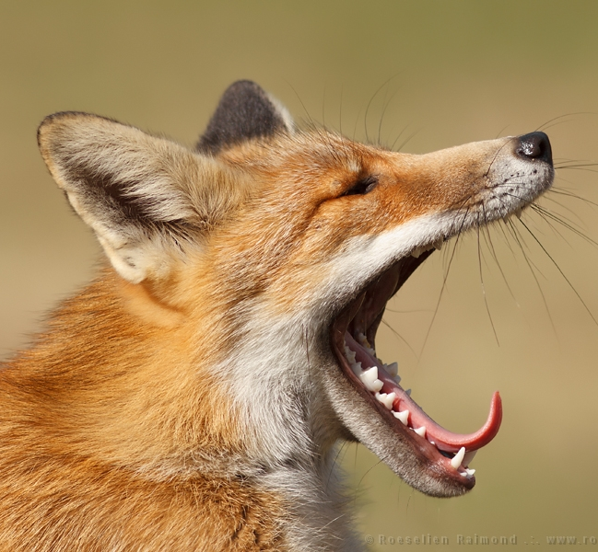
The Red Fox – Vulpes vulpes
Most widely distributed land carnivore
Opportunistic omnivores, consume a wide variety of foods
10 subspecies present in North America
The Sierra Nevada Red Fox (Vulpes vulpes necator) is native to the Sierra Nevada Mountains and endangered
Increasing contact with urban habitats and anthropogenic food and non-food items
Photo Credit: Roeselien Raimond Photography
Notes:
Some subspecies are native, such as the sierra Nevada red fox, while others are introduced. Introductions began in the 1890s for the fur trade and hunting of Vulpes vulpes fulva from the Eastern US and Europe
Increased contact between foxes and anthropogenic food and non-food items could result in higher prevalence of dental pathology

Slide 3
Why Teeth?
Links between oral health and systemic health suggest that dental pathology is very important to consider when assessing overall health
Animals interact with the environment primarily through their mouths, dental pathology may negatively impact survival
Museum collections allow for observation of specimens collected over several decades, teeth are easily preserved for later analysis
Similarities allow for the comparison of dental pathology with other canid species

Slide 4
Aims of Project
Aim 1
Aim 2
Characterize and document dental and temporomandibular joint pathology of the red fox – understand frequency and prevalence of abnormal conditions and dental disease in the species
Compare incidence of dental pathology to other North American fox species – the grey fox, kit fox, island fox, and arctic fox which have previously been studied
Hypothesis:
Dental pathology and abnormalities in the red fox will be similar to those present in other fox species (grey fox, kit fox, island fox, and arctic fox ), but more severe due to their urban habitat and anthropogenic contact

Slide 5
Methods
390 skulls from the Museum of Vertebrate Zoology in Berkeley, California were analyzed
Specimen sex, age, collection location and date, and subspecies were recorded if provided, along with any general observations
Juvenile, mixed dentition, and specimens from outside North America were not included
Consistent scoring criteria were used to grade dental disease, each tooth was individually assessed

Slide 6
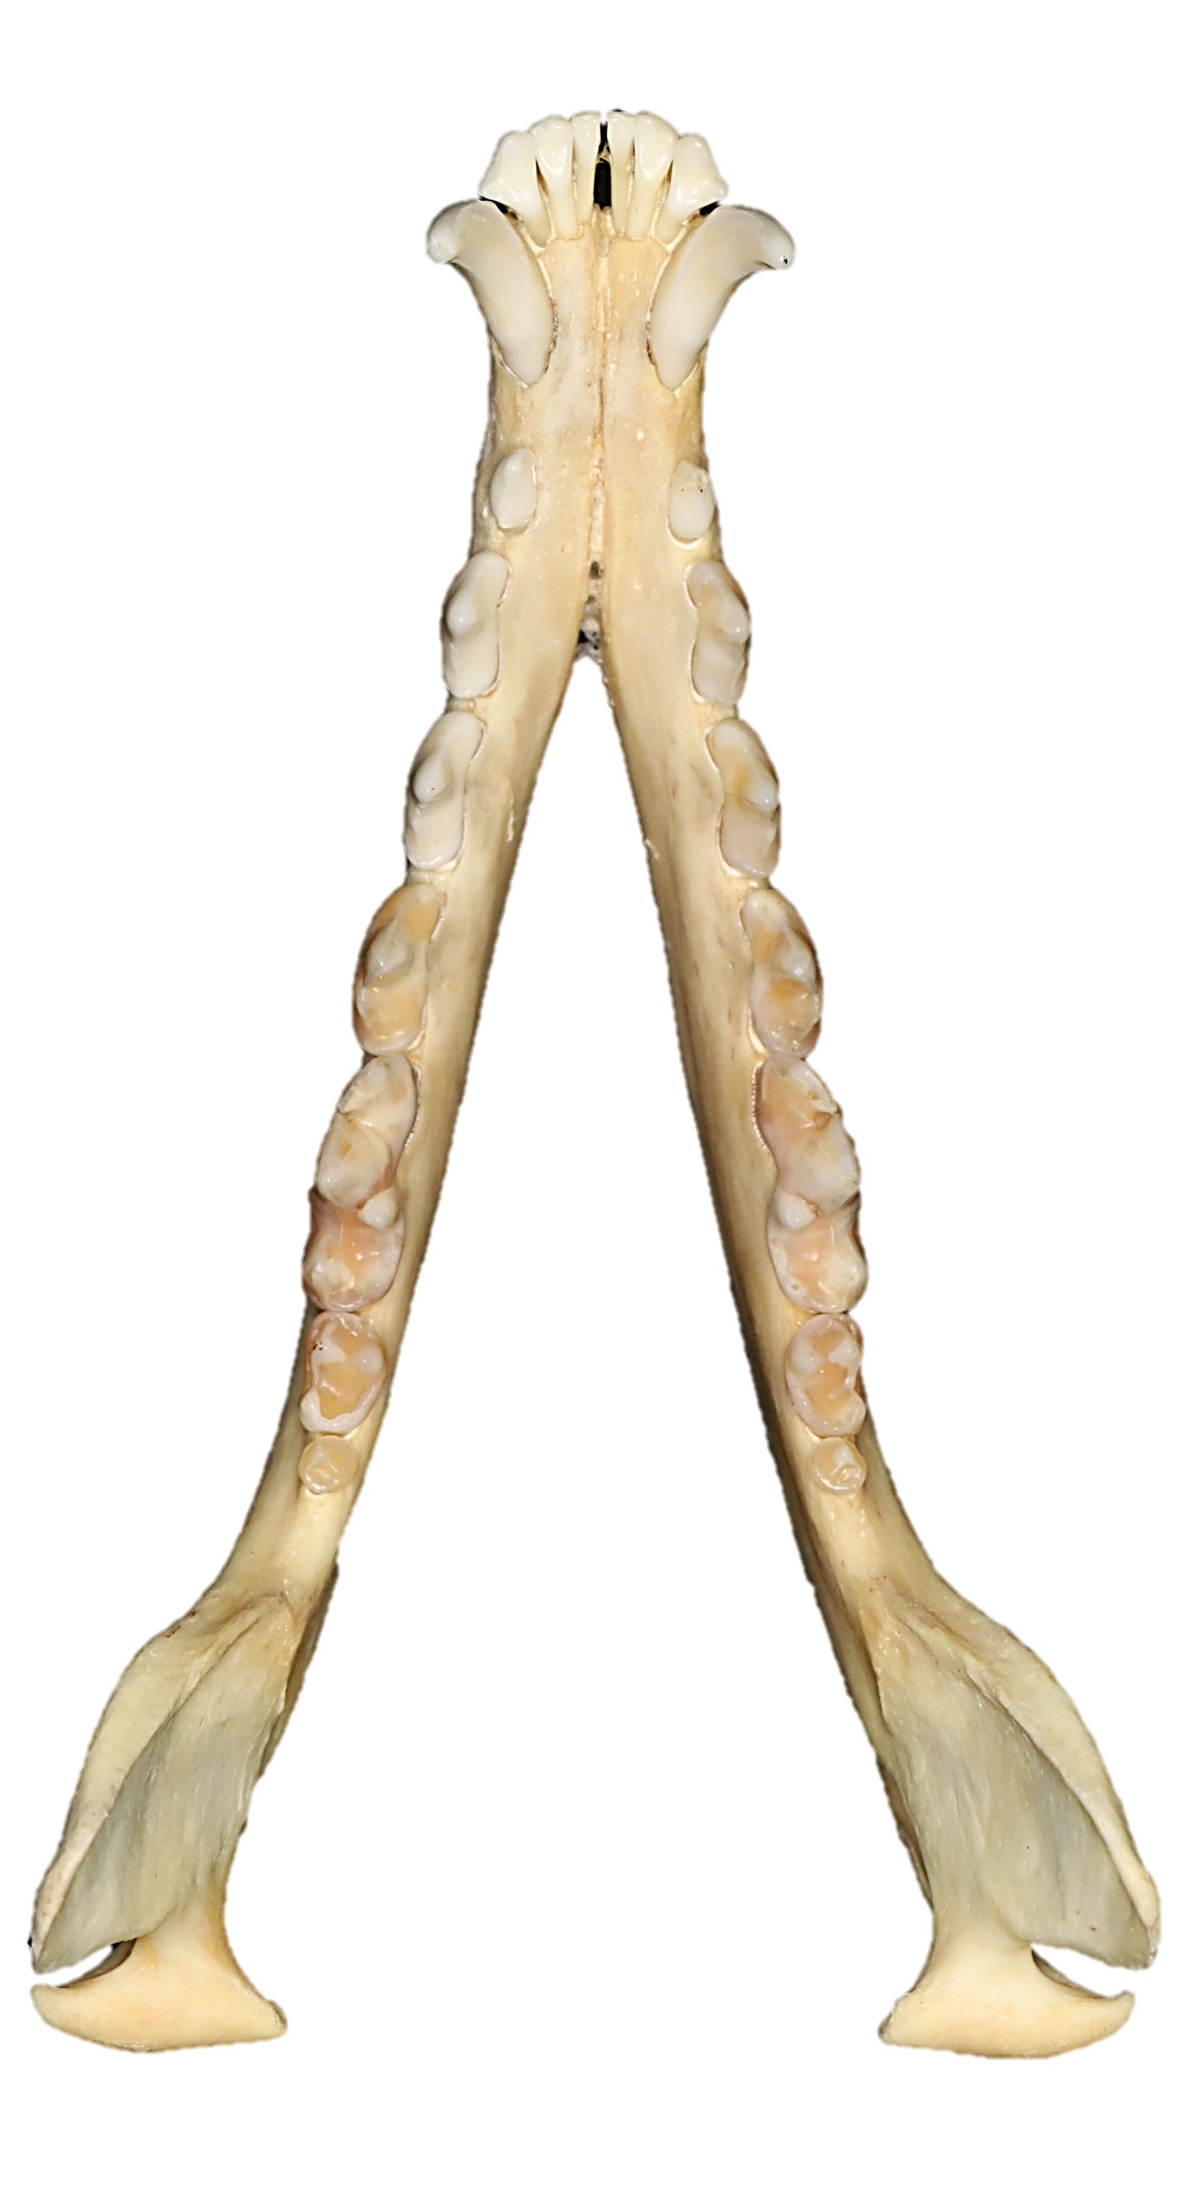
Methods
I1
I2
I3
C
P1
P2
P3
P4
M1
M2
M3
$$I\frac{3}{3}:C\frac{1}{1}:P\frac{4}{4}:M\frac{2}{3}=42$$
Notes:
Like other canids, the red fox has 42 teeth
Maxilla: 3 incisor teeth, 1 canine tooth, 4 premolar teeth, and 2 molar teeth
Mandible: 3 incisor teeth, 1 canine tooth, 4 premolar teeth, and 3 molar teeth

Slide 7
Methods
Each skull was assessed for:
Anatomical and developmental findings
Tooth presence
Tooth form
Supernumerary teeth
Supernumerary roots
Persistent deciduous teeth
Enamel hypoplasia
Periodontal findings
Periodontitis
Endodontal findings
Attrition and abrasion
Dental fractures
Periapical lesions
Other findings
Temporomandibular joint findings
Osteoarthritis

Slide 8
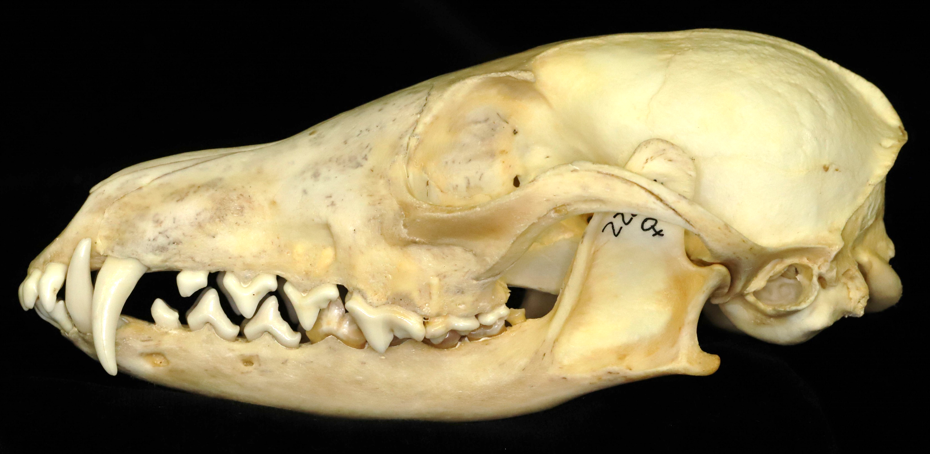
Results
305 specimens collected between 1906-2008 were included in the data analysis
103 female (33.77%), 131 male (42.95%), and 71 unknown (23.28%)
67 young adult (21.97%) and 238 adult (78.03%)
Location, subspecies and year collected were also recorded and will be used in further statistical analyses

Slide 9
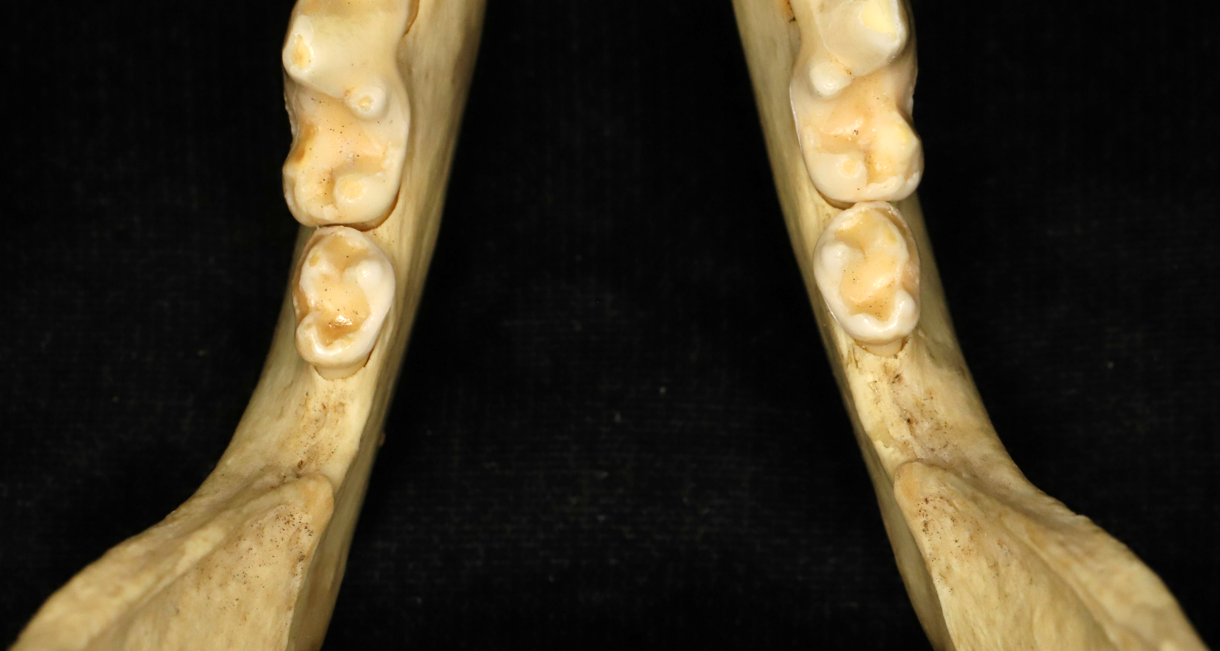
Tooth Presence
123 out of 305 specimens (40.33%) had all teeth present - 12355 out of 12810 possible teeth were present for analysis (96.45%)
Tooth artifactually absent – 280 (2.19%)
Acquired tooth loss – 97 (0.76%)
Congenital tooth loss – 72 (0.56%)
*Further statistical analysis needed to determine relationships between tooth presence and different factors
Notes:
The majority of teeth in the specimens were present and available for analysis, however some teeth were artifactually absent, lost some time post-mortem either during the preparation process or having fallen out. These post-mortem losses were recognized by the clear sharp alveolus left where the tooth should be, with no rounding present. Some teeth were considered to be an acquired loss, or lost ante-mortem sometime during the animal’s lifetime. These were determined due to the rounded alveolus and evidence of bone growth. Some teeth were considered to be congenitally absent - most frequent being the 3rd mandibular molar followed by the 1st mandibular premolar – these were evidenced by smooth bone were the tooth should be.

Slide 10
Tooth Form, Supernumerary Roots & Teeth
Notes:
Some rare but interesting developmental findings include abnormalities in tooth form, such as this tooth demonstrating tooth gemination as well as a supernumerary root – making for 3 total roots instead of the 2 expected
On the right side is an example of a supernumerary tooth, while only 4 supernumerary teeth were found, this is a very uncommon placement for this to occur

Slide 11
Persistent Deciduous Teeth Enamel Hypoplasia
Notes:
The most common persistent deciduous teeth were canines, and most persistent deciduous canines were fractured, this was one of the only skulls with an intact deciduous canine.
Enamel hypoplasia, which is the banding on the enamel that can result from infection with Distemper Virus was found on several skulls. ***Enamel hypoplasia can give a clue into systemic disease that the animal may have experienced during development ***

Slide 12
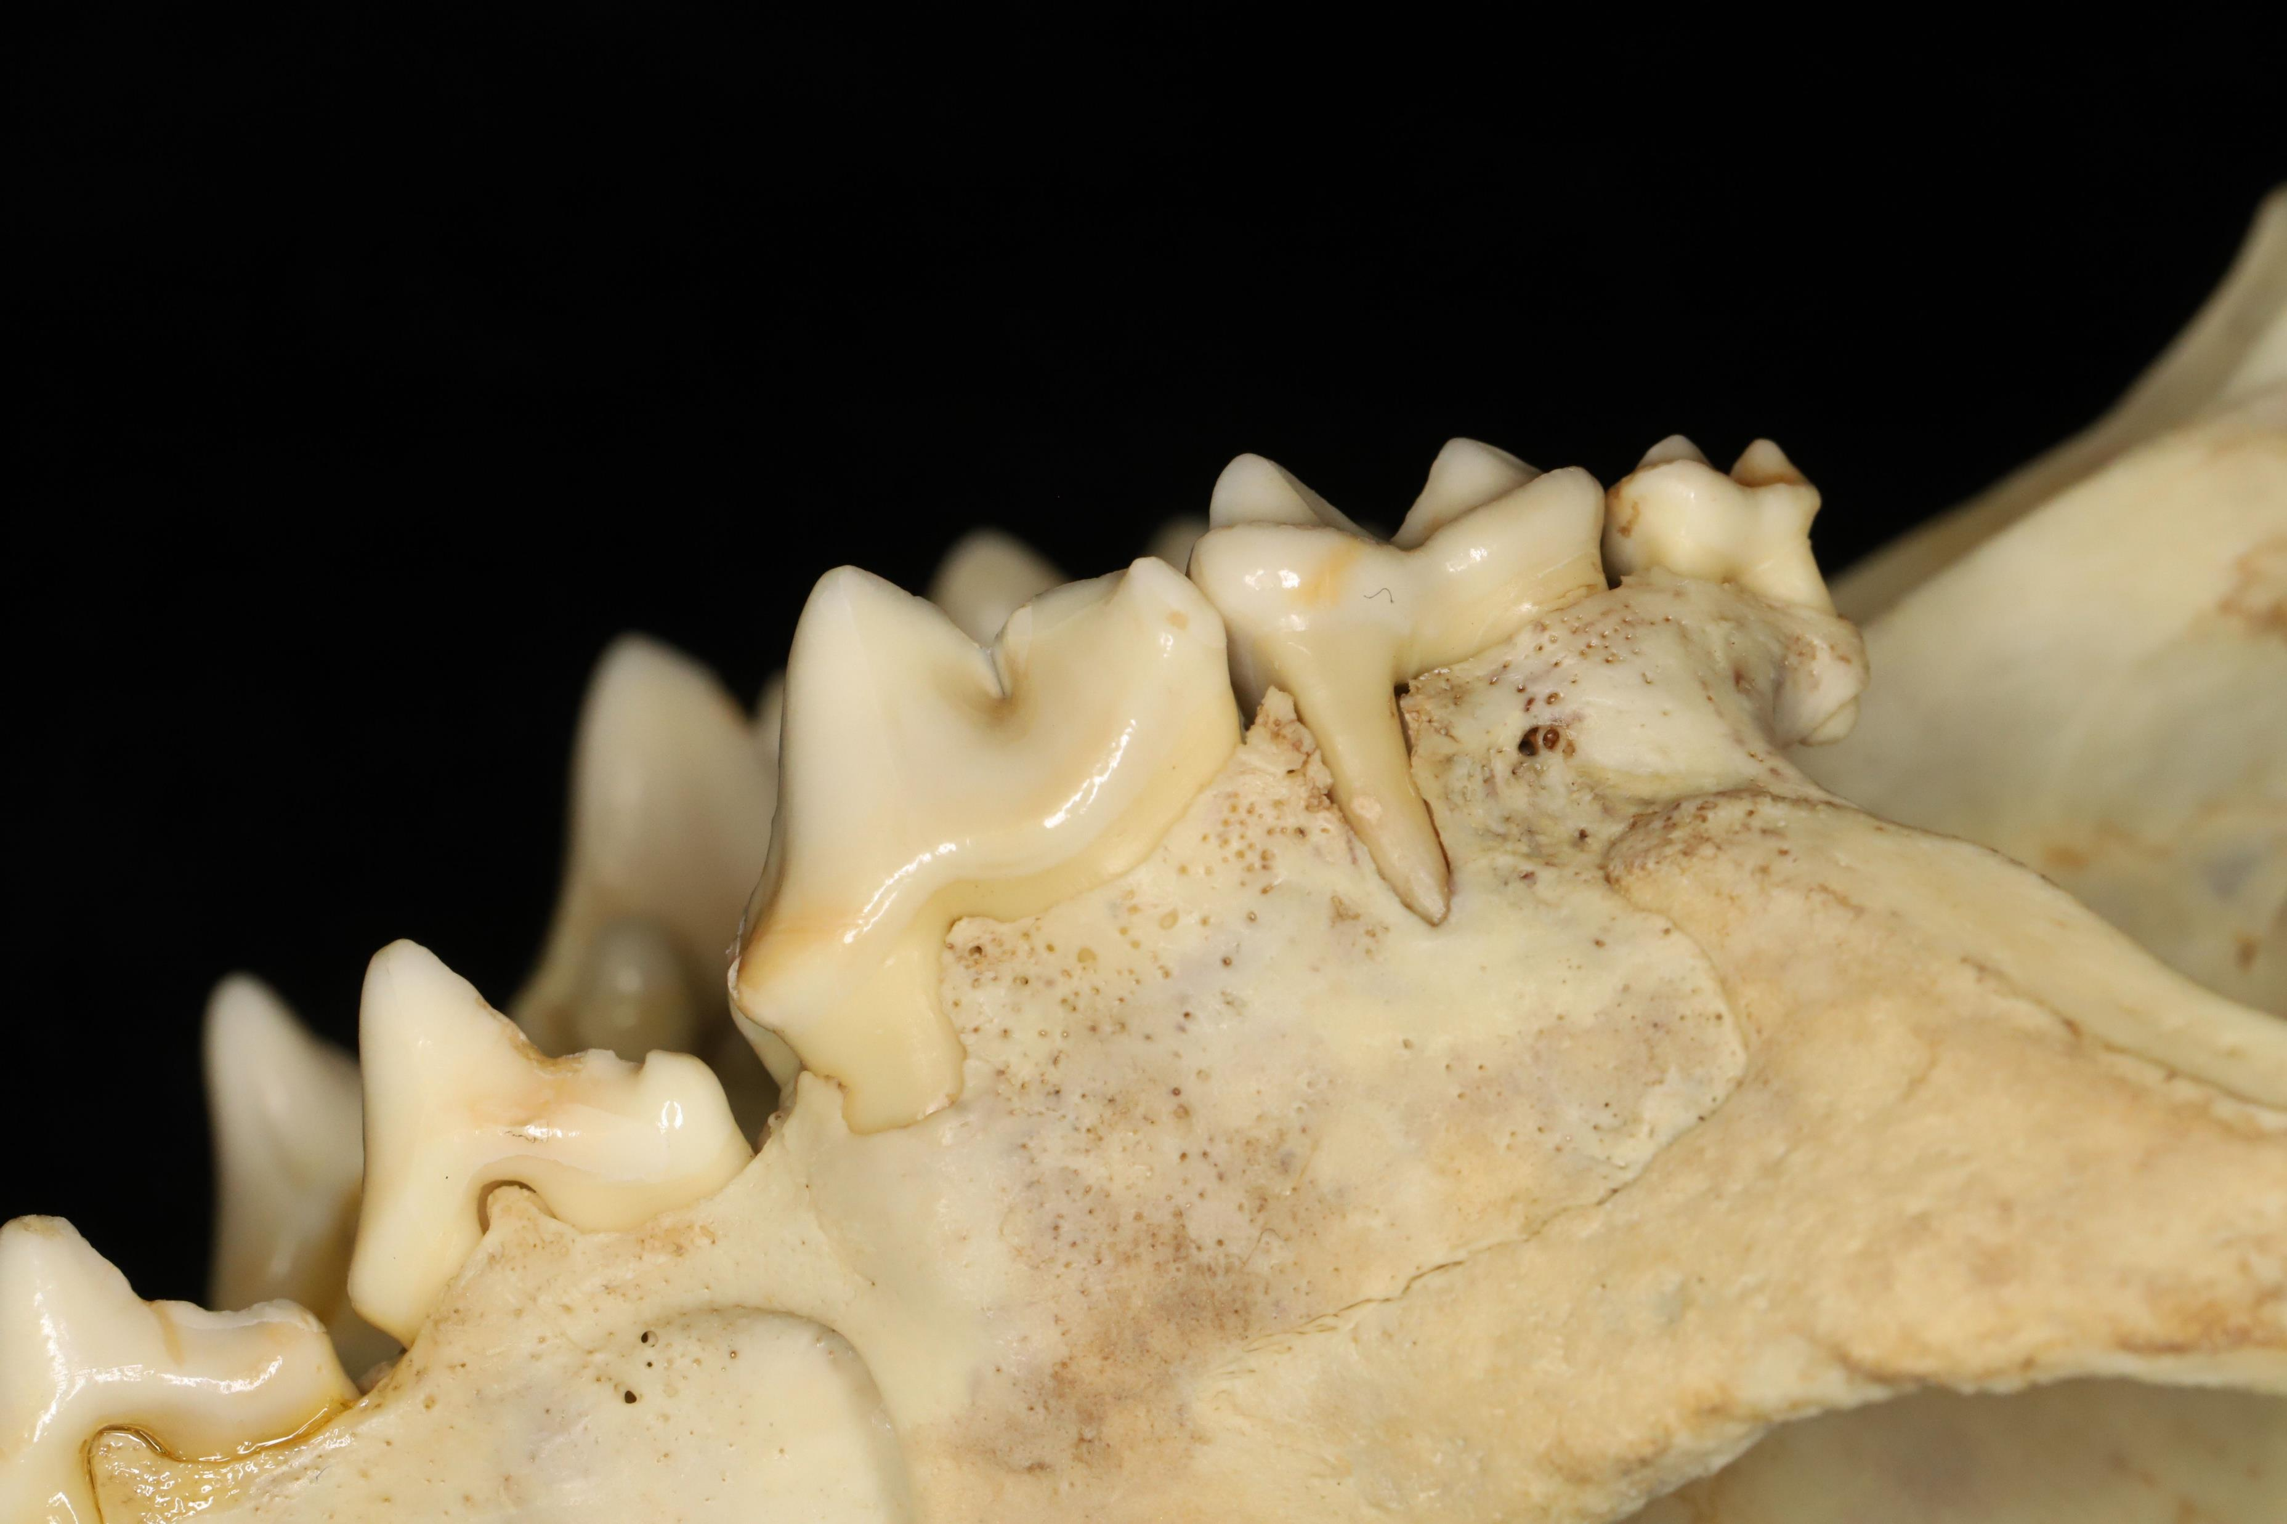
Periodontitis
Stage 1: Gingivitis – not assessed by this study
Stage 2: Increased vascularity, mild alveolar bone loss
147 specimens (48.2%)
Stage 3: Moderate horizontal or vertical alveolar bone loss and/or furcation involvement
61 specimens (20%)
Stage 4: Severe horizontal or vertical alveolar bone loss and/or furcation exposure
12 specimens (3.93%)
Found much lower rates and severity than expected - similar rates to other fox species

Slide 13
Attrition and Abrasion
Normal tooth contact and abnormal mechanical processes result in varying stages of tooth wear
Stage 1: Mild enamel wear
3236 teeth (25.26%)
Stage 2: Exposure of dentine
1533 teeth (11.97%)
Stage 3: Tertiary dentine formation
712 teeth (5.56%)
Stage 4: Pulp cavity exposure
291 teeth (2.27%)
4
3
2

Slide 14
Fractures
Several different fracture types:
Enamel Fracture – 32 teeth (0.25%)
Uncomplicated Crown Fracture – 17 teeth (0.13%)
Complicated Crown Fracture – 104 teeth (0.81%)
Uncomplicated Crown Root Fracture – 5 teeth (0.04%)
Complicated Crown Root Fracture – 94 teeth (0.73%)
Root Fracture – 128 teeth (0.99%)

Slide 15
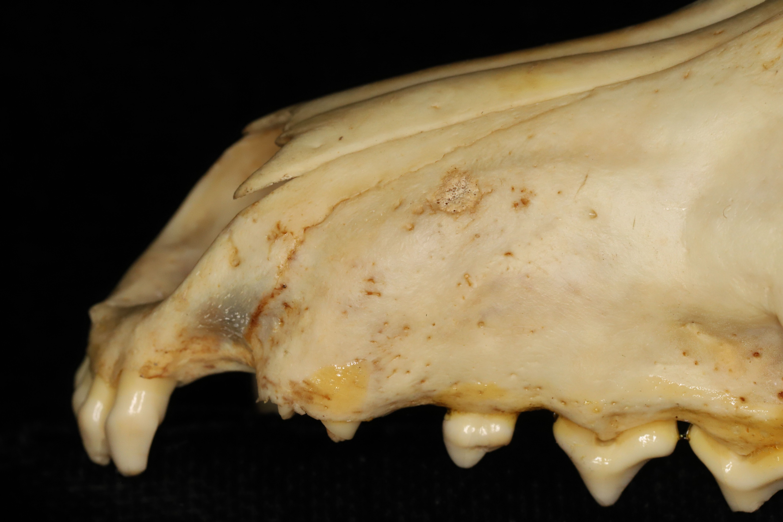
Periapical Lesions
Bony remodeling around the apex of a tooth root
11 periapical lesions
9 specimens (2.9%)

Slide 16
Temporomandibular Joint
TMJ was assessed for osteoarthritis and fractures, no fractures were noted
Both the mandibular head and fossa were assessed
Lesions were more common on the mandibular head
35 specimens had TMJ lesions (11.48%)
21 specimens had bilateral lesions
14 specimens had a unilateral lesion

Slide 17
Summary
Much less pathology than expected compared to other fox species – expected to see more frequent and severe disease than was present
Further statistical analysis needed to determine relationship between dental pathologies present and other factors (sex, age, collection date, etc.)

Slide 18
Acknowledgements
Special thanks to:
Chris Conroy
Dr. Janny Evenhuis
Dr. Philip Kass
Financial support was provided by the Students Training in Advanced Research (STAR) Program through an SVM endowment
Thank you to the Museum of Vertebrate Zoology at UC Berkeley for use of their facilities and specimen collection

Slide 19
References
Aubry K.B ., Statham M.J., Sacks B.N., Perrine J.D., and Wisely S.M. (2009). Phylogeography of the North American red fox: Vicariance in Pleistocene forest refugia. Molecular Ecology, 18, 2668-2686.
Evenhuis V.J., Zisman I., Kass P.H., and Verstraete F.J.M. (2018) Dental Pathology of the Grey Fox (Urocyon cinereoargenteus). Journal of Comparative Pathology, 158, 39-50.
Golightly, R.T., Faulhaber, M.R., Sallee, K.L., and Lewis, J.C. (1994). Food habits and management of introduced red fox in Southern California. Proceedings of the Sixteenth Vertebrate Pest Conference (1994). Paper 21.
Pereira Dos Santos, J. D., Cunha, E., Nunes, T., Tavares, L., & Oliveira, M. (2019). Relation between periodontal disease and systemic diseases in dogs. Research in veterinary science, 125, 136–140.
Verstraete F.J.M. (2003) Dental pathology and microbiology. Textbook of Small Animal Surgery, Vol. 2, DH Slatter, Ed., WB Saunders, Philadelphia, pp. 2638e2651.
Yanagisawa N., Wilson R.E., Kass P.H., and Verstraete F.J.M. (2019) Dental and Temporomandibular Joint Pathology of the Kit Fox (Vulpes macrotis). Journal of Comparative Pathology, 167, 60-72.

Slide 20
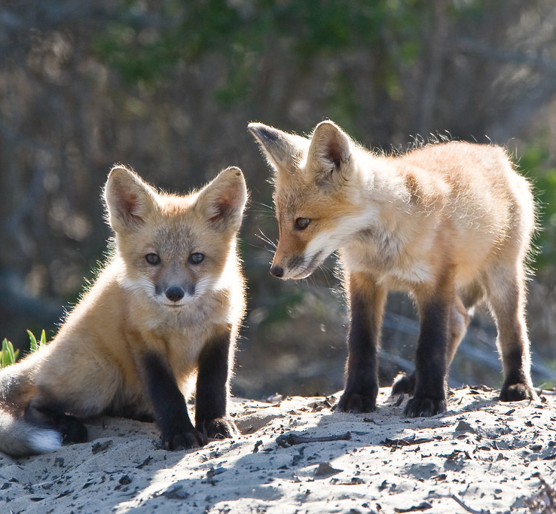
Questions?
Photo Credit: Mike Baird; Wikimedia Commons

