Slide 1
Validation of automated MRI segmentation protocols of neuroanatomical regions of the rhesus macaque brain
Brittany Davis
Bliss-Moreau Laboratory

Slide 2
Outline
Background and Rationale
Aims and Hypotheses
Methods
Preliminary Results and Interpretation
Discussion and Future Plans
Acknowledgements

Slide 3
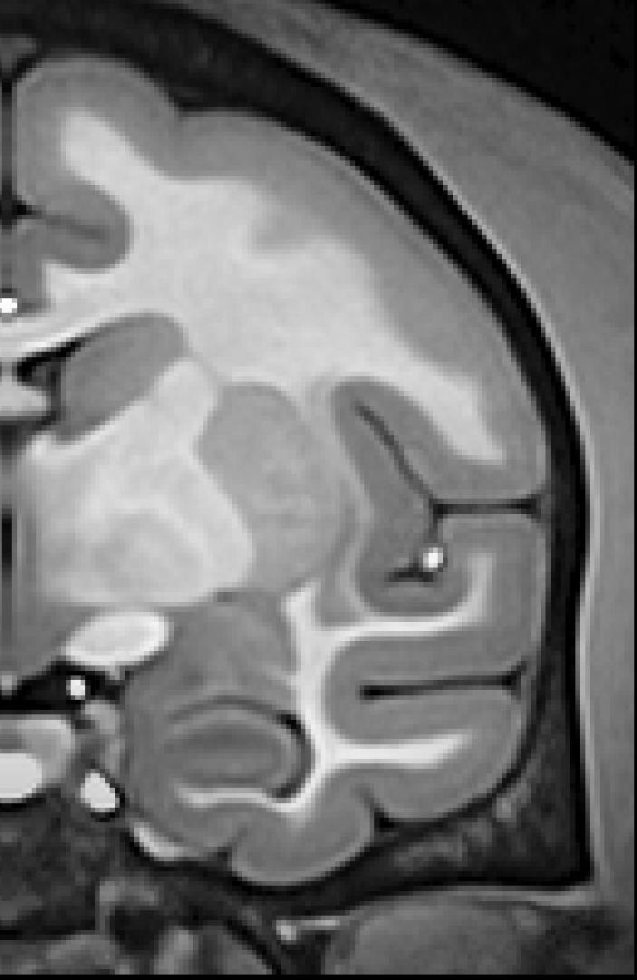
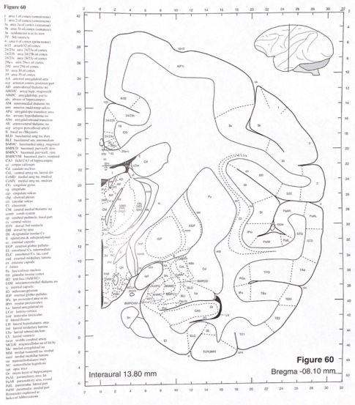
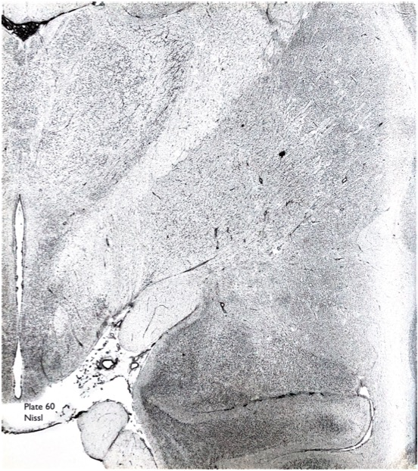
MRI as a neuroanatomical tool in vivo
National Institute of Mental Health Macaque Template:
“NMT v2 Brain”
MRI and Histology Atlases:
Saleem & Logothetis, 2012
Paxinos et al., 2009
Seidlitz et al., 2018

Slide 4
Hand Segmentation
Automated Segmentation
Pros:
”Gold standard" for accuracy
Cons:
Time intensive
Labor intensive
Pros:
Fast
Precise
Cons:
Unproven accuracy
Minimal* labor input

Slide 5
Aims and Hypotheses
Primary Aim: Compare the performance of automated and hand segmentation methods on subcortical and cortical regions of interest (ROIs).
Hypothesis: Applying automated segmentation methods to MRI data will not result in reliable morphometric and volumetric measurements of subcortical (amygdala) and cortical (insula) structures in juvenile and adult rhesus macaques.

Slide 6

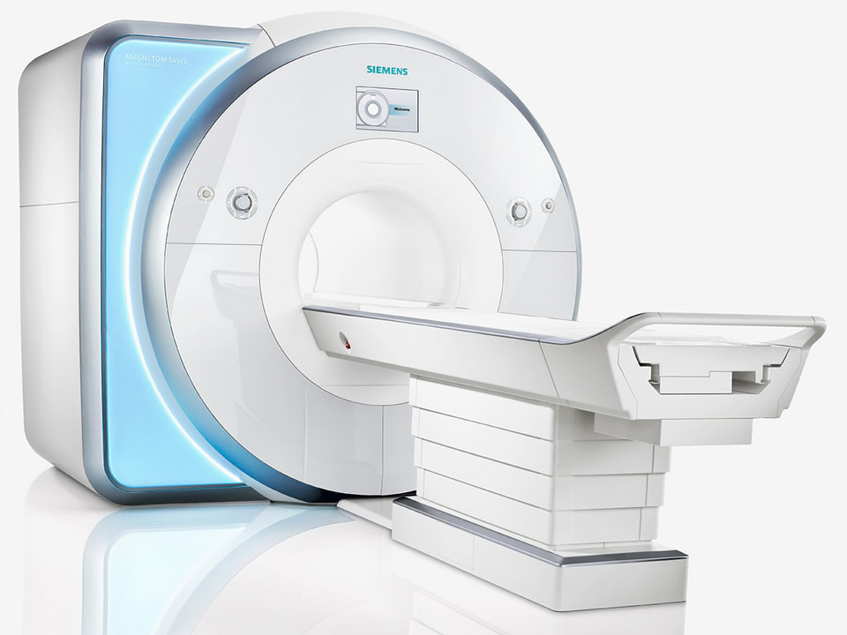
Methods
16 rhesus macaques
  14 females, 2 males
  1.1-20.3 years old
  Group housed at CNPRC
T1w images acquired on Siemens 3T Skyra

Slide 7

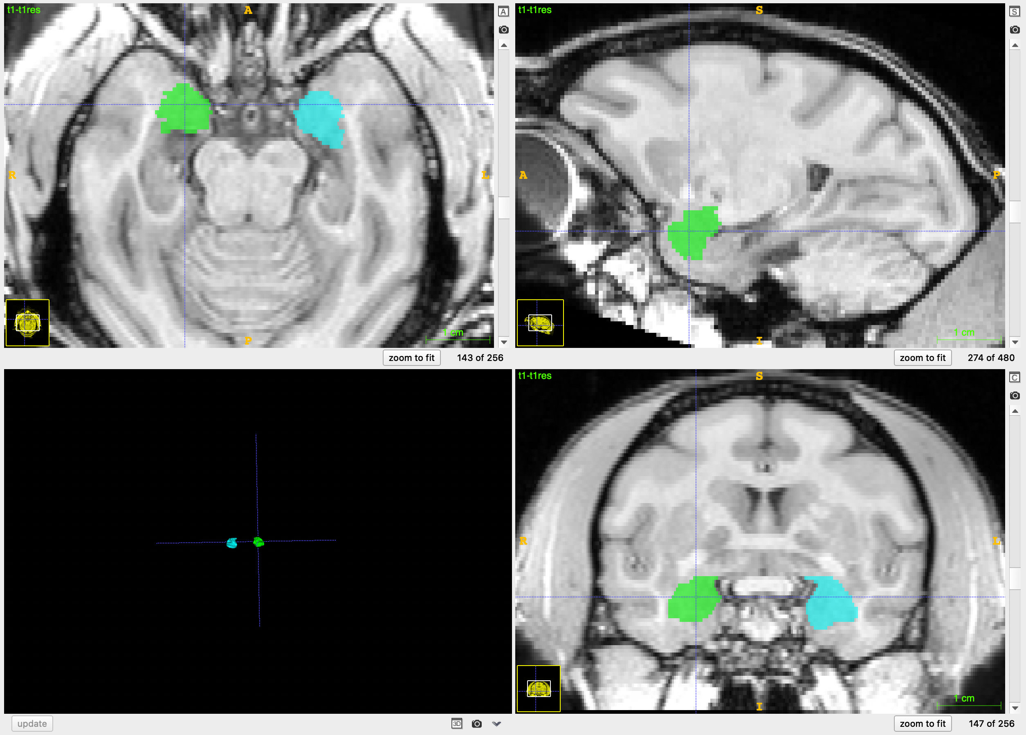
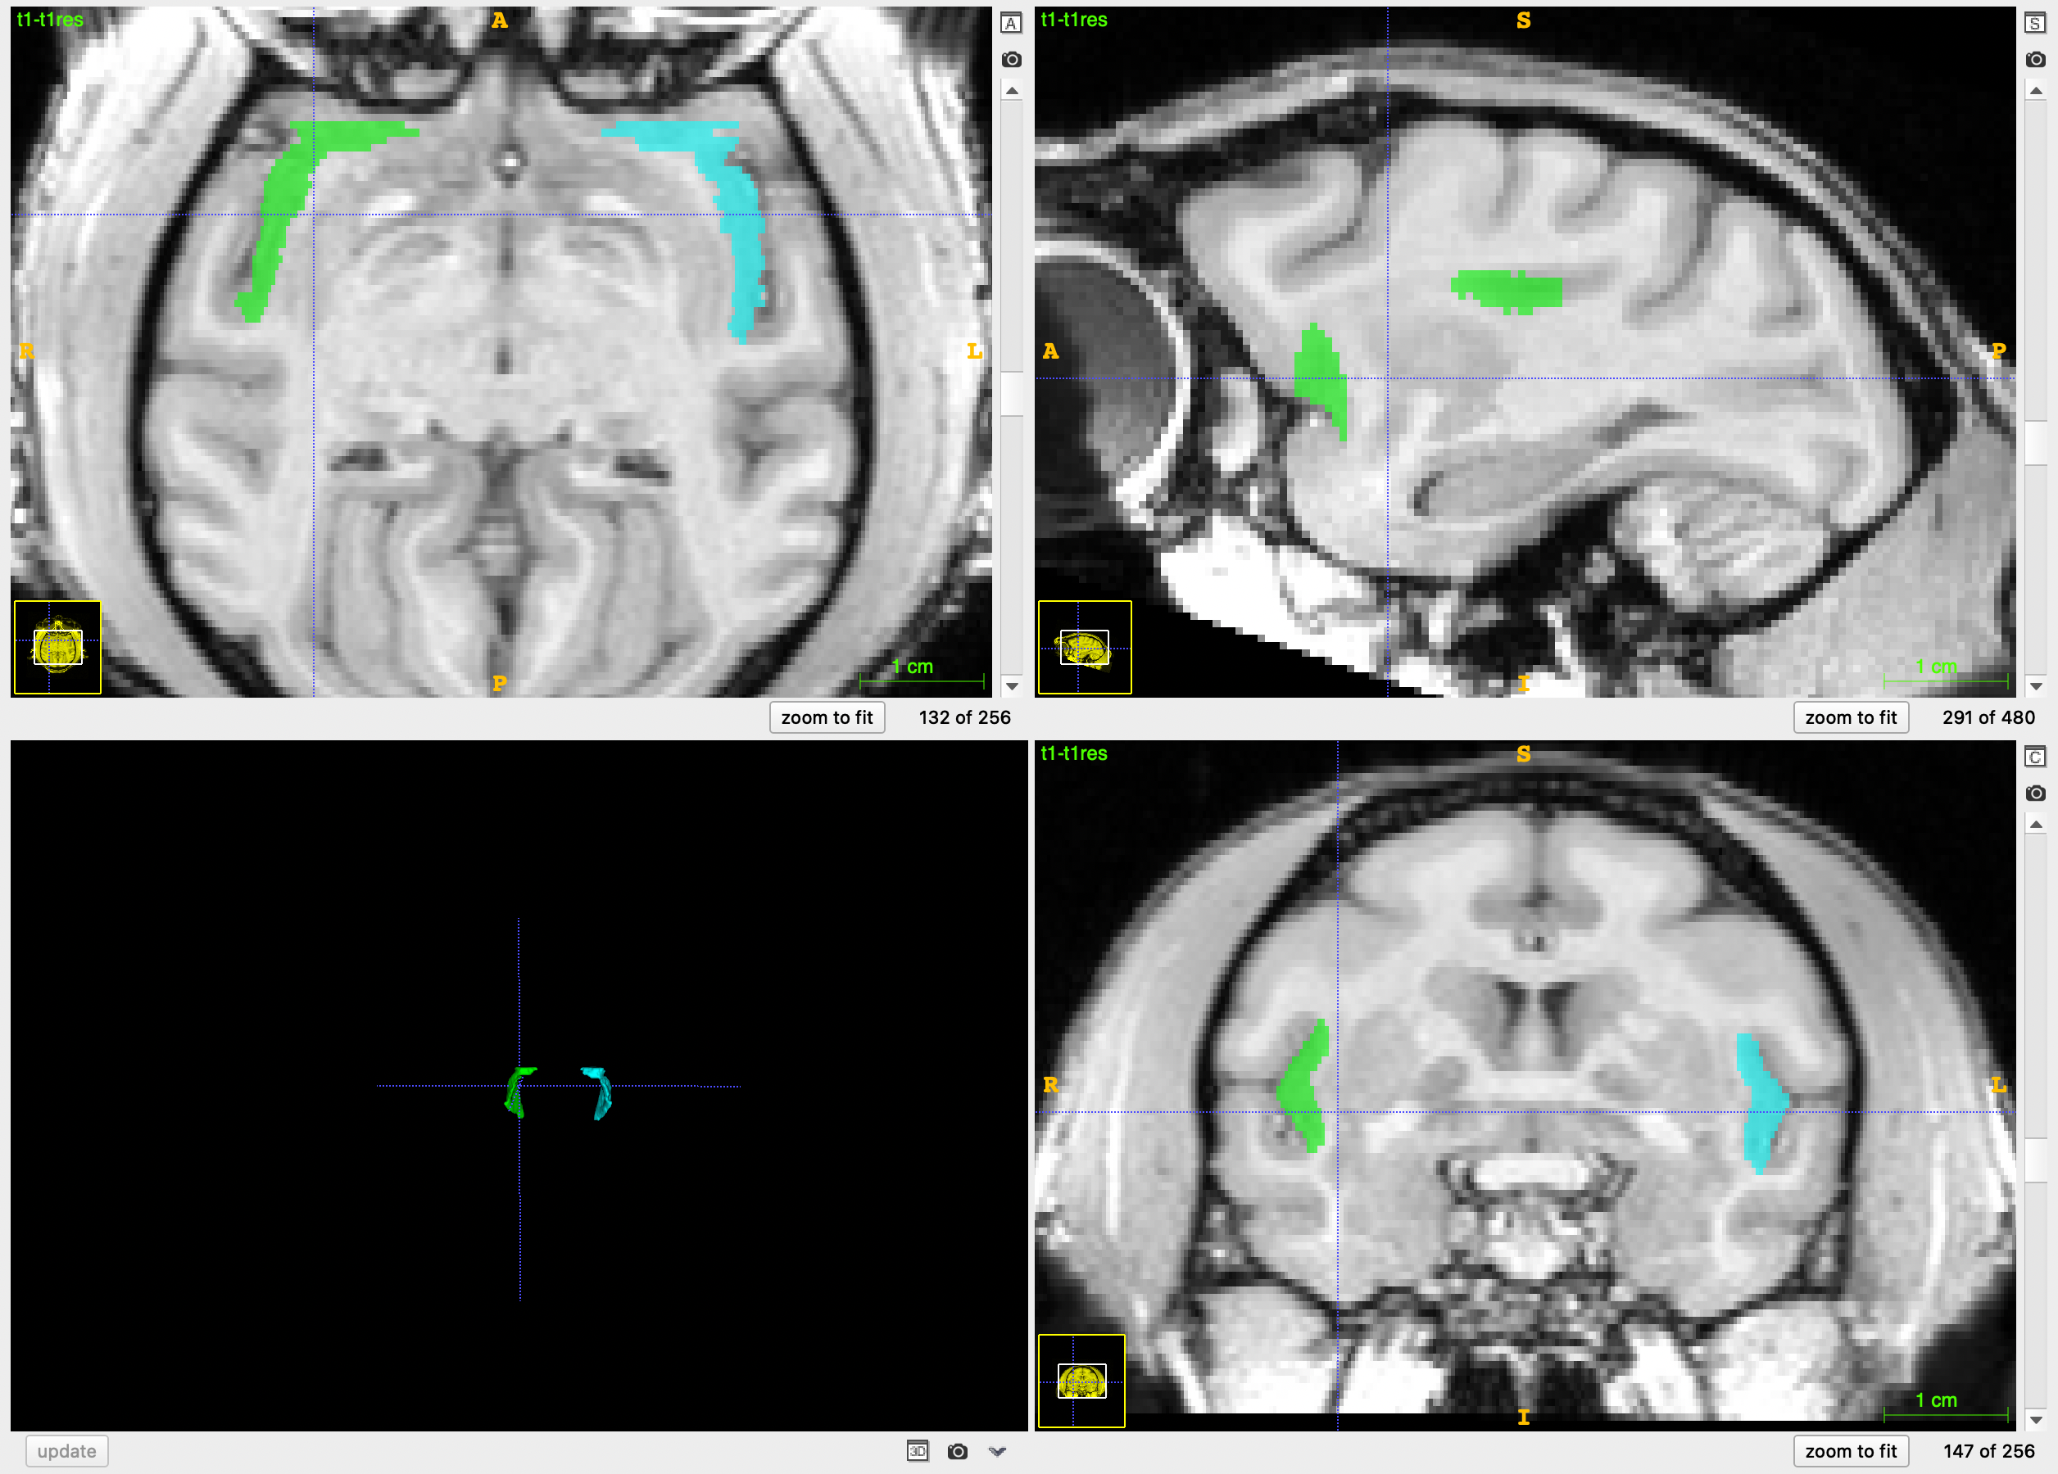
Methods: Hand Segmentation of ROIs
Yushkevich et al., 2006
Subcortical Amygdala
Cortical Insula

Slide 8

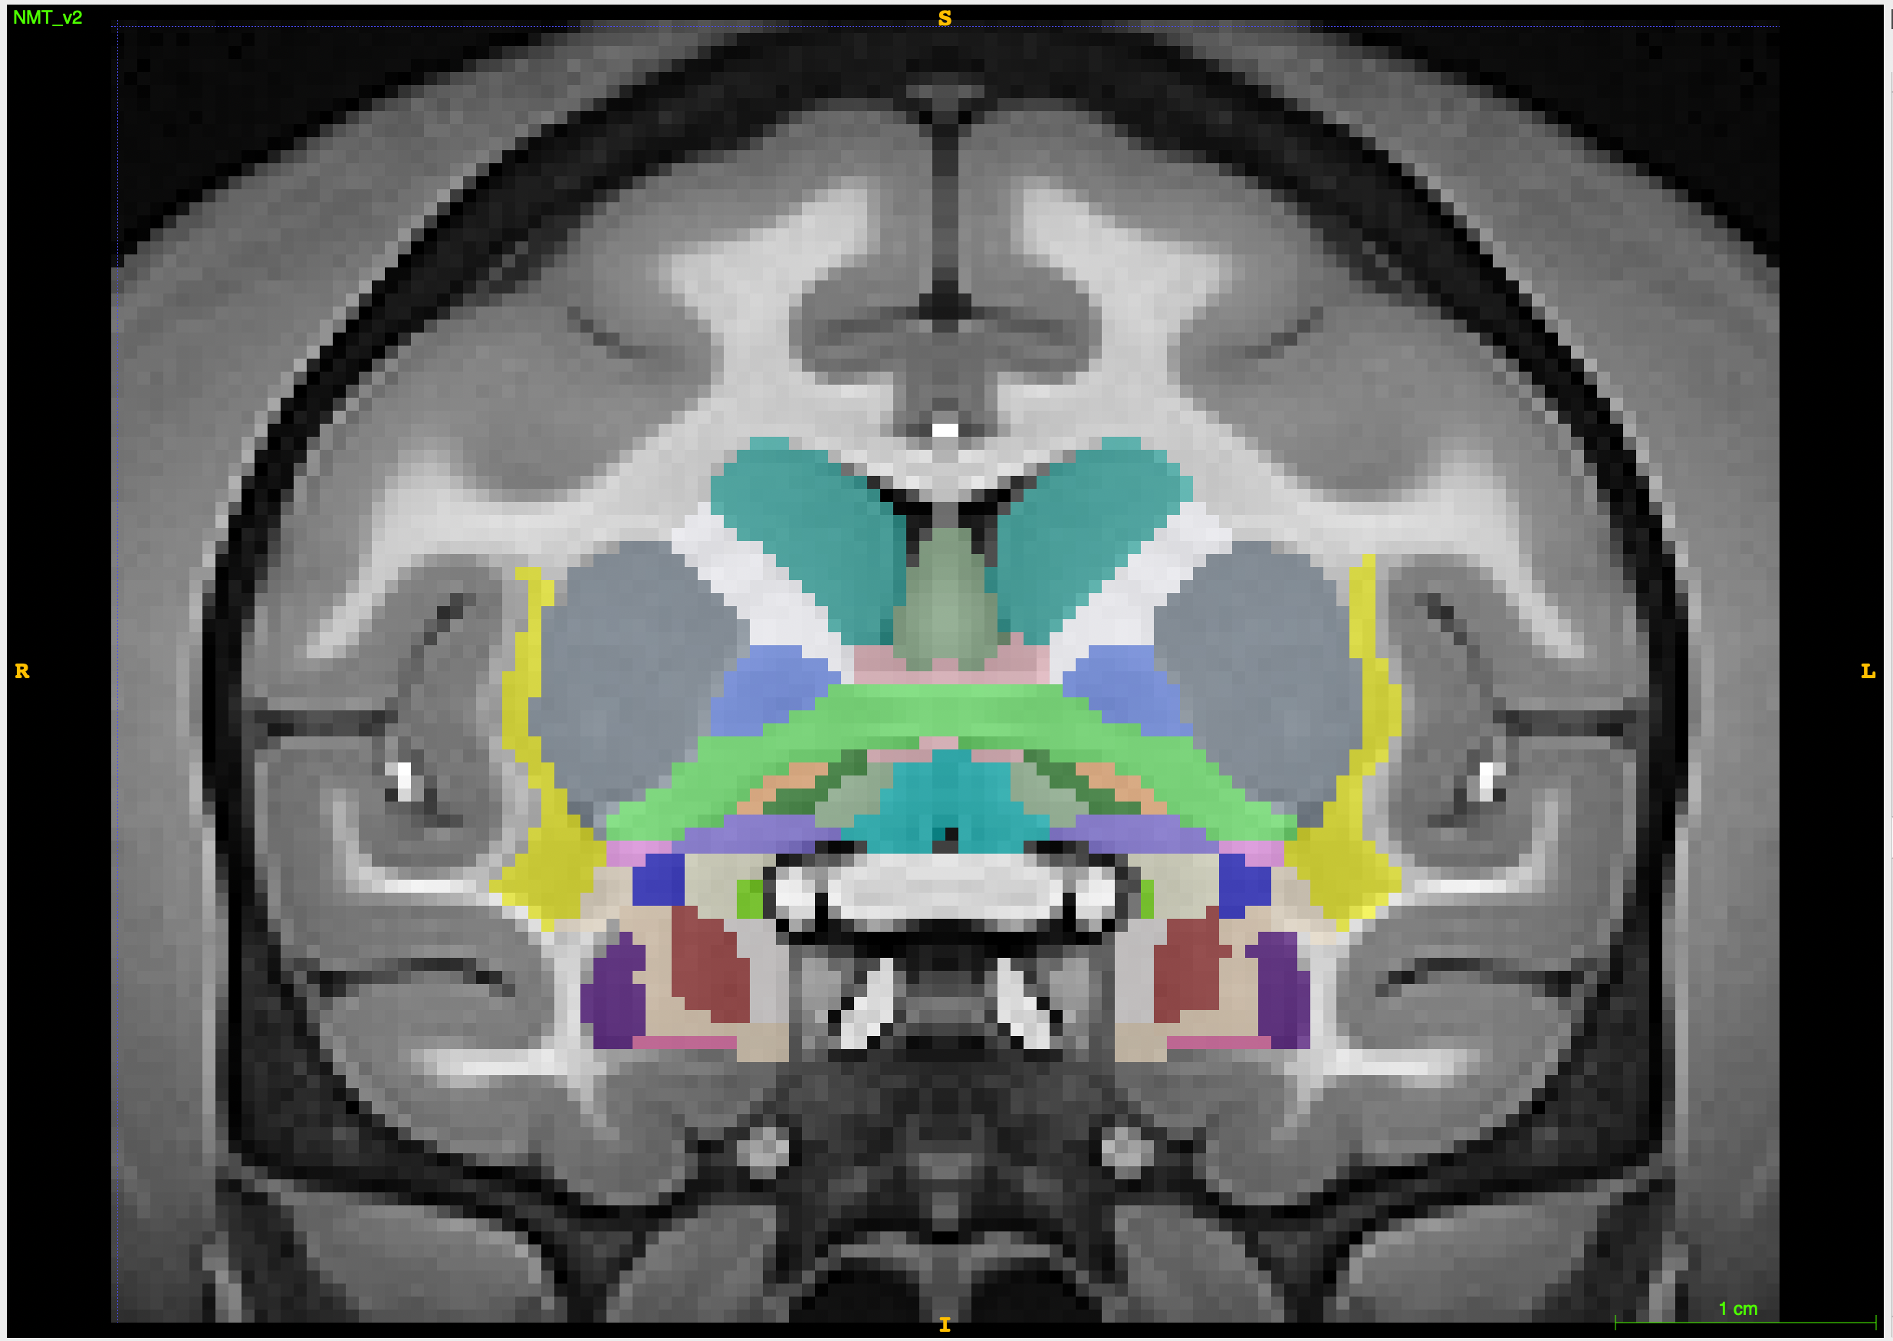
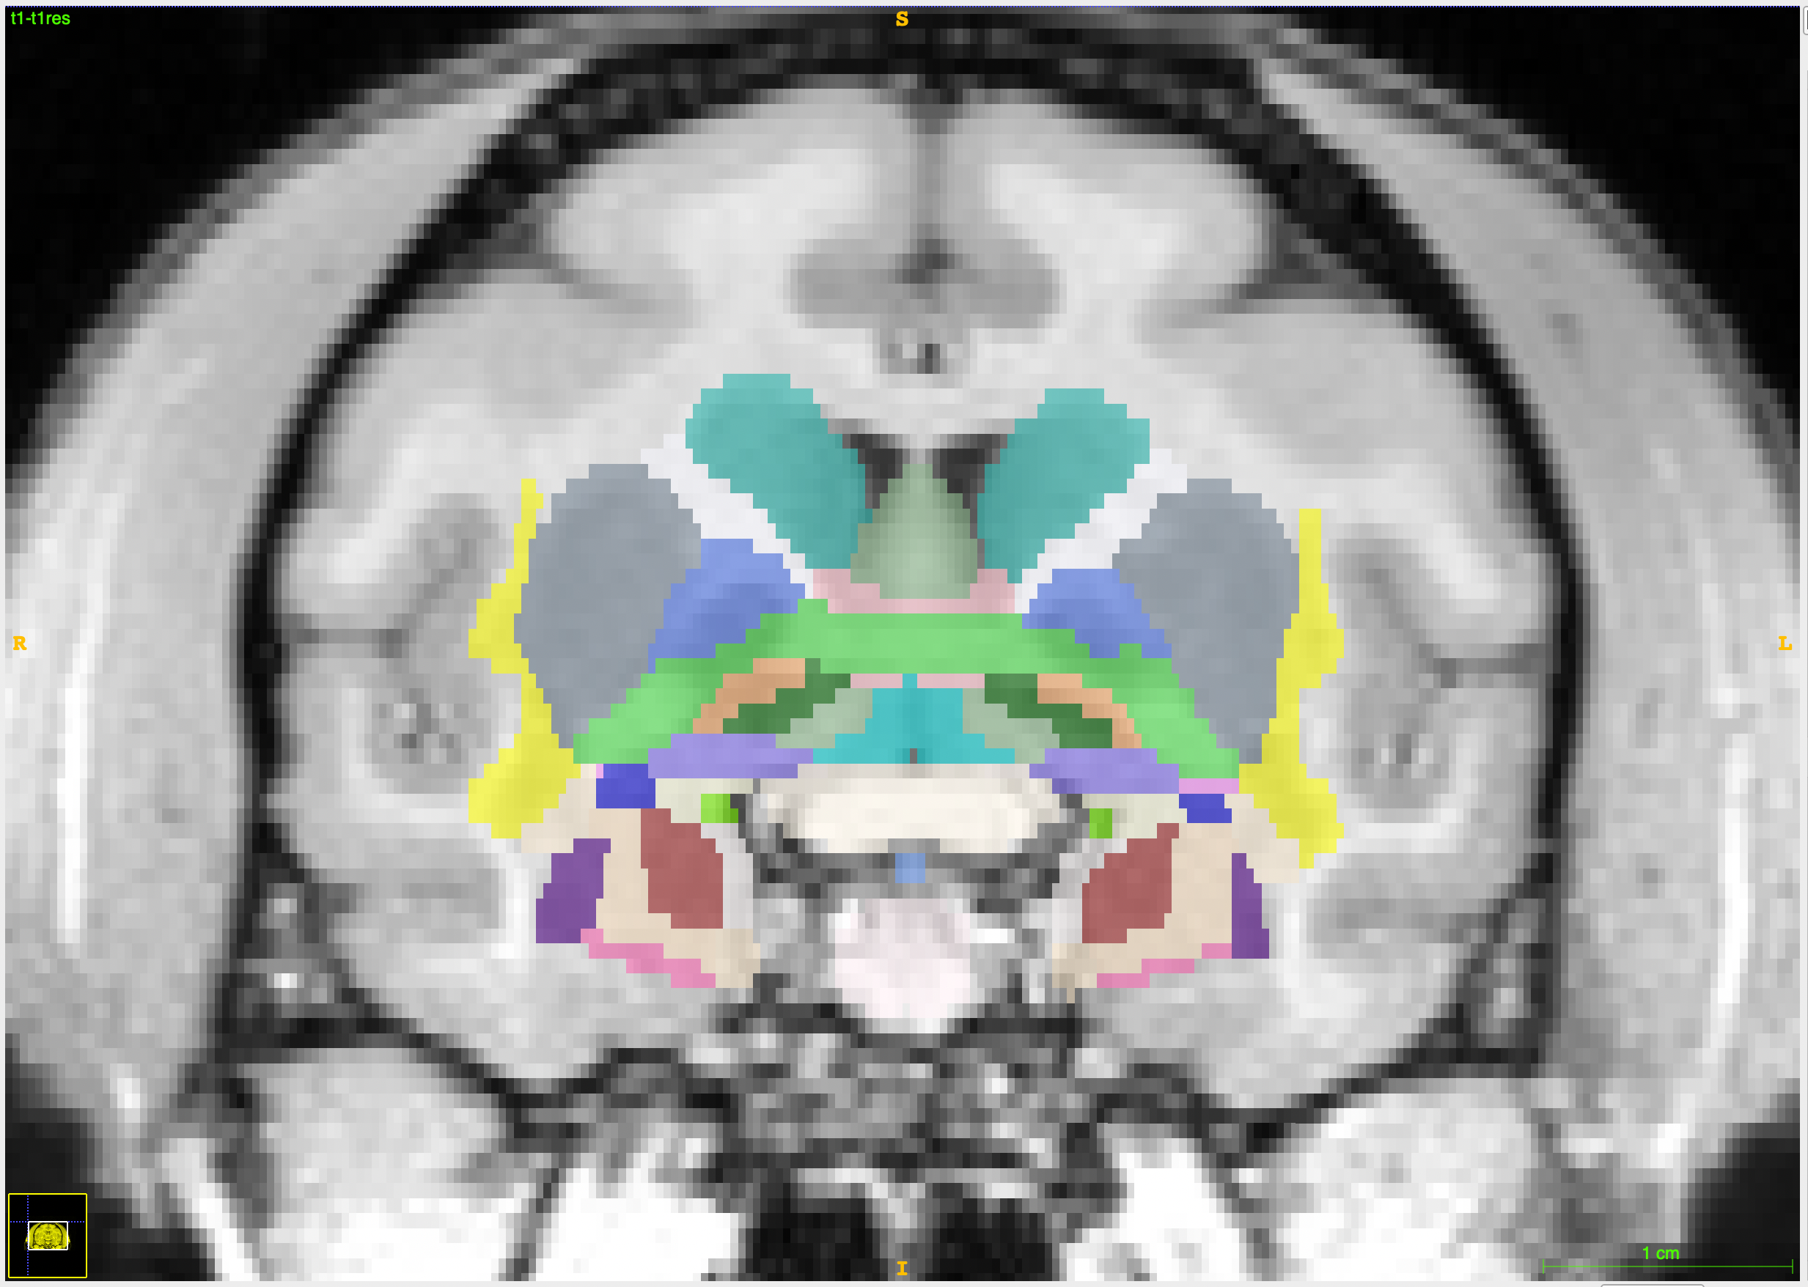
Methods: Automated Segmentation of Subcortical ROIs using SARM
Hartig et al., 2021
NMT v 2.0 Template Brain
Subject Brain

Slide 9
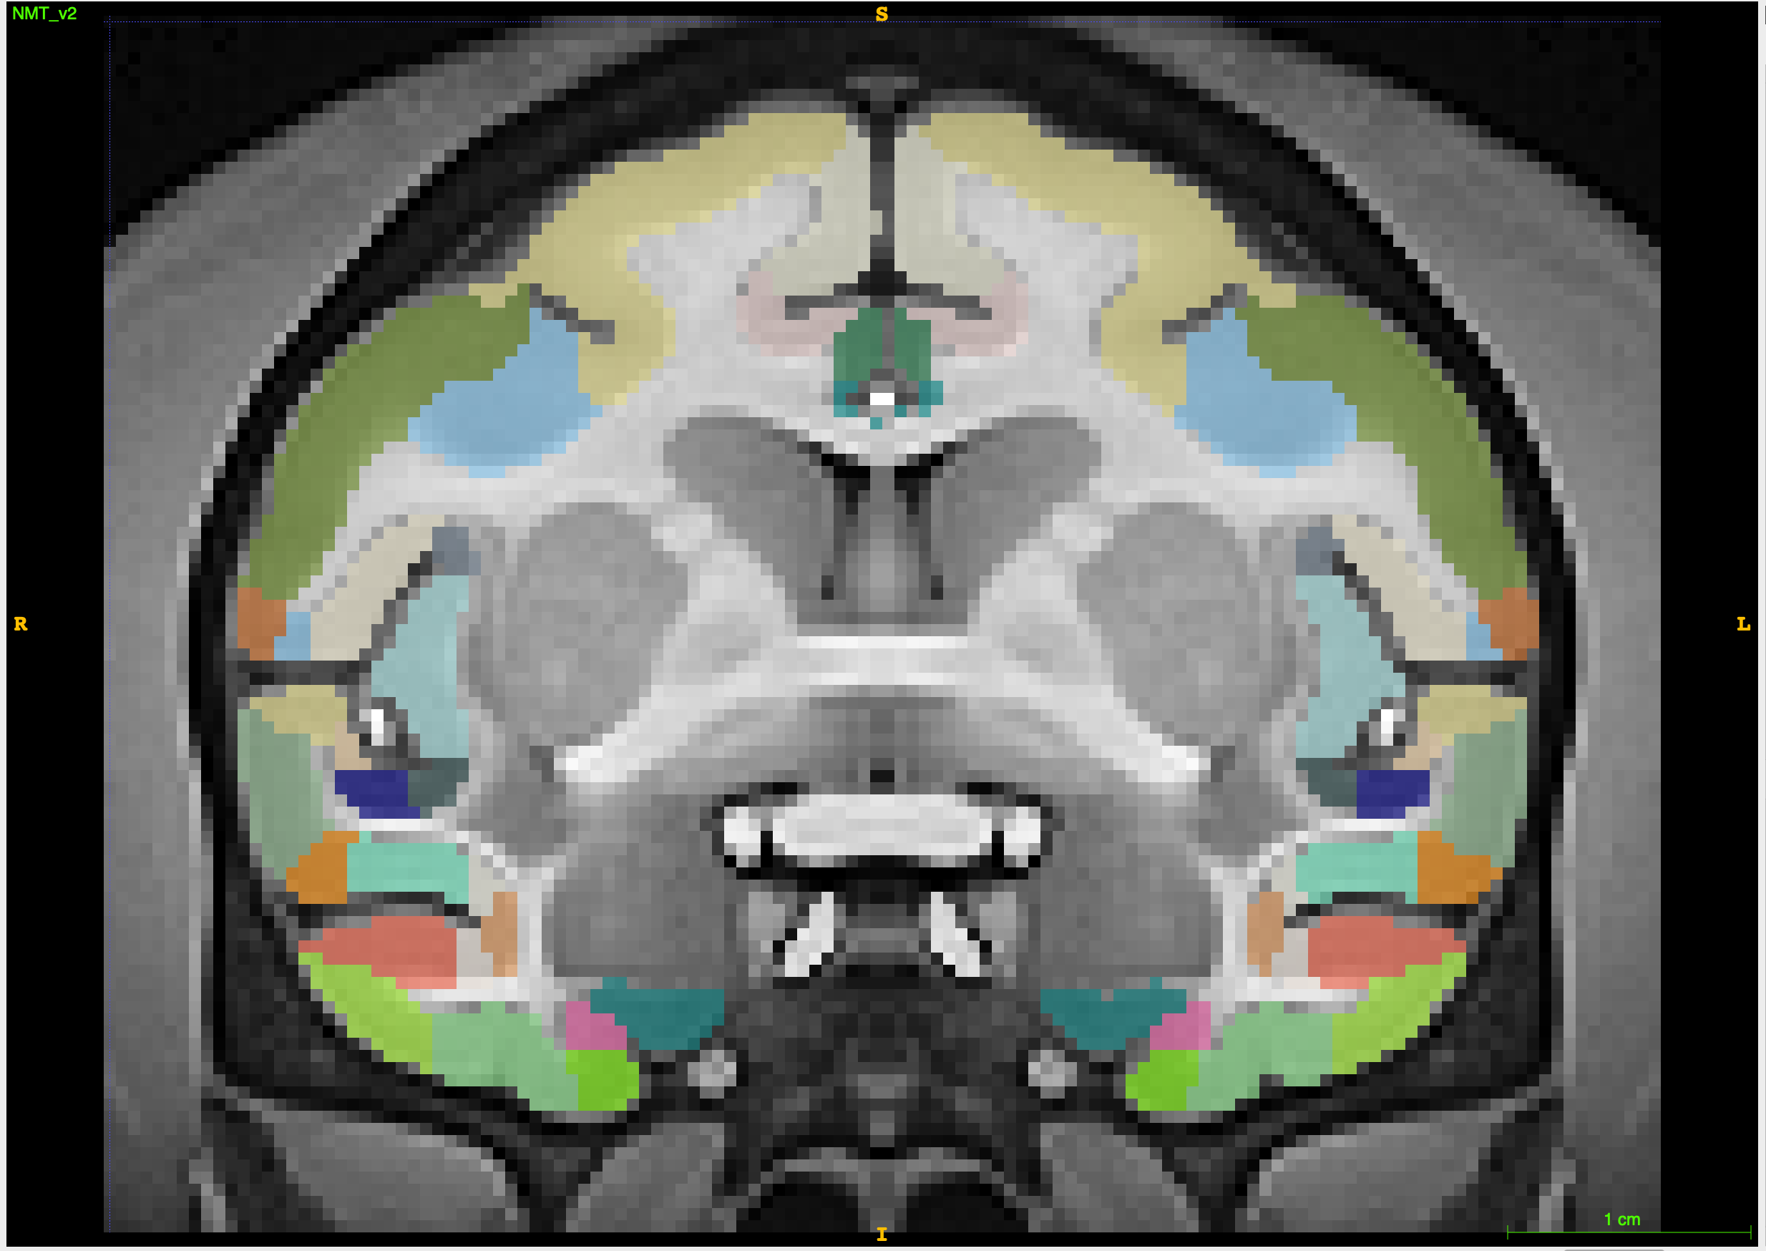
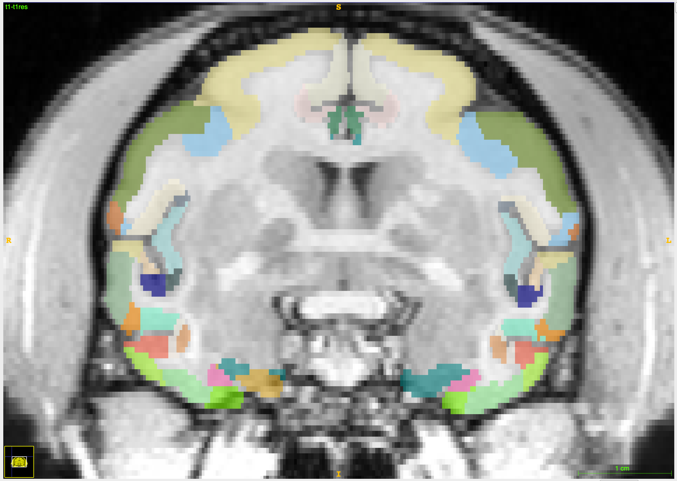
Methods: Automated Segmentation of Cortical ROIs using CHARM
Jung et al, 2021
NMT v 2.0 Template Brain
Subject Brain

Slide 10

Methods: Analysis
Plan:
  Calculate and compare relative volumes for amygdala and insula between automated and hand segmentation methods
  Are relative volumes from automated segmentation a significant predictor of volumes from hand segmentation?

Slide 11
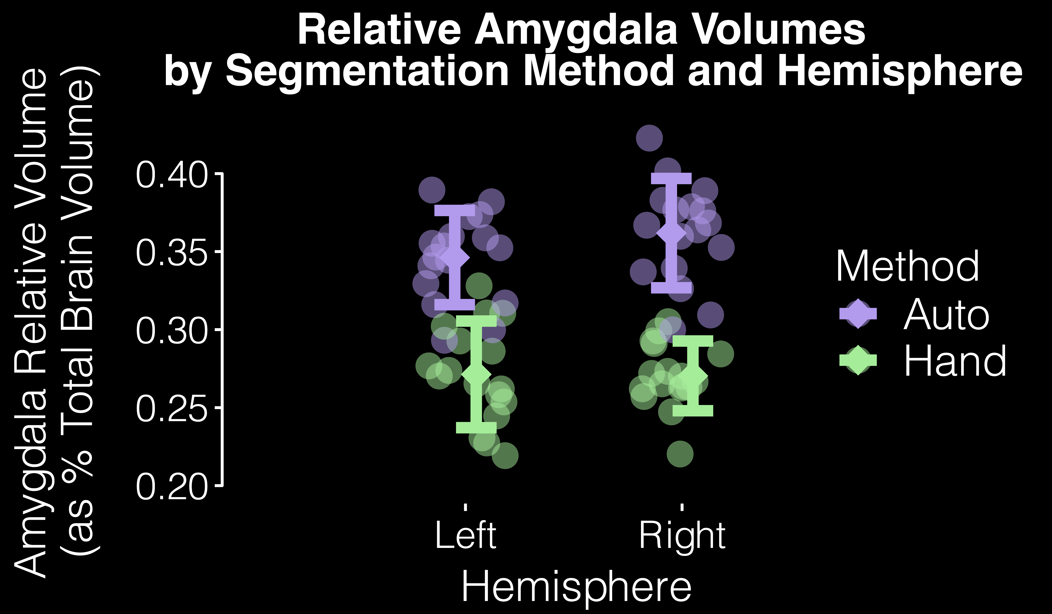
Results:

Slide 12
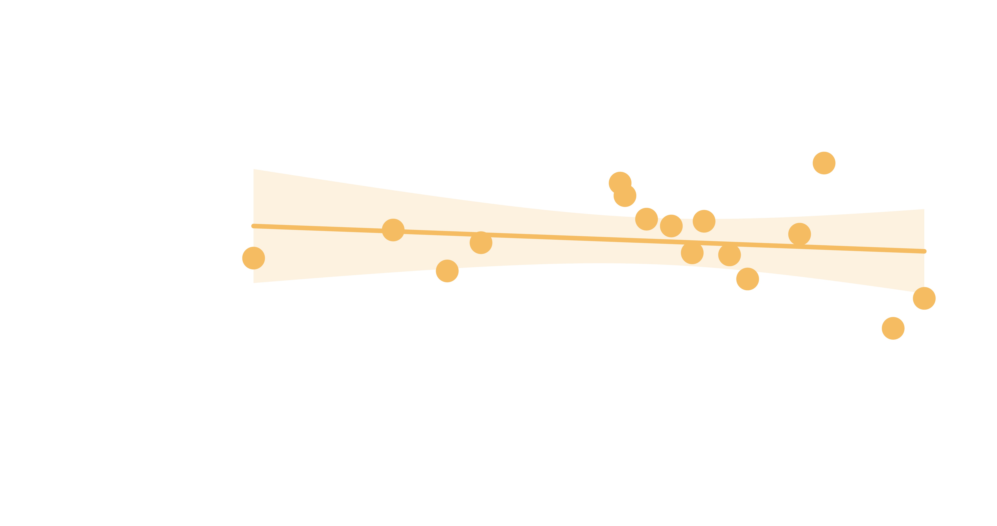
Results:
Linear Mixed Model :
  Auto segmented volume was NOT a significant predictor of hand segmented volume
    χ² (1) = 0.35, p = 0.56
  No effect of age
    χ² (1) = 0.38, p = 0.53
  No effect of sex
    χ² (1) = 1.96, p = 0.16
  r = -0.16
  p = 0.54

Slide 13
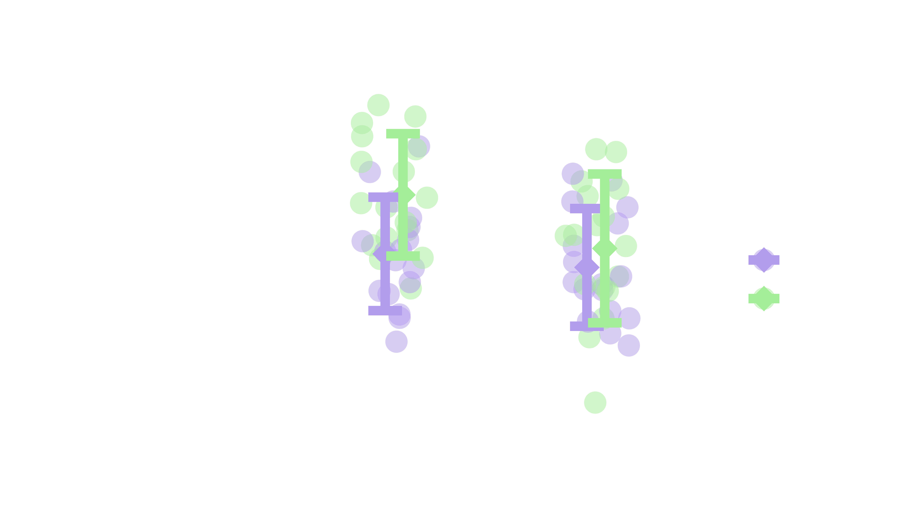
Results:

Slide 14
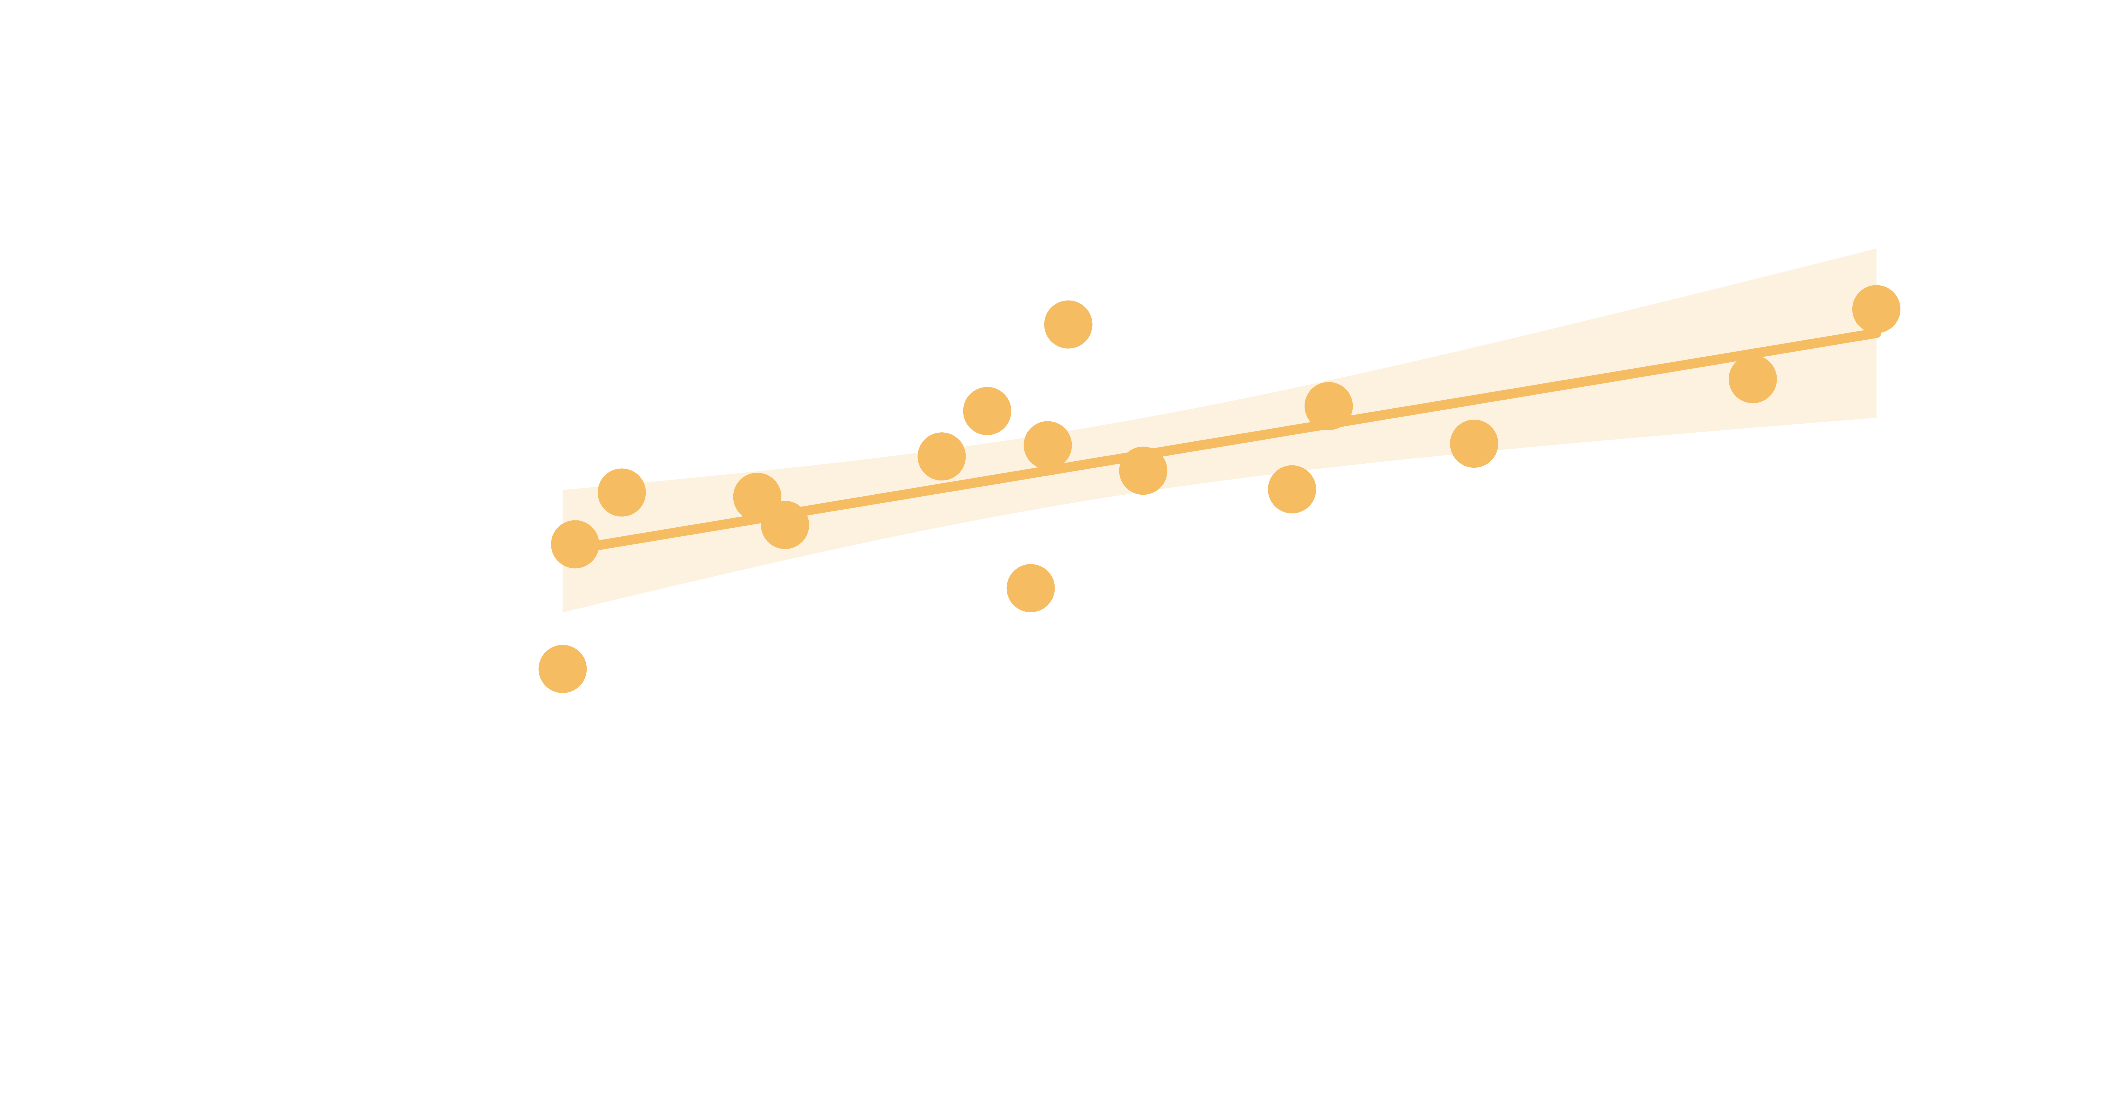
Results:
Linear Regression Model :
  Auto segmented volume WAS a significant predictor of hand segmented volume
    χ² (1) = 10.91, p < 0.001
  No effect of age
    χ² (1) = 0.04, p = 0.83
  No effect of sex
    χ² (1) = 0.57, p = 0.45
  r = 0.71
  p < 0.01

Slide 15
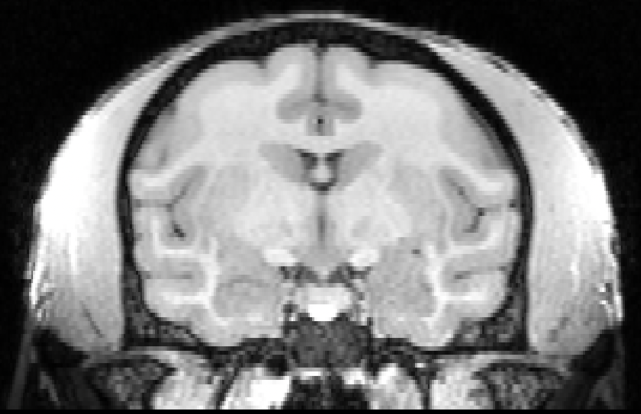
Results and Interpretation
Automated segmentation volumes were a significant predictor for hand segmentation volumes in the insula but not in the amygdala.
  Differences in grey-white matter boundaries?
Implications: Using automated atlases may lead to drawing incorrect conclusions about the volumes of anatomical structures and their relationships to one another.

Slide 16

Future Directions
Expand data set to include second cohort (this summer)
Troubleshoot and optimize automated segmentation methods
  Create our own mask on NMT brain, utilize pipeline to apply that
  Consider surface or hybridized automated methods
  Currently working with one of the developers of these atlases to troubleshoot differences between SARM and manual methods
Investigate the performance of automated segmentation methods in additional ROIs

Slide 17






Acknowledgements
Bliss-Moreau Laboratory
  PI: Eliza Bliss-Moreau, PhD
  Staff Research Associate: Jeff Bennett
  PhD Candidate: Joey Charbonneau
  Postdoctoral Scholar: Erika Raven, PhD
Financial support was provided by the Students Training in Advanced Research (STAR) Program through a UC Davis School of Veterinary Medicine Endowment Fund

Slide 18
References
Hartig, R., Glen, D., Jung, B., Logothetis, N. K., Paxinos, G., Garza-Villarreal, E. A., Messinger, A., & Evrard, H. C. (2021). The Subcortical Atlas of the Rhesus Macaque (SARM) for neuroimaging. Neuroimage, 235, 117996. https://doi.org/10.1016/j.neuroimage.2021.117996
Jung, B., Taylor, P. A., Seidlitz, J., Sponheim, C., Perkins, P., Ungerleider, L. G., Glen, D., & Messinger, A. (2021). A comprehensive macaque fMRI pipeline and hierarchical atlas. Neuroimage, 235, 117997. https://doi.org/10.1016/j.neuroimage.2021.117997
Paxinos, G., Huang, X.F., Petrides, M., Toga, A.W. (2009). The Rhesus Monkey Brain in Stereotaxic Coordinates (2nd Ed.) Academic Press, Elsevier Inc..
Saleem, K., & Logothetis, N. (2012). A combined MRI and Histology Atlas of the Rhesus Monkey Brain in Stereotaxic Coordinates. 2nd edition with Horizontal, Coronal, and Sagittal Series. Elsevier/Academic Press.
Seidlitz, J., Sponheim, C., Glen, D., Ye, F. Q., Saleem, K. S., Leopold, D. A., Ungerleider, L., & Messinger, A. (2018). A population MRI brain template and analysis tools for the macaque. Neuroimage, 170, 121-131. https://doi.org/https://doi.org/10.1016/j.neuroimage.2017.04.063
Yushkevich, P. A., Piven, J., Hazlett, H. C., Smith, R. G., Ho, S., Gee, J. C., & Gerig, G. (2006). User-guided 3D active contour segmentation of anatomical structures: Significantly improved efficiency and reliability. Neuroimage, 31(3), 1116-1128. https://doi.org/https://doi.org/10.1016/j.neuroimage.2006.01.015

Slide 19
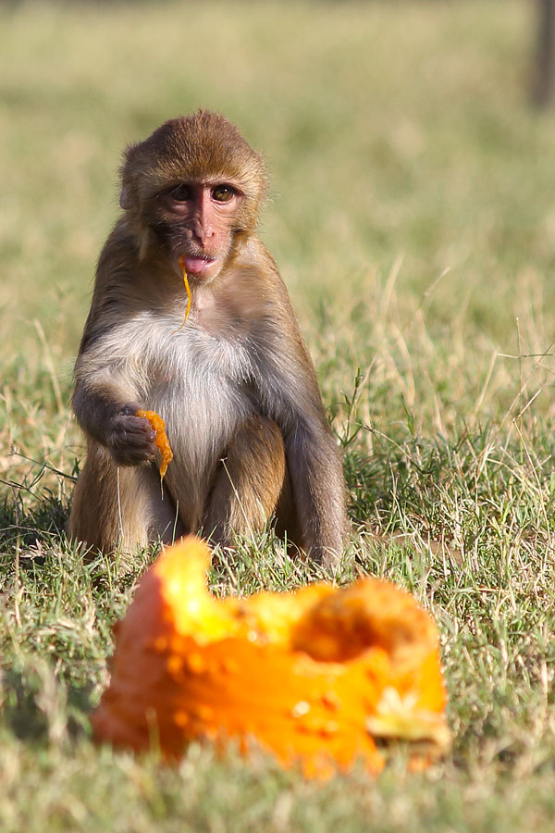
Questions?
cnprc.ucdavis.edu

Slide 20
Supplemental Slides

Slide 21
Animal Descriptive Data: Age

Slide 22
Animal Descriptive Data: Weight

Slide 23
Automated Segmentation Process
Template Brain
Atlas
Pipeline
AFNI @animal_warper
NMT
CHARM
SARM

Slide 24
Amygdala AS ROIs
BM | basomedial amygdaloid nucleus
VCo | ventral cortical amygdaloid nucleus
AHi | amydalopiriform transition
La | lateral amygdaloid nucleus
APir | amygdalopiriform transition
BL | basolateral amygdaloid nucleus
PaL | paralaminar amygdaloid nucleus
Me | median amygdaloid nuclues
AA | anterior amygdaloid area
STIA | intra-amygdaloid division of the bed nucleus of the stria terminalis
Insula AS ROIs
Iam/Iapm | medial agranular insular region
Iai | intermediate agranular insula area
Ial | lateral agranular insula area
Iapl | posterior lateral agranular insula area
G | gustatory cortex
Pi | parainsula
Ia/Id | agranular and dysgranular insula
Ig | granular insula
Ri | retroinsula
Notes:
SARM/CHARM subregions included in amygdala/insula volumetric calculations

Slide 25
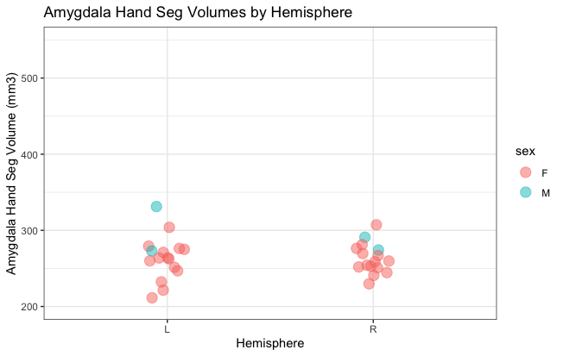
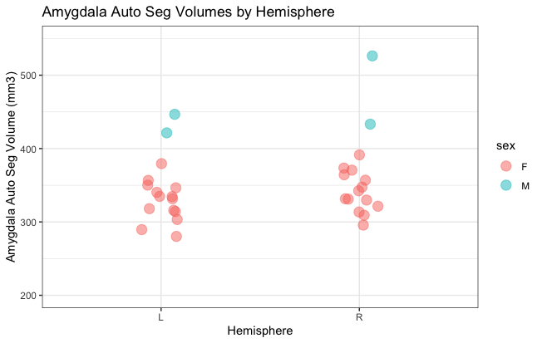
Results: Amygdala (Absolute Volumes)
Hand Seg:
Mean +/- SD L: 263.9464 +/- 29.2117
Mean +/- SD R: 263.1116 +/- 19.7427
Auto Seg:
Mean +/- SD L: 341.4677 +/- 44.1882
Mean +/- SD R: 358.6346 +/- 56.3938
Notes:
The male with the highest points on the AS is the male who wouldn’t fit in the stereotax.

Slide 26
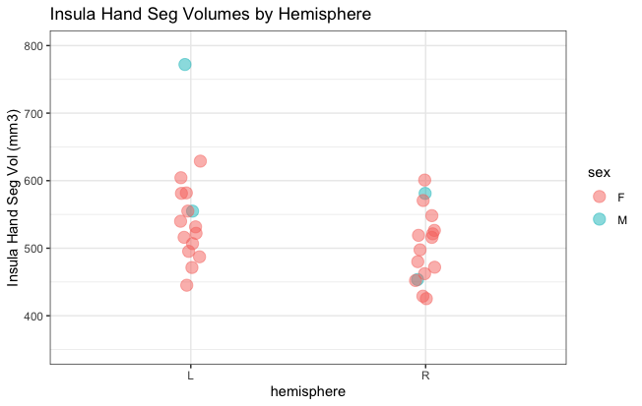
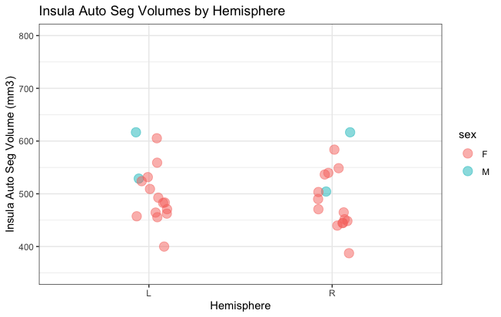
Results: Insula (Absolute Volumes)
Hand Seg:
Mean +/- SD L: 549.6392 +/- 76.9402
Mean +/- SD R: 503.4722 +/- 53.7549
Auto Seg:
Mean +/- SD L: 502.7597 +/- 56.8576
Mean +/- SD R: 492.1816 +/- 60.3310
Notes:
The outlier on the left HS is the male who didn’t fit in the stereotax.

Slide 27
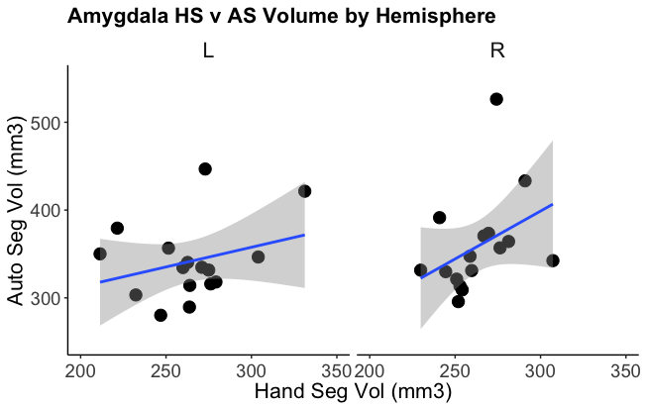
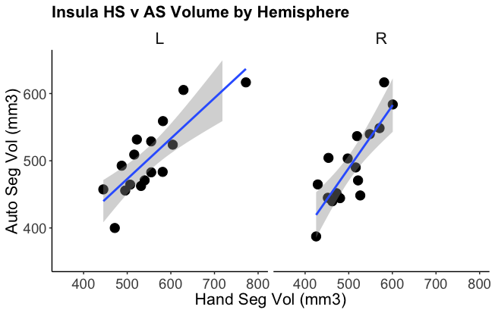
Auto v Hand Seg By Hemisphere
Amygdala
Insula

Slide 28
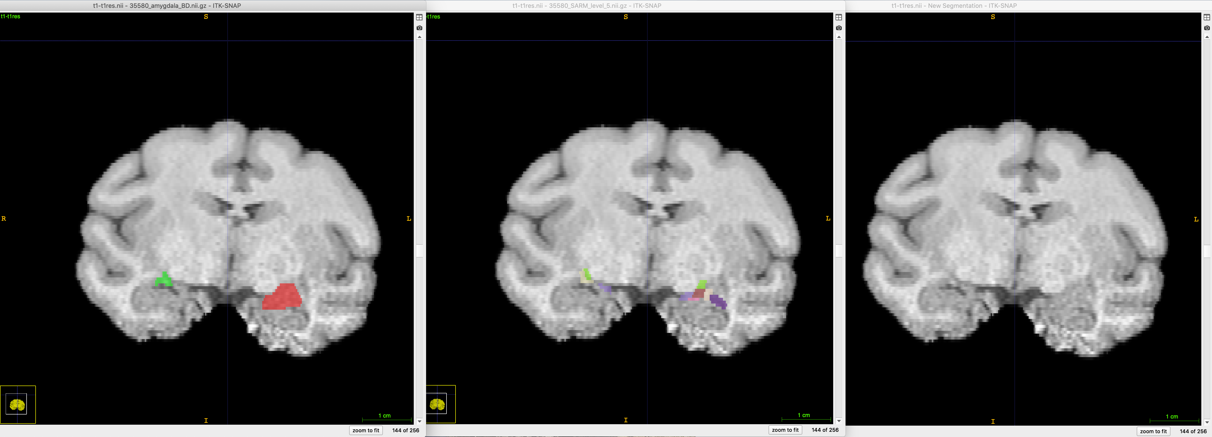
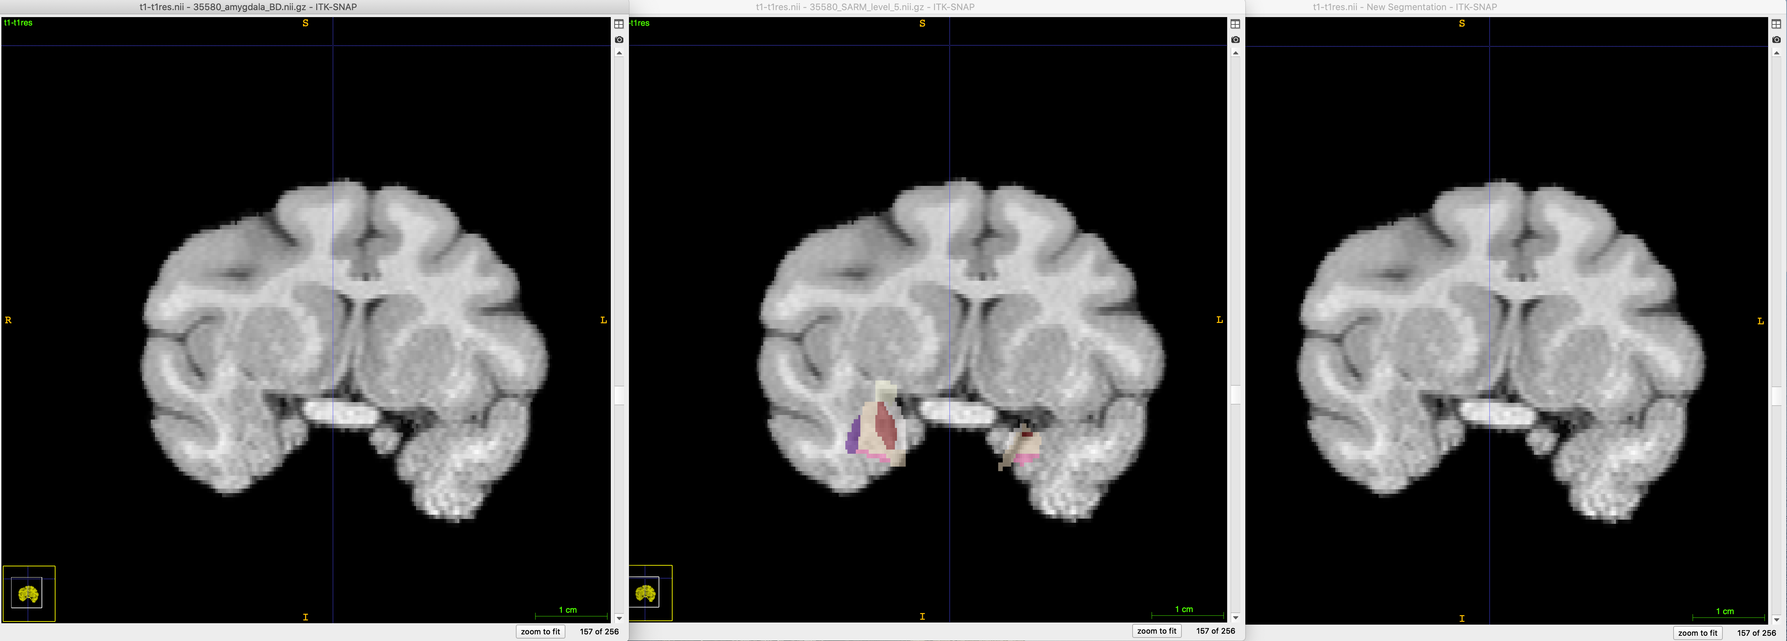
35580 segmentation differences
L-most pane: hand segmentation
Middle pane: auto segmentation
R-most pane: no segmentation
Notes:
Screenshots comparing hand and auto parcellations

Slide 29
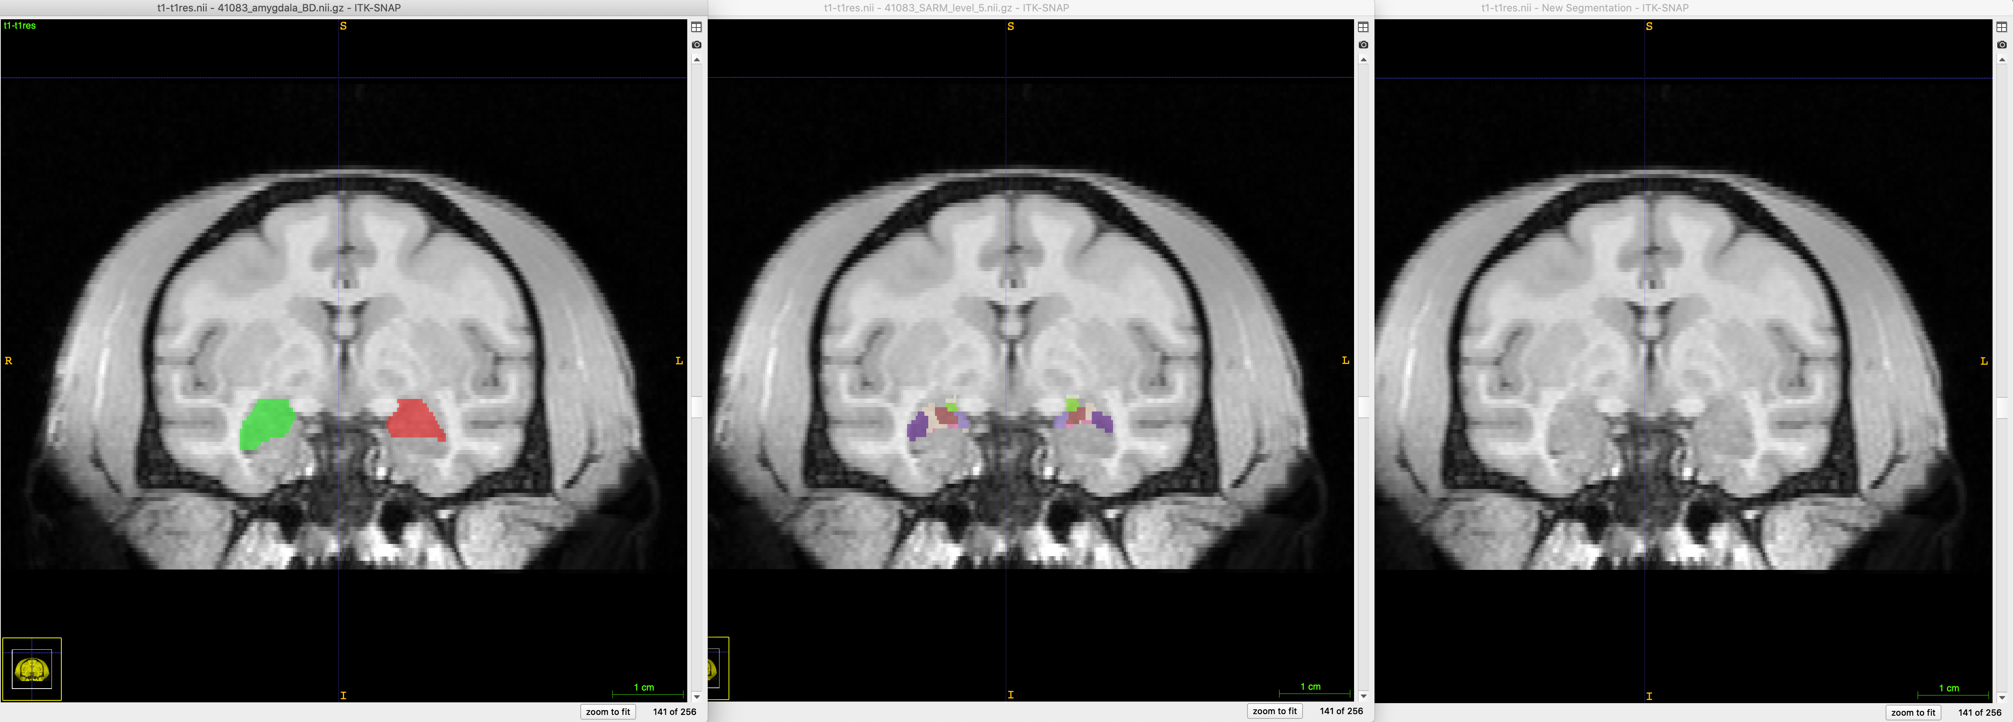
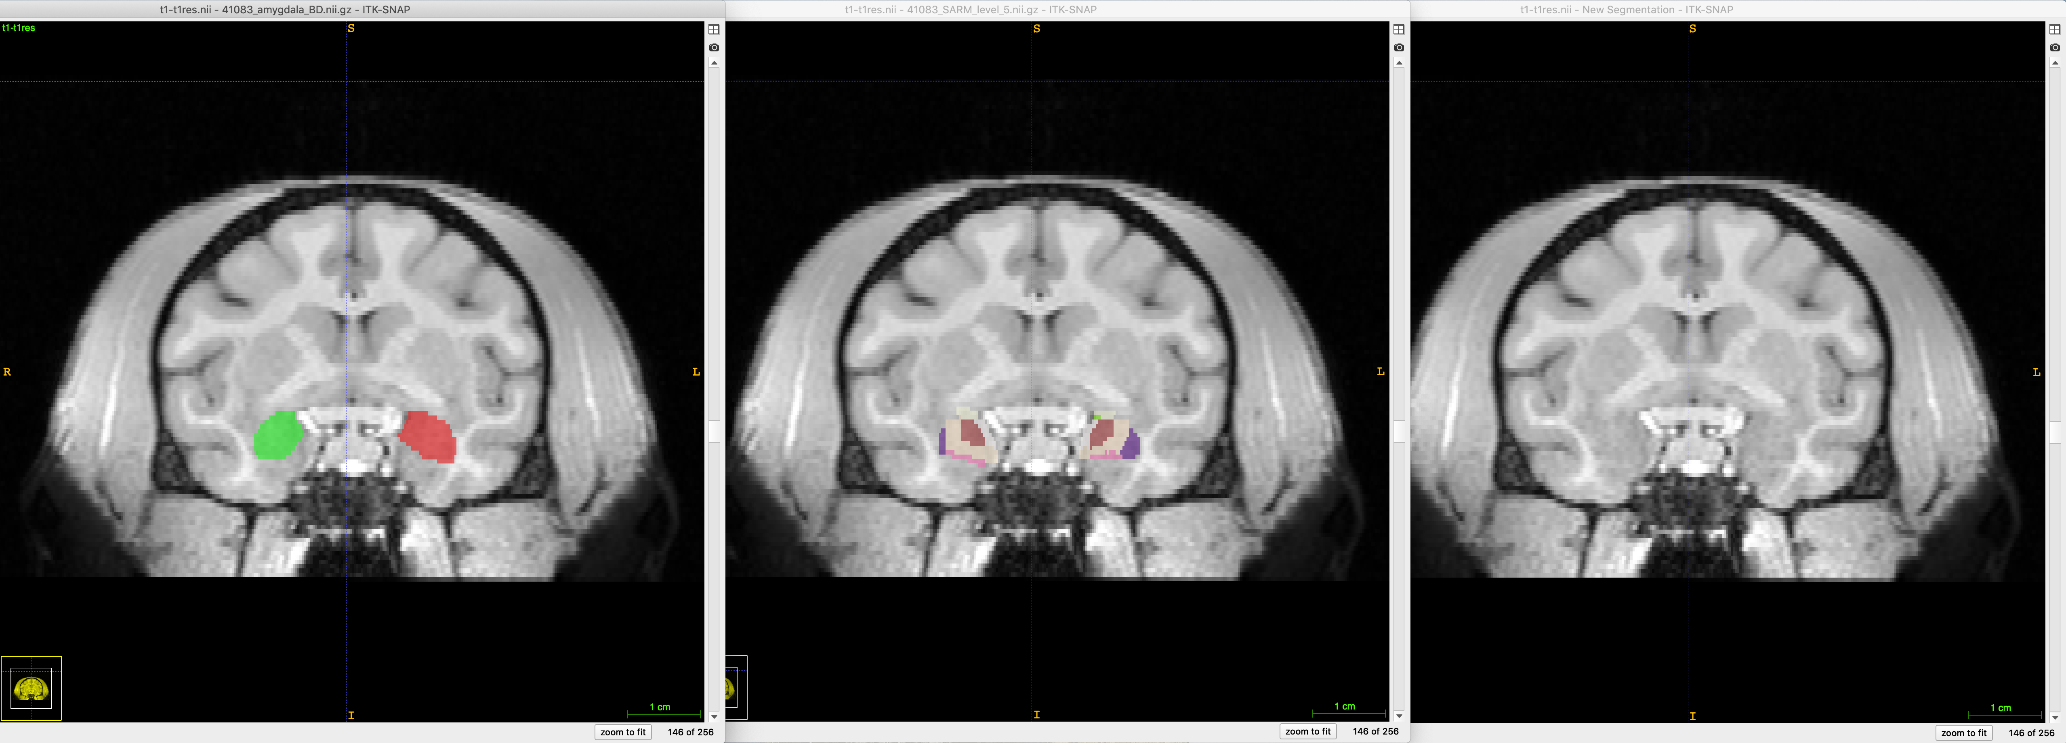
41083 segmentation differences
L-most pane: hand segmentation
Middle pane: auto segmentation
R-most pane: no segmentation
Notes:
Screenshots comparing hand and auto parcellations

