Slide 1
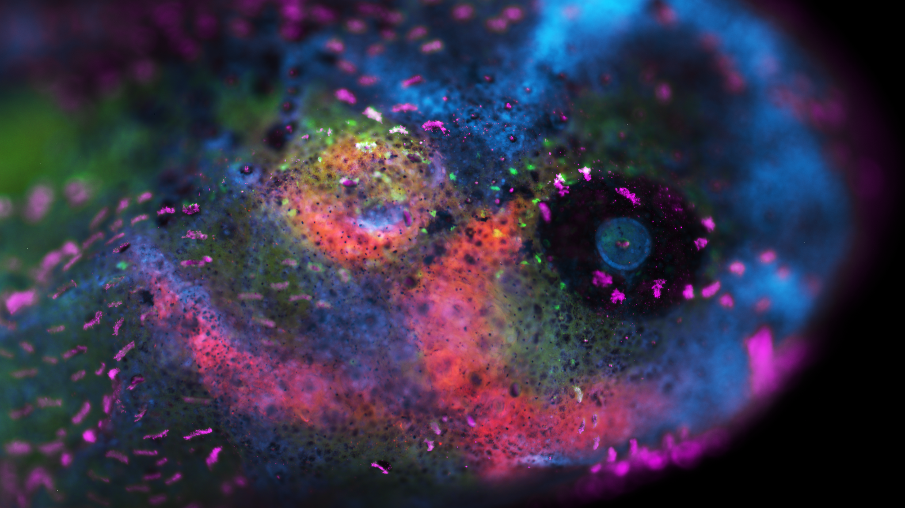
Consequences of Naproxen Exposure During Early Development on NCC-derived Cartilage Formation
MJ Marshall
STAR 2022
Rogers’ Lab UC Davis

Slide 2
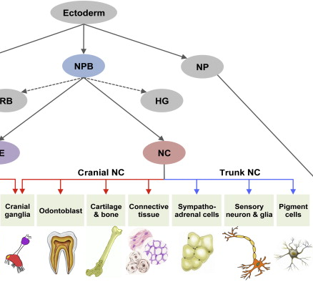
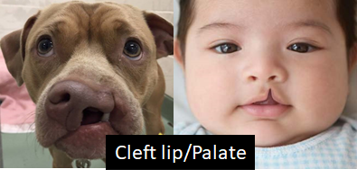
NSAIDs and neurocristopathies
Neural crest cells are multipotent progenitors
NSAIDs like naproxen inhibit the enzyme cyclooxygenase
Disruption of bone healing post fracture
In utero exposure causes birth defects
Bae and Saint-Jeannet, Evol Dev and Disease, 2014
Notes:
Neural crest cells are a population of multipotent, mesenchymal, stem-like cells which give rise to a variety of tissues in the adult organism including cranial cartilage and bone, schwann cells, peripheral nerves of the enteric nervous system, and melanocytes. Since they give rise to such a diverse set of cell types and tissues, aberrations in their development can lead to a wide variety of developmental disorders known broadly as neurocristopathies with a common example being cleft palate. Dr. Rogers’ Lab is focused on investigating neural crest development with a specific focus on identifying the molecular mechanisms involved in normal neural crest specification, migration, and differentiation in a variety of vertebrate models. Related preliminary experiments from the Rogers Lab identified expression of the enzymes cyclooxygenase 1 and 2 in the neural tube region during early embryonic development. Cyclooxygenase is an enzyme involved in the production of cell mediator molecules called prostaglandins from arachidonic acid and is inhibited by the commonly used class of drugs know as non-steroidal anti-inflammatory drugs or NSAIDs. We know that NSAIDs interfere with bone healing after fracture and have been linked to many birth defects such as preterm birth, neural tube closure defects, and orofacial malformations following in utero exposures. From the types of defects that arise from NSAID exposure and the localization of COX expression during development, it is clear that neural crest cells are implicated as targets of NSAIDs which led me to investigate in my project the consequences of exposure to the NSAID naproxen on craniofacial cartilage development from neural crest progenitors.
Neural crest derivatives
Neurocristopathies
Rogers Lab Mission and prior research
Cyclooxygenase function and NSAIDs
NSAIDs and birth defects

Slide 3
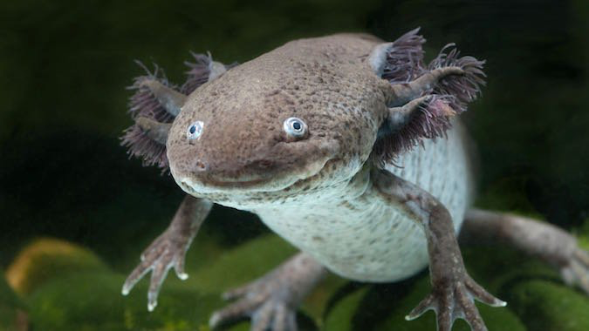
Encouraging responsible use of NSAIDs
Informed decision-making regarding NSAID use
Human and veterinary medicine
Notes:
Despite how commonly naproxen is used in the mitigation of pain and inflammation, the effects of naproxen on developing embryos are poorly understood and should be evaluated to determine potential risks for use during pregnancy in both human and veterinary medicine. In my experiment, we are using the aquatic axolotl, an externally developing vertebrate model, as an indicator species to identify risks related to exposure to naproxen during development— information which could extend to applications in human pain management, treatment of osteoarthritis in pregnant animals in veterinary medicine, and recommendations for physicians to encourage responsible use of NSAIDs to their patients and the public.
Pain management
Treating osteoarthritis in pregnant animals
Encouraging responsible use of NSAIDs

Slide 4
Identifying molecular mechanisms linking NSAID exposure and neurocristopathies
Overall Goal: Understand the molecular changes underlying the development of orofacial malformations following exposure to NSAIDs
Key Questions:
What is the phenotype of axolotls that develop following exposure to naproxen (NPX) during early development?
What is the nature of the dose-response relationship that exists between exposure to naproxen and the degree of cranial cartilage defects that occur?
When is the stage of susceptibility of axolotl embryos to perturbations in cartilage development from NCCs due to exposure to naproxen?
Notes:
The goal of my project is to better understand the molecular changes underlying the development of craniofacial malformations following exposure to NSAIDs in early development. I’m interested in investigating the relationship that exists between the level of naproxen exposure during development and the severity of the development defects that occur, as well as understanding if there is a specific window of susceptibility of these embryos to naproxen-induced craniofacial defects.

Slide 5
Hypothesis and Aims
Overall Goal: Understand the molecular changes underlying the development of orofacial malformations following exposure to NSAIDs
Hypothesis: Exposure to naproxen during early development will inhibit the normal formation of neural crest-derived cranial cartilage in axolotl embryos.
Specific Aims:
Aim 1: Dose-response relationship
Aim 2: Stage of susceptibility
Notes:
I hypothesized that inhibition of COX1 and COX2 signaling by exposure to naproxen during development will prevent normal chondrogenic differentiation of neural crest cells (NCCs) during orofacial development. My first aim of my project, which has now become the main focus of my STAR project, is to define the dose-response relationship that exists between the level of naproxen exposure during early development and the severity of neural crest-derived cartilage defects that develop. My second aim and future goal of my project is to better define the stage of susceptibility of axolotl embryos to naproxen-induced craniofacial defects based on the preliminary information I have gained from my current experiments which show altered craniofacial development in response to naproxen at later stages in development following the tailbud stages.

Slide 6
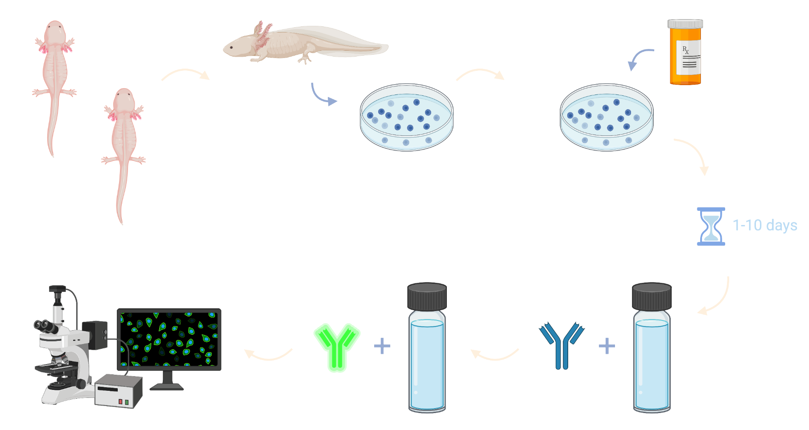
Methods: axolotl embryo exposures and analysis
Notes:
I started my experiment by mating a pair of axolotls from Dr. Rogers’ colony and harvesting the eggs over the next 12-96 hours. These eggs were incubated in an aquaria medium called Holtfreter’s solution until they were around stage 19 of axolotl development, having completed both gastrulation and neurulation. The embryos were separated into 4 treatments which were exposed to varying biologically relevant concentrations of naproxen including 5, 10, and 20 ug/mL. Embryos were exposed chronically to naproxen from stage 19 until one of three collections stages, either st 28, st 36 or st 45. These three developmental stages were chosen to give us a broad understanding of the molecular changes that occur due to NSAID exposure throughout the process of development but also to help narrow the stage of susceptibility to NSAID toxicity for future experiments. After collection, the embryos were incubated in antibody mixtures for immunohistochemistry and ultimately fluorescence microscopy.

Slide 7
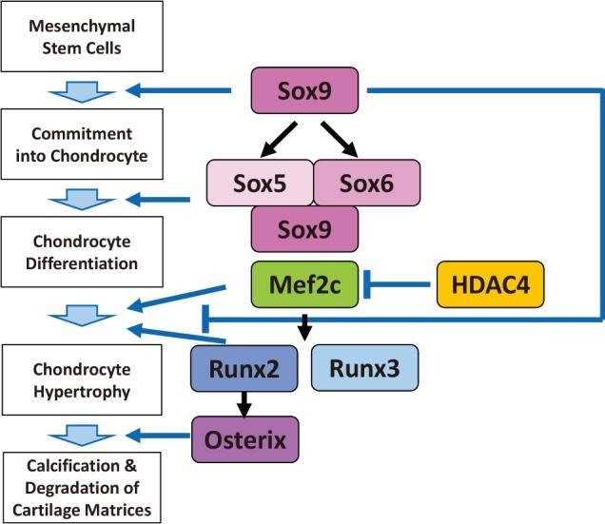
Identifying molecular and structural changes after exposure
Immunohistochemistry (IHC)
Whole mount and sections
SOX9: Chondrogenic differentiation of CNCCs
Col2a: Matrix protein
RUNX2: Involved throughout chondrogenesis and osteogenesis
Bone and Cartilage Staining
Alizarin Red → Bone
Alcian Blue → Cartilage
Col2a
Notes:
For my immunohistochemistry experiments, I am evaluating a number of different markers relevant to neural crest development, as well as markers for various neural crest derivatives. Of those markers, I am evaluating several that are specific to craniofacial cartilage and bone development, namely SOX9, RUNX2, and Col2a. To expand on those markers, SOX9 is a transcription factor vital for the specification and differentiation of cranial neural crest cells towards the chondrogenic lineage. Col2a or collagen 2a is a major matrix protein produced and secreted by chondrocytes during the formation of the cartilage model for endochondral ossification. RUNX2 is a transcription factor with many different roles in development including chondrocyte maturation, osteoblastic differentiation of CNCCs, and regulation of expression of bone morphogenetic protein (or BMP) genes. Preliminary results of my experiment also suggest it may be involved in development of the lateral line sensory system in axolotls.

Slide 8
No morphological changes are apparent after NPX exposure at early stages
D
P
A
V
Notes:
Moving onto results, in the early stage axolotl embryos, we weren't seeing any blatantly apparent changes in the gross morphology of the embryos with respect to the degree of naproxen exposure. However at later stages the changes became far more apparent.

Slide 9
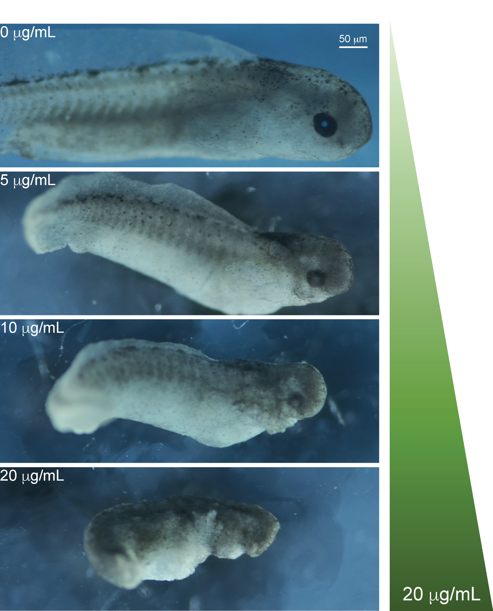
Exposure to NPX causes progressively abnormal axial development
D
P
A
V
Notes:
As you can see here, the later stage embryos show gross abnormalities in both cranial and axial development which we evaluated using three parameters: head length, dorsal fin height, and eye diameter.
Key points:
Statistically significant difference in head length between all treatment groups and the control group
No significant difference between each of the treatment groups

Slide 10
Exposure to NPX causes progressively abnormal axial development
D
P
A
V
Notes:
Key points:
Statistically significant difference in head length between all treatment groups and the control group
In regards to dorsal fin height, we also see a significant difference between each of the treatment groups

Slide 11
Exposure to NPX causes progressively abnormal axial development
D
P
A
V
Notes:
Key points:
More complex relationship exists between eye diameter and exposure to naproxen
Significant difference in the eye diameter of embryos treated chronically with the mid and high concentrations of NPX 10 and 20 ug/mL
There is no significant difference between the control embryo’s eye diameters and those of the low concentration NPX treatment group

Slide 12
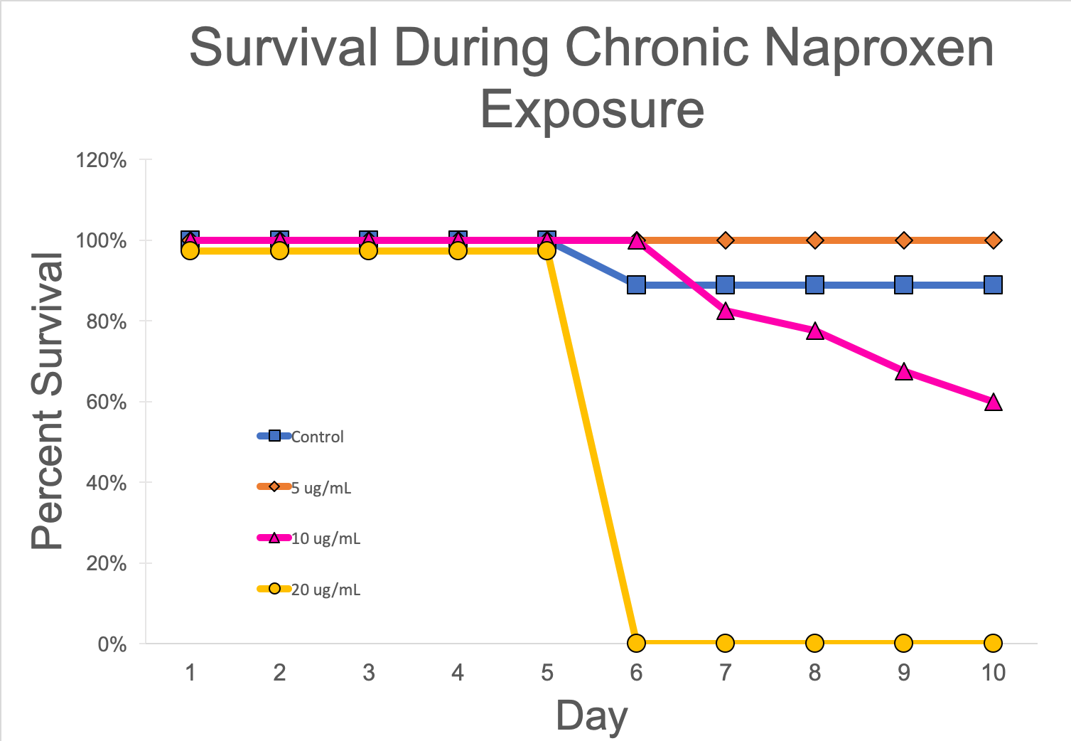
Exposure to NPX decreases survival
Notes:
Along with the gross changes noted in cranial and axial morphology, we also noted a decrease in survival with increasing exposure to naproxen. This graph shows the overall rate of survival throughout the experiment and from this we can see clear reduction in survival in the mid and high concentration groups compared to the control and even the low concentration treatment.
Notes: Include images from staging chart for each day to help with understanding, redo title or axis names, redo chart only considering stage 45 embryos as total and not any of the ones that were culled for the entire experiment, comment on issues with aquatic species that if one is apoptotic then all the others will get the death signals

Slide 13
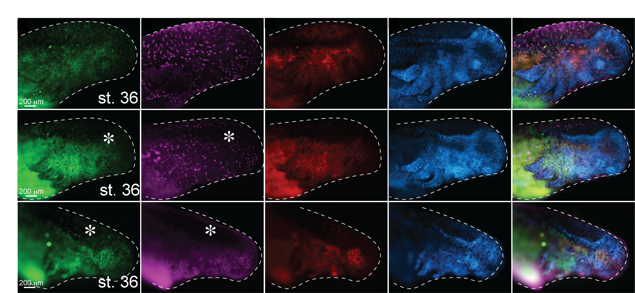
Embryos exposed to NPX exhibit abnormal patterning of NCC and derivative markers
SOX9: NCC differentiation
RUNX2: Sensory System
Col2a: Cartilage
D
P
A
V
SOX9 expression is reduced and RUNX2 patterning is abnormal in all NPX treatments
Notes:
Key Points:
Middle stage
SOX9 already only expressed here in low levels because it is a neural crest specification marker?
Loss of normal RUNX2 patterning in addition to reduced expression
Apparent changes in Col2a expression but since col2a is matrix-associated we will need to quantify the fluorescence in sections in order to better understand the changes occurring with Col2a
Notes: Labels on the side for sox9=chondrogenic NCC, runx2=lateral line,

Slide 14
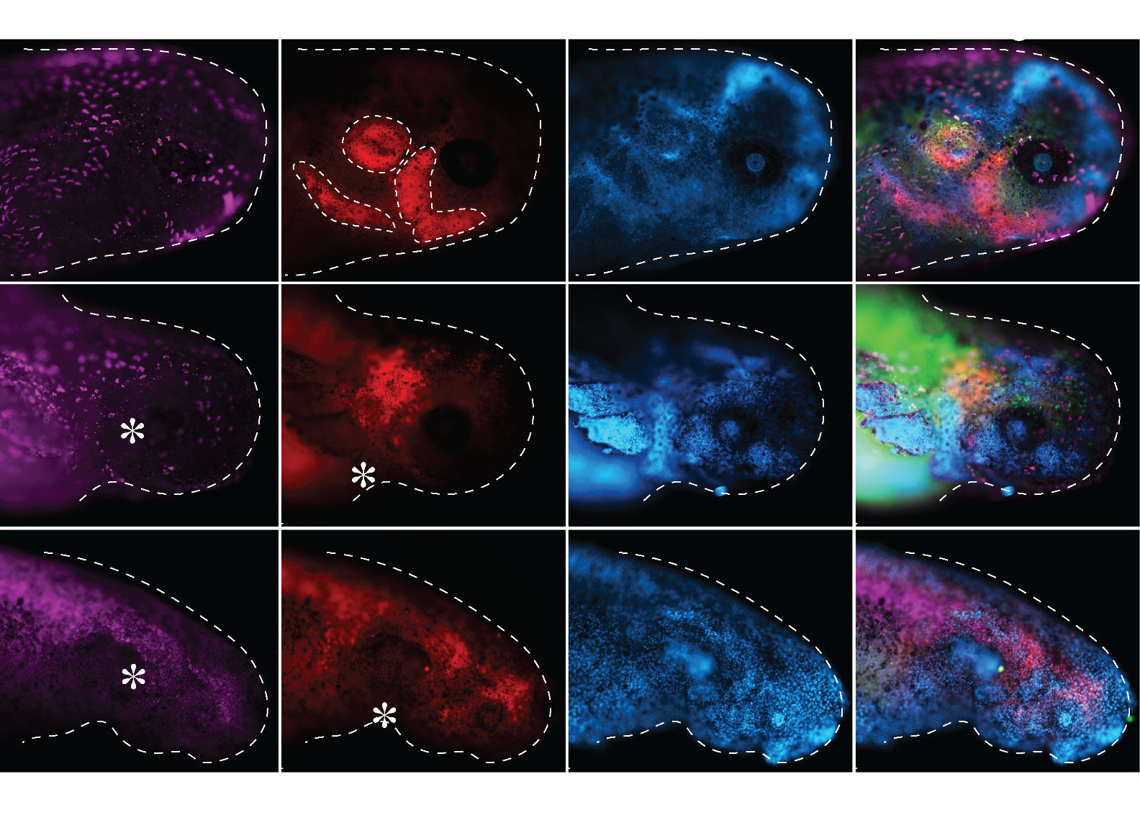
Exposure to NPX inhibits cartilage differentiation
D
RUNX2: Sensory System
Col2a: Cartilage
P
A
V
RUNX2 and Col2a expression is reduced or lost in all NPX treatments
Notes:
Key Points:
Late stage
Overall: Reduced expression of RUNX2 and Col2a expression observed across treatment groups
Cartilage structures in the head are forming discrete cartilage models for endochondral ossification. These structures shown here with likely develop into the mandible and quadrate bones of the amphibian jaw; the columella auris which is a unique hyomandibular cartilage structure in amphibians, reptiles and birds; and lastly the pterygoid bone, forming a component of the developed palate and jaw.

Slide 15
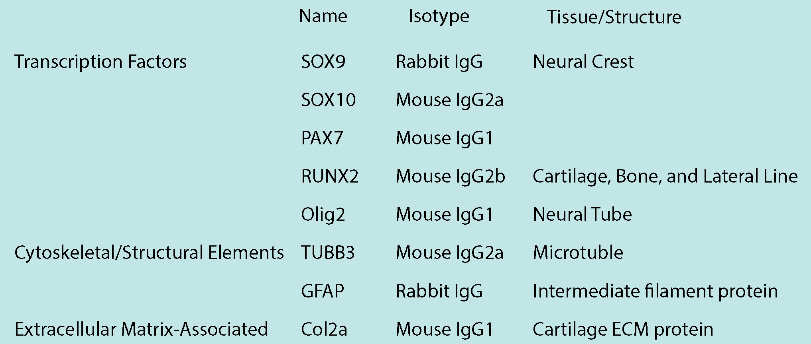
Next steps

Slide 16
Future directions
Quantify changes in NCC markers and differentiation of NCC-derived cartilage and sensory cells
Section, cell counts, fluorescence intensity, bone/cartilage staining
Define stage of susceptibility
Identify mechanisms causing irregular migration of NCCs (cell death/abnormal migration)
Notes:
Tenascin C is an extracellular matrix protein that is expressed in CNCCs and has been shown to be involved in the normal migration of enteric neural crest-derived cells. Tenascin C mainly functions in cell proliferation and migration and has been linked to the processes of inflammation, injury healing, and tumor metastasis. Of interest to my project, the expression of tenascin C is upregulated in inflammation and trauma in order to promote a pro-inflammatory microenvironment necessary for wound healing. I’m interested to see how NSAIDs may influence TN-C and subsequently NCC delamination and migration as it is clear that TN-C plays a role in EMT, also evidenced by its role in tumor metastasis. Very interested in doing KD and OE experiments with SOX9 to better understand how expression RUNX2 and other proteins like TN-C are affected.

Slide 17
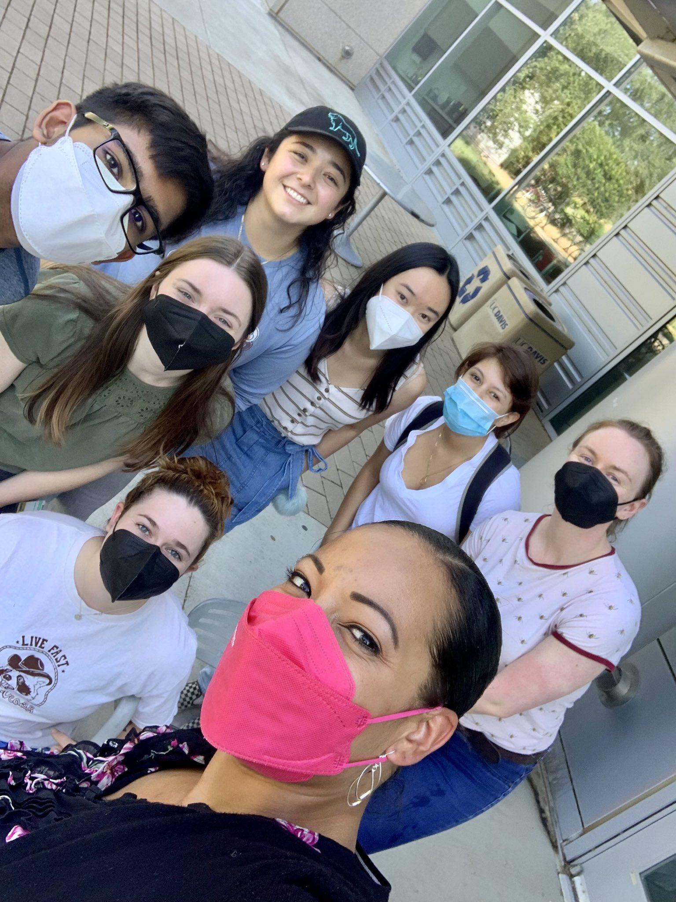
Acknowledgements
The Rogers’ Lab
Dr. Crystal Rogers
Tess Leathers
Camilo Echeverria
Heddy Menendez
Maxim Kawashima
Carly Adamson (former lab member)
Nikolas Morrison-Welch (CSUN)
Financial support was provided by the Students Training in Advanced Research (STAR) Program through the UC Davis School of Veterinary Medicine Endowment Funds

